Slide 1
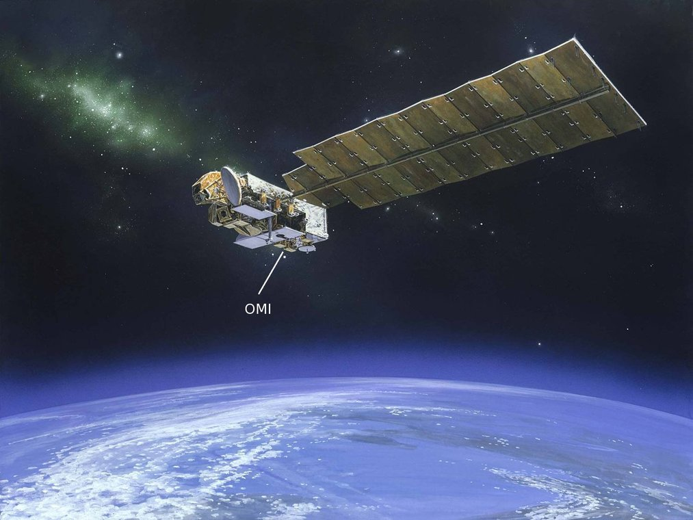
Reconstruction of surface NO₂ concentrations using a conservative downscaling of OMI, GOME-2, and CMAQ
Hyun Cheol Kim^{1,2}, Sang-Mi Lee³, Tianfeng Chai^{1,2}, Barry Baker^{1,2}, Fong Ngan^{1,2}, Li Pan^{1,2}, and Pius Lee¹
¹Air Resources Laboratory, National Oceanic and Atmospheric Administration, College Park, MD
²Cooperative Institute for Climate and Satellites, University of Maryland, College Park, MD
³South Coast Air Quality Management District, Diamond Bar, CA

Slide 2
Motivation
Need for high-resolution and full coverage NO₂ data
For epidemiology,
One of NAAQS pollutants
Raised levels of nitrogen dioxide causes respiratory problems. Significant impacts on people with asthma.
For emission estimation,
Import precursor of ozone and particulate matter
Detection of urban emission sources
Fine-scale air quality simulations
Notes:
위성자료를 이용한 배출량의 보정은 우선 위성에서 관측된 VCD와 모델에서 계산된 VCD를 정확하게 비교하는 과정이 필요합니다.
위성 VCD에 맞추어 모델에서 특정 시간을 맞추어 추출해야 하며, 수직적인 민감도를 고려하기 위해 averaging kernel 기법을 도입합니다.
위성 VCD의 경우 격자 해상도가 위성에 비해 성기기 때문에 이를 보완하기 위해 최근에 개발된 Conservative Downscaling 기법을 이용합니다.
- 자세한 사항은 다음 슬라이드에 제시되어 있습니다.
VCD는 대기 중 가스상 오염물질의 분포로, 배출량과 보정을 하기 위해 장기런을 이용한 배출량 – 농도 전환율을 고려합니다.

Slide 3
Topics to discuss
Fair comparison of model and satellite
Temporal sampling (diurnal)
Spatial resolution (downscaling)
Vertical sensitivity (averaging kernel)
Reconstruction of surface NO₂ concentration
Data fusion
Conversion to emission
Machine learning (See Kim et al. poster [#4] tomorrow)

Slide 4
Top-down estimation of NO_{x} emissions
Satellite
Model
Local pass time
(Temporal match)
AK
sVCD
mVCD
Conservative Downscaling
(Horizontal match)
Emission
Adjustment
Averaging Kernel
(Vertical match)
sVCD/DS
mVCD/AK
Emission-to-VCD
Conversion
Comparison
Notes:
위성자료를 이용한 배출량의 보정은 우선 위성에서 관측된 VCD와 모델에서 계산된 VCD를 정확하게 비교하는 과정이 필요합니다.
위성 VCD에 맞추어 모델에서 특정 시간을 맞추어 추출해야 하며, 수직적인 민감도를 고려하기 위해 averaging kernel 기법을 도입합니다.
위성 VCD의 경우 격자 해상도가 위성에 비해 성기기 때문에 이를 보완하기 위해 최근에 개발된 Conservative Downscaling 기법을 이용합니다.
- 자세한 사항은 다음 슬라이드에 제시되어 있습니다.
VCD는 대기 중 가스상 오염물질의 분포로, 배출량과 보정을 하기 위해 장기런을 이용한 배출량 – 농도 전환율을 고려합니다.

Slide 5
Problems
Model uncertainties: Chemical & Meteorological (e.g. PBL)
Retrieval uncertainties: Detection limit & Instrumental error
Satellite
Model
Diurnal profile
Local pass time
(Temporal match)
AK
sVCD
mVCD
Conservative Downscaling
(Horizontal match)
Emission
Adjustment
Footprint resolution
Averaging Kernel
(Vertical match)
AK quality & spatial resolution
sVCD/DS
mVCD/AK
Emission-to-VCD
Conversion
Comparison
Conversion ratio
Transport
Notes:
위성자료를 이용한 배출량의 보정은 우선 위성에서 관측된 VCD와 모델에서 계산된 VCD를 정확하게 비교하는 과정이 필요합니다.
위성 VCD에 맞추어 모델에서 특정 시간을 맞추어 추출해야 하며, 수직적인 민감도를 고려하기 위해 averaging kernel 기법을 도입합니다.
위성 VCD의 경우 격자 해상도가 위성에 비해 성기기 때문에 이를 보완하기 위해 최근에 개발된 Conservative Downscaling 기법을 이용합니다.
- 자세한 사항은 다음 슬라이드에 제시되어 있습니다.
VCD는 대기 중 가스상 오염물질의 분포로, 배출량과 보정을 하기 위해 장기런을 이용한 배출량 – 농도 전환율을 고려합니다.

Slide 6
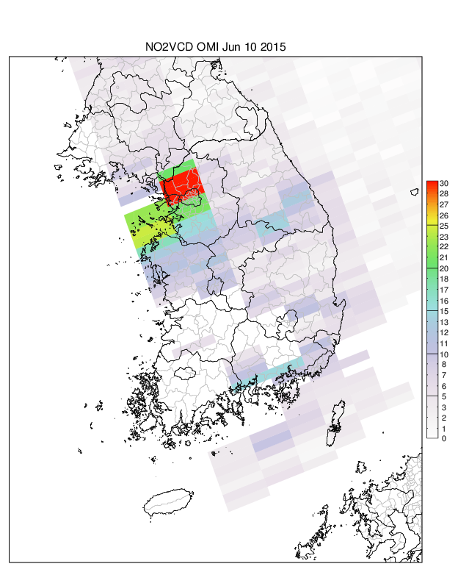
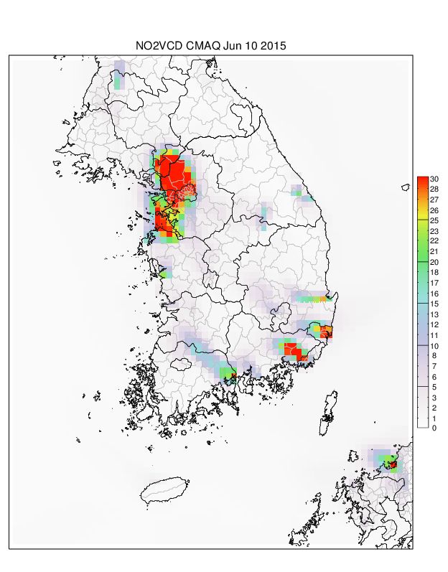
How to compare?
(A) OMI
(B) CMAQ

Slide 7
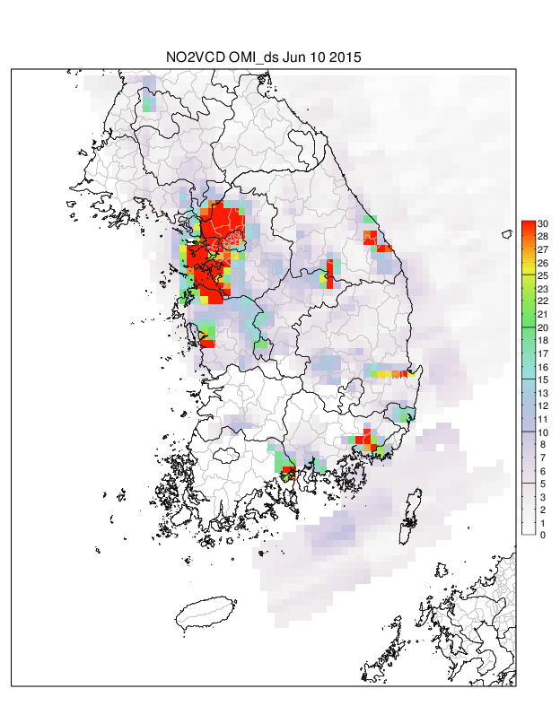
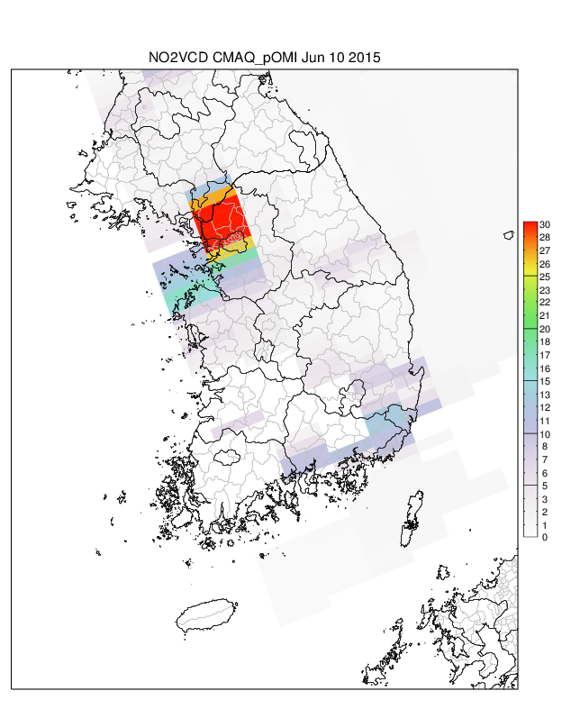
(A) OMI
(B) CMAQ
Fair comparison
Downscaling
Upscaling
(D) CAMQ-upscaled
(Pseudo-OMI)
(C) OMI-downscaled

Slide 8
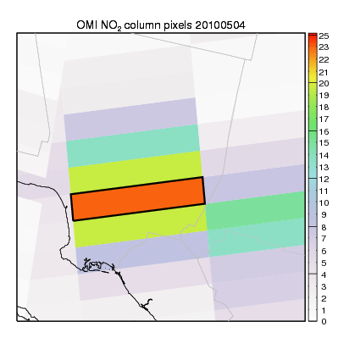
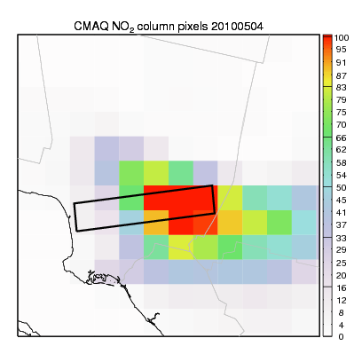
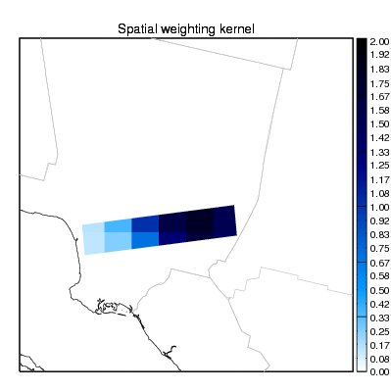
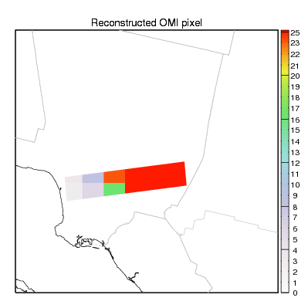
Conservative downscaling of NO₂ column density
OMI
CMAQ
Apply model’s spatial information to OMI pixels
Model’s emission inventory has high uncertainty in its intensity, but has reliable accuracy in the location of emission sources.
OMI’s original quantity is strictly preserved
Spatial weighting kernel
Reconstructed OMI

Slide 9
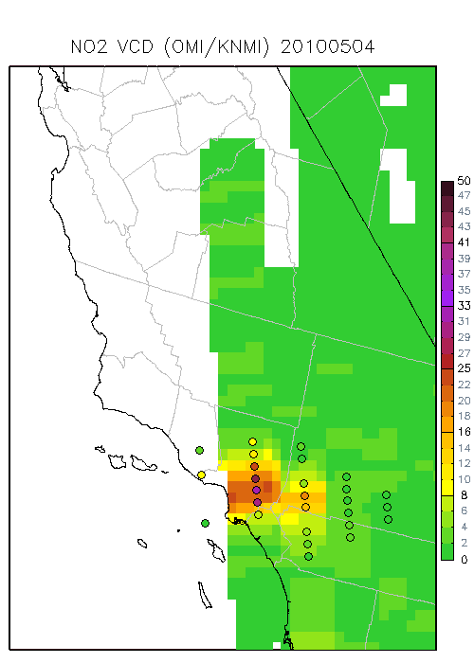
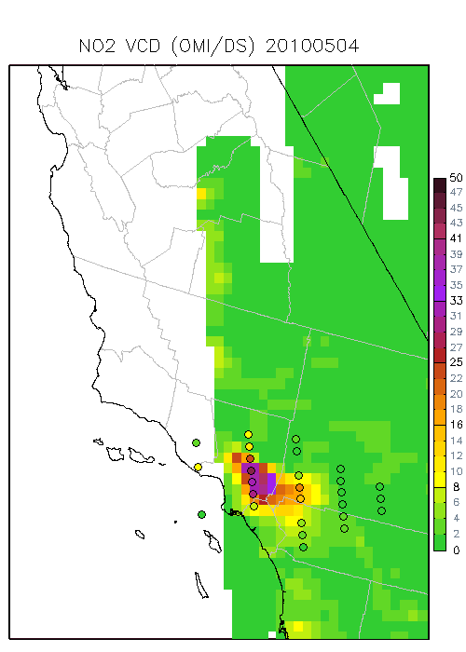
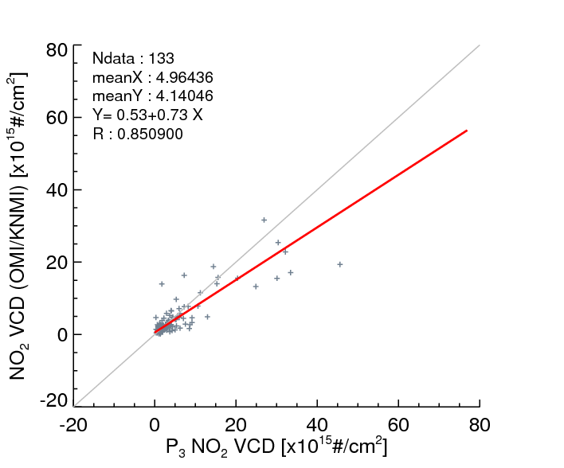
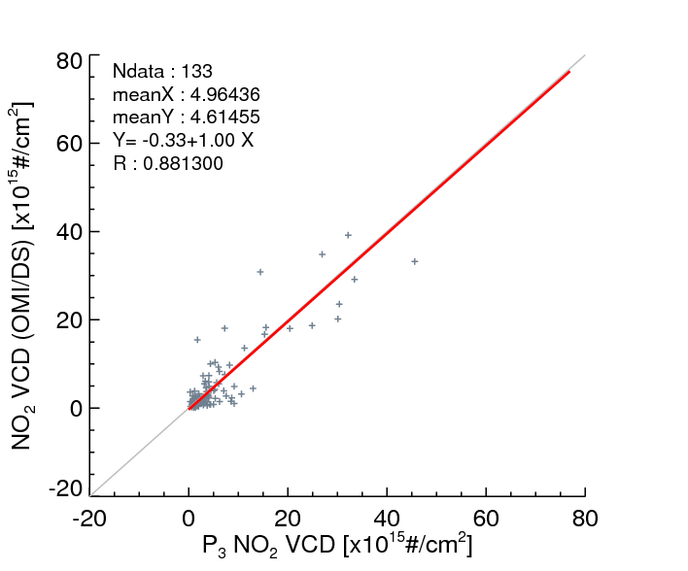
OMI & P3 NO₂ column density (CALNEX2010)
(A)
(B)
Original
Downscaled
[X10 ¹⁵ #/cm²]
[X10 ¹⁵ #/cm²]

Slide 10
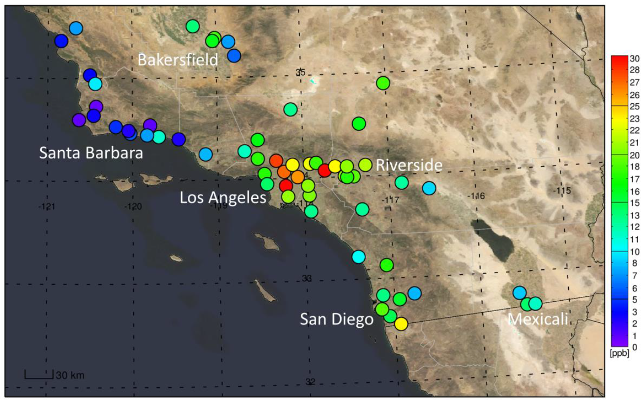
Model and observations
4-km WRF-CMAQ simulations over Southern California (SCAQMD)
AQS surface observations
OMI and GOME-2 NO2 column densities (KNMI, TEMIS)

Slide 11
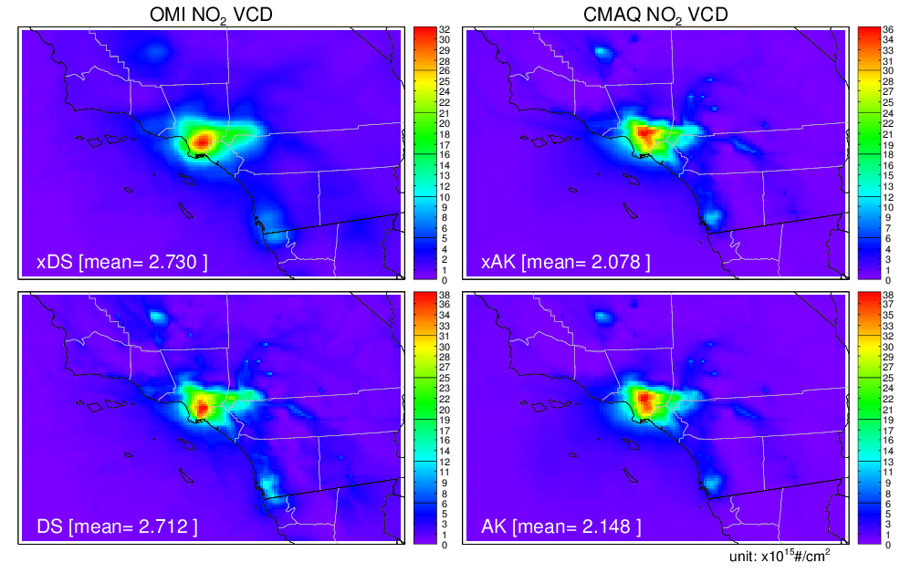
Spatial distribution of OMI and CMAQ NO₂ column densities. “DS” and “xDS” denote OMI NO₂ column densities with and without the downscaling method, respectively, whereas “AK” and “xAK” denote CMAQ NO₂ column densities with and without the averaging kernel, respectively.

Slide 12
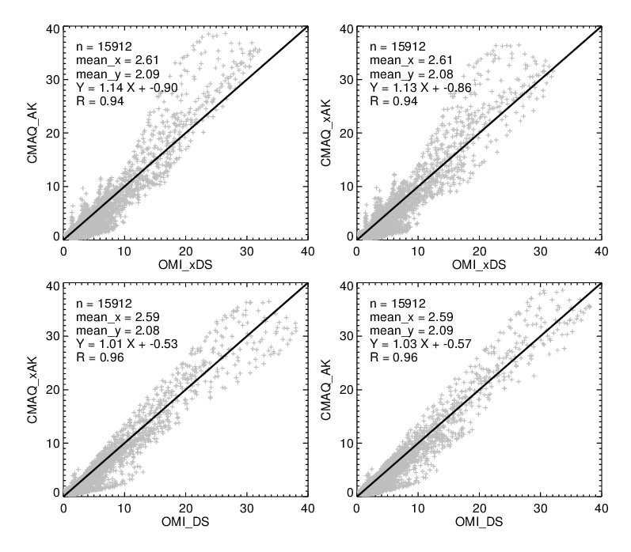
AK
DS
DS+AK
Scatter plot comparison of OMI and CMAQ NO₂ column densities. “DS” and “xDS” denote OMI NO₂ column densities with and without the downscaling method, respectively, whereas “AK” and “xAK” denote CMAQ NO₂ column densities with and without the averaging kernel, respectively.

Slide 13
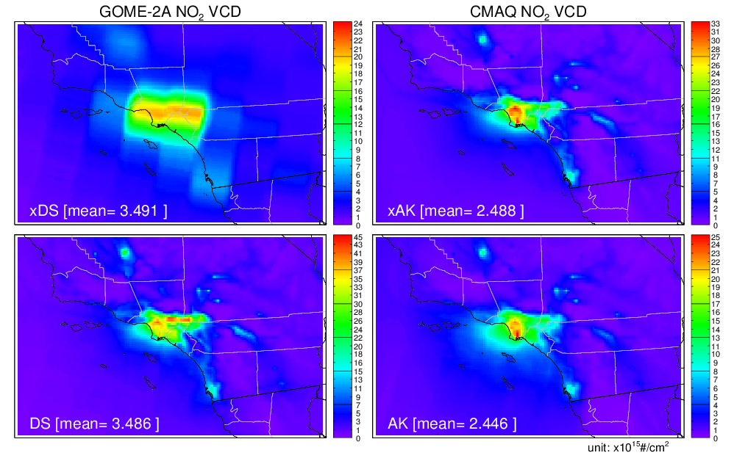
Spatial distribution of GOME-2 and CMAQ NO₂ column densities. “DS” and “xDS” denote GOME-2 NO₂ column densities with and without the downscaling method, respectively, whereas “AK” and “xAK” denote CMAQ NO₂ column densities with and without the averaging kernel, respectively.

Slide 14
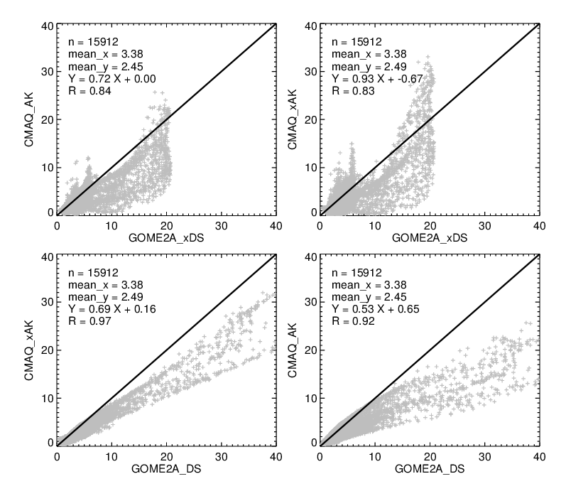
AK
What’s wrong with GOME-2 AK?
DS
DS+AK
Scatter plot comparison of GOME-2 and CMAQ NO₂ column densities. “DS” and “xDS” denote GOME-2 NO₂ column densities with and without the downscaling method, respectively, whereas “AK” and “xAK” denote CMAQ NO₂ column densities with and without the averaging kernel, respectively.

Slide 15
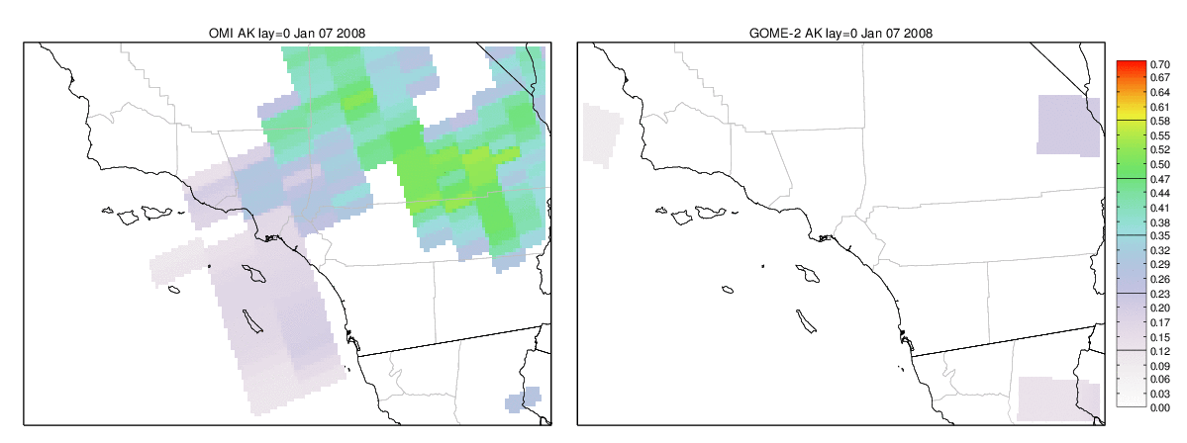
Averaging Kernel (bottom layer)
OMI
GOME-2
Daily snapshots

Slide 16
Reconstruction of surface NO₂ concentration
Satellite inferred surface NO₂ concentrations
where α is an additional adjustment due to satellite and model uncertainties.
For perfect model and satellite, α=1.

Slide 17
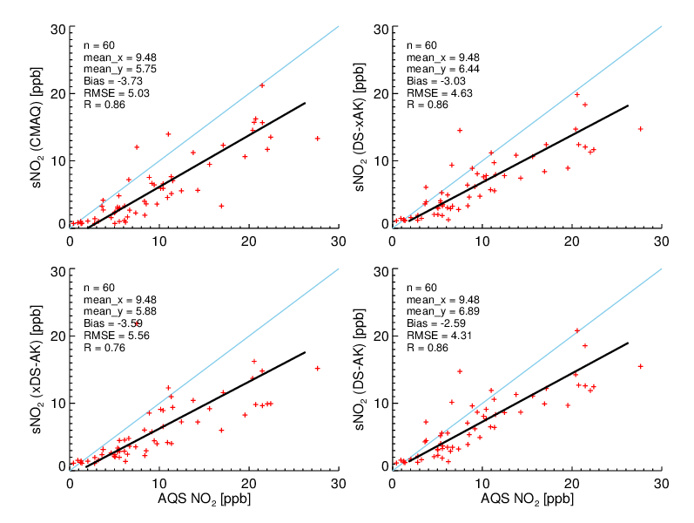
Reconstructed NO₂ [OMI]
DS
Bias = -3.03
RMSE=4.63
R=0.86
CMAQ
Bias = -3.73
RMSE=5.03
R=0.86
DS & AK
Bias = -2.59
RMSE=4.31
R=0.86
AK
Bias = -3.59
RMSE=5.56
R=0.76

Slide 18
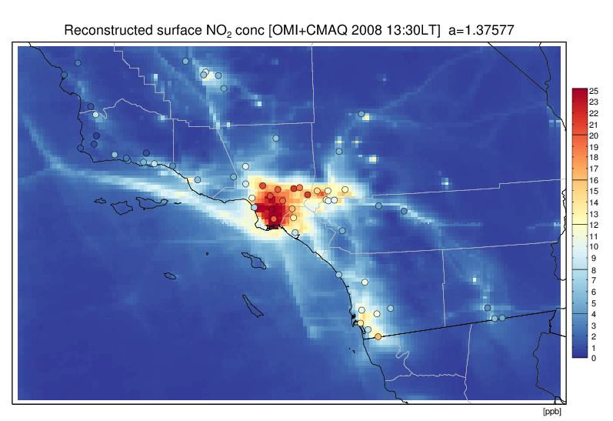
Reconstructed surface NO₂ concentrations using OMI column densities and CMAQ column-to-surface ratios at 13:30 local time in 2008.

Slide 19
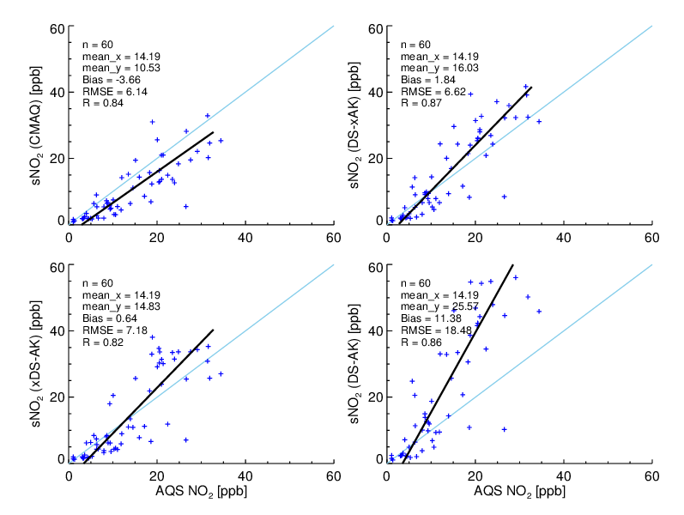
Reconstructed NO₂ [GOME-2]
DS
Bias = 1.84
RMSE=6.62
R=0.87
CMAQ
Bias = -3.66
RMSE=6.14
R=0.84
DS & AK
Bias = 11.38
RMSE=18.48
R=0.86
AK
Bias = 0.64
RMSE=7.18
R=0.82

Slide 20
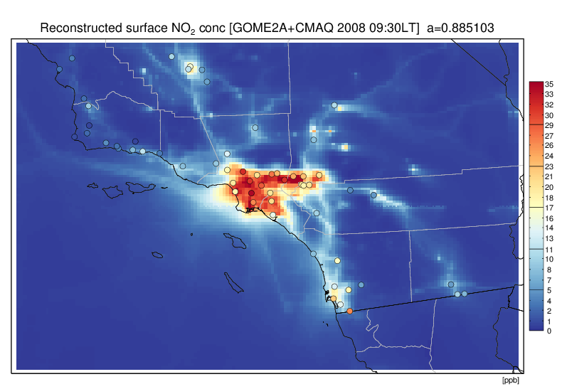
Reconstructed surface NO₂ concentrations using GOME-2 column densities and CMAQ column-to-surface ratios at 09:30 local time in 2008.

Slide 21
OMI with α=1.37
Bias = 0, RMSE=4.31, R=0.86
GOME-2 with α=0.88
Bias = 0, RMSE=6.62, R=0.87

Slide 22
Conclusion
A conservative downscaling was designed to enhance the spatial resolution of satellite measurements by applying the fine-scale spatial structure from the model, with strict mass conservation at each satellite footprint pixel level.
With the downscaling approach, NO₂ column densities from the OMI (13×24 km) and the GOME-2 (40×80 km) show excellent agreement with the CMAQ (4×4 km) NO₂ column densities, with R = 0.96 for OMI and R = 0.97 for GOME-2.
We further reconstructed surface NO₂ concentrations by combining satellite column densities and simulated surface-to-column ratios from the model. Compared with AQS surface observations, the reconstructed surface concentrations show a good agreement; R = 0.86 for both OMI and GOME-2.
Limitation in using current GOME-2 AK is also discussed.

