Slide 1
Influence of Brazilian Land Use Data on WRF Modeling Performance
Authors: Rizzieri Pedruzzi^{1,2}, Willian L. Andreão¹, Bok H. Baek², Jared H. Bowden³ and Taciana T. A. Albuquerque¹.
Federal University of Minas Gerais – Brazil
Institute for the Environment – UNC Chapel Hill
Department of Applied Ecology – NCSU
17th Annual CMAS Conference - 2018
Notes:
Good afternoon, my name is Rizzieri Pedruzzi, im a PhD student from Brazil and our work is the .. READ Title.
This research is at beginning… so we only have preliminary results
I would like to thank all authors, which helped me develop this worf

Slide 2
Introduction
WRF input data (topography, LULC, Soil, etc.) plays a critical role in modeling results (Dy and Fung (2016); Nedbor-gross et al. (2017); Jiménez-Estevez et al. (2018);
Geographic input data available in WRF (Default) is low-medium resolution for South America or is outdated (e.g. USGS LULC is from 1992);
2
Notes:
All right, WRF model is well known around scientific world and its use is well spread around the world as well...
But, the model was developed to North hemisphere, more focus on USA... What is make sense, since the developers are concentrated here. However the entire world use it and makes updates to it.
To run WRF model, there are some important input data which play a key role on model results, like Topography, LULC and soil texture…. The influence were highlighted by READ authors.
Since the WRF is more focus over here, these geographic data have high resolution for USA, what is great, but tor other places, like Brazil, it is not like this. Sometime the available data for other countries are not good enough, or they are outdated, or simply does represent the reality… what brings the necessity to improve those input data, what is, sometimes, not a easy task…
But, why is necessary to work on update these inputs ?
2

Slide 3
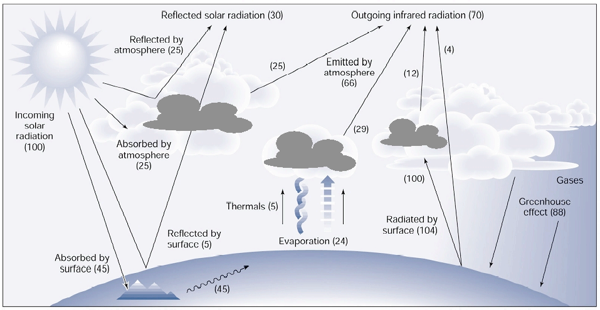
Introduction
Source: Adapted from Chen, (2007). Available at: https://www.atmos.illinois.edu/~snesbitt/ATMS597R/notes/noahLSM-tutorial.pdf
3
Notes:
The answers is.... The geographic input data really play a role on the WRF simulation… Like topography change the wind pattern, which flow around hill, mountains and constructions finding the easy way.
The LULC and soil texture can affect in special the heat and radiations process on model… Because these two input have specific information, like Albedo, Roughness length, bowen ratio, moisture content…. Like the vegetation, which has a totally different albedo from a urban area, meaning that the arriving radiation would be absorbed or reflected, what impacts on heat flux
Like latent heat flux, which is higher when there are mores moistures, what also affects sensible heat, which is responsible to heat the surface, what starts the vertical movement, and increase the planetary boundary layer, turbulence, and associated to updrafts movements, take moisture to higher levels and create clouds… and so on… All these means that, if you want a good WRF modeling, you need good input data.. And since these inputs are important, comes to our goals, which is
3

Slide 4
Objective
Improve topography resolution to SA;
Translate IBGE land use data into MODIS/WRF;
Run WRF with both, Default and Updated input data with IBGE;
Compare the WRF results with observed values;
4
Notes:
Read the objectives
So, with this modeling test we will be able to say if all these changes have influenced on WRF results or not
4

Slide 5
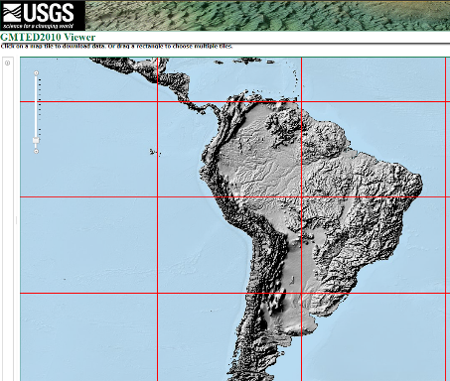
Methodology - New topography
https://lta.cr.usgs.gov/GMTED2010
Download the GMTED2010 for South America – Resolution 7.5-arc-second (~250m);
Convert them to binary format with convert_geotiff;
(https://github.com/openwfm/convert_geotiff)
5
Notes:
To reach all these goals, we started by the topography data… Bu default on the newer version of WRF, the topography are from GMTED 2010 with more or less 900m of grid spacing…
However, there the same data base with higher resolution, like de GMTED 2010 with 7.5 arc-seconds, approximately 250 meters. What is great, almost four times higher resolution.
So, we collect the data from USGS website on geotiff format and it was converted to binary format… require to input to WRF model
Great, fist step done
5

Slide 6
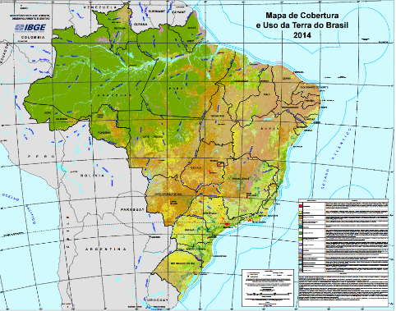
Methodology - New Land Use/Land Cover
Download the latest 2014 shapefile of LULC for Brazil from IBGE;
Map the IBGE classification to WRF-MODIS 20 classes;
Convert them to binary format with convert_geotiff;
https://www.ibge.com.br
(https://github.com/openwfm/convert_geotiff)
6
Notes:
Another input, which is very important, is the LULC data. WRF have two data set to it… the 1997 USGS classification with 24 classes, and a newer version from MODIS with 20 classes and another MODIS with 21 classes( adding lakes on it). These two option are available for entire world on WRF repository, it is just use it.
However, in 2014, Brazilian geographic institute released the National Land Use data for the entire country on a vector format (shape file)… this data was made based on satellite data and observed data… what is supposed to make it more realistic.
With the Goal to input this information on WRF, this IBGE data were mapped as MODIS 20 classes and later converted into binary format using geotiff functions.
6

Slide 7
Mapping LULC IBGE to MODIS-WRF
IBGE | WRF - MODIS 20 classes
Artificial Area | 13 | Urban and Built-Up
Agricultural area | 12 | Croplands
Planted pasture | 10 | Grasslands
Mosaic of agriculture with forest remnants | 14 | Cropland/Natural Vegetation Mosaic
Forestry | 2 | Evergreen Broadleaf Forest
Forests | 2 | Evergreen Broadleaf Forest
Mosaic of forest vegetation with agricultural areas | 14 | Cropland/Natural Vegetation Mosaic
Rural vegetation | 7 | Open Shrublands
Wet area | 11 | Permanent Wetlands
Natural pasture | 10 | Grasslands
Agriculture mosaic with remnants of the rural areas | 14 | Cropland/Natural Vegetation Mosaic
Continenral water body | 17 | Water
Coastal water body | 17 | Water
Barren or Sparsely Vegetated | 16 | Barren or Sparsely Vegetated
7
Notes:
7

Slide 8
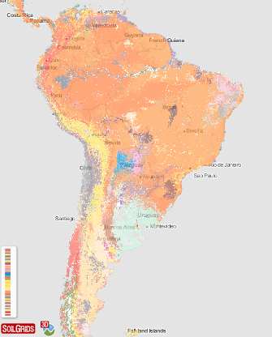
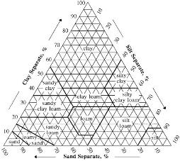
Methodology - New Soil texture
https://soilgrids.org
Download the 1km*1km raster file with clay, silt and sand % all 6 layers;
Classify the data according Soil Survey Division staff (1993) – TOP and BOTTOM;
Convert it to binary format with convert_geotiff;
(https://github.com/openwfm/convert_geotiff)
8
Notes:
The input data do not stop there… there are also the soil texture. Which is an important information for WRF on moisture content of it the temperature diffusion over the soil layer…
The soil texture is an mixture of clay, sand and silt contents. It is needed to get all these information to find the specific soil texture. WRF model is allow to read 16 soil textures, which comes from the Soil Survey division which uses the soil triangle to specify it.
To create a new input data for soil, it was used the data from Soils Grid, which has 6 layers which represent one lever under the grounds… varying from 0cm to 200cm. The soils Grid has data with 250m resolution, but he data was really big about 80 Gb to be processed.. So it was used the country bases with 1km of grid spacing, which is better than WRF default soil information for South America…
Since WRF use two soil layers, it used the aggregate of the three first one to represent the TOP Soil and more to to reach the WRF bottom Soil, which is at 1 meter below the ground.
After selecting which layer of Soil Grids will go for Top and Bottom… we classified each grid cell according its content of clay, silt and sand and the soil triangle and set it to matches the WRF input data.
Finishing the mapping, this data was also converted in binary format
8

Slide 9
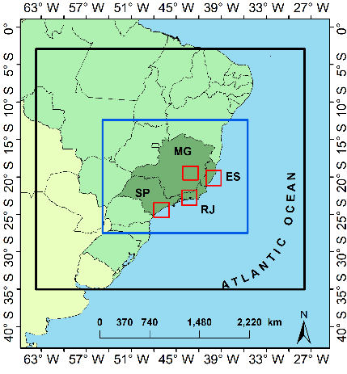
Methodology – WRF configuration
Domain confguration
Number of points in WE | 150
Number of points in SN | 100
Vertical levels | 41
Grid spacing | 25-5-1 km
Map projection | Lambert conformal
Center latitude | -19.817
Center longitude | -43.956
Physics options
Longwave radiation | Rapid Radiative Transfer Model (RRTM)
Shortwave radiation | Dudhia scheme
Surface layer | Revised MM5 similarity
Land surface | NOAH LSM
PBL scheme | BouLac PBL
Cloud microphysics | WRF Single-Moment 3-class scheme
Cumulus cloud | Betts-Miller-Janjic scheme
Notes:
So, after

Slide 10
Preliminary Results
New Topography from GMTED 2010 7.5 arc-second;
LULC and Soil texture comparison between scenarios;
WRF model evaluation for Temperature and Humidity;
10
Notes:
The input data do not stop there… there are also the soil texture. Which is an important information for WRF on moisture content of it the temperature diffusion over the soil layer…
The soil texture is an mixture of clay, sand and silt contents. It is needed to get all these information to find the specific soil texture. WRF model is allow to read 16 soil textures, which comes from the Soil Survey division which uses the soil triangle to specify it.
To create a new input data for soil, it was used the data from Soils Grid, which has 6 layers which represent one lever under the grounds… varying from 0cm to 200cm. The soils Grid has data with 250m resolution, but he data was really big about 80 Gb to be processed.. So it was used the country bases with 1km of grid spacing, which is better than WRF default soil information for South America…
Since WRF use two soil layers, it used the aggregate of the three first one to represent the TOP Soil and more to to reach the WRF bottom Soil, which is at 1 meter below the ground.
After selecting which layer of Soil Grids will go for Top and Bottom… we classified each grid cell according its content of clay, silt and sand and the soil triangle and set it to matches the WRF input data.
Finishing the mapping, this data was also converted in binary format
10

Slide 11
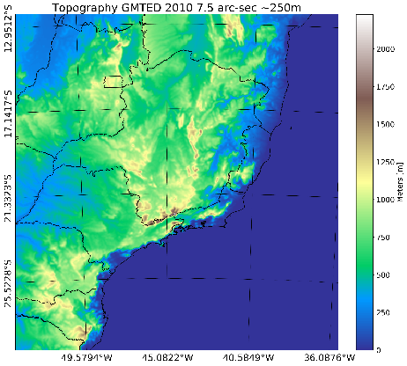
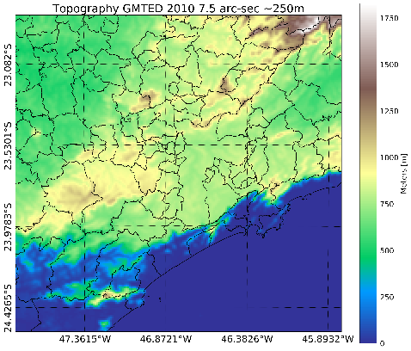
Preliminary Results
Topography from GMTED 2010 7.5 arc-seconds – Applied to all cases
11
Notes:
11

Slide 12
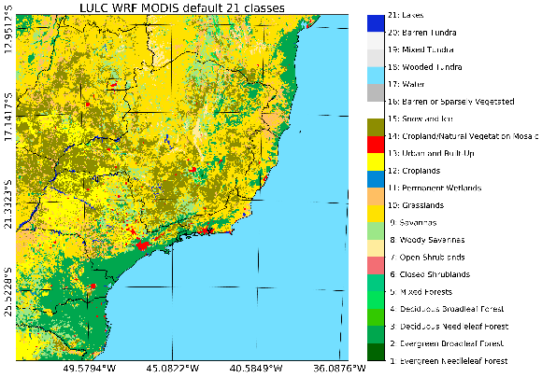
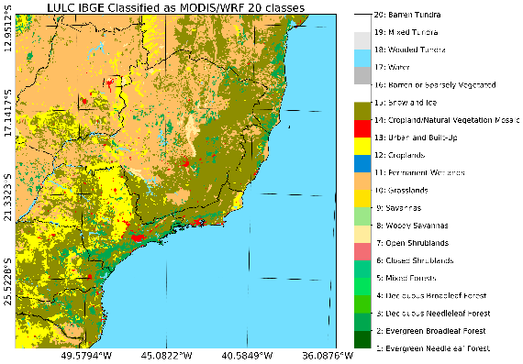
LULC Comparison
WRF Default input
WRF Updated input
12
Notes:
12

Slide 13
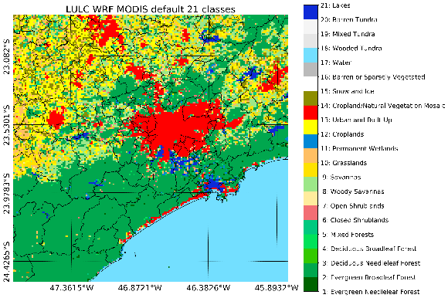
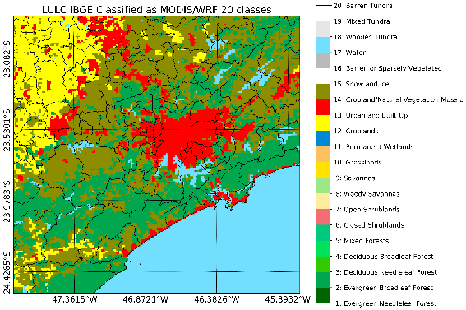
LULC Comparison – São Paulo
WRF Default input
WRF Updated input
13
Notes:
13

Slide 14
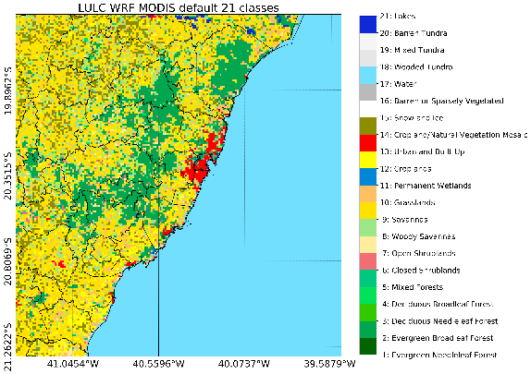
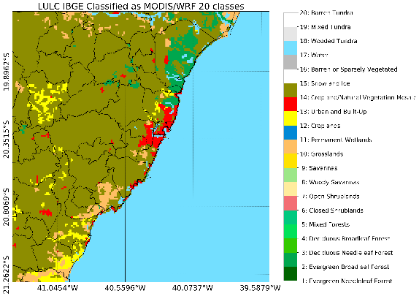
LULC Comparison – Espírito Santo
WRF Default input
WRF Updated input
14
Notes:
14

Slide 15
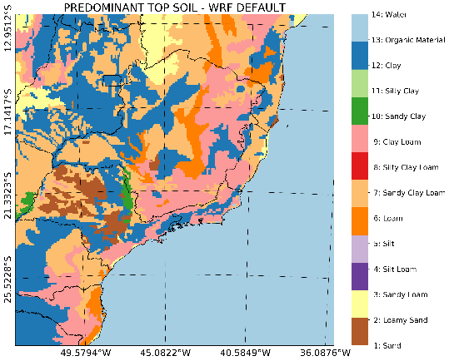
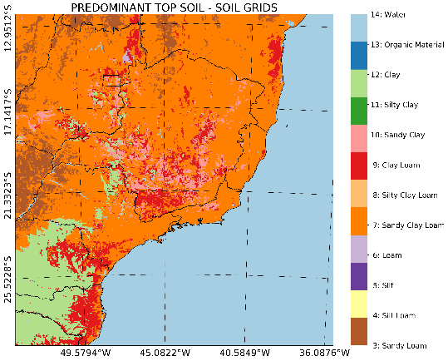
Soil Type Change
WRF Default input
WRF Updated input
15
Notes:
15

Slide 16
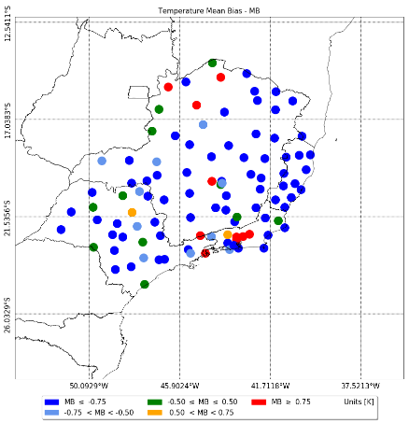
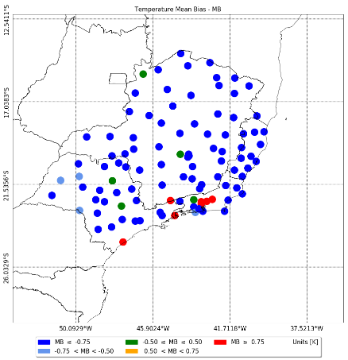
WRF Evaluation - Temperature
WRF Default input
WRF Updated input
Notes:
16

Slide 17
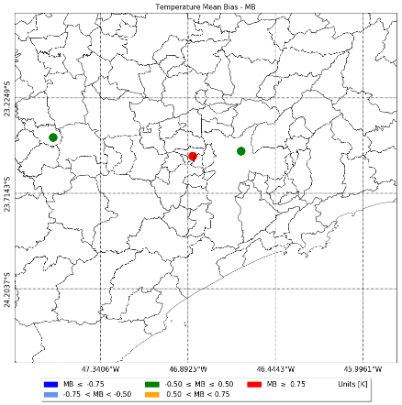
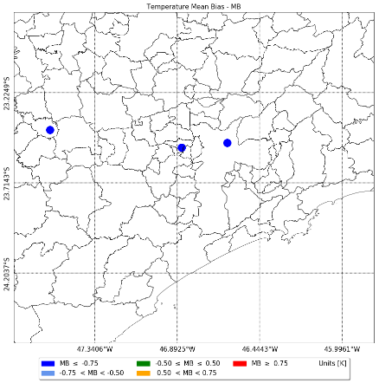
WRF Evaluation - Temperature
WRF Default input
WRF Updated input
Notes:
17

Slide 18
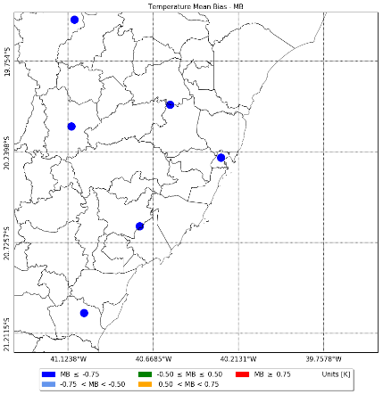
WRF Evaluation - Temperature
WRF Default input
WRF Updated input
Notes:
18

Slide 19
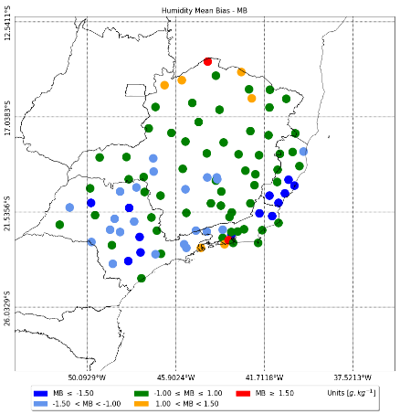
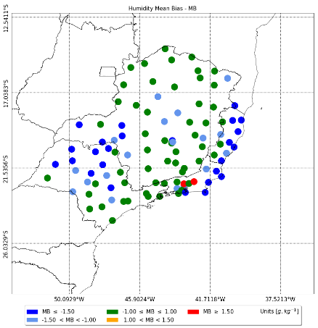
WRF Evaluation - Humidity
WRF Default input
WRF Updated input
Notes:
19

Slide 20
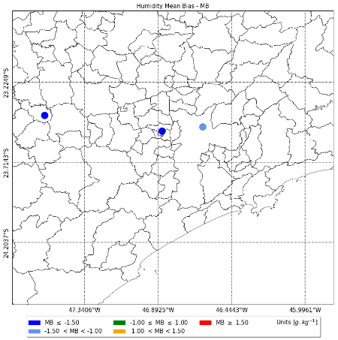
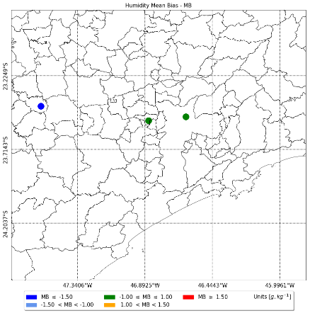
WRF Evaluation - Humidity
WRF Default input
WRF Updated input
Notes:
20

Slide 21
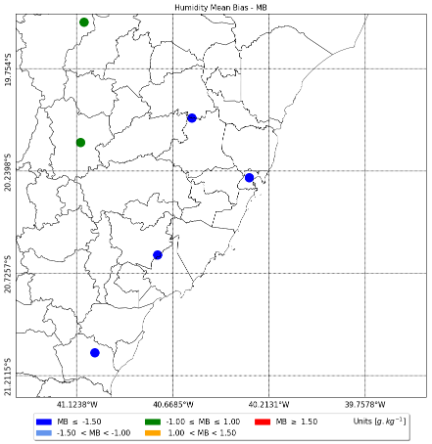
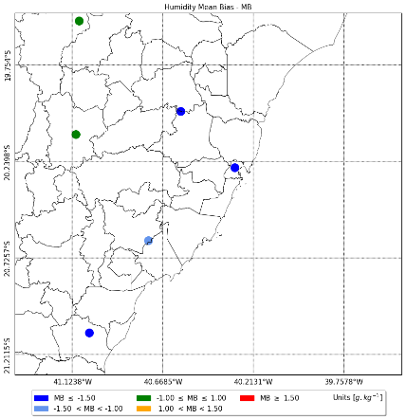
WRF Evaluation - Humidity
WRF Default input
WRF Updated input
Notes:
21

Slide 22
Next steps
Collect more observed weather data from monitoring stations;
Investigate possible errors on input data from IBGE and SOIL GRIDS texture;
Use the IBGE’s data from soil type mapped to soil texture;
Review WRF parameters of Bowen ration, roughness length and Albedo for Brazil LULC;
Notes:
22

Slide 23
www.poluicaodoar.com.br
pedruzzi@email.unc.edu
rpedruzzi@ufmg.com
+1 919 2657007

