Slide 1
Modeling the effects of climate change on US mid 21st century PM_{2.5} and O₃ by dynamical downscaling of meteorology and chemistry from a global model
Surendra B. Kunwar¹, Jared H. Bowden², George Milly³, Michael Previdi³, Arlene M. Fiore³, J. Jason West¹
¹Department of Environmental Sciences and Engineering, University of North Carolina at Chapel Hill; ²Department of Applied Ecology, North Carolina State University;
³Lamont-Doherty Earth Observatory, Columbia University
(Tuesday October 23, 2018; CMAS Conference 2018)

Slide 2
Climate Change Impacts on Air Quality: Pathways
Δ CLIMATE
Δ FUTURE AIR QUALITY
Δ ANTHROPOGENIC EMISSIONS
Δ NATURAL EMISSIONS
Δ METEOROLOGY
Δ AIR CHEMISTRY
Δ Land Use/Cover
Adapted: Jacob and Winner, 2009
Notes:
Air quality is ozone and pm2.5

Slide 3
Climate Variability vs Climate Change
Internal Variability (noise) can confound Climate Change (signal)
≠
NATURAL CLIMATE VARIABILITY = fluctuation around a steady mean
CLIMATE CHANGE (SIGNAL) = long term change of mean
+
NATURAL FORCING = caused by solar activity, volcanoes
INTERNAL VARIABILITY (NOISE) = internally arising due to chaotic nature of climate system
Figure: Measurement at a (CASTNet) site: July MDAO8 (black line and circles) and July mean daily maximum temperature (red line and triangles) from 1988 to 2014.
}
Variability around mean over a decade
}
Source: Fiore et al 2015
Change of mean over short period

Slide 4
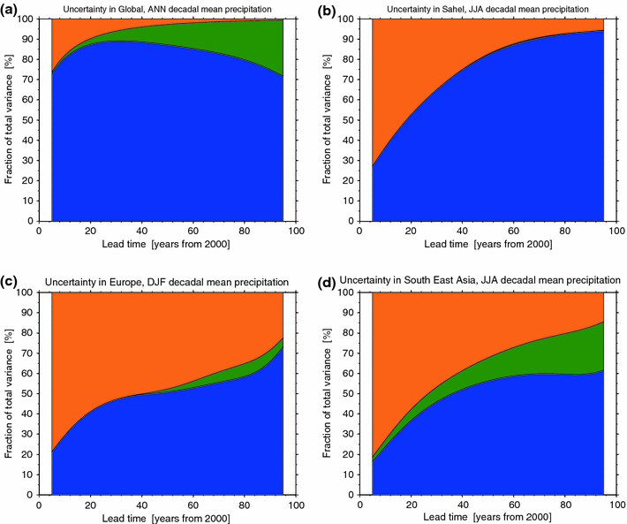
Significance of Climate Variability in Model Projections
Uncertainty due to internal variability can be large, especially in regional climate model projections till 2050s
internal variability (orange)
model uncertainty (blue)
scenario uncertainty (green)
Fraction of total variance in decadal mean precipitation projections explained by internal variability (orange), model uncertainty (blue), and scenario uncertainty (green), for a global, annual mean, c European DJF mean
Source: Hawkins & Sutton, 2011
Notes:
(These figures are from Jared’s suggestion)

Slide 5
Past Studies of Climate Change on US PM_{2.5} and O₃
Attributes:
        limited number of future years averaged
        single realization of one climate model
        future land surface changes not included
Findings:
        synoptic meteorology is key driver of PM_{2.5} and O₃
        Separating climate variability from climate change is a challenge
 | [O₃] results | [PM_{2.5}] results
↑ Direction | Consistently +ve | Inconsistent sign
↑ Magnitude | 1-10 ppb (polluted regions) | Between ±0.1 and ±1 µgm⁻³
Source: Fiore et al, 2015; Jacob and Winner, 2009

Slide 6




Objectives of Our Study
Overall objectives (Columbia Univ.+UNC): Use large ensemble of global models NCAR CCM and GFDL CM3 (with 500+ years of control runs) to
  define probability distributions of PM_{2.5} and O₃ air quality in different US regions till mid-21st century
  characterize the role of climate variability and change in PM_{2.5} and O₃ distributions in US regions
Objectives of UNC team: Use finer scale regional meteorology and air quality models to
  dynamically downscale selected years from global simulations to the continental US at fine resolution (12km)
  define return periods for high PM_{2.5} (the probability of observing a PM_{2.5} level of certain magnitude (or higher) in a given year) in sub regions of the CONUS using probability distributions of global models
Notes:
EPA Star Grant Project, Collaboration

Slide 7

Major Steps of Our Study
Global Chemistry-Climate Model
Global Chemistry-Climate Model
GFDL CM3 model, with RCP8.5 global change scenario and PM_{2.5} and O₃ precursor emissions kept constant at 2005 levels, provides meteorology and air chemistry globally at 2.5⁰ × 2⁰ longitude-latitude and 6hr resolutions.
Year Selection
Perform EOF analysis to identify some years that represent full PM_{2.5} distribution for different regions of the CONUS (really representing the internal variability in climate).
Dynamical
Downscaling
Use WRF (Weather Research and Forecasting) model to simulate regional climate and variability 12km horizontal resolution for selected years.
Air Quality
Downscaling
Use CMAQ (Community Multi-scale Air Quality) model to resolve air quality at 12km resolution over the CONUS with RCP8.5 emissions processed in SMOKE.
Analysis
Obtain model-projected probability distributions for PM_{2.5} and for the effects of climate change on PM_{2.5} in different US regions during 2005-2065; conduct focused sensitivity analysis of Western US wildfires and Eastern biogenic SOA.

Slide 8
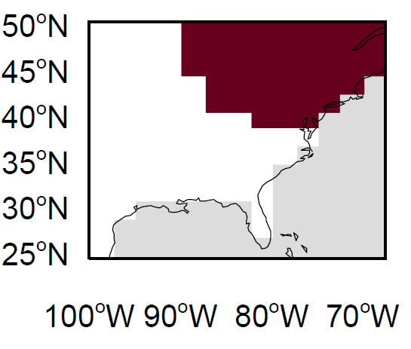
Selection of Years for Downscaling based on Empirical Orthogonal Function (EOF) Analysis of GFDL Output
Our intention is to select years that represent upper quartile and median PM_{2.5} levels in each US geographical region
Method of Year Selection
Leading rotated-EOF of Eastern US PM_{2.5} for 2006-2015
Daily PM_{2.5} from GFDL-CM3
EOF analysis of GFDL
Identify US regions that vary coherently
Annual Mean PM_{2.5}
(spatial pattern of the EOF)
Probability distribution analysis
Identify frequency of upper-quartile and median PM_{2.5} events in each US region for each year
Select years for downscaling in WRF/CMAQ
Year
Notes:
Using multiple (5 here) rotated-EOF (Empirical Orthogonal Function) to explain most of the variance in PM_{2.5} in a region over time (spatiotemporal variation)
Rotated-EOFs are used to identify multiple regions whose PM_{2.5} levels vary coherently
Time series analysis of selected EOFs shows the frequency of high PM_{2.5} events with time for different regions of the US
With the PM_{2.5} frequency information for RCP8.5 scenario, the years with median and high PM_{2.5} levels are selected for different regions of the US

Slide 9
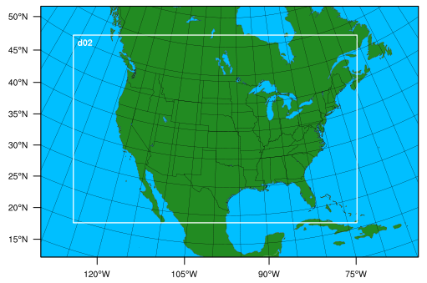
WRF Simulations and Options
Test for 2006-07 on 36km/12km domains on WRFv3.9.1.1
Spectral nudging is applied to moisture for better precipitation results (Spero et al, 2018)
Physics Options used in WRF simulations
Domains used in Simulations
Parameter | Physics options used in WRF simulation
mp_physics = 6 | WSM 6-class graupel scheme microphysics
ra_lw_physics = 4 | RRTMG radiative transfer scheme used for longwave radiation
ra_sw_physics = 4 | RRTMG radiative transfer scheme used for shortwave radiation
sf_surface_physics = 2 | Unified Noah land-surface model
cu_physics = 1 | Kain-Fritsch (new Eta) scheme for cumulus parameterization
num_land_cat = 40 | 40 land categories of NLCD2006 used
num_soil_cat = 16 | 16 soil categories of soil data
12km domain
36km domain
Notes:
WRFv3.9.1.1 with spectral nudging obtained from Tanya Spero, EPA

Slide 10
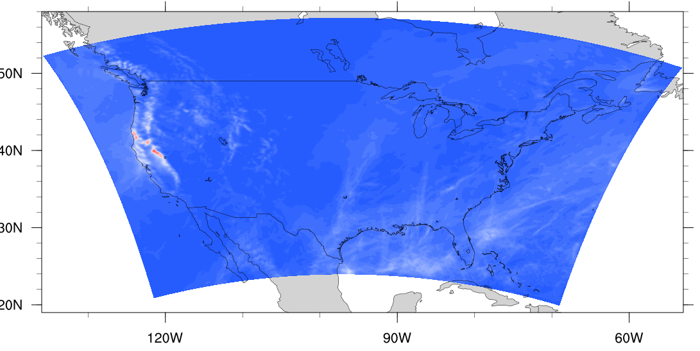
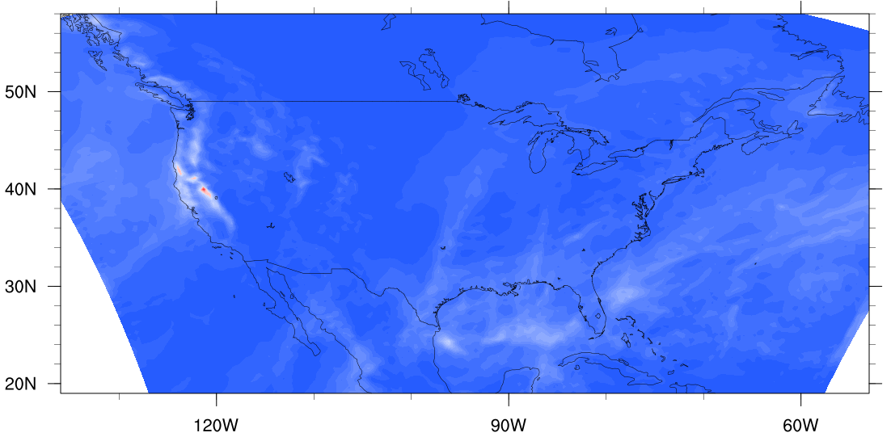
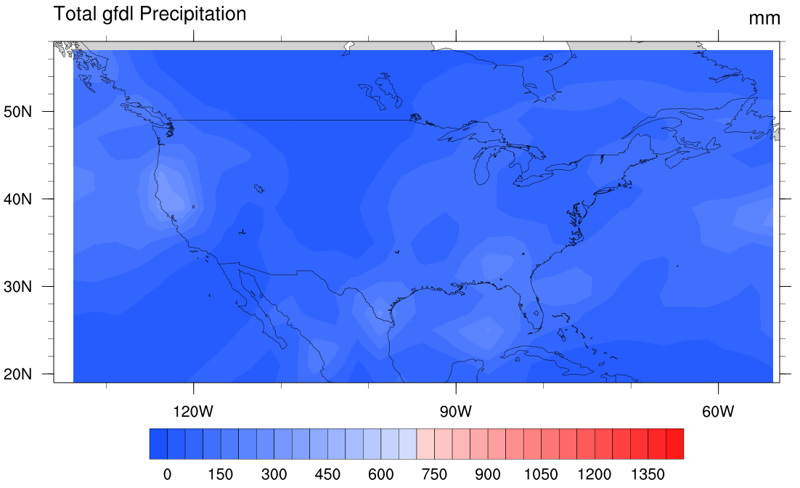
Comparing GFDL and WRF monthly precipitation totals for Jan 2006 test case
WRF 12km domain
WRF 36km domain
Value addition (spatial refining of total precipitation totals of GFDL data) by WRF:
GFDL maximum ~ 300mm
WRF36km maximum ~ 1300mm
WRF12km maximum ~ 1200mm
GFDL domain
Notes:
Worth maybe mentioning some delay getting the driving global fields and simulations are underway.

Slide 11
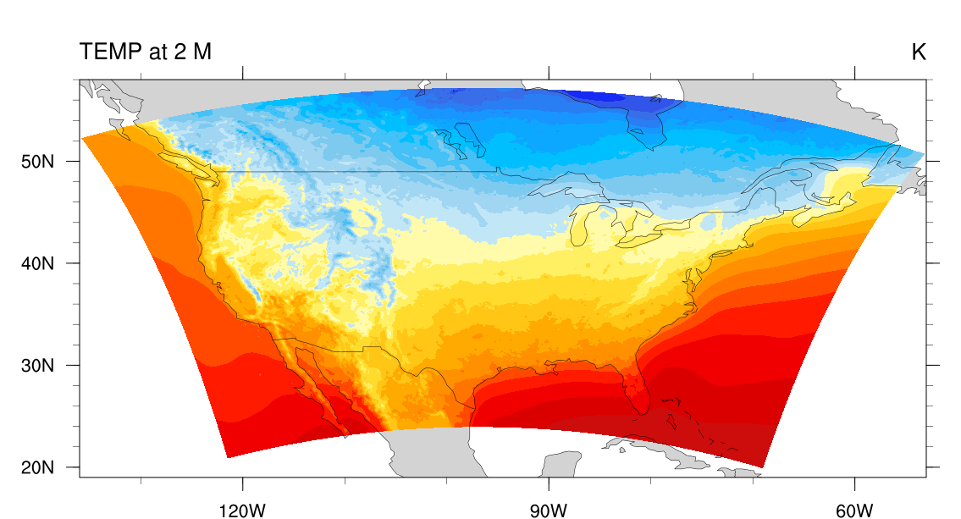
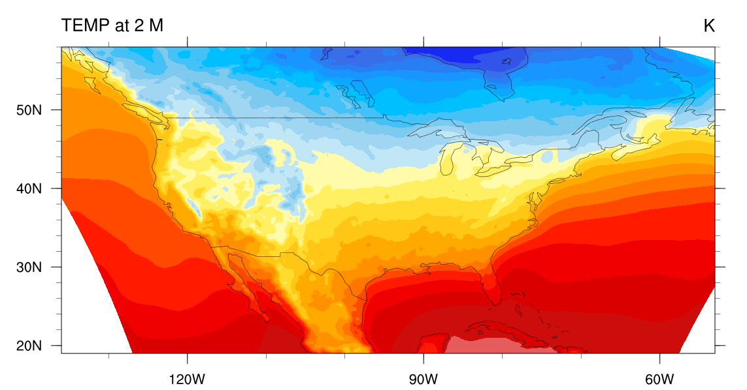
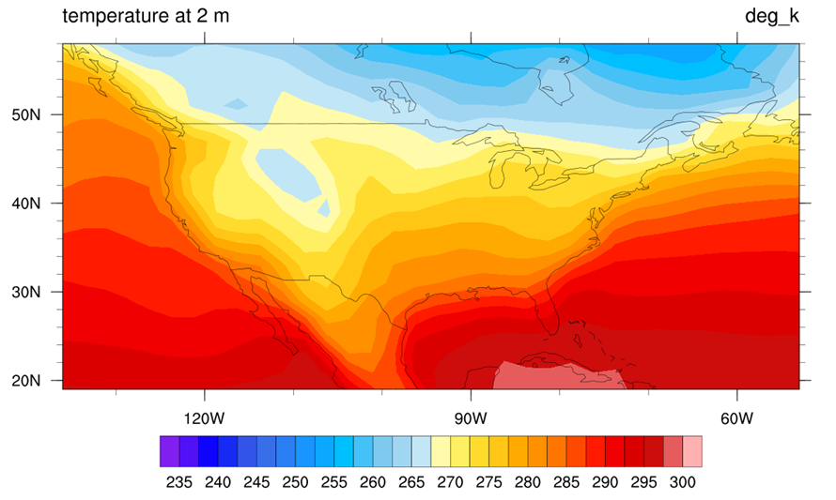
Comparing GFDL and WRF monthly average 2m Temperature for Jan 2006 test case
12km WRF domain
36km WRF domain
GFDL domain

Slide 12
WRF/CMAQ Simulations Proposed
GFDL Simulations | Meteorology | Anthropogenic Emissions | # of Realizations
RCP8.5_WMGG | 2005 RCP8.5 | 2005 RCP8.5 | 12
RCP8.5_WMGG | 2050 RCP8.5 | 2005 RCP8.5 | 20
2050 RCP8.5 | 2050 RCP8.5 | 2050 RCP8.5 | 10
RCP8.5-compatible Land Use/Cover dataset will be used for all simulations RCP8.5_WMGG fixes aerosol, ozone precursors emissions at 2005 level, showing effects of only meteorology; this will be our initial focus 2050 RCP8.5 lets both aerosol, ozone precursor emissions and meteorology evolve as per RCP8.5 scenario

Slide 13
Additional Sensitivity Scenarios Proposed
Western US Wildfire Sensitivity Simulations
GFDL Simulations | Meteorology | Anthropogenic Emissions | # of Realizations
2050 RCP8.5_WILDFIRE | 2050 RCP8.5 | 2050 RCP8.5 | 3*
* Includes a dry year
Eastern US SOA Sensitivity Simulations
Simulation ID | SOA Mechanism in CMAQ | Biogenic Emissions | Meteorological Driver
1 | Base Simulation | - | 2050 RCP8.5
2 | SAPRC07 with advanced aerosol chemistry | 2050 MEGAN | 2050 RCP8.5
3 | SAPRC07 with advanced aerosol chemistry | 2050 BEIS | 2050 RCP8.5
4 | SAPRC07 with advanced aerosol chemistry | 2005 MEGAN | 2050 RCP8.5
5 | SAPRC07 with advanced aerosol chemistry | 2005 forest cover | 2050 RCP8.5
No additional WRF simulations required for the focused sensitivity simulations, only emissions and/or chemical mechanisms changed

Slide 14
Tasks in the Near Future
Finalize land use dataset for RCP8.5 scenario
Process RCP8.5 emissions in SMOKE
Perform CMAQ test case run
Achieve full year downscaling in WRF-SMOKE-CMAQ for selected ‘present day’ and ‘future’ years
Notes:
Academic side:
Take the qualifiers
Spend more time in lab compared to courses

Slide 15
Expected Outcomes
Map probability distributions of PM_{2.5} and O₃ in US regions to identify climate change impacts on PM_{2.5} and O₃ distinct from the range of natural climate variability in 2050.
Make improved air quality projections for the individual US regions, and highlight the importance of climate change for future air quality.
Deduce implications of changes in PM_{2.5} and O₃ for air quality planning, regional haze, and probabilistic health impact assessment

Slide 16
References
Deser, C., R. Knutti, S. Solomon, and A. S. Phillips (2012a), Communication of the role of natural variability in future North American climate, Nature Clim. Change, 2(12), 888-888.
Fiore, A. M., Naik, V., & Leibensperger, E. M. (2015). Air quality and climate connections. Journal of the Air & Waste Management Association, 65(6), 645-685.
https://www.cmascenter.org/smoke/
https://www.epa.gov/sites/production/files/2016-10/documents/community_multi-scale_air_quality_model_fact_sheet.pdf
https://www.sercc.com/NOAA_NESDIS_Tech_Report_Climate_of_the_Southeast_U.S.pdf
https://journals.ametsoc.org/doi/10.1175/JAMC-D-17-0360.1
https://link.springer.com/article/10.1007/s00382-010-0810-6
https://link.springer.com/content/pdf/10.1007%2Fs00382-010-0810-6.pdf

Slide 17
Thank You!
Advisor
Mentors
Collaborators
PhD Committee
CHAQ Lab
Department of ESE, UNC-Chapel Hill
CMAS Center
Audience

Slide 18
Questions

