Slide 1
Demonstrating Sensitivity Analysis with the Multi-Complex Variable Method in ISORROPIA
Bryan Berman¹, Isaiah Sauvageau¹, Ryan Russell², Shannon Capps¹
¹ Drexel University
² University of Texas at Austin
Funded by GAANN (U.S. Department of Education)
Notes:
Hello everyone! My name is Bryan Berman and I am a graduate student at Drexel University. Today I will be presenting my work on the implementation of the Multi-Complex Variable method in ISORROPIA and demonstrating sensitivity analysis results using this method

Slide 2
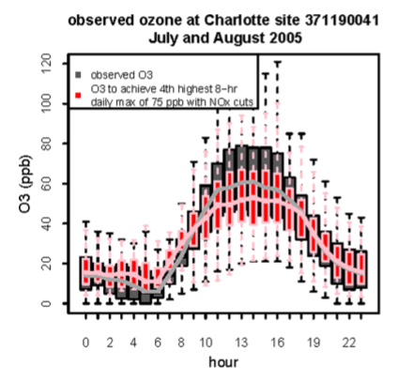
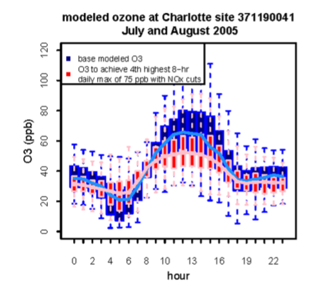
Why is Sensitivity Analysis Important?
Sensitivity analysis using atmospheric chemical transport models (CTMs) provides a deeper understanding of how specific emissions affect pollutant concentrations
Sensitivity analysis is important to understanding nonlinear processes
Simon et al., Environmental Science & Technology, 2013
Notes:
Sensitivity analysis is important when using chemical transport models because it gives us a deeper understanding on how specific emissions affect pollutant concentrations. For instance, if we have a model where emissions are inputs and pollutant concentrations are outputs, sensitivity analysis can be done by computing the partial derivatives of the underlying function with respect to their input variables. Sensitivity analysis is also important to understanding nonlinear processes.
PICTURE: To fully understand the impacts of air pollution policy on human health and wellbeing, policy makers must estimate how pollutant concentrations will vary after policies are implemented. Consider a study conducted in Charlotte by Heather Simon and her team, where they use HDDM to calculate sensitivities in order to provide estimates of how spatially and temporally varying ozone concentrations might look after changes to precursor emissions. However, there are some challenges involved when using models, namely that models aren’t perfect.
The black and red figure shows observed hourly distributions of ozone in an urban site in Charlotte from July and August of 2005. The centerline shows the median values and the boxes show the 25th and 75th percentiles. The whiskers extend to 1.5 times the interquartile range. The observed values are shown in grey and black. The pink color is the adjusted values using HDDM to reach 75 ppb for the 4th highest 8-hour daily maximum at the highest site in the area. The right figure is similar except it is showing modeled ozone distributions.
Before sensitivity analysis, in order to measure ozone, a background concentration of 40 ppb was needed to model ozone. However, as seen from these figures, higher order sensitivities makes this value unnecessary since HDDM can capture values below it.

Slide 3
Why is Multi-Complex Variable Method (MCX) Useful?
Provides higher order derivatives for Taylor Series approximation when the function is nonlinear
  Captures the response of secondary pollutants to emissions changes
  Better answer various environmental questions
MCX improves accuracy, computational cost, and ease of implementation over the finite difference method (FD) and decoupled direct method (DDM)
Notes:
One of the major benefits to implementing and using MCX is that it allows users to easily calculate higher order derivatives. This is extremely useful when we need to analyze nonlinear processes such as ozone’s response to emission changes. This is because it reduces error when using sensitivities to predict changes in model output with increments in the input parameters.
Furthermore, with higher order sensitivity analysis we can better answer important environmental questions such as:
1) How would lowering concentrations at a violating monitor affect PM2.5 concentration throughout an urban area or 2) How would meeting the standard affect ozone concentrations during non-peak hours?
Historically, sensitivity analysis has been done using methods like the finite difference method or more recently the decoupled direct method. However, today, I will be utilizing the multi-complex variable method (MCX). This method was chosen because it improves accuracy and reduces computational cost over the finite difference method. It also improves ease of implementation and use over DDM, which requires the implementation of new code every time the model is developed.

Slide 4
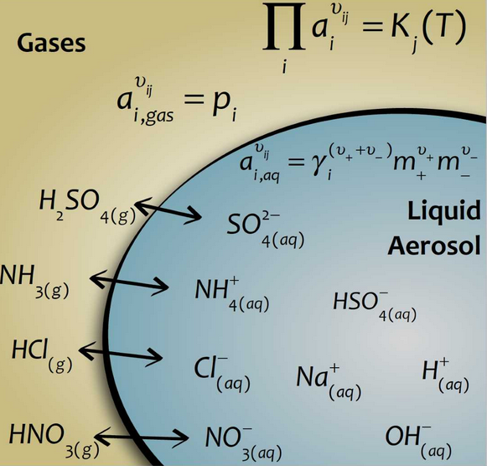
MCX in ISORROPIA
MCX is utilized in the inorganic aerosol thermodynamic equilibrium model, ISORROPIA
  Enough inputs and outputs to demonstrate simultaneous calculation of the sensitivities of all outputs with respect to multiple inputs
  ISORROPIA is used in CMAQ
Nenes et al., 1998; Fountoukis et al., 2007
Notes:
MCX was implemented in ISORROPIA as proof of concept before implementation into CMAQ. For those of you that don’t know what ISORROPIA is, it is a thermodynamic equilibrium model where when given a relative humanity, a temperature and the total concentration of various pollutants one can determine how much of the pollutant will be in each phase (such as gaseous phase or aerosol phase).
This is an adequate proof of concept because not only is there enough inputs and outputs to demonstrate simultaneous calculation of the sensitivities of all outputs with respect to multiple inputs, but also because ISORROPIA is used in CMAQ.

Slide 5
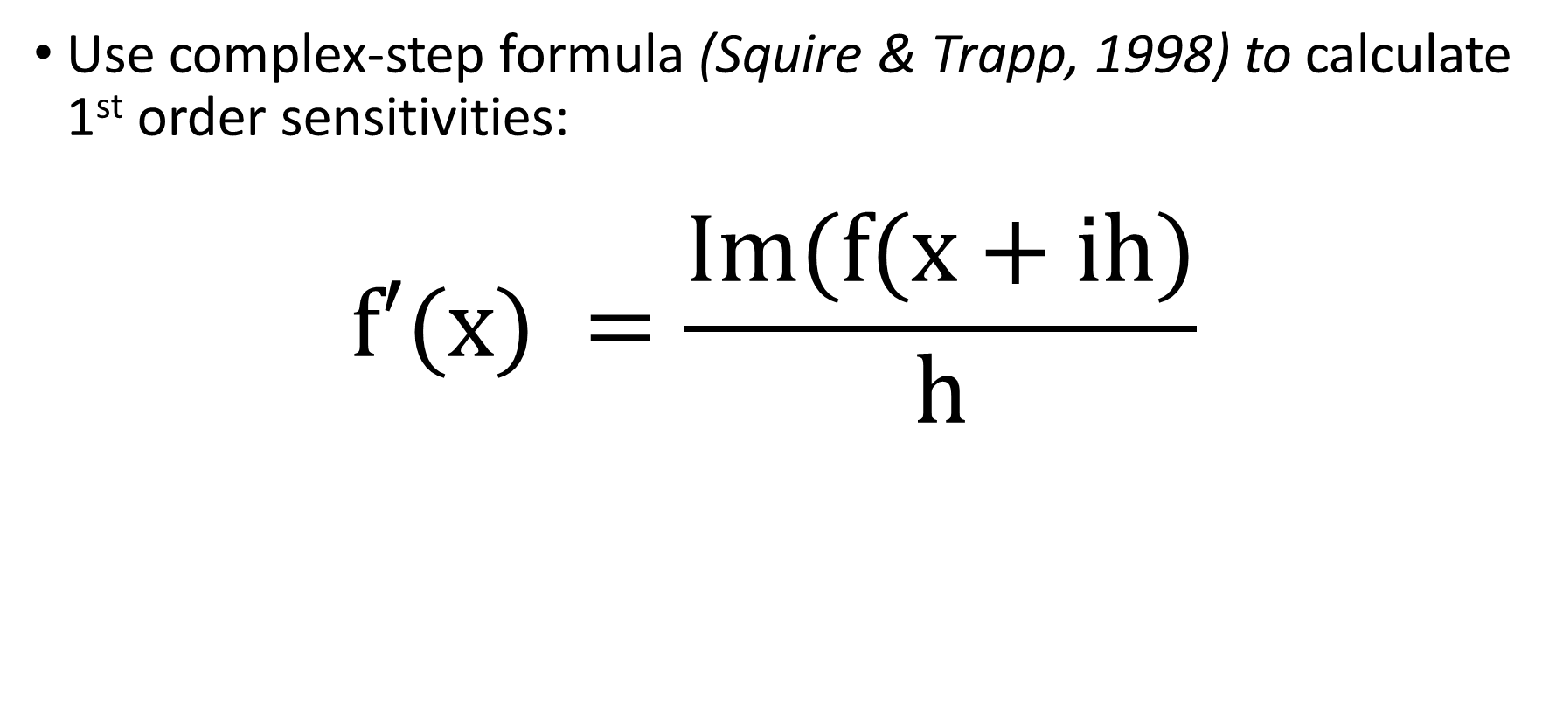
Goal 1: Implement the complex variable method (CVM) into ISORROPIA
Use complex-step formula (Squire & Trapp, 1998) to calculate 1st order sensitivities:
$$f′(x) =\frac{Im(f(x+ih)}{h}$$
Squire & Trapp, SIAM REV., 1998
Notes:
In order to begin implementing the Multi-complex variable method. I first had to implement the complex variable method. The outcome we were going for was to be able to use the complex step formula to calculate the 1st order sensitivities. This formula involves evaluating an analytic function at a complex argument by recasting it in terms of a complex variable. Taking the imaginary part and dividing by the step size gives us the 1st order sensitivity. Here, IM represents the imaginary part of the function f and h is the step size.

Slide 6
Goal 1: Implement CVM into ISORROPIA
Step 1: “Complexify” the real version of ISORROPIA
Notes:
The first step to doing this was to complexify the original version of ISORROPIA

Slide 7
Goal 1: Implement CVM into ISORROPIA
Step 1: “Complexify” the real version of ISORROPIA
  Change all occurrences of “real” to “complex” with python script provided by Dr. J.R.R.A. Martins (Michigan)
  Overload operators and intrinsic functions using CVM library also provided by Dr. Martins
  Test by comparing outputs from original ISORROPIA with complexified ISORROPIA
Notes:
The process was started by changing all real declaration and casted variables from real to complex. We also had to overload all operators and intrinsic functions. We utilized code written by Dr. Martians to do this. However, the remaining necessary operators and intrinsic functions were implemented and tested. I tested the complexified version of ISORROPIA by comparing its outputs with the outputs from the original ISORROPIA. I tested this using multiple temperatures and Relative Humitities.

Slide 8
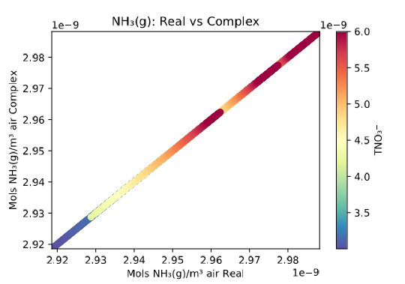
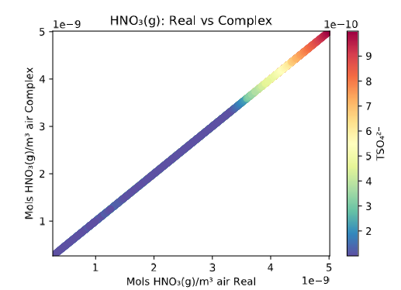


Results: RH = 30%, T = 255K
$$\frac{{mols TNO}_{3}^{−}}{m^{3 }air }$$
$$\frac{{mols TSO}_{4}^{2−}}{m^{3 }air }$$
Notes:
These are the results comparing the outputs from the real and complex versions of ISORROPIA. The RH = 30% and Temp = 255K. As you can see, results are the same order of magnitude and lie across a perfectly linear y=x line. Furthermore, the outputs have a y intercept of 0 and an x intercept of 0 indicating there is no bias.

Slide 9
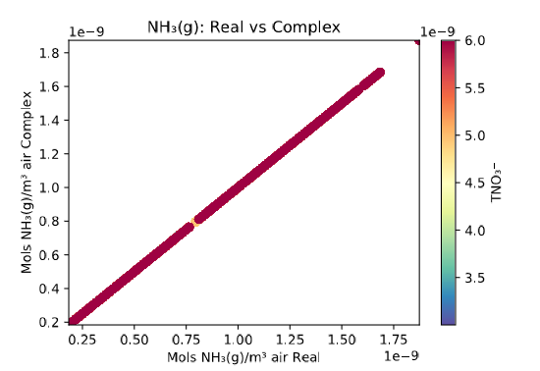
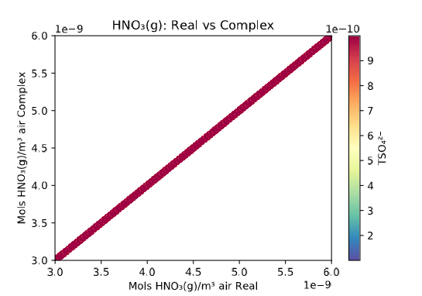


Results: RH = 90%, T = 295K
$$\frac{{mols TSO}_{4}^{2−}}{m^{3 }air }$$
$$\frac{{mols TNO}_{3}^{−}}{m^{3 }air }$$
Notes:
These are results for RH = 90% and temp = 295 kelvin. Similar results can be seen for all tests change units mols of to m3 of air

Slide 10
Goal 1: Implement CVM into ISORROPIA
Step 2: Add meaningful values to the imaginary part of complex variables
Notes:
The next step was to add meaningful values into the imaginary part of complex variables. In other words, I needed to add the step size to the imaginary component of the concentration of interest.

Slide 11
Goal 1: Implement CVM into ISORROPIA
Step 2: Add meaningful values to the imaginary part of complex variable
  Add the step size to the imaginary component of the input concentration
  Refine input and output with NetCDF to handle complex numbers
Gaseous Nitrate
Real part of Gaseous Nitrate
Imaginary part of Gaseous Nitrate
Notes:
This was actually a little harder than expected since netCDF doesn’t straight up take in complex numbers.
So to solve this problem two different output variables were created. One to hold information about the real part and a 2nd variable to hold information about the imaginary part. For instance, if my output is Gaseous Nitrate I needed to create 2 output variables. One to hold the real part and one to hold the imaginary part of that variable.

Slide 12
Goal 1: Implement CVM into ISORROPIA
Step 3: Calculate 1st order sensitivities using the complex step method
Notes:
The 3rd step was to calculate the 1st order sensitivities using the complex step method

Slide 13
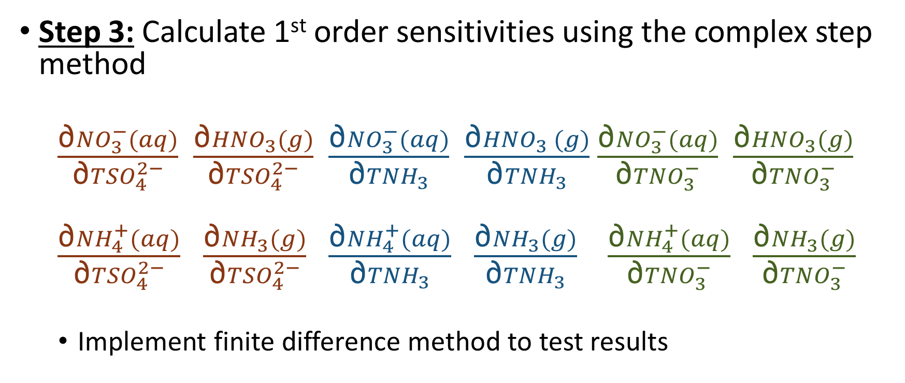
Goal 1: Implement CVM into ISORROPIA
Step 3: Calculate 1st order sensitivities using the complex step method
  $\frac{\text{∂}{NO}_{3}^{−}(aq)}{\text{∂}{TSO}_{4}^{2−}}$ $\frac{\text{∂}{HNO}_{3}(g)}{\text{∂}{TSO}_{4}^{2−}}$ $\frac{\text{∂}{NO}_{3}^{−}(aq)}{\text{∂}{TNH}_{3}}$ $\frac{\text{∂}{HNO}_{3} (g)}{\text{∂}{TNH}_{3}}$ $\frac{\text{∂}{NO}_{3}^{−}(aq)}{\text{∂}{TNO}_{3}^{−}}$ $\frac{\text{∂}{HNO}_{3}(g)}{\text{∂}{TNO}_{3}^{−}}$
  $\frac{\text{∂}{NH}_{4}^{+}(aq)}{\text{∂}{TSO}_{4}^{2−}}$ $\frac{\text{∂}{NH}_{3}(g)}{\text{∂}{TSO}_{4}^{2−}}$ $\frac{\text{∂}{NH}_{4}^{+}(aq)}{\text{∂}{TNH}_{3}}$ $\frac{\text{∂}{NH}_{3}(g)}{\text{∂}{TNH}_{3}}$ $\frac{\text{∂}{NH}_{4}^{+}(aq)}{\text{∂}{TNO}_{3}^{−}}$ $\frac{\text{∂}{NH}_{3}(g)}{\text{∂}{TNO}_{3}^{−}}$
  Implement finite difference method to test results
Notes:
Sensitivities aerosol nitrate, gaseous nitric acid, aerosol ammonium and gaseous ammonia with respect to total sulfate, total ammonia and total nitrate were calculated. I performed these calculations using different temperatures and relative humities. To test this method, I compared sensitivity results from the complex step method with the finite difference method.

Slide 14
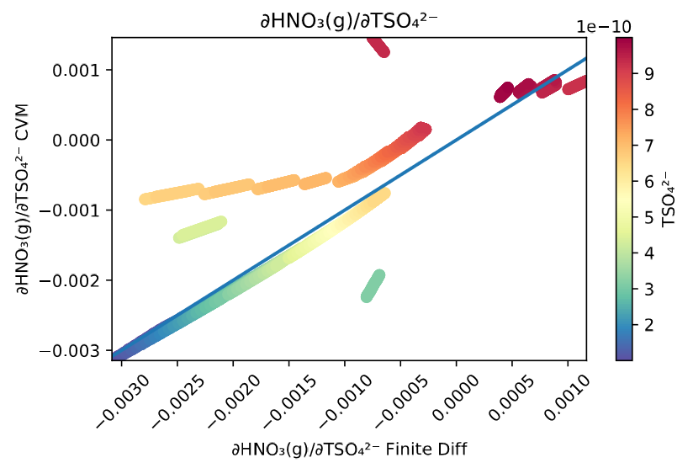
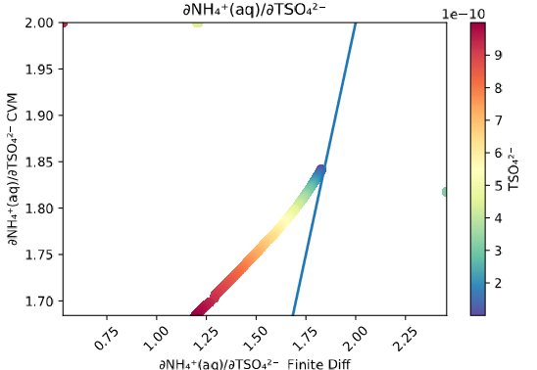



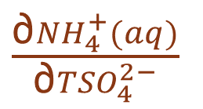

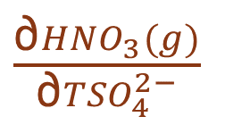


Results: RH = 90%, T = 295K, Pert = 40%
$\frac{\text{∂}{HNO}_{3}(g)}{\text{∂}{TSO}_{4}^{2−}}$
$\frac{\text{∂}{NH}_{4}^{+}(aq)}{\text{∂}{TSO}_{4}^{2−}}$
CVM $\frac{{mols NH}_{4}^{+} \left(aq\right)}{mols {TSO}_{4}^{2−} }$
CVM $\frac{{mols NH}_{4}^{+} \left(aq\right)}{mols {TSO}_{4}^{2−} }$
$$\frac{{mols TSO}_{4}^{2−}}{m^{3 }air }$$
$$\frac{{mols TSO}_{4}^{2−}}{m^{3 }air }$$
Finite Difference $\frac{{mols HNO}_{3}(g)}{mols {TSO}_{4}^{2−}}$
Finite Difference $\frac{{mols NH}_{4}^{+} \left(aq\right)}{mols {TSO}_{4}^{2−} }$
Notes:
Increasing the total sulfate would increase the amount of ammonium in the aerosol phase because the sensitives are positive.

Slide 15
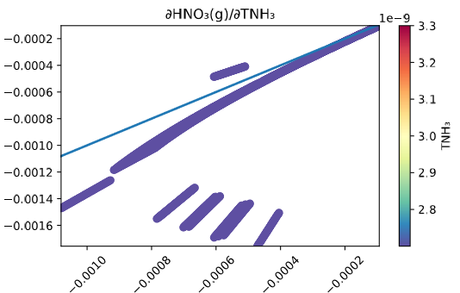
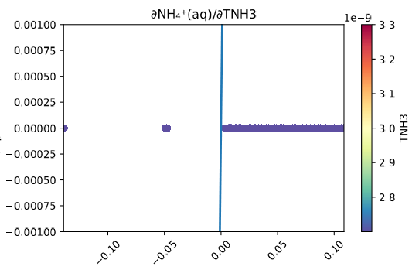
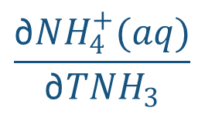




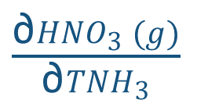


Results: RH = 90%, T = 295K, Pert = 40%
$\frac{\text{∂}{HNO}_{3} (g)}{\text{∂}{TNH}_{3}}$
$$\frac{\text{∂}{NH}_{4}^{+}(aq)}{\text{∂}{TNH}_{3}}$$
CVM $\frac{{mols HNO}_{3}(g)}{mols{ TNH}_{3} }$
CVM $\frac{{mols NH}_{4}^{+} \left(aq\right)}{mols{ TNH}_{3} }$
$$\frac{{mols TNH}_{3}}{m^{3} air }$$
$$\frac{{mols TNH}_{3}}{m^{3} air }$$
Finite Difference $\frac{{mols HNO}_{3}(g)}{mols{ TNH}_{3} }$
Finite Difference $\frac{{mols NH}_{4}^{+} \left(aq\right)}{mols{ TNH}_{3} }$
Notes:
These are graphs showing sensitivities of gaseous nitric acid and aersol ammonium with respect to total ammonia

Slide 16
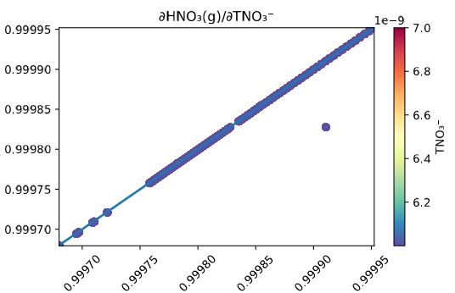
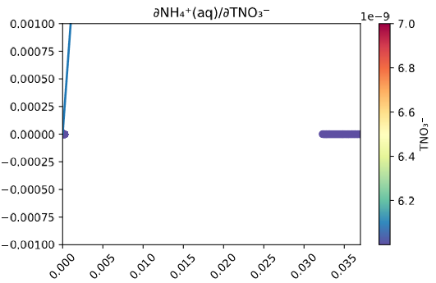








Results: RH = 90%, T = 295K, Pert = 40%
$$\frac{\text{∂}{HNO}_{3}(g)}{\text{∂}{TNO}_{3}^{−}}$$
$$\frac{\text{∂}{NH}_{4}^{+}(aq)}{\text{∂}{TNO}_{3}^{−}}$$
CVM $\frac{{mols NH}_{4}^{+} \left(aq\right)}{mols {TNO}_{3}^{−} }$
CVM $\frac{{mols HNO}_{3}(g)}{mols {TNO}_{3}^{−}}$
$$\frac{{mols TNO}_{3}^{−}}{m^{3 }air }$$
$$\frac{{mols TNO}_{3}^{−}}{m^{3 }air }$$
Finite Difference $\frac{{mols NH}_{4}^{+} \left(aq\right)}{mols {TNO}_{3}^{−} }$
Finite Difference $\frac{{mols HNO}_{3}(g)}{mols {TNO}_{3}^{−}}$
Notes:
And these are with respect to total nitrate. As you can see from the graphs some of the sensitivities from the complex step method match those from the finite difference, while others do not. An explanation for this is because of the nonlinearity associated with these functions and the inability of the finite difference method to accurately calculate sensitivities because of this. This explains the need for MCX. In fact, higher order sensitives get increasingly less accurate as they are calculated with finite difference

Slide 17
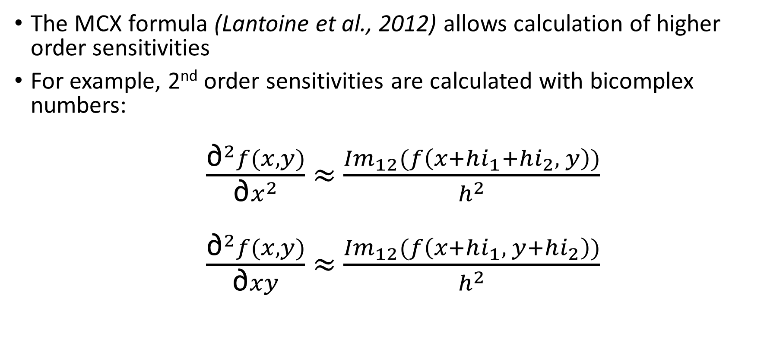
Goal 2: Implement MCX into ISORROPIA
The MCX formula (Lantoine et al., 2012) allows calculation of higher order sensitivities
For example, 2nd order sensitivities are calculated with bicomplex numbers:
  $\frac{{\text{∂}}^{2}f(x,y)}{\text{∂}x^{2}}$ ≈ $\frac{{Im}_{12}(f\left(x+hi_{1}+hi_{2}, y\right))}{h^{2}}$
  $\frac{{\text{∂}}^{2}f(x,y)}{\text{∂}xy}$ ≈ $\frac{{Im}_{12}(f\left(x+hi_{1}, y+hi_{2}\right))}{h^{2}}$
Lantoine et al., ACM Transactions on Mathematical Software, 2012
Notes:
The next goal was to implement the Multi-complex variable method into ISORROPIA. This process is similar to how the complex step method was implemented and we use similar equations that works conceptually the same as the equation I showed previously. The top equation used for calculating the 2nd order sensitivity with respect to one input, while the 2nd equation can be used to calculate cross sensitivities. However these equations can be extended to get sensitives using p parameters and up to the nth order.

Slide 18
Goal 2: Implement MCX into ISORROPIA
Step 1: “Bicomplexify” the real version of ISORROPIA
Notes:
The process is similar to that of the complex variable method, except now instead of complexifying ISORROPIA, we have to bicomplexify ISORROPIA

Slide 19
Goal 2: Implement MCX into ISORROPIA
Step 1: “Bicomplexify” the real version of ISORROPIA
  Change all occurrences of “complex” to “Type(bicomplex)”
  Overload operators and intrinsic functions with MCX library provided by Dr. Ryan Russell
  Demonstrate with single call to ISORROPIA
Notes:
The process is similar to that of the complex variable method, except now instead of complexifying ISORROPIA, we have to bicomplexify ISORROPIA

Slide 20
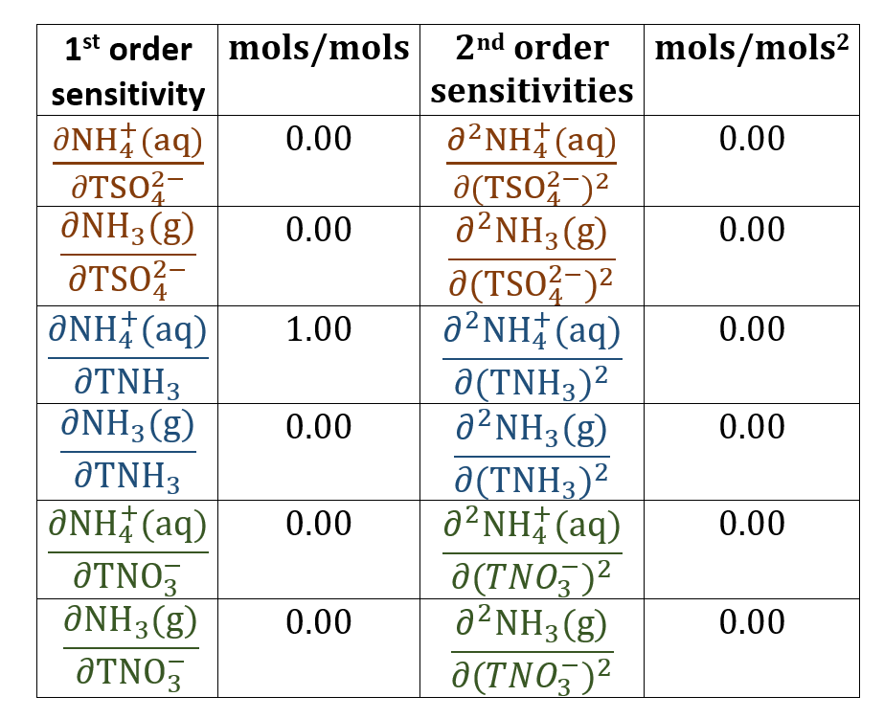
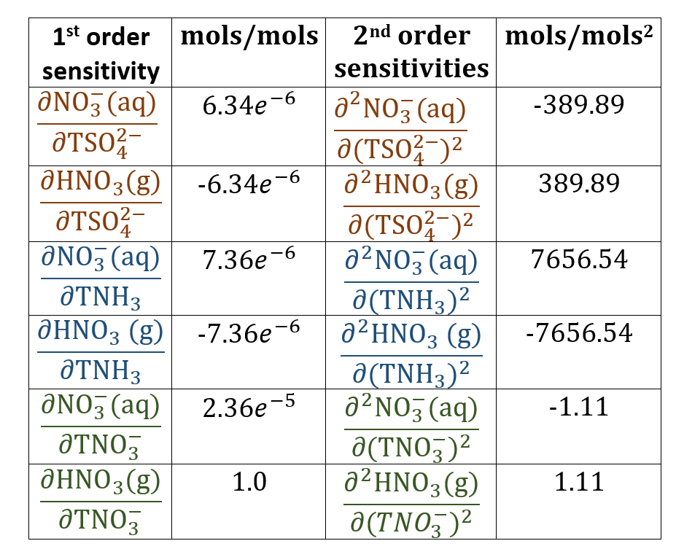
Preliminary Results:
RH = 90%, T = 295K
Totals: 0.098 µg sulfate/m³ air, 0.0018 µg ammonium/m³ air, 0.0186 µg nitrate/m³ air
Notes:
These are 1st and 2nd order results from the single call to ISORROPIA. Note that these results still need to be verified. However, it also important to note that ISORROPIA can be modified to handle bicomplex numbers, which is essential for calculating higher order derivatives.

Slide 21
Summary and Future Work
Implemented and tested 1st order sensitivities using ISORROPIA-CVM
Calculated 2nd order sensitivities using single call to ISORROPIA-MCX
Test ISORROPIA-MCX with HDDM including cross sensitivities
Develop CMAQ-MCX
Notes:
In the future we aim to implement this method into CMAQ. Before we do this we want to test the sensitivity analysis with the Decoupled Direct Method to confirm results.
However, implementation of MCX into CMAQ will eliminate the need for DDM and the finite difference method allowing us to calculate sensitivities accurately with ease. Thank you for your attention
IF they ask about DDM
DDM has been used to find sensitivities by adding the derivatives line by line, which sometimes required reformulating algorithms in major parts of the code. Since the equations for sensitivities come in many different forms, this becomes a necessary, long and tedious step. Therefore, DDM, like the automatic differentiation method, requires the addition of new code every time the model is developed.

Slide 22
References
Capps, S. L., Henze, D. K., Hakami, A., Russell, A. G., & Nenes, A. (2012). ANISORROPIA: The adjoint of the aerosol thermodynamic model ISORROPIA. Atmospheric Chemistry and Physics, 12(1), 527–543. https://doi.org/10.5194/acp-12-527-2012
Garza, J., & Millwater, H. (2016). Higher-order probabilistic sensitivity calculations using the multicomplex score function method. Probabilistic Engineering Mechanics. https://doi.org/10.1016/j.probengmech.2015.12.001
Ibrahim, R. W., & Jalab, H. A. (2015). Image denoising based on approximate solution of fractional cauchy-euler equation by using complex-step method. Iranian Journal of Science and Technology, Transaction A: Science, 39(A3), 243–251.
Lantoine, G., Russell, R. P., & Dargent, T. (2010). Using multicomplex variables for automatic computation of high-order derivatives. Advances in the Astronautical Sciences, 136(3), 1729–1746. https://doi.org/10.1145/2168773.2168774
Napelenok, S. L., Cohan, D. S., Odman, M. T., & Tonse, S. (2008). Extension and evaluation of sensitivity analysis capabilities in a photochemical model. Environmental Modelling and Software, 23(8), 994–999. https://doi.org/10.1016/j.envsoft.2007.11.004
Russell, R. P., Arora, N., & Gaylor, D. (n.d.). Aas 12-204 Second-Order Kalman Filters Using Multi-Complex. Russell The Journal Of The Bertrand Russell Archives, 1–16.
Sandu, A., Daescu, D. N., Carmichael, G. R., & Chai, T. (2005). Adjoint sensitivity analysis of regional air quality models. Journal of Computational Physics, 204(1), 222–252. https://doi.org/10.1016/j.jcp.2004.10.011
Seinfeld, J. H., & Pandis, S. N. (2006). Atmospheric Chemistry and Physics: From Air Pollution to Climate Change. Atmospheric Chemistry and Physics. https://doi.org/10.1063/1.882420
Simon, H., Baker, K. R., Akhtar, F., Napelenok, S. L., Possiel, N., Wells, B., & Timin, B. (2013). A direct sensitivity approach to predict hourly ozone resulting from compliance with the national ambient air quality standard. Environmental Science and Technology, 47(5), 2304–2313. https://doi.org/10.1021/es303674e
Squire, W., & Trapp, G. (1998). Using Complex Variables to Estimate Derivatives of Real Functions. SIAM Review, 40(1), 110–112. https://doi.org/10.1137/S003614459631241X
Zhang, L., Chen, Y., Zhao, Y., Henze, D. K., Zhu, L., Song, Y., … Huang, B. (2018). Agricultural ammonia emissions in China: Reconciling bottom-up and top-down estimates. Atmospheric Chemistry and Physics (Vol. 18). https://doi.org/10.5194/acp-18-339-2018
Zhang, W., Capps, S. L., Hu, Y., Nenes, A., Napelenok, S. L., & Russell, A. G. (2012). Development of the high-order decoupled direct method in three dimensions for particulate matter: Enabling advanced sensitivity analysis in air quality models. Geoscientific Model Development, 5(2), 355–368. https://doi.org/10.5194/gmd-5-355-2012
Zhu, L., Henze, D. K., Cady-Pereira, K. E., Shephard, M. W., Luo, M., Pinder, R. W., … Jeong, G. R. (2013). Constraining U.S. ammonia emissions using TES remote sensing observations and the GEOS-Chem adjoint model. Journal of Geophysical Research Atmospheres, 118(8), 3355–3368. https://doi.org/10.1002/jgrd.50166

Slide 23
Notes:
Published work shows similar results

