Slide 1
The predicted impact of VOC emissions from Cannabis spp. cultivation facilities on ozone concentrations in Denver, CO.
Chi-tsan Wang¹, Christine Wiedinmyer², Kirsti Ashworth³,
John Ortega⁴, Peter Harley, William Vizuete^{*1}
CMAS 2018 conference
Chi-tsan Wang
Oct 24, 2018

Slide 2
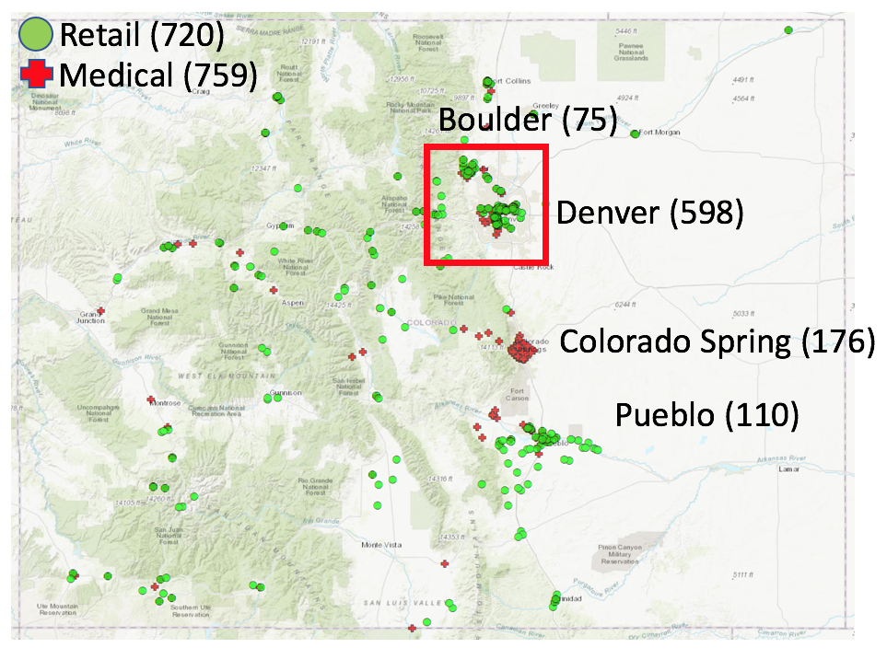
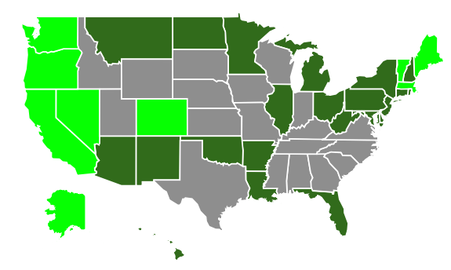
Cannabis industry status in the US and Colorado
2018 CDOR

Slide 3
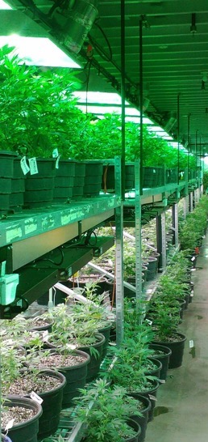
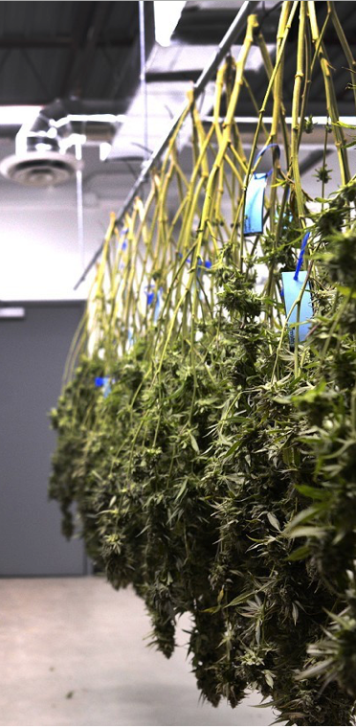
Can Cannabis industry impact regional air quality?
The biogenic VOC concentrations range are reported in the Cannabis Cultivational Facilities (CCF) (Martyny 2013) :
Vegetative rooms is 50-100 ppb
Flower room: 800ppb
Trim room: 6ppm
(Martyny 2013)
https://www.shutterstock.com/image-photo/commercial-marijuana-grow-operation-631014320?src=4fLy_muzSLGlLQDXBvVUBQ-1-7
https://images1.westword.com/imager/u/original/9206625/den_011217_veritas_grow_slentz009.jpg
http://www.techtimes.com/articles/129956/20160202/this-is-what-happens-when-you-use-marijuana-every-day-for-five-years.htm

Slide 4
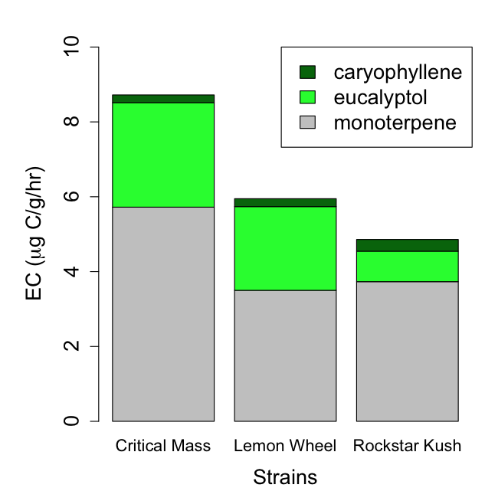
The cannabis emission capacities (µgC g⁻¹ hr⁻¹ )
The BVOC emission compositions are vary by different growth stages and different strains.
The emission capacities EC (µgC g⁻¹ hr⁻¹ ) for all terpenoids among the three strains is about 5-9 (µgC g⁻¹ hr⁻¹ )
(Wang 2018 accepted)

Slide 5
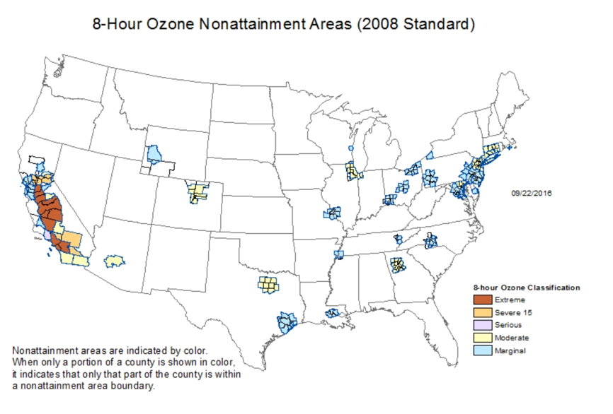
Why the BVOC emissions from CCFs are important in Denver?
Marginal (2015)
Moderate (2016)
Moderate (2017)

Slide 6
The Western Air Quality Study (WAQS) model
Air Quality Model (WAQS2011b) This model was developed in 2017 and it’s the latest model for state implementation plan (SIP).
CAMx6.10, 90days(6/15~9/15), from Intermountain West Data Warehouse (IWDW)
Emission : 2011 NEI, MEGAN
Meteorological data: WRF
Chemical mechanism : CB6r2
Process Analysis was enabled
We can not compare the model result with monitoring data, because the model year is 2011 and the cannabis industry started in 2014.
The 36km x 36km Western Air Quality Model Study (WAQS) and nested inner 12km x 12km domains (dark green) and 4km x 4km domains (light green) for the Comprehensive Air Quality Model with Extensions (CAMx).

Slide 7
The Cannabis emission estimate for the model:
What factors should be considered for emission estimate?
Emission factors and emission composition for flower plant (µgC g⁻¹ hr⁻¹ )
Dry plant weight (g)
Cannabis strains
Plant counts for each facility
Ventilation rate (scfm)
Operating condition: light, temperature, humidity.
The type of facilities and their locations.
https://www.shutterstock.com/image-photo/commercial-marijuana-grow-operation-631014320?src=4fLy_muzSLGlLQDXBvVUBQ-1-7

Slide 8
Model study assumption for cannabis industry
All Monoterpenes emissions from Marijuana are simplified to a single TERP species in the CB6r2 mechanism.
We assumed the temperature is 30ºC and light energy is 1000 μmol m⁻² s⁻¹ , 24/7 at same condition. The emission rate is constant.
We assumed all Biogenic VOCs from the plants are directly released into atmosphere, there are no chemical loss, wall loss and No emission control in CCF.

Slide 9
Ensemble Model scenarios setup
The factors for each facility : Emission Capacities, Dry plant weight, Plant count
Scenario name | EC (ug/g/hr) | Dry biomass weight (g/plant) | Plant count in Retail MCF | Plant count in Medical MCF
BC | 0 | 0 | 0 | 0
1_EC | 10 | 1500 | 1800 | 3600
2_EC | 50 | 1500 | 1800 | 3600
3_EC | 100 | 1500 | 1800 | 3600
4_DW | 50 | 750 | 1800 | 3600
5_DW | 50 | 2500 | 1800 | 3600
6_PC | 50 | 1500 | 1000 | 1000
7_PC | 50 | 1500 | 3600 | 6000
8_PC | 50 | 1500 | 6000 | 10000
9_MAX | 100 | 2500 | 6000 | 10000
Terpene emission rate in each facility = EC x Dry plant weight x plant count

Slide 10
How the cannabis industry emission rate affect the Biogenic VOC emission in Colorado and Denver?
+14%
+0.15%
+1.2%

Slide 11
How the cannabis industry emission rate affect the Biogenic VOC emission in Colorado and Denver?
+8500%
+1301%
+894%
+781%
+745%
22458
+447%
+90%
+154%
+224%

Slide 12
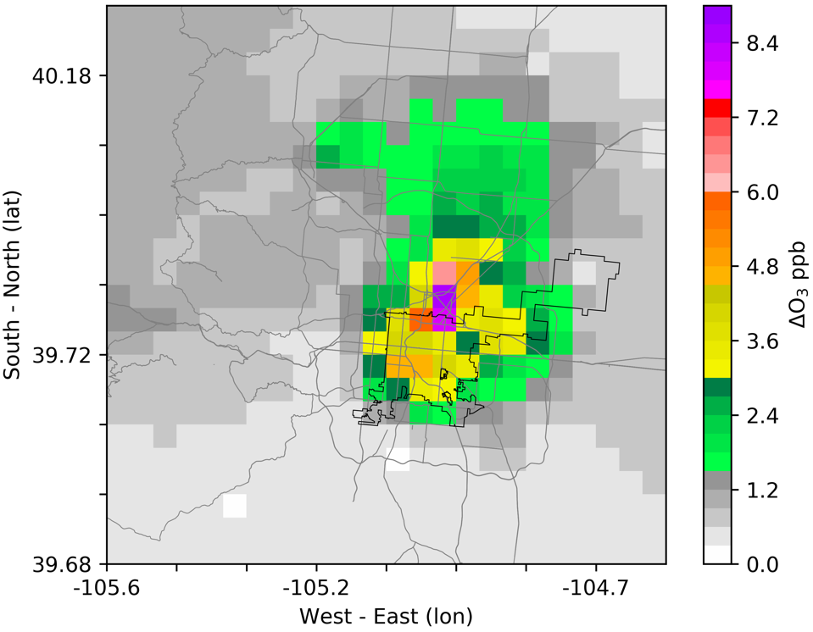
8-hour ozone difference in 90days
Day time 8-hr ozone change : 0.1-6.4 ppb
Night time 8-hr ozone change : 0.3-8.7 ppb

Slide 13
Maximum hourly ozone difference in 90 days

Slide 14
Case study for daytime and night time ozone
Case description | Date | DM8H in AQS (ppb) | DM8H in model base case (ppb) | Day time increase at 9AM(ppb) | Night time increase at 1AM (ppb) | Early morning increase at 6 AM (ppb)
Max daytime ozone increase | Jul 18 | 86 | 91.05 | 12.7 | 8.7 | 5.3
Max nighttime ozone increase | Jul 31 | 83 | 76.08 | 3.5 | 10.6 | 8.1
Early morning ozone increase | Aug 28 | 70 | 71.73 | 6.7 | 8.2 | 13.4

Slide 15
Conclusion:
Yes, the model prediction suggest that 0.13-6.4ppb impact on daytime 8 hour ozone.(one hour ozone impact is 0.3-13ppb)
Lacking of data for plant count, emission rate data for different strains and dry plant weight. There is a lot of uncertainty in this model study. (Terpene emission range in Colorado is from 490 - 49000 ton/year)
Daytime ozone increase is driven by the injection of Highly reactive VOC (terpene) emission in urban area.
Nighttime terpene react with NO₃ , and generate more organic nitrate and RO₂ radicals. This additional terpene emission impact the NOx budget, and remove N₂O₅ at night.

Slide 16
Thank you
Acknowledgement :
NCAR Advanced Study Program(ASP) Fellowship
Intermountain West Data Warehouse (IWDW)
Advisor: Dr. William Vizuete Dr. Christine Wiedinmyer Dr. Kirsti Ashworth Dr. Peter Harley Dr. John Ortega Dr. Jason Surratt Dr. Michael Barna Dr. Feng-Chi Hsu(David Hsu) Grant Josenhans

