Slide 1
Complex Variable Method for Calculating Sensitivities in CMAQ
Isaiah Sauvageau¹, Bryan Berman¹, Congmeng Lyu¹, Shannon Capps¹
¹Drexel University
Notes:
Sensitivity analysis is a powerful tool that is used in the CMAQ air quality model. The goal of sensitivity analysis is to calculate the most accurate sensitivities at the lowest computational cost

Slide 2
Finite Difference Method
$$∆y=\frac{F\left(x_{0}+∆x\right)−F(x_{0})}{∆x}$$
∆(Nitrate Aerosol Conc.)
∆(Mobile NOx Emissions)
∆(Organic Aerosol Conc.)
∆(Ozone Conc.)
$$\frac{{∆Model Output Fields}_{i,j}}{∆Mobile Emissions}$$
Notes:
One method for calculating sensitivities is the Finite Difference Method. This method calculates sensitivities by expanding a Taylor series about a point x and truncating it to give the equation shown at the top. Notice the subtraction in the numerator. This causes a size step dilemma because you want a small step size to decrease the truncation error, but decreasing the step size increases the subtractive cancelation error. Thus, the Finite Difference Method has an accuracy limit based on the step size. This method inputs changes in emissions to find sensitivities of species concentrations.

Slide 3
Continuous Analytical Tangent Linear Model
Partial derivatives of CTM equations are calculated by hand
Implemented numerically agnostic manner (e.g., CMAQ (H)DDM-3D)
Continuous Derivative of CTM
∂(Nitrate Aerosol Conc.)
∂(Mobile NOx Emissions)
∂(Organic Aerosol Conc.)
Partial Differential Equations of CTM
∂(Ozone Conc.)
Notes:
Another method of calculating sensitivities in CMAQ is the Continuous Analytical Tangent Linear Model. This method calculates the partial derivatives of CTM equations by hand, then implements them into CMAQ numerically. Thus, sensitivities of species concentration to emissions changes can be calculated.

Slide 4
Discrete Analytical Tangent Linear Model
Partial derivatives of CTM equations calculated by hand
Tangent linear model is numerically consistent with forward code
Discrete Derivative of CTM
∂(Nitrate Aerosol Conc.)
∂(Mobile NOx Emissions)
∂(Organic Aerosol Conc.)
Partial Differential Equations of CTM
∂(Ozone Conc.)
Notes:
The Discrete Analytical TLM is similar to the Continuous Method. It calculates the partial derivatives of CTM equations by hand. Then, an additional line of code is added to discretize the equations before solving them numerically for concentrations sensitivities to emissions.

Slide 5
Example Application of Sensitivity Analysis
Consider air quality case study of power plant Bowen in Georgia
The power plant burns bituminous coal which releases SO₂
Use CMAQ DDM-3D to find sensitivity of PM_{2.5} to SO₂
Use sensitivities to find monetized health impacts due to PM_{2.5}
Kerl, Zhang, Moreno-Cruz; et al, PNAS, 2015
Notes:
Sensitivity Analysis is applied in an air quality case study on a coal-burning powerplant in Georgia. The study measures the health impact that the plant has on the surrounding area by burning Bituminous coal. CMAQ models the sensitivity of PM_{2.5} concentrations to SO₂ emissions. The increased PM_{2.5} concentrations cause a monetized health impact. Which is seen on the next slide.

Slide 6
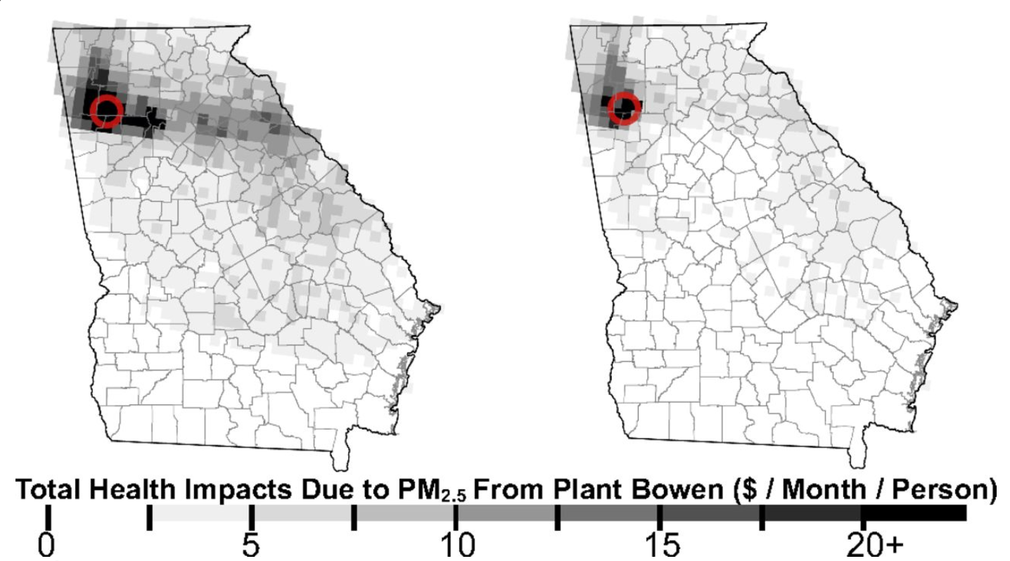
Example Application of Sensitivity Analysis
Cost optimized
Cost & health impact externality optimized
Kerl, Zhang, Moreno-Cruz; et al, PNAS, 2015
Notes:
The figure compares the health impact due to PM_{2.5} under two operating scenarios. One optimized to minimize power plant operation cost and the other optimized to minimize the operation cost along with the health impact externality. This figure demonstrates the value of first-order sensitivity analysis.

Slide 7
Complex-Step Approximation
$f\left(z\right)=u+iv$ , $z=x+iy$
$$\frac{du}{dx}=\lim_{h→0}{\frac{v\left(x+i\left(y+h\right)\right)−v(x+iy)}{h}}$$
$y=0$ , $u\left(x\right)=f(x)$ , $v\left(x\right)=0$
$$\frac{df}{dx}=\lim_{h→0}{\frac{v(x+ih)}{h}}$$
$$\frac{df}{dx}≈\frac{Im [f\left(x+ih\right)]}{h}$$
Martins, Sturdza, Alonso, ACM Transactions on Mathematical Software, 2003
Notes:
The complex step method applies the following theory to solve for sensitivities. Consider a complex function of a complex variable f(z) that are differentiable in the complex plane. By applying a perturbation to the imaginary part of the input, we can calculate the derivative of the real component of the output with respect to the real component of the input. Since the functions we are interested in are real functions of real variables, we can assume the imaginary parts will be equal to zero. This causes v(iy) to cancel leaving us with the expression df/dx. Since the step size used will be very small, the derivative is approximately df/df.

Slide 8
Complex Variable Method
$$∂y=\frac{Imag[F\left(x_{0}+i∆x\right)]}{∆x}$$
∂(Nitrate Aerosol Conc.)
∂(Mobile NOx Emissions)
∂(Organic Aerosol Conc.)
∂(Ozone Conc.)
$$\frac{∂{Model Ouput Fields}_{i,j}}{∂Mobile Emissions}$$
Squire and Trapp, SIAM Rev, 1998; Giles and Pierce, Flow, Turbulence & Combustion, 2001
Notes:
The equation for the complex step method is shown. Note the lack of subtraction in the numerator. This eliminates the subtractive cancellation error, so step size can be as small as the working precision of the computer. This allows highly accurate sensitivities of concentrations to emissions to be calculated.

Slide 9
Implementation of Complex Step Method
Automate the change of real variables to complex variables
Create overloaded operators for complex variables
Compile with overloaded operator library
Notes:
To implement the CVM into CMAQ, real-type variables must be defined as complex-type variables, and automation of this process is necessary for efficiency purposes. Many intrinsic operators expect real-type variables, so these operators must be overloaded to handle complex-type variables. Thus, CMAQ must be compiled with a library of complex-friendly overloaded operators.

Slide 10
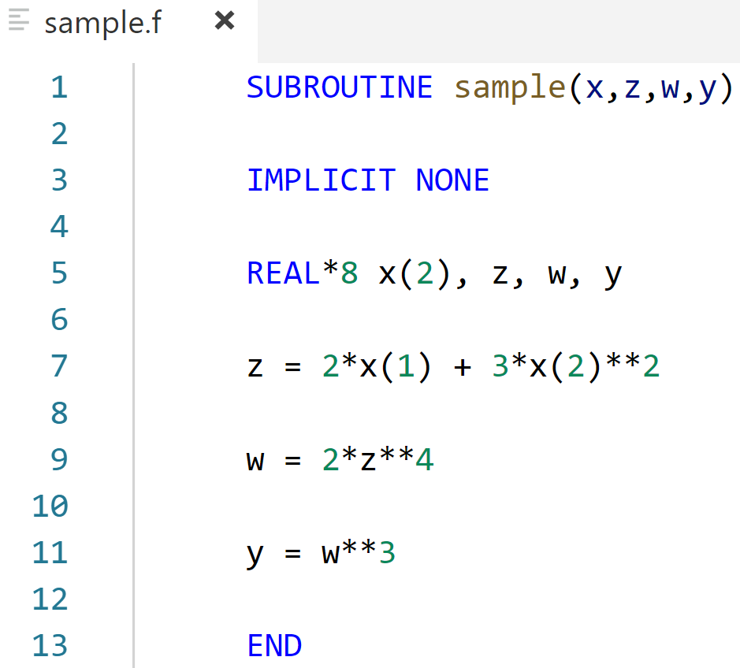
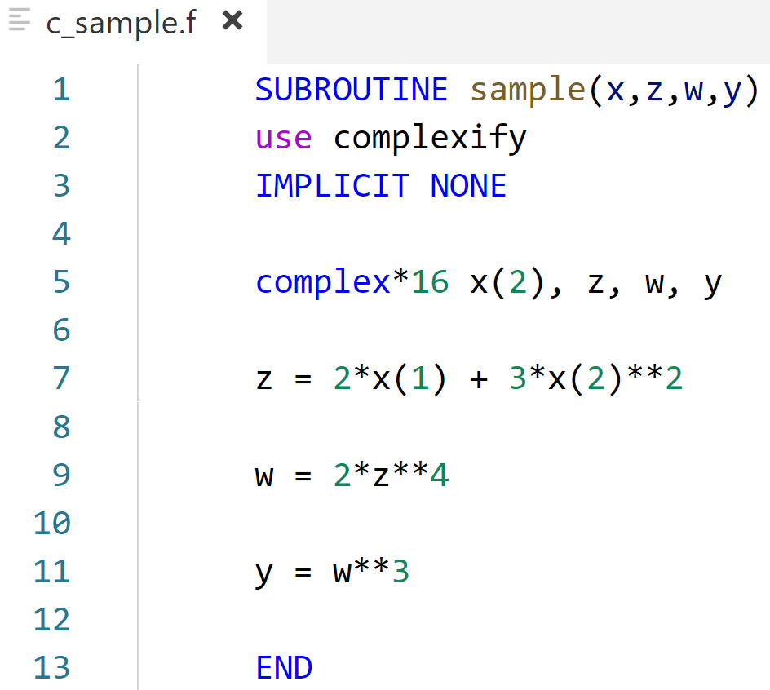
Automation of Implementation
Complexify
Martins, Sturdza, 2000
Notes:
The change of variable type is done by a script called Complexify. Complexify creates a new file with the prefix c_, replaces real variable declarations with complex declarations, and includes the complex library via a use statement.

Slide 11
Operator Overloading
In-Built Operators
User-Defined Operators
(Real)
(Real, Imaginary)
user-defined operation to real value
intrinsic
operation
intrinsic
operation
Real Output
Complex Output
Notes:
The overloaded operators allow intrinsic functions to act on complex variables. Intrinsic functions would typically operate on a real variable for a real output. When an operation is encountered, overloading operators allow the real information to be passed to a user-defined operation where only the real part is acted upon so that the imaginary part can hold sensitivity information without interference.

Slide 12
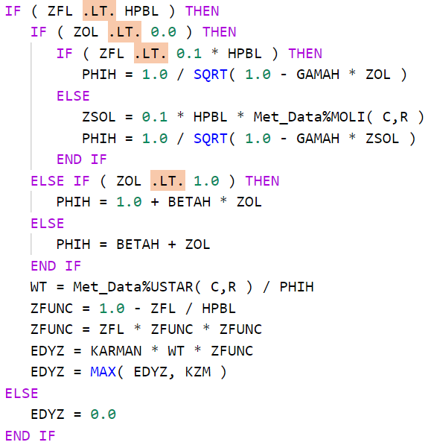
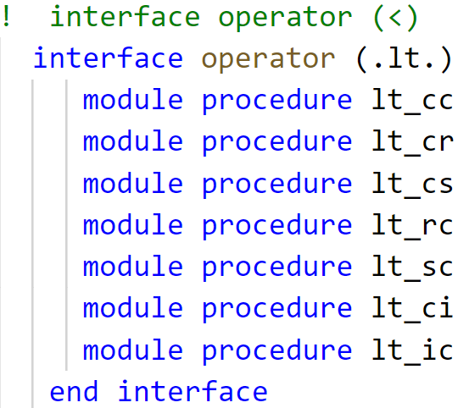
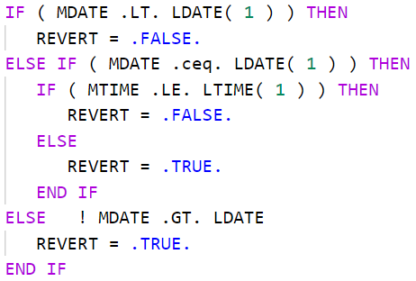
Complex Library
Martins, Sturdza, 2000
Notes:
On the left side you can see a sample of code from CMAQ. The less than operations are acting on complex variables. Instead of the intrinsic less than operation being used, the information is passed to the interface operator which chooses a module procedure based on the variable input types. Since the left hand side and right hand side of the first less than operator are both complex, lt_cc is used which uses complex inputs. Then the result of the logical function is output with only the real part being operated on.

Slide 13
Future Work
Continue development
Improving overloaded operator library
Refining input/output with complex numbers
Implementing sensitivity calculation with complex output
Notes:
To continue developing CVM in CMAQ, the complex operator library must be augmented with inputs that have not been defined. For example, I defined operators to handle allocatable arrays of multiple dimensions as inputs as well as pointers. One place for improvement is defining operators to handle arrays of multiple dimensions that have one dimension defined and another dimension still allocatable.
Lastly, the sensitivity calculations to get complex output must be implemented in CMAQ.

