Slide 1
CMAS conference, 24 Oct. 2018
KORUS Ver. 2.0 : An Emissions Inventory in Support of the KORUS-AQ Field Campaign
Younha Kim¹, Jung-Hun Woo^{1*}, Bok Haeng Baek², Jinseok Kim¹, Jinsu Kim¹, Youjung Jang¹, Minwoo Park¹, Yungyeong Choi¹, Eunji Lee¹, Hyunjin Park¹
1 Konkuk University, Seoul, Korea
2 University of North Carolina, Chapel Hill, USA
Notes:
Hi, my name is minwoo park, from konkuk university, south korea. I’m going to present on behalf of dr. Younha Kim.
This time, I’ll present about “KORUS Ver. 2.0 : An Emissions Inventory in Support of the KORUS-AQ Field Campaign”
I want to briefly introduce our Inventory for support KORUS-AQ, and talk about several issues which were discovered pre/during the field campaign.
Such as ‘SO2 emissions seem to be underestimated near the large point sources’ and ‘biogenic VOC emissions from urban and shore areas’.
So we have updated our inventory by updates point source database and improve plant information for KORUS-AQ Field Campaign.

Slide 2

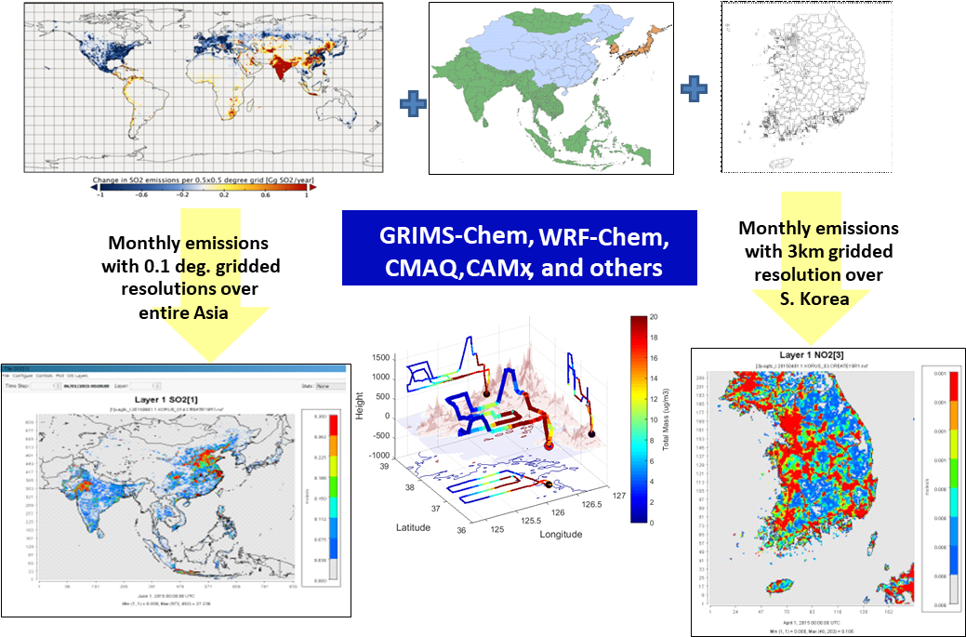
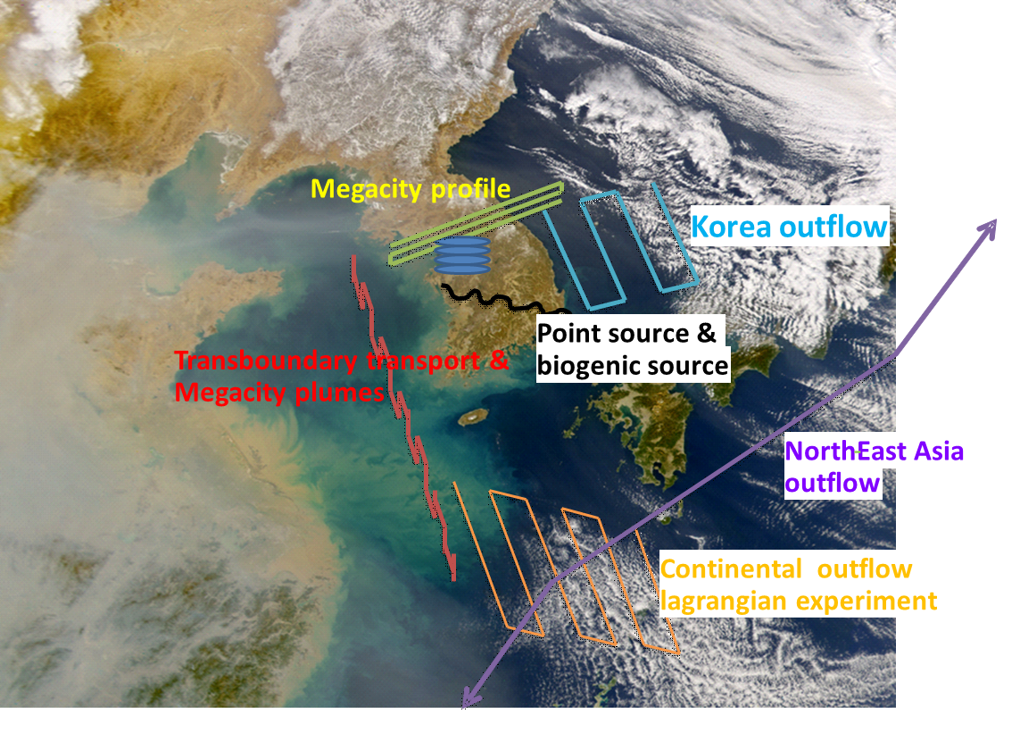
CMAS 23. OCT, 2018
1. Background and Objectives
Base Emissions Inventory: NIER/KU-CREATE*
Anthropogenic Emissions Inventory
- GAINS-Korea/Asia with national activities/policies
Year 2010, Asia regions, ~300 SCCs
Pols.: CO₂, NO_{x}, PM₁₀, PM_{2.5}, SO₂, VOC, NH₃, CO
Biogenic(MEGAN), Biomass burning(BlueSky)
Science
Better understanding of the factors controlling air quality
Test and improve model simulations of air quality
Societal Impact
Provide guidance on measures to improve air quality in Korea
KORUS Emissions Inventory (ver. 1.0/2.0)
* Comprehensive Regional Emissions for Atmospheric Transport Experiments
Notes:
First, What is the KORUS-AQ campaign?
The KORUS-AQ aircraft field campaign have been conducted by Korea Ministry of Environment and NASA to study the air quality of over korea and east asia. And this is the scientific air quality measurements campaign. In this campaign, various types of air quality modeling systems have been used for this field campaigns including WRF-Chem, MOZART, and CAMx and CMAQ. The CMAQ model with WRF and SMOKE modeling system was used in our study to provide a better understanding of the air quality issues between the countries in East Asia. Also these data collected during the campaign have been used to improve the model simulation results.
The emissions inventories used in this campaign is based on the latest East Asia emissions inventory data called CREATE which stands for Comprehensive Regional Emissions for Atmospheric Transport Experiments.

Slide 3
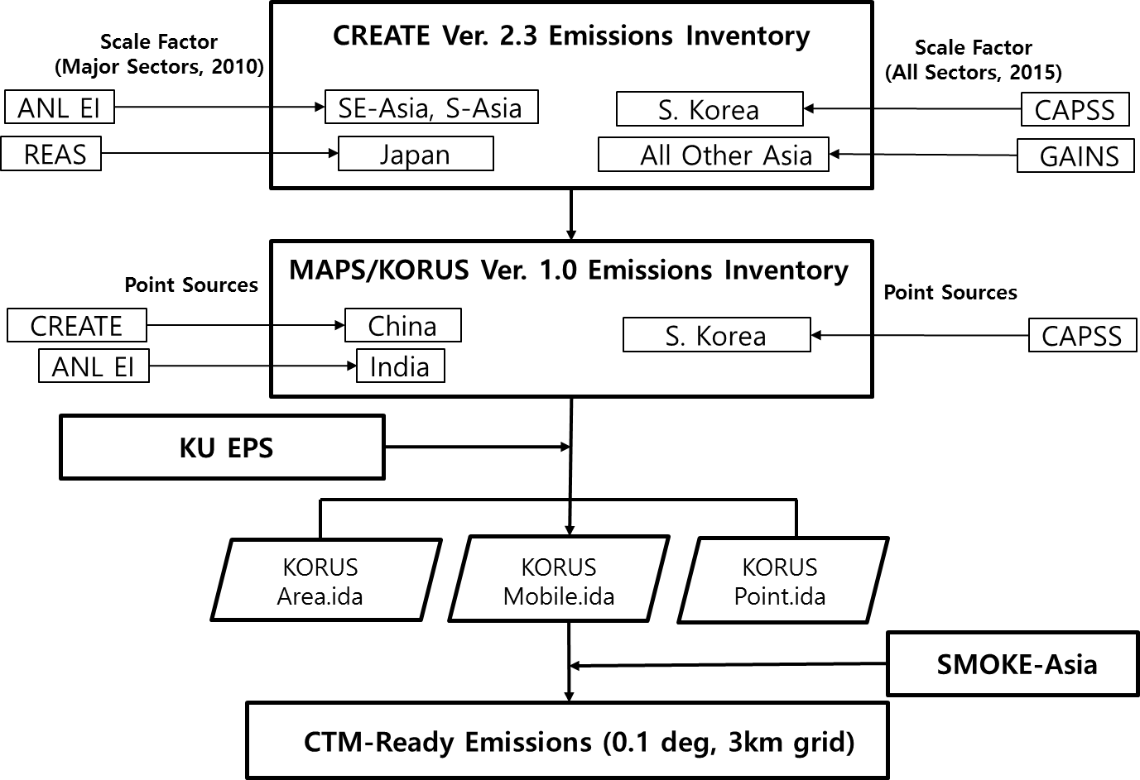
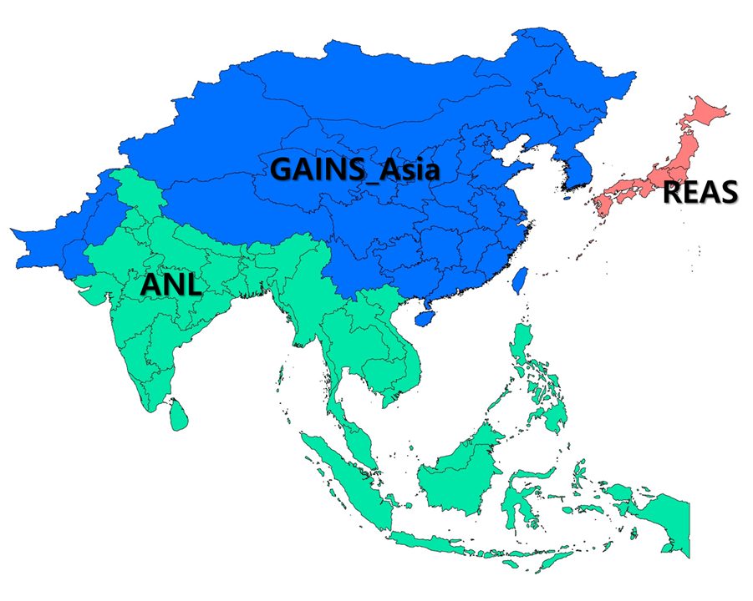
CMAS 23. OCT, 2018
1. Background and Objectives
Framework of Inventory for KORUS Modeling
CREATE Ver. 3.0 Emissions Inventory
KORUS Ver. 2.0 Emissions Inventory
Notes:
Before the campaign, we have been working on developing and updating the East Asia bottom-up emissions inventories based on the latest information from various countries including China, Japan, and so on.
It includes the GAINS-Asia, Japanese Inventory REAS, ANL(argonnne national Lab). These collected inventories have been compiled through our group emissions processor to develop the KORUS inventory.
During the field campaigns, we are providing gridded modeling emissions inventory to air quality models, such as CMAQ, WRF-Chem, CAMx, GEOS-Chem, MOZART, for forecasting and post-analysis modes.
Today, we will share some of findings during the KORUS inventory development especially for domestic and foreign stationary Large Point Sources which affects local and regional air quality.

Slide 4
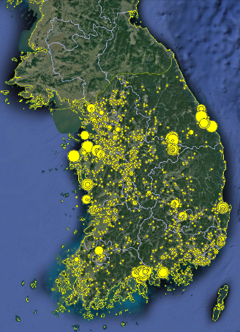
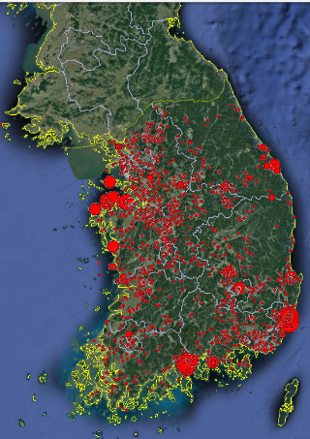
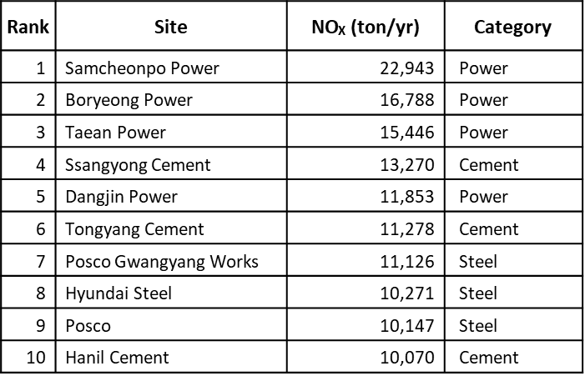
CMAS 23. OCT, 2018
1. Background and Objectives
Objective 1 : Evaluate Large Point Sources(LPSs) in Korea
Evaluate LPSs near Seoul
using KORUS-AQ flight measurement
NOx
SOx
Site of Large Amount Emission in 2016
Seoul
Seoul
MOE, 2017
Notes:
Our first objective of this study is to evaluate the Large Point Sources in Korea.
The KORUS-AQ aircraft field campaign was conducted in 2016(two thousand sixteen). As you can see in this picture, there are various types of measurements happened during campaign including vertical air measurements using the aircraft over the megacity like Seoul, and the surrounded oceans between China and Japan.
Fine particle has been a big issue in Korea for the public health and LPSs emissions play a critical role to understand and control the local and regional air quality.
So, we have focused on evaluating the Large Point Sources near Seoul using KORUS-AQ measurements

Slide 5
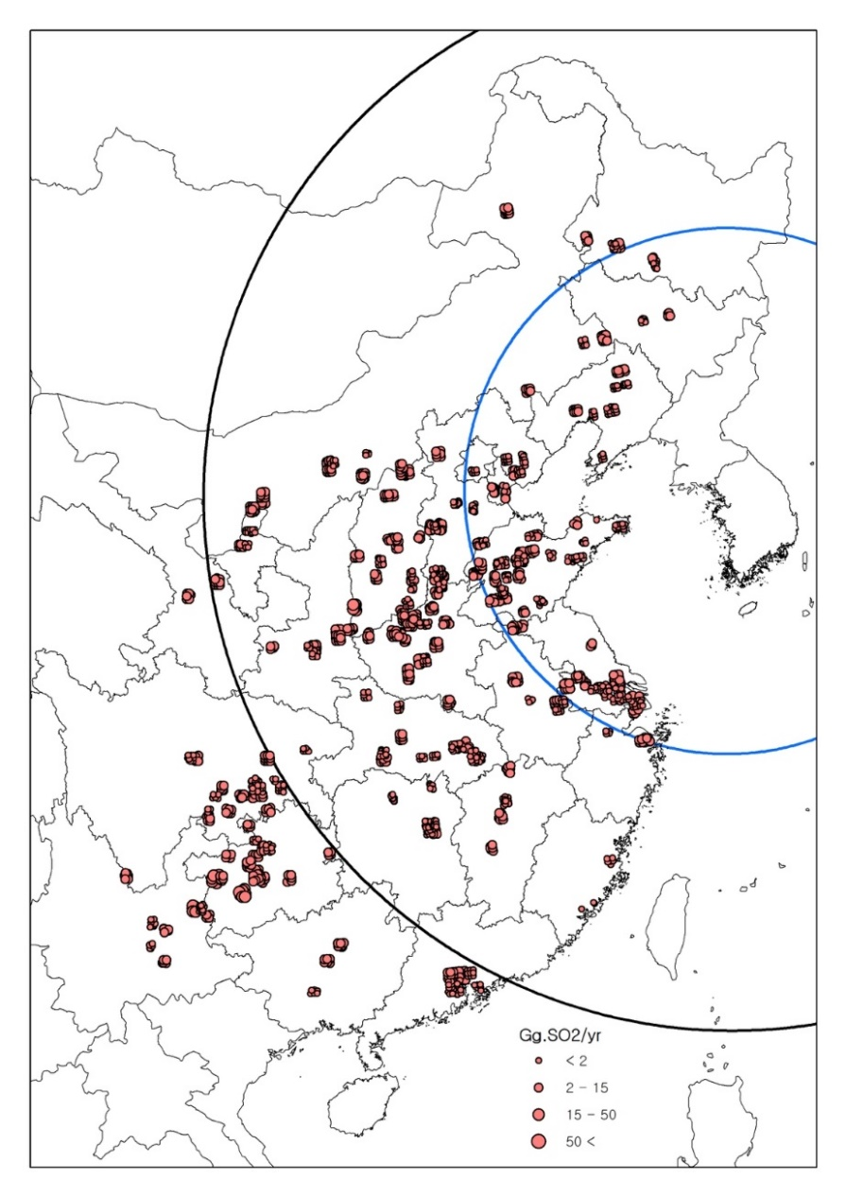
CMAS 23. OCT, 2018
1. Background and Objectives
Objective 2 : Develop LPSs Inventory in China
: Importance of China LPSs to Air Quality in Korea
Max. 48hrs
J.-H. Woo et al., Atmospheric Environment, 2012
China LPS SO₂ Emission
Develop LPSs inventory in China
to improve CTM modeling for KORUS-AQ
Notes:
Second, We developed our LPSs inventory in China
As you can see in the figure, we were able to identify the list of LPS from China and also found out that they can reach Korea in just 2days when the wind is from the west.
These LPSs are not currently treated as elevated sources in our inventory. So, we developed the bottom-up LPSs inventory in China along with its stack parameters such as stack height, stack diameter, exit velocity, and so on to treat them as elevated point sources in our inventory as well as in air quality modeling studies.

Slide 6
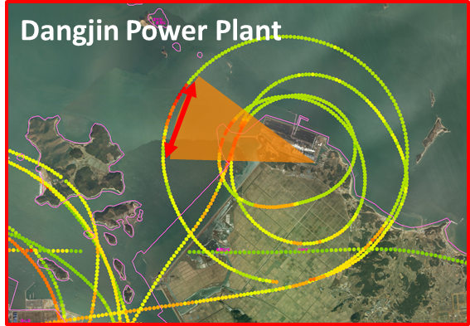
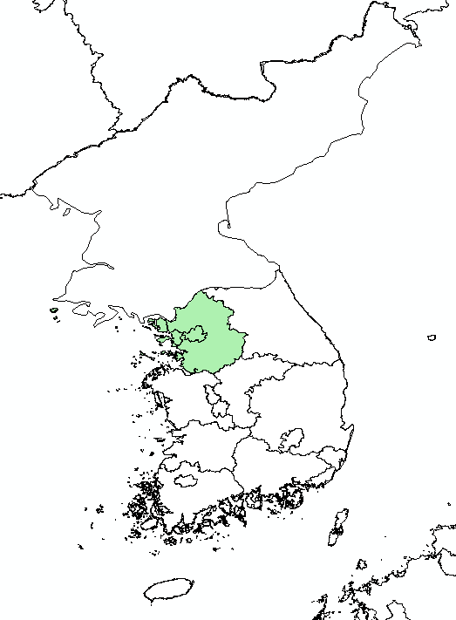
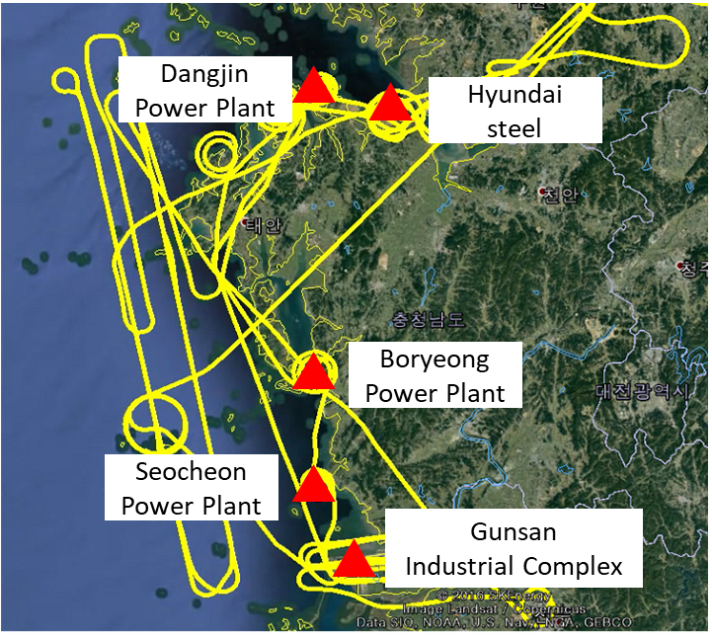
2-1. Research Setting
CMAS 23. OCT, 2018
2. Evaluate Large Point Sources(LPSs) in Korea
KORUS-AQ aircraft field campaign
Seoul Metro Area
Circular Flight around Stack
Objective : Evaluate LPS(Large Point Source) Emissions using the DC-8 flight (June 5, 2016)
Large Power Plants and Industrial Complex are located at Chungcheongnam-do and Jeallabuk-do.
Large Point sources (LPSs) influence largely to Seoul Metro(SMA)’s air quality.
In particular, LPSs in Chungcheongnam-do put great impacts because they are close to SMA
So, we wanted to evaluate the accuracy of CAPSS, which is Korea National Emissions Statistics using KORUS-AQ measurement
Notes:
There pictures show how ambient measurements near the major LPS area located in west coast.
NASA DC-8 aircraft flighted near LPSs to measure plumes during the campaign
because they could give the large impacts to air quality in Seoul metro area.
Five LPSs were selected for the evaluation
We evaluated the accuracy of current latest Korea National Emission Inventory called CAPSS

Slide 7
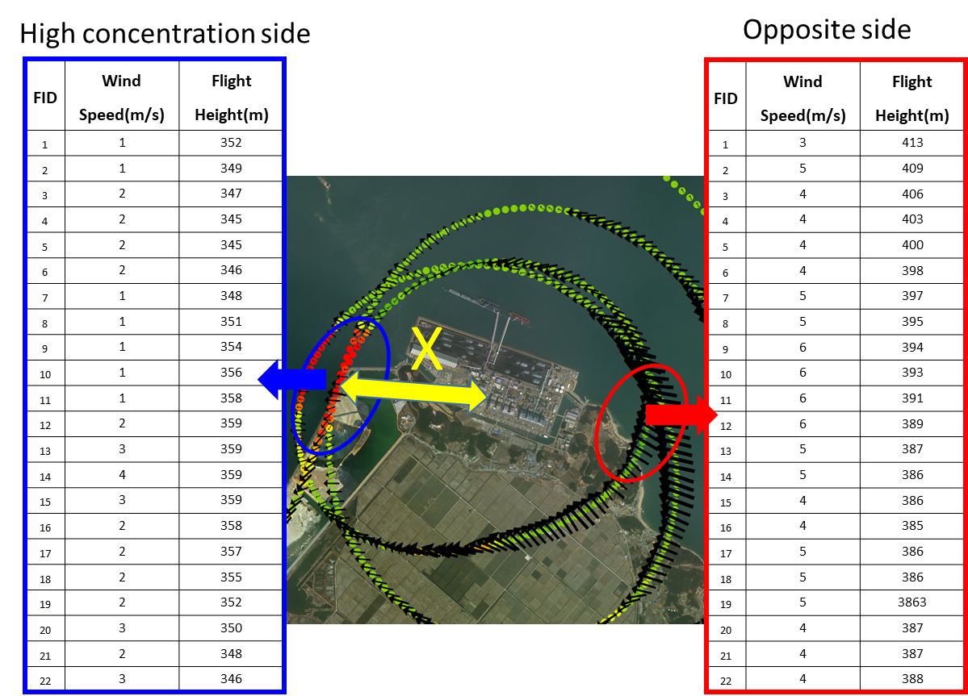
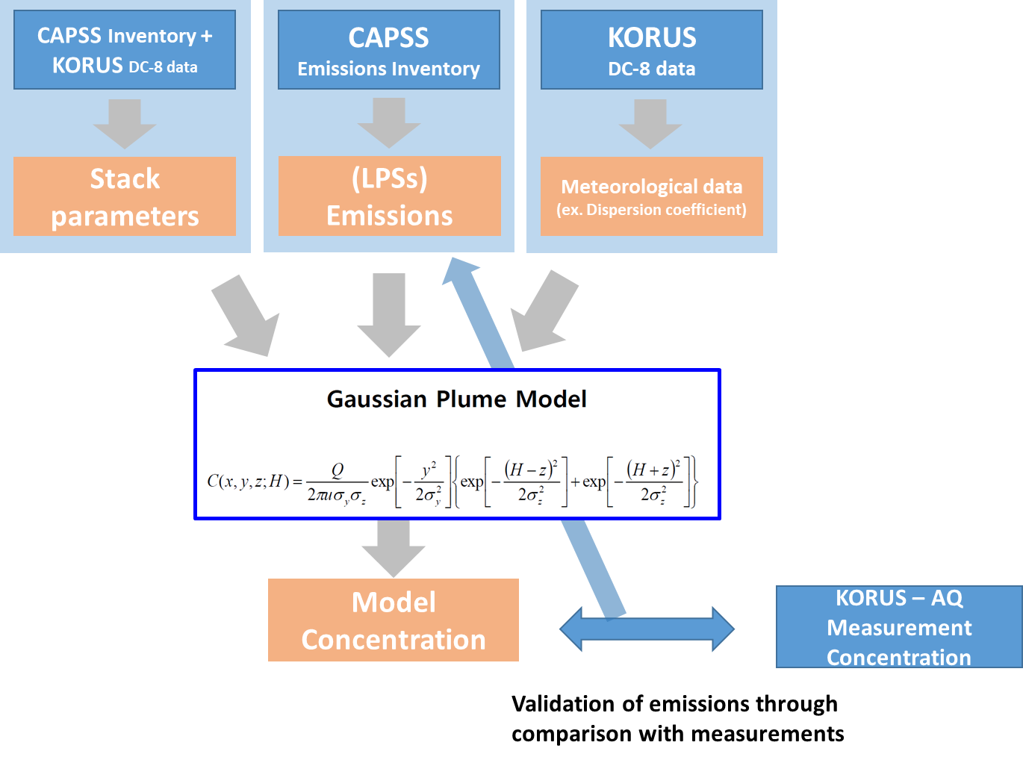
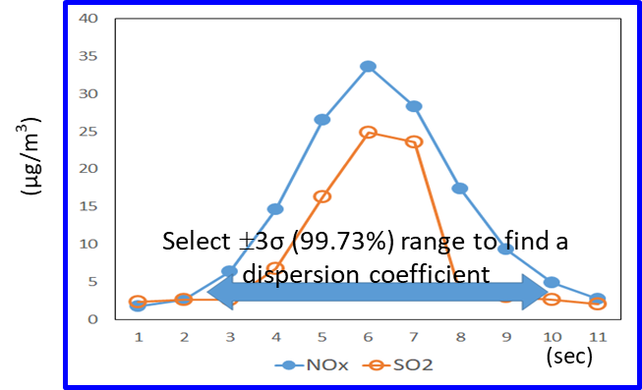
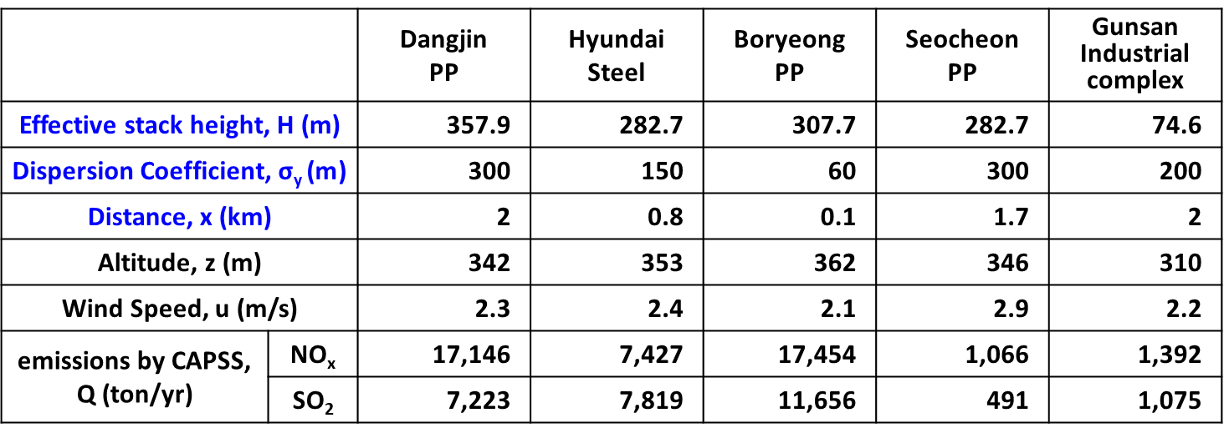
2-2. Method
CMAS 23. OCT, 2018
2. Evaluate Large Point Sources(LPSs) in Korea
Calculation of
Average Wind Speed
Average between blue and red
The Wind Speed and Flight Height values in blue and red circles were averaged to calculate ‘U’ and ‘Z’ at each LPSs
‘X’ is the distance from stacks to measurements, which also explains the wind direction.
Notes:
This is our methodology on how we evaluated the LPS in Korea.
We used measurements-driven Gaussian plume modeling results to estimate plume concentration of SO2 and NOx
We have used stack parameters and emissions from various sources and meteorology data from KOR-US measurements were used in this modeling run.
As an example, to model the concentration from these LPS, we used both red and blue area wind speed, and height from aircraft to generate the averaged vertical profile.
The point source emissions from Korea Inventory CAPSS and concentration from NASA DC-8 measurement were used to evaluate the modeling results from Gaussian plume model

Slide 8
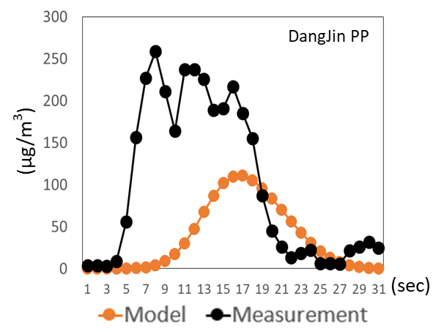
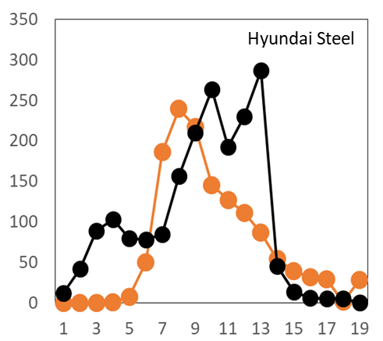
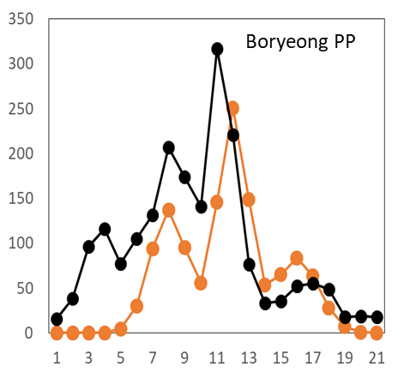
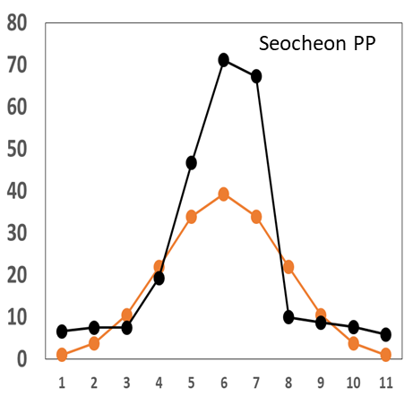
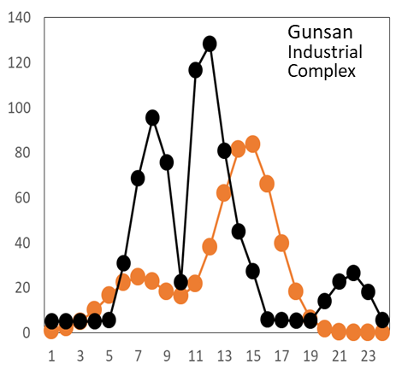
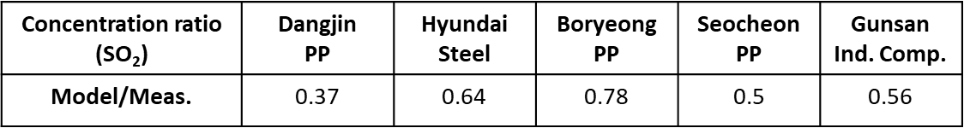
2-3. Result (SO₂)
CMAS 23. OCT, 2018
2. Evaluate Large Point Sources(LPSs) in Korea
Up to 63% of possible under estimation of LPS emission
Notes:
This is our result of SO2 for 5 different LPSs.
Black dots are concentrations measurements and Orange dots are modeled values by Gaussian Plume Model.
Bottom table shows the ratio of model to the measurement.
At the Dangjin PP location, SO2 emission were up to 63%(sixty-three) underestimated while Boryeong PP location shows less then 22% differences.

Slide 9
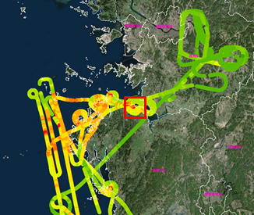
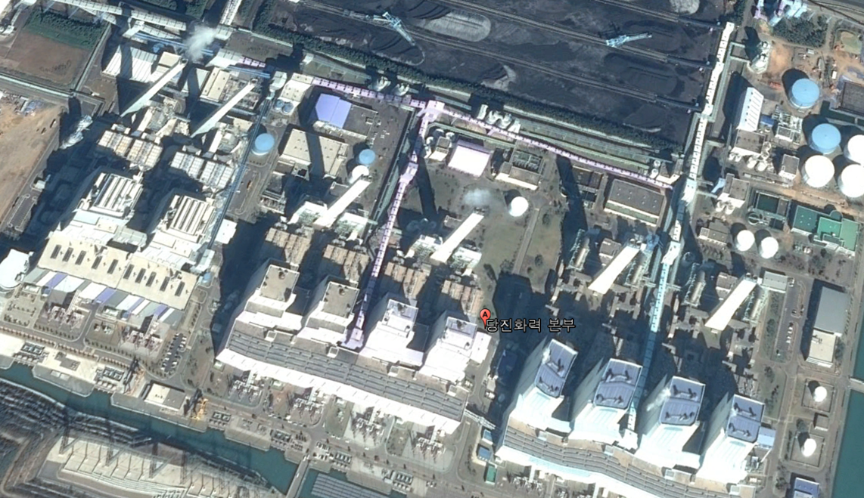
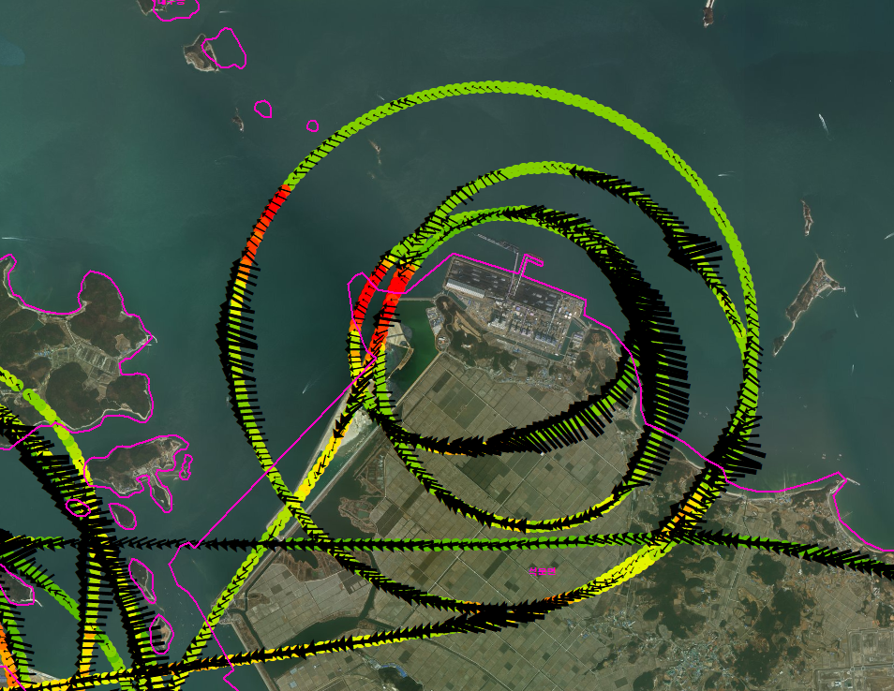
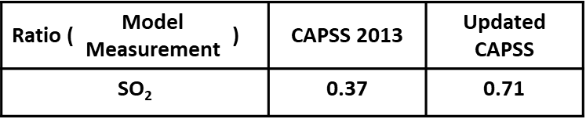
2-3. Result (Dangjin P.P)
CMAS 23. OCT, 2018
2. Evaluate Large Point Sources(LPSs) in Korea
KORUS-AQ, DC-8 flight (5 June 2016)
Source : In-situ CIMS measurements of PANs, SO2, and HCl
Dangjin Power Plant
Wind direction(East)
Only one-third of measured SO₂ concentrations were reproduced by LPS emissions!
Notes:
For danjin Power plant, the western part of the circle was selected because of easterly wind condition. The initial inter comparison result showed the model to measurement ratio is 0.37 which means only one-third of measured SO2 concentrations were reproduced by the LPS emissions.

Slide 10
2-3. Result (Dangjin P.P)
CMAS 23. OCT, 2018
2. Evaluate Large Point Sources(LPSs) in Korea
KORUS-AQ, DC-8 flight (5 June 2016)
Source : In-situ CIMS measurements of PANs, SO2, and HCl
Dangjin Power Plant
Wind direction(East)
CAPSS 2013 : 4 Large Point Source Stacks
Updated CAPSS : 4 stacks plus 2 New Stacks
Ratio ( | Model Measurement | ) | CAPSS 2013 | Updated CAPSS
SO₂ |  |  | 0.37 | 0.71
Notes:
To understand this under-estimate at the dangjin PP location, we have revisited the location and evaluate the emission sources in the inventory.
And we found out that there have been two new stacks added at danjin power plant in red circle. We also found that these new stacks emit twice more than the other four existing stacks in blue circle.
Therefore, total emission was almost doubled after the new construction, which ratio from 0.37 to 0.71.

Slide 11
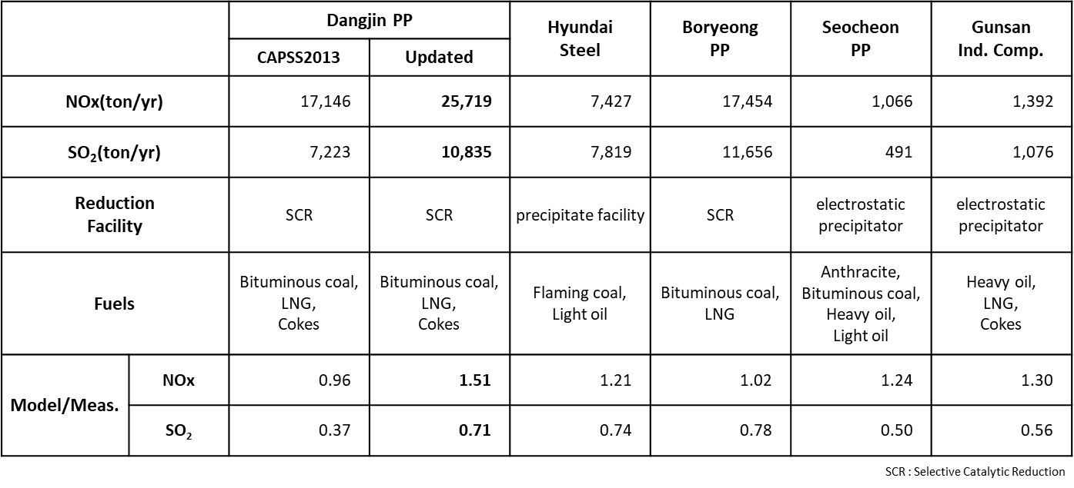
2-4. Result of Korea LPSs Inventory evaluation
CMAS 23. OCT, 2018
2. Evaluate Large Point Sources(LPSs) in Korea
At 5 sites, NOx emissions seem to be overestimated (ratio from 0.96 to 1.51 ) and SO₂ seem to be underestimated(ratio from 0.5 to 0.78 )
Evaluation of the model-measurement ratio helped improving emissions information in case of the Dangjin Power Plant
Using the multiple fuels could increase the uncertainty of the emission inventory
Notes:
This is overall results of Korea LPSs inventory evaluation at the Dangjin Power Plant.
NOx emission seem to be overestimated, and SO2 seems to be underestimated.
In the case of Dangjin PP, we updated the emission information including the new constructions as follows,
CAPSS inventory used for modeling is for 2013(two thousand thirteen)
, measurement conducted in 2016(two thousand sixteen).
During that period, Dangjin PP added 2 more stacks, which make SO2 emission’s ratio is almost doubled
As a result, Danjin PP’s agreements for SO2 was improved to 0.71

Slide 12
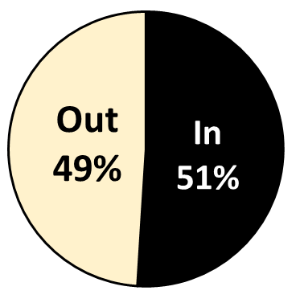
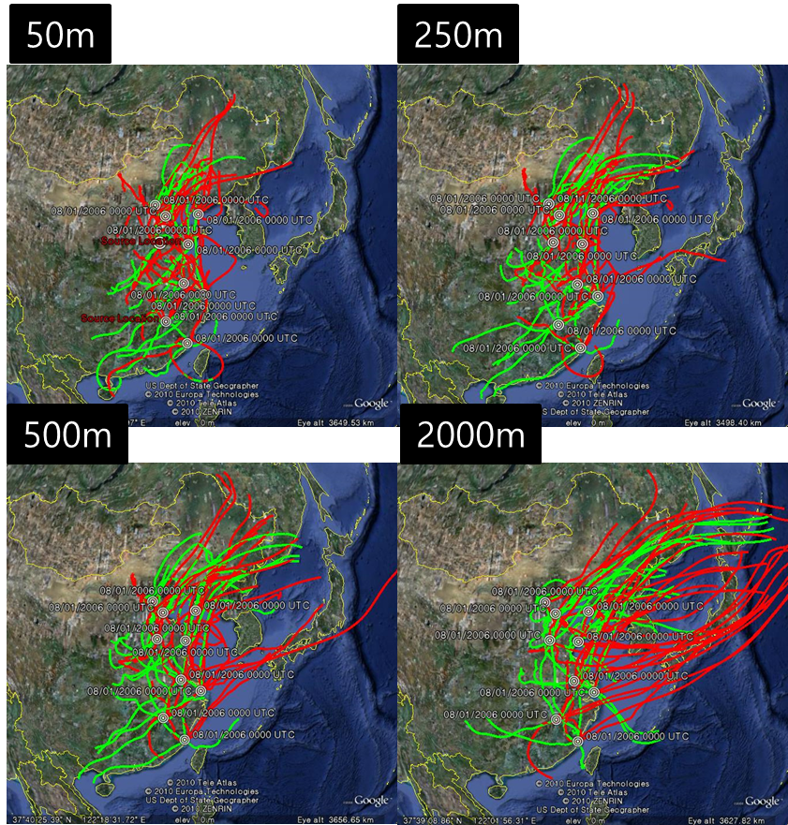
CMAS 23. OCT, 2018
3. Develop LPSs Inventory in China
3-1. Background
Horizontal Transport
by Vertical Injection Height (HYSPLIT)
Local vs. Transboundary Contribution
<Selecting LPSs
in Google Map >
Seoul Metro
KORUS AQ, DC-8 flights
J. Woo, MICS, 2011
KORUS RSSR, NIER/NASA, 2017
Notes:
Now we would like to show you how we develop and update the Chinese Large Point sources inventory
In this figure, you can see the trajectories from different injection heights show big differences in their horizontal transport.
According to KORUS-AQ field campaign results, the transboundary pollution impact to Korea can go up to 49%(forty-nine). The PM2.5 (fine particle) impact from China can be around 34% and up to 9% for North Korea.

Slide 13
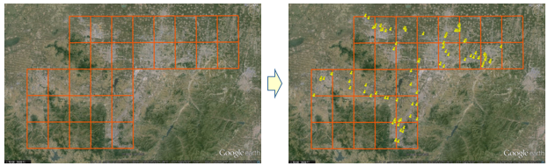
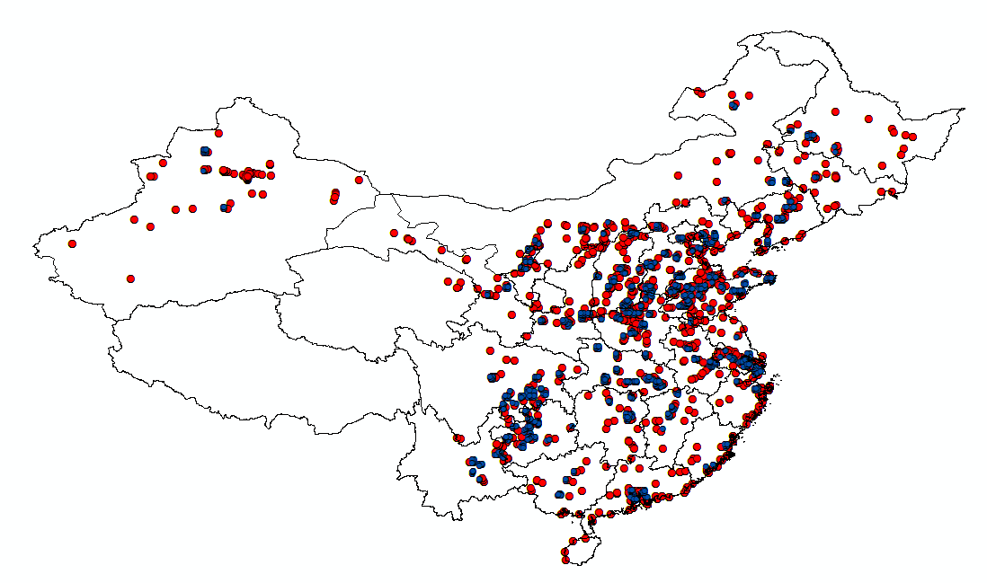
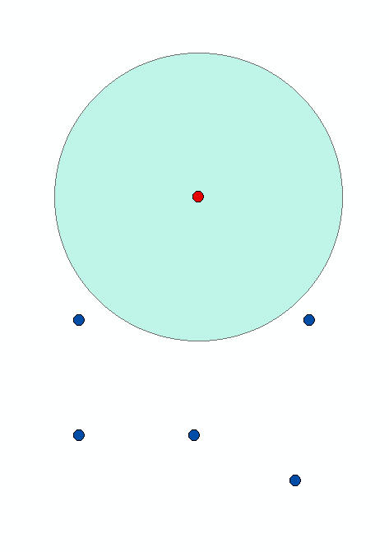
CMAS 23. OCT, 2018
3. Develop LPSs Inventory in China
3-2. Research Setting
Global Coal Plant Tracker’s info.
: location, status, operator, size, CO₂ emis.
HTAP_v2 dataset with 0.1˚×0.1˚ Grid map
: SO₂ emis. From Energy sector in 2010
Operating , over 30 MW Coal Plant in 2016
→ Coal PP
<Selecting LPSs
in Google Map >
→ Non-Coal PP
China Point source = Coal PP + Non-Coal PP
0.125d
Coal PP
*
Non-Coal PP
Red : Coal PP
Blue : Non-Coal PP
Total : 3,798 stack
Notes:
To develop China LPSs,
First, we used locations of China Coal Power Plants using Global Coal tracker.
And then, location of Non-coal Power Plants was used HTAP dataset.
But HTAP dataset is gridded emission.
So, satellite maps used to find point source on the gridded emission.
In this case, only the point, out of radius 0.125(point one-two-five)degree of Coal PP was considered as Non-Coal PP
because HTAP dataset’s Chinese part resolution was originally made as 0.25(point two-five)degree.
Through this method, a total of 3,798(thirty-seven hundred ninety-eight) stacks were found.

Slide 14
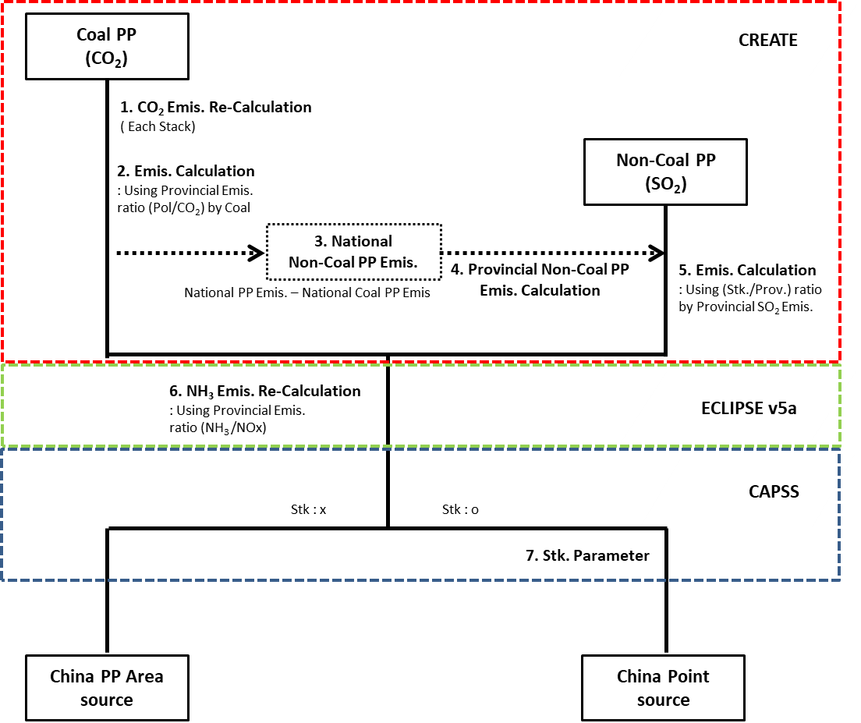
CMAS 23. OCT, 2018
3. Develop LPSs Inventory in China
3-3. Process of LPS emission inventory development in China
Procedure
Data
1. CREATE Power sector inventory
NIER/KU-CREATE (Projected 2015)
Anthropogenic Emissions Inventory Improved GAINS-Korea/Asia emissions using national info.,
Asia regions, ~300 SCCs
Pols.: CO₂, NO_{x}, PM₁₀, PM_{2.5}, SO₂, VOC, NH₃, CO
2. GAINS ECLIPSE v5a Scenario emissions
Scenario in GAINS Framework
Estimated from IEA Energy Data
Assumption on effects of economic development and mitigation policies
3. CAPSS (NEI of Korea)
Korea’s Clean Air Policy Support System
Includes stack parameters in the point source inventory
Notes:
This is the process of LPS emission inventory development in China.
We have used 3 major datasets(Right side)
Base Emission inventory is power plant sector in the CREATE inventory.
As CREATE was based in 2010(two thousand ten), it did not consider the increase in NH3(Ammonia) emission due to new NOX reduction technology.
So, NH3 Emission re-estimated using recent ECLIPSE scenario in GAINS model.
And, we applied the stack parameters in CAPSS inventory, to the each stacks in China.

Slide 15
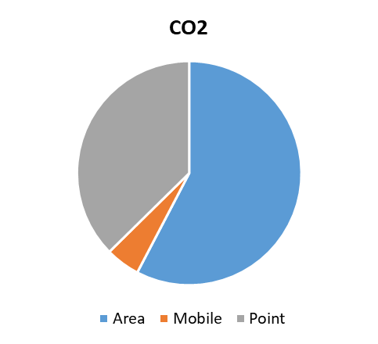
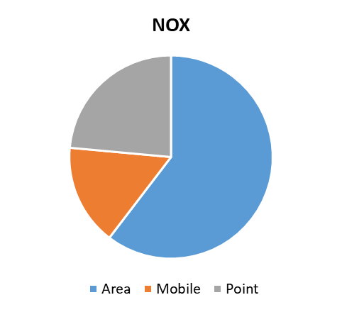
CMAS 23. OCT, 2018
3. Develop LPSs Inventory in China
3-4. Inventory development result
Gg/yr
CO₂
NO_{x}
 | ① CREATE Power Sector (②+③+④) | ② Coal PP [Point] | ③ Non-Coal PP [Point] | ④ Small Non-Coal PP [Area]
CO | 520 | 478 | 37 | 6
CO₂ | 4,019,663 | 3,929,389 | 81,690 | 8,584
NH₃ | 121.92 | 119.78 | 1.93 | 0.20
NO_{X} | 6,345 | 6,196 | 137 | 12
PM10 | 2,819 | 2,809 | 10 | 0.49
PM2.5 | 1,111 | 1,101 | 10 | 0.47
SO₂ | 8,847 | 8,765 | 78 | 4
VOC | 102 | 94 | 8 | 0.55
37.4%
23.5%
Power sector emissions were allocated to LPSs
Total 3,798 stacks (Coal PP : 2,706 , Non-Coal PP : 1,092) were found as China Large Point Sources(LPSs)
China Point source based on Power Plant(PP) sector in CREATE inventory.
Power Plant(PP) sector emissions in the CREATE inventory were allocated to each stack.
Of the total emissions, the power sector accounts for 37.4% of CO₂ and 23.5% of NO_{X}.
For NH₃, the emissions increased 92 times from the year 2010 level to correctly represent new installation of NO_{X} abatement technologies in China. The GAINS ECLIPSE v5a scenario was used.
Notes:
This table shows how much of Emissions allocated in Power sector.
Power sector emission were all allocated to LPSs.
So, Point source has only Power sector.
Of the total emissions, the power sector account for 37%(thirty-seven) of CO2, and 24%(twenty-four) of NOX
For NH3, the emissions increased 92(ninety-two) times using ECLIPSE scenario.

Slide 16
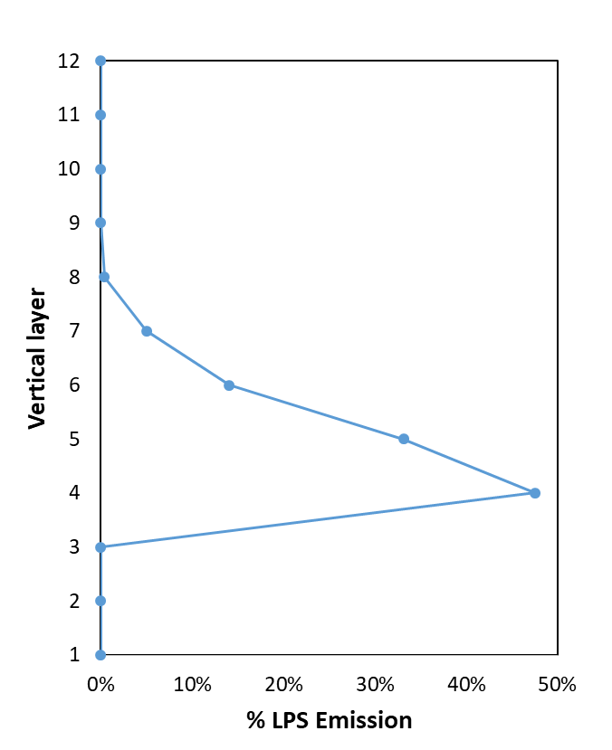
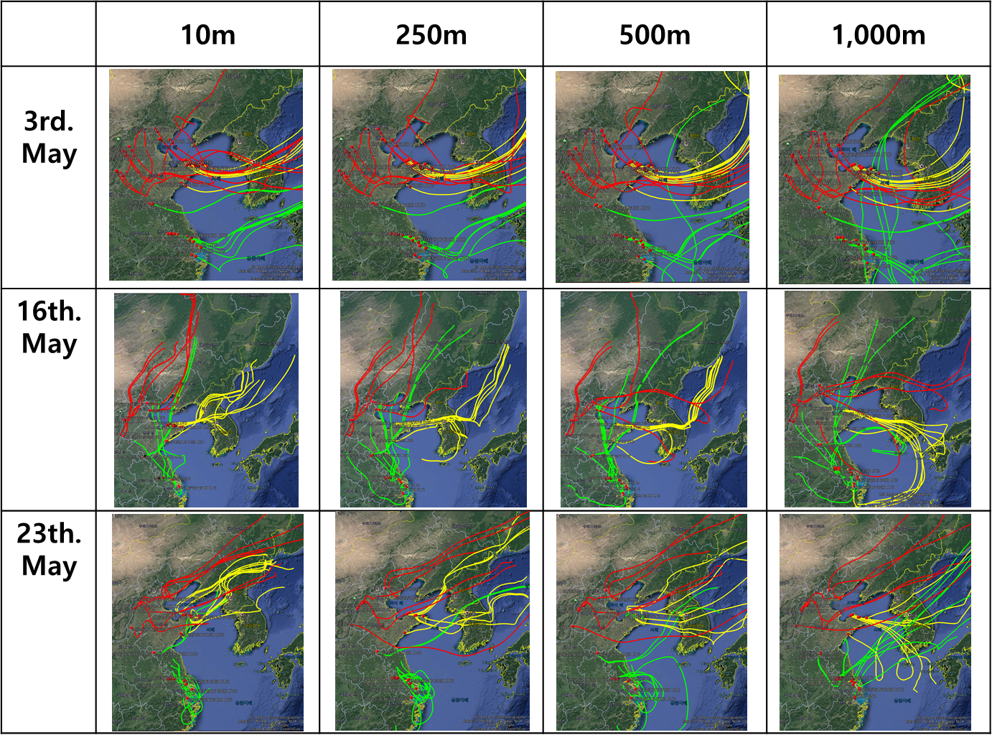
CMAS 23. OCT, 2018
3. Develop LPSs Inventory in China
3-5. Evaluation of Transport
Horizontal Transport with respect to the injection height (HYSPLIT)
Point source emission vertical profiles
72hr forward modeling
(May 23, 2016 )
4th layer includes 47% of total LPSs emissions
Yellow : 50m
Green : 500m
Red : 250m
Blue : 1000m
Date : May 3, 16, 23, 2016
  Transboundary case during KORUS-AQ
Location : JJJ, Shandong, YRD
Injection height range
  between 250m and 1,000m.
Notes:
Now, We evaluated China Point sources.
this graph shows The vertical distribution of emissions.
In the fourth layer is including 47%(forty-seven) of total emissions.
And the majority of point source emissions injected between 250(two-fifty) and 1,000m(one thousand) heights.
We also used HYSPLIT model to examine the horizontal transport.
LPSs in Shandong province were selected which are large and close to Korea.
As a you can see, emissions from Shandong LPSs with higher injection height were transported more to Korea.

Slide 17
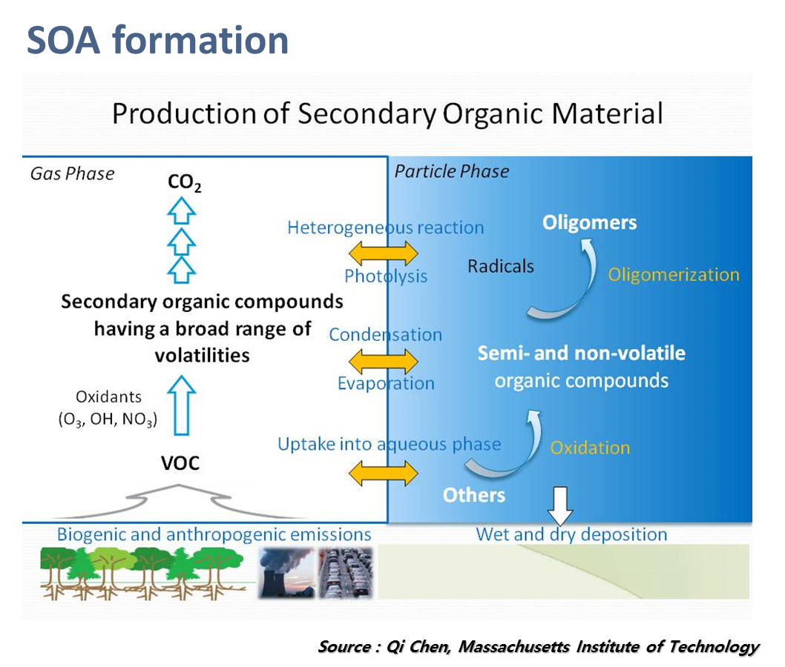
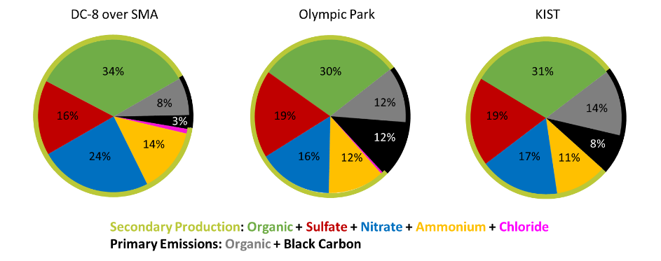
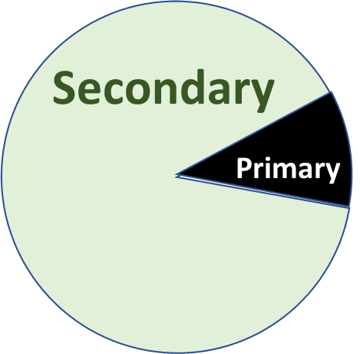
CMAS 23. OCT, 2018
4. Ongoing Study (updating BVOCs emission inventory)
4-1. improving BVOCs emission inventory
The biogenic emissions as well as anthropogenic ones were very important factor to model and analyze atmospheric environment which also could be true for South Korea, since more than 70% of its land area are vegetated such as forest, cropland.
For modeling-based BVOC emission estimation, geographical distribution of PFT (plant functional type) and LAI (Leaf Area Index) are considered as very important driving variables. Most of cases, PFTs and LAI were derived from the satellite-based information, such as MODIS
BVOC emissions were estimated using MEGAN version 2.10 model (Guenther et al., 2006)
Air Pollution issue of fine particle in Seoul Metropolitan Area
Kim et al., 2018
(over Seoul Metro from KORUS AQ, DC-8 flights)
NIER/NASA, 2017
Notes:
Not only anthropogenic emissions, But also biogenic emission is very important to analyze atmospheric environment.
Especially for South Korea. Because South Korea’s land area is consisted of more than 70% of vegetation like forest, cropland, and so on.
For modeling-based BVOC emissions estimation, Plant Functional Type’s and Leaf Area Index‘s geographical distributions are considered very important driving variables.
Most of researches, they were derived from the satellite-based information such as MODIS.
Below figure explain Secondary Organic Aerosol formation.
And right one shows the formation of PM2.5 in seoul.
As you can see, almost 90% are made by secondary production.
We are curreting working on developing updated version of biogenic VOC emissions using the latest PFT and LAI data from other data souces.

Slide 18
CMAS 23. OCT, 2018
5. Summary and Future work
Large Point Sources(LPSs) emission inventories were evaluated(Korea) and improved(China) in support of NIER/NASA KORUS-AQ
We have evaluated NO_{X} and SO₂ Emissions from 5 LPSs over that western part of South Korea (near SEOUL) using the DC-8 June 5th flight, CAPSS inventory, and measurement-driven Gaussian plume model
Inter-comparison of modeled and measured concentration were conducted to understand validity of large point source emissions
At 5 sites, NO_{X} emissions tend to be overestimated (ratio from 0.96 to 1.3 ) and SO₂ tend to be underestimated(ratio from 0.5 to 0.78). The ranges are, however, fair considering the averaging time of both dataset
For China LPS inventory, total 3,798 stacks (Coal PP : 2,706 , Non-Coal PP : 1,092) were found
From the analysis of injection layer height using SMOKE-Asia, 47% of the total emissions in the 4th layer, and most of emissions were injected between 250 and 1,000 meters
Updating Biogeinc VOC Emissions with the latest PFT and LAI datasets.

Slide 19
Thank you

