Slide 1
Coupling Meteorology-sensitive Emissions with Air Quality Forecasting System in Korea
B. H. Baek
University of NC at Chapel Hill / CMAS
SoonTae Kim & Changhan Bae
Ajou Unversity

Slide 2
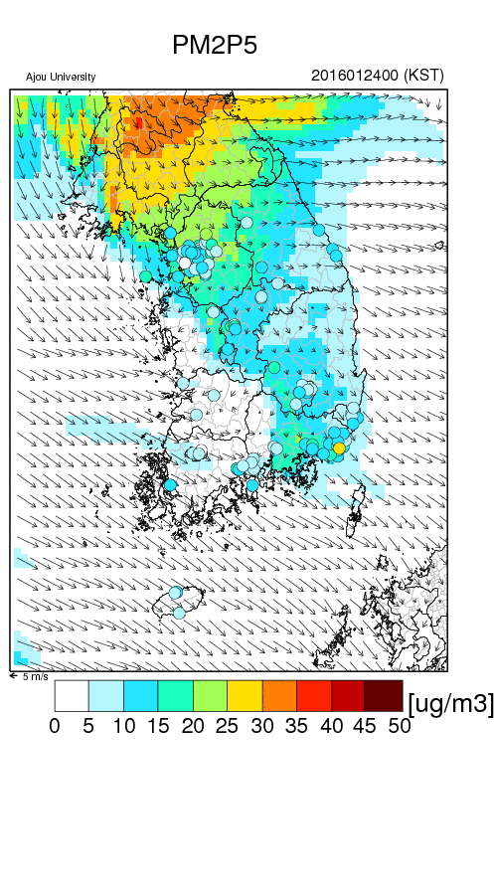
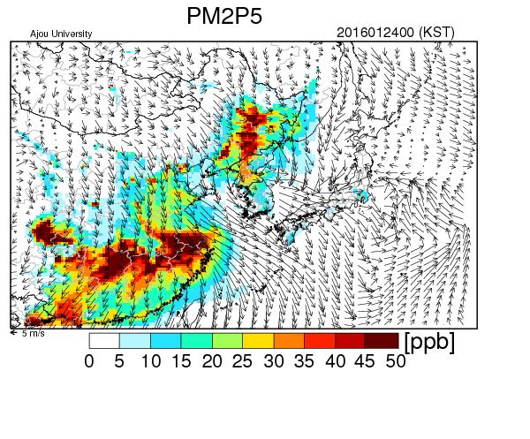
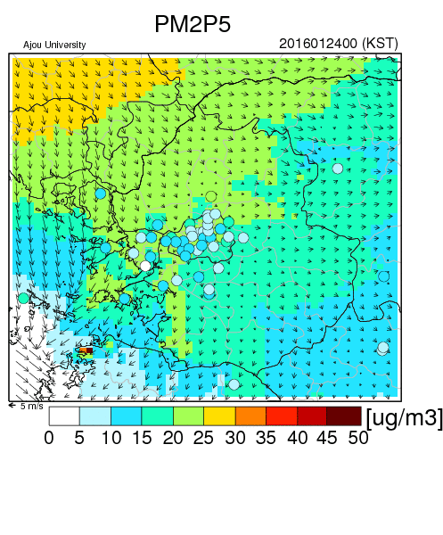
Motivations

Slide 3
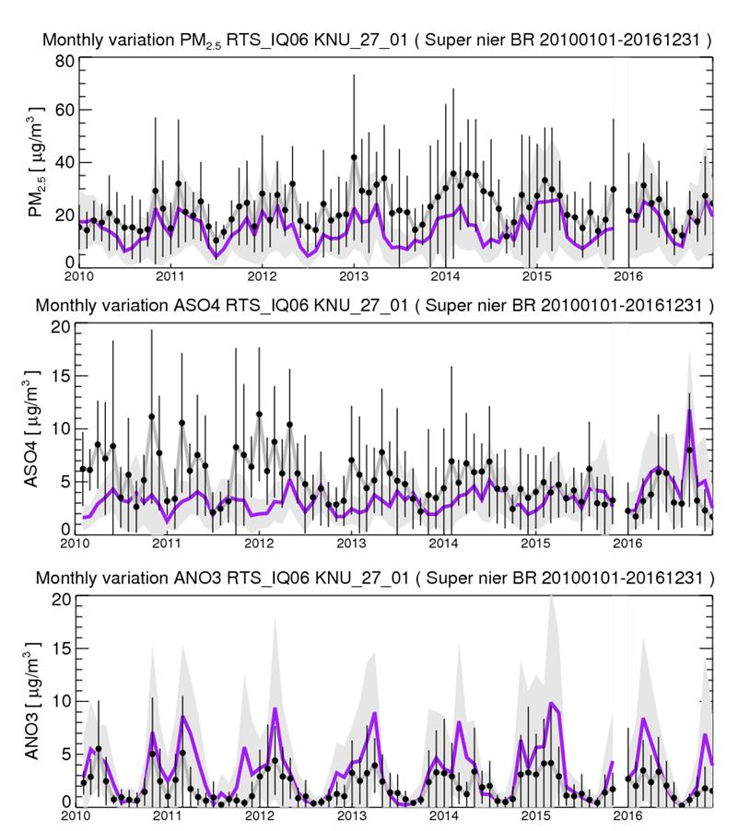
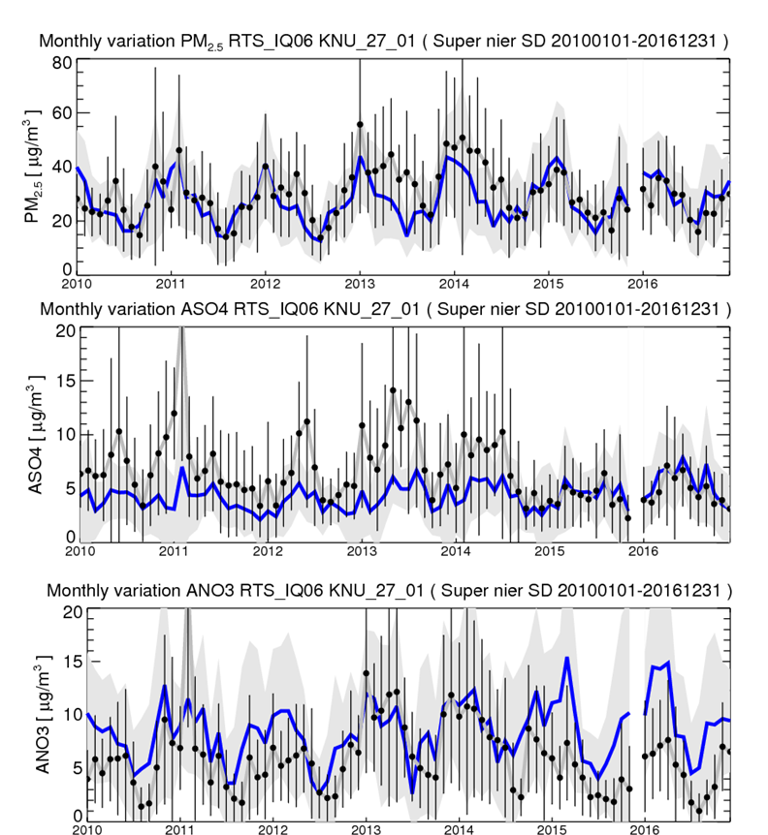
Long-term PM_{2.5} Performances
Obs. location b/n China & Korea
Obs location in Seoul
SO₄ Overestimate since 2015?
NO₃: Overestimate: NOx or NH₃ Emissions?

Slide 4
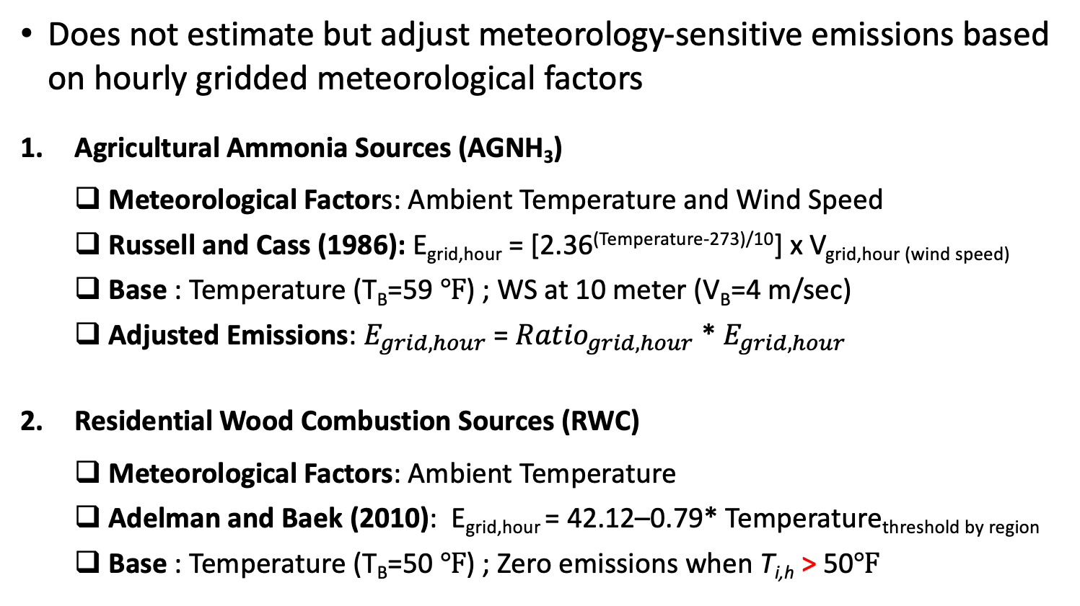
Meteorological Adjustor (MetADJ)
Does not estimate but adjust meteorology-sensitive emissions based on hourly gridded meteorological factors
Agricultural Ammonia Sources (AGNH₃)
  Meteorological Factors: Ambient Temperature and Wind Speed
  Russell and Cass (1986): E_{grid,hour} = [2.36^{(Temperature-273)/10}] x V_{grid,hour (wind speed)}
  Base : Temperature (T_{B}=59 ℉) ; WS at 10 meter (V_{B}=4 m/sec)
  Adjusted Emissions: $E_{grid,hour}$ = ${Ratio}_{grid,hour}$ * $E_{grid,hour}$
Residential Wood Combustion Sources (RWC)
  Meteorological Factors: Ambient Temperature
  Adelman and Baek (2010): E_{grid,hour} = 42.12–0.79* Temperature_{threshold by region}
  Base : Temperature (T_{B}=50 ℉) ; Zero emissions when T_{i,h} > 50℉

Slide 5
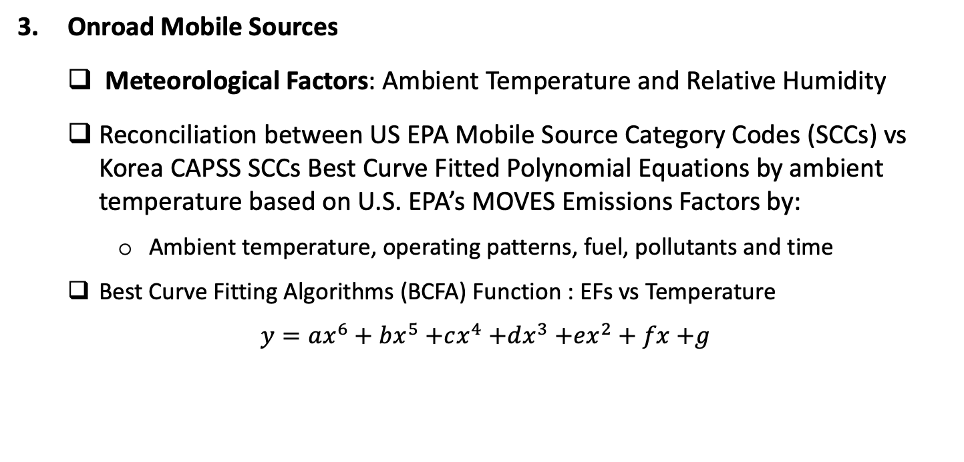
Meteorological Adjustor (MetADJ)
Onroad Mobile Sources
  Meteorological Factors: Ambient Temperature and Relative Humidity
  Reconciliation between US EPA Mobile Source Category Codes (SCCs) vs Korea CAPSS SCCs Best Curve Fitted Polynomial Equations by ambient temperature based on U.S. EPA’s MOVES Emissions Factors by:
    Ambient temperature, operating patterns, fuel, pollutants and time
  Best Curve Fitting Algorithms (BCFA) Function : EFs vs Temperature
$y=ax^{6}+bx^{5}$ $+cx^{4}$ $+dx^{3}$ $+ex^{2}+fx$ $+g$
US EPA MOVES Emissions Factor Lookup Tables
BCFA
Polynomial Equations by SCC, Pollutants,Fuel,,,,

Slide 6
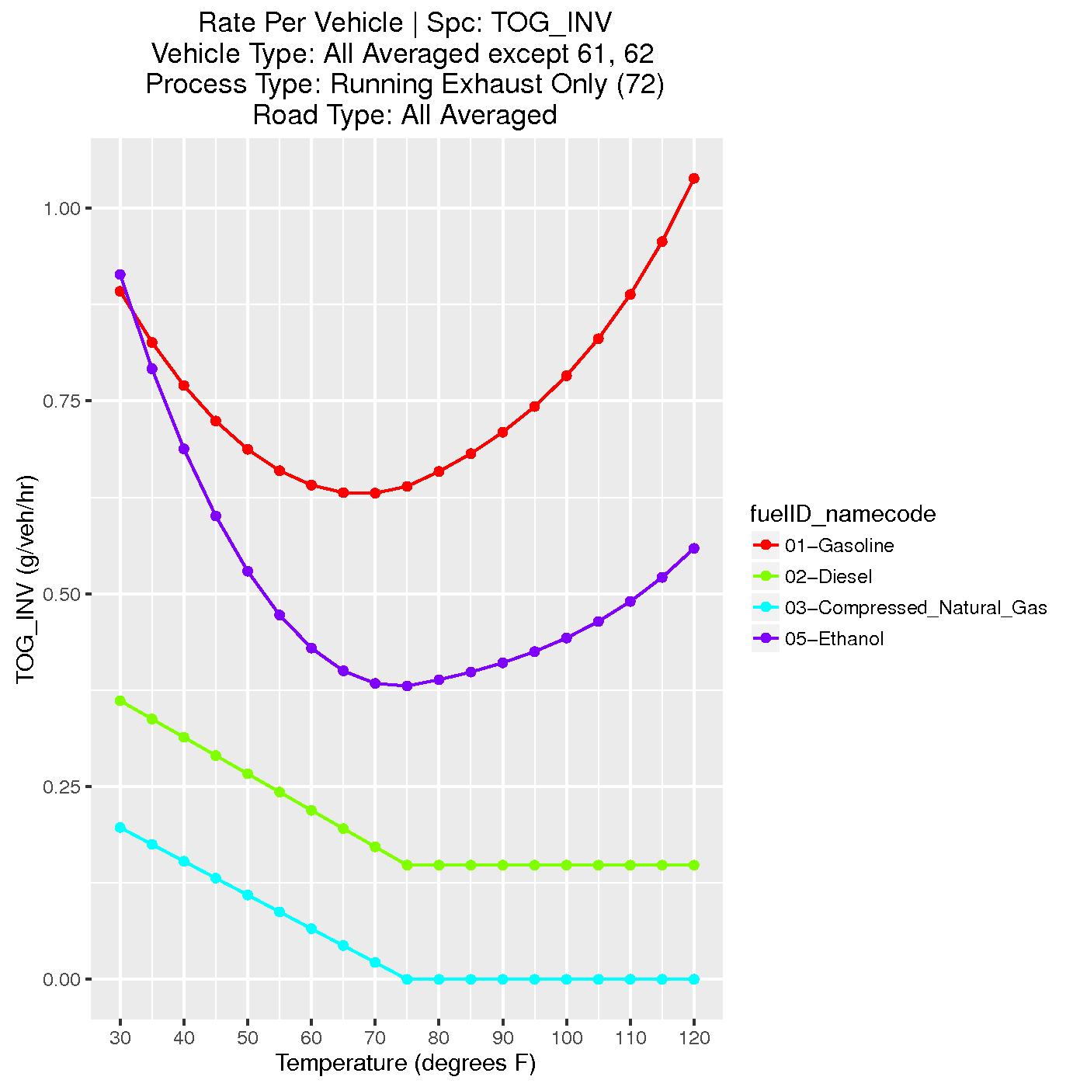
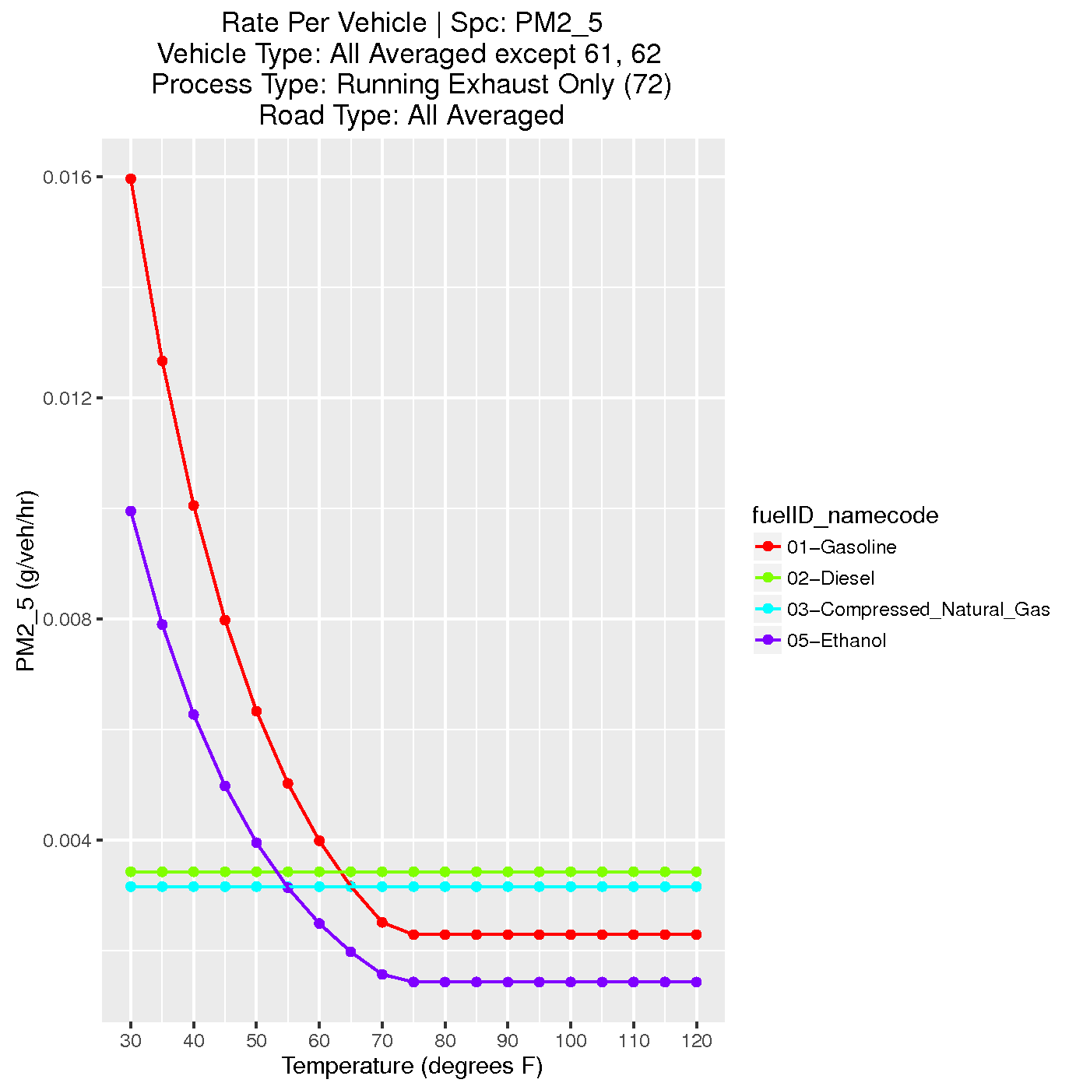
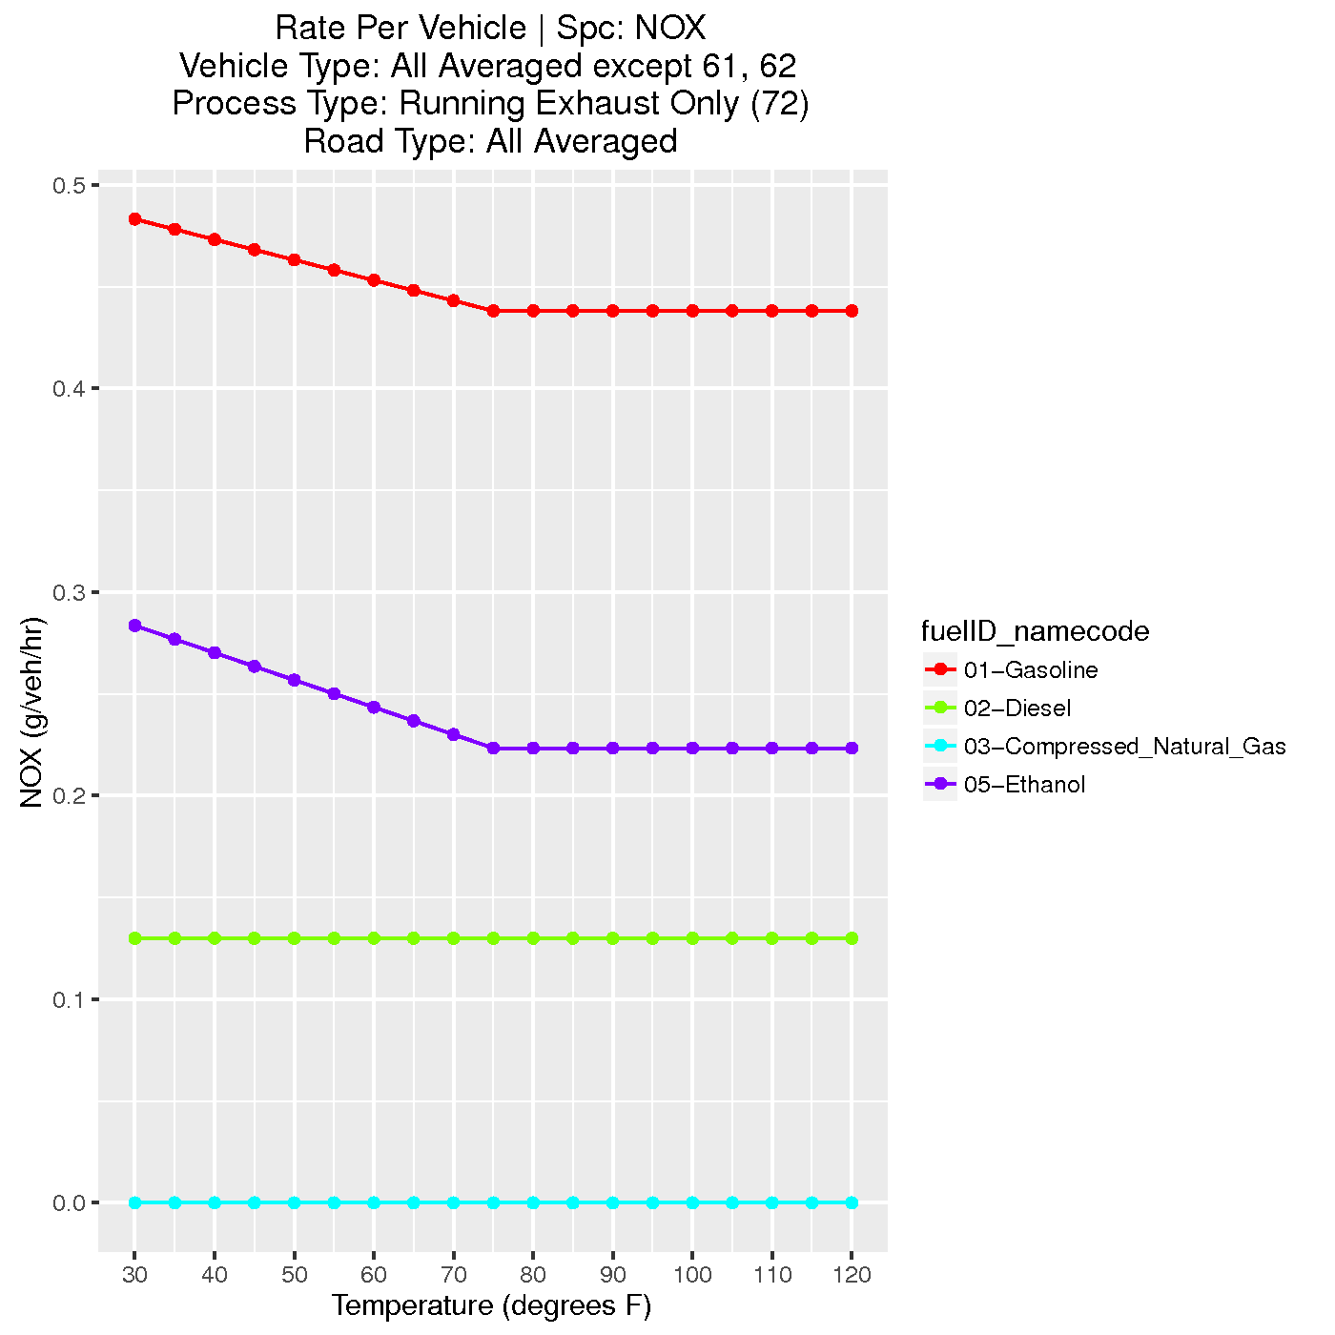
Mobile Emissions by Temperature

Slide 7
Meteorological Adjustor (MetADJ)
Emissions Inventory
AG_NH3
Meterology
RWC
Mobile 1
SMOKE
MetADJ
CMAQ-ready Emissions
Mobiles 2
Mobile 3
Mobile 4
Polynomial Eqs for Mobile Src
Others

Slide 8
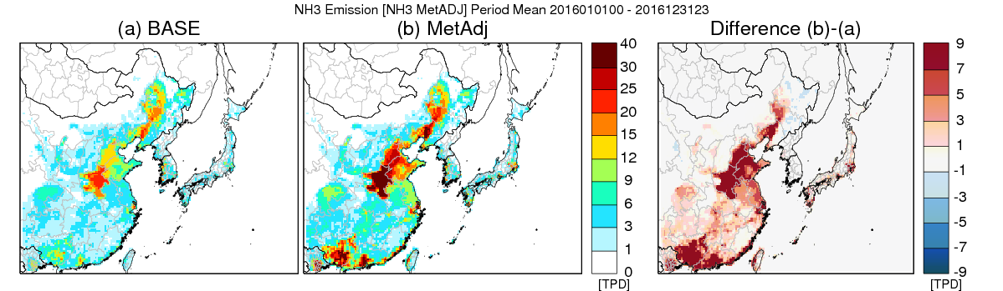
Met. Adjusted NH₃ Emissions in China

Slide 9
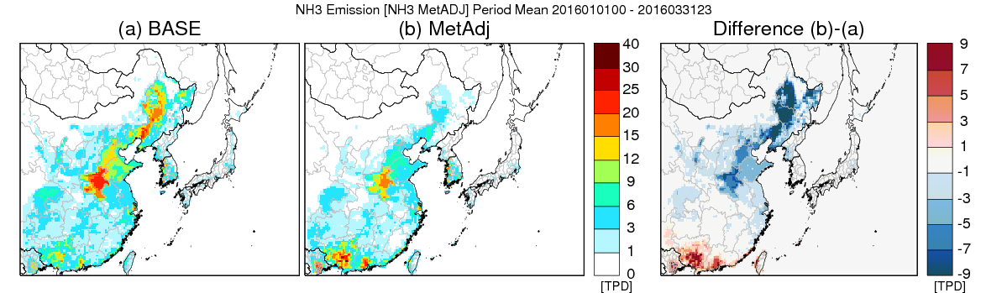
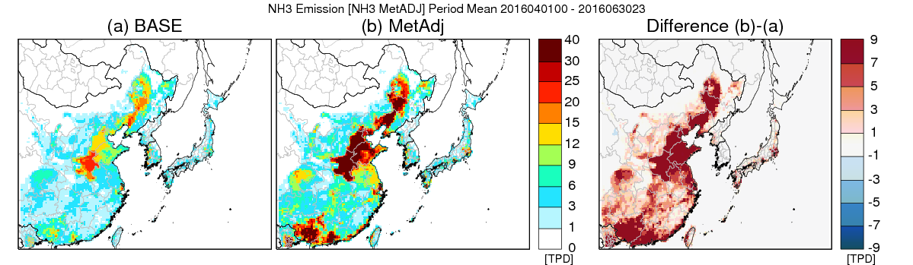
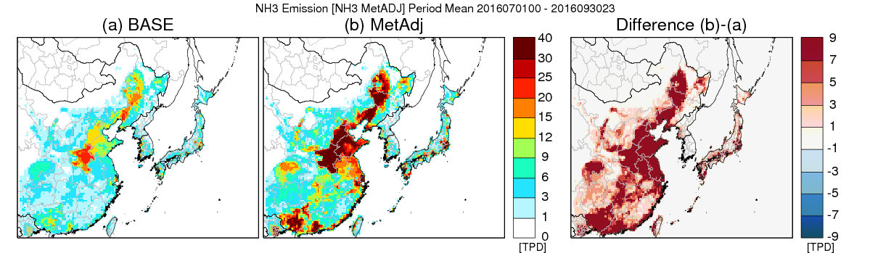
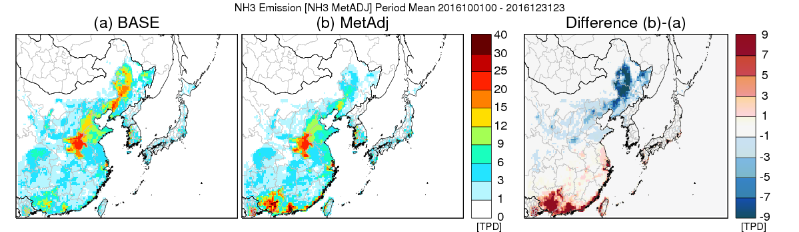
Seasonal Adjustment NH₃ in China
Jan-Mar
Clear Seasonal and Regional Variations
South region shows the increase of NH₃ during Winter
North region shows the decrease of NH₃ due to temperature differences
Apr-Jun
Jul-Sep
Oct-Dec

Slide 10
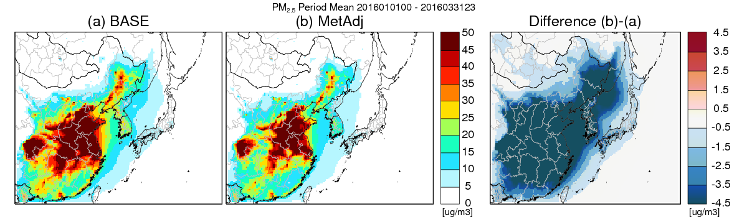
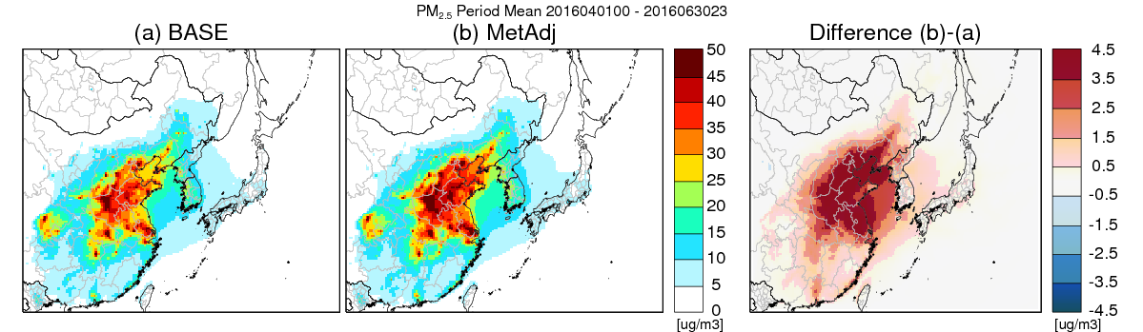
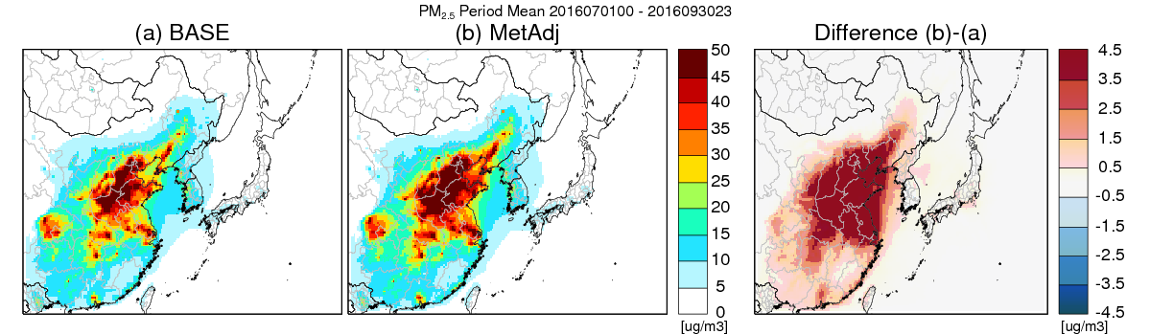
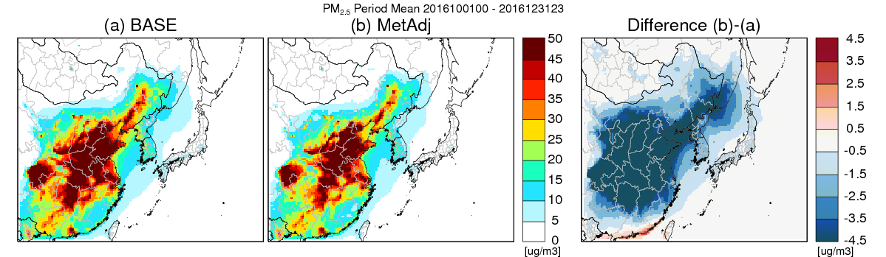
Seasonal [PM_{2.5}] Variation in China
Jan-Mar
Clear Seasonal Variation overall
Lower PM_{2.5} Estimates during Winter
Higher PM_{2.5} Estimates during Summer
Apr-Jun
Jul-Sep
Oct-Dec

Slide 11
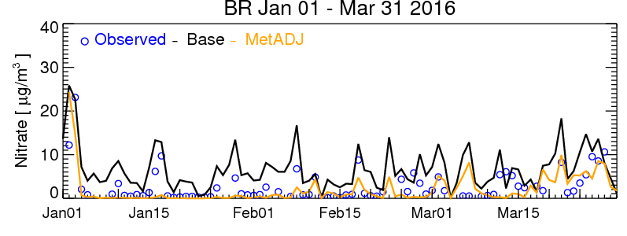
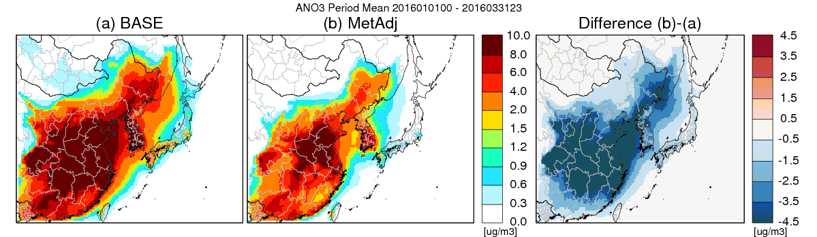
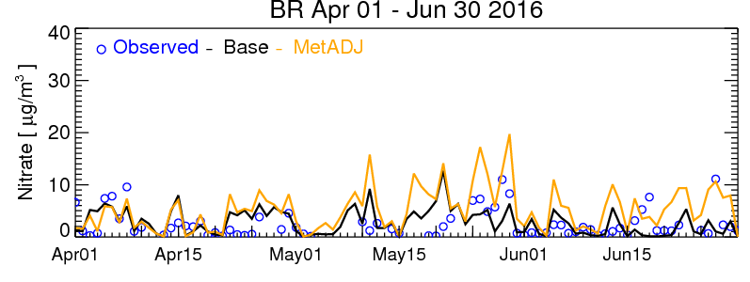
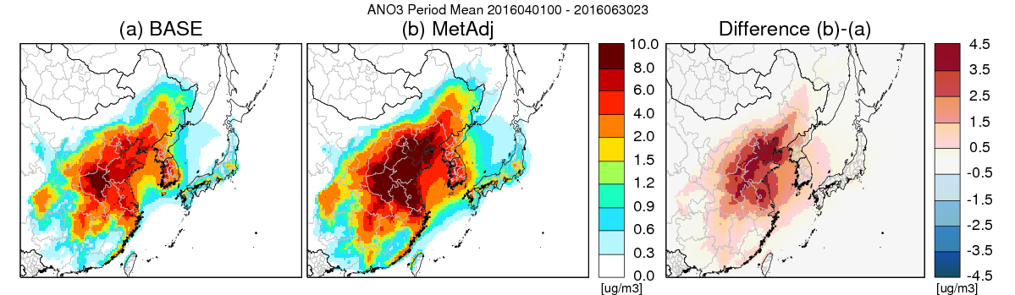
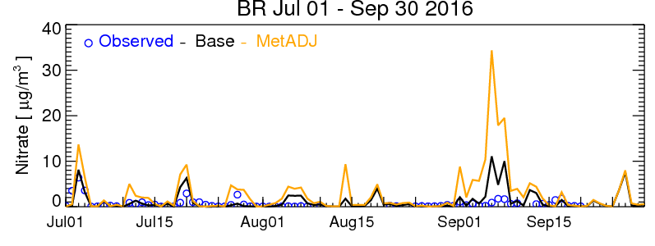
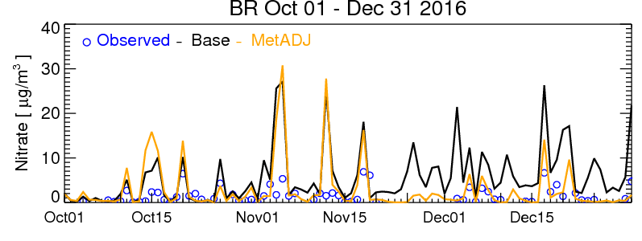
Daily [NO₃⁻] Evaluation @ Obs. b/n China & Korea
Jan-Mar
~10 ㎍/㎥
Apr-Jun
■ MetADJ case shows the overall improvements on [NO₃⁻] estimates compared to the [PM_{2.5}].
■ MetADJ case over-estimated high [NO₃⁻] episode : Need further investigation!

Slide 12
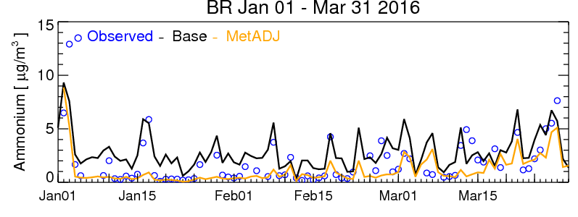
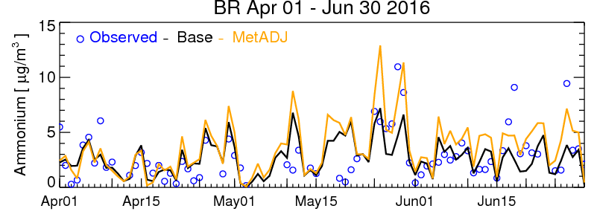
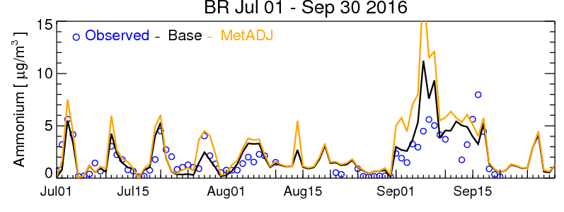
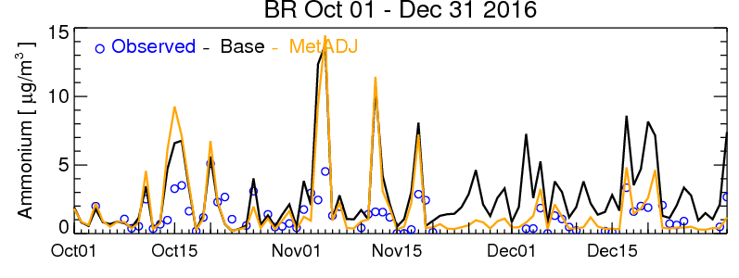
Daily [NH₄⁺] Evaluation @ Obs. b/n China & Korea
■ Daily [NH₄⁺ ] Performance is better compared to [PM_{2.5}]
  Winter Season: Under-Estimates ; Summer Season: Over-estimates
■ Improvement on estimating low concentrations during the Winter season
■ Trying to capture some high peak of Daily [NH₄⁺ ] during the Summer season

Slide 13
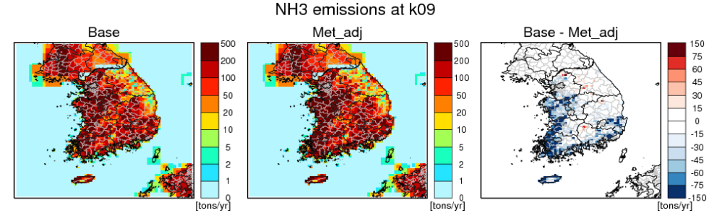
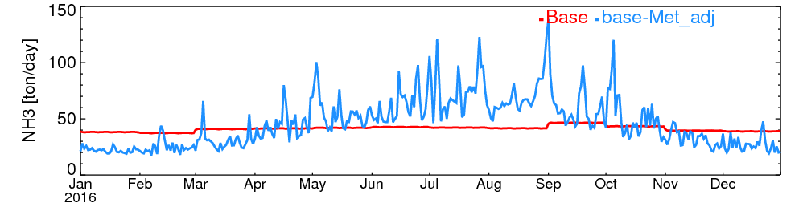
Met. Adjustment of NH₃ in Korea
High Agricultural Activity Regions ≅ High NH₃ Emissions Variations over the seasons
Total NH₃ Emissions:
15.6 % Increase

Slide 14
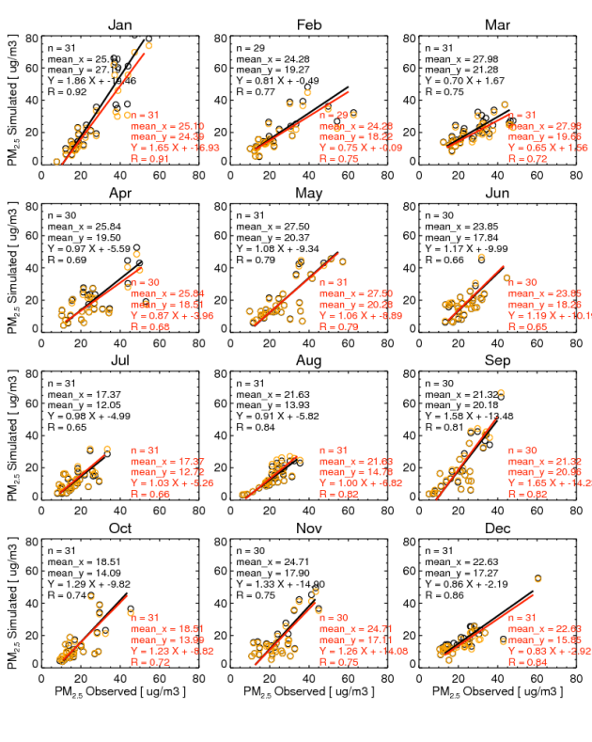
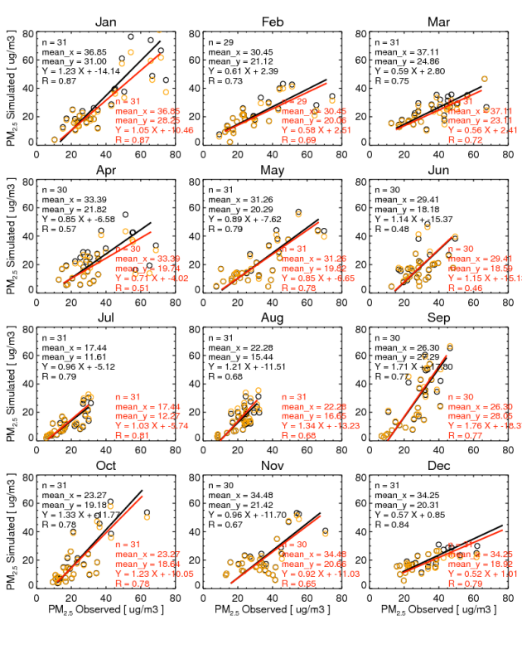
PM_{2.5} Variation by NH₃ Changes in Rural
South Region
North Region

Slide 15
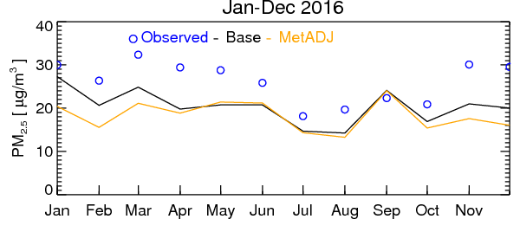
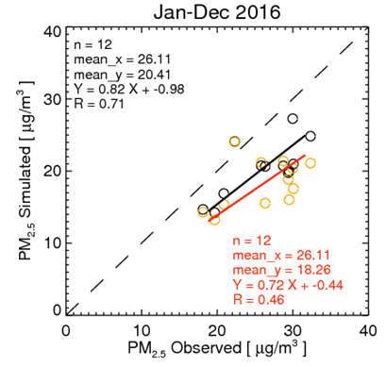
PM_{2.5} Evaluation in Seoul
Monthly average PM_{2.5} shows under-estimates overall.
  Before: Annual average PM_{2.5} 5.7 ㎍/㎥ underestimates
  After: Annual average PM_{2.5} 7.9 ㎍/㎥ underestimates
No PM_{2.5} changes shown during the summer due to no NH₃ increase in Seoul
  Due to no significant NH₃ increase during Summer
  No agricultural NH₃ sources near Seoul area

Slide 16
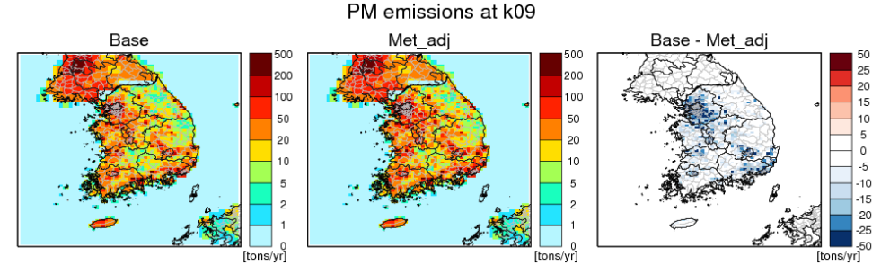
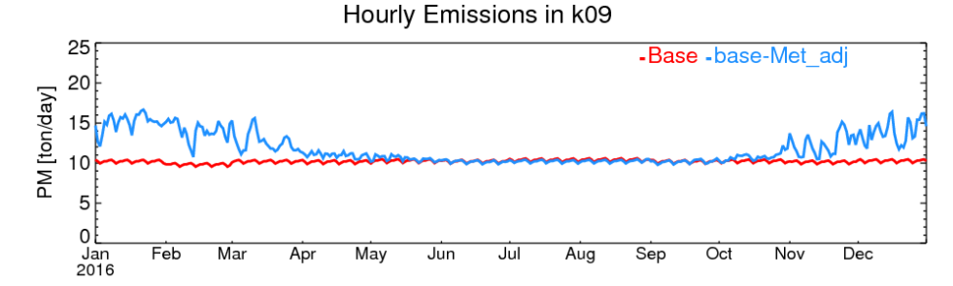
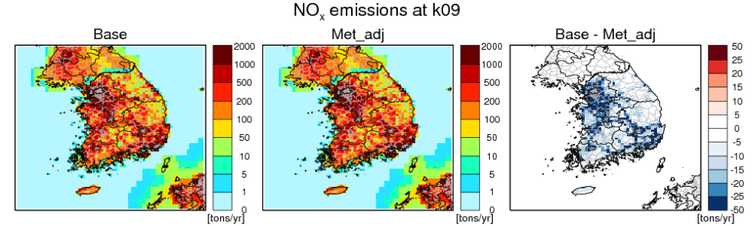
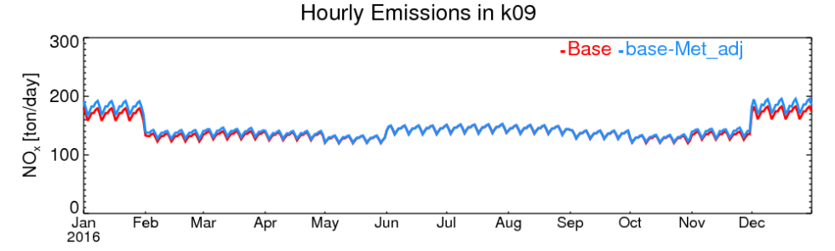
Met. Adjustment to Mobile Emissions
PMFINE Emissions → 25.6% Increase
NO_{X} Emissions → 2.9% INcrease
Increase of PM_{2.5} and NOx Emissions in Metropolitan Area during Winter Season
  Due to the dependency of Cold Engine Start PM2.5 and NOx Emissions and Evaporative NOx Emissions to local ambient temperature.

Slide 17
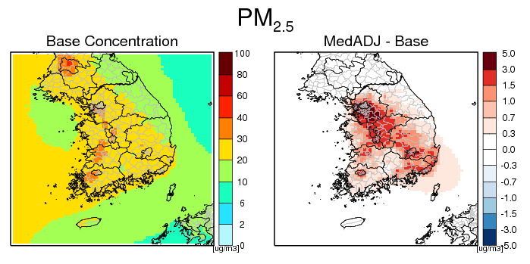
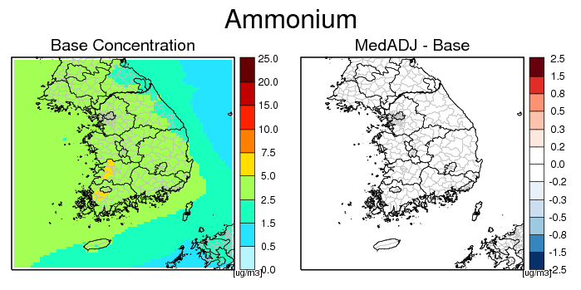
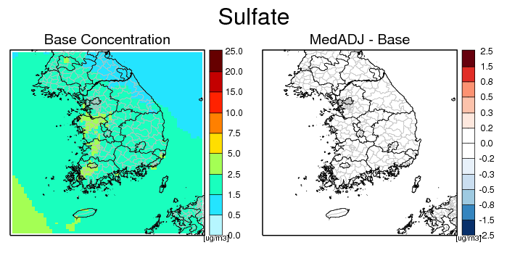
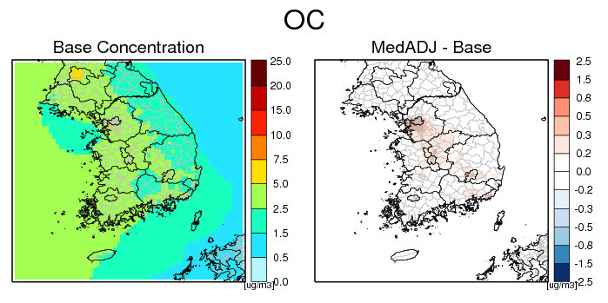
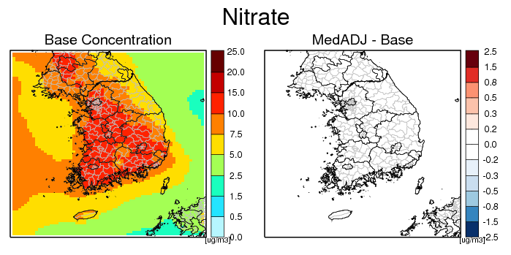
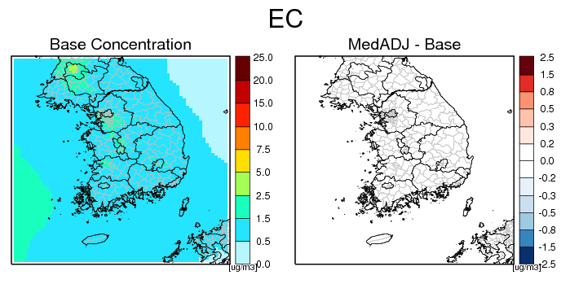
Regional Variation of PM_{2.5} by Mobile Emissions

Slide 18
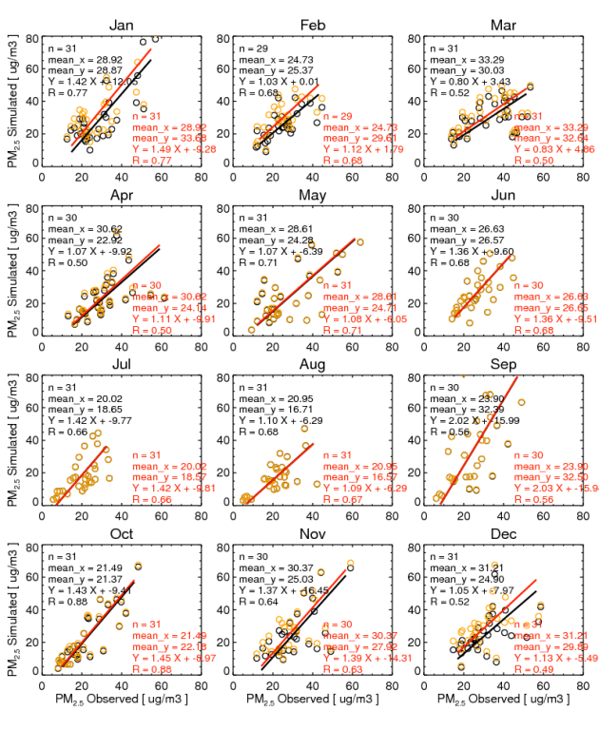
Monthly PM_{2.5} Evaluation in Seoul
Cold Engine Start PM_{2.5} Emissions increase approximately 5 ㎍/㎥ in Seoul during Winter Season
No changes of PM_{2.5} during the Summer season : Due to no changes in PM2.5 emissions during Summer

Slide 19
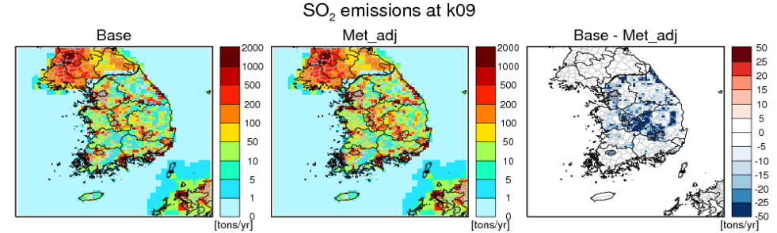
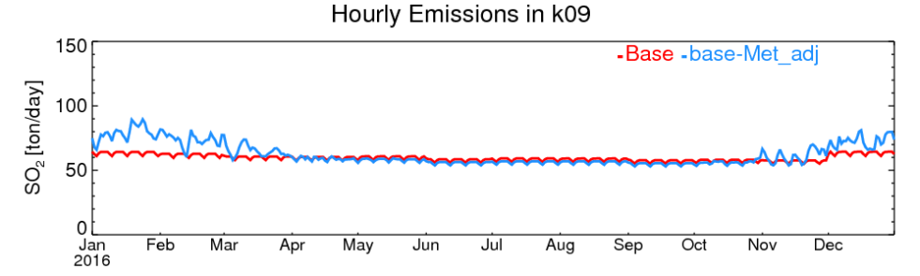
Met. Adjustment for Residential Wood Combustion
SO₂ Emissions Increase approximately 2.9%
Mostly Increased during the Winter season due to the increase of heating

Slide 20
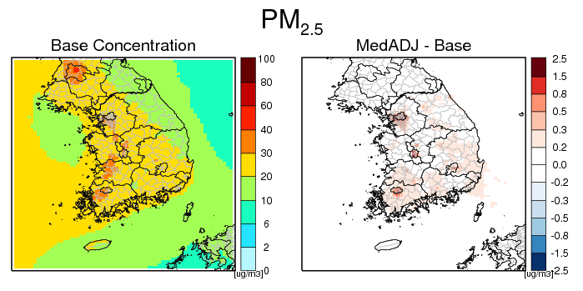
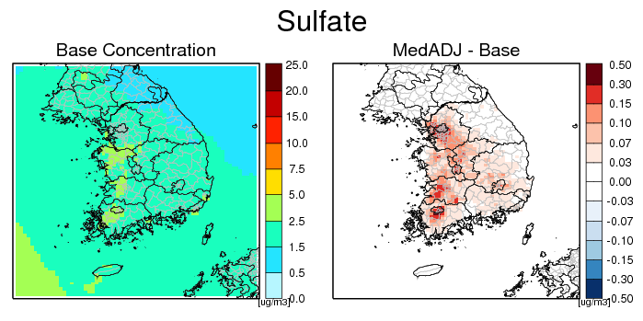
Annual Average [PM_{2.5} ] Regional Variation
SOx Emissions Increases ≅ Increase of PM_{2.5} concentrations near Metropolitan Area
SO₄²⁻ concentration increased surrounding of Metropolitan Area

Slide 21
Conclusion and Future Plans
AGNH3: Lower NH₃ during Winter, Higher NH₃ during Summer
Mobile: Higher PM_{2.5} emissions during Winter due to Cold Engine Start
RWC: Higher PM_{2.5} emissions during Winter due to Residential Heating
Future Detail Analysis are needed but we concluded that there are some improvements on forecasting of the peak of PM_{2.5} and Ozone concentrations.
Future Plans
Long-term Cumulative Sector-impact studies (AGNH₃+Mobile+RWC)
Regional Analysis
Episodic Analysis

Slide 22




Acknowledgement
Korea National Institute of Environmental Research (NIER)
National Strategic Project-Fine Particle:
(NRF-2017M3D8A1092022)
National Research Foundation of Korea (NRF)
Ministry of Science and ICT(MSIT)
Ministry of Environment(ME)
Ministry of Health and Welfare(MOHW)

