Slide 1
Direct estimates of health improvements from reduced coal power plant emissions exposure
Lucas Henneman
Department of Biostatistics, Harvard School of Public Health
CMAS Conference
Chapel Hill, NC
22 October, 2018

Slide 2
The Team
Project 4 of the Harvard/MIT ACE Center
EPA STAR Grant #RD83587201
Team
Cory Zigler
Christine Choirat
Kevin Cumminskey
  West Point
Chanmin Kim
  Boston University
Harvard/MIT Center
Petros Koutrakis
Francesca Dominici
Joel Schwartz
Noelle Selin
Minghao Qiu
Sebastian Eastham
Irene Dedoussi
Outside Center
Cesunnica Ivey
  Univ. California Riverside
Julian Marshall
  Univ. of Washington
Chris Tessum
  Univ. of Washington

Slide 3
Regulating Power Plants in the United States
~1,000 electricity generating units (power plants) contribute to elevated air pollution
Emissions regulations…
  are costly ($10’s of billions year⁻¹)
  are implemented at local, state, and national levels
  lead to intervention at individual units
SO₂ emissions decreased 65% between 2005 and 2012
Interested in these actions’ impacts on public health (accountability)
https://www.flickr.com/photos/wigwam/2630349031
25 largest facilities
Notes:
Reducing run time
Installing scrubber
Shuttering

Slide 4
Research question: What are the downstream health impacts when a power plant reduces emissions?
Related (but different) questions
  What are the health effects of increased air pollution?
  What are the health effects of exposure to emissions from certain sources?
Intermediate questions
  Where does the emitted pollution go (i.e., which populations are exposed)?
  How does the exposure change with the intervention?

Slide 5
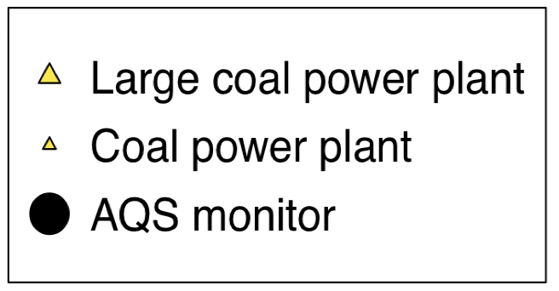
Connecting emission sources and populations: desirable qualities
Individual source impacts
Broad spatial coverage (e.g., entire US)
Fine spatial resolution (e.g., ZIP code, ∼1 km)
Flexibility to apply to different periods, time spans, and interventions

Slide 6
Connecting individual emission sources and populations: existing approaches
Assigning exposure by proximity or nearby emissions
Chemical Transport Model-based approaches
  Brute Force
  Direct sensitivity/adjoint approaches
  OSAT/PSAT
Reduced complexity air quality models
  Use baseline year-long chemical transport model or dispersion model run
  Build reduced complexity approach on top of base year
  Estimate impacts of perturbing emissions
CMAQ
Geos-CHEM
AP3 (APEEP)
EASIUR
Notes:
CHECK APEEP

Slide 7
Previous approach limitations in air pollution accountability health studies
Require excessive resources
  Rely on single chemical transport model simulation year
  Mis-matched meteorology/emissions years
  Infeasibility of identifying large numbers of single-source impacts
Indirectly apply to pollution-health response function in accountability assessments
  Typically estimated on different population assuming set list of covariates
  Likely not directly applicable to population of interest
  Accountability—health impacts of regulatory interventions may not be accurately characterized
Notes:
This might not be realistic for the talk, but one thought I’ve had about motivating this work is to show quotes from papers that illustrate the limitations of current use of full-scale models. Like when papers say they fix one year’s meteorology and use estimated emissions from another year....stuff like that, where its fairly clear that the reason they did those things is just because those are the years the had CMAQ for or whatever. That recent JAWMA paper I reviewed was full of statements like that, but I’m use others are too. So the point to be made is that there’s virtue in NOT having to do that for some types of studies, in particular health focused studies.
﻿this approach assumes that any observed exposure-response relationship would persist amid the com- plex realities of actual regulatory implementation that will typically affect a variety of factors. As a consequence, the
Another suggestion: You could expand the intro to Reduced Form Models before mentioning HYSPLIT. I fear that if you go right to HYSPLIT without pausing more to motivate RFMs, folks may get confused why you’re using something so simple. Would also give you a chance to mention other RFMs like InMAP, APEEP, etc. to set the stage that you’re work is in a similar vein. It might help orient the audience to what you’re trying to do. This was kind of the part that got lost not he AE when you sent your evaluation to ES&T, and I don’t want you to lose folks in the same way.

Slide 8
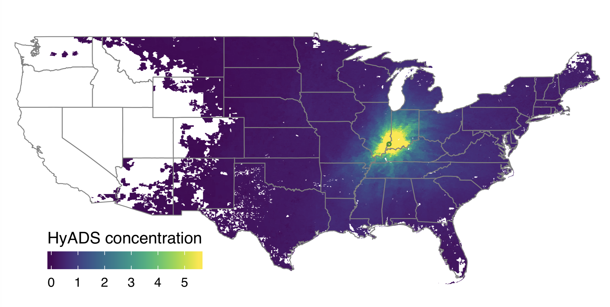
Resolution: coal emissions exposure using HYSPLIT Average Dispersion (HyADS)
Simulate dispersion of 100 parcels starting at individual stack
  Parcels tracked for 10 days
  Omit near-source impacts
  Omit parcels above planetary boundary layer
  Parcels not resuspended
  Repeat at 6 hour intervals daily
  NCEP Reanalysis meteorology
Locations aggregated to .1º x .1º grid and over-layed on ZIP codes
Weight by monthly emissions
2005 HyADS exposure for facility 6113, Unit 1
Accessible through R package (www.github.com/lhenneman/hyspdisp)
Monthly impacts from each of ~1,000 units in ~2 weeks

Slide 9
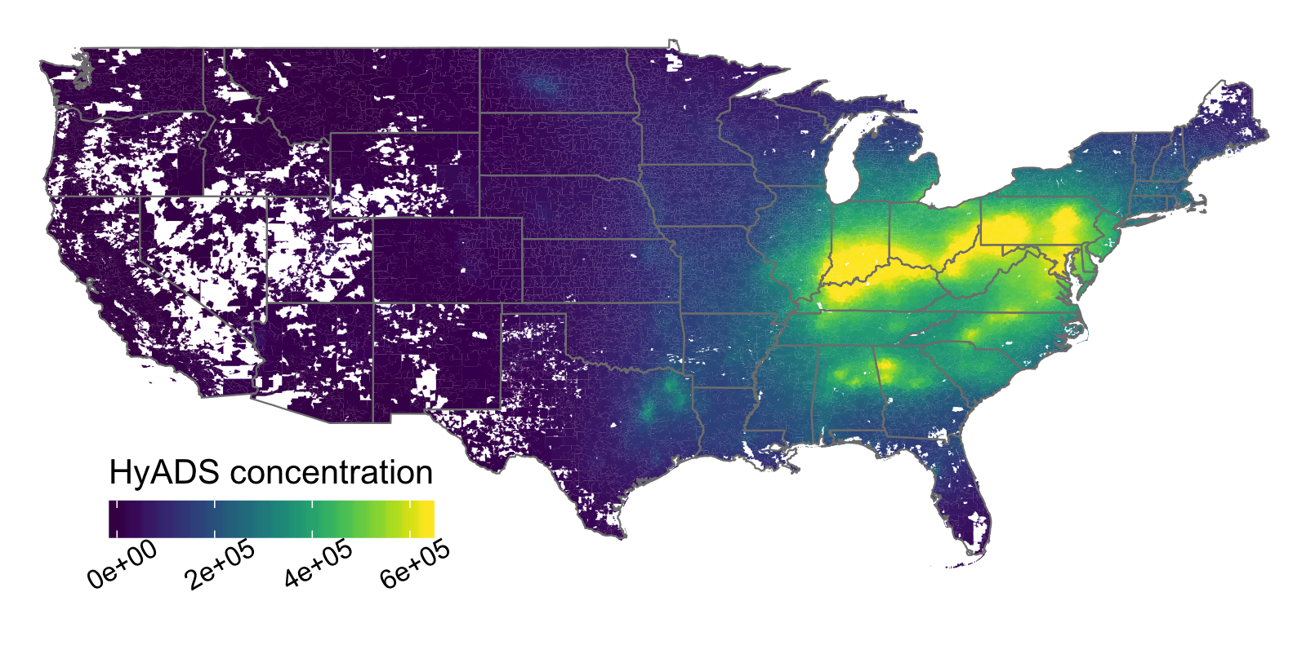
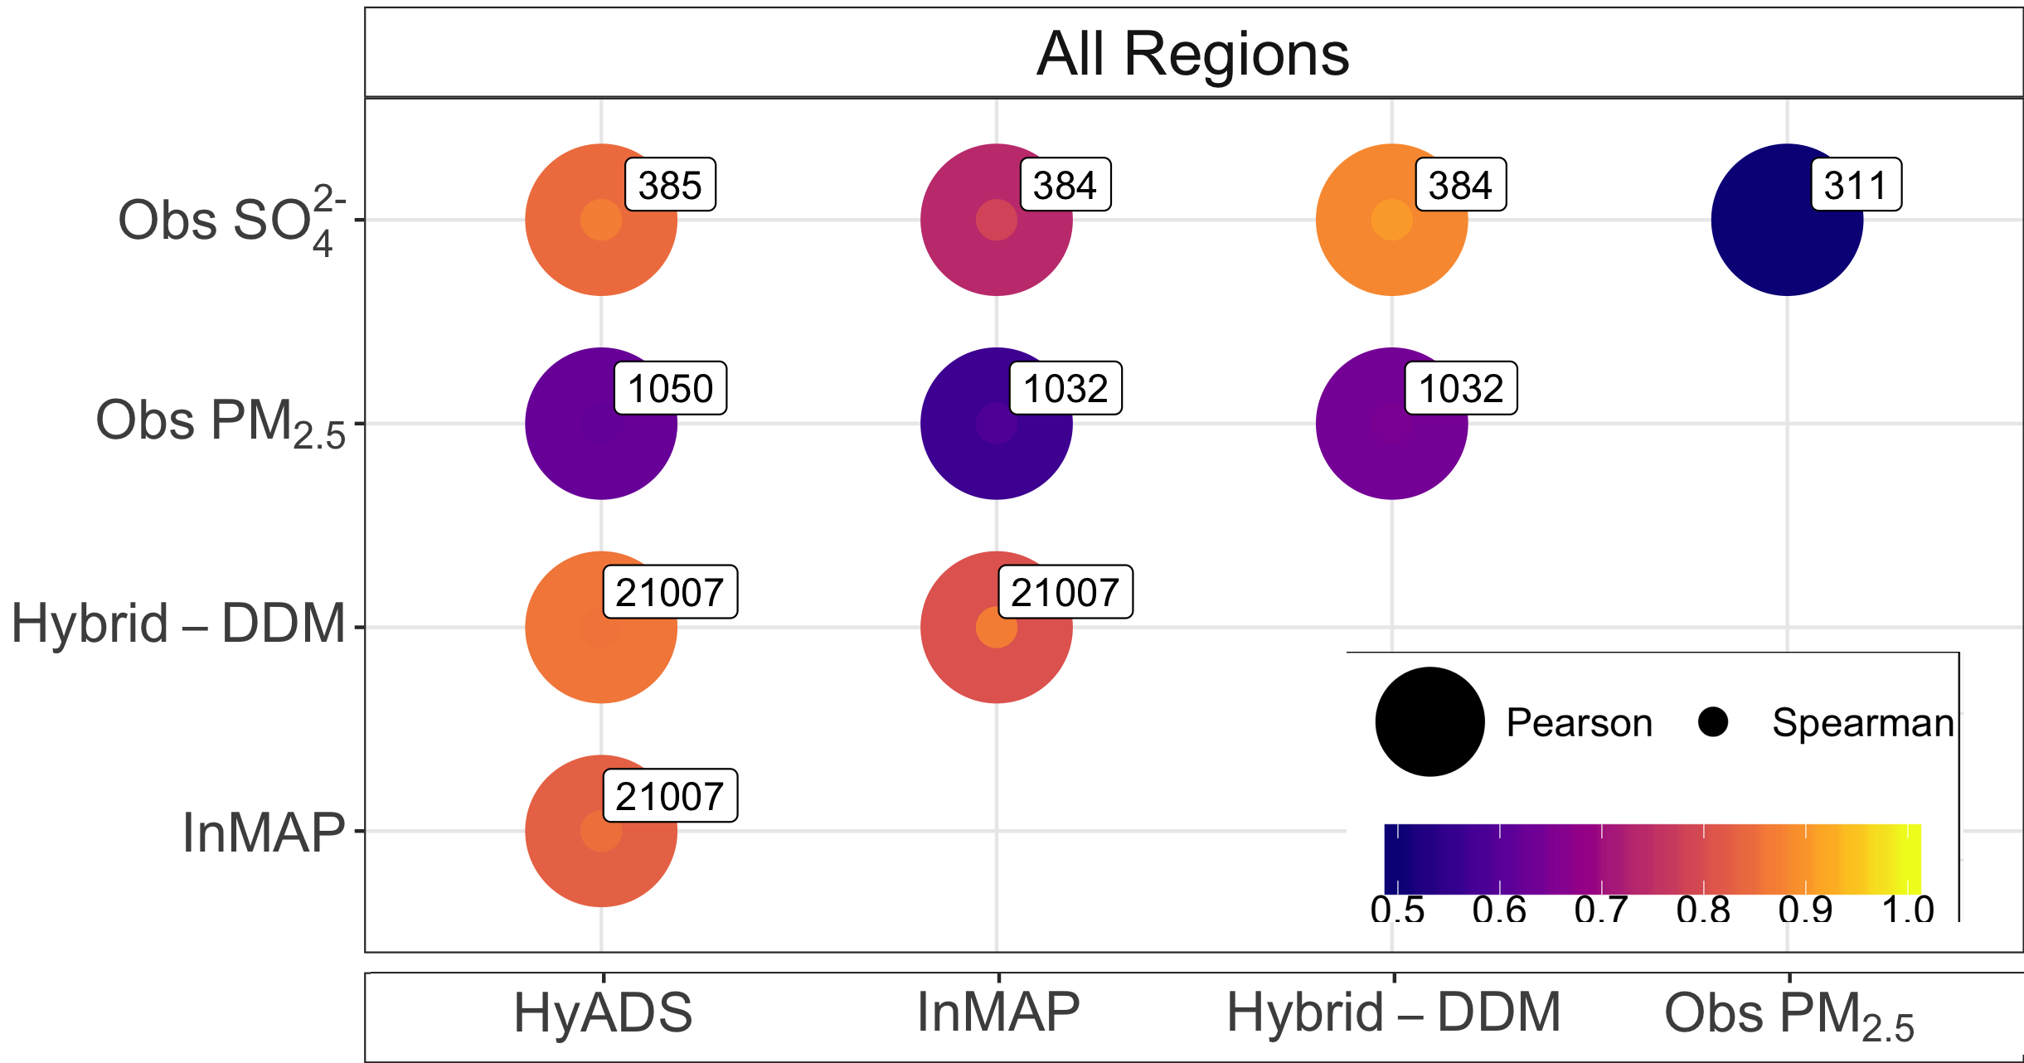
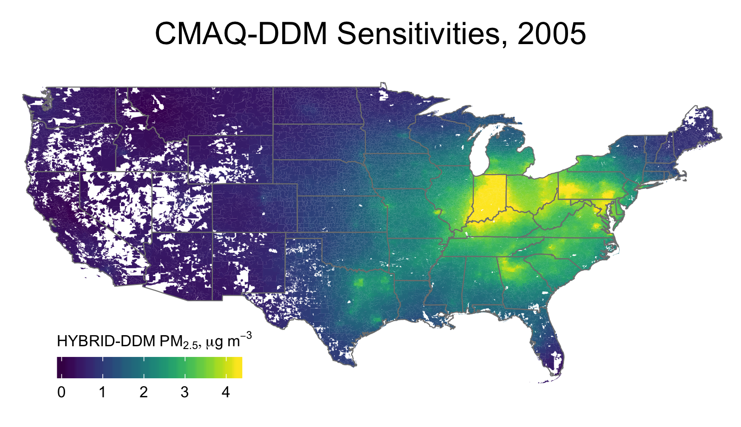
Annual HyADS evaluation: all units
HyADS (2005)
Hybrid CMAQ-DDM/Source apportionment coal impact fields (Ivey et al., 2015)
Observed PM_{2.5} and sulfate
InMAP (Tessum et al., 2016)
Hybrid CMAQ-DDM coal impacts (2005)

Slide 10
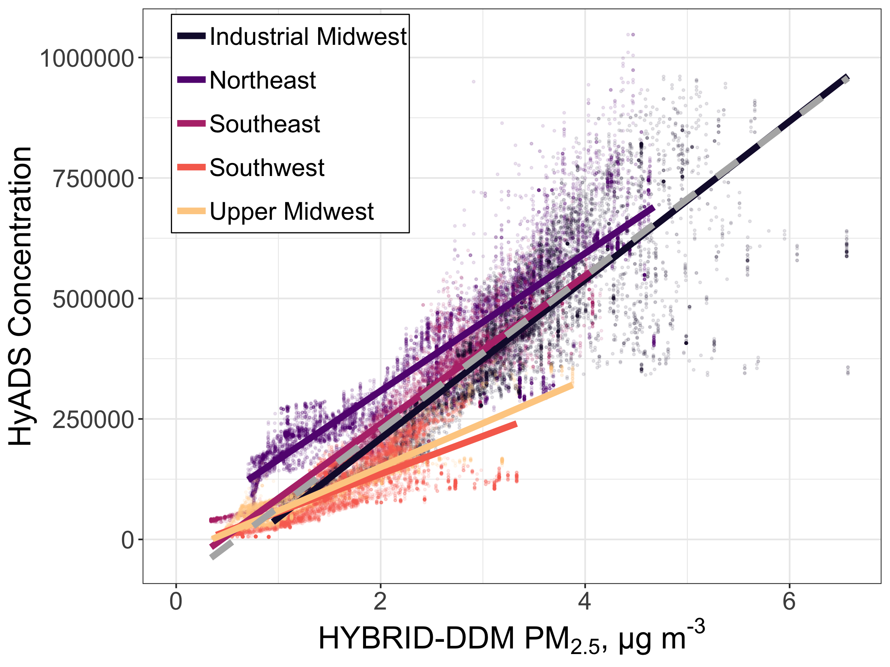
HyADS Evaluation: Regional comparison with CMAQ-DDM hybrid sensitivities
CMAQ-DDM hybrid PM_{2.5} coal sensitivities seen as gold standard
All regions generally agree
Relative negative bias in Southwest and Upper Midwest likely due to small number of sources not included in HyADS coal facility database

Slide 11
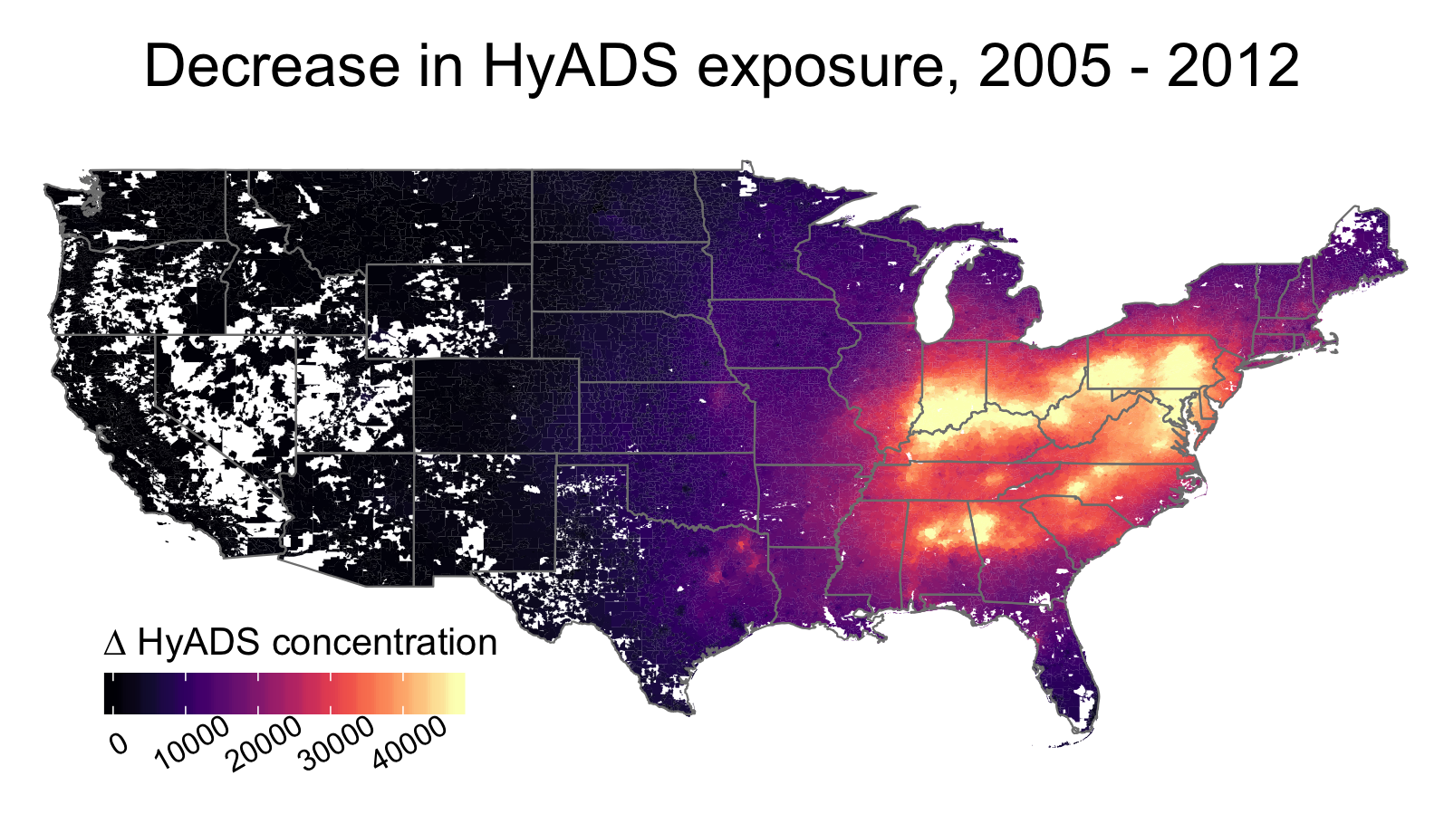
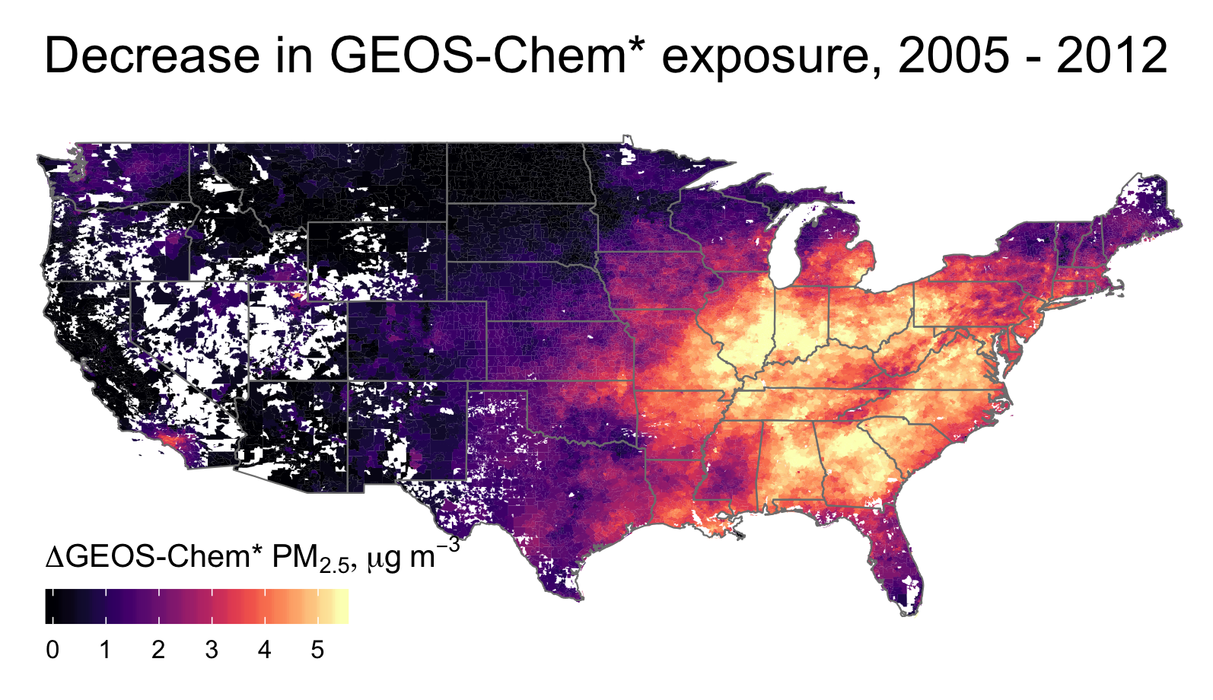
Health effects of national interventions with HyADS
65% reduction in SO₂ emissions from coal power plants, 2005-2012
69% reduction in annual HyADS exposure, 2005-2012
32% reduction in average PM_{2.5} concentration, 2005-2012 (not all attributable to coal emissions reductions)
Boys et al., (2014). Env. Sci. & Tech.

Slide 12
Emissions reductions and health outcomes: two hypotheses
Populations that have experienced the greatest reductions in exposure have seen the largest decreases in adverse health outcome rates
Changes in total exposure have impacted health outcomes in different ways than changes in exposure to coal emissions specifically

Slide 13
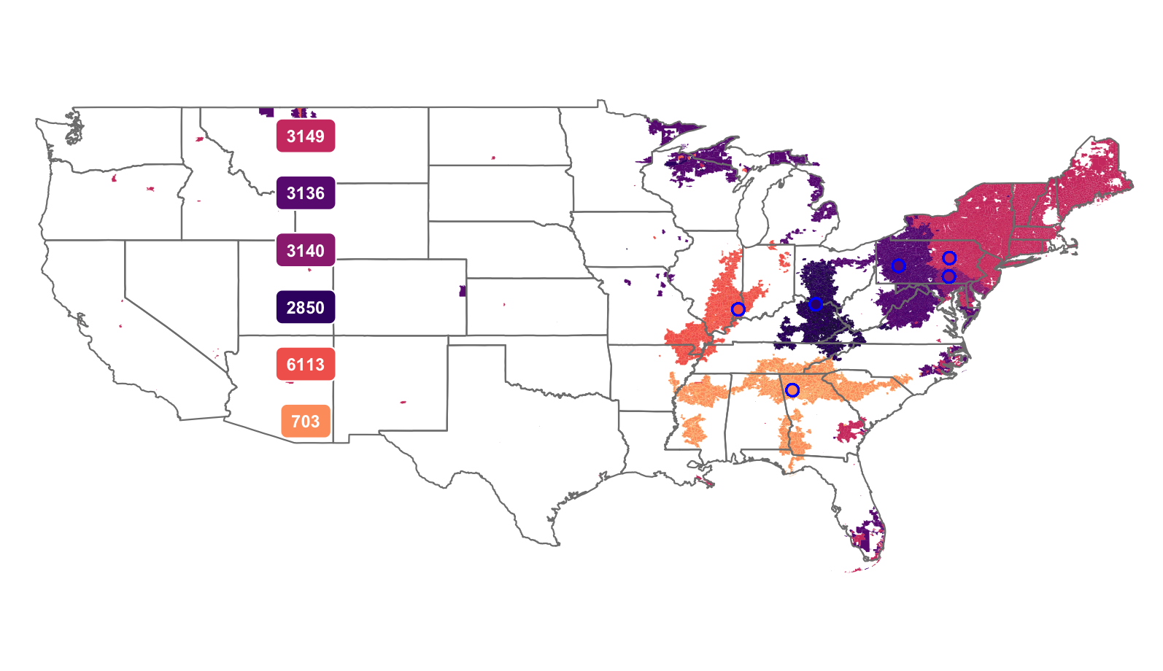
Facilities with maximum population-weighted exposure in 2005
Colors denote ZIP codes in which each facility contributes the maximum population-weighted exposure
Potential tool to prioritize future interventions
Highlights importance of both amount of emissions and location
Numbers refer to Facility ID

Slide 14
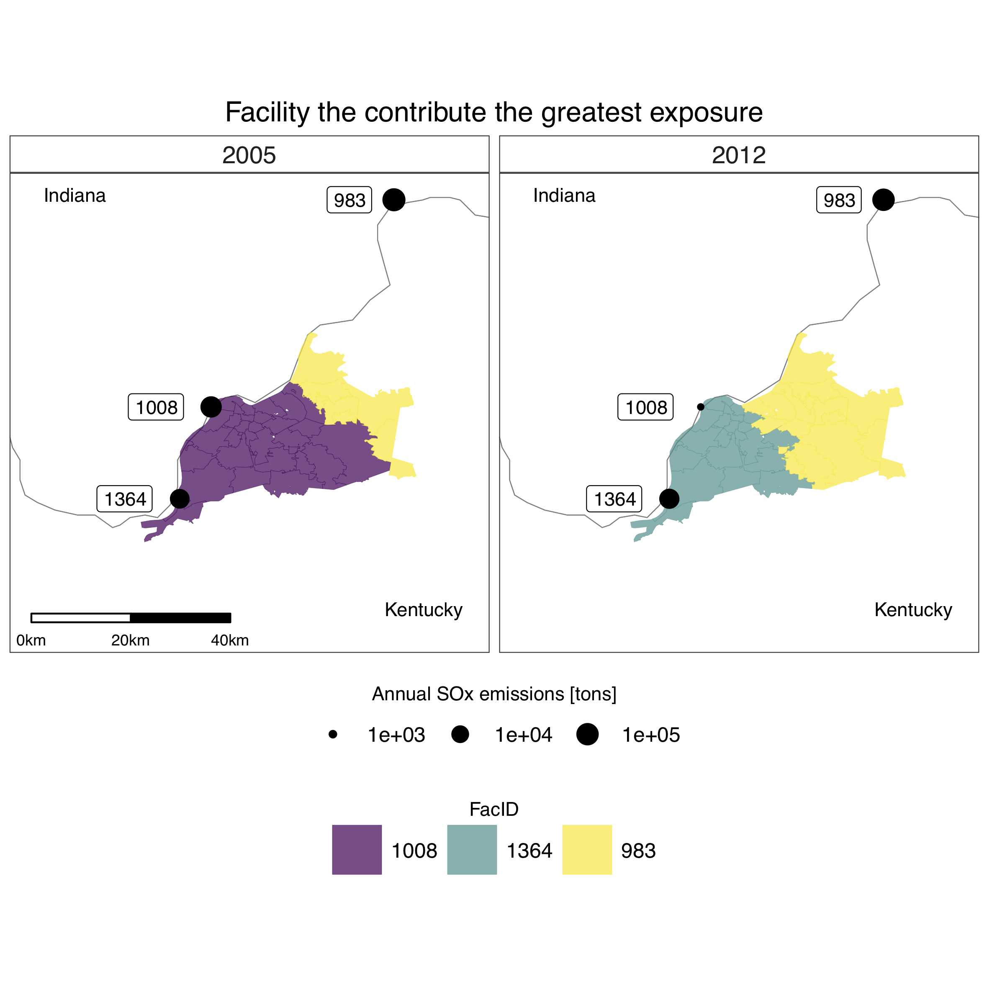
Health effects of local interventions: asthma in Louisville, KY
Relating changes in asthma prevalence across Louisville with interventions
East-west divide between facilities that contributes greatest exposure in Louisville ZIP codes
Facility #1008 installed SO₂ scrubber in 2011

Slide 15
Ranking facilities by population-weighted impact in Louisville, KY
Top 20 facilities that impact Louisville are spread through the Midwest
Three facilities with large impacts remained in 2012

Slide 16
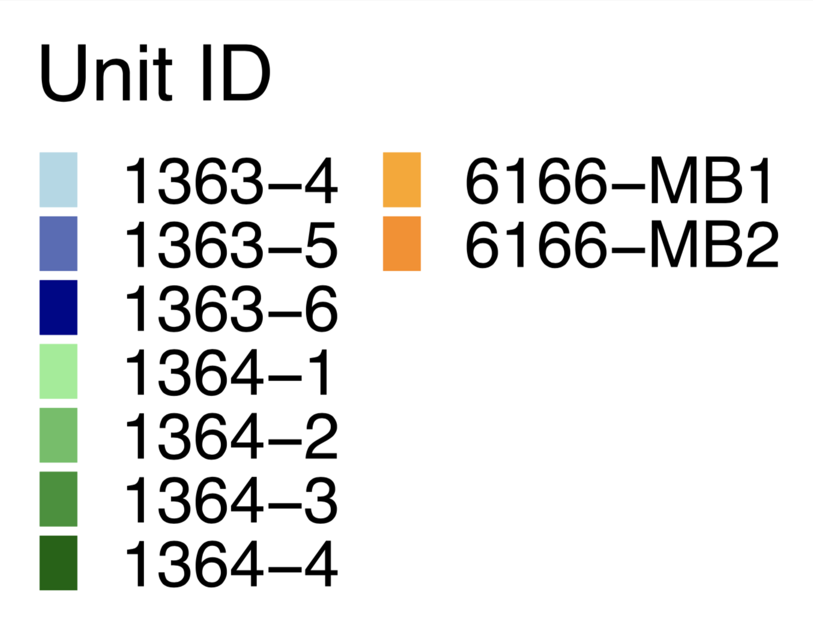
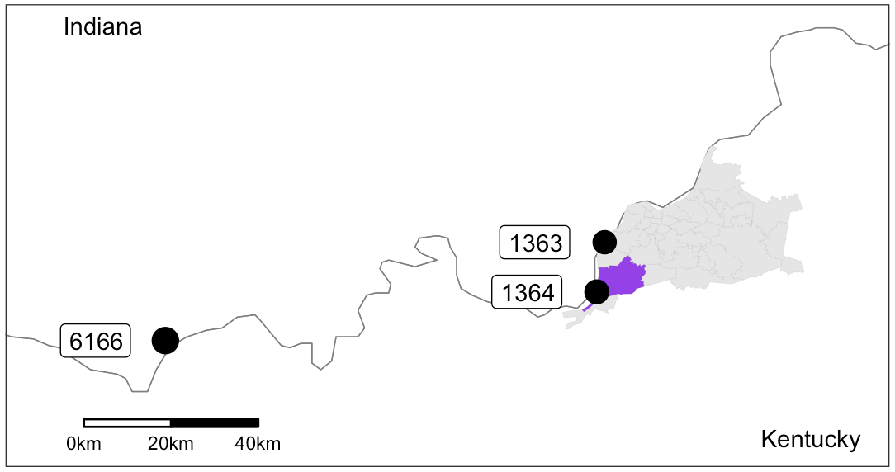
Impacts from individual units in Louisville ZIP code that contains an SO₂ monitor
Unweighted HyADS
Weighted HyADS
Raw HyADS impacts (not weighted by emissions) are highly seasonal
Weighting by emissions reveals impacts of control devices and closures
Spikes observed in 2012 and 2014 summers match observations (2013 missing)
Monthly
SO₂, ppb

Slide 17
Conclusions
HyADS source-population linkages
  foregoing full scale chemistry and transport
  increased source resolution and ability to investigate multiple time periods
  nimble enough for a variety of source-specific health studies
  opens the door to more direct accountability
  allows accountability studies of source specific actions/emissions using observed health outcomes (instead of historic C-R functions)
Reduced coal exposure leads to improved health, with differences from reduced total PM_{2.5} exposure
Complete analysis underscore the importance of quantifying source-specific impacts
These tools enhance our ability to quantify quantify benefits of specific regulatory actions taken in complex regulatory web
Evaluation for application to specific problems to continue

Slide 18
References
Boys, B. L., Martin, R. V., Van Donkelaar, A., MacDonell, R. J., Hsu, N. C., Cooper, M. J., … Wang, S. W. (2014). Fifteen-year global time series of satellite-derived fine particulate matter. Environmental Science and Technology, 48(19), 11109–11118. http://doi.org/10.1021/es502113p
Health Effects Institute. (2003). Assessing Health Impact of Air Quality Regulations: Concepts and Methods for Accountability Research. Retrieved from http://pubs.healtheffects.org/getfile.php?u=261
Henneman, L. R., Liu, C., Mulholland, J. A., & Russell, A. G. (2016). Evaluating the Effectiveness of Air Quality Regulations: A Review of Accountability Studies and Frameworks. Journal of the Air & Waste Management Association, 67(2), 144–172. http://doi.org/10.1080/10962247.2016.1242518
Henneman, Lucas R.F., Christine Choirat, Cesunica E. Ivey, and Corwin M Zigler. n.d. “Characterizing Population Exposure to Coal Emissions Sources in the United States.” In Review.
Henneman, Lucas R.F., Christine Choirat, and Corwin M Zigler. n.d. “Decreases in Negative Health Outcomes Associated with Coal Emissions Reductions between 2005 and 2012 in the United States.” In Review.
Ivey, C. E., Holmes, H. A., Hu, Y. T., Mulholland, J. A., & Russell, A. G. (2015). Development of PM_{2.5} source impact spatial fields using a hybrid source apportionment air quality model. Geoscientific Model Development, 8(7), 2153–2165. http://doi.org/10.5194/gmd-8-2153-2015
Tessum, C. W., Hill, J. D., & Marshall, J. D. (2017). InMAP: A model for air pollution interventions. PLoS ONE, 12(4), 1–26. http://doi.org/10.1371/journal.pone.0176131

