Slide 1



Evaluation of Novel NASA Aerosol Products during the Yosemite Rim Fire
S. Marcela Loría-Salazar¹, Heather A. Holmes¹, Neil Lareau^{1,2}, and James D. Long¹
¹ Atmospheric Sciences Program, Department of Physics, University of Nevada Reno, Reno, Nevada, U.S.A.
² Department of Meteorology and Climate Science, San Jose State University, San Jose, California, U.S.A.
October 22nd, 2018
17th Annual CMAS Conference
Chapel Hill, North Carolina, USA

Slide 2
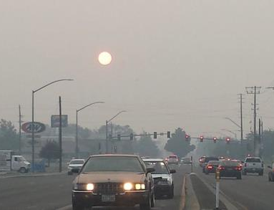

Motivation
Plumb Ln
Reno, NV
09-2014
~3:00 pm
Human health impacts of wildfire smoke exposure
Visibility and radiative forcing impacts for climate
Increasing drought conditions in western U.S. = more fires
Notes:
However, the semi-arid western U.S. continues to be an unproven and infrequently explored area for remotely sensed atmospheric aerosol pollution retrievals. The study of aerosol transport and optical properties in this area is a challenge due to the complex terrain, bright surfaces, presence of anthropogenic and biogenic emissions, secondary organic aerosol formation, smoke from wildfires, and low aerosol concentrations during non-fire conditions.
Previous studies have shown that MODIS retrievals failed to estimate column-integrated aerosol pollution levels and particle size over Nevada and California in the summer months of 2012 and 2013 due to high surface albedo, heterogeneous vertical profile of aerosol concentrations, and incorrect parameterizations for surface reflectance. MODIS algorithms overestimated AOD by more than a factor of 3 in Reno, NV and more than a factor of 2 over Fresno, CA.

Slide 3
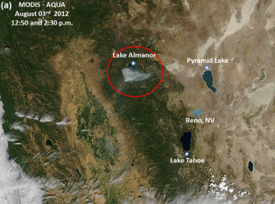
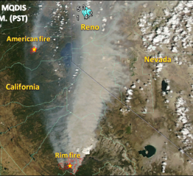
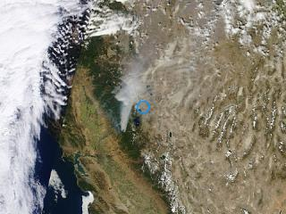
Motivation
70km
70km
70km
Chips Fire 2012
Aqua - 3 Aug 2012
Rim Fire 2013
Aqua –22 Aug 2013
King Fire 2014
Terra- 17 Sep 2014
Uncertainties in aerosol optical depth (AOD) satellite remote sensing algorithm
  Uniformly mixed aerosols of homogeneous composition
  All aerosols are contained within the boundary layer
  Surface reflectance: MAIAC & Deep-Blue
Notes:
However, the semi-arid western U.S. continues to be an unproven and infrequently explored area for remotely sensed atmospheric aerosol pollution retrievals. The study of aerosol transport and optical properties in this area is a challenge due to the complex terrain, bright surfaces, presence of anthropogenic and biogenic emissions, secondary organic aerosol formation, smoke from wildfires, and low aerosol concentrations during non-fire conditions.
Previous studies have shown that MODIS retrievals failed to estimate column-integrated aerosol pollution levels and particle size over Nevada and California in the summer months of 2012 and 2013 due to high surface albedo, heterogeneous vertical profile of aerosol concentrations, and incorrect parameterizations for surface reflectance. MODIS algorithms overestimated AOD by more than a factor of 3 in Reno, NV and more than a factor of 2 over Fresno, CA.

Slide 4
Objectives and Hypothesis
Objectives
Evaluate aerosol satellite retrievals during fires and non-fire periods using new NASA Deep-Blue Collection 6.1 and MAIAC algorithms
Evaluate Plume Injection Height products from NASA ASHE and MAIAC algorithms against ground-based LIDAR during the Rim Fire
Hypotheses
Improvement on fire detection on the new Collection 6.1 Deep-Blue
MAIAC AOD evaluation performs better than Deep-Blue Collection 6.1
Notes:
However, the semi-arid western U.S. continues to be an unproven and infrequently explored area for remotely sensed atmospheric aerosol pollution retrievals. The study of aerosol transport and optical properties in this area is a challenge due to the complex terrain, bright surfaces, presence of anthropogenic and biogenic emissions, secondary organic aerosol formation, smoke from wildfires, and low aerosol concentrations during non-fire conditions.
Previous studies have shown that MODIS retrievals failed to estimate column-integrated aerosol pollution levels and particle size over Nevada and California in the summer months of 2012 and 2013 due to high surface albedo, heterogeneous vertical profile of aerosol concentrations, and incorrect parameterizations for surface reflectance. MODIS algorithms overestimated AOD by more than a factor of 3 in Reno, NV and more than a factor of 2 over Fresno, CA.

Slide 5
Measurements
  Aerosol Optical Depth (AOD)
  AERONET (Ground-based sun photometer)
  MODIS Deep-Blue (Data-based characterization of surface reflectance)
  MODIS Multi-Angle Implementation of Atmospheric Correction (MAIAC) (MODIS retrievals of surface reflectance)
  Plume injection height
  Aerosol Single Scattering Albedo and Height Estimation (ASHE)
  MAIAC
  LIDAR
  Ground-based measurements
  Fire Radiative Power
  Intensity of the fire
Notes:
However, the semi-arid western U.S. continues to be an unproven and infrequently explored area for remotely sensed atmospheric aerosol pollution retrievals. The study of aerosol transport and optical properties in this area is a challenge due to the complex terrain, bright surfaces, presence of anthropogenic and biogenic emissions, secondary organic aerosol formation, smoke from wildfires, and low aerosol concentrations during non-fire conditions.
Previous studies have shown that MODIS retrievals failed to estimate column-integrated aerosol pollution levels and particle size over Nevada and California in the summer months of 2012 and 2013 due to high surface albedo, heterogeneous vertical profile of aerosol concentrations, and incorrect parameterizations for surface reflectance. MODIS algorithms overestimated AOD by more than a factor of 3 in Reno, NV and more than a factor of 2 over Fresno, CA.

Slide 6
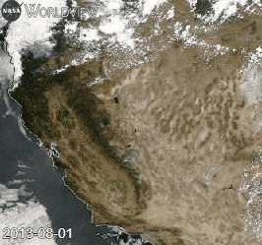
Improvement C6.1 and MAIAC AODs
Fire season, August, 2013
Study case:
August, 2013
Multiple fires (e.g. Yosemite Rim Fire)
MODIS DB C6.1 (?) (Pi: Christina Hsu, PhD)
Improvement in fire detection
Reduction in the impact of surface reflectance in the AOD
MAIAC (?) (Pi: Alexei Lyapustin, PhD)
High-resolution AOD (1-km)
Plume injection height
Better characterization of surface reflectance in the AOD
https://worldview.earthdata.nasa.gov/
Notes:
Health effects of ambient air quality
Georgia Birth Cohort
Geo-coded patient information
Atlanta - epidemiologic results using central monitor data suggest associations of acute health effects and mobile source emissions
Spatially resolved health study needs spatial air quality metrics

Slide 7
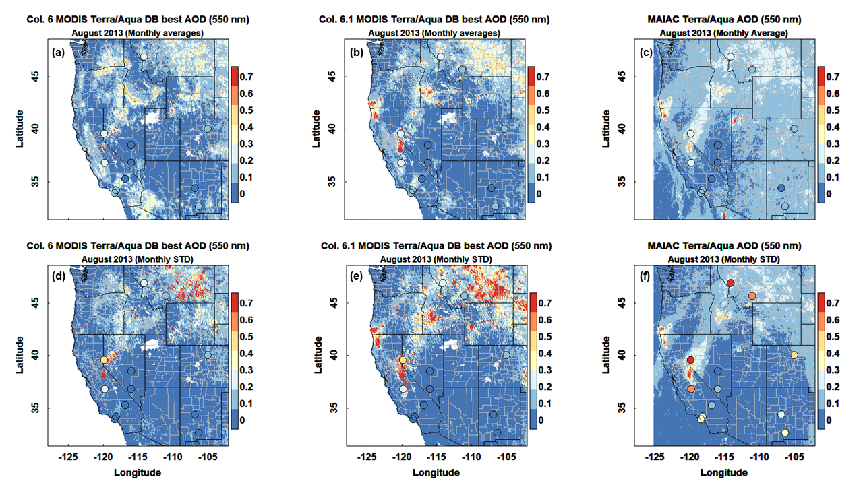
Improvement in AOD
Western U.S., August, 2013
Loria-Salazar et al., (In-preparation)
Notes:
Health effects of ambient air quality
Georgia Birth Cohort
Geo-coded patient information
Atlanta - epidemiologic results using central monitor data suggest associations of acute health effects and mobile source emissions
Spatially resolved health study needs spatial air quality metrics

Slide 8
Improvement in AOD: C6.1
Western U.S., August, 2013
Results:
C6 (r² ~0.58; p <0.01)
C6.1 (r² ~0.71; p <0.01)
Fire detection (?)
Albedo (?)
Loria-Salazar et al.,
(In-preparation)
Improvement
Notes:
Health effects of ambient air quality
Georgia Birth Cohort
Geo-coded patient information
Atlanta - epidemiologic results using central monitor data suggest associations of acute health effects and mobile source emissions
Spatially resolved health study needs spatial air quality metrics

Slide 9
Improvement in AOD: C6.1
Western U.S., August, 2013
Results (Fires):
High STDs in AOD help to detect fire activity
Results (Albedo):
Low STDs in AOD help to detect areas of albedo issues
Loria-Salazar et al., (In-preparation)
Notes:
Health effects of ambient air quality
Georgia Birth Cohort
Geo-coded patient information
Atlanta - epidemiologic results using central monitor data suggest associations of acute health effects and mobile source emissions
Spatially resolved health study needs spatial air quality metrics

Slide 10
Improvement in AOD: MAIAC
Western U.S., August, 2013
Results:
MAIAC (r²=0.74, p <0.01)
Limitations to retrieve AOD over fire periods (underestimation).
Low STDs in AOD help to detect areas of albedo issues
Loria-Salazar et al., (In-preparation)
Notes:
Health effects of ambient air quality
Georgia Birth Cohort
Geo-coded patient information
Atlanta - epidemiologic results using central monitor data suggest associations of acute health effects and mobile source emissions
Spatially resolved health study needs spatial air quality metrics

Slide 11
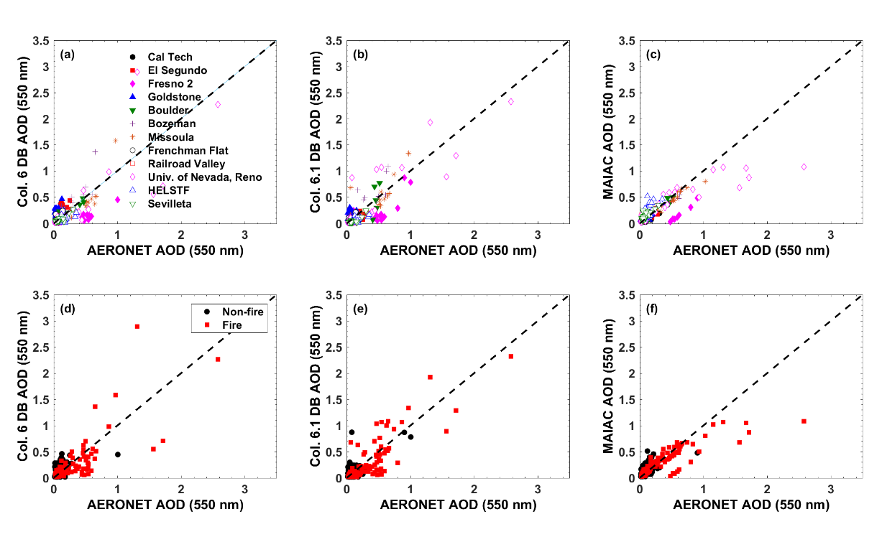
Evaluation of NASA MODIS AOD
Western U.S., August, 2013
Loria-Salazar et al., (In-preparation)
Notes:
Health effects of ambient air quality
Georgia Birth Cohort
Geo-coded patient information
Atlanta - epidemiologic results using central monitor data suggest associations of acute health effects and mobile source emissions
Spatially resolved health study needs spatial air quality metrics

Slide 12
Improvement in AOD
Western U.S., August, 2013
Loria-Salazar et al., (In-preparation)
Notes:
Health effects of ambient air quality
Georgia Birth Cohort
Geo-coded patient information
Atlanta - epidemiologic results using central monitor data suggest associations of acute health effects and mobile source emissions
Spatially resolved health study needs spatial air quality metrics

Slide 13
Improvement in AOD: Fires
Western U.S., August, 2013
Loria-Salazar et al., (In-preparation)
Notes:
Health effects of ambient air quality
Georgia Birth Cohort
Geo-coded patient information
Atlanta - epidemiologic results using central monitor data suggest associations of acute health effects and mobile source emissions
Spatially resolved health study needs spatial air quality metrics

Slide 14
Improvement in AOD: High-resolution
Western U.S., August, 2013
Loria-Salazar et al., (In-preparation)
Notes:
Health effects of ambient air quality
Georgia Birth Cohort
Geo-coded patient information
Atlanta - epidemiologic results using central monitor data suggest associations of acute health effects and mobile source emissions
Spatially resolved health study needs spatial air quality metrics

Slide 15
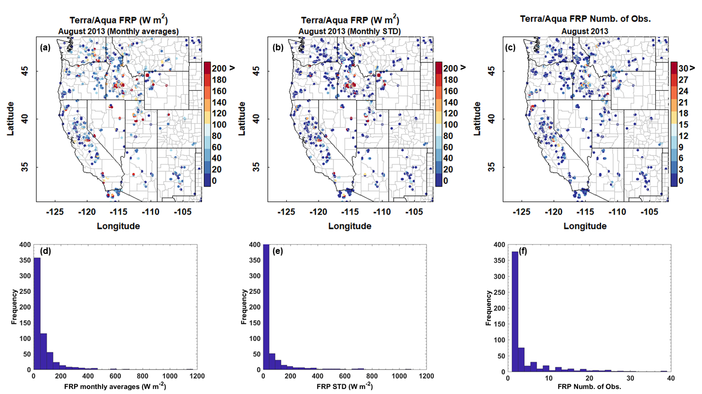
Evaluation of NASA Col. 6 FRP
Western U.S., August, 2013
Loria-Salazar et al., (In-preparation)
Notes:
Health effects of ambient air quality
Georgia Birth Cohort
Geo-coded patient information
Atlanta - epidemiologic results using central monitor data suggest associations of acute health effects and mobile source emissions
Spatially resolved health study needs spatial air quality metrics

Slide 16
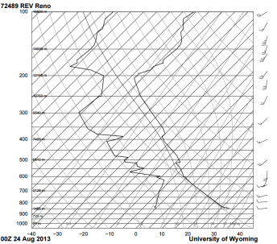
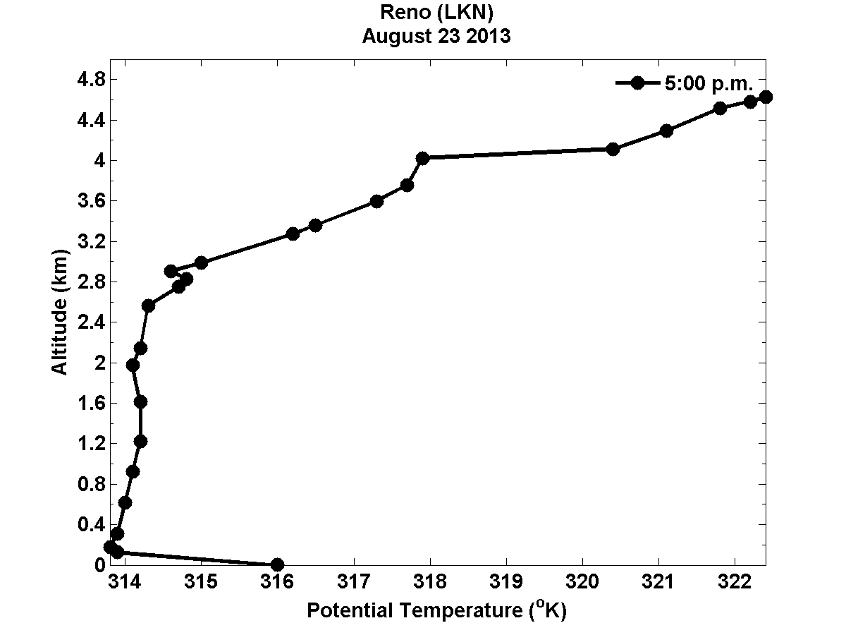
Planetary boundary layer
CBLH
5PM
Notes:
The transport physics of wildfire smoke plumes complicate the MODIS retrievals because the smoke plumes can travel at ground level or aloft with limited downward mixing to the surface. This transport is investigated using the planetary boundary layer height and the apparent optical height to characterize the extent of vertical mixing of the aerosol

Slide 17
Planetary boundary layer
CBLH
5PM
Vertical potential temperature gradient method [Stull, 1988]
The height at which the potential temperature exceeds the surface potential temperature by 1.5 K [Holzworth, 1964; Seibert et al., 2000]
The bulk Richardson number (RB~0.2) [Stull, 1988]
Notes:
The transport physics of wildfire smoke plumes complicate the MODIS retrievals because the smoke plumes can travel at ground level or aloft with limited downward mixing to the surface. This transport is investigated using the planetary boundary layer height and the apparent optical height to characterize the extent of vertical mixing of the aerosol

Slide 18

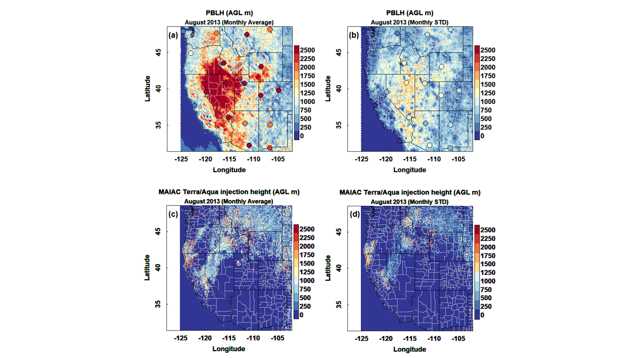
MAIAC Plume Injection Height and PBLH
Western U.S., August, 2013
Average PIH (m)
Average PBLH (m)
Loria-Salazar et al., (In-preparation)

Slide 19
MAIAC Plume Injection Height and PBLH
Western U.S., August, 2013
Average PIH (m)
Average PBLH (m)
Loria-Salazar et al., (In-preparation)

Slide 20
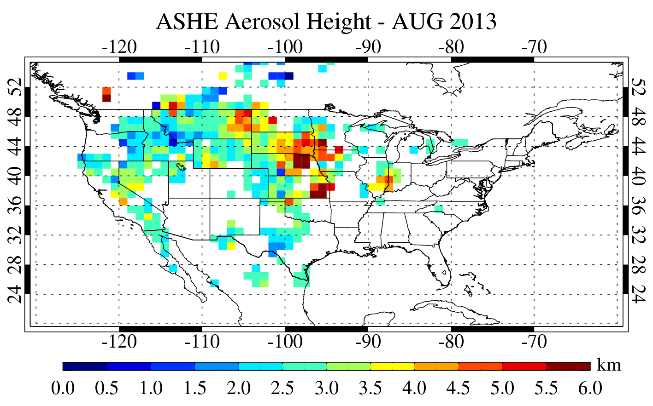
ASHE Plume Injection Height and PBLH
Western U.S., August, 2013
Average PBLH (m)
Loria-Salazar et al., (In-preparation)

Slide 21
HYSPLIT Back Trajectories: 31 Aug 2013
24 hour, NAM 12-km
Reno
Reno:
100m & 2000m near plume
Fresno:
4000m & 5000m near plume
100m & 200m west of plume, clean air
Fresno
Loria-Salazar et al., 2015 (CMAS 2015)
Loria-Salazar et al., (In-preparation)
Notes:
The boundary layer physics and smoke transport can be investigated using backward air mass trajectories from the Hybrid Single Particle Lagrangian Trajectory (HySplit) model. In Figure 4 (right), the HySplit model trajectories are overlaid on the visible satellite image from MODIS. The visible image shows a smoke plume over Fresno on Aug. 31st 2013, however based on the data sown in the time series plot of AOD and PM2.5 it is evident that the plume does not reach ground level (i.e., AOD increases while surface PM2.5 is not elevated). The plume transport physics can be further investigated by looking at the heights of the HySplit trajectories.
The two trajectories from Fresno that pass over the smoke plume are at 4km and 5km, above the PBL height therefore the smoke plume is not mixed down to surface level. It is important to investigate both the complex smoke plume physics and emissions inventory uncertainties to improve the modeling for smoke plume transport and surface air quality prediction related to wildfire smoke emissions.

Slide 22
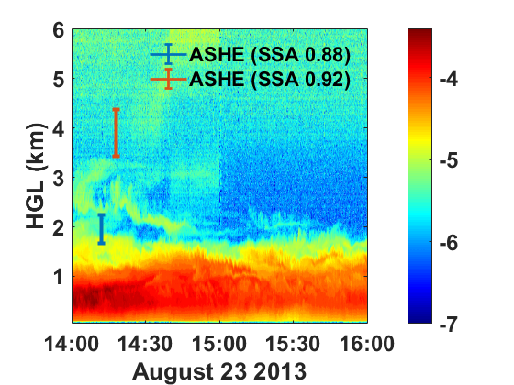
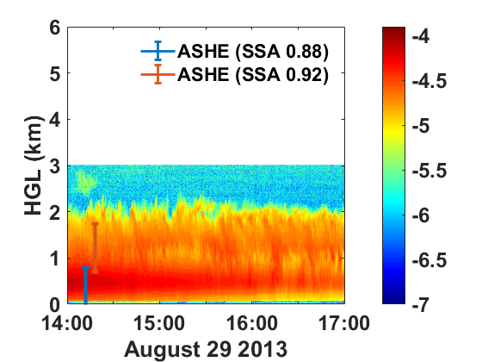
ASHE Plume Injection Height and
LIDAR data
Yosemite Rim Fire, August, 2013
Dodge Ridge Ski Resort
38.2 N and -119.97 W
2010 m (ASL)
Donnell Vista
38.5 N and -119.93 W
1922 m (ASL)
Log r (m⁻¹ sr⁻¹)
Log r (m⁻¹ sr⁻¹)
Loria-Salazar et al., (In-preparation)

Slide 23


Summary
Objective
1. Evaluate aerosol satellite retrievals during fires and non-fire periods using new NASA Deep-Blue Collection 6.1 and MAIAC algorithms
DB retrievals is able to estimate 63% of AOD in C6
Surface reflectance cause high AOD values
Fire detection improvement in DB from C6 to C6.1
MAIAC and C6.1 correlates with AERONET (r²~0.7)
MAIAC shows limitations during fire periods
Hypotheses
Improvement on fire detection on the new Collection 6.1 Deep-Blue
MAIAC AOD evaluation performs better than Deep-Blue Collection 6.1
Notes:
However, the semi-arid western U.S. continues to be an unproven and infrequently explored area for remotely sensed atmospheric aerosol pollution retrievals. The study of aerosol transport and optical properties in this area is a challenge due to the complex terrain, bright surfaces, presence of anthropogenic and biogenic emissions, secondary organic aerosol formation, smoke from wildfires, and low aerosol concentrations during non-fire conditions.
Previous studies have shown that MODIS retrievals failed to estimate column-integrated aerosol pollution levels and particle size over Nevada and California in the summer months of 2012 and 2013 due to high surface albedo, heterogeneous vertical profile of aerosol concentrations, and incorrect parameterizations for surface reflectance. MODIS algorithms overestimated AOD by more than a factor of 3 in Reno, NV and more than a factor of 2 over Fresno, CA.

Slide 24
Summary
Objective
1. Evaluate Plume Injection Height products from NASA ASHE and MAIAC algorithms against ground-based LIDAR during the Rim Fire
Both products show encouraging results!!! =)
Notes:
However, the semi-arid western U.S. continues to be an unproven and infrequently explored area for remotely sensed atmospheric aerosol pollution retrievals. The study of aerosol transport and optical properties in this area is a challenge due to the complex terrain, bright surfaces, presence of anthropogenic and biogenic emissions, secondary organic aerosol formation, smoke from wildfires, and low aerosol concentrations during non-fire conditions.
Previous studies have shown that MODIS retrievals failed to estimate column-integrated aerosol pollution levels and particle size over Nevada and California in the summer months of 2012 and 2013 due to high surface albedo, heterogeneous vertical profile of aerosol concentrations, and incorrect parameterizations for surface reflectance. MODIS algorithms overestimated AOD by more than a factor of 3 in Reno, NV and more than a factor of 2 over Fresno, CA.

Slide 25

Acknowledgments
Financial Support
NASA Earth and Science Student Fellowship (NNX16AN94H, PI: H. A. Holmes)
Nevada Space Grant Consortium – Research Infrastructure (PI: H. A. Holmes)
Yellowstone/UCAR
We would like to acknowledge high-performance computing support from Yellowstone (ark:/85065/d7wd3xhc) provided by NCAR's Computational and Information Systems Laboratory, sponsored by the National Science Foundation
NASA DB Mission
N. Christina Hsu, PhD
Andrew M. Sayer, PhD
Jaehwa Lee, PhD
NASA MAIAC Mission
Alexei Lyapustin, PhD

