Slide 1

Air quality, social vulnerability, and health of communities exposed to intense prescribed fire activity in the Southeastern U.S.
17th Annual CMAS Conference
Chapel Hill, NC
October 22, 2018
Sadia Afrin and Fernando Garcia Menendez
NC State University
Notes:
The title of my presentation is …
I need to mention about the co authors.

Slide 2
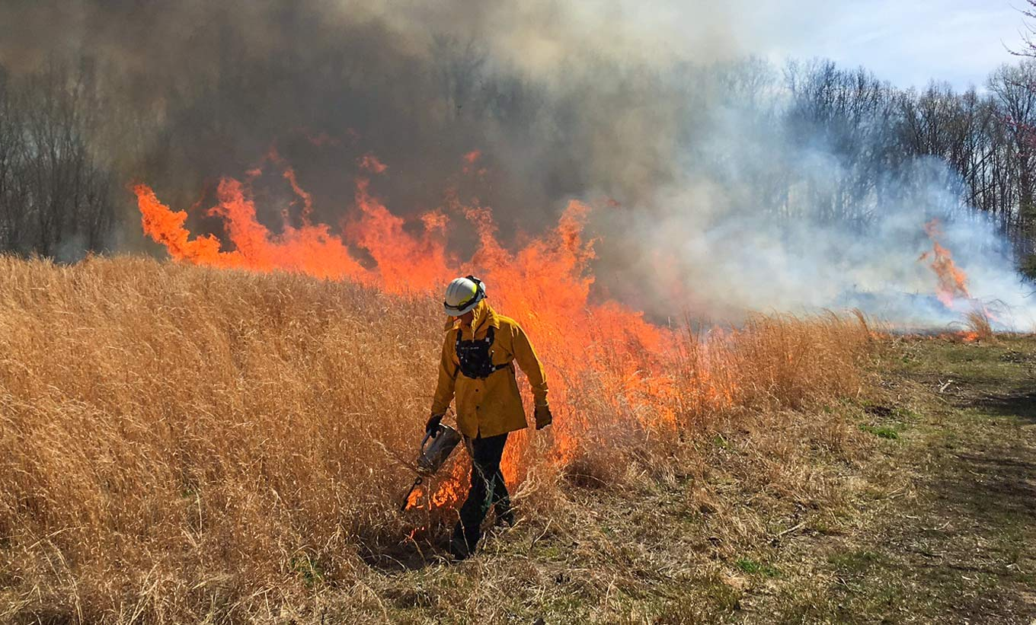
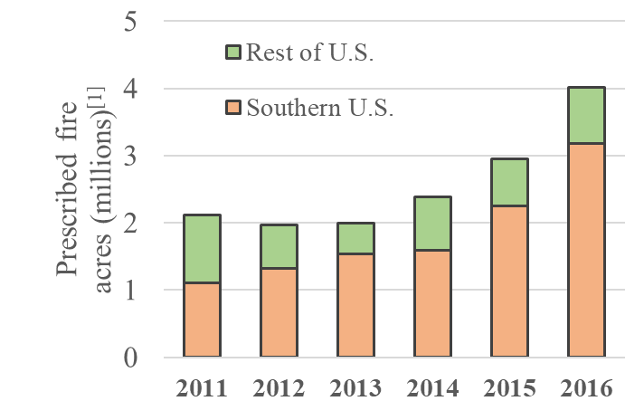
Prescribed fire in the Southeastern U.S
5
4
3
2
1
0
Rest of U.S.
Southeastern U.S.
Prescribed fire acres (millions) ^{[1]}
2011 2012 2013 2014 2015 2016
www.tva.gov
[1] National Interagency Coordination Center. 2016
About ½ of wildland fire PM_{2.5} emissions in the U.S. are released by prescribed fires (2014 NEI)
Most of the prescribed fire in the U.S. occurs in the Southeast.
According to 2014 NEI, ¼ of all PM_{2.5} emissions in Southeast are attributable to prescribed burning.
What is the impact of the largest PM_{2.5} emission source over the southeastern U.S. ?
We are using permit-derived prescribed fire data to explore the connections between prescribed fire, air quality and communities.

Slide 3
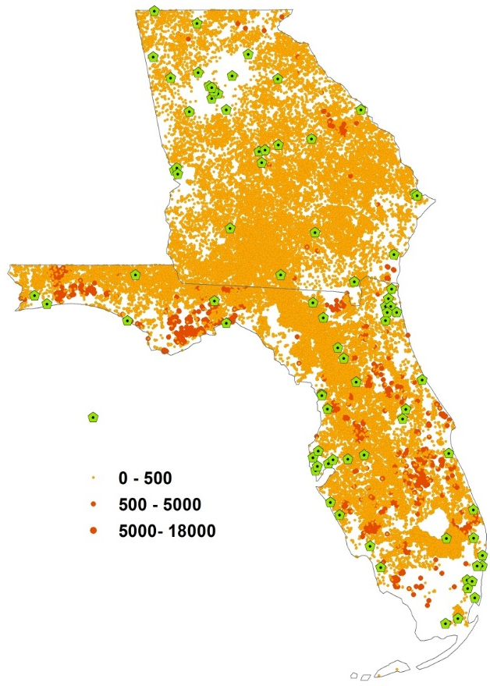
Influence of prescribed fire on PM_{2.5}
Can we see a prescribed burn permit signal in observed PM_{2.5} at the monitoring stations in the Southeast?
Correlation of daily acreage burned & PM_{2.5} at Albany
Albany
PCC
Air Stations
Insignificant
Permitted burn(Acres)
Acres (Millions)
Most (>90%) sites show a significant positive correlation (p<0.05) between 24-hr PM_{2.5} and prescribed burn permits.
For example, at Albany permits can explain as much as 50% of the variance in PM_{2.5} concentration from January to April.

Slide 4
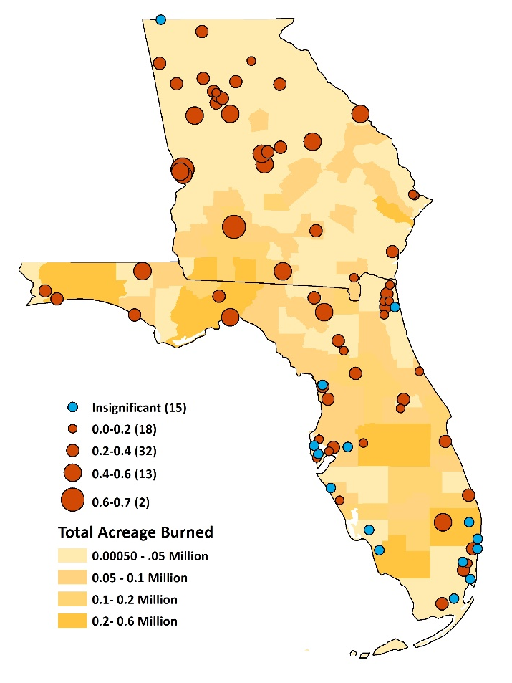
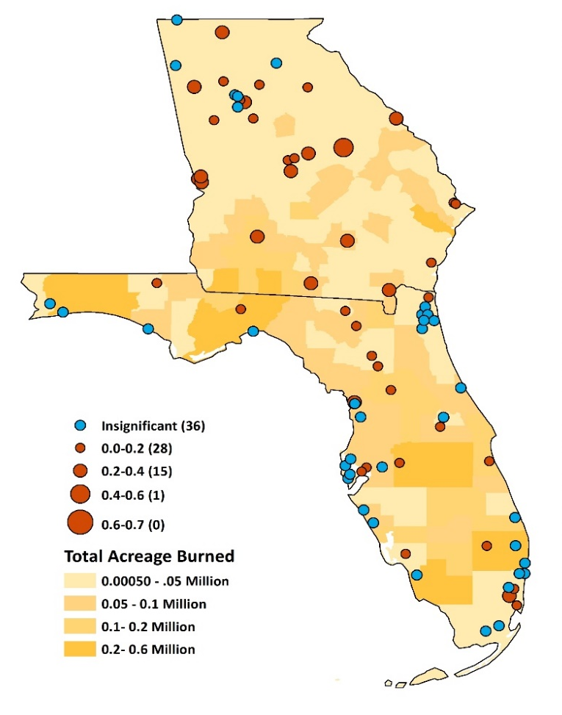
Permit-based and Satellite-derived fire data
How do the fire records compare?
24-h PM_{2.5} and permitted burn area
vs
24-h PM_{2.5} and satellite burn area
PCC
PCC
Most sites show a stronger correlation between PM_{2.5} and permitted prescribed fire.

Slide 5

Social vulnerability
What is the social vulnerability of the people living in the
burn intensive areas ?
SVI: Resilience of communities when confronted by external stresses on human health.
People with lower socio-economic status in neighborhoods showed a stronger association between PM_{2.5} and mortality ^{[1]}
CDC’s SVI
1
0
Less vulnerable
Highly vulnerable
2016 SVI, Center for Disease Control and Prevention (CDC)
Wang, Y., Shi, L., Lee, M., Liu, P., Di, Q., Zanobetti, A., and Schwartz, J.D. (2017). Long-term Exposure to PM2.5 and Mortality Among Older Adults in the Southeastern US. Epidemiology, 28(2):207–214.

Slide 6
Burn intensity and SVI
SVI
Burn intensity =
Acres burned/mi²
Tract-level burn intensity
CDC’s Tract-level SVI
People in burn intensive regions tend to be more socially vulnerable.
The average SVI (0.64) in the 10% Georgia tracts with the highest burn intensity is 33% higher than that in the rest of the state.
Average income is lower in tracts with high burn intensity.

Slide 7
Social vulnerability in burn-intensive areas
X
X
X
12 of 15 variables are higher for the burn-intensive regions (top 10% tracts) compared to rest.
The high percentage of people below poverty, with disability and age over 65 are the driving variables for high SVI in the burn intensive regions.

Slide 8
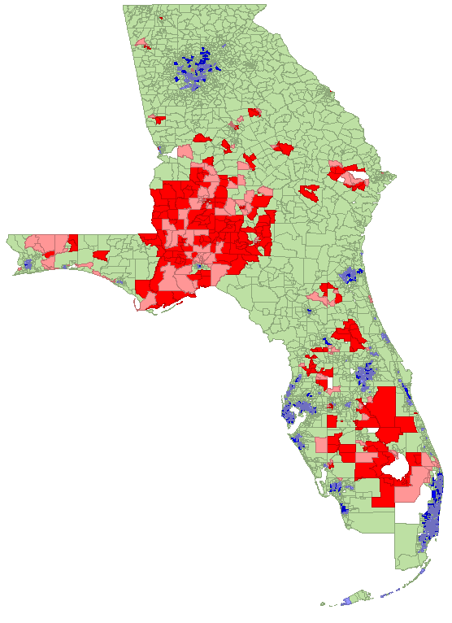
Spatial association between burn intensity and SVI
Is there any spatial association between burn intensity and SVI?
Local indicators of spatial association (LISA):
Approximately 15% of the total area in Georgia and Florida has spatial clustering of high social vulnerability and high burn intensity (i.e., “hot spots”).
Hot spots are concentrated in Southwestern Georgia, Northwest Florida and Southcentral Florida.
Bivariate LISA Cluster Map
HighSVI_HighBI (Hot spots)
LowSVI_HighBI
HighSVI_LowBI
LowSVI_LowBI (Cold spots)
Insignificant

Slide 9
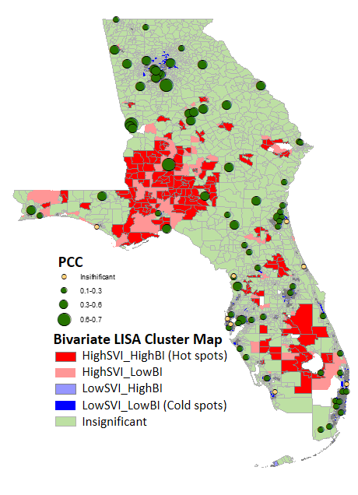
Burn intensity, SVI and air quality
Stations within or near hot spots have higher influence of prescribed burning on PM_{2.5} concentrations.
Air monitoring stations are scarce around these hotspots.
Albany
Bivariate LISA Cluster Map
HighSVI_HighBI (Hot spots)
LowSVI_HighBI
HighSVI_LowBI
LowSVI_LowBI (Cold spots)
Insignificant

Slide 10
Prescribed fire impacts on air quality and health
What is the prescribed fire associated health impacts in the
burn intensive areas ?
Reduced form air quality model: CO-Benefits Risk Assessment (COBRA) Health Impacts Screening and Mapping Tool
Source-receptor matrix
Concentration response functions
Economic valuation
Changes in emissions
Changes in health impacts
Monetized impacts
Changes in PM_{2.5} concentration
Prescribed fire emissions:
2016 GA Environmental Protection Division (GAEPD16).
2014 EPA National Emission Inventory (NEI14)

Slide 11
Prescribed fire impacts on air quality and health
GAEPD16
NEI14
Hotspots
ΔPM_{2.5} (µg/m³)
0-1.0
1.0-2.0
2.0-3.0
3.0-4.0
4.0-4.8
Prescribed fire related annual ΔPM_{2.5}
Based on GAEPD16 permit-based emissions, the highest impacts of burning on PM_{2.5} occur in Southwest Georgia, with an increase of nearly 5 µg/m³ in annual-average concentration at Thomas County.
Impacts based on NEI14 differ significantly.
High burning-social vulnerability hotspots are exposed to larger fire-related PM_{2.5}.

Slide 12
Prescribed fire impacts in Georgia
Approximate projected impacts | Emission inventory |  | Epidemiological study
 | GAEPD16 | NEI14
Adult Mortality (>30yr) | 290 | 310 | Krewski et al. (2009)
Adult Mortality (>25yr) | 660 | 710 | Lepeule et al. (2012)
Older adult Mortality (>65yr) | 770 | 780 | Wang et al. (2017)^{[1]}
Upper Respiratory Symptoms | 8,300 | 9,200 | Pope et al. (1991)
Lower Respiratory Symptoms | 5,700 | 6,400 | Schwartz and Neas (2000)
Asthma Exacerbation | 8,500 | 9,500 | Mar et al. (2004), Ostro et al. (2001)
Minor Restricted Activity Days | 22,000 | 244,000 | Ostro and Rothschild (1989)
Work Loss Days | 36,400 | 41,000 | Ostro (1987)
Based on COBRA projections, 290 (Krewski et al. 2009) to 660 (Lepeule et al. 2012) adult deaths in Georgia were attributable to prescribed fire emissions in 2016 recorded in the GAEPD16 inventory.
Using Wang et al. 2017 (> 65 years) , 2016 prescribed fires were associated with 770 older adult deaths, which is 1.5% of the all-cause mortality for older adults.
In Thomas county – a high burn intensity and social vulnerability hotspot – this fire-related increase in older adult mortality is equivalent to ~10% of the all-cause mortality among older adults.
Wang, Y., Shi, L., Lee, M., Liu, P., Di, Q., Zanobetti, A., and Schwartz, J.D. (2017). Long-term Exposure to PM_{2.5} and Mortality Among Older Adults in the Southeastern US. Epidemiology, 28(2):207–214.

Slide 13
Prescribed fire health impacts in Georgia
Adult (>65yr) mortality rate
Adult (>25yr) mortality rate
Incidence/Million
0-200
200-400
400-600
600-735
GAEPD16
NEI14
GAEPD16
NEI14
Respiratory symptoms rate
Asthma exacerbation rate
Incidence/Million
0-2000
2000-4000
4000-6000
6000-8000
8000-11000
1.1 % of the county population
GAEPD16
NEI14
GAEPD16
NEI14
Based on NEI14, the largest impact of prescribed fire on asthma, respiratory symptoms and older adult mortality rates occur in Jones county.
Based on GAEPD16 emission, the largest impact of prescribed fire on asthma, respiratory symptoms and adult mortality rates is in Thomas county.

Slide 14
Health impacts of prescribed fire compared to other sectors
Approximate health impacts in Georgia projected for a 10% emissions reduction by sector
Reduction in incidents
Reduction in incidents
Prescribed fire emission reductions have a larger impact on adult mortality than reductions to industrial combustion and highway vehicle emissions across Georgia.
A 10% reduction in prescribed burning emissions also has a comparable impact on respiratory symptoms and asthma exacerbation than equivalent reductions to industrial combustion and highway vehicle emissions.

Slide 15
Conclusions
Prescribed fire has a significant influence on PM_{2.5} concentrations at multiple locations in the Southeast.
The correlation is stronger with the permit-based burn areas than with burn areas derived from satellite detections.
Burn-intensive tracts tend to have more socially vulnerable populations.
Spatial clusters of high burn intensity and high social vulnerability are concentrated in Southwestern Georgia, Northwest Florida and Southcentral Florida.
The potential health impacts associated with prescribe fire emissions in Georgia are significant, especially near burning-social vulnerability hot spots, and are comparable to larger to those attributable to other major emissions sources.

Slide 16
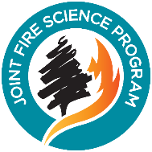
Thank you
Sadia Afrin
safrin@ncsu.edu
We acknowledge funding from the Joint Fire Science Program under Project JFSP 16-1-08-1

