Slide 1
Improving the Vertical Distribution of Fire Emissions in CMAQ
Joseph L. Wilkins¹,
George Pouliot¹, Thomas Pierce¹, Robert Gilliam¹, Jeff Vukovich², Hyun Deok Choi³, Amber Soja³
¹Office of Research and Development, National Exposure Research Laboratory, U.S. Environmental Protection Agency, Research Triangle Park, NC, USA
²Office of Air Quality Planning and Standards, air Quality Assessment Division, U.S. Environmental Protection Agency, Research Triangle Park, NC, USA
³National Institute of Aerospace, NASA-Langley, Hampton, VA, USA
17th Annual CMAS Conference
Oct. 22-24, 2018
Chapel Hill, NC
Office of Research and Development
Computational Exposure Division, National Exposure Research Laboratory

Slide 2
Plume Rise Introduction
Wildfires globally - 300 M ha yr⁻¹ and 300k deaths yr⁻¹
Wildfires in US - 2 M ha yr⁻¹ and 5-8k deaths yr⁻¹
Injection height determines transport distance
Transport distance determines exposure
Highly dependent on wind, temperature, layer stability, heat from source (buoyancy)
Plume rise review in Paugam et al., 2016 ACP
Notes:
The classification of a fire within the inventory
WF (~2 M ha per year) + Rx (~5 M ha per year),
Ag burning set to layer 1 (~20 m). Zoplitz et al. in press
Fire energetics can be poorly characterized
The traditional approach of injecting all cropland burning emissions into the surface layer does not realistically represent vertical plume structure.
Zhou et al., 2018 STE
Flaming/smoldering and residual smoldering emissions
Current plume rise algorithms put 2-9% of PM_{2.5} and VOC emissions from wildland fires in layer 1. Jeff V

Slide 3
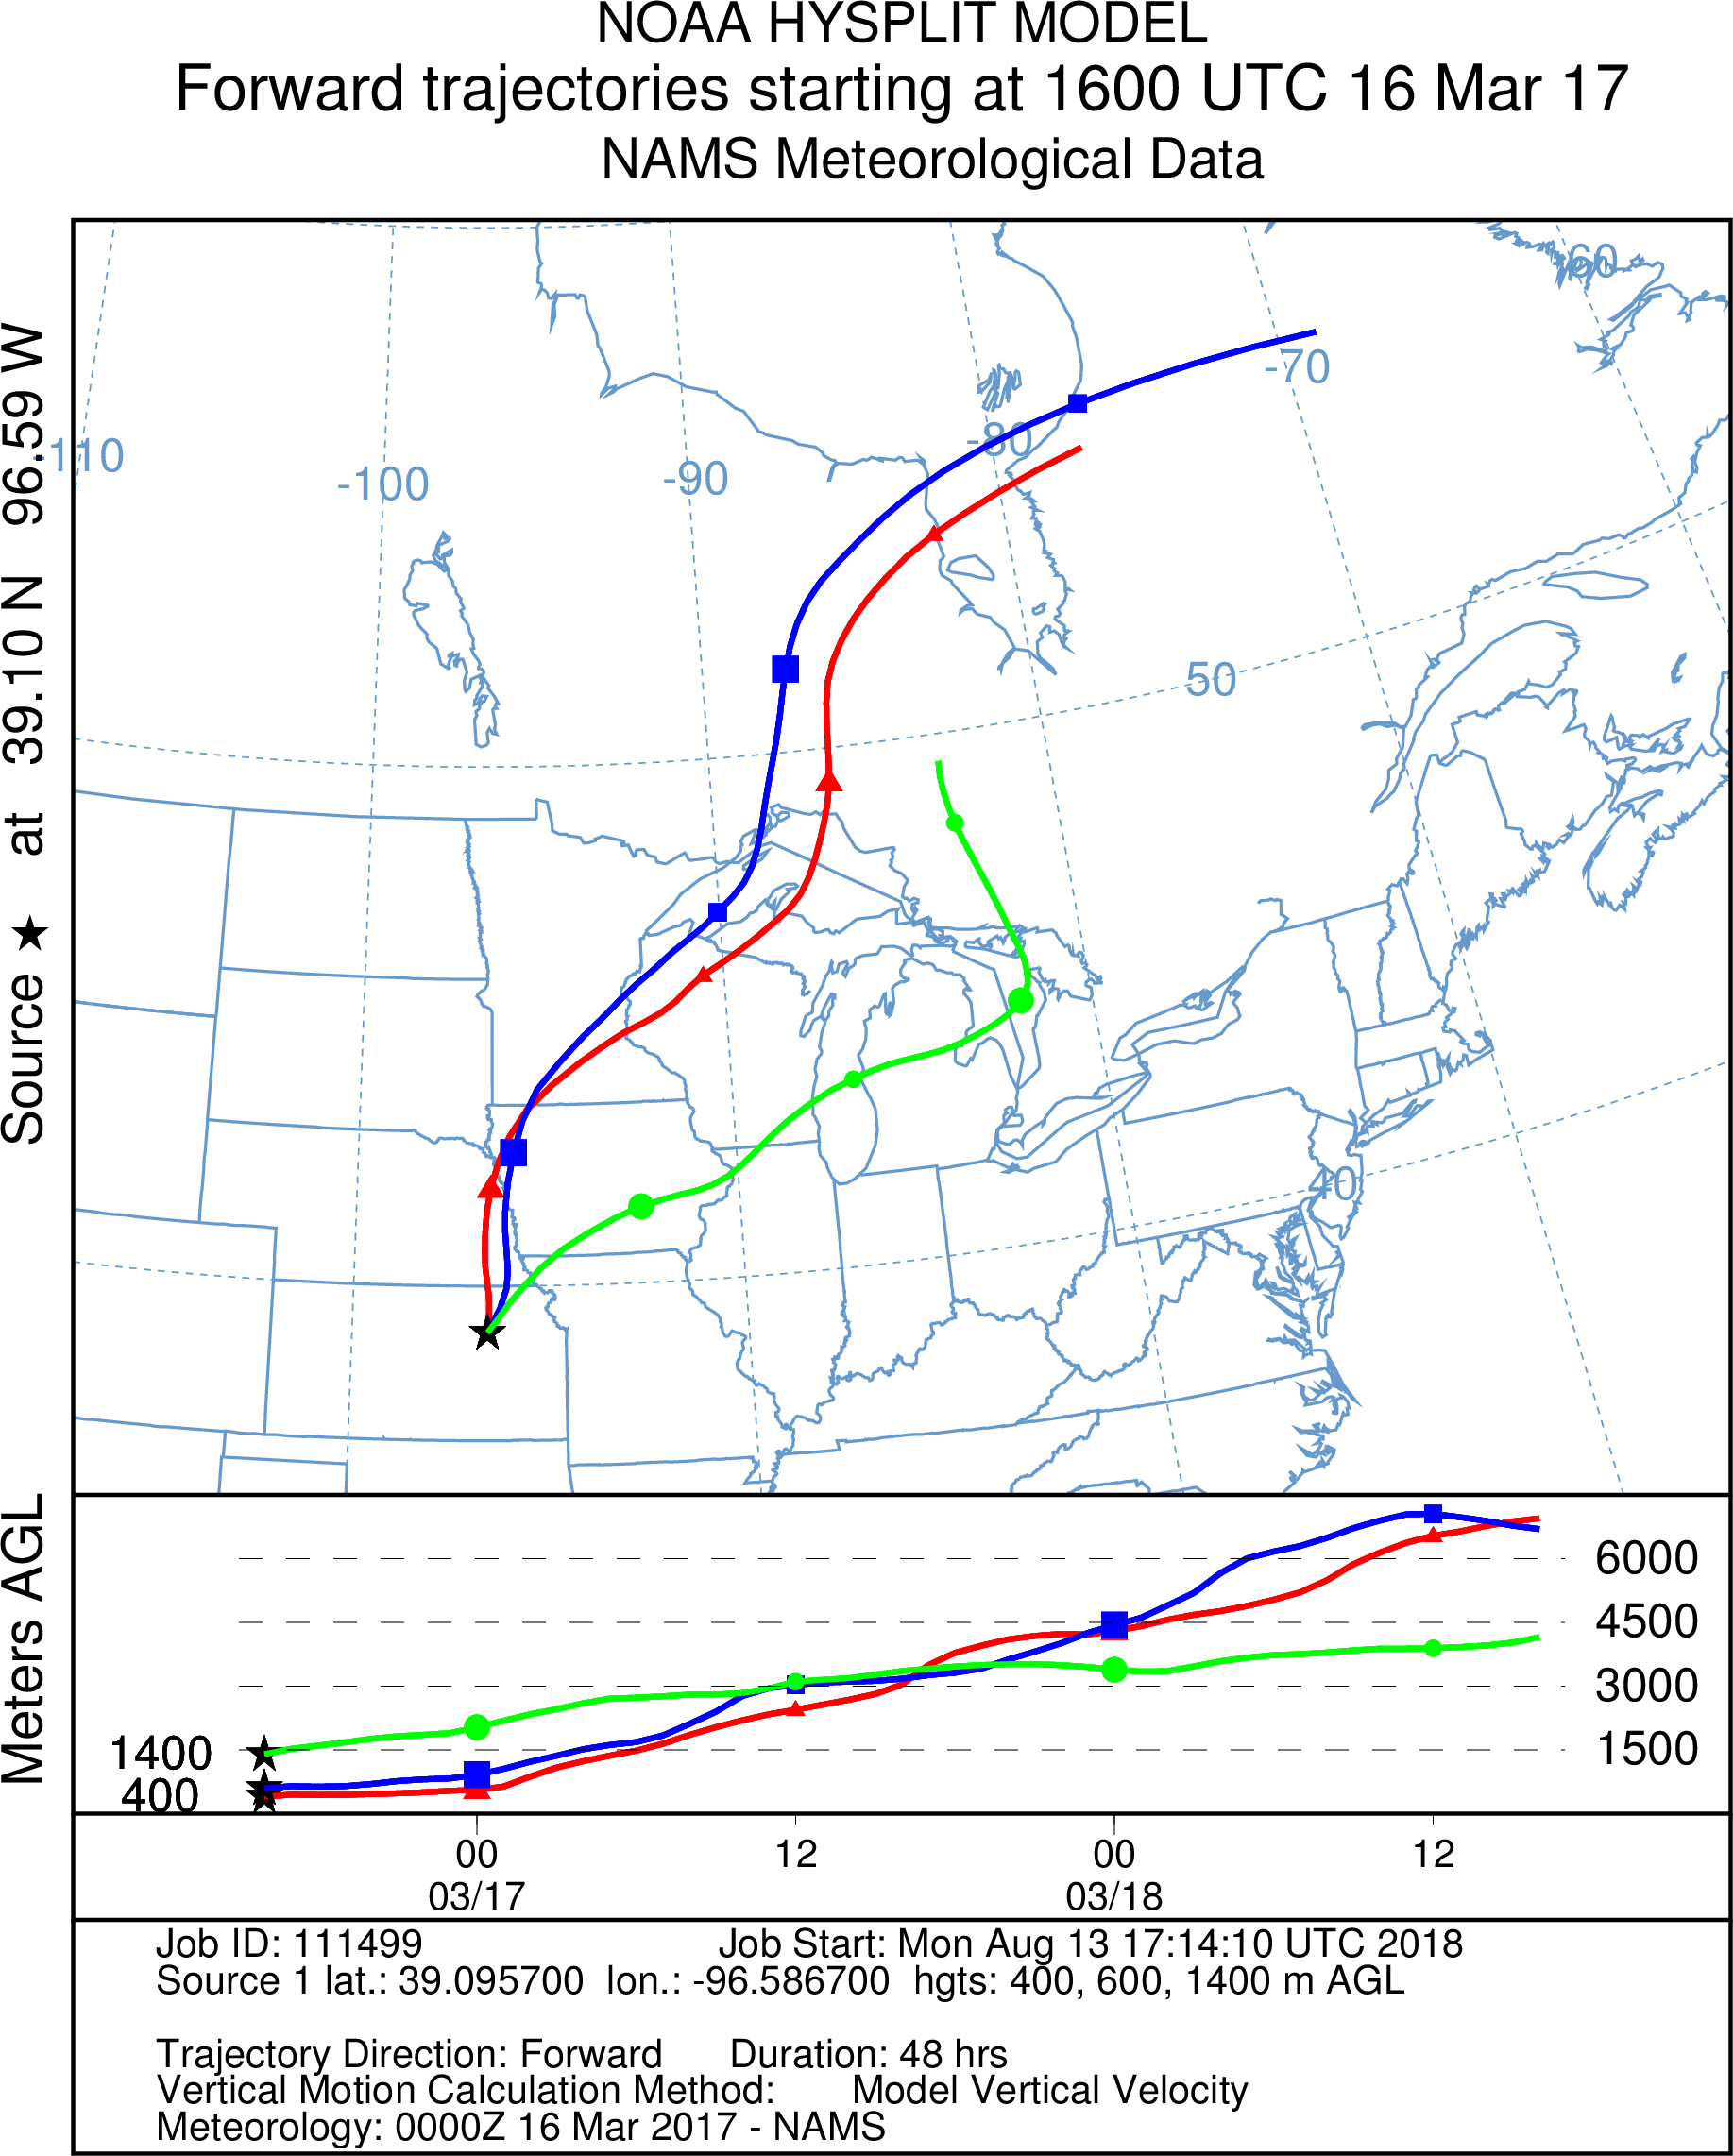
Factors for Models and Plume Rise
When a plume rise algorithm is employed
results can vary from model to model due to inputs
Summary of issues listed
in Wilkins et al., 2018 IJWF
Fire classification/detection
Active stage (flaming or smoldering)
Thermodynamic profile
Portion of smoke injected above vs within the PBL
Lack of plume rise validation data
(field/remote sensing)
Regional scale modeling
Example Flint Hills 16 March 2017
boundary layer height importance
Above PBL – Green
Below PBL – Red & Blue
NOTE: Model run and figure generated using on-line NOAA Air Resources Laboratory HYSPLIT model (Rolph, 2003).
Notes:
the model still exhibits a low bias at higher observed concentrations and a high bias at lower observed
concentrations
Performance is situational and can be moderate to poor¹;
Therefore, we consider other factors outside of performance
Ease of implementation
availability and reliability of input parameters
Supplement current weaknesses
Algorithm comparison to available observations
No current strong quantitative agreement with remote sensing (sat/lidar) and model-based estimates of plume heights
- Most validated using MISR
Furthermore, the degree of
improvement given by actually including plume rise parameterizations
in atmospheric chemistry transport models can
be difficult to interpret due to the complex interactions with
other atmospheric processes Chen et al. (2009).
Fire-induced up-draft on wildfire plume lofting appears, in general, to remain rather poorly understood and often weakly represented in current large-scale atmospheric modelling efforts
Parameter dependency
Portion of smoke injected above vs within the PBL
Fire classification/detection
Lack of plume rise validation data
(field/remote sensing)
Impact of fire-induced updraft on atmospheric thermodynamics
Active stage (Flaming or smoldering)
Characterization of fire energetics

Slide 4
Plume Rise Methods
Method | Briggs | Sofiev
Description | Designed for smoke stacks Plume tops based on Stability of layer Plume bottom (2/3 method) | Designed based on MISR Plume heights for wildfires Two–stage method Determines plume top only
Parameters | burned area fire location coordinates fuel loading wind speed duration of fire heat content | PBL height fire location coordinates potential temperature fire radiative power heat flux Brunt-Väisälä frequency
References | Pouliot et al., 2005 | Sofiev et al., 2012
For additional methods see Val martin et al., 2012 JGR
Notes:
M0 – Current Briggs implementation
(Pouliot et al., 2005)
M1 – Current Briggs with emissions only during active burning phase
(Zhou et al., 2018)
M2 – The energy-balance parameterization
(Sofiev et al., 2012)
M3 – Statistical assumption that the plume height likely will be PBL+500 m
“2/3 law” dependence of stack plume height on termination distance based on analysis of data from 16 types of sources/stacks; modified for wild fire by Pouliot et al. (2005);
fire-size dependence based on WRAP-FEJF
Energy-balance-based parameterization (similar to convective cloud formulations) accounting for planetary boundary layer (PBL) mixing, power law dependence of fire intensity, and stability in free troposphere, with 4 fitted tunable parameters to match observed plume heights by MISR

Slide 5
Plume Rise Methods
Method | Briggs | Sofiev
Pros | Already included in CMAQ/SMOKE Used for wildland fires and anthropogenic combustion sources | Does not require info on wind/fuels Energy balance based on fire energetics Tested against satellites
Cons | Designed for smoke stacks Buoyancy flux does not scale well for fires Requires info on wind/fuels | Tuned parameters (MISR) Original tuning learning data set all < 4 km
References | Pouliot et al., 2005 | Sofiev et al., 2012
Neither method can handle individual fire cores
Notes:
“2/3 law” dependence of stack plume height on termination distance based on analysis of data from 16 types of sources/stacks; modified for wild fire by Pouliot et al. (2005);
fire-size dependence based on WRAP-FEJF
Energy-balance-based parameterization (similar to convective cloud formulations) accounting for planetary boundary layer (PBL) mixing, power law dependence of fire intensity, and stability in free troposphere, with 4 fitted tunable parameters to match observed plume heights by MISR
You may get push back from the audience that not using vertical wind/stability info is a pro for using the Sofiev algorithm. Maybe you can note that not using vertical wind/temperature info removes some uncertainty ... but in my view our ability to predict atmospheric thermodynamics (absence local fire heat/moisture effects) is actually pretty good all things considered.
Sofiev limitations: algorithm configuration based on fire energetics, plume height is proportional to FRP/Heat flux (fires diurnal profile) and heavily dependent on reliability of inputs.
Briggs limitations: heat flux from fires does not behave like heat flux from smoke stacks, dependent on wind and stability layers.

Slide 6
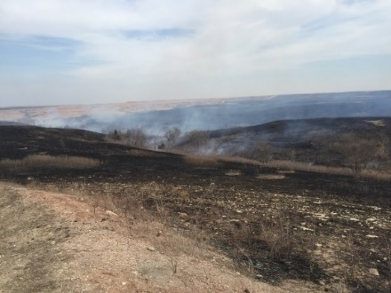
Case study Plume rise algorithms
Test performance of a new algorithm;
from a variety of algorithms and science approaches
M0 – Current Briggs implementation
(Pouliot et al., 2005)
M1 – Current Briggs with emissions only during active burning phase
(Zhou et al., 2018)
M2 – The energy-balance parameterization
(Sofiev et al., 2012)
M3 – Statistical assumption that the plume height likely will be PBL+500 m
Prescribed Burn Flint Hills, Kansas Mar. 2017
Note: M1 and M3 are adaptations of M0 and will only be applied to Rx,
Similar method of distribution for emissions below calculated plume top
Notes:
PPRM- explicitly simulate the process of plume convection due to buoyancy, entrainment from the ambient environment, and water phase changes in the plume. First law of thermos. Similar to convective cloud
Briggs industrial stack (stack height and termination distance) incorporates
WRAP-FEJF empirical approach, set of equations and look up table “ expert opinon” fire size and dynamics based on time of day
S12- energy balance parameterization – convective cloud, accounting for stab, fire intensity, and pbl.
Moderate to poor: Therefore, factors other than performance, such as cost of implementation, theoretical basis, and availability and reliability of input parameters, need to be considered.

Slide 7
Case Studies
Episode | Prescribed fire | Wild fire
Location | Konza Prarie Biological Station in Flint Hills, Kansas | Stanislaus National Forest in California
Date | Mar. 15-20, 2017 | Aug. 17- Nov. 4, 2013
Acres burned | 1500 | 257,314
Image
References | Wilkins et al., in prep | Peterson et al., 2014 BAMS

Slide 8
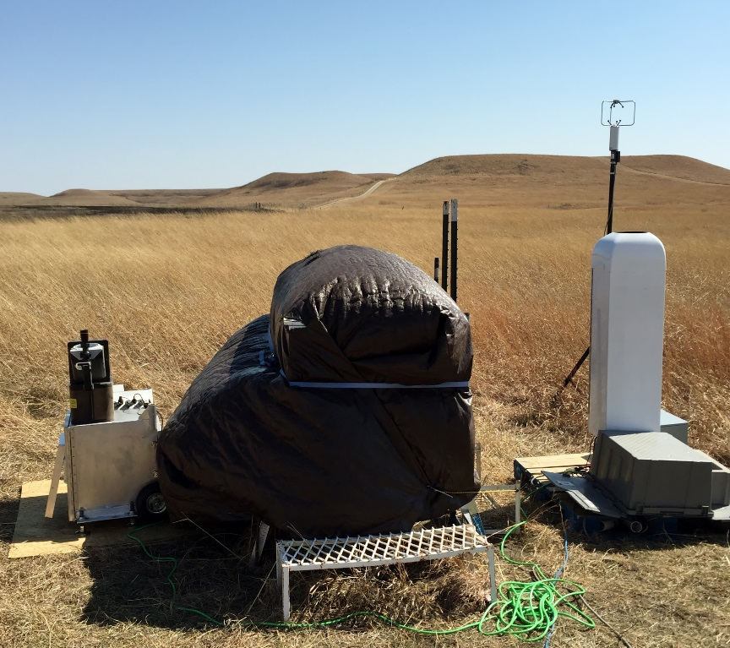
Konza Prairie Biological Station Prescribed Burn Experiment - Mar. 2017
Purposes of the study: 1. Capture fire smoke plumes 2. Study the PBL height.
 | Sigma Space MiniMPL | Vaisala CL51
Range resolution | 30 m | 10 m
Minimum range | 150 m | 5 m
Accumulation time | 1 sec – 15 min | 6-160 s
Detection range | Up to 10 km | Up to 15 km
Scanning | Yes | Vertical or 12˚ titled
Laser wavelength | 532 nm | 910 nm

Slide 9
The Community Multiscale Air Quality (CMAQ) Modeling System
Simulation
2013 AUG / 2017 Mar
CMAQv5.0.2
12km resolution
SMOKE version 3.1
2013/2017 BlueSky &
SMARTFIREv2 emissions
Weather Research and Forecasting Model (WRF) version 3.4
35 vertical layers

Slide 10
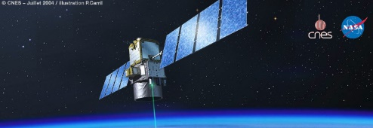
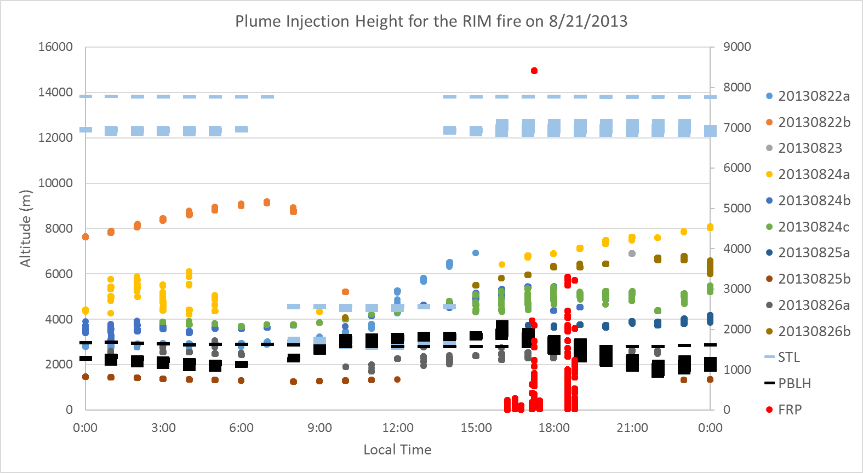
Cloud-Aerosol Lidar with Orthogonal Polarization (CALIOP) aboard the CALIPSO satellite
Variables associated with air parcel and MODIS fire detection coincidence (at smoke plume height)
CALIOP curtains are used with GEOS-5 back trajectories to associate aerosol layers with fire origins
derived parameters
stable layers (STL)
plume heights (dots)
boundary layer (PBLH)
The Goddard Earth Observing System Model, Version 5 (GEOS-5) is documented in Rienecker et al. (2008).
Notes:
SAY CALIOP derived not observation…

Slide 11
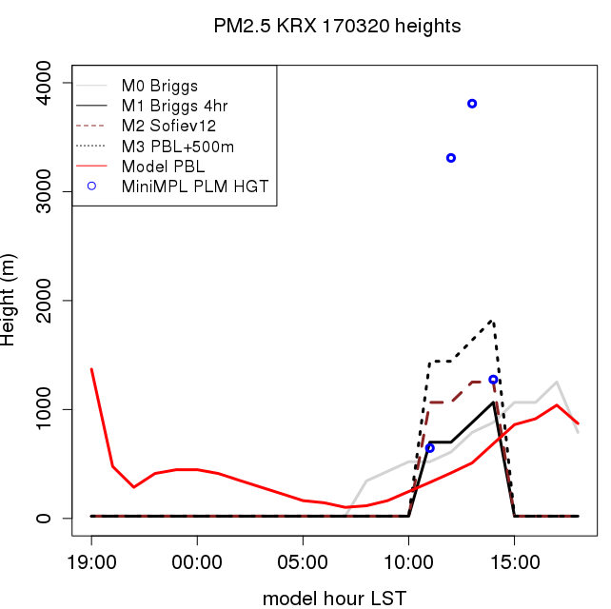
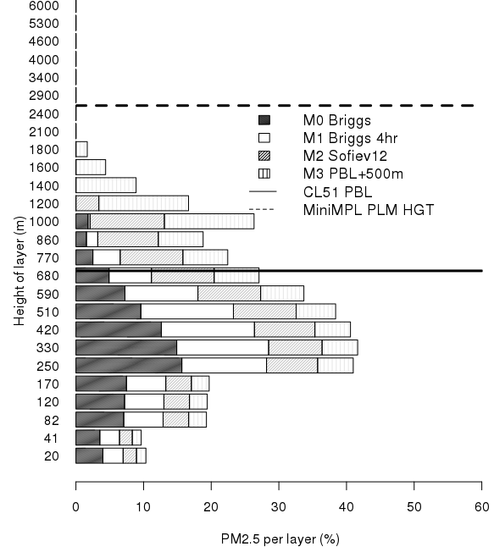
Prescribed Burn 20 March 2017
CMAQ-Briggs is biased low and misses observed plume height,
with only 6% of the emissions exceeding the observed PBL
compared to 30% (Sofiev) and 50% (PBL+500)
~1000 acres
in 4 hrs
Height (m)
Height (m)
Model Hour (LST)
PM_{2.5} per layer (%)
Notes:
Briggs improves with time allocation for small fires
Sofeiv performs better for small fires cases, or plume heights under 4km
Pbl+500 would work if the fire energectics are not strong enough to penetrate that stable boundary layer.
Briggs emissions are mostly within the pbl while in this case more should be above.

Slide 12
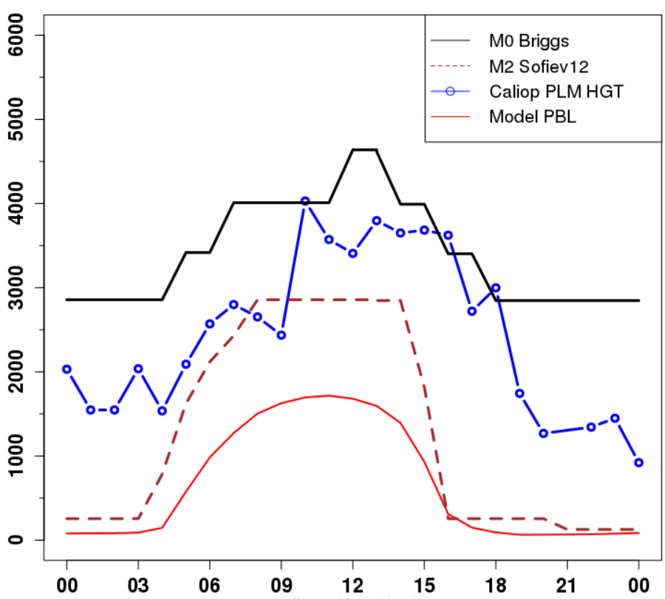
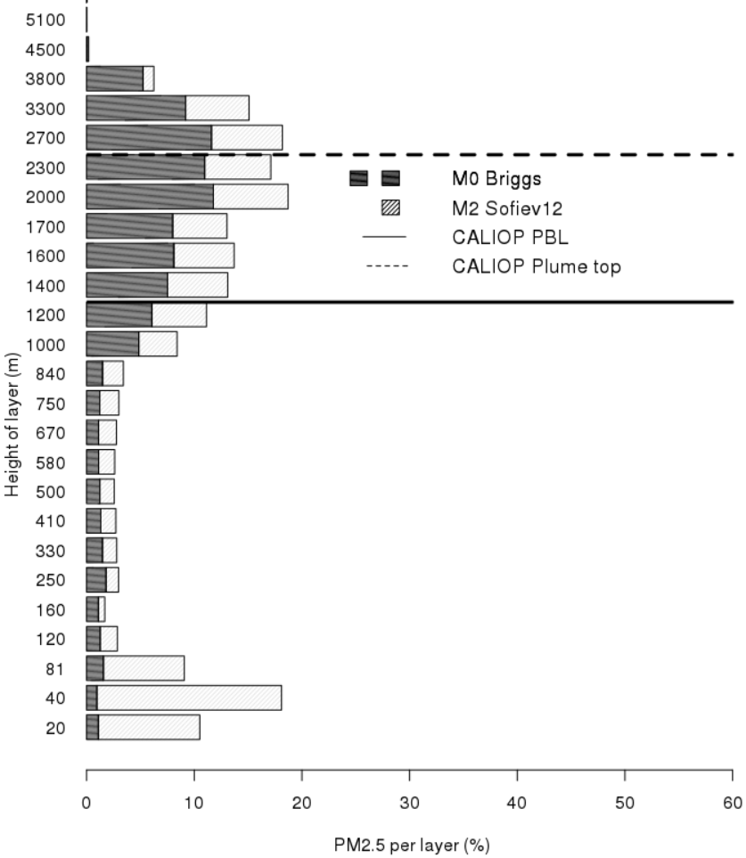
Wildfire Episode 24 August 2013
CMAQ-Briggs biased high, but captures observed plume pattern.
Uniform plume pattern above PBL, with nighttime elevated plume heights
Night time differences
Height (m)
Height (m)
PM_{2.5} per layer (%)
Model Hour (LST)
Notes:
Nighttime briggs is over estimating plume rise, or at least its height is not supported by the other methods.
Sofeiv is not able to handle the heights over 4km as it was not originally designed to do so.
The derived heights pattern is closer to briggs, indicating that briggs performs better for wildfire then sofiev.
Sofiev patter based on heat flux is near zero at night, however if ingesting FRP from satellite, Sofeiv would place the plume near 2000m still under where briggs places it.

Slide 13
Prescribed Burn Model Bias March 2017
Model bias
Briggs M0 (& M1) +/-
High =
0%
Good =
80%
Low =
20%
Model bias
Sofiev +/-
PBL500 +
High =
0% (70%)
Good = 80% (10%)
Low =
20% (20%)
High
Good
Model Plume Height (m)
Low
MiniMPL Plume height (m)
Notes:
Bias nearly the same, however, duration of the burn does play a major factor with prescribed burns. More data points and other fields needed.
Also, it indicates that a plume rise should be included for a small burn, as these injection heights would be missed.
This is more of a detection issue, and temporal allocation issue.
This could explain why emissions from small fires are biased high.

Slide 14
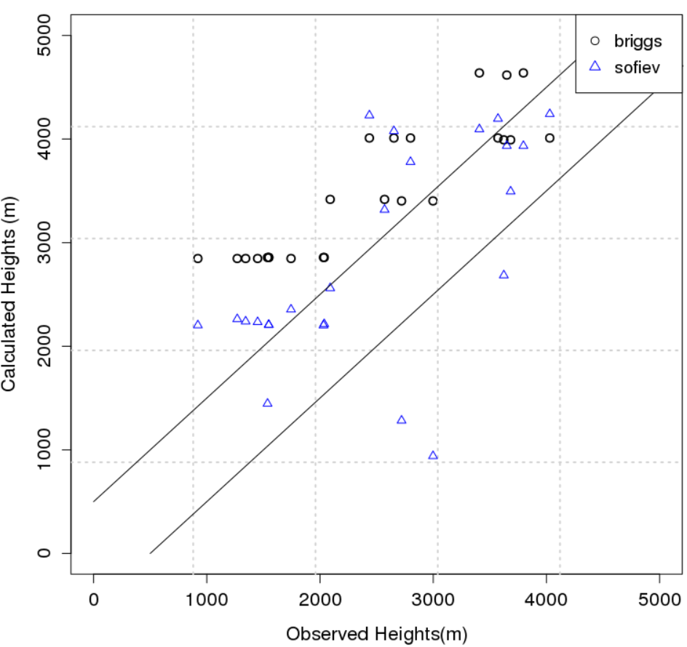
Wildfire Episode Model Bias August 2013
Model bias
Briggs +
High =
73%
Good =
27%
Low =
0%
Model bias
Sofiev +
High =
50%
Good =
36%
Low =
14%
High
Good
Model Plume Height (m)
Low
CALIOP Derived Heights (m)
Caliop derived Plume height (m)
Notes:
Briggs is biased high for wildfires, emissions probably placed too high esp at nighttime.
This probably explains why emissions from larger fires are biased low.
Sofeiv more closely matches Caliop, which we would expect.
Needs to be tested for multiple fires, against other data sets, e.g. airplanes, lidar, etc.

Slide 15
Preliminary Results
Wildfire episode
(CALIOP obs)
Prescribed burn
(MiniMPL obs)
Briggs performs well daytime while overestimating nighttime.
Sofiev perform well daytime with no plume tops nighttime.
Briggs vertical emissions biased low, improves with time allocation method
Sofiev performs better per hr compared to obs
Notes:
pbl heights talk to pliem about how the model does.
Fire energetics matter, but it appears the focus should switch to stability layers determination.
Fourthly, Brunt-V¨ais¨al¨a frequency is an external parameter
with regard to fire and varies strongly with altitude. Therefore,
the ratio Pf/N2 in Eq. (8) cannot be expected to stay as
a unique descriptor of the case. We shall consider these variables
separately. To avoid problems with N2 0 inside the
unstable ABL, we shall take its FT value N =Nft(z2Habl)
but allow for some part of the ABL passed “freely” by adding
a fraction of Habl to Hp. In addition, instead of N2
0
N2 we
shall use exp(−N2
N2
0 ), which for small N2 limits the Hp
growth by replacing N2
0
N2 with 1/(1+N2
N2
0 ). For large
N2 it quickly approaches zero, as one would expect for very
stable stratification.
Plumes with Sofeiv seems to be not capturing nighttime plume heights. In addition if the pbl height is low then sofeiv method is lacking in skill. More tweaking is needed.
It appears we need to adjust the parameters a bit. More dependence on FRP as oppose to the pbl measurements. Upsilon <= pbl to .49 and > pbl
compare CALIOP-based plume heights and pbl.
This, however, is the upper limit of Hp because additional
losses to friction and changing atmospheric and plume
parameters (e.g. gradual slowing down of the rise and faster than-
linear widening of the plume with height) will result in
a smaller power <0.5.

Slide 16
Remaining Issues in Fire Modeling
Specific problems
Proposed solutions
Plume rise
(as a function of fire size)
Fire burn time allocation
Smoldering/flaming
Improving inventories and input
Lack of validation
Sync definitions and improve inputs and observations (determine in what situation to use which inventory)
Determine time dependency of buoyancy
Update plume rise algorithm (ag burn vs Rx, smoldering vs flaming)
More targeted experiments (emission factors and dynamics)
Notes:
Impacts to human health is not part of the issue w/ fire modeling. We hope to inform those studies, but fire modeling is a technical issue not a human health assessment one.

Slide 17
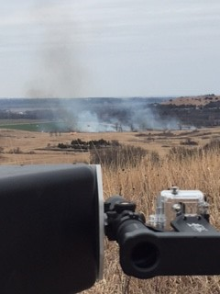
Acknowledgments
We would like to thank Shawn Roselle, Wyat Appel, Luxi Zhou, Kristen Foley, Shannon Koplitz, Kirk Baker, Tanya Spero, and Patrick Campbell for their valuable contributions and comments. We would like to thank CSRA for their assistance with conducting model simulations.
The views expressed in this article are those of the authors and do not necessarily represent the views or policies of the U.S. EPA.
Disclaimer
The views expressed in this presentation are those of the authors and do not necessarily reflect the views or policies of the U.S. EPA

Slide 18
Available plume rise algorithms
Performance is situational and can be moderate to poor¹;
Therefore, we consider other factors outside of performance
Ease of implementation
availability and reliability of input parameters
Supplement current weaknesses
Algorithm comparison to available observations
Table from Val martin et al, 2012 JGR
¹Plume rise methods review Paugam et al, 2016 ACP
Notes:
PPRM- explicitly simulate the process of plume convection due to buoyancy, entrainment from the ambient environment, and water phase changes in the plume. First law of thermos. Similar to convective cloud
Briggs industrial stack (stack height and termination distance) incorporates
WRAP-FEJF empirical approach, set of equations and look up table “ expert opinon” fire size and dynamics based on time of day
S12- energy balance parameterization – convective cloud, accounting for stab, fire intensity, and pbl.
Moderate to poor: Therefore, factors other than performance, such as cost of implementation, theoretical basis, and availability and reliability of input parameters, need to be considered.

Slide 19
The Goddard Earth Observing System Model, Version 5 (GEOS-5)
The GEOS-5 systems are being developed to support NASA's earth science research in data analysis, observing system modeling and design, climate and weather prediction, and basic research.
Simulation for Rim Fire
2013 AUG
12km resolution
Earth System Modeling Framework
72 vertical layers
The GEOS-5 ADAS is documented in Rienecker et al. (2008).

Slide 20
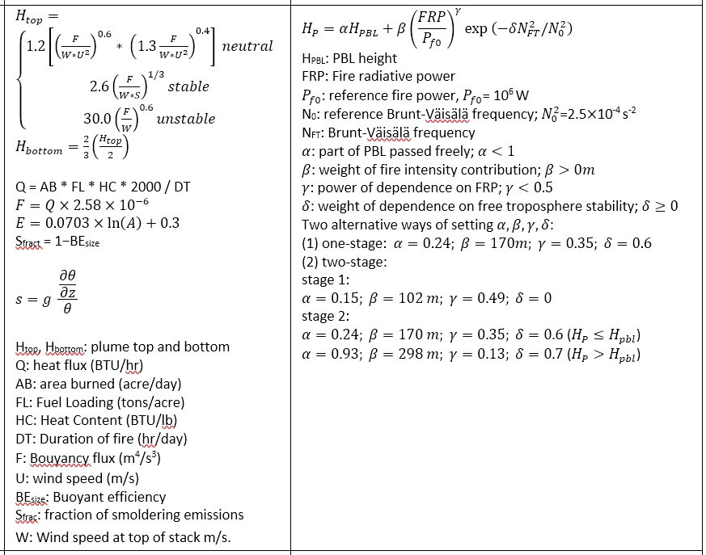
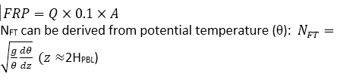
plume rise methods
Briggs
Sofiev
Simulation
2013 AUG
CMAQv5.0.2 12km
“SMOKE” version 3.1
2008-2012 BlueSky & SMARTFIREv2 emissions
Weather Research and Forecast Model (WRF) version 3.4
35 vertical layers
Notes:
“2/3 law” dependence of stack plume height on termination distance based on analysis of data from 16 types of sources/stacks; modified for wild fire by Pouliot et al. (2005);
fire-size dependence based on WRAP-FEJF
Energy-balance-based parameterization (similar to convective cloud formulations) accounting for planetary boundary layer (PBL) mixing, power law dependence of fire intensity, and stability in free troposphere, with 4 fitted tunable parameters to match observed plume heights by MISR

Slide 21
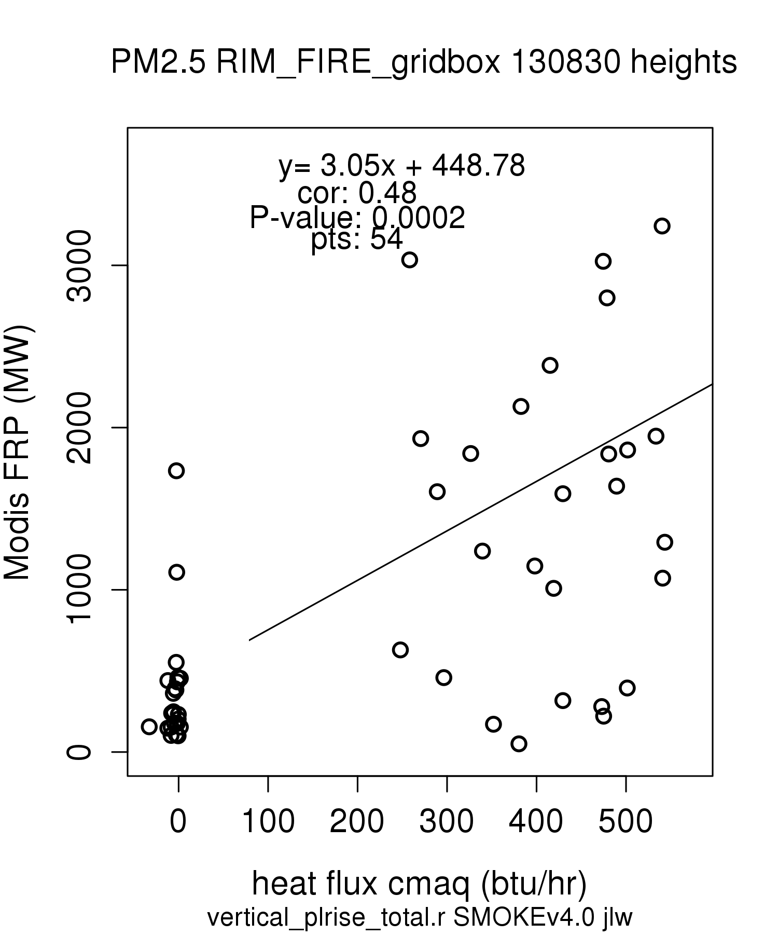
FRP relatability
FRP_cal = Q x 0.1 X AB if heat flux (Q) < 0 set hfx = 0 FRP = 500 mcip.HFX can go negative
Notes:
summary(mcip.HFX.sub) 21 aug 2018 in rim fire box.
Min. 1st Qu. Median Mean 3rd Qu. Max.
-87.21 -34.31 -12.24 47.28 133.78 278.33

Slide 22
Table S1: CMAQ and WRF Model Options for all simulations
 |  | Options | References
Model Options
 | CMAQ Version | 5.0.1 (except 5.0.2 for 2012) | Byun and Schere, 2006
 | Chemistry | CB05 | Yarwood G, 2005
 | Grid projection | Lambert Conformal
 | H Res | 12 km
 | V Res | 35 layers
 | Boundary Conditions | GEOS-CHEM version 9-01-01
 | Model top | 50 mb
 | Spinup period | 10 days
Meteorology Options | Off-line | Yes
 | WRF version |  | Skamarock et al, 2008
 | Initialization | NCEP/NCAR Reanalysis | Skamarock et al, 2008
 | FDDA | NCEP/NCAR Reanalysis | Skamarock et al, 2008
 | Landuse | MODIS
 | Cumulus Parameterization | Kain–Fritsch 2 cumulus parameterization | Kain, 2004
 | Radiation | RRTMg | Iacono et al., 2008
 | PBL | Asymmetric Convective Model version 2 | Pleim, 2007a and b
 | Land Surface Model | Pleim-Xu | Xiu and Pleim, 2001; Pleim and Xiu, 1995

Slide 24
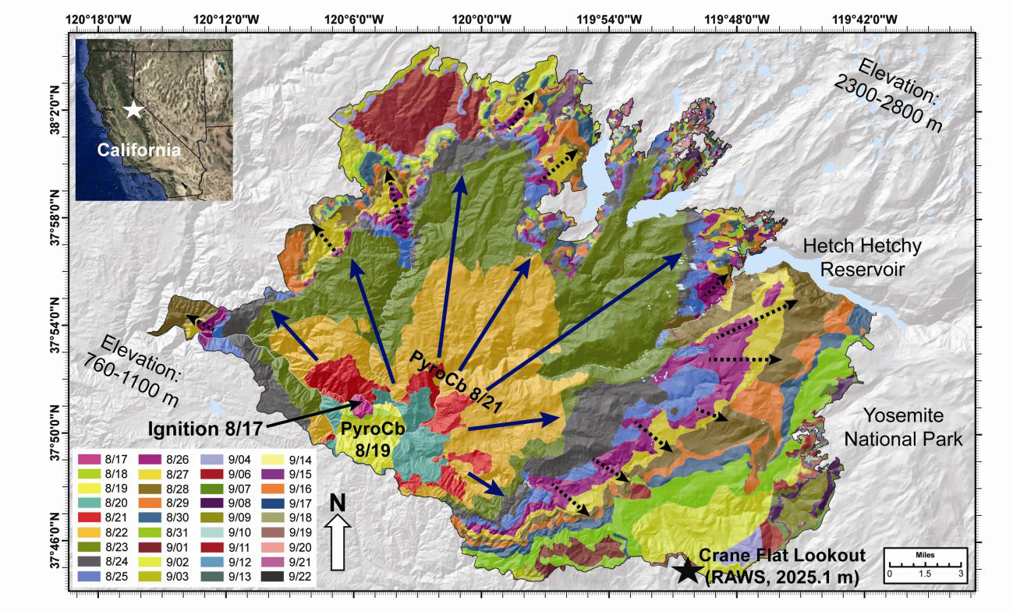
2013 California Rim Fire
Case study for the two plume rise approaches
Stanislaus National Forest
- Aug 17-Nov 4, 2013
- 3,500 homes,
- 257,314 acres
Cost ~$127 mil
Grew to 100,000 acres in 36 h
Figure caption. Rim Fire map, with color scheme indicating the USFS estimated daily fire progression based on the NIROPS observation closest to local midnight for 17 August to 22 September 2013. Solid blue and dashed black arrows indicate the approximate area burned during spread event #1
and spread event #2, respectively.
Peterson et al. 2014 (BAMS)

Slide 25
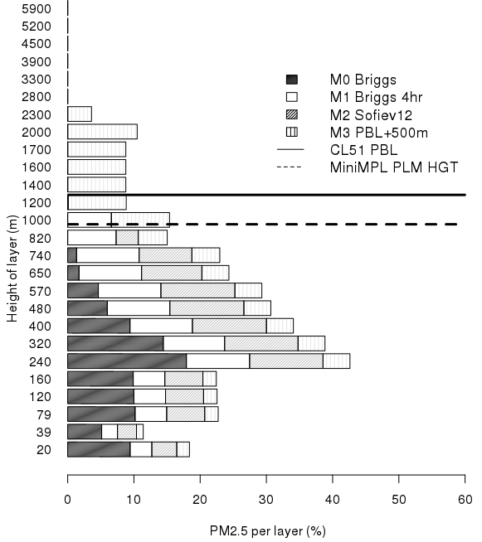
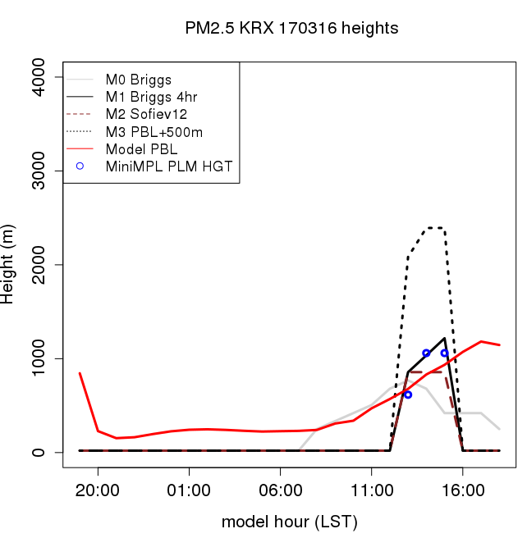
K9 - 16 March 2017

Slide 26
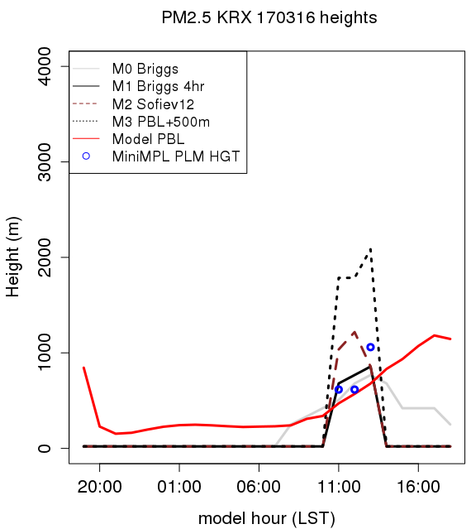

K8 - 16 March 2017
CMAQ-Briggs performs well and captures plumes pattern;
However, all the emissions are placed below the observed PBL,
>93% below the observed plume height (20% above Sofiev)
~80 acres
in 2 hrs
Height (m)
Height (m)
Model Hour (LST)
PM_{2.5} per layer (%)

Slide 27
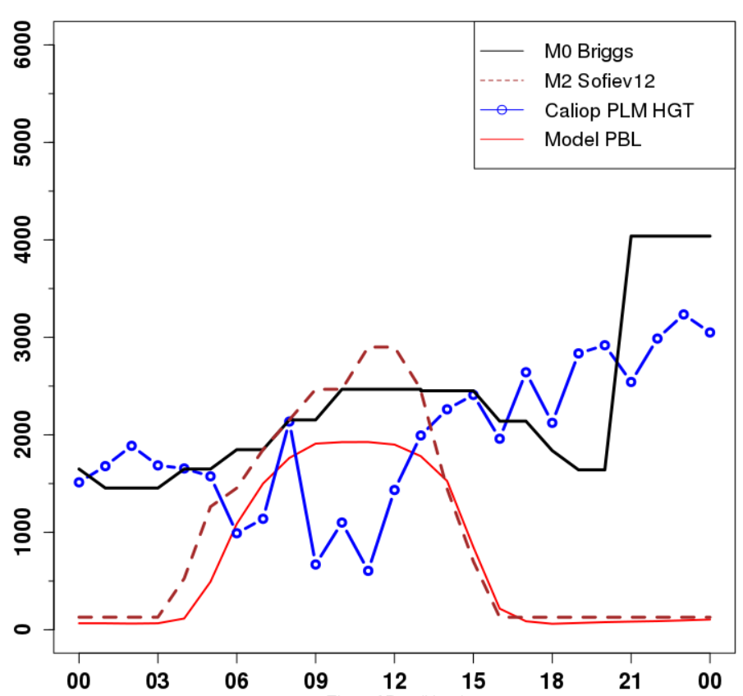
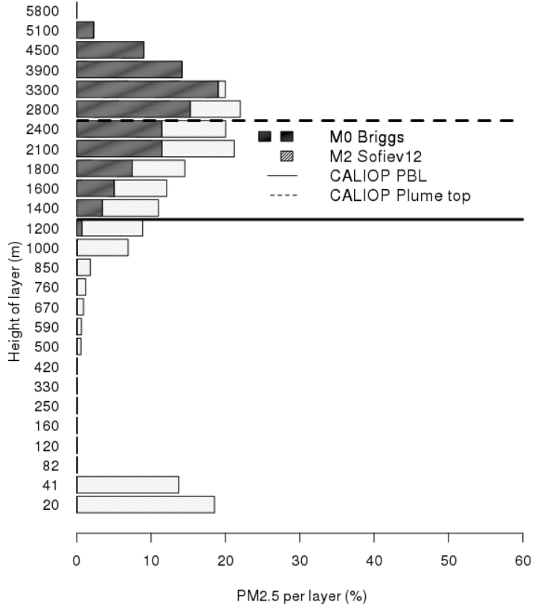
R1 - 21 August 2013
CMAQ-Briggs biased high, but captures observed plume pattern; However, 99% of the emissions are above the observed PBL
compared to 62% (Sofiev) – nighttime impact due to no heat flux
Height (m)
Height (m)
PM_{2.5} per layer (%)
Model Hour (LST)

Slide 28
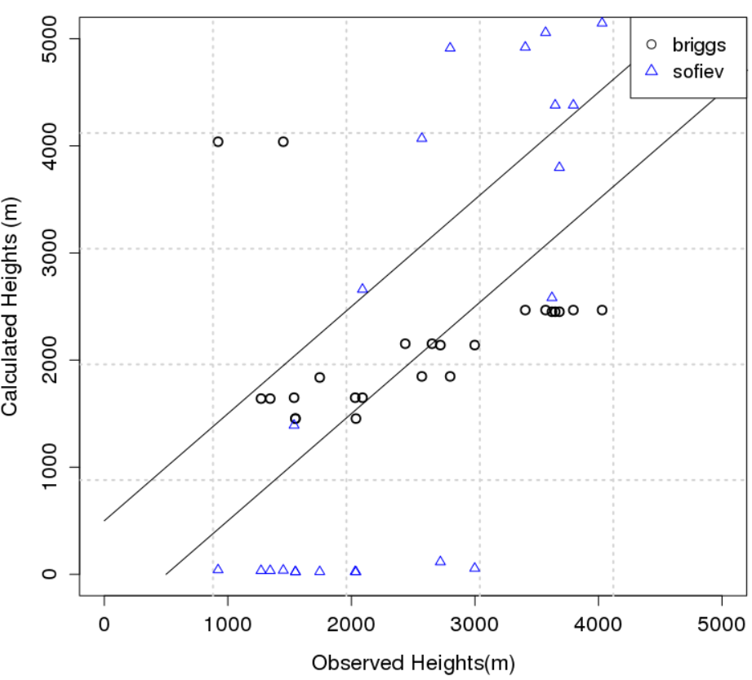
Model Bias 21 Aug. 13 Rim Fire
Model bias
Briggs +
High =
10%
Good =
50%
Low =
40%
Model bias
Sofiev –
High =
27%
Good =
18%
Low =
55%
High
High
Good
Good
Model Plume Height (m)
Low
Low
CALIOP Derived Heights (m)
Caliop derived Plume height (m)
Notes:
Pbl heights in the back. From both. Or solid area under the curv. Check the validity of the obs. Sat derived pbl? Vs wrf?
Dirunal profile of fire creating a unrealistic profile for plume. Maybe what we are doing for nighttime and smaller fires needs tweeks. Prescribed and wild. Maybe set plume equal to boundary layer and see how that does.
Ask amber: When did caliop fly over a fire and can we look at them in detail.

