Slide 1
Development of the 2016 Collaborative Emissions Modeling Platform
Alison Eyth (U.S. EPA Office of Air Quality Planning & Standards)
and
Zac Adelman (Lake Michigan Air Director’s Consortium)
2018 CMAS Center Conference
October 24, 2018

Slide 2
Overview of the National Emissions Inventory Collaborative
Purpose
A new, multi-purpose emissions modeling platform is needed to replace the 2011 and 2014 platforms
Motivation
States and regional organizations want to be more involved in creating the national emissions modeling platform
Approach
For the first time, EPA, states, and regional organizations are engaging in collaborative emissions modeling platform development
2016 base year was selected through a collaborative process
2023 and 2028 future years selected for regulatory relevance
Notes:
A new multi-purpose emissions modeling platform based is needed to replace the 2011 platform
State Implementation Plans, federal analyses
An outgrowth of states and regional organizations wanting to be more involved
For the first time, EPA, states, and MJOs are engaging in collaborative emissions modeling platform development
The 2016 base year was selected via a collaborative process
Regional and state organizations led this process
2016 emissions are different than 2014, most recent NEI year
Future years selected due to regulatory relevance
2023 is relevant for Ozone NAAQS moderate non-attainment areas
2028 is a key year for regional haze

Slide 3
Organizational Structure
Coordination co-leads: Zac Adelman (Lake Michigan Air Directors COnsortium) and Alison Eyth (EPA OAQPS)
Develop process and communication structures, help resolve issues, documentation requirements, coordinate distribution of resulting data
Coordination committee: regional, state, local, and EPA leaders
Define processes, raise and resolve issues, co-lead workgroups
Includes overall and workgroup co-leads plus regional directors
Sector-specific workgroups: one regional/state staff and one EPA staff (where possible)
Focus on preparing emissions estimates for 2016 and future years and improve how the emissions sectors are modeled
Include over 100 participants from EPA/states/locals/regions

Slide 4
Collaborative Workgroups
Electric Generating Units (EGUs)
Non-EGU Point (including aircraft)
Nonpoint (agriculture, fugitive dust, res. wood, other)
Oil and gas (point and nonpoint)
Onroad (also VIN-decoding subgroup)
Nonroad
Rail
Commercial Marine Vessels (CMV)
Fires
Biogenic
Emissions Modeling
Wiki hosted by Intermountain West Data Warehouse has more information on and notes from each workgroup
http://views.cira.colostate.edu/wiki/wiki/9169

Slide 5
2016 Platform Versions & Schedule
Alpha: preliminary version based on 2014 National Emission Inventory (NEI) version 2 for some and 2016 for other key sectors (released Spring 2018)
Used for initial testing of 2016 model runs
Compatible versions of 2014 and 2015 were also released
Beta: improved and/or new version of 2016 emissions for most sectors and preliminary projected emissions to 2023 and 2028 (November 2018)
Use for base and future year preliminary analyses
v1.0: fully updated 2016 emissions and complete projected emissions for 2023 and 2028 (Winter-Spring 2019)

Slide 6
Current Work: 2016 Beta Platform
Workgroups are developing base and future year emissions inventories and documentation
States/locals have provided 2016-specific data for some sectors (e.g., EGUs, non-EGUs, onroad vehicle miles traveled [VMT] and population [VPOP], fires, oil & gas)
States/locals have reviewed data for many sectors
EPA is helping by running models and tools
MOtor Vehicle Emissions Simulator (MOVES) for onroad and nonroad (2016, 2023, 2028)
Oil & Gas Tool (2016)
Blue Sky Framework / SMARTFIRE2 (2016)

Slide 7
Overview of Beta Emissions (1)
EGUs: 2016 point submittals and national data sets; Integrated Planning Model (IPM) and ERTAC EGU outputs for 2023/2028
Non-EGU point: 2016 point submittals
Incorporate growth, consent decrees and key regulations for 2023/2028, project airports
Nonpoint: Start with 2014NEIv2; adjust paved road dust, livestock, and some others to 2016; project to 2023, 2028
Nonpoint oil and gas: oil and gas tool output for 2016 plus new spatial surrogates and temporal profiles; simple projections to 2023/2028
Onroad: State/local 2016 activity with 2016 emission factors, new on-roadway spatial surrogates

Slide 8
2014 and 2016 Point Source Emissions
tons/yr
There was a substantial drop in NOx and SO2 from 2014 to 2016
A large fraction of NOx and SO2 emissions are based on CEMS data

Slide 9
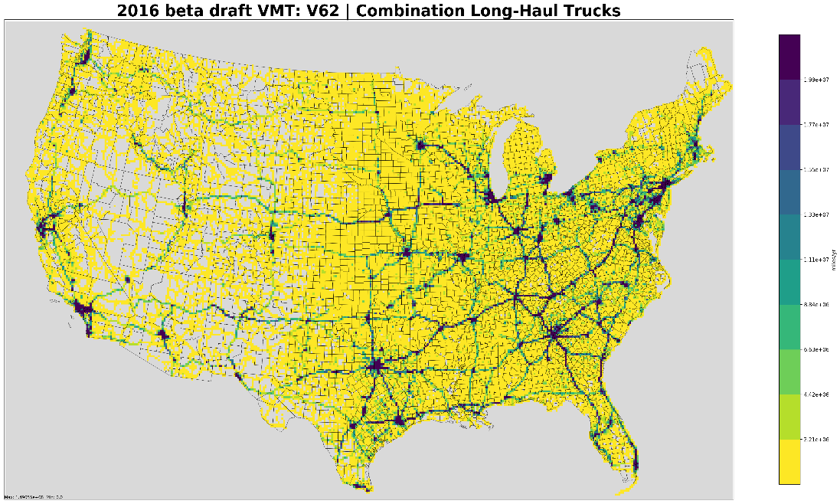
2016 beta Onroad Emissions Totals
Onroad
emissions are
predicted to
go down from
‘14 to ‘16
tons/yr
NOx emissions by county
Gridded Combination Truck VMT

Slide 10
Overview of Beta Emissions (2)
Nonroad: MOVES2014b outputs for all years – these are expected to be more than 20% lower than 2014NEIv2
Rail: New 2016 inventory, including new commuter rail
Commercial Marine vessels: 2014NEIv2 adjustments to 2016 and projection to 2023/2028
Biogenics: BEIS 3.61 and MEGANv3 run with 2016 meteorology
Fires: 2016 wild and prescribed fires based on updated inputs, agricultural fires by point and day, non-US fires
Canada: New 2015 emissions expected, plus projection to 2025
Mexico: 2008 projected to 2016, 2023, 2028 plus MOVES-Mexico for each of the years

Slide 11
Inventory Collaborative Successes and Challenges
Successes
Convened and leveraging a national knowledge base for developing emissions to be used in air quality planning
Educated skilled regional, state, and local staff about emissions modeling and projections
Received data for 2016 from many states: non-EGU emissions, onroad activity data, fires, oil and gas
States submitted data about consent decrees and closures that we probably wouldn’t have known about otherwise
Challenges
Effort coincides with the 2017 NEI cycle – strains resources
It can be hard to find agreement on new methods and approaches
Some workgroup members want new methods to improve estimates but are not sure how to make it better

Slide 12
Inventory Collaborative Next Steps
Workgroups are working to release beta inventories and documentation
Preparing for v1.0
States/workgroups review beta inventories
Update emissions for some sectors, including:
Onroad age distributions, commercial marine vessels, nonroad
Develop improved projection methods for some sectors
Air quality modeling of alpha, beta, and v1.0 versions of the platform by EPA and others
Plan to track uses of the alpha and beta inventories and assimilate feedback into the data and platform based on modeling
Emissions modeling workgroup is forming
Collaboratively collating the inventory data into a modeling platform
Apply, test, and improve ancillary data used in emissions models
Review air quality model results from alpha and beta

Slide 13
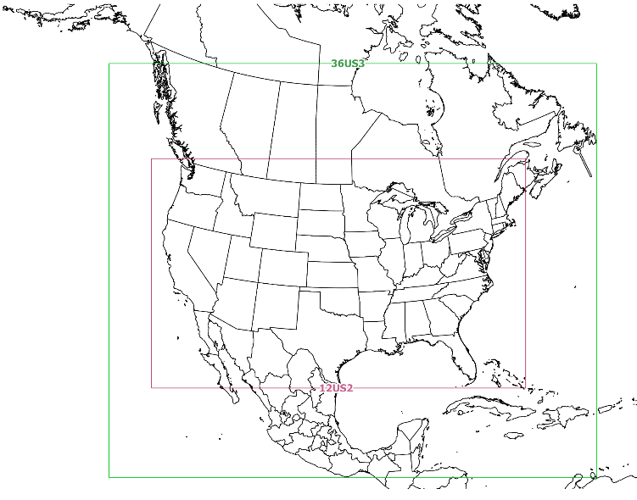
EPA’s Air Quality Modeling of the 2016 Emissions Platform
CMAQ and CAMx alpha model runs are underway using the alpha inventory as part of a “shake out” of the platform
12 km national domain nested within a 36 km domain (see map below)
Boundary conditions for the 36 km domain are from a 2016 Hemispheric CMAQ run
2016 beta emissions will be modeled starting later this year
We are open to sharing our modeling outputs; but, we have not yet settled on a timeframe for this
36 km domain
12 km domain

Slide 14
Data Downloads
SMOKE inputs and scripts for 2016 alpha and 2014v2
https://www.epa.gov/air-emissions-modeling/2014-2016-version-7-air-emissions-modeling-platforms
Platform as large zip files plus sample outputs: https://drive.google.com/drive/folders/1caRJVHx_SzY0sSD6DL-TE7rgAoSDqrt-
Wiki for workgroup notes and pointers to beta data:
http://views.cira.colostate.edu/wiki/wiki/9169

Slide 15
EPA’s 2019 International Emission Inventory Conference
Biennial conference that connects offices across EPA, regional/state/local/tribal staff, researchers, consultants, and students who work on various aspects of emissions inventory development
2019 Theme: “Collaborative Partnerships to Advance Science and Policy”
July 29-August 2, 2019 in Dallas, Texas
Training on Monday, July 29
Tuesday-Friday: plenary session, technical sessions, lightning talks
More info coming soon to: https://www.epa.gov/ air-emissions-inventories/international-emission-inventory-conference

Slide 16
Acknowledgements
Coordination Committee:
Workgroup leaders: Doug Boyer (TCEQ), Alison Eyth (EPA), Caroline Farkas (EPA), Mark Janssen (LADCO), Serpil Kayin (EPA), Tammy Manning (NC DENR), Julie McDill (MARAMA), Tom Moore (WESTAR), Sarah Roberts (EPA), Rebecca Simpson (CO DPHE), Jennifer Snyder (EPA), Jeff Vukovich (EPA), Eric Zalewsky (NY DEC)
Regional Organization Leaders: Zac Adelman (LADCO), Jim Boylan (SESARM), Dave Foerter (OTC), John Hornback (SESARM), Michael Vince (CENSARA), Mary Uhl (WESTAR)
Workgroup members: Over 100 state, local, and regional staff are actively participating, plus additional EPA staff working on the inventories

