Slide 1

Representing the nonlinear responses of tropospheric ozone and fine particulate matter to precursor emission changes
Jia Xing¹, Dian Ding¹, Shuxiao Wang¹, Bin Zhao^{1,4}, Carey Jang², Yun Zhu³, Jiming Hao¹
¹ School of Environment, Tsinghua University, Beijing, China
² Office of Air Quality Planning & Standards, US EPA, RTP, NC, USA
³ South China University of Technology, Guangzhou, China
⁴ University of California, Los Angeles, CA, USA
22 Oct 2018, 17th Annual CMAS Conference, Friday Center, UNC-Chapel Hill
Notes:
1
两控区
2018/10/22
大气处
1

Slide 2


Nonlinear-Relationship between Emission and pollution
Emissions
O₃
Pollution
PM_{2.5}

Slide 3
Nonlinear-Relationship between Emission and pollution
Emissions
Nonlinear
O₃
Pollution
PM_{2.5}

Slide 4
A promising method to address that issue
Response Surface Model (RSM)
——a meta-model built upon multi-“Brute Force” model simulations, to explore the response relationship between emission changes and air quality responses
Ambient Concentration
Sensitivity (e.g., DDM)
“real atmosphere”
RSM
Source Apportionment (e.g., ISAM)
0
1
Emission ratio
base

Slide 5
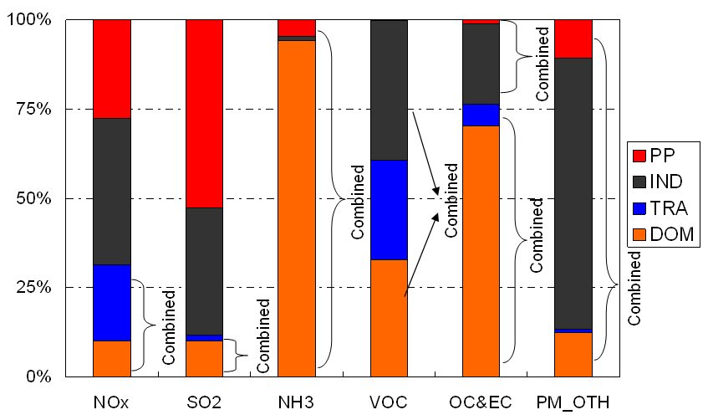

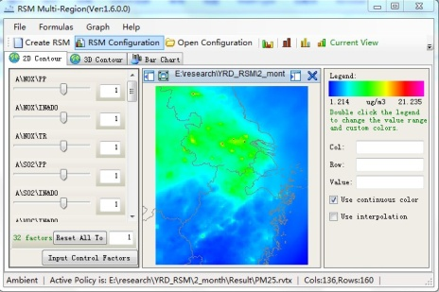
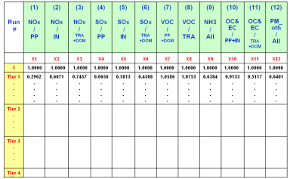
Development of the RSM
Primary emission
RSM
Air quality
PM_{2.5} response surface
4.Statistical
results
1.Control
factors
Baseline
Source A- NOx/industry
Source B- NMVOC/mobile
…
SO2 emission ratio
NOx emission ratio
2.Emission
scenarios
Mperk
RSM-VAT
Source C
Source A
Source B
Latin Hypercube Sample (LHS)
Hammersley quasi-random Sequence Sample (HSS)
3.CMAQ
simulation

Slide 6
Development of the Extended-RSM (ERSM)
interregional effects (IND) among multiple regions, representing the impacts on the contribution from one source region by other source regions (new in ERSMv2.0)
RSM_TT
Indirect effects
Transport
regional transport (TP) of the pollutant from the source region to the receptor region
Transport
+
Transport
Transport
Precursor
Precursor
Precursor
Precursor
+
RSM
RSM
RSM
RSM
local chemistry (CM) associated with the change in its precursor levels at the receptor region
Region 1
Region 2
Region i
Region n
…
…
Xing et al., ES&T, 2017

Slide 7
improved Performance in the latest ERSM v2.0
PM_{2.5} response to changes in emissions
Improvement under large reduction condition
X-scale: NH₃
Y-scale: NO_{x}
X-scale: NH₃
Y-scale: SO₂
“True” response
ERSMv1.0
ERSMv2.0

Slide 8
Overview of the RSM evolution
How to further reduce the number of cases required in RSM?
pf-RSM

Slide 9
The prior knowledge of pollutant responses to emissions
The isopleths of 1-h maxima O₃ response to changes of NOx/VOC emissions
(established based on 30 Brute-Force CMAQ runs, monthly average, July 2005)
Urban site (in Beijing city)
Rural site (in Miyun, northern Beijing)
VOC-limited
NOx-limited
Pollution concentrations contributed by its sources and sinks through a series of atmospheric processes in which the nonlinear behavior contributes to the nonlinearity in the responses of concentrations to precursor emissions
(Xing J. et al. ACP, 2011)

Slide 10
The prior knowledge of pollutant responses to emissions
Beijing
High Ozone(>70ppb)
Low Ozone(<30ppb)
Shanghai
Guangzhou
Similar responsive functions can be expected across regions and time

Slide 11
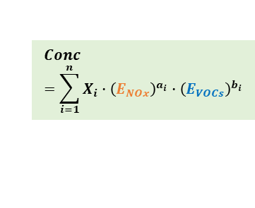
Design of RSM with polynomial functions
Original training samples
Ozone response
Regression-based
RSM (Traditional)
regression
VOC
VOC
NO_{x}
NO_{x}
Fewer samples
Prior knowledge
fitting
Fitting-based RSM
(pf-RSM)
VOC
$$Conc=\sum_{i=1}^{n}{X_{i}∙{\left(E_{NOx}\right)}^{a_{i}}∙{\left(E_{VOCs}\right)}^{b_{i}}}$$
VOC
NO_{x}
NO_{x}
the prior knowledge was characterized as a series polynomial functions
Fewer samples->high efficiency (60% reduction in the sample number)
Easier investigation on the nonlinearity (e.g., peak value, derivative)
(Xing J. et al. ACP, 2018)

Slide 12
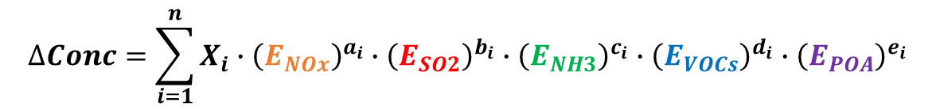
Design of RSM with polynomial functions
$$∆Conc=\sum_{i=1}^{n}{X_{i}∙{\left(E_{NOx}\right)}^{a_{i}}∙{\left(E_{SO2}\right)}^{b_{i}}∙{\left(E_{NH3}\right)}^{c_{i}}∙{\left(E_{VOCs}\right)}^{d_{i}}∙{\left(E_{POA}\right)}^{e_{i}}}$$
O₃
PM_{2.5}
1st
1st
1st
POA
2nd
VOC
NO_{x}
1st
1st
2nd
3rd
SO₂
NH₃
2nd
2nd
3rd
4th
3rd

Slide 13
Composition of O₃ response to NO_{x} (Beijing)
Term1-NO_{x}⁵; Term2-NO_{x}⁴; Term3-NO_{x}³; Term4-NO_{x}²; Term5-NO_{x}
VOC-limited
VOC-limited
NOx-limited
VOC-limited
the change in the Term 4 and Term 5 from positive to negative largely contributes to the nonlinear behavior in O₃ response to NO_{x}

Slide 14
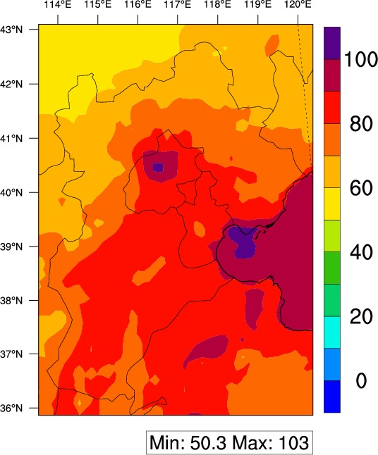
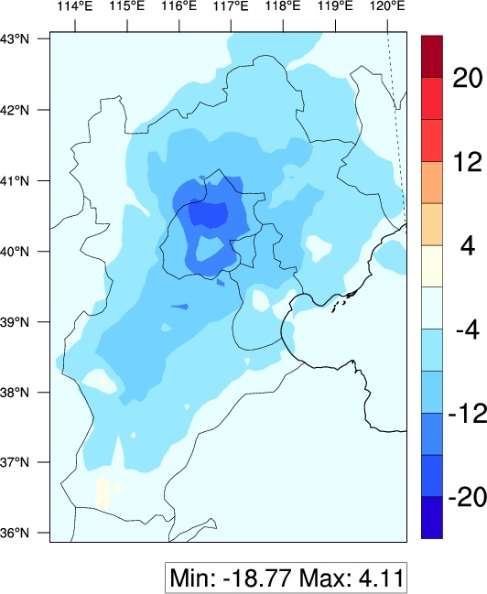
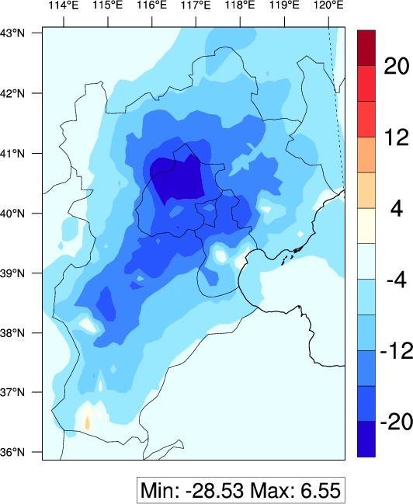

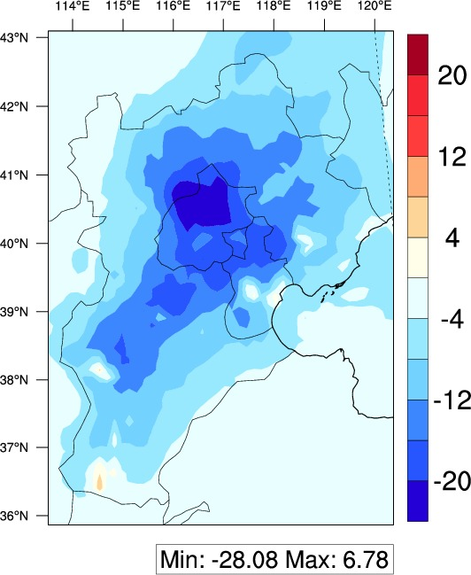
Validation of pf-RSM prediction
Baseline
ΔCase1 (moderate control)
ΔCase2 (strict control)
CMAQ
pf-RSM
O₃ (monthly averages of daily 1-hour maxima in July 2014, unit: ppb)

Slide 15
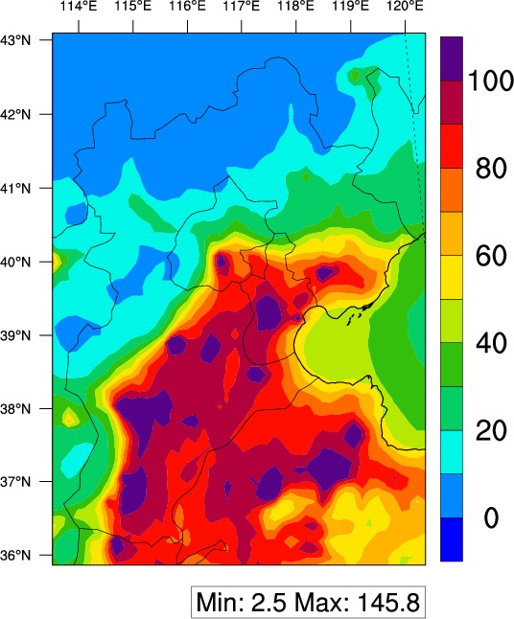
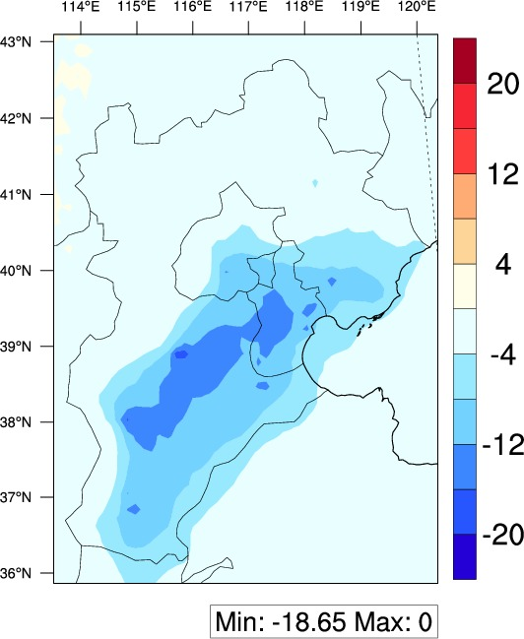
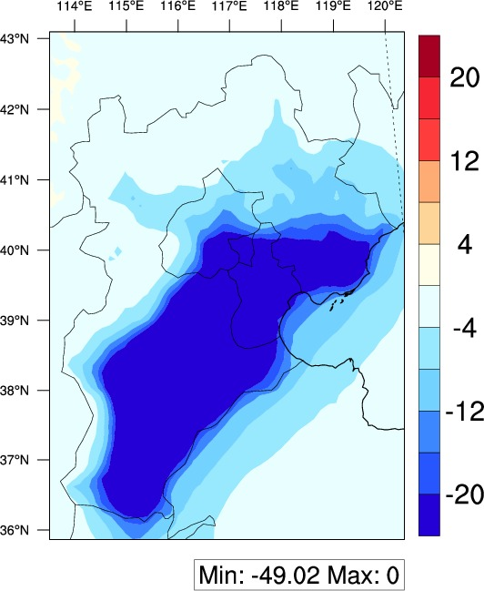


Validation of pf-RSM prediction
Baseline
ΔCase1 (moderate control)
ΔCase2 (strict control)
CMAQ
pf-RSM
PM_{2.5} (monthly averages in January 2014, unit: µg m⁻³)
(Xing J. et al. ACP, 2018)

Slide 16



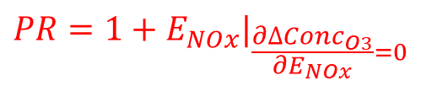
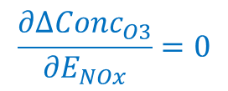
Definition of Peak Ratio (PR)
2-D isopleths of O₃ sensitivity to NO_{x} and VOC emission changes
$$\frac{∂∆{Conc}_{O3}}{∂E_{NOx}}=0$$
1.2
1.0
0.8
0.6
0.4
0.2
0.0
PR <1: VOC-limited PR>1: NO_{x}-limited
NOx-limited
95.00
90.00
85.00
80.00
75.00
70.00
65.00
60.00
55.00
$${1+E}_{VOC}$$
VOC-limited
PR can be directly calculated from the polynomial function
0.0 0.2 0.4 0.6 0.8 1.0 1.2
$$PR={1+E}_{NOx}|_{\frac{∂∆{Conc}_{O3}}{∂E_{NOx}}=0}$$
$${1+E}_{NOx}$$

Slide 17
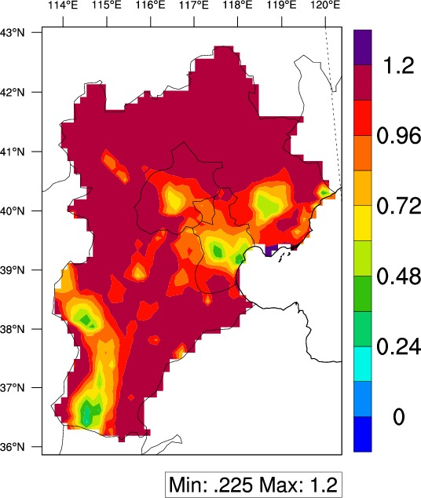
Peak Ratio (PR) in the BTH region
PR map
2014/7
 | Jan | Jul
Beijing | 0.11 | 0.76
Tianjin | 0.1 | 0.45
HebeiN | 0.19 | >1.2
HebeiE | 0.15 | 0.74
HebeiS | 0.13 | 0.59
Smaller PRs (0.4–0.8) were evident in urban areas where NO_{x} emissions are saturated, resulting in a strong VOC-limited condition

Slide 18
Comparion between photochemical indicators and PR
Strong correlations, while some indicators fail to capture the O₃ chemistry

Slide 19


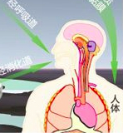
ABaCAS: a scientifically sound decision support system
Target
  SMAT
  RSM
Emission
Air quality
  CoST
  BenMAP
Cost
Benefit

Slide 20
ABaCAS: a scientifically sound decision support system
Xing, J. et al. ABaCAS: an overview of the air pollution control cost-benefit and attainment assessment system and its application in China. The Magazine for Environmental Managers - Air & Waste Management Association 2017, April.

Slide 21
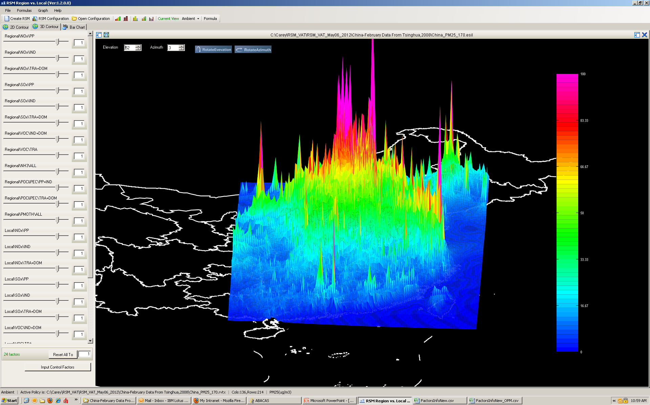
Baseline
RSM-VAT
Control factor
PM_{2.5} Response Surface Modeling

Slide 22
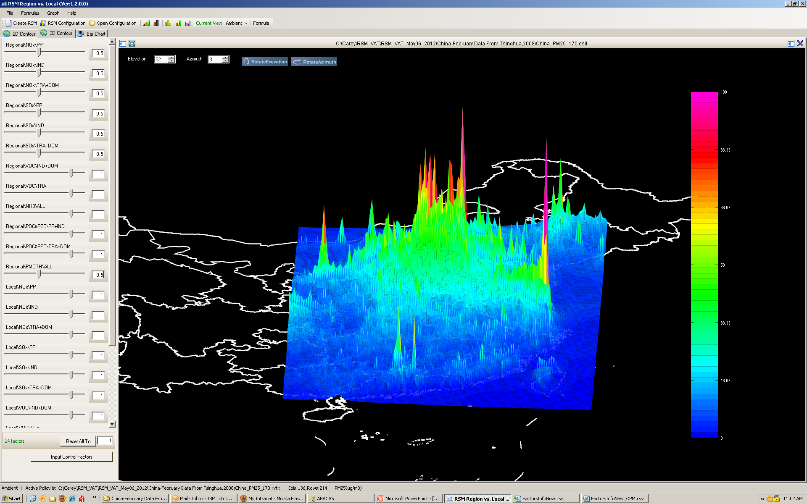
Control Scenario
RSM-VAT
Control factor
PM_{2.5} Response Surface Modeling

Slide 23
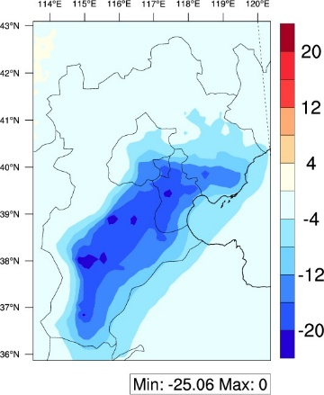
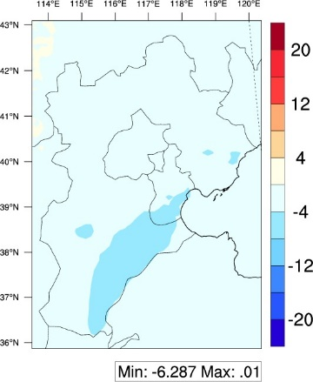
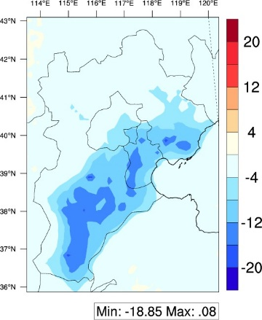
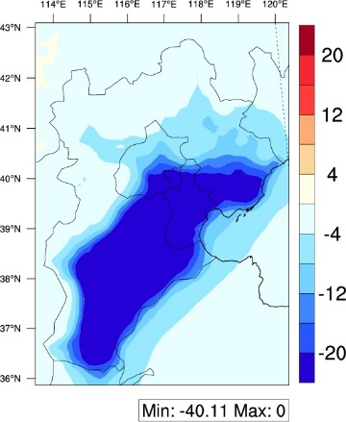

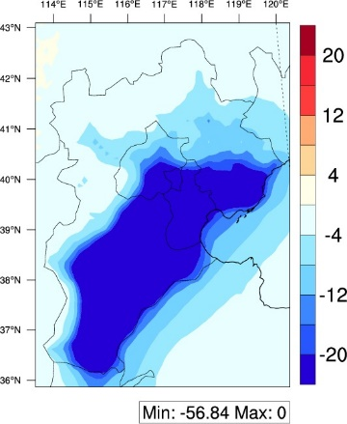
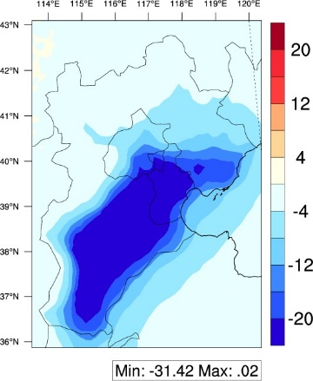
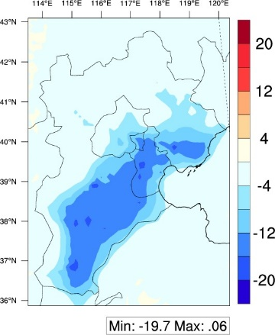
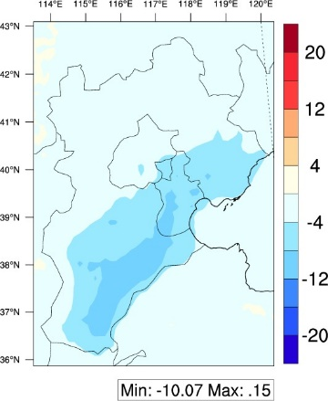
Real-time prediction under various scenarios
10000 scenarios
NOx
Reduce 10%
Reduce 100%
SO2
Reduce 10%
Reduce 100%
…
…
Reduce 10%
VOC
Reduce 100%
Reduce 10%
…
NH3
…
Reduce 100%
Real time Pred. by RSM
√
√
√

Slide 24
LECO: optimization of control pathway
S1: No NH₃ control
S2: With NH₃ control
Optimal control pathway to achieve certain concentration:
S1: NOx(-35%), SO2(-75%), VOC(-65%), PM(-85%)
S2: NOx( -5%), SO2(-75%), VOC(-25%), PM(-85%), NH3(-65%)
NH₃ emission controls can be a cost-efficient strategy to reduce PM_{2.5}
Xing et al., in prep.

Slide 25
LECO: optimization of control pathway
S1: No NH₃ control
S2: With NH₃ control
Response of PM_{2.5} and O₃
Large co-benefit for O₃ reduction
Small co-benefit for O₃ reduction

Slide 26
Multi-regional scenario: Local vs Regional
5 × = 50000
5 × 10000 = 50000 scenarios
L:R = 1:1
L:R = 1:0.75
L:R = 1:0.5
L:R = 1:0
L:R = 0.5:1
NOx
Reduce 10%
Reduce 100%
SO2
Reduce 10%
Reduce 100%
…
…
Reduce 10%
VOC
Reduce 100%
Reduce 10%
…
NH3
…
Reduce 100%
Real time Pred. by RSM
Control ratio between Local and Regional
…

Slide 27
Multi-regional scenario: Local vs Regional
the same level of reductions should be conducted across the whole BTH region to achieve more aggressive targets
PM_{2.5}
O₃
local reduction has priorities for attaining moderate targets
(L:R = 1:1): the same reduction rate is applied in local and regional sources;
(L:R = 1:0.75): regional reduction rate is 75% of the local reduction rate;
(L:R = 1:0.5): regional reduction rate is half of the local reduction rate;
(L:R = 0.5:1): regional reduction rate is twice the local reduction rate;
(L:R = 1:0): only local reductions are considered)
Xing et al., in prep.

Slide 28
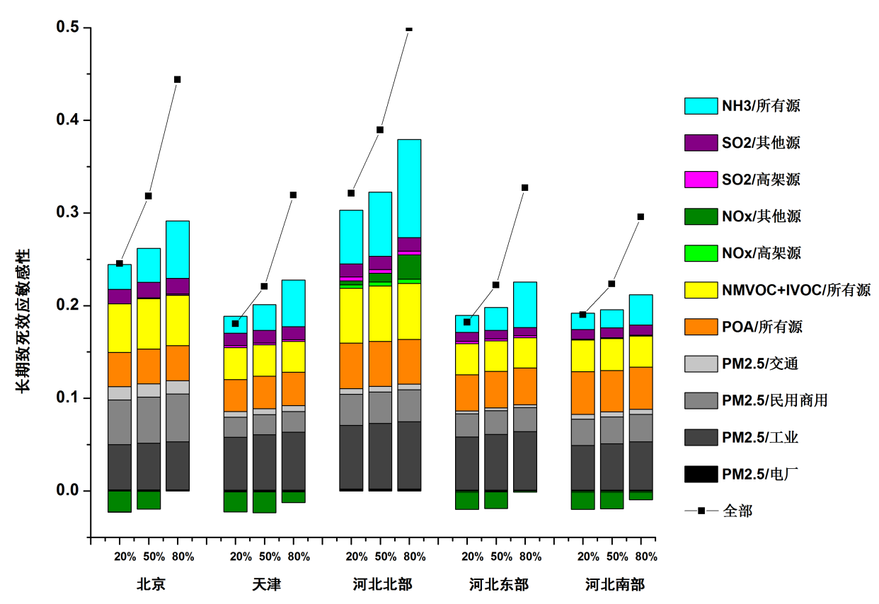
Sensibility of health outcomes
Sensitivity of health outcomes to stepped control of individual air pollutants (left) and individual pollutant-sector combinations (right)
defined as the change ratio of health outcome divided by the reduction ratio of emissions
Sensibility of chronic health outcomes
All
Other
LPS
Other
LPS
All
All
Transportation
Residential & Commercial
Industry
Power plant
All
Beijing Tianjin N Hebei E Hebei S Hebei

Slide 29



2018 ABACAS & CMAS-ASIA-PACIFIC
Please visit ABaCAS website for more information: http://www.abacas-dss.com/

Slide 30

Thank you very much!
Jia Xing
Associate Professor
School of Environment, Tsinghua University
Beijing, China, 10084
Email: xingjia@tsinghua.edu.cn

