Slide 1
Quantifying the error in satellite AOD retrievals associated with surface reflectance uncertainties in the semi-arid western U.S.
S. Marcela Loría-Salazar, Heather A. Holmes, Jayne M. Boehmler, Patrick W. Arnott, and James D. Long
Atmospheric Sciences Program, Department of Physics, University of Nevada, Reno
October 22nd, 2018
17th Annual CMAS Conference
Chapel Hill, North Carolina, USA

Slide 2
Motivation
Pictures with
different filters
Satellite
remote sensing
Algorithms:
- Parameterization
- Assumptions
NASA MODIS
AOD
http://www.fashionelite.com/local-professional-runway-models/
Loria-Salazar et al., (2016)
Notes:
However, the semi-arid western U.S. continues to be an unproven and infrequently explored area for remotely sensed atmospheric aerosol pollution retrievals. The study of aerosol transport and optical properties in this area is a challenge due to the complex terrain, bright surfaces, presence of anthropogenic and biogenic emissions, secondary organic aerosol formation, smoke from wildfires, and low aerosol concentrations during non-fire conditions.
Previous studies have shown that MODIS retrievals failed to estimate column-integrated aerosol pollution levels and particle size over Nevada and California in the summer months of 2012 and 2013 due to high surface albedo, heterogeneous vertical profile of aerosol concentrations, and incorrect parameterizations for surface reflectance. MODIS algorithms overestimated AOD by more than a factor of 3 in Reno, NV and more than a factor of 2 over Fresno, CA.

Slide 3
Motivation
Terra true color
July 28, 2012
Pictures with
different filters
Satellite
remote sensing
Algorithms:
- Parameterization
- Assumptions
NASA MODIS
AOD
Loria-Salazar et al., (2016)
Notes:
However, the semi-arid western U.S. continues to be an unproven and infrequently explored area for remotely sensed atmospheric aerosol pollution retrievals. The study of aerosol transport and optical properties in this area is a challenge due to the complex terrain, bright surfaces, presence of anthropogenic and biogenic emissions, secondary organic aerosol formation, smoke from wildfires, and low aerosol concentrations during non-fire conditions.
Previous studies have shown that MODIS retrievals failed to estimate column-integrated aerosol pollution levels and particle size over Nevada and California in the summer months of 2012 and 2013 due to high surface albedo, heterogeneous vertical profile of aerosol concentrations, and incorrect parameterizations for surface reflectance. MODIS algorithms overestimated AOD by more than a factor of 3 in Reno, NV and more than a factor of 2 over Fresno, CA.

Slide 4
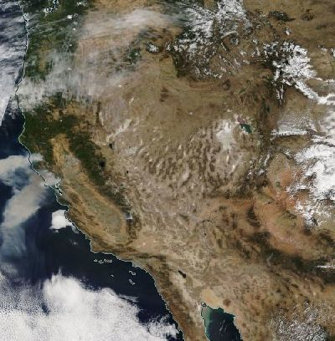
Challenges of aerosol satellite retrievals
Aerosol satellite algorithms need to distinguish between the atmosphere composition and the underlying surfaces
Type of surfaces
Ocean
Lakes
Deserts
Vegetation
Snow
Urban areas
Sun glint
Atmosphere
Clouds
Gases
October 9th 2017
Terra MODIS
Loria-Salazar et al., (2016)
Notes:
However, the semi-arid western U.S. continues to be an unproven and infrequently explored area for remotely sensed atmospheric aerosol pollution retrievals. The study of aerosol transport and optical properties in this area is a challenge due to the complex terrain, bright surfaces, presence of anthropogenic and biogenic emissions, secondary organic aerosol formation, smoke from wildfires, and low aerosol concentrations during non-fire conditions.
Previous studies have shown that MODIS retrievals failed to estimate column-integrated aerosol pollution levels and particle size over Nevada and California in the summer months of 2012 and 2013 due to high surface albedo, heterogeneous vertical profile of aerosol concentrations, and incorrect parameterizations for surface reflectance. MODIS algorithms overestimated AOD by more than a factor of 3 in Reno, NV and more than a factor of 2 over Fresno, CA.

Slide 5
High surface reflectance California and Nevada, summer, 2012
High surface reflectance
Terra-DB AOD (550 nm)
July, 2012
Loria-Salazar et al., (2016)
Notes:
Health effects of ambient air quality
Georgia Birth Cohort
Geo-coded patient information
Atlanta - epidemiologic results using central monitor data suggest associations of acute health effects and mobile source emissions
Spatially resolved health study needs spatial air quality metrics

Slide 6
High surface reflectance California and Nevada, summer, 2012
High surface reflectance
Terra-DB AOD (550 nm)
July, 2012
Terra true color
July 28, 2012
Loria-Salazar et al., (2016)
Notes:
Health effects of ambient air quality
Georgia Birth Cohort
Geo-coded patient information
Atlanta - epidemiologic results using central monitor data suggest associations of acute health effects and mobile source emissions
Spatially resolved health study needs spatial air quality metrics

Slide 7
High surface reflectance California and Nevada, summer, 2012
High surface reflectance
Terra-DB AOD (550 nm)
July, 2012
Terra true color
July 28, 2012
Albedo (650 nm)
July, 2012
Loria-Salazar et al., (2016)
Notes:
Health effects of ambient air quality
Georgia Birth Cohort
Geo-coded patient information
Atlanta - epidemiologic results using central monitor data suggest associations of acute health effects and mobile source emissions
Spatially resolved health study needs spatial air quality metrics

Slide 8
High surface reflectance California and Nevada, summer, 2012
High surface reflectance
Terra-DB AOD (550 nm)
July, 2012
Terra true color
July 28, 2012
Albedo (650 nm)
July, 2012
Complex terrain in the western U.S. led to artificial hotspots in retrieved AOD
Surface data base was not being able to resolve the heterogeneity of the terrain
Shadowing
Loria-Salazar et al., (2016)
Notes:
Health effects of ambient air quality
Georgia Birth Cohort
Geo-coded patient information
Atlanta - epidemiologic results using central monitor data suggest associations of acute health effects and mobile source emissions
Spatially resolved health study needs spatial air quality metrics

Slide 9
Objectives and Hypothesis
Objectives
Evaluate aerosol satellite retrievals of AOD over bright surfaces in the western U.S. using the NASA Deep-Blue algorithm (Collection 6.1)
Evaluate a portable albedometer instrument against satellite retrievals using MODIS and Landsat ETM instruments
Determine the impact of surface reflectance in Deep-Blue AOD algorithm (Collection 6.1)
Hypotheses
While It is expected improvement on AOD over bright surfaces in Deep-Blue Collection 6.1, surface reflectance may cause unrealistic high AOD over bright surfaces over non-fire periods (e.g. Black Rock Desert, NV)
MODIS retrievals underestimates surface reflectance
High uncertainty of AOD due to surface reflectance causes high uncertainty in MODIS Deep-Blue AOD
Notes:
However, the semi-arid western U.S. continues to be an unproven and infrequently explored area for remotely sensed atmospheric aerosol pollution retrievals. The study of aerosol transport and optical properties in this area is a challenge due to the complex terrain, bright surfaces, presence of anthropogenic and biogenic emissions, secondary organic aerosol formation, smoke from wildfires, and low aerosol concentrations during non-fire conditions.
Previous studies have shown that MODIS retrievals failed to estimate column-integrated aerosol pollution levels and particle size over Nevada and California in the summer months of 2012 and 2013 due to high surface albedo, heterogeneous vertical profile of aerosol concentrations, and incorrect parameterizations for surface reflectance. MODIS algorithms overestimated AOD by more than a factor of 3 in Reno, NV and more than a factor of 2 over Fresno, CA.

Slide 10
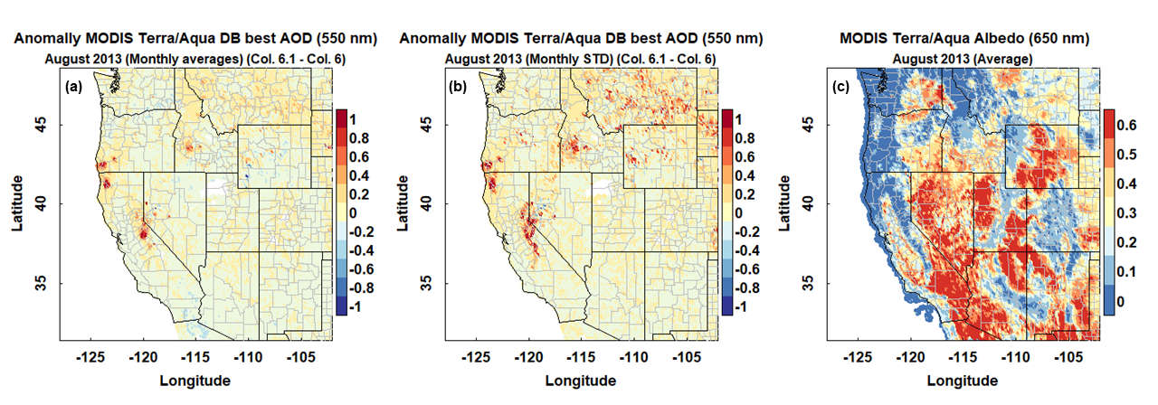
Aqua MODIS DB AOD C6.1 Western U.S., August, 2013
Loria-Salazar et al., In-preparation
Notes:
The presence of wildfire smoke impacts the correlation between surface and satellite measurements of AOD in this region. AOD from AERONET and MODIS showed low correlation for days with typical ambient pollutant concentrations (e.g. R²~0.46 for Terra-MODIS over Las Vegas, NV in August 2013). During fire periods the correlation between instruments showed an improvement (e.g. R²~0.87 for Terra-MODIS over Reno, NV in August 2012 and R²~0.82 for Aqua-MODIS over Fresno, CA in August 2013) because of the increase in columnar aerosol concentration.

Slide 11
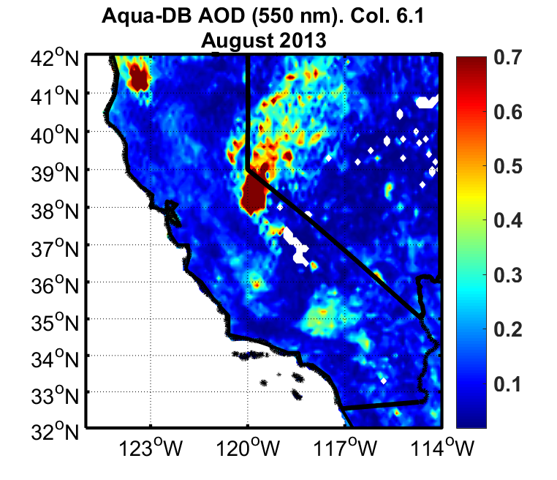
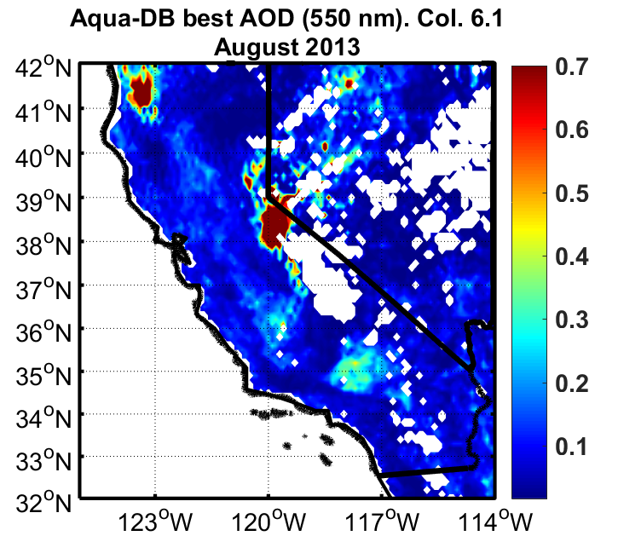
Aqua MODIS DB AOD C6.1 California and Nevada, August, 2013
Loria-Salazar et al., In-preparation
Notes:
The presence of wildfire smoke impacts the correlation between surface and satellite measurements of AOD in this region. AOD from AERONET and MODIS showed low correlation for days with typical ambient pollutant concentrations (e.g. R²~0.46 for Terra-MODIS over Las Vegas, NV in August 2013). During fire periods the correlation between instruments showed an improvement (e.g. R²~0.87 for Terra-MODIS over Reno, NV in August 2012 and R²~0.82 for Aqua-MODIS over Fresno, CA in August 2013) because of the increase in columnar aerosol concentration.

Slide 12
Aqua MODIS DB AOD C6.1 California and Nevada, August, 2013
Loria-Salazar et al., In-preparation
Notes:
The presence of wildfire smoke impacts the correlation between surface and satellite measurements of AOD in this region. AOD from AERONET and MODIS showed low correlation for days with typical ambient pollutant concentrations (e.g. R²~0.46 for Terra-MODIS over Las Vegas, NV in August 2013). During fire periods the correlation between instruments showed an improvement (e.g. R²~0.87 for Terra-MODIS over Reno, NV in August 2012 and R²~0.82 for Aqua-MODIS over Fresno, CA in August 2013) because of the increase in columnar aerosol concentration.

Slide 13
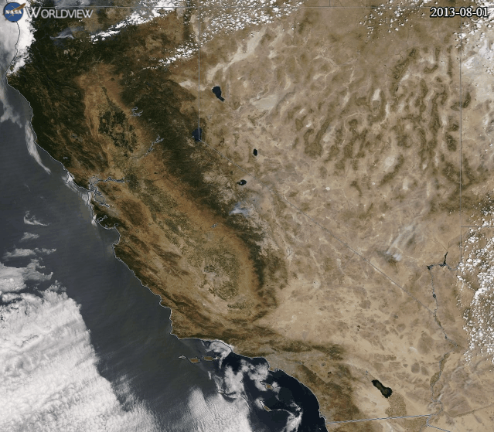
Aqua MODIS DB AOD C6.1 California and Nevada, August, 2013
Loria-Salazar et al., In-preparation
Notes:
The presence of wildfire smoke impacts the correlation between surface and satellite measurements of AOD in this region. AOD from AERONET and MODIS showed low correlation for days with typical ambient pollutant concentrations (e.g. R²~0.46 for Terra-MODIS over Las Vegas, NV in August 2013). During fire periods the correlation between instruments showed an improvement (e.g. R²~0.87 for Terra-MODIS over Reno, NV in August 2012 and R²~0.82 for Aqua-MODIS over Fresno, CA in August 2013) because of the increase in columnar aerosol concentration.

Slide 14
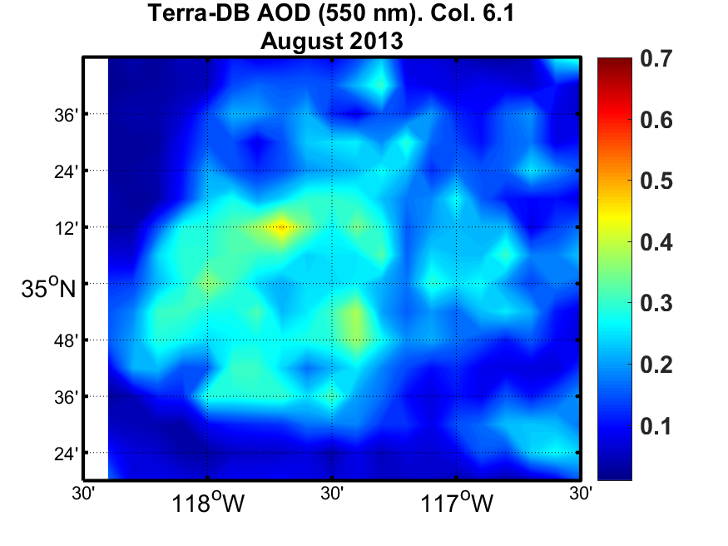
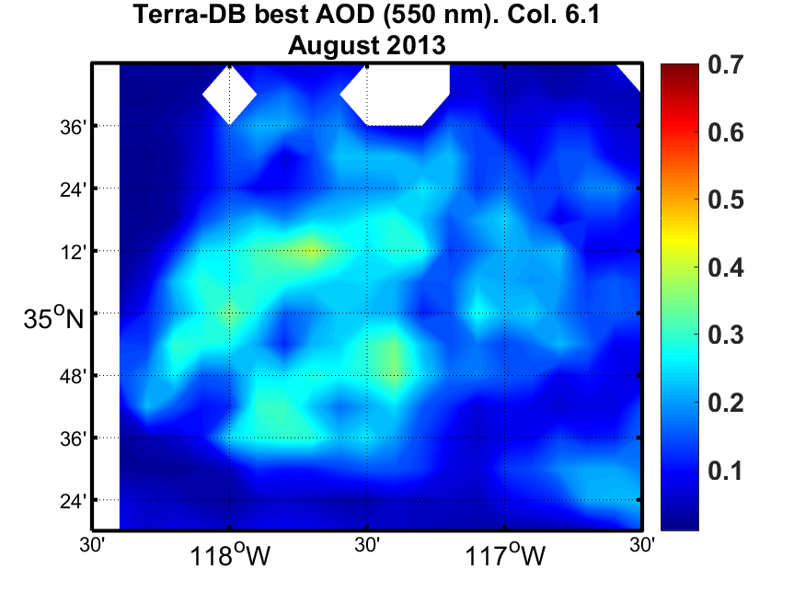
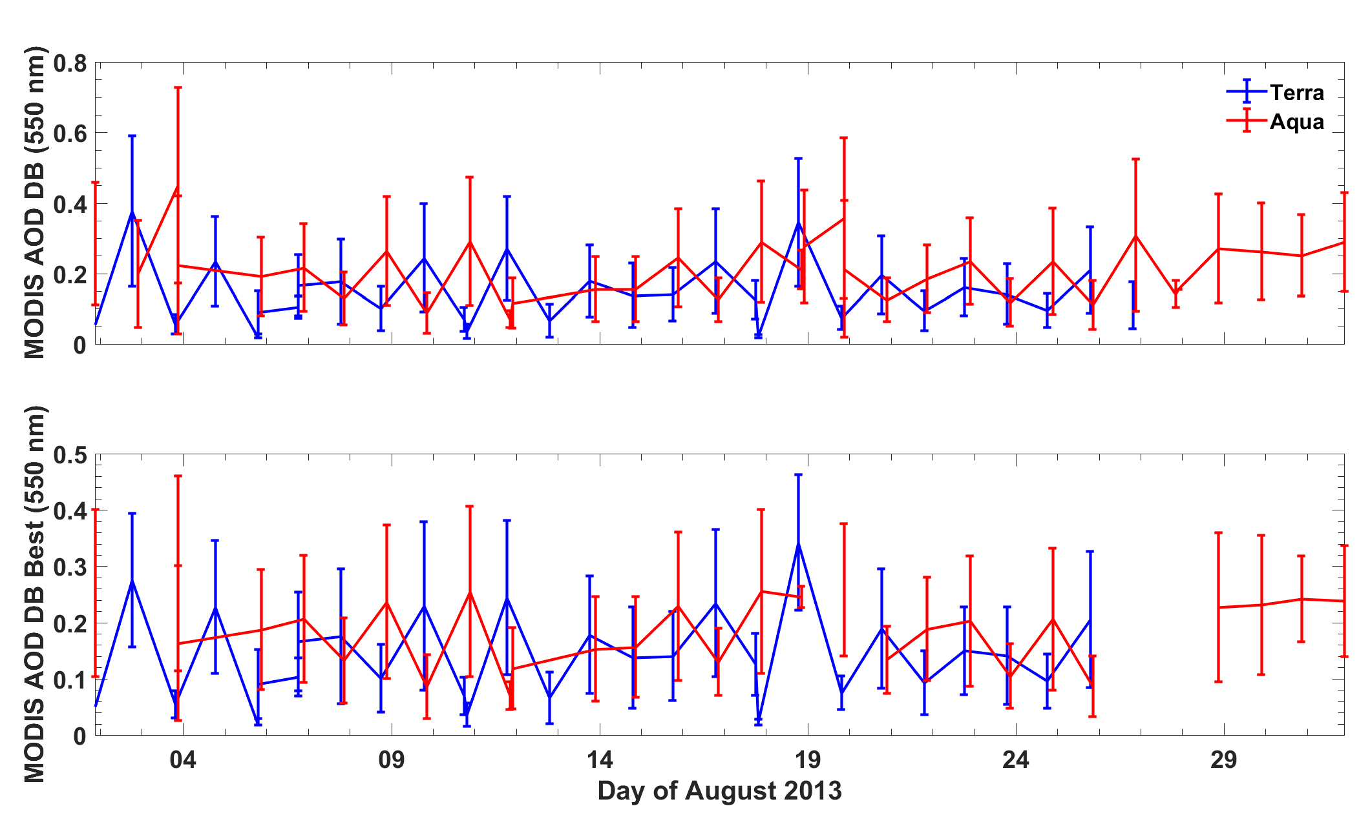
Aqua MODIS DB AOD C6.1 California and Nevada, August, 2013
Loria-Salazar et al., In-preparation
Notes:
The presence of wildfire smoke impacts the correlation between surface and satellite measurements of AOD in this region. AOD from AERONET and MODIS showed low correlation for days with typical ambient pollutant concentrations (e.g. R²~0.46 for Terra-MODIS over Las Vegas, NV in August 2013). During fire periods the correlation between instruments showed an improvement (e.g. R²~0.87 for Terra-MODIS over Reno, NV in August 2012 and R²~0.82 for Aqua-MODIS over Fresno, CA in August 2013) because of the increase in columnar aerosol concentration.

Slide 15
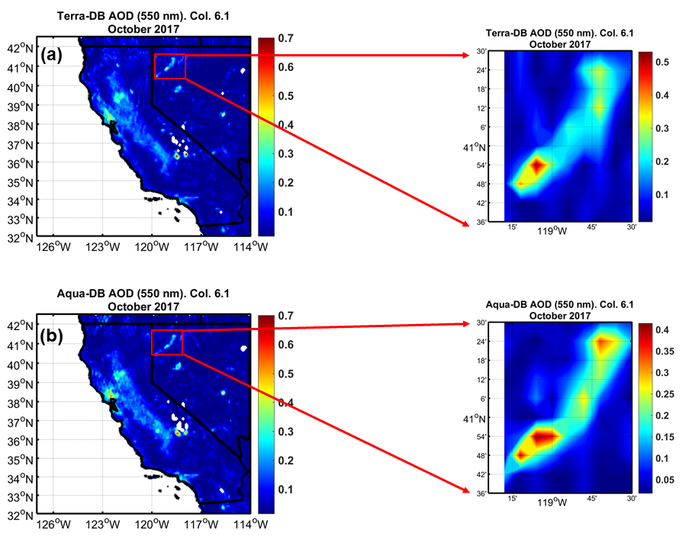
MODIS DB AOD C6.1 California and Nevada, October, 2017
Boehmler et al., 2018
Notes:
Health effects of ambient air quality
Georgia Birth Cohort
Geo-coded patient information
Atlanta - epidemiologic results using central monitor data suggest associations of acute health effects and mobile source emissions
Spatially resolved health study needs spatial air quality metrics

Slide 16
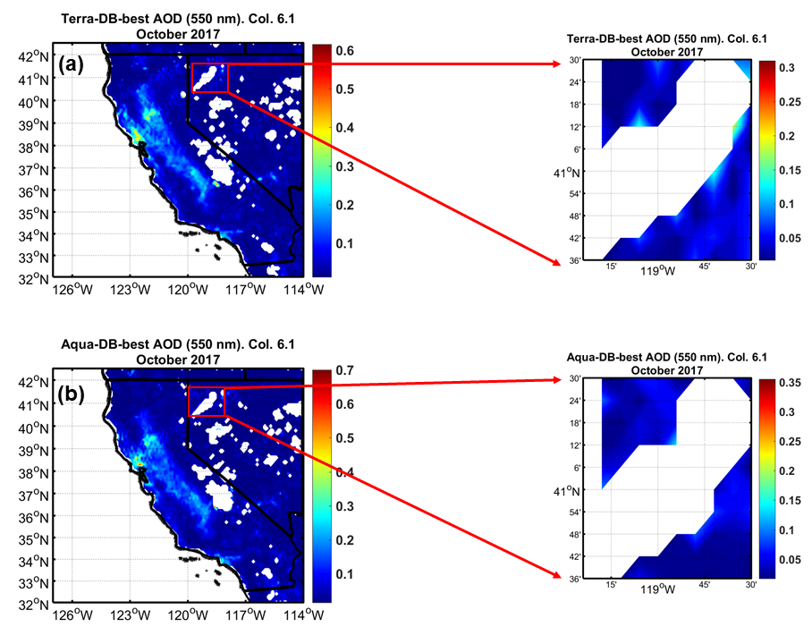
MODIS DB-best AOD C6.1 California and Nevada, October, 2017
Boehmler et al., 2018
Notes:
Health effects of ambient air quality
Georgia Birth Cohort
Geo-coded patient information
Atlanta - epidemiologic results using central monitor data suggest associations of acute health effects and mobile source emissions
Spatially resolved health study needs spatial air quality metrics

Slide 17
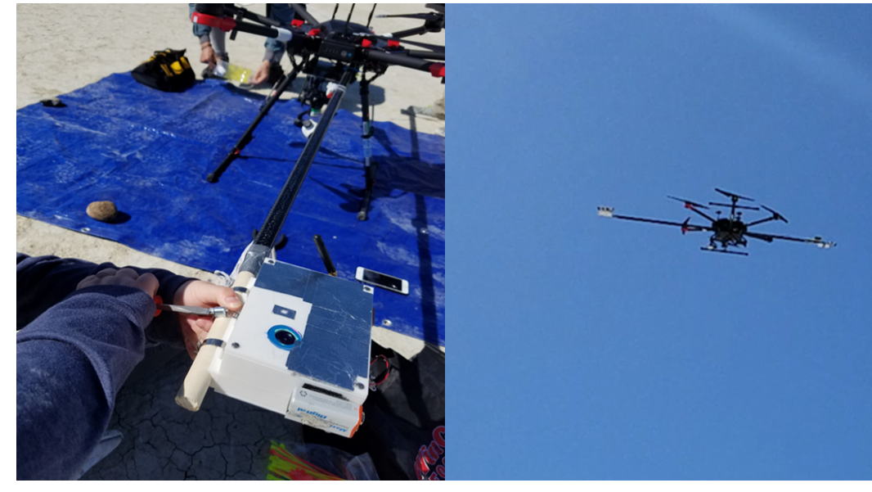
Albedometer measurements Black Rock Desert NV, October 5th, 2017
Albedometer
Compact
Portable
Unmanned aircraft system (UAS). spectrometer range: 340–780 nm
Measures Incident and reflected solar radiation at the surface
Satellite instruments
1. MODIS
Bands: 459-479 nm, 545-565 nm, and 620-670 nm
2. Landsat7 ETM
Bands: 450-520 nm, 520-600 nm, 630-690 nm, and 770-900 nm
Boehmler et al., 2018
Notes:
Health effects of ambient air quality
Georgia Birth Cohort
Geo-coded patient information
Atlanta - epidemiologic results using central monitor data suggest associations of acute health effects and mobile source emissions
Spatially resolved health study needs spatial air quality metrics

Slide 18
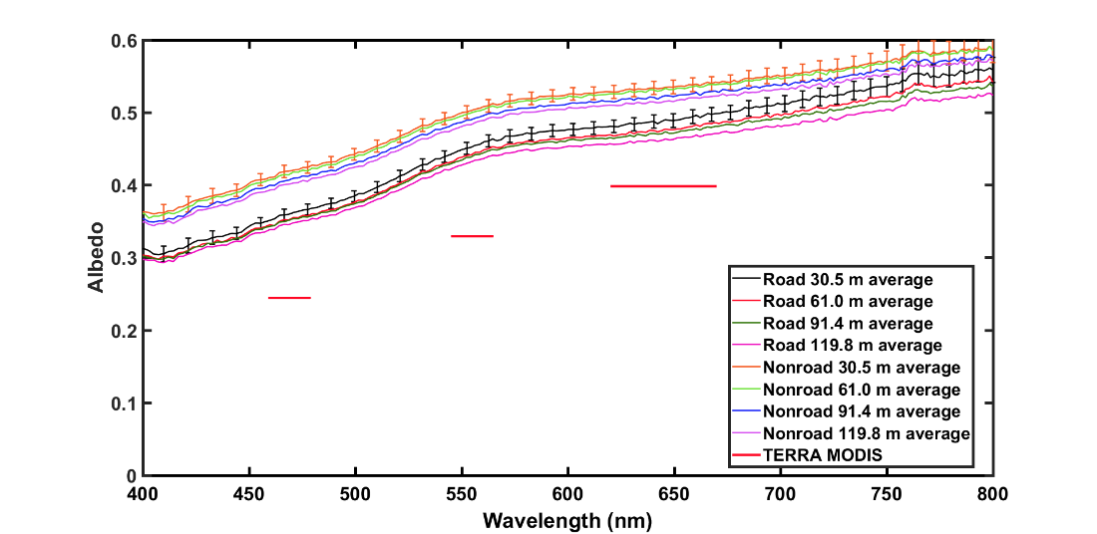
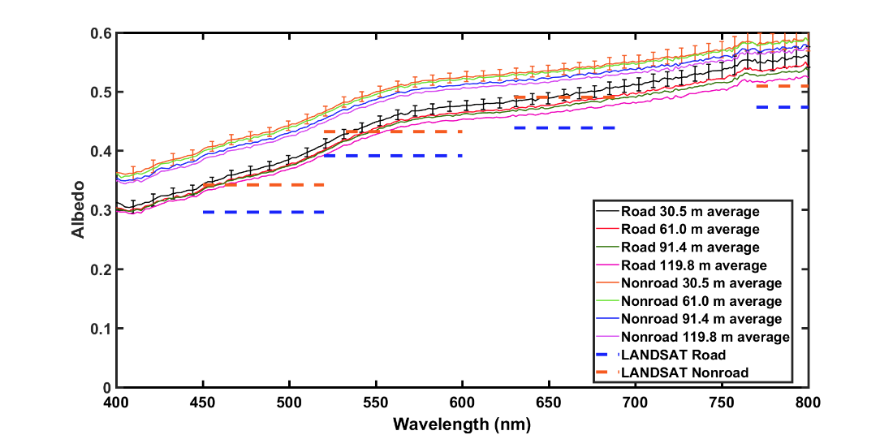
Albedometer measurements Black Rock Desert NV, October 5th, 2017
Terra-MODIS
LANDSAT7-LANDSAT7 ETM
Boehmler et al., 2018
Notes:
Health effects of ambient air quality
Georgia Birth Cohort
Geo-coded patient information
Atlanta - epidemiologic results using central monitor data suggest associations of acute health effects and mobile source emissions
Spatially resolved health study needs spatial air quality metrics

Slide 19
Albedometer measurements Black Rock Desert NV, October 5th, 2017
Terra-MODIS
LANDSAT7-LANDSAT7 ETM
MAIAC AOD retrievals are based in MODIS albedo retrievals
Boehmler et al., 2018
Notes:
Health effects of ambient air quality
Georgia Birth Cohort
Geo-coded patient information
Atlanta - epidemiologic results using central monitor data suggest associations of acute health effects and mobile source emissions
Spatially resolved health study needs spatial air quality metrics

Slide 20
Sensitivity of AOD to surface reflectance 1-D radiative model, BRD NV, October 5th, 2017
Total radiation received by the satellite
TOA
Atmosphere
Aerosol
Surface
Notes:
Health effects of ambient air quality
Georgia Birth Cohort
Geo-coded patient information
Atlanta - epidemiologic results using central monitor data suggest associations of acute health effects and mobile source emissions
Spatially resolved health study needs spatial air quality metrics

Slide 21
1-D radiation ∂AOD/ ∂A (660 nm) Black Rock Desert, October, 2017
Total radiation received
by the satellite
Direct beam radiation
from the surface
Diffuse beam radiation
from aerosols
Boehmler et al., 2018
Notes:
Health effects of ambient air quality
Georgia Birth Cohort
Geo-coded patient information
Atlanta - epidemiologic results using central monitor data suggest associations of acute health effects and mobile source emissions
Spatially resolved health study needs spatial air quality metrics

Slide 22
1-D radiation ∂AOD/ ∂A (660 nm) Black Rock Desert, October, 2017
Assumptions
Aerosol layer is infinitesimally thin
Rayleigh (~0.04) and aerosol optical depth (< 0.1) at 660 nm
Single scattering and single surface reflection apply
Single Scattering albedo ~ 0.975 (660 nm) from DB
Asymmetry parameter ~ 0.71 (660 nm) for weakly absorbing dust (Sayer et al., 2016)
$${∂AOD}/{∂A}\sim 54.5$$
MAIAC AOD retrievals are based in MODIS albedo retrievals
Boehmler et al., 2018
Notes:
Health effects of ambient air quality
Georgia Birth Cohort
Geo-coded patient information
Atlanta - epidemiologic results using central monitor data suggest associations of acute health effects and mobile source emissions
Spatially resolved health study needs spatial air quality metrics

Slide 23
1-D radiation ∂AOD/ ∂A (660 nm) Black Rock Desert, October, 2017
Critical albedo
The backscatter by the aerosol layer is the same as the combination of forward scattering by the layer and backscattering by the surface albedo
A_{crit}~0.42 when $\tilde{ω}$~0.97 and g~0.7
A_{BRD}~0.48
Boehmler et al., 2018
Loria-Salazar et al., In-preparation
Notes:
Health effects of ambient air quality
Georgia Birth Cohort
Geo-coded patient information
Atlanta - epidemiologic results using central monitor data suggest associations of acute health effects and mobile source emissions
Spatially resolved health study needs spatial air quality metrics

Slide 24
Summary
Objective
1. Evaluate aerosol satellite retrievals of AOD over bright surfaces in the western U.S. using the NASA Deep-Blue algorithm (Collection 6.1)
Surface reflectance cause high AOD values in the DB algorithm using
QF (0,1,2, and 3).
Surface reflectance removed every single pixel in the DB algorithm using
QF (2 and 3).
Hypothesis
1. While It is expected improvement on AOD over bright surfaces in Deep-Blue Collection 6.1, surface reflectance may cause unrealistic high AOD over bright surfaces over non-fire periods (e.g. Black Rock Desert, NV)
Notes:
However, the semi-arid western U.S. continues to be an unproven and infrequently explored area for remotely sensed atmospheric aerosol pollution retrievals. The study of aerosol transport and optical properties in this area is a challenge due to the complex terrain, bright surfaces, presence of anthropogenic and biogenic emissions, secondary organic aerosol formation, smoke from wildfires, and low aerosol concentrations during non-fire conditions.
Previous studies have shown that MODIS retrievals failed to estimate column-integrated aerosol pollution levels and particle size over Nevada and California in the summer months of 2012 and 2013 due to high surface albedo, heterogeneous vertical profile of aerosol concentrations, and incorrect parameterizations for surface reflectance. MODIS algorithms overestimated AOD by more than a factor of 3 in Reno, NV and more than a factor of 2 over Fresno, CA.

Slide 25
Summary
Objective
2. Evaluate a portable albedometer instrument against satellite retrievals using MODIS and Landsat instruments
MODIS and LANDSAT7 ETM+ surface reflectance consistently underestimated albedo across all spectral bands.
LANDSAT7 ETM+ retrieved values agreed more with measured likely due to the finer spatial resolution of the LANDSAT7 ETM+ instrument
Hypothesis
2. MODIS retrievals underestimates surface reflectance
Notes:
However, the semi-arid western U.S. continues to be an unproven and infrequently explored area for remotely sensed atmospheric aerosol pollution retrievals. The study of aerosol transport and optical properties in this area is a challenge due to the complex terrain, bright surfaces, presence of anthropogenic and biogenic emissions, secondary organic aerosol formation, smoke from wildfires, and low aerosol concentrations during non-fire conditions.
Previous studies have shown that MODIS retrievals failed to estimate column-integrated aerosol pollution levels and particle size over Nevada and California in the summer months of 2012 and 2013 due to high surface albedo, heterogeneous vertical profile of aerosol concentrations, and incorrect parameterizations for surface reflectance. MODIS algorithms overestimated AOD by more than a factor of 3 in Reno, NV and more than a factor of 2 over Fresno, CA.

Slide 26
Summary
Objective
3. Determine the impact of surface reflectance in Deep-Blue AOD algorithm (Collection 6.1)
${∂AOD}/{∂A}\sim 54.5$ (660 nm)
AOD satellite retrievals over bright surfaces are extremely sensitive to errors in surface albedo but also in single scattering albedo
Hypothesis
3. High deviation of AOD due to surface reflectance causes high uncertainty in MODIS Deep-Blue AOD
Notes:
However, the semi-arid western U.S. continues to be an unproven and infrequently explored area for remotely sensed atmospheric aerosol pollution retrievals. The study of aerosol transport and optical properties in this area is a challenge due to the complex terrain, bright surfaces, presence of anthropogenic and biogenic emissions, secondary organic aerosol formation, smoke from wildfires, and low aerosol concentrations during non-fire conditions.
Previous studies have shown that MODIS retrievals failed to estimate column-integrated aerosol pollution levels and particle size over Nevada and California in the summer months of 2012 and 2013 due to high surface albedo, heterogeneous vertical profile of aerosol concentrations, and incorrect parameterizations for surface reflectance. MODIS algorithms overestimated AOD by more than a factor of 3 in Reno, NV and more than a factor of 2 over Fresno, CA.

Slide 27
Summary
Future work
Improvement in the design and spectral bands of the albedormeter instrument
3-D dimensional radiative model to propagate the uncertainty of AOD to surface reflectance, single scattering albedo, and asymmetry parameter
Using other AOD algorithms (e.g. MISR and MAIAC)
Acknowledgments
Financial Support
NASA Earth and Science Student Fellowship (NNX16AN94H, PI: H. A. Holmes)
Clemons-Magee Physics Professorship program (PI: W. P. Arnott)
Collaboration with NASA DB Mission
N. Christina Hsu, PhD
Andrew M. Sayer, PhD
Notes:
However, the semi-arid western U.S. continues to be an unproven and infrequently explored area for remotely sensed atmospheric aerosol pollution retrievals. The study of aerosol transport and optical properties in this area is a challenge due to the complex terrain, bright surfaces, presence of anthropogenic and biogenic emissions, secondary organic aerosol formation, smoke from wildfires, and low aerosol concentrations during non-fire conditions.
Previous studies have shown that MODIS retrievals failed to estimate column-integrated aerosol pollution levels and particle size over Nevada and California in the summer months of 2012 and 2013 due to high surface albedo, heterogeneous vertical profile of aerosol concentrations, and incorrect parameterizations for surface reflectance. MODIS algorithms overestimated AOD by more than a factor of 3 in Reno, NV and more than a factor of 2 over Fresno, CA.

