Slide 1
Application of Low-cost PM_{2.5} Sensors to Quantify the Impacts of Prescribed Burning on Air Quality in Southwestern Georgia
Ran Huang¹, Raj Lal¹, Momei Qin², Yongtao Hu¹, Armistead G. Russell¹, M Talat Odman¹
¹Georgia Institute of Technology, Atlanta, Georgia, USA
²Environmental Protection Agency, Chapel Hill, NC, USA
CMAS Conference, October 2018
Remote Sensing/Sensor Technology and Measurements Studies
Notes:
Good afternoon, I’m Ran Huang, from Georgia Tech. My talk today is about low-cost PM sensor’s application in quantifying prescribed fire impact and evaluation using air quality model.

Slide 2
Acknowledgements
Dr. Susan O'Neill
Sadia Afrin, Dr. Fernando Garcia Menendez
Notes:
First, I would like to thank those who support us and provide us with the data

Slide 3
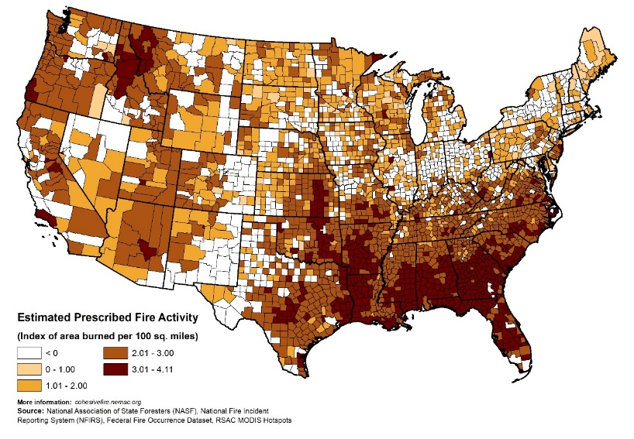
Prescribed Burning (PB)
PB is a land management tool practiced to reduce wildfire risks, control insects and disease and recycle nutrients back to soil.
According to US EPA 2014 NEI:
13% of PM_{2.5} emissions in the US come from PB;
PB is the largest source of PM_{2.5} (24%) in the southeastern US.
Southeastern US has one of the highest health vulnerabilities in the nation.
A better understanding of the contributions of PB to air pollution and public health is important for effective fire, air quality and health management.
Limited observations to provide spatial information for generating exposure fields for health study.
Estimated Prescribed Fire Activity
Community health-vulnerability Index (CHVI)
(Rappold et al., Environ. Sci. Technol, 2017)
Notes:
PB ..
However, sparse distribution of monitoring sites may not provide enough information to understand the impact of those PB on local air quality and public health. Finding another inexpensive device, like low-cost sensors, to measure the ambient concentration is needed.

Slide 4
Study Area
PM_{2.5} Monitoring Sites in GA
Turner Elementary site (13095007):
Albany, GA
BAM
GA Air Protection Branch Ambient Monitoring Program (GA EPD site)
19.2 km
1.1 km
25.6 km
https://airgeorgia.org/
Georgia is one of the most active PB state in the Southeastern US with a total burn area around 550,000 ha in 2016.
*Yellow areas are the counties that have the PM_{2.5} monitoring sites.
Notes:
We want to know whether low-cost sensor could be used to detect the impact from prescribed fires.
GA is one …
This map shows the current locations of PM2.5 monitoring site in GA. Southwest GA is the most active burn area in GA, however there’s only one monitoring site (Turner Elementary Site, it’s located at … The instrument is BAM. The site is based on …). Only one monitoring site may not capture the spatial variation of the impact from prescribed fire.
We decided to focus our measurement in this area near the EPD site.
Three low-cost PM sensors were deployed at Dougherty, Lee and Worth County High Schools since July 2017 and a fourth sensor was placed next to the state monitoring site since March 2018.
The sensor at Dougherty county high school is the closest one to the EPD site, only about 1km away.

Slide 5
Low-cost Sensor
PM sensor: $17
Micro-controller: $208
Box: $22
Total: $247
PM_{2.5} Sensor: Plantower PMS 3003
The Plantower PMS 3003 sensor uses an optical method to measure PM₁, PM_{2.5} and PM₁₀.
The sensor performance was better when ambient PM_{2.5} was higher. (Zheng, T. et al., Atmos. Meas. Tech. Discuss. 2018, 1–40.)
Notes:
Here’s the box we deployed. The low-cost PM sensor we used is Plantower PMS 3003. Zheng has evaluated the sensor and shows that it has better performance in higher concentrated area while fire impact usually cases high PM2.5 concentration level.

Slide 6
Calibration
Linear regression calibration
RH correction calibration
Albany BAM (Referenced PM_{2.5}) & Sensor PM_{2.5}: 20180314~20180620, hourly
RH data: Southwest Georgia Regional Airport
Distance: 13 km
RH correction factor
$$= \frac{\text{raw} \text{PMS}\text{3003 }\text{PM}\text{2.5} \text{conc}}{\text{reference} \text{PM}\text{2.5} \text{conc}\text{. }}$$
$$=a+b×\frac{{RH}^{2}}{1−RH}$$
$$Calibrated data=0.36RawData+1.98$$
6
Notes:
When using those low-cost sensors, calibration of raw data is important. Usually, people used the RH correction calibration, to have the RH correction factor. However, for our case, there’s no obvious correlation between the RH and referenced pm2.5, so we decide to use the linear regression calibration. Here’s the equation that was applied to all sensors’ raw data to have the following results.

Slide 7
PM_{2.5} Hourly Concentration
Albany (EPD site)
Dougherty
Worth
Lee
Low-cost sensors are less sensitive to changes in PM_{2.5} concentrations than BAM due to the detection limitations. In comparison to BAM, lower or higher peaks at sensors other than EPD Site are likely due to fire plumes missing the sensors altogether.
Notes:
Here’s the hourly temporal trend of PM2.5. We can see that low-cost sensors …

Slide 8
PM_{2.5} Daily Concentration
Albany
(EPD site)
Dougherty
Worth
Lee
Daily trends of PM_{2.5} concentrations from the sensor at Dougherty County High School and monitoring site show that the high school sensor (=33 µg/m³) did not capture the exceedance (=50 µg/m³) on March 10, 2018.
Notes:
Here’s the daily temporal trend of PM2.5. … there’s an exceedance on March 10, however, no sensors capture the exceedance, but the concentration from Dougherty County High School (33) is still the highest among the whole measurement period.

Slide 9
Daily Linear regression (BAM vs Sensor)
R²:0.76
R²:0.71
R²:0.44
R²:0.52
Albany vs Albany
Dougherty vs Albany
Lee vs Albany
Worth vs Albany
Lower R² does not mean the low-cost sensor performance is not good. Considering the distance between the sensors and monitoring site, and also the fire plume positions, those lower R² are expected. They show the spatial variation of fire impact on concentration and that a single monitoring site may miss high concentrations in the area.
Notes:
Here’s the daily linear regression between the all four low-cost sensors and EPD site. All the slopes are less than 1, and the R2 between the low-cost sensor and BAM at EPD site is the largest. But, lower R2 …

Slide 10
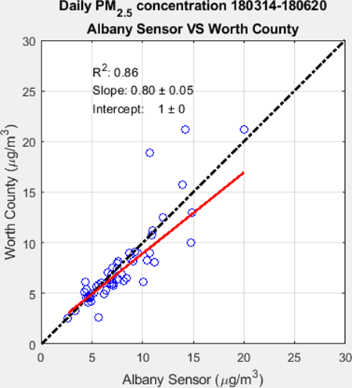
Worth vs Albany
Lee vs Albany
Dougherty vs Albany
R²:0.86
R²:0.92
R²:0.98
Intercomparison Orthogonal Regression
Dougherty vs Worth
Lee vs Worth
Lee vs Dougherty
R²:0.94
R²:0.94
R²:0.93
Notes:
Here’s the intercomparison between all the sensors. Dougherty VS Albany sensor has the largest R². The increased R² when comparing Worth, Lee and Dougherty sensors with Albany sensor show the spatial variation of the PM_{2.5} concentration that is affected by prescribed fire while Worth County High School is the farthest sensor from Albany sensor.

Slide 11
Exceedance Day (2018/03/10)
Permits
Number: 247
Total Acres: 7148
Albany EPD Daily PM_{2.5}: 50.2 µg/m³
Simulation period: 20180308~20180315
CMAQv 5.0.2, DDM
Fire emissions: BlueSky, all fires start at 11 am (EST), and last 3 hours
Notes:
As I just mentioned, there’s an exceedance day during our measurement period. It’s on Mar.10. The left figure shows the permit locations on that day, with a total number of 247 permits, total acres around 7,000 acres. The red circles represent the fires larger than 150 acres.
The daily concentration from the EPD site is 50 ug/m3.
The right figure shows the total acres per day for the nearby days. Red numbers is the daily PM2.5 concentration from the site and the green is the total burn acres from permit data. From Mar 13 to Mar 15, the daily total burn acres are quite large, over 5,000 acres everyday. It’s highly possible that those fires could cause severe impact on air quality, but no evidence from observation could prove the assumption.
So, we decided to focus on the exceedance day and the nearby days with large permitted burn acres using air quality model to simulate the PM2.5 concentration and evaluate the low-cost sensor’s performance.
We used CMAQ-DDM to simulate the period since 0308 to 0315. The fire emissions come from BlueSky framework. We assume all fires start at 11am local time and the flaming and smoldering process last 3 hours.

Slide 12
Comparison between observed and simulated PM_{2.5}, and fire impact @ EPD site on Mar. 09–10
Mar. 09
Mar. 10
Peak concentration in Mar. 9th: level captured, but hour missed; May be due to:
fire start time (11 am in the simulation)
duration of fire (3 hours in the simulation)
There are permits approved to start in the afternoon and end at night.
Notes:
Here’s the comparison between observation and simulation @ EPD site on Mar09 and 10.
We can see the peak …
By looking at the permit data, there’re permits …

Slide 13
Comparison between observed and simulated PM_{2.5}, and fire impact at EPD site on Mar. 09–10
Mar. 09
Mar. 10
The simulation does not show the exceedance on Mar. 10th.
Wind speed from observation (KABY: Southwest Georgia Regional Airport) is 0 from 00:00 to 07: 00 and 19:00 to 23:55 EST on Mar. 10th, however WRF simulation shows higher wind speed. WRF has a systematic bias that overestimates nighttime wind speed.
The peak at 10:00 am may be caused by a new fire starting early and located close to the monitoring site. However, it’s hard to tell which fire it is.
Notes:
However, the simulation doesn’t …
For the red square period, these difference may be mainly caused by meteorology. Wind speed from OBS …

Slide 14
Comparison between observed and simulated PM_{2.5}, and fire impact at EPD site and Dougherty County High School on Mar. 09–10
Albany (EPD site)
Dougherty
The spatial variation of fire impact cannot be captured with 4-km resolution model simulations.
Notes:
Usually, we’d like to fuse observation from monitoring site and model simulations to provide more accurate exposure fields that model simulations are used to provide spatial information. However, from this case we can see that this hour, the simulated concentrations are from two nearby grids at 4km resolution, the difference of concentration between observations are quite large, but the simulation doesn’t show the similar variations.

Slide 15
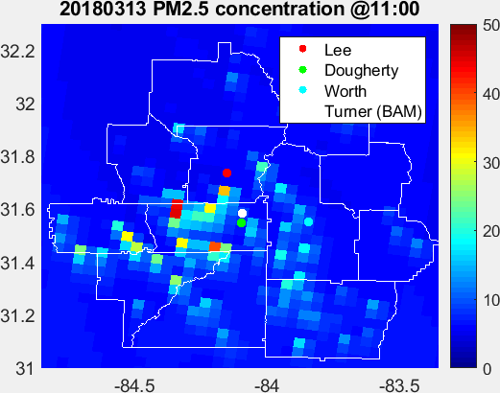
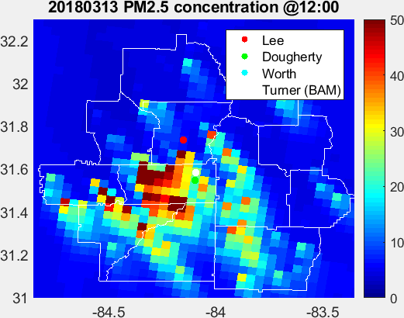
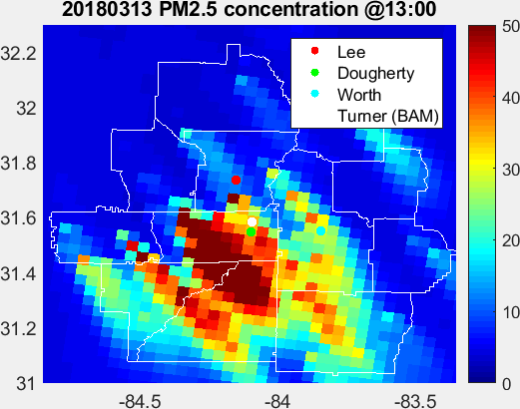
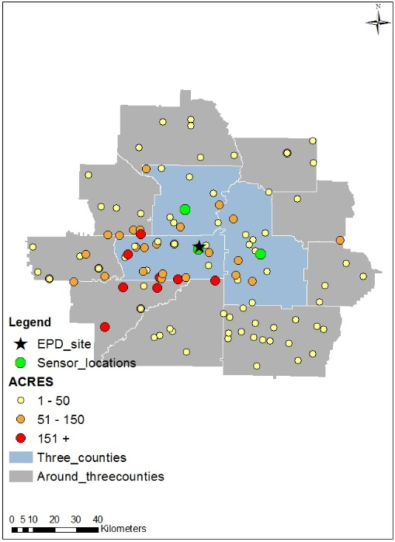
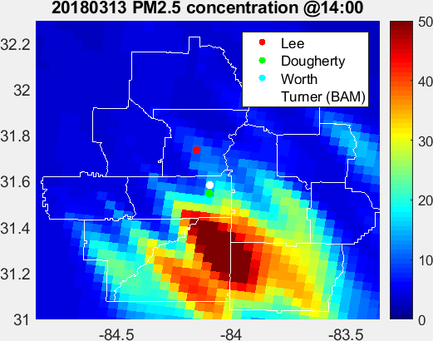
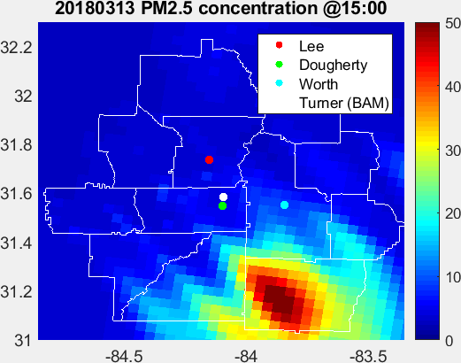
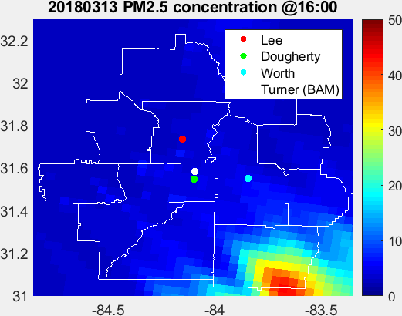
13 March 2018 Permits
Hourly PM_{2.5} concentrations (EST)
Notes:
Here’s the spatial plots of hourly concentration since 11 am to 4 pm on Mar.13, this is the permit locations. There’re some large fires in this area, and the wind comes from the northwest, so the plume goes to the southeast, and just missed the monitoring site and the Dougherty Sensor while the observations are both quite flat at low concentration.

Slide 16
13 March 2018 Permits
Hourly PM_{2.5} concentrations (EST)
Notes:
And for the Worth Sensor, this peak and high concentration, is because those medium size fires.

Slide 17
13 March 2018 Permits
Hourly PM_{2.5} concentrations (EST)
Notes:
But still, those counties, include Dougherty, are severely affected by those big fires, but the monitoring site and the sensor doesn’t capture it.

Slide 18
Conclusions
Due to the shortage of monitoring sites in Southwestern Georgia, the severe impact of prescribed fires on local air quality and public health may be missed.
Low-cost sensors could be used to detect prescribed fire impacts and provide spatial information.
Sensor calibration is important. Published RH corrections may not help.
Accuracy of fire impact simulation is highly dependent on meteorology.
PM_{2.5} concentrations in Southwestern Georgia are not homogeneous; the spatial variation cannot be captured even with 4-km resolution model simulations.
1-km (or finer) resolution together with better knowledge of start and end times of the burns could improve the simulations. However, the uncertainties in wind speed and direction would still limit the accuracy.
We recommend fusing the model simulations with observations from a dense network of low-cost sensors for accurate estimation of exposures to smoke from prescribed burning.

Slide 19
Questions?

Slide 20
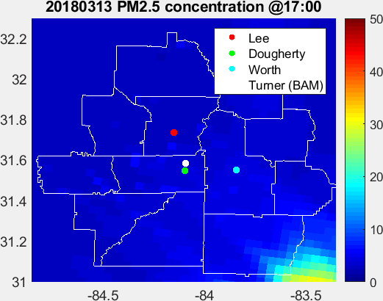
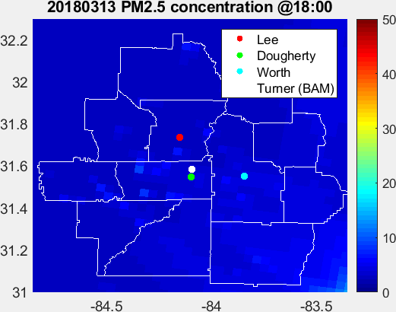
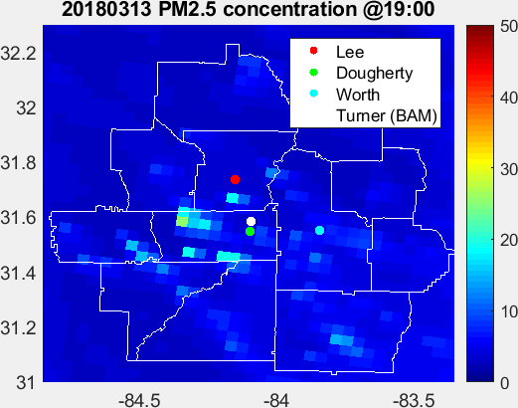
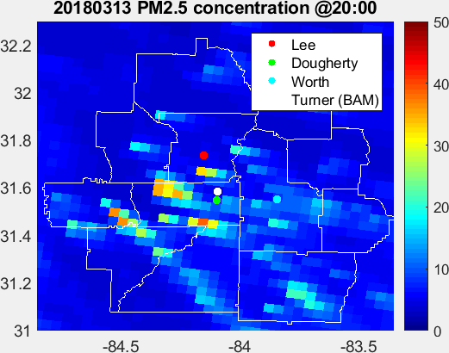
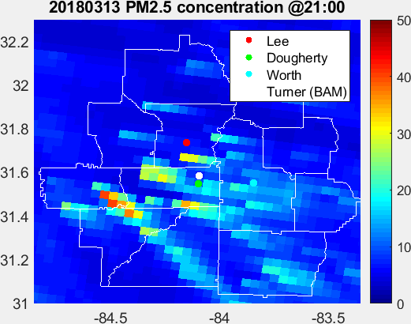
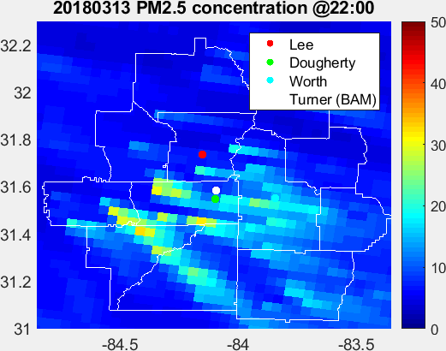
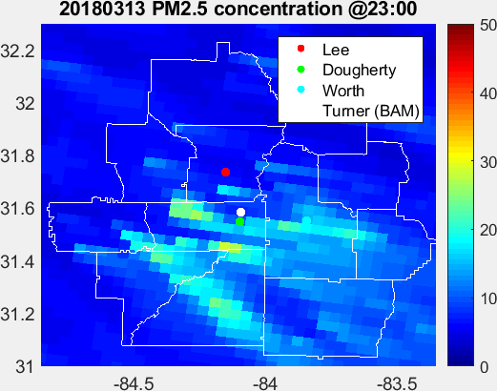
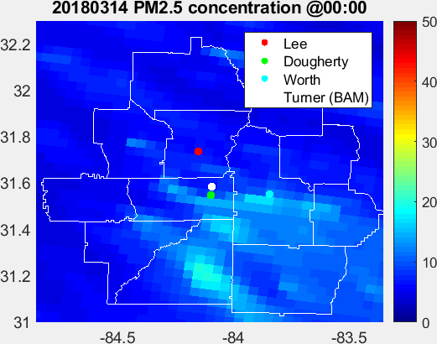
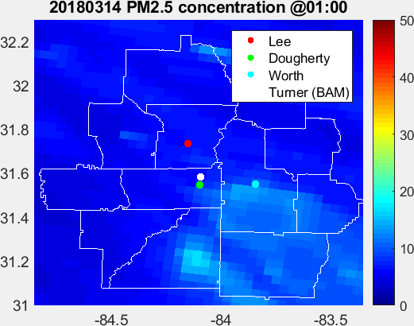
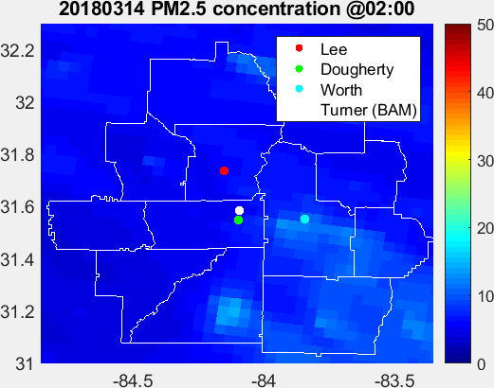
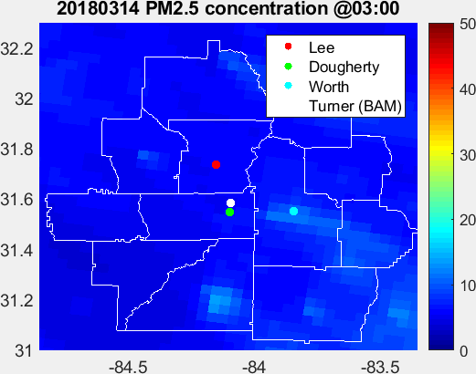
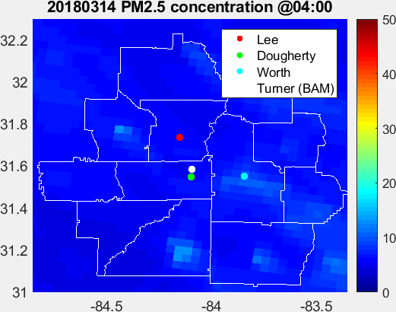
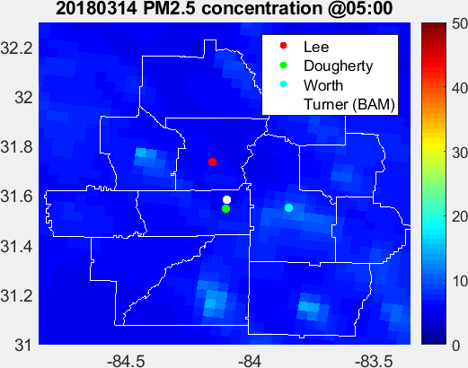
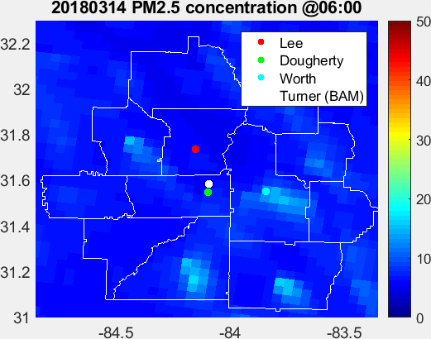
20180313 Permits
Hourly PM_{2.5} concentrations (EST)
Notes:
Here’s the spatial plots of hourly concentration since 11 am on Mar.9, this is the permit locations.
Lacking monitor sites and sensors in the southwest area misses the severe impact from prescribed fires on these areas.

Slide 21
20180309 Permits
Hourly PM_{2.5} concentrations (EST)
Notes:
Here’s the spatial plots of hourly concentration since 11 am on Mar.9, this is the permit locations.
Lacking monitor sites and sensors in the southwest area misses the severe impact from prescribed fires on these areas.

Slide 22
Discussion

Slide 23
Comparison between observed and simulated PM_{2.5}, and fire impact at EPD site on Mar. 09–10
Mar. 09
Mar. 10
The simulation does not show the exceedance on Mar. 10th.
Wind speed from observation (KABY: Southwest Georgia Regional Airport) is 0 from 00:00 to 07: 00 and 19:00 to 23:55 EST on Mar. 10th, however WRF simulation shows higher wind speed. WRF has a systematic bias that overestimates nighttime wind speed.
The peak at 10:00 may be caused by a new fire starting early and located close to the monitoring site. However, it’s hard to tell which fire it is.
Notes:
However, the simulation doesn’t …
For the red square period, these difference may be mainly caused by meteorology. Wind speed from OBS …

Slide 24
PM2.5 Hourly Concentration
Albany Linear Regression
JST RH corrected calibration

Slide 25
PM2.5 Daily Concentration
Albany Linear Regression
JST RH corrected calibration

Slide 27
Hourly Linear Regression

Slide 28
Linear Regression – Albany: BAM VS Low-cost sensor
Albany Linear Regression
JST RH corrected calibration

Slide 29
Linear Regression – Albany VS Dougherty
Albany Linear Regression
JST RH corrected calibration

Slide 30
Linear Regression – Albany VS Lee
Albany Linear Regression
JST RH corrected calibration

Slide 31
Linear Regression – Albany VS Worth
Albany Linear Regression
JST RH corrected calibration

Slide 32
Daily Linear Regression

Slide 33
Linear Regression – Albany: BAM VS Low-cost sensor
Albany Linear Regression
JST RH corrected calibration

Slide 34
Linear Regression – Albany VS Dougherty
Albany Linear Regression
JST RH corrected calibration

Slide 35
Linear Regression – Albany VS Lee
Albany Linear Regression
JST RH corrected calibration

Slide 36
Linear Regression – Albany VS Worth
Albany Linear Regression
JST RH corrected calibration

Slide 37
Comparison between simulated CO, and fire impact

Slide 38
Vertical simulation

Slide 39
Vertical Simulation

