Slide 1
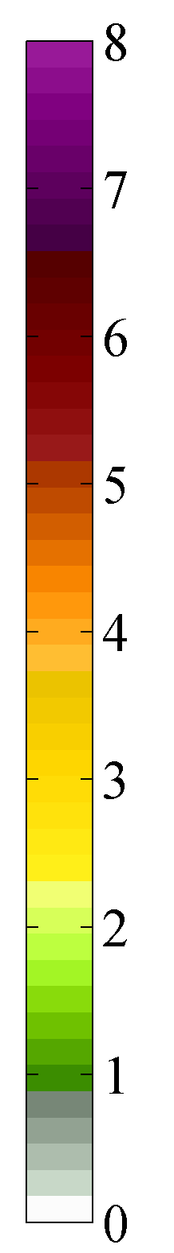
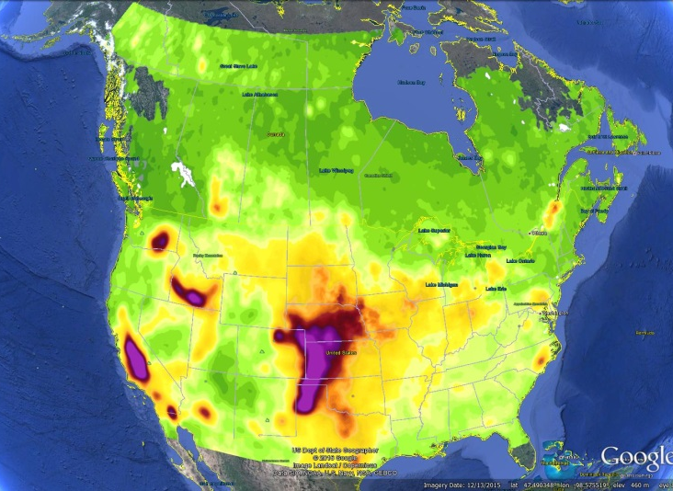
CrIS Observations of Ammonia: Retrievals, Validation and Spatiotemporal Variability
Forest Fires Sources
Agricultural Sources
Karen E. Cady-Pereira¹ , Mark W. Shephard², Shailesh K. Kharol², Enrico Dammers², Cynthia Whaley², Cristen Adams², Jesse Thompson² , Nolan Dickson², Ed Hare², Matt Alvarado¹ and Chantelle Lonsdale¹
¹Atmospheric and Environmental Research (AER), Lexington, Massachusetts, USA
² Environment and Climate Change Canada (ECCC), Toronto, Ontario, Canada

Slide 2
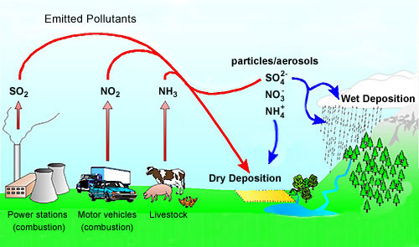
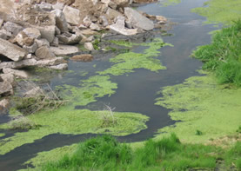
Why are we interested in measuring ammonia (NH₃)?
Air, Soil, and Water Quality
  Ammonia is listed as a Criteria Air Contaminant (CAC) as it is a main precursor to the secondary production of fine particulate matter (PM_{2.5}); a key contributor to smog
    PM_{2.5} associated with increased risk of cardiovascular and respiratory diseases
      Input into the Air Quality Health Index (AQHI)
  Ammonia is one of the most important reactive nitrogen species
    Reactive nitrogen deposition from ammonia leads to soil acidification and water eutrophication (e.g. algal blooms)
    Ammonia (ammonium) is the least well known part of the nitrogen cycle
Mostly Agricultural Emissions in Canada
      Ammonia + Acidic Species (i.e. nitric and sulphuric acid from NOx and SOx) = PM_{2.5}
PM_{2.5}
Soil Acidification
Water Eutrophication

Slide 3
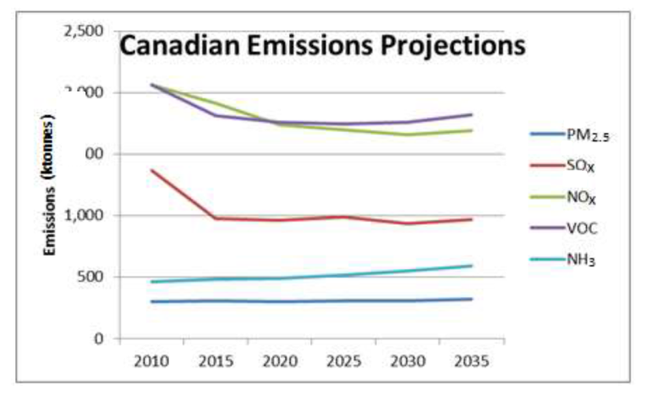
Why are we interested in measuring ammonia (NH₃)?
Global (NH₃) emissions are forecast to increase:
  Demand for more and better food in developing countries
    More livestock production
    Greater use of fertilizer
RPC Emission Scenarios
Mostly Agricultural Emissions in Canada
ECCC’s National Pollutant Release Inventory (NPRI)
SO_{x}, NO_{X} in general have been decreasing due to increased emission controls
  Catalytic converters on vehicles (NOx)
  Scrubbers installed in power plant stacks (SOx)
2.5
2.0
1.5
1.0
0.5
0
Emissions (Tg/yr)
Canada-USA Transboundary Particulate Matter Science Assessment, 2013
Ammonia (NH₃) is the only PM_{2.5} precursor that is both currently increasing and expected to continue to increase in the future

Slide 4
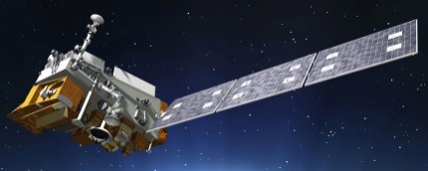
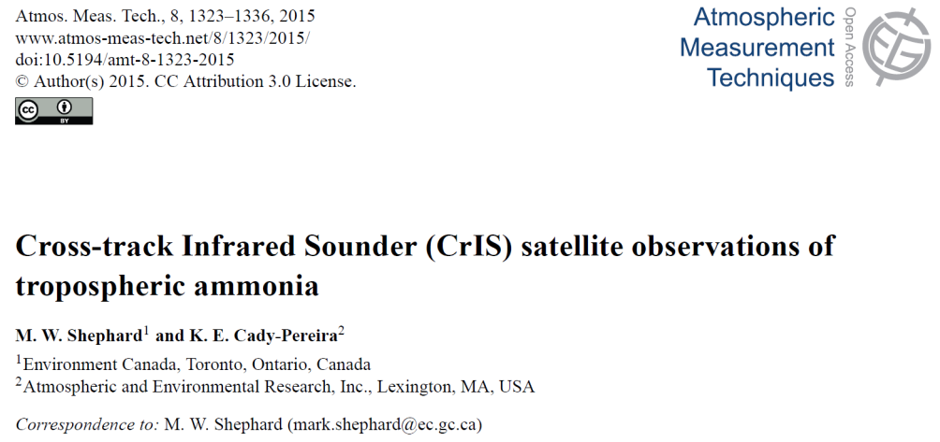
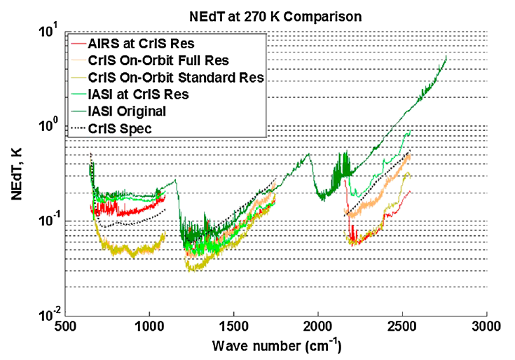
Cross-Track Infrared Sounder (CrIS)
  Launched in fall 2011 on S-NPP
  Also now flying on JPSS1: three more to follow through 2038
  Spatial Resolution = 14 km (diameter)
  ~1:30 and 13:30 overpass: ideal for NH₃
  Global spatial coverage
  Spectral Resolution (cm⁻¹) @ 970 cm⁻¹ = 0.625
  Excellent noise
    NEdT ~0.05K at 270K
    ~4x better noise than similar sensors
  TES-like sensitivity with IASI/AIRS-like spatial coverage

Slide 5
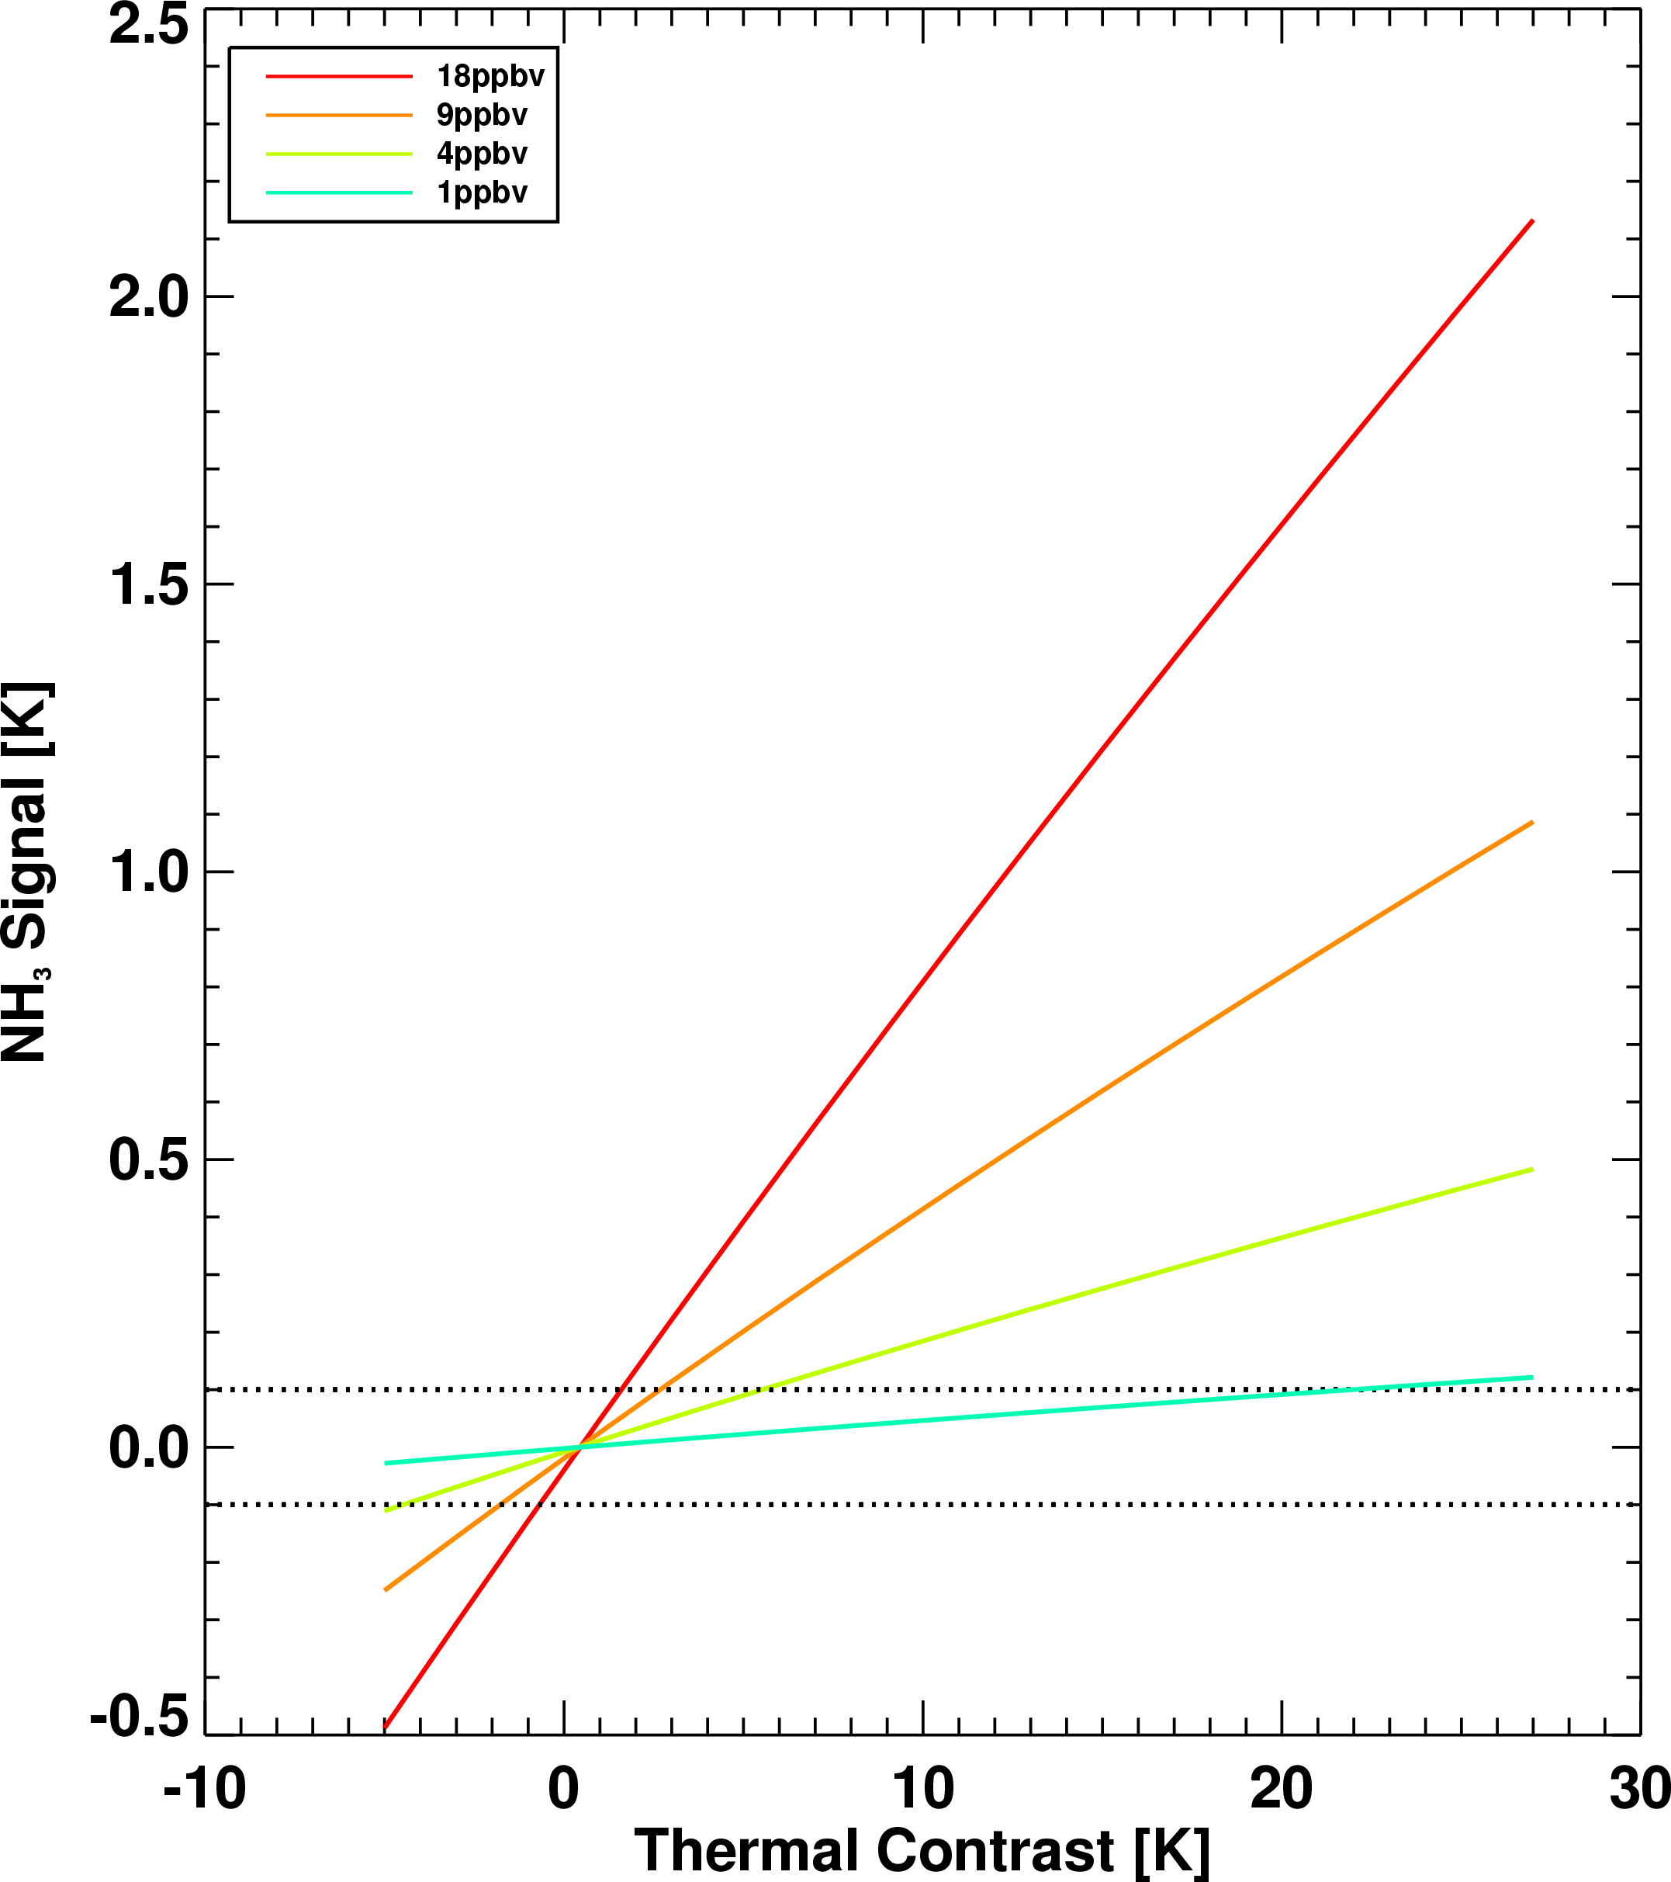
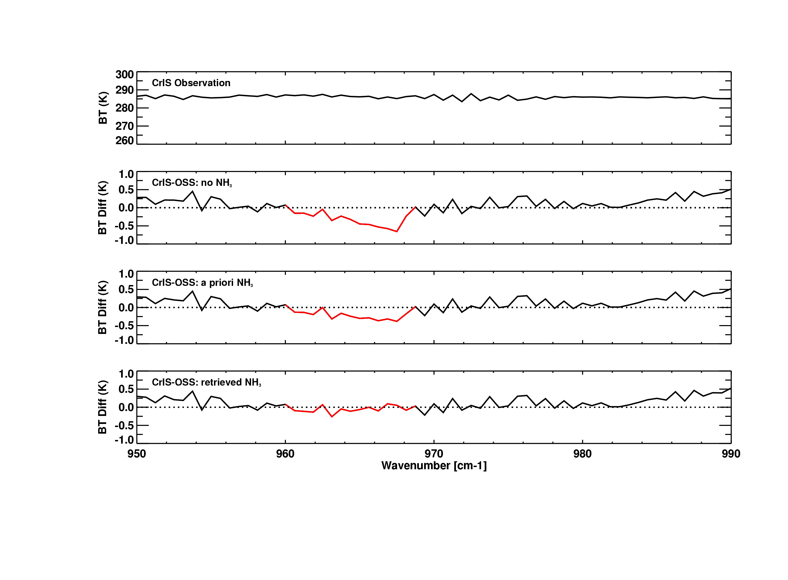
CrIS Fast Physical Retrieval (CFPR) Algorithm for NH₃
  developed in collaboration between Canada (ECCC) and USA (AER)
  TES heritage
  optimal estimation (Rodgers, 2000) implemented in IDL
  OSS as forward model
NH₃ Signal vs TCON
Observations
CrIS Obs
Observations
Observations
Observations
Observation – Forward Model Calculations
No NH₃
O₃
CrIS Obs
H₂O
CrIS Obs
CrIS Obs
NH₃
Observation – Forward Model Calculations
No NH₃
Observation – Forward Model Calculations
No NH₃
O₃
H₂O
O₃
NH₃
H₂O
Initial Guess
NH₃
Initial Guess
Retrieval
Detectability is ~ 0.25 ppbv under ideal conditions
Thermal contrast plays an important role
Thermal Contrast: Surface- Air Temperature
For more details see: Shephard M.W. and K. E. Cady-Pereira, AMT, 2015

Slide 6
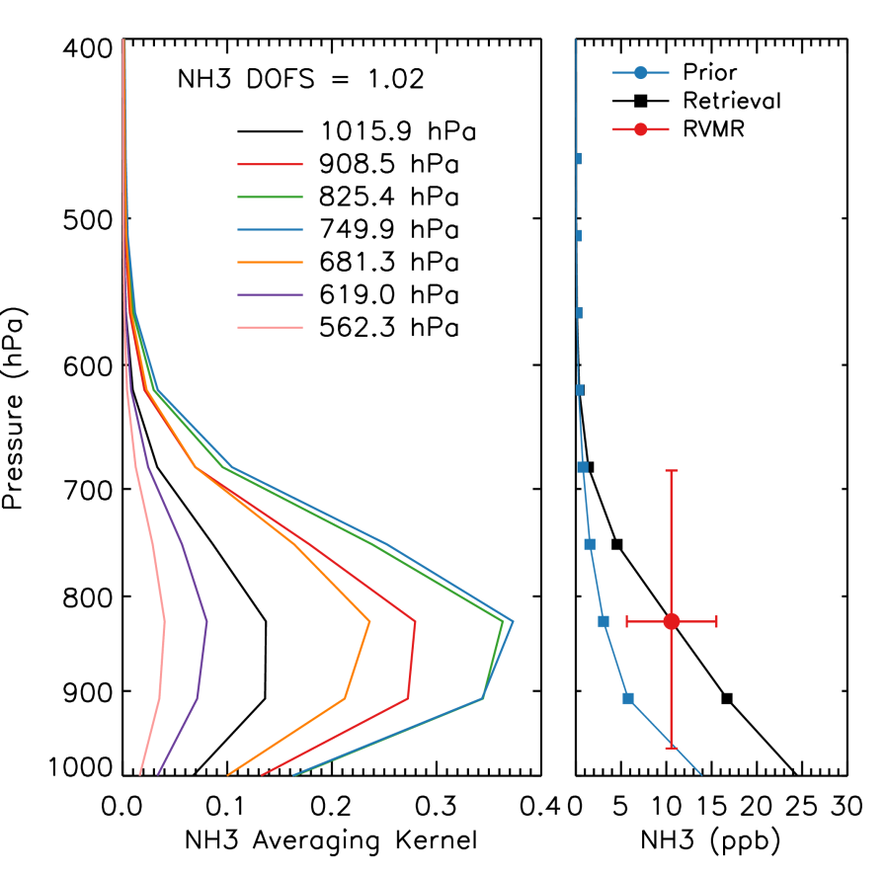
CrIS Fast Physical Retrieval (CFPR) for NH₃
CrIS most sensitive to NH₃ between 950 and 700 mb (~0.5 to 3 km)
Sensitivity varies from profile-to-profile
Surface retrieved values are driven by sensitivity in boundary layer
~1 piece of information:
  DOFS~1
For more details see: Shephard M.W. and K. E. Cady-Pereira, AMT, 2015

Slide 7
How do CrIS NH₃ retrievals compare with other measurements?
CrIS: an instantaneous profile over a footprint at least 14 km in diameter
Most ground measurements: point data at the surface
  Often a bi-weekly average:
    Ammonia Monitoring Network (AMoN)
    Canadian Air and Precipitation Monitoring Network (CAPMoN)
Ground-based Fourier Transform InfraRed (FTIR)
  Profile and total column measurements
  Instantaneous cloud-free sampling (middle of the day)
Aircraft: profiles of point data
  DISCOVER-AQ campaigns in California and Colorado
All measurements come with large uncertainties:
  NH₃ is sticky, highly reactive and has high spatial and temporal variability validation is not straightforward

Slide 8
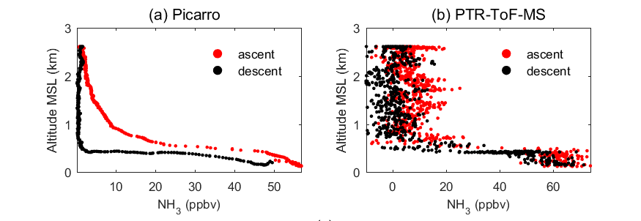
Validation: Uncertainty in aircraft profiles
Sample profiles from the California DISCOVER AQ campaign January-February 2013
Picarro slow response leads to hysteresis:
  Overestimates on ascent and underestimate on descent
PTR-ToF-MS signal is very noisy

Slide 9
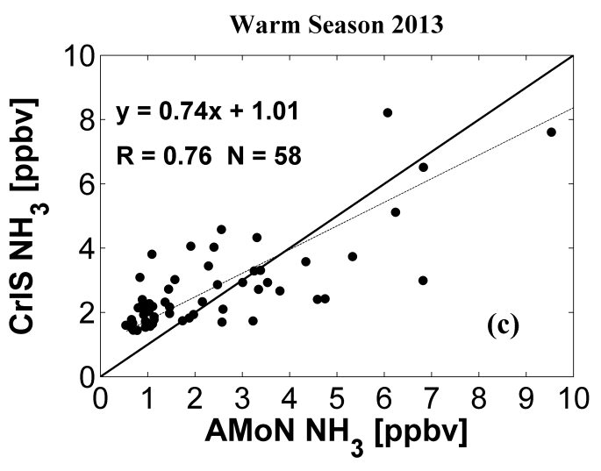
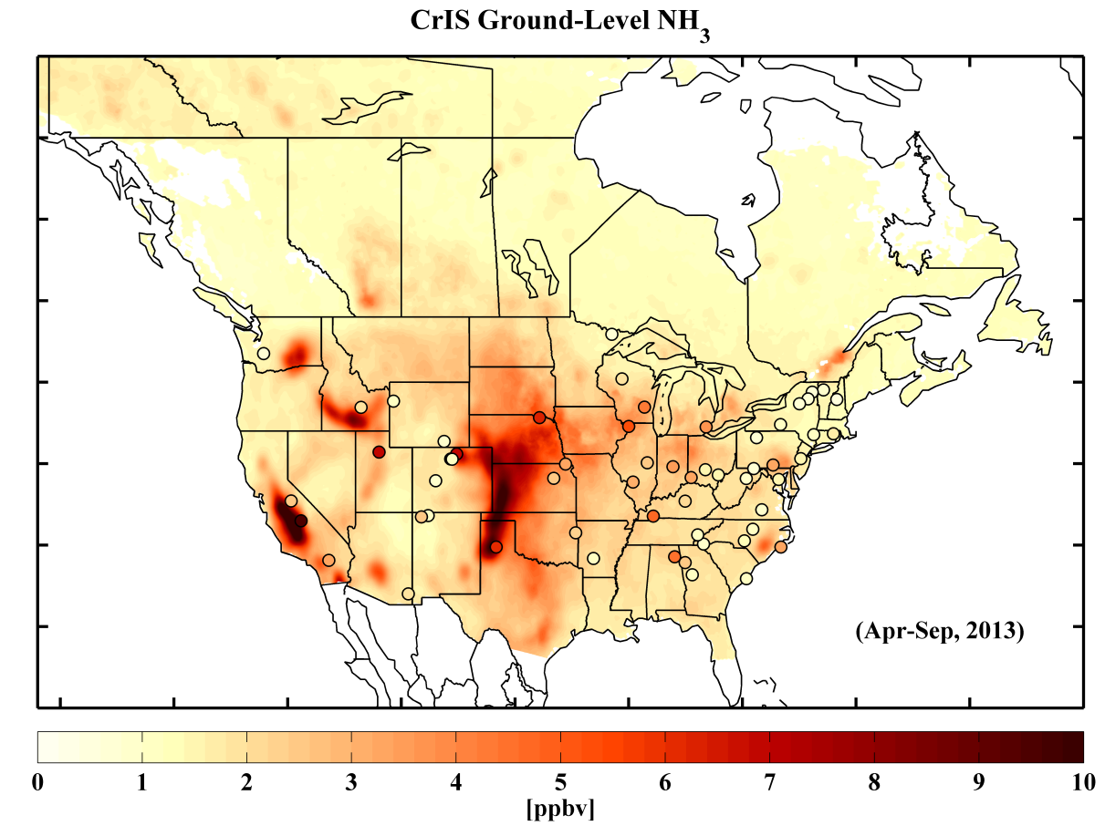
Surface NH₃ from CrIS and the AMoN Network
Initial assessment shows that the satellite and AMoN surface obs agree well despite sampling differences
Correlation of 0.76
Mean difference of +0.4 ppbv (~+15%)
Shailesh Kharol et al., in preparation, 2018

Slide 10
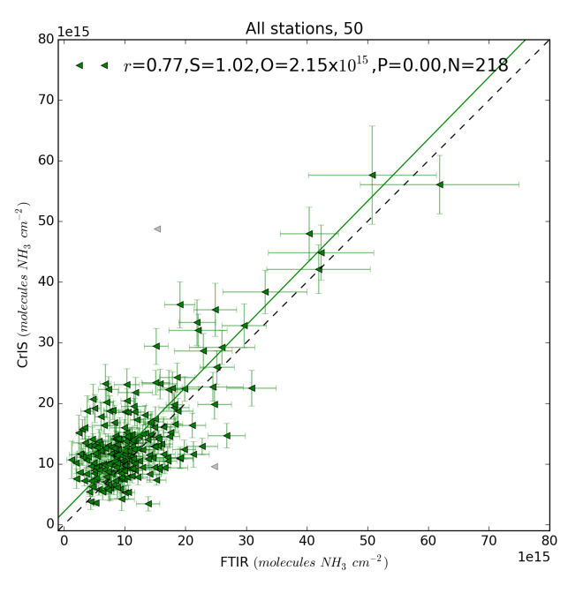
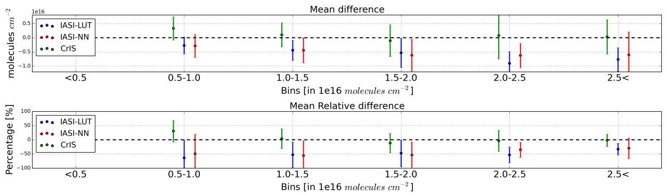
CrIS and ground-based FTIR
Total column comparisons with ground-based Fourier Transform InfraRed (FTIR) obs. at several locations globally
  Bremen, Germany; Toronto Canada; Boulder USA, Pasadena USA, Wollongong, Australia; Lauder, New Zealand, Mexico City, Mexico
Satellite
Results look good with mean relative column differences of ~0 to -5% for the medium to large values
  CrIS shows slight overestimate of smaller values
FTIR
Enrico Dammers et al., Validation of the CrIS fast physical NH3 retrieval with ground-based FTIR, Atmos. Meas. Tech., 10, 2645-2667, https://doi.org/10.5194/amt-10-2645-2017, 2017.

Slide 11
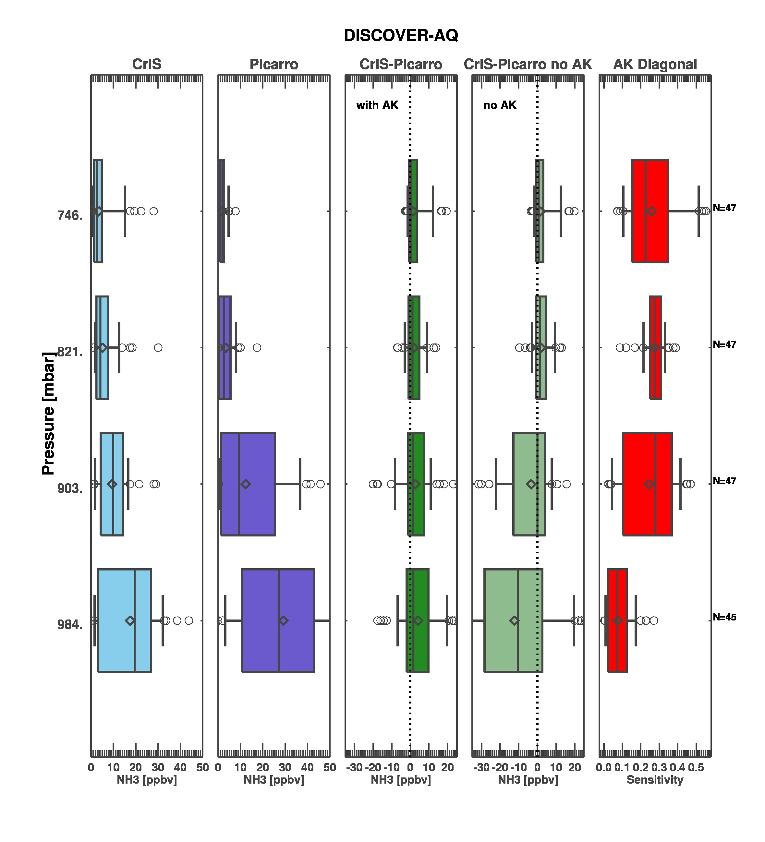
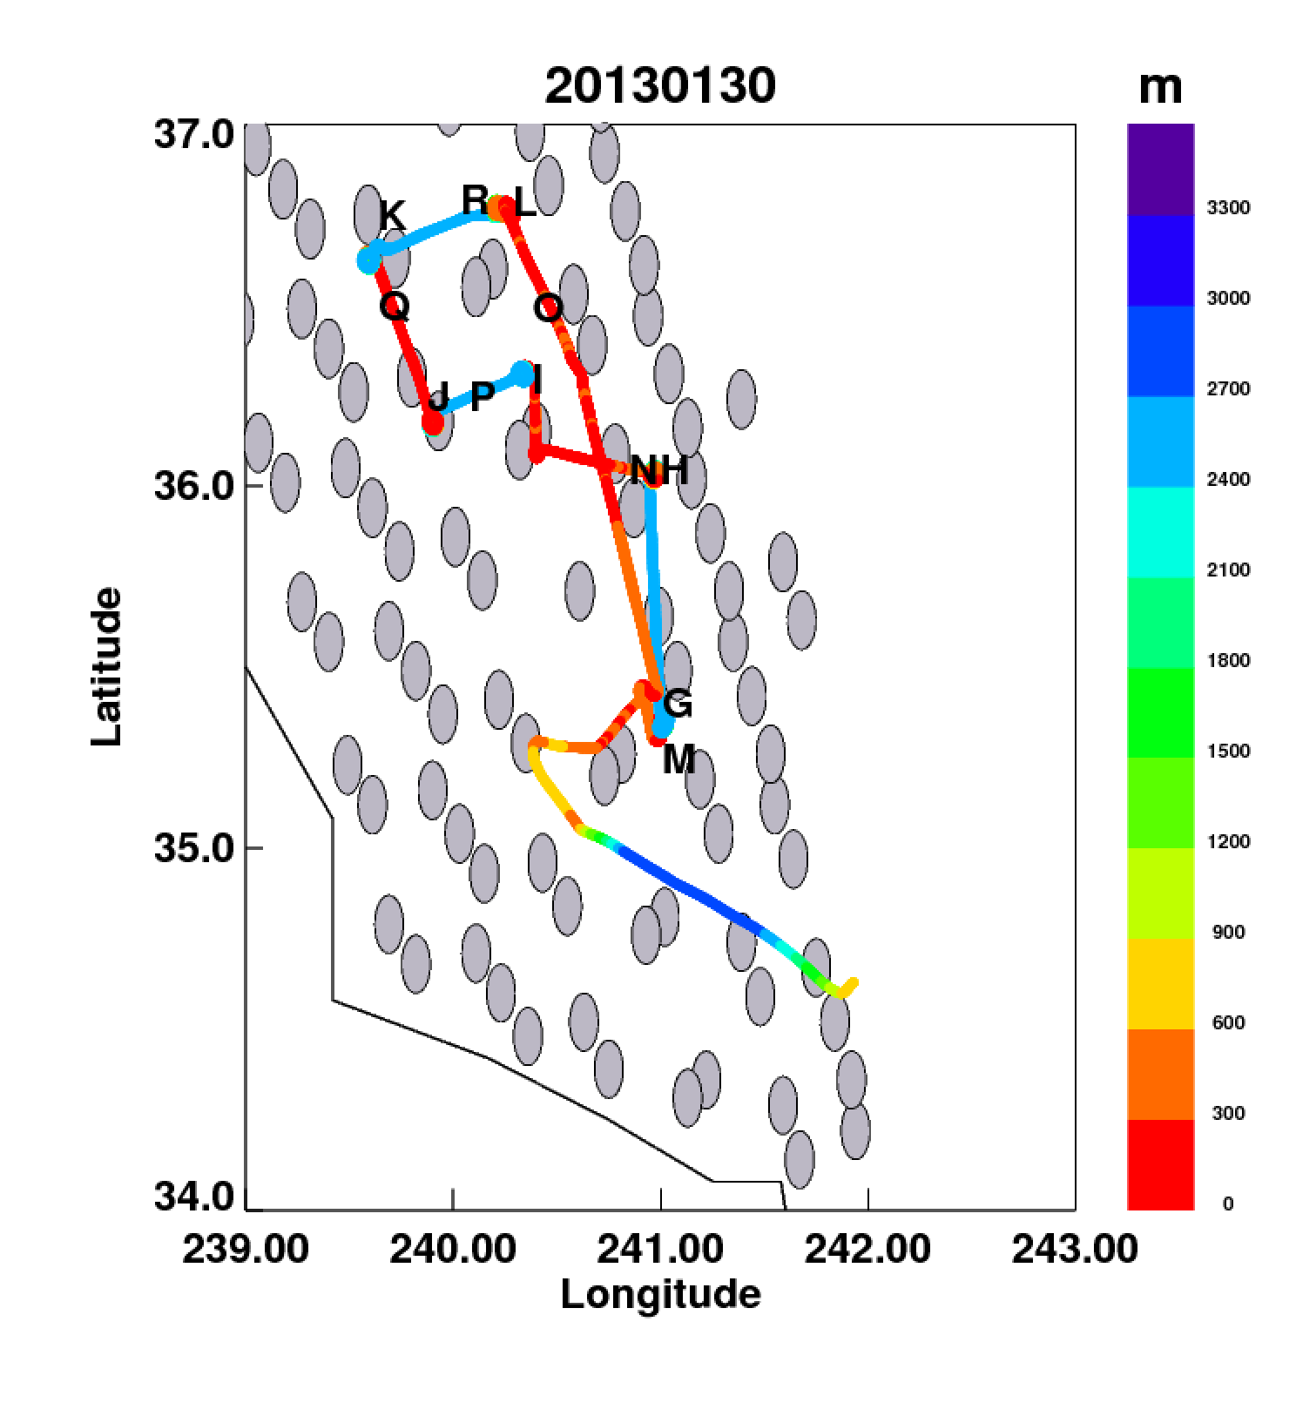
CrIS during DISCOVER-AQ California 2013
What does NOT applying the instrument operator tell you?
Jan 30 NASA P3B flight

Slide 12
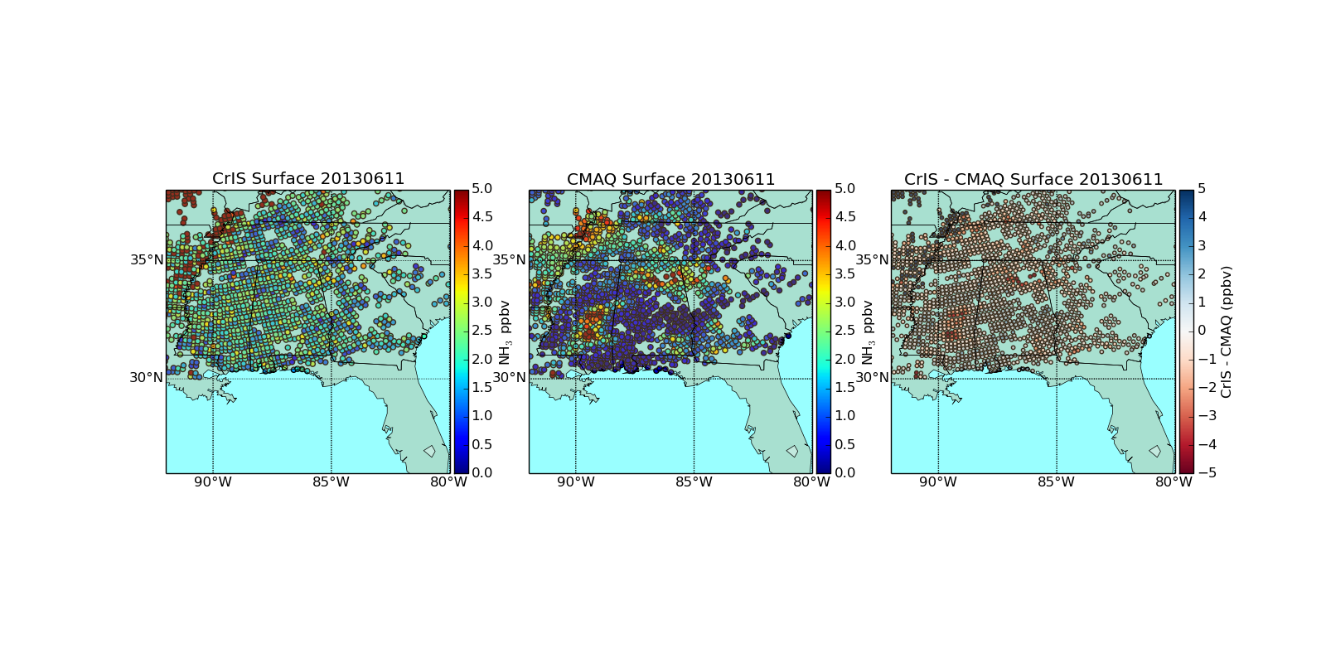
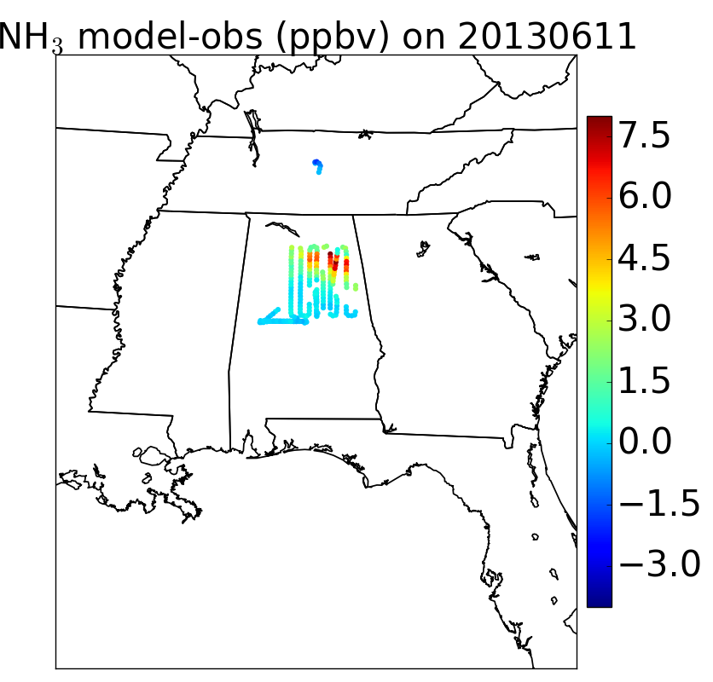
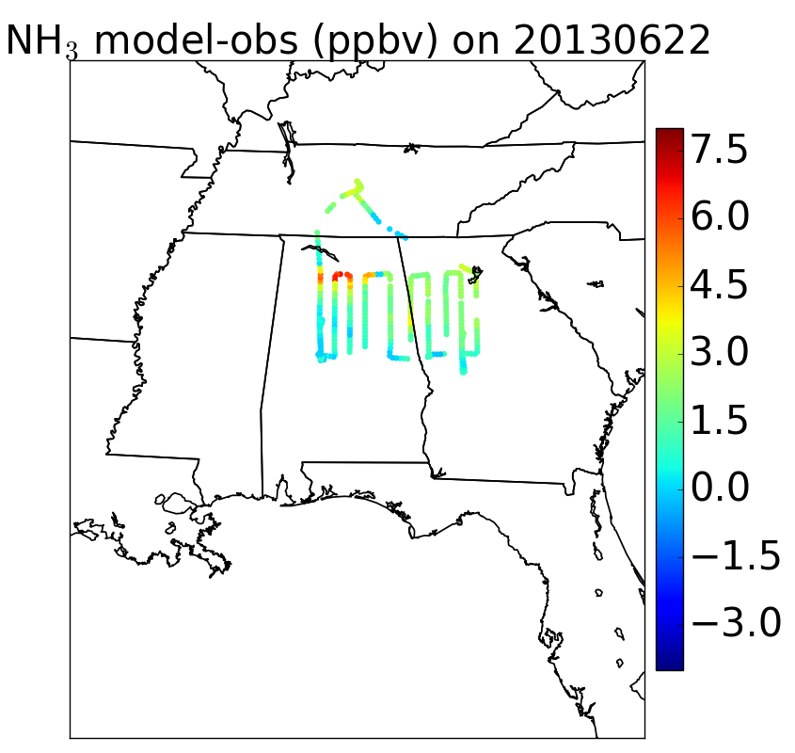
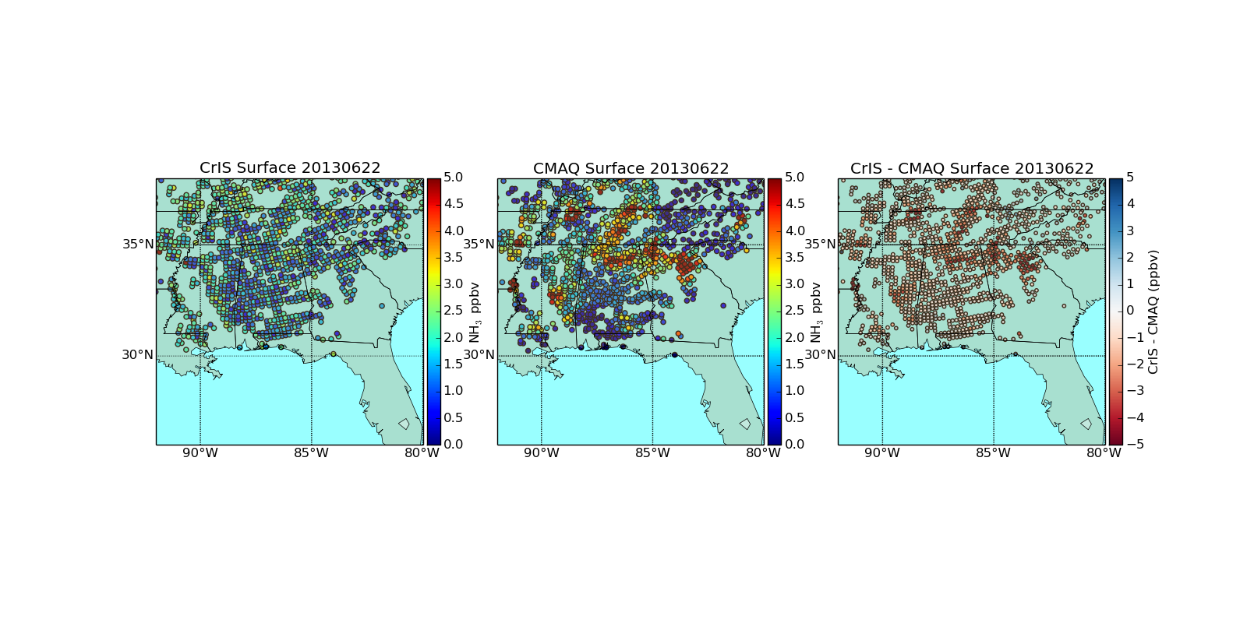
Surface NH₃ during SENEX Campaign
CrIS
CMAQ
CMAQ – NOAA P3 ₃
CrIS and aircraft data both indicate that CMAQ is overestimating NH3

Slide 13
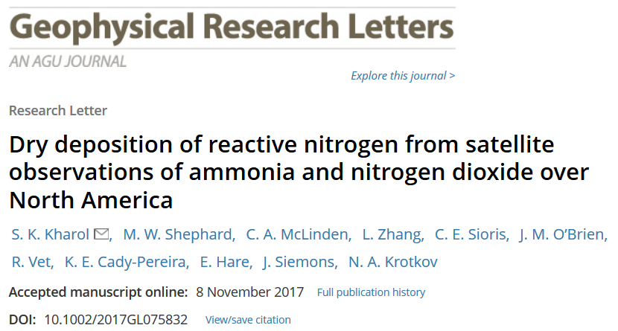
Satellite derived dry deposition flux of nitrogen from ammonia (NH₃)
Applying an approach similar to Caroline Nowlan, Randall Martin, et. al, (2014) used for NO₂ and SO₂
Meteorological Data
(GEM Model)
Deposition Velocity (from Big-Leaf model (BLM);
(Leiming Zhang et al., 2003 (ACP))
F = - V_{d} x C
Surface Concentration of NH₃ (from CrIS Satellite)
NH₃ Dry Deposition
Flux at Surface
CrIS (NASA/NOAA)
(Shephard & Cady-Pereira, 2015 (AMT))

Slide 14
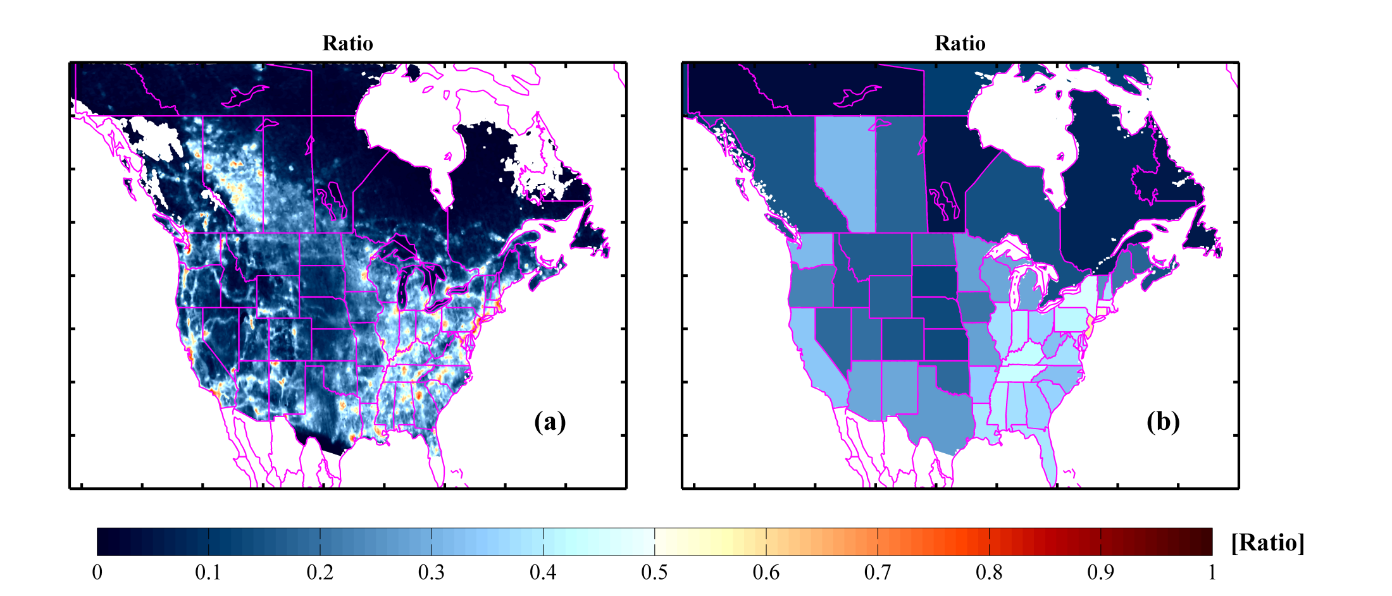
Ratio of N dry deposition flux over North America
Ratio = NO₂ Flux / (NO2 + NH3) Flux
Mostly NH₃
Mostly NO₂
NO₂ dry deposition flux hot-spots dominates in urban regions and power plants (e.g. North-East).
NH₃ dry deposition flux dominates mostly in agricultural and remote regions (e.g. Mid-West)
Decreasing trends in NO₂ emissions +increasing trends in NH₃
NH₃ dominates N_{r} dry deposition over most regions.

Slide 15
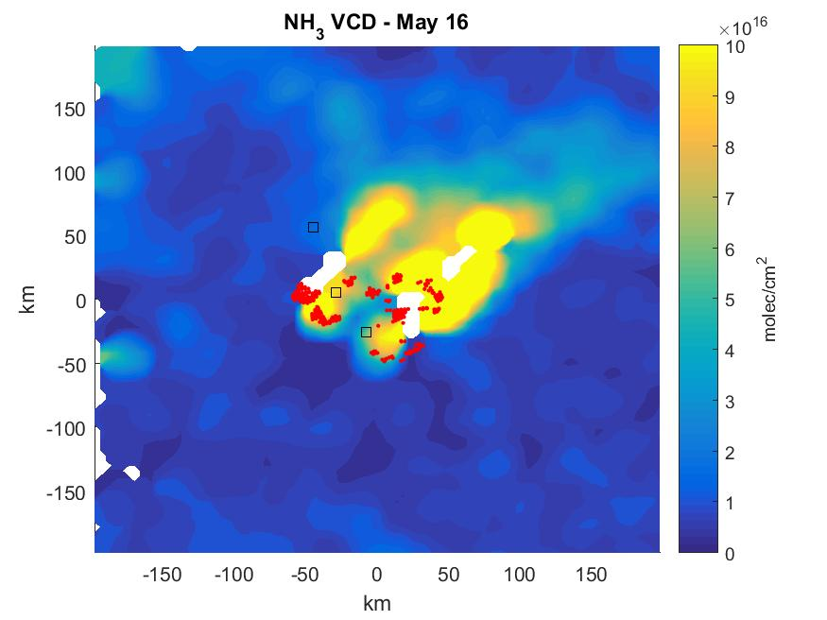
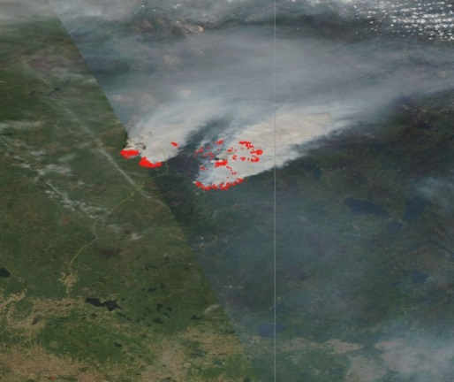
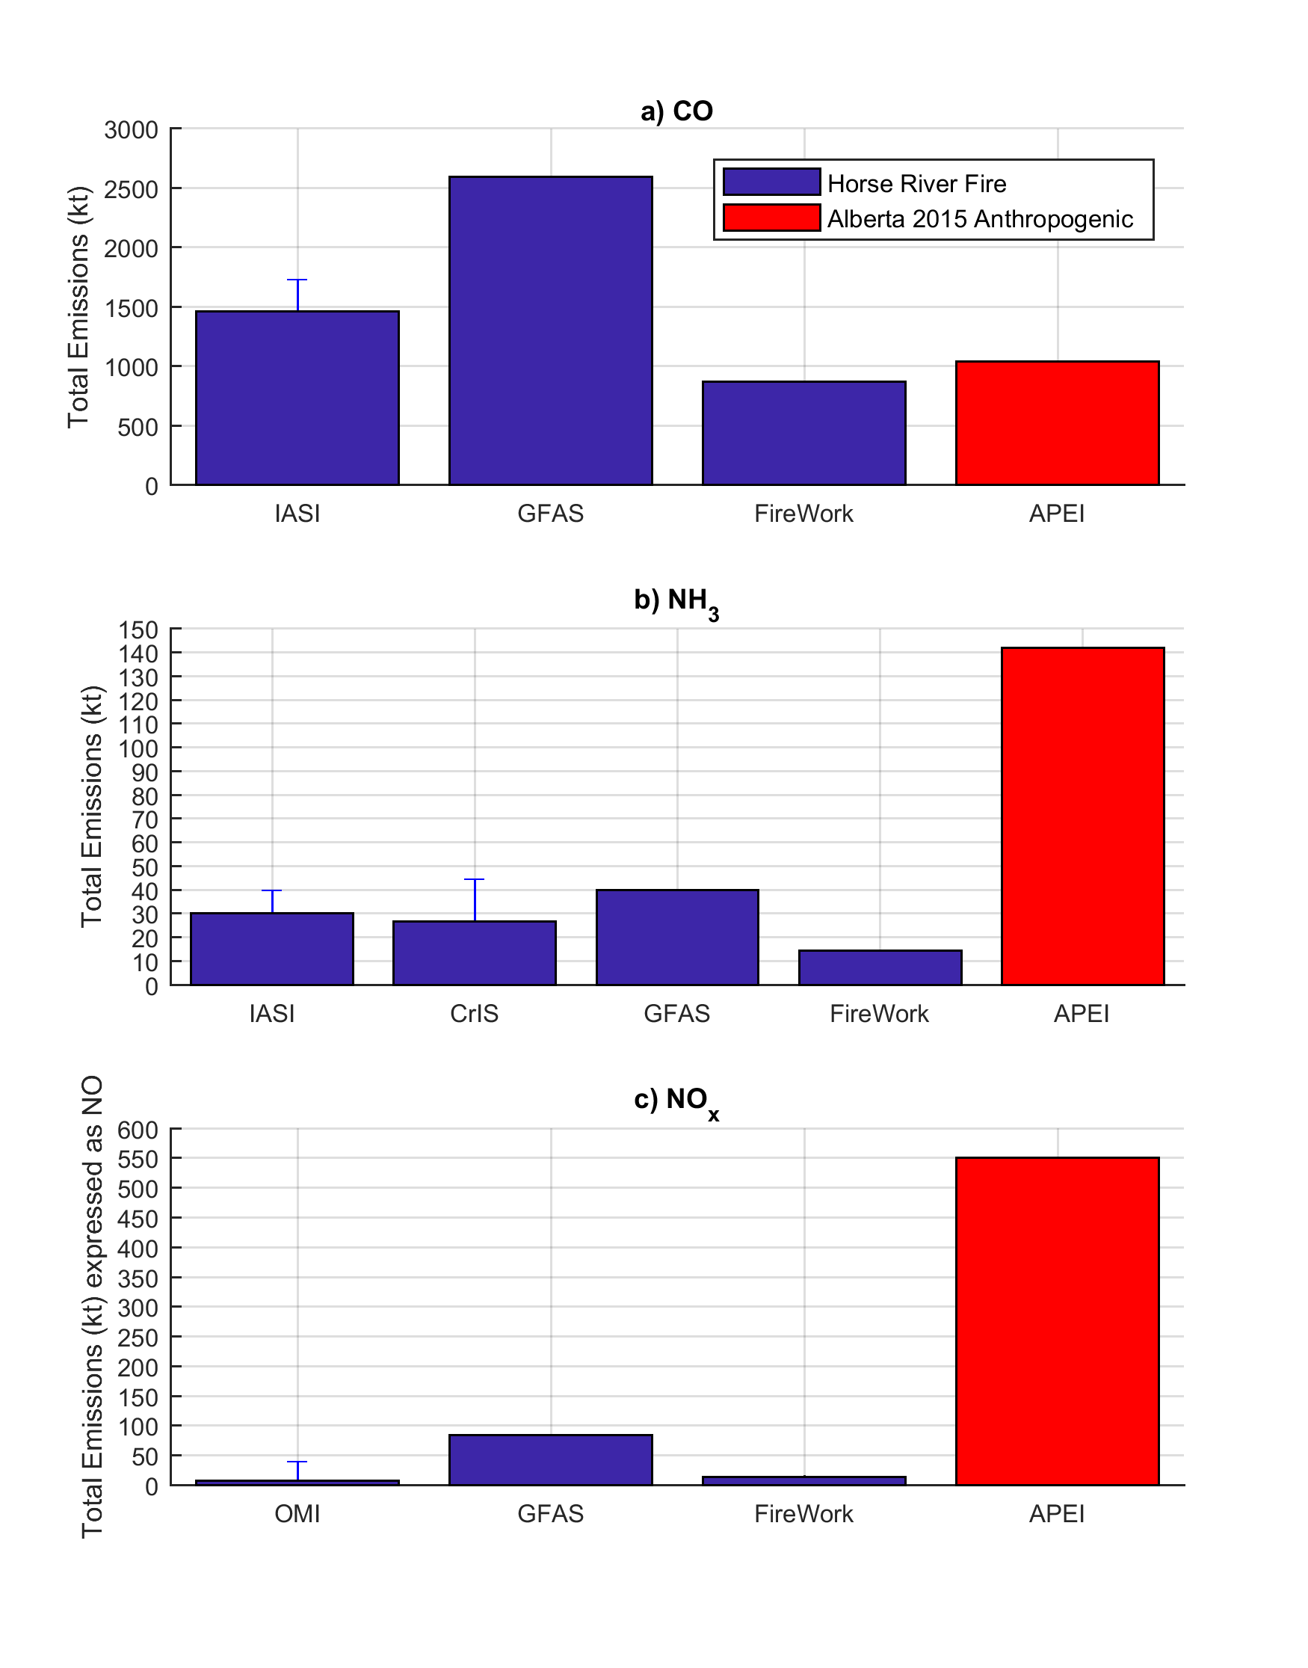
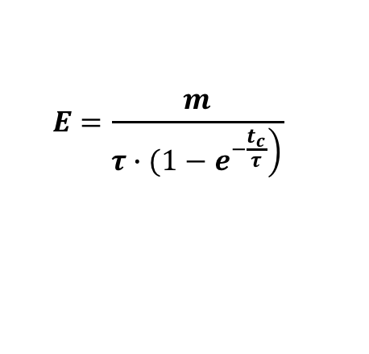
NH₃ Emissions from Wildfires Fort McMurray : May 2016
16 May 2016
Total NH₃ Emissions from Fort McMurray Wildfires
MODIS - Aqua
CrIS – NH₃
$$E=\frac{m}{\left.τ∙(1−e^{−\frac{t_{c}}{τ}}\right)}$$
M = mass of NH₃ (from CrIS)
𝛕 = NH₃ lifetime
t_{c} = time in box = f(wind speed, box size)
Canada’s wildfire smoke model
Adams et al., in preparation, 2018

Slide 16
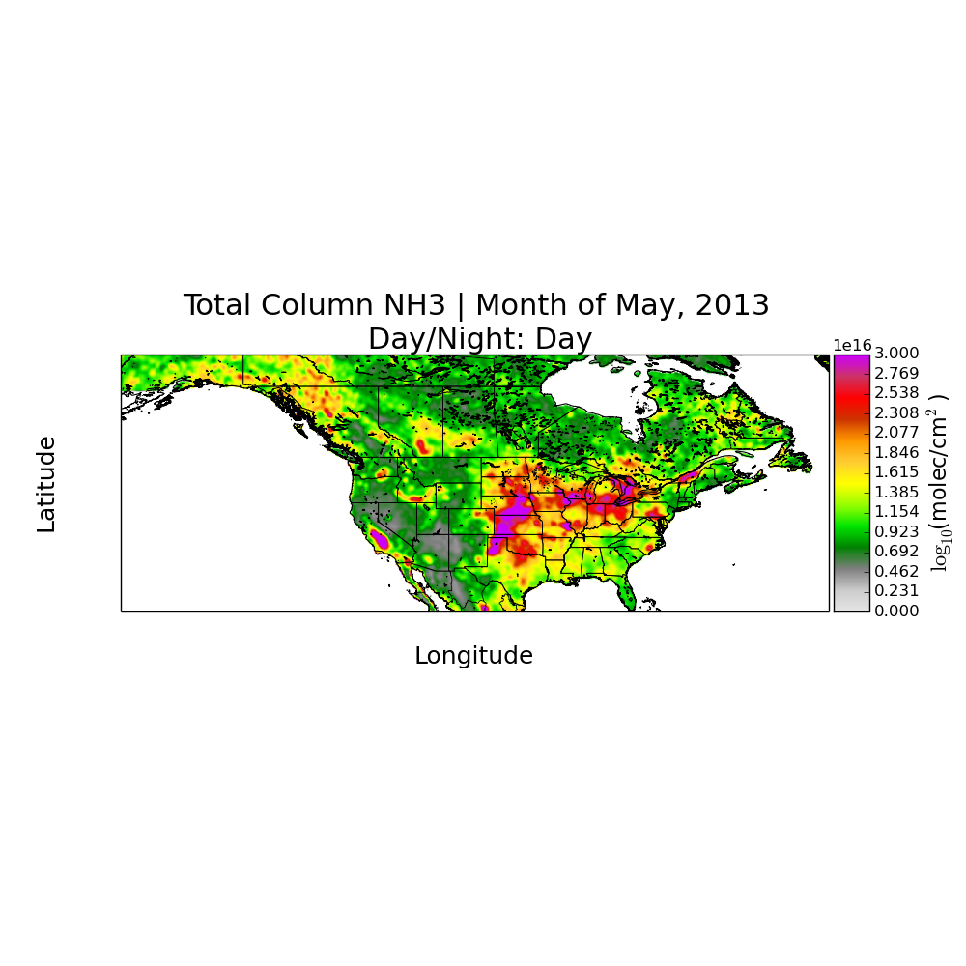
Large Scale Inversion for Emissions
2013 May Total Column NH3
GEOS-Chem
CrIS

Slide 17
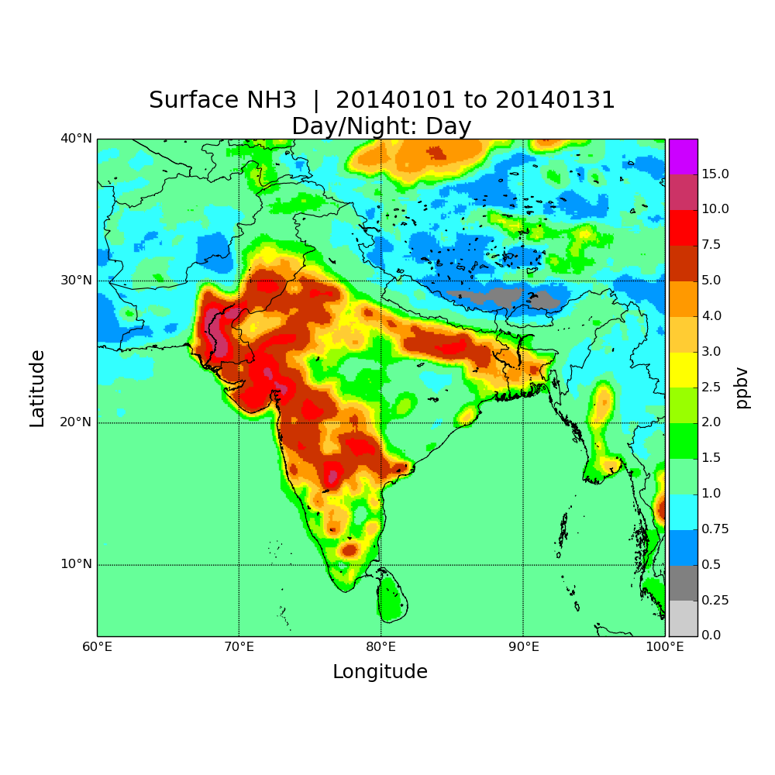
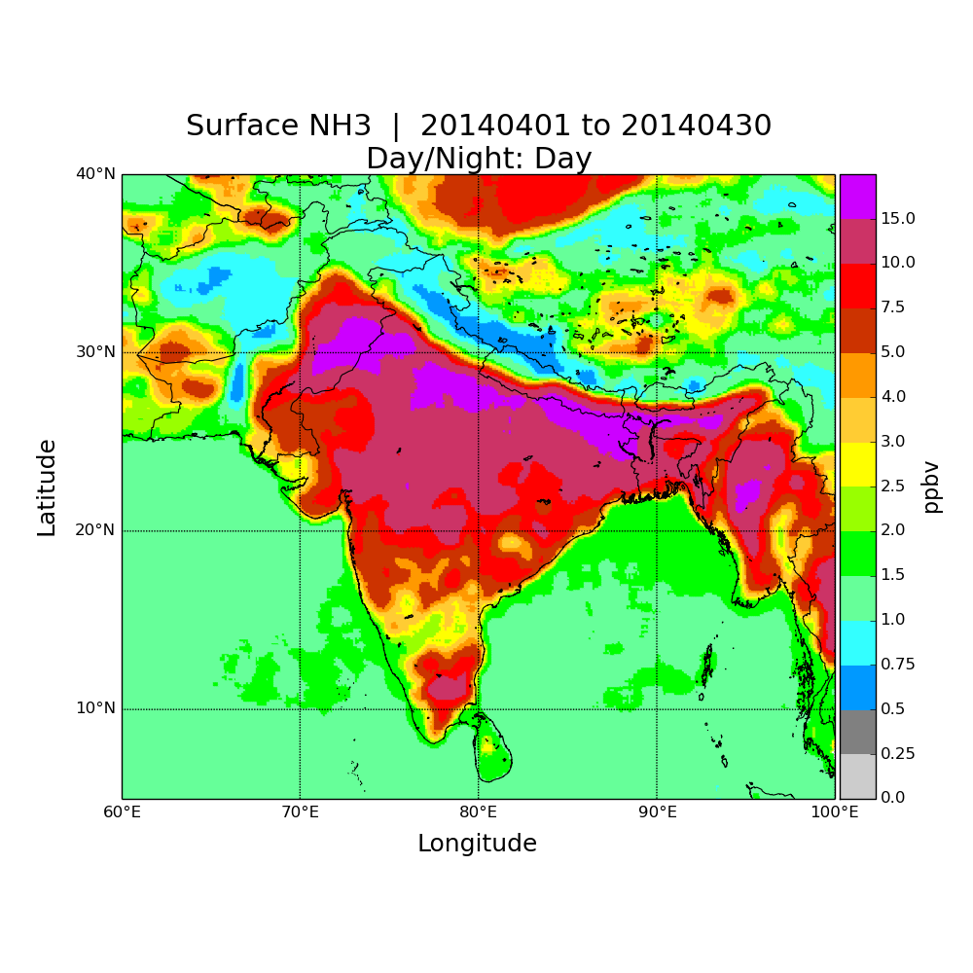
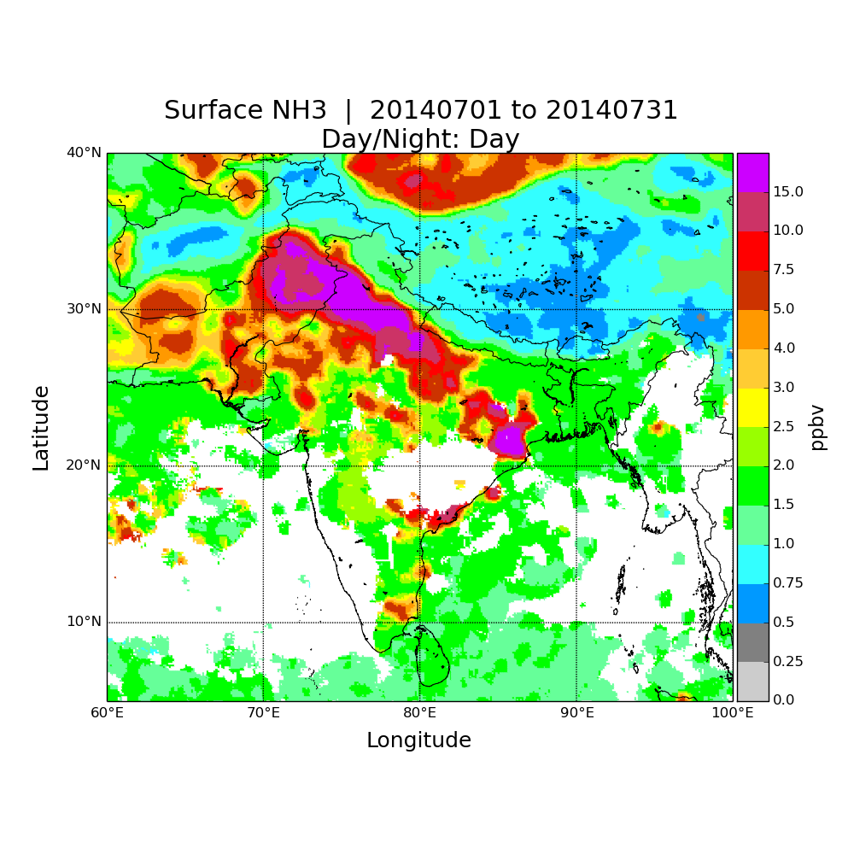
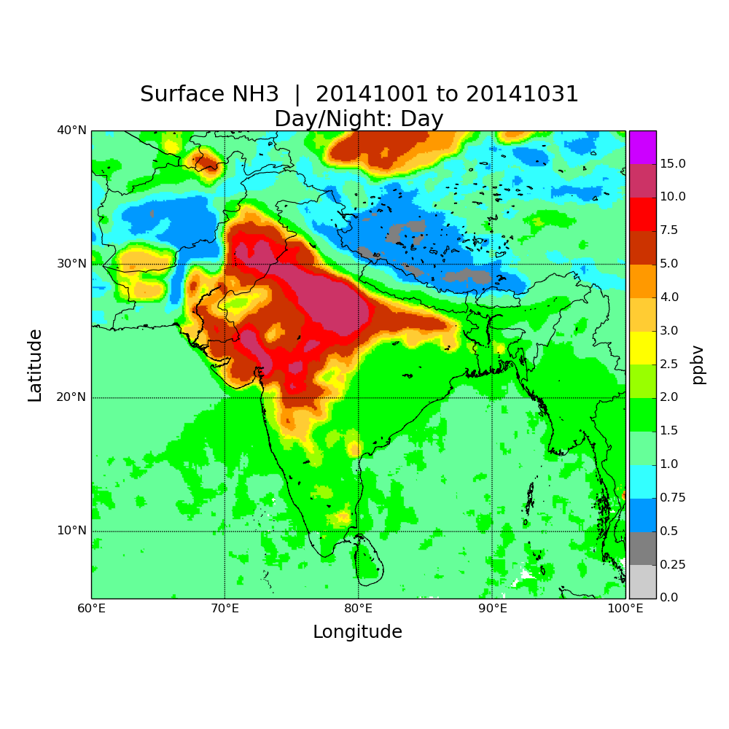
Seasonal Cycle over India in 2014
Jan
Apr
Jul
Oct

Slide 18
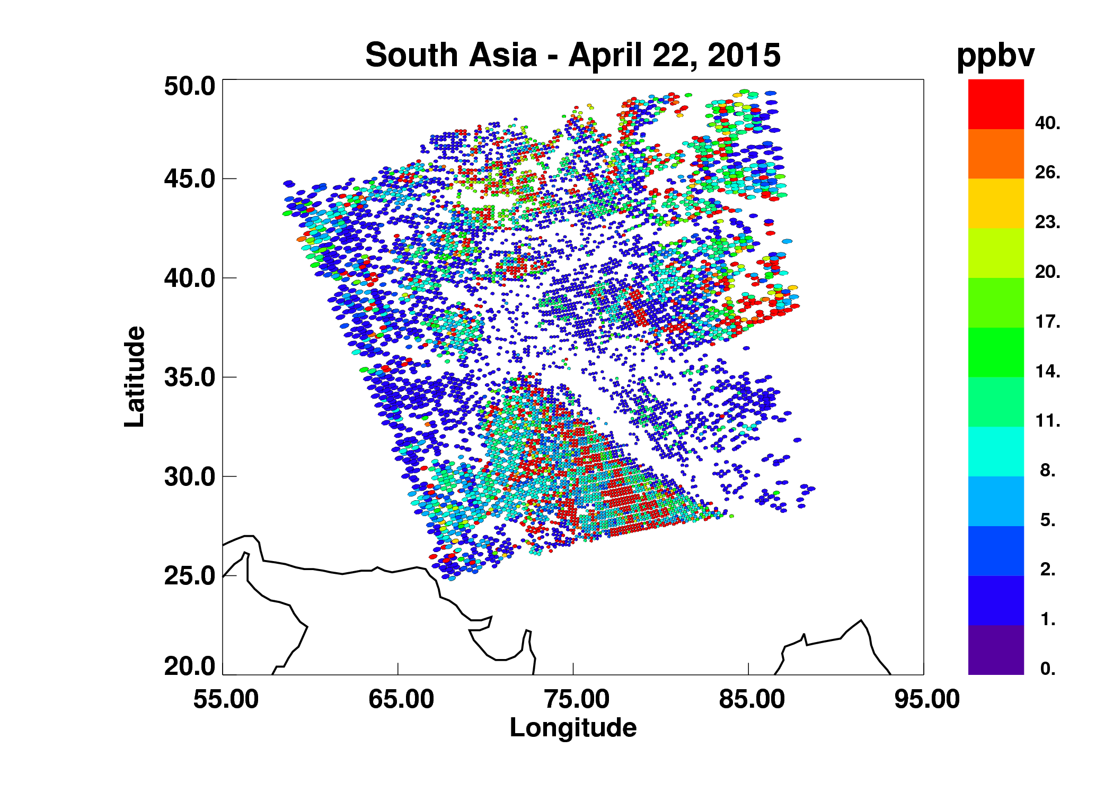
Where to get the data?
CrIS NH3 from the CFPR algorithm
  over North America from 2013 through 2017
  available from Environment Canada
Contact Mark Shephard:
  mark.shephard@Canada.ca
NASA is implementing an all FORTRAN version (ESSPA)
Global operational product will become available in 2019

Slide 19
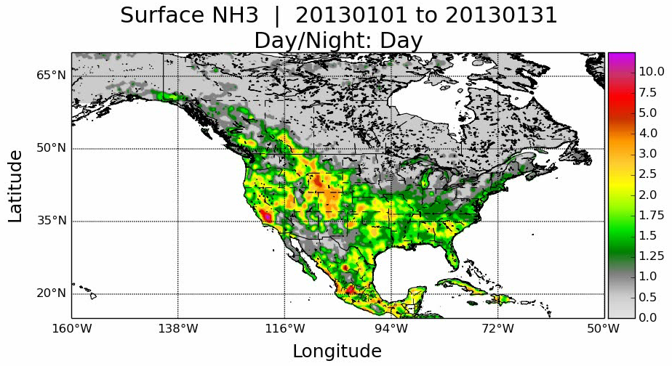
Monthly Spatiotemporal Variability of Surface NH₃ over North America in 2013
ppbv
(Click here to view movie)
  Captures expected temporal and spatial distributions of ammonia
      Spring fertilizer applications (May over Canada)
      Episodic events (e.g. Northern forest fires in middle of summer)

Slide 20
Operational algorithm currently under implementation at the SNPP SIPS
ESSPA software: FORTRAN retrieval code with OSS as forward model
Optimal estimation: same a priori profiles/constraints/selection as CFPR
First guess emissivity from
University of Wisconsin database
From previous retrievals (CLIMCAPS):
Water vapor profiles
Temperature profiles
Surface temperature
From each observation:
Radiances
Noise estimate
Optimal estimation first step
Refinements of
  Surface temperature
  Emissivity
Use radiances for
a priori selection from three possible profiles
Cloud screening
Optimal estimation second step
NH₃ profiles
Error estimates
Averaging kernels
For more details see: Shephard M.W. and K. E. Cady-Pereira, AMT, 2015

Slide 21
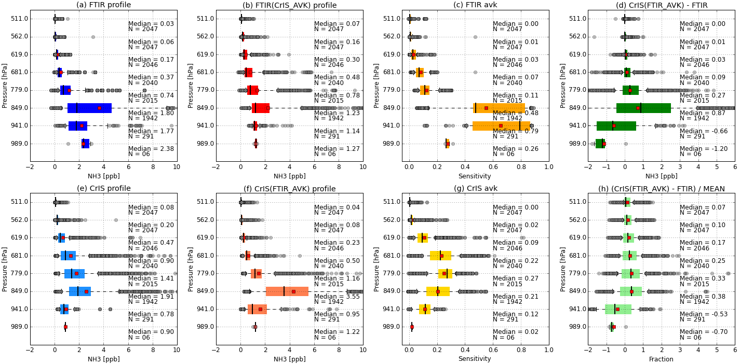
Satellite Validation: Ground-based FTIR profiles
Profile comparisons done by applying the FTIR instrument operator
CrIS
CrIS-FTIR
FTIR AVK

