Slide 1
2018 CMAS Conference
Development of an Integrated Assessment Model for Korea :
The GHGs and Air pollutants Unified Information DEsign System for Environment(GUIDE)
Younha Kim¹, Jung-Hun Woo^{1*}, Bok Haeng Baek², Jinseok Kim¹, Jinsu Kim¹, Youjung Jang¹, Minwoo Park¹, Yungyeong Choi¹, Eunji Lee¹, Hyunjin Park¹
1 Konkuk University, Seoul, Korea
2 University of North Carolina, Chapel Hill, USA
Notes:
Good morning Everyone. I appreciate for the opportunity to share my recent work with you this morning.
I'm Jinseok Kim from Kunkuk University in South Korea. Today, I am presenting this work in behave of Dr. Kim.
This morning I would like to share our recent development of an integrated Assessment model called GUIDE which stands for Green House Gases and Air Pollutants Unified Information Design System for Environment in Korea. This model is consisted of three major parts. The first one is the cost-benefit decision making system, the second one is the air quality modeling system and then last one is information service platform that integrates all the output from both systems and allows users to understand this complex system between cost-benefit, and air quality control strategy results. This last information service platform is currently under the development. This morning I am going to focus on showing the air quality modeling system outcomes we recently completed.

Slide 2
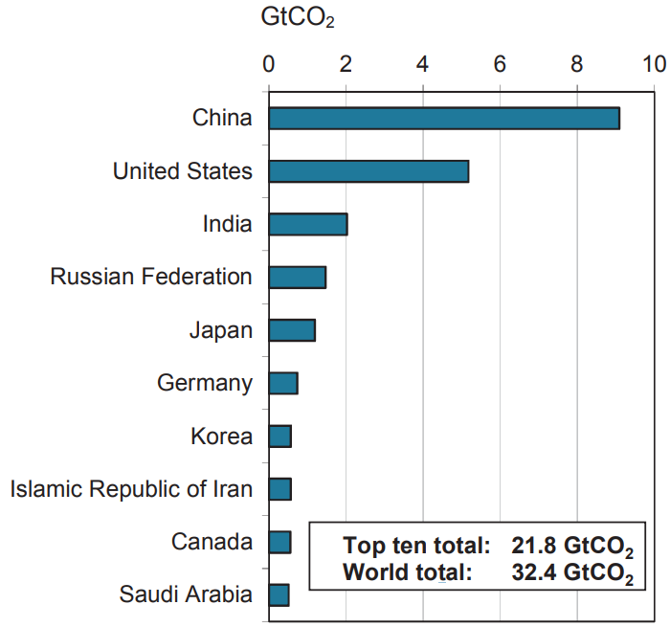
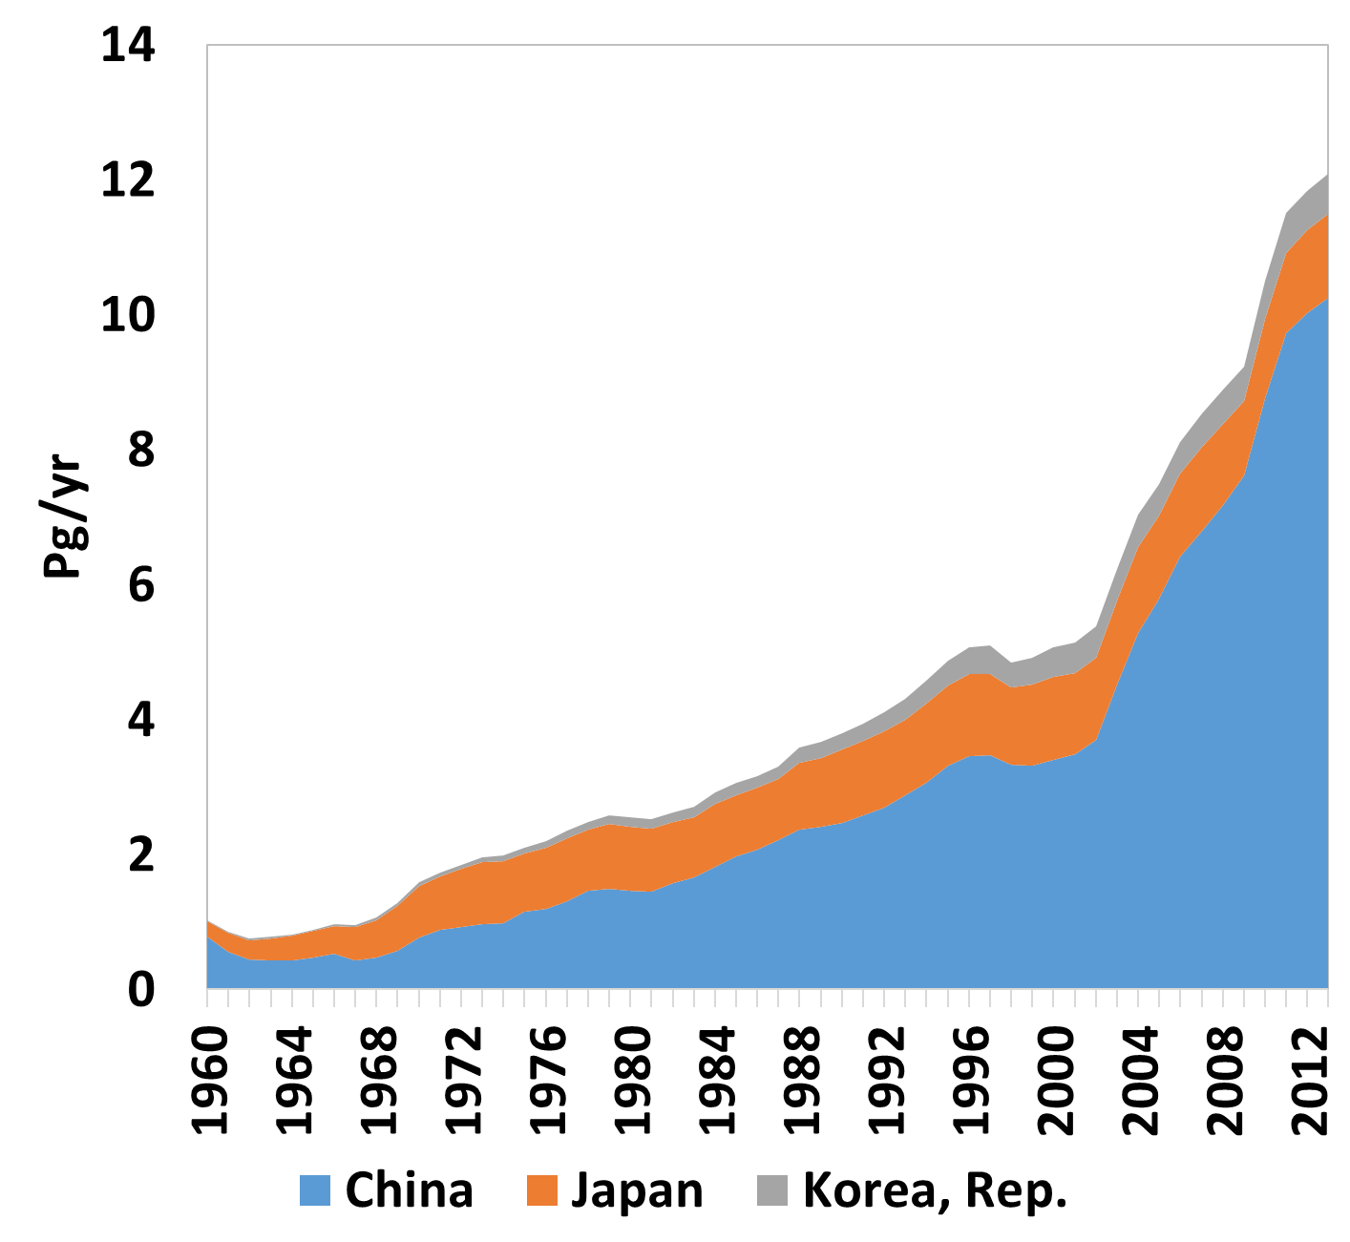
Background
CO₂ Emission Trend in Northeast Asia
Top 10 GHGs emitting countries in 2014
1st. China
5th. Japan
Source : IEA, 2016
Source : World bank
7th. Korea
2
Notes:
Before I show you our results, I want to briefly cover our motivation of this GUIDE modeling system development.
As you can see in this figure, over the last 60 years, GHG emissions have increased.
There are major Green House Gases contributors in the world including China, US and India, and Korea ranks the 7th place. Last two decades, Korea has been making a great efforts to reduce these green house gases to comply with the IPCC’s future RCP and also Korea introduced the GHG reduction plan from INDC of Paris Agreement.
While we are working on the Climate Changes, we also have been facing the serious air quality issues in local level.

Slide 3
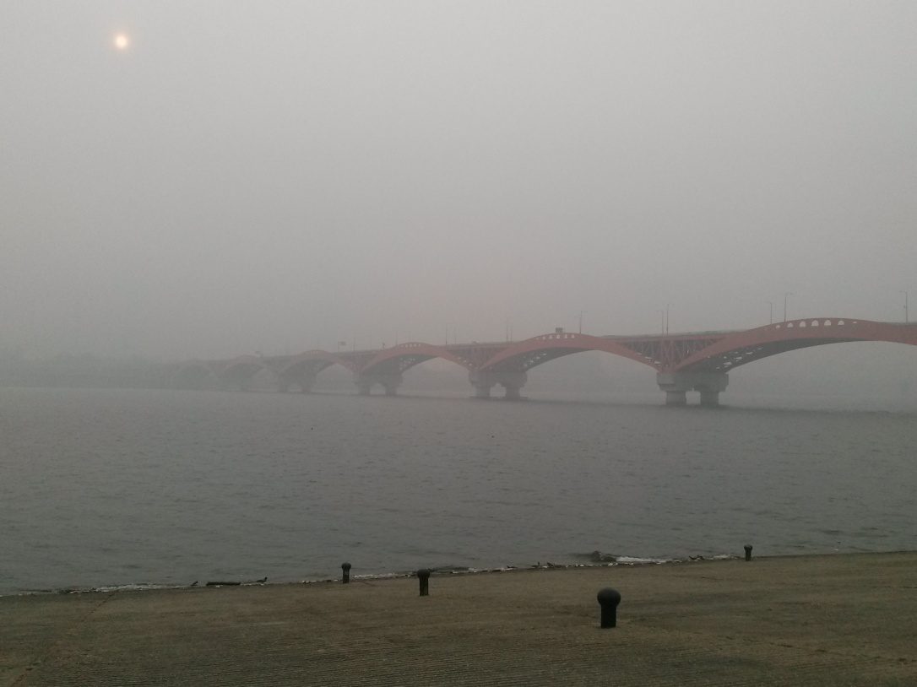
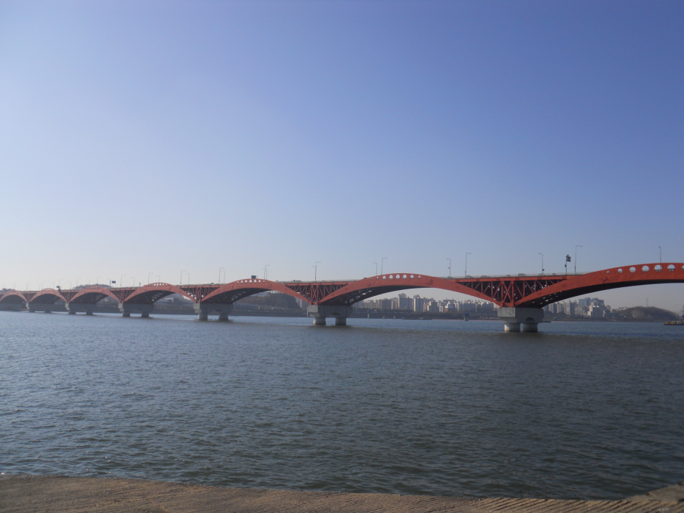
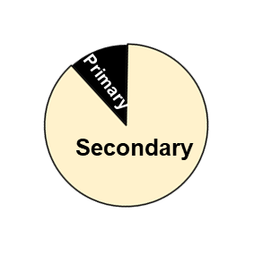
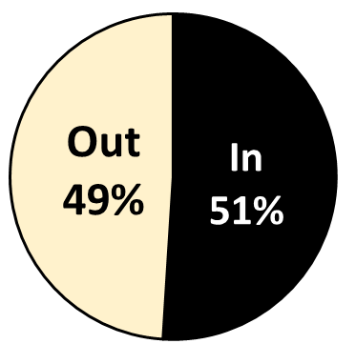
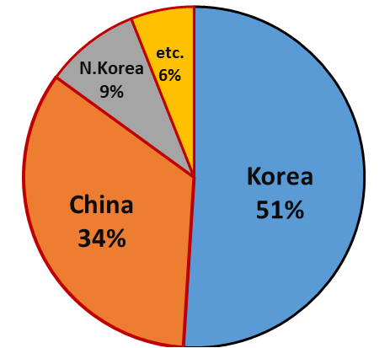
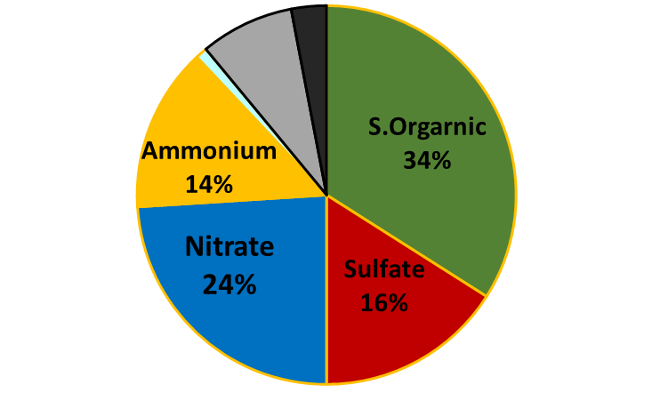
Background
Recent Air Pollution issue in Seoul Metropolitan Area
2013, Dec 5th
PM₁₀: 166 ug/m³
2013, Dec 6th
PM₁₀: 35 ug/m³
Han river in Seoul
fine particulate matter
(NASA KORUS-AQ Campaign)
Local vs.
Transboundary
Contribution
Primary vs.
Secondary
Composition
Black
Carbon
8%
P. Orgarnic 8%
Chloride 1%
NIER/NASA, 2017
3
Notes:
Seoul, the capital of Korea, has recently faced atmospheric environmental problems. As you see the pictures in this slide, local air quality issues like PM2.5 has been causing many concerns on human health impacts. Although Korea has been working hard to reduce our own emissions from various major emissions sources like large stationary point sources, onroad mobile sources. We have been facing the air quality impacts from our neighbor countries like China, North Korea, and other countries next to South Korea.
To understand these regional air quality issues, last 2017, Korea government had completed the collaborative research air quality field campaing with NASA, it is called “KOR-US”. Based on this campaign study with NASA, we have found out that almost 34% of high PM2.5 episode are caused by China and 9% by North Korea. And also this secondary organic aerosol among PM2.5 is about 34%, sulfate, nitrate and ammounium are 16%, 24% and 14%, respectively.
So, to understand this complex air quality issues and come up with a better control strategies, we have been working on developing this integrated, assessment model, GUIDE modeling system.

Slide 4
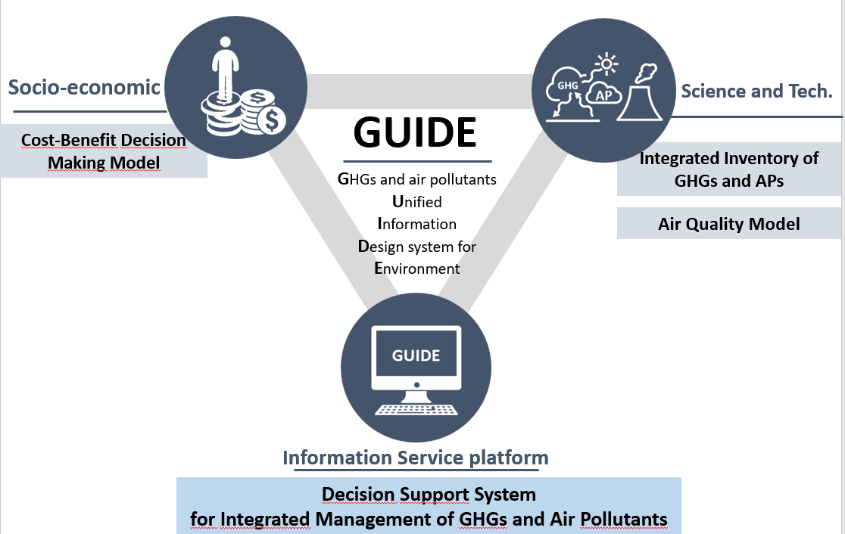
Objective of GUIDE System
The GHGs and Air pollutants Unified Information DEsign System for Environment
(GUIDE)
이 전 슬라이드가 왠지 외국인들이 한번에 딱 캐취하기가 좀 복잡할 수도 있을 것 같아서. 이것도 혹시 모르는 플랜B로 간직해봐바. 백박사님과 물론 의논 해야 겠지만^^
이 그림이 어제 캐리 장 박사가 소개했던
한국에서 개발되고 있는 한국형 Integrated Assessment Model 의 체계도입니다.
저는 여기에서 Air Quality Model 개발 및 작성을 담당하고 있고, 오늘 프리젠테이션에서는 이 부분을 포커스 하여 발표하도록 하겠습니다.. 등의 내용으로~~
4
Notes:
This figure shows the GUIDE model development framework.
The GUIDE model is consisted of three major groups. The Group of objective 2 on the left is the group that develops the economic and energy projection model and the cost-benefit decision making model.
and the Group of objective 1 on the right is the group that conducts the inventory development and the study to create the Air quality module.
The Group of Objective 3 is currently working on combining these developments into one platform.

Slide 5
Objective of GUIDE System
Objective 1
: Integrated Emissions Inventory &
Policy Supporting Air Quality Model
GUIDE Model
Objective 1
Integrated GHGs and AP Emissions Inventory
Activity
Emis. Factors
Control Tech.
Integrated GHGs-AP Inventory
Policy Supporting Air Quality Model
Source-Receptor
(RSM-VAT)
Met. Model
Air Quality Model
Emissions Model
5
Notes:
In this presentation, I will be focusing on showing the design of the Integrated Emissions Inventory and Policy Supporing Air Quality Modeling syste. It includes the construction of RSM (Respose Surface Model), a policy-supporting air quality modeling system in GUIDE models.

Slide 6
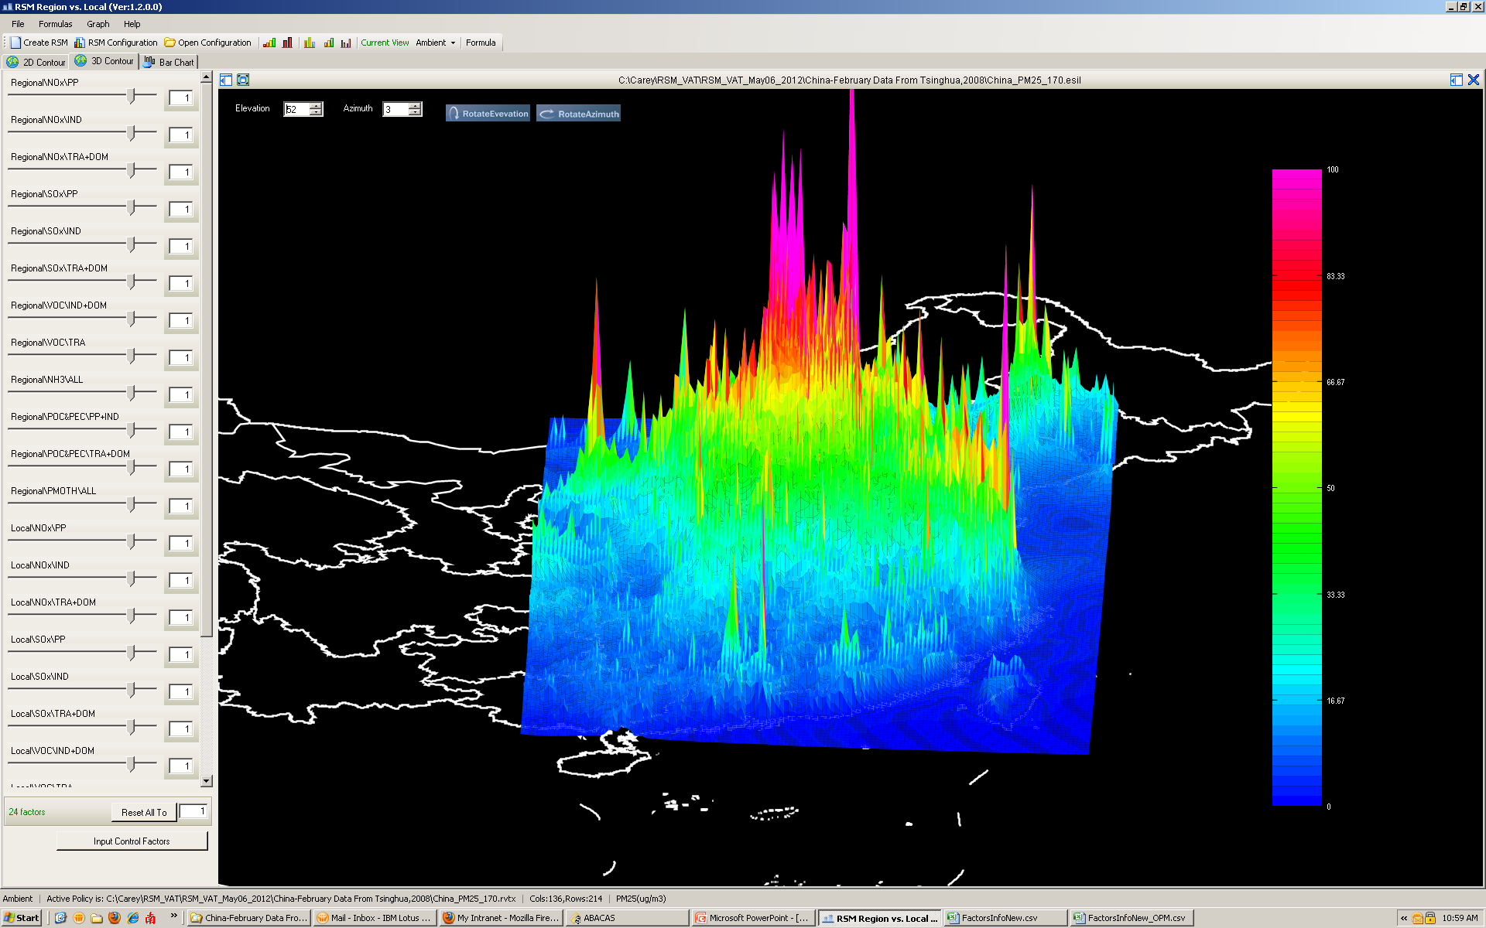
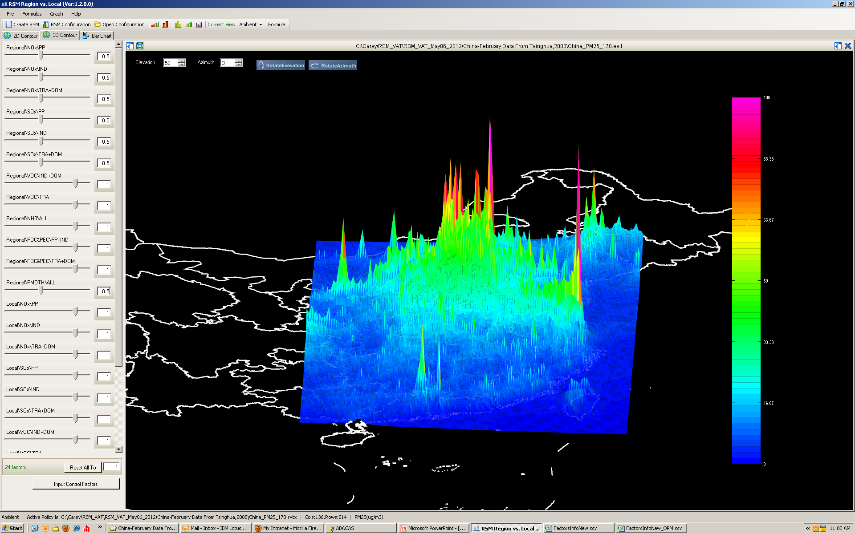
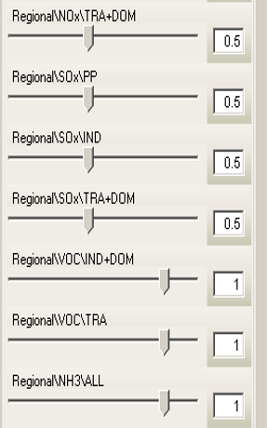
Objective: Integrated Emissions and Atmospheric Transport Model
Policy Supporting Air Quality Model
우선적으로 SMOKE와 CMAQ을 활용한
Simulation of the SMOKE-CMAQ system about 200 times according to the reduced emission scenarios by region/sector to generate the Response Surface Model (RSM) and visualization of the system using the Visualization Analysis Tool (VAT).
Real-time(near-realtime) atmospheric chemical transport information integrated into decision making system.
Baseline
NOx/SO2/PM
50% Control
Examples of utilizing RSM and VAT.
(East China)
(Jiming Hao et al., 2017)
6
Notes:
Since many of you already heard about the RSM model from yesterday’s talks from Dr. Carey Chang from U.S. EPA and Professor Jia Xing from Tinghua university in China, I won’t go into the detail. In this study, we have adopted the RSM module from ABaCAS to develop the real-time air quality modeling results for Group 2 decision making model under the GUIDE system.
In our study, we have identified a total of 120 control factors for the RSM model. They are based on by regions, by pollutants and by emission sectors. Based on these 120 control factors, we have initially simulated around 200 RSM scenarios CMAQ modeling runs.
To create the RSM, we have simulated about SMOKE-CMAQ system about 200 times according to the reduced emission scenarios by region and sector to generate the air quality input dataset for Response Surface Model (RSM) and the visualization analysis tool called VAT

Slide 7
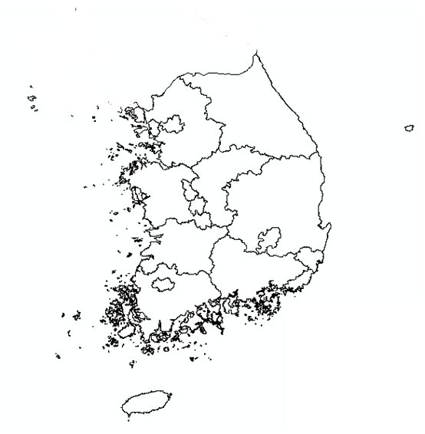
Objective: Integrated Emissions and Atmospheric Transport Model
RSM* Design for “GUIDE”
  Region, pollutants, and sector
  17 Regions
  8 Pollutants
  7 Sectors
Region | Pollutant | Sector
Seoul | CO | Power(POW)
Busan | CO₂ | Industry(IND)
Daegu | NH₃ | Mobile(MOB)
Incheon | NO_{X} | Residential/commercial(RES)
Gwangju | SO₂ | Agriculture(AGR)
Daejeon | PM₁₀ | Other(OTH)
Ulsan | PM_{2.5} | Solvent(VOC)
Sejong | VOC | Boundary condition(BC)
Gyunggi-do
Gangwon-do
Chungcheongbuk-do
Chungcheongnam-do
Jeollanam-do
Jeollabuk-do
Gyeongsangbuk-do
Gyeongsangnam-do
Jeju
Region-Sector Control Factors : ~119 Factors + Boundary Condition
= 120 Factors
*Response Surface Modeling
7
Notes:
The RSM design for the GUIDE model is as follows.
Korea is divided into 17 regions, and There are a total of 8 pollutants (CO, CO2, NOx, Ammonia and so on) with a total of 7 sectors like power, industry, mobile, residential, agriculture and the Solvent VOC sector. SMOKE processing is drived by utilizing the sectors classified as above.
So, we have created a total of 119 factors by region and sector with boundary conditions to consider the impacts from our neighbor countries like China and North Korea.

Slide 8
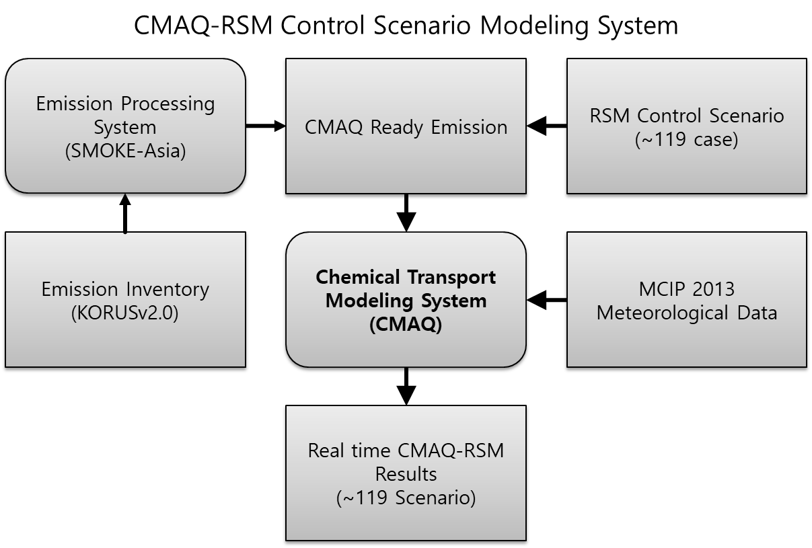
Objective: Integrated Emissions and Atmospheric Transport Model
Chemical Transport Modeling System(SMOKE-CMAQ-RSM) Modeling Framework
LHS* method Scenario
(~120 Scenario)
Emission Inventory
(KORUSv2.1)
KORUS E.I. :
Younha Kim
Oct. 24th 2pm presentation
Real time CMAQ-RSM
Results
(~120 Scenario)
Base Scenario Emission was created using KORUSv2.1 Emission Inventory and SMOKE-Asia Emission Processing System. (The KORUS emission inventory was developed in support of the KOREA-NASA KORUS-AQ aircraft field campaign.)
Using Latin Hypercube Sampling(LHS), 120 control scenarios were created and modeled.
The generated 120 scenario CMAQ results were applied to RSM.
*Latin Hypercube Sampling
8
Notes:
This is the modeling framework for creating the SMOKE-CMAQ-RSM. Base Scenario Emission was created using KORUSv2.1 Emission Inventory th rough SMOKE-Asia Emission Processing System. If you are interested in how the emissions inventories are created for this 2017 KOR-US field campaingns, please check out the Dr. Younha Kim’s presentation tomorrow at 2pm.
And we also used the Latin Hypercube Sampling(LHS) to develop a total of intial 120 control scenarios for RSM.
The generated 120 scenario CMAQ results were applied to RSM.

Slide 9
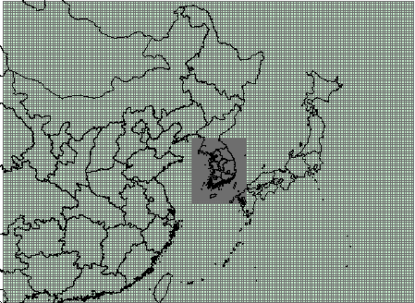
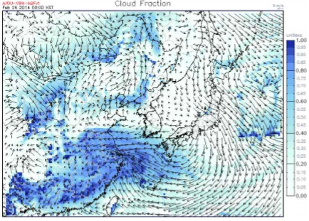
Objective: Integrated Emissions and Atmospheric Transport Model
Chemical Transport Modeling System(CMAQ-RSM) Modeling Framework
Chemical Transport Model | CCTM in CMAQ v4.7
 | (U.S. CMAS)
• chemical mechanism | SAPRC-99 aero3
Emissions
• anthropogenic emission model | SMOKE-Asia (Woo et al., 2009)
• emissions inventory | CREATEv3.0 (Woo et al., 2018) (KORUSv2.1)
Meteorological Model | WRF (U.S. NCAR)
Period | January, April, July, October, 2013
Domain | • Extent :
 | Domain 1 (East Asia) Domain 2 (South Korea)
 | • Grid resolution (domain):
 | 27 ⅹ27km²(174 x 128) 9 ⅹ9km²(67 x 82))
 | • N. of vertical layer: 30
Domain
Meteorological data
-cloudiness-
*Response Surface Modeling
9
Notes:
For our Chmical Transport Modeling system, we used the CMAQ v4.7 with Chemical Mechanism SAPRC99.
Emissions were processed using SMOKE-Asia with KORUS v2.1 inventory which is based on the latest East Asia region emissions inventory called CREATE v3.0.
The meteorological model was WRF. To represent the seasonality of air quality, we modeled January, April, July, October. A total of four month with 10 sinup days.
The one in the redbox is the 27km by 27km modeling domain and the smaller black box around South Korea is 9km * 9km modeling domain.

Slide 10
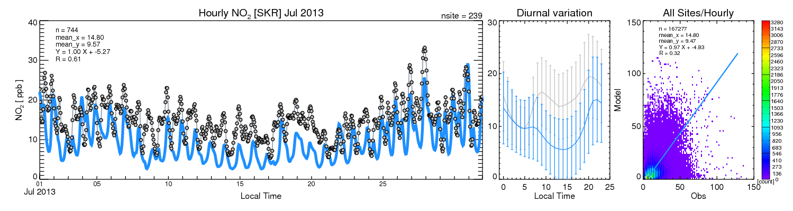
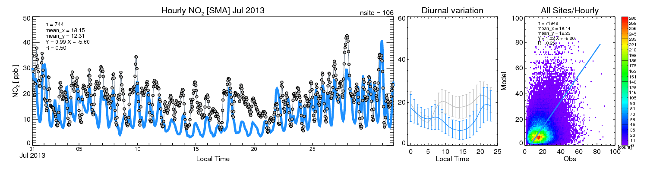
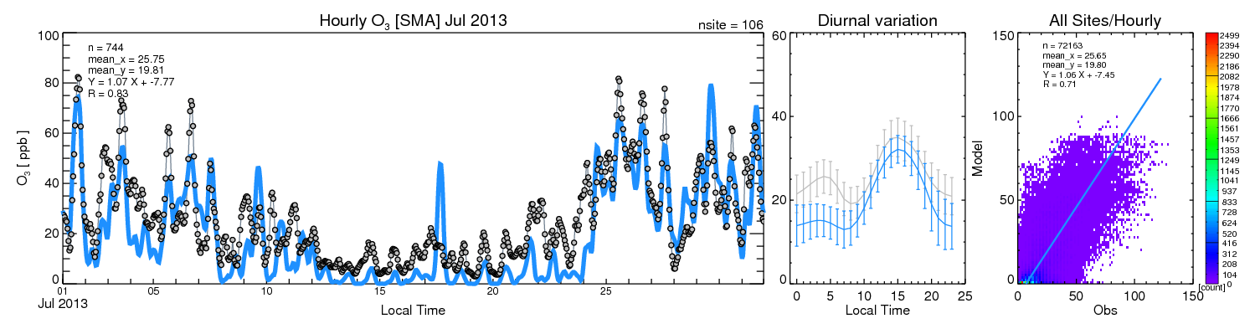
Objective: Integrated Emissions and Atmospheric Transport Model
Comparison between CMAQ simulation results and actual data for the High Ozone Season (July)
(a: Rural Area NO₂, b: Metropolitan Area NO₂,
c: Metropolitan Area O₃)
CMAQ Base Modeling Evaluation
Comparison of the simulated concentration of ozone and the measured concentration of atmospheric measurement network
a)
b)
c)
Notes:
Before we start the CMAS-RMS control scenario simulations, we peformed the complete CMAQ based modeling evaluations. These plots are showing the NOx and ozone simulation results in July.
The R square of NOx is about 0.6, but the R square of ozone is more than 0.7.
Based on these evaluations, I concluded that the performance of CMAQ was reasonable.

Slide 11
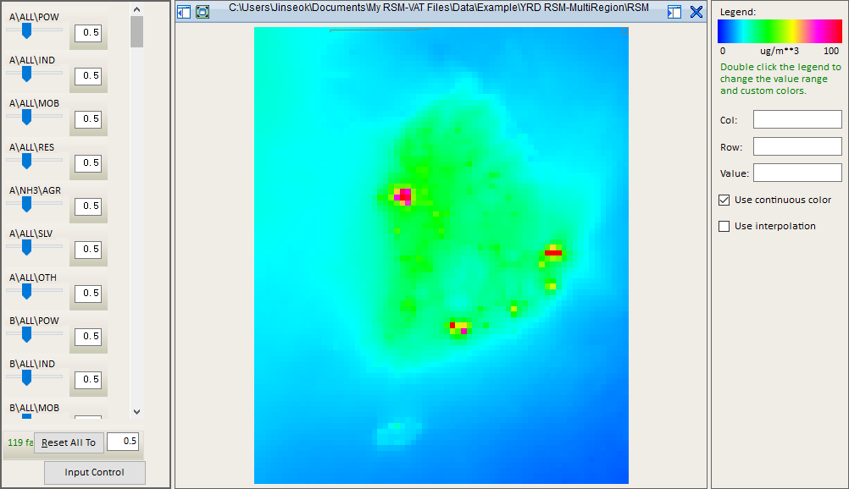
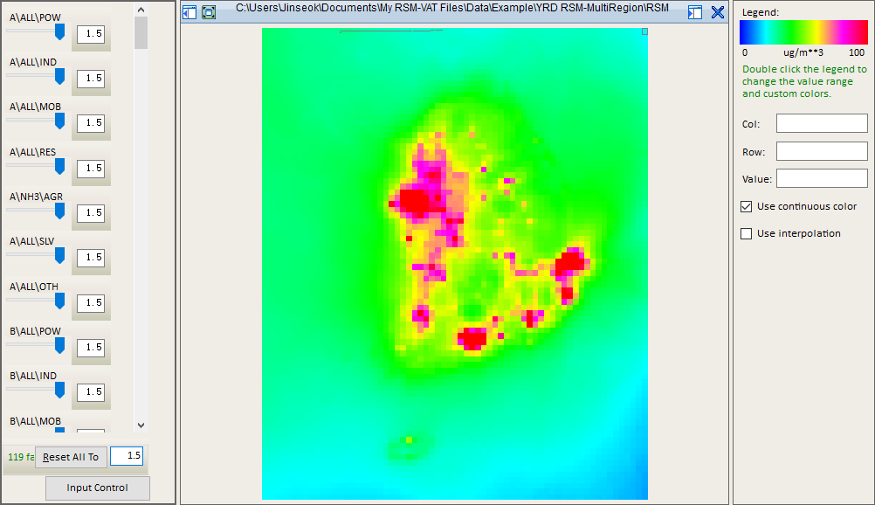
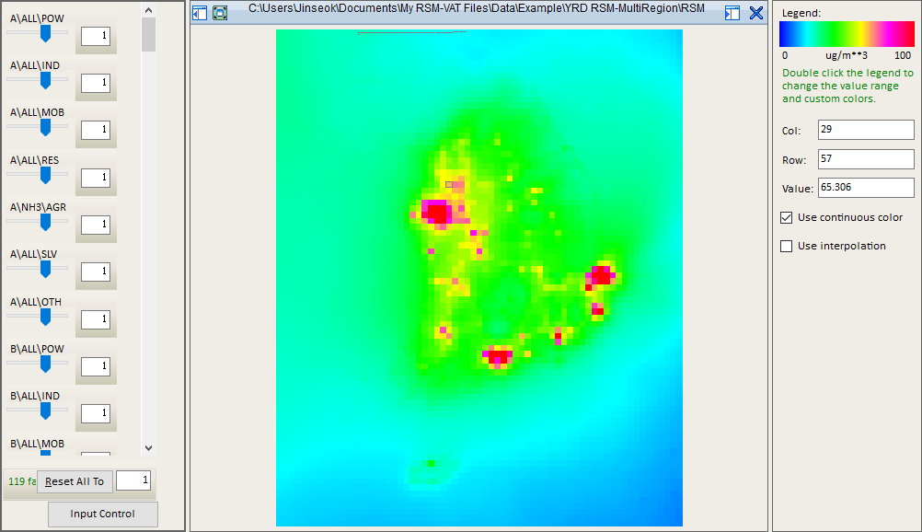
Result
RSM Base Scenario [PM2.5]
11
Notes:
The results of the RSM are shown as follows.
This figure is the result of RSM for PM2.5, which shows the Base Scenario.
As we expected, the high concentration area in the Red Box are shown around the industry complex or megacity area.

Slide 12
Result
RSM 50% Reduction Scenario [PM2.5]
12
Notes:
The following shows the results when all emissions are reduced by 50%. As you can see that the concentration of PM2.5 in the high concentration area are significantly reduced compared with the base scenario shown in the previous slide.

Slide 13
Result
RSM 50% Increase Scenario [PM2.5]
Sensitivity
13
Notes:
The following shows the results when all emissions are increased by 50%. You can see that the high PM2.5 concentrations are occurred near those metropolitan and megacity regions
With this RSM visualization tool, you can see the response of the PM2.5 concentration changes while adjusting the emission amount in real time.

Slide 14
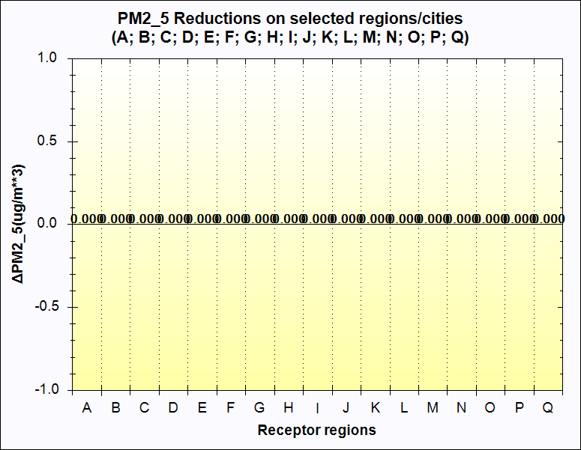
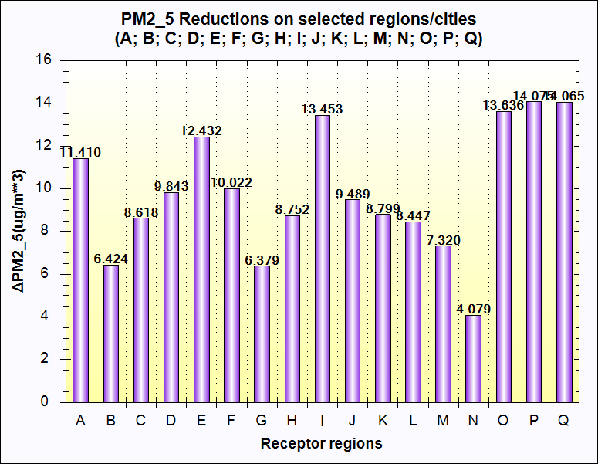
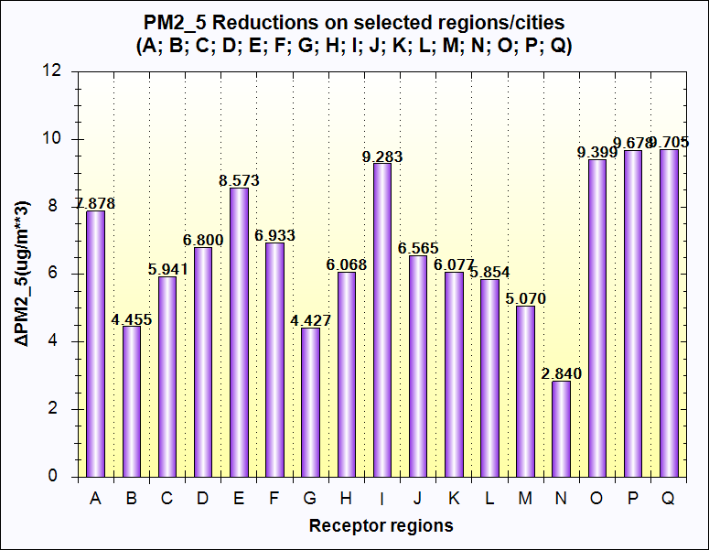
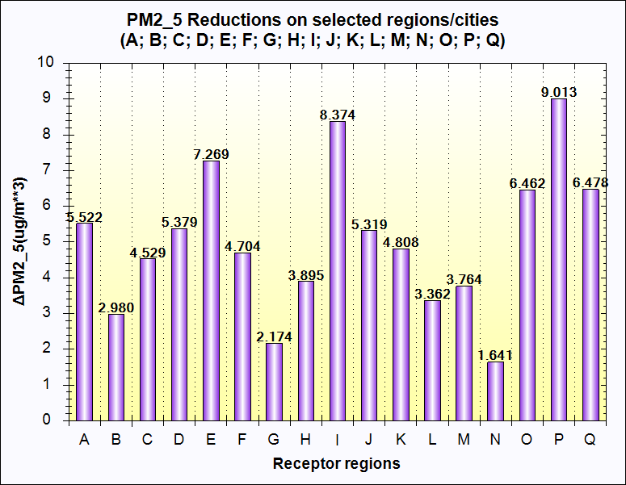
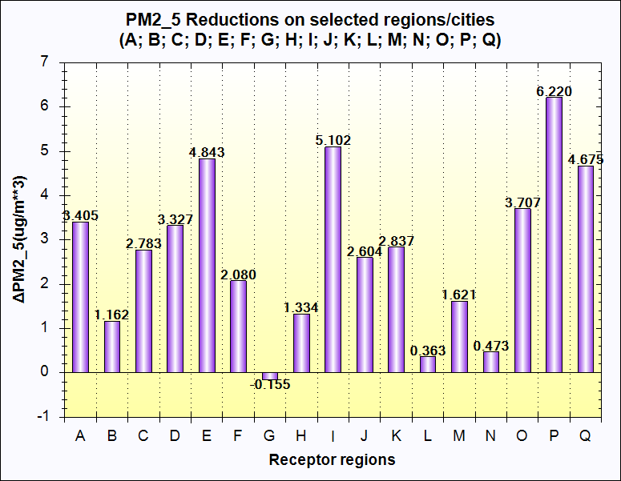
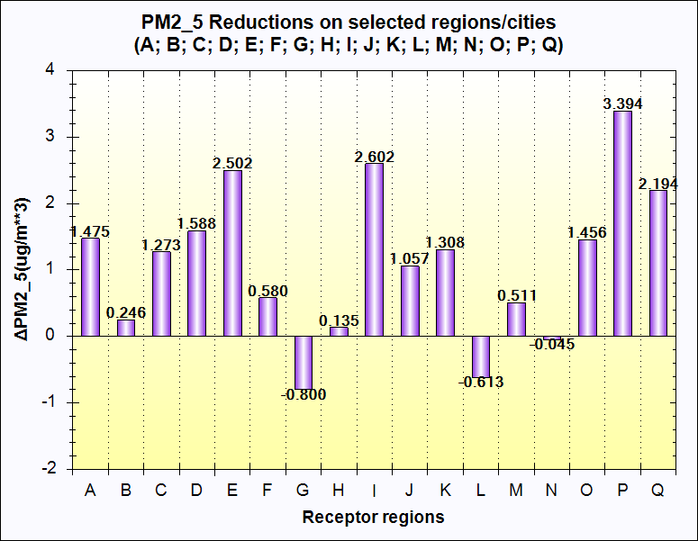
Result
RSM Results (△PM2.5) [Base-Scenario] : △Reduction(+)
(A)
(B)
(C)
(D)
(E)
(F)
A : Base Scenario; B : All sector 30% reduction; C : All sector 20% reduction;
D : Power 17%, Industry 32%, Mobile 28%, Residential 23% reduce (Recommend policy in Korea);
E : Solvent VOC 20% increase, the others 30% reduction;
F : Solvent VOC 20% increase, the others 20% reduction;
Notes:
The following are the results of testing base scenarios and reduction scenarios using RSM.
The meaning of each graph is shown below.
Graph A is the base case. there is no concentration of PM2.5 that is reduced or increased.
Graphs B and C are scenarios that reduce all emissions by 30% and 20%. Even if korea reduce the amount of emissions uniformly across all regions, we can see that the responses from each region are different.
Graph D shows the result of applying the desired PM2.5 reduction policy from 2017 to 2022 planned in Korea.
I'll tell you about more detail about this in the next slide.
Graph E and F show the results when the emissions of Solvent VOC Sector, the source of VOC, are increased while the emissions of the remaining sectors are decreased.
The results of Graphs E and F show that it is important in Korea to regulate VOC emissions to reduce PM2.5 concentration.

Slide 15
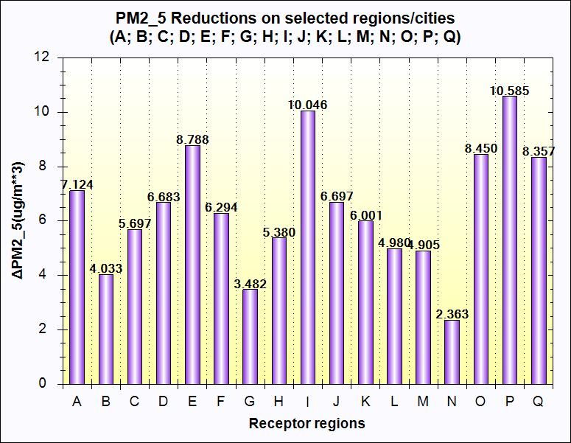
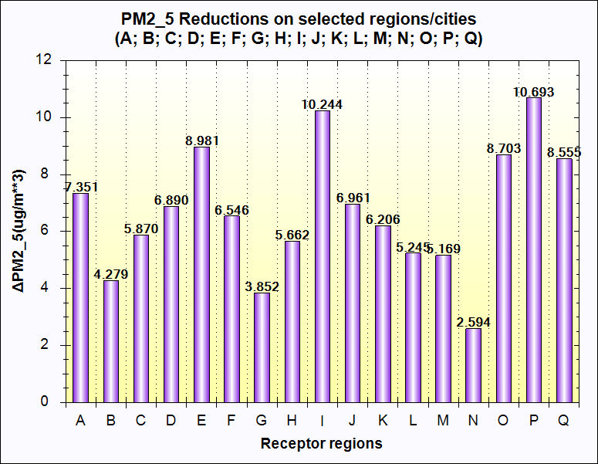

Result
Recommended policy in Korea for PM_{2.5}
(A)
(B)
Targeted PM_{2.5} in A region:
8ug/m³ Reduction
(A) : Power 17%, Industry 32%, Mobile 28%, Residential 23% Reduction
(B) : (A) + Solvent VOC 10% Reduction
(C) : (A) + Solvent VOC & Agriculture Sector 10% Reduction
(D) : (A) + Solvent VOC 20% Reduction
(C)
(D)
15
Notes:
We also analyzed the current policy using RSM.
Graph A is the one from the previous slide and the concentration of PM2.5 that is reduced base on the Korea’s PM2.5 policy.
The goal of this policy is to cut down the PM2.5 concentration in region A by 8 ug/m3.
However, we have derived the RSM result that it is difficult to achive the target with the current policy alone.
So, we have reduced the VOC emission from Solvent sector by 19% in Graph B, and Solvent VOC and Agriculture 10% reduction in Graph C, and finally recuded the Solvent VOC 20% in Graph D to see whether we can achieve the goal.
While Graph B and C did not meet the goal in region A, Graph D showed that reducing the solvent VOC sector by 20% will allows us to meet the requirement of current policy goal.
Using RSM in this way allows decision makers to consider what policies need to be implemented to achieve their goals.

Slide 16
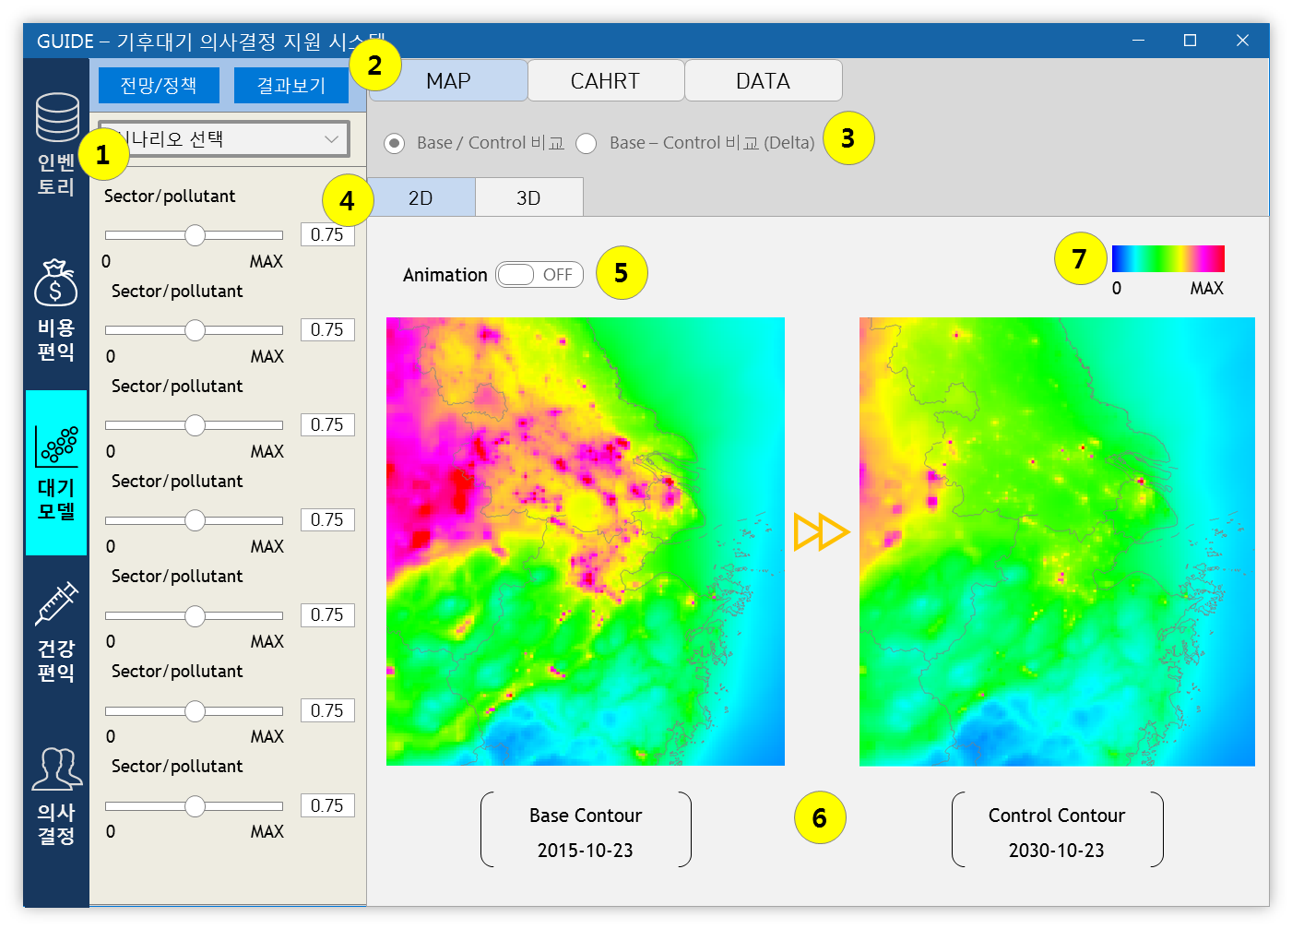
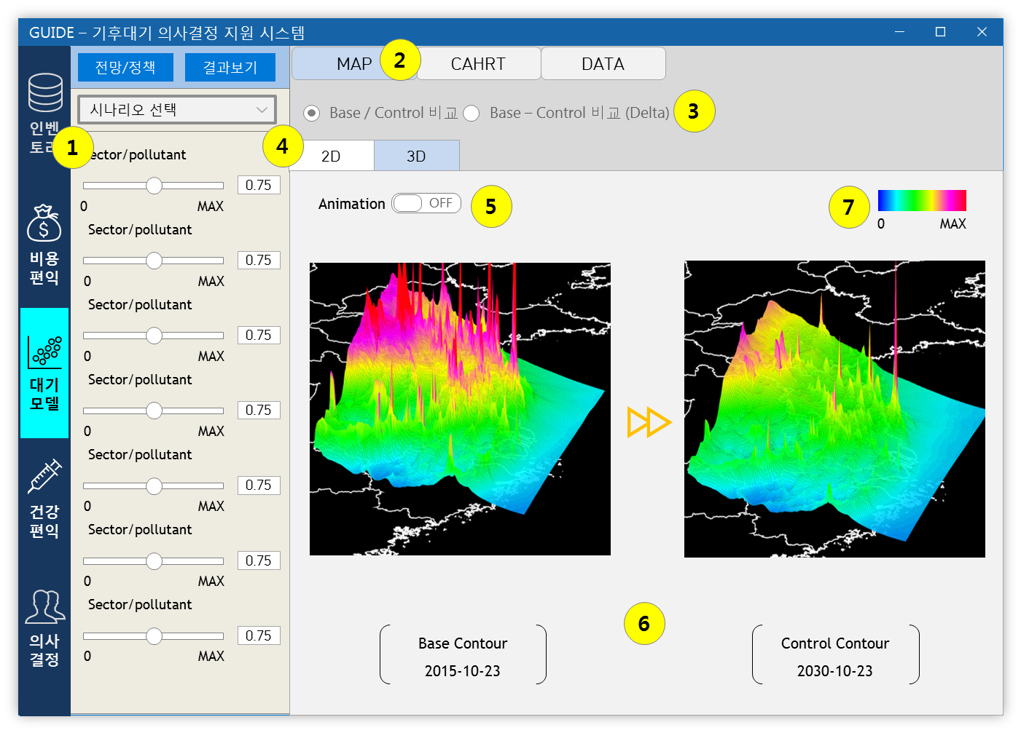
Development of “GUIDE” Prototype
GUIDE-RSM : Displaying map results [2D/3D] : Under Development
Display results of RSM model in real time according to user input change
Provides atmospheric model results in three forms ; MAP, CHART and DATA (Benchmarking from ABaCAS)
①Weight control function for each sector and region
②Select results button in map, graph, and table format
③Base year/Control year comparison, Delta result selection radio button
④2D/3D selection button
⑤Animation on/off button
⑥Display of 2D concentration line results
⑦Show graph legend
16
Notes:
The resulting RSM results are being applied to the GUIDE system for information service platform.
The above figure is a prototype of informationve service platform system in the GUIDE system.

Slide 17
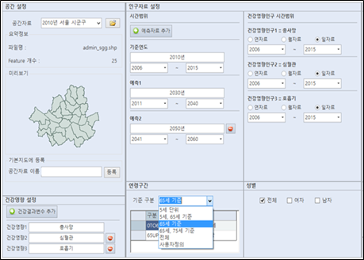
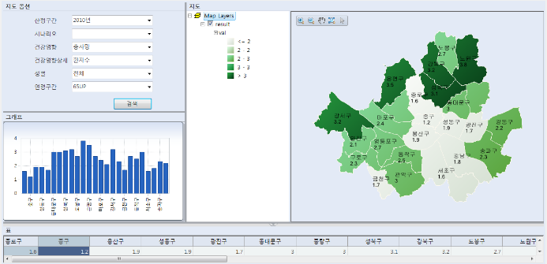
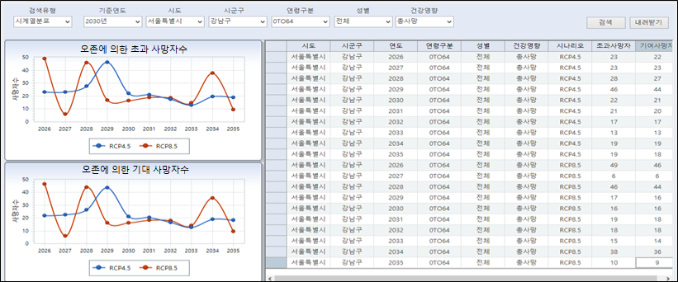
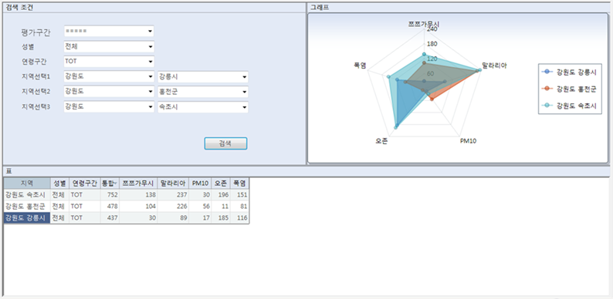
Development of “GUIDE” Prototype
Health Benefit Model : Under Development
After implementing the input and output sections of the health benefits model as a separate prototype -> platform integration
Output the results of the health benefit model in the form of maps using tables, graphs and GIS
17
Notes:
The following is the Health Benefit model developed by the Group of objective 2.
Likewise, these results are being applied to the GUIDE system by the Group of objective 3 .

Slide 18
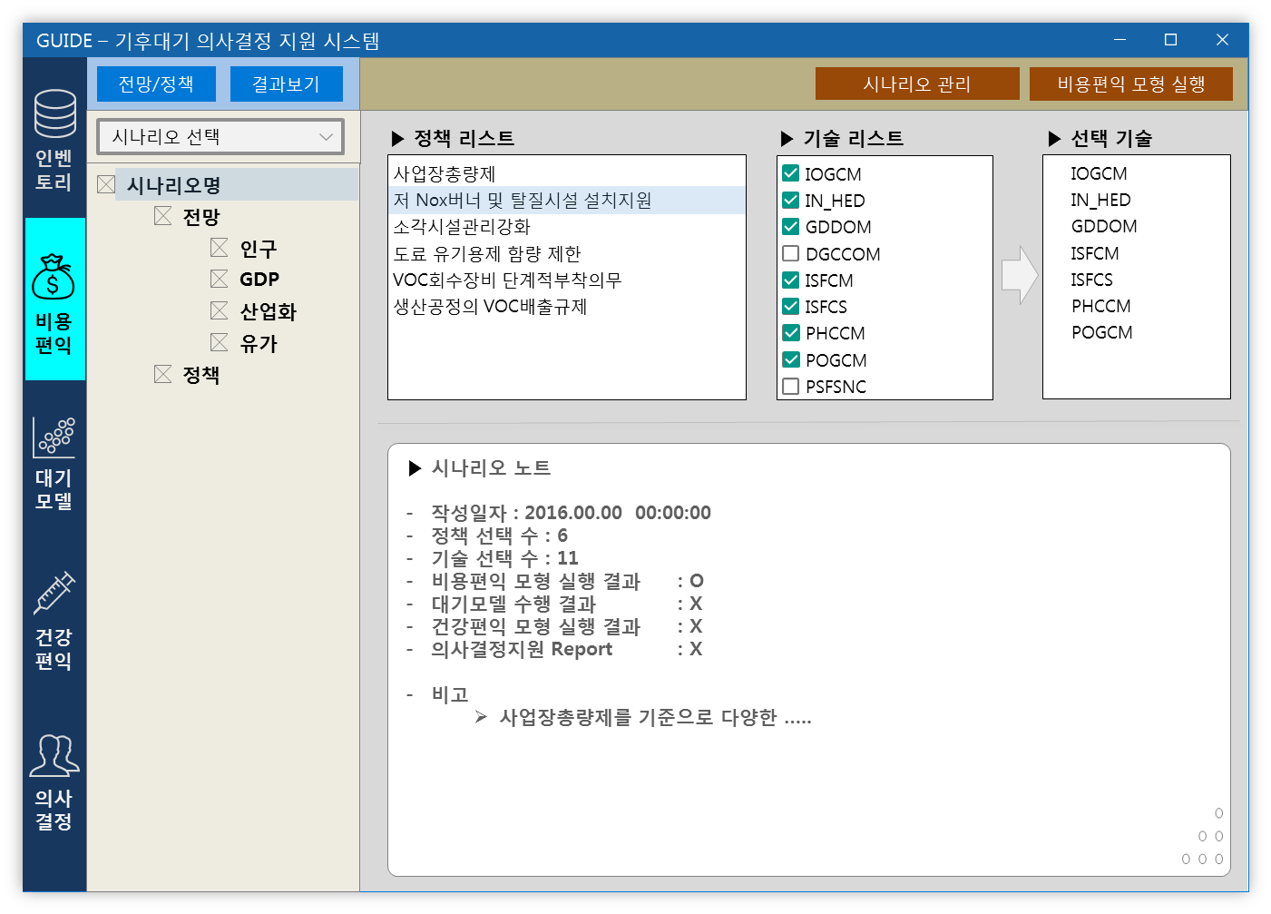
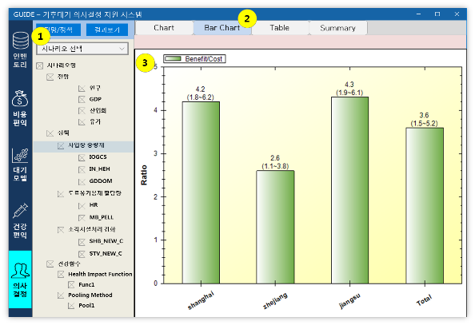
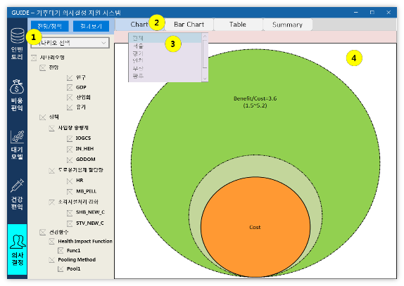

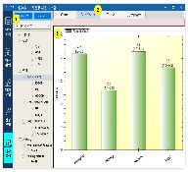

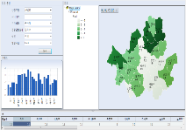
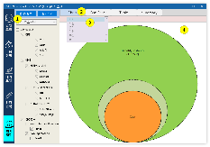
Development of “GUIDE” Prototype
Final GUIDE Decision Making Model : Future Design
Scenario 1
Cost benefits
RSM
Health benefits
Policy Selection
Technology Selection
Constraints
Graph
Diagram
Report
Display the results of decision support by scenarios in graphs, cumulative ben diagrams, etc.
Integrate the results of the input elements of the decision making model and output the entire result as a report
18
Notes:
Finally, combining these studies to develop the Decision Making Model GUIDE is a comprehensive goal.

Slide 19
Summary & Future Work
Summary
To improve the fine particle pollution in Korea, it is necessary to consider the secondary formation.
Complete SMOKE-CMAQ-RSM modeling for 120 control scenarios.
Successfully implemented the RSM model based on the 120 control scenarios CMAQ results.
Future Work
Increase the number of scenarios to improve the accuracy of RSM.
Full integration with “cost-health benefit” module to estimate the air quality & health benefits over the cost of control strategy.
Full integration with information service system.
19
Notes:
finally, summary and future work.
We are Created 120 control factors considering 17 regions, 7 sectors, and Boundary condition.and Complete SMOKE-CMAQ-RSM modeling for 120 scenarios.
in conclusion, To improve the fine particle pollution in Korea, it is necessary to consider the secondary formation.
Future work is as follows.

Slide 20
Thank you

Slide 21
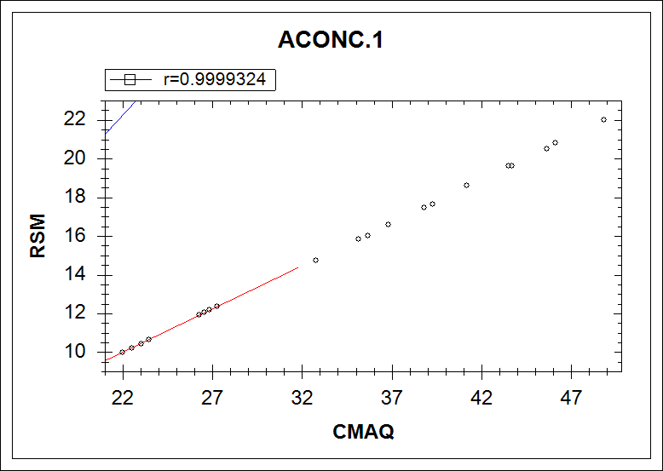
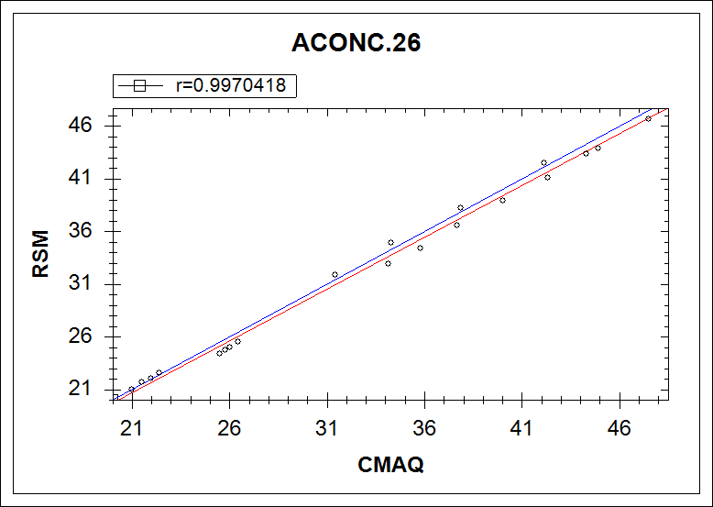
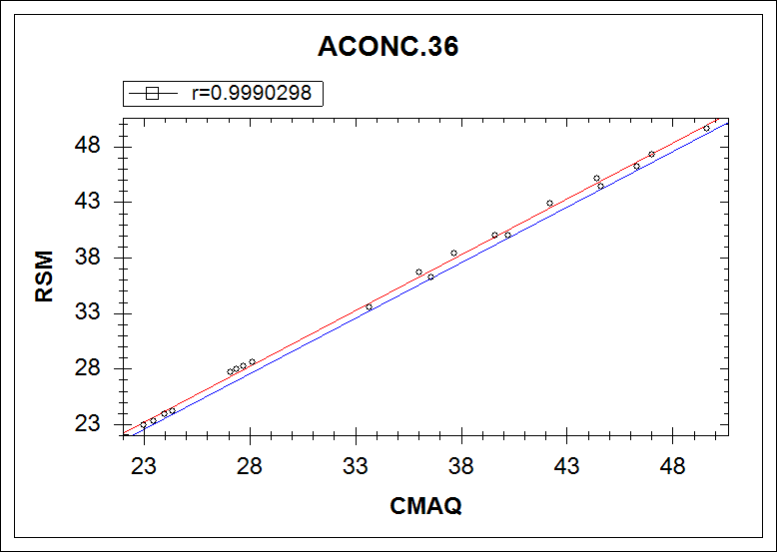
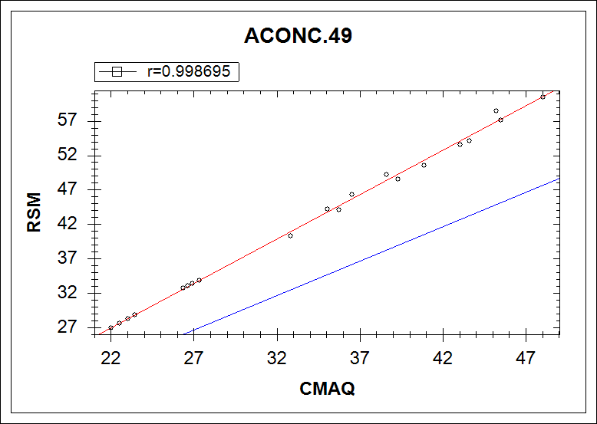
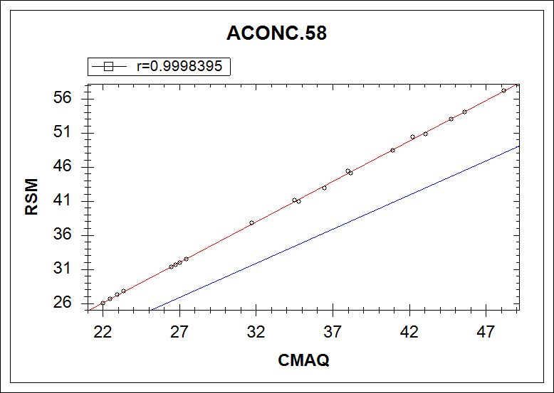
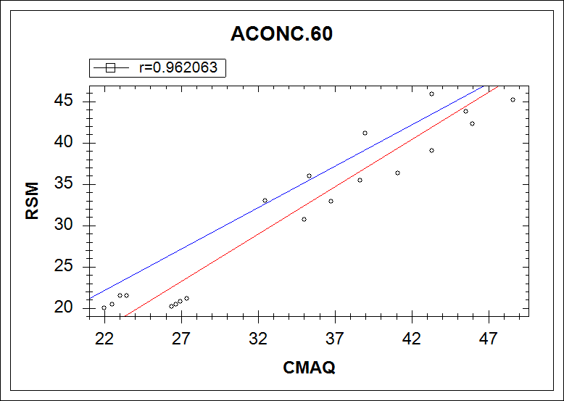
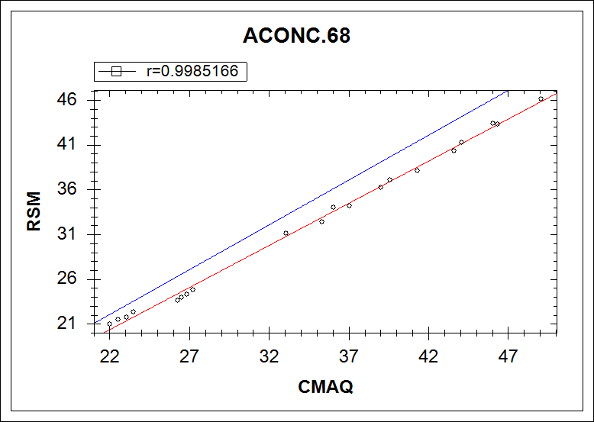
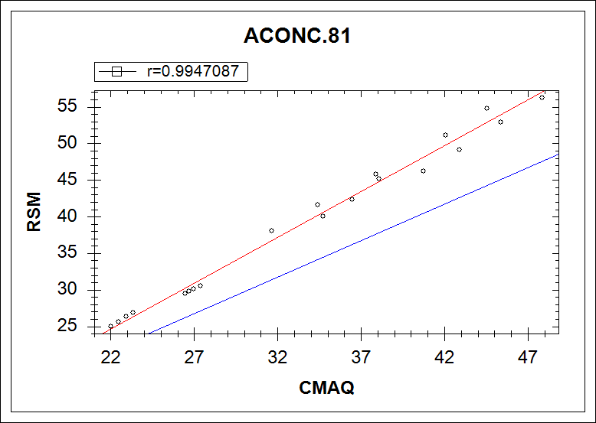

Intercomparison of CMAQ & RSM Concentration

