Slide 1
Evaluation of Dynamically Downscaled,
36- and 12-km Simulations of the WRF Model in Development of Intensity-Duration-Frequency (IDF) Curves for US Urban Areas
Anna M. Jalowska and Tanya Spero
Environmental Futures Analysis Branch | Systems Exposure Division
National Exposure Research Laboratory | Office of Research and Development | U.S. EPA
17th Annual CMAS Conference, Chapel Hill, NC
October 23, 2018 at 11:20am

Slide 2
Acknowledgments
The views expressed in this presentation are those of the authors and do not necessarily represent the views or policies of the U.S. Environmental Protection Agency.
The first author was supported in part by an appointment to the ORISE participant research program supported by an interagency agreement between EPA and DOE.
The authors thank Chuen Meei Gan for conducting some preliminary analysis. The authors appreciate valuable discussions with Jared Bowden (North Carolina State University) and John Loperfido (City of Durham, North Carolina).

Slide 3
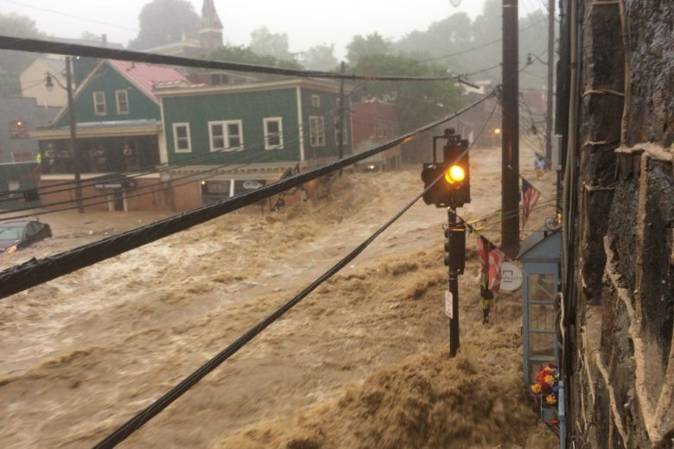
Extreme Precipitation
Extreme precipitation results in major floods and erosive runoff.
Between 1895 and 2010, the extreme precipitation frequency index in the Southeast increased by 11% and in the Midwest by 21%.
Warming climate may lead to fewer but more intense precipitation events.
Higher temperatures over urban areas can induce more rainfall over the city.
Flood waters in Ellicott City, MD on May 27, 2018, after a 1000-year rain event (source: Twitter user Max Robinson/@DieRobinsonDie)

Slide 4
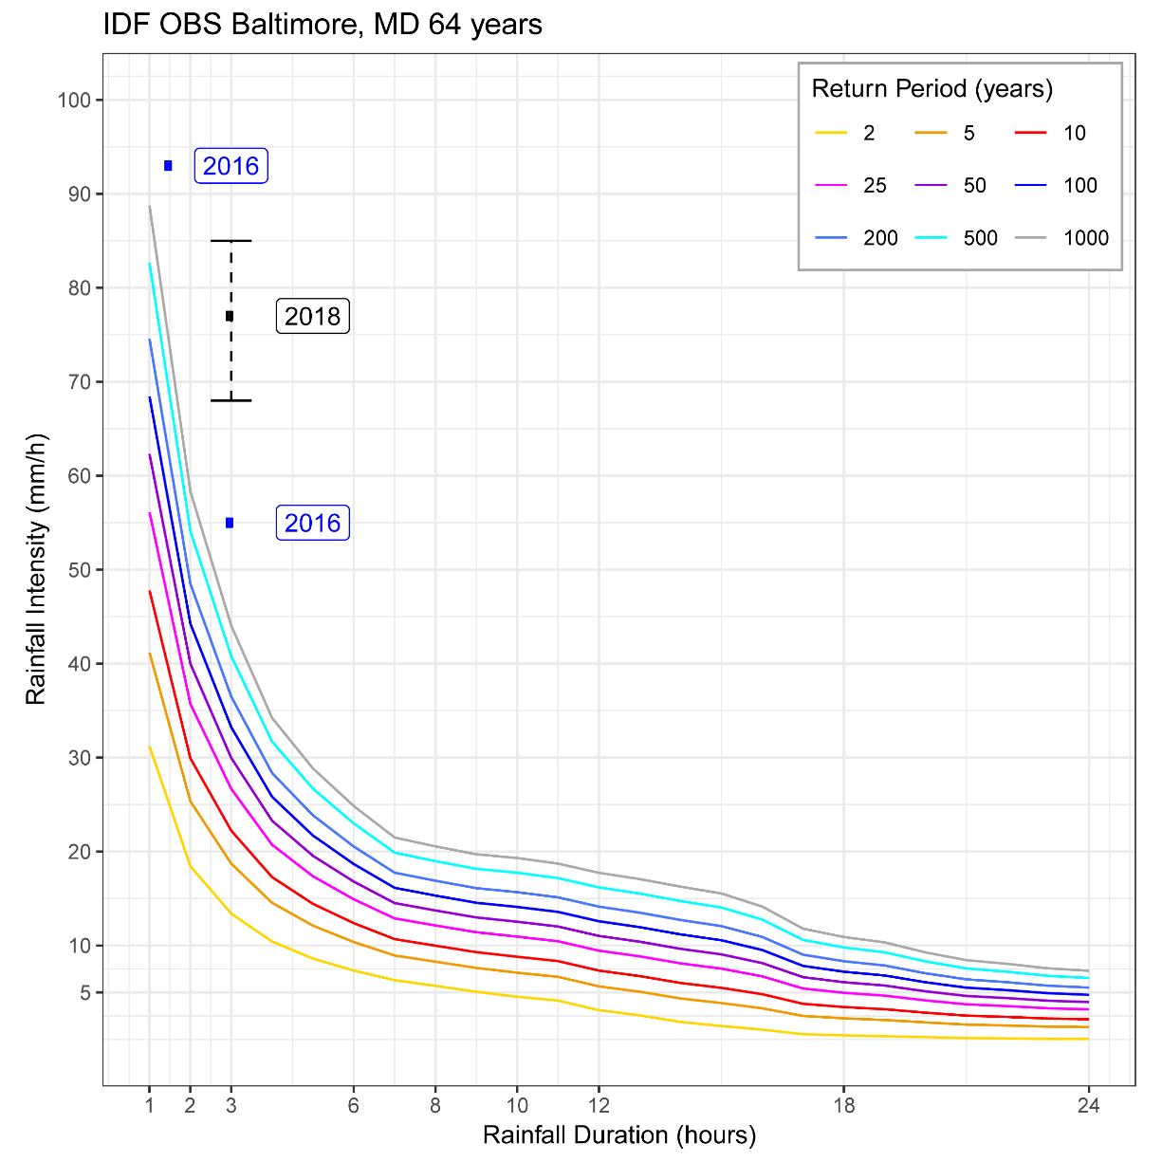
What are IDF Curves ?
Frequency (years)
IDF curves graphically represent the probability that extreme event of particular INTENSITY for a particular DURATION will occur.
20 years of precipitation data
Annual Maximum Series (AMS)
Fitting probability functions
Calculating probability distributions
Intensity (mm/h)
Frequency
Duration (hours)
IDF curve example for Ellicott City, MD
Notes:
USED IN THE DESIGN OF URBAN STORM-WATER SYSTEMS, HIGHWAYS AND RAILWAYS CULVERTS

Slide 5
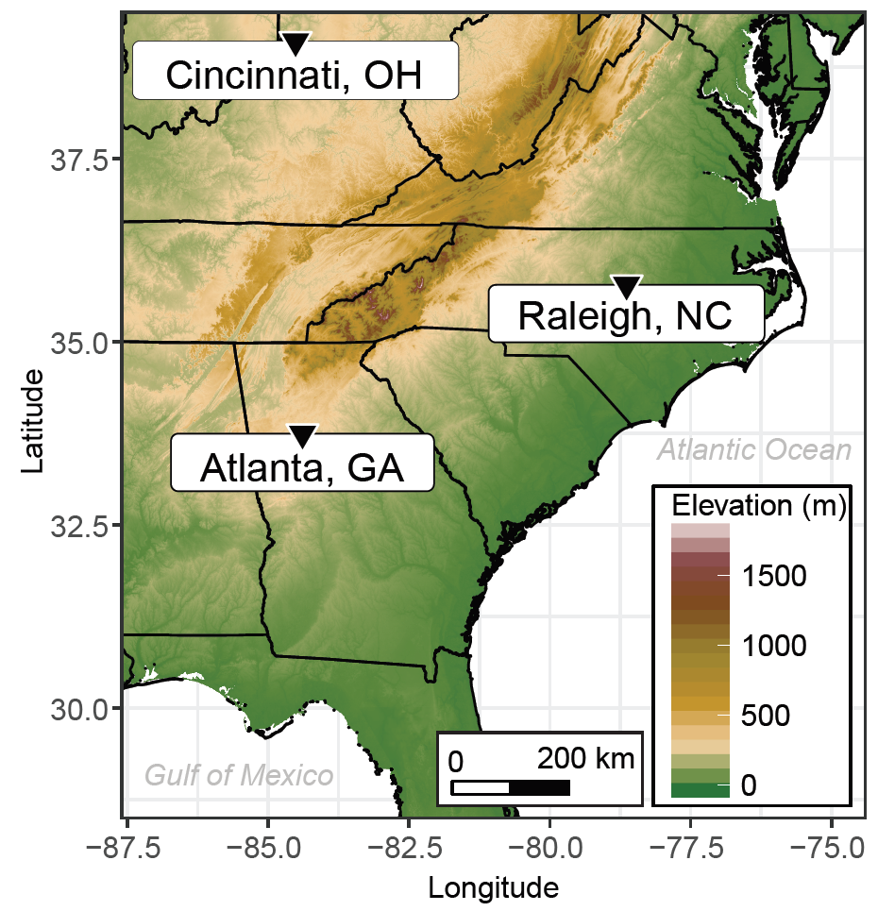
Methods- OBSERVATIONAL DATA
Cincinnati, Raleigh, and Atlanta
Sites are at least 100 km from the coast and mountains
Sites are more than 500 km apart
Hourly precipitation data for from NOAA's National Centers for Environmental Information (NCEI) for 1988–2010
Used 10 stations per city
Data evaluated for quality and consistency
Notes:
AT LEAST 100 KM FROM THE COAST AND MOUNTAINS TO MINIMIZE THE INFLUENCES OF STEEP TOPOGRAPHICAL GRADIENTS AND LAND-WATER INTERFACES WHICH COULD FURTHER AFFECT THE HETEROGENEITY OF THE DISTRIBUTION AND ACCUMULATION OF PRECIPITATION.
MORE THAN 500 KM APART, WHICH MINIMIZES THE POTENTIAL OVERLAP IN THE METEOROLOGICAL CONDITIONS EXPERIENCED AT THESE LOCATIONS

Slide 6
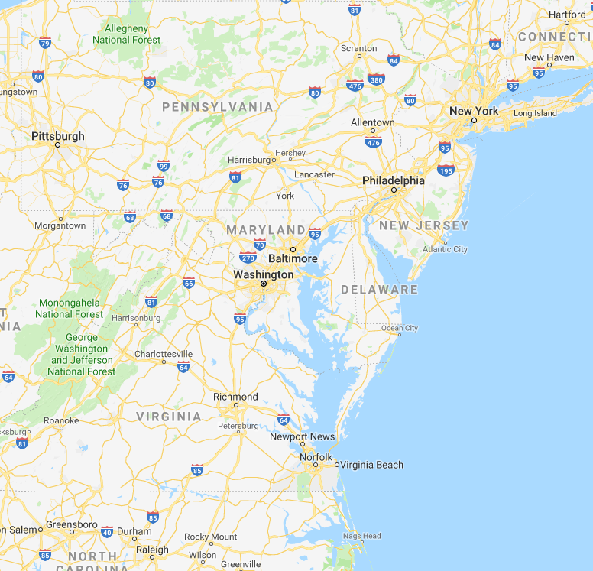
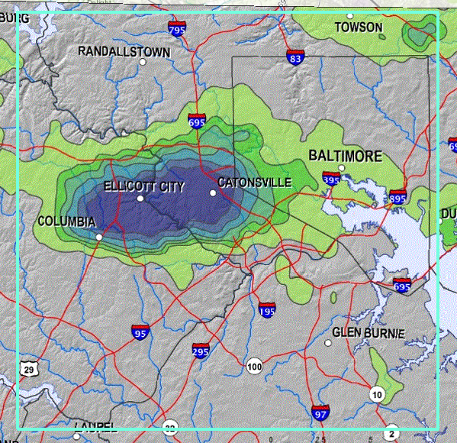
Methods- MODELED DATA
GLOBAL MODELS
REGIONAL MODEL
NCEP–DOE AMIP-II Reanalysis (R2)
2.5° × 2.5°
(~300 km)
DOWNSCALING
WRF (36-km)
ERA-Interim
0.75° × 0.75°
(~80 km)
WRF (12-km)
Notes:
REFERENCE:STORM
INITIAL AND LATERAL BOUNDARY CONDITIONS WERE UPDATED EVERY 6 HOURS
WRFv3.4.1
WRFv3.9

Slide 7
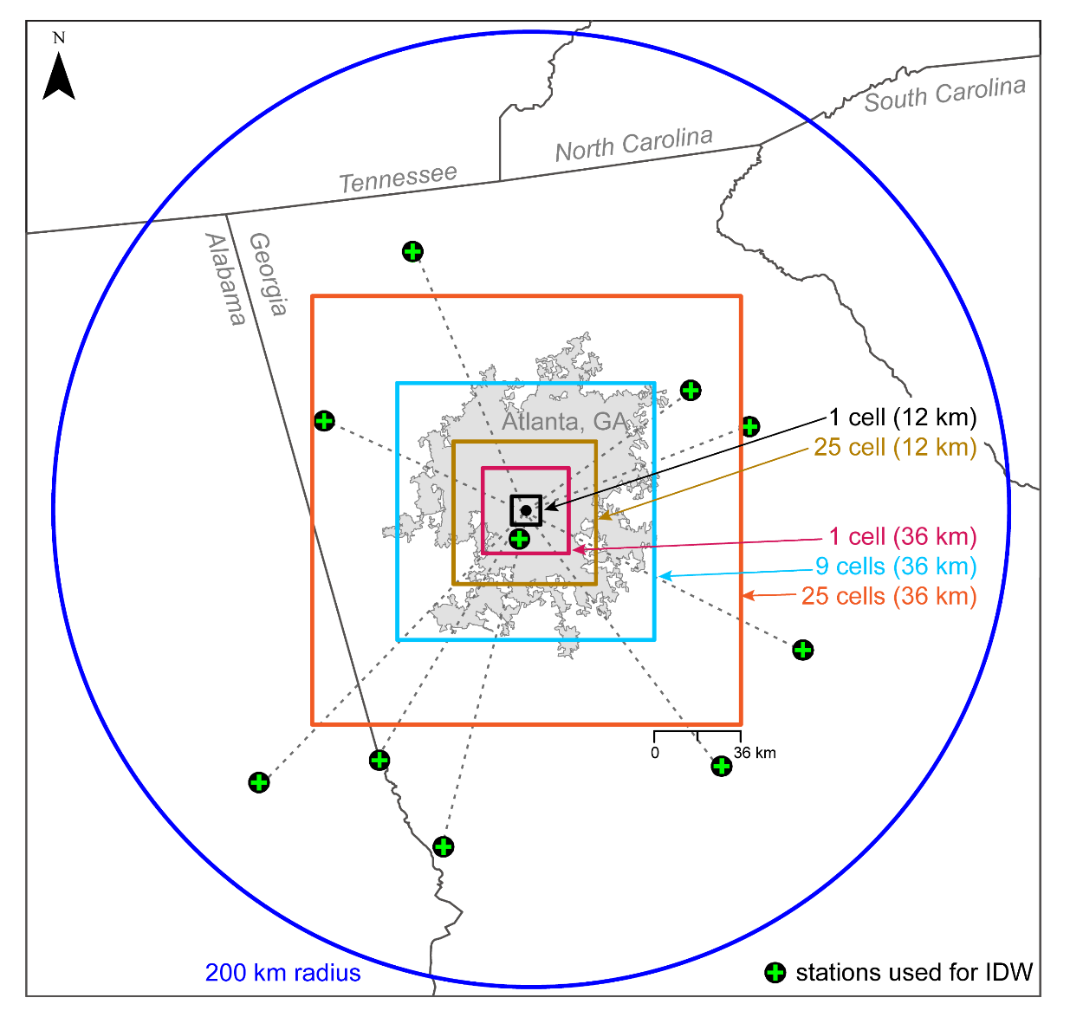
Methods- MODELED DATA
WRF simulations over CONUS were initialized at 00 UTC 1 November 1987 to provide a 2-month spin-up period
January 1988 to January 2011
Data from WRF model simulations were optimized to spatially represent the urban area:
  9-cells for 36-km simulations
  25-cells for 12-km simulation
Station used in IDW for Atlanta, and sizes of WRF cell subsets

Slide 8
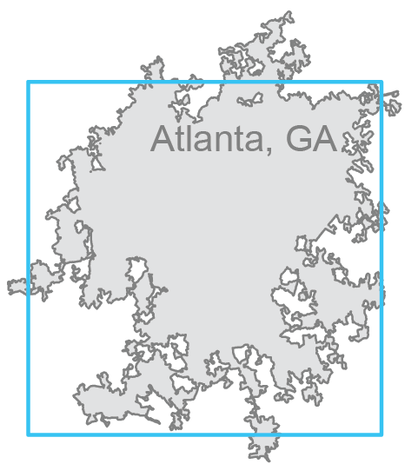
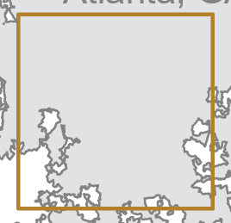


Methods- MODELED DATA
Data from cell subsets were aggregated using the Inverse Distance Weighting (IDW) method
WRF (36-km) IDW from 9 cells
WRF (12-km) IDW from 25 cells

Slide 9
Methods- MODELED DATA
Data from cell subsets were aggregated using the Inverse Distance Weighting (IDW) method
WRF (36-km) from 9 cells
WRF (12-km) from 25 cells
STORM
STORM
STORM
STORM
STORM
Notes:
IN IDW A MOVING STORM CAN BE ACCOUNTED MULTIPLE TIME.

Slide 10
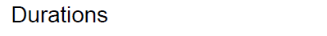
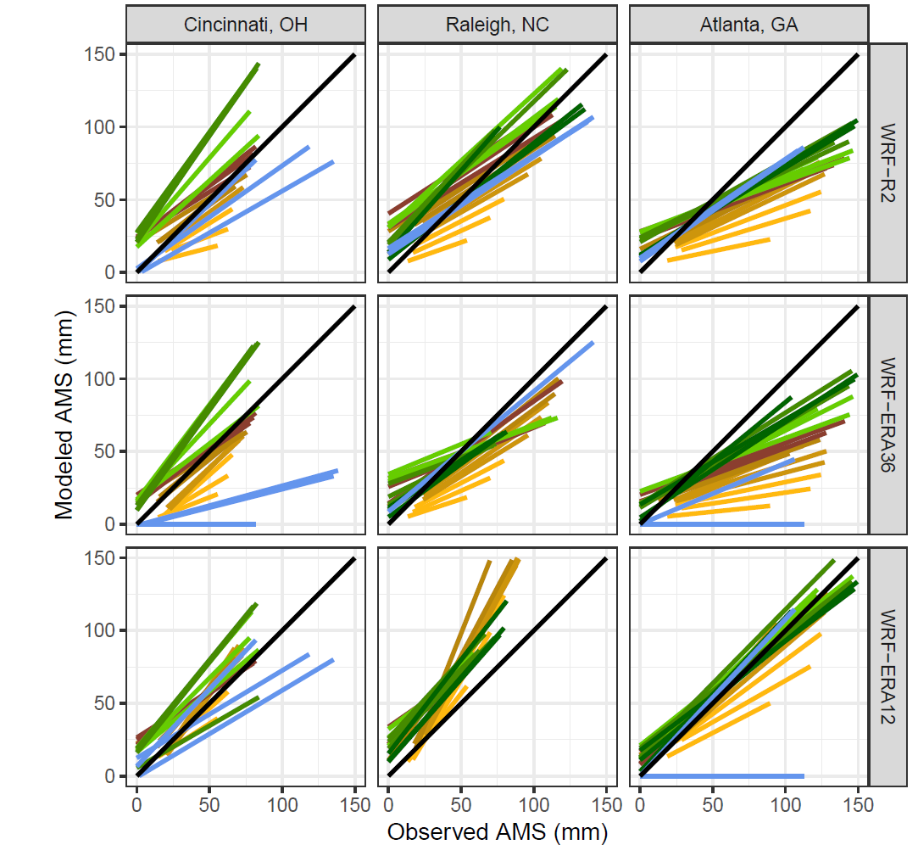
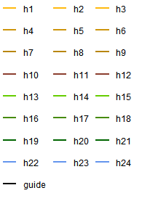
Model Evaluation- Annual Maximum Series (AMS)
WRF-R2 and WRF-ERA36 underestimate large precipitation events and
overestimate small events
WRF-ERA12 best reproduce observed AMS

Slide 11
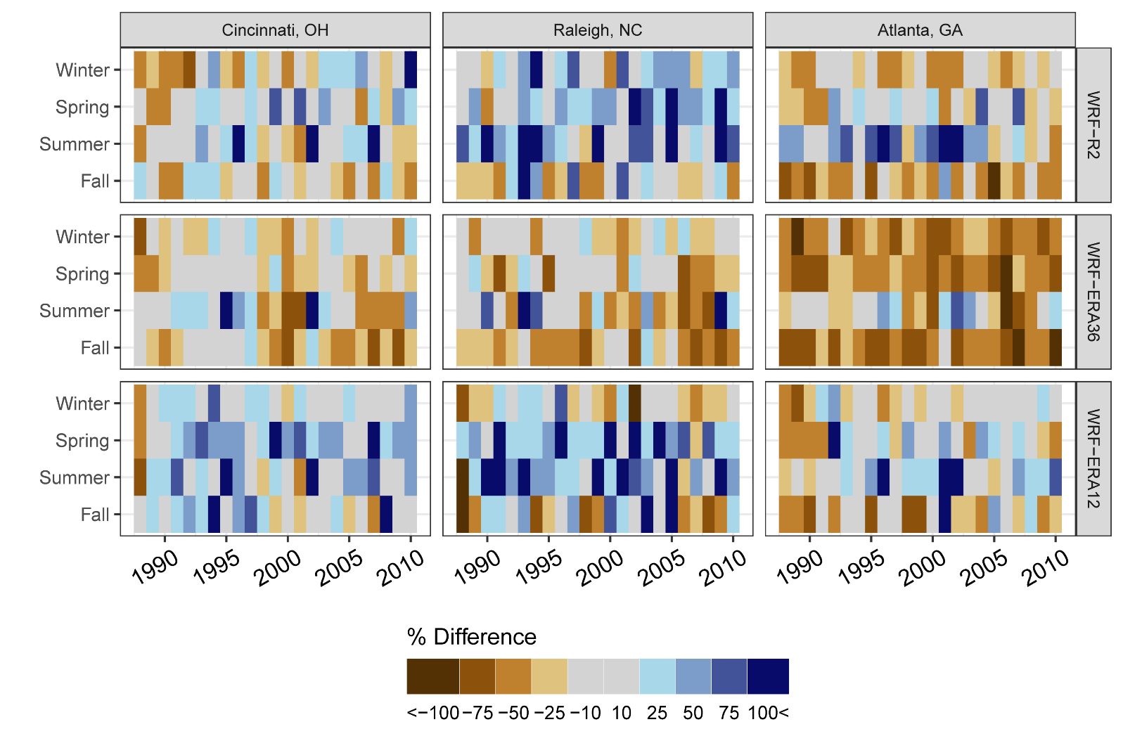
Model Evaluation- Seasonal Precipitation
Seasonal differences in precipitation between observed and modeled data
Smallest deviations
in the winter
WRF-ERA36 resulted in overall drier seasons than WRF-R2
Largest deviations in the summer when precipitation is dominated by convective activity
Inherited biases from the WRF driving data (global models)
Notes:
SPATIAL VARIABILITY
CINCINNATI THE BEST

Slide 12
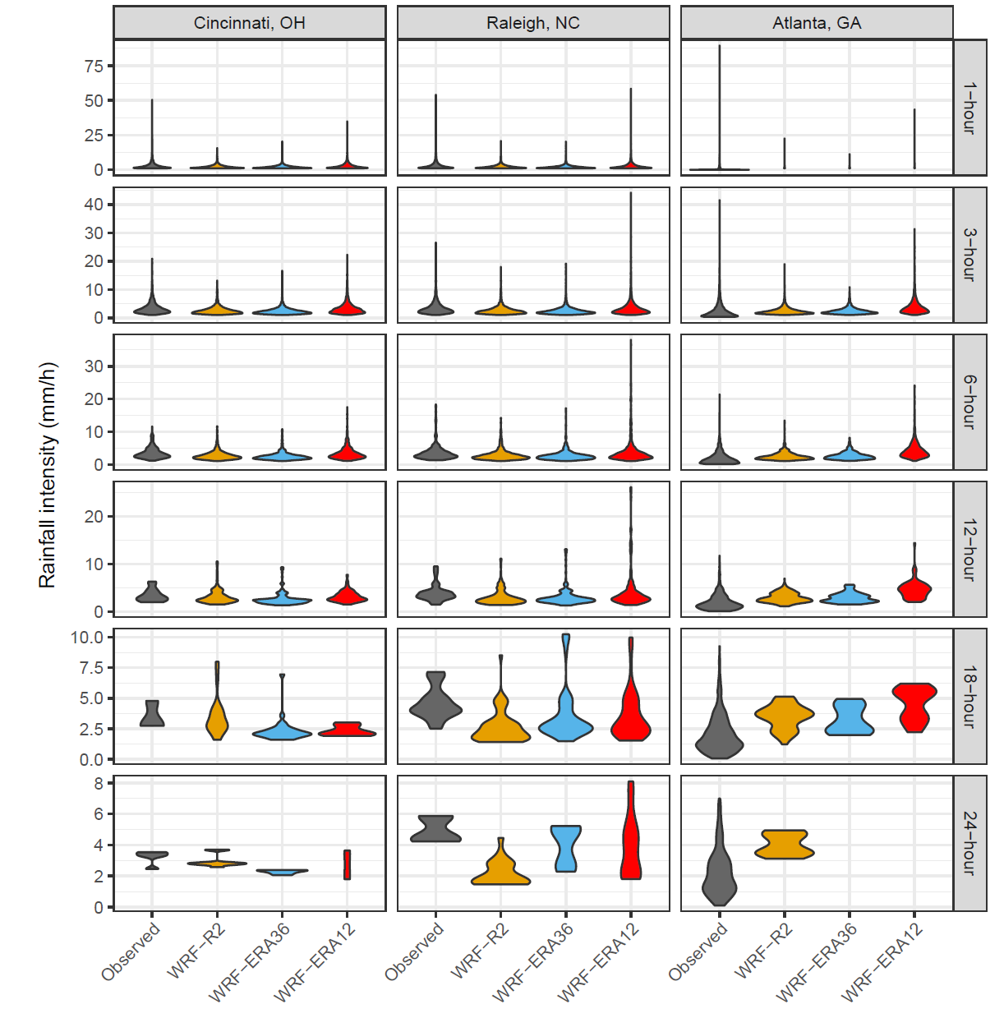
Model Evaluation- Hourly Precipitation
WRF-R2 and WRF-ERA36:
  both runs underestimated high-intensity and
  overestimate number of 1-3-hour events.
  replacing R2 with ERA improved intensities in 3-12-hour events.
WRF-ERA12:
  best reproduced 3-24-hour events.
  improved 1-hour events, but overestimated frequency and underestimated intensity.
Precipitation intensity distributions at six durations
Notes:
SPATIAL VARIABILITY

Slide 13
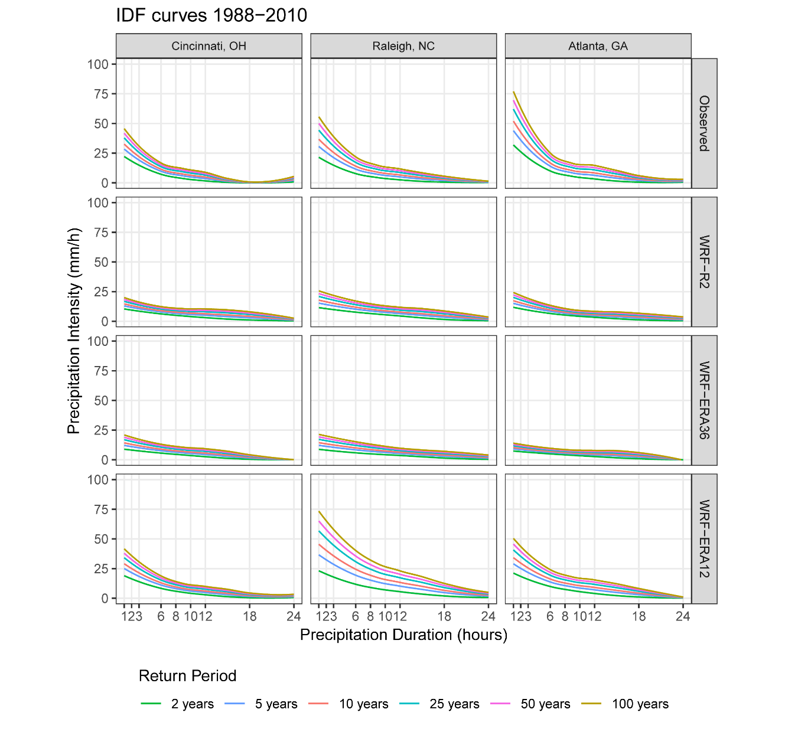
IDF Curves
The IDF curves were constructed based on AMS, fitted with Gumbel distribution using the L-moments estimation method.
In WRF-R2 and WRF-ERA36, the 1-hour to 3-hour events were greatly underestimated.
In both 36-km simulations, the 18-hour to 24-hour events were overestimated.
Increasing the resolution of WRF to 12-km improved modeled IDF curves.
WRF-ERA12 still underestimates annual maxima in the shortest durations, which suggests that higher-resolution WRF simulations (e.g., 4-km or finer) may be needed to reproduce the highest intensities at the shortest durations.

Slide 14
IDF Curves
The IDF curves were constructed based on AMS, fitted with Gumbel distribution using the L-moments estimation method.
In WRF-R2 and WRF-ERA36, the 1-hour to 3-hour events were greatly underestimated.
In both 36-km simulations, the 18-hour to 24-hour events were overestimated.
Increasing the resolution of WRF to 12-km improved modeled IDF curves.
WRF-ERA12 still underestimates annual maxima in the shortest durations, which suggests that higher-resolution WRF simulations (e.g., 4-km or finer) may be needed to reproduce the highest intensities at the shortest durations.

Slide 15
IDF Curves
The IDF curves were constructed based on AMS, fitted with Gumbel distribution using the L-moments estimation method.
In WRF-R2 and WRF-ERA36, the 1-hour to 3-hour events were greatly underestimated.
In both 36-km simulations, the 18-hour to 24-hour events were overestimated.
Increasing the resolution of WRF to 12-km improved modeled IDF curves.
WRF-ERA12 still underestimates annual maxima in the shortest durations, which suggests that higher-resolution WRF simulations (e.g., 4-km or finer) may be needed to reproduce the highest intensities at the shortest durations.

Slide 16
IDF Curves
The IDF curves were constructed based on AMS, fitted with Gumbel distribution using the L-moments estimation method.
In WRF-R2 and WRF-ERA36, the 1-hour to 3-hour events were greatly underestimated.
In both 36-km simulations, the 18-hour to 24-hour events were overestimated.
Increasing the resolution of WRF to 12-km improved modeled IDF curves.
WRF-ERA12 still underestimates annual maxima in the shortest durations, which suggests that higher-resolution WRF simulations (e.g., 4-km or finer) may be needed to reproduce the highest intensities at the shortest durations.

Slide 17
Conclusions
The 36-km WRF dataset driven by R2 produced IDF curves that were acceptable at the 6-hour to 18-hour durations.
Increasing the resolution of WRF’s driving data from R2 to ERA-Interim marginally improved the 6-hour to 18-hour durations.
36-km WRF data did not reproduce the high-intensity, short-duration events or the long-duration events.
12-km WRF reproduced IDF curves developed from observations.
12-km WRF dramatically improved the frequency and intensity of the 1-hour to 3-hour.
Some locations (here, Raleigh) could be more impacted by biases inherited from the driving models, as well as those within WRF at a given resolution.
Notes:
data did not apply equally to all study sites, suggesting further modifications to the model and/or methodology are necessary

Slide 18
Future Directions
Consider scale-aware convective schemes in the WRF model.
Refine the model resolution to 4-km.
Include developed techniques to build IDF curves in the EPA’s Storm Water Management Model (SWMM) and Climate Resilience Evaluation and Awareness Tool (CREAT), allowing public communities to aid in storm water management planning, thereby avoiding negative economic impacts.

Slide 19
Thank you

Slide 20
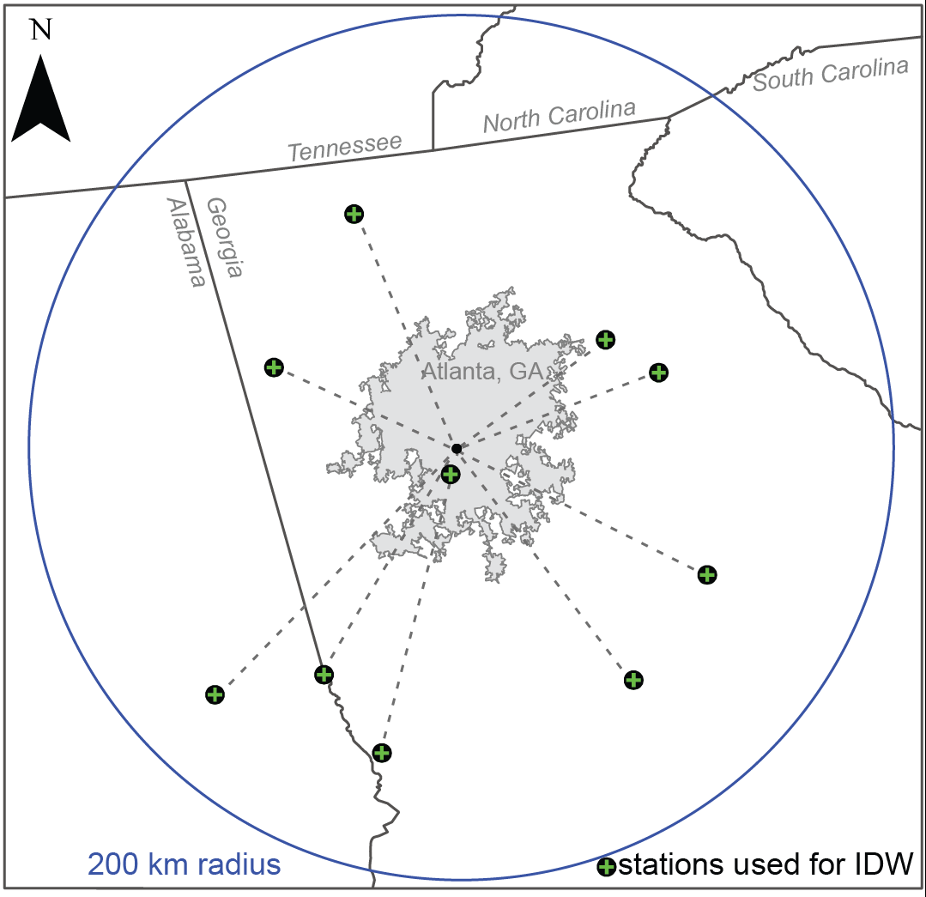
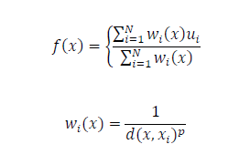
Methods- OBSERVATIONAL DATA
For each city:
Data from 10 stations within 200 km radius from the city;
Data were aggregated using:
Average of hourly data and
The Inverse Distance Weighting (IDW) method (Shepard, 1968).
location x is determined from a weighted interpolation of N
observed data points ui at each location xi.
The distance-based weights wi (x ≠ xi) is a function of the distance d between xi and x. The distance weighting is adjusted using the power parameter p=2.
Station used in IDW for Atlanta, and sizes of WRF cell subsets.
Notes:
at least 95% of valid precipitation observations during the study period;
located within 150 km of Atlanta and at least 85% valid precipitation observations during the study period;
or located within 100 km of Atlanta and at least 75% valid precipitation observations during the study period

Slide 21
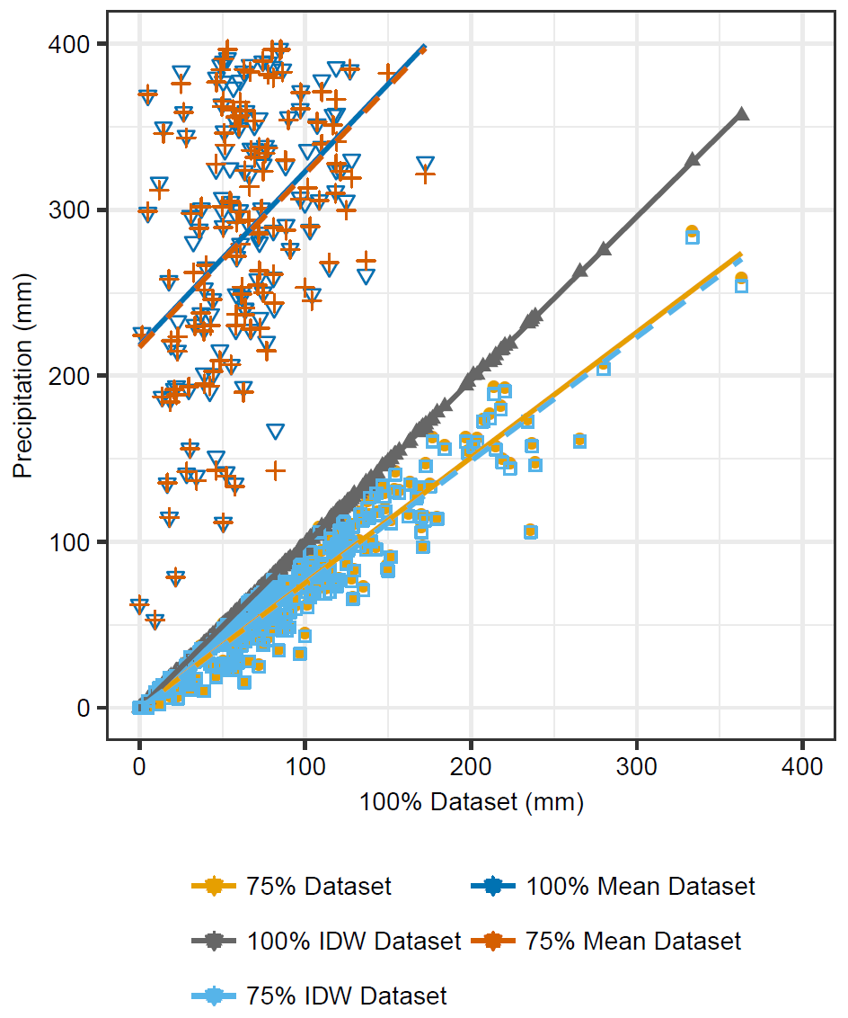
Observed data evaluation
100% IDW Dataset reproduced the 100% Dataset the best;
The Mean Datasets performed the poorest, greatly overestimating monthly values;
75% IDW Dataset and 75% Dataset were indistinguishable.
R²=0.47
PBIAS=370%
R²=1, PBIAS=0%
R²=0.92
PBIAS=25%
Notes:
The single station observation dataset for Atlanta (100% Dataset) was compared with:
single station observation dataset with 25% data removed (75% Dataset)
100% IDW Dataset – IDW with 100% Dataset;
75% IDW Dataset – IDW with 75% Dataset;
100% Mean Dataset – hourly mean with 100% Dataset
75% Mean Dataset – hourly mean with 75% Dataset

