Slide 1

Evaluating reduced-form modeling tools for simulating annual average PM2.5 impacts
October 2018
Kirk Baker, Heather Simon, Gobeail McKinley, Neal Fann, Elizabeth Chan

Slide 2
Motivation
Reduced form/complexity tools are often used to replicate air quality and health impacts for emissions scenarios to avoid using resource-intensive photochemical (full-form) grid models
Intend to understand the strengths and weaknesses of multiple reduced form tools and “fit for purpose” for different types of regulatory assessments as well as provide an evaluation framework for similar tools or future iterations of these tools; this assessment is not intended to pick “winners or losers”
Part 2 of presentation focused on monetized health benefits follows

Slide 3
Full and Reduced Form Approaches in this Assessment
Community Multiscale Air Quality (CMAQ) model
Comprehensive Air Quality Model with eXtensions (CAMx)
Intervention Model for Air Pollution (InMAP)
Air Pollution Emission Experiments and Policy Analysis (APEEP) versions 2 (AP2) and 3 (AP3)
Estimating Air pollution Social Impact Using Regression (EASIUR)
Source Apportionment Informed Benefit-Per-Ton based on the 2005 NEI (EPA SA-BPT)

Slide 4
Review of Model Input and Output Resolution
INPUTS
CMAQ/CAMx-BenMap:
  Area-source emissions: gridded (12 km), hourly
  Point-source emissions: actual stack heights
  Meteorology: gridded (12 km) hourly meteorology
InMAP:
  Area-source emissions: gridded (12 km), annual
  Point-source emissions: actual stack heights
  Meteorology: gridded (12 km) annual meteorology
APEEP:
  Area-source emissions: County-level, annual
  Point-source emissions: low, medium, and tall stack heights
  Meteorology: None (mid-1990s S-R matrix)
EASIUR:
  Area-source emissions: gridded (36 km), annual
  Point-source emissions: low, medium, and tall stack heights
  Meteorology: None (plumes adjusted by avg. winds)
SA-BPT (2005 NEI):
  Area-source emissions: national, annual
  Point-source emissions: national, annual
  Meteorology: None (based on 2005 base-year CAMx modeling)
OUTPUTS
CMAQ/CAMx-BenMap:
  AQ species: Total and speciated PM2.5, ozone, and deposition
  AQ and Health resolution: gridded (12 km), hourly
  Annual Monetary benefits calculated
InMAP:
  AQ species: Total and speciated PM2.5
  AQ and Health resolution: gridded (12 km), annual
  Annual Monetary benefits calculated
APEEP:
  AQ species: Total and speciated PM2.5
  AQ and Health resolution: County-level, annual
  Annual Monetary benefits calculated
EASIUR:
  AQ species: None
  AQ and Health resolution: None
  Annual Monetary benefits calculated
SA-BPT (2005 NEI):
  AQ species: None
  AQ and Health resolution: None
  Annual Monetary benefits calculated

Slide 5
3 Major Evaluation Elements:
Air quality output
Monetized health benefits
Nationally aggregated BPT
1) Modeled air quality surfaces will be compared
2) Reduced-form monetized health benefits comparison at county level
3) Nationally aggregated BPT will be compared along with EPA’s SA-BPT
CMAQ/
CAMx
BPT
12 km Annual PM_{2.5}
BenMAP
CMAQ-BenMAP Monetized Health Benefits
InMAP
12 km Annual PM_{2.5}
BenMAP
BPT
InMAP-BenMAP Monetized Health Benefits
Future baseline emissions
APEEP
(AP2/AP3)
County Annual PM_{2.5}
BenMAP
APEEP-BenMAP Monetized Health Benefits
BPT
Control scenario emissions
APEEP Monetized Health Benefits
BPT
EASIUR
BPT
*does not output air quality information, only monetized health benefits
SA-BPT (2005NEI)
BPT
*does not output air quality information, only monetized health benefits

Slide 6
Logistical Considerations
InMAP:
  well documented open source code
  substantial resources needed to generate scenario specific inputs and to run the model
  model runs comparatively slower than other reduced form models applied here
APEEP:
  not as well documented as InMAP and EASIUR; difficult to fully understand differences between version 2 and 3
  requires proprietary software (MatLab);
  substantial resources needed to generate scenario-specific inputs
  model runs very quickly
EASIUR:
  well documented tool
  does not predict air quality surface (only nationally aggregated damages)
    No characterization of AQ/health impacts spatial patterns
  substantial resources needed to generate scenario-specific inputs
  model runs very quickly
EPA-SA BPT (2005 NEI version):
  well documented tool
  does not predict air quality surface (only nationally aggregated damages)
    No characterization of AQ/health impacts spatial patterns
  model runs very quickly
  underlying source-receptor matrix needs periodic update as emissions source magnitude and spatial patterns change

Slide 7
Policy Scenarios
Mobile sector scenario: Tier 3 Final (2030 base and control)
EGU sector trading scenario: Clean Power Plan Proposal (2025 base and control)
  Increases and decreases in emissions included in this scenario
Also modeled multiple hypothetical sector scenarios: cement kilns, refineries, pulp & paper
Notes:
May want to mention that phase 3 is still to come and that we will look at three industrial sectors in that part of the comparison.

Slide 8
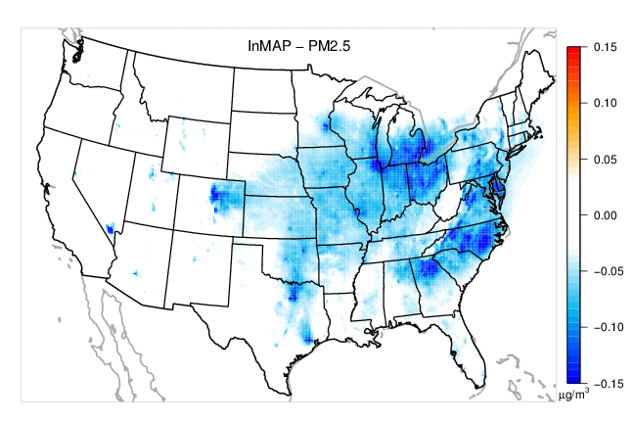
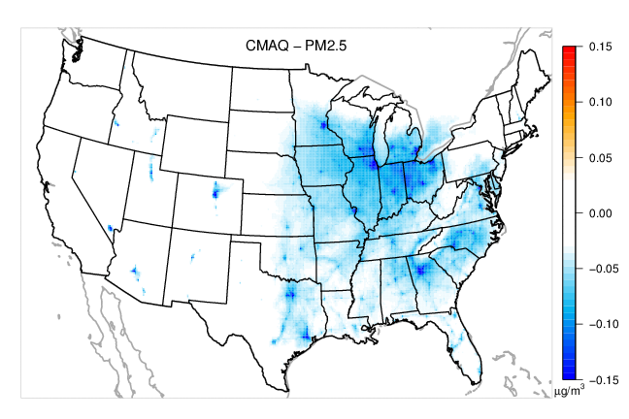
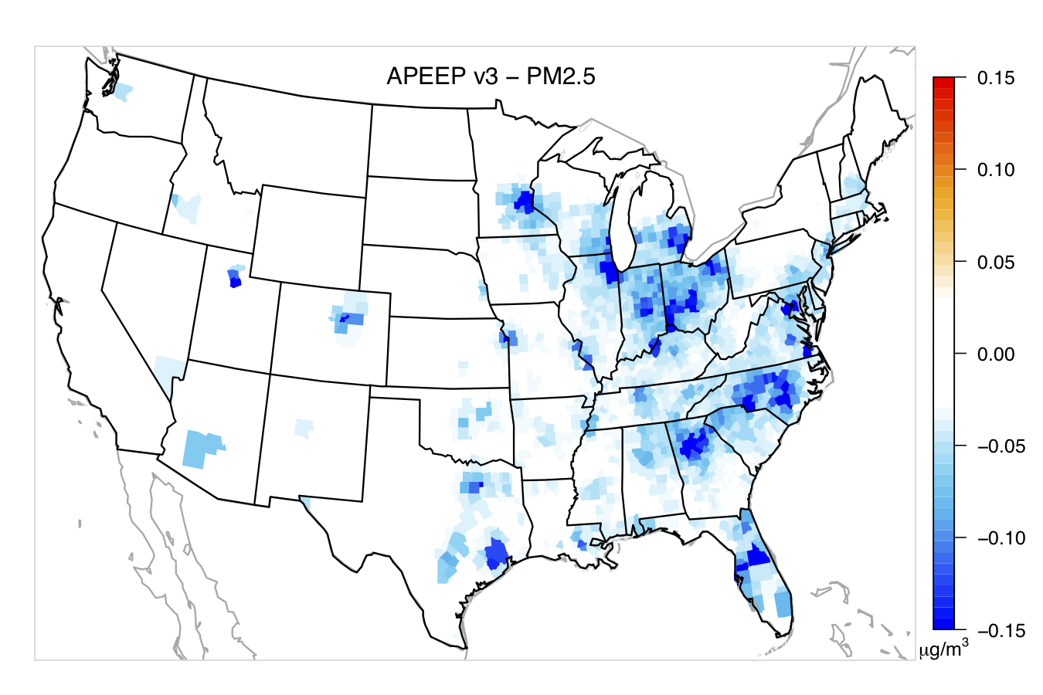
Annual average change in total PM_{2.5} from mobile scenario
2030 projected future year from 2007 base year
CMAQ (left), InMAP (top right), and AP3 (bottom right)
Cool colors show PM_{2.5} reductions due to the control plan
CMAQ: Total PM_{2.5} Reduction

Slide 9
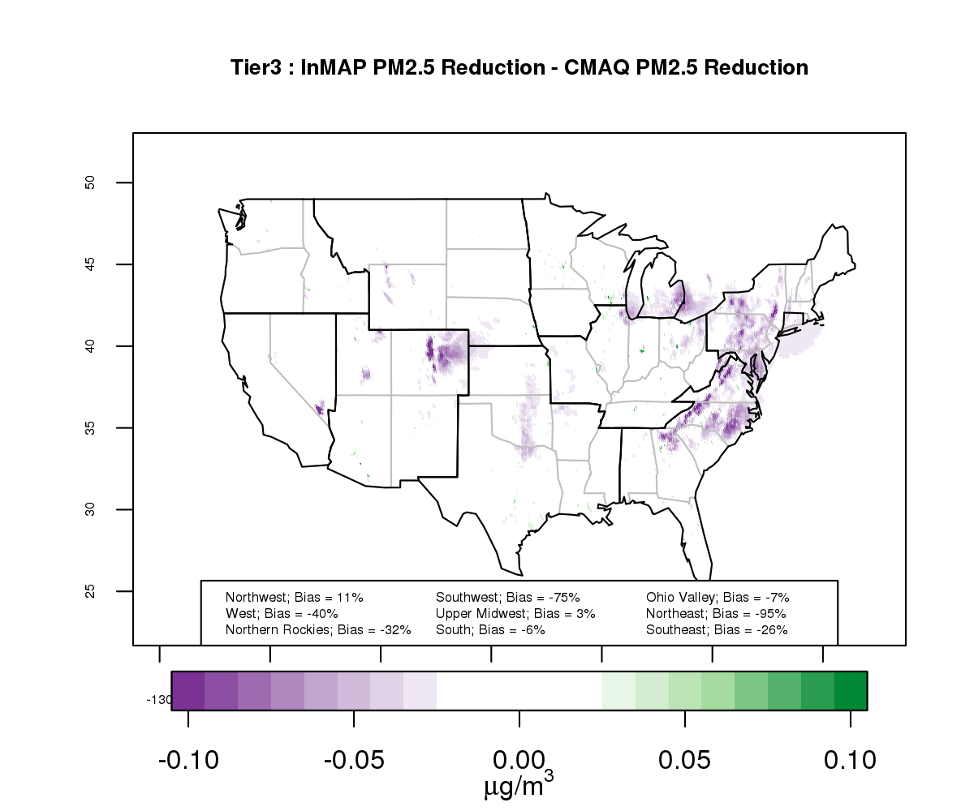
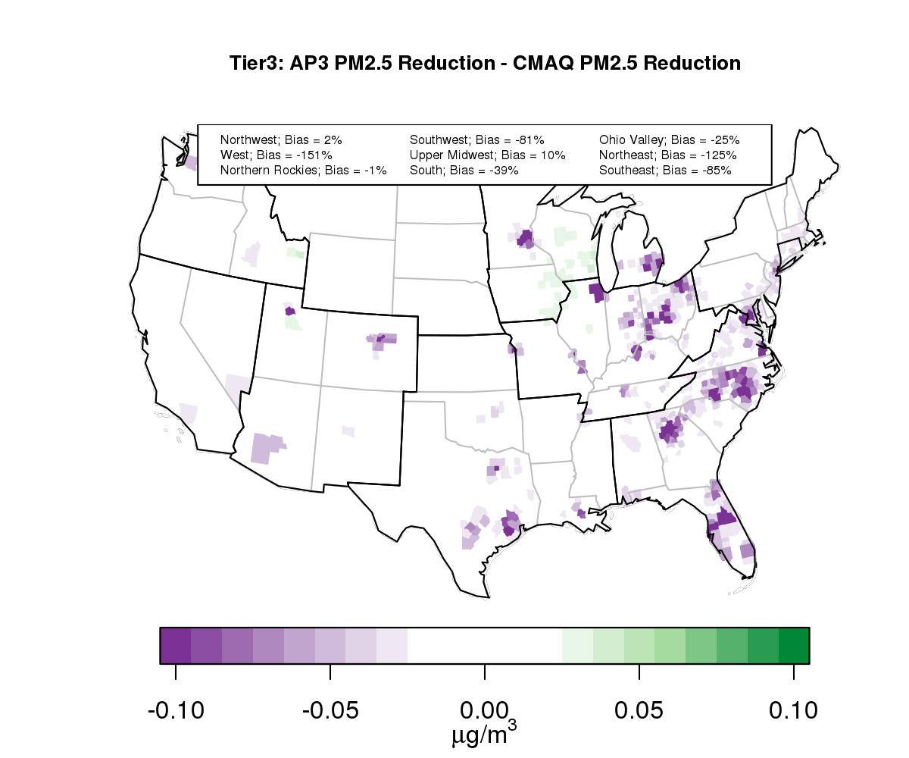
Mobile Scenario – Quantification of Differences between Models/Tools
Purple shading indicates where InMAP or APEEP predicts greater PM_{2.5} reductions and green shading where CMAQ or CAMx predicts greater PM_{2.5} reductions

Slide 10
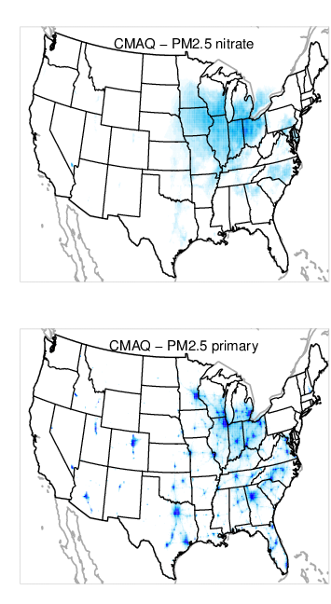
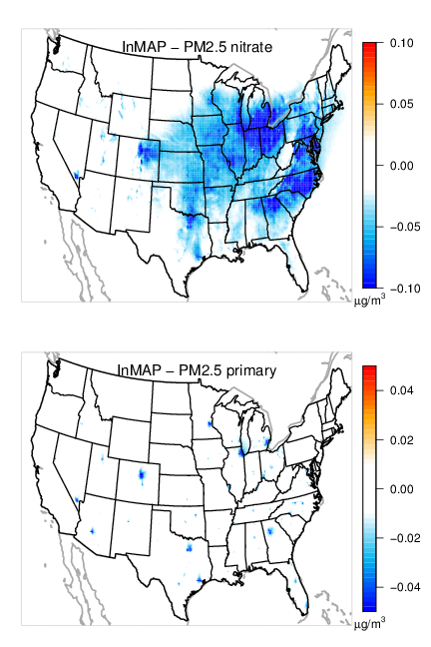
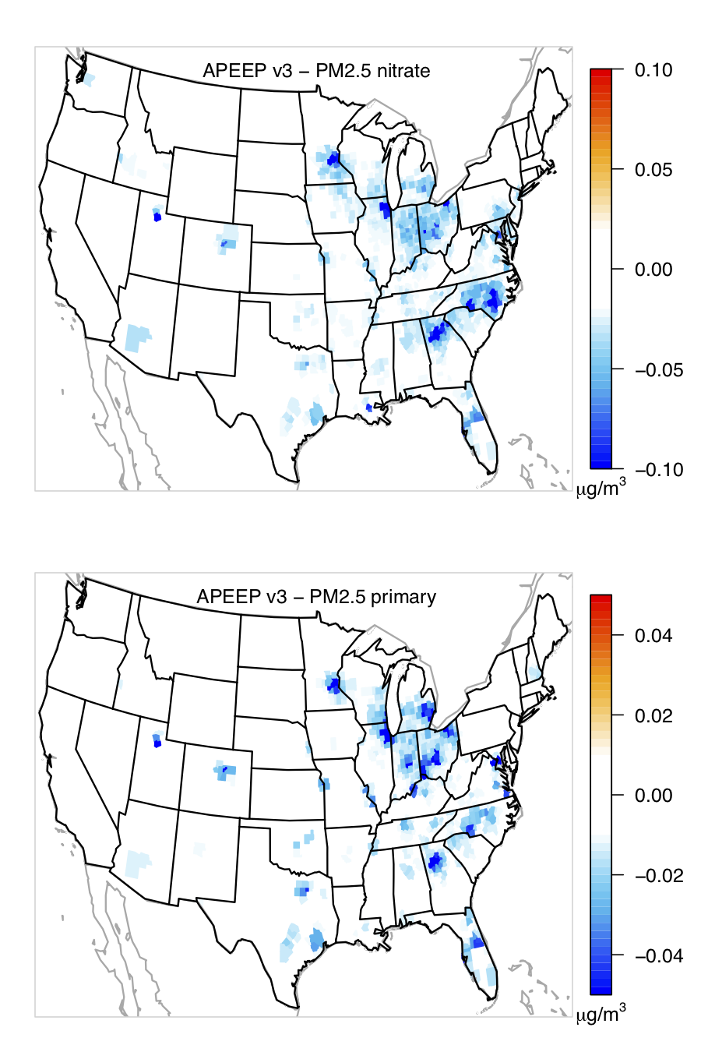
CMAQ
InMAP
APEEP3
NITRATE
PRIMARY

Slide 11
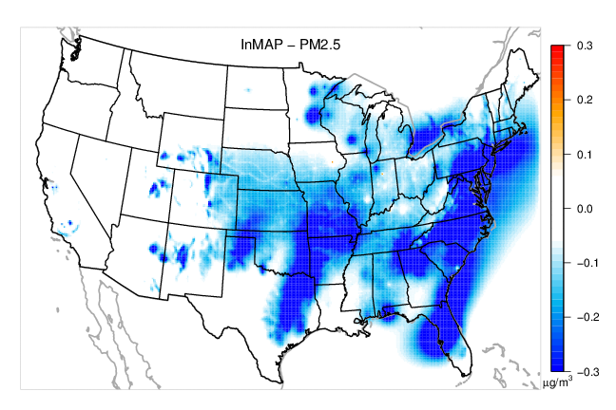
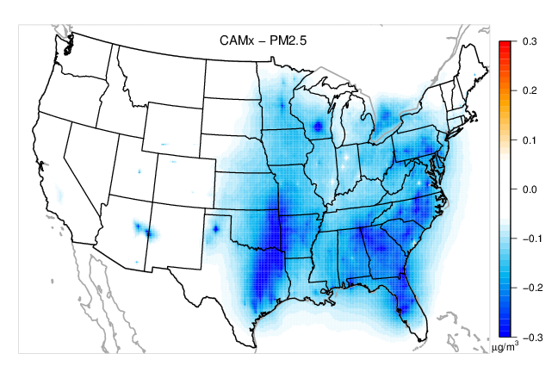
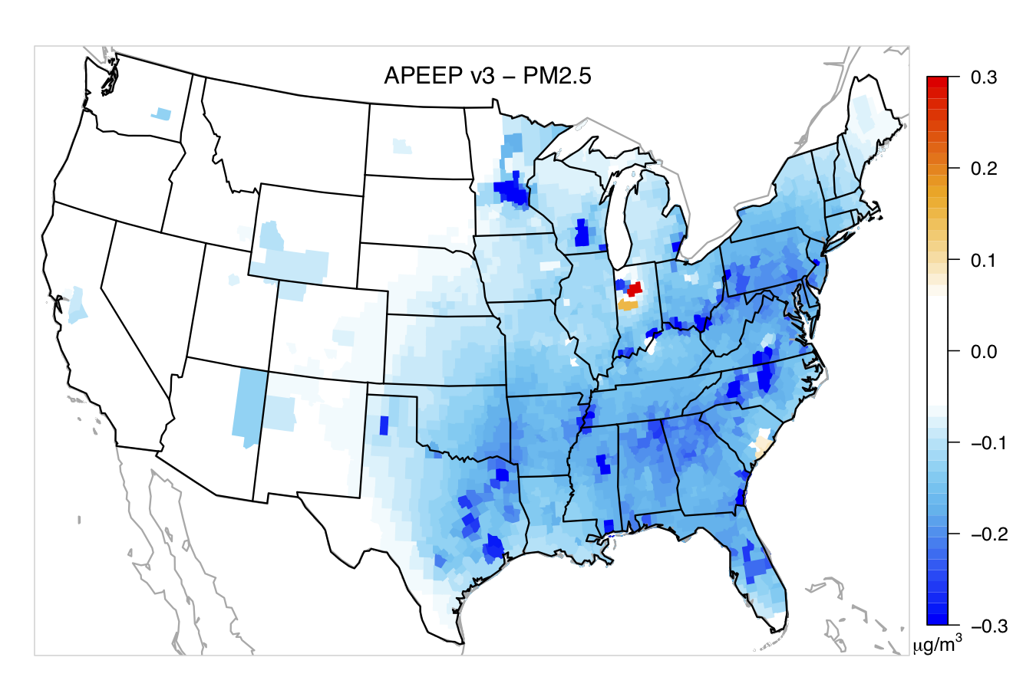
Annual average change in total PM_{2.5} from EGU scenario
2025 projected future year from 2011 base year
CAMx (left), InMAP (top right), and AP3 (bottom right)
Cool colors show PM_{2.5} reductions due to the control plan
CAMx: Total PM2.5 Reduction

Slide 12
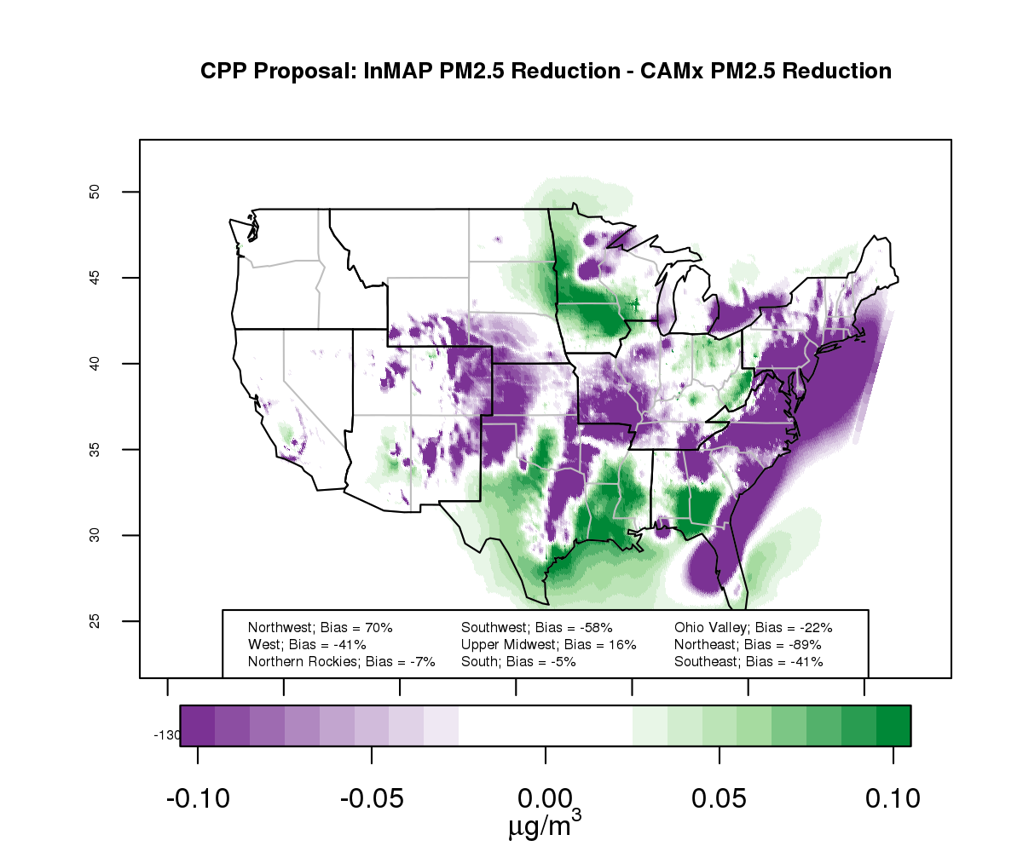
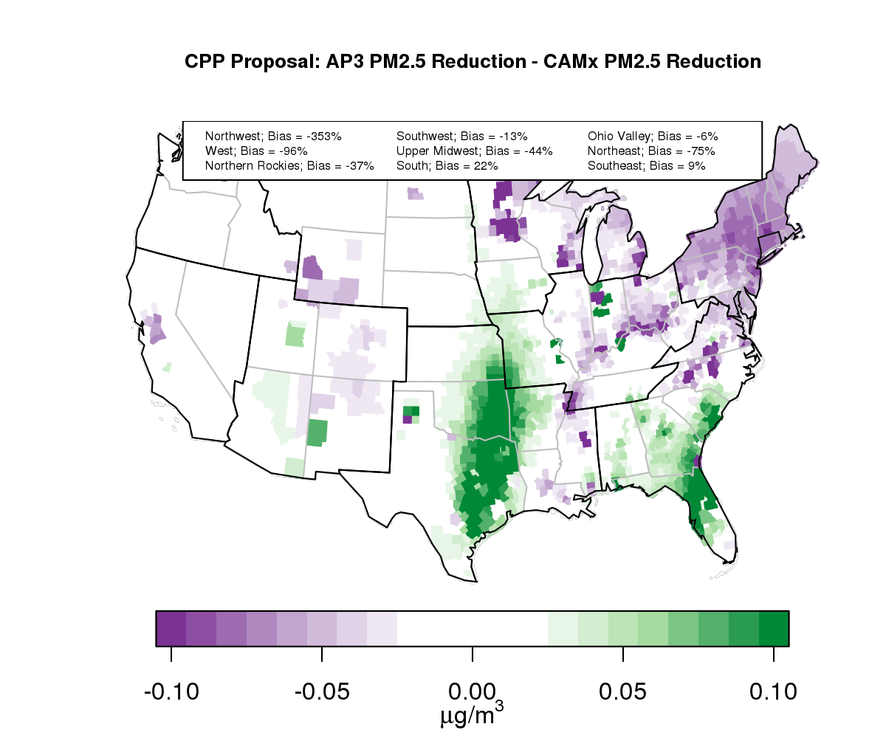
EGU scenario – Quantification of Differences between Models/Tools
Purple shading indicates where InMAP or APEEP predicts greater PM_{2.5} reductions and green shading where CMAQ or CAMx predicts greater PM_{2.5} reductions

Slide 13
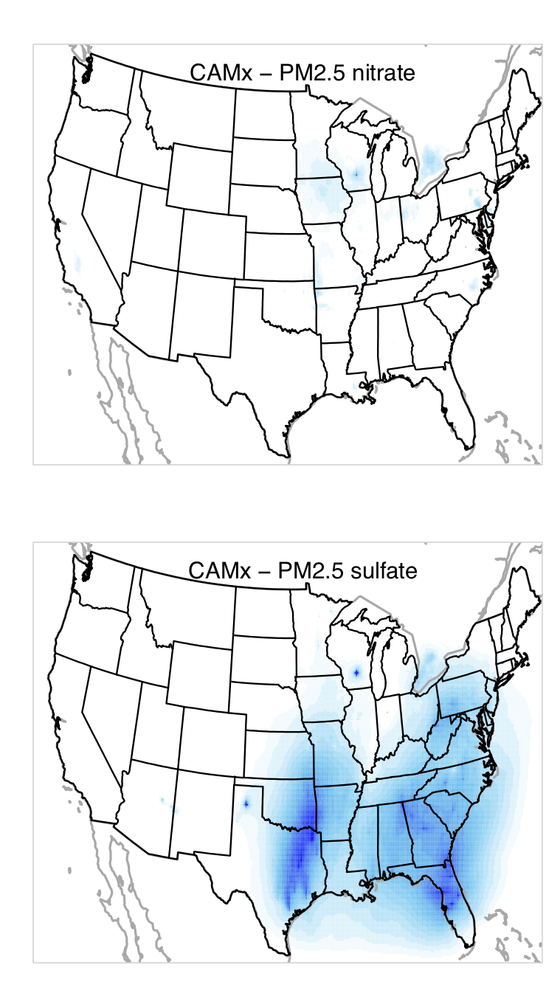
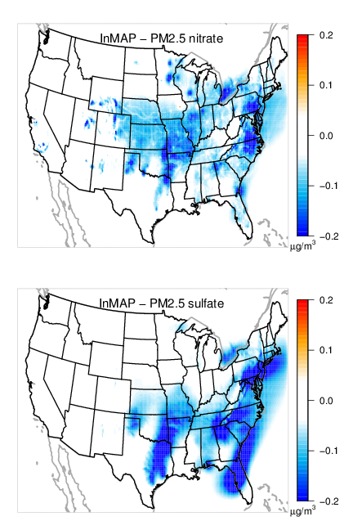
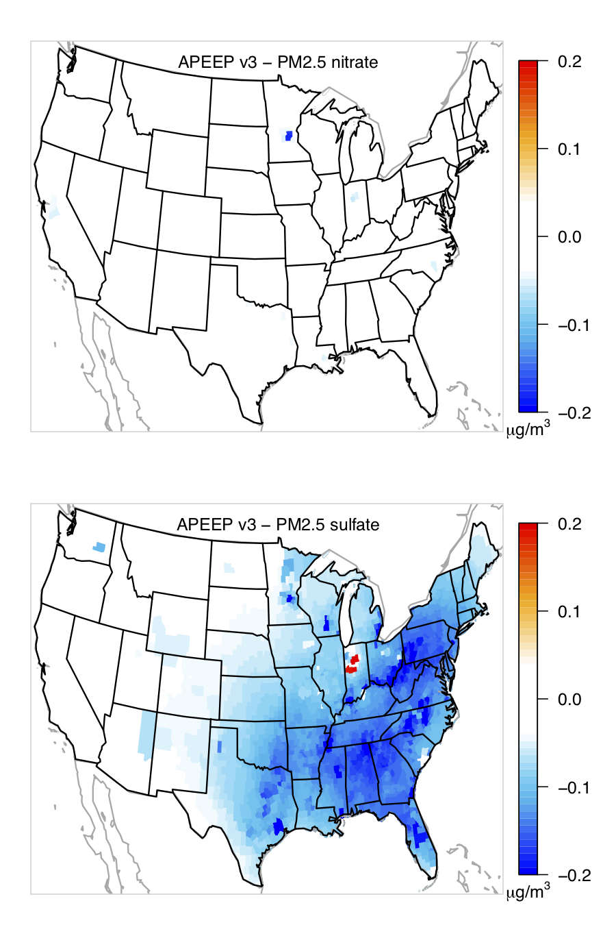
CAMx
InMAP
APEEP3
NITRATE
SULFATE

Slide 14
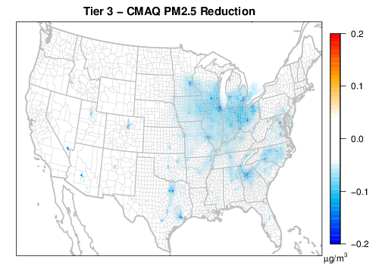
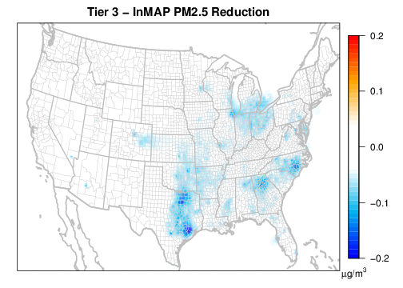
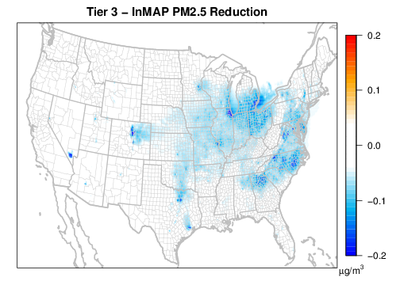
InMAP – Sensitivity to input meteorology & chemistry
Using InMAP with provided annual 2005 WRF-Chem meteorology/chemistry file results in large differences in model predicted PM_{2.5} when using the same emissions
CMAQ results using 2007 WRF
InMAP results using 2005 WRF-Chem
InMAP results using 2007 WRF and CMAQ

Slide 15
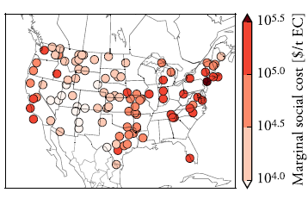
EASIUR
Heo et al, 2016
EASIUR does not provide air quality surfaces so the underlying tool development approach was examined to get an initial sense about how health impacts may differ from the other tools
Approach based on single sources modeled with full scale photochemical grid model that were aggregated to a single representation of annual average downwind air quality impacts
The selection of hypothetical single sources (top right) to inform the statistical model relating precursors with monetized health benefits may not represent important PM_{2.5} formation regimes in the eastern U.S.
Little seasonal variability and difference in downwind impact from different precursors

Slide 16
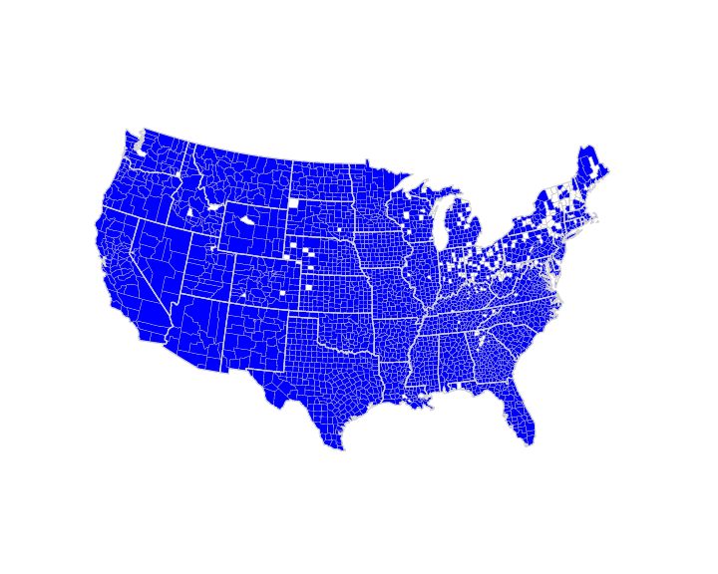
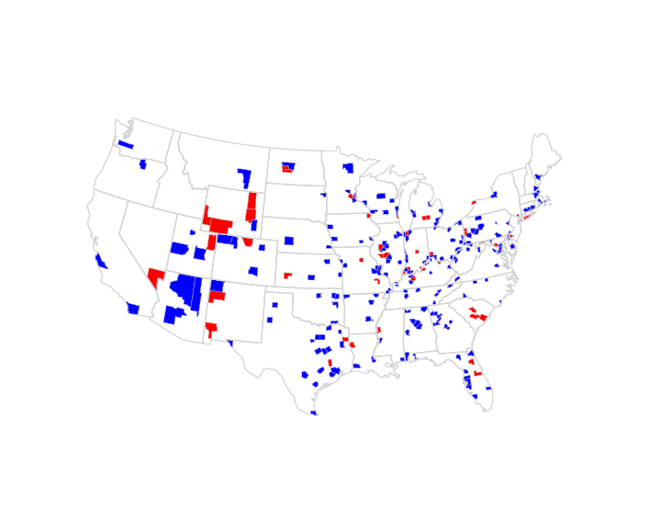
S-R Matrix (used in APEEP model)
Climatological Regional Dispersion Model (CRDM) formed the basis of the source-receptor (S-R) matrix used in multiple reduced form models including APEEP and COBRA
  S-R matrices based on CRDM modeling developed in 1994
  CRDM assumptions similar to ISC2LT but includes wet and dry deposition of gases and particles and chemical conversion of SO2 and NOX to PM2.5
  Adjusted based on other dispersion modeling to have higher impacts in the county where emissions sources are located
  Emission inventory included non-point emissions for 3,080 counties and 61,619 point sources
  Points binned by county and effective stack height levels: low, medium, and tall
Counties with tall stack emissions in 2011 NEI (center) and APEEP tall stack S-R matrix (right)

Slide 17
Initial Findings
Initial results from this reduced-form modeling effort suggest:
  The patterns of total PM_{2.5} response to these scenarios can differ geographically
  The response of individual PM_{2.5} components to these scenarios can differ substantially
  The fraction of total benefits associated with different thresholds can differ substantially
Gained a great deal of knowledge and experience with the setup, time allocation and application of multiple reduced-complexity models
There is a time savings benefit compared to full-scale photochemical model application, however:
  Development of inputs for each of the reduced form models is resource intensive and requires the application of an emissions model
  Additionally, full-scale photochemical models can provide a more tailored representation of where AQ impacts will occur in the model domain; also provide other key information (e.g., O3 and deposition)

Slide 18
Acknowledgements
Nick Muller, Peter Adams, Christopher Tessum
Meredith Amend, Stefani Penn, Joshua Bankert, Henry Roman
James Beidler, Chris Allen, Kevin Talgo, Christos Efstathiou, Lara Reynolds

Slide 19
END OF PRESENTATION
Extra Slides

Slide 20
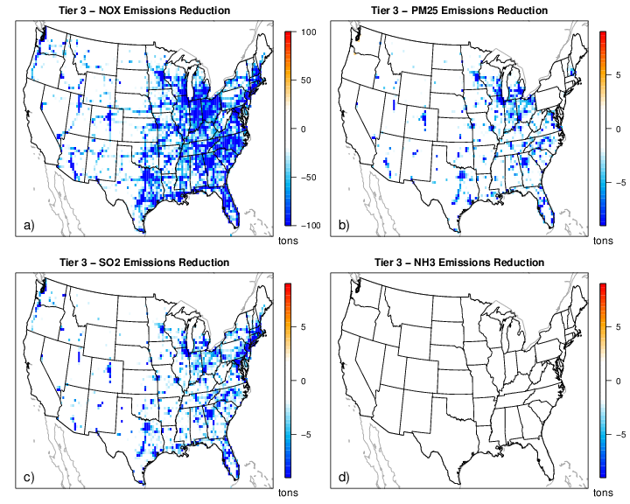
Tier 3 emission reductions by precursors: a) NO_{X}, b) primary PM_{2.5}, c) SO₂, and d) NH₃
Emissions are gridded to 36 km

Slide 21
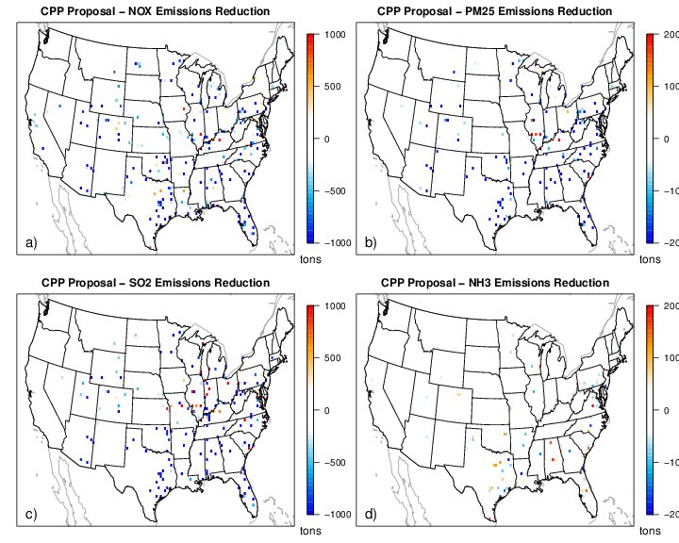
Clean Power Plan Proposal emission reductions by precursors: a) NO_{X}, b) primary PM_{2.5}, c) SO₂, and d) NH₃
Emissions are gridded to 36 km
Some areas had increased emissions based on this rule

