Slide 1

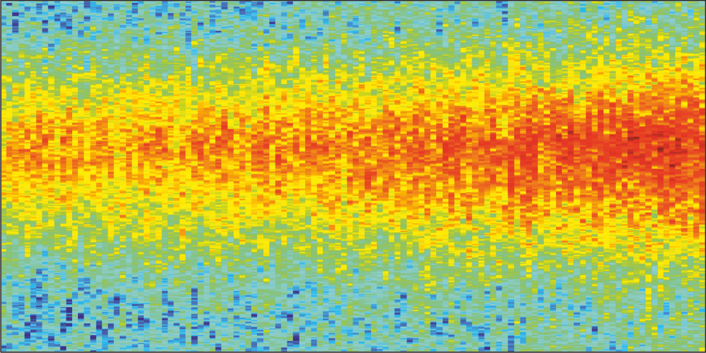
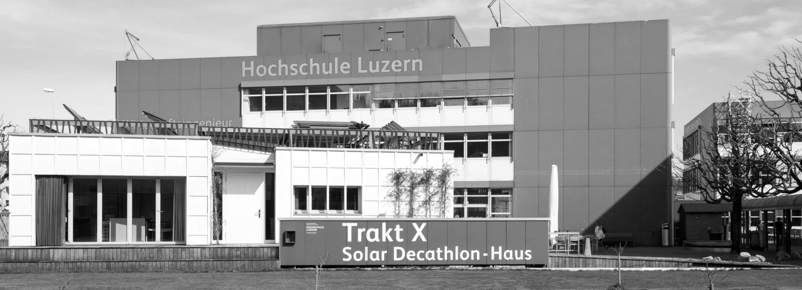

Feedback between anthropogenic factors and climate: Energy consumption for space heating
Dr sc ETH Matthias Berger
Head of Assessment @CC TES
Notes:
Former IIASA researcher, moved to HSLU following the statement of Mr. Elvis Presley: A little less conversation, a little more action please.

Slide 2
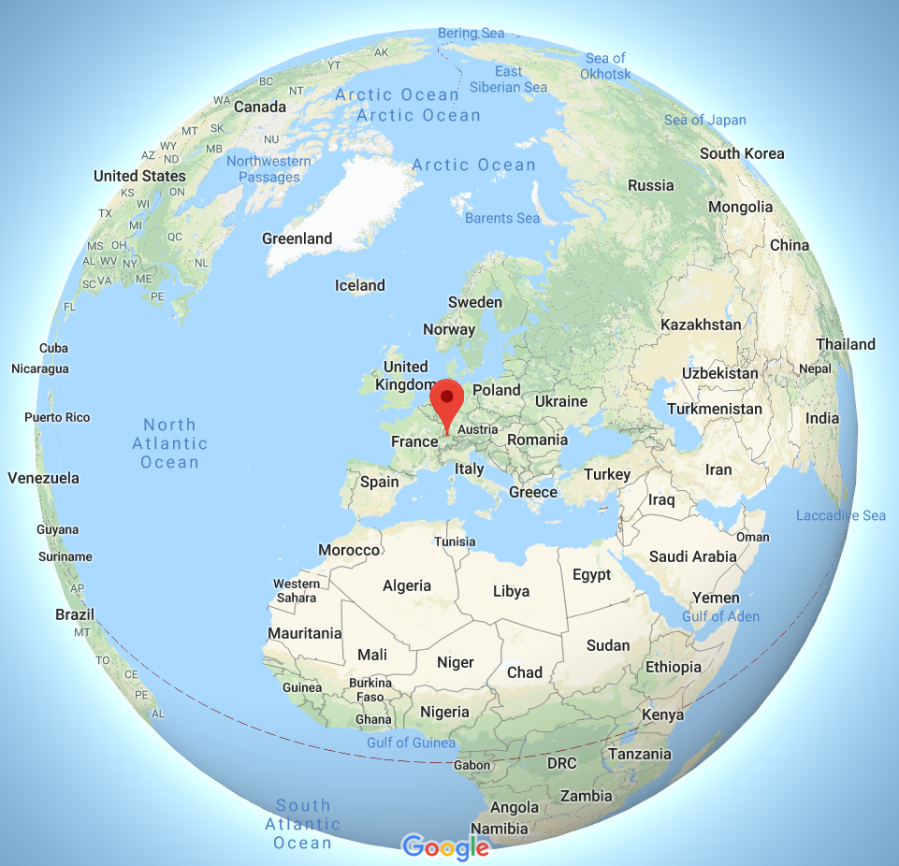
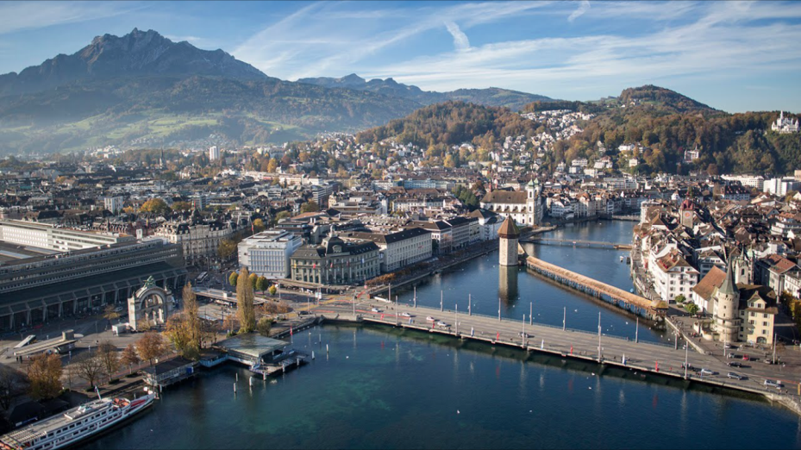
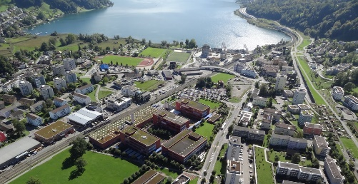
Lucerne/ Switzerland
City center of 50’000 inhabitants
>2.5 million lodging nights p.a.

Slide 3
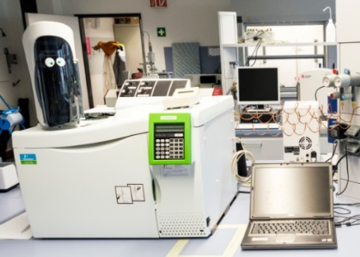
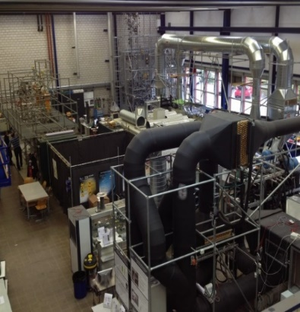
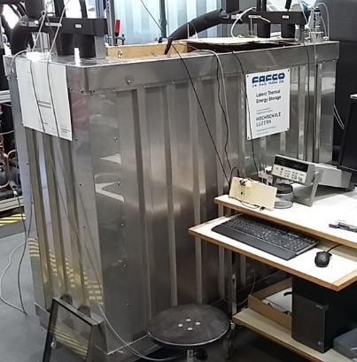
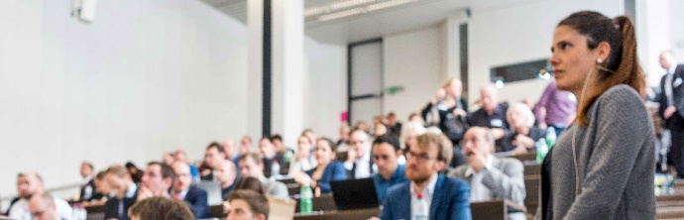
Competence Center
Thermal Energy Storage (CC TES)
3 Professors & 27 Research associates
Material characterization in the analytical lab
Pilot plants and fundamental research
System modelling and optimization of components
‘Swiss Symposium Thermal Energy Storage’

Slide 4
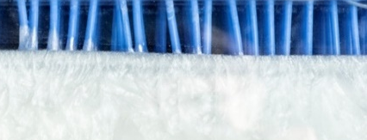

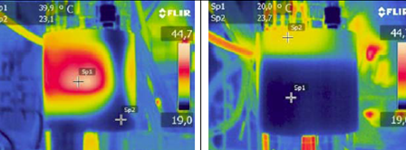
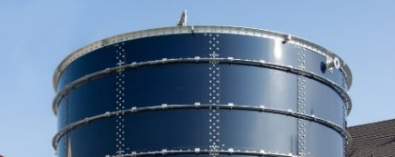
Main Research Areas
Latent heat storage
Assessment of storage
Latente Hitzespeicher
Temperature stability
Seasonal energy storages

Slide 5



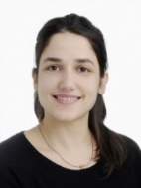



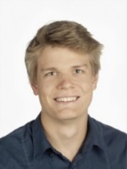


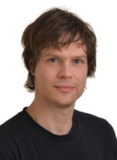







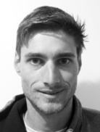





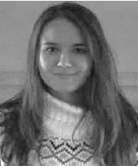
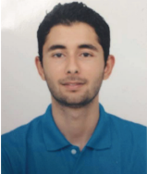
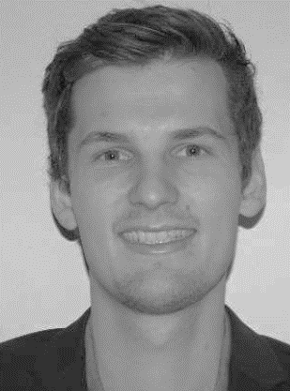
Competence Center
Thermal Energy Storage (CC TES)
Jörg Worlitschek
Ludger
Fischer
Philipp
Schütz
Anastasia
Stamatiou
Willy Villasmil
Matthias
Berger
Damian
Gwerder
Simon
Maranda
Remo
Waser
Silvan
von Arx
Benjamin
Schroeteler
Marcel
Troxler
Damian
Gwerder
Stephanie Snoek
Stefan Krimmel
Oliver Fellmann
Janine
Leiggener
Roger Zimmermann
David
Schiffmann
Stefan
Frehner
Patrick
Meyer
Rebecca
Ravotti
Roman Durrer
Sebastian Ammann
William
Delgado
Andreas
Melillo
Poppy
O’Neill
Yasser Baddour
(Zivi)
Roger
Buck
(Zivi)

Slide 6
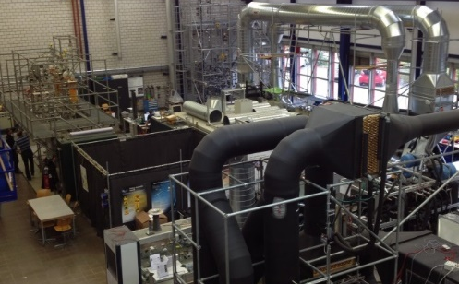
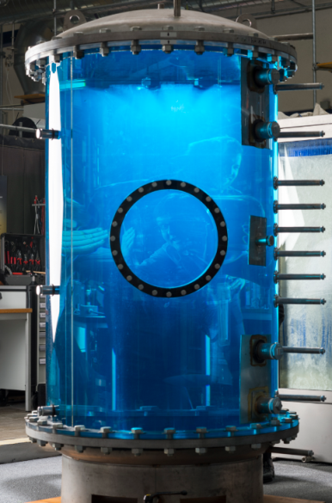
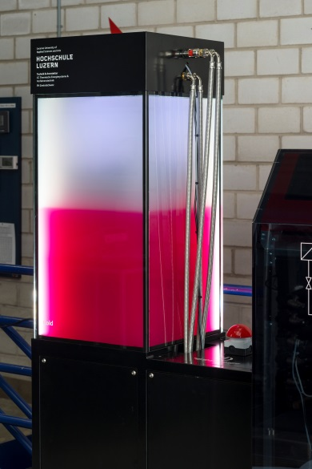
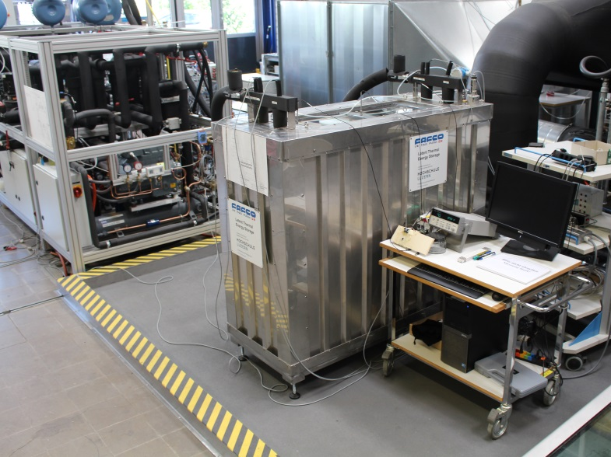
Infrastructure
Research facilities
Latent heat storages (10- 500 l)
Sensible storages
Phase Change Dispersions test rig
Phase Change Slurries test rig

Slide 7
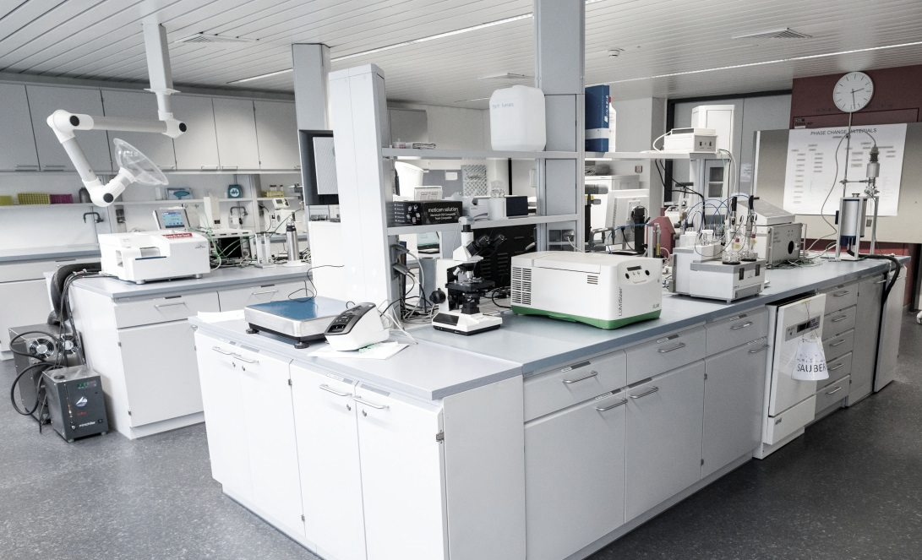
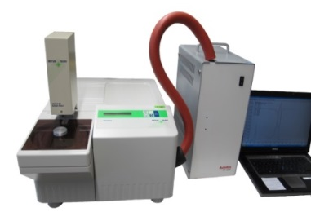
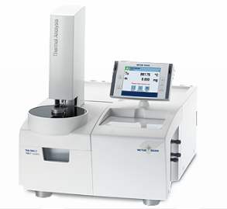
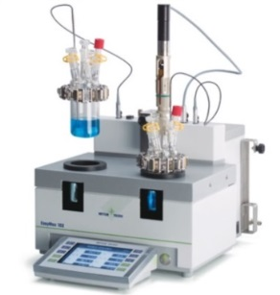
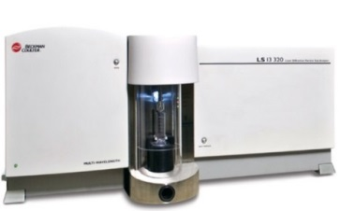
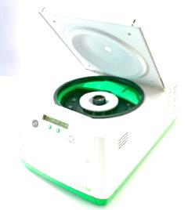
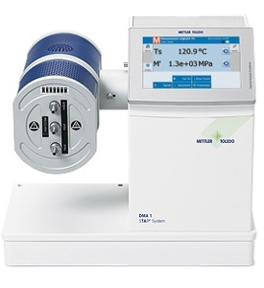
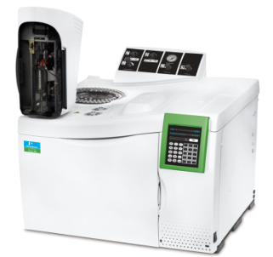
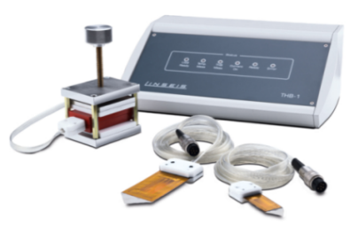
Analytical lab
Differential Scanning Calorimerty (DSC)
Thermogravitemtric analysis (TGA)
Beckmann-Coulter
Easy Max
Infraredspectroscopy (FTIR)
Lumisizer
Dynamic Mechanical Analyzer (DMA)
Transient-Hot-Bridge (THB)
Gas chromatograph

Slide 8
Partners & Cooperation
V-Zug
Mettler Toledo (Instrumentation)
Fafco S.A., Bienne
Falkeis Architects Vaduz, Vienna
Regionalwerke Baden
Hybridwerk Aarmatt / Solothurn
Nussbaum AG
BMS-Energietechnik AG
Step-Tec AG
Leutenegger + Frei
Walter Meier AG
Sunamp Ltd. / Edingburgh
Swisscom Energy Solutions
Swiss Competence Centers for Energy Research
International Energy Agency
Process Net Fachgruppe Thermische Speicher
Forum Energiespeicher
Verein Deutscher Ingenieure (VDI)
energiecluster – IG Speicher
AIT, Austria
BRGM, France
LAMTE, Dalhousie University, Canada
TU Wien, Austria
TU Eindhoven, Netherlands
Heriot-Watt University, Scotland
Universitat de Lleida, Spain

Slide 9
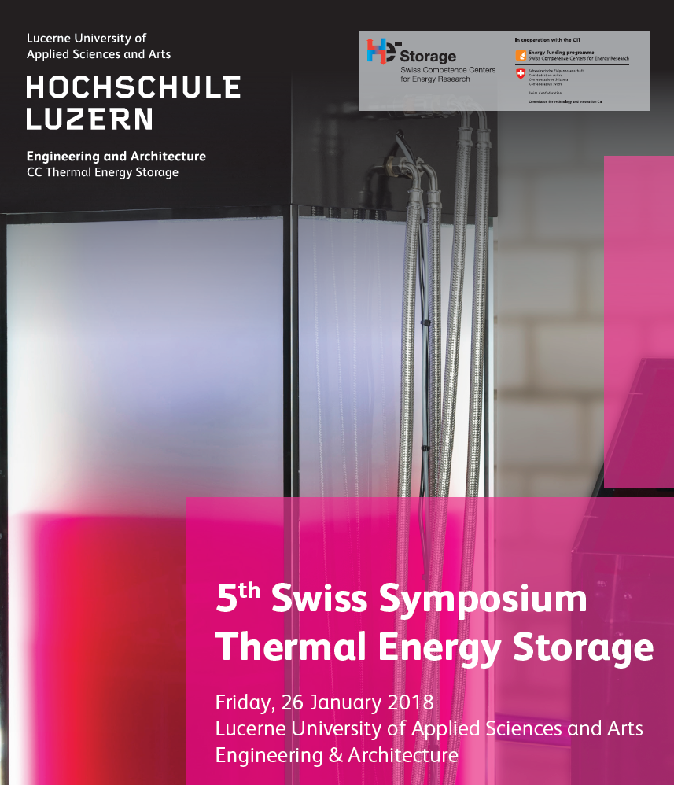
Swiss Symporium Thermal Energy Storage
Next dates:
26 January 2018
25 January 2019

Slide 10
Juxtaposing climate and anthropogenic factors

Slide 11
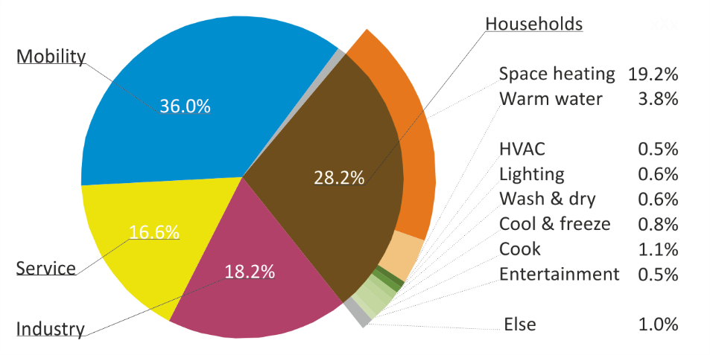
Background:
Energy and Heat
Energy end-use by sector
34.11 million tons CO2 from combustion of fossil fuels, which is 71%
of all GHG emissions (in 2016), 17.86 million tons for space heating
Kyoto target: reduction by 10 million tons by 2030
M. Berger, J. Worlitschek, “A novel approach for estimating residential space heating demand”, Energy, 159: 294-301, 2018.

Slide 12
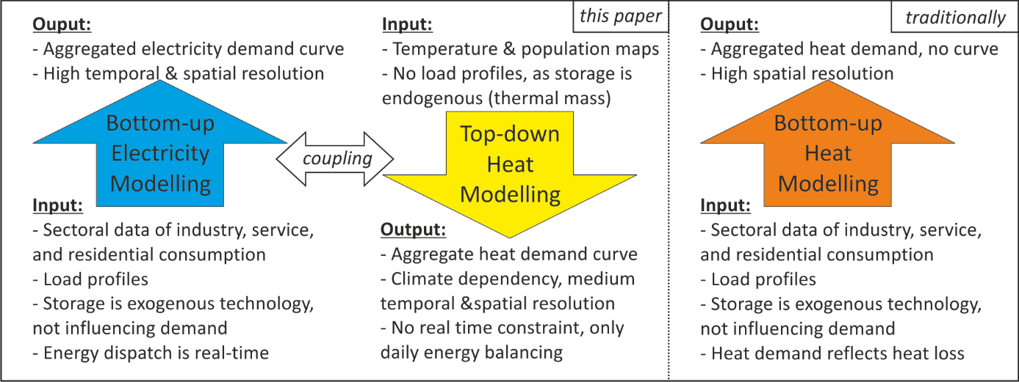
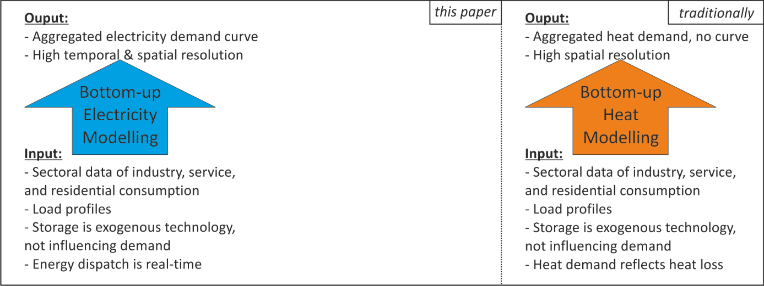
Background:
Energy System Models
M. Berger, J. Worlitschek, “A novel approach for estimating residential space heating demand”, Energy, 159: 294-301, 2018.

Slide 13
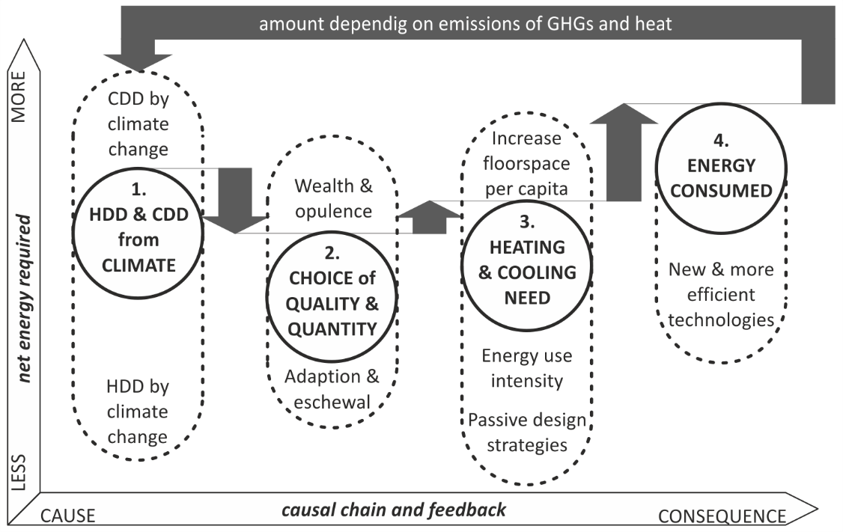
Background:
Energy and Heat
M. Berger, J. Worlitschek, “The influence of climate trends on heating and cooling demand”, Weather and Climate Extremes, [in review].

Slide 14
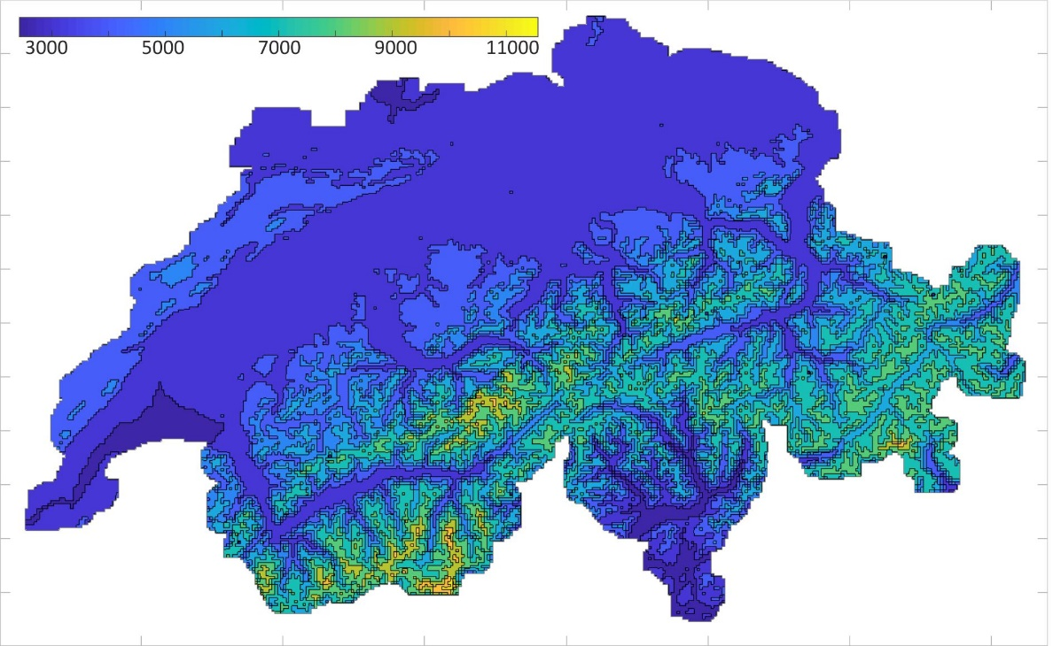
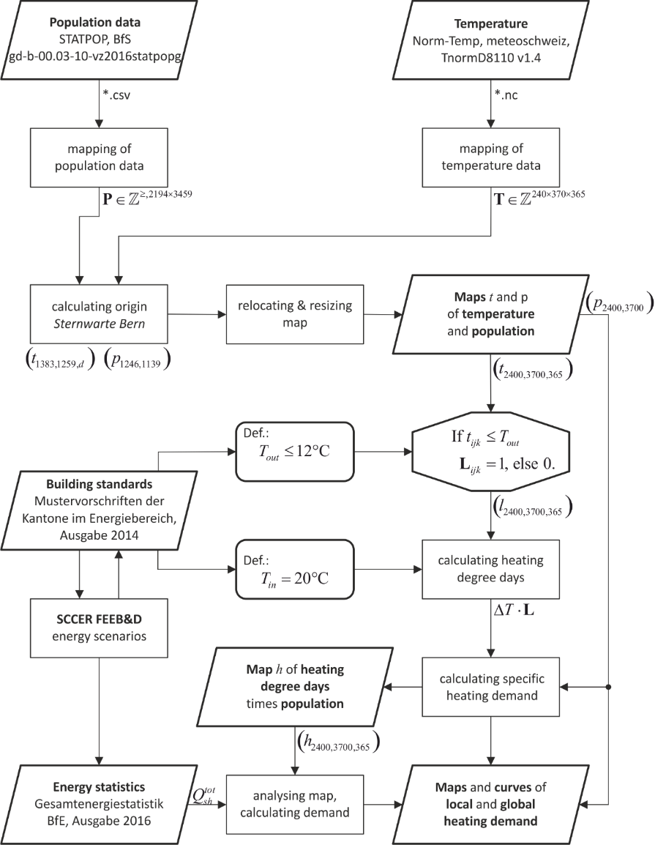
Background:
Heat and Climate
M. Berger, J. Worlitschek, “A novel approach for estimating residential space heating demand”, Energy, 159: 294-301, 2018.
M. Berger, “Heating and cooling future of Europe and interactions with electricity”, IEEE - European Public Policy Committee, 2018.

Slide 15
From Climate Norm Periode to Trends

Slide 16
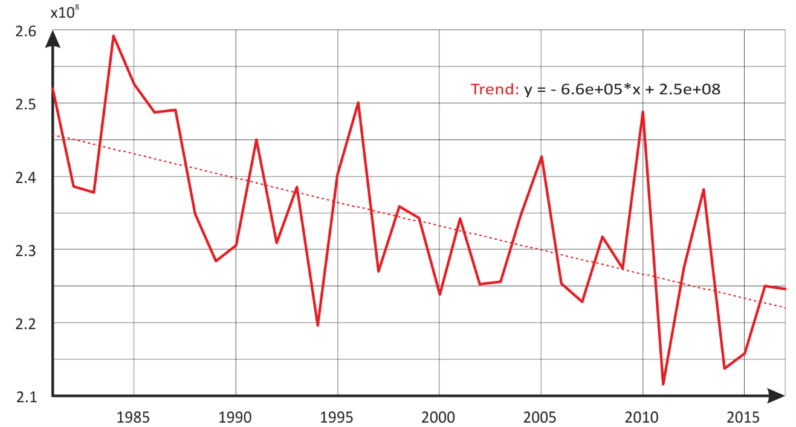
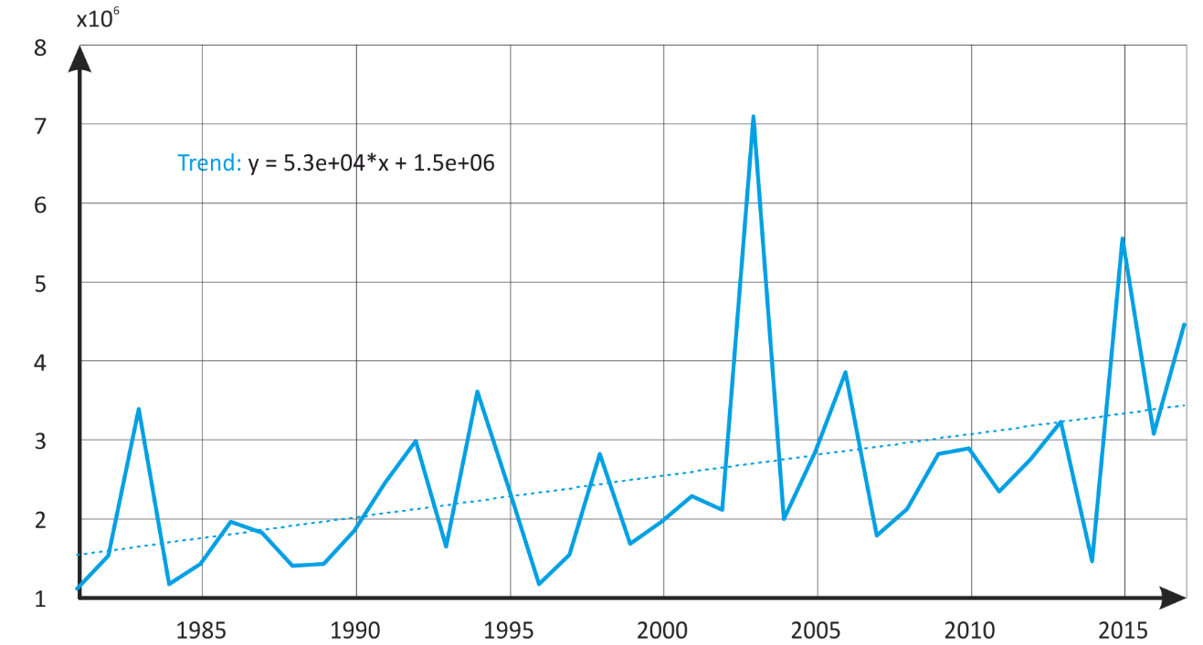
Results:
Energy, Heating and Cooling
Notes:
Calculated heating degree days in Switzerland for 1981 to 2017 with a trend line of -2.5% per decade.
Calculated cooling degree days in Switzerland for 1981 to 2017 with a trend line of +34% per decade.

Slide 17
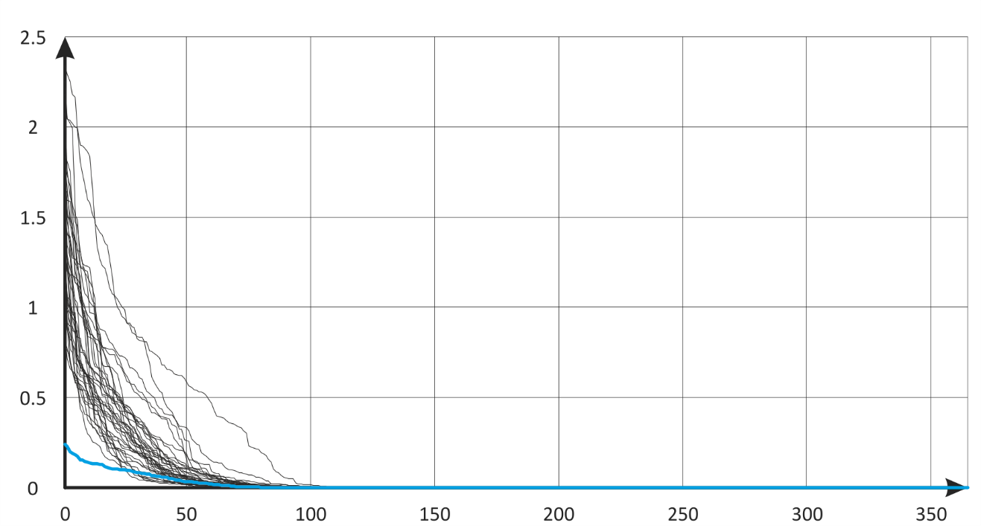
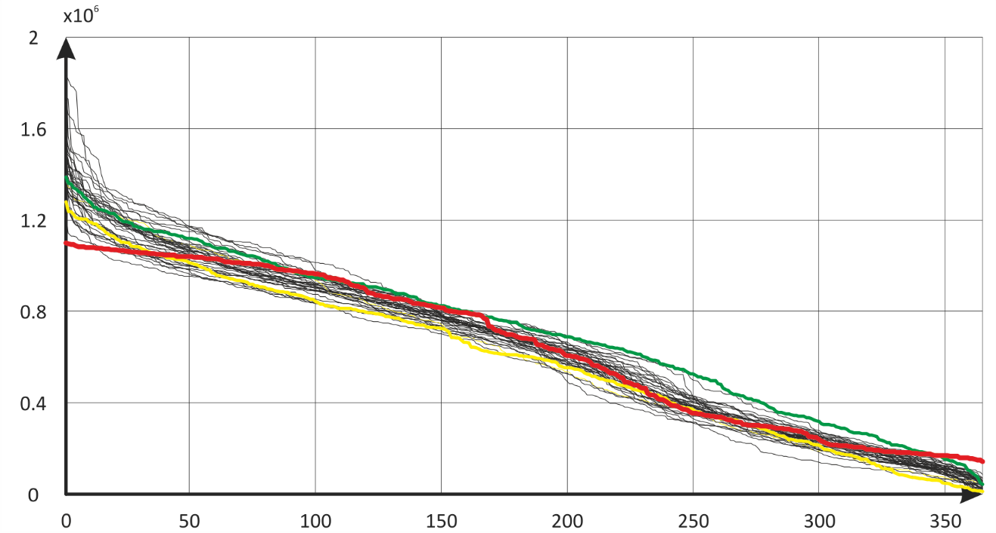
Results:
Energy, Heating and Cooling
Notes:
Histogram of annual distribution of heating degree days in Switzerland for 1981 to 2017, compared to the red line indicating the norm period 1981-2010.
Histogram of annual distribution of cooling degree days in Switzerland for 1981 to 2017, compared to the blue line indicating the norm period 1981-2010.

Slide 18
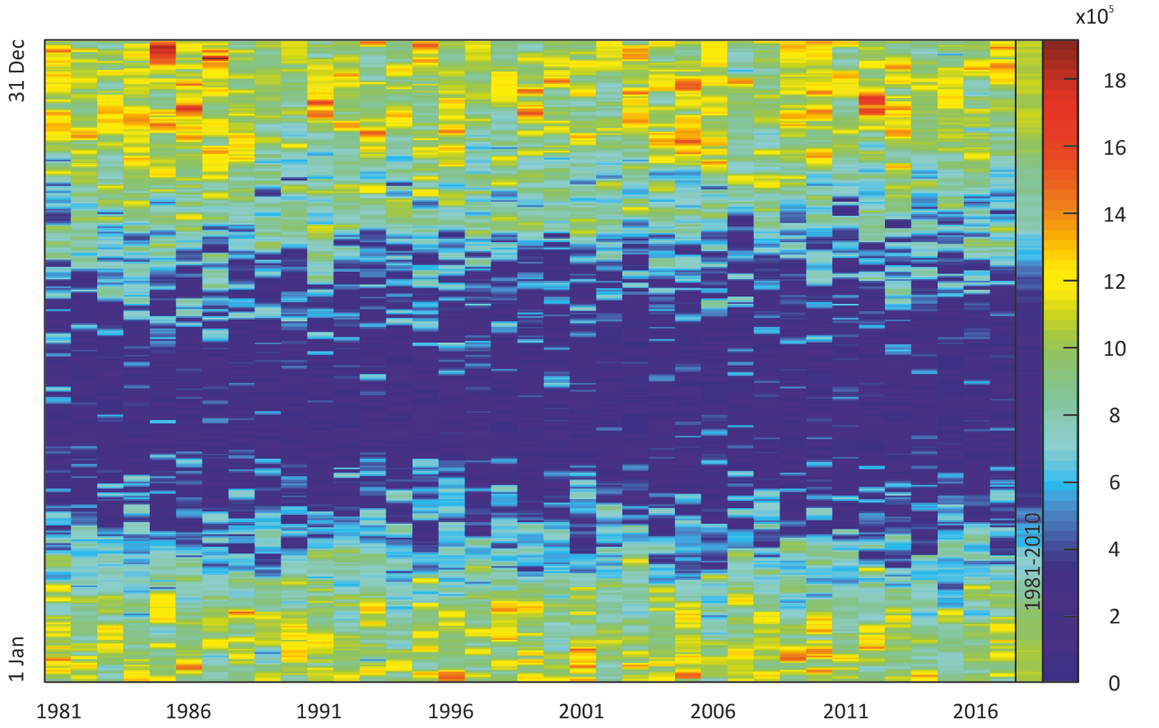
Results:
Energy, Heating and Cooling
Notes:
Pattern of heating degree days in Switzerland for 1981 to 2017 compared to the norm period 1981-2010 on the right side.

Slide 19
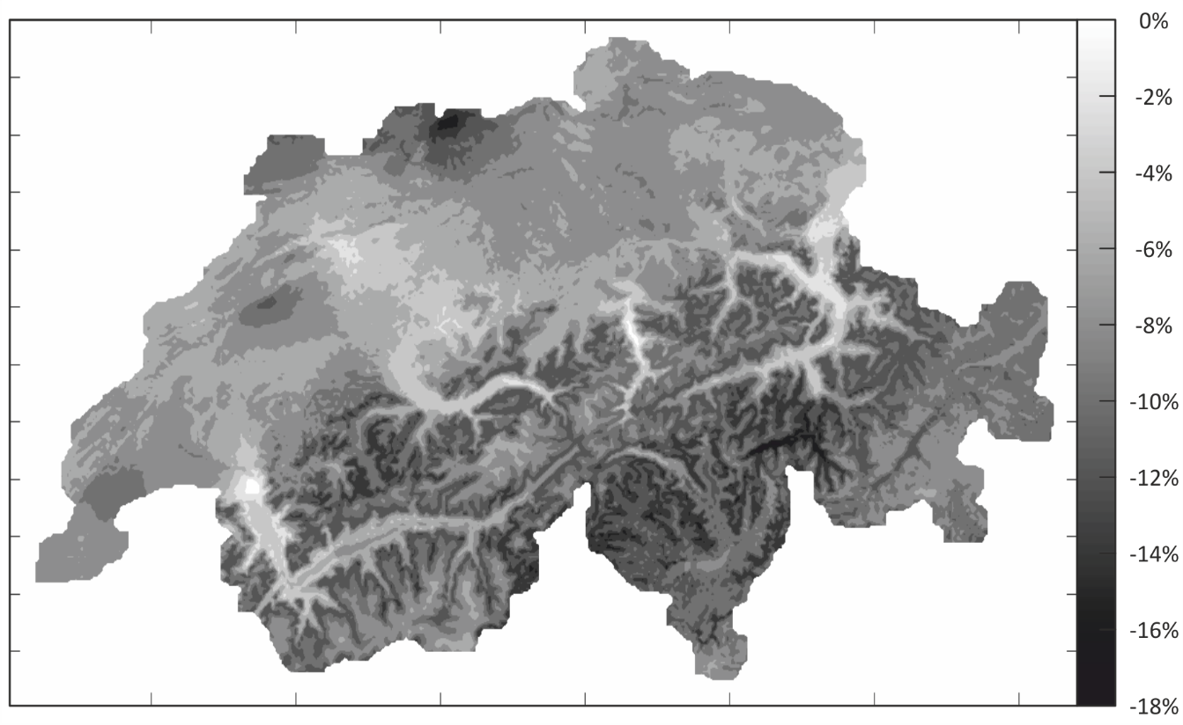
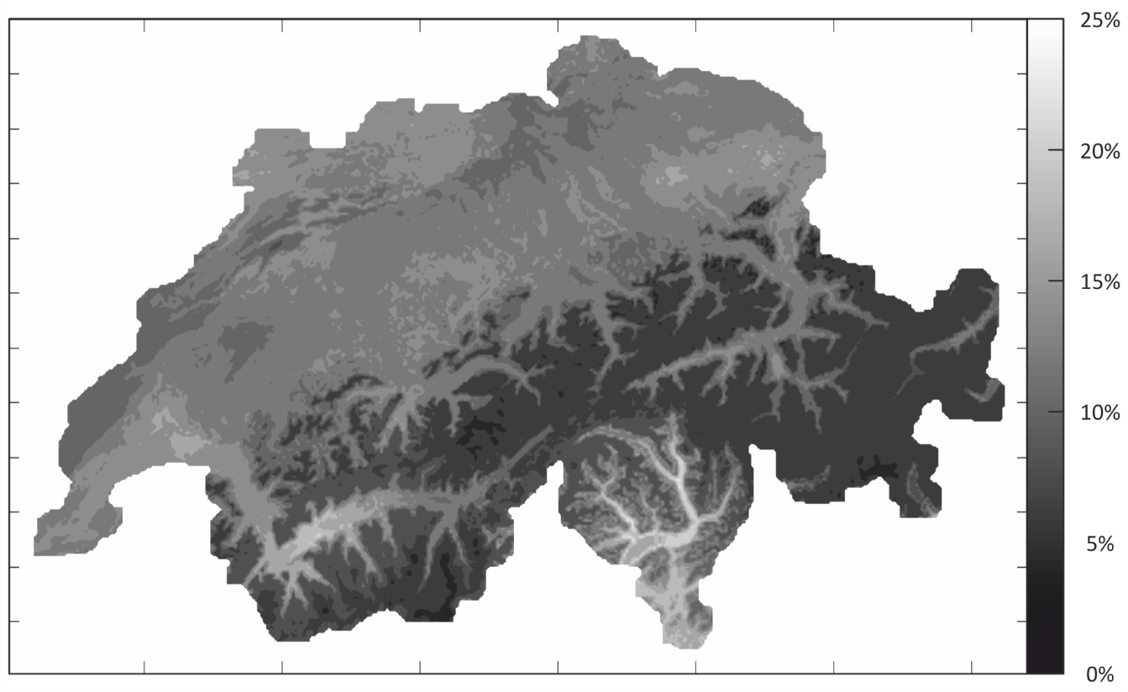
Results:
Energy, Heating and Cooling
Notes:
Map of the relative difference in heating degree days between 2015, the warmest year between 1981-2017, and the norm period 1981-2010.
Map of the relative difference in heating degree days between 1984, the coldest year between 1981-2017, and the norm period 1981-2010.

Slide 20
From Climate Norm Periode to Trends

Slide 21
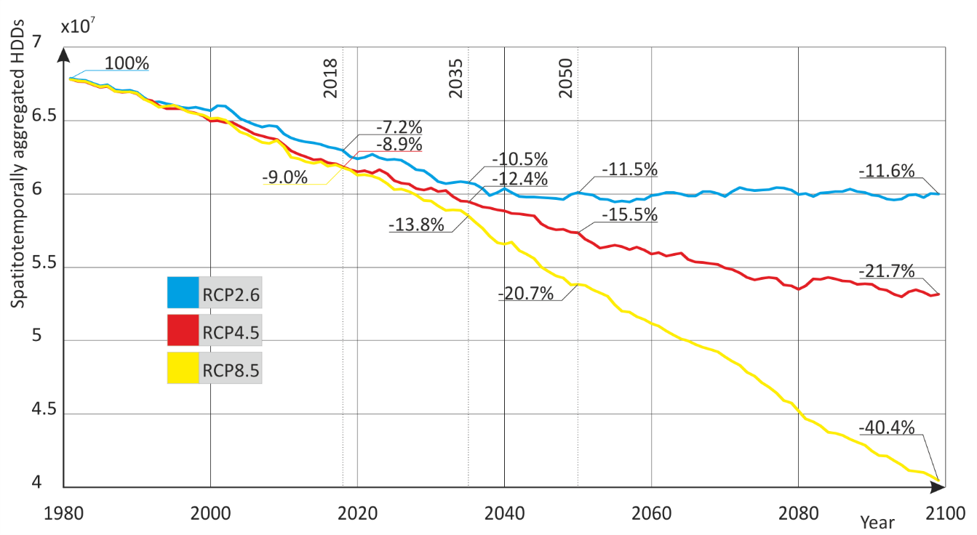
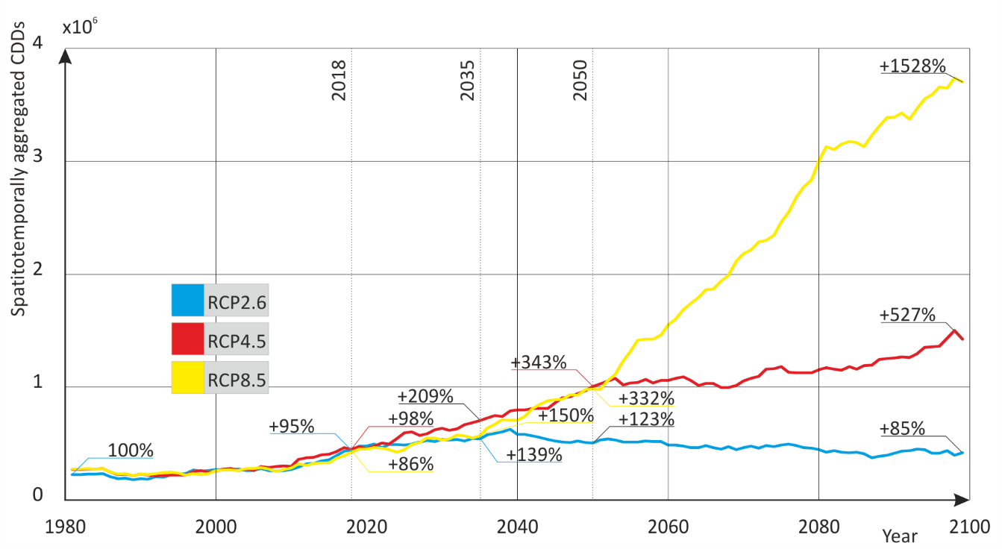
CH2018 by C2SM

Slide 22
Key Takeaways
Energy-related modelling & simulation is based on historical data for consumption and demand in combination with scenarios for future trends
Models address challenges posed by climate change and propose technological change to counter anthropogenic effects
Anthropogenic factors are influenced by climate change, therefore scenarios should include the feedback
This bidirectional feedback loop has net reduction effect on energy consumption for heating, but increases the need for cooling during summer (in CH)

Slide 23
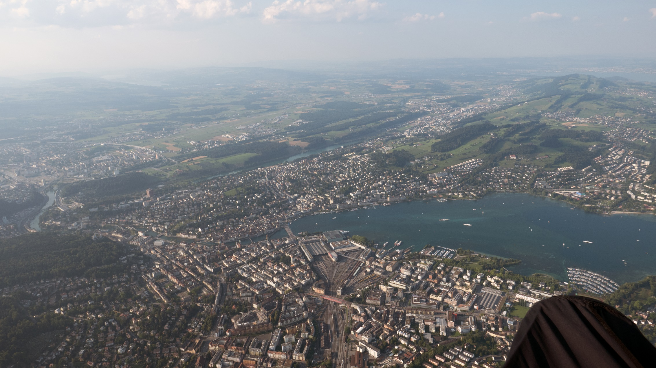
The End
Thanks!

