Slide 1
International Contributions to ozone Across the United States
Maria Zatko, Ramboll
October 22, 2018

Slide 2
Collaborators:
Ramboll: Ralph Morris
Alpine Geophysics: Dennis McNally
Denver RAQC: Ken Lloyd, Amanda Brimmer

Slide 3
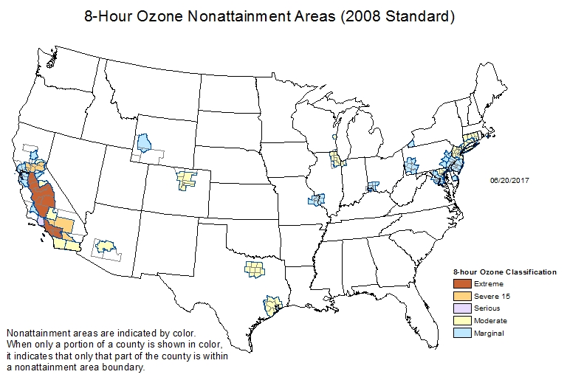
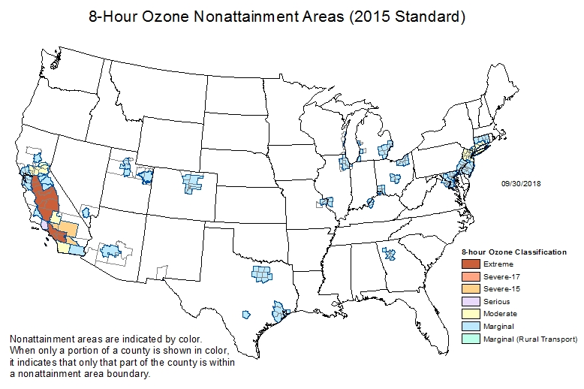
Project motivation
Objective:
To assess ozone levels in United States with contributions of international anthropogenic emissions removed.
8-Hour Ozone Nonattainment Areas
(75 ppb, 2008 Standard)
8-Hour Ozone Nonattainment Areas
(70 ppb, 2015 Standard)
Notes:
US: https://www3.epa.gov/airquality/greenbook/map8hr_2008.html
Current ozone NAAs for 2015 70 ppb ozone NAAQS
Areas violating 70 ppb 2015 NAAQS using 2012-2014, lower ozone years in 2015-2016 so expect many less areas will ultimately be designated ozone nonattainment

Slide 4
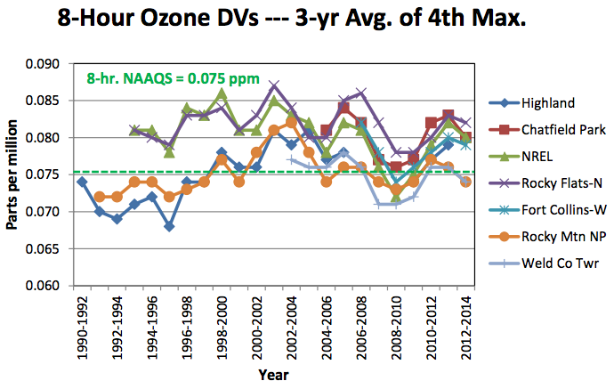
Project motivation
Denver/North Front Range Region Ozone Design Values 1990-2014
Many ozone Non-Attainment Areas (NAAs) still need to comply with the 2008 ozone NAAQS (75 ppb)
Additional NAAs also have to attain the new 2015 ozone NAAQS (70 ppb)
The ozone NAAQS is expressed as the three year average of the 4th highest daily maximum 8-hour ozone (MDA8).
2008 NAAQS = 0.075 ppm
2015 NAAQS = 0.070 ppm
Notes:
Mention that although this plot is not showing 2015-2017, you can see the ozone monitors with highest ozone DVs are often over the 75 ppb.
Some Marginal NAAs failed to achieve attainment of the 2008 NAAQS in 2017

Slide 5
Project motivation
Attainment of the 2008 (75 ppb) and 2015 (70 ppb) ozone NAAQS by the time required by the Clean Air Act (CAA) may be difficult for many areas due to large contributions of ozone transport.
Reasonable local and state ozone precursor control strategies may be insufficient to attain the ozone NAAQS by date required by the CAA.
Section 179B of the Clean Air Act (“International Border Areas”) can also be considered, which allows an area to demonstrate that they would have attained the ozone NAAQS but for the contributions from international sources
Notes:
For many areas in west, ozone transport from upwind states, international sources and natural emissions are the largest component of the local ozone concentration.
Mobile sources are frequently the largest local source contributor, but their emissions are regulated by EPA and mobile source emission controls may take years to realize reductions as fleet turnover takes time.
States have limited options for controlling mobile sources (e.g., I/M programs, transportation control measures that reduce activity, fleet rules, scrappage programs, adoption of California cars).
Under Section 179B of the CAA, state’s have an option to do a “but for” SIP by demonstrating that they would attain the ozone NAAQS but for international emissions. This allows states to buy time as regional (e.g., CSAPR) and local (e.g., fleet turnover) controls reduce emissions.

Slide 6
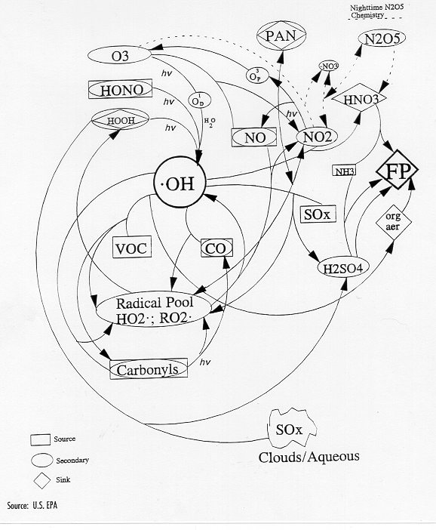
Background: Ground-level ozone
Not emitted directly into the air (secondary pollutant)
Primary precursors are nitrogen oxides (NO_{x}), volatile organic compounds (VOC)
Has complex nonlinear photochemistry
High ozone events are usually associated with sunshine and warm temperatures
Non-linearity makes it very difficult to predict
Control strategy and planning usually involves Photochemical Grid Models (PGMs)
Notes:
Ozone formation typically occurs due to complex photochemical reactions involving NOx and VOC in the presence of sunlight.
For urban areas typically occurs under hot stagnant meteorological conditions.
Some rural areas can have ozone NAAQS exceedances solely due to transport from upwind, such as Great Basin National Park in eastern Nevada.
Winter ozone exceedances in oil and gas development areas in Uinta Basin, Utah and Southwest Wyoming have also occurred.

Slide 7
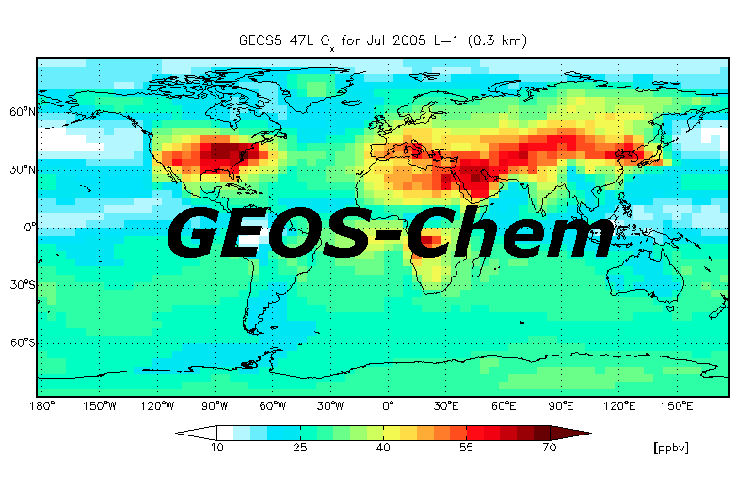
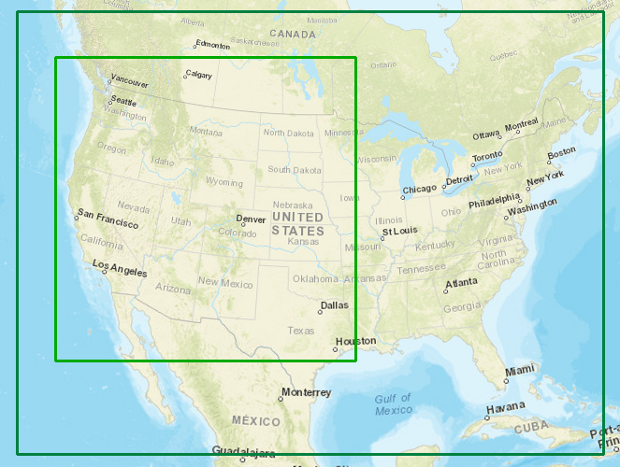
Project Approach
Run global (GEOS-Chem) and regional (CAMx) Photochemical Grid Models
2011 Base Case Emissions
2011 Simulation Without International Anthropogenic Emissions
Extract boundary conditions
CAMx
Compare ozone concentrations between simulations to estimate impact of non-US, international
anthropogenic emissions on ozone concentrations across the United States
Notes:
Mention the CAMx grids: 36 km/12 km (CONUS/WESTUS).
2011 modeling year selected because it is aligned with a National Emissions Inventory (NEI) year, was minimally affected by the recession and had ozone formation conducive meteorological conditions across the western U.S. (e.g., hot and dry).
(note: 2011 was unusually hot and dry in Texas and nearby states with high wildfires so they used 2012 modeling year).
These models have complex chemistry schemes which are necessary to simulate ozone and also have robust emissions and meteorological inventories

Slide 8
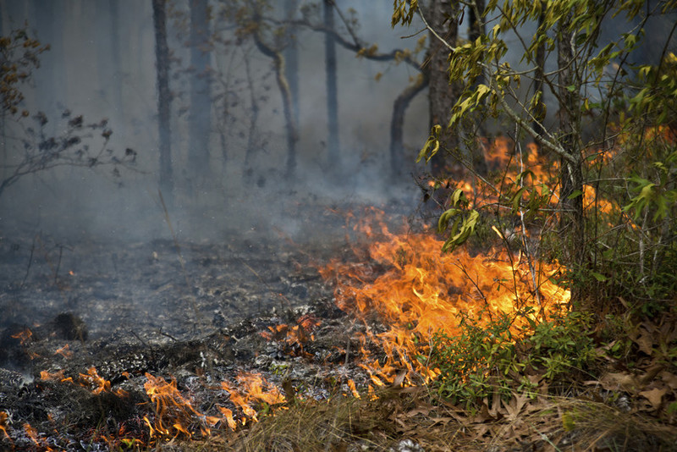
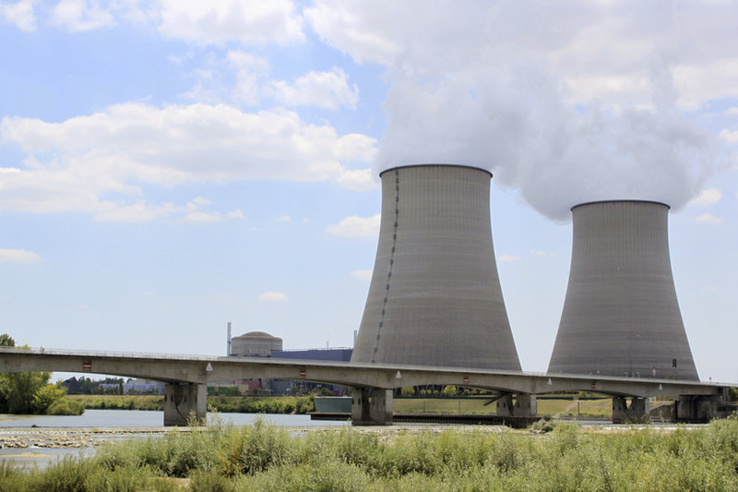
Model fundamentals Emission inventories
Anthropogenic
On and Off-Road Mobile
Electrical Generating Units
Industry
Area Sources
Aircraft, Ship
Biogenic
Biomass burning
Lightning NO_{x}
Speciality emissions
Notes:
Miscellaneous includes soil/fertilizer NOx, chlorophyll-A, oceanic DMS, volcanoes

Slide 9
GEOS-CHEM vs CAMx 2011 Model Comparison
GEOS-Chem v10.01 (June, 2015)
Global Modeling Domain
2.0 x 2.5 degree (~200 km)
72 vertical Layers to region top of 0.01 mb
(~ 80 km MSL)
17 Layers below ~3,000 m
Benchmark chemistry simulation
Tropchem mechanism
UCX stratospheric chemistry
SOA mechanism (without semivolatile POA)
FAST-JX radiative transfer algorithm
ISORROPIA aerosol thermodynamics
CAMx v6.20 (March, 2015)
36 km Continental US and 12 km Western US domains
25 vertical layers to region top of 50 mb (~19 km MSL)
16 layers below ~3,000 m
CB6r2 chemical mechanism
RADM aqueous-phase chemistry
ISORROPIA aerosol thermodynamics
Notes:
Take away message is that both models are photochemical grid models that different in scale and resolution
For meteorology, use GEOS-5 for GEOS-Chem and WRF for CAMx

Slide 10
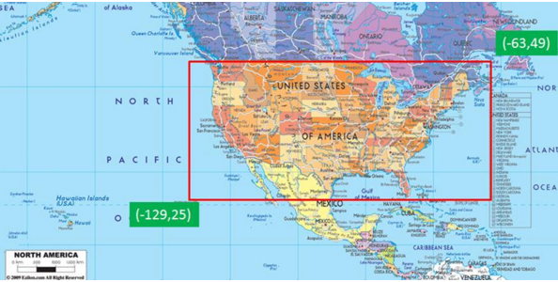
GEOS-Chem Approach for NO non-U.S. international Anthropogenic emission contributions
Turn off all countries anthropogenic emissions except for U.S. (2011 NEI)
For shipping and aircraft emissions that are not associated with a country, remove emissions outside of red box
Mexican and Canada (Mex/Can) anthropogenic emissions part of 2011 NEI
So use additional mask following USA boundaries to eliminate Mex/Can anthropogenic emissions from 2011 NEI

Slide 11
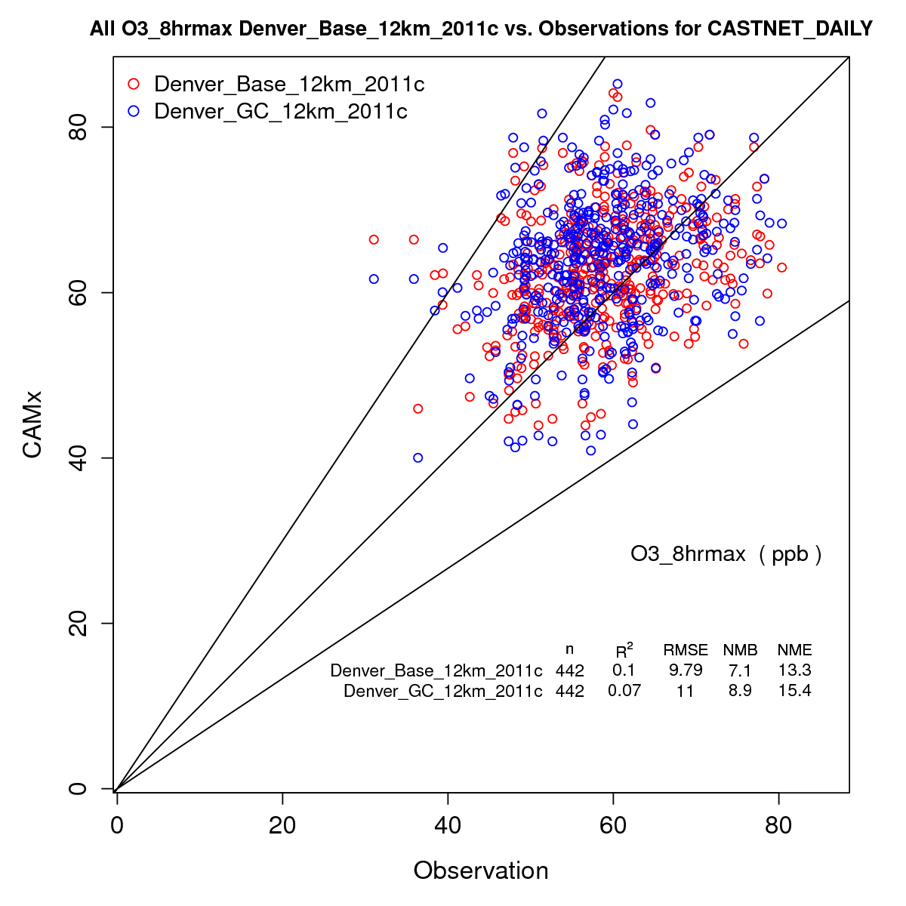
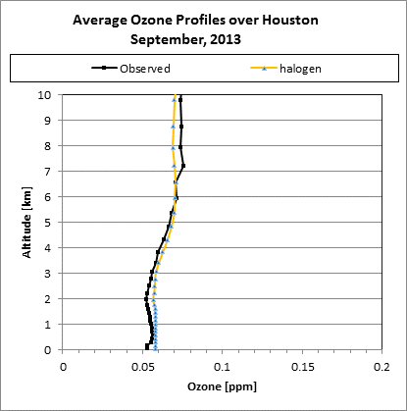
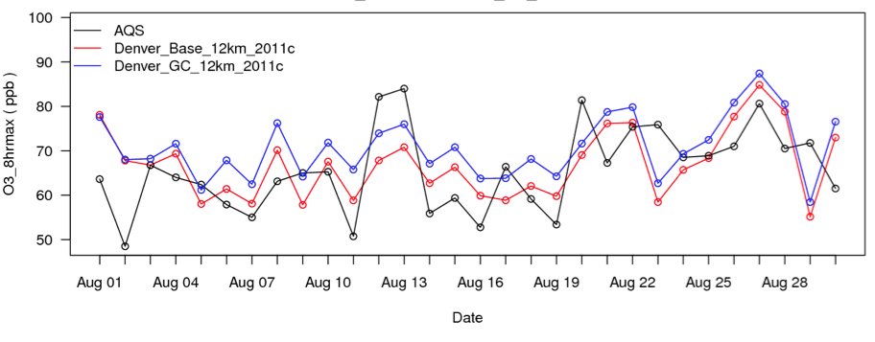
Model performance evaluation compare model results to observations
Compare base case model results to observations in and near Non-Attainment Region
Daily MDA8 Ozone Scatterplots
Vertical Ozone Profiles
Timeseries
Average Ozone Profiles
September 2013
Observations
Model run 1
Model run 2
Model run 1
Model run 2
Observed
Modeled
Compare in time at one location
Compare in time and space
at multiple locations
Compare vertically in atmosphere at ozonesonde locations
Notes:
Timerseries – useful for comparing obs/model at one location over time ; scatterplots – useful for comparing obs/model at multiple locations in space and time ; vertical profiles – useful for examining vertical slice of atmosphere at locations of ozonesonde observations

Slide 12
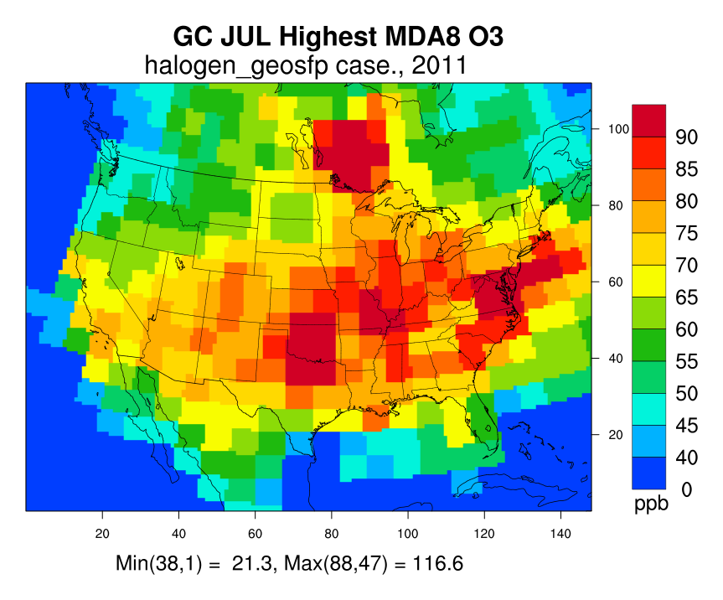
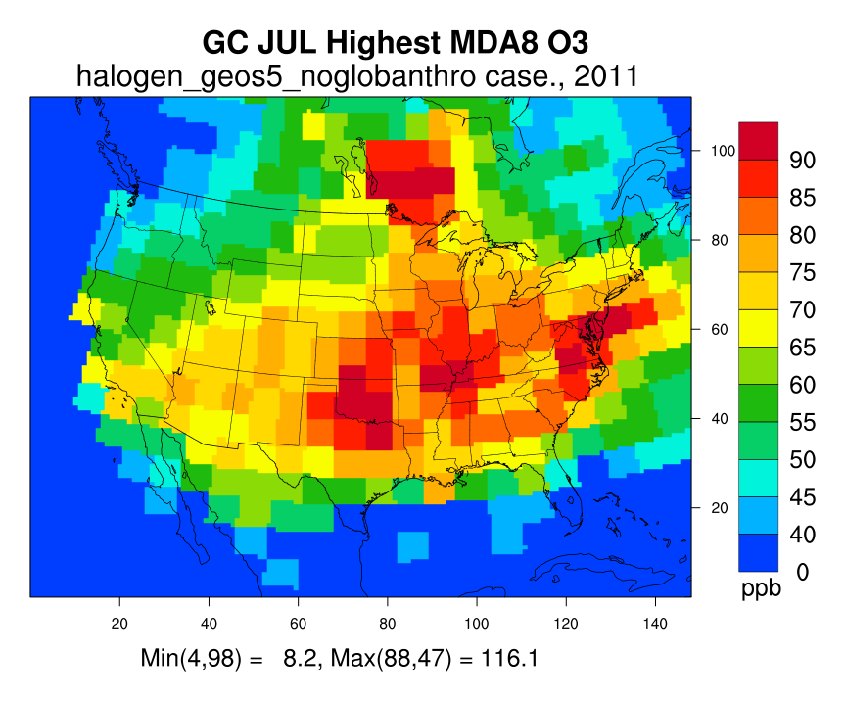
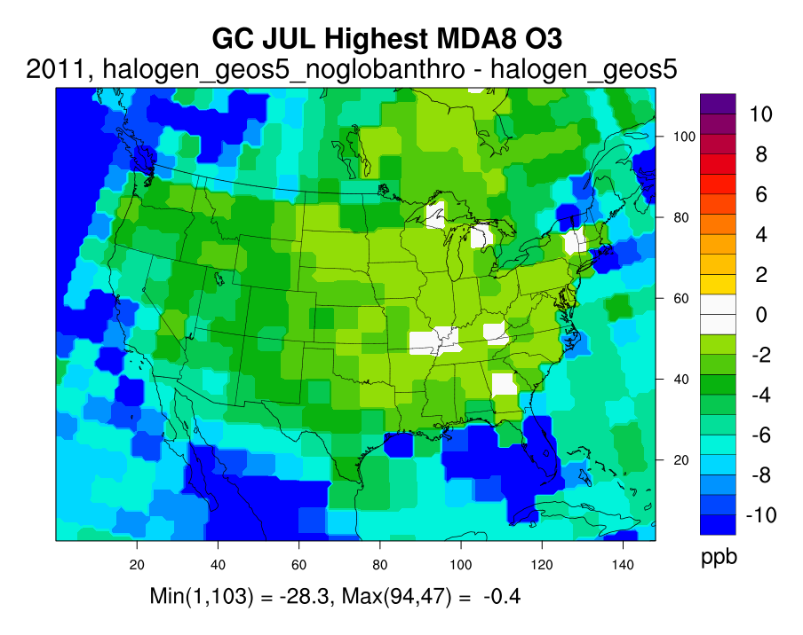
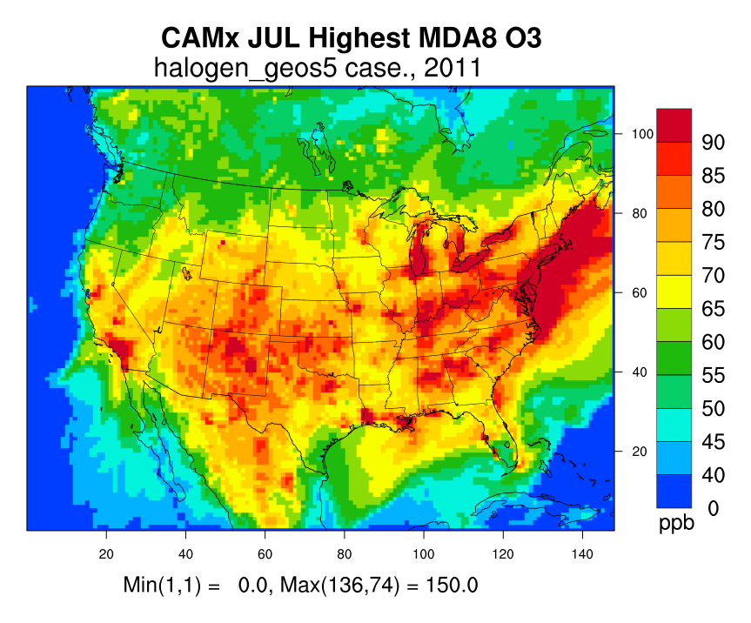
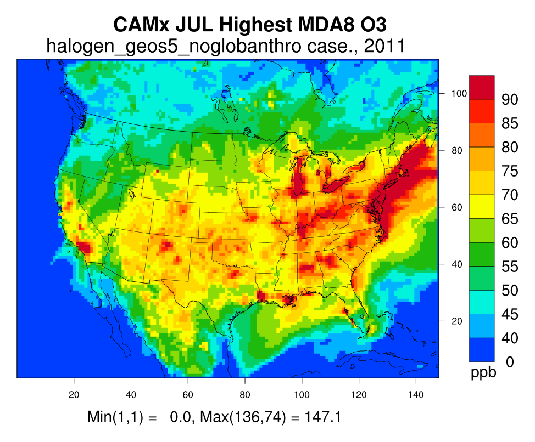
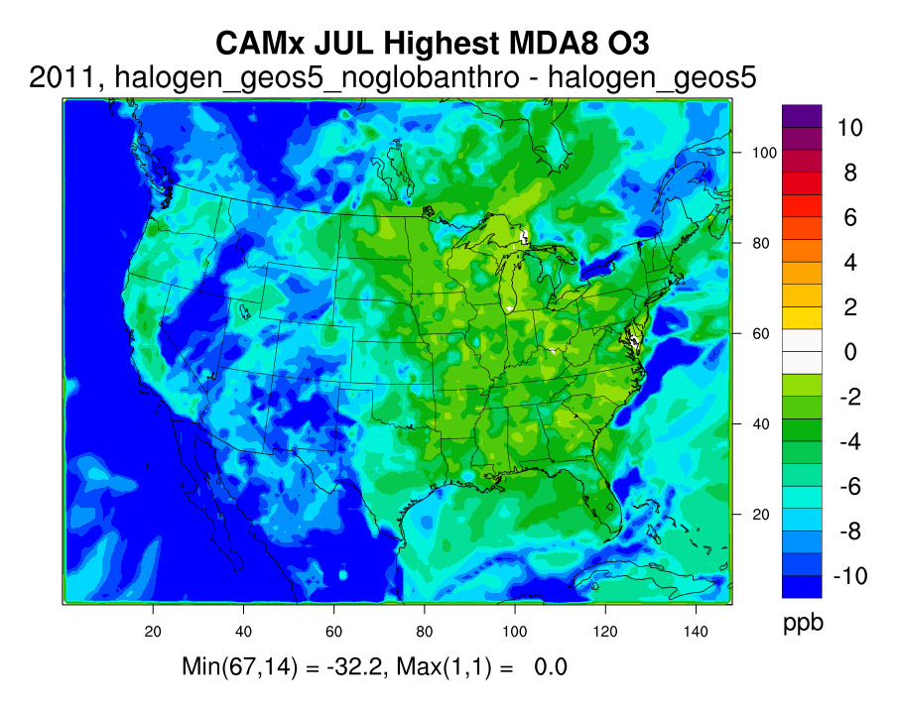
highest mda8 ozone July 2011 -- GEOS-Chem vs. CAMx
Base Case
US-only Anthro. Emissions
US-only anthro. – Base Case
Base Case
US-only Anthro. Emissions
US-only anthro. – Base Case

Slide 13
Highest mda8 ozone July 2011 -- GEOS-Chem vs. CAMx
Within Colorado, change in maximum MDA8 ozone in July:
1-6 ppb GEOS-Chem (~200 km) and 3-11 ppb CAMx (12 km)
Ozone contribution of international anthropogenic emissions in CAMx ~2x GEOS-Chem
GEOS-Chem
CAMx
Notes:
Liikely related to coarse grid resolution used in GEOS-Chem (~200 km)
Reduced vertical transport
GEOS-Chem fails to see full terrain effects that can generate higher vertical velocities and mixing

Slide 14
Estimating Ozone concentrations Across US without influence of international anthropogenic emissions
Estimate ozone design values (DVs), which are comparable to NAAQS (3-yr avg of 4th highest MDA8)
Use EPA tool, MATS, to calculate DVs:
Ozone estimates from CAMx base case simulation
Ozone estimates from CAMx US-only anthropogenic emissions
Ozone measurements from 5 years (e.g., 2009-2013) at monitoring sites in NAA
To estimate ozone DVs without contribution of anthropogenic emissions outside of the US:
Ozone DVs = ozone DVs calculated using observations * RRF
RRF= Modeled ozone from US-only anthropogenic emission run / modeled ozone from base year run
Notes:
RRF = relative response factor)
Use 5 years because EPA guidance (2014) says to use 5-year DV centered on your modeling year. The 5-year DV is average three DVs (e.g., 2009-2011, 2010-2012, 2011-2013), which leads to weighting of 2009-2013 5-years by 1,2,3,2,1.

Slide 15
2011 Ozone Design Values No International Emissions
International anthropogenic emissions contribute from 6.1 to 8.3 ppb to 2011 (2009-2013) ozone DVs in Colorado
Maximum ozone DV without contribution from international anthropogenic emissions = 74.1 ppb
“But for” non-U.S. anthropogenic emissions, the Denver Metro/North Front Range NAA would have attained the 2008 75 ppb ozone NAAQS in 2011
Site ID | Site | County | DVC | NoIntl | Diff
80350004 | CHAT | Douglas | 80.7 | 74.1 | 6.6
80590006 | RFNO | Jefferson | 80.3 | 73.9 | 6.4
80590011 | NREL | Jefferson | 78.7 | 72.2 | 6.5
80690011 | FTCW | Larimer | 78.0 | 71.8 | 6.2
81030006 | RANG | Rio Blanco | 77.0 | 68.7 | 8.3
80050002 | HIGH | Arapahoe | 76.7 | 70.3 | 6.4
80013001 | WELB | Adams | 76.0 | 69.8 | 6.2
80590005 | WELC | Jefferson | 75.7 | 69.4 | 6.3
80690007 | RMNP | Larimer | 75.7 | 69.6 | 6.1
80130011 | SOBC | Boulder | 74.7 | 68.5 | 6.2

Slide 16
Ozone 2011 Design values > 75 ppb 2008 Ozone NAAQS
Example areas with 2011 (2009-2013) Ozone DVs above the NAAQS
Several areas would have attained the 2008 ozone NAAQS “but for” contributions of international anthropogenic emissions
Example 2008 Ozone Non-Attainment Areas
Site ID | State | County | DVC | NoIntl | Diff
60376012 | California | Los Angeles | 97.3 | 91.6 | 5.7
60670012 | California | Sacramento | 93.3 | 87.5 | 5.8
480391004 | Texas | Brazoria | 88 | 84.1 | 3.9
421010024 | Pennsylvania | Philadelphia | 83.3 | 80.4 | 2.9
240053001 | Maryland | Baltimore | 80.7 | 78.6 | 2.1
80590006 | Colorado | Jefferson | 80.3 | 73.9 | 6.4
60773005 | California | San Joaquin | 79.0 | 72.6 | 6.4
211110051 | Kentucky | Jefferson | 77.3 | 75.0 | 2.3
370670022 | North Carolina | Forsyth | 75.3 | 72.5 | 2.8
560350099 | Wyoming | Sublette | 77.3 | 69.3 | 8.0
250070001 | Massachusetts | Dukes | 77.0 | 72.1 | 4.9
490353006 | Utah | Salt Lake | 76.0 | 69.1 | 6.9
60592022 | California | Orange | 72.0 | 66.9 | 5.1
80310014 | Colorado | Denver | 71.0 | 65.2 | 5.8

Slide 17
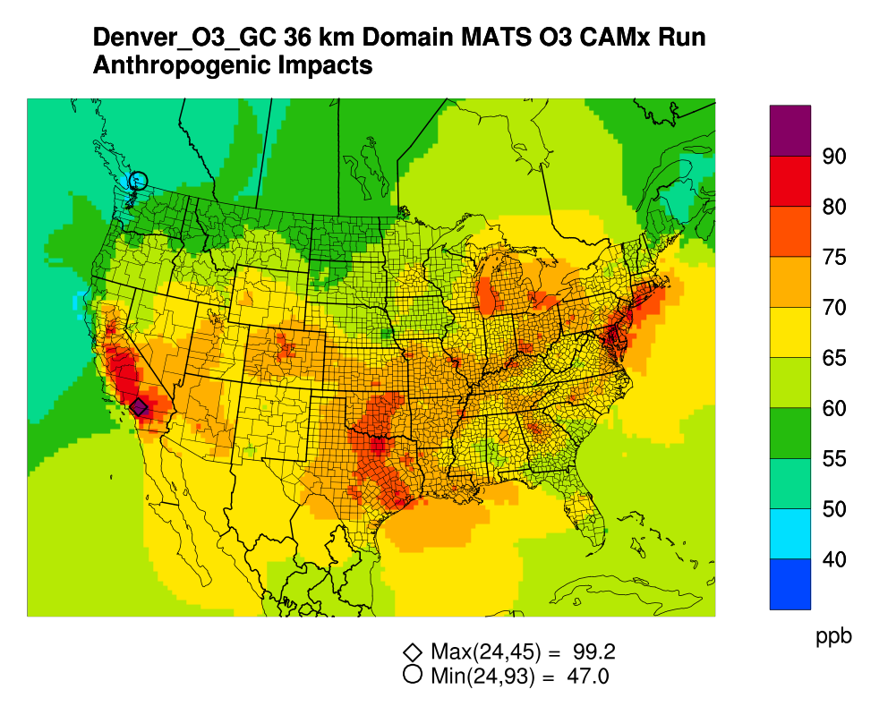
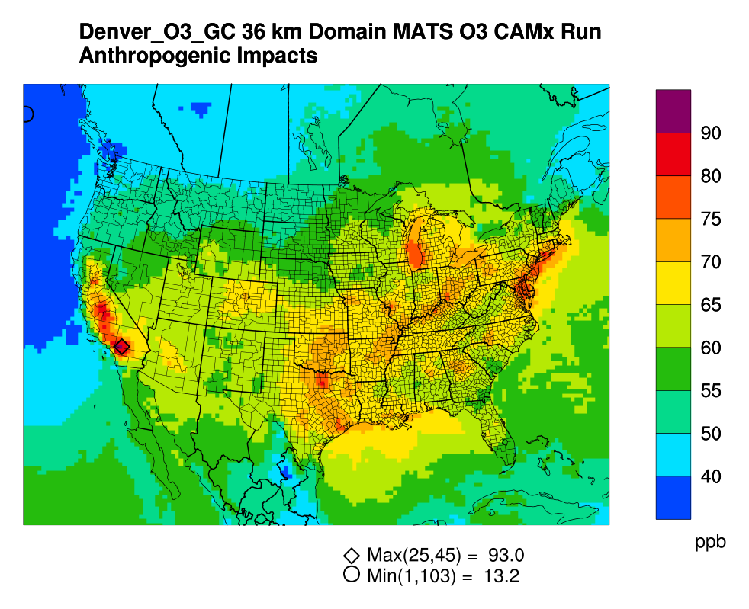
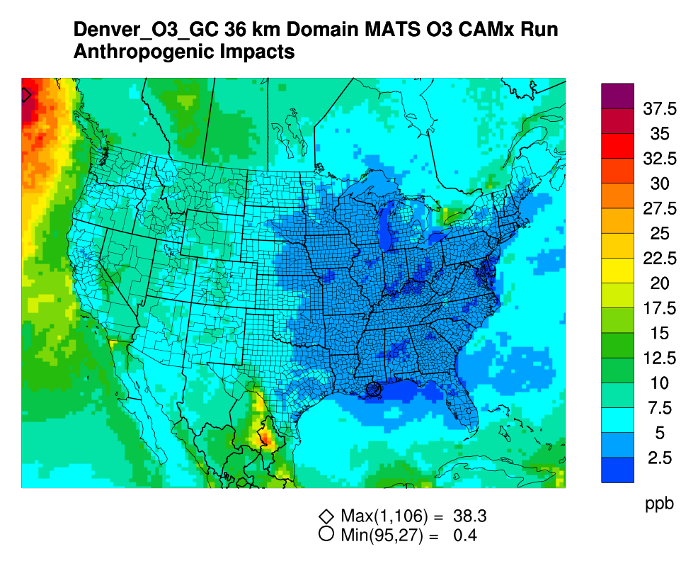
Contribution of international anthropogenic emissions on ozone concentrations across us
Contribution of International Anthropogenic Emissions to 2009-2013 Ozone Design Values Across US
Base Case
US-only Anthro. Emissions
US-only anthro. – Base Case
Notes:
Highest international anthropogenic emissions ozone contributions entering north part of western BCs (Max = 38 ppb).
Higher international anthro contributions in western U.S. light blue (5 ppb) to green (15 ppb)
Lower international anthro contributions in eastern U.S., dark blue (0-2.5 ppb)

Slide 18
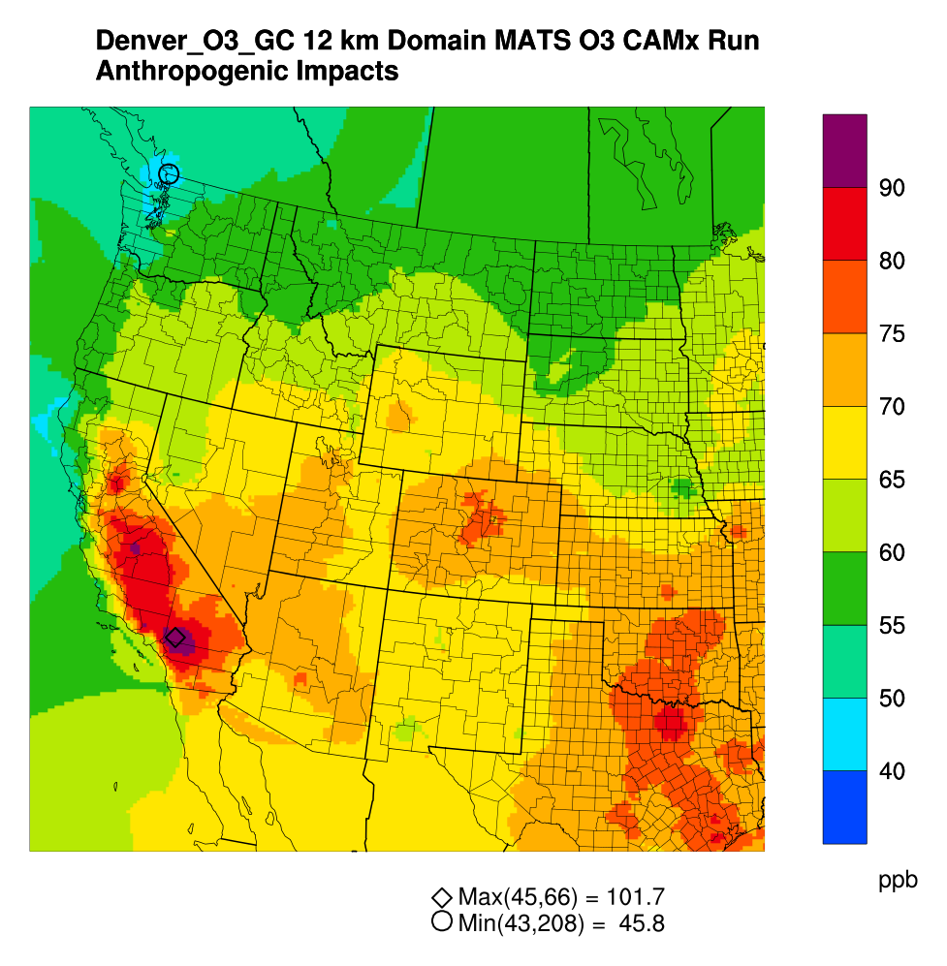
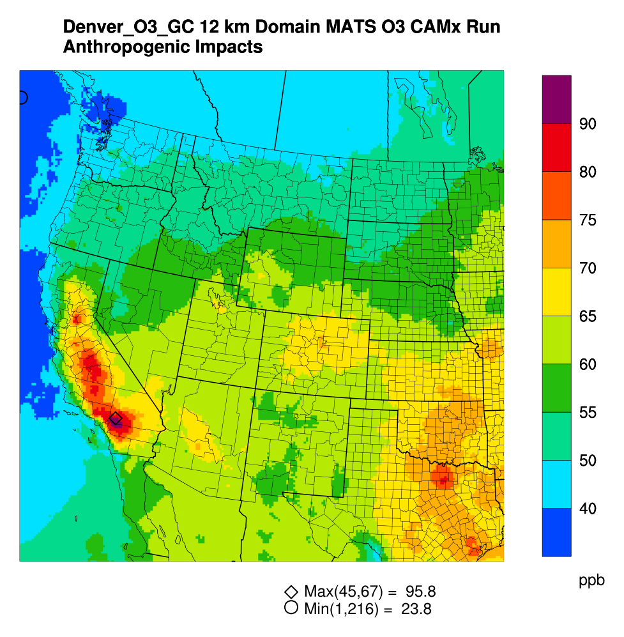
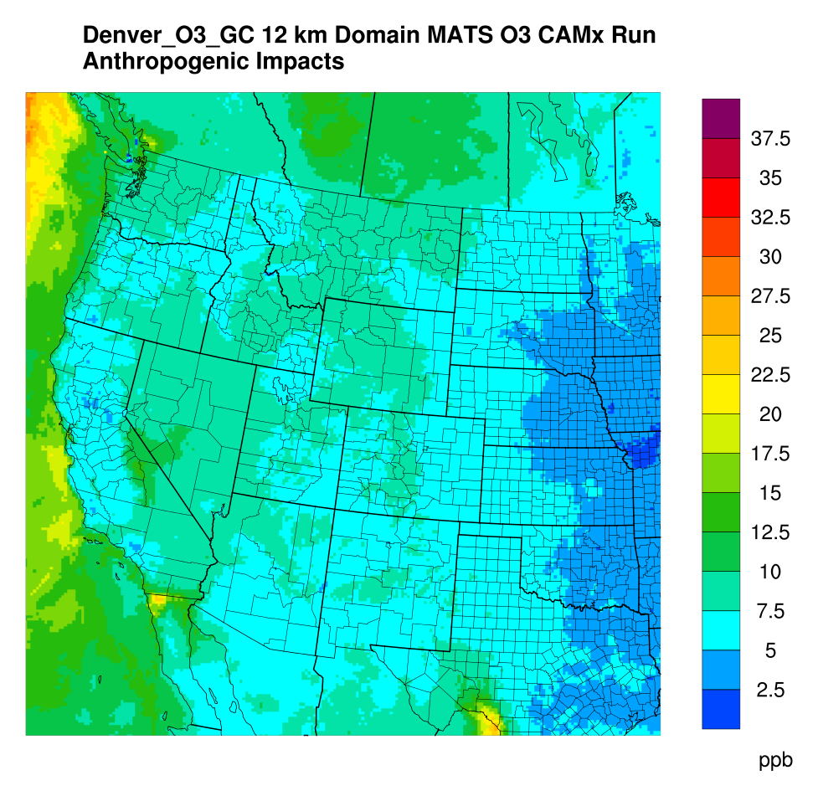
Contribution of international anthropogenic emissions on ozone concentrations in western us
Contribution of International Anthropogenic Emissions to 2009-2013 Ozone Design Values in Western US
Base Case
US-only Anthro. Emissions
US-only anthro. – Base Case
US-only anthro. – Base Case
28.8
0.0
Notes:
5-15 ppb contribution of intl anthro in western U.S.
Highest contributions tend to occur on high terrain features, Sierra Nevada and Rocky Mountains

Slide 19
Conclusions
Currently several areas in the U.S. are trying to comply with 75 ppb 2008 ozone NAAQS and additional NAAs will need to comply with the new 70 ppb ozone NAAQS.
Along with considering various ozone precursor control strategies, agencies may wish to investigate impacts of international emissions on local ozone concentrations, following Section 179B of the Clean Air Act.
CAMx contributions of non-U.S. anthropogenic emissions to 2009-2013 average ozone DVs show wide range over United States (0.4 to 12 ppb), with bigger impacts in West compared to East.
6-12 ppb in Pacific Northwest
3-11 ppb in Intermountain West
1-4 ppb in Eastern U.S.

Slide 20
THANK YOU! Maria Zatko mzatko@ramboll.com
End slide
Notes:
Endslide

Slide 21
extra

Slide 22
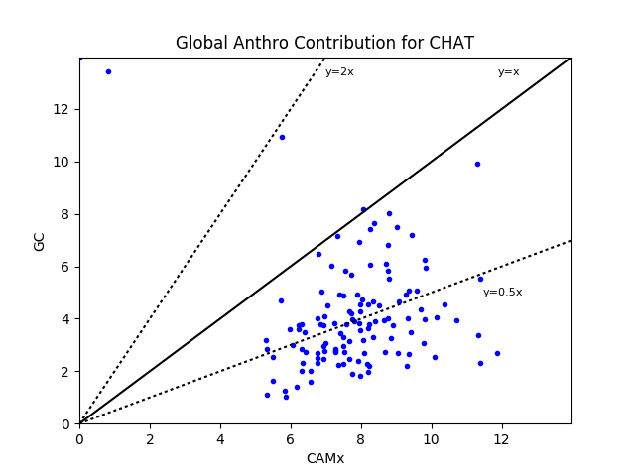
CAMx vs. GEOS-Chem global anthropogenic contribution to MDA8 ozone
CAMx global anthropogenic contribution ~2x GEOS-Chem
Consistent with spatial maps presented previously
Reasons why GEOS-Chem international anthropogenic contributions is lower not clear
Likely related to coarse grid resolution used in GEOS-Chem (~200 km)
Reduced vertical transport
GEOS-Chem fails to see full terrain effects that can generate higher vertical transport
Global Anthro Contribution to Ozone

Slide 23
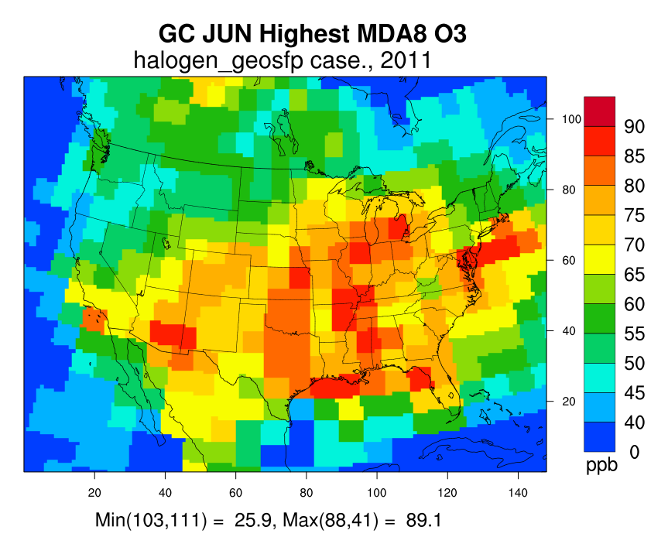
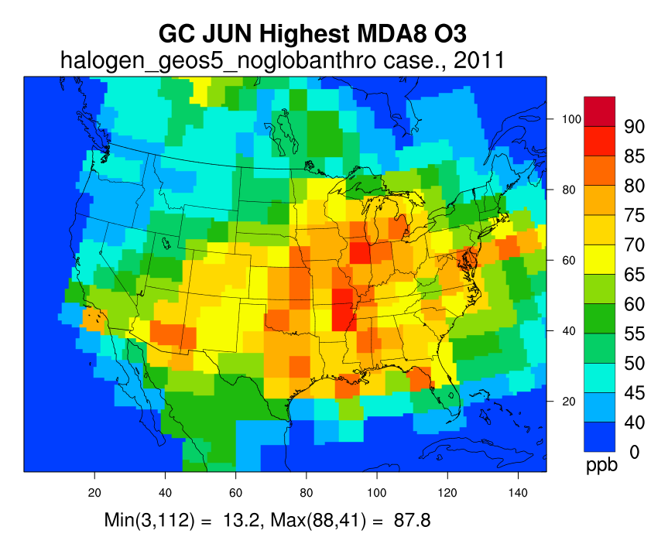
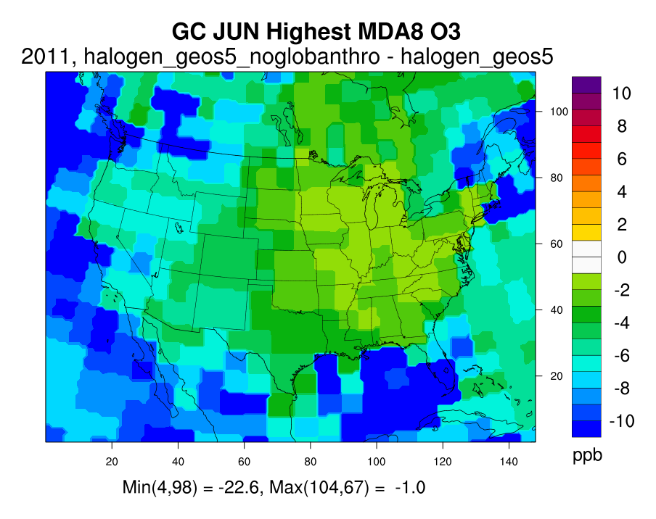
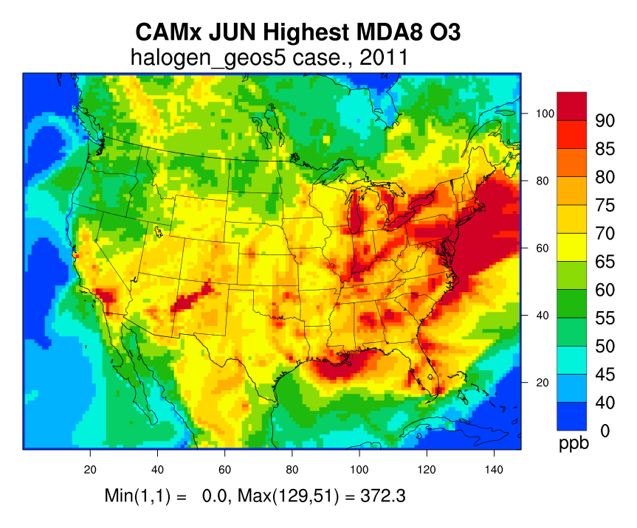
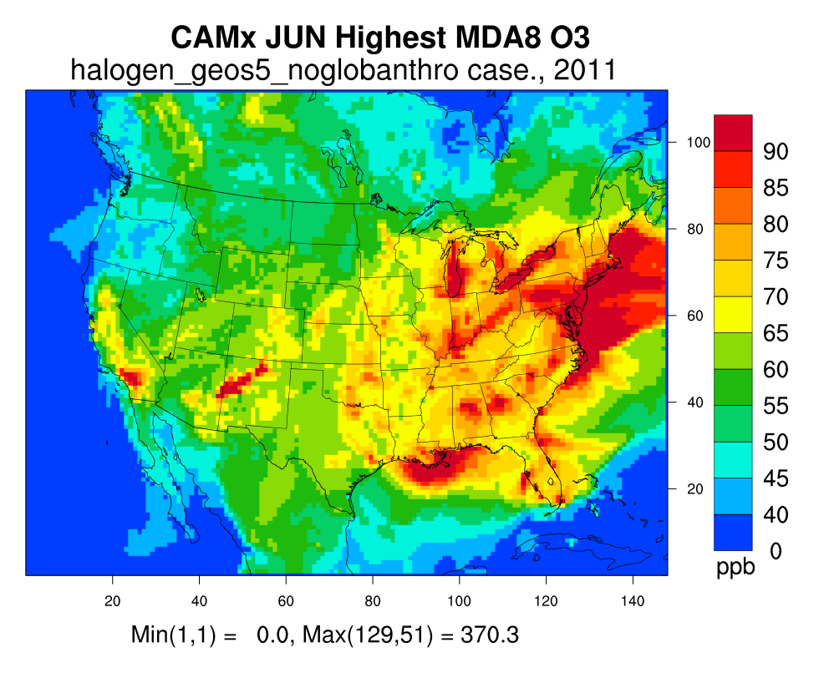
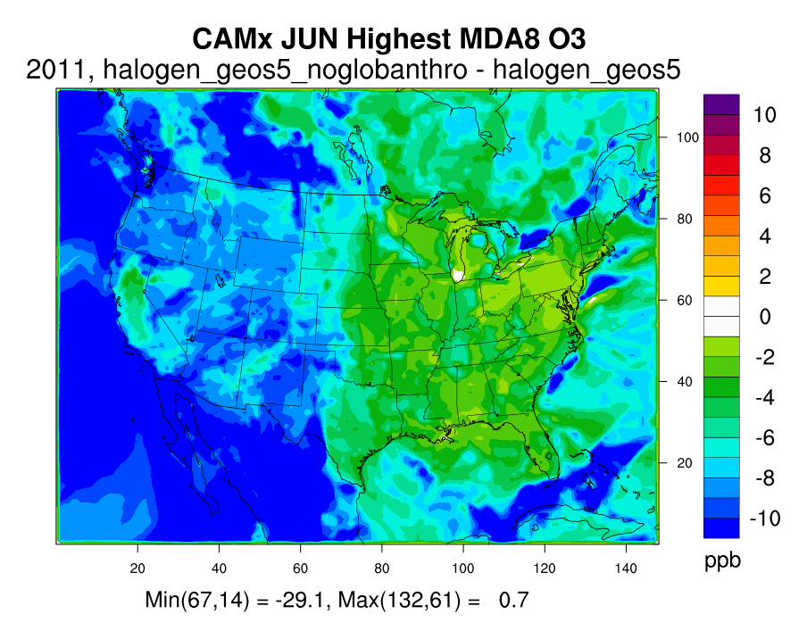
Max mda8 ozone June 2011 -- GEOS-Chem vs. CAMx
Base Case
US-only Anthro. Emissions
US-only anthro. – Base Case
Base Case
US-only Anthro. Emissions
US-only anthro. – Base Case
Notes:
Top figures are GEOS-Chem and bottom figures are CAMx results

Slide 24
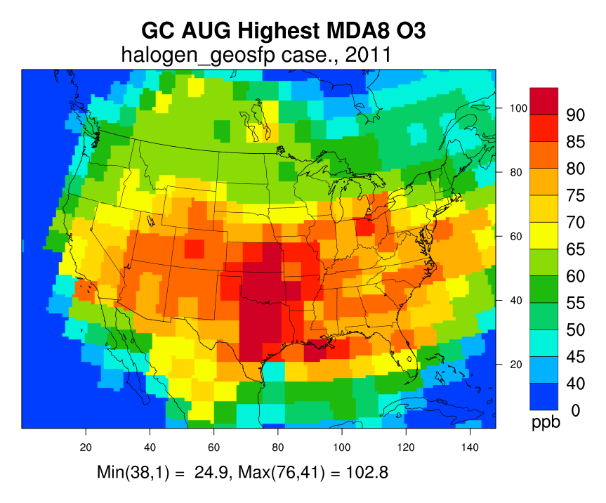
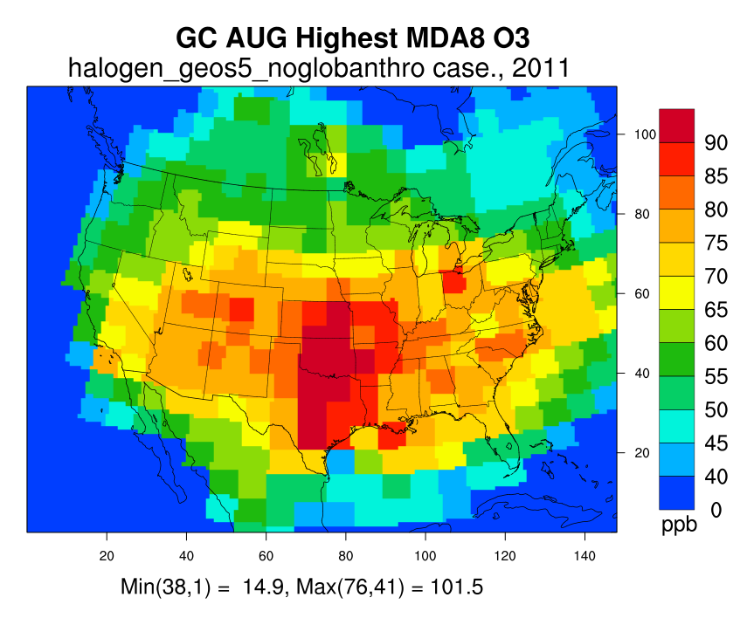
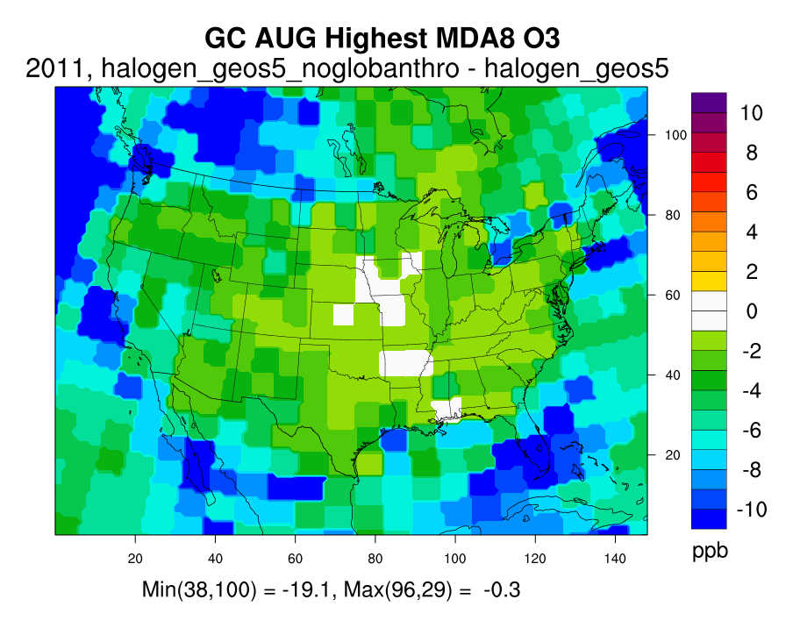
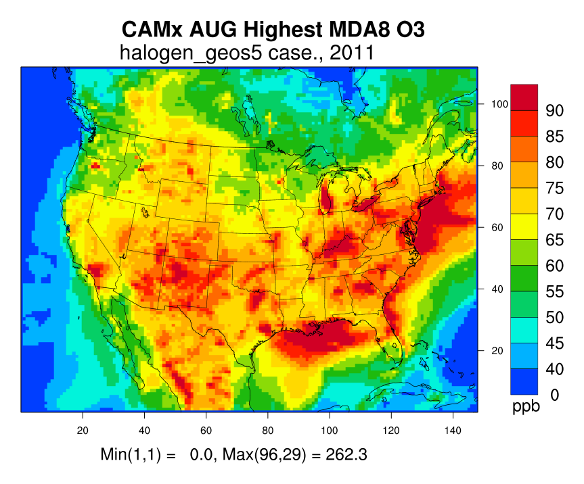
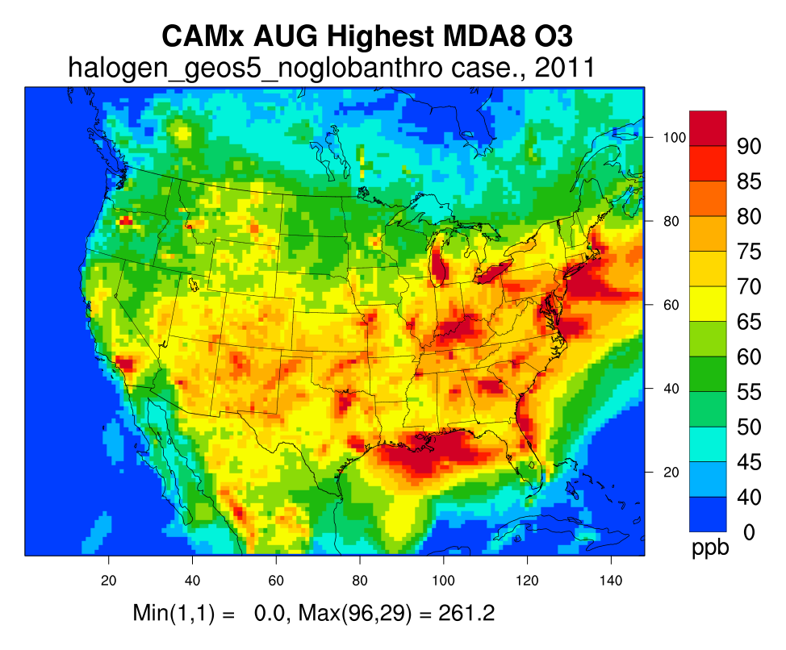
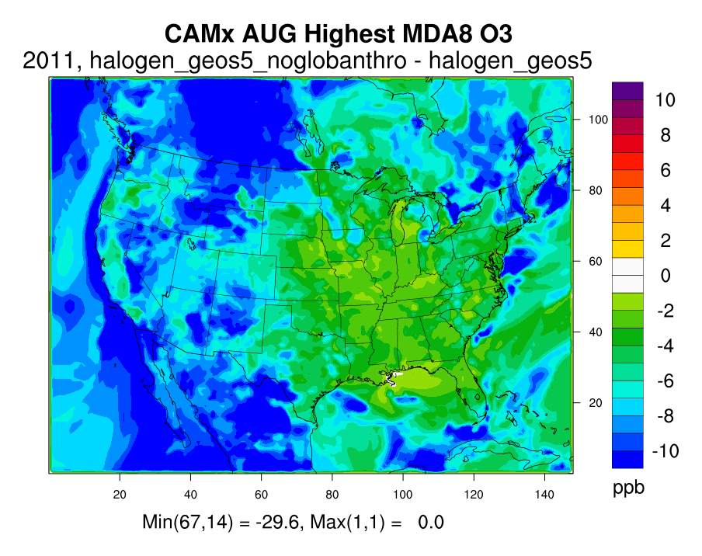
Highest mda8 ozone August 2011 -- GEOS-Chem vs. CAMx
Base Case
US-only Anthro. Emissions
US-only anthro. – Base Case
Base Case
US-only Anthro. Emissions
US-only anthro. – Base Case

Slide 25
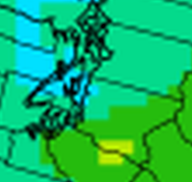
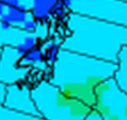
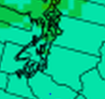
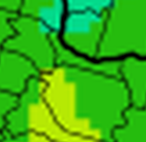
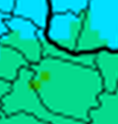
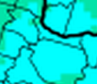
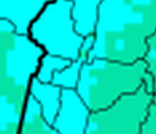
Contribution of international anthropogenic emissions on ozone concentrations in Western us
Base Case
US-only Anthro.
US-only Anthropogenic Emissions – Base Case
Seattle
45-65 ppb
40-60 ppb
10-12 ppb
Portland
50-65 ppb
40-60 ppb
5-10 ppb
Boise
60-65 ppb
50-60 ppb
5-10 ppb
Notes:
Seattle has lowest base case and US-only anthro ozone concentrations and Boise has the highest concentrations. Seattle and Portland fall in-between and the Portland area tends to have higher ozone concentrations compared to Seattle overall.

Slide 26
Modeled Ozone Design values
Counties in Pacific Northwest
Example 2008 Ozone Non-Attainment Areas
Site ID | State | County | DVC | NoIntl | Diff
160230101 | Idaho | Butte | 62.3 | 53.8 | 8.5
160550003 | Idaho | Kootenai | 56.0 | 49.6 | 6.4
300298001 | Montana | Flathead | 54.7 | 47.8 | 6.9
410050004 | Oregon | Clackamas | 64.0 | 58.0 | 6.0
410090004 | Oregon | Columbia | 51.3 | 46.2 | 5.1
410290201 | Oregon | Jackson | 61.7 | 55.6 | 6.1
410391007 | Oregon | Lane | 60.0 | 54.3 | 5.7
410470004 | Oregon | Marion | 59.3 | 53.4 | 5.9
410510080 | Oregon | Multnomah | 56.7 | 50.8 | 5.9
410591003 | Oregon | Umatilla | 61.3 | 55.0 | 6.3
530090013 | Washington | Clallam | 55.0 | 42.9 | 12.1
530110011 | Washington | Clark | 56.0 | 50.2 | 5.8
530330023 | Washington | King | 65.0 | 55.6 | 9.4
530530012 | Washington | Pierce | 56.0 | 47.1 | 8.9
530630046 | Washington | Spokane | 58.7 | 52.0 | 6.7
530670005 | Washington | Thurston | 55.7 | 47.0 | 8.7
530730005 | Washington | Whatcom | 45.0 | 32.9 | 12.1
Site ID | State | County | DVC | NoIntl | Diff
60376012 | California | Los Angeles | 97.3 | 91.6 | 5.7
60670012 | California | Sacramento | 93.3 | 87.5 | 5.8
480391004 | Texas | Brazoria | 88 | 84.1 | 3.9
421010024 | Pennsylvania | Philadelphia | 83.3 | 80.4 | 2.9
240053001 | Maryland | Baltimore | 80.7 | 78.6 | 2.1
80590006 | Colorado | Jefferson | 80.3 | 73.9 | 6.4
60773005 | California | San Joaquin | 79 | 72.6 | 6.4
211110051 | Kentucky | Jefferson | 77.3 | 75.0 | 2.3
370670022 | North Carolina | Forsyth | 75.3 | 72.5 | 2.8
560350099 | Wyoming | Sublette | 77.3 | 69.3 | 8.0
250070001 | Massachusetts | Dukes | 77 | 72.1 | 4.9
490353006 | Utah | Salt Lake | 76 | 69.1 | 6.9
60592022 | California | Orange | 72 | 66.9 | 5.1
80310014 | Colorado | Denver | 71 | 65.2 | 5.8
There are NAAs with 2009-2013 design values above 75 ppb.
“But for” non-U.S. anthropogenic emissions, some NAAs would attain the 2008 75 ppb ozone NAAQS
Same analysis can be performed for 2015 70 ppb ozone NAAQS standard
Non-U.S. anthropogenic emissions contribute from
5.1 to 12.1 ppb to 2009-2013 ozone DVs in PNW

Slide 27
Model performance evaluation compare model results to observations
Compare base case model results to observations in and near Non-Attainment Region
Vertical Profiles
Scatterplots
Timeseries
Average Ozone Profiles
September 2013
Observations
Model run 1
Model run 2
Model run 1
Model run 2
Observed
Modeled
Compare in time at one location
Compare in time and space
at multiple locations
Compare vertically in atmosphere at ozonesonde locations
Notes:
Timerseries – useful for comparing obs/model at one location over time ; scatterplots – useful for comparing obs/model at multiple locations in space and time ; vertical profiles – useful for examining vertical slice of atmosphere at locations of ozonesonde observations

Slide 28
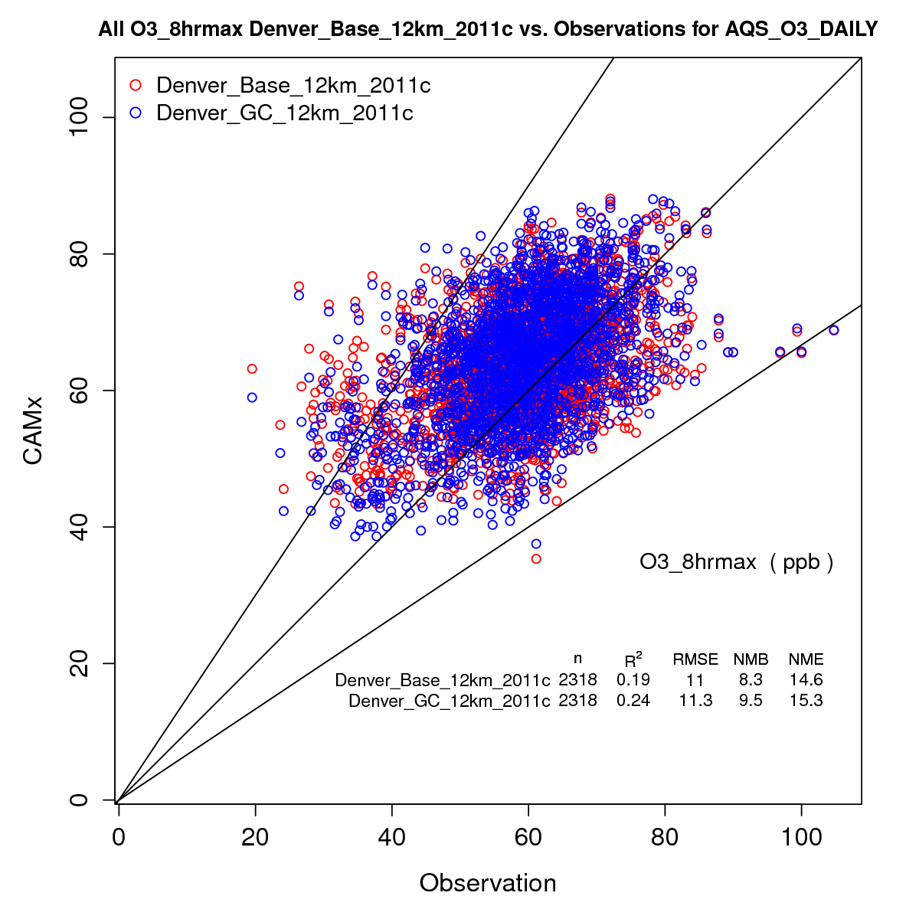
Model performance evaluation CAMx 12km Base case run compared to Ozone observations
Hourly MDA8 Ozone (AQS monitor sites)
Daily MDA8 Ozone (CASTNET monitor sites)
CAMx shows good agreement with hourly (AQS) and daily (CASTNET) ozone observations Modeled values within ~9% of observed values overall (MPE goal ≤±15%)
Notes:
Note: mention to just focus on blue dots

Slide 29
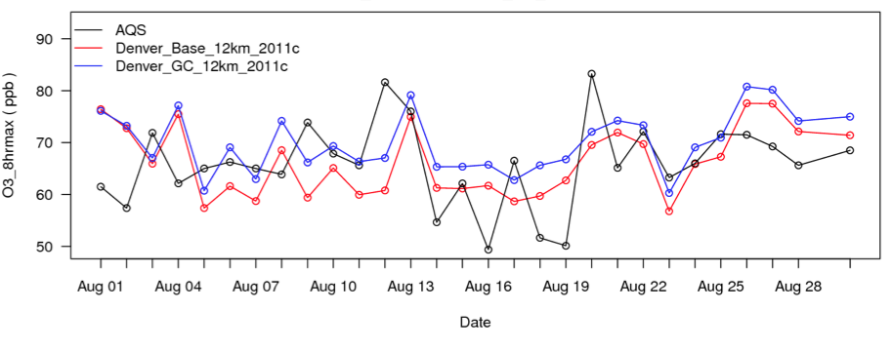
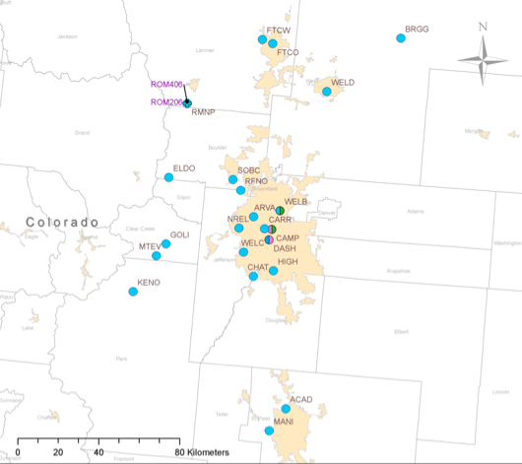
Model performance evaluation CAMx 12km Base case run compared to Ozone observations
AQS Monitor Site – RFNO
Bias = 6.4%
AQS Monitor Site – CHAT
Bias = 7.8%
Notes:
Note: just focus on blue lines

Slide 30
CAMx Processing
Emissions Inventory Data
Meteorological
Inputs
Global Model
(e.g. GEOS-Chem) Output
Regional Met.
Model (WRF)
SMOKE
GEOS2CAMx
WRFCAMx
CAMx Emission
Input
(FORTRAN binary)
CAMx IC/BC
(FORTRAN binary)
CAMx
CAMx Output (FORTRAN Binary)

Slide 31
Geos-chem Processing
Emissions Inventory Data
Meteorological
Inputs
Miscellaneous Chemistry Inputs
GMAO datasets
(operational or reanalysis)
HEMCO
-Radiative transfer properties
-Leaf area index
Download grid-resolution specific files
GEOS-Chem Emission
Input
(netCDF)
GEOS-Chem
Choose chemistry scheme
GEOS-Chem Output
(Mix of binary punch format and netCDF)
Notes:
Question: what is required to develop the various inputs?
General answer: No pre-processing needed for GEOS-Chem. As long as you download correct input files and choose the right settings, the model is ready to run.
Emissions: Collection of emission inventory data; automatically regridded to desired domain. HEMCO also contains parameterizations to calculate some emissions based on environmental variables (e.g., ozone concentrations, wind speed, temperature)
Met: Global Modeling Assimilation Office provides ready-to-use met data. Some datasets are reanalysis and others are operational. For operational, data assimilation techniques use observations and model results to produce datasets; data analysis techniques can change over record. For reanalysis, observations (generally satellite) and model results are incorporated into data assimilation schemes to produce long data set. Data assimilation techniques not changed over record.
Other: These are pre-produced text, bpch, and NetCDF files that contain useful parameters, such as IOPs and LAI.

Slide 32
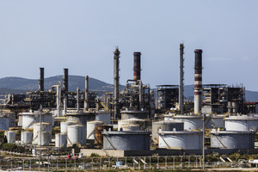
Photochemical grid models simulated processes
Meteorology
Radiation
Photochemistry
In-cloud chemistry
Aerosol chemistry
Emissions
Snow/Ice
Dry and wet deposition
Sea salt particles
Runoff
Evaporation
Oceanic chemistry
Notes:
Main point: In order to simulate ozone formation processes requires treatment of numerous processes with complex photochemical models

Slide 33
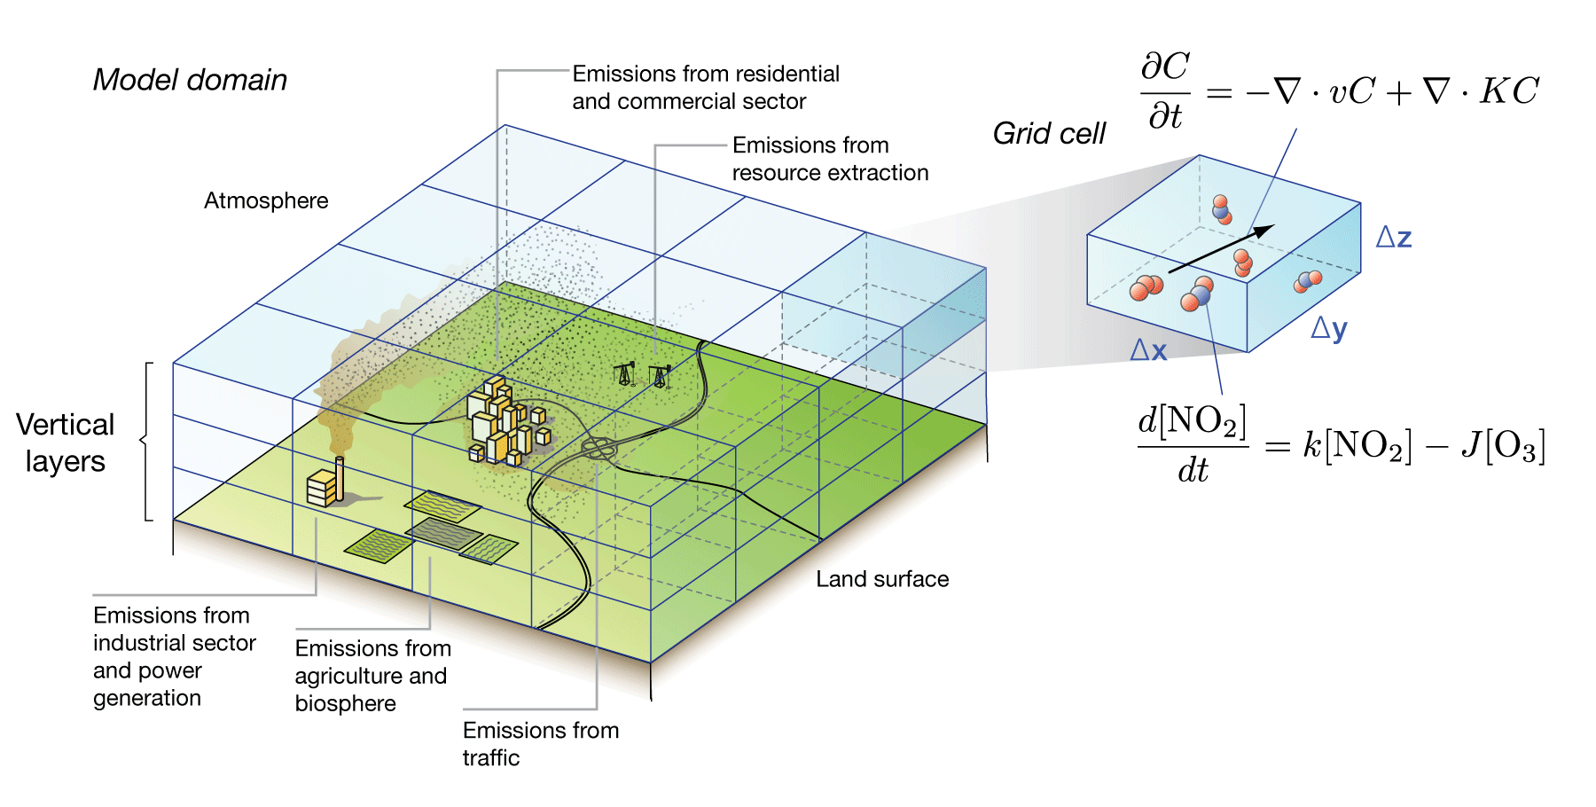
photoChemical grid models transport and chemistry
Simulate atmospheric chemistry across large regions utilizing variety of chemistry schemes, reanalysis meteorological data, and emissions inventories
Atmospheric “box”
Spatial distribution of X not resolved
Chemical
Production
Chemical
Loss
Inflow
Outflow
X
Emission
Deposition
Sources = Inflow + Emission + Chemical Production
Sinks = Outflow + Deposition + Chemical Loss
Mass balance of X in grid box = Sources - Sinks
Notes:
Walk through all of this, describe that this is computationally expensive.

Slide 34
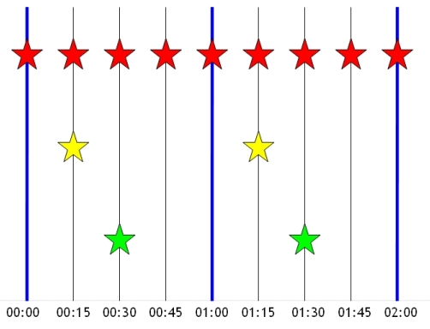
photoChemical grid models timestep algorithms
Centralized Chemistry Timestep Algorithm
Transport operations
(advection, PBL mixing,
cloud convection)
ΔT(transport) = 15 min
Chemistry operations
(emissions, deposition,
Photolysis, reactions)
ΔT(chemistry) = 60 min
Time of day when sun
angles are computed
(for photolysis)
Model Time

