Slide 1
Using Photochemical Models to Assess the Exceptional Event Rule’s Q/D Screening Guidance
Matthew J. Alvarado, Benjamin Brown-Steiner,
Chantelle R. Lonsdale, and Jennifer D. Hegarty
Atmospheric and Environmental Research
2018 CMAS Conference
UNC-Chapel Hill
October 22, 2018
This presentation is based on work supported by the State of Texas through a contract from the Texas Commission on Environmental Quality. The conclusions are the authors’ and do not reflect TCEQ policy.
Copyright 2018, Government sponsorship acknowledged.

Slide 2
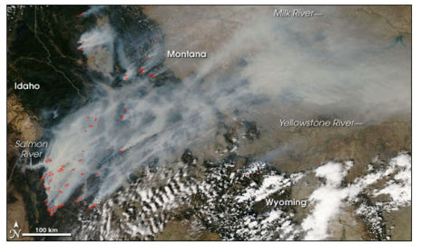
Wildfire Exceptional Event Demonstrations
Jiang et al., Environ. Sci. Technol., 2012
Poor air quality events due to wildfires can be excluded from NAAQS attainment.
Must demonstrate a clear, causal relationship between the wildfire event and the monitor.
Photochemical models can be used to calculate the O₃ impacts of fires, but they are computationally expensive.
Thus, there is a need for screening methods to identify likely exceptional events.
Lonsdale et al., AQRP Report 16-024, 2017

Slide 3
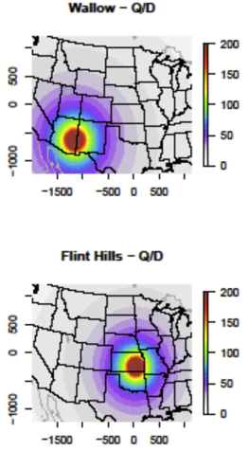
Screening Wildfire Impacts of Ozone
‘Q/D’ Metric
  Q : NO_{x} and VOC emissions from fire
  D : Distance of monitor from fire
  If Q/D > 100 tons/day/km, no photochemical modeling (Tier 2)
EPA notes that:
  Q/D alone is not enough to demonstrate O₃ impacts
  Threshold of 100 tpd/km is a “conservative value”

Slide 4
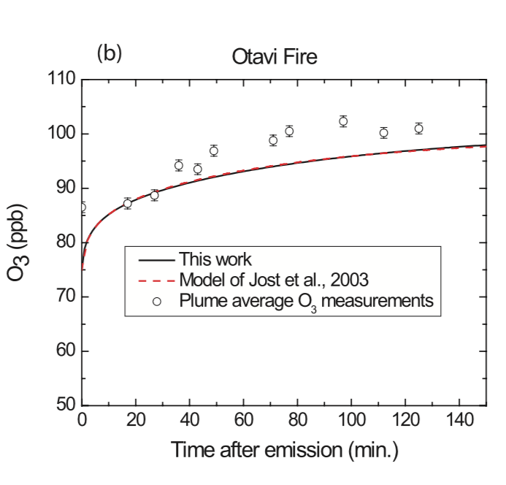
Is the Q/D metric appropriate for O₃?
O₃ is a secondary pollutant rapidly produced by the photochemistry of NO_{x} and VOCs emitted by fires
The concentration of O₃ increases with distance downwind until plume dilution is greater than chemical production
Alvarado and Prinn., JGR, 2009

Slide 5
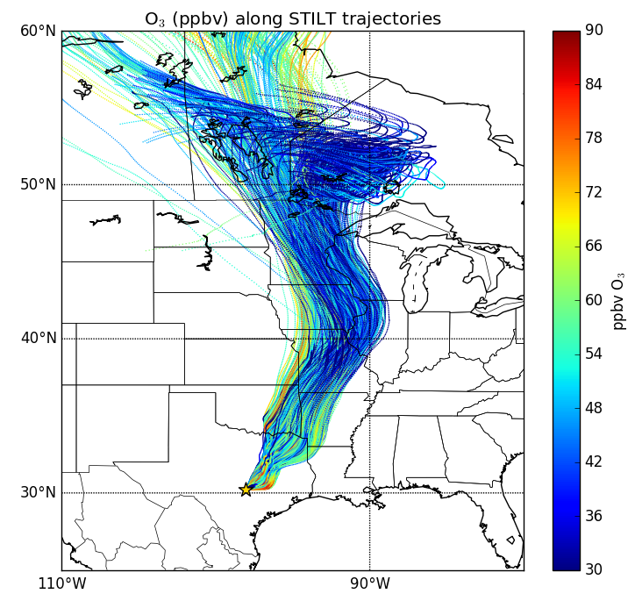
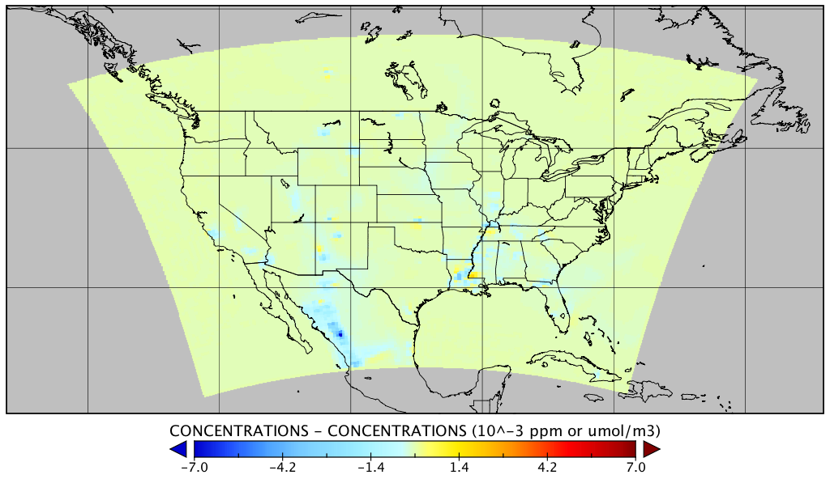
Investigating the Q/D Metric for Wildfires
Literature Review
Simulate two Texas fire events
  El Paso event from Hog Fire
  Houston event from Yucatan
Using three photochemical modeling approaches
  Lagrangian parcel model (ASP)
  Lagrangian chemical transport model (STILT-ASP)
  Eulerian grid model (CAMx, El Paso only)
Difference in O₃ when a fire plume chemistry parameterization is added to CAMx.
Lonsdale et al., AQRP Report 16-024, 2017
ASP: Alvarado et al., ACP, 2015.
Lonsdale et al., AQRP Report 16-024, 2017

Slide 6
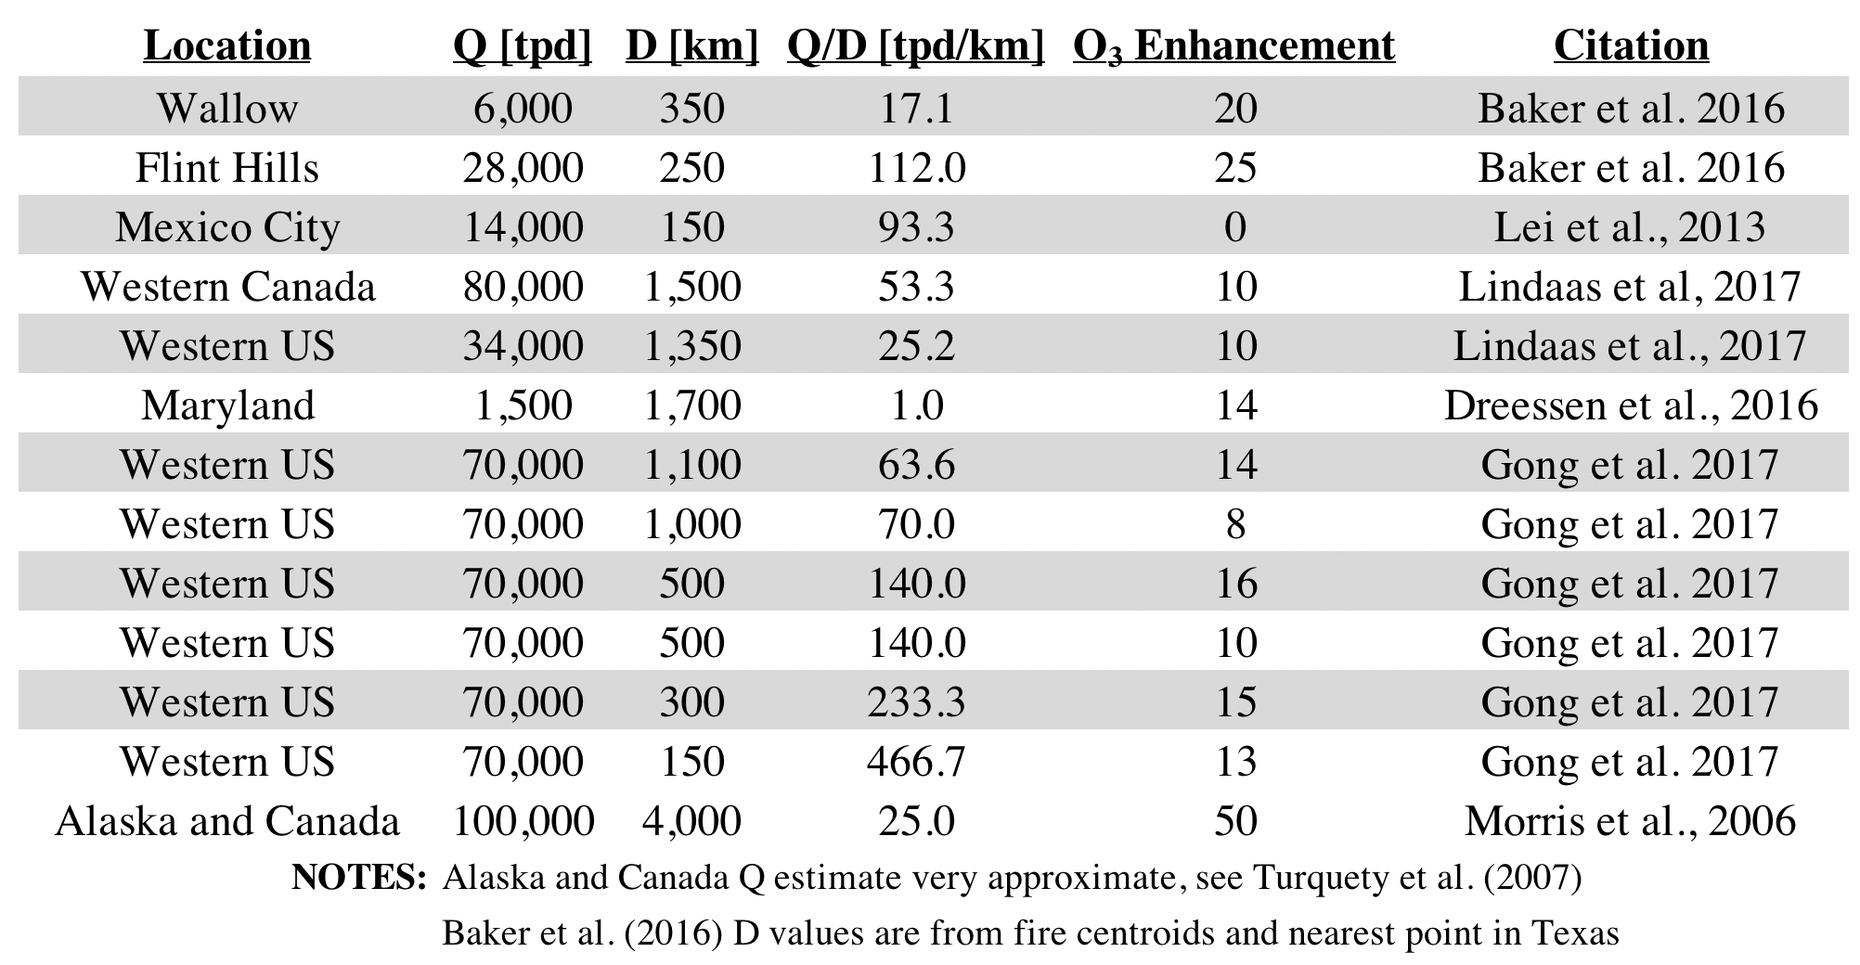
Literature summary of Q/D versus O₃
Table 2: Summary of Q, D, and Ozone Enhancement Values from selected literature

Slide 7
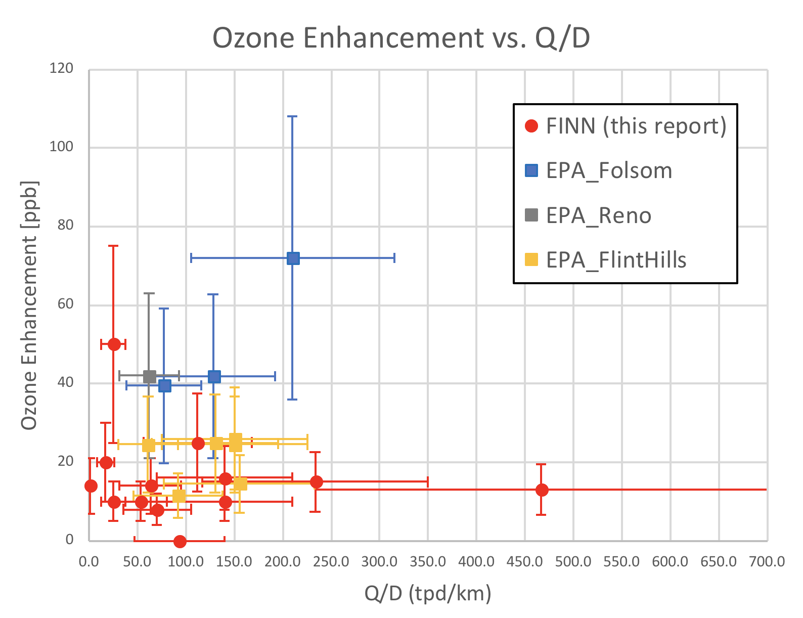
O₃ enhancement not a function of Q/D
O₃ Enhancement (∆O₃) = O₃(in plume) – O₃ (background)
R² < 0.01

Slide 8
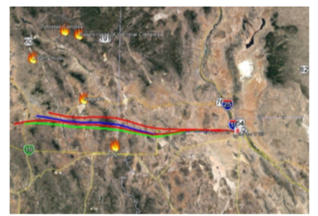
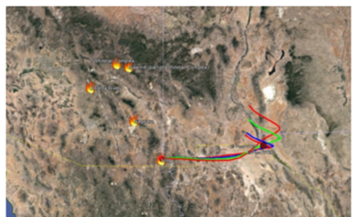
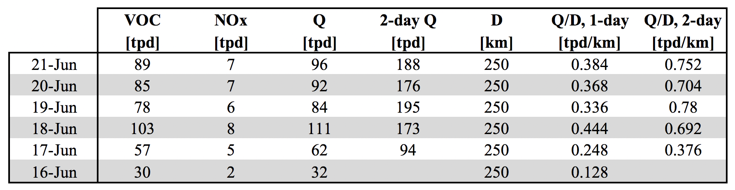
El Paso Case Study – Hog Fire
El Paso
El Paso
Hog Fire
Hog Fire
HYSPLIT Back-Trajectories for CAMS 12.
HYSPLIT Forward Trajectories from Hog Fire.

Slide 9
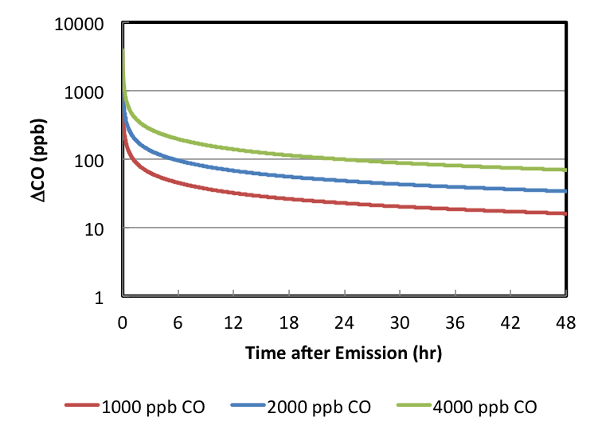
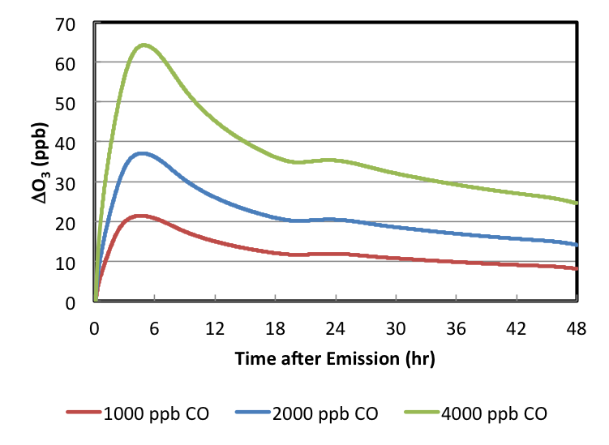
Hog Fire Lagrangian Parcel Simulations
∆O₃ = O₃(in plume) – O₃ (background)
O₃ enhancement increases for first 6 hours after emission (if emitted at 12:00 LST), then decreases, which is not consistent with Q/D
O₃ enhancement is roughly proportional to initial plume concentrations
  Initial concentration controlled partly by emissions (Q), but also mixing height, fire size, wind speed, etc.

Slide 10
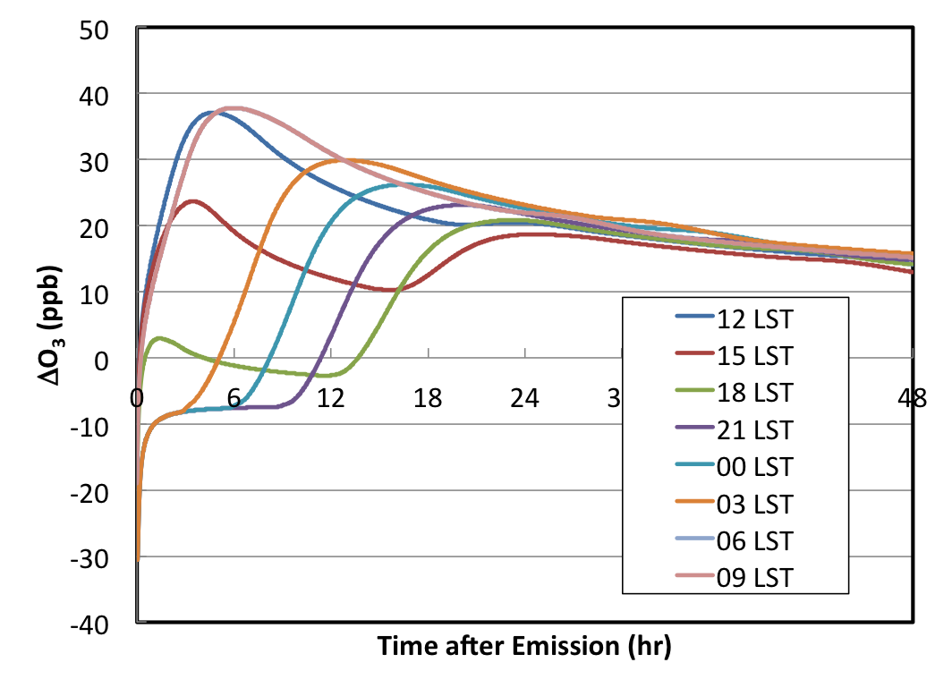
Hog Fire Lagrangian Parcel Simulations
O₃ enhancement in first 24 hours depends on what time of day the parcel is emitted, but enhancements all very similar after 24 hours!
Consistent with review of Jaffe and Wigdar (2012), which suggested similar values for ∆O₃/∆CO after 1-2 days aging.
∆O₃ = O₃(in plume) – O₃ (background)

Slide 11
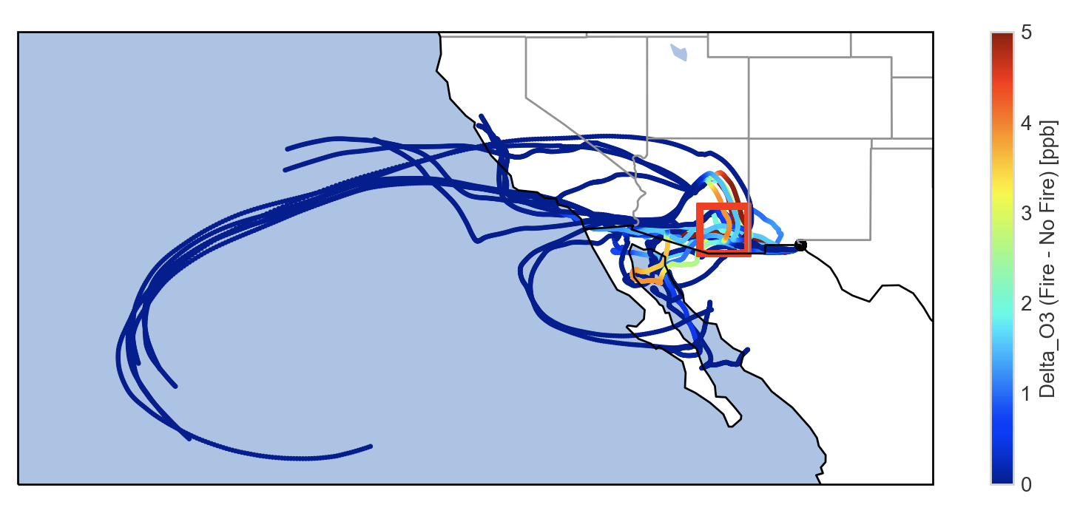
El Paso Lagrangian CTM Simulations
El Paso
∆O₃ = O₃(with fires) – O₃ (without fires)
Only small fraction of the 500 back-trajectories encountered the fires.
O₃ enhancement is produced near the fire source and stays constant with distance after that.
“Straight line” distance a poor proxy for trajectory distance or parcel age.

Slide 12
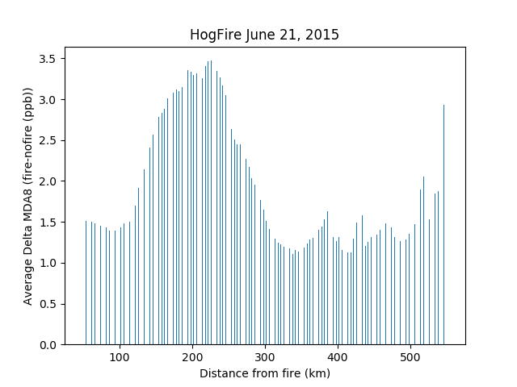
El Paso CAMx simulations
(Performed by Ramboll, provided by TCEQ)
Mean ∆MDA8 O₃ (ppb)
Distance from Fire (km)
Average difference in MDA8 O₃
with distance from the Hog Fire.
Difference in MDA8 O₃ due to fire emissions.
∆O₃ = O₃(with fires) – O₃ (without fires)
MDA8 O₃ impact increases with distance from fire up to ~225 km.
Inconsistent with Q/D, but consistent with Lagrangian parcel simulations.

Slide 13
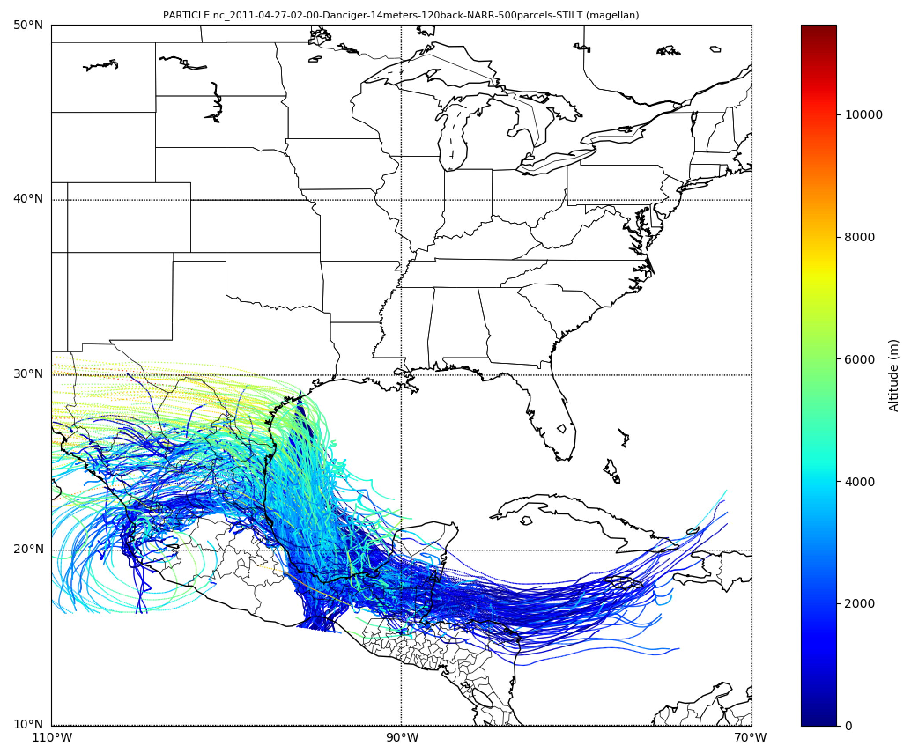
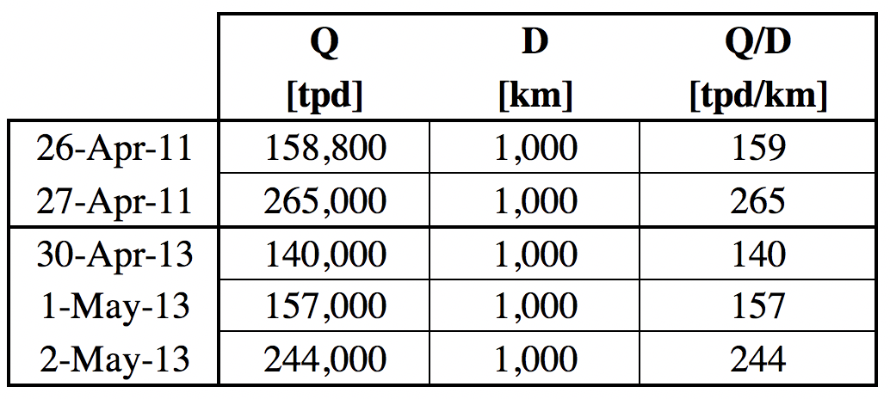
Houston Case Study – Yucatan Fires
April 26, 2011
Two events identified by Prof. Yuxuan Wang of the University of Houston.
  April 26-27, 2011
  May 1-2, 2013
Altitude (m)

Slide 14
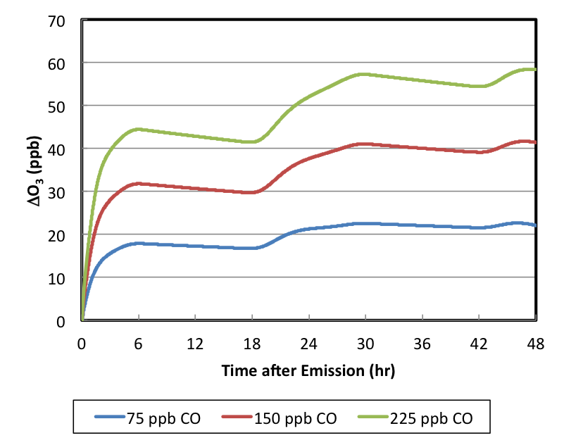
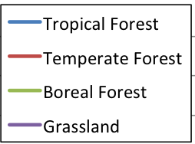
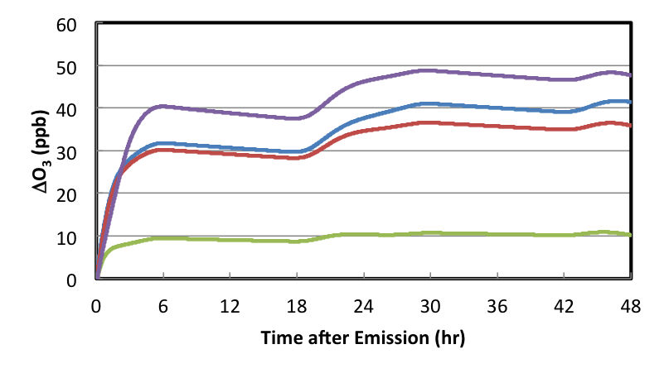
Houston Lagrangian Parcel Simulations
Tropical forest, temperate forest, and grassland emission factors all have similar changes in O₃ enhancement with time after emission (and thus distance)
But boreal forests make much less O₃ for same Q (NO_{x}+VOCs) suggesting they need a different Q/D threshold.
Yucatan plume is large, so dilution is very slow
O₃ increases for at least 2 days
O₃ enhancement proportional to initial plume concentrations, consistent with Q/D if all else is equal (e.g., PBL height)

Slide 15
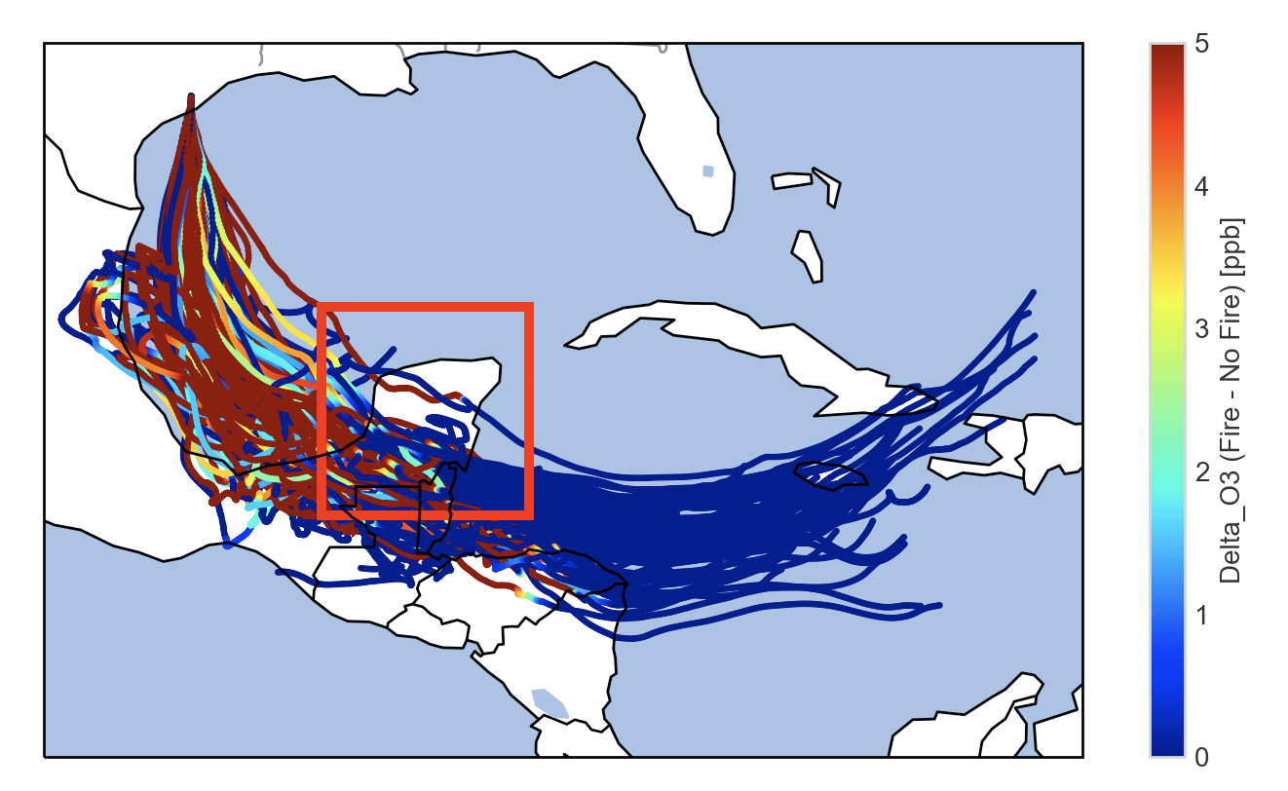
Houston Lagrangian CTM Simulations
∆O₃ = O₃(with fires) – O₃ (without fires)
About a third of the 500 back-trajectories encountered the fires.
O₃ enhancement is produced near the fire source, increases for some distance downwind, then decreases.

Slide 16
Alternative Screening Metrics
Use Jaffe and Wigder (2012) review as the basis of a screening metric.
  ∆O₃/∆CO = 0.2 ± 0.1 after 1-2 days (-0.1 to 0.9)
  Boreal forest lower, ∆O₃/∆CO = 0.005 ± 0.019 (Alvarado et al., 2010)
Use STILT or HYSPLIT back-trajectories and fire CO emission inventories to estimate ∆CO.
  Could use ∆O₃/∆NO_{y} or ∆O₃/(∆NO_{y}+VOCs) instead

Slide 17
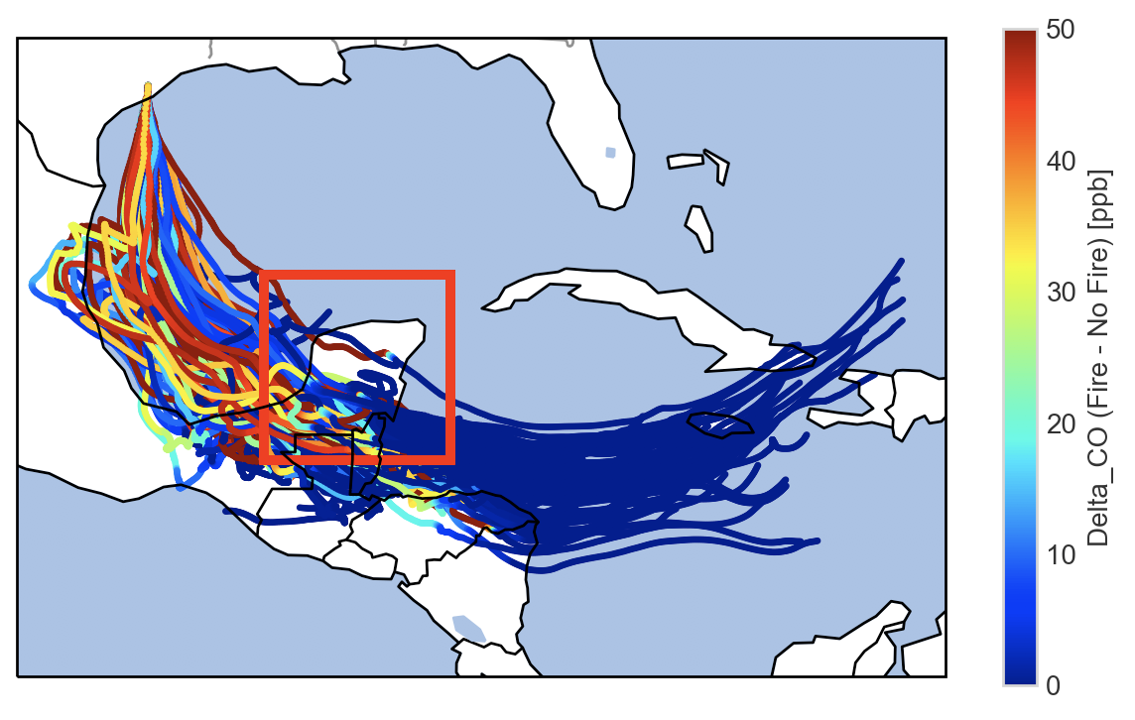
Alternative Screening Metrics
Danciger HGB Monitor, April 26, 2017
  Example: ∆CO is ~20 ppbv from STILT, so we expect 2-6 ppbv O₃ from the fires.
  Full STILT-ASP simulation gave 1.8 ppbv, but this may be an underestimate due uncertain organic nitrate chemistry (Lonsdale et al., 2017).

Slide 18
Conclusions
The Q/D metric is not consistent with the literature or the photochemical modeling performed in this study.
  The Lagrangian parcel (ASP) simulations show O₃ increasing with distance downwind.
    The O₃ was proportional to Q if other parameters (e.g., mixing height, fire area) are held constant.
    O₃ formation from boreal forest fires is lower than other fuel types.
  The meandering STILT-ASP trajectories suggest straight-line distance is a poor proxy for parcel age or dilution rate.
  CAMx-simulated fire impacts on MDA8 O₃ for the El Paso event increase with distance within 200 km of the fire.
We recommend an approach that uses literature values of ratios of ∆O₃/∆CO or ∆O₃/∆NO_{y} with STILT and HYSPLIT back-trajectories.

