Slide 1
Evaluation of the CMAQ Model Performance during Persistent Cold Air Pool Events
17th Annual CMAS Conference
Xia Sun¹, Heather A. Holmes¹, Kirk R. Baker², and Cesunica E. Ivey³
Atmospheric Sciences Program, Department of Physics, University of Nevada, Reno, NV
U.S. Environmental Protection Agency, Research Triangle Park, NC
Chemical and Environmental Engineering, University of California, Riverside, CA
Oct 22 2018, Chapel Hill, NC

Slide 2

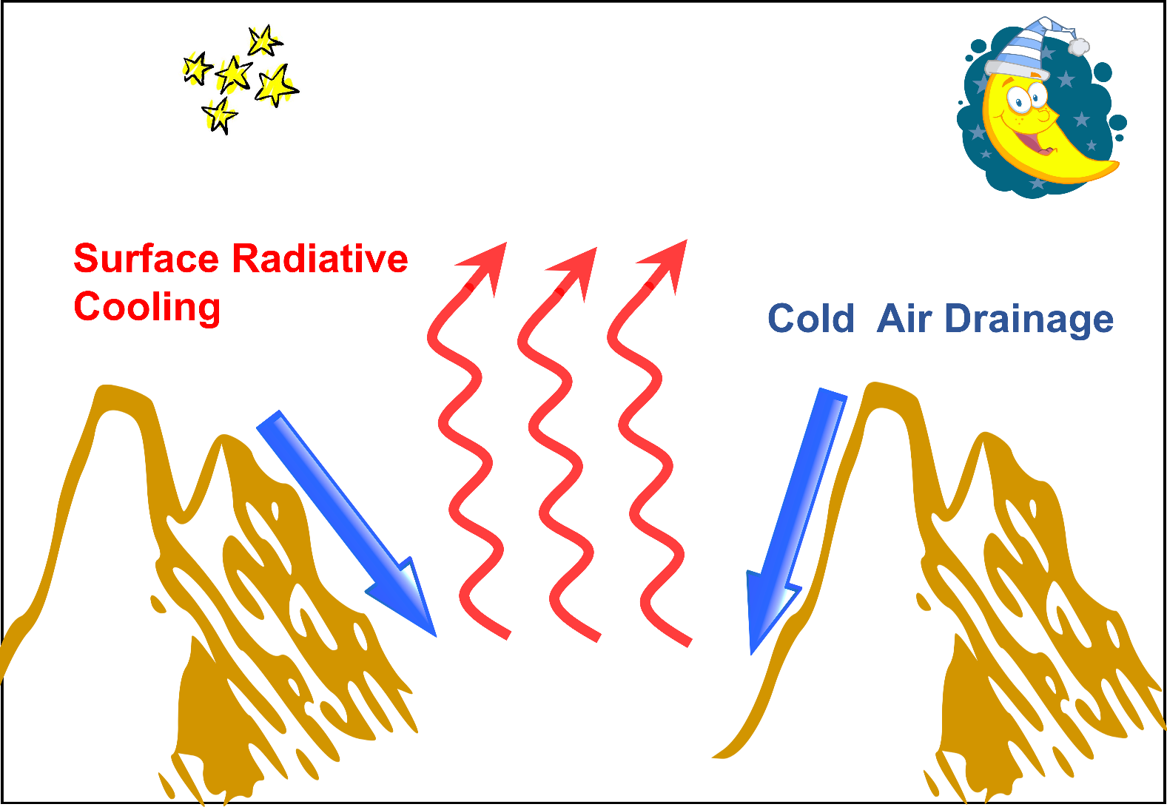
Persistent Cold Air Pools (PCAPs)
Model Challenges
Difficult to replicate the multiday stagnant conditions (Baker et al. 2011)
Complex terrain
Chemistry during PCAPs (Baasandorj et al. 2017)
Topographic depression with cold air
During wintertime in mountain areas
Notes:
Snow at Christmas, less radiation, more chance ; mountain diurnal wind system, cold temperature, less radiation, cloudiness, and high background pm2.5 during pcaps make it different than non-pcaps

Slide 3
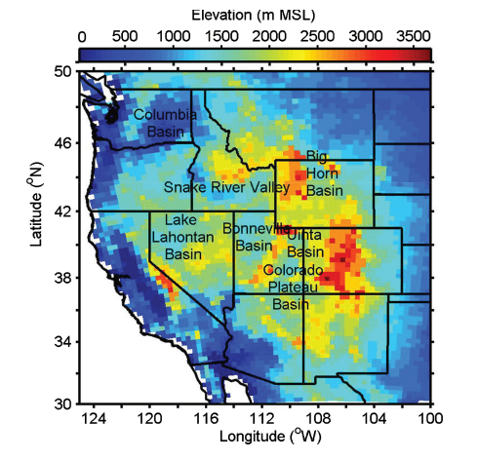
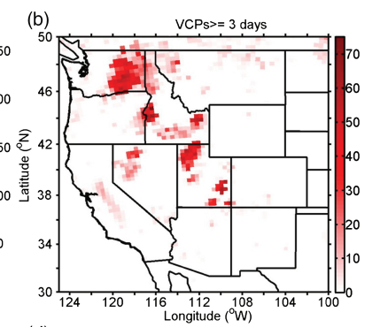
Persistent Cold Air Pools (PCAPs)
Total number of the occurrences of PCAPs ≥3 days during 1979 to 2012
(Yu et al. 2016)
Notes:
NARR, a VCP is identifed if 65% of a temperature profle in the
lowest 1.5 km above ground level (AGL) has a lapse rate of
2.5∘C km−1 or less and the 10-m wind speed is 3.0 m s−1
or less. Our results will be meaningful

Slide 4
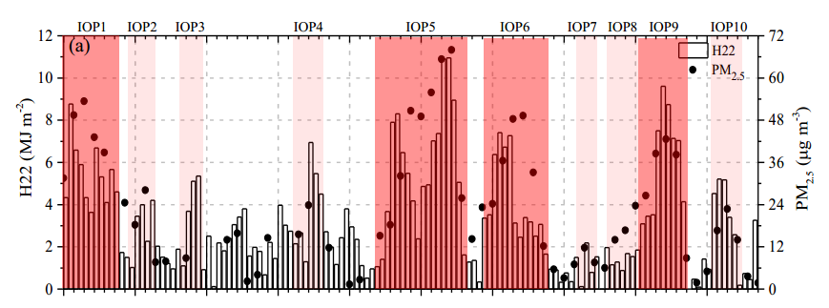

The Persistent Cold Air Pool Study
（Utah, 2010-2011, PI: C. David Whiteman)
Valley heat deficit:
CAPs are accompanied by high PM_{2.5}
(Sun et al. 2018, under review)

Slide 5
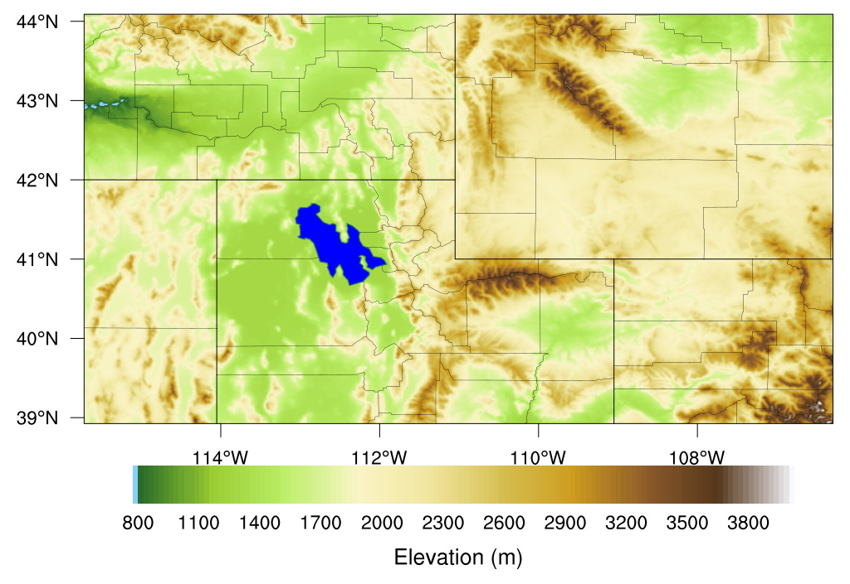
WRF Model Configurations (v 3.7)
d01: 12km, d02: 4km
NAM, 12 km, 6hr reanalysis with 3hr forecasting dataset
NLCD 40-class land use
41 vertical layers
Four Dimensional Data Assimilation
Notes:
First layer around 12 m, acm2 run extra 10 days for the soil nudging scheme

Slide 6
WRF Model Configurations
Microphysics: Thompson scheme
Longwave radiation: RRTM
Shortwave radiation: Dudhia
Convective precipitation: Kain-Fritsch 2
Jan1-Jan31, 2011, 7 days segmental run with spin up time of 1 day
NAM_ACM2, NAM_YSU,NAM_MYJ
Pleim-Xiu LSM ran extra 10 days for its soil nudging scheme
Notes:
First layer around 12 msNo-temperature or moisture nudging in the diagnosed PBL, wind nudging applied at all levels. Temperature and wind nudging strength was 3.0*10⁻⁴ s⁻¹; moisture 1.0*10⁻⁵ s⁻¹.

Slide 7
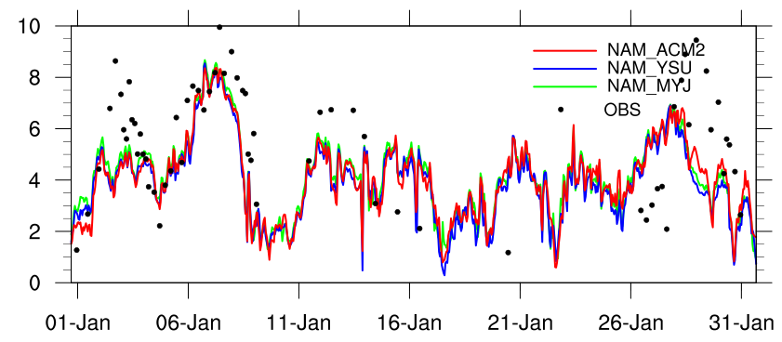
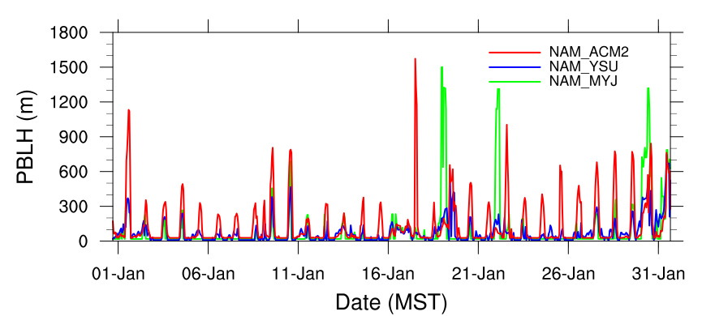
Valley Heat Deficit (H22) and PBLH
Strong PCAPs
H22 (MJ m⁻²)
Underestimated H22
NAM_ACM2 produced the highest PBLH
At the NCAR sounding site (40.60º N, 111.93º E)
Notes:
Ncar site

Slide 8
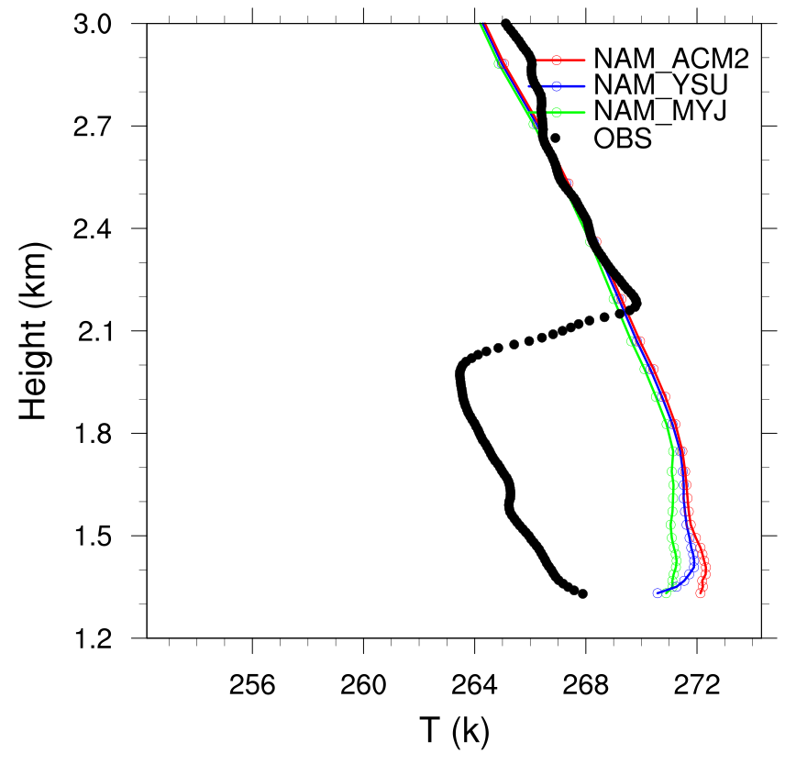
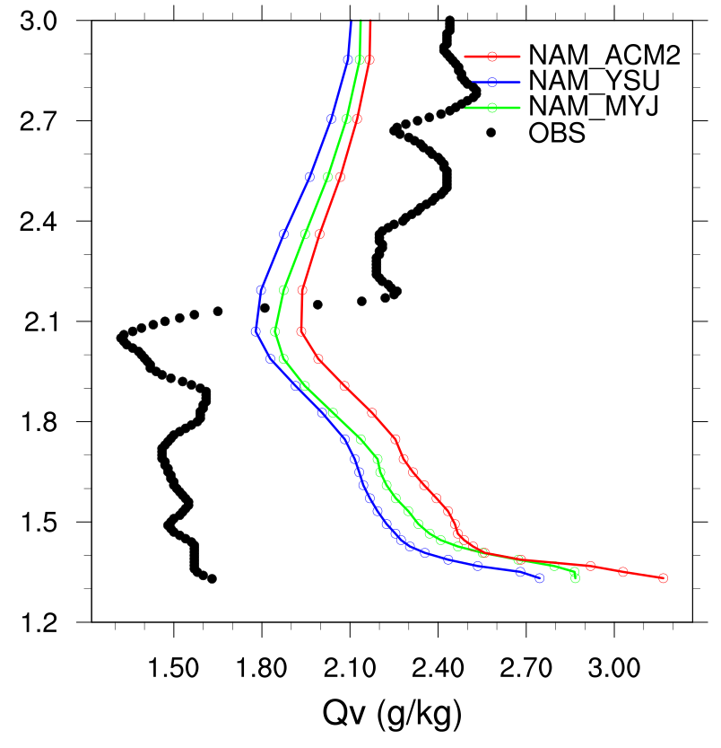
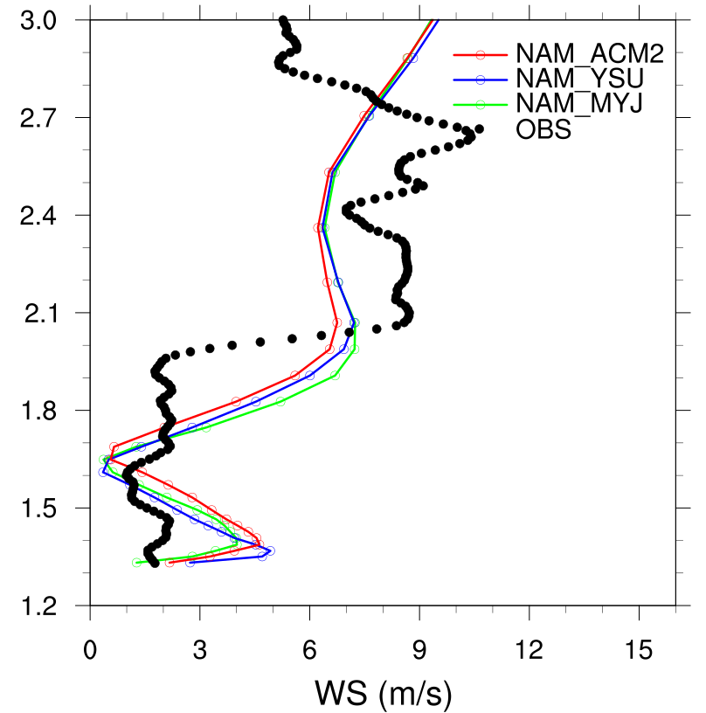
Vertical Profiles (2011/01/02 1700 MST)
For this sounding:
WRF did not capture the inversion at 2km MSL
Overestimated water vapor mixing ratio near the ground
Higher simulated wind in the low levels
Notes:
Higher surface temperature ,Higher latent heat flux,

Slide 9
CMAQ Model Configurations (v 5.2)
Meteorology: WRF v 3.7
Emissions: 2011 National Emission Inventory
Mechanism: cb6r3_ae6_aq
--CB6, revision 3 gas-phase mechanism
--sixth-generation CMAQ aerosol mechanism with
sea salt and speciated PM Other
--aqueous phase chemistry
Notes:
Kirk Baker provided the emissions

Slide 10
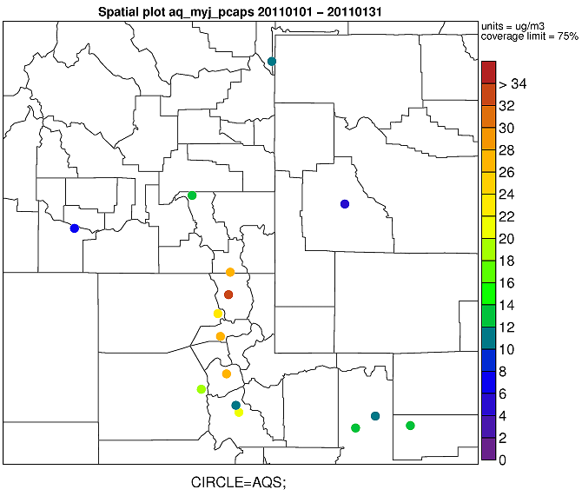
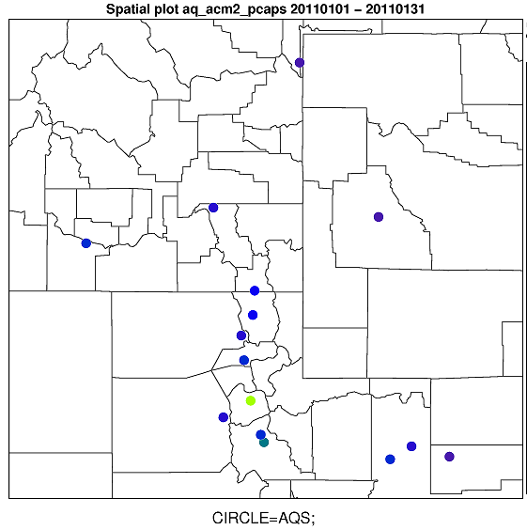
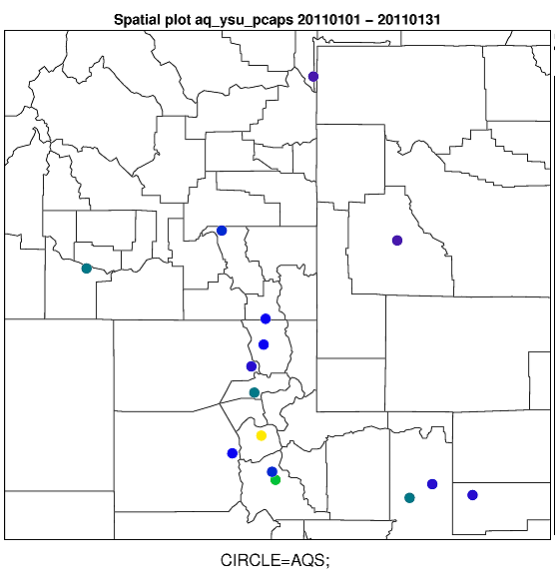
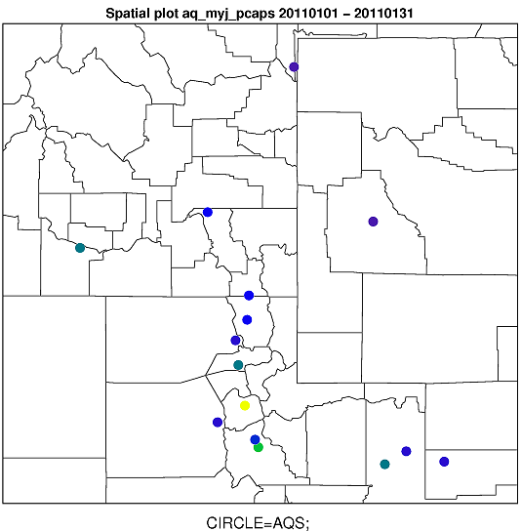
PM_{2.5} Spatial Variation
OBS
NAM_ACM2
units=µg/m³
coverage limit=75%
NAM_YSU
NAM_MYJ

Slide 11
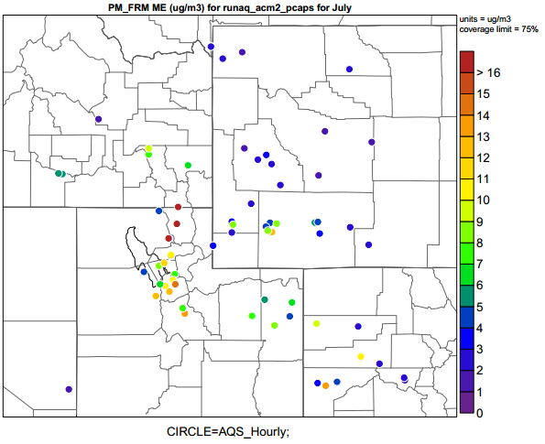
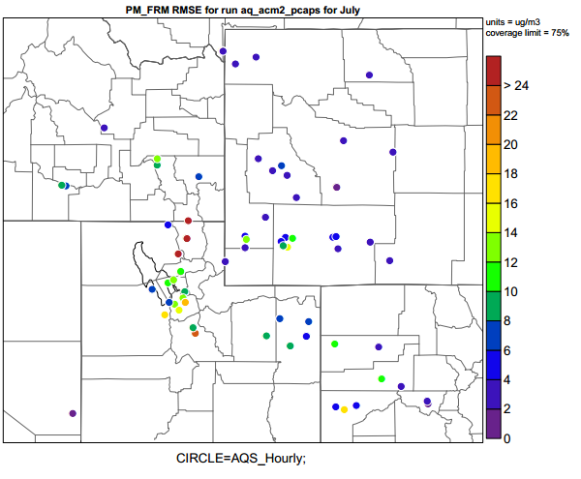
PM_{2.5} Statistics
ME - µg/m³
RMSE - µg/m³
>16
>24
12
18
12
8
6
4
0
0
Higher ME and RMSE in the region impacted by PCAPs (NAM_ACM2)

Slide 12
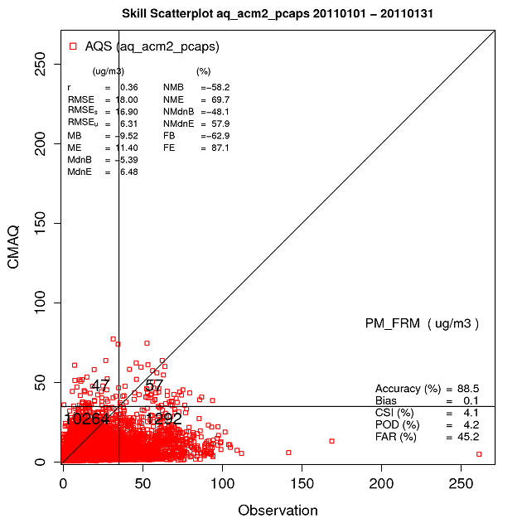
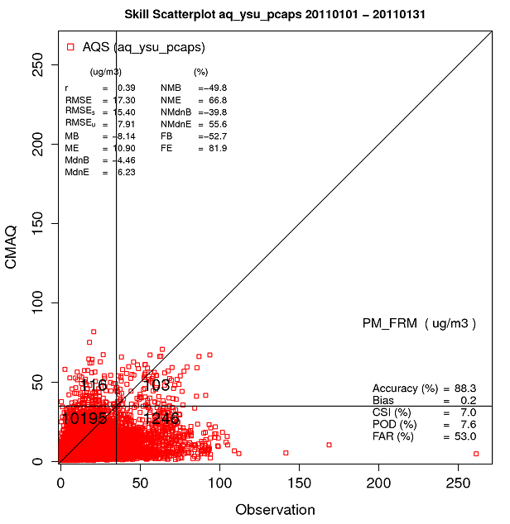


PM_{2.5} Confusion Matrix
NAM_ACM2
NAM_YSU
NAM_MYJ
Accuracy (%) = 88.5
CSI(%) =4.1
POD(%) =4.2
FAR(%) =45.2
Accuracy (%) = 88.3
CSI(%) =7.0
POD(%) =7.6
FAR(%) =53.0
Accuracy (%) = 88.5
CSI(%) =6.2
POD(%) =6.5
FAR(%) =46.7
Critical Success Index
$$Accuracy(\%)=\frac{HitNonExceed+HitExceed}{All}$$
$$CSI(\%)=\frac{HitExceed}{FalseAlarm+MissExceed+HitExceed}$$
Probability of Detection
False Alarm Ratio
$$POD(\%)=\frac{HitExceed}{MissExceed+HitExceed}$$
$$FAR(\%)=\frac{FalseAlarm}{FalseAlarm+HitExceed}$$
Notes:
Bias <- round((false_alarm+hit_exceed)/(miss_exceed+hit_exceed),1)

Slide 13
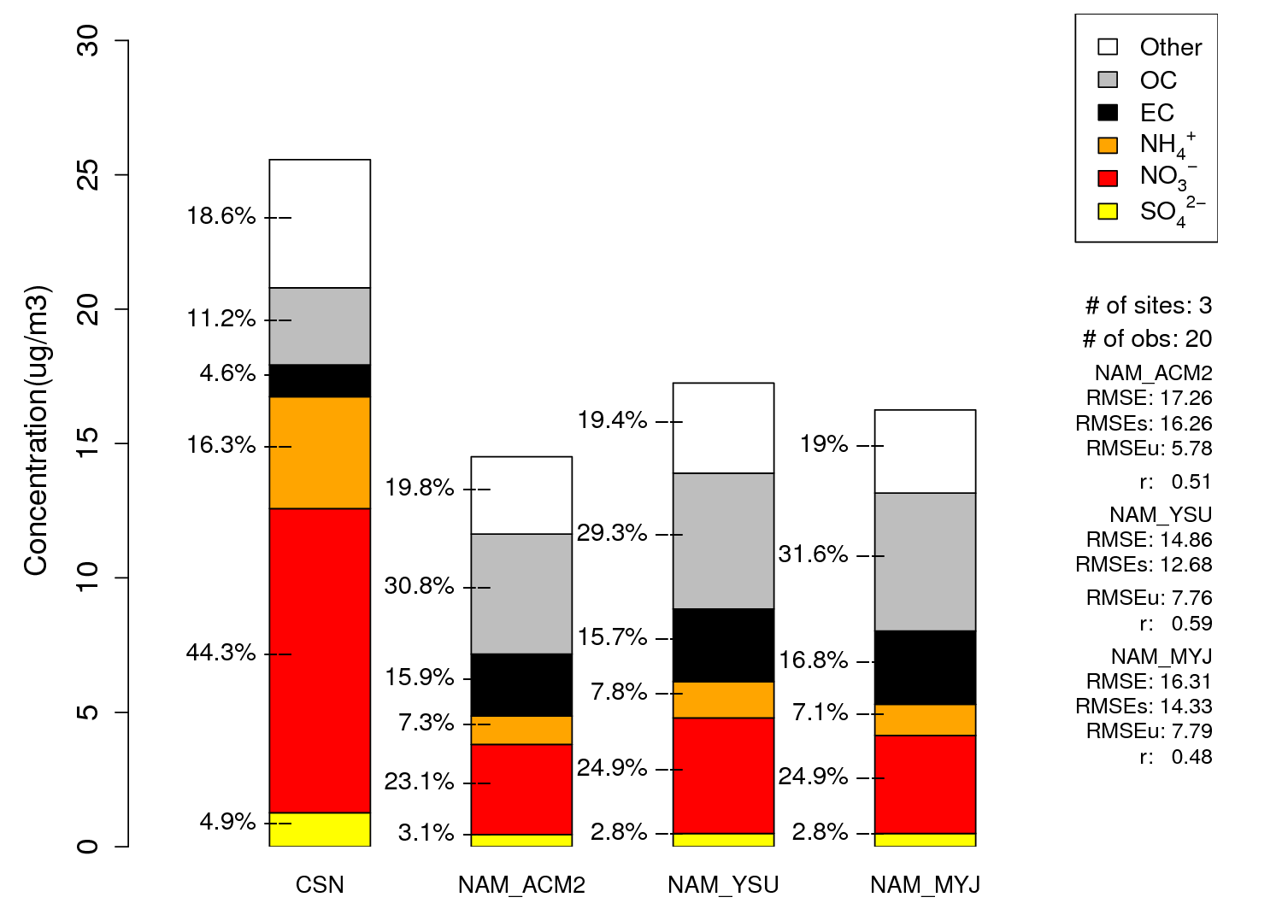
Speciated PM_{2.5} (CSN)
Large underestimation of NH₄ and NO₃⁻
Notes:
Possible chemical mechanisim may not be accurate enought

Slide 14
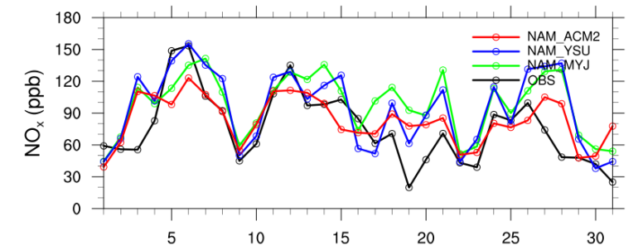
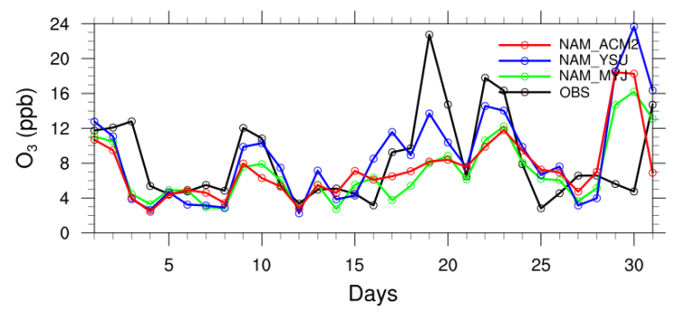
Time series (Hawthorne site)
24-hour averages
Daily variation of NO_{x} was well captured
Lower O₃ during CAP pollution episodes
Notes:
It has the most measurements

Slide 15
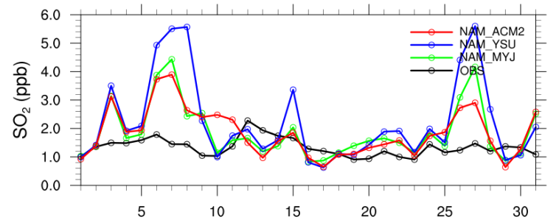
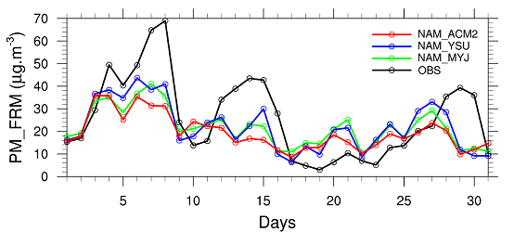
Time series (Hawthorne site)
24-hour averages
Overestimated SO₂
PM_{2.5} daily trend was captured but underestimated the peaks during strong PCAPs

Slide 16
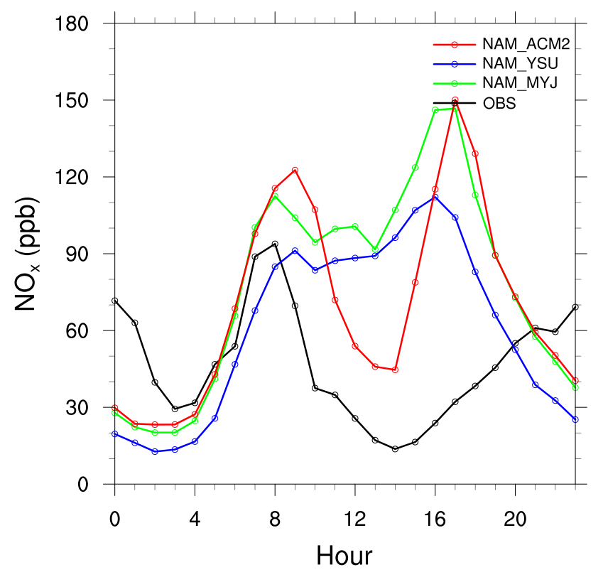
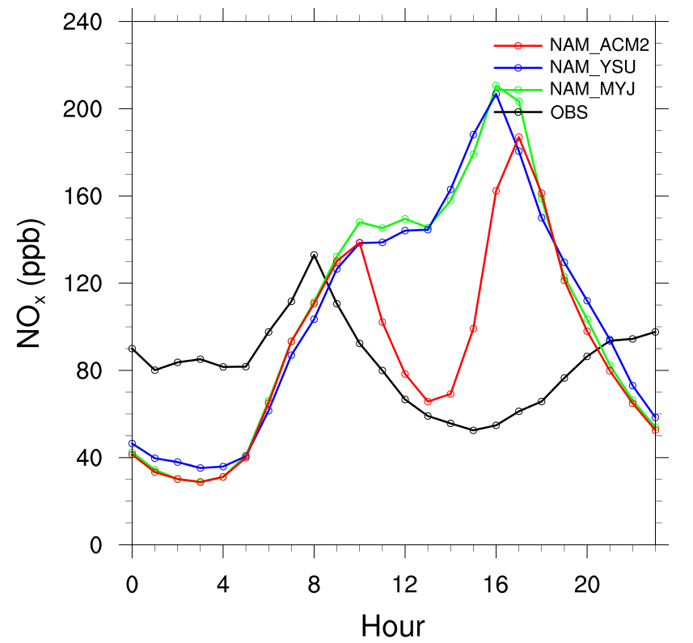
Diurnal Variations-NOx
Non-PCAPs
PCAPs
High NOx observed during nighttime
Peak at 4 pm simulated by model
Notes:
Consistent NOx source or the lack of NOx removal in the residual boundary layer at night); model increase fast for the nox built up in the evening hours

Slide 17
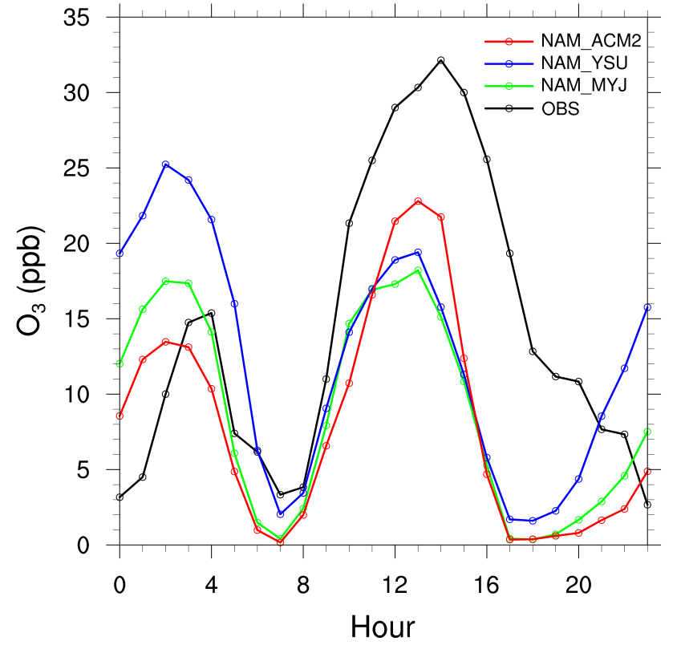
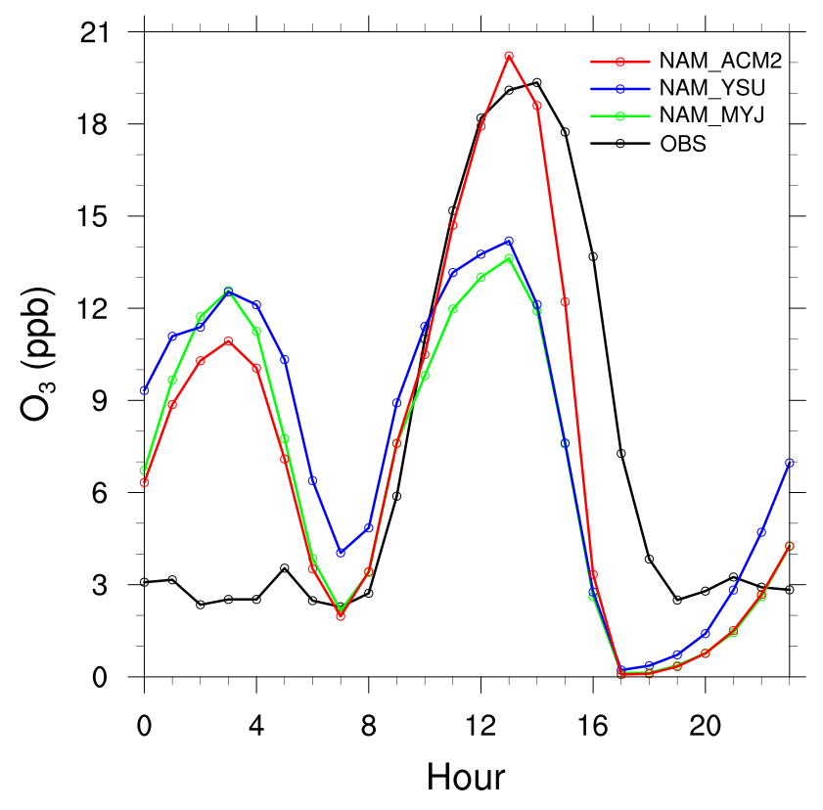
Diurnal Variations-O₃
Non-PCAPs
PCAPs
Ozone diurnal variation during non-PCAPs was well simulated.
Overestimation of nighttime ozone during PCAPs might be due to underestimation of NO_{x} or be chemistry related

Slide 18
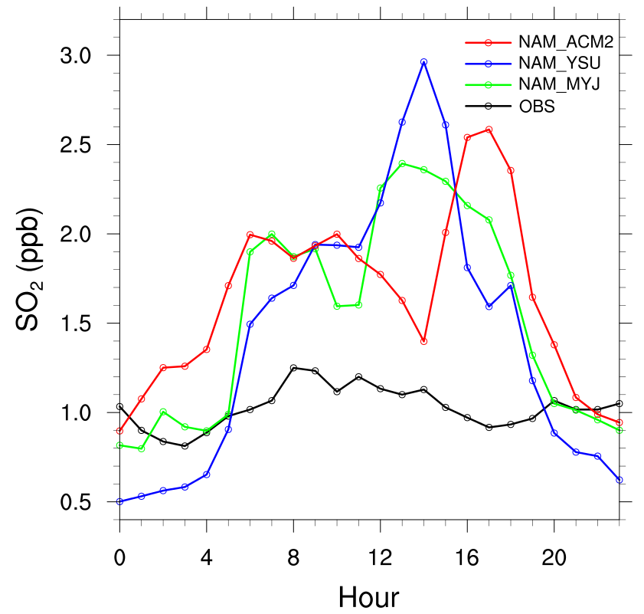
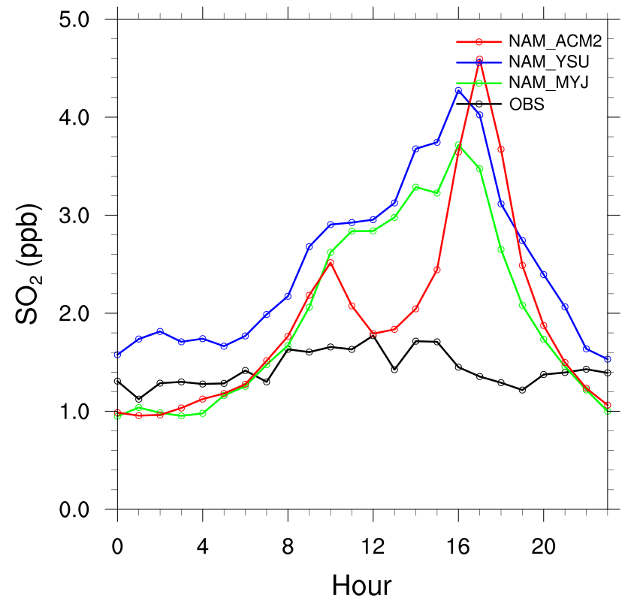
Diurnal Variations-SO₂
Non-PCAPs
PCAPs
Consistent overestimation of SO₂

Slide 19
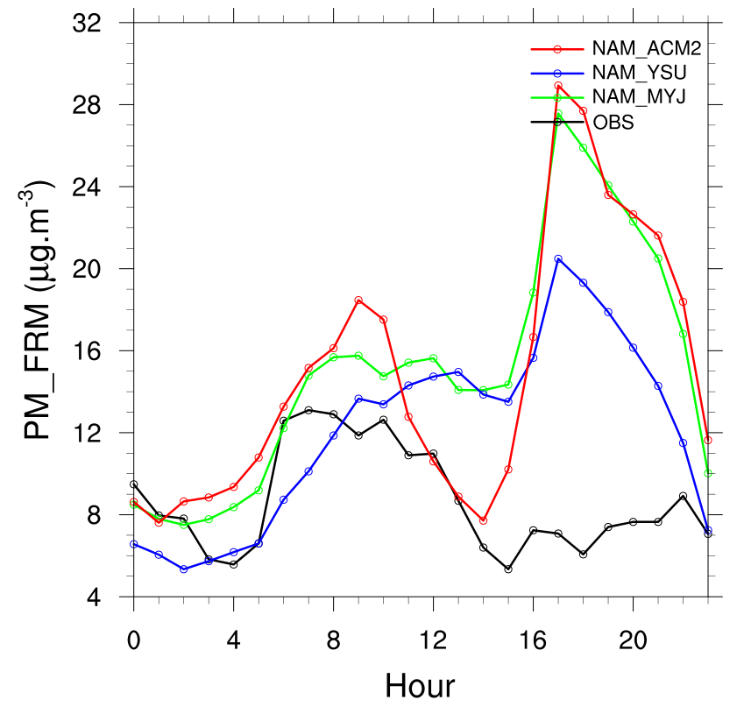
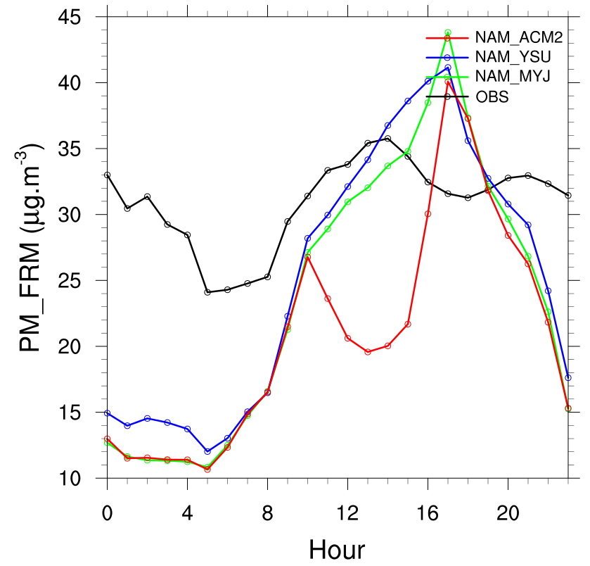
Diurnal Variations-PM_{2.5}
Non-PCAPs
PCAPs
Overestimation of PM_{2.5} in the afternoon during non-PCAPs, associated with EC and OC
Underestimated PM_{2.5} at nighttime during PCAPs, associated with underestimated NO_{x}, chemistry, and meteorology uncertainties

Slide 20
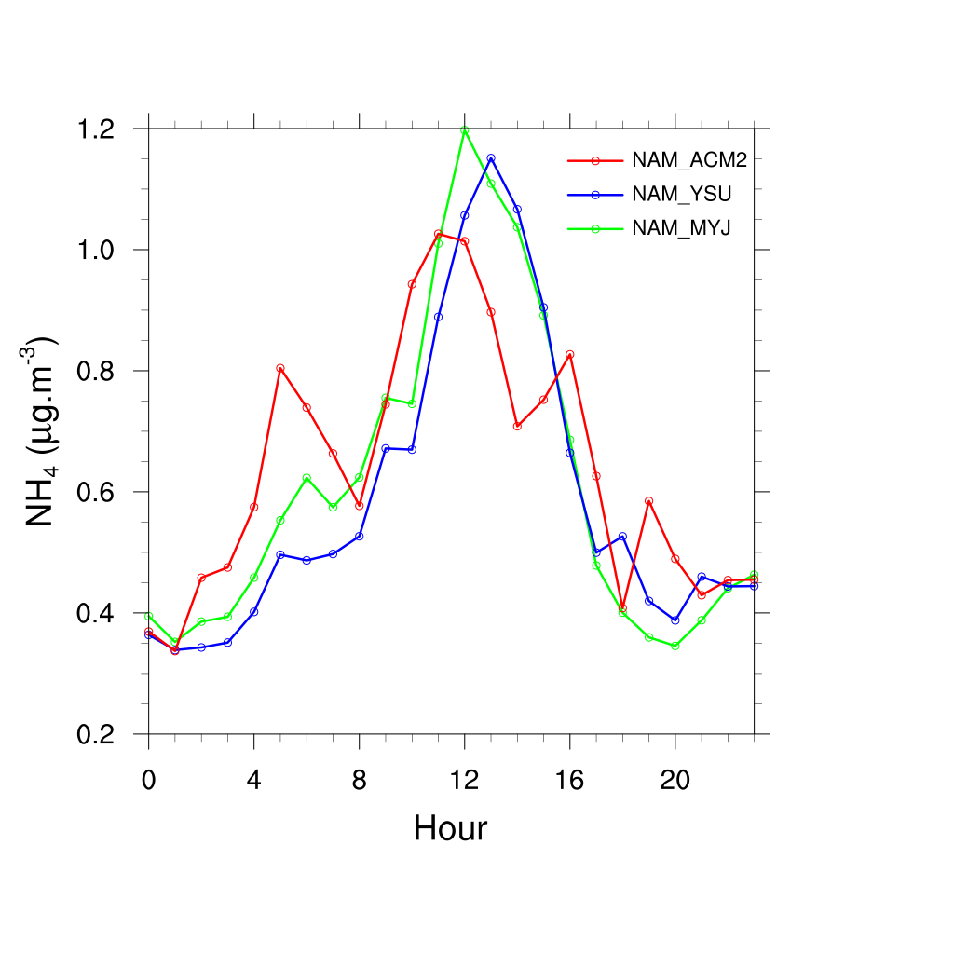
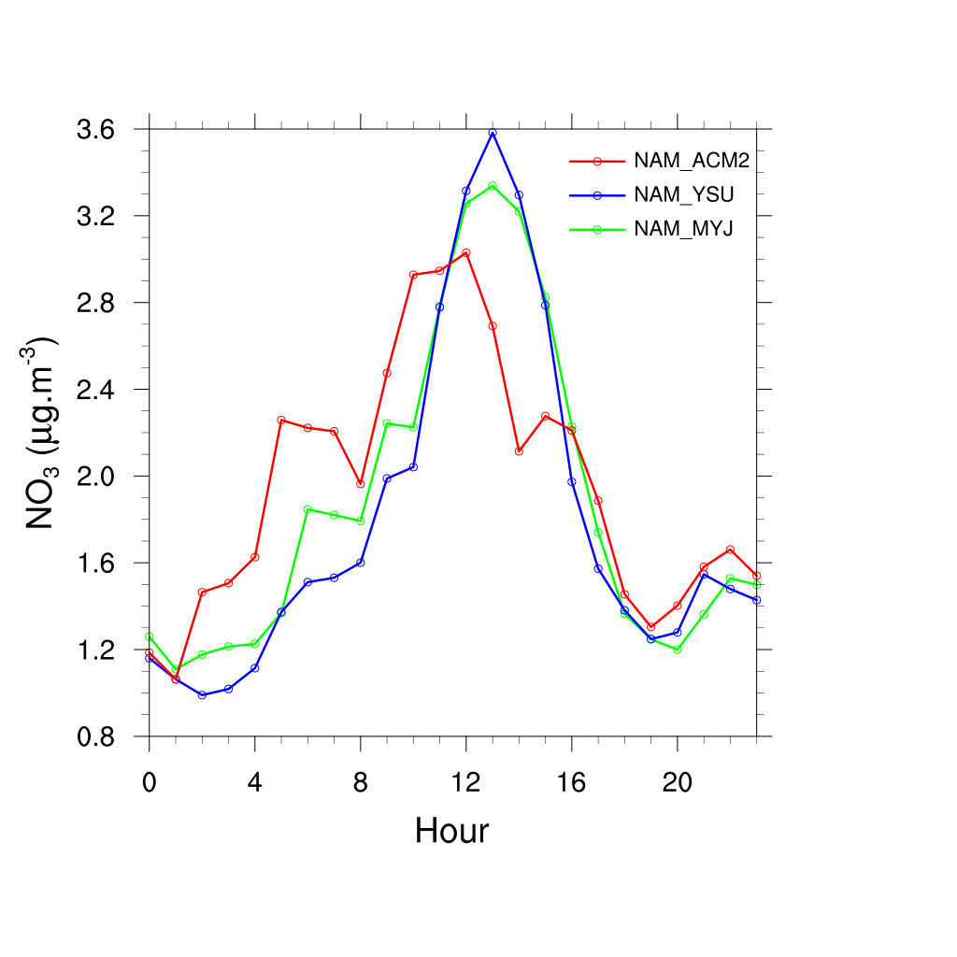
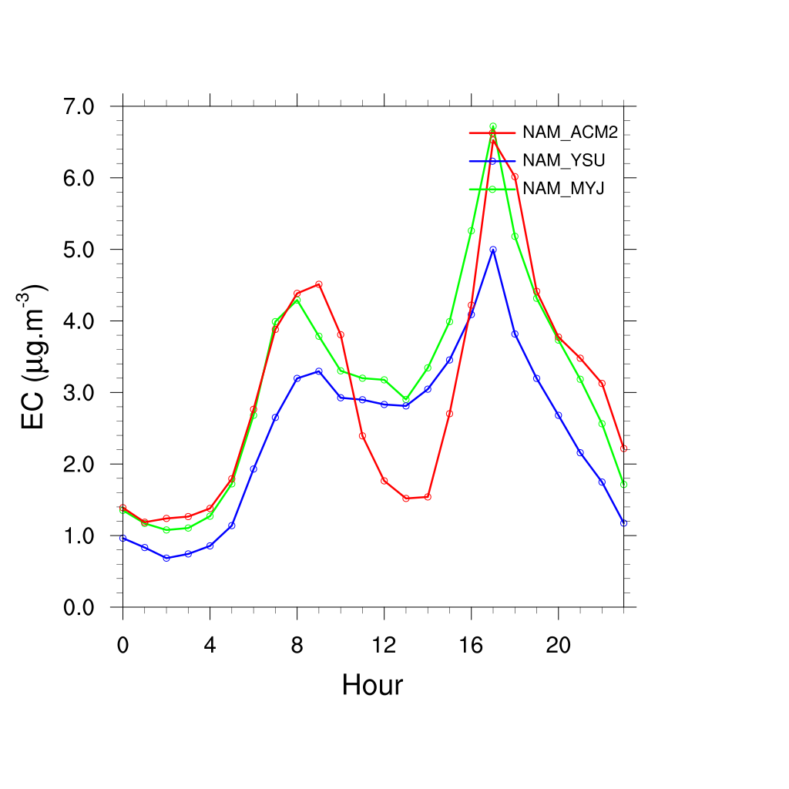
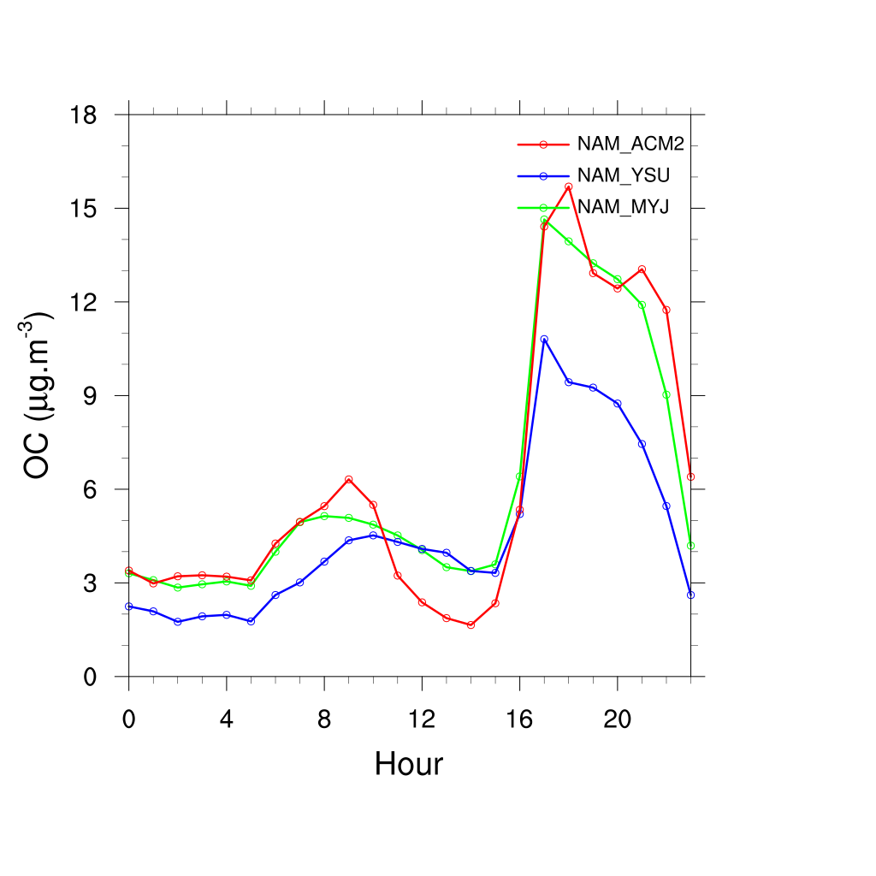
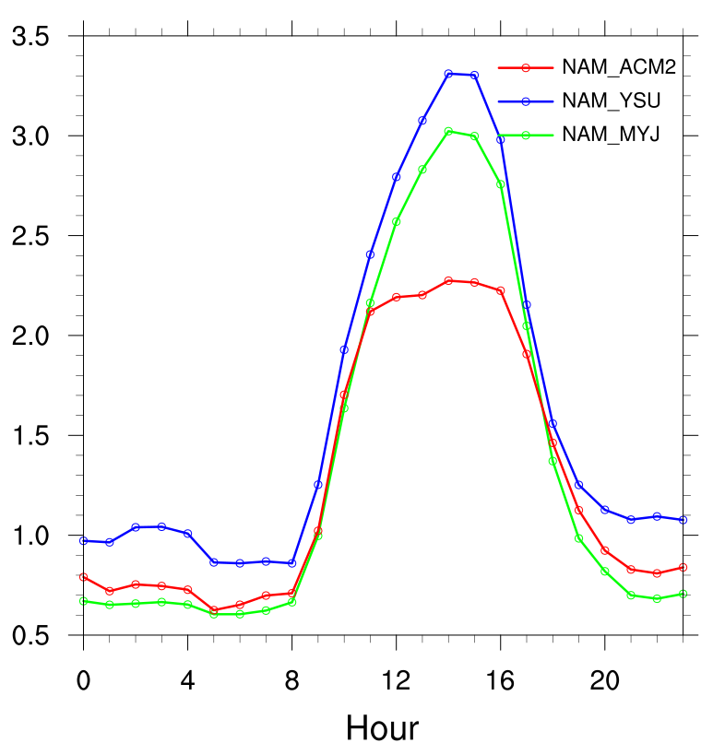
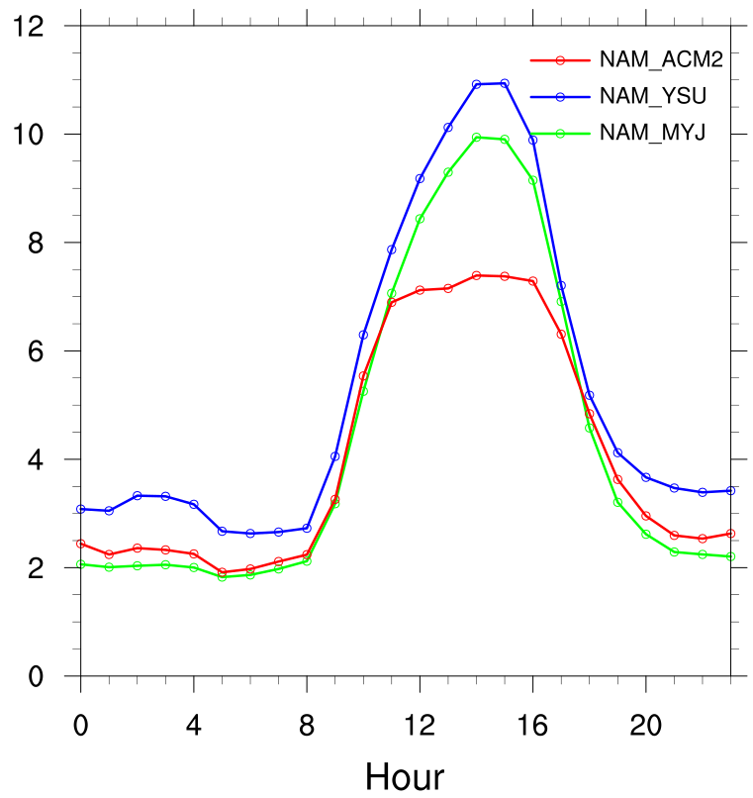
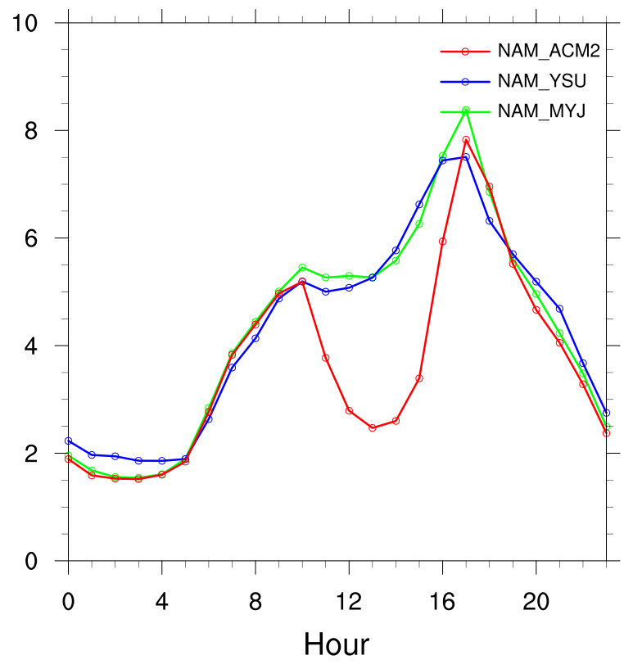
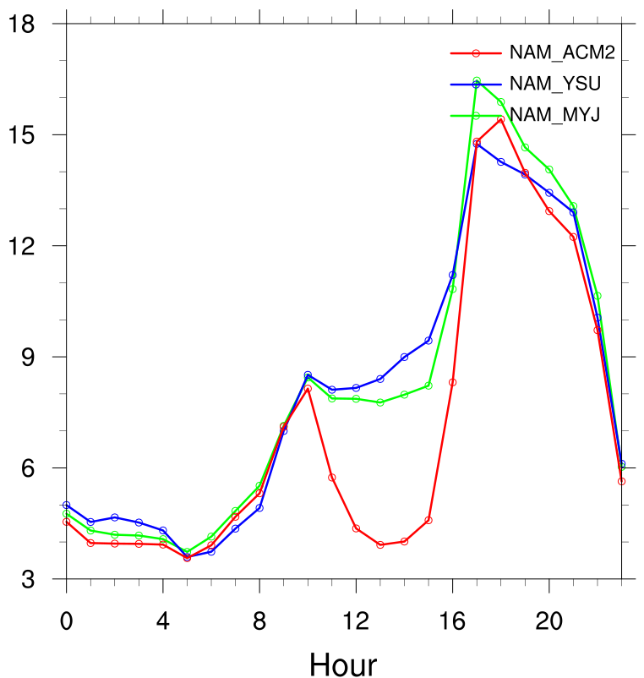
Diurnal Variations-Speciated PM_{2.5}
Non-PCAPs
PCAPs
Notes:
Significant increase from ammonium and nitrate, slightly enhanced EC, oc doesn’t vary too much in pcaps.

Slide 21
Stacked Plots (Hawthorne site)
Non-PCAPs
PCAPs
Notes:
No need to add emissions in this case

Slide 22
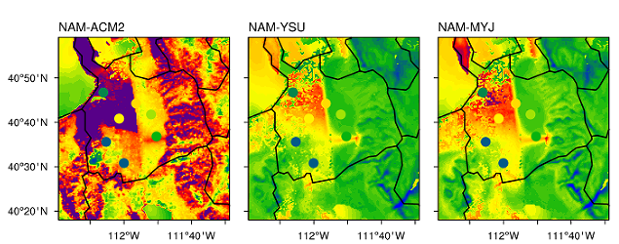

Conclusions
WRF did not capture some of the inversions during PCAPs
CAMQ underestimated PM_{2.5} during PCAPs
NH₄NO₃ was underestimated and OC was overestimated for speciated PM_{2.5}
Simulated and obs avg. daytime surface sensible heat fluxes during Jan1 to Jan 9 2011 in Salt Lake Valley

Slide 23
THANKS!

