Slide 1


Python as a data science platform for air quality studies
Andy Lewin
Scott Hamilton
Nicola Masey
© Ricardo plc 2017
Notes:
Good morning
My name is Andy Lewin, I am from Glasgow in Scotland.
Initially I’d like to thank the conference organisers for inviting me to speak to you all today
(approx 20 secs)

Slide 2

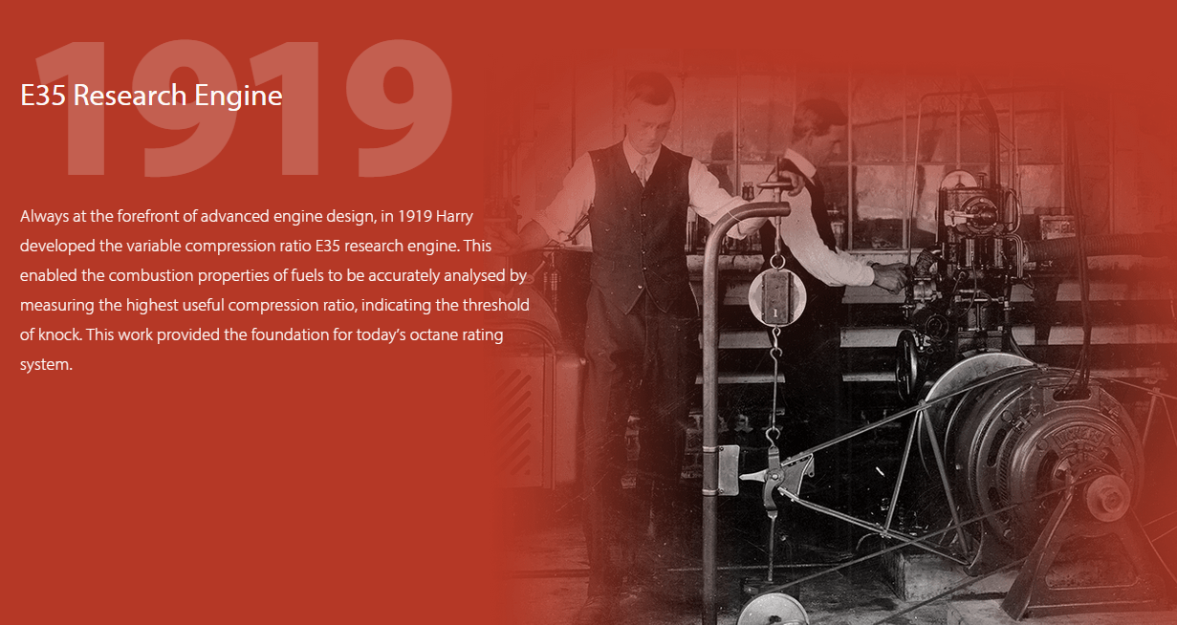


Ricardo- engineers working in AQ since the 1950s
140 air quality experts in measurements, inventories, dispersion modelling and policy support
Notes:
I work for the UK based environmental consultancy Ricardo Energy & Environment in their air quality and environment practice, as an air quality scientist and modeller
We are part of the wider Ricardo group. This slide contains a bit more detail about the groups history.

Slide 3
Topics for this presentation
Introduction
Python as a data science platform for air quality studies
Some advantages of using python for air quality science
Key libraries we use in our work
Examples of practical application
Processing of millions of observation based records
Grouping processes into larger workflows or applications
Bringing it all together into ‘software’
Try to give some insights from our experience in adopting python for our work
Notes:
To introduce what I will be presenting:
Initially I will provide some introductory information about using Python for air quality modelling studies , including some advantages and the key python libraries used.
I’ll then talk through some examples of what we have used python for over the last couple of years to enhance what we can do as air quality modellers

Slide 4




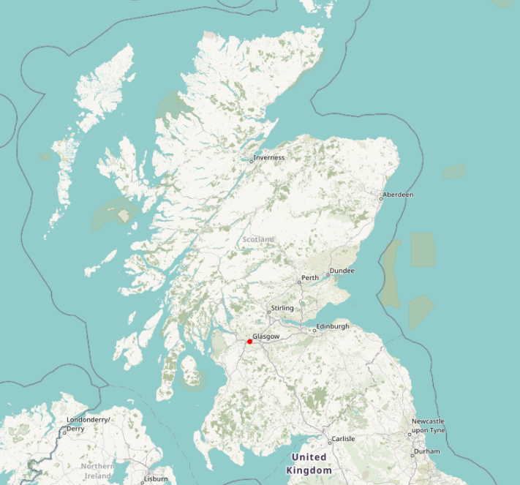

Ricardo Energy & Environment
Scottish Team Python Users:
Scott Hamilton
Nicola Masey
Andy Lewin
Notes:
A quick slide to introduce my colleagues Scott and Nicola, also both based in Glasgow, Scotland.
Scott presented here at CMAS last year showcasing our RapidAir model which has been developed using python.
Scott and Nicola are the main developers of RapidAir which is the most complex example of python use I will cover later.
I would describe myself more as an air quality modeller who knows a little bit about applying Python to modelling

Slide 5






Introduction
Challenges
Data is in abundance, but there are barriers to unlocking its latent potential
Huge volumes of data present a data management challenge to air quality practitioners e.g.
  Emission source activity observations
  Air quality observations
  Meteorological measurements
This can make it difficult to extract insights with which to aid decision makers
With such volumes of data how will we ever use it to extract knowledge?
Solution
Python's many numerical and statistical libraries (other languages are available!)
Some neat programming backed up by domain knowledge
Simple but powerful solutions can be written in a few lines of code
Getting what you want from data, and only what you want
Notes:
Old saying amongst modellers – rubbish in – rubbish out – we are now able to process and work with more actual observations, providing more confidence in our model inputs – and hopefully outputs.
The challenge is being able to work with the amount of data that is available to us and then extract useful things from that data. We also often need to locate observations in time and space - so geo-processing can be a requirement
Various Python libraries offer us a solution to these challenges, whereby relatively simple coding can be learned & applied by AQ modellers such as myself
Meaning our experience can be applied to finding solutions. i.e. we as topic experts can learn to code rather than coders trying to learn how to be air quality scientists.
Image represent different data types, where we are only interested in a few bits of each, the cogs are the code getting us to the bullseye result.

Slide 6

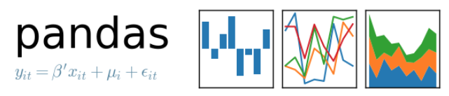




Python’s big hitters for air quality science
The fundamental libraries for us (and how we use them) are:
Numpy- creating and manipulating arrays, e.g. emission grids, billions of data points can be processed, VERY fast
Pandas- built on top of Numpy- reading and processing 2D data tables, e.g. traffic activity observation processing; also used in combination with Dask for much larger datasets
SciPy – huge collection of scientific modules- we use the image processing library to process emission grids
GDAL – every geospatial function you could ever want, we use it for processing spatial data in dispersion models
Honourable mentions go to:
Anaconda- excellent python distribution/package manager
Jupyter- the ‘Notebook’ is becoming the benchmark for prototyping and sharing scientific code
Matplotlib- fundamental plotting library
Notes:
This slide provides a summary of the main open source python libraries and tools we have used recently, Mainly Numpy, Pandas & SciPy for number crunching, along with GDAL for the geo-processing aspects.
All of these powerful tools are available to anyone free of charge which is fantastic, and the capacity to innovate using them is unlimited.
We commonly use Jupyter Notebooks to share code and collaborate. Its currently our go to tool for data processing using Python, as reproducibility is very easy to achieve.

Slide 7
Advantages of programmatic data processing (Python particularly)
Readability- python is very easy to read, so QA is easy
Flexibility- the language has thousands of libraries tuned to all manner of data manipulation problems
Reproducibility- complex data manipulation routines can be checked and recreated by third parties
Reusability- a coded solution should be a reusable solution. Intellectual capital can be built up over time and reused
Efficiency- compared to other languages, python offers a rapid development cycle. The ‘time to solution’ is minimised
Transform data
Read data
Create insights
Notes:
Using these tools has many advantages
Including:
Readability – the code tends to be easy to read
It provides reproducible results – which is important to us as scientists;
and can be re-used for similar projects multiple times

Slide 8
Examples
We now provide some examples, both of which are fairly simple then some information about development of our own modelling software using python
Large traffic activity dataset handling – to provide inputs for city scale modelling of road traffic emissions – Clean Air Zone studies
  Handling of several million traffic data observations for emissions inventory compilation
    GPS journey time/speed observations
    ANPR data analysis to characterise vehicle age variation in the fleet
    Tracer study - GPS observations from Scottish local authorities’ vehicle fleet telemetry data – (included in ancillary slides)
Creating integrated air quality tools and models
  Setting up and controlling dispersion models such as AERMOD
  Developing a complete road traffic emissions model from python functions (the RapidEMS system)
  Building a complete urban modelling platform - (the RapidAIR sytem (which we presented at CMAS 2017)
Input data
Process
Outputs
Notes:
I’ll now move on to describe some practical examples.
To provide some context first – all of these solutions relate to city scale modelling, primarily of road traffic emissions.
Why are we modelling at the city scale? As one example - Currently in the UK many cities are investigating the implementation of Clean Air Zones. This requires city scale AQ modelling at what we would describe as reasonably resolved or local scale resolution e.g. 1m.
The first examples I describe cover very simple but also very powerful data analysis using python to create inputs for dispersion modelling. Whereby we have processed large traffic observation datasets to provide data that can be used in our emission calculations.
I’ll then move on to provide a summary description of a more complex application where my colleagues have developed our own modelling software using Python – the RapidAir system
My colleague Scott presented more detail on RapidAir last year, so I will provide a quick summary of what it can do and the main python libraries used for each aspect of the model. More information is available in last years extended abstract and other published papers on RapidAir

Slide 9
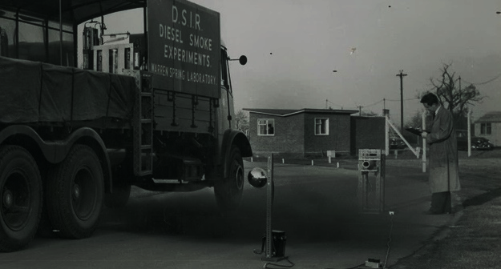
Processing traffic observations for city scale modelling
Notes:
Moving on to my first examples
Actually planning to present 2 examples here, with much more detail presented in the first example and a brief summary for the 2nd example.
In essence, both relate to processing large traffic observation datasets to provide emission data for road traffic dispersion modelling studies

Slide 10


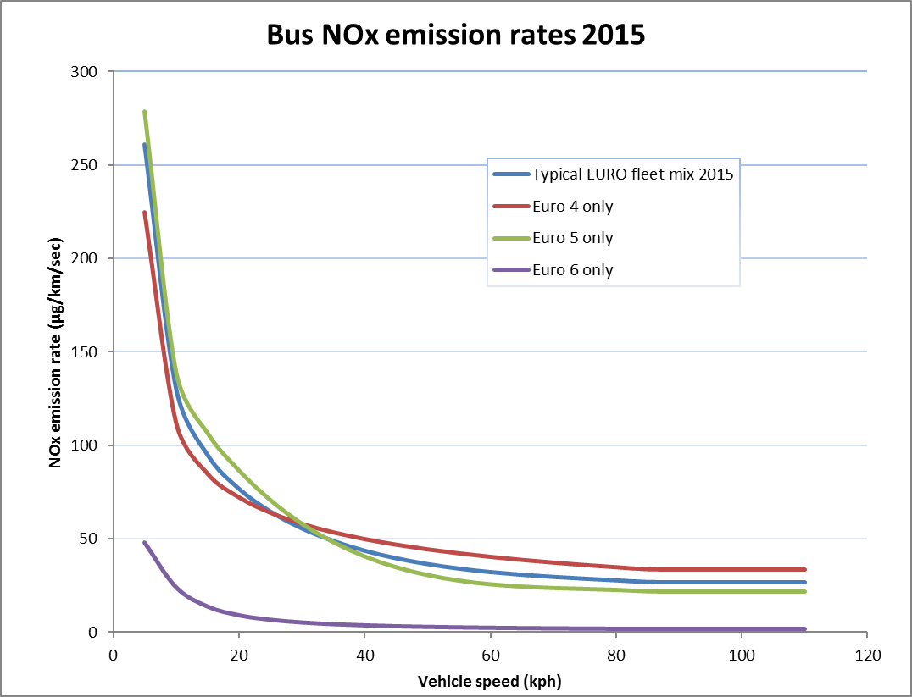
Processing traffic observations for city scale modelling
Example 1: Processing millions of journey time/speed observations from GPS/Sat Nav devices in vehicles
Reason – To provide a robust dataset of observed link specific average speed for use in vehicle emission calculations
  In UK we use average speed based vehicle emission factors (COPERT5) Typically modelling studies have used either assumed speeds, spot measurements at a traffic count point, or traffic model outputs – good to have access to actual link specific observations over the road network.
In UK we can use the TrafficMaster dataset from Teletrac:
  millions of individual journey time observations - in 15 minute segments
  for road links of known length (allowing speed to be calculated)
  broken down into 15 minute segments throughout the day
  Each individual journey time record is identified by a corresponding numerical code which links it to a unique road link id in our GIS dataset of road links).
  Very useful data when estimating average road traffic emission rates
Input data
Notes:
Our first example relates to processing a large number of observed journey time observations from GPS sat Nav devices.
Why do we want to do this ? To calculate average speeds which can be used in conjunction with the average speed based vehicle emission factors. In the UK we currently use the COPERT5 database.
Typically modelling studies have used either assumed speeds, spot measurements of speed at a traffic count point, or traffic model outputs – we can now use averages of actual link specific observations over the road network measured using GPS devices – which represents more robust input data.
The dataset is called Trafficmaster; and is provided by Teletrac, one of the largest fleet management solution providers in the UK and USA. The data is purchased by the UK Department for Transport and is made available to local government, meaning we can use it for AQ studies.
At the city scale, an annual dataset typically contains hundreds of millions of individual journey time observations for road links of known length, broken down into 15 minute segments throughout the day.
It is made up of observations from a mixture of vehicle types it therefore provides a very useful dataset when calculating average speeds for modelling road traffic emissions.

Slide 11
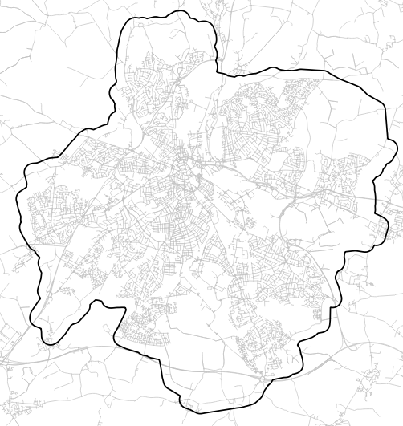
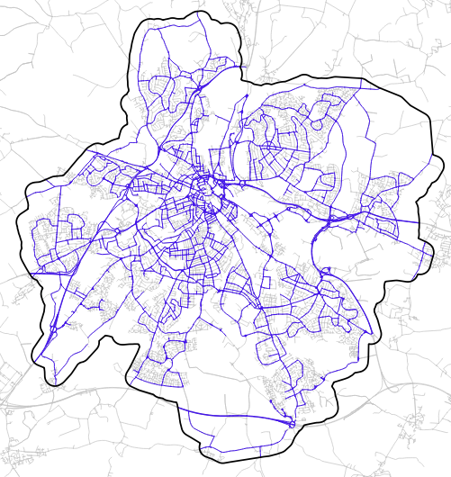
Processing traffic observations for city scale modelling
Example 1 cont: Processing millions of journey time/speed observations from GPS/Sat Nav devices
We don’t model every road link with available observations.
Our model has approximately. 4800 road links
Each road link has a unique_ID in our GIS dataset of road links
Input data
Notes:
Each individual journey time record is identified by a corresponding numerical code which links it to a unique road link id in our national GIS dataset of road links – this is how we can cross reference the journey time data with the spatial data – following processing.
To provide an example – the polygon here represents our citywide model domain – the grey road network GIS dataset represents all of the links for which traffic master data is available – and the blue polylines are the main roads we are modelling, in this case app 4800 road links
We therefore need to subset the millions of observations relevant to our 4800 links and then do some further calculations,

Slide 12
Processing traffic observations for city scale modelling – Example 1
Load input data
Subset
Convert to speed
Other useful statistics
Calculate averages
Notes:
Here is the process flow

Slide 13
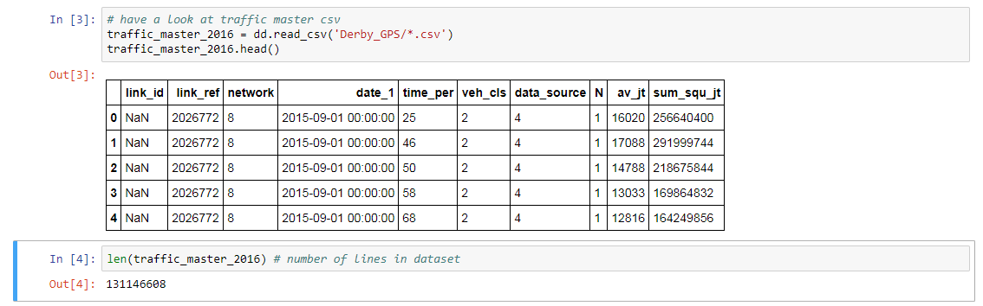
Processing traffic observations for city scale modelling
Example 1 cont: Processing millions of journey time/speed observations from GPS/Sat Nav devices
Number of Traffic Master observations across the whole city in an annual dataset can range up to 100s of millions e.g.
Load input data
Subset
Convert to speed
Other useful statistics
Calculate averages
Notes:
Firstly we load our input data, code snippets here are screen clips from a jupyter notebook,
In this case we have 131 million observations - Can’t deal with this volume of data using excel
Could be done another way e.g. databases such as SQL or other data science tools e.g. R
Next step is to subset this

Slide 14

Processing traffic observations for city scale modelling
Example 1 cont: Processing millions of journey time/speed observations from GPS/Sat Nav devices
We now need to:
  sub-set this data to extract the observations for the road links we are interested in
  Reducing our working dataset to ~ 46 million rows
  Then convert average journey times to speed (kph)
Load input data
Subset
Convert to speed
Other useful statistics
Calculate averages
Notes:
Need to subset this to observations for the links we are interested in – can be done fairly quickly using the ‘merge’ command in the Pandas python library
Reduces our number of observations to 46 million
we can then do some simple maths to use the link length to convert average journey time into average speeds in kph

Slide 15

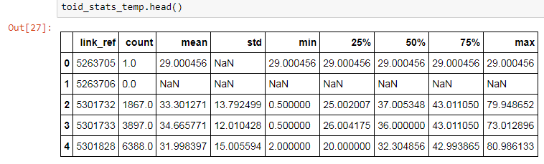
Processing traffic observations for city scale modelling
Example 1 cont: Processing millions of journey time/speed observations from GPS/Sat Nav devices
Now calculate average speed and other summary statistics
Load input data
Subset
Convert to speed
Other useful statistics
Calculate averages
Notes:
We can then go on to use the ‘groupby’ command to calculate the ‘average’ speed for each of our 4800 links
And also use the pandas ‘describe’ command to produce other useful statistics e.g. count, std dev, percentiles,
Example here count column shows first link ref only had one observation

Slide 16
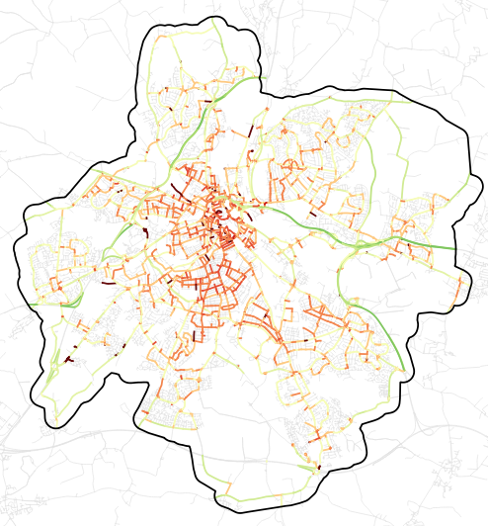
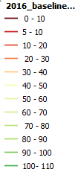
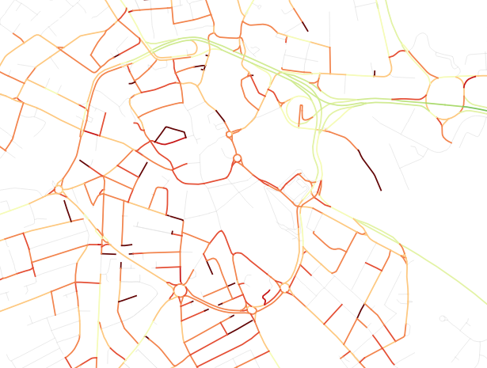
Processing traffic observations for city scale modelling
Example 1 : Processing millions of journey time/speed observations from GPS/Sat Nav devices
We have reduced 131 million traffic observations into 4800 link specific average speeds for use in our emission calculations
Average observed vehicle speeds (kph)
Notes:
when we join the averaged speeds back to our GIS shapefile, in this example the averaged speeds are represented as graduated colours.
So using 5 or 6 lines of python code we have reduced 131 million traffic observations into 4800 link specific average speeds for use in our emission calculations.
Reasonable impressive!

Slide 17
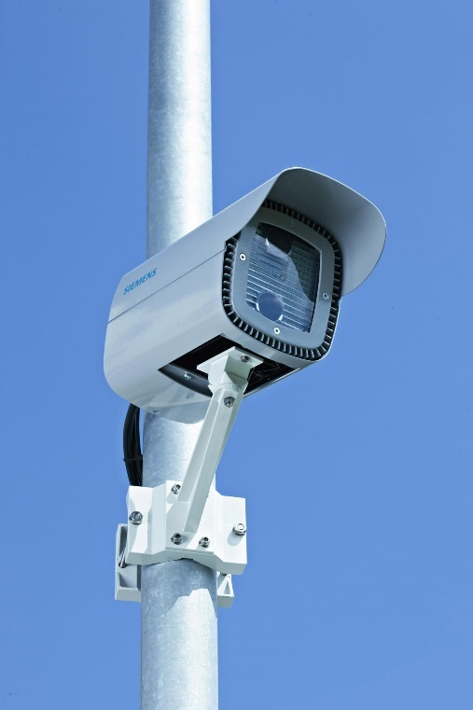
Processing traffic observations for city scale modelling
Example 1b: Processing millions of ANPR camera observations to determine vehicle fleet age variation
Reason - Automatic number plate recognition cameras used to capture detailed information about the typical vehicle fleet on main routes in city
We are modelling to test the impact of Clean Air Zone (CAZ) policy measures e.g. charging scheme for Buses and HGV’s older than Euro 6 classification/emission standard.
We need to understand the current and future baseline makeup of the vehicle fleet so we can apply the correct proportion of emission rates for each Euro class (as per COPERT5 dataset)
In this case – 38 ANPR cameras across city – 1 week survey
Approximately 3.5 million observations
Notes:
The next quick example also relates to distilling large datasets down in to something we can use for city scale modelling.
As the methods are pretty much the same as used in the previous example, I won’t provide any code snippets here, I will just briefly describe what has been done and why.
In this case we are processing millions of ANPR camera observation to understand the typical age of different vehicle types passing along main routes in the city. This is required to test the impact of Clean Air Zone policy measures e.g. one of which could be charging scheme for Buses and HGV’s that don’t meet the Euro 6 emission standard.
We need to understand the current and future baseline makeup of the different vehicle types within the observed fleet so we can apply the correct emission rates from COPERT5
.

Slide 18
Processing traffic observations for city scale modelling – Example 1b
Load input data
Create various very useful subsets specific to our needs using Pandas ‘groupby’ command
Approximately 3.5 millions observations from 38 ANPR cameras
Also clean data to remove useless observations
Subset into various e.g.
Air Quality modelling
Zone specific e.g. city wide, city centre, port area
  Vehicle type
    Propulsion type - diesel/petrol/electric/hybrid
      Euro class/vehicle age
    Data for our economists e.g.
  Unique vehicles in zone per day (bus, HGV, taxi)
  Number of days spent in zone by unique vehicles that may be affected by the charging scheme.
Typically we wouldn’t get this freedom of analysis from an ANPR survey output from the survey contractor provided in xlsx format – hence Pandas is very useful
Notes:
In this example we have approximately 3.5 million observations from 38 ANPR camera sites
Once the data is loaded, we can use the methods described in the previous example showed you to subset the data into various useful groupings.
E.g. for the AQ modelling aspect – we need to quantify the fleet split in terms of vehicle type, vehicle propulsion type and Euro class/vehicle age
We can also provide bespoke groupings for our economists for their calculations
Typically we wouldn’t get this freedom of analysis from an ANPR survey output from the traffic survey contractor provided in xlsx format – hence Pandas is very useful

Slide 19
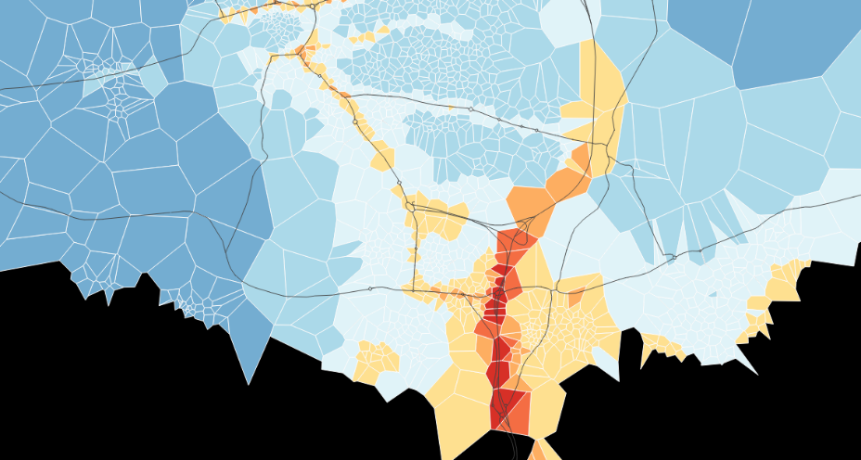
Building a modular air quality modelling platform- RapidAIR™
Notes:
Moving on to an example of a more complex application of python coding
The RapidAir modelling platform, which comprises of various more simple modular processes

Slide 20
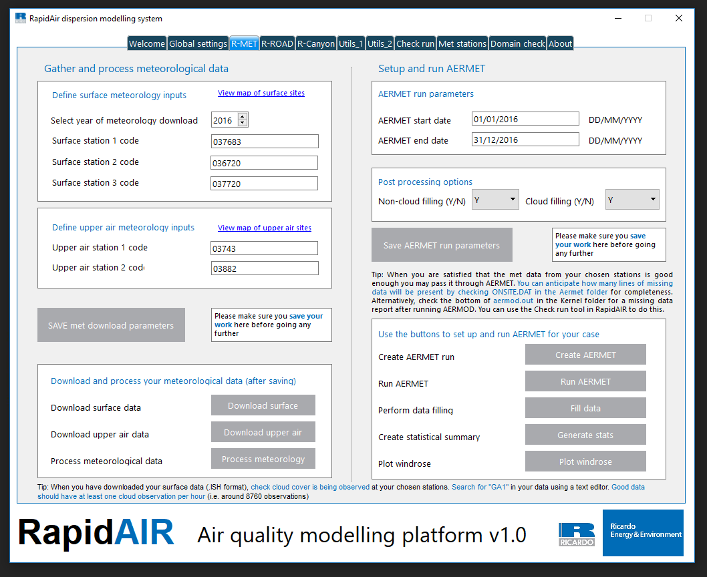
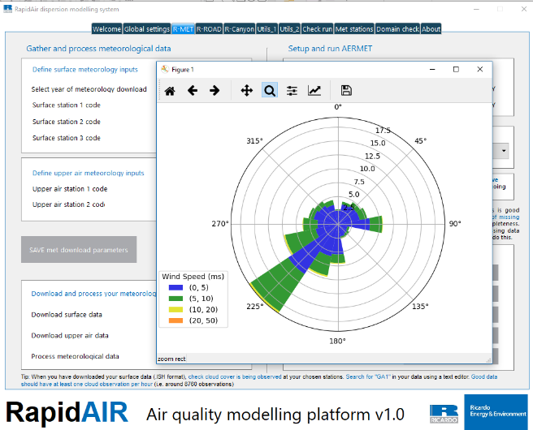
What is RapidAir®?
Dispersion modelling suite for (mainly) road traffic sources. We wrote it in python 2.7, using an open source stack including numpy, gdal and scipy.
which automates much of the workflow for dispersion modelling for road t
Traffic emissions model- COPERT 5 written in pandas
Road dispersion model (based on AERMOD)
Street canyon model (based on AEOLIUS/OSPM)
Area source model (based on AERMOD)
Practically unlimited domain size and resolution
Met data- sourcing, processing and AERMET modelling
Lots of utilities (data viewers, simple GIS tools etc)
GUI written in QT5GUI)
Run time 5 hrs Vs 0.5 seconds
Notes:
In essence RapidAir is a dispersion modelling suite used for (mainly) road traffic sources.
Traffic emissions model built in (1 million links in 1 minute, covers NOx, fNO2, NH3, CO2, PM10, PM2.5, gradients, builds an inventory, source apportionment…)
Road dispersion model (1m resolution possible)
Street canyon model
Area source model e.g. for large dispersed sources (e.g. domestic, shipping)
Unlimited domain size and resolution (testing with 3 billion locations)
Domain splitting unlimited domain size
Met data handling- met data gathering, filling, substitution, running AERMET
Automatic handling of background values (in the UK)
Model scaling can be done automatically
Lots of utilities (data viewers, simple GIS tools etc)
Various empirical NOx NO2 chemistry options (with road NOx, fNO2 effects)
Interactive plotting (in a customisable GUI)
GUI driven option (in a customisable GUI)

Slide 21
RapidAIR python modules
Meteorology
Emissions
Dispersion
Gather surface and upper air data
Write AERMET files
Run AERMET and process output
Python libraries used in each module in parentheses
Red modules are not in the standard library, white modules are included out of the box.
We can see the power of only a handful of python libraries for complex tasks
‘requests’
‘pandas’
‘csv’
‘os’
‘sys’
‘pandas’
Process traffic data
Compute emission intensity
Allocate emissions to a grid
‘pandas’
‘pandas’
‘GDAL’
‘numpy’
Write AERMOD control files
Run AERMOD and process outputs
Run convolution model
‘csv’
‘os’
‘sys’
‘pandas’
‘scipy’
Notes:
The model need to deal with big multi-step complex processes
e.g. handling meteorology encompasses everything from downloading data to cleaning it and running AERMET
We also need to control AERMOD, to create dispersion kernels then run the convolution step
All of the steps above are done in python code using pandas, numpy, scipy and the built in libraries.

Slide 22
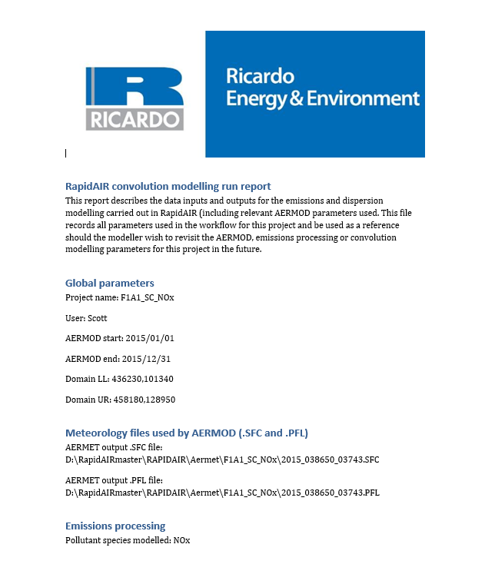
Example- automated report writing
RapidAIR is a complex system but its made up of simple parts, all of which are written in python 2.7
Python modules perform a variety of small closely linked tasks
e.g. we control AERMOD with python scripts to write the aermod.inp file from variables input to the GUI
e.g. we control AERMET with python writing the aermet.inp file
e.g. we process road traffic emissions numerically and then spatially in numpy and GDAL
e.g. we compute dispersion in scipy using the GDAL emission grids and scipy’s convolution routines
e.g. it even writes some of our report sections using the python-docx library
Values for key variables are written into the word file for QA and auditability
from docx import Document
document = Document()
document.add_heading(‘RapidAIR convolution modelling run report', 0)
document.add_paragraph(“This report describes the data inputs and.... etc”)
Notes:
It is a complex system but its made up of simple parts, all of which are written in python 2.7
As mentioned on the previous slide we are just automating the process of setting up AERMOD and AERMET using python to write to the input text files
We use numpy and pandas to do the numerical calculations , and use GDAL for the spatial aspects, the SciPy library is used for the convolution step for the kernel based dispersion modelling
It now also even writes some of our report sections using the python docx library

Slide 23
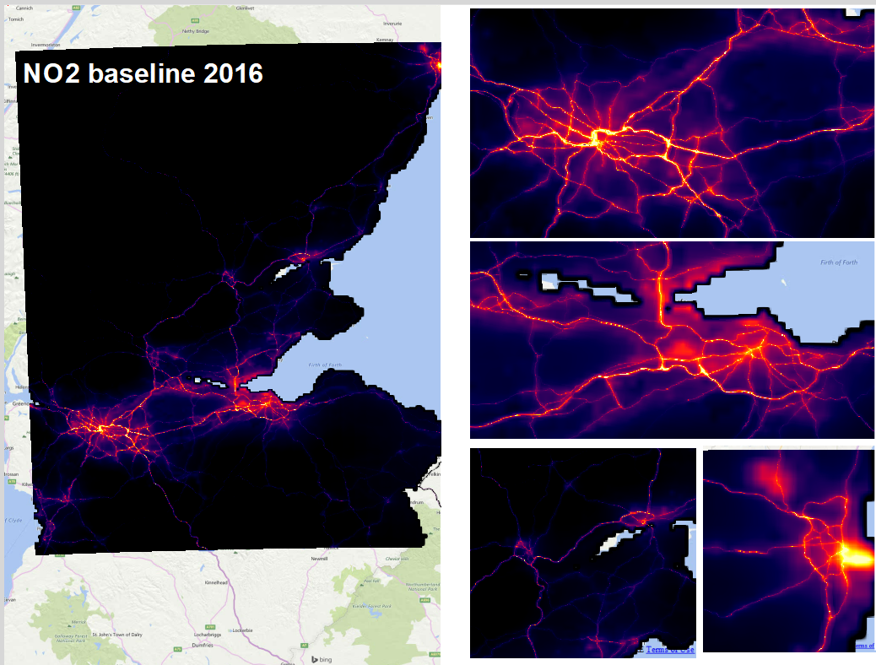

Notes:
And finally, here is an example of RapidAir outputs for NO2 annual mean concentrations modelled across a reasonably large regional model domain central Scotland.
Scott likes to flip between this and the next slide to demonstrate instant policy analysis…

Slide 24
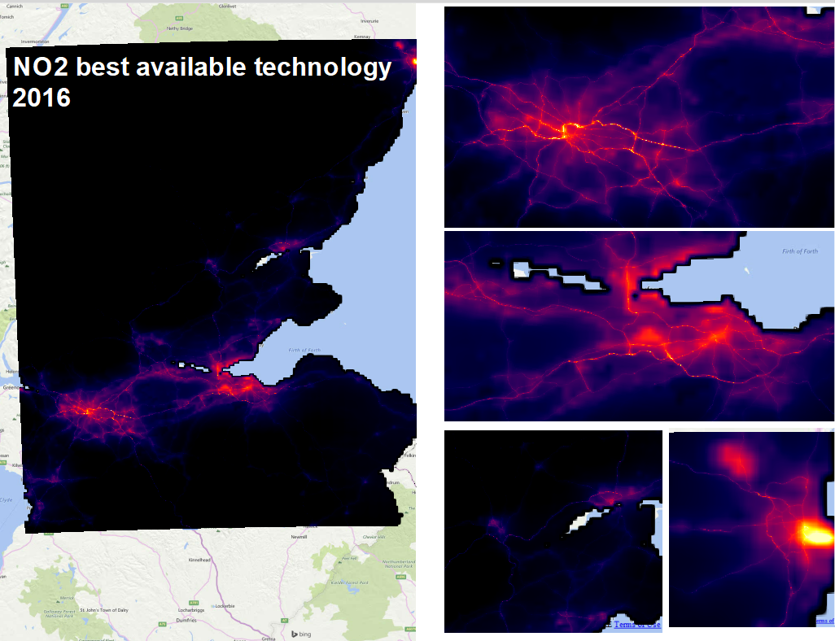
NO2 in 2016 – the baseline
Notes:
And that concludes my presentation..
There are also a number of ancillary slides in the slide pack with additional and more complex code examples relating to processing met data, geo-processing and
Thanks for listening,

Slide 25
Ancillary material

Slide 26
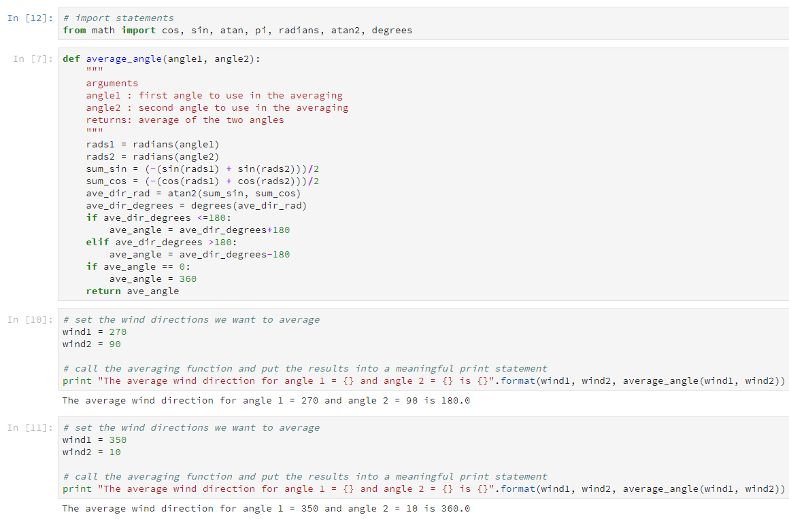
A few useful code examples…..
Averaging two wind directions

Slide 27
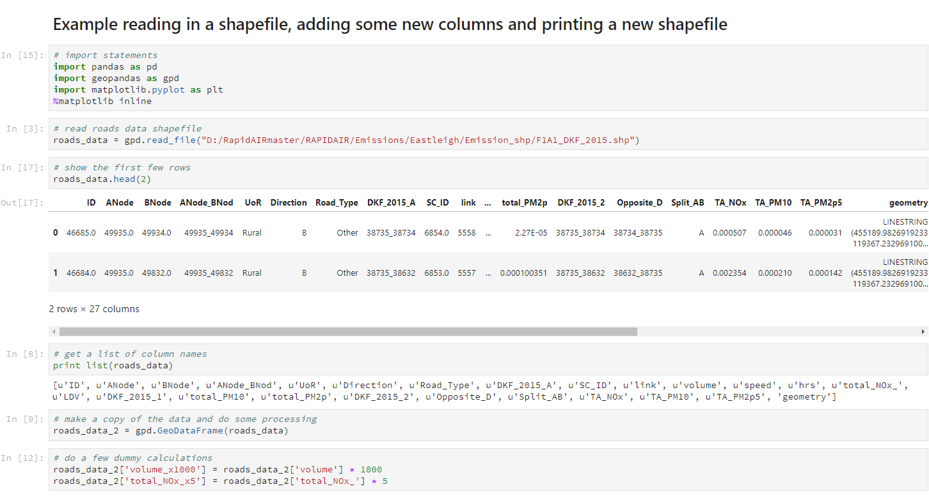
A few useful code examples…..

Slide 28
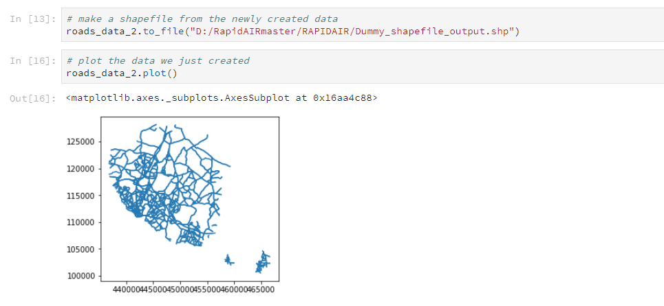
A few useful code examples…..
This shapefile can now be loaded in any GIS

Slide 29
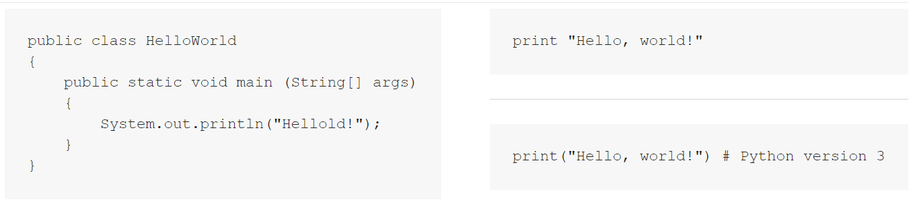
Python is designed to be very readable
Compare the ‘Hello, World!” example for Java and Python….
Java
Python
This really helps with not just the code writing, but also in checking for QA purposes.

Slide 30
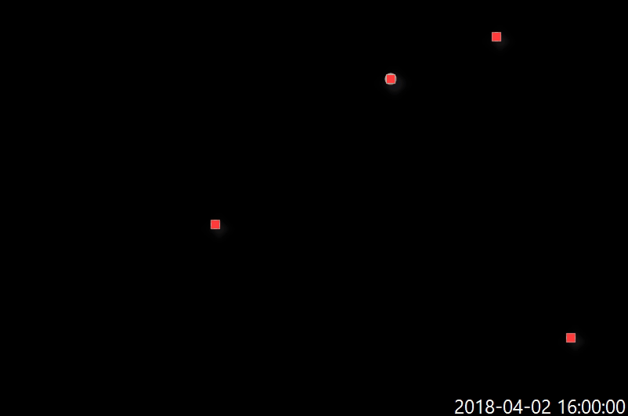
Ancillary Example
Spatial allocation of local government vehicle emissions from GPS data

Slide 31
Problem statement
Diagnose the source emission signal from local government vehicles transiting small towns during business hours
Key things we need:
Processing of GPS measurements
Computation of emissions for each time step and vehicle
Spatial allocation of emissions to help inventory compilation
More modular approach with scripts ‘talking’ to each other
Python’s flexibility allows all of this using only a few libraries
The project allowed us to add significant value to an existing dataset (GPS)

Slide 32
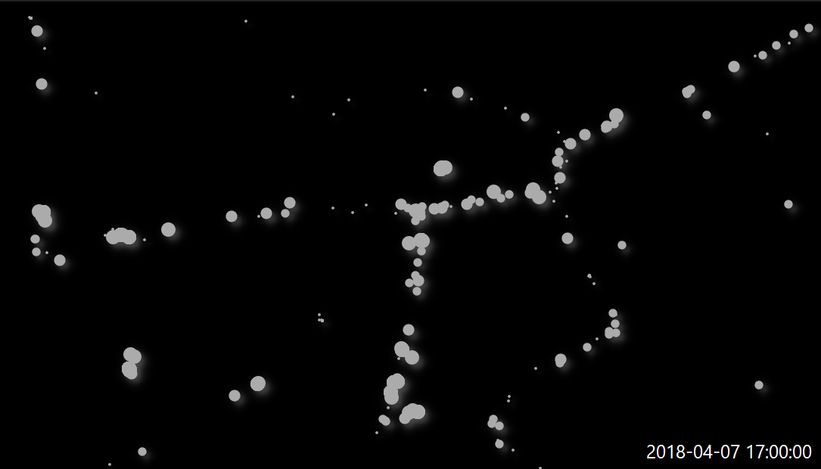
Evolution of the traffic emissions signal
Emissions calculated at hourly time steps for local government LGV fleet. Each observation is passed through the RapidEMS model to obtain emission rates which are then allocated in time and space.
All processing of observations done in ‘pandas’ with heavy use of the ‘groupby’ function to allocate emissions to vehicles by number plate
Large circles indicate higher intensity vehicle emissions, lower emissions signified by smaller circle- mainly due to newer technologies or smaller engines.
Later we used the ‘geopandas’ library to allocate emissions to discrete spatial locations.

