Slide 1
EASIUR: A Reduced-Complexity Model Derived from CAMx
Peter J. Adams and Jinhyok Heo
Center for Atmospheric Particle Studies (CAPS)
Carnegie Mellon University
CMAS Conference 2018
Funding: EPA Center for Air, Climate, and Energy Solutions (CACES)

Slide 2
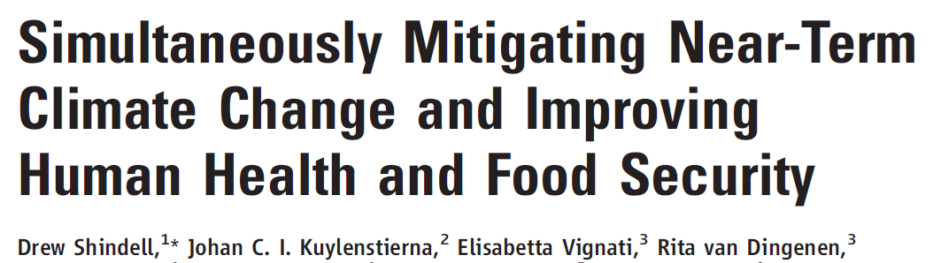
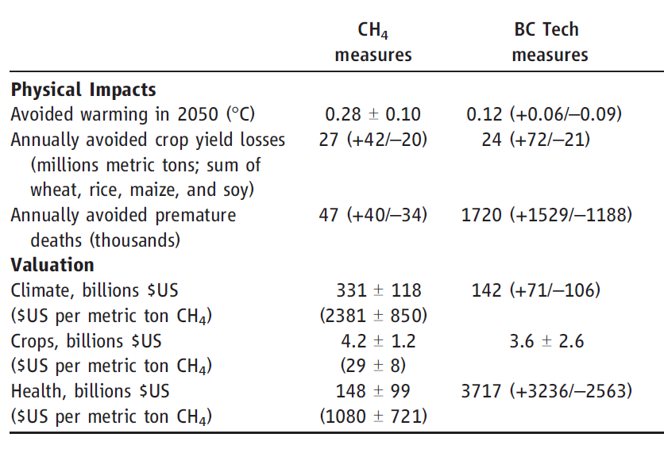
Air Pollution Often Dominates
Science (2012)
Black carbon mitigation may have some benefits as a short-lived climate forcer
…but definitely has large benefits now for health (25x as big)

Slide 3
Impact Assessment
Chemical transport models (CTMs) vs reduced-form models
Marginal social cost =
$ damages per incremental ton

Slide 4
Limitations of Current Tools
Chemical transport models (CTMs)
  PMCAMx, CMAQ, WRF-Chem, others
  Downside: computationally intensive
Reduced-form from dispersion models
  APEEP, COBRA, CRDM, others
  Downside: simplified chemistry and transport
Reduced-form from CTMs
  RSM, papers by Fann et al.
  Downside: lack spatial resolution (e.g. national averages for a sector)

Slide 5
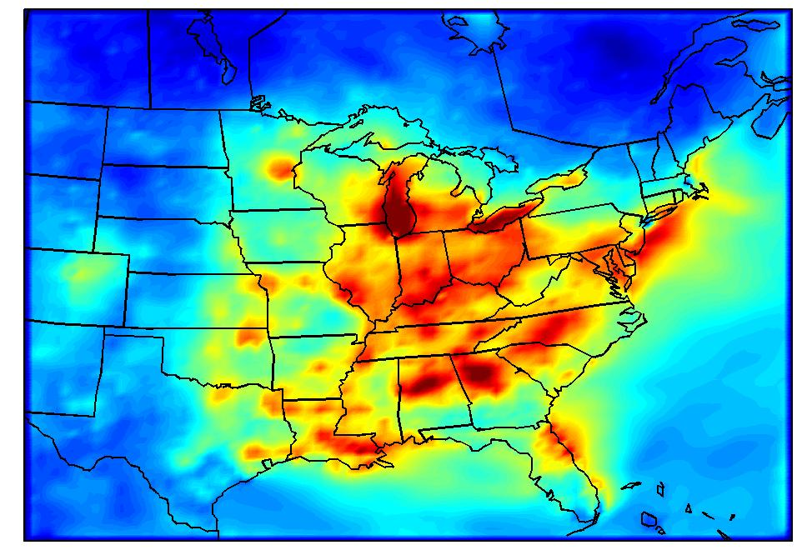
The Brute Force Approach…
+Emissions Perturbation
Take Difference…
Baseline Emissions
Doing this for every pollutant and every county…
~9000 CPU-years!

Slide 6
Goal
Provide marginal social costs ($/ton) that are
  simple, easy-to-use
  computationally efficient
  based on state-of-science CTM
  approx county-scale spatial resolution
Brute force: ~9,000 CPU-years
Resulting tool is EASIUR
  (Estimating Air quality Social Impacts Using Regression)

Slide 7
Our Approach
“tagged” simulations
Full Chemical Transport Model
Social Costs at 100 random locations
Train w/ 50
Social Costs everywhere
Statistical Model
Test w/ 50

Slide 8
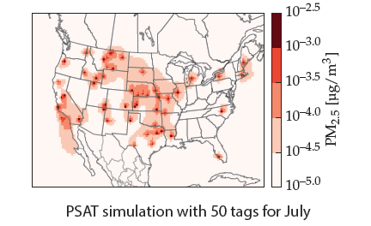
Partial Solution: “Tagged” Simulations
PSAT = Particulate Source Apportionment Tracking
(Wagstrom et al., 2008)
One simulation: 50 emissions perturbations
  Reduces computer cost by ~10x
Provides large data set of locations
  …still not every county in US

Slide 9
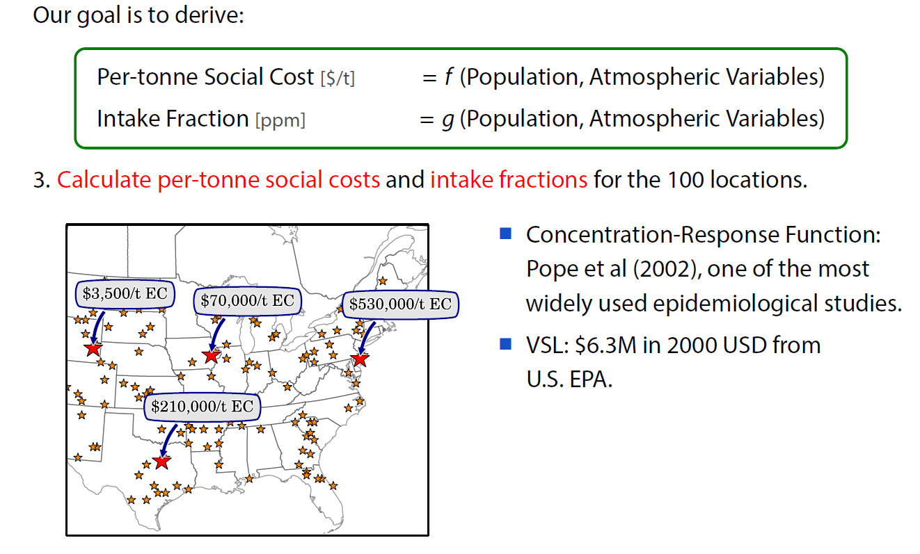
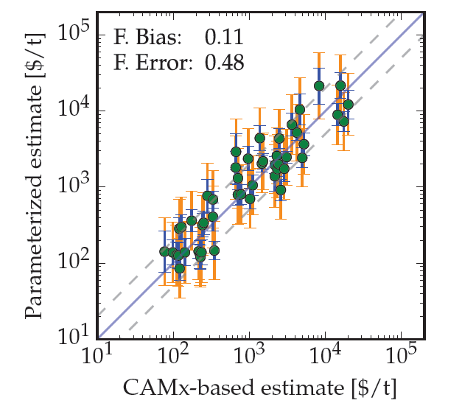
Parameterize Results and Evaluate
NOx (summer) out-of-sample

Slide 10
Social Cost: Primary PM (July)

Slide 11
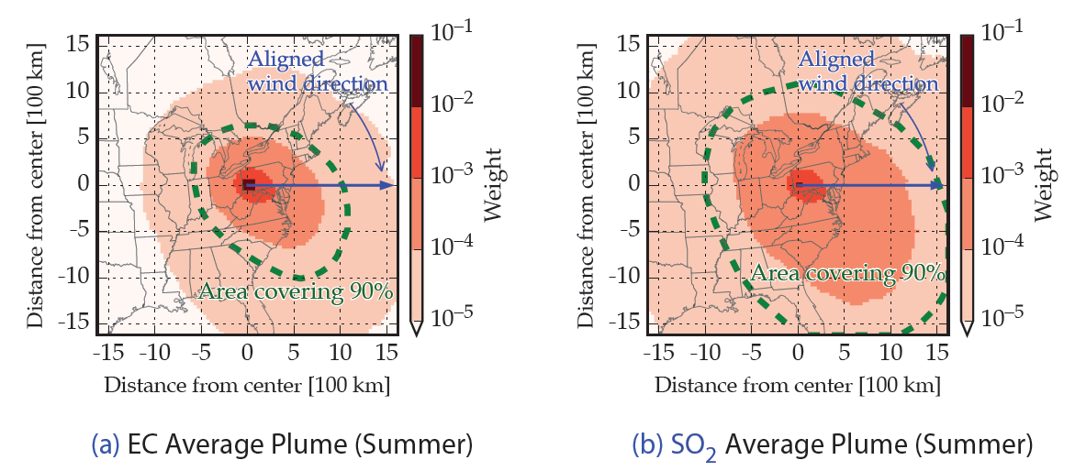
“Plumes” From Unit Emissions
Used to assess downwind exposed population
Differ by species, season, not location

Slide 13
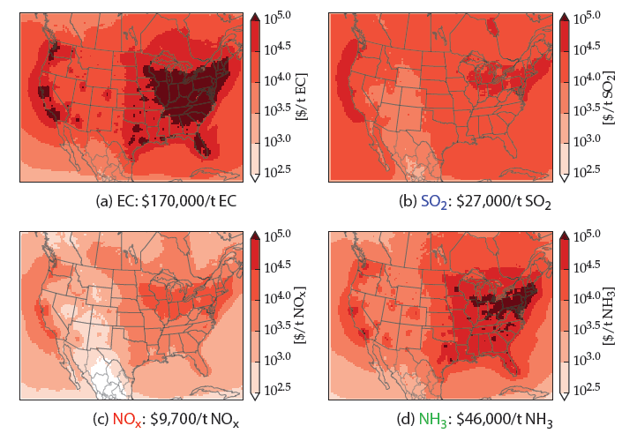
EASIUR Results (per tonne)
EC
SO₂
These are damages by source location
Spatial: Proximity to population centers
Species: PM_{2.5} formation efficiency
…for user, this is a “lookup table”
NO_{x}
NH₃

Slide 14
Adding Back Spatial Resolution
APSCA =
Air Pollution Social Cost Accounting

Slide 15
Adding Back Spatial Resolution

Slide 16
Adding Back Spatial Resolution

Slide 17
EASIUR: Contribution
CTMs: too slow for much policy analysis
  not accessible to many research communities
Previous tools either
  not based on rigorous model
  lacked high spatial resolution for sources/receptors
Built “EASIUR” to address deficiencies
  lookup table of $/ton marginal social costs
  source-receptor matrix too
Uncertainty in marginal social costs
  <30% fractional error compared to CAMx
Available online with other RCMs:
  www.caces.us (Wed afternoon tutorial)

