Slide 1
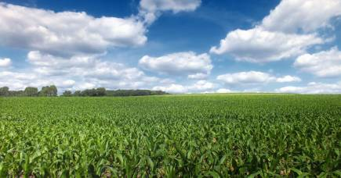

Mechanistic representation of soil nitrogen emissions in CMAQ
Quazi Z. Rasool^{1*}, Jesse O. Bash², and Daniel S. Cohan¹
¹ Department of Environmental Science and Engineering, UNC- Chapel Hill
*formerly at Department of Civil engineering, Rice University
²Computational Exposure Division, NERL, US Environmental Protection Agency
17th Annual CMAS Conference, UNC-Chapel Hill
October 24, 2018

Slide 2
Outline
Motivation: Importance of soil nitrogen emissions to air quality
Methods and results
  Parametric modeling of soil NO
  Mechanistic modeling of soil N oxide emissions (NO, HONO, N₂O)
  WRFv3.7-CMAQv5.1 with FEST-C v1.2 simulation for May and July 2011*
Future work & conclusions
* Appel et al. (2017), GMD
Notes:
Introduce biochar

Slide 3

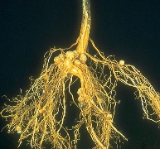
Soil Nitrogen cycling : sources and emissions
N sources/inputs
Fertilization
Deposition
Natural fixation
PM_{2.5}
Ozone & PM_{2.5}
Health Risks
Ozone & PM_{2.5}
GHG
Plant N uptake
NO OH
Surface nutrient runoff
hν
NH₃
NO
N₂O HONO
Atmosphere
Soil
Organic N
Volatilization
Volatilization
Denitrification
NH₄⁺
NO₂⁻
NO₃⁻
Microbial or active N
Org N
Mineralization
Leaching
Nitrification
Immobilization
Adapted from Fowler et al. (2013), Pilegaard (2013), Su et al.(2011)

Slide 4
Reactive soil N in air quality models
Parametrized NO emissions and soil-atmosphere exchange of NH₃
  HONO and N₂O typically neglected
NO and NH₃ influence ozone and particulate matter
Soil NO ~ 20% of global NO_{x} budget
Large underestimations and uncertainties in traditional scheme
  No deposition, poor representation of soil moisture, lack of spatial heterogeneity
Updated parameterized approach
Vinken et al. (2014), Bash et al. (2013), Hudman et al. (2012)

Slide 5
Motivation
Soil nitrogen emissions altered by increasing fertilizer use
Decline in fossil fuel NO_{x}, increasing soil NO_{x} contribution
Inconsistent treatment of N species in soils and fluxes
  Bi-directional scheme for ammonia but not other species
  NO parameterized; HONO ignored
  Nitrification and denitrification not represented
Reduce uncertainties of soil N emissions and air quality predictions

Slide 6
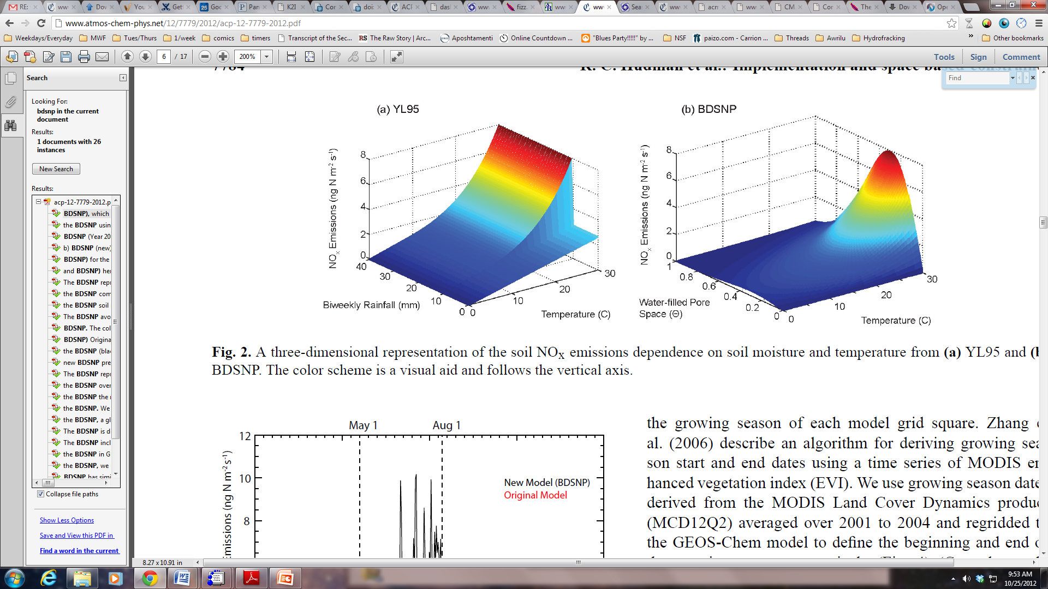
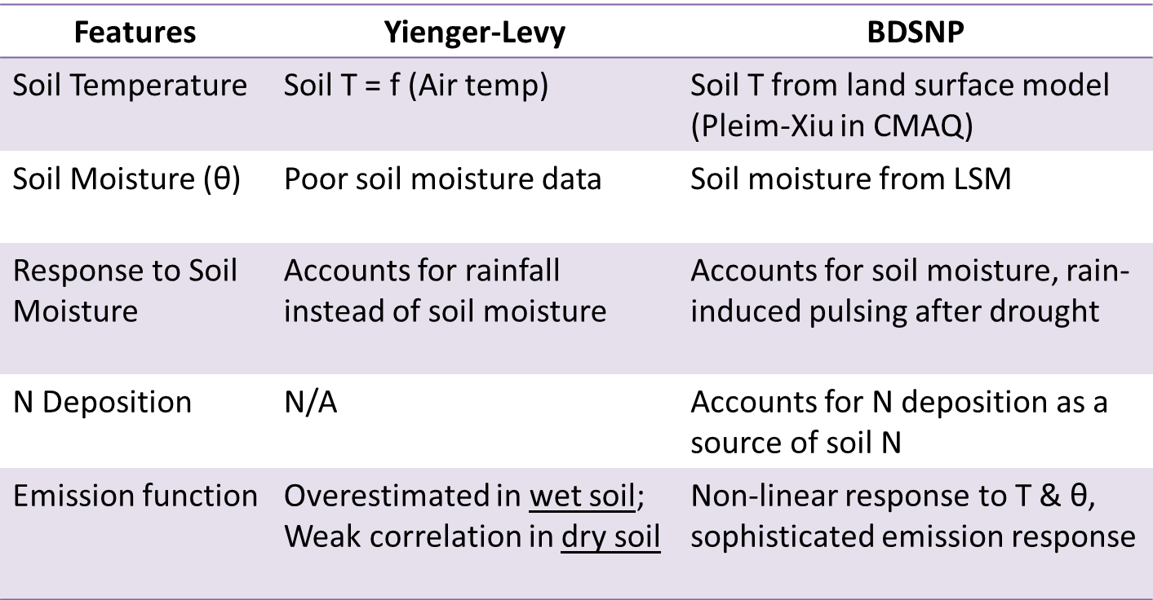
YL algorithm vs BDSNP
(Default soil NO_{x} scheme in CMAQ) (Updated soil NO_{x} scheme)
Yienger and Levy (1995), Hudman et al. (2010), Hudman et al. (2012)

Slide 7
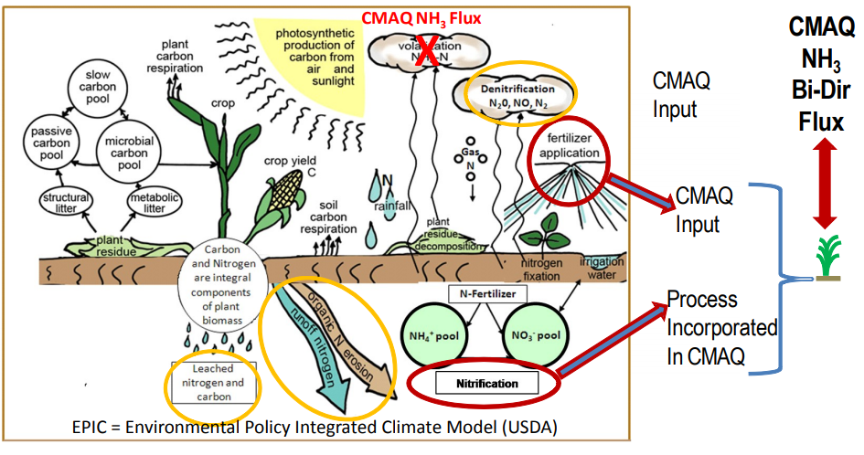
Environmental Policy Integrated Climate (EPIC) agricultural model
Wet Dep
Dry Dep
NH₃ emission
NH₃ deposition
Org N pool
(Cooter et al., 2012)
Notes:
HUSC to Schedule Vegetable Plantings, Predict Harvest Dates and Manage Crops
Temperature controls the development of many organisms that don’t have complex thermoregulatory systems. This allows us to predict the development of different organisms by accurately using development or phenology models which are based on the accumulation of heat units (i.e. degree days) during a growing season.

Slide 8
Current implementation of EPIC in CMAQ as part of FEST-C for estimating bi-directional NH₃
Anthropogenic emissions
Chemical Transport Model (CMAQ)
Physical and chemical processes in the atmosphere
Pollutants
(Ozone, PM, etc.)
Meteorology & Land surface model (WRF)
Net soil NH₃
Deposition
EPIC
Crop fertilization
Fertilizer timing
Ag soil management
NH₃ bi-directional exchange scheme
Soil NH₄⁺ and H⁺
Nitrification, Volatilization
Soil properties
Land use data
Background soil NH₄⁺ and H⁺

Slide 9
Reactive N cycling schematic
(Parametrized vs Mechanistic)
Mechanistic
Parametrized
NH₃
NO N₂O
N₂
NO N₂O HONO
HNO₃
Fertilizer, Deposition, Biome
NO₂
NO
Atmosphere
Soil
NH₃
N₂
N₂O
NO
NO
N₂O
NO₂
HNO₃
HNO₂
H⁺
H⁺
NH₄⁺
NO₂⁻
NO₃⁻
Org N
Org N
Total N
N (-3)
Denitrification
N (+5)
Nitrification
Adapted from Su et al., 2011; Pilegaard, 2013 and Medinets et al., 2015

Slide 10
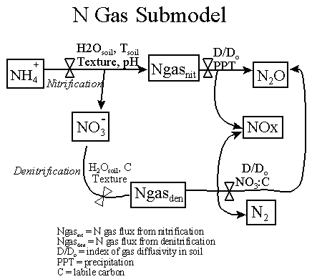
Mechanistic soil N scheme: DAYCENT
Simulates all terrestrial ecosystems
Widely calibrated and validated for:
  Crop yield, soil C, NO₃⁻, soil T and water content, N₂O
More complex mechanistic models available
  Advantage: Bi-directional exchange between soil and atmosphere
  Disadvantage: Very few validations and extensive computational requirement
(Necpálová et al., 2015; Butterbach-Bahl et al., 2013; Parton et al., 2001)

Slide 11
Integration of EPIC and DAYCENT in CMAQ for soil N emissions
Anthropogenic emissions
Chemical Transport Model (CMAQ)
Physical and chemical processes in the atmosphere
Pollutants
(Ozone, PM, etc.)
Meteorology & Land surface model (WRF)
Soil N emissions (NH₃, NO, HONO)
Mechanistic soil N scheme
NH₃ bi-directional exchange scheme
DAYCENT soil N gas sub-model
HONO emission from nitrification
Deposition
EPIC
Crop fertilization
Fertilizer timing
Ag soil management
Soil NH₄⁺, NO₃⁻, Organic N & C
Soil properties
Land use data
Non-Ag soil N and C

Slide 12
Mechanistic soil N scheme : Overview
Meteorology,
canopy structure,
biome/vegetation coverage
(LAI and bulk stomatal resistance),
deposition coefficients
Sub-grid
NLCD40 biomes
Gas diffusivity
Soil
pH
Soil temperature
Soil
moisture
Length of dry period before rain
Agricultural
(EPIC)
Non-Agricultural
(Schimel and Weintraub et al.)
Wang et al. canopy reduction factor
Pulsing events
¹
²
Soil NH₄ , NO₃, C
DayCENT - Nitrification and Denitrification algorithm
N Deposition
Oswald et al.
f(Soil water holding capacity,
biome specific optimum NO:HONO)
Soil organic N and C
- Non-agricultural (Xu et al.)
Mechanistic scheme
Nitrification |  |  | Denitrification
NO | HONO | N₂O | NO | N₂O
Soil organic N and C
Agricultural
(EPIC)
¹
Canopy reduction factor applies to all NO and HONO emissions
Pulsing factor applies only to nitrification NO and HONO
²

Slide 13
Organic to inorganic N transformation in mechanistic soil N scheme
Non-agricultural¹ soil organic
C and N data
(Xu et al.)
Microbial biomass C:N
Biome, geographical location
O₂ available,
bulk density, tillage
soil T
and moisture
Microbial (i.e. active) N
Immobilization²
soil composition,
organic residue C:N,
inorganic N available
Agricultural soil organic
C and N data
(EPIC)
Mineralization²
NO, HONO, N₂O
NO, N₂O
NH₄
Nitrification
Denitrification
NO₃
N₂
¹Also includes non-US agricultural areas
²Schimel and Weintraub Algorithm for Non-Agricultural and
EPIC algorithm for Agricultural regions
DAYCENT N emission sub-model

Slide 14
Updates in CMAQ : parameterized and mechanistic
Features in CMAQ | Parameterized | Mechanistic
Species emitted | Nitric oxide (NO), NH₃ | NO, NH₃, HONO, N₂O
Approach* | BDSNP equations for NO | DayCENT submodel representing nitrification, denitrification, and mineralization
Variables considered | Total soil N, soil T, soil moisture, rainfall, and biome type | Soil water content (irrigated and unirrigated), T, NH₄⁺, NO₃⁻, gas diffusivity, and labile C by soil layer
Soil N data source | EPIC (agricultural soil only) | EPIC for agricultural soil Microbial biomass C, N, and properties for non-agricultural
*CMAQ bi-directional for NH₃ (Bash et al., 2013) in both
Notes:
DAYCENT and EPIC model both based on CENTURY ecosystem model
CENTURY simulates cycling of reactive N (along with other nutrients) between soil, vegetation, atmosphere and water
EPIC differs from DAYCENT since:
EPIC has been implemented on a regional scale in CMAQ and,
NH₃ Bi-directional feedback implemented in EPIC-CMAQ framework
(Cooter et al., 2012)
EPIC does not give how much of NO and N₂O each came from nitrification and denitrification
N sub model of DAYCENT addresses that mechanistically based on
soil water content (WFPS), temp, soil NH₄⁺ and NO₃⁻ concentrations, gas diffusivity and labile C availability at various soil layers
(Parton et al 1998; Del Grosso et al., 2000; Parton et al., 2001)
Soil HONO still not addressed in current biogeochemical models

Slide 15
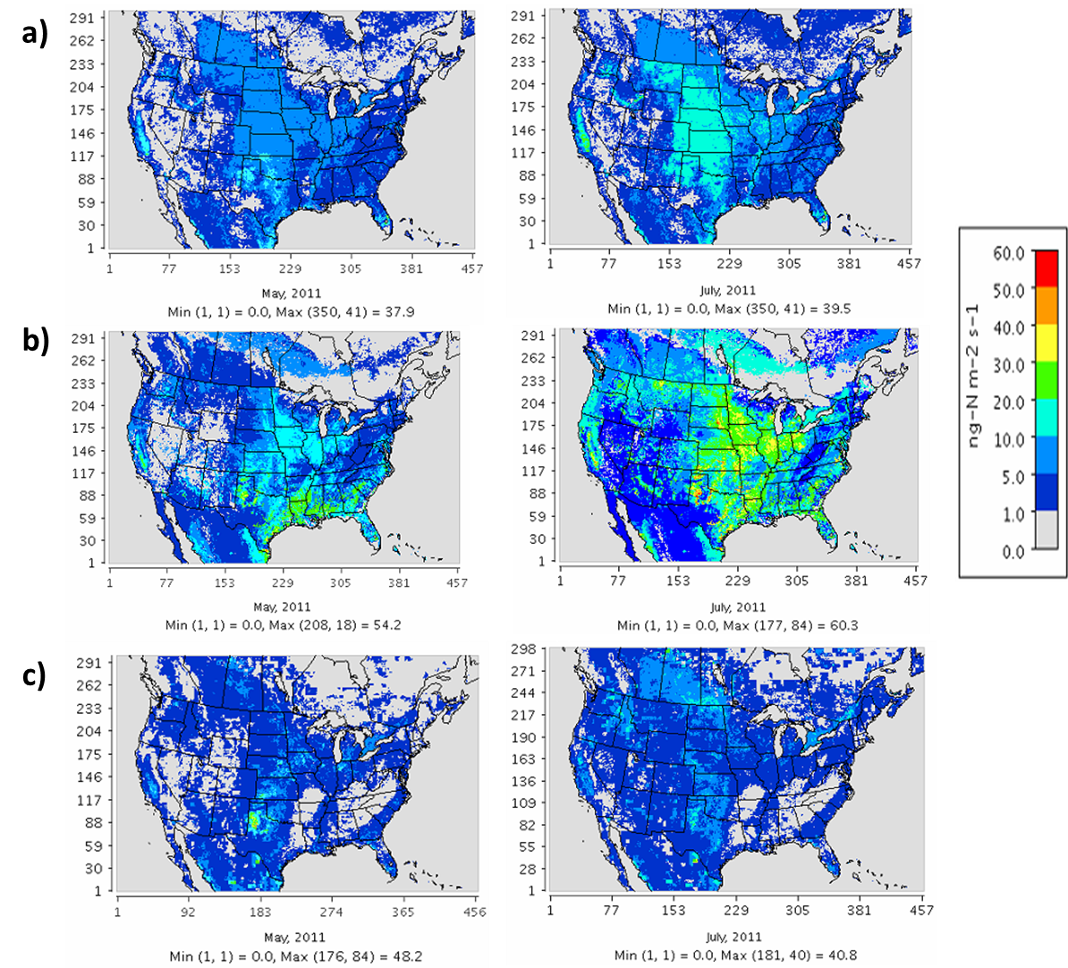
Comparison of Soil NO and HONO across schemes
May 2011 July 2011
YL
BDSNP
Mechanistic*
Soil NO and HONO emissions in ng-N/m²/s
*Only Mechanistic scheme shows both NO and HONO

Slide 16
Soil N₂O emission estimate from Mechanistic scheme
May 2011
July 2011
Soil N₂O emissions in ng-N/m²/s

Slide 17
Observed maximum summertime soil NO (monthly avg.) compared across schemes
Iowa fertilized fields (Williams et al., 1992) Montana fertilized fields (SCHIAMACHY NO₂ derived) (Bertram et al., 2005) South Dakota fertilized fields (Williams et al., 1991)
Texas grasses and fields (both fertilized) (Hutchinson and Brams, 1992) Colorado natural grasslands (Parrish et al., 1987; Williams et al., 1991; Martin et al., 1998)
Notes:
Iowa fertilized fields (Williams et al., 1992)
Montana fertilized fields* (Bertram et al., 2005)
South Dakota fertilized fields (Williams et al., 1991)
Texas grasses and fields (both fertilized) (Hutchinson and Brams, 1992)
Colorado natural grasslands (Parrish et al., 1987; Williams et al., 1991; Martin et al., 1998)

Slide 18
Relative contribution of soil NO_{x} to total NO_{x} across schemes
May 2011 July 2011
Mechanistic scheme shows:
Eastern U.S. has lower soil NO_{x} than expected
Regions with high soil NO_{x} contribution: Agricultural plains (N Dakota to Texas) & West U.S.
Soil NO_{x} is not more than 10-13% of total NO_{x} <- Higher fossil fuel NO_{x} concentrated in urban and industrial locations
BDSNP showed highest soil NO_{x} contributing 25-33% to total NO_{x}
YL
BDSNP
Mechanistic

Slide 19
Impact of Mechanistic scheme on soil NO and HONO emissions and total NO_{x} concentration
Soil NO + HONO (Mechanistic – YL)
Total NO_{x} (Mechanistic – YL)
May
July

Slide 20
Impact of Mechanistic scheme on OH, O₃, PM and PM NO₃
PM_{2.5} total (Mechanistic – YL)
PM_{2.5} NO₃ (Mechanistic – YL)
OH (Mechanistic – YL)
Max. daily 8-hr O₃ (Mechanistic – YL)
May
July

Slide 21
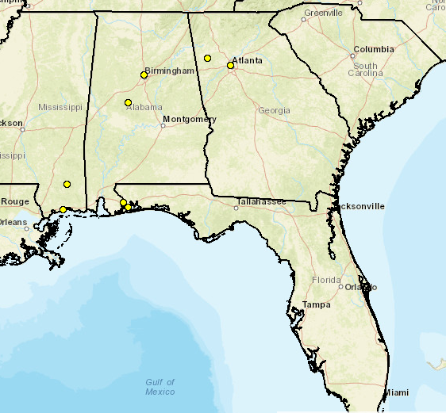
Reduction in bias in predicted NO_{x} concentrations with mechanistic scheme
South Eastern Aerosol Research and
CHaracterization (SEARCH) Network, 2011
(YRK) Yorkville
(BHM)
(JST)
Centerville
(CTR)
Pensacola (OLF)
Gulfport (GFP)

Slide 22
Tropospheric NO₂ column change (Mechanistic – YL) @ OMI overpass time
Regions in black show depreciated model performance and red shows improved

Slide 23
Tropospheric NO₂ columns across schemes compared to OMI observations
Mechanistic scheme improves trop. NO₂ estimates for sensitive regions in West U.S.
Inconsistency in May and July for CA <-overestimation and spatial heterogeneity in OMI estimates in July (Lamsal et al., 2014)
Midwest agricultural plains NO₂ underestimated

Slide 24
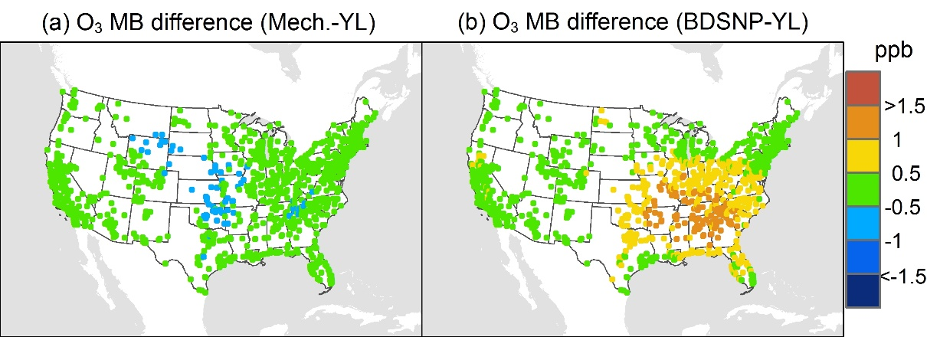
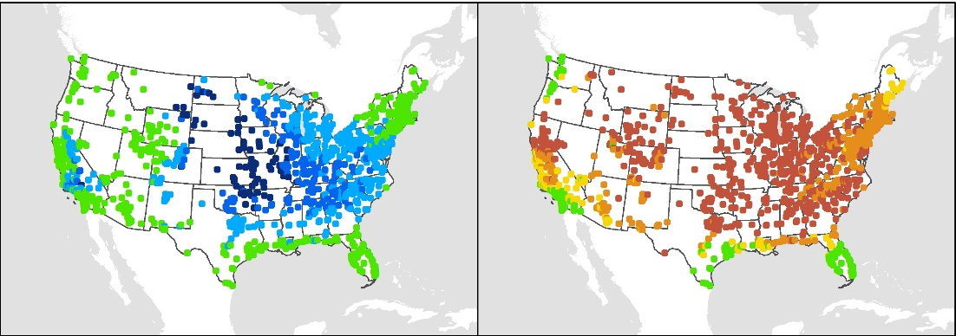
Reduced bias in O₃ and PM_{2.5} nitrate in Mechanistic Scheme
May 2011
July 2011
Mean Bias (MB) relative to AQS O₃ observations

Slide 25
Future work and scope
Extend bi-directional approach to N species beyond NH₃
Necessitates field measurements to understand HONO, soil-plant canopy N exchanges
Representation of farming practices in mechanistic models, impact on NO, HONO
  Excess nutrient management on farms (Livestock manure)
  Biochar
  Nitrification inhibitors, tillage, controlled irrigation, injection of fertilizer
Creating offline version of the mechanistic model
Account for previously ignored sources of soil N and transformation process
  Rock weathering and Bio-crusts -significant fraction of global terrestrial N
  Unexplored mechanisms like Anammox
  (Anaerobic ammonium oxidation, where NH₄⁺ and NO₂⁻ form N₂)

Slide 26
Conclusions
Key enhancements in mechanistic absent in parametric
  Consistent representation across N species
  Mechanistic representation of actual soil processes
  Extended to non-agricultural soil types
Improved OMI NO₂ predictions overall with mechanistic, underestimates in Midwest
BDSNP overestimates NO_{x} , O₃ and PM_{2.5} relative to YL
Mechanistic scheme improves NO_{x} , O₃ and PM_{2.5} estimates relative to parametric

Slide 27
Disclaimer: The views expressed in this presentation are those of the authors and do not necessarily reflect the views or policies of the U.S. EPA.
Office of Research and Development
National Exposure Research Laboratory , Computational Exposure Division
Office of Research and Development
National Exposure Research Laboratory, Computational Exposure Division
Notes:
Disclaimer may be placed elsewhere in the presentation (such as the title slide or the “final” slide); however, it should be clearly legible.

Slide 28
Acknowledgements
CED, NERL at US EPA for the opportunity as a visiting researcher
NASA Air Quality Applied Sciences Team
NASA grant NNX15AN63G (via UAH)
Dr. Ellen Cooter (US EPA), Dr. Rui Zhang (CSU)

Slide 29
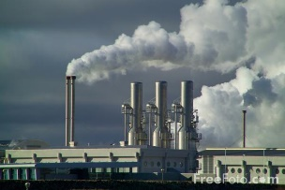

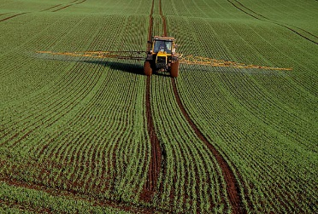

Air quality modeling and soil N emissions
Pollutants
(Ozone, PM, etc.)
Anthropogenic emissions
Chemical transport model (CMAQ)
Physical and chemical processes in the atmosphere
Deposition
Meteorology & land surface model (WRF)
Biogenic emissions
Vegetation VOCs
Soil NO and NH₃
Land use data
Adapted from Saylor and Hicks (2016)

Slide 30
Yienger-Levy (YL) default soil NO scheme in CMAQ: Overview
Biome classification
NLCD40
Soil temperature
Rainfall
Leaf and stomatal
area index (LAI, SAI)
Biome specific base emissions
(non-agricultural,
non-growing season)
Growing season emissions
(base grassland + fertilizer)
Rainfall
(if original YL);
Soil moisture
(if PX-LSM)
Pulsing events
YL wet and dry soil NO algorithm
Canopy reduction
Yienger and Levy Soil NO emission

Slide 31
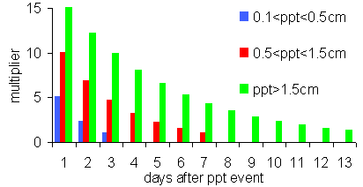
YL pulsing term
YL Pulsing multiplier

Slide 32
Berkley Dalhousie Soil NO_{x} Parametrization (BDSNP) scheme : Overview
MODIS24 mapping
to sub-grid NLCD40 biomes
Soil temperature
Soil
moisture
Length of dry period before rain
Meteorology,
canopy structure,
biome/vegetation coverage
(LAI and bulk stomatal resistance), and
deposition coefficients
Biome specific background NO emission factor
Fertilizer and deposition N (EPIC)
BDSNP soil NO algorithm
Pulsing events
Wang et al. canopy reduction factor
BDSNP
Soil NO emission

Slide 33
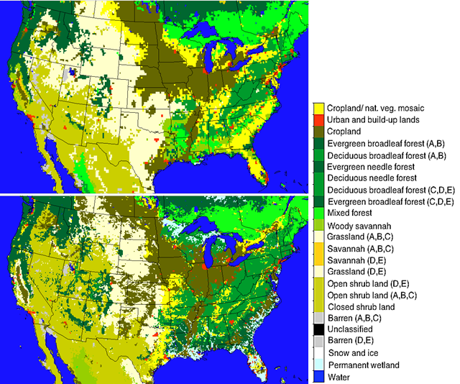
Soil Biome / Land Cover Dataset Enhancements
GEOS-Chem (0.25° x 0.25°)
GEOS-Chem
24 MODIS land cover categories
Too coarse for regional modeling
CMAQ
Mapped 40 NLCD categories from Pleim-Xiu to 24 MODIS categories
Köppen-Geiger climate zones
Sub-grid fractionation of biomes
CMAQ (12 km x 12 km)
Rasool et al. (2016), Geosc. Model Dev.

Slide 34
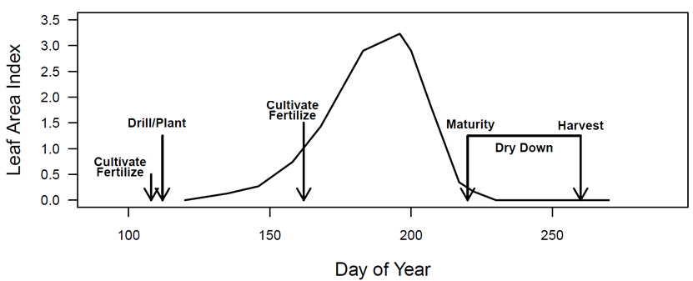
Environmental Policy Integrated Climate (EPIC) agricultural model
Fertilizer quantity: USDA Agricultural Resource Management Survey database, validated with fertilizer sales data
Fertilizer timing: Determined by plant nutrient stress
Can simulate varied agricultural practices (e.g., tillage, fertilizer type)
Fertilizer Emission Scenario Tool for CMAQ (FEST-C) incorporates EPIC simulated agricultural soil N into CMAQ runs
(Cooter et al., 2012)
Notes:
HUSC to Schedule Vegetable Plantings, Predict Harvest Dates and Manage Crops
Temperature controls the development of many organisms that don’t have complex thermoregulatory systems. This allows us to predict the development of different organisms by accurately using development or phenology models which are based on the accumulation of heat units (i.e. degree days) during a growing season.

Slide 35
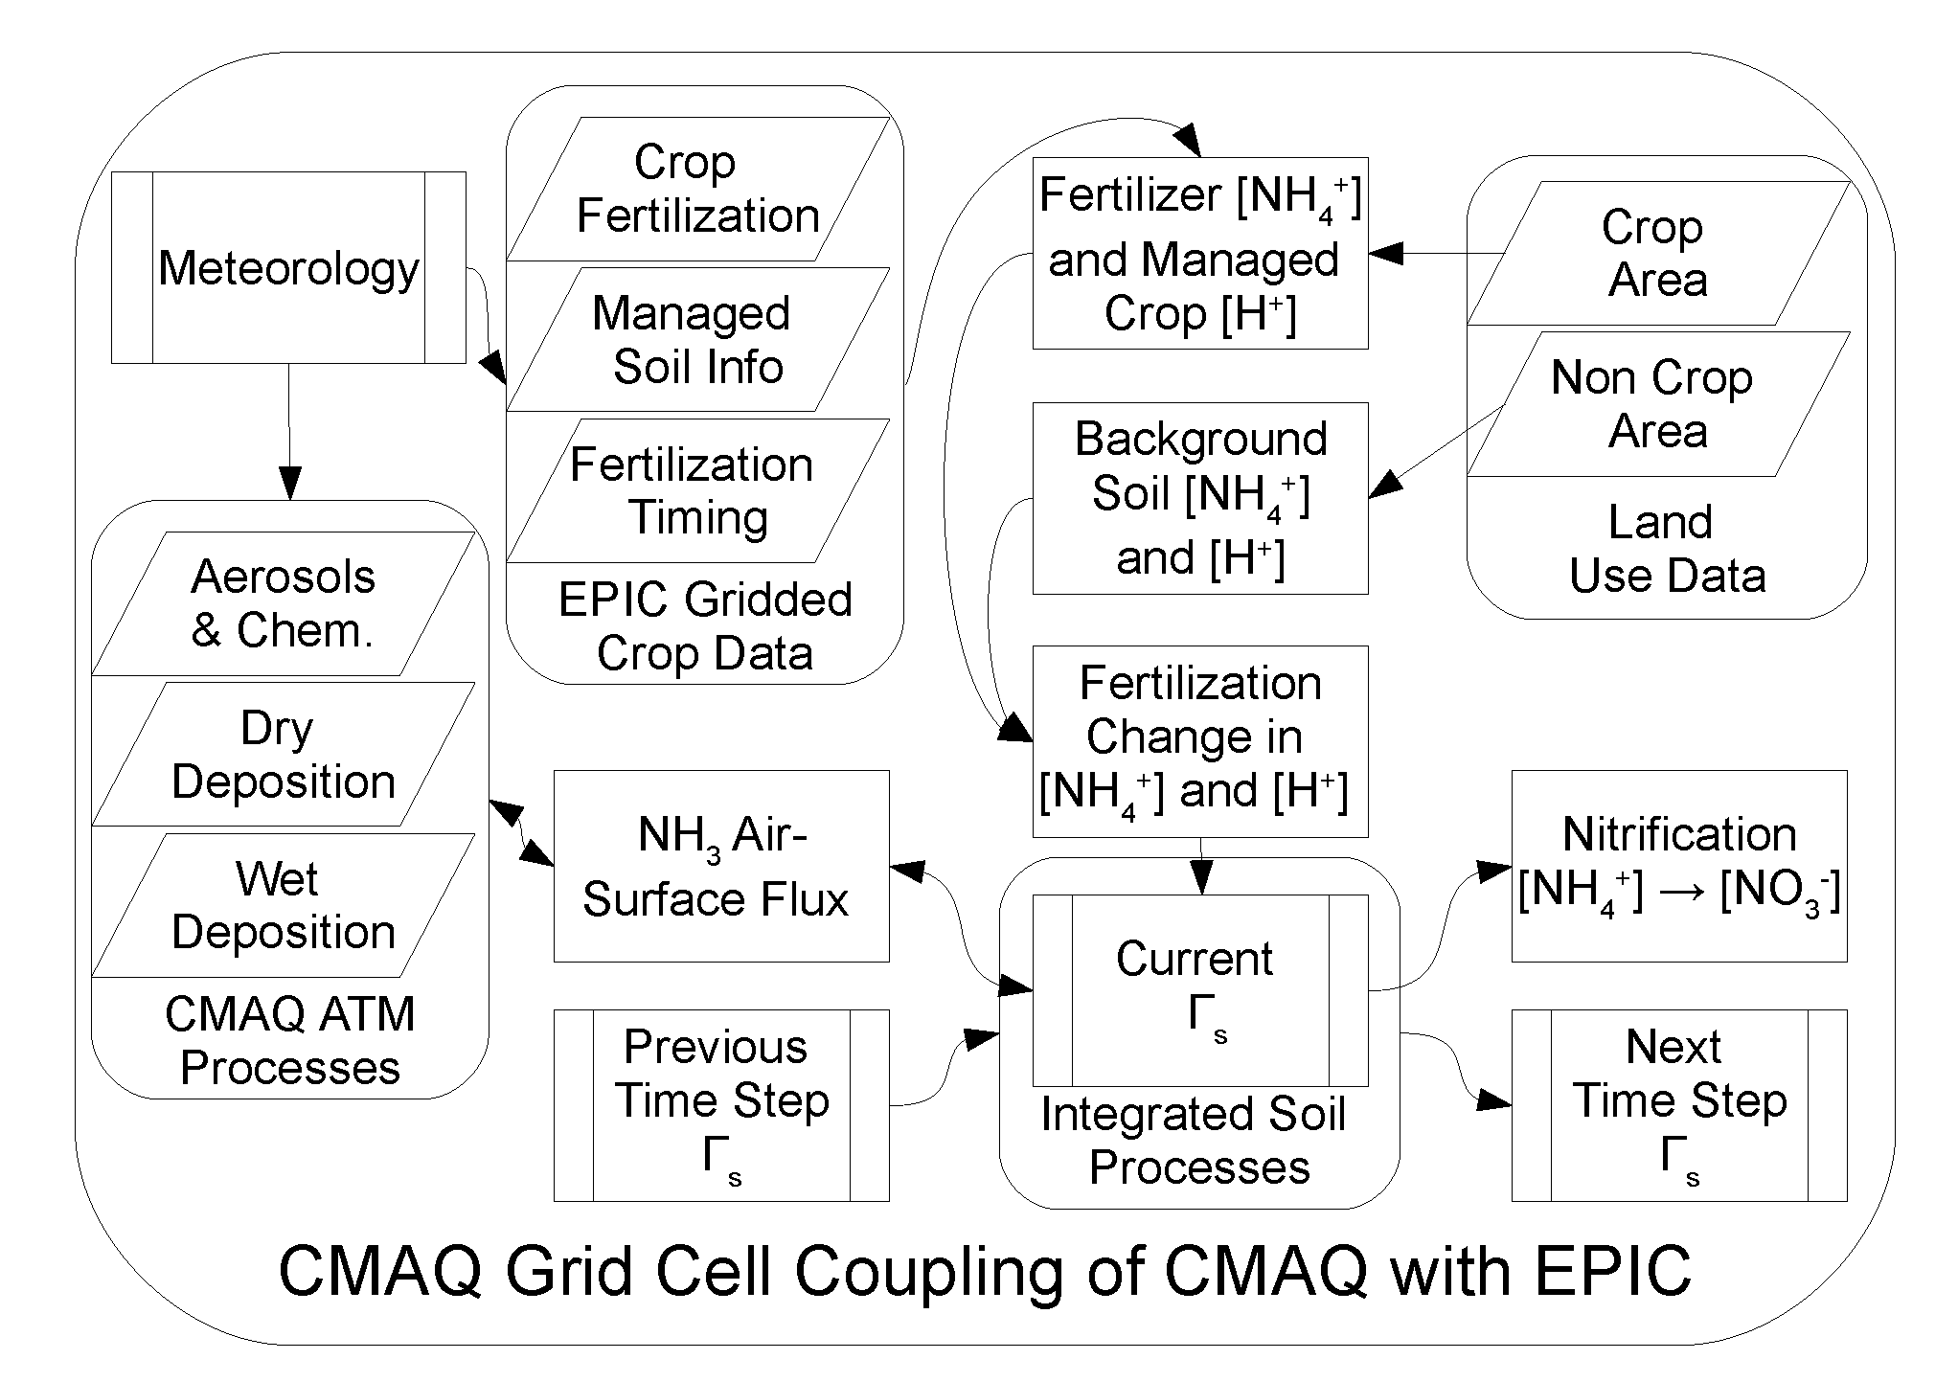
Current implementation of EPIC in CMAQ as part of FEST-C for estimating bi-directional NH₃
Bi-directional Ammonia exchange scheme
Bash et al. (2013)

Slide 36
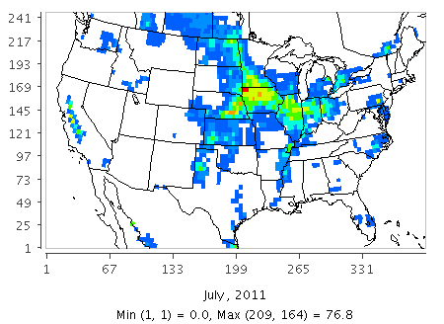
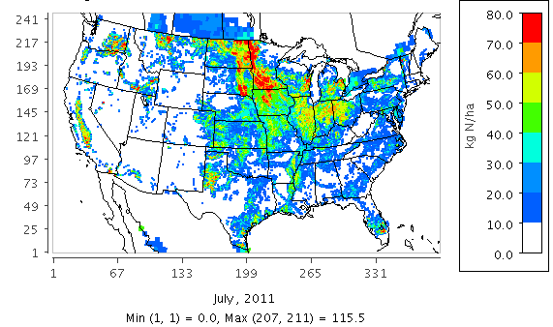
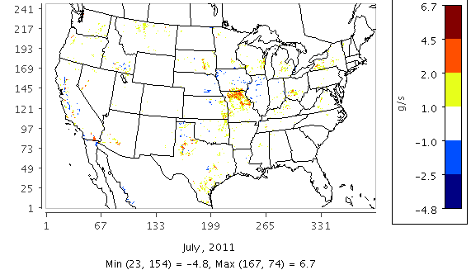
Impact of Potter vs EPIC Fertilizer Data on Soil NO
Potter
EPIC
Fertilizer
Application (kgN/ha)*
EPIC - Potter
Difference in BDSNP
Soil NO (g/s)*
*Averaged over July 2011

Slide 37
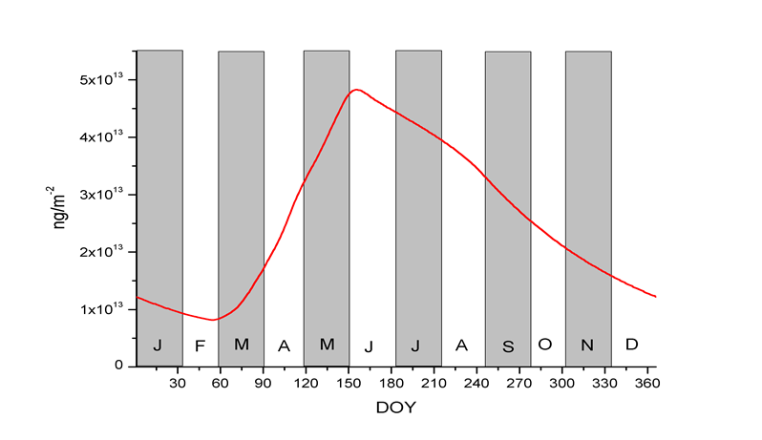
Seasonality in BDSNP soil NO estimates

Slide 38
Impact of BDSNP scheme on soil NO emission and total NO_{x} concentration
Soil NO (BDSNP – YL)
Total NO_{x} (BDSNP – YL)
May
July

Slide 39
Impact of BDSNP scheme on OH, O₃, PM and PM NO₃
Max. daily 8-hr O₃ (BDSNP – YL)
PM_{2.5} total (BDSNP – YL)
PM_{2.5} NO₃ (BDSNP – YL)
OH (BDSNP – YL)
May
July

Slide 40
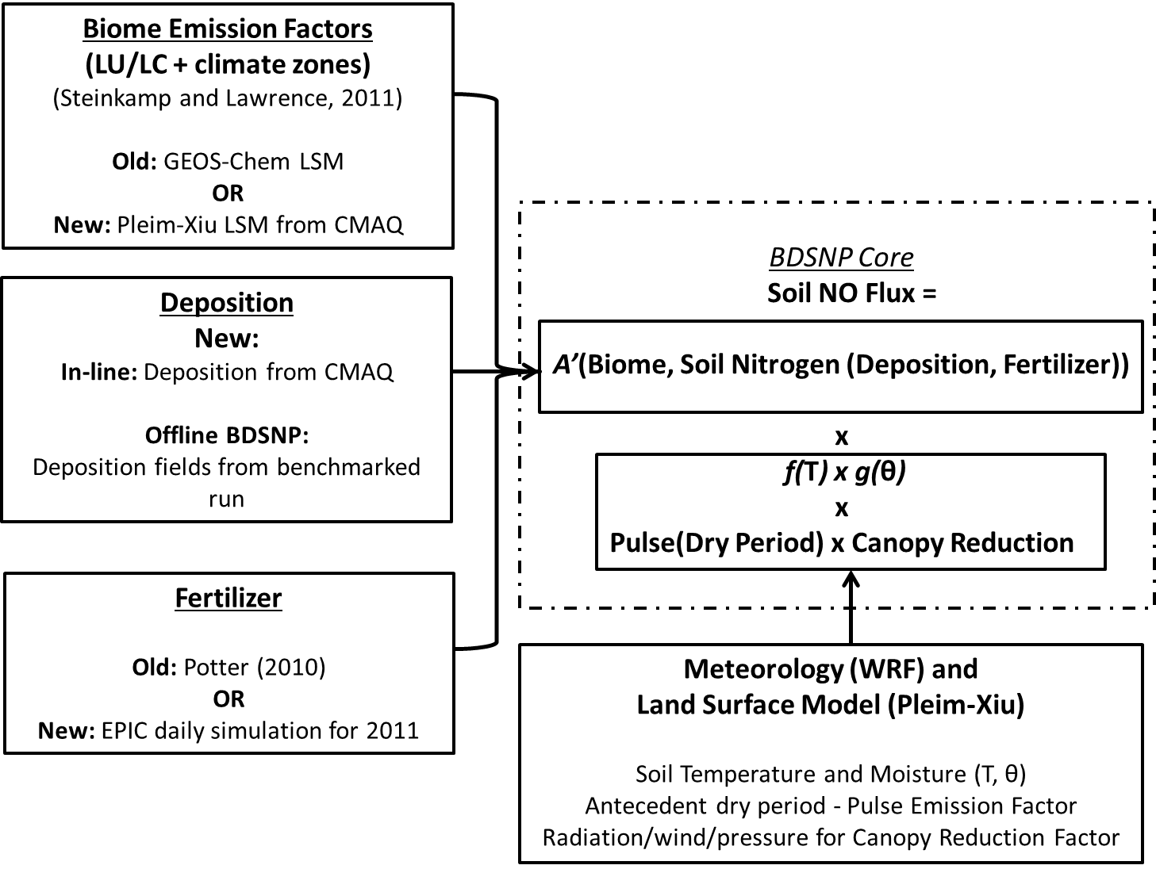
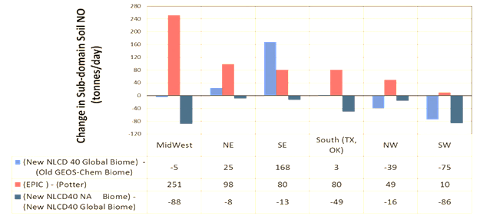
Sensitivity of BDSNP to different inputs
CMAQ biome
New fertilizer data
North American emission factors
Rasool et al. (2016) GMD

Slide 41

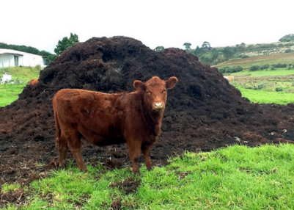
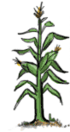
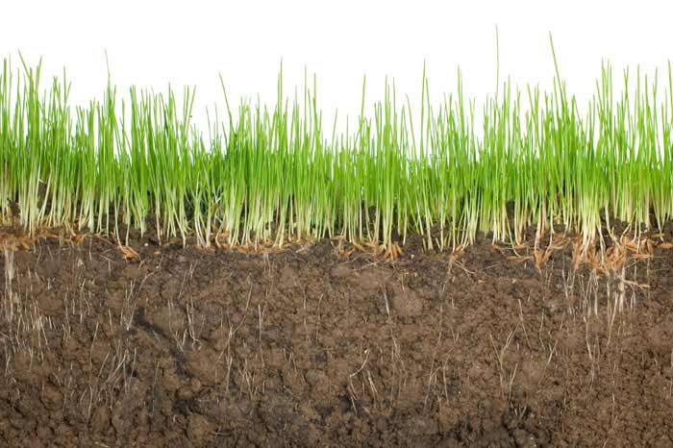
Biochar as soil amendment
Crop residues
Manure
Organic waste
Energy crop residue
(grass, willow, wooden chips)
Bio-fuel and Syngas (CO+H₂)
Energy sector Transportation
Industry
Pyrolysis
(~ 500℃)
Biomass (C)
Residual heat
Biochar (Solid residue)
Potential benefits of biochar
C sequestration
Reduces nutrient runoff
Mitigating GHGs and air pollutants
Alters soil pH and moisture
Soil
Adapted from Lehmann (2007)

Slide 42
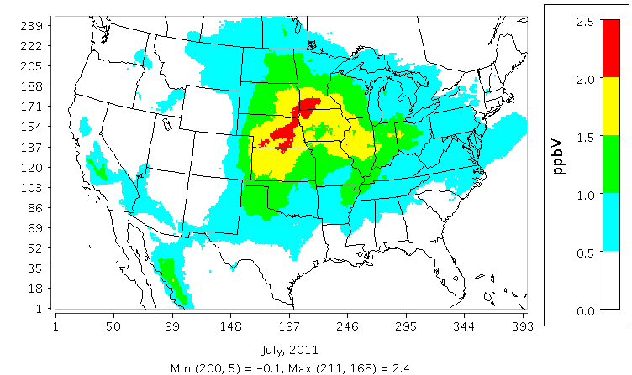
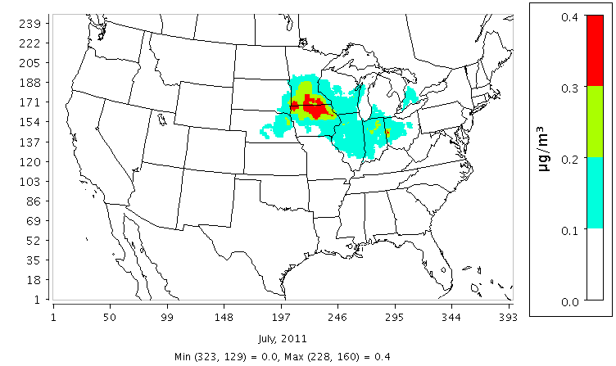
Potential air quality benefits of biochar-aided soil NO emission reductions
Studies differ on whether biochar reduces soil NO by 47-67% (Nelissen et al, 2014) or not at all (Xiang et al., 2015)
Impact on O₃
Impact on PM_{2.5}
Pourhashem et al. (2017) ES&T
July 2011 impacts using BDSNP, Ozone is Max. 8-hr Daily Avg.

Slide 43
DAYCENT: scope for application in CMAQ
DAYCENT and agro-ecosystem EPIC model used in CMAQ for agricultural NH₃ use same C-N mineralization scheme: CENTURY model
CENTURY extensively validated like its daily version i.e. DAYCENT
Mechanistic models face limitation for validation of gaseous N emissions critical to air quality
CMAQ provides opportunity to apply DAYCENT to estimate soil N oxide emissions and then validate their impact on atmospheric chemistry
Compare NO and HONO emissions estimates and associated estimates of tropospheric NO₂ column, ozone, and PM_{2.5} with those obtained from CMAQ using the YL and BDSNP parametric schemes

Slide 44
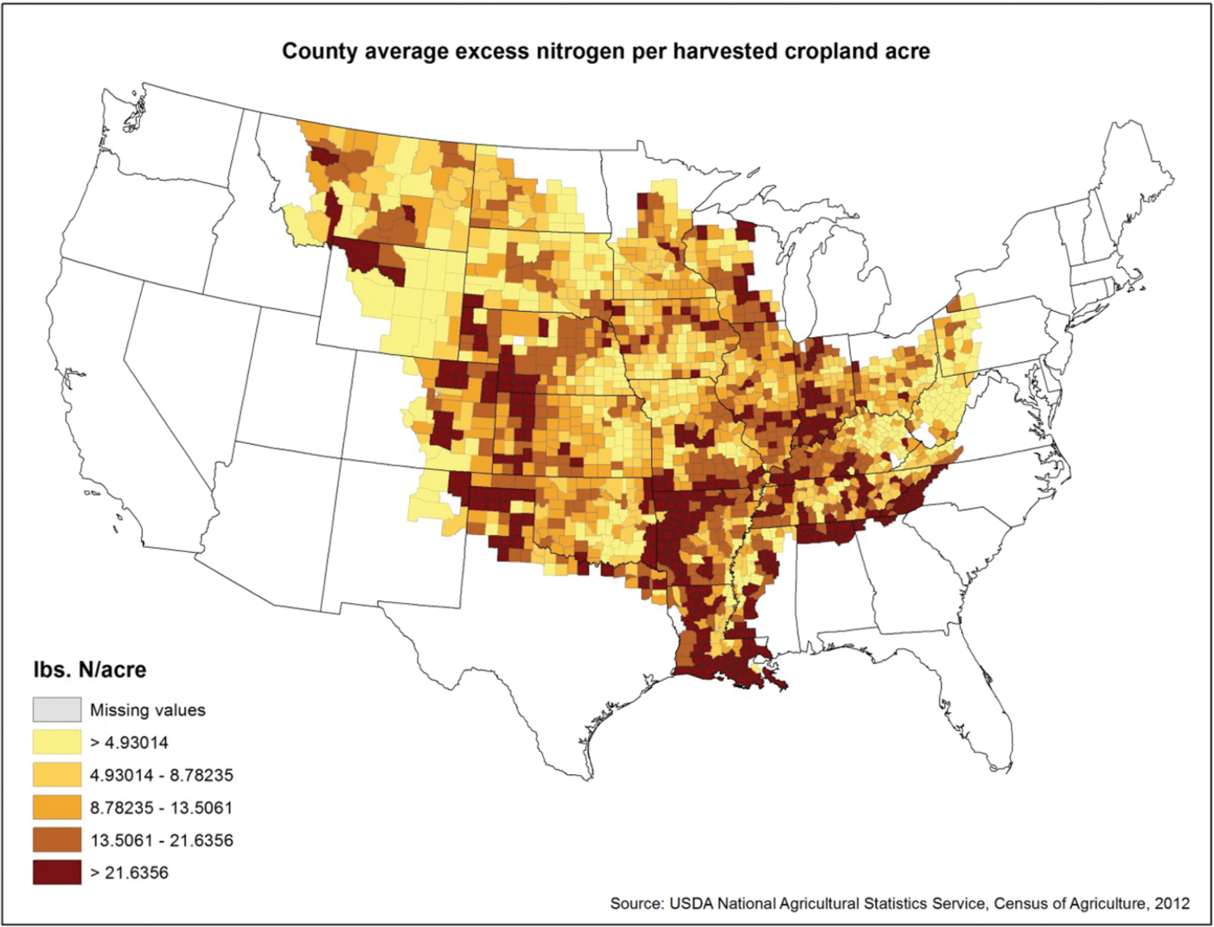
Excess nitrogen (Livestock manure management)
USDA NASS, 2012
From: The Potential Role for a Nitrogen Compliance Policy in Mitigating Gulf Hypoxia
Appl Econ Perspect Policy. 2016;39(3):458-478. doi:10.1093/aepp/ppw029
Appl Econ Perspect Policy | Published by Oxford University Press on behalf of the Agricultural and Applied Economics Association 2016. This work is written by US Government employees and is in the public domain in the US.
Notes:
Figure 1 County average excess nitrogen per harvested cropland acre
44

Slide 45
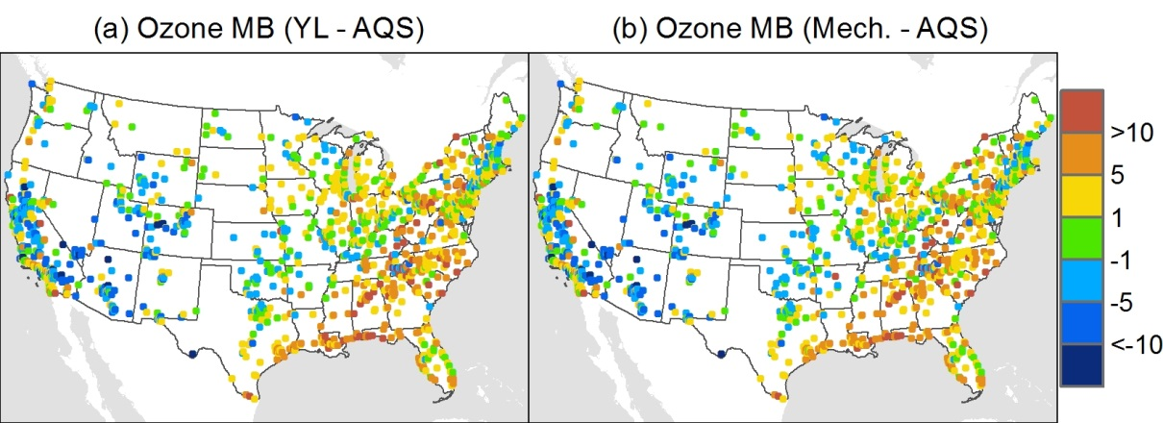
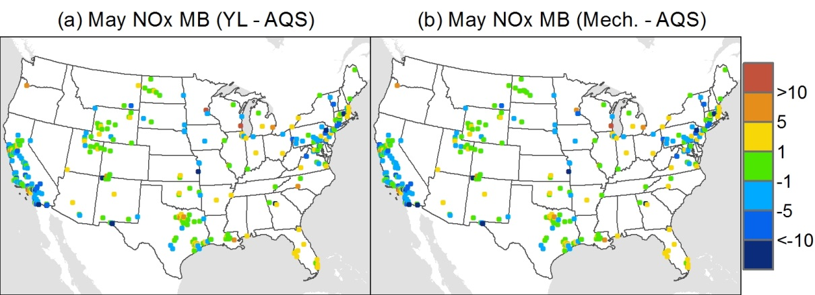
Mean Bias for Ozone and NOx concentration relative to AQS observations
In ppb

Slide 46
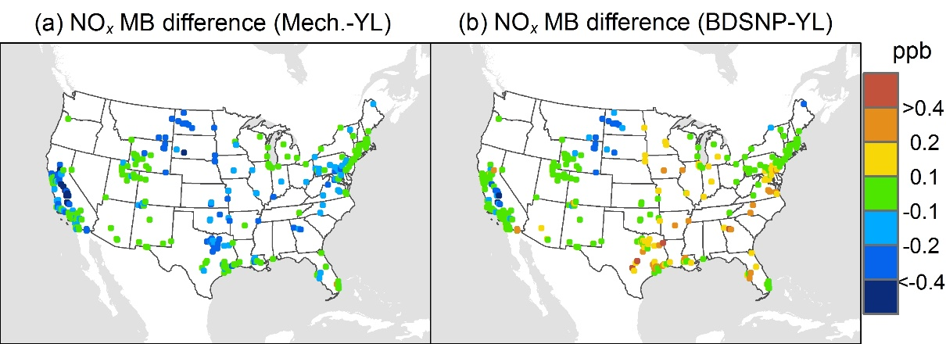
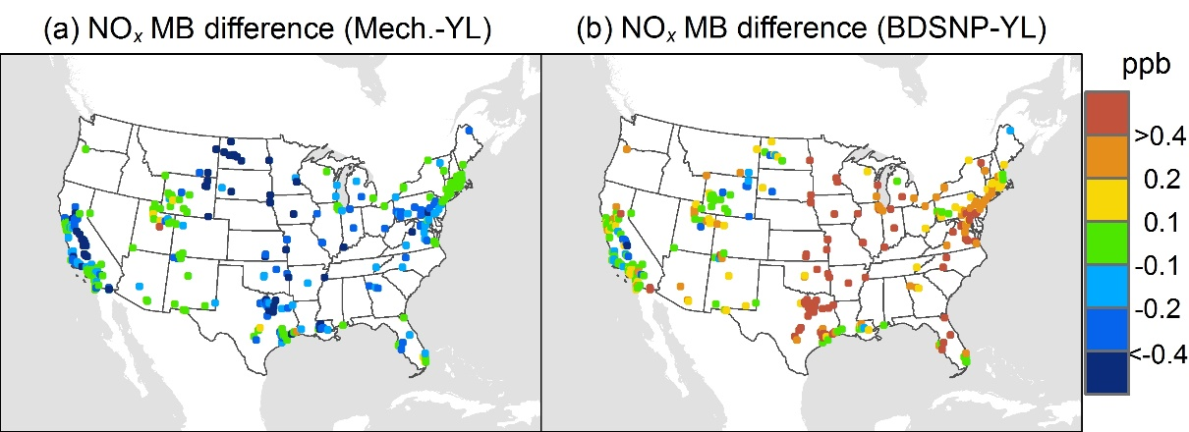
Reduced bias in NO_{x} in Mechanistic Scheme
May 2011
July 2011
Mean Bias (MB) relative to AQS NOx observations

Slide 47
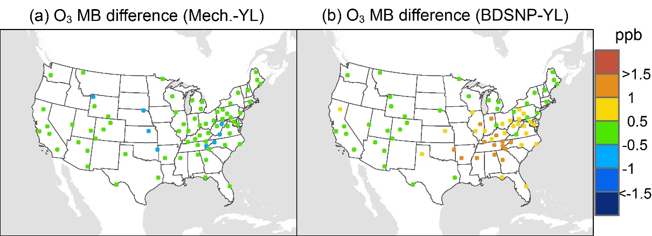
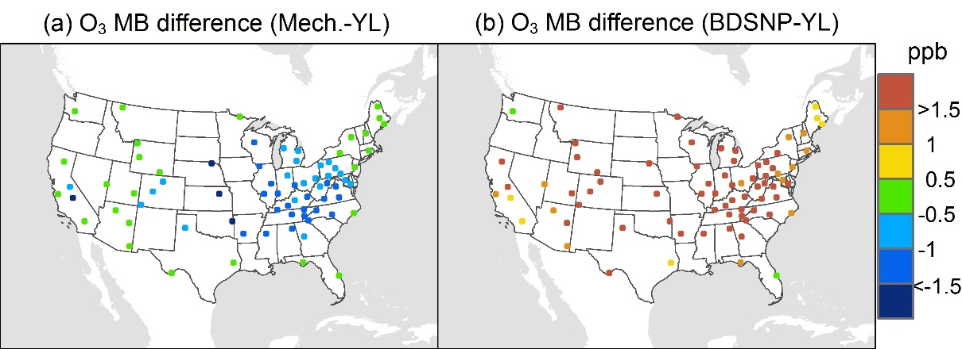
Reduced bias in O₃ in Mechanistic Scheme
May 2011
July 2011
Mean Bias (MB) relative to CASTNET O₃ observations

Slide 48
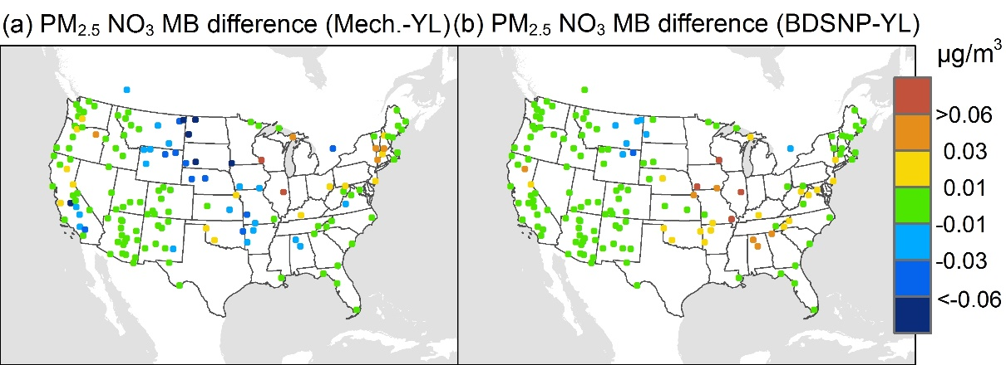
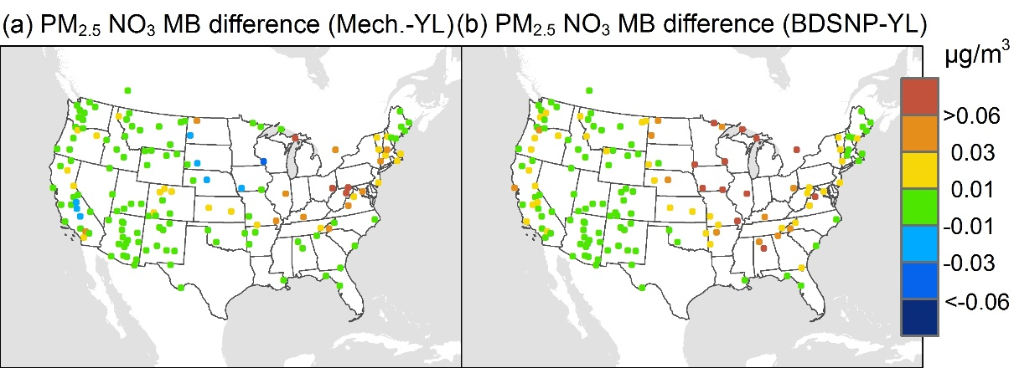
Reduced bias in PM_{2.5} nitrate in Mechanistic Scheme
May 2011
July 2011
Mean Bias (MB) relative to IMPROVE PM NO₃ observations

Slide 49
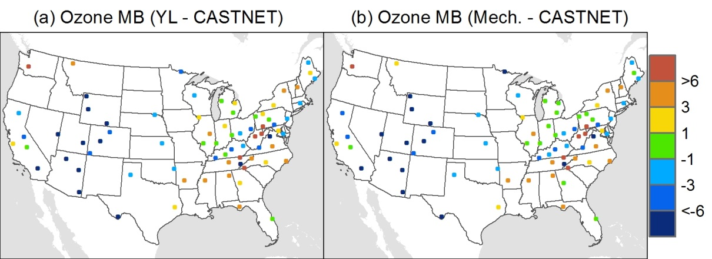
Mean Bias for Ozone concentration relative to CASTNET observations
In ppb

Slide 50
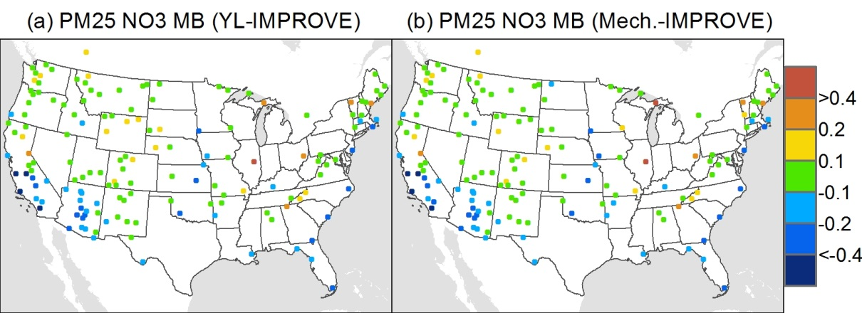
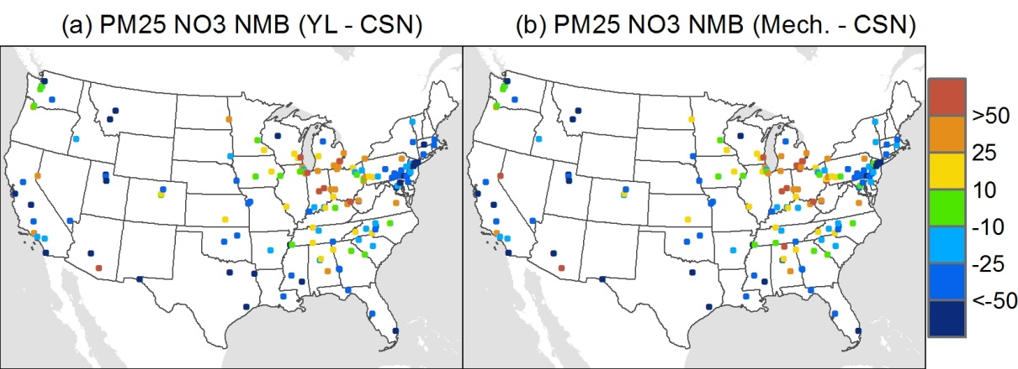
Mean Bias for PM2.5 NO3 concentration relative to IMPROVE and CSN observations
In μg/m³

Slide 51
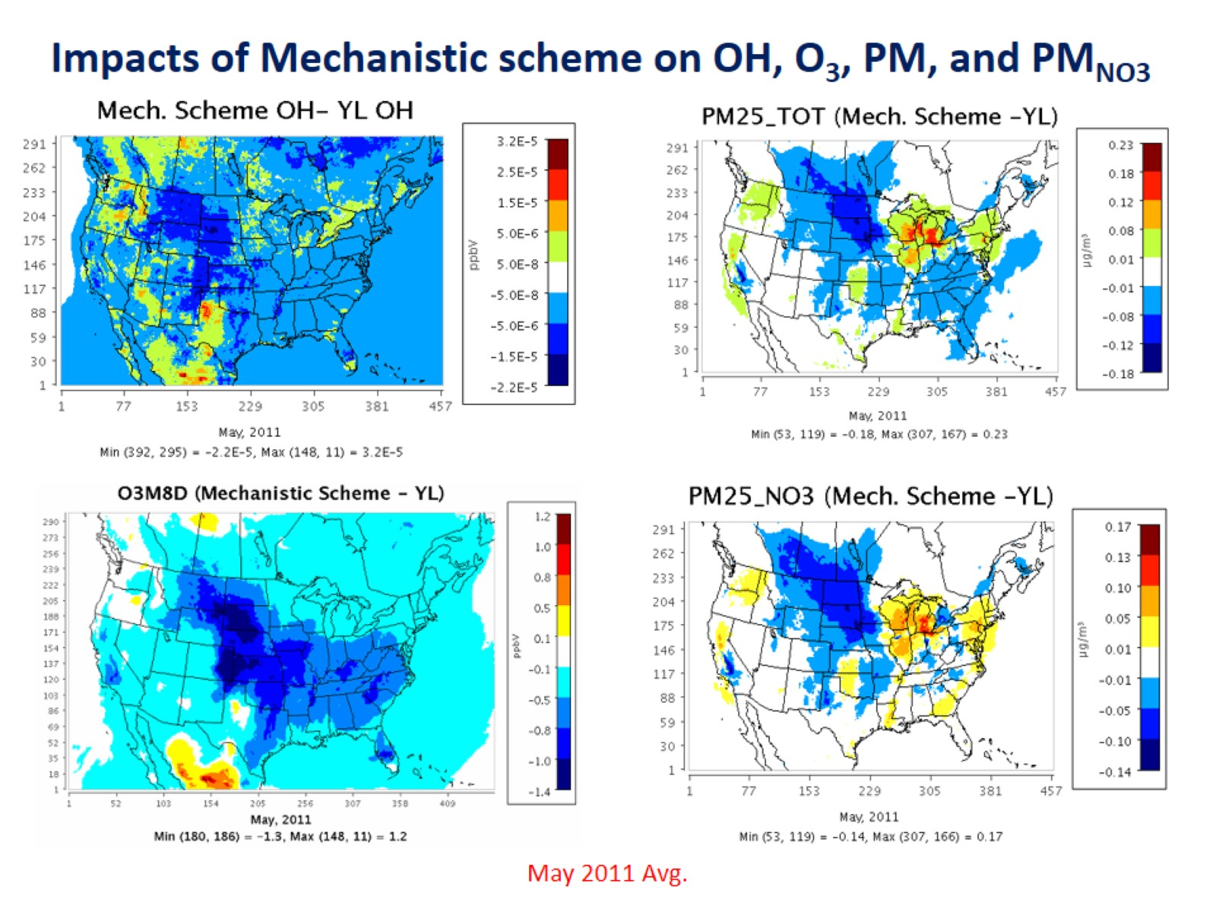

Slide 52
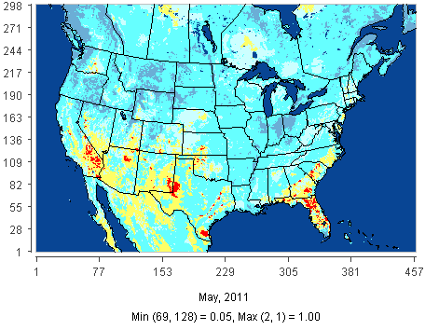
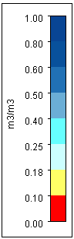
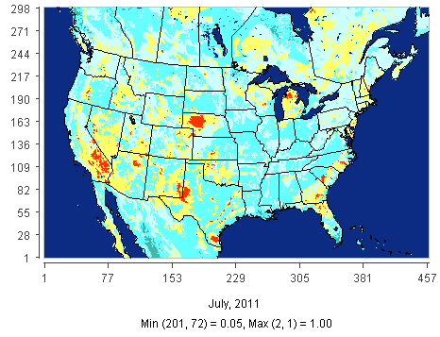
Soil moisture (m³/m³) on a monthly mean basis
(May and July 2011) for CONUS
http://www.cpc.ncep.noaa.gov/products/analysis_monitoring/regional_monitoring/palmer/2011/

