Slide 1
Long Run EGU Siting to Account for Spatial and Temporal Variability
Linking Energy Sector and Air Quality Models Through Downscaling
Benjamin F. Hobbs
Schad Professor of Environmental Management, Johns Hopkins University
Chair, Market Surveillance Committee, California ISO
Emily Fisher, Shen Wang, Xinrui Zhong, Xiaoxue Hou, J. Hugh Ellis
Department of Environmental Health & Engineering
The Johns Hopkins University
17th CMAS Conference
Oct. 22-24 2018 | Chapel Hill, NC
Air Climate & Energy (ACE) Center Grant funded by US Environmental Protection Agency Assistance Agreement No. RD835871

Slide 2
Notes:
Brief introduction
Walk through
Show
Dig more

Slide 3
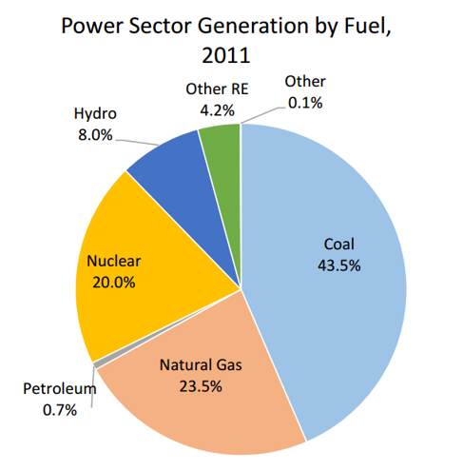
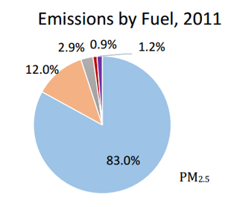
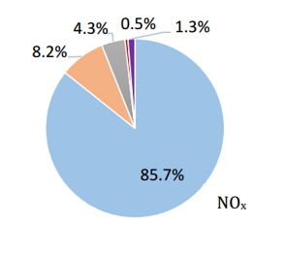
1.1 Why we need Downscaling?
National long-term energy policy models :
Cannot be directly used for air quality and human health research!
(Ran, Loughlin et al., Geosci. Model. Dev., 2015)
National Energy Modeling System (NEMS)
The Integrated MARKAL-EFOM System (TIMES) model
Downscaling
The Regional Energy Deployment System (ReEDS)
Air Quality Models
(e.g. CMAQ)
Research questions. How can we simulate:
Future energy transitions?
Corresponding emissions?
Consequent air quality?
Public health effects?
Power sector generation and emissions of select air pollutants by fuel (NEI)
Notes:
Currently, we have several great energy system models for energy projections, system planning and policy analysis. Also, there are NEI (showed in Pie charts) that we usually use as a baseline emission dataset by various sectors. With help of system planning model, we are able to project these emissions to next few decades to study the relationship between changes of emissions and future energy system. Well, when it comes to future emissions, we probably have more questions like 1,2. In order to answer these questions, we might have to coupled with the air quality models. However these is a gap between these two types of model, since they are typically in very different scales. The energy system model always projects highly aggregated results(like in national level or annually ), while AQM need more finer granularity emissions as input, such as hourly emissions. Here, the projected emissions Cannot be directly used for air quality and human health research. So, we are trying to build the link for these two types pf model. That is downscaling method.

Slide 4
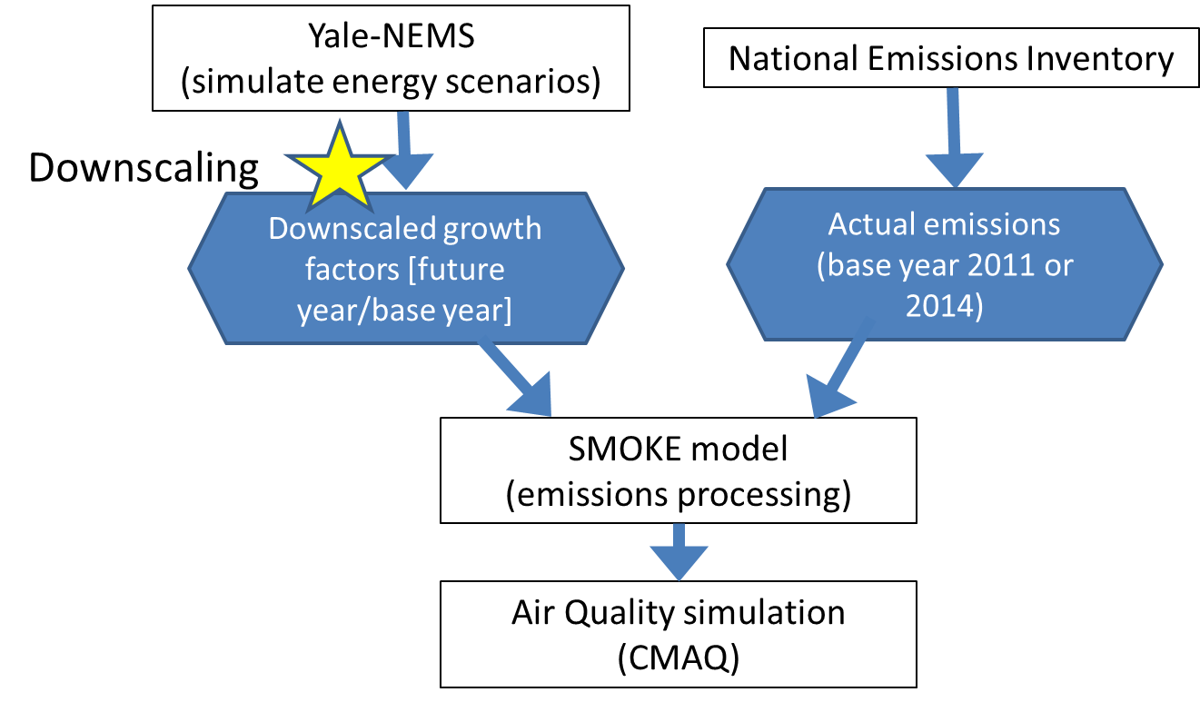
1.2 What is Downscaling?
Yale-JHU SEARCH Center Information Flow:
Geographical and temporal downscaling:
Notes:
We have developed a set of energy “transition” scenarios which will be modeled using a national model of the U.S. energy system. We will calculate the downscaled growth factors based on NEMS results and then apply them on NEI data to get proper scales, and finally feed them into AQM. The simulated changes in emissions will be used in subsequent projects to analyze changes in air quality and human health.
More specific, downscaling includes both spatial disaggregation and temporal disaggregation; for spatial downscaling, we will step down from NEMS EMM regions to county or even grid level, and for temporal downscaling, we are going to generate the hourly emission profile from the annual emissions.

Slide 5
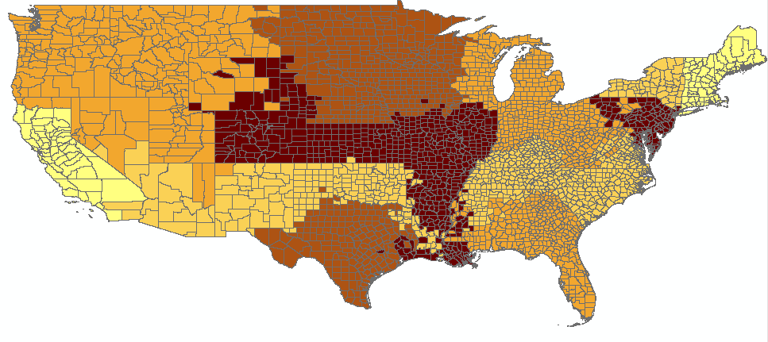
1.3 GIP Downscaling for EGUs
Limited to a few years into the future
Assumes no major shifts in future siting & operating patterns of the energy system
But renewables, EVs, distributed resources…
Traditional Method: “Grow-in-Place” (GIP):
For each region and pollutant: Assume emissions in all locations grow in proportion to region’s emissions
Base case EGU NO_{x} growth 2011 - 2040
Alternative: Optimize siting and operations of new EGUs
Notes:
In this paper, we are focusing on methodology of EGUs downscaling. Traditional methods for point sources downscaling rely on Grow-in-Place method, which consists of calculating growth in emissions from a baseline year based on changes in emissions, fuel use or vehicle miles traveled.
It assumes any future emission release projected by the energy model will be located at the same places with the same type of sources.
Its results would be relative unreliable in long term planning.
Or big shifts in the overall structure of the energy system are not expected.
So the main drawback of “grow-in-place” method disregards economic, technical, and policy factors that will site plants differently in the future

Slide 6
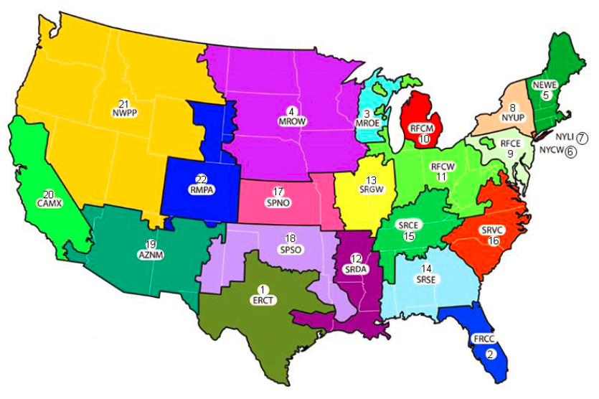
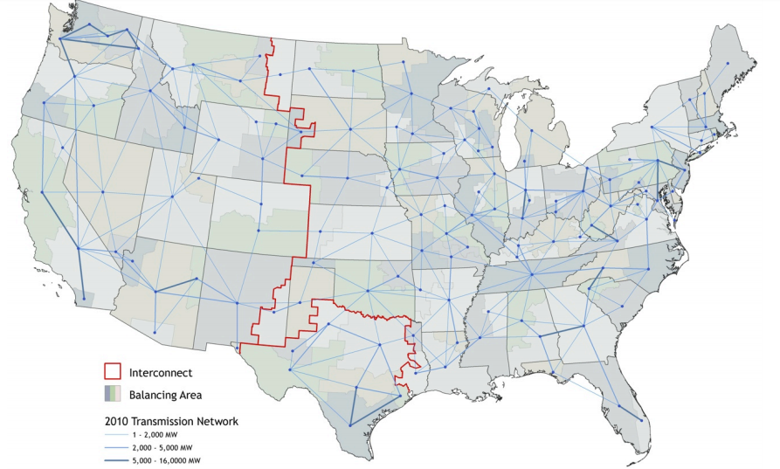
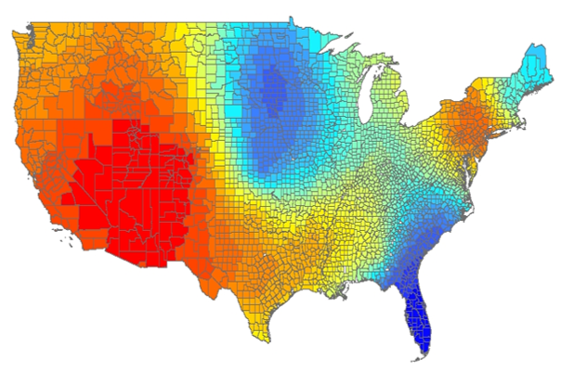
2.1 Downscaling for EGUs
3 step “Site-&-Grow” (SAG) method for siting new EGUs for more realistic emissions projections:
National/Regional
1. Step Down to Sub-regions:(LP generation expansion)
Allocate new capacity to sub-regions
2. GIS-Based County Screening:
Classify land as available or not.
Sub-regional
3. Step Down to Counties (Least-cost or multi-attribute optimization):
Specify placement of new capacity
County level
Notes:
1. Status: building up sub-regions based on ReEDS balancing area.
2. Status: recognizing important spatial characteristics of siting decisions -- transmission limitations, availability of renewable resources.
3. Status: differentiating fuel and variable costs at county level.

Slide 7
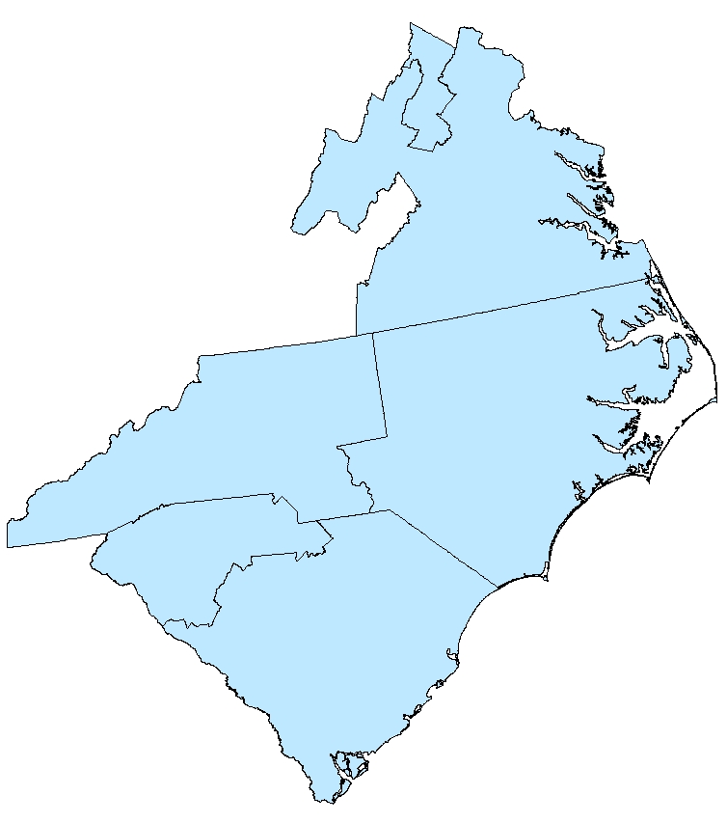
2.2 Step 1 LP Generation Expansion
Objective Function：
Minimize location-dependent O&M + investment cost
Decision variables:
MW of new capacity of each type by sub-region
MW operations in each load slice
Load balancing
Generator max capacity
Total capacity by type = NEMS output
Total energy by type, slice = NEMS output
Transmission constraints
Constraints：

Slide 8
3.1 Step 1 Example: EGU Siting
Total Regional Capacity (MW) NEMS 2040
High Natural Gas Q Scenario
Downscaled Capacity Expansion (MW):
“Site & Grow” vs. “Grow in Place”
Notes:
Others includes

Slide 9
3.1 Step 1: SAG vs GIP
Why does SAG differ from GIP?
New technologies (e.g., distributed resources, dry cooling)
System interactions (e.g., with renewables, grid availability)
Here:
Combined cycle / combustion turbines dominate new fossil technologies
But coal dominates emissions even in 2040
Much higher NO_{x} emissions rate in 2040 (~0.7 vs. ~0.1 lb/MWh)
Implies:
Coal retirements key
New plant siting differences make less of difference in emissions
Notes:
Others includes

Slide 10
3.1 Step 1: Grow-in-Place vs. Site-&-Grow
2017 AEO Reference Case: 2040 Emissions (t/hr)
GIP SAG
Change in
location &
timing
NO_{x} t/hr emissions: Peak & Offpeak
SO₂ t/hr emissions: Peak & Offpeak
Notes:
Others includes

Slide 11
3.1 Step 1: Energy Scenarios Compared
Base case (NEMS AEO 2017)
Low long-term natural gas prices
Natural Gas Prices
3. High electric vehicle penetration
4. Modernize ports & marine shipping
What makes more of a difference?
Downscaling vs. Scenario?
Notes:
Others includes

Slide 12
3.1 Step 1: Scenarios Compared
Comparison of SAG & GIP NO_{x} Emissions (t/hr) under Four Energy Scenarios
SAG
GIP
Notes:
Others includes

Slide 13
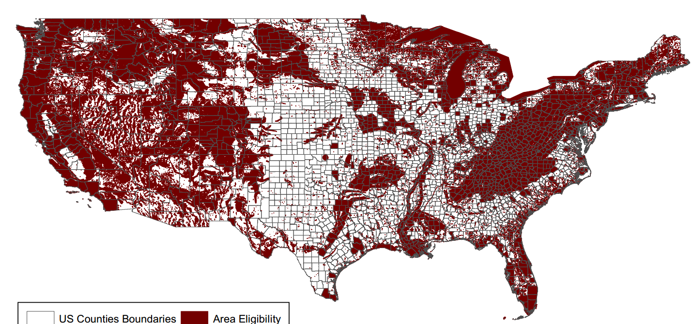
3.2 Step 2. GIS Preliminary Screening
Landslide
National parks
Open water
Populated area(>500/sq miles)
Classify all counties in study region as either available or not available for new EGU placement based on predefined factors(data source: Argonne National Laboratory, Oak Ridge National Lab)

Slide 14
3.3 Step 3: Variable Cost Differentiation
Kriging method for cost differentiation
Input
Process
Output
County-scale natural gas prices derived from kriging NEMS EMM region prices

Slide 15
4. Next Steps
Energy Transitions to be Modeled:
High electric vehicle penetration
Low long-term natural gas prices
Modernize ports & marine shipping
More distributed generation & demand response
Innovations in building energy efficiency
Apply Site-&-Grow method within eastern US study region
NEMS → 143 NREL ReEDS balancing authorities → Point souces
Temporal downscaling：Formulation and testing of weather-responsive emissions rates reflecting dynamics of
Plant efficiency
Demand

Slide 16
Questions?
Acknowledgments: ACES Centers Program, US Environmental Protection Agency Assistance Agreement No. RD835871
Ken Gillingham, Stephanie Weber, Pei Huang, Dan Esty, Yale University
Julie McDill and Susan Wierman, Mid-Atlantic Regional Air Management Association
Usual disclaimer applies
Notes:
Thank you for your patience. We are here to answer any questions!

