Slide 1
FEST-C v1.4: An integrated Agriculture, Atmosphere, and Hydrology Modeling System for Ecosystem Assessments
Limei Ran¹, Ellen Cooter^{1,6}, Dongmei Yang², Yongping Yuan¹, Verel Benson³,
Jimmy Williams⁴, Jonathan Pleim¹, Wyat Appel¹, Ruoyu Wang⁵, Adel Hanna², Val Garcia¹, Rohit Mathur¹
¹Computational Exposure Division, USEPA/ORD/NERL, Research Triangle Park, NC, USA
²University of North Carolina at Chapel Hill, Chapel Hill, North Carolina, USA
³Benson Consulting, Columbia, Missouri, USA
⁴Blackland Research & Extension Center, Texas A&M University, Texas, USA
⁵University of California, Davis, California, USA
⁶Retired
Acknowledgements: Liz Adams at UNC-IE, Shawn Roselle, Daiwen Kang, George Pouliot at USEPA
17th Annual CMAS Conference, Chapel Hill, NC: October 22-24, 2018

Slide 2
1. Fertilizer Emission Scenario Tool for CMAQ
(FEST-C)
FEST-C: https://www.cmascenter.org/fest-c/
    First release of FEST-C v1.0 in October 2013
    Current release FEST-C V1.4 in September, 2018
Contains Java-based interface, Spatial Allocator, and EPIC (Williams, 1990)
Facilitates EPIC simulations over pasture and crop land
Integrated with WRF and CMAQ
Integrated with SWAT (Soil & Water Assessment Tool) for watershed hydrology and water quality
Generate EPIC output for CMAQ modeling with the bi-directional NH₃ options and SWAT
Becoming a critical element for integrated, one-biosphere assessments of air, land and water quality in light of social drivers and human and ecological outcomes
Cooter et al., 2010, 2012, 2017; Ran et al., 2011; Fu et al., 2015; Garcia et al., 2017

Slide 3
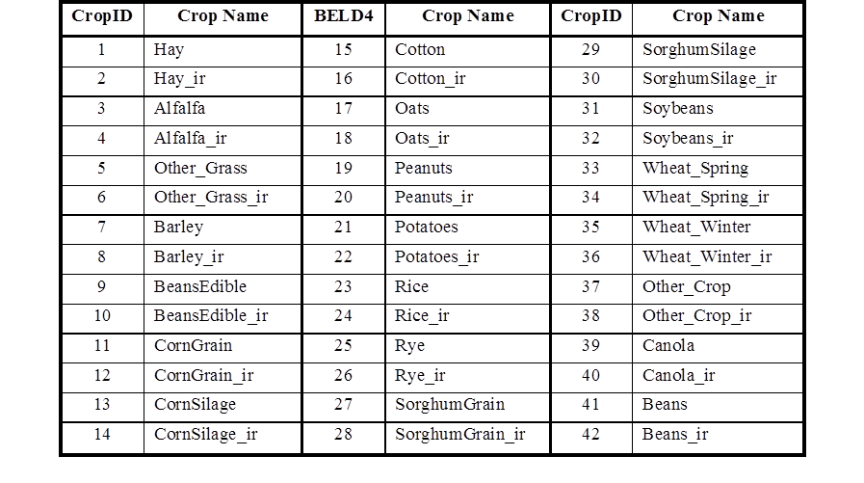
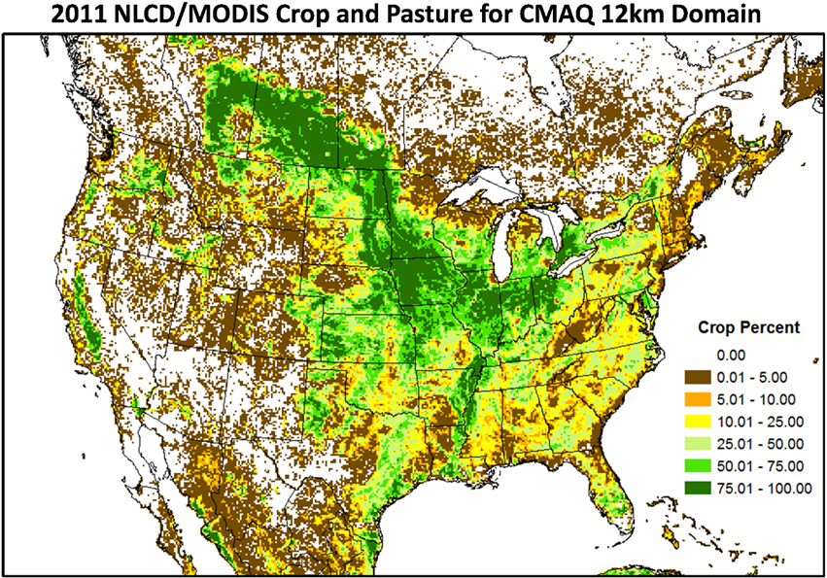
2. FEST-C EPIC Input: grassland and cropland
21 grassland and crop types with rainfed and irrigated information at CMAQ modeling grid cells
Crop fractions at each modeling grid cell are from:
  NLCD/MODIS land cover (2001, 2006, 2011)
  USDA NASS - USDA National Agricultural Statistics Service (2002, 2007, 2012)
  Census of Agriculture - Statistics Canada
  MEXICO Agricultural Census (not in current system)
The system is configured for the U.S. agricultural land in the domain

Slide 4
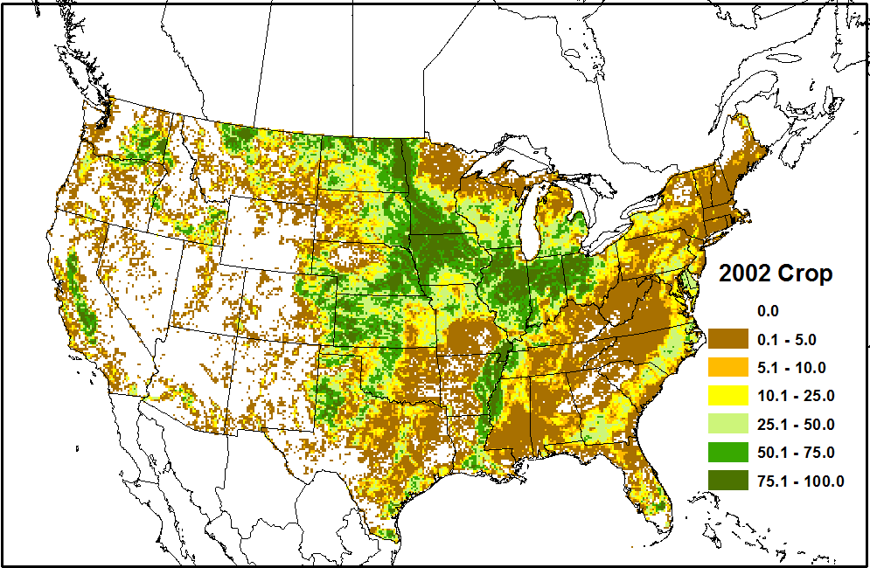
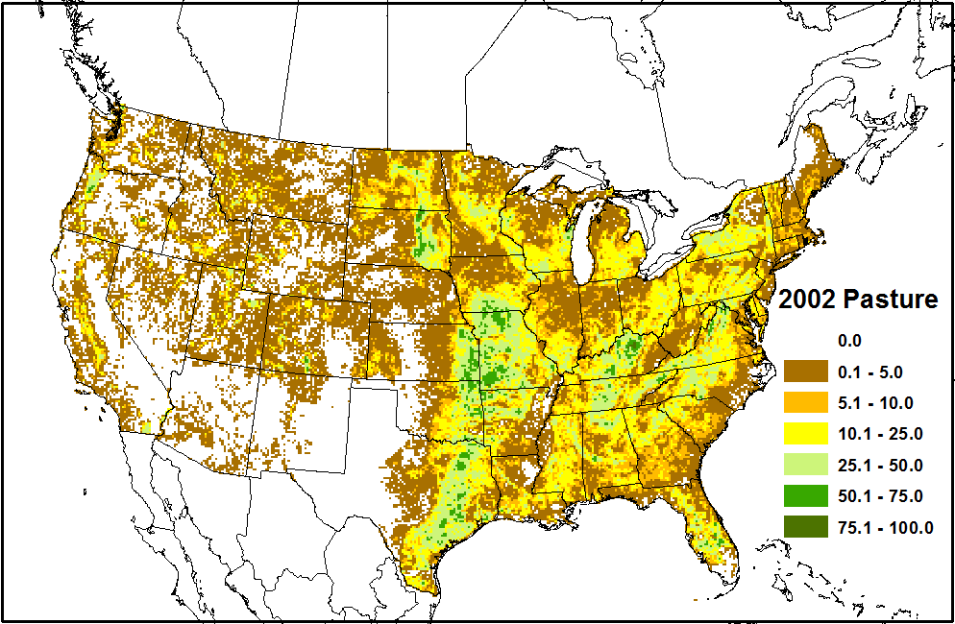
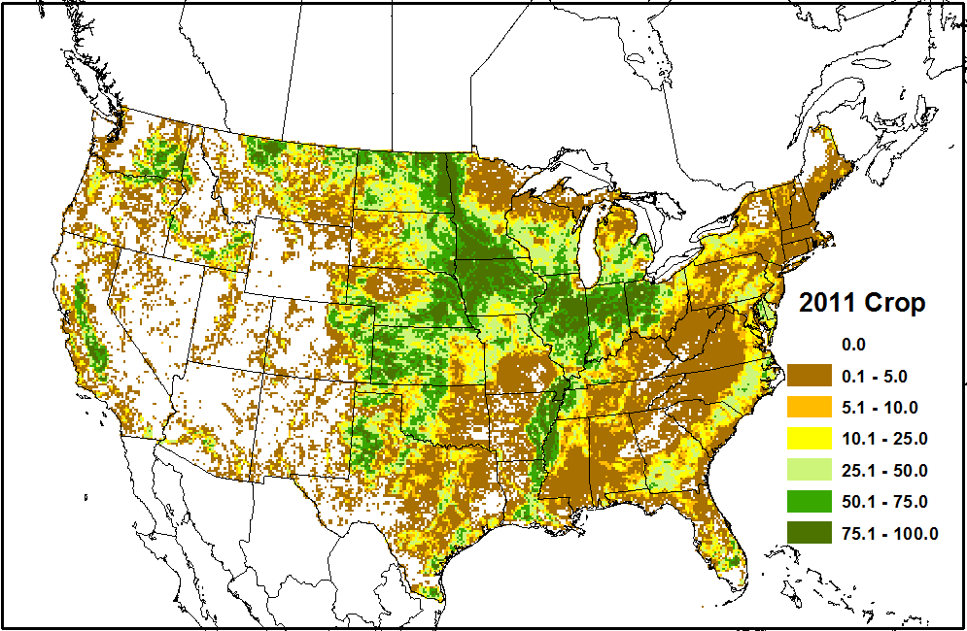
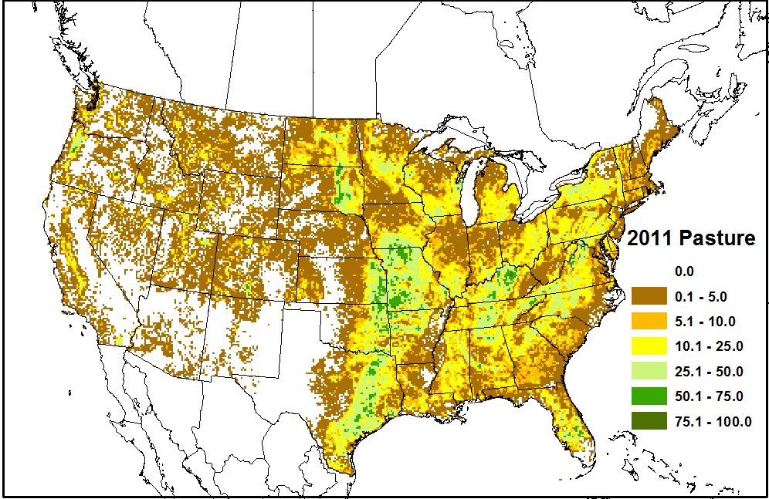
2. FEST-C EPIC Input: grassland and cropland
Agriculture land in CMAQ 12km Domain (areas are similar over the years)
Cropland
Pasture
2002
2011

Slide 5
2. FEST-C EPIC Input: grassland and cropland
Percent of the domain agriculture land by crop types for 2002, 2006, and 2012
Pasture (1 to 6): ~30% of total FEST-C EPIC agricultural land
Dominant crops: hay, alfalfa, grain corn, soybean, wheat (spring+winter), and other crops
More grain corn area since 2006
Lower soybean land in 2006
More hay land and less other grass land since 2006
Decreasing Other Crop area from 2002 to 2012 (all area reporting crops not explicitly modeled)

Slide 6
3. FEST-C v1.4 and IMS-EPIC Evaluation
Updates in FEST-C v1.4 with modified EPIC0509:
      EPIC to SWAT sub-interface
      C-N cycles (e.g. denitrification)
      Hydrology (e.g. curve number computation – surface runoff, percolation)
      Management, Spatial Allocator Tools, SWAT R tools, and EPIC output changes
FEST-C v1.3 and v1.4 Simulations for US 12km domain:
  2010: 2011 NLCD, 2012 NASS, 2010 WRF3.4/CMAQ5.01
  2011: 2011 NLCD, 2012 NASS, 2011 WRF3.4/CMAQ5.01
  2012: 2011 NLCD, 2012 NASS, 2012 WRF3.4/CMAQ5.02
  (NLCD – National Land Cover Database, NASS - National Agricultural Statistics Service)
  Same spinup for soil and N fertilization initialization
  Application: WRF and CMAQ input

Slide 7
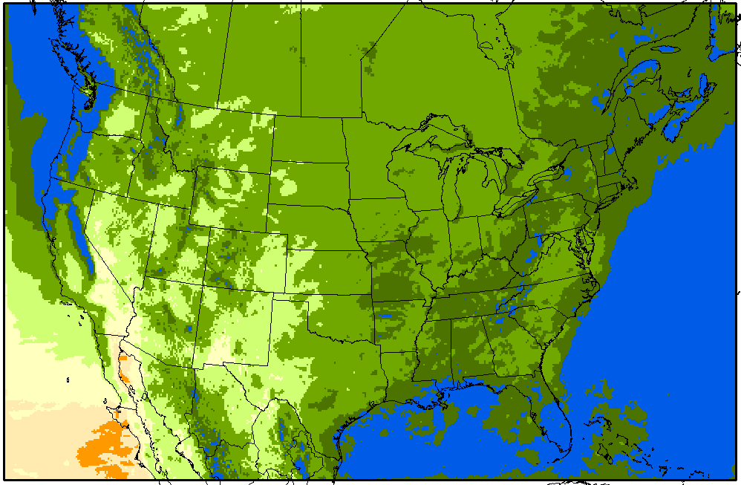
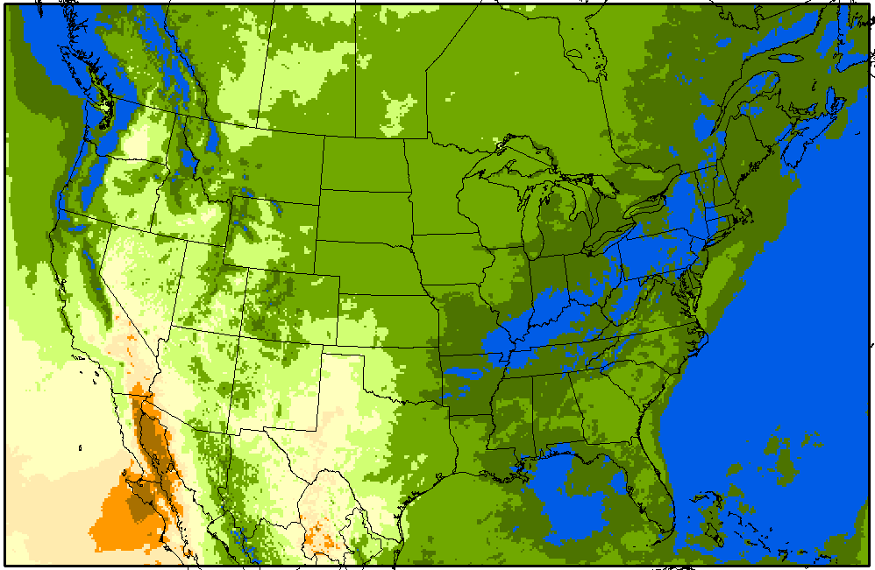
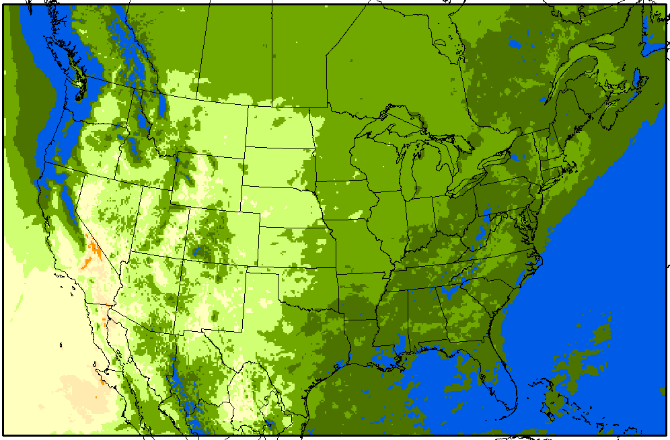
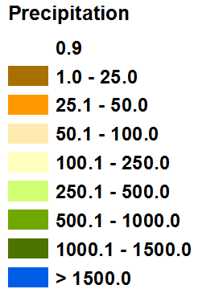
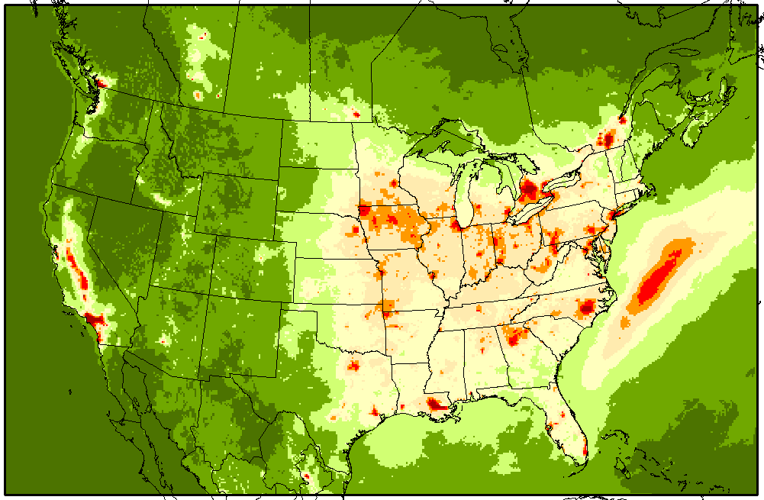
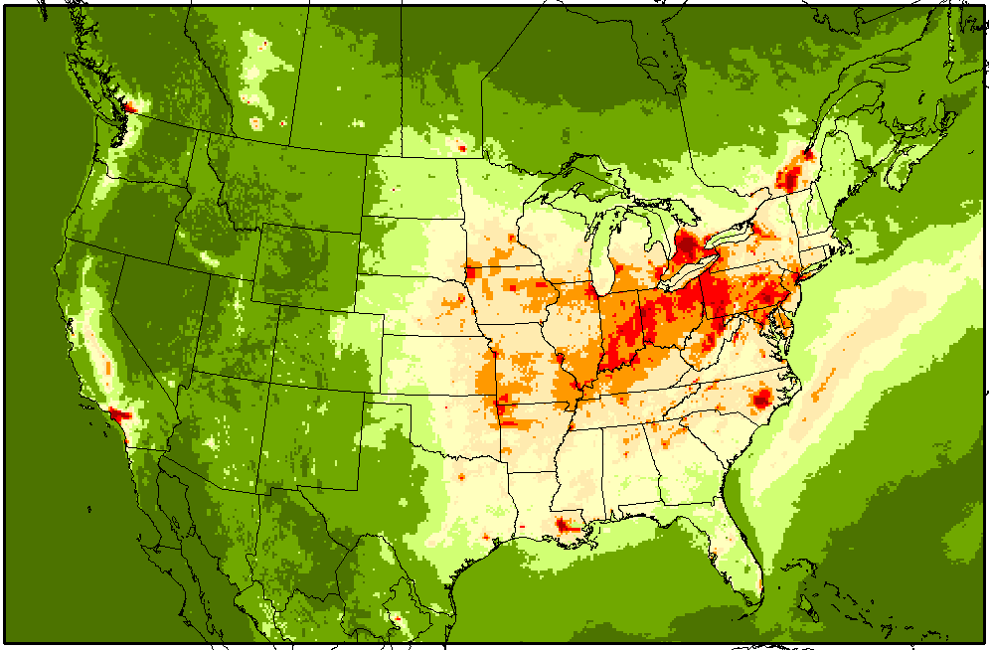
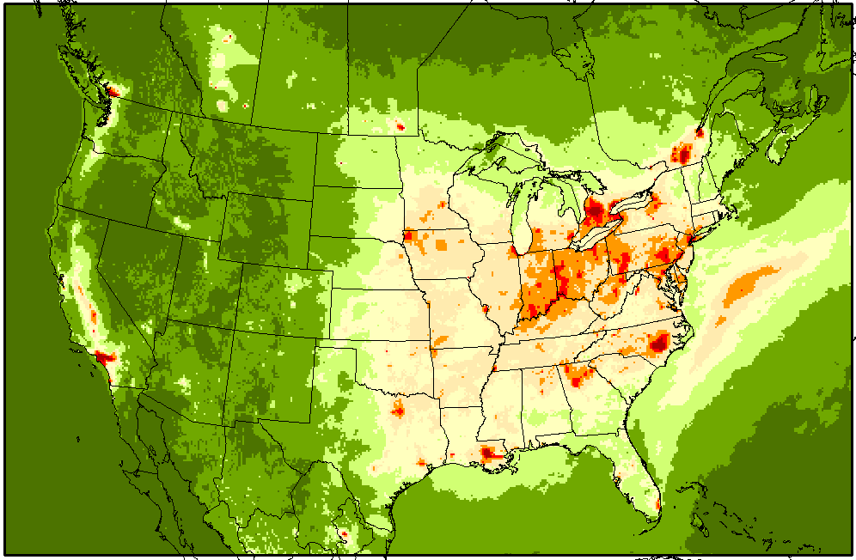
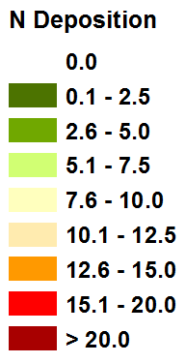
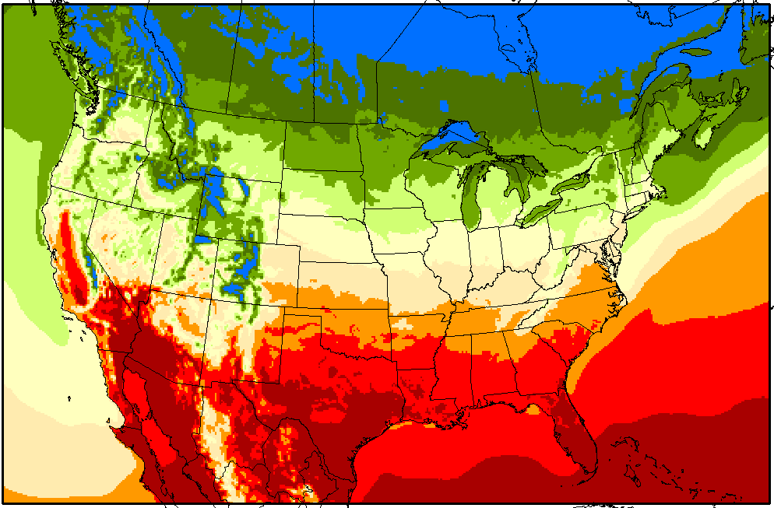
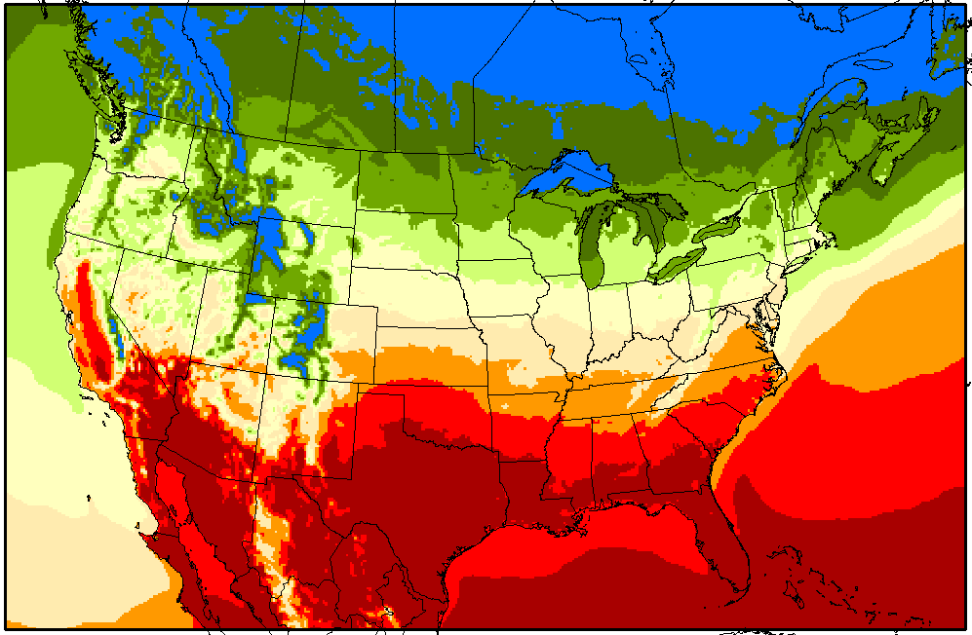
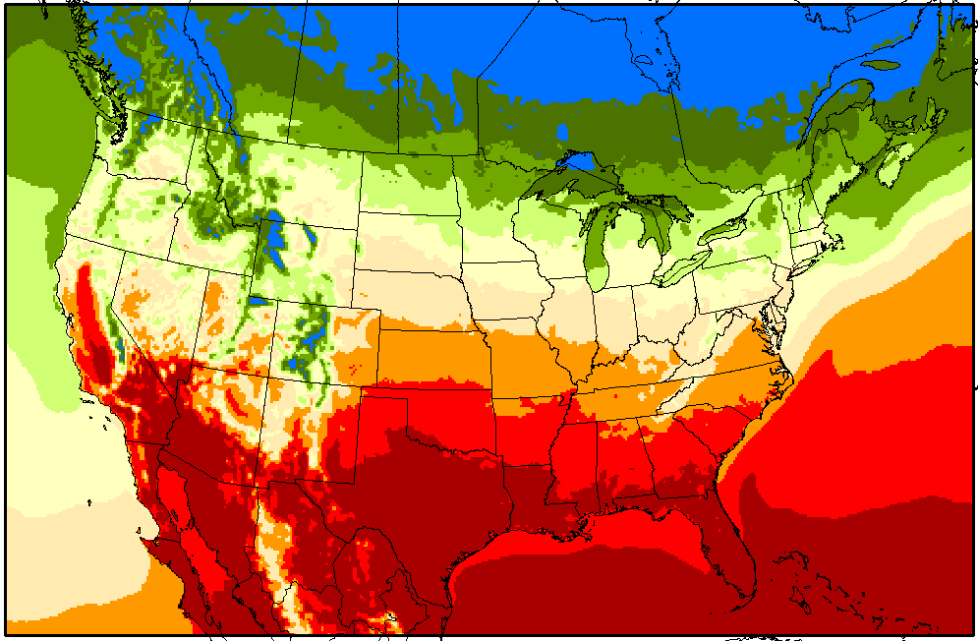
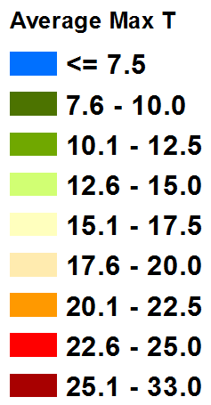
3. FEST-C v1.4: IMS-EPIC Evaluation – Atmosphere
2010
2011
2012
Precipitation (mm)
N Deposition (kg ha⁻¹)
Average Daily Maximum Temperature (C)

Slide 8
3. FEST-C v1.4: IMS-EPIC Evaluation – Yield
EPIC does well in simulating yields for corn grain and soybeans
  Decreasing trend consistent with USDA NASS reports (due to drought)
  EPIC has high yields in normal precipitation year 2010 (no insect and storm loss in EPIC)

Slide 9
3. FEST-C v1.4: IMS-EPIC Evaluation – MN fertilization
FEST-C V1.3
FEST-C V1.4
FEST-C v1.3 significantly overestimates fertilization
  Much higher than USGS reported fertilization
  An error in denitrification codes resulted in high denitrification rate (more out) -> high fertilization rate (more in)
FEST-C v1.4 fertilization is much more reasonable than v1.3
  Lower than USGS sale data as EPIC is a need-based model

Slide 10
3. FEST-C v1.4: IMS-EPIC Evaluation – 2011 N Budget
Source
Loss
N sources and loss in FEST-C V1.4:
  Lower fertilization rate
  (< 60 kg/ha – much better)
  Lower Denitrification rate
  (< 20 kg/ha, much more
  reasonable)
  Higher percolation and lower runoff
  Lower volatilization
Detailed N budget information in a paper under preparation by Ran et al.

Slide 11
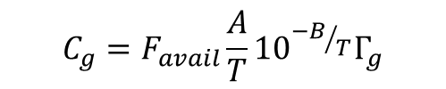
3. FEST-C v1.4: IMS-CMAQ Evaluation for 2011
CMAQ v5.3 M3DRY with EPIC: new bi-directional NH₃ approach
Requires FEST-C v1.4 “EPIC to CMAQ” output
Use EPIC simulated soil NH₄⁺ and soil properties directly (Pleim et al., 2013) (different from CMAQ simulated soil NH₄⁺ mainly with EPIC fertilization in CMAQ 5.2 or early)
  Fully coupled with EPIC which counts all N sources (fertilization, N deposition, N fixation, net mineralization) and losses (runoff, percolation, volatilization, denitrification, plant uptake, harvesting)
  Soil NH₃ compensation concentration
  F_{avail} is the fraction of NH₄⁺ in the soil that is available for volatilization, A and B are constants, T is leaf or soil temperature
  Details in a paper under preparation by Pleim et al.
$$C_{g}=F_{avail}\frac{A}{T}{10}^{{−B}/T}Γ_{g}$$
where

Slide 12
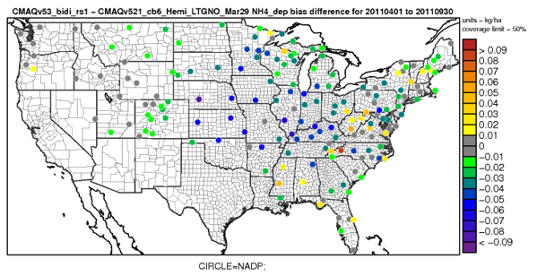
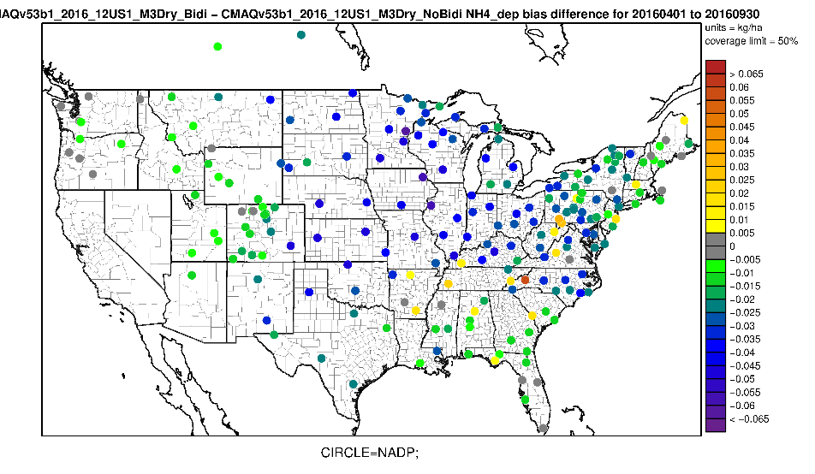
3. FEST-C v1.4: IMS-CMAQ Evaluation for 2011, 2016
NH₄⁺ wet deposition bias difference: BIDI - Base
(2011 04 to 09)
NH₄⁺ wet deposition bias difference: BIDI - Base
(2016 04 to 09)
NH₃ concentration: 2016 04 to 09
  CMAQ v5.3 simulations with the new M3dry approach:
  Domain-wide improvement on simulated NH₄⁺ wet deposition for both 2011 and 2016 over the growing season
  Better performance from 2016 likely from improved meteorology (e.g. precipitation) with lightning assimilation
  Distinct improvement domain-wide in NH₃ concentration each month for the 2016 growing season

Slide 13
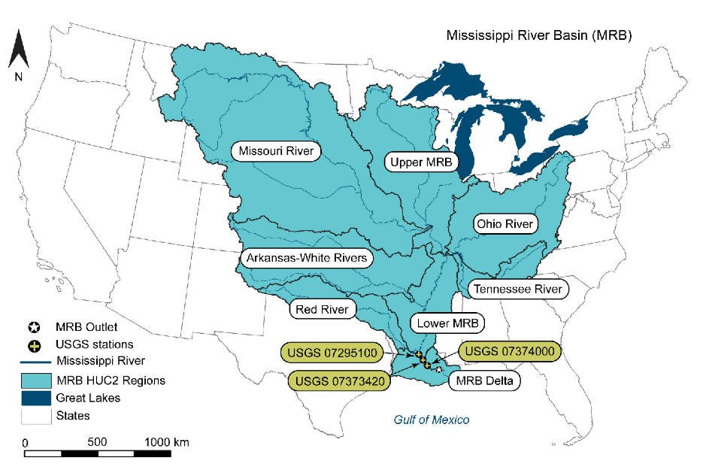
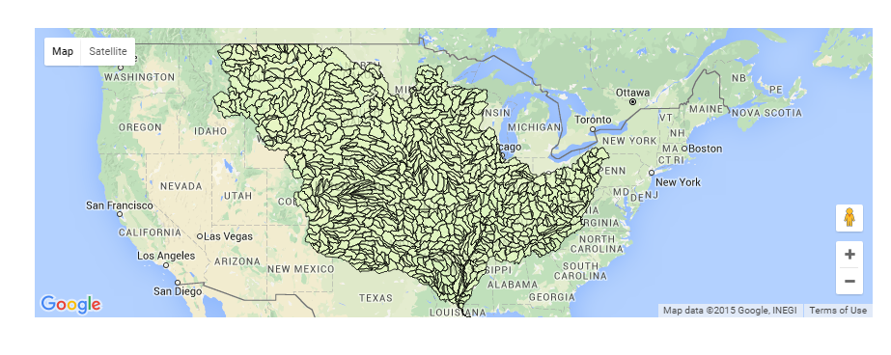
3. FEST-C v1.4: IMS-SWAT Evaluation
Integrated modeling system - SWAT with EPIC-WRF-CMAQ
Requires FEST-C v1.4 “EPIC to SWAT” output
  EPIC simulated edge of field runoff, sediment, and nutrients
  WRF/CMAQ generated weather and N deposition
Application of IMS-SWAT to the Mississippi River Basin (MRB) 8-digit HUCs
Yuan et al., 2018, BGC (accepted)
Figure 2 from the paper

Slide 14
3. FEST-C v1.4: IMS-SWAT Evaluation
IMS-SWAT simulations with 2010 to 2012 EPIC-WRF-CMAQ input from FEST-C v1.4
  Reasonable performance given no calibration
  High flow bias in late Spring and low dissolved N from summer to winter
FEST-C v1.4 paper under preparation by Ran et al.

Slide 15
3. Conclusions and Future Work
Conclusions
  EPIC performs reasonably well on production and fertilization
    Very sensitive to soil C-N-P and hydrology processes – a lot of uncertainties
    High carbon accumulation at the end of the spinup (25 years) -> high mineralization
  New bi-di approach in CMAQ M3DRY Improves NH₃ concentrations and NH₄ wet deposition
    Directly uses EPIC soil NH₄ and soil properties
    Flux is very responsive to soil conditions
  Performance of IMS (integrated SWAT with EPIC-WRF-CMAQ) is reasonable
    Very sensitive to WRF precipitation
  Future Work
  Improve EPIC C-N-P processes with field data
  Improve crop, soil, and management input data sets – challenge for large region
    2011 and 2016 fertilizer types
    2016 NLCD and 2017 NASS data

Slide 16
Disclaimer
While this work has been reviewed and cleared for presentation by the U.S. EPA, the views expressed here are those of the authors and do not necessarily represent the official views or policies of the Agency.

