Slide 1



Forecasting Exposures to Prescribed Fire Smoke for Health Predictions in Southeastern USA
Talat Odman, Ha Ai, Yongtao Hu, Armistead Russell, Ambarish Vaidyanathan and Scott Goodrick
17th Annual CMAS Conference
Chapel Hill, North Carolina
October 24, 2018

Slide 2
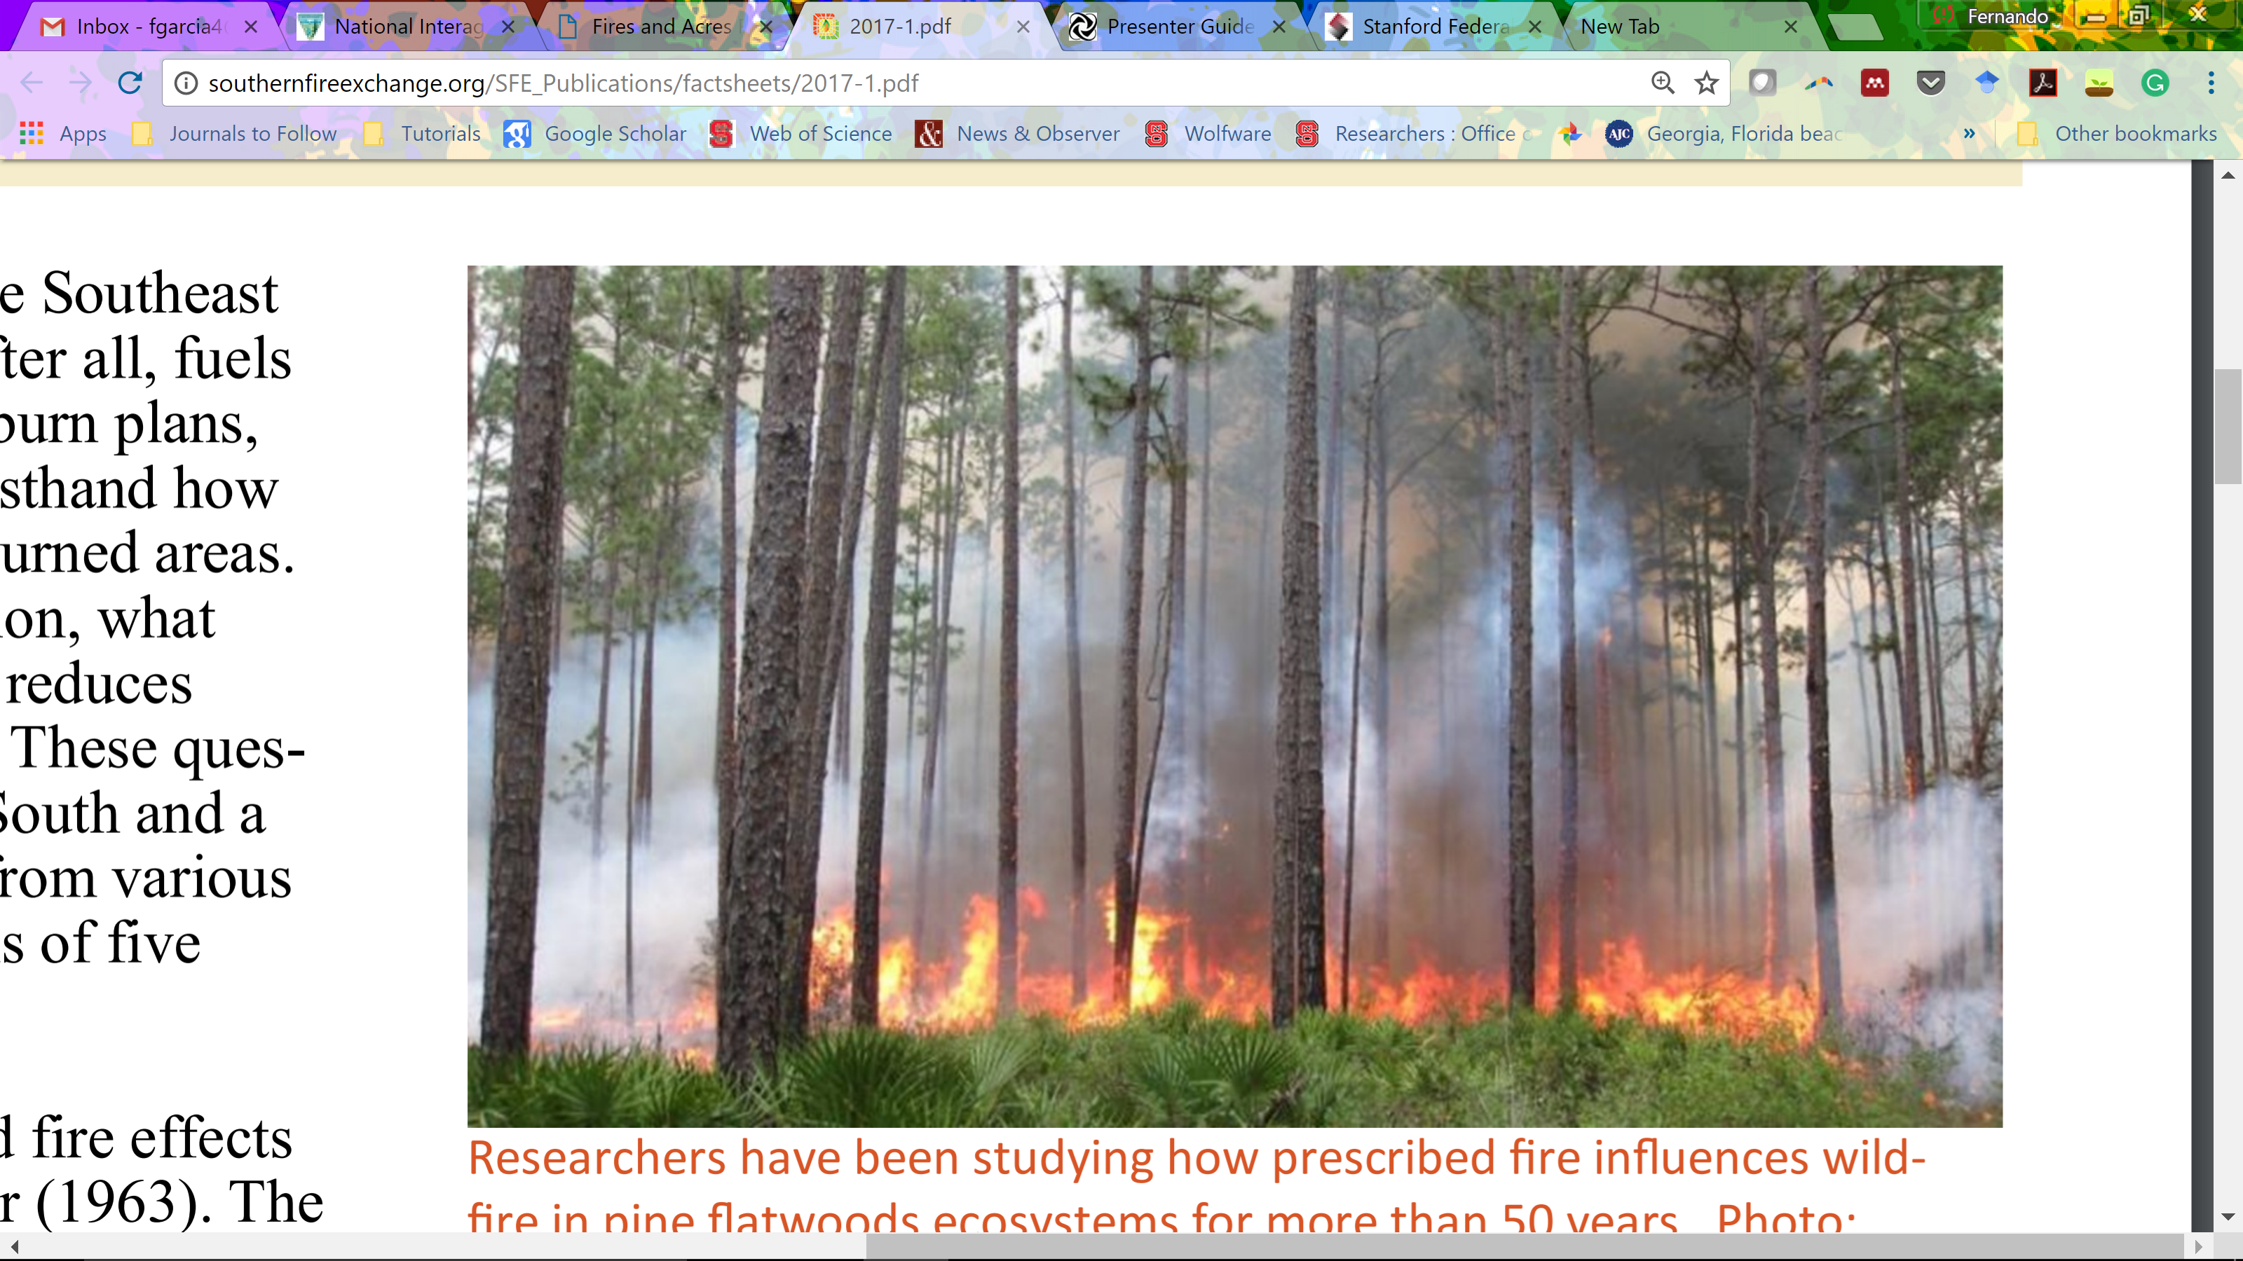
Prescribed fire, air quality and public health
Prescribed fire is a forest management tool utilized to improve/maintain ecosystem health and reduce wildfire risk [Ryan et al., Front. Ecol. Environ. 2013].
About ½ of wildland fire PM2.5 emissions in the US are attributed to prescribed fire [US EPA, 2014 NEI].
Over 40% of Americans are estimated to live in areas with a moderate or high contribution of wildland fires to ambient PM2.5 concentrations. [Rappold et al., Environ. Sci. Technol., 2017].
Wildland fire smoke has been associated with negative health effects by a large number of epidemiological studies [Reid et al., Environ. Health Perspect., 2016].
Photo: Southern Fire Exchange

Slide 3
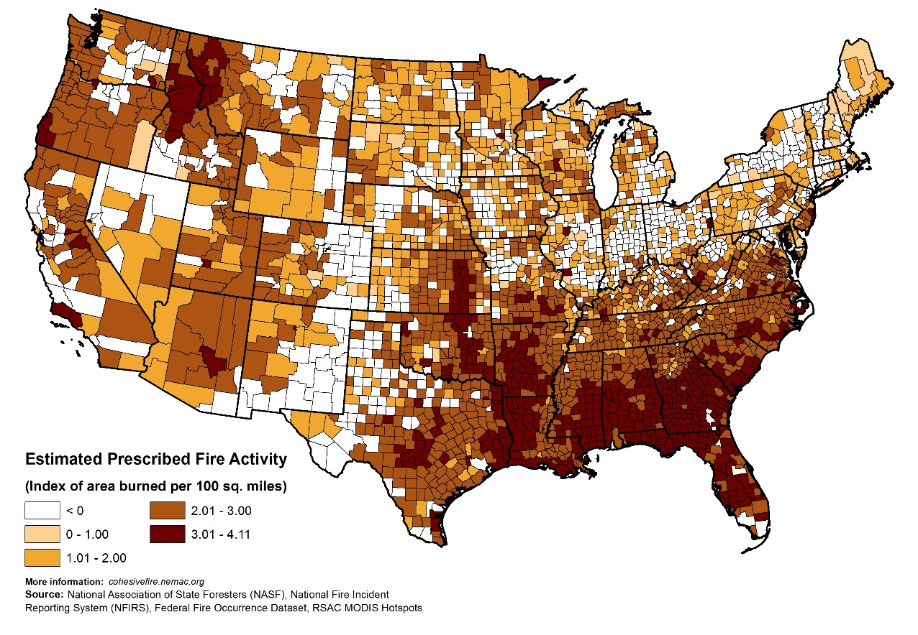
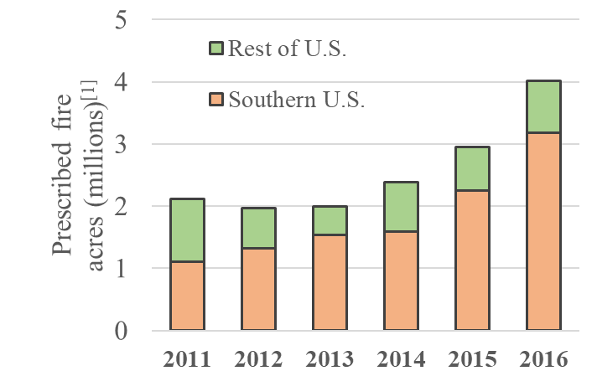
Prescribed fire is the largest source of PM_{2.5} emissions in Southeastern U.S.
National Interagency Coordination Center
According to 2014 NEI, ¼ of all PM2.5 emissions in Southeastern USA are attributable to prescribed fire.

Slide 4
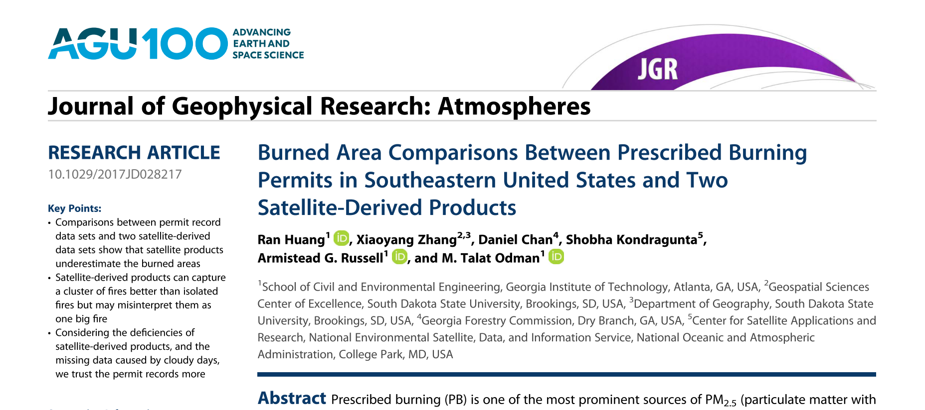
A comparison between satellite-based and permit-based data

Slide 5
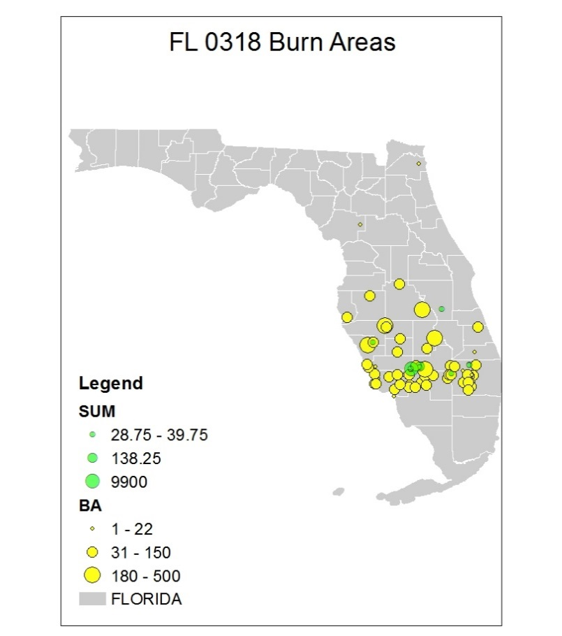
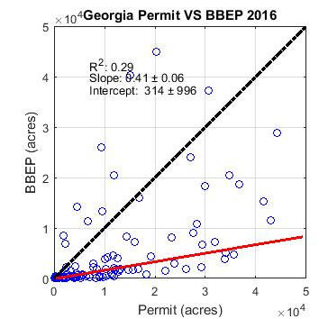
Satellites either miss small fires or misinterpret a cluster of small fires as one big fire
Satellite
Permit
Notes:
Comparison of daily state total burn areas for the first four months of 2015 and 2016 in Georgia and Florida: BBEP versus permit record data.

Slide 6


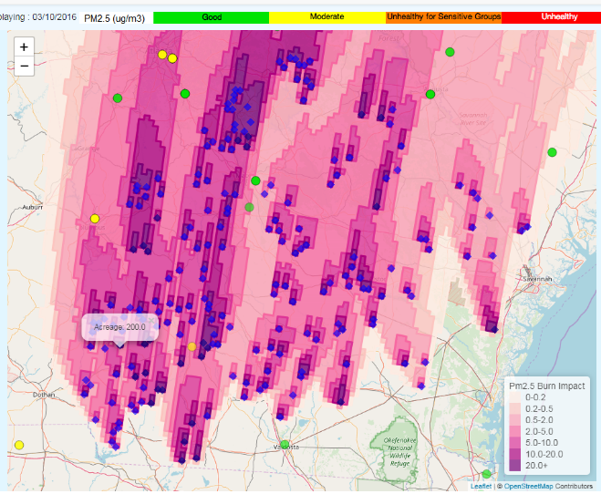
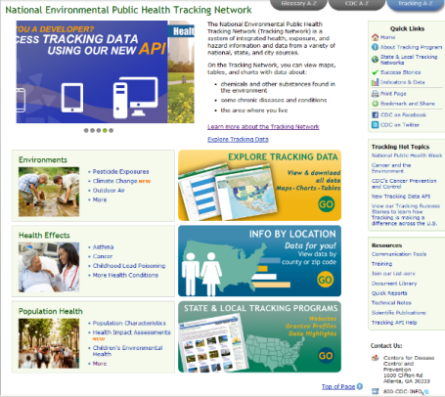
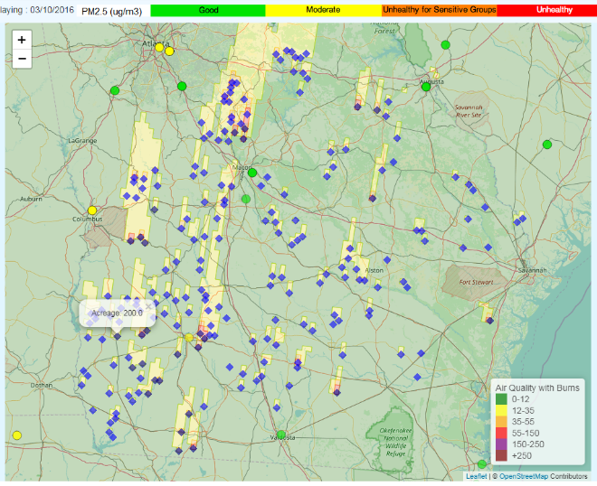
Operational forecasting of prescribed fire impacts
Daily forecasts of prescribed-fire related air quality impacts to state agencies for prescribed burn and air quality management
https://forecast.ce.gatech.edu
Prescribed-fire related exposures to CDC and its partners for public health tracking and source-specific epidemiological assessments
https://ephtracking.cdc.gov
PM_{2.5} Forecast
Burn Impact Forecast
Public Health Tracking Network

Slide 7
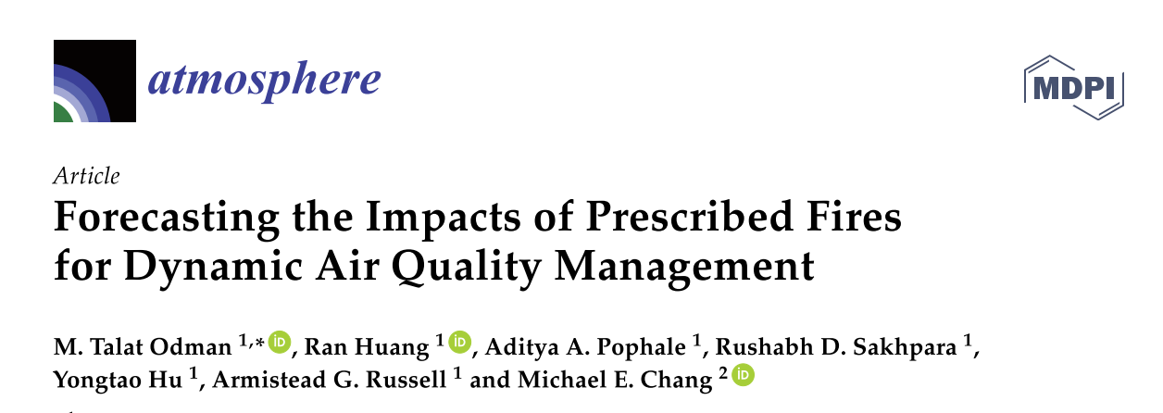
Description of the forecasting system and an evaluation of its performance

Slide 8
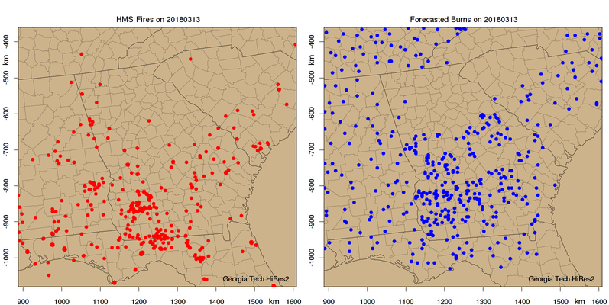
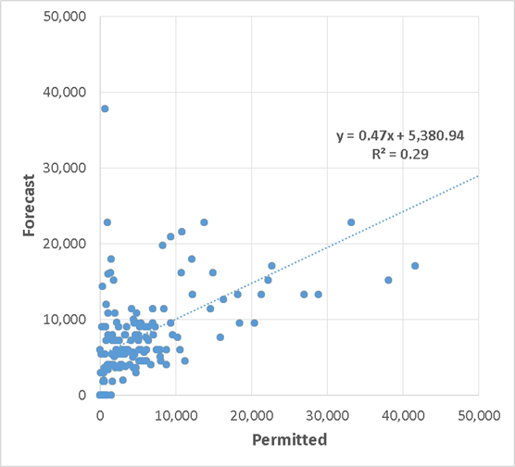
Burn activity forecast is based on weather forecast and historic burning patterns.
Qualitative comparison to NOAA’s Hazard Mapping System (HMS) Fire and Smoke Analysis, a product blended from GOES-E, GOES-W, MODIS, and AVHRR satellites
Quantitative comparison to Georgia Forestry Commission’s burn permit database
HMS Fire Detections
Our Burn Forecast
Forecast vs. Permitted
Burn Areas
Notes:
Note that we only forecasts burns for Georgia.

Slide 9
Features of HiRes-X forecasting system
WRF for weather forecast
Prescribed burn activity forecast (number, location, size of burns are forecast)
BlueSky framework for prescribed fire emissions (fuel loads, fuel consumption, emission factors, plume rise)
NEI and SMOKE for other emissions
CMAQ for air quality forecast
Decoupled Direct Method (DDM) for prescribed fire impact forecast
WebGIS-based dissemination of forecast products

Slide 10
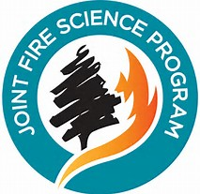
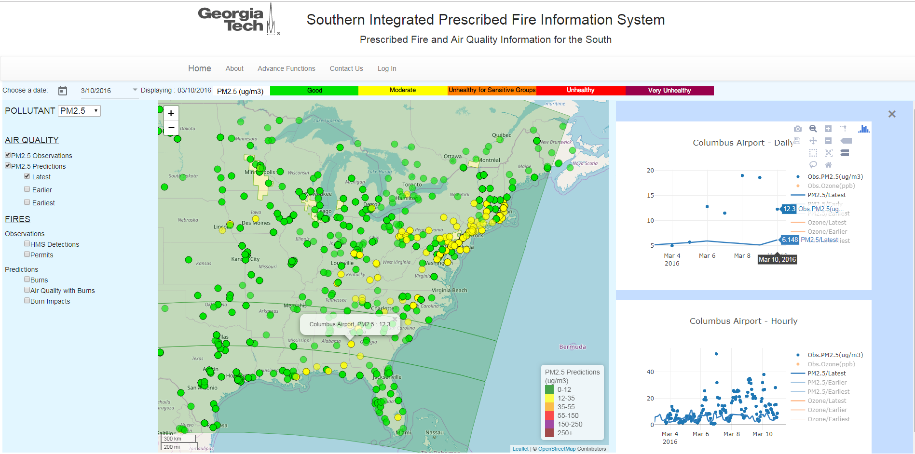
https://sipc.ce.gatech.edu/SIPFIS/map/

Slide 11
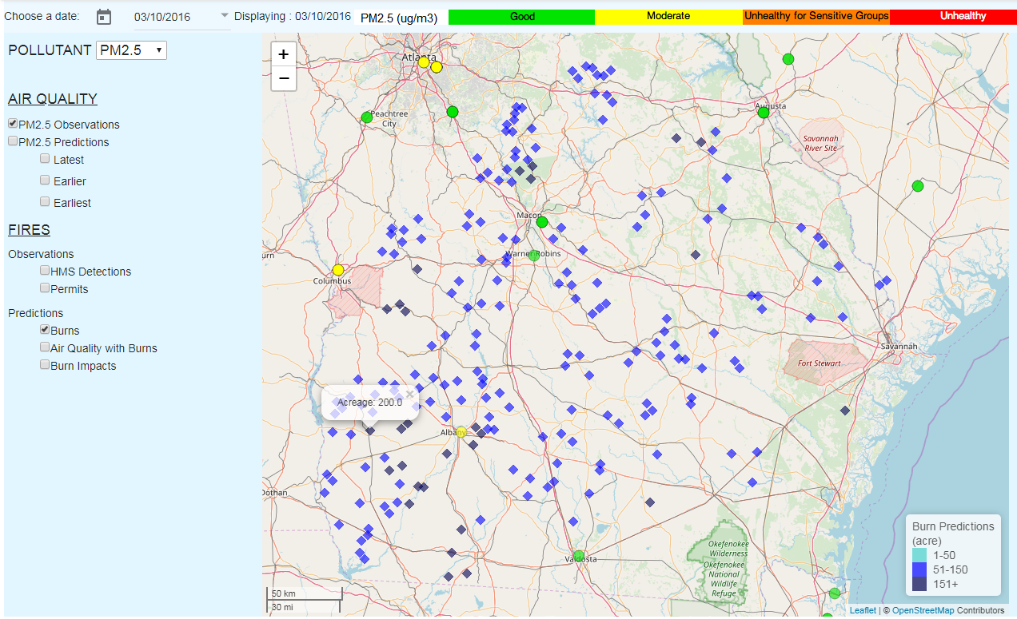

Slide 12
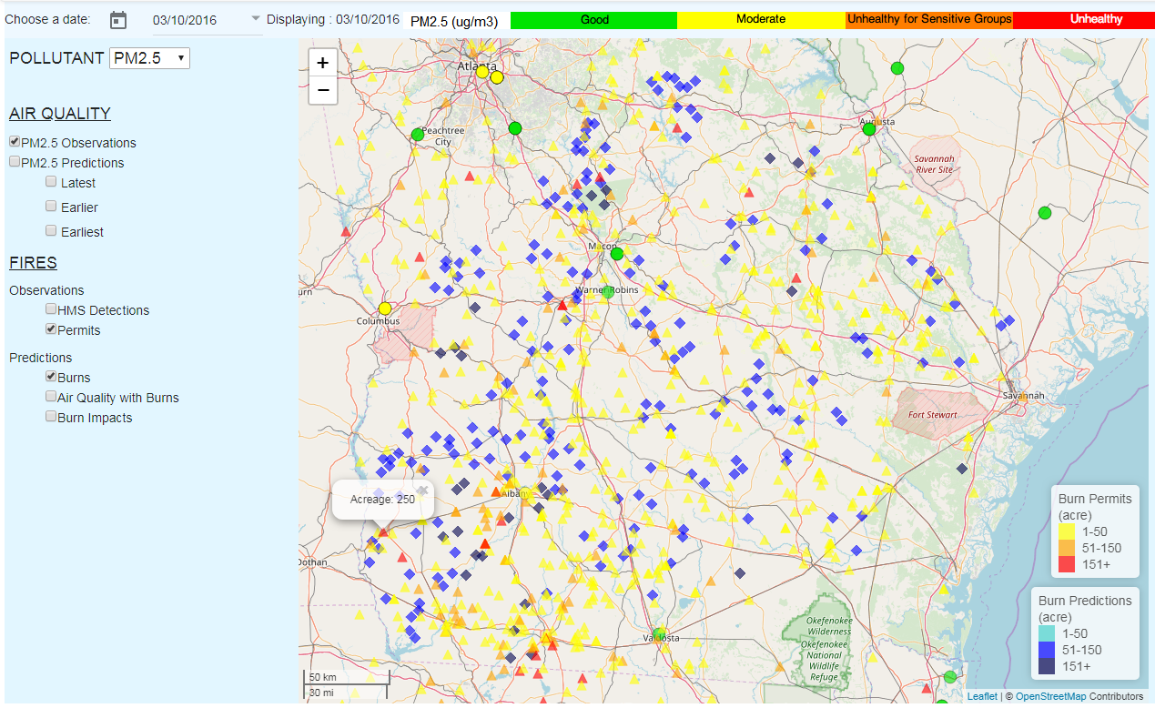

Slide 13
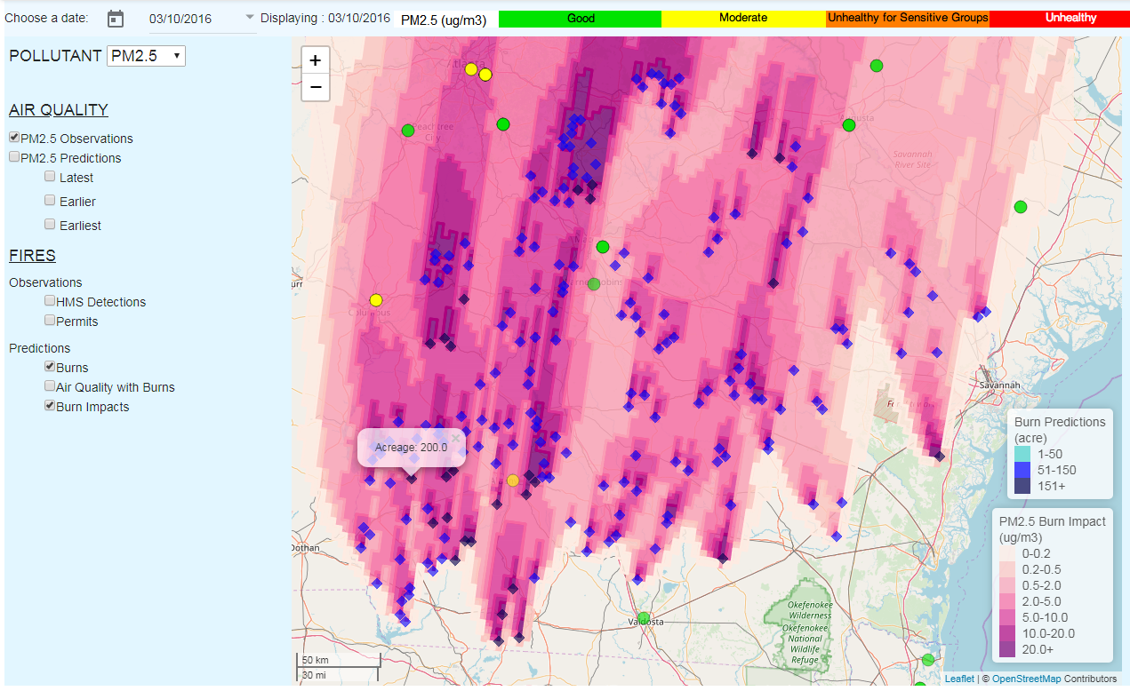

Slide 14
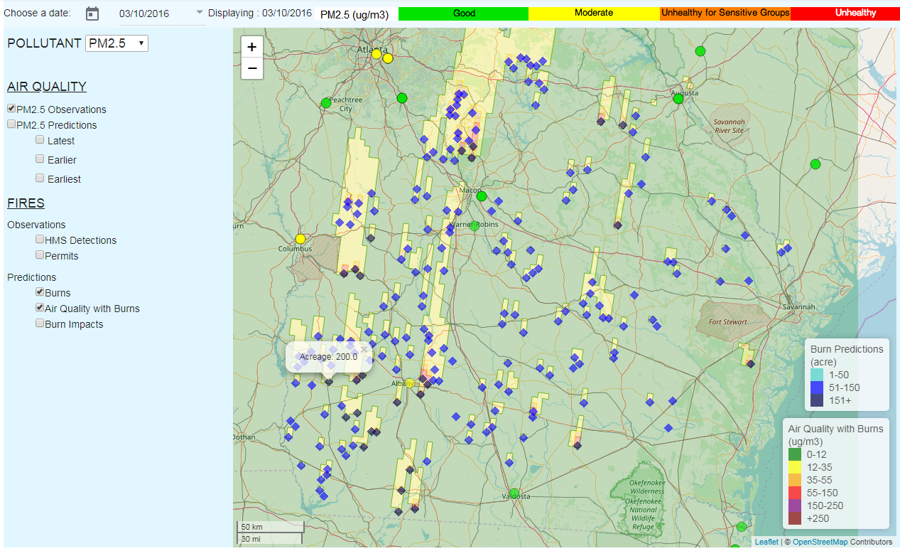

Slide 16
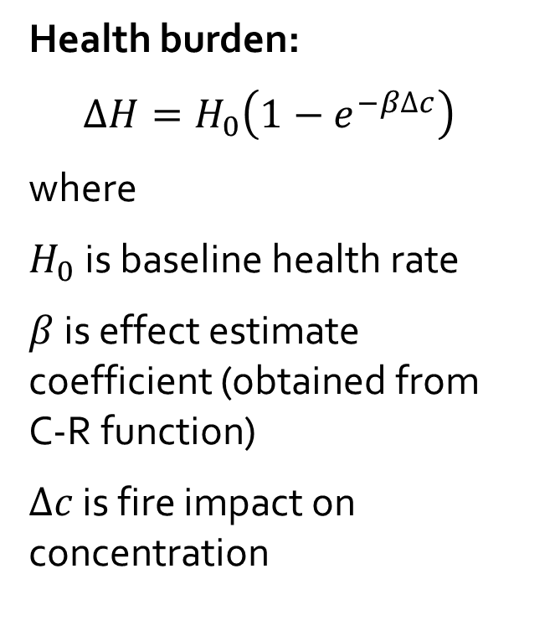
Health impacts layer is under development.
C-R function for Asthma ER visits

Slide 17
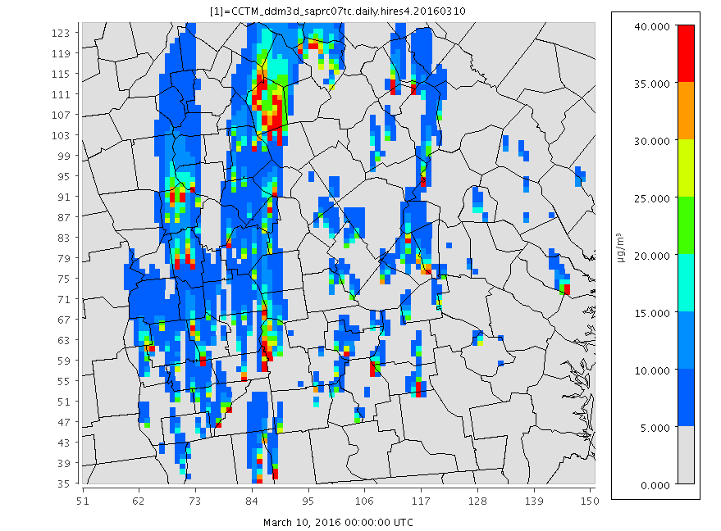
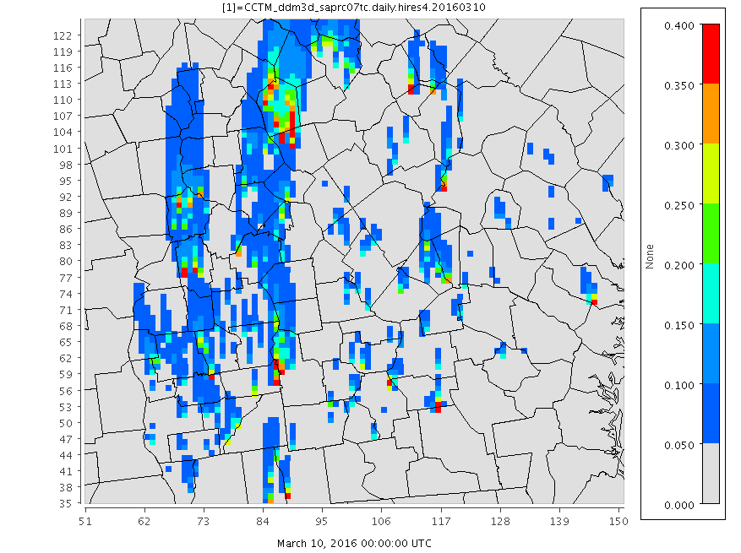
PM_{2.5} and asthma ER visits (β=0.008, Alman et al. 2016)
Δc (PM_{2.5})
ΔH/H₀

Slide 18
Summary
We are compiling a prescribed fire record for the Southeastern U.S. using permit- and satellite-based data. If you have any such data please contact odman@gatech.edu.
We developed HiRes-X, a system to forecast the air quality impacts of prescribed fires in Georgia [Odman et al. 2018, Atmosphere]. Recently, we expanded the forecasts to other states in the Southeast.
We are extending the prescribed fire impact forecasts to include human exposure and health burden forecasts.
We developed a WebGIS tool to disseminate data and forecasting products (https://sipc.ce.gatech.edu/SIPFIS/map/).
HiRes-X and SIPFIS are expected to benefit air quality, forest, and health service agencies in Southeastern U.S.

Slide 19

Questions?
odman@gatech.edu

