Slide 1
Dynamic evaluation of WRF-CMAQ PM_{2.5} simulations over the Contiguous United States for the period 2000-2010
Huiying Luo¹, Marina Astitha¹, Christian Hogrefe²,
Rohit Mathur², and S. Trivikrama Rao^{1,3}
¹University of Connecticut
²US Environmental Protection Agency
³North Carolina State University
huiying.luo@uconn.edu
AirMG Group led by Dr. Astitha: airmg.uconn.edu

Slide 2
Scope and Objectives
How well can we capture changes in PM_{2.5} induced by variations in meteorology and/or emissions over a decade?
Analyze and interpret features embedded in PM_{2.5} observations and model outputs
Assess the model’s ability to reproduce changes/trends in observed PM_{2.5} concentrations
Improve confidence in model’s use for policy analysis

Slide 3
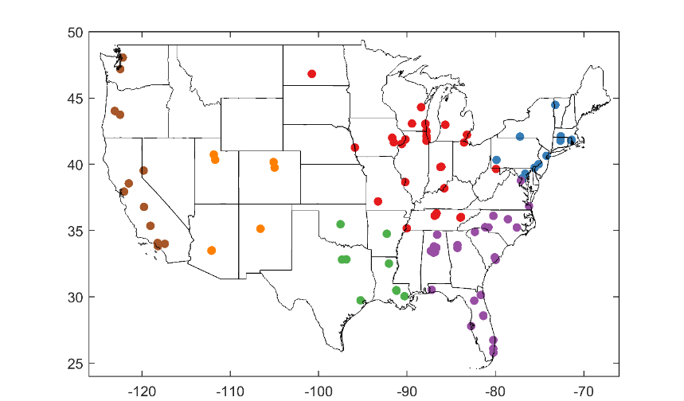
Data
Coupled 2000-2010 WRF-CMAQ (vers. 5.0.1) with 36-km grid cells over the USA (Gan et al. 2015; Xing et al. 2013)
Observations:
Daily total PM_{2.5} spanning 2000-2010 are retrieved from U.S. EPA’s Air Quality System (AQS).
SO₄, NO₃, NH₄, OC, EC, and Cl with the total PM_{2.5}, are retrieved from both Chemical Speciation Network (CSN) and Interagency Monitoring of Protected Visual Environments (IMPROVE) networks. Only 1 CSN and 1 IMPROVE site on the map are used here for illustrative purposes.
AQS (100), 2000-2010
Min coverage each year: 30%
IMPROVE site
Also a CSN site

Slide 4
Methodologies
1. Kolmogorov-Zurbenko (KZ) filter
$$KZ\left(m,k\right)$$
Total PM2.5 with its BL component
$$Y\left(t\right)=\frac{1}{m}\sum_{s=−(m−1)/2}^{\left(m−1)/2\right.}{\left.X(t+s\right)}$$
PM_{2.5} BL
$Y\left(t\right)$is the long-term component of $X\left(t\right)$
$m$: window length
$k$: number of application of the moving average
Selection of $m$ and $k$depends on:
Timescales of interest (Synoptic scale)
Desired degree of separation
Data structure (Sampling frequency)
$$KZ(9,2)$$
- Scale separation of 29 days
Power spectrum
$${PM}_{2.5}\left(t\right)=BL\left(t\right)+SY\left(t\right)$$
Synoptic Forcing (SY): shorter-term component attributable to weather-induced variations
Baseline Forcing (BL): longer-term component attributable to seasonality, emissions policy, inter-continental transport, and trend components
PM_{2.5}
BL
SY
(Rao et al., 1994, 1995, 1997; Eskridge el., 1997; Hogrefe et al., 2003)

Slide 5
Methodologies
2. Empirical Mode Decomposition (EMD)
Decomposition of total PM_{2.5} with EMD
Signal $x$is decomposed to multiple Intrinsic Mode Functions (IMFs) $d_{i}$and a residual trend $r_{k}$through sifting processes (Huang et al., 1998):
$x=$ $\sum_{i=1}^{k}{d_{i}+}r_{k}$
An IMF must satisfy:
the number of extrema (maxima and minima) and zero-crossings must be equal or differ at most by one;
the local mean, defined as the mean of the upper and lower envelopes, must be zero.
A unique technique that enables model evaluation at multiple time scales that is intrinsic to the PM time series.
Multiple improvements to address mode mixing as well as other problems and the most recent version of Improved Complete Ensemble Empirical Mode Decomposition with Adaptive Noise (Improved CEEMDAN) is used (Wu and Huang, 2009; Yeh et al., 2010; Torres et al., 2011; Colominas et al., 2014).

Slide 6
PM_{2.5} Density scatter
Operational Evaluation
MW(30) NE(13) S(9) SE(29) SW(7) W(12)
Q1 Q2 Q3 Q4
Binned every 2 μg/ m³.
Model behavior depends on locations.
Largely underestimates PM_{2.5} total in SW and W regions. Need for speciated PM_{2.5} to identify the causes of these discrepancies.
Cooler seasons (Q1 and Q4) have a bimodal distribution, which represents the spatial variations from eastern to western US as shown in regional scatter plots.

Slide 7
Evaluation of 11 years daily PM_{2.5} and BL (2000-2010)
Operational Evaluation
R RMSE Bias
PM_{2.5}
BL
Model simulations and observations are highly correlated in MW
Difficulty in simulating BL for some sites in CA and near large water bodies
Overall overestimation in eastern and underestimation in western CONUS.

Slide 8
Trend analysis (2000-2010)
OBS CMAQ Bias
BLmean
98th pct
Significant trends (p< 0.05) are circled.
μg/m³/yr
A general decreasing trend of BL mean and 98th percentile can be seen from both observations and CMAQ for most locations. The increasing trends (noted in orange and red in 1st, 2nd col.) are not statistically significant.
The decreasing is underestimated (red in last col.) in W, SW and Florida, while overestimation occurs in MW and NE.

Slide 9
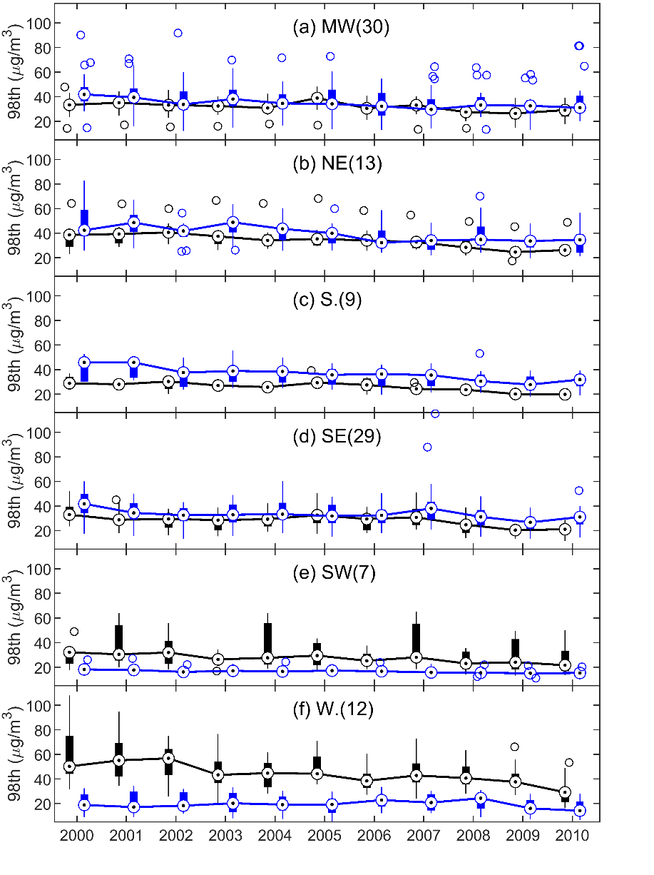
Trend analysis (2000-2010)
Obs
CMAQ
CMAQ agrees with the magnitude and trends of observed 98th percentiles of PM_{2.5} in MW, NE, and SE.
98th percentiles are underestimated in SW and W regions and overestimated in the S.
The notable decreasing trend in the W seen in observations is not captured by the model.

Slide 10
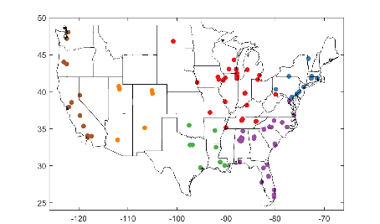
Trend analysis (2000-2010)
μg/m³/yr
CMAQ agrees with observations in the sign of the trends for all regions and seasons but varies in magnitude.
CMAQ shows more trend variability in SE and less variability in MW and W.
CMAQ underestimates the decreasing trend at the 90th percentile in SW and W, while it overestimates the trend in NE and S.
Trends in cooler seasons (Q1, Q4) are more challenging to simulate than warmer seasons.
μg/m³/yr
(Quarter mean)

Slide 11
How well is CMAQ representing a 5-yr change?
98th percentile Conc. Absolute Change
Sites in W, SW and near large water bodies exhibit larger errors.
RMSE is lower when we look at the 5-yr change, esp. in regions close to the coast.
Percentage of systematic error (RMSEs) in RMSE is much larger than that of unsystematic error (RMSEu = 100 - RMSEs) in 98th percentile, which points to feasible improvement in CMAQ’s ability to simulate exceedances in total PM_{2.5}.
(%)
(%)

Slide 12
Quabbin Summit, MA (RURAL, IMPROVE) Total PM_{2.5}
EMD analysis with speciated PM_{2.5}
Obs CMAQ
Peak cycle (days)
Mean cycle (days)

Slide 13
Quabbin Summit, MA (RURAL, IMPROVE) Total PM_{2.5}
EMD analysis with speciated PM_{2.5}
Obs CMAQ
Mean cycle (days)
Very clear annual cycles of PM_{2.5} exist in both obs and CMAQ, but they are out of phase by up to six months.
The residual (trend) indicates the overestimation of magnitude of trend component by CMAQ.

Slide 14
EMD analysis with speciated PM_{2.5}
Quabbin Summit, MA (IMPROVE)
TS Annual cycle Trend
Good
Good
SO₄
NO₃
Cl
OC
EC
Overestimated magnitude
Overestimated magnitude and trend
Varies
Problematic*
Shifted nearly half year
Overestimated magnitude and trend
Overestimated magnitude, cycle
Overestimated magnitude
Obs CMAQ
Mean cycle (days)

Slide 15
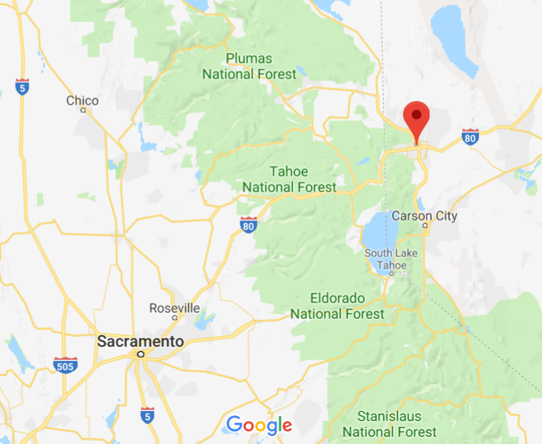
Reno, NV (urban - AQS, CSN) Total PM_{2.5}
EMD analysis with speciated PM_{2.5}
Obs CMAQ
Mean cycle (days)
The underestimation can be partially explained by missing the extreme wildfire events such as the 2008 California Wildfires.

Slide 16
Reno, NV (AQS, CSN)
EMD analysis with speciated PM_{2.5}
TS Annual cycle Trend
Shifted
Underestimated trend
SO₄
NO₃
NH₄
OC
EC
Underestimated magnitude
Underestimated mag. and trend
Underestimated magnitude, shifted
Underestimated magnitude
Underestimated excl. 05-07, shifted
Underestimated magnitude, varies
Underestimated excl. 05-07, shifted
Underestimated magnitude, varies
Obs CMAQ
Mean cycle (days)

Slide 17
Summary and Future Work
For daily PM_{2.5}, the longer-term baseline component and the annual extreme (98th pct.) are overestimated in the eastern United States and underestimated in the west.
A universal decreasing trend in PM_{2.5} 10th, 50th, 90th and 98th percentiles can be seen from both observations and CMAQ. The notable decreasing trend in the 98th percentile that was observed in the West is not captured by the model.
Percentage of the 98th percentile’s systematic error (83.5%) is much larger than that of unsystematic error (16.5%), which suggests that CMAQ’s ability to simulate exceedances in total PM2.5 could be improved.
EMD decomposition enables model evaluation at multiple time scales that is intrinsic to the PM time series. Our preliminary analysis shows CMAQ dose not simulate the magnitude or phase of PM_{2.5} annual cycles well. However, CMAQ is capable of simulating the trend well, even if the magnitude of the trend component is less accurate.

Slide 18
Acknowledgements
The views expressed in this presentation are those of the authors and do not necessarily represent the views or policies of the U.S. Environmental Protection Agency.
Part of this work was supported by the Electric Power Research Institute (EPRI) Contract #00-10005071, 2015-2017 (MA and HL)

