Slide 1
Plausible energy scenarios for use in robust decision making
Kristen E Brown
US EPA
CMAS Conference October 23, 2018
Co-authors: Troy A. Hottle, Rubenka Bandyopadhyay, Samaneh Babaee,
Rebecca S. Dodder, P. Ozge Kaplan, Carol S. Lenox, Daniel H. Loughlin
Disclaimer: The views expressed in this presentation are those of the author and do not necessarily represent the views or policies of the US Environmental Protection Agency.

Slide 2
Background
Workshop in 2010
Air Quality (AQ) managers, analysts, research staff
2 biggest uncertain factors influencing AQ management in coming decades:
capacity for technological change
capacity for societal change in response to environmental considerations
Uncertain factors include
Population growth
economic growth
climate change
technology change
land use change
fuel price & availability
consumer choices
policy drivers
New Paradigms
Conservation
iSustainability
Stagnant
Society
Transformation
Technology
Muddling
Through
Go Our
Own Way
Old and Known Patterns

Slide 3
Motivation
Uncertainty
What will the future energy system look like?
Reduce dependence on a single baseline
Longer term projections are more important for some new mitigation strategies
Capital investments have long term impacts (e.g. efficiency, renewables)
Manageable number of simulations
Able to evaluate mitigation strategies within scenarios

Slide 4
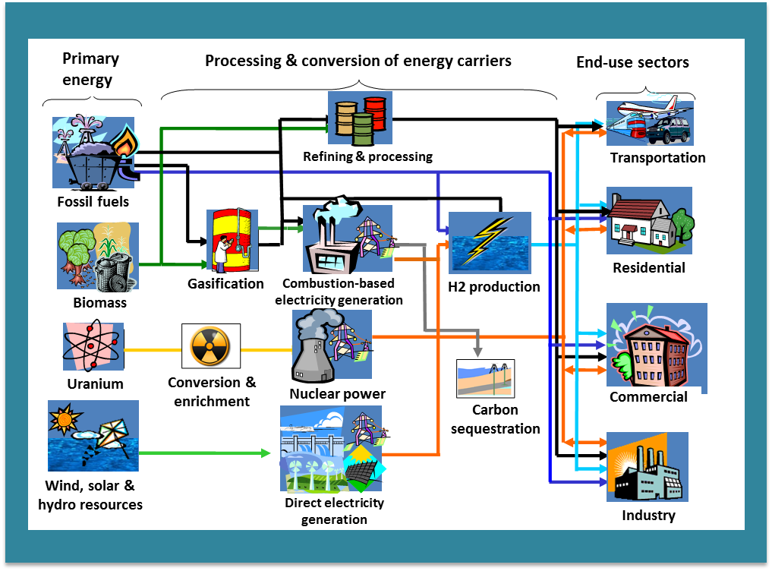
EPAUS9r MARKAL
Bottom-up and technology-rich
Captures the full system from energy resource supply/extraction technologies to end-use technologies in all sectors
Energy technologies (existing and future techs) are characterized by cost, efficiency, fuel inputs, emissions
Technologies are connected by energy flows
Covers 9 US Census divisions
Optimization
The model picks the “best” way (lowest system-wide cost) to meet energy demands choosing from the full “menu” of energy resources and technologies
The model makes these choices from 2005 to 2055, giving us a snapshot of possible future energy mixes
Emissions and impacts
All technologies and fuels have air and greenhouse gas (GHG) emissions characterized
Standards and regulations are included in the baseline, and additional policies can be modeled

Slide 5
Scenario Narratives
New Paradigms
Conservation
iSustainability
Stagnant
Limited R&D funds
Consumption reflects conservation ideals
Advanced techs power econ growth
Recognize need for social change to mirror technology change
Society
Technology
Transformation
Muddling Through
Go Our Own Way
Consumers prefer cheap and familiar
Money goes to more goods, larger houses, increased travel instead of energy
Desire for domestic energy spurs investment in R&D
Economic benefit increases investment in efficiency
Old and Known Patterns

Slide 6
Attributes: desirable or not
New Paradigms
Conservation
iSustainability
Stagnant
Positive Negative
Renewable Advanced
Low emission
Efficient
Positive Negative
Advanced Conventional
Renewable Lifetime
Low emission extension
Efficient
Society
Transformation
Technology
Muddling Through
Positive Negative
Conventional Advanced
Infrastructure
Go Our Own Way
Positive Negative
Advanced Conventional
Lifetime extension
Infrastructure
Old and Known Patterns

Slide 7
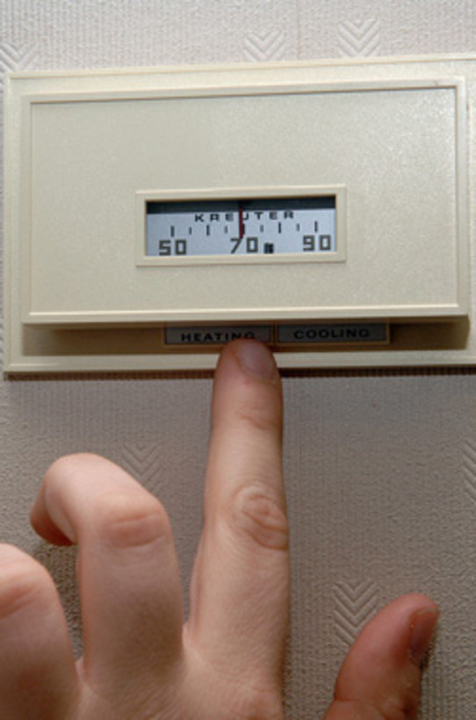
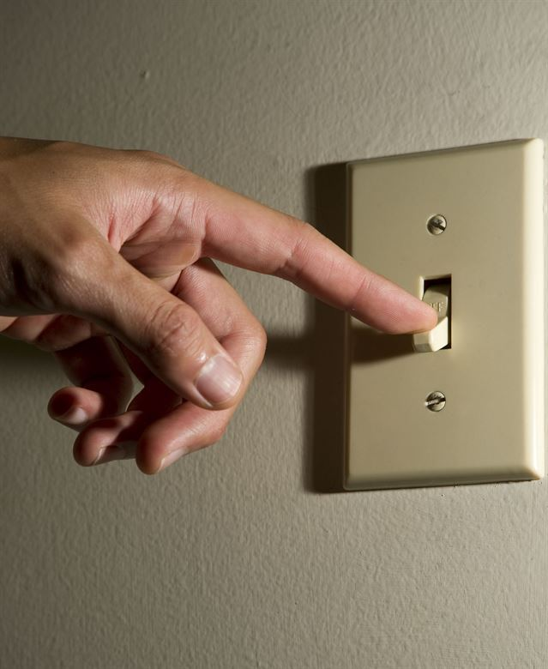
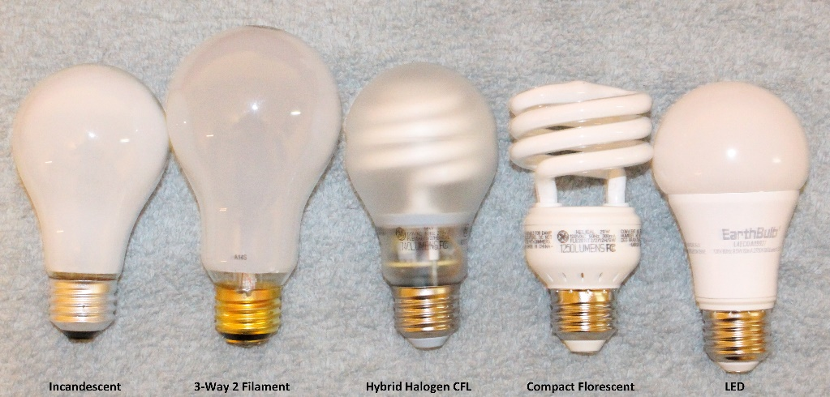
End Use Demands
Demands for services are defined
Technology choices are made in model

Slide 8
Telework,
online shopping, mass transit
Demand Changes compared to BAU
New Paradigms
Conservation
Residential, trucking, busing
Stagnant
iSustainability
All
LDV, Comm-ercial
Society
Transformation
Technology
Muddling Through
Go Our Own Way
All
Business as usual
Old and Known Patterns
Notes:
All changes 15%
Telework: less travel, but more residential energy demand (daytime lights, computers, heating)
Muddling through: larger houses need more energy, increased commutes, more industrial production

Slide 9
Electricity Generation
solar
wind
coal
Natural gas

Slide 10
Electricity Use
Transport
Commercial
Residential

Slide 11
Light Duty Vehicles (LDV)
EV
Flex fuel
Plug-in flex
Hybrid flex
Gasoline
Hybrid gasoline

Slide 12
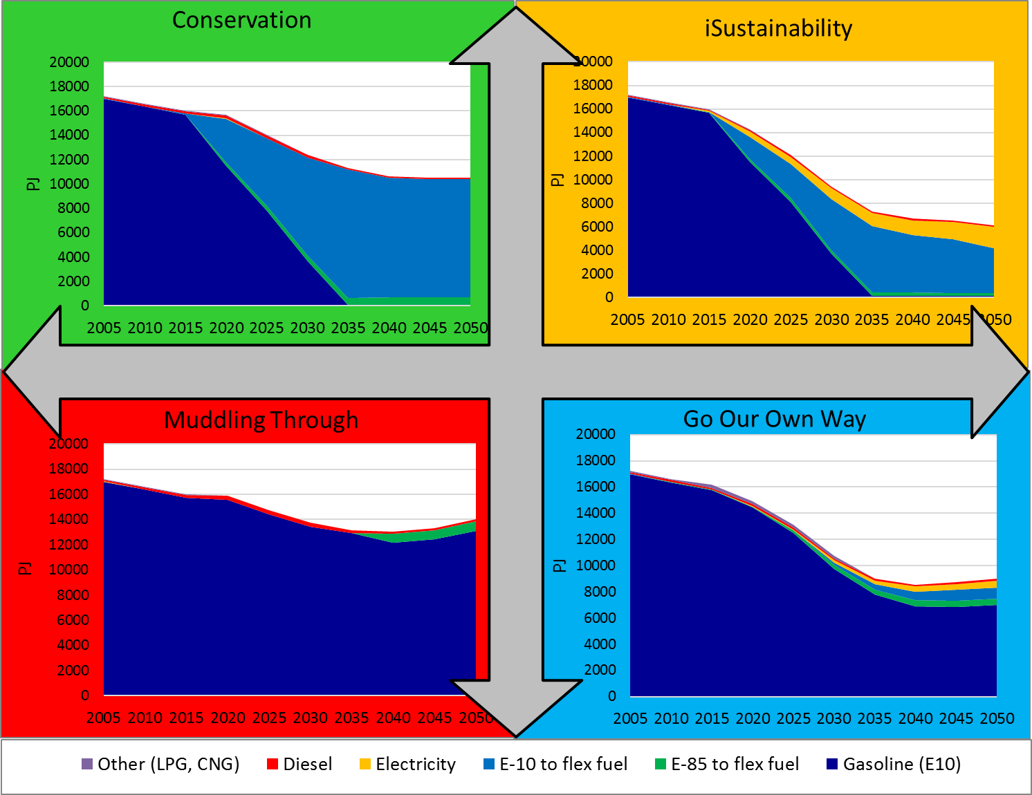
Fuel Use in Light Duty Vehicles
Notes:
Evs are efficient
Flex fuel mostly uses gas

Slide 13
CO2 Emissions

Slide 14
Criteria Emissions
For calculation of these values see Brown et al. Environ. Sci. Technol. 2018 DOI: 10.1021/acs.est.8b00575
Notes:
Cons and mudl similar

Slide 15
Conclusions
Improved technology will increase efficiency
Leads to lower emissions even if environmental impacts not prioritized
Existing technologies can be used to reduce emissions
Harder to do in transportation
Less/slower improvement for criteria pollutants
Retirements/lifetime extensions drive emissions
Mitigation strategies can be evaluated within each of the four scenarios
May highlight unintended consequences

Slide 16
Extra Slides

Slide 17
Monetized Emission Impacts
Notes:
Conservation has higher CAP emission damages in mid years than Muddling Through b/c of high PM

Slide 19
Notes:
Coal into cons decreases even when output looks constant, moving to more efficient units

Slide 20
Image sources
All available for reuse
Light switch https://www.hurlburt.af.mil/News/Features/Display/Article/206496/fall-into-energy-awareness/
Thermostat https://www.vance.af.mil/News/Photos/igphoto/2000298560/
Lightbulbs https://commons.wikimedia.org/wiki/File:Lightbulbs.jpg

