Slide 1
GLIMPSE decision support system for air quality management: Overview and application
Dan Loughlin*, Yang Ou^{*o}, Steve Smith^{p}, and Chris Nolte*
* U.S. EPA Office of Research and Development
º Oak Ridge Institute for Science and Education participant
^{p} Pacific Northwest National Laboratory, Joint Global Change Research Institute
Office of Research and Development
National Risk Management Research Laboratory, Air and Energy Research Program

Slide 2
Foreword
Additional contributors to this work
EPA: Tai Wu, Carol Lenox
ORISE: Wenjing Shi, Samaneh Babaee
PNNL: Catherine Ledna, Gokul Iyer
UNC-CH: Jason West
Purpose of this presentation
Discuss development and application of GLIMPSE, a GCAM-USA-based decision support tool for air quality management
Intended audience
The emissions and air quality modeling communities
Caveats
All results shown are intended to be illustrative. Caveats and assumptions are not fully discussed here. Please do not cite results.
Disclaimer
The views expressed in this presentation are those of the authors and do not necessarily represent the views or policies of the U.S. EPA

Slide 3
Abbreviations
Emissions species
BC – black carbon
CH₄ – methane
CO – carbon monoxide
CO₂ – carbon dioxide
N₂O – nitrous oxide
NH₃ - ammonia
NO₂ – nitrogen dioxide
NOx – nitrogen oxides
O₃ – ozone
OC – organic carbon
PM_{2.5} – particulate matter with diameter < 2.5 microns
SO₂ – sulfur dioxide
VOC – volatile organic compounds
Policies and regulations
CAFE – Corporate Vehicle Fleet Economy Standard
CSAPR – Cross-State Air Pollution Rule
NAAQS – National Ambient Air Quality Standards
NSPS – New Source Performance Standards
RGGI – Regional Greenhouse Gas Initiative
RPS – Renewable Portfolio Standard
Modeling
GCAM – Global Change Assessment Model
GCAM-USA – GCAM with state-level resolution for the U.S.
GLIMPSE – GCAM Long-term Interactive Multi-Pollutant Scenario Evaluator
Energy and technologies
CCS – Carbon capture and sequestration
CNG – Compressed natural gas
CHP – Combined heat and power
NG – natural gas
Units
EJ – Exajoules (exa is 10^18)
MTC – Mega tonnes of Carbon (mega is 10^6)
TWh – Terawatt hours (tera is 10^12)
bil – billion
mil – million
Standard state postal abbreviations are used

Slide 4
Outline
Background and objectives
GLIMPSE overview
Illustrative application: Co-benefits assessment
Additional considerations and future steps
Future directions
Questions?
Note: A demo of the GLIMPSE graphical user interface will be available at the next break at the U.S. EPA Office of Research and Development table in the lobby

Slide 5
Background and objectives

Slide 6
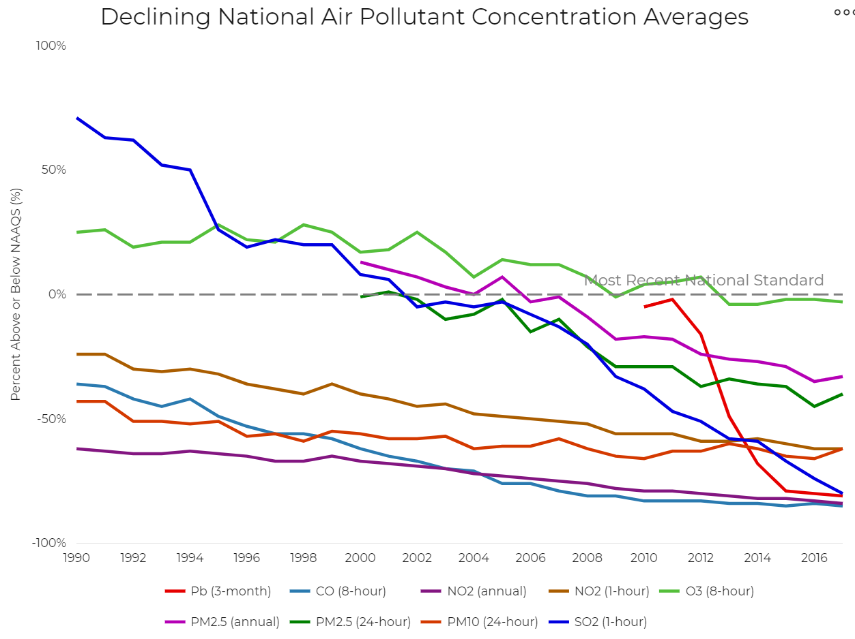
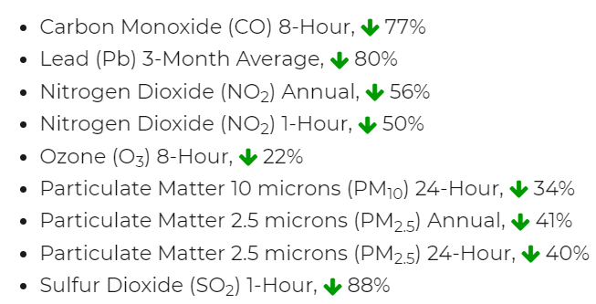
U.S. air quality trends
The U.S. has made great strides in reducing air pollution since the passage of the Clean Air Act Amendments
Nat’l average concentration changes since 1990
Source: https://gispub.epa.gov/air/trendsreport/2018/#highlights

Slide 7
Remaining air quality issues
Despite this progress, an estimated 132 million people (40% of the U.S. population) live in areas that exceed a NAAQS or that have been re-designated to attainment subject to maintenance
Source: https://www.epa.gov/green-book/green-book-map-download

Slide 8
Attainment in the future
State-level factors that will affect future air pollutant emissions
Population growth and migration
Economic growth and transformation
Energy supplies and their depletion
Technology stock and turnover
Technology development
New and emerging demands for energy
Transformations in mobility and land use patterns
Supply limits and competition among sectors for water
Climate change impacts on energy demands, cooling water availability, and atmospheric chemistry
Human behavior and choices
Other energy, environmental, and climate policies
Can we model how will these factors may affect attainment in the future and proactively develop air quality management strategies?

Slide 9
GLIMPSE GCAM Long-term Interactive Multi-Pollutant Scenario Evaluator

Slide 10
The GLIMPSE project
Objective: Provide a state-level tool for supporting air quality planning
Understand future threats to attainment
Evaluate potential management strategies under uncertainty
Assist in identifying management strategies that simultaneously, cost-effectively, and robustly meet state energy, environmental, and climate goals
Complement other detailed sector-specific modeling tools by providing insights about cross-sector interactions, counterintuitive responses, and unintended consequences
Approach
The Global Change Assessment Model with U.S. state-level resolution (GCAM-USA) is being modified to more fully reflect U.S. air quality regulations and state-level policies
“Levers” reflecting management options are being integrated into the model
A GLIMPSE graphical-user-interface prototype has been developed to facilitate running GCAM-USA and examining its results
Internal beta testers are using GLIMPSE to evaluate its installation and use
GCAM-USA is being used within a range of applications, one of which is summarized here

Slide 11
GCAM-USA model
GCAM-USA
Global Change Assessment Model with U.S. Resolution
Human-Earth System Models
Background:
30-yr track record of scenario assessment applications
Air pollutant emissions added in 2000s
U.S. state level resolution added in 2010s
Type: Technology-rich, energy focused simulation model
Maintained by: Pacific Northwest National Laboratory/JGCRI
Time Horizon: 2010 – 2100, 5-year increments
Spatial Resolution: 32 global regions, 50 states
Pollutants: CO₂, NOx, SO₂, PM_{2.5}, CO, NH₃, VOC, CH₄, N₂O, BC, OC
(emission factors are derived from EPA models and analyses)
Policies included: CAFE, CSAPR, Tier 3, RGGI, and many NSPSs
(not yet included: state-level RPS, Regional Haze, other state-specific actions)
Runtime: 1 to 5 hours
Requirements: Desktop PC
Availability: Public domain, open source, free
Economy
Energy
Water
Agriculture
Scenario
Environmental Impacts
Buildings
Land Use
Simulates evolution of these systems through
time, accounting for their interactions

Slide 12
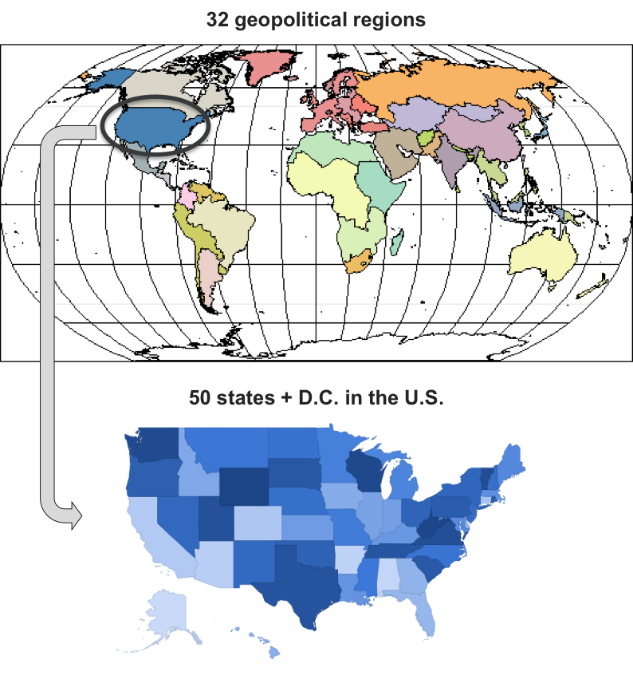
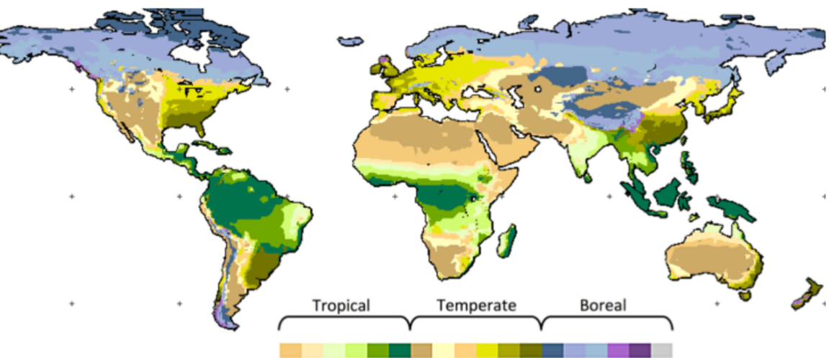
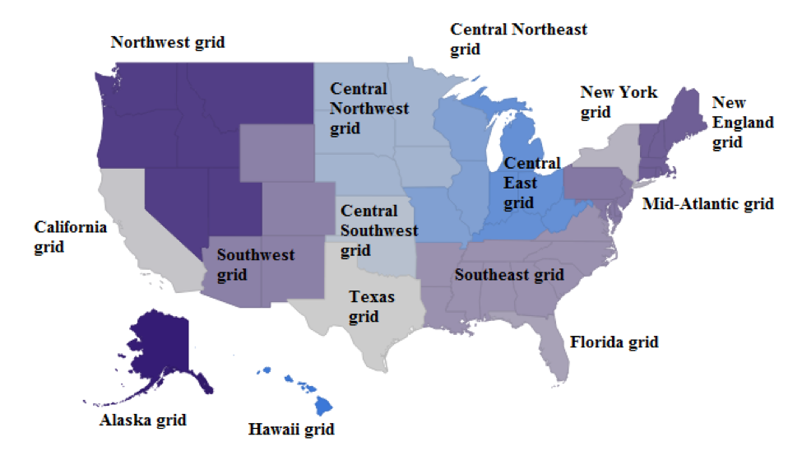
GCAM-USA regions
Source of graphics: PNNL GCAM 5.1 documentation
Energy-economic geographic regions
Agricultural economic zones
U.S. electricity grid regions

Slide 13
Example GCAM-USA outputs
Solar
CHP
CNG
Electric
Transportation
Hydro
Wind
Nuclear
Hybrid
Industry
Other
Natural gas
Buildings
Coal
Conventional
Nonroad
Electricity
On-road
Biomass
Industry
Natural gas
Electric sector
Fuel oil

Slide 14
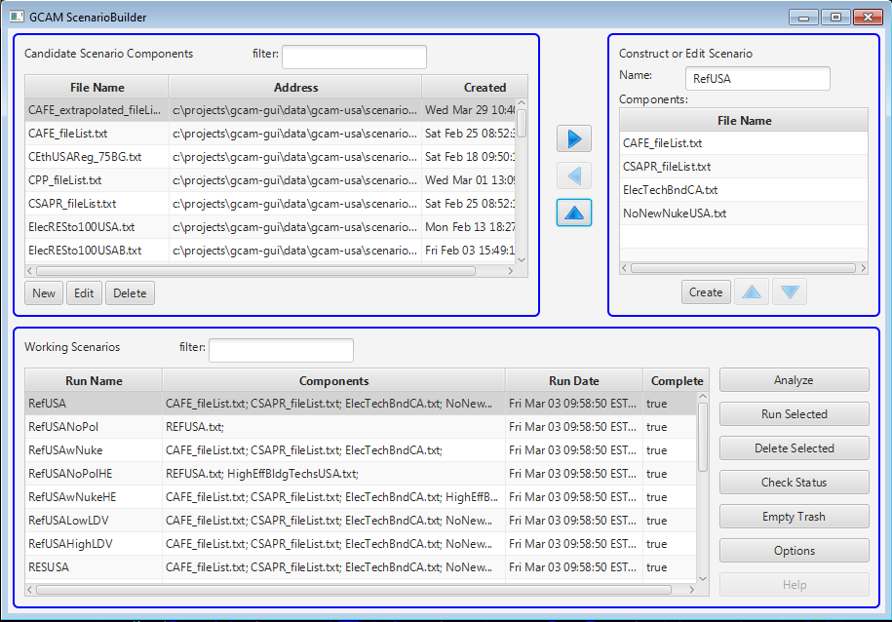
GLIMPSE Scenario Builder
Scenario
building
blocks
Creating
a scenario
Analysis of
results
Library of
scenarios
One-click
scenario
execution

Slide 15
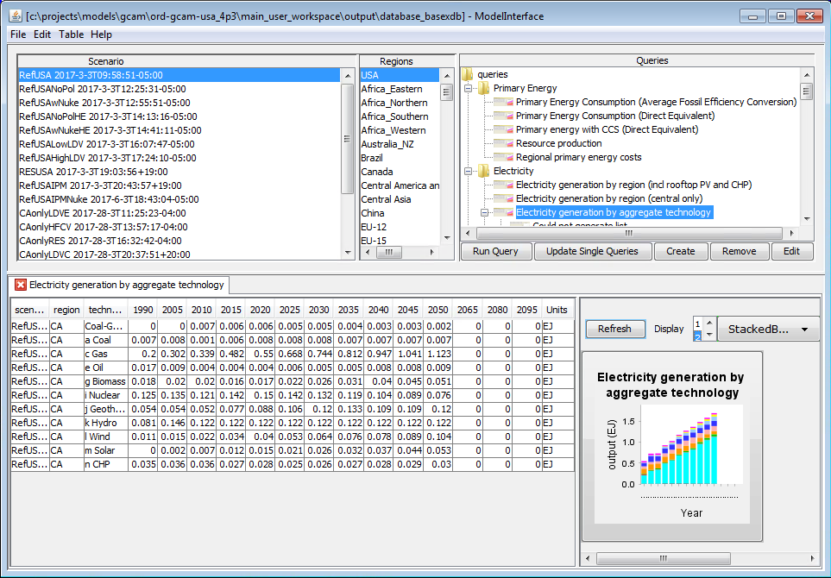
GLIMPSE Enhanced ModelInterface
Scenarios
in results
database
List of scenario
outputs that can
be queried
Modeled
regions
Query
visualization
Query results
An extension of the GCAM ModelInterface

Slide 16
See EPA booth next to registration table for demo at next break

Slide 17
Illustrative application Co-benefits assessment

Slide 18
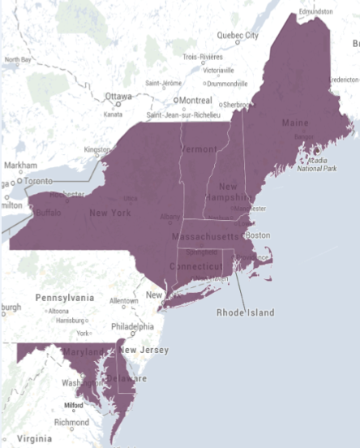
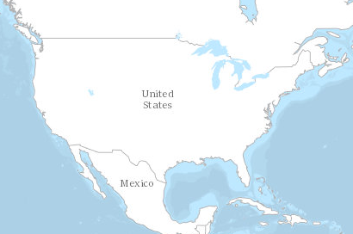
Application: Co-benefits assessment
Goal: Estimate changes in air pollutant emissions and
associated PM mortality costs of current and
proposed Regional Greenhouse Gas Initiative (RGGI)
targets
Region-wide electric sector CO₂ caps
2015 - 89 x 10⁶ tons
2020 - 78 x 10⁶ tons
2025 - 66 x 10⁶ tons
2030 - 55 x 10⁶ tons
Recently
proposed
RGGI region: CT, DE, ME, MD, MA, NH, NY, RI, VT (total population: >40 million)
Notes:
Constraint better as a graphic?

Slide 19
Application: Co-benefits assessment
Illustrative results
Electricity production (EJ) without RGGI
Electricity production (EJ) with RGGI
Coal Gas Biomass Nuclear Geothermal Hydro Wind Solar CHP

Slide 20
Application: Co-benefits assessment
Illustrative results
Electricity production (EJ) without RGGI
Electricity production (EJ) with RGGI
Coal Gas Biomass Nuclear Geothermal Hydro Wind Solar CHP

Slide 21
Application: Co-benefits assessment
Illustrative results
Electricity production (EJ) without RGGI
Electricity production (EJ) with RGGI
Coal Gas Biomass Nuclear Geothermal Hydro Wind Solar CHP

Slide 22
Application: Co-benefits assessment
Electricity production by aggregated technology category in the RGGI region
EJ
EJ
EJ
Gas w/
CCS
Coal Gas Biomass Nuclear Geothermal Hydro Wind Solar CHP
RGGI region: CT, DE, ME, MD, MA, NH, NY, RI, VT
Illustrative results

Slide 23
Application: Co-benefits assessment
Comparison of emission trajectories for CO₂, NO_{x}, SO₂, and PM_{2.5} in the RGGI region states with and without the proposed regional targets.
Bars show annual estimates of avoided PM_{2.5} mortality costs from RGGI.
Source- and pollutant-specific PM_{2.5} mortality impact factors obtained from OAQPS report: “Estimating the benefit per ton of reducing PM_{2.5} precursors from 17 sectors.” National average values used.
Baseline CO₂
RGGI CO₂
Estimate of reduced
PM_{2.5} mortality costs
Solid = RGGI
Dash = no RGGI
Illustrative results

Slide 24
Application: Co-benefits assessment, part 2
In November, 2017, Virginia developed a draft rule that would allow it to join RGGI.
The would expand the number of people living within the RGGI region by ~22% and the electric generation by ~25%.
RGGI would comprise approximately 9% of US generation.
Can GLIMPSE provide insights into the emissions and health co-benefits of adding Virginia to RGGI?
Note: This is an illustrative application. We did not attempt to model Virginia’s proposal in detail.
Notes:
Constraint better as a graphic?

Slide 25
Application: Co-benefits assessment
How could PM_{2.5} mortality costs change when Virginia joins RGGI?
Adding VA to the RGGI region results in a reduction of up to $1.75bil in PM mortality costs in 2050
NY could see additional benefits; NY generates additional electricity to make up for a reduction from VA. However, NY must do so with lower-emitting technologies and fuels because of CSAPR and RGGI
Other states may see some disbenefits as GHG emission reductions and air pollution co-benefits shift to VA
Other RGGI states
New York
Virginia
Note: This is just one scenario of VA joining RGGI. It is indicative of the types of insights that could be gained using GLIMPSE
Illustrative results

Slide 26
Other applications
Technology assessment
Electric vehicles
Electrification of space and water heating in buildings
Co-benefit assessment
alternative electric sector technology pathways
state-level energy and emission goals
Air quality management
challenges associated with population growth and climate change on air pollutant emissions
Optimal control strategies, simultaneously considering traditional controls, energy efficiency, renewable energy, and end-use electrification

Slide 27
Future directions

Slide 28
Future directions
Ongoing GCAM-USA improvements:
Add seasonality (winter or summer) and time-of-day (day or night) to energy supply and demand
Continue to improve policy representations within the model
Incorporate existing state-level renewable portfolio standards
Continue to update technology characterizations to account for new developments
Improve the industrial sector representation to represent state-level fuel and technology decisions more fully
Add life cycle factors to represent emissions associated with fuel extraction and transportation
Ongoing GLIMPSE improvements:
Working with a small set of internal beta-testers to improve design and functionality
Adding “levers” to allow air quality managers to use the system to evaluate policy options
Improving visualization and analysis tools

Slide 29
Questions?
Loughlin.Dan@EPA.gov
(919) 541-3928

Slide 30
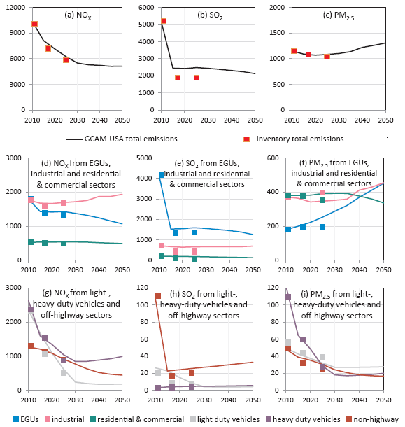
Projection of air pollutant emissions Evaluation
Shi, W., Ou, Y., Smith, S.J., Ledna, C., Nolte, C.G., and D.H. Loughlin. Projecting state-level air pollutant emissions using an integrated assessment model: GCAM-USA. Applied Energy, 208(2017), pp 511-521. DOI: https://doi.org/10.1016/j.apenergy.2017.09.122
Summary
Comparison of GCAM-USA outputs with EPA projections
Objectives:
Describe U.S. EPA modifications to GCAM-USA to support air pollutant emission projections
Apply the updated GCAM-USA to project emissions of NOx, SO₂, and PM_{2.5}
Compare the projections by comparing to EPA regulatory analyses
Introduce and apply “Quality Metric (QM)” to evaluate national- and state-level results
Findings:
GCAM-USA is a fast and flexible mechanism for projecting state and national air pollutant emissions
After the modifications, GCAM-USA projections much more closely matched EPA estimates, capturing major trends at the national and sectoral levels
The QM provides information that may be useful in examining state- and sectoral-level performance, helping determine the types of questions that can be answered

Slide 31
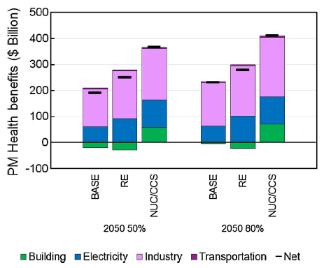
Projection of air pollutant emissions Application to alternative scenarios
Ou, Y., Shi, W., Smith, S.J., Ledna, C.M., West, J.J., Nolte, C.G., and D.H. Loughlin. Estimating environmental co-benefits of U.S. GHG reduction pathways using an integrated assessment model with state-level resolution. Applied Energy, 216(2018) pp. 482-493. DOI: https://doi.org/10.1016/j.apenergy.2018.02.122
Summary
PM mortality health benefits by sector for low-carbon pathways
Objectives:
Apply the modified GCAM-USA that was described by Shi et al.
Describe the addition of PM mortality and water use factors
Evaluate the low-carbon scenarios from the Energy Modeling Forum 24 exercise to compare their relative air quality-related health co-benefits
Pathways:
All technologies; Renewables focus; Nuclear and carbon capture focus
Low-carbon targets:
50% reduction from 2005; 80% reduction from 2005
Findings:
GCAM-USA can be used to evaluate co-benefits of alternative low-carbon pathways
Co-benefits are shown to differ by pathway and spatially
RE (as modeled) achieves greater water use co-benefits
NUC/CCS (as modeled) achieves greater health co-benefits
Treatment of residential biomass and assumptions about the adoption of cleaner biomass combustion technologies has a large effect on health results
BASE – all technologies are available
RE – emphasis on renewable technologies
NUC/CCS – emphasis on nuclear power and CCS

