Slide 1

Modeling PM_{2.5} Concentrations from Wildland Fires for
Health Impact Assessments
Xiangyu Jiang, Eun-Hye Enki Yoo
Department of Geography, University at Buffalo
Notes:
Hello everyone, my name is Xiangyu Jiang, today, I am going present my current research working with my advisor, Dr. Yoo, Modeling PM2.5 concentrations from Wildland Fires for Health impact assessments.

Slide 2
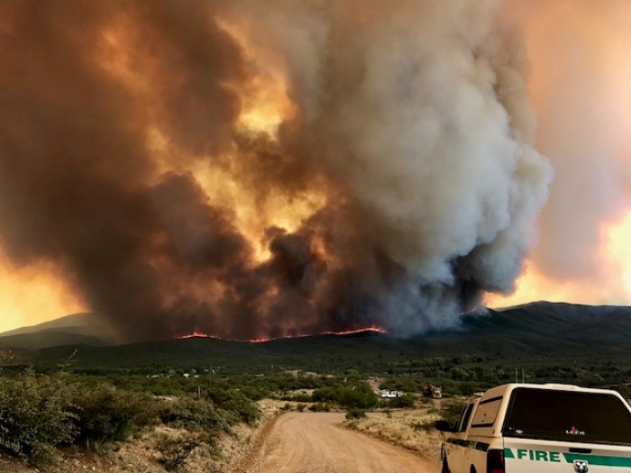
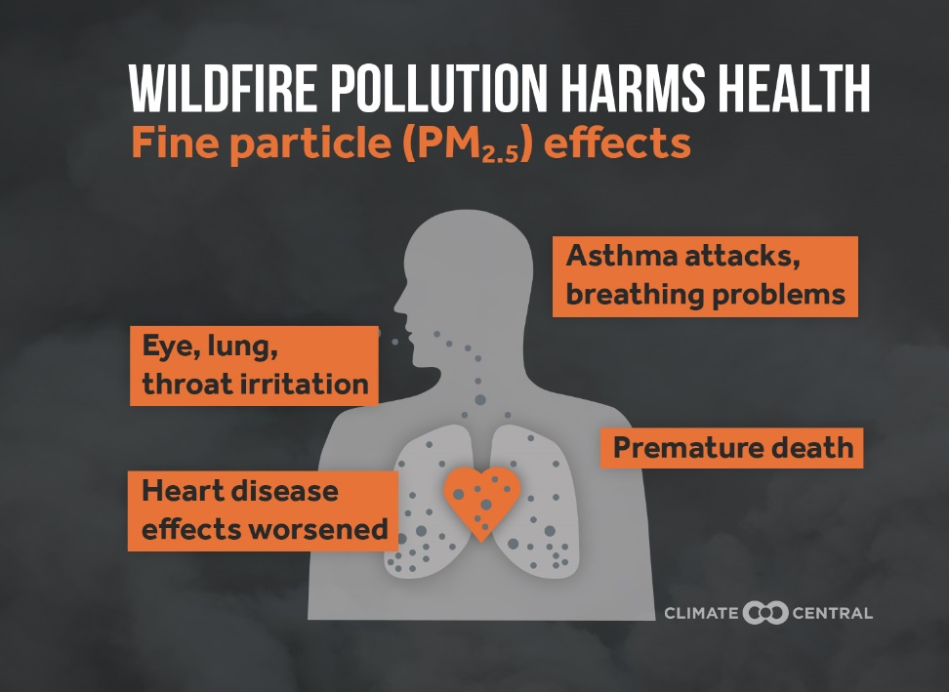
Introduction
Wildfire has become a frequent and dreadful threat across the U.S. in recent years.
Wildland fires is a health hazard as they are significant sources of fine particulate matters (PM_{2.5}).
It is a challenging to study health effects of wildland fire-specific PM_{2.5} due to the lack of accurate exposure data.
http://medialibrary.climatecentral.org/resources/wildfires-air-quality-2017
Notes:
As we know that US has experienced increasing wildfire activities with higher frequency, longer duration, and larger area burned sizes. One possible reason for these wildfire events are due to the climate change. For example, the earlier snowmelt due to warming in the spring and summer seasons can lead to dry and hot conditions. These dry and hot conditions can boost the fire activities in some areas.
Wildland fire are significant sources of air pollution. One of the air pollution, fine particular matter (PM2.5) deserves special attentions because fire-related air pollution are strongest for PM2.5. Some epidemiological studies have reported strong association between PM2.5 and adverse health effects, such as increased mortality rates, low birth weights, and elevated respiratory and cardiovascular hospital admissions. Though the health effect of PM2.5 has been well characterized, the health effects of wildfire-emitted PM2.5 are not well understood. One of the challenging in studying the health effects of wildland fire PM2.5 is due to the lack of accurate exposure data

Slide 3
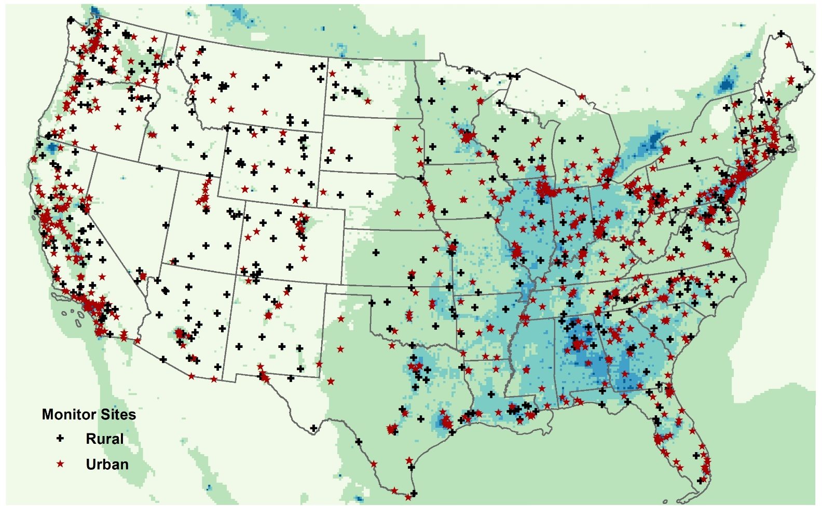
Data Sources for Exposure Estimation
Data Sources | Strength | Weakness
In-situ measurements | Easy accessibility Fine spatial resolution | Sparse spatial coverage Limited temporal resolution and coverage
EPA AQS monitor sites, 2014
Notes:
Currently, there are two common data sources for exposure estimation. The most common data source is the ground observations. The advantage of these data sources is that it’s very easy to get these data since they are public available . Another advantage is that these data have fine spatial resolution, at point level. However, there are only a limited number of monitoring stations with sparse spatial coverage. As you can see from this map, most of the stations are placed in the urban areas, states like Nevada, center of Texas, north part of NYS only has a few sites. Moreover, the monitor stations do not operate every day, they may only provide daily average PM2.5 values every three days or 6 days which makes hard to capture the PM2.5 during fire events.

Slide 4
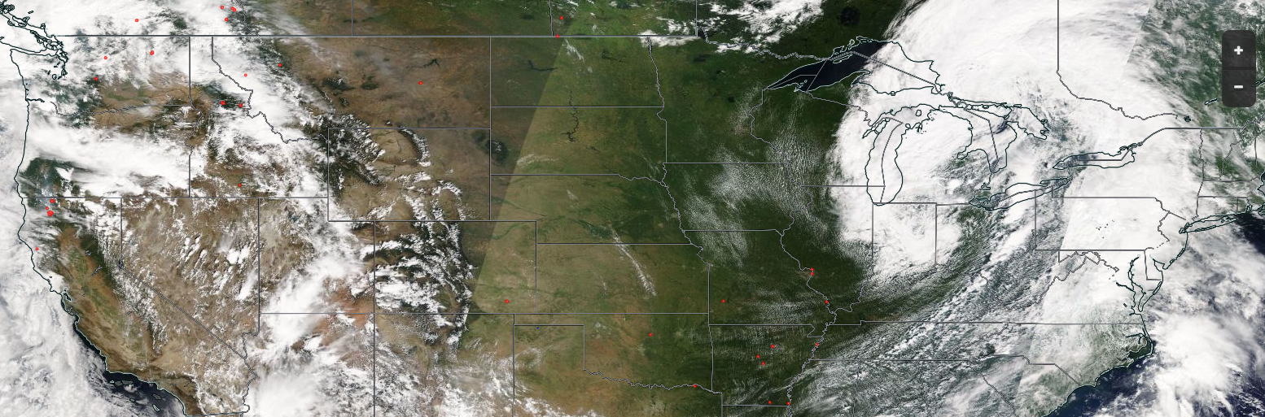

Data Sources for Exposure Estimation
Data Sources | Strength | Weakness
In-situ measurements | Easy accessibility Fine spatial resolution | Sparse spatial coverage Limited temporal resolution and coverage
Satellite-based observations | Global spatial coverage High spatial resolution | Missing data in the presence of clouds or extremely thick smoke Smoke information in the entire atmospheric column, not at ground level
Happy Camp Complex Fire, Aug. 12th, 2014
Happy
https://worldview.earthdata.nasa.gov
Notes:
To address the spatial coverage issue, another common data source is the satellite based observations, such as Aerosol optical depth (AOD). Compared to ground observations, satellite data provides global spatial coverage at high spatial resolution, however, the satellite data is restricted by weather conditions such as cloud cover. Retrievals often fail in the presence of heavy clouds or thick smoke. For example, this picture shows the satellite images over US. The fire symbol represents the Happy Camp Complex fire occurred over the northern California on Aug. 12th, 2014. According to the satellite images, we can find that on the top of the fire events, it covers by both smoke and clouds and makes it difficult to distinguish whether it is the smoke emitted by wildfire, or clouds. One the same day, there are a few fire events over north part of Washington. The satellite data is restricted by thick clouds over this region. So, we are not able to find out the fire impact areas through the AOD data only.

Slide 5
Data Sources for Exposure Estimation
Data Sources | Strength | Weakness
In-situ measurements | Easy accessibility Fine spatial resolution | Sparse spatial coverage Limited temporal resolution and coverage
Satellite-based observations | Global spatial coverage High spatial resolution | Missing data in the presence of clouds or extremely thick smoke Smoke information in the entire atmospheric column, not at ground level
Unable to Capture wildland fire-specific PM_{2.5} exposure
Chemical-transport model (CTM)
Notes:
Another limitation for both data sources is that they do not provide wildland fire-specific PM2.5 exposure directly. For example, monitor sites measured PM2.5 values from all different emission sources, such as urban emissions, biogenic emissions, wildfire emissions. We cannot get how much PM2.5 concentrations is emitted from wildland fires. In order to address the challenges described above, we plan to use chemical transport model. It can not only fill in the spatial and temporal gaps of monitoring and satellite data, but also capture the wildland fire –specific PM2.5 exposure.

Slide 6
Objectives
Quantify the amounts of PM_{2.5} stemming from wildland fires.
  We modeled wildland fire-related PM_{2.5} concentrations using Community Multiscale Air Quality (CMAQ v5.2.1) over northeastern US for the year 2014
Evaluate the health burden associated with wildland fire PM_{2.5.}
  We quantified excess mortality and hospital admissions attributable to exposure to wildland fire-related PM_{2.5} using the Benefits Mapping and Analysis Program (BenMAP) – Community Edition v1.4
Notes:
Therefore, our studies plan to address two questions. The first question is to quantify how much PM2.5 is stemming from wildland fires. We are going to use up to date CMAQ v5.2.1 to simulate wildland fire specific PM2.5. Secondly, we want to evaluate how much health burden is associated with wildland fire PM2.5. We will use BenMAP software to assess the excess mortality and morbidity due to exposure to wildland fire PM2.5

Slide 7
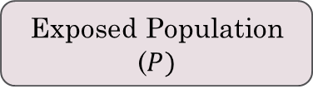

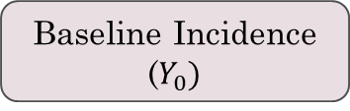
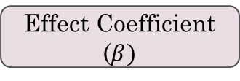



Method
Step 1: Estimating Wildland fire PM_{2.5} exposure
Step 2: Quantifying Wildland fire PM_{2.5} associated health burden
Epidemiology Studies
Krewski et al (2009)
Zanobetti et al (2009)
Emissions Processing System (SMOKE)
Fire + Other Emissions
$${CMAQ}_{All}$$
Effect Coefficient ($β)$
Meteorological Model System(WRF)
  $$Y_{0} \left(e^{β∙{PM2.5}_{Fire}}−1\right)∙P$$
Health Burden
$${PM2.5}_{Fire}$$
$${CMAQ}_{NoFire}$$
Baseline Incidence
($Y_{0})$
Emissions Processing System (SMOKE)
Exposed Population
($P)$
Other Emissions
Notes:
In order to address these two questions, it involves two steps. The first step is to estimate Wildland fire PM2.5 exposure. We generated estimates under two CMAQ simulations. For the first simulation, we prepared meteorological data using WRF model and processed emissions using SMOKE model. The emissions sources include all types of emissions such as transportation, industry, power plants, and fires. Then using CMAQ model, we estimated all-source PM2.5 concentrations. For the other CMAQ simulation, we use exactly same meteorological inputs data and emissions sources, but exclude wildland fire emissions. Then, we can get non-fire PM2.5. The difference between outputs from these two simulations provides an estimate of the wildfire-specific PM2.5 for each day and over each grid cell. Our next step is to characterize the magnitude and distribution of mortality and respiratory hospital admissions that are associated with exposure to fire PM2.5. We selected two epidemiological studies which reported long-term and short-term PM2.5 effect coefficients. After preparing baseline death and hospital admissions, exposure population data, we use concentration-response relationship to quantify how much health burden is associated with wildfire specific PM2.5

Slide 8
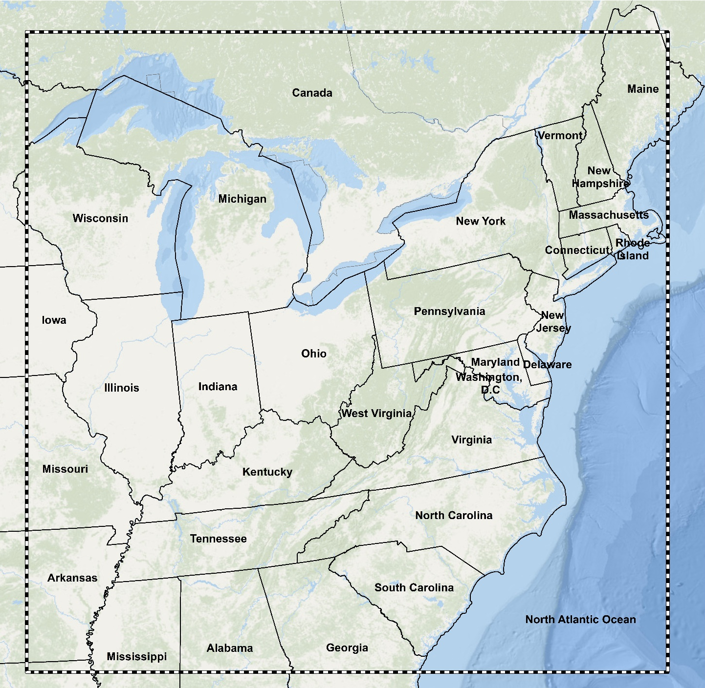
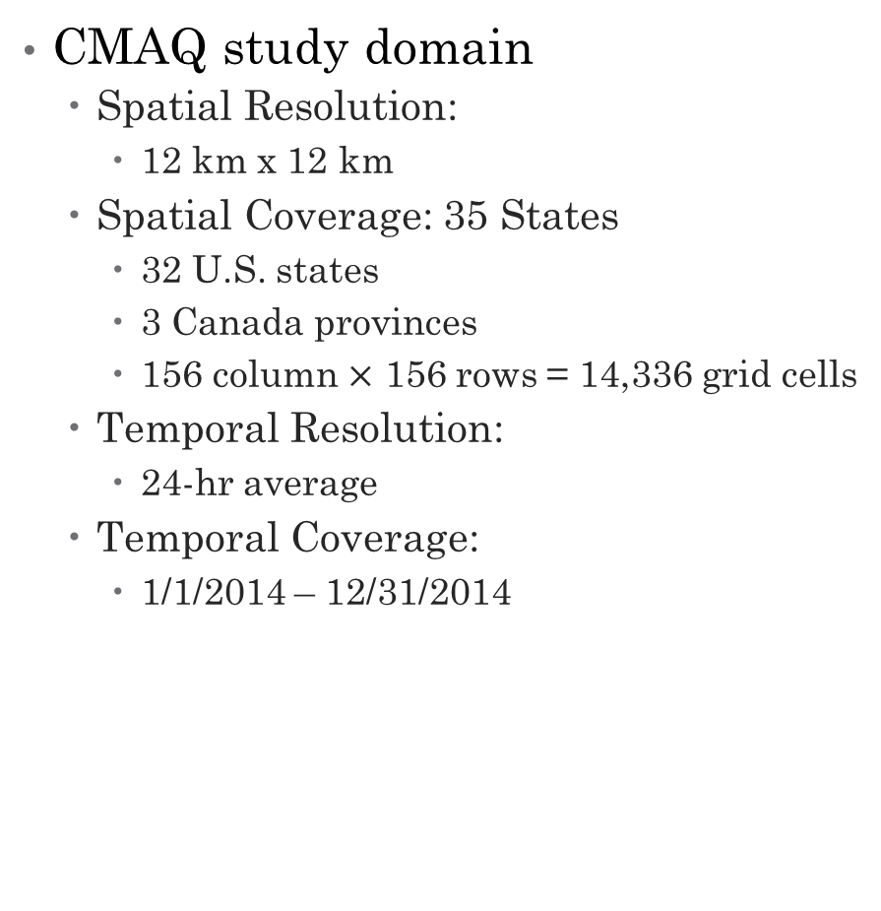
Study Area and Data
CMAQ Domain
CMAQ study domain
  Spatial Resolution:
    12 km x 12 km
  Spatial Coverage: 35 States
    32 U.S. states
    3 Canada provinces
    156 column $×$ 156 rows = 14,336 grid cells
  Temporal Resolution:
    24-hr average
  Temporal Coverage:
    1/1/2014 – 12/31/2014
Notes:
Our study region is the north eastern US which covers 32 states and 3 Canada providences. The CMAQ spatial resolution is 12 by 12 km and temporal resolution is hourly. We aggregated hourly outputs to 24 hr average and simulate PM2.5 over the entire year 2014.

Slide 9
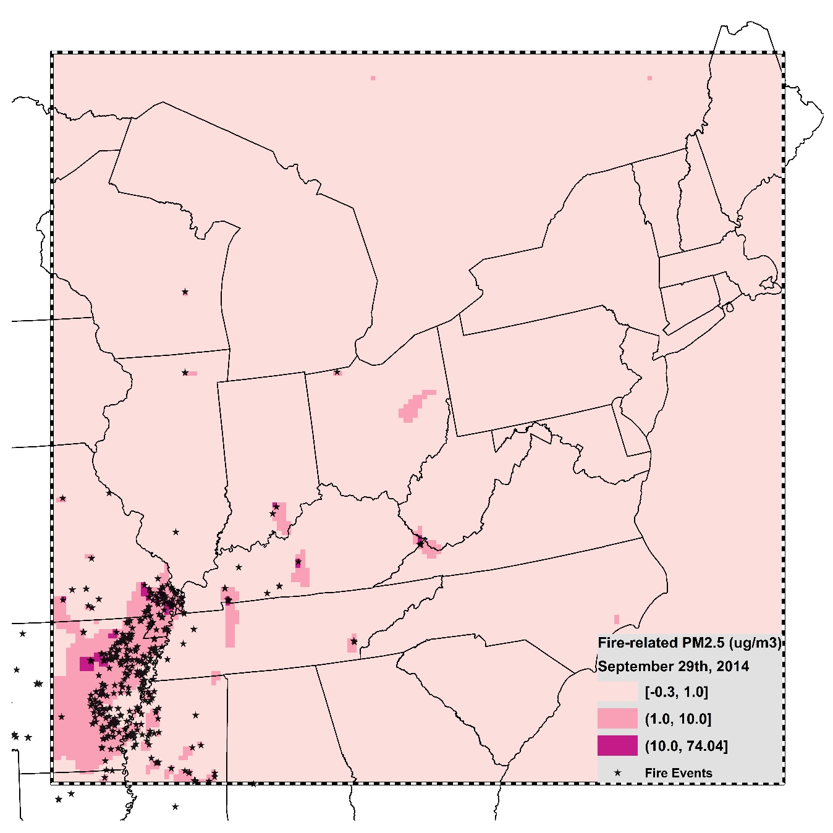
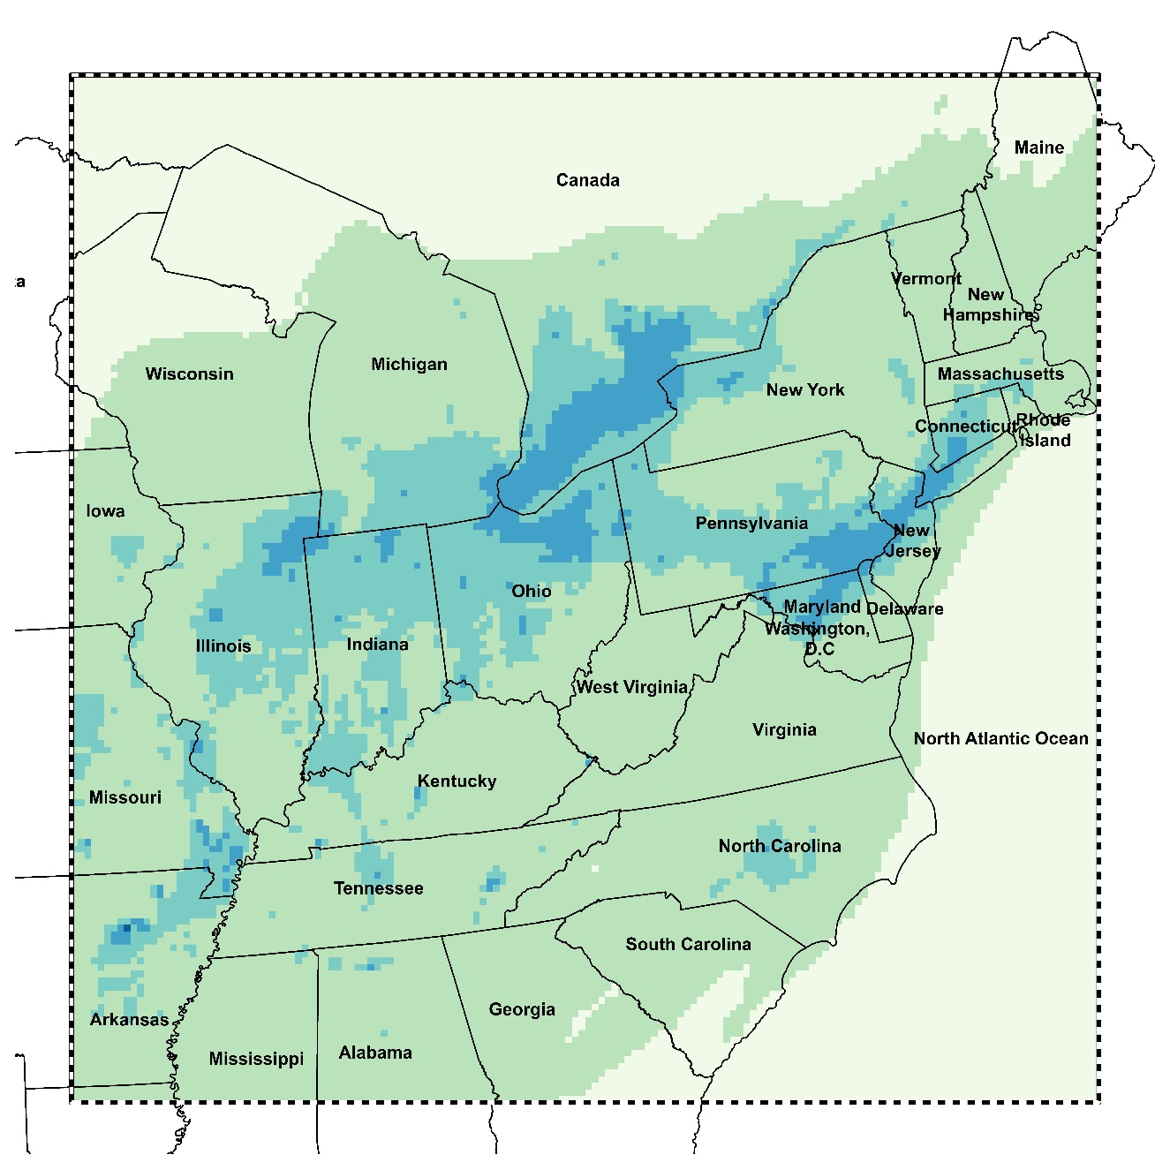
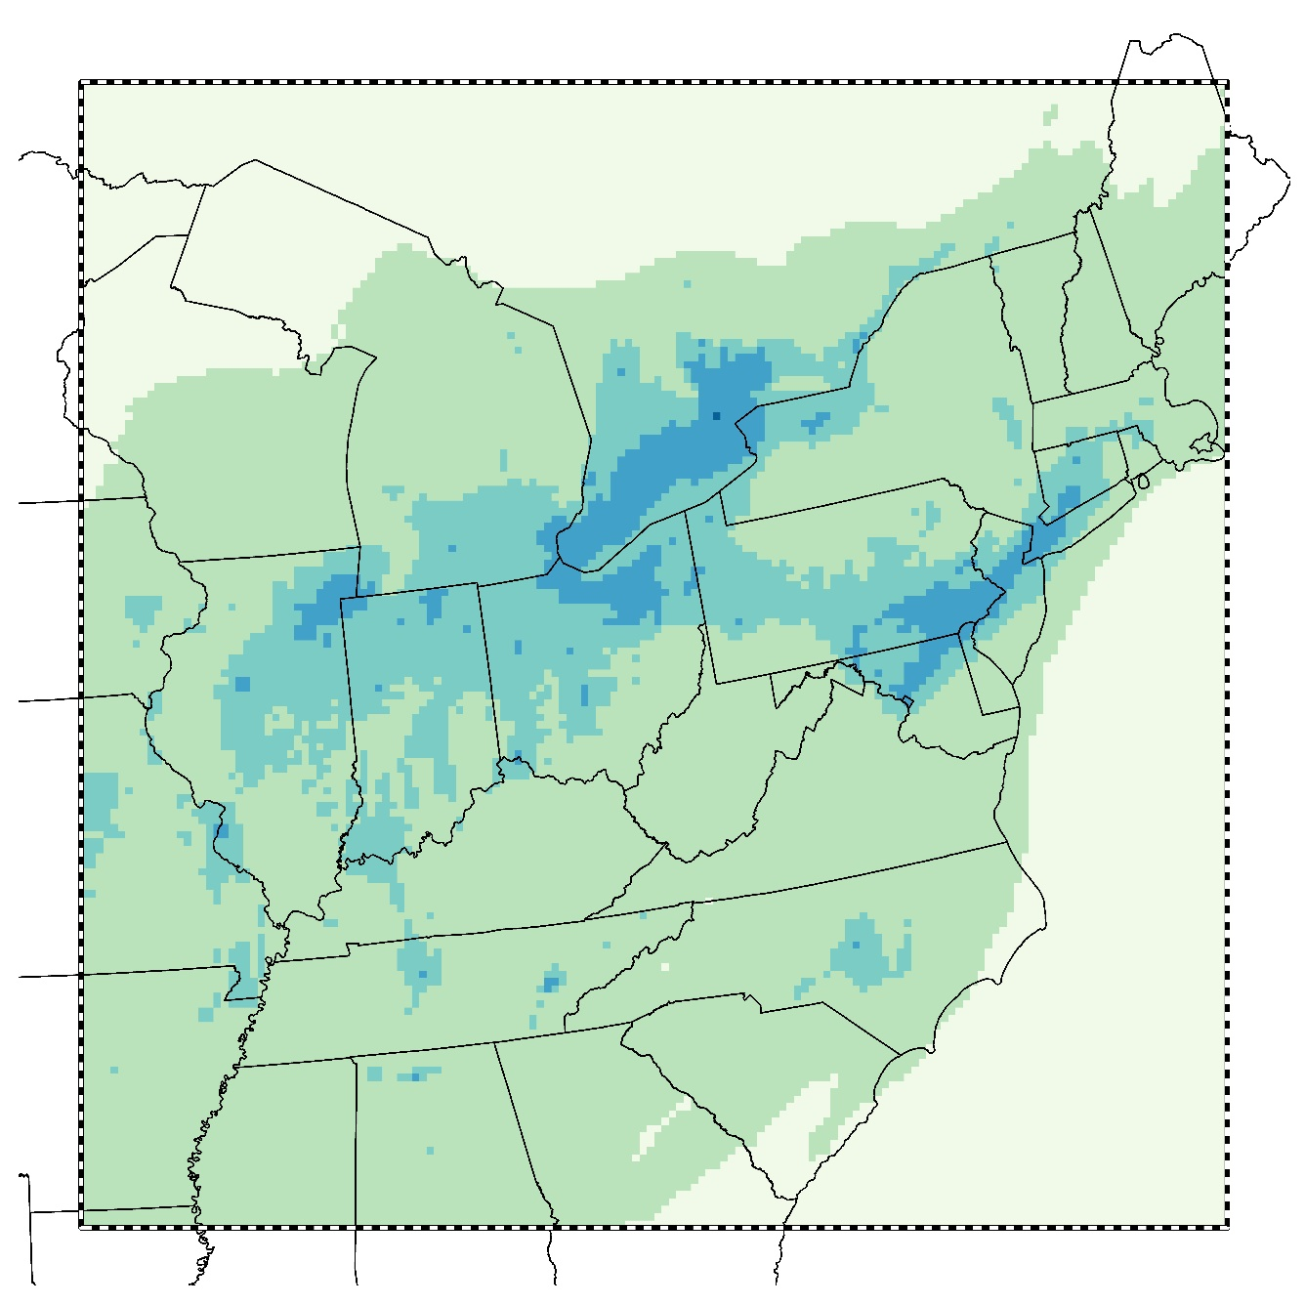
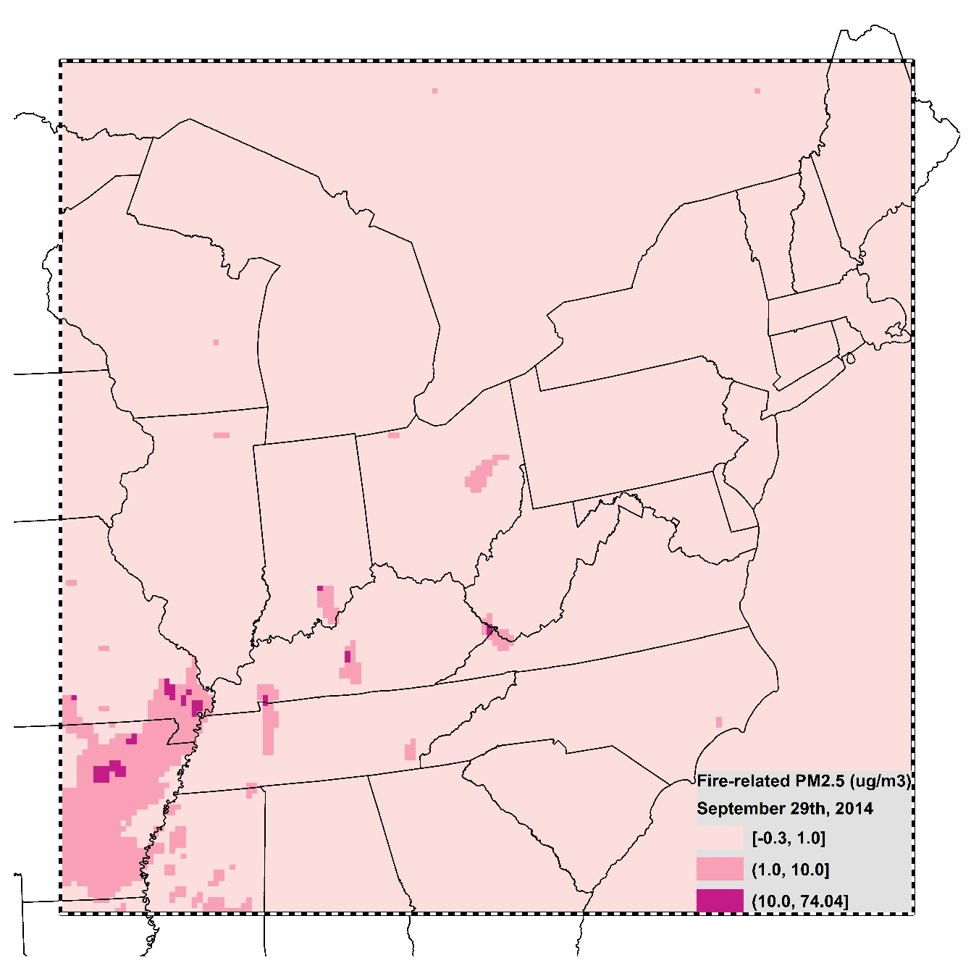
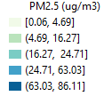
Daily PM_{2.5} without Fire Emissions (9/29/2014)
Results
Daily PM_{2.5} with Fire Emissions (9/29/2014)
Wildland Fire-specific PM_{2.5} (9/29/2014)
Notes:
Here is one example of CMAQ outputs. The left figure shows the daily PM2.5 with fire emissions on 9/29/2014, and right figure shows the daily PM2.5 concentrations without fire emissions. If we compare them, it’s like the game of spot the difference, we could find the major difference between these two figures are over the left corner of study region. It indicates the PM2.5 with fire emissions is higher over this region. If we calculate the difference between these two outputs, we could find out the PM2.5 stemming from these regions are greater than 1 ug/m3. These dark pink areas show the wildfire-contributed PM2.5 is even greater than 10 ug/m3. In order to demonstrate the CMAQ model indeed capture the fire event impact areas, we plotted the fire events locations occurred on the same data, reported by Hazard mapping system, we found the wildfire-contributed PM2.5 areas captured fire events.
这个地方再好好改改

Slide 10
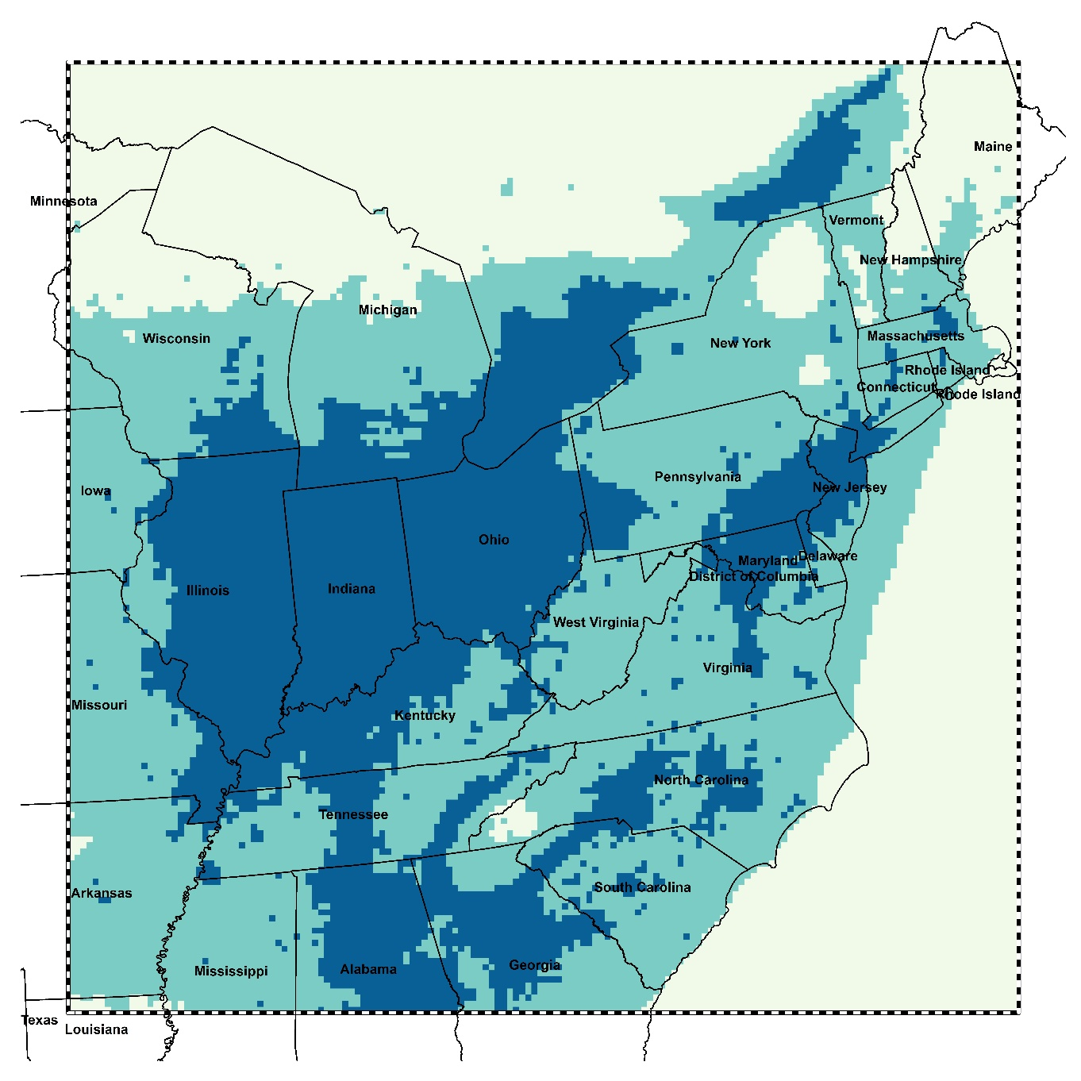
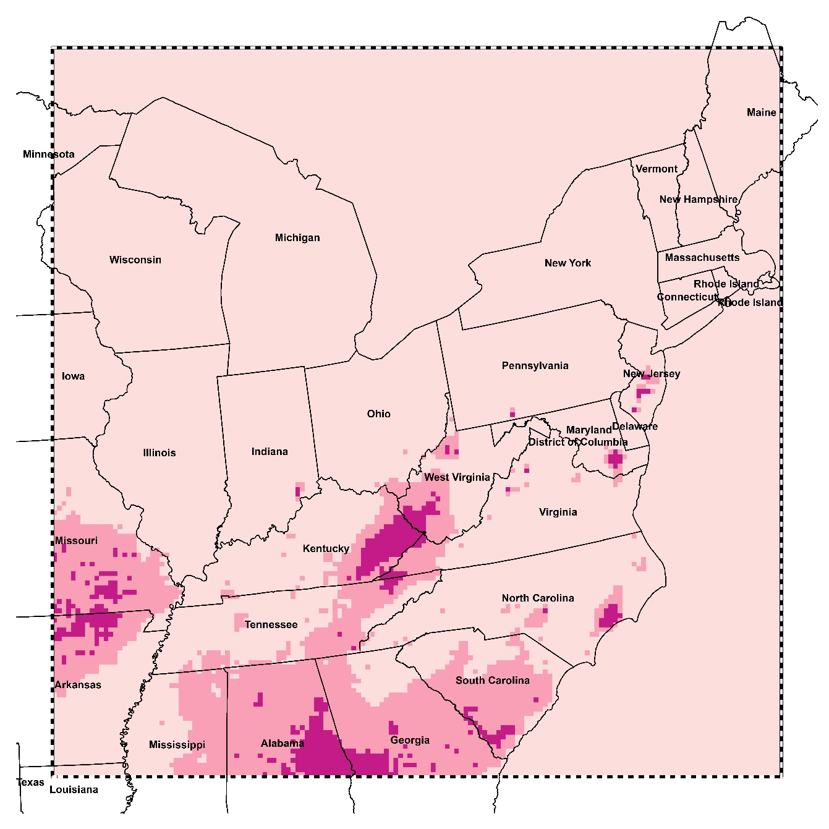


Wildland Fire-Attributable Annual Mean PM_{2.5}
Results
Annual Mean All-source PM_{2.5}
Notes:
These two figures show the annual average all-source PM2.5 and wildfire-specific PM2.5. From left figure, we find the big cities such as NYC, Detroit and Chicago have higher PM2.5 concentrations, however, among the all-source PM2.5 values, wildfire PM2.5 contributed a little, less than 0.5 ug/m3. However, if we take a look the eastern part of Kentucky, thought the annual average pm2.5 values are around 7.31, there are a large portion of pm2.5 are emitted from wildfire. This map shows the proportion of annual PM2.5 is from wildland fire. It shows more than 20% of PM2.5 were contributed by wildland fire over eastern Kentucky, southeastern of North Carolina. .

Slide 11
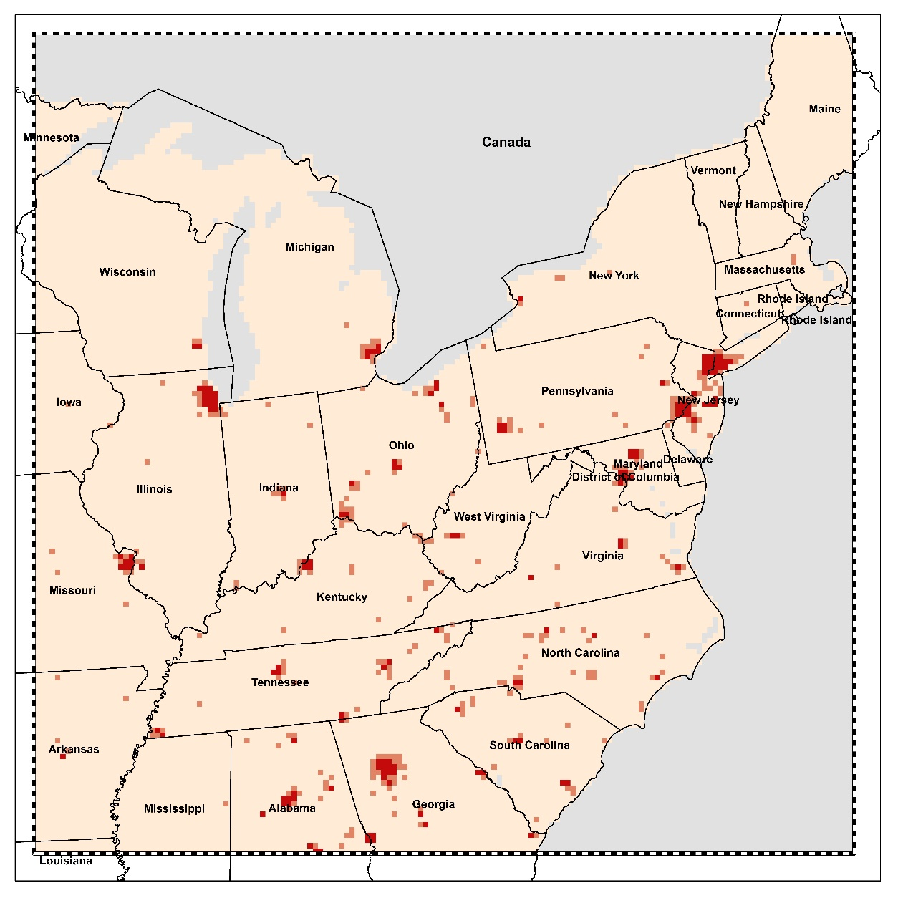
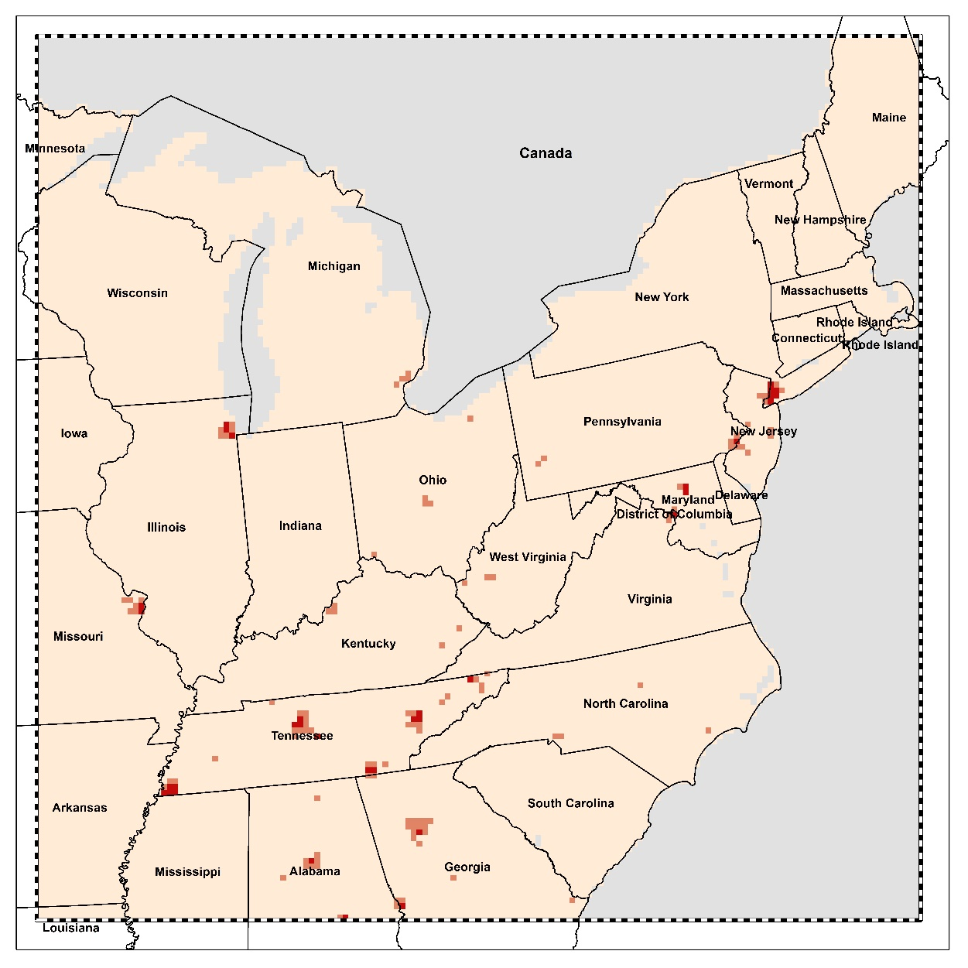


Health Burden attributable to wildland fire-related PM_{2.5}
Premature deaths
Respiratory Hospital Admissions
Total: 2713 (1825 – 3573)
Total: 1223 (707 – 1735)
Notes:
Then we quantified how much health burden attributable to wildland fire PM2.5. According to the health impact functions, we find more than 2700 mortality was due to fire related PM2.5. Though the wildland fire only contribute a small portion of PM2.5 over metropolitan areas, such as NYC, Detroit, Chicago, there are still a number of deaths are due to wildfire PM2.5. For the eastern Kentucky, though the wildfire contributed a lot PM2.5 over these regions, smaller number of deaths is due to wildfire PM2.5. If we calculated the % of wildland fire associated mortality over the total mortality due to all source PM2.5, it shows that there are a large portion of mortality are due to wildfire over eastern Kentucky.

Slide 12
Summary & Discussion
We applied CMAQ to capture PM_{2.5} due to wildland fire and demonstrated its application in northeastern US.
We assessed the impact of PM_{2.5} related wildland fire on the the magnitude and distribution of excess mortality and respiratory hospital admissions.
We found that CMAQ predictions are subject to systematic bias.
Notes:
Overall, we 1. 2).
However, we also found the CMAQ model suffers from systematic bias and uncertainties. As we know that CMAQ model is highly impacted by our input data. If the fire emission sources are insufficient, then the simulated wildfire PM2.5 might be underestimated. Another limitation of our study is that the PM2.5 effect coefficients used in this study did not necessarily account for the effect of wildland fire related PM2.5. Therefore, it may over- or under estimate health impacts of wildfire-related PM2.5

Slide 13
Ongoing Work
Calibration of wildland fire-specific PM_{2.5} concentrations at finer spatial resolution will be explored using a Bayesian downscaler model .
The health effects of PM_{2.5} solely stemming from wildland fire in New York State will be investigated.
Notes:
Therefore, in our future study, we plan to calibrate our CMAQ derived wildland fire PM2.5 concentrations outputs and downscaled them from 12 by 12km to census tract level for further health study assessments.
Moreover, we will investigate the health effects of PM2.5 solely stemming from wildland fire in New York State.
The PM_{2.5} effect coefficients (𝛽) used in the present health study did not necessarily account for the effect of wildland fire related PM_{2.5}.

Slide 14



Acknowledge
Notes:
Lastly, We appreciate the support provided by the Center for Computational Research (CCR) and the seed grant from University at Buffalo’s Research and Education in Energy, Environment & Water (RENEW) Institute. And we are greatly thankful for the EPD to share the WRF data for our project.

Slide 15
Thank you!
Xiangyu Jiang
Department of Geography, University at Buffalo
Email: xiangyuj@buffalo.edu

Slide 16
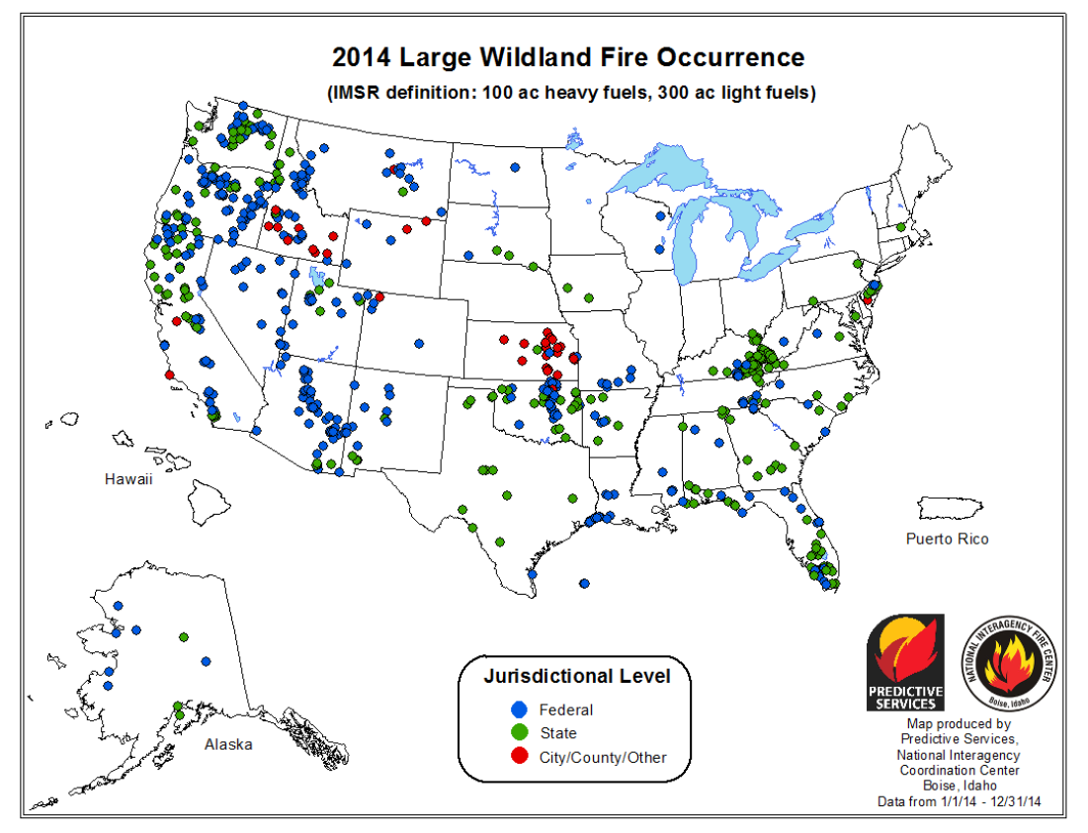
Wildland Fire-Attributable Annual Mean PM_{2.5}
https://www.nifc.gov/fireInfo/fireInfo_statistics.html

Slide 17
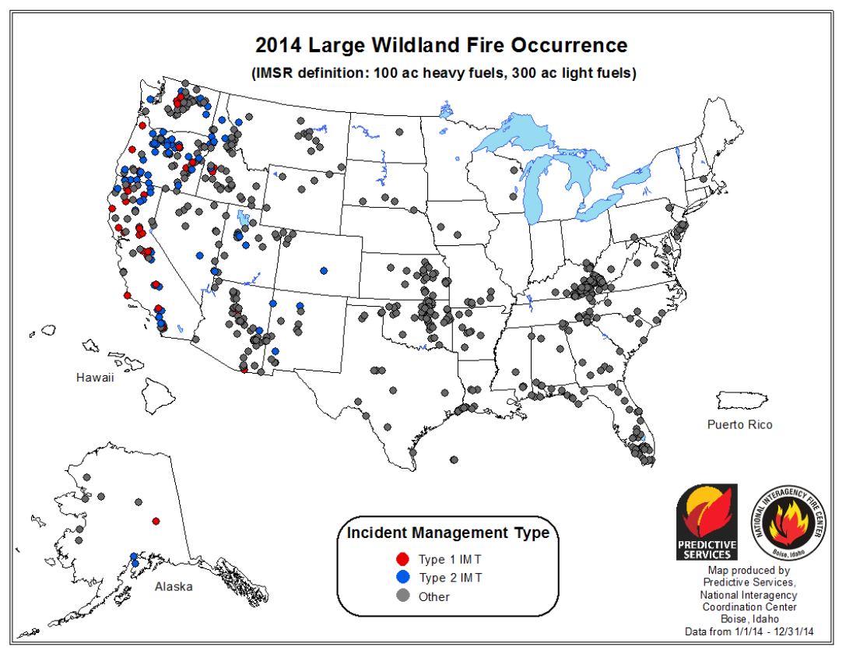
2014 Large Wildland Fire Occurrence
https://www.nifc.gov/fireInfo/fireInfo_statistics.html

Slide 18
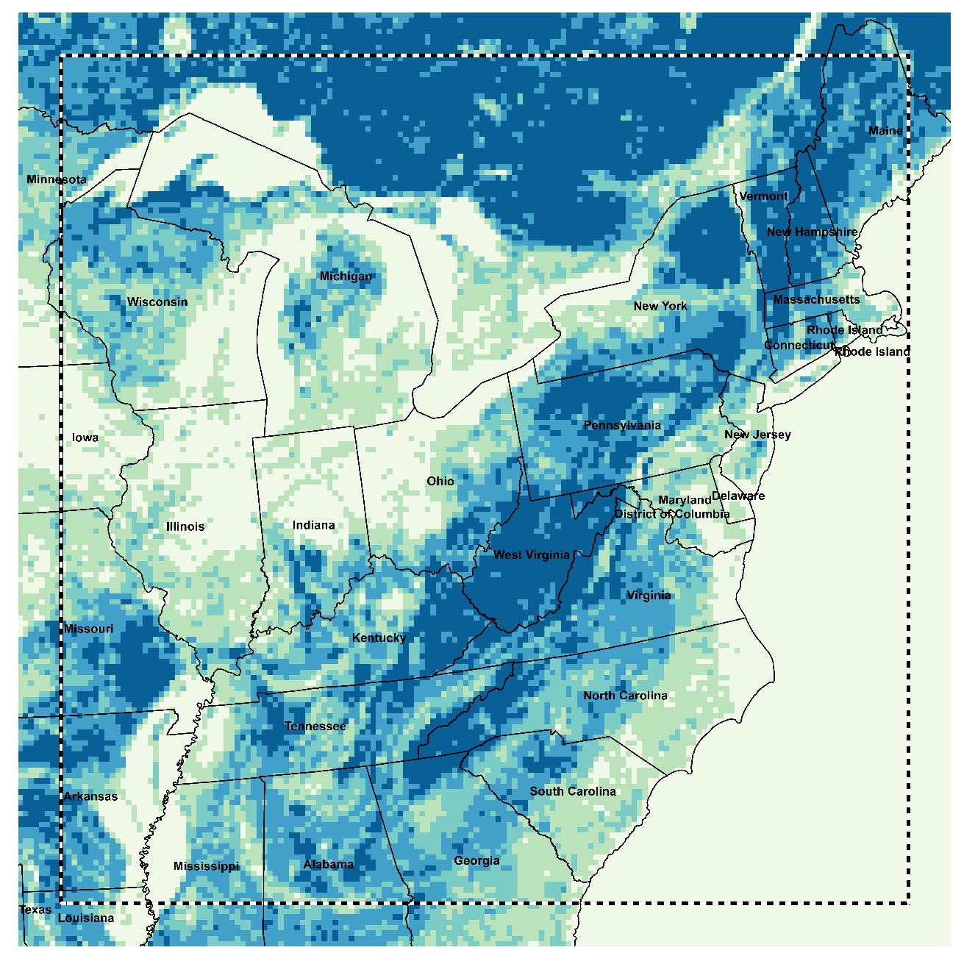
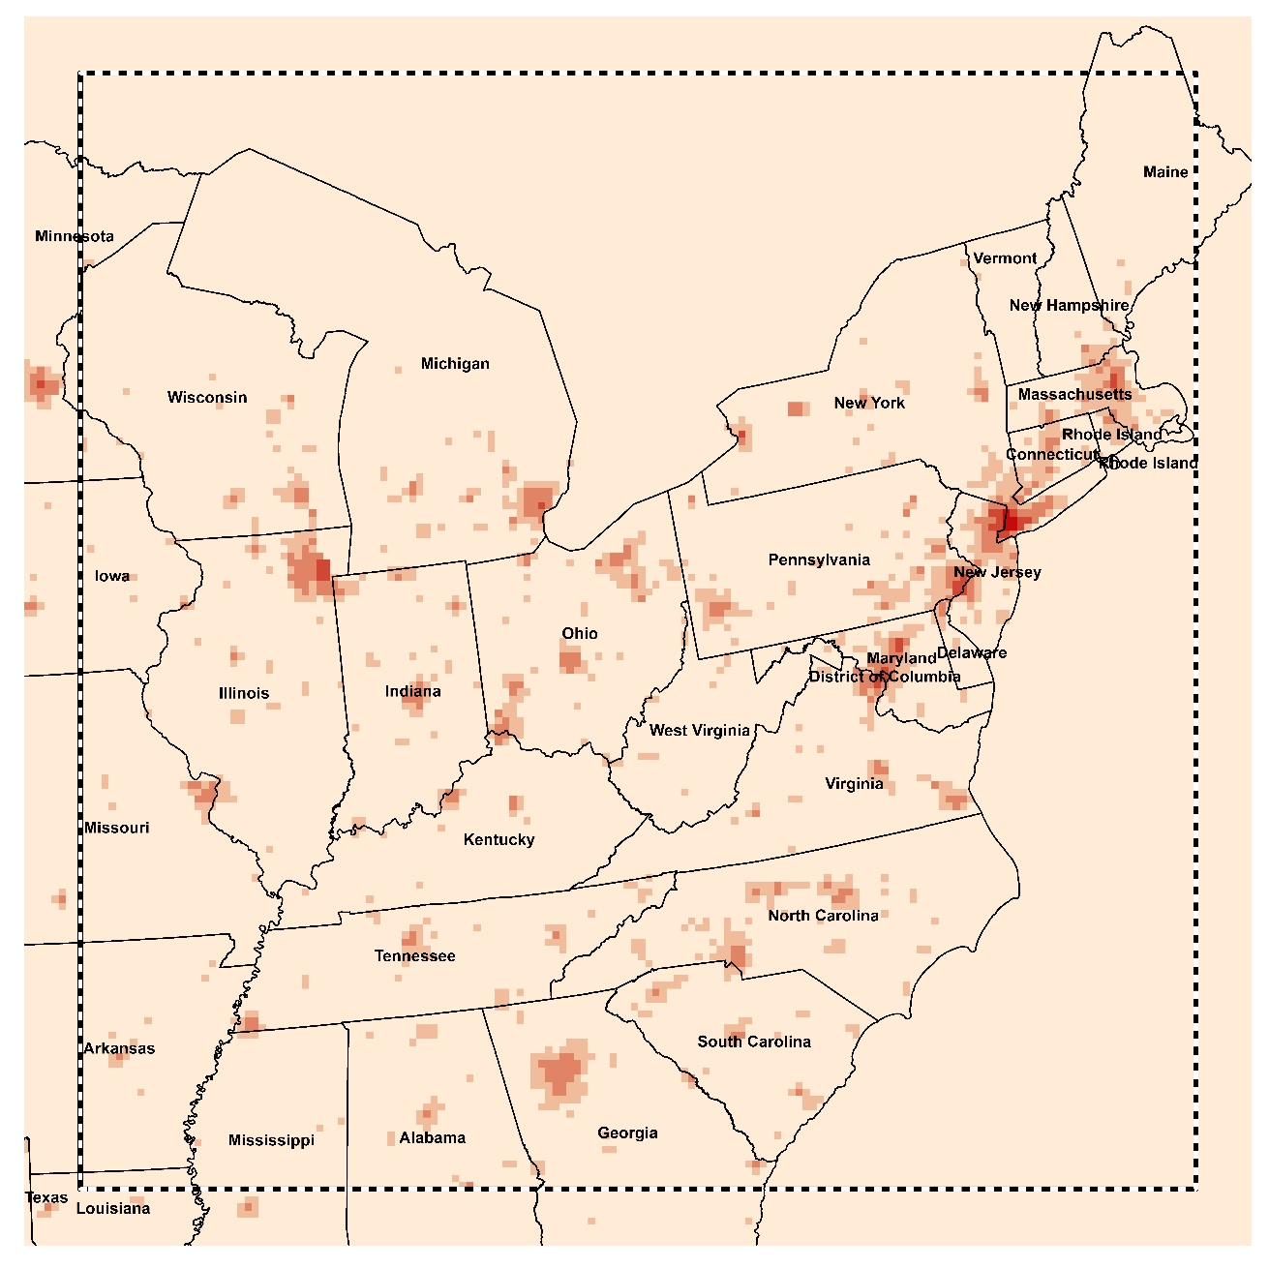
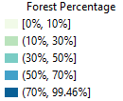
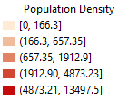
Forest Percentage over CMAQ grid cell
Population Density over CMAQ grid cell

Slide 19
Estimating wildfire-related PM2.5 exposure using CTM
Literature | CTM | Methods | Limitations
Alman et al., 2016 | WRF-Chem | Modeling PM2.5 concentrations using Weather Research and Forecasting with Chemistry (WRF-Chem) during wildfire period | Did not distinguish between PM2.5 concentrations from wildfire emissions and other emission sources
Gann et al., 2017; Lassman et al., 2017 | WRF-Chem | Blended model outputs - background air pollution | Background levels of PM2.5 are estimated using surface monitor only.
Jaffe et al., 2013; Gong et al., 2017 | CMAQ | Wildfire-related O3 concentrations = statistical model (GAM) residuals | Primary interest is O3 concentration, not PM2.5
Fann et al., 2018 | CMAQ | Wildfire-specific PM2.5 concentrations are modeled by CMAQ (CMAQ with fire emissions – CMAQ without fire emissions) | 1) Did not calibrate CMAQ outputs 2) Chemical mechanism scheme CB05 leads to underestimation of PM2.5 during summer periods.
Notes:
2) The risk coefficients did not specifically consider wildland fire episodes, which may under- or over-estimate health impacts

Slide 20
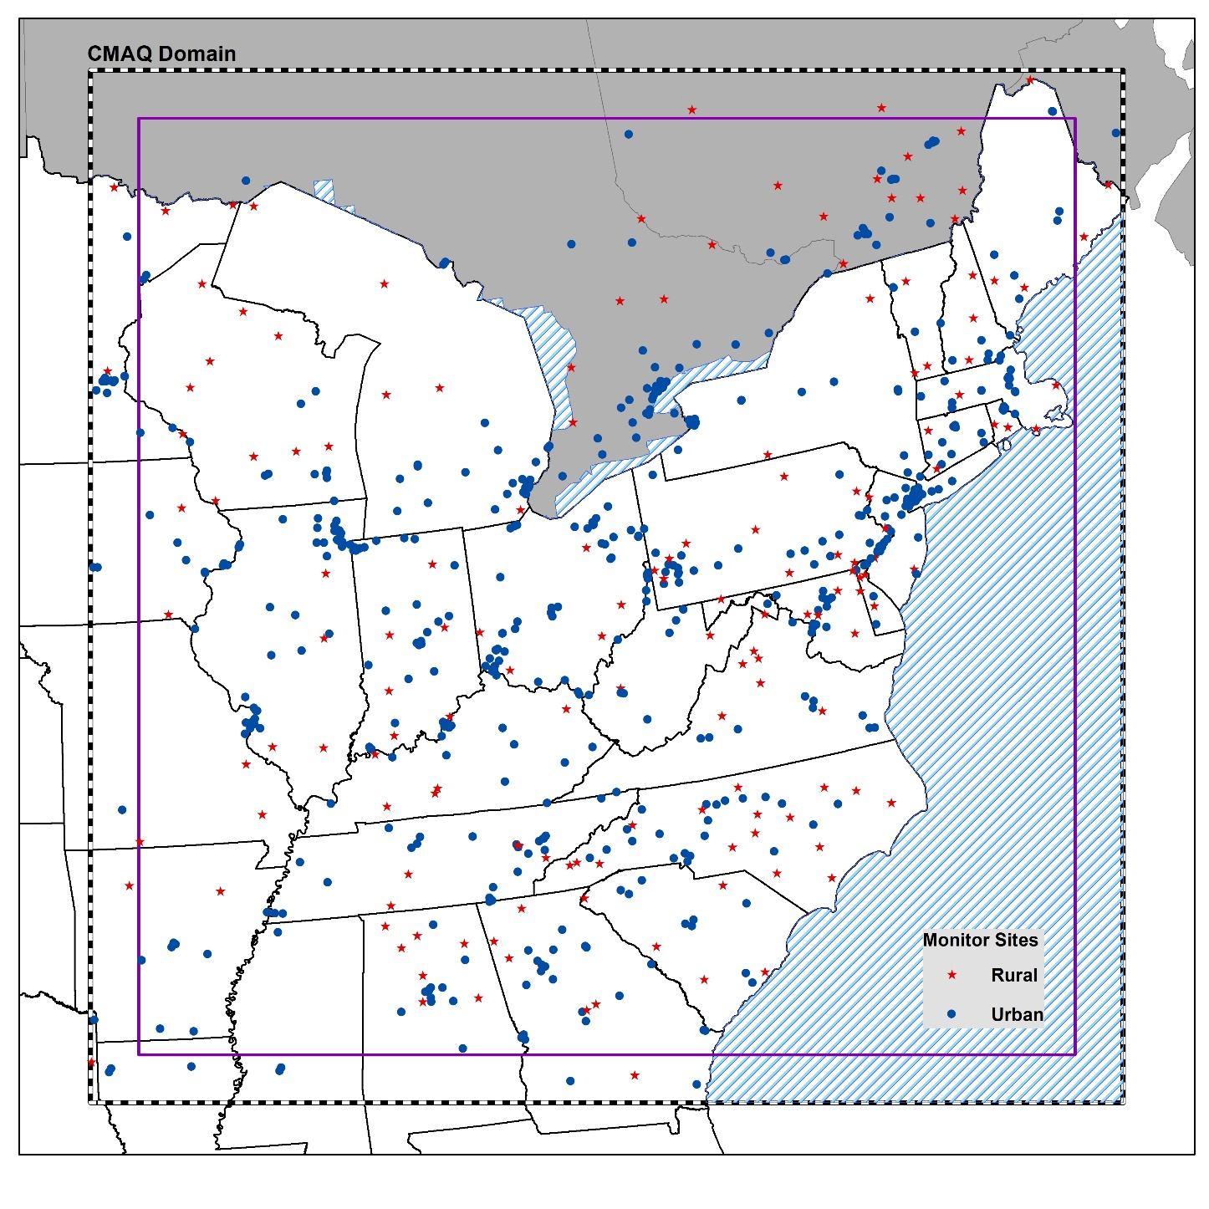
Study Area and Data
CMAQ outputs
  Spatial Resolution: 12 km x 12 km
  Spatial Coverage: 156 columns x 156 rows
  Temporal Resolution: hourly
  Temporal Coverage: 1/1/2014 – 12/31/2014
In situ measurements
  Spatial Resolution: point level
  Spatial Coverage: 655 monitor sites
    Urban sites: 515
    Rural sites: 150
  Temporal Resolution:
    Hourly,
    Daily
    Once every three days
    Once every six days
  Temporal Coverage: 1/1/2014 – 12/31/2014
North Atlantic Ocean

Slide 21
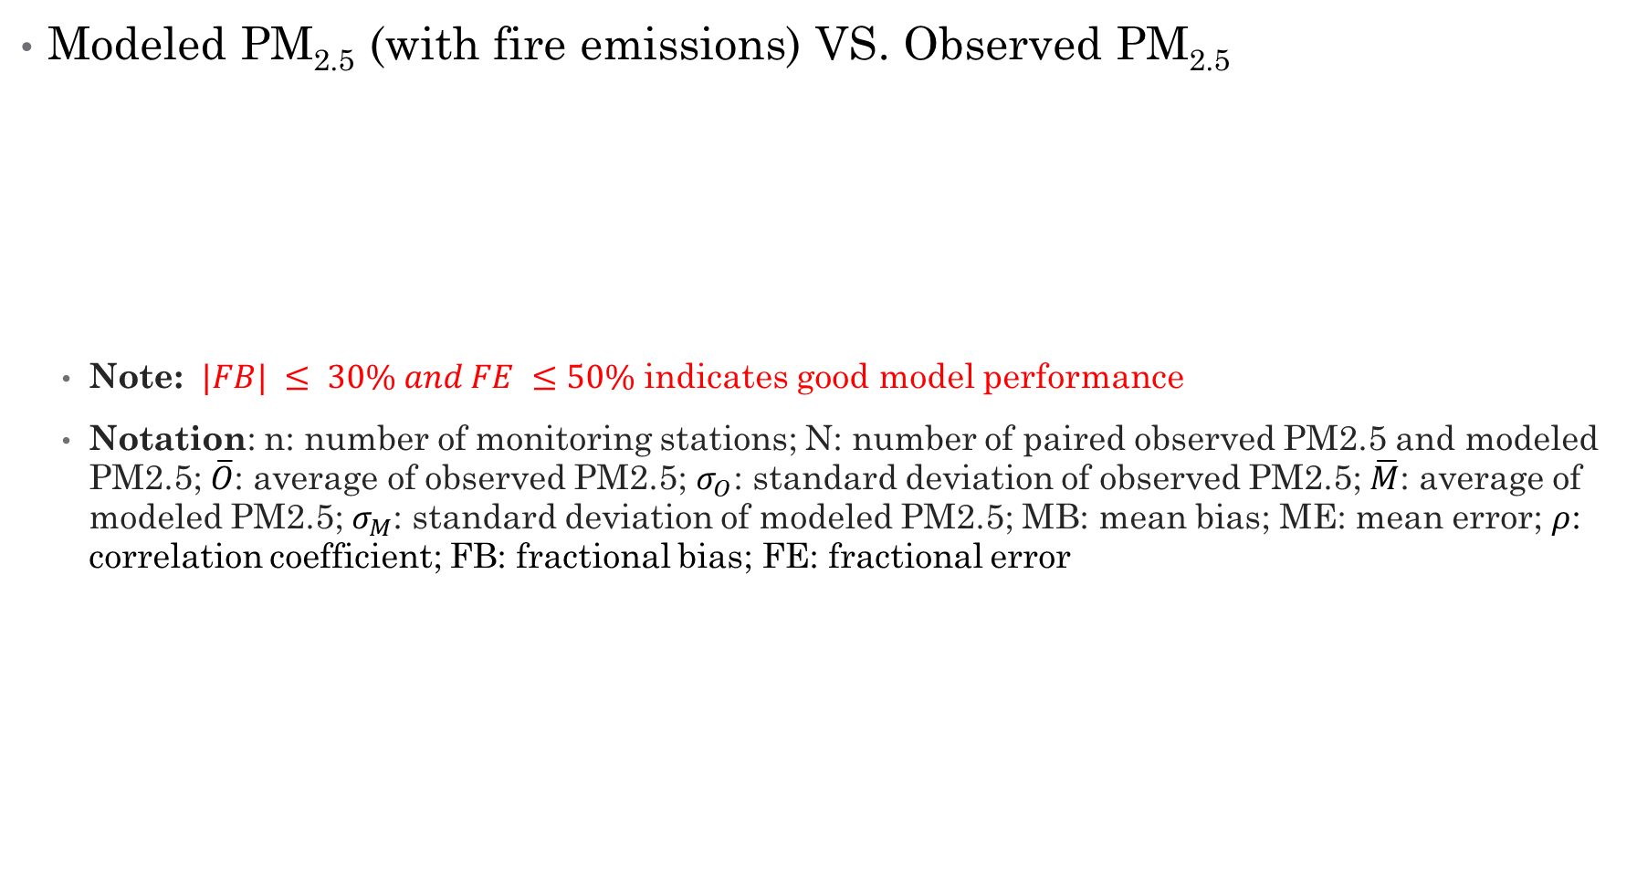
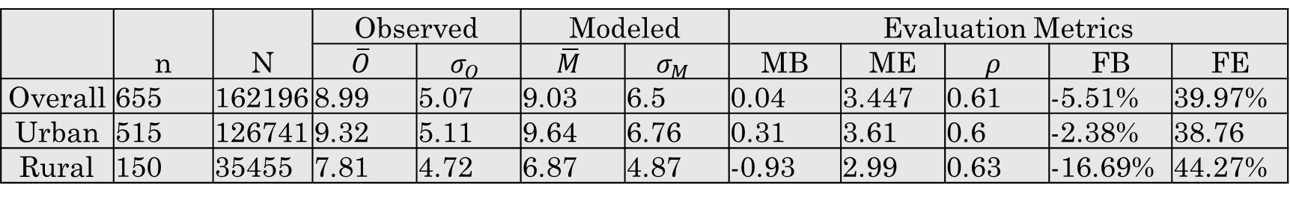
CMAQ model performance evaluation (MPE)
Modeled PM_{2.5} (with fire emissions) VS. Observed PM_{2.5}
    Note: $|FB| ≤ 30\% and FE ≤50\%$ indicates good model performance
    Notation: n: number of monitoring stations; N: number of paired observed PM2.5 and modeled PM2.5; $\overline{O}$: average of observed PM2.5; $σ_{O}$: standard deviation of observed PM2.5; $\overline{M}$: average of modeled PM2.5; $σ_{M}$: standard deviation of modeled PM2.5; MB: mean bias; ME: mean error; $ρ$: correlation coefficient; FB: fractional bias; FE: fractional error
 | n | N | Observed |  | Modeled |  | Evaluation Metrics
 |  |  | $$\overline{O}$$ | $$σ_{O}$$ | $$\overline{M}$$ | $$σ_{M}$$ | MB | ME | $$ρ$$ | FB | FE
Overall | 655 | 162196 | 8.99 | 5.07 | 9.03 | 6.5 | 0.04 | 3.447 | 0.61 | -5.51% | 39.97%
Urban | 515 | 126741 | 9.32 | 5.11 | 9.64 | 6.76 | 0.31 | 3.61 | 0.6 | -2.38% | 38.76
Rural | 150 | 35455 | 7.81 | 4.72 | 6.87 | 4.87 | -0.93 | 2.99 | 0.63 | -16.69% | 44.27%

Slide 22

Limitations
CMAQ suffers from systematic bias in model predictions.
  CMAQ tends to over-estimate PM_{2.5} in urban areas, but underestimates over rural areas.
  CMAQ tends to underestimate PM_{2.5} in summer months
  ${CMAQ}_{diff} ({CMAQ}_{fire}$ - ${CMAQ}_{nofire}$) ranges from -0.82 to 1055.31 $μg/m^{3}$
Overestimate
PM2.5
Underestimate
PM2.5

Slide 23
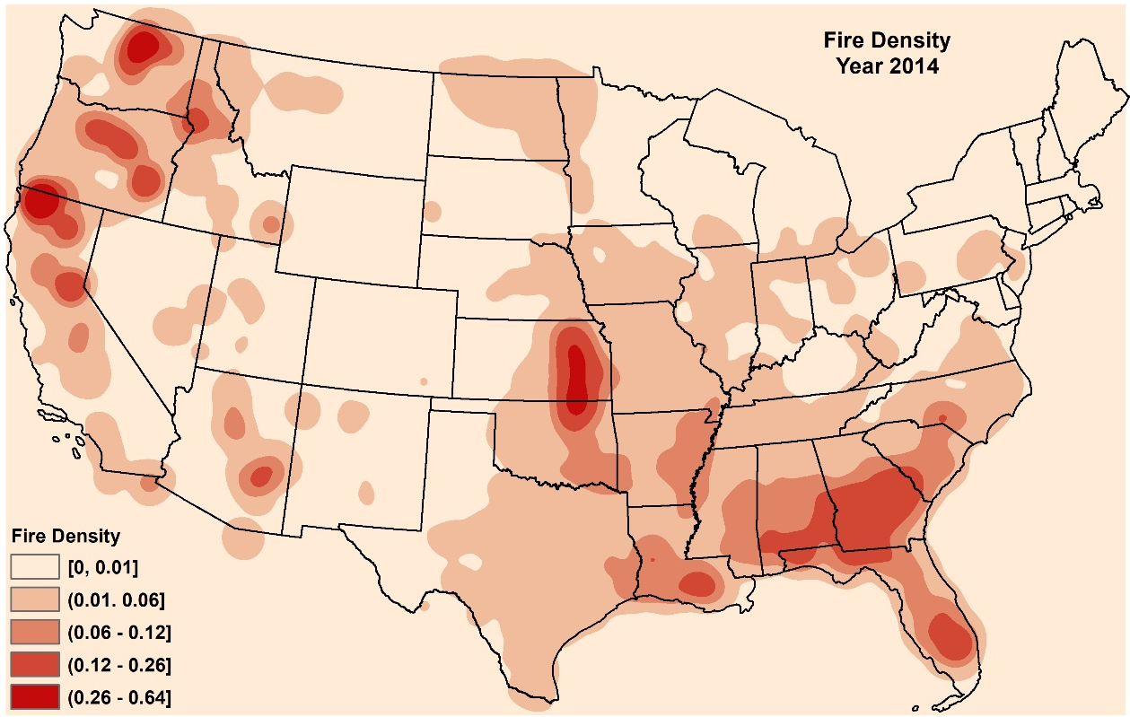
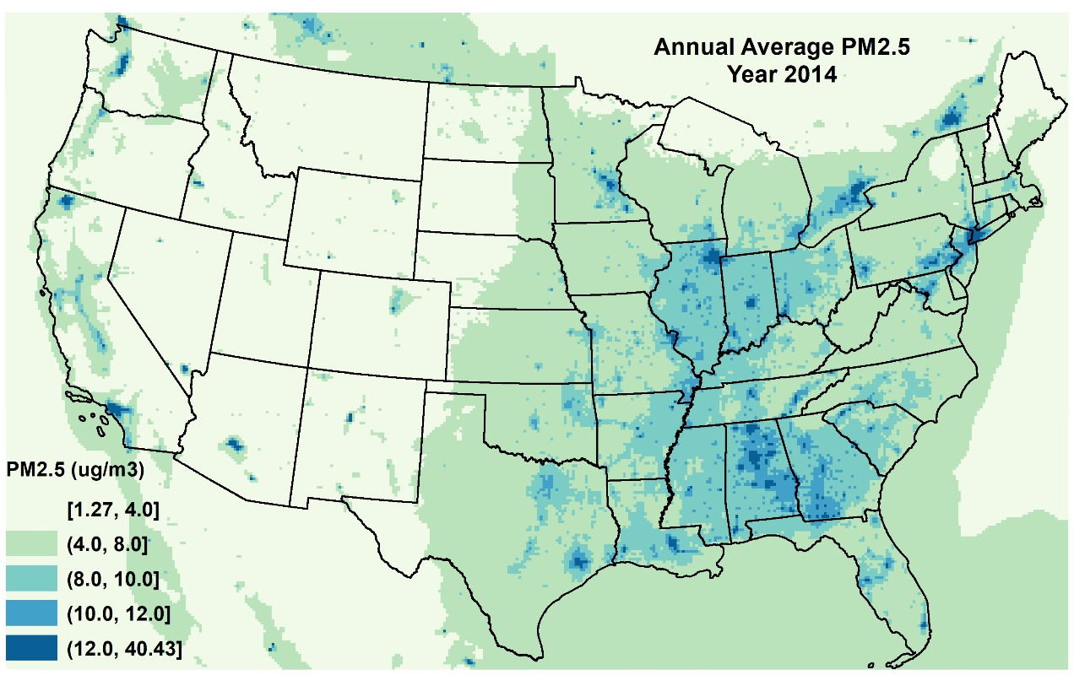
Introduction
Fire Density
Annual Average PM_{2.5}
Notes:
Wildfires are a major source of fine particulate matter (diameter <2.5 µm; PM_{2.5})
with an aerodynamic diameter less than or
equal to 2.5 lm (hereafter referred to as PM2.5)
Numerous epidemiological studies
have investigated associations between individual and/or population
exposure to ambient PM2.5 and negative health effects

Slide 24
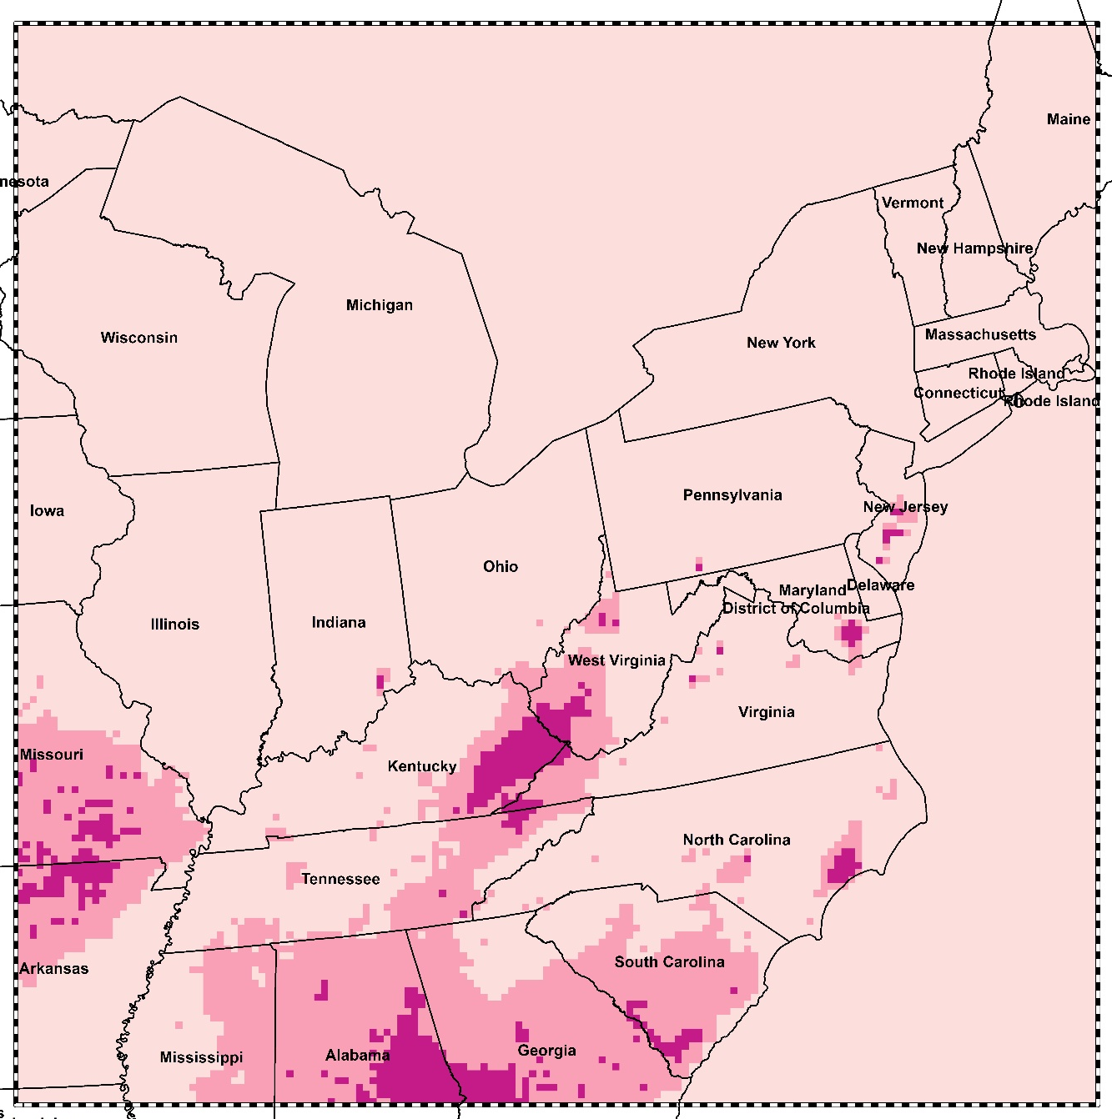
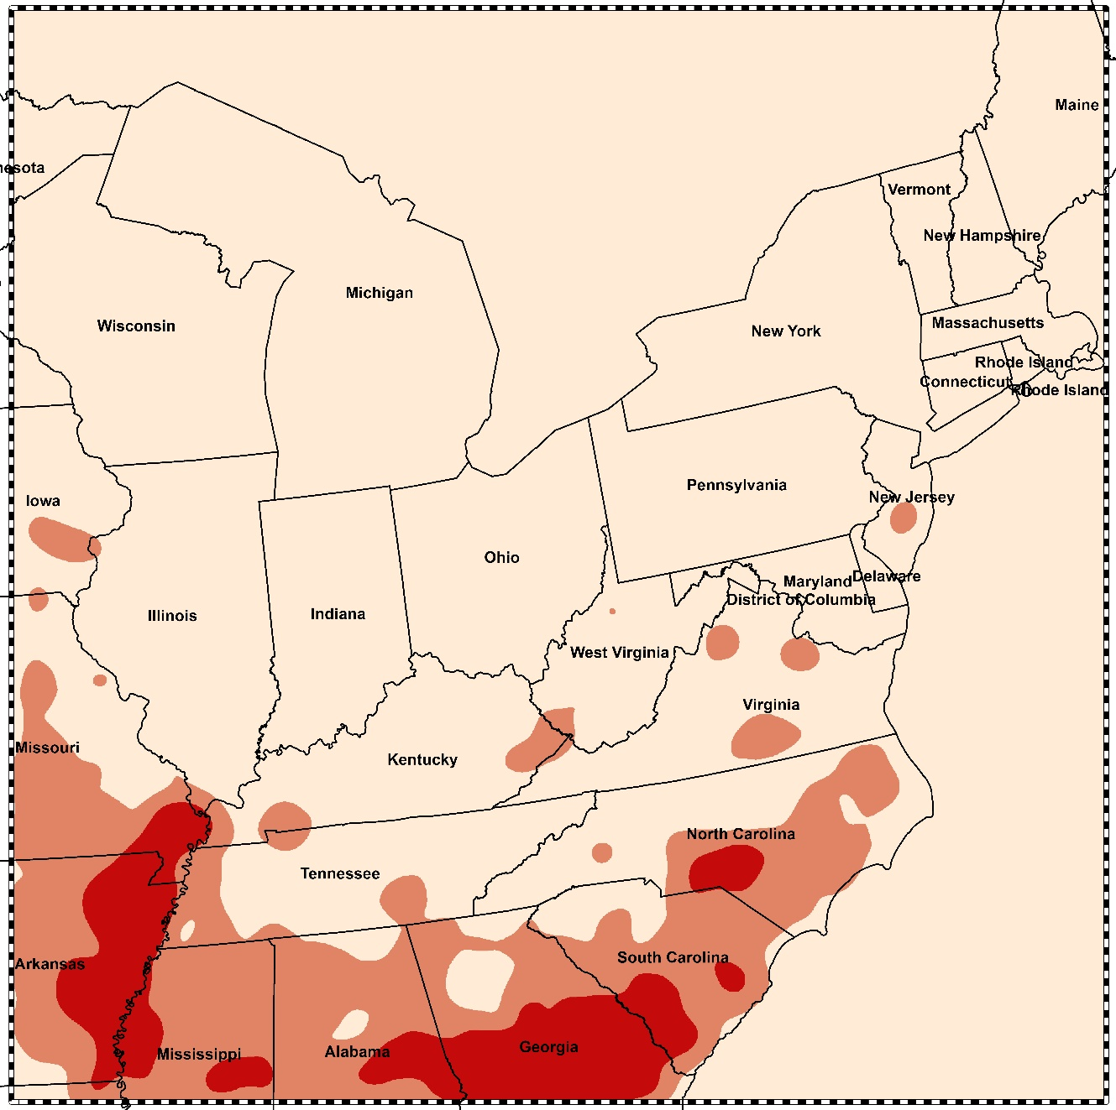


Wildland Fire-Attributable Annual Mean PM2.5
Annual Fire Density over CMAQ study domain

Slide 25
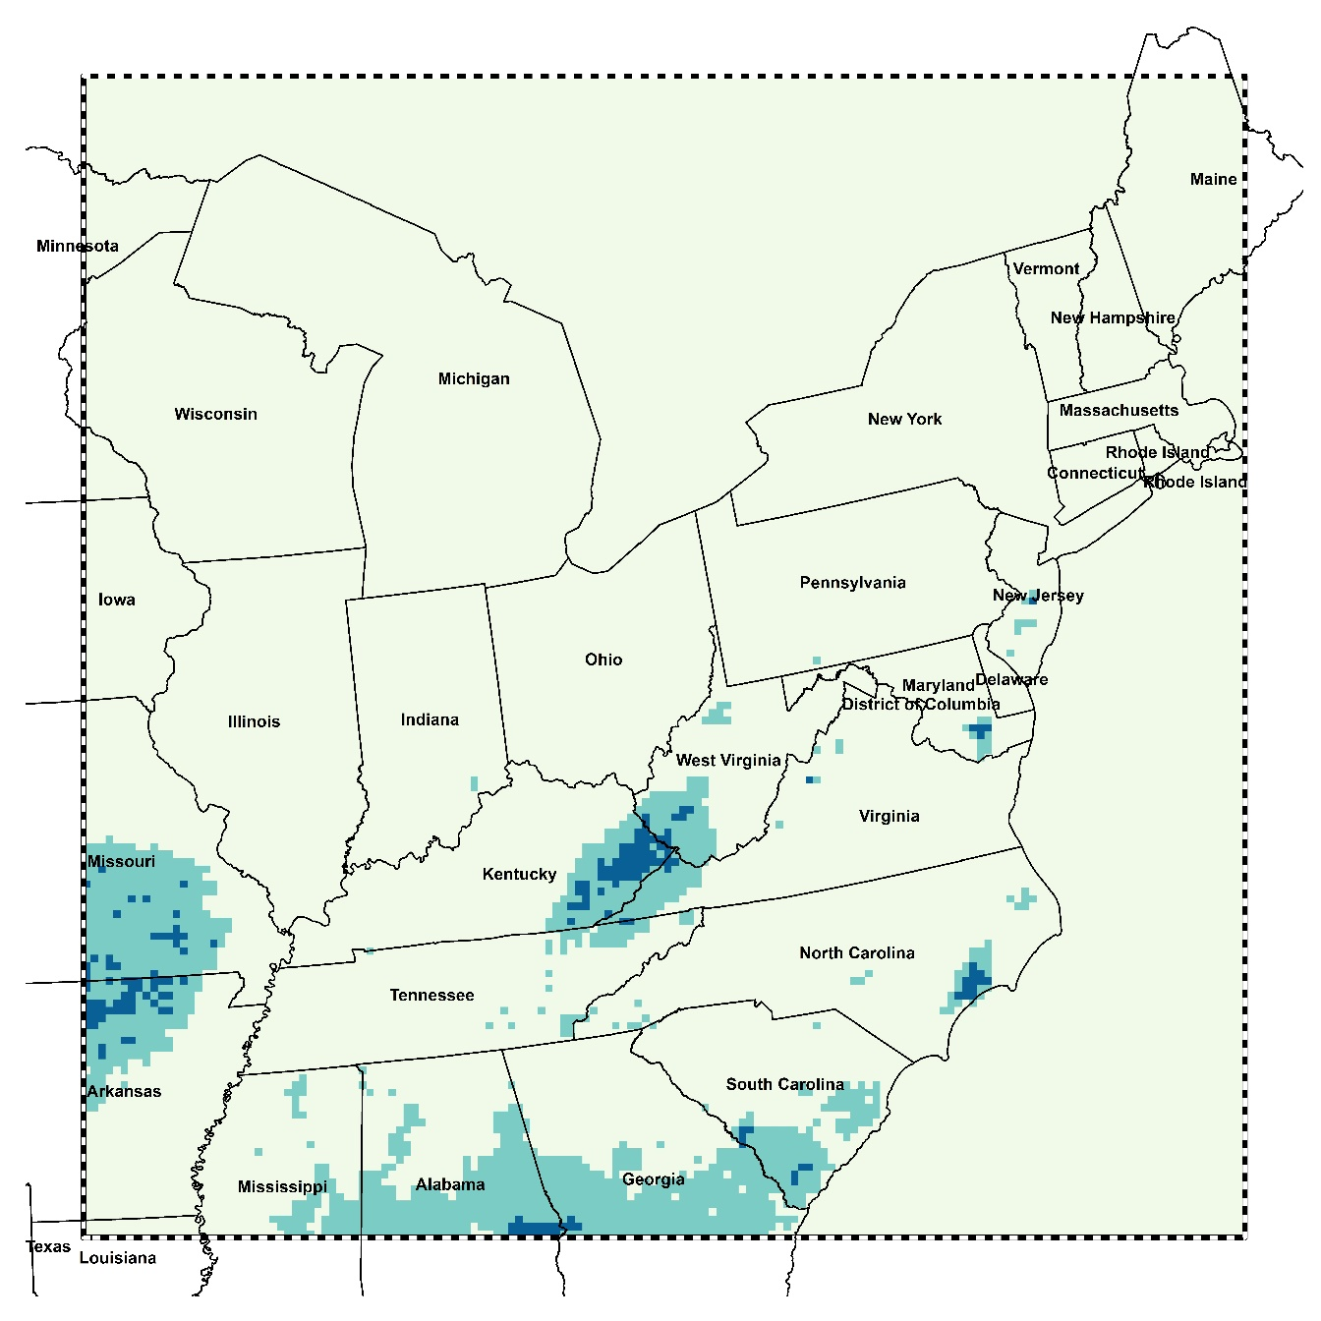

Wildland Fire-Attributable Annual Mean PM_{2.5}
Results
Annual Mean All-source PM_{2.5}
Wildland Fire-Attributable PM_{2.5} Ratio
Notes:
These two figures show the annual average all-source PM2.5 and wildfire-specific PM2.5. From left figure, we find the big cities such as NYC, Detroit and Chicago have higher PM2.5 concentrations, however, among the all-source PM2.5 values, wildfire PM2.5 contributed a little, less than 0.5 ug/m3. However, if we take a look the eastern part of Kentucky, thought the annual average pm2.5 values are around 7.31, there are a large portion of pm2.5 are emitted from wildfire. This map shows the proportion of annual PM2.5 is from wildland fire. It shows more than 20% of PM2.5 were contributed by wildland fire over eastern Kentucky, southeastern of North Carolina. .

Slide 26
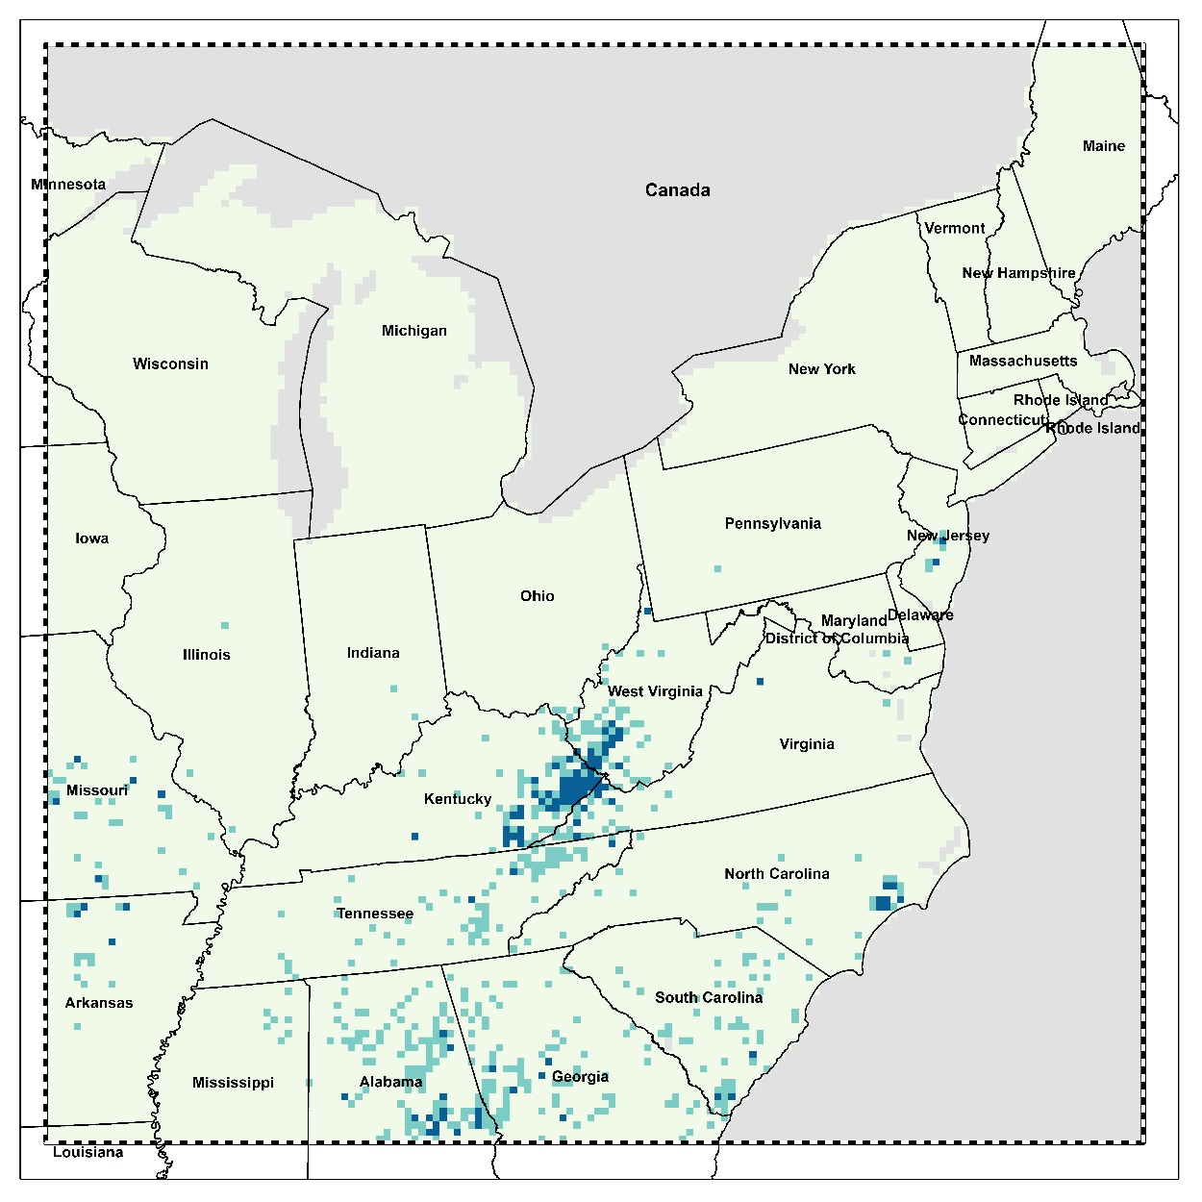

% of premature deaths due to wildland fire-related PM_{2.5}
Health Burden attributable to wildland fire-related PM_{2.5}
Premature deaths
Total: 2713 (1825 – 3573)
Notes:
Then we quantified how much health burden attributable to wildland fire PM2.5. According to the health impact functions, we find more than 2700 mortality was due to fire related PM2.5. Though the wildland fire only contribute a small portion of PM2.5 over metropolitan areas, such as NYC, Detroit, Chicago, there are still a number of deaths are due to wildfire PM2.5. For the eastern Kentucky, though the wildfire contributed a lot PM2.5 over these regions, smaller number of deaths is due to wildfire PM2.5. If we calculated the % of wildland fire associated mortality over the total mortality due to all source PM2.5, it shows that there are a large portion of mortality are due to wildfire over eastern Kentucky.

Slide 27
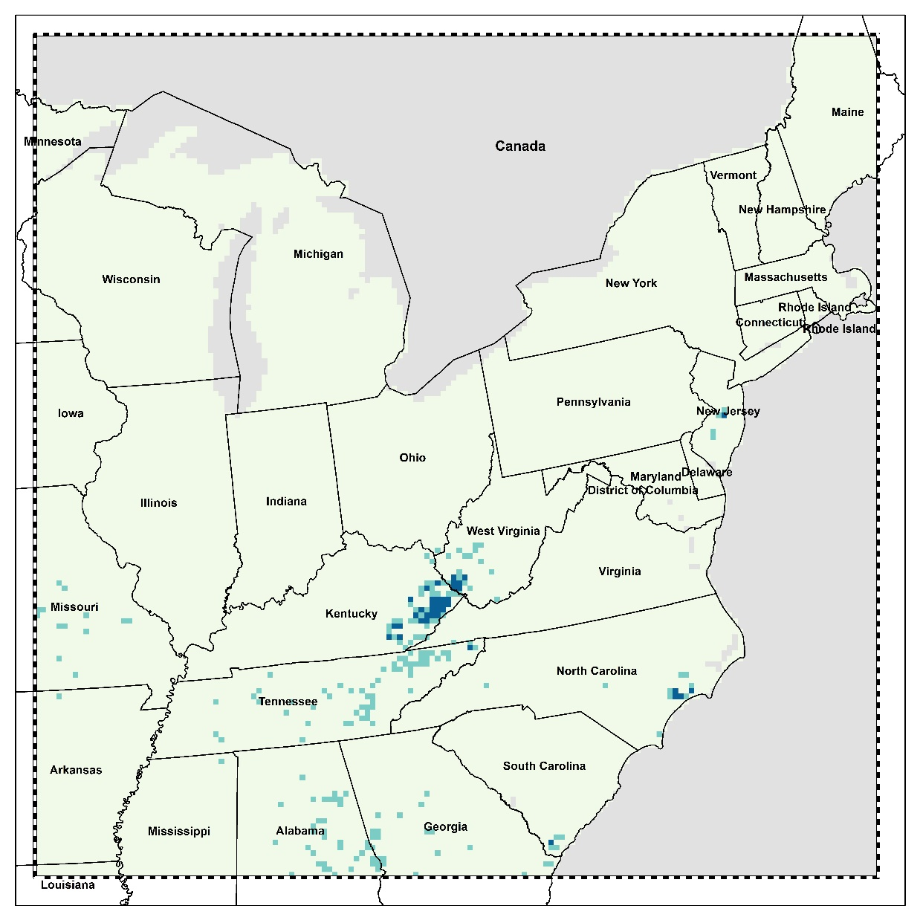

% of Respiratory Hospital Admissions due to wildland fire-related PM_{2.5}
Health Burden attributable to wildland fire-related PM_{2.5}
Respiratory Hospital Admissions
Total: 1223 (707 – 1735)
Notes:
We can get similar results for the wildland fire PM2.5-associated respiratory hospital admissions.

