Slide 1



State-level contributors to present and future fine particulate matter health costs in the United States
Yang Ou^{1,2}, Wenjing Shi¹, Steven J. Smith³, J. Jason West²,
Christopher G. Nolte¹, Daniel H. Loughlin¹
¹ U.S. EPA Office of Research and Development
² University of North Carolina at Chapel Hill
³ Joint Global Change Research Institute, PNNL

Slide 2
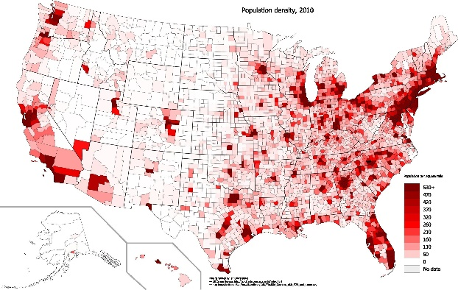
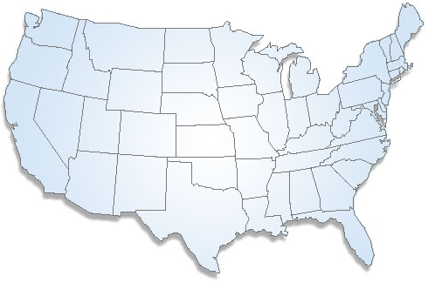
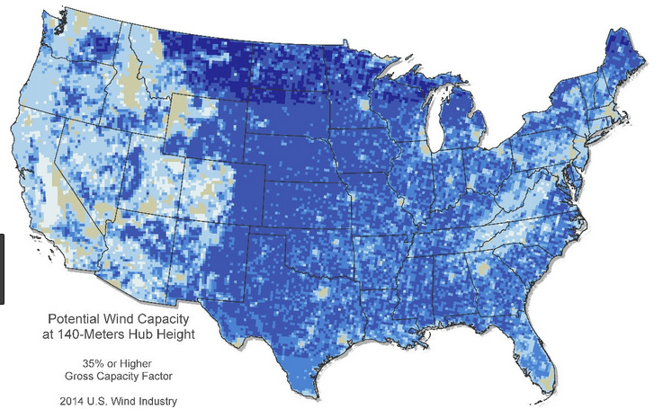
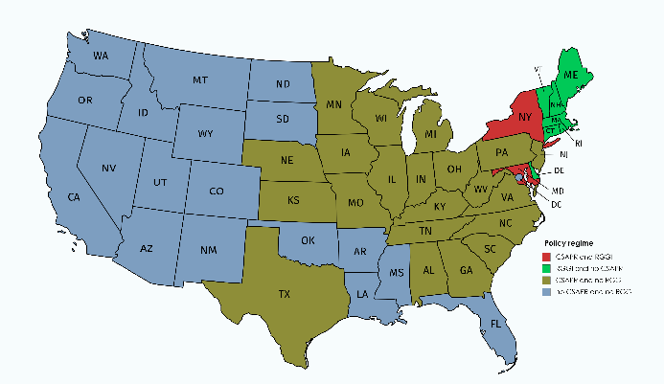
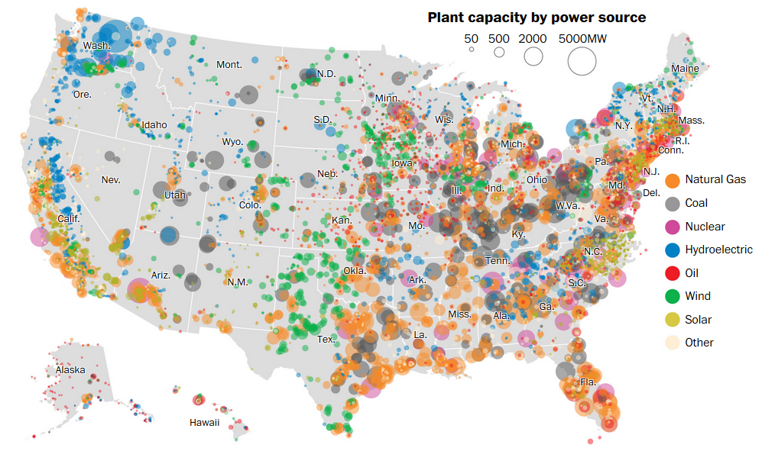
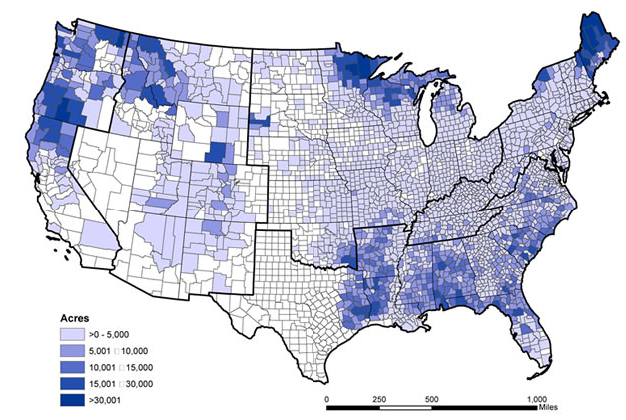
Background
  Factors such as historical energy use patterns, geographic location, and population change, can affect a state’s energy system projection as well as the fine particulate matter (PM_{2.5}) health consequences
Population density
PM_{2.5} mortality now and future
Potential Wind power capacity
?
Policy regime
Existing Plant capacity
Biomass supply
Various online sources, illustrative purpose only

Slide 3

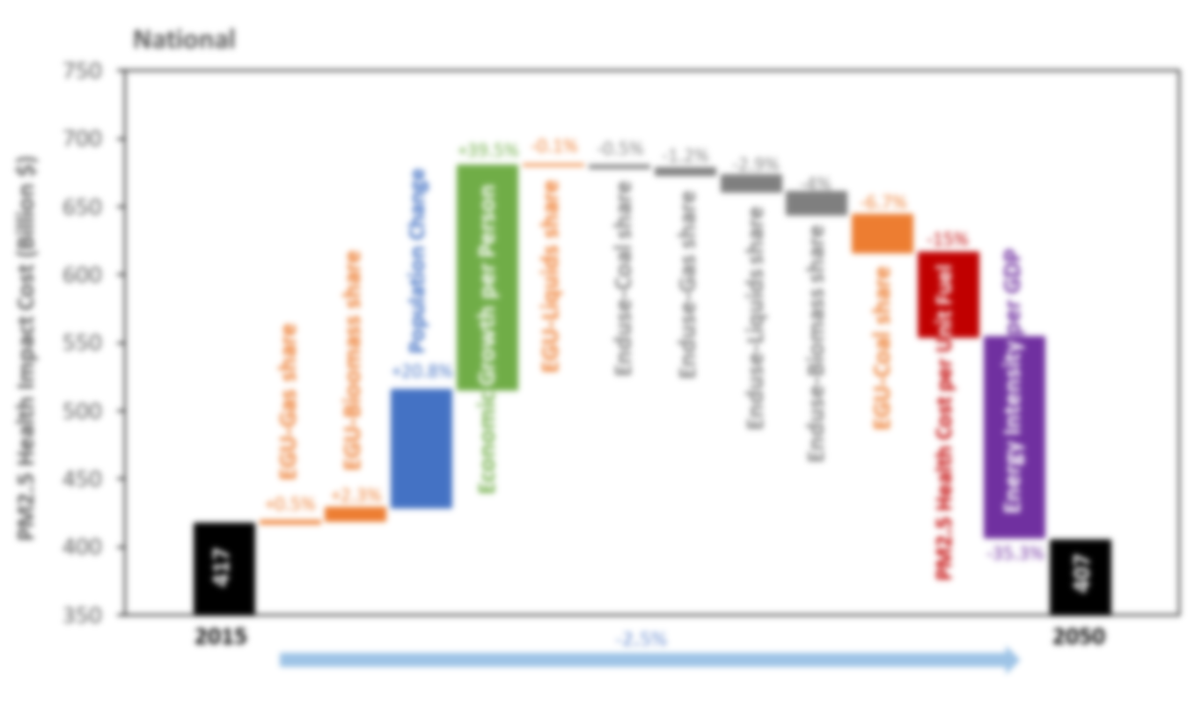
Objectives
Quantify the percentage contributions of changes in population, economic growth, energy intensity, fuel shares, and PM_{2.5} mortality intensity (cost per unit fuel consumption) to the changes in US state-level PM_{2.5} mortality costs ($) between 2015 and 2050
Determine the important factors that affect future PM_{2.5} mortality costs and identify commonalities and differences among states to explain state trends in PM_{2.5} mortality cost projections

Slide 4
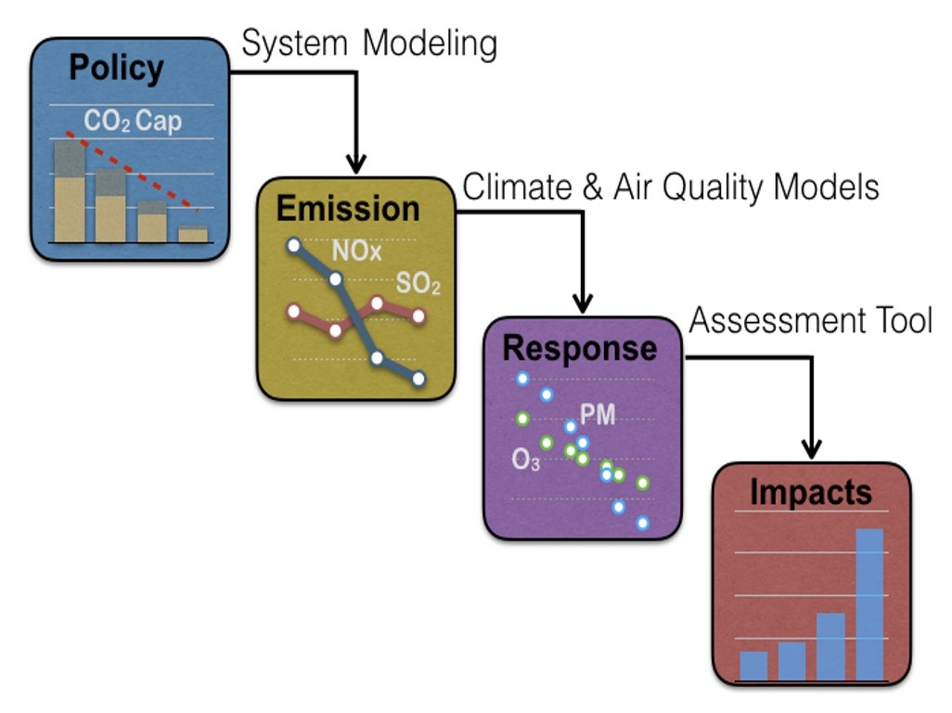
Assessment of public health impact of PM_{2.5} pollution
Example applications:
Global burden of disease
Co-benefit studies
Impact assessment of a specific policy

Slide 5
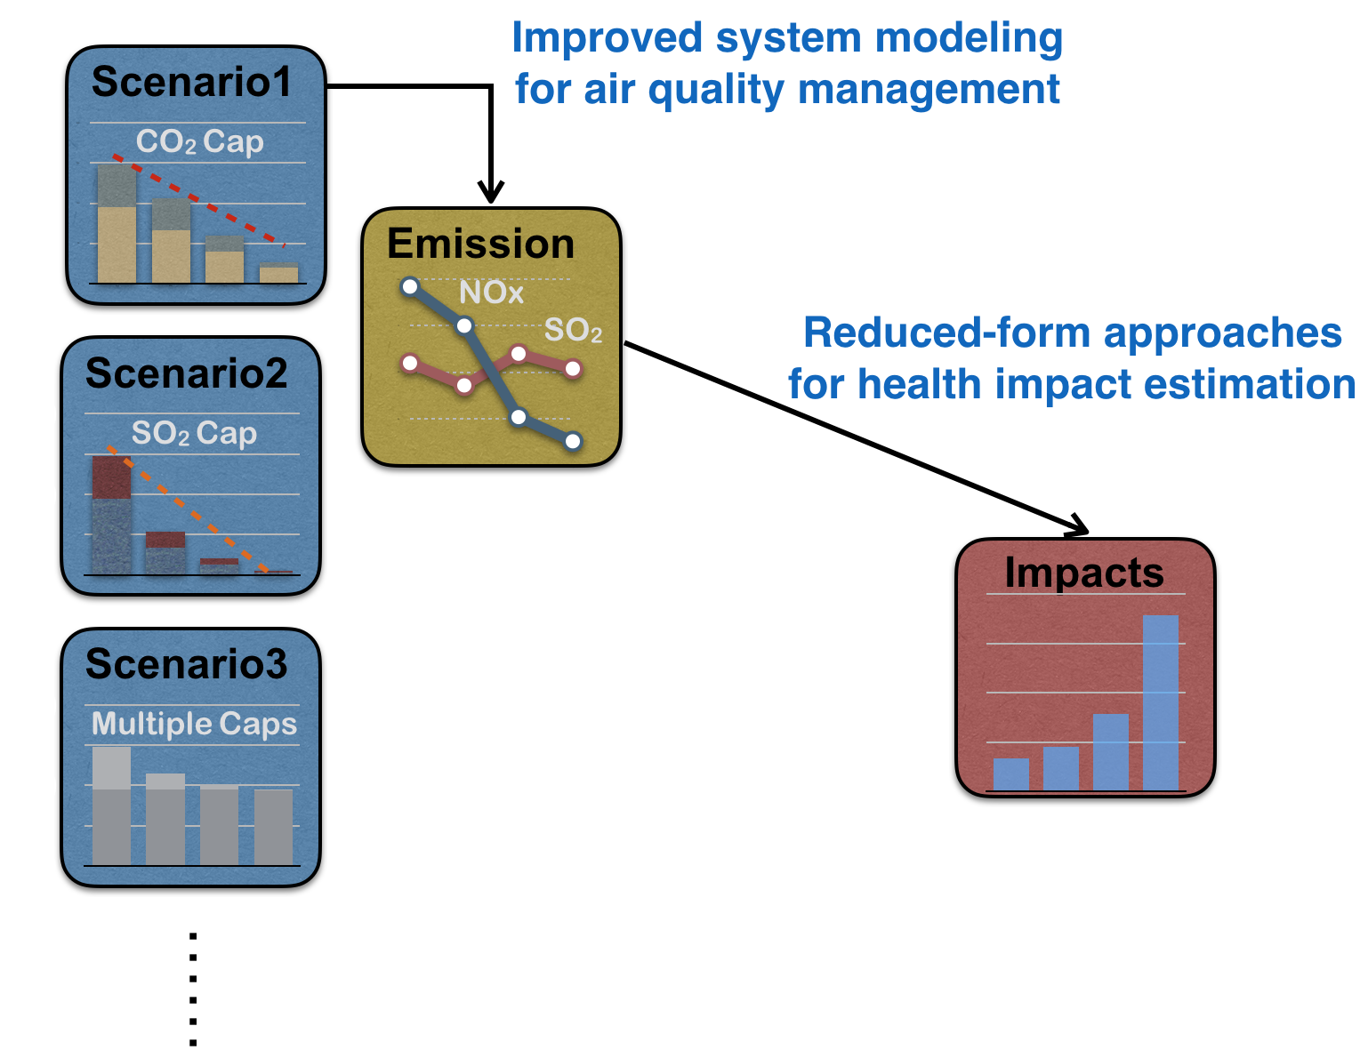
Estimate PM_{2.5} mortality cost using GCAM-USA
($/ton emission)

Slide 6
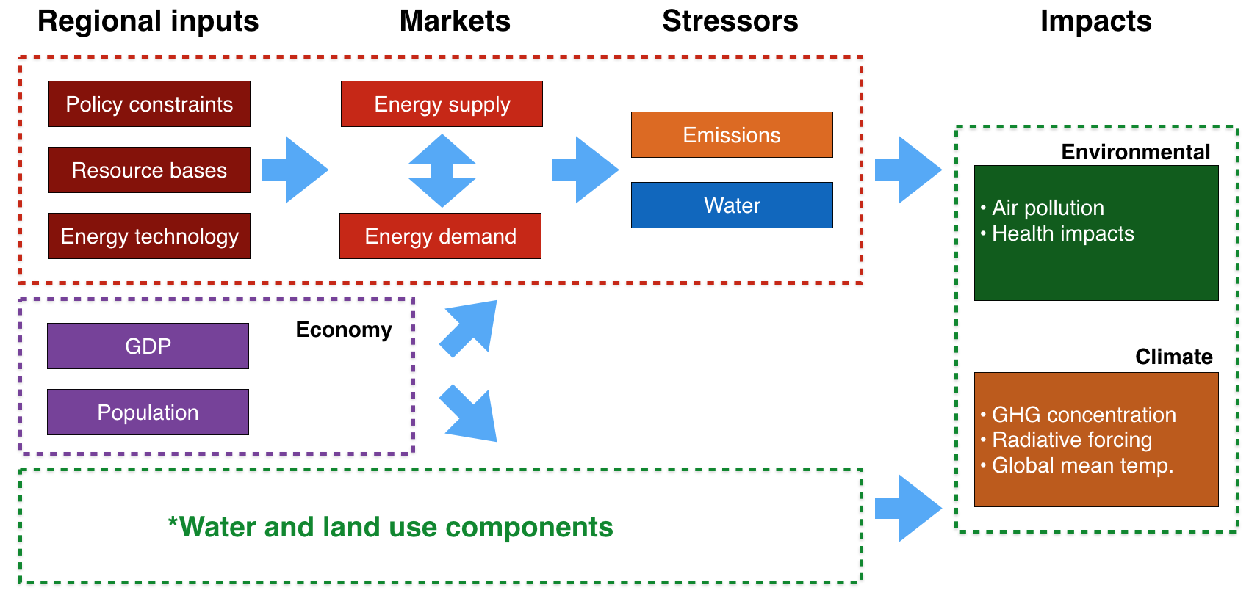
Research tool: GCAM-USA
  The Global Change Assessment Model with U.S. state-level resolution
  Applications:
    Representative Concentration Pathways (RCP)
    Shared Socioeconomic Pathways (SSP)
($/ton emission)
Notes:
It focuses on the energy-economic system and allows exploration of technology and policy scenarios to see effects on the economy and emissions.

Slide 7
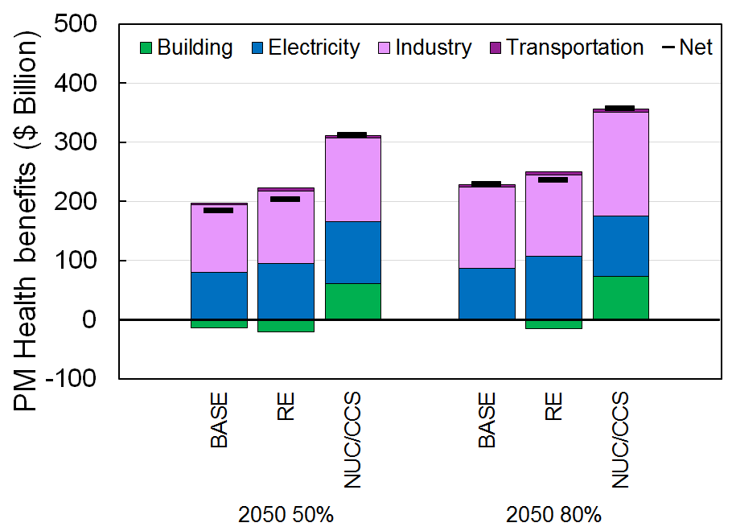
Application: Health co-benefit of low-carbon pathways
2050
RE - no new builds of nuclear or CCS, low cost of renewables
NUC/CCS - low cost of nuclear/CCS, limited supply of biomass
CO₂ targets:
50% reduction
80% reduction
Health benefits mainly come from industrial and electric sectors
RE and NUC/CCS greatly differ in the buildings sector, where RE yields disbenefit!

Slide 8
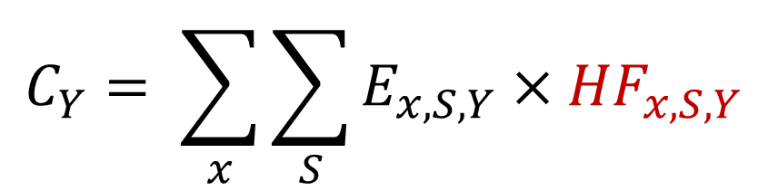
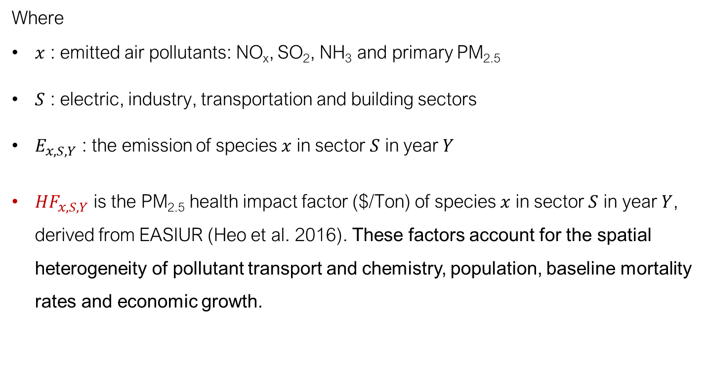
PM_{2.5} mortality cost for emissions from a single state
$$C_{Y}= \sum_{x}{\sum_{S}{E_{x, S, Y}×{HF}_{x, S,Y}}}$$
Where
$x$ : emitted air pollutants: NO_{x}, SO₂, NH₃ and primary PM_{2.5}
$S$ : electric, industry, transportation and building sectors
$E_{x, S, Y}$ : the emission of species $x$ in sector $S$ in year $Y$
${HF}_{x, S,Y}$ is the PM_{2.5} health impact factor ($/Ton) of species $x$ in sector $S$ in year $Y$, derived from EASIUR (Heo et al. 2016). These factors account for the spatial heterogeneity of pollutant transport and chemistry, population, baseline mortality rates and economic growth.
Heo et al. (2016). Reduced-form modeling of public health impacts of inorganic PM_{2.5} and precursor emissions. Atmospheric Environment

Slide 9

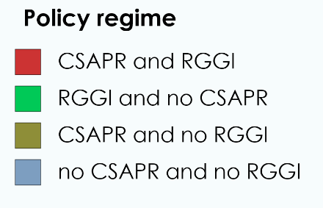
Modeling scenario: current air quality regulations and greenhouse gas policies
CSAPR: Cross-State Air Pollution Rule
RGGI: Regional Greenhouse Gas Initiative
Notes:
*An overview of GCAM-USA for long-term state-level air quality management will be covered by the next presentation by Dr. Loughlin.

Slide 10
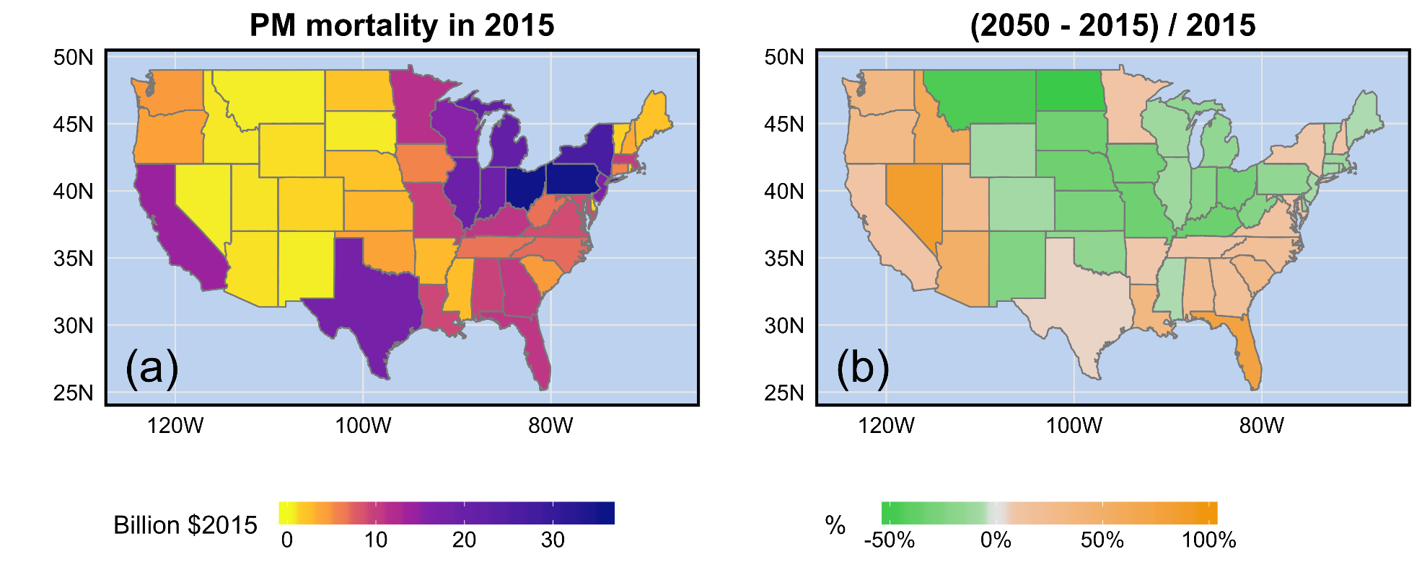
State-level PM_{2.5} mortality
PM_{2.5} mortality cost in 2015
(2050 – 2015) / 2015

Slide 11
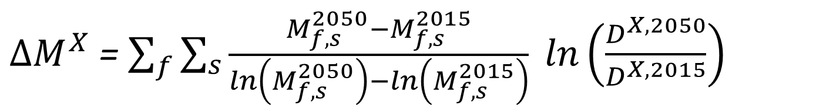
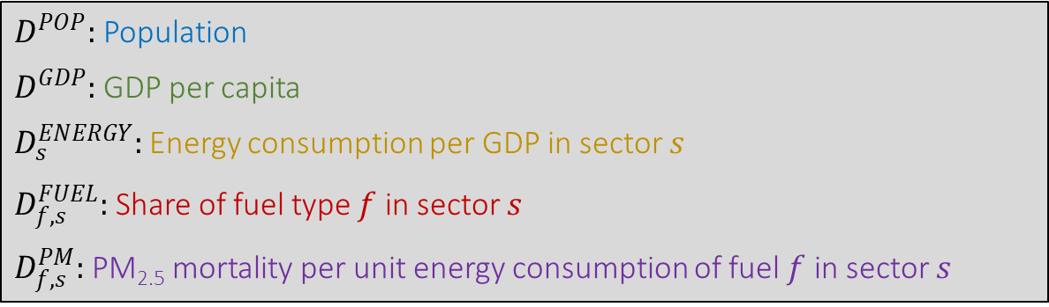
Logarithmic Mean Divisia Index (LMDI)
The changes of PM_{2.5} mortality (ΔM) for a given state can be decomposed as
Where
$X$ : POP, GDP, ENERGY, FUEL, PM
$f$ : Fuels that directly result in PM_{2.5} pollution (coal, gas, refined liquids and biomass)
$s$ : GCAM-USA sectors – electricity, industry, transportation and building
$D^{POP}:$ Population
$D^{GDP}:$GDP per capita
$D_{s}^{ENERGY}:$Energy consumption per GDP in sector $s$
$D_{f, s}^{FUEL}:$Share of fuel type $f$ in sector $s$
$D_{f, s}^{PM}:$PM_{2.5} mortality per unit energy consumption of fuel $f$ in sector $s$
Notes:
Explain Ds one by one

Slide 12
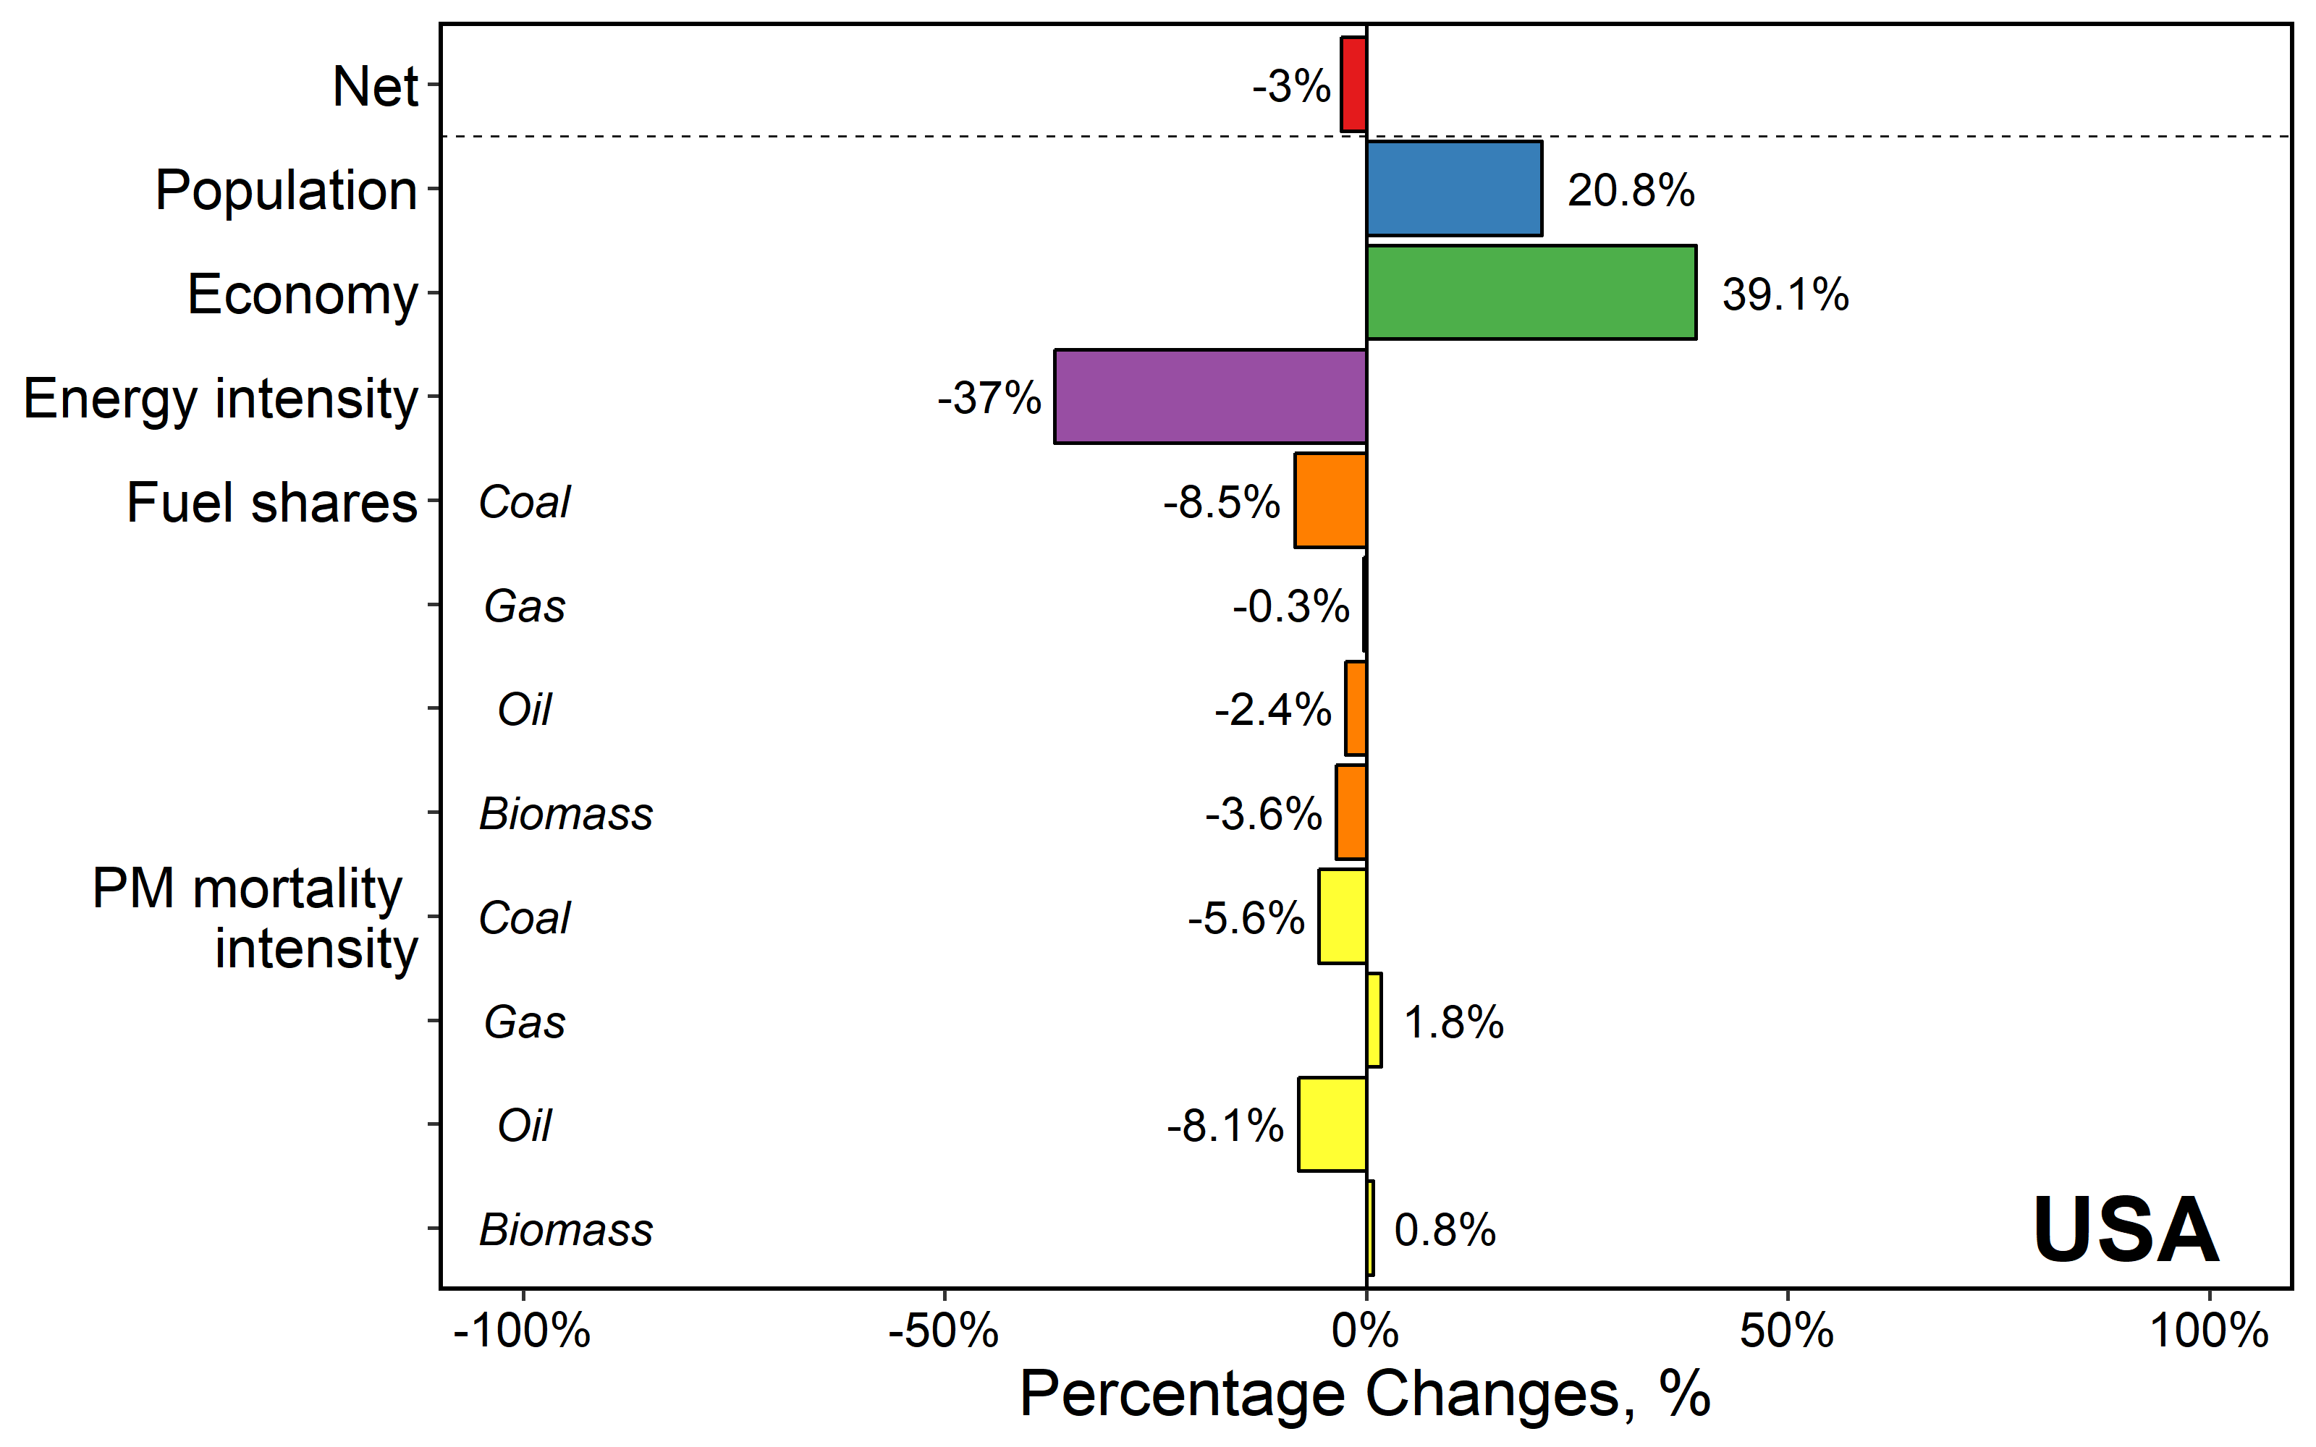
Decomposition of national PM_{2.5} mortality change between 2015 and 2050
Relative contribution, %

Slide 13
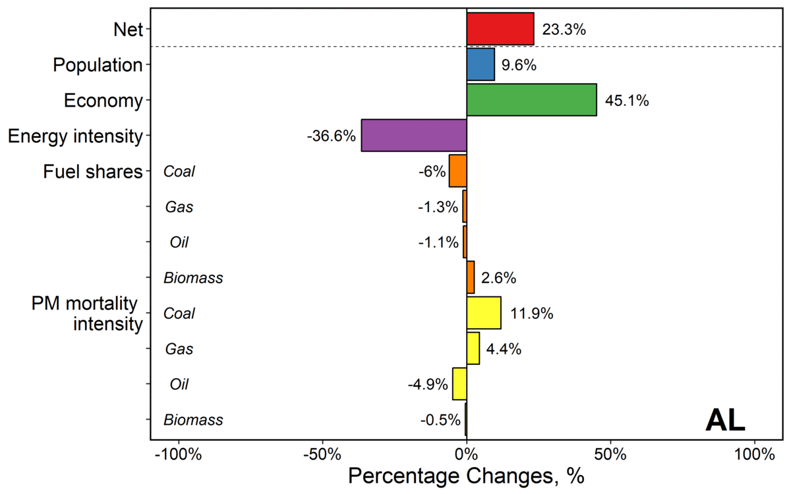
Decomposition of state-level PM_{2.5} mortality change between 2015 and 2050
Relative contribution, %

Slide 14
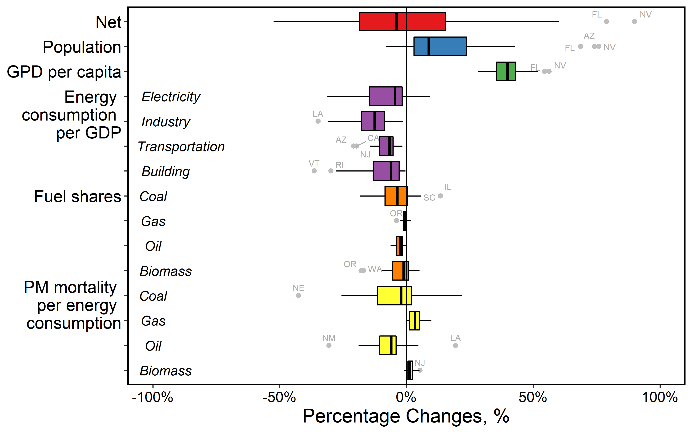
Summary of LMDI decomposition for all states
* AK, DC and HI are not included
Relative contribution, %

Slide 15
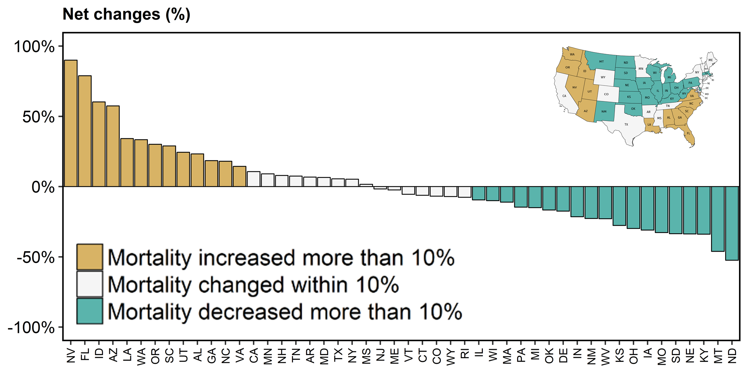
States grouped by PM_{2.5} mortality changes

Slide 16
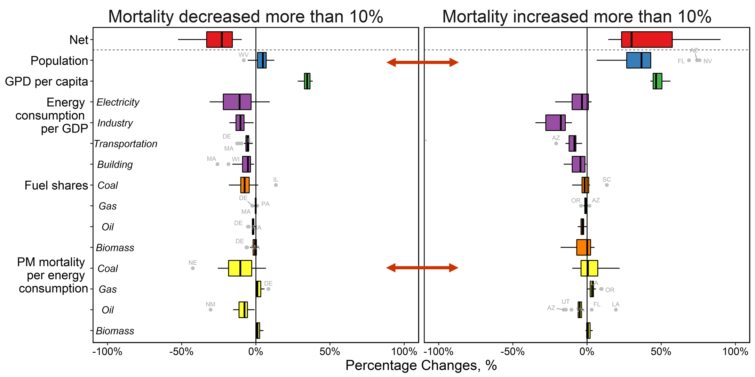
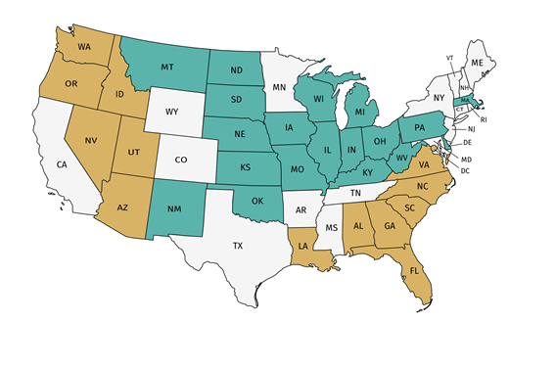
Commonalities and differences between decreased-mortality states and increased-mortality states
Decreased-mortality (>10%) states
Increased-mortality (>10%) states
Relative contribution, %

Slide 17
Preliminary findings and significance
  States have large variation in PM_{2.5} mortality changes in 2050 relative to 2015, ranging from -50% to +80%
  Changes in population and GDP per capita have the largest contribution in increasing PM_{2.5} mortality
  Changes in population and PM_{2.5} mortality per unit of coal consumption have very different contributions to PM_{2.5} mortality changes in increased-mortality (>10%) states and decreased-mortality (>10%) states

Slide 18
Preliminary findings and significance
  States have large variation in PM_{2.5} mortality changes in 2050 relative to 2015, ranging from -50% to +80%
  Changes in population and GDP per capita have the largest contribution in increasing PM_{2.5} mortality
  Changes in population and PM_{2.5} mortality per unit of coal consumption have very different contributions to PM_{2.5} mortality changes in increased-mortality (>10%) states and decreased-mortality (>10%) states
  These findings provide insights on identifying the most important state-level drivers of PM_{2.5} health impact changes in the future

