Slide 1

A System for Developing and Projecting PM_{2.5} Spatial Fields to Correspond to Just Meeting National Ambient Air Quality Standards
17th Annual CMAS Conference, Chapel Hill, NC
24 October 2018
James Kelly, Carey Jang, Brian Timin, Brett Gantt, and Adam Reff
U.S. Environmental Protection Agency
Office of Air Quality Planning & Standards
Research Triangle Park, NC USA

Slide 2
Background
Air quality is often projected to meet national ambient air quality standards (NAAQS) in regulatory assessments; e.g.,
  Risk and Exposure Assessments (REAs) associated with NAAQS reviews
  Regulatory Impact Analyses (RIAs) associated with NAAQS rulemakings
Projecting air quality to meet target standards with photochemical grid models is computationally expensive, particularly for applications that involve many areas throughout the U.S. and multiple standard levels
Modeling tools have been developed to improve the efficiency of air quality projections (e.g., response-surface models, reduced-complexity models, reduced-form models)
Yet existing tools do not directly provide the information needed to project design values at monitors and corresponding spatial fields to meet target NAAQS throughout the U.S.
Here a system for generating, evaluating, and projecting PM_{2.5} spatial fields to correspond with just meeting PM_{2.5} NAAQS is developed and demonstrated

Slide 3
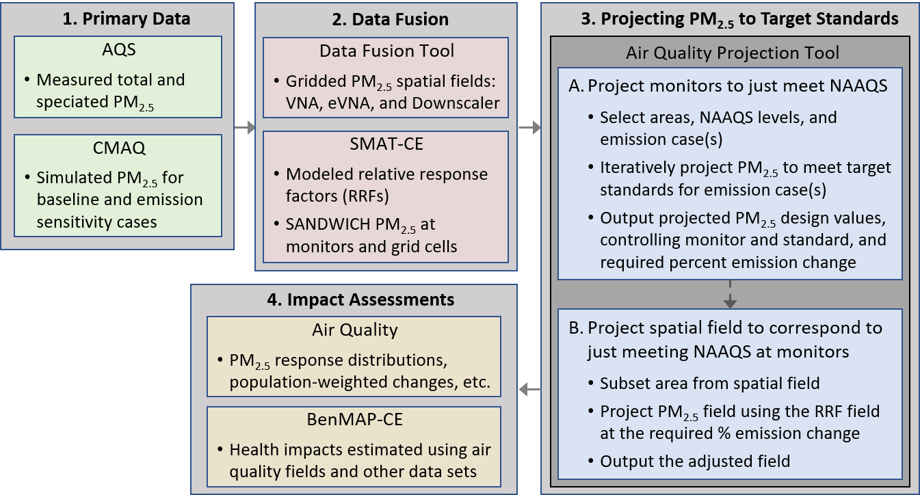
System for Projecting PM_{2.5} Fields to Target NAAQS
AQS: Air Quality System
CMAQ: Community Multiscale Air Quality model
SMAT-CE: Software for Model Attainment Test-Community Edition
RRF: Relative Response Factor (used to project measured PM_{2.5})
Monitor projection method: Kelly et al. (2017) Atmos. Environ.
BenMAP-CE: Benefits and Mapping Analysis Program-Community Edition

Slide 4
I. Developing and Evaluating Baseline PM_{2.5} Fields

Slide 5
2015 Baseline Air Quality Modeling
Modeling for 2015 was performed with the Community Multiscale Air Quality (CMAQ) model to inform development of baseline PM_{2.5} fields
Model configuration
  CMAQ version 5.2.1
  12-km horizontal resolution for a domain covering the contiguous U.S.
  Emissions from the 2014 National Emission Inventory, version 2
  Boundary conditions based on hemispheric CMAQ
Model performance was generally consistent with previous national 12-km modeling

Slide 6
2015 Baseline Hybrid PM_{2.5} Fields
The Data Fusion Tool (DFT, version 1.5*) was used to develop PM_{2.5} fields from baseline CMAQ modeling and monitor data according to three approaches:
  VNA (Voronoi Neighbor Averaging): inverse-distance-squared weighted interpolation of monitors in neighboring Voronoi polygons
  eVNA (extended-VNA): VNA interpolation of monitors that have been scaled by the ratio of CMAQ predictions in the target cell to the monitor cell
  Downscaler: Bayesian statistical model that regresses CMAQ modeling on monitoring data and makes predictions using a CMAQ input field
DFT was also used for cross-validation
  Standard ten-fold cross validation for withheld monitors
  Ten-fold cross validation based on withholding spatial clusters of monitors
*Available: www.abacas-dss.com/abacas/Software.aspx

Slide 7
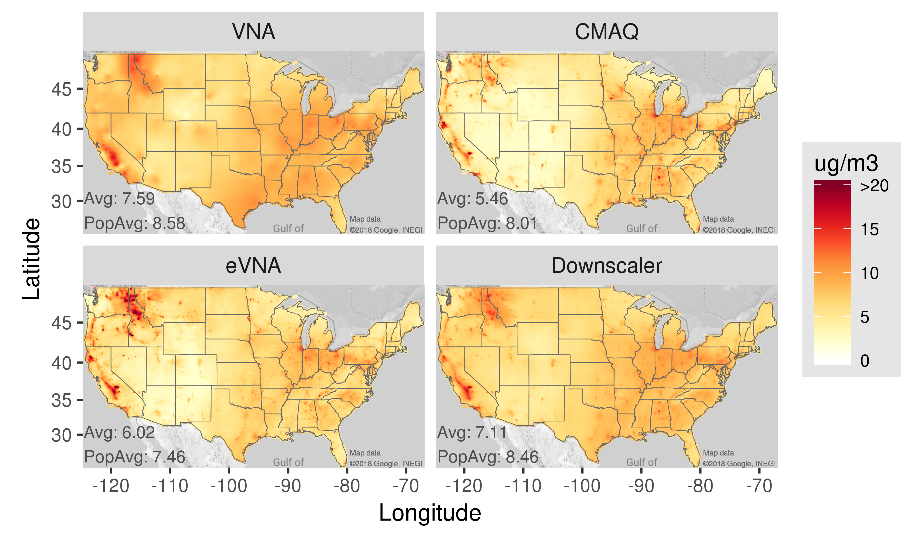
Annual Average 2015 PM_{2.5} Fields

Slide 8
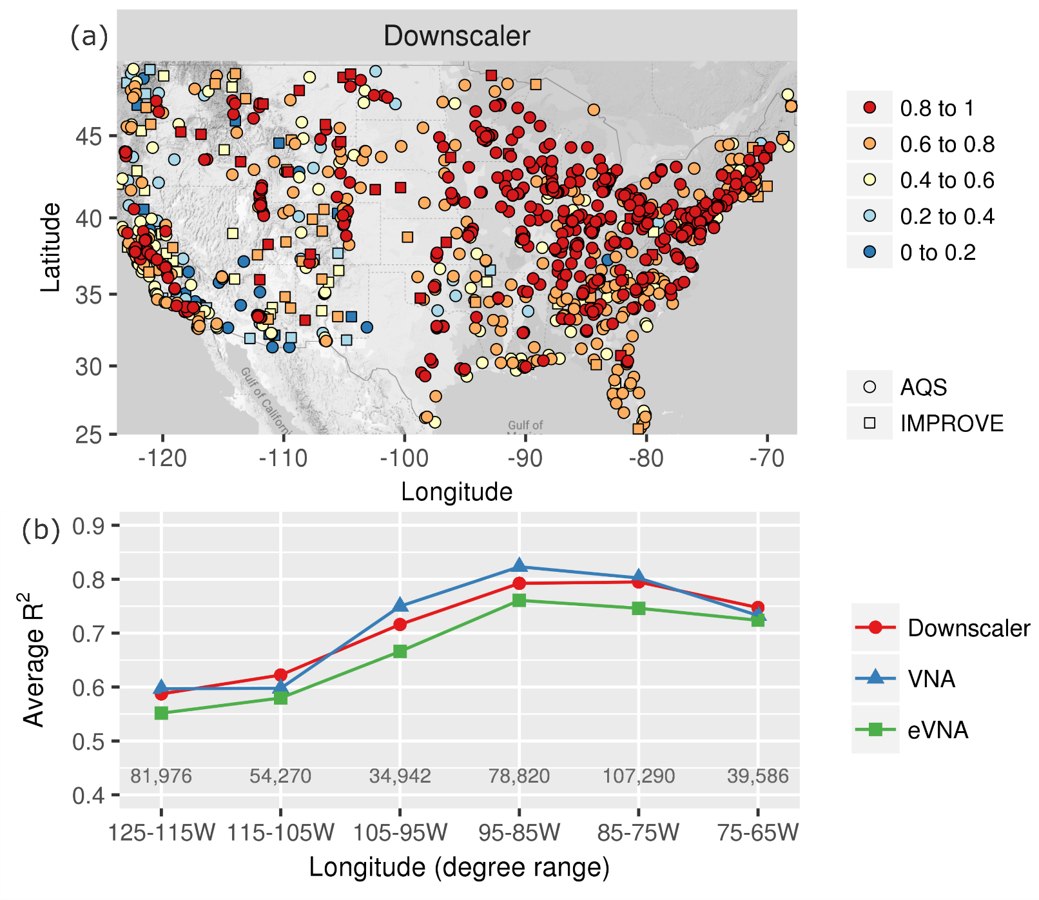
Ten-Fold Cross Validation
R²
The cross-validation R² for individual sites provides information on the temporal performance of the methods
Model performance is influenced by
  Distance to nearest in-sample monitor
  Performance of the underlying CMAQ simulation
  Smoothness of the ambient PM_{2.5} field
  Other factors
Map data ©2018 Google, INEGI

Slide 9
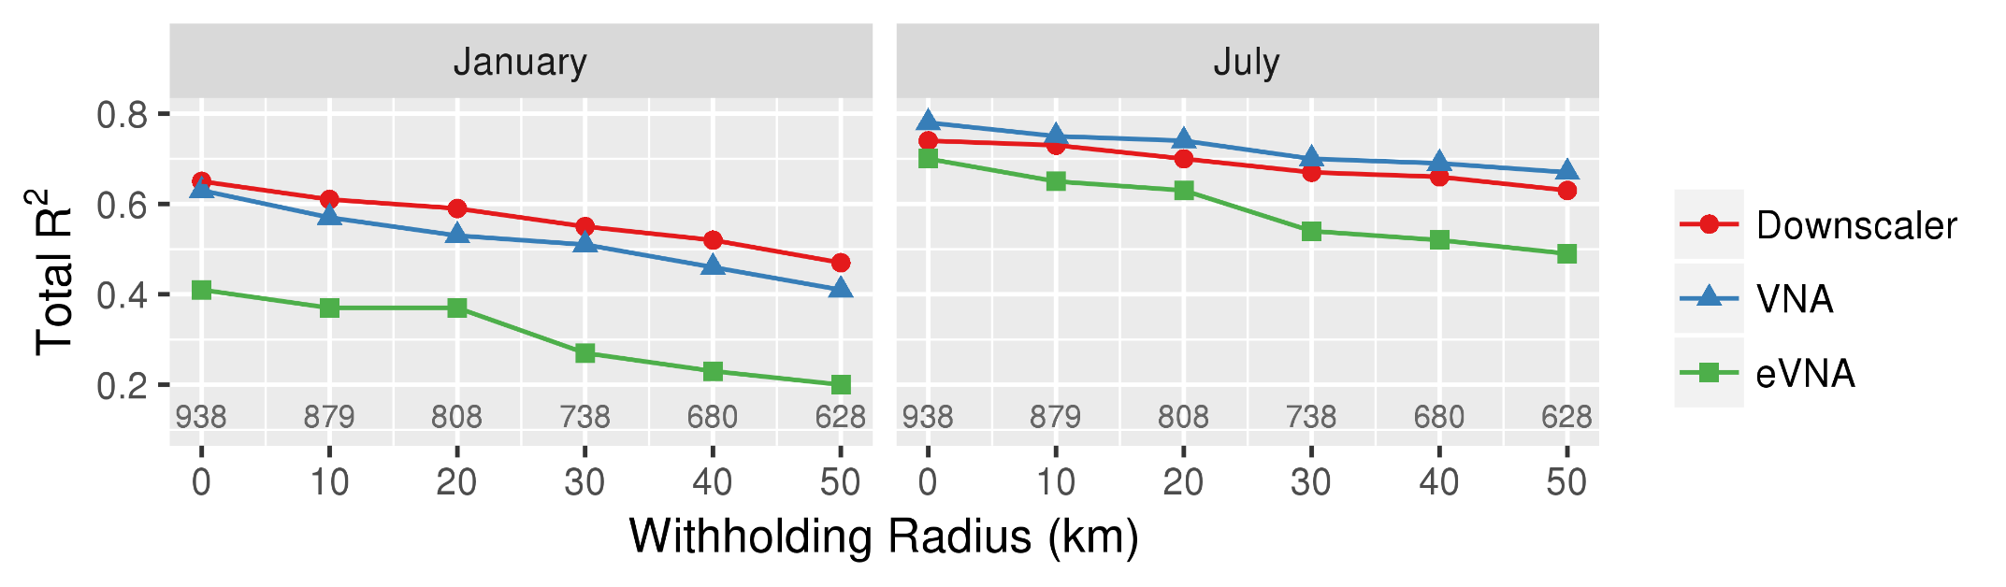
Cross Validation using Spatial Cluster Withholding
National R² decreases for the methods as the radius of withholding increases

Slide 10
II. Developing PM_{2.5} Projection Factors

Slide 11
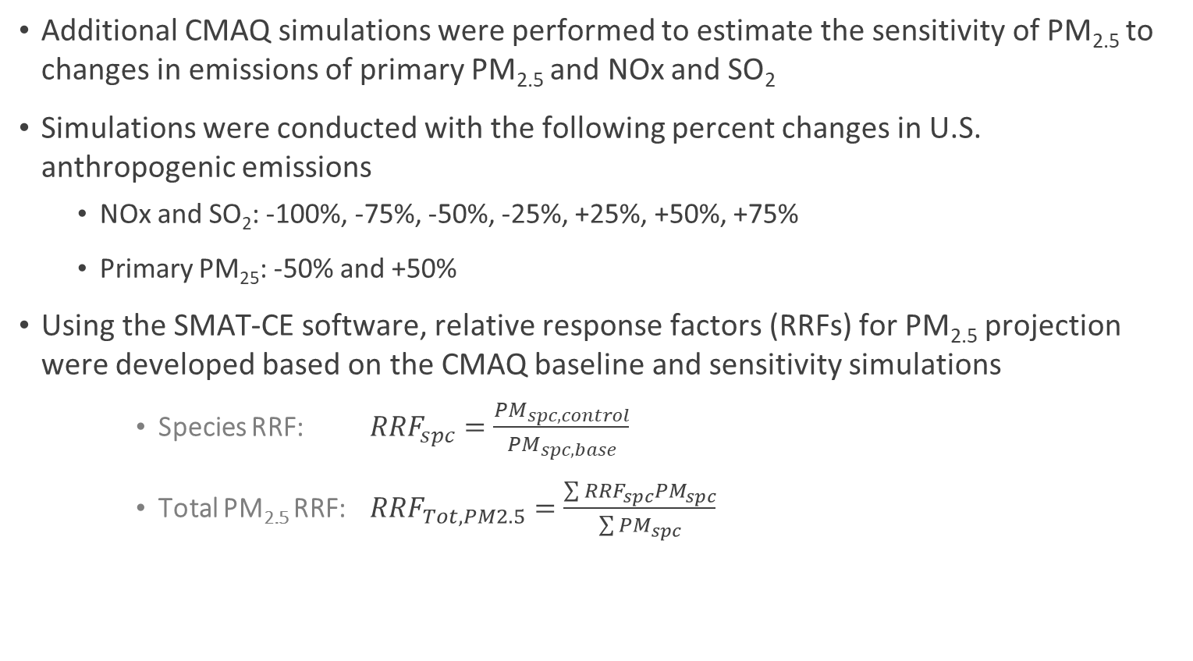
2015 Sensitivity Air Quality Modeling
Additional CMAQ simulations were performed to estimate the sensitivity of PM_{2.5} to changes in emissions of primary PM_{2.5} and NOx and SO₂
Simulations were conducted with the following percent changes in U.S. anthropogenic emissions
  NOx and SO₂: -100%, -75%, -50%, -25%, +25%, +50%, +75%
  Primary PM₂₅: -50% and +50%
Using the SMAT-CE software, relative response factors (RRFs) for PM_{2.5} projection were developed based on the CMAQ baseline and sensitivity simulations
    Species RRF: ${RRF}_{spc}=\frac{{PM}_{spc,control}}{{PM}_{spc,base}}$
    Total PM_{2.5} RRF: ${RRF}_{Tot, PM2.5}=\frac{\sum{{RRF}_{spc}{PM}_{spc}}}{\sum{{PM}_{spc}}}$

Slide 12
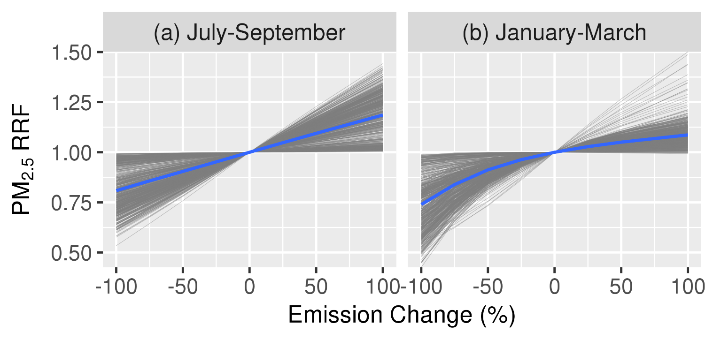
PM_{2.5} RRFs at Monitors for NOx and SO₂ Emissions
The response of PM_{2.5} to NOx and SO₂ emission changes is approximately linear in summer
Curvature in the relationship in winter is due to chemical feedbacks associated with changes in NOx mixing ratios

Slide 13
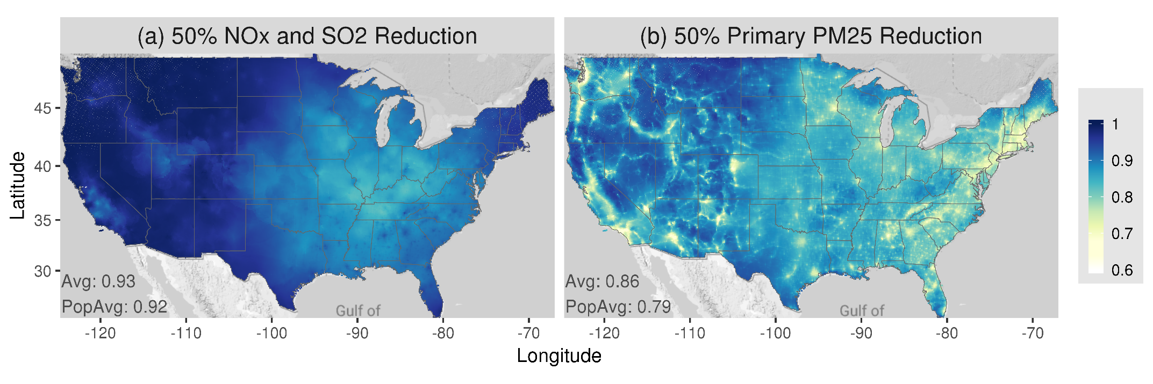
Spatial Field of PM_{2.5} RRFs
Map data
©2018 Google, INEGI
Map data
©2018 Google, INEGI
Spatial response patterns in PM_{2.5} indicated by RRFs are smooth for NOx and SO₂ emission changes
PM_{2.5} response is greater on average and more concentrated in urban areas for primary PM_{2.5} emission changes

Slide 14
III. Projecting PM_{2.5} to Meet Target NAAQS

Slide 15
Projecting Monitored and Gridded Fields of PM_{2.5}
Air Quality Projection Tool
First, an area, NAAQS level, and emission case (i.e., primary PM_{2.5}, NOx and SO₂, or combination) are selected
PM_{2.5} is then projected in two steps
  Monitored PM_{2.5} is projected such that highest design value equals (i.e., just meets) the NAAQS
  The spatial field over the area is then projected according to the percent emission change required for the monitors to just meet the NAAQS
Project monitors to just meet NAAQS
  Select areas, NAAQS levels, and emission case(s)
  Iteratively project PM_{2.5} to meet target standards for emission case(s)
  Output projected PM_{2.5} design values, controlling monitor and standard, and required percent emission change
Project spatial field to correspond to just meeting NAAQS at monitors
Subset area from spatial field
Project PM_{2.5} field using the RRF field at the required % emission change
Output the adjusted field

Slide 16
IV. Illustrative Example

Slide 17
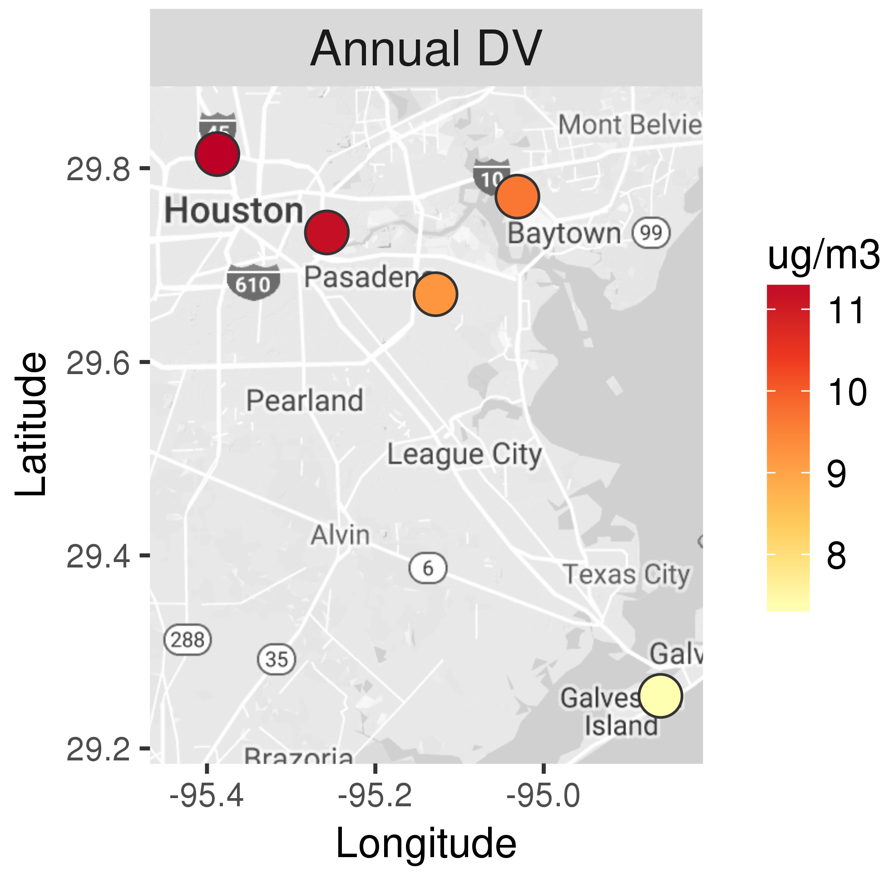
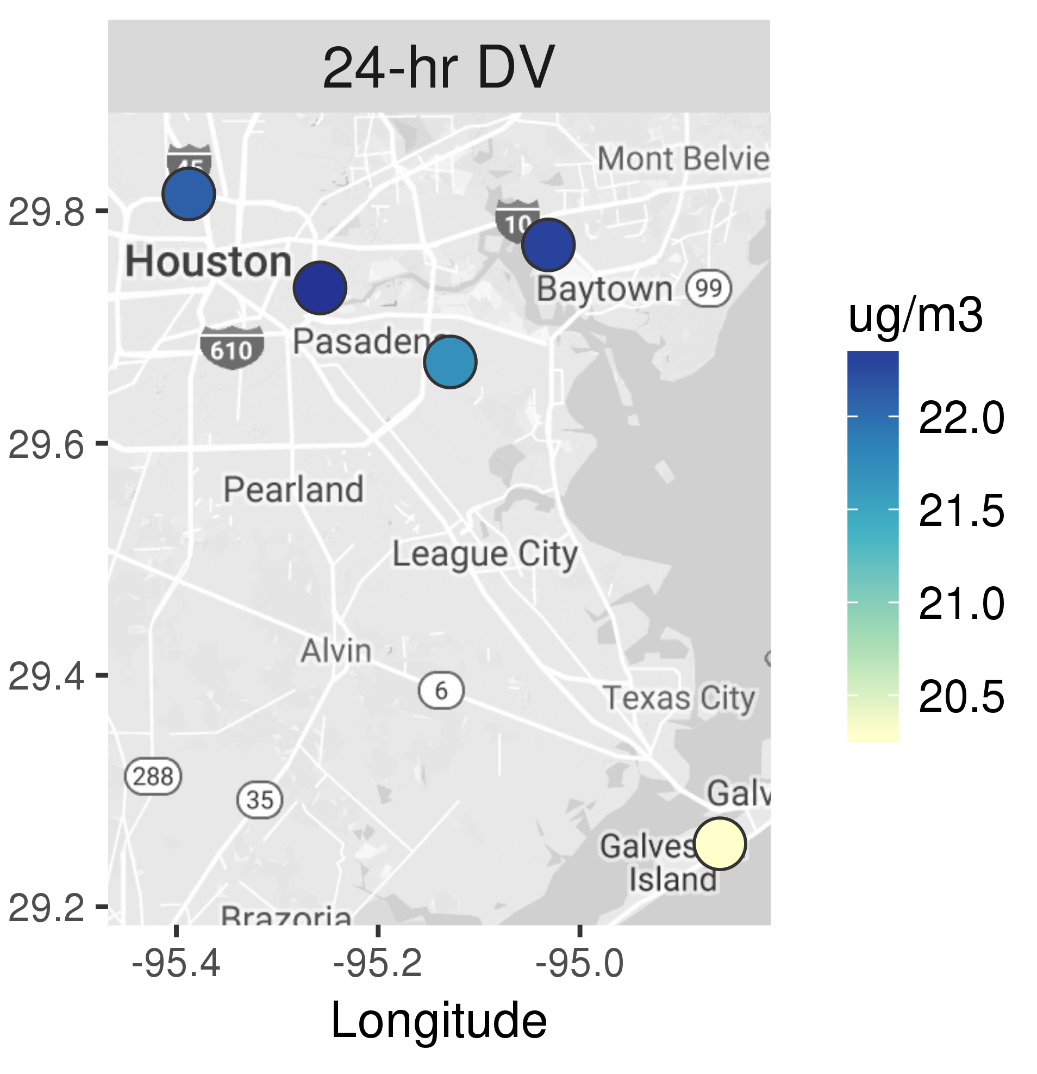
Houston Case Study
Category | Selection
Area | Houston
Period | PM_{2.5} design values: 2014-2016 Air quality modeling: 2015
Target Standard | Annual: 12 μg m⁻³ Daily: 35 μg m⁻³
Max DVs | Annual: 11.2 μg m⁻³ Daily: 22 μg m⁻³
Emission Cases | NOx and SO₂ Primary PM_{2.5} Combined NOx and SO₂ & Primary PM
Spatial Fields | VNA, eVNA, and Downscaler
Map data
©2018 Google, INEGI

Slide 18
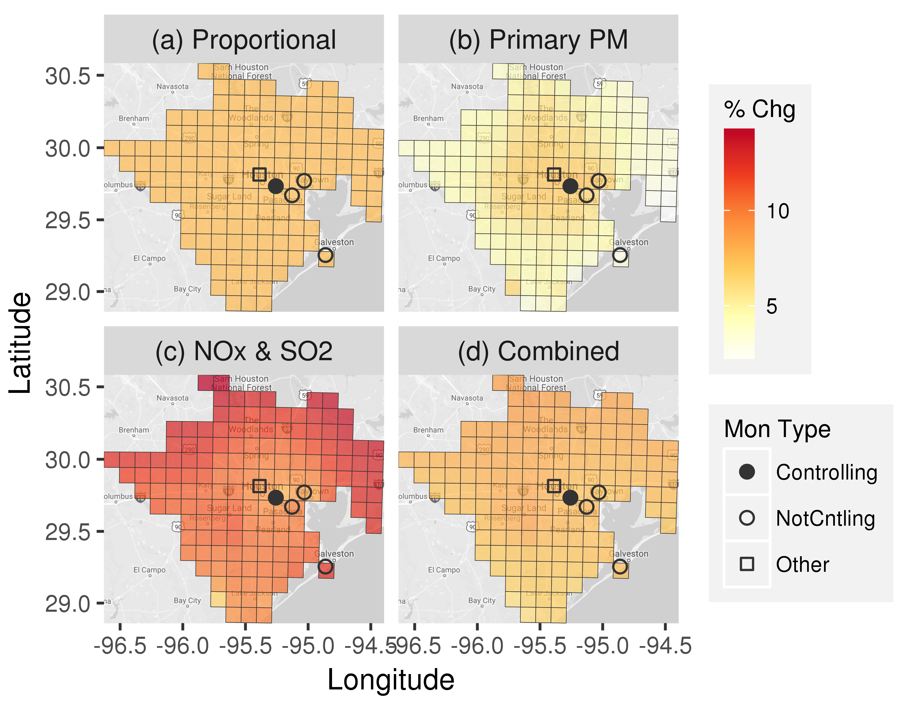
Percent Increase in PM_{2.5} to Just Meet NAAQS
Proportional adjustment yields a uniform 7% increase in PM_{2.5} based on controlling monitor in Harris
Primary PM_{2.5} emission increases yield relatively large PM_{2.5} increases in the urban core and smaller increases elsewhere
NOx and SO₂ emission increases yield relatively large PM_{2.5} increases outside of the urban core
Combined* primary PM_{2.5} and NOx and SO₂ emission increases yield PM_{2.5} increases similar to proportional projection
Map data
©2018 Google, INEGI
*’Combined’ indicates that 50% of exceedance increment was resolved with primary PM_{2.5} and 50% with NOx and SO₂ emission reductions

Slide 19
Summary
A system for generating, evaluating, and projecting PM_{2.5} spatial fields to correspond with just meeting PM_{2.5} NAAQS is developed and demonstrated
The Data Fusion Tool is found to be effective for developing hybrid PM_{2.5} fields and evaluating them with standard and cluster-withholding cross validation
Cross-validation results indicate that performance of the three methods improves with decreasing distance to the nearest in-sample monitor, improved PGM performance, and increasing distance from sources of PM_{2.5} heterogeneity
The projection tool developed here is found to be effective for quickly projecting PM_{2.5} fields to just meet NAAQS according to realistic spatial response patterns based on air quality modeling for multiple emission cases

Slide 20
Disclaimer
Although this work was reviewed by the US Environmental Protection Agency and approved for presentation, it may not necessarily reflect the views and the policies of the Agency

