Slide 1
Scientific and Structural Developments in CMAQv5.3
Ben Murphy
K. Wyat Appel, Jesse Bash, Kathleen Fahey, Barron H. Henderson, Bill Hutzell, Daiwen Kang, Deborah Luecken, Rohit Mathur, Sergey Napelenok, Chris Nolte, Havala Pye, Jon Pleim,
Momei Qin, Limei Ran, Shawn Roselle, Golam Sarwar, Donna Schwede, Qian Shu, Tanya Spero
and the CMAQ Development Team
National Exposure Research Laboratory
Research Triangle Park, North Carolina
Disclaimer:
The views expressed in this presentation are those of the authors and do not necessarily reflect the views or policies of the U.S. EPA.
Office of Research and Development
National Exposure Research Laboratory, Computational Exposure Division
Notes:
(1) While “arial” is used in this example, other fonts may be used. Please strive for consistency in font type and size.
(2) While a blue background is shown here, other colors noted on the EPA/ORD intranet site may be used.
(3) A picture may be added if desired.
--- The goal is to promote our CED “brand” and maintain some degree of consistency among CED presentations.

Slide 2
Priority Announcements
CMAQv5.3 Beta model is available for download!! www.github.com/usepa/cmaq
  Leave feedback and post issues
  Official release planned for summer 2019
Community contributions are highly sought:
  Submit via GitHub Pull request. Check out our guide for developers. Available on CMAQ website and in the documentation folder of the CMAQ repo. (https://www.epa.gov/cmaq/cmaq-developers-guide)
  Request that contributors notify our team early to plan for submission, testing, etc.
User Survey is Now Available (deadline October 31)
  Go to: https://unc.az1.qualtrics.com/jfe/form/SV_1IcuS1wIZ2PQUu1
    www.cmascenter.org (link on homepage) -or-
    www.epa.gov/cmaq (link on recent news banner) -or-
    www.github.com/usepa/cmaq (link in top-level Readme text)
  CMAS and U.S. EPA take this feedback very seriously!
CMAQ Aerosol Committee – bring together research, development, and evaluation across the CMAS community. Membership is open to all. Currently seeking 3 chairs external to U. S. EPA. Email murphy.ben@epa.gov or pye.Havala@epa.gov with questions.

Slide 3
CMAQv5.3 (Beta): Now Available on GitHub
Science Application Updates
  Advanced processing of meteorological input data – added support for WRF features.
  Chemistry mechanisms updated and consolidated. Complexity of chemical speciation
    reduced
  Long-range transport of ozone – photolysis and halogen updates
  Secondary pollutant generation in clouds – expanded the Kinetic Mass
    Transfer Module (version 2, KMT2)
  Biogenic secondary organic aerosol production revised
  Water uptake to aerosol organic phase – applications to
    chemistry, mixing state, optics, etc.
  Deposition parameterizations – updates to surface
    uptake for gases and aerosols
  Two deposition modules now available –
    M3dry (consolidated) and STAGE (tiled)
User-Oriented Development Goals
  Transparency of
  emissions source options
  and online scaling
  Diagnostic tools – updates for
  emissions, process analysis, photolysis
  parameters, and column extraction
  Numerical Efficiency – improved handling of
  many routine processes with vectorized
  algorithms
  Improved organization, transparency and content of
  default output logs. Metadata including runtime options
  recorded by default.
Notes:
Why should you upgrade or adopt?
What can you expect?

Slide 4
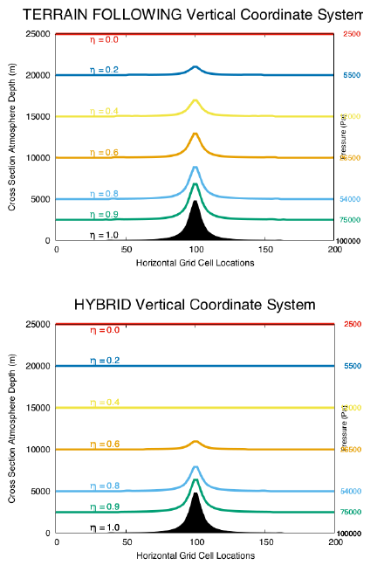
Meteorology: MCIPv5.0 Included with Official Release
Meteorology-Chemistry Interface Processor
Support for hybrid σ-P vertical coordinate
(available since WRFv3.9; default in WRFv4.0+)
  Reduces “noise” in vertical velocities at upper levels in complex terrain, especially at finer resolutions
Support for science updates in WRFv4.0
Aligning variable names with
two-way WRF-CMAQ
IO restructuring
Elimination of support for MM5 data
Minor bug fixes
Contact: Tanya Spero
Courtesy NCAR (WRFv4 User’s Guide)

Slide 5
Chemistry: Mechanism Updates
Mechanisms available in v5.3:
All solvers can now run
Integrate Reaction Rate
(IRR) Analysis
Photolysis updates:
  OMI data file, containing satellite-observed total column ozone, has been extended through end of 2017
  Diagnostics have been added to explicitly report aerosol optical properties (e.g. optical depth, single-scattering albedo, back scatter coefficient, Ångstrom exponent, etc.)
Description | Gas Species | Aerosol Species | Nonreactive Species | Total Species | Gas-Phase Reactions
CB6r3-AERO7 | 126 | 80 | 11 | 217 | 338
CB6r3-AERO7-KMT2 | 126 | 80 | 11 | 217 | 338
CB6r3-AERO7-Marine | 161 | 82 | 11 | 254 | 452
CB6r3-AERO6 | 128 | 83 | 17 | 228 | 335
CB6mp-AERO6 | 128 | 119 | 47 | 294 | 335
RACM2-AERO6 | 146 | 82 | 18 | 246 | 407
SAPRC07tic-AERO7i | 205 | 86 | 11 | 302 | 925
SAPRC07tic-AERO7i-KMT2 | 205 | 86 | 11 | 302 | 925
SAPRC07tic-AERO6i | 210 | 91 | 17 | 318 | 934
Contact: Bill Hutzell

Slide 6
Chemistry: Mechanism Updates
Mechanisms available in v5.3:
All solvers can now run
Integrate Reaction Rate
(IRR) Analysis
Entire chlorine portion of CB6 was reexamined. Uniform across all CB6 mechanisms:
19 reactions unchanged from v5.2 implementation (carryover from CB05)
1 new reaction added for propane
11 reactions updated to be consistent with IUPAC, treatment of OH oxidation or CAMx implementation
5 reactions associated with new species: chlorine nitrate (CLNO3), providing an additional NOx sink
Description | Gas Species | Aerosol Species | Nonreactive Species | Total Species | Gas-Phase Reactions
CB6r3-AERO7 | 126 | 80 | 11 | 217 | 338
CB6r3-AERO7-KMT2 | 126 | 80 | 11 | 217 | 338
CB6r3-AERO7-Marine | 161 | 82 | 11 | 254 | 452
CB6r3-AERO6 | 128 | 83 | 17 | 228 | 335
CB6mp-AERO6 | 128 | 119 | 47 | 294 | 335
RACM2-AERO6 | 146 | 82 | 18 | 246 | 407
SAPRC07tic-AERO7i | 205 | 86 | 11 | 302 | 925
SAPRC07tic-AERO7i-KMT2 | 205 | 86 | 11 | 302 | 925
SAPRC07tic-AERO6i | 210 | 91 | 17 | 318 | 934
Contact: Deborah Luecken

Slide 7
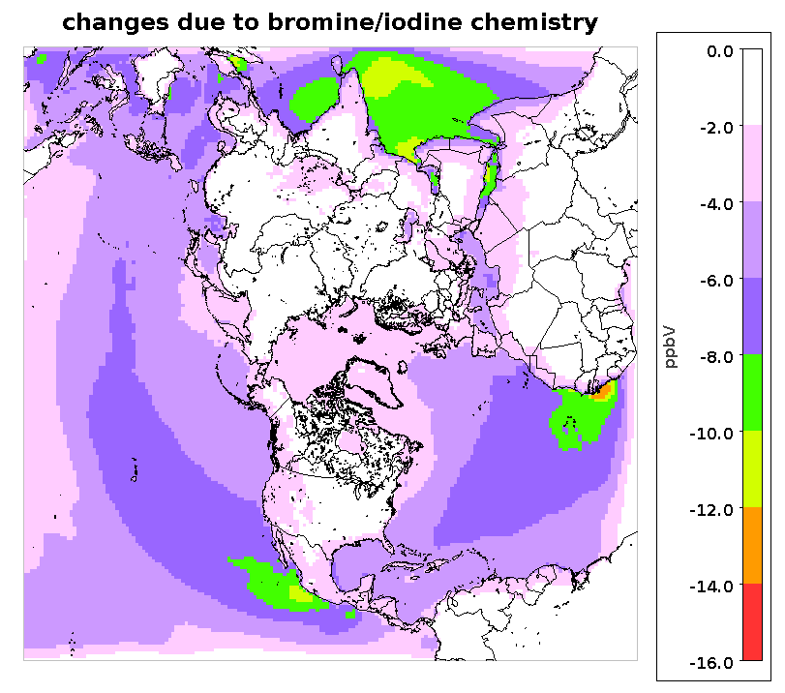
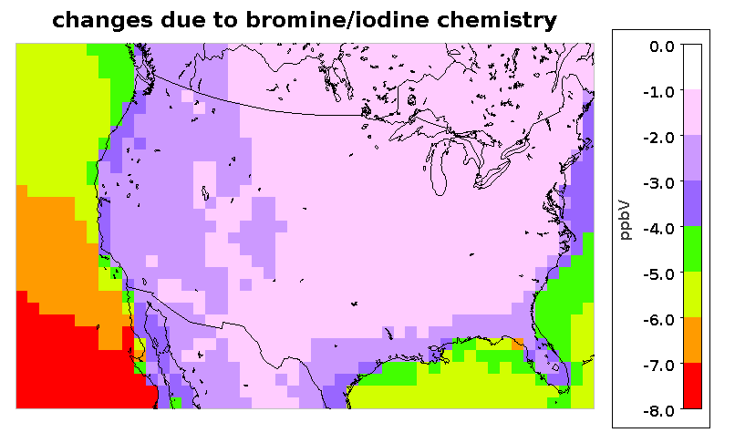
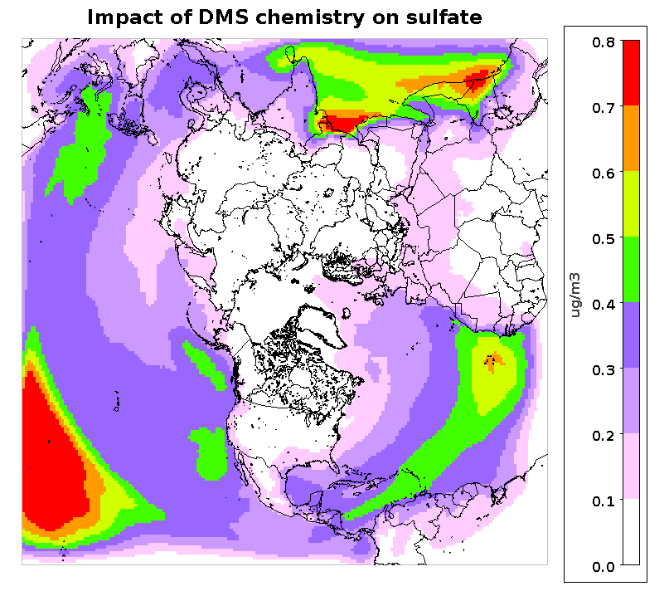
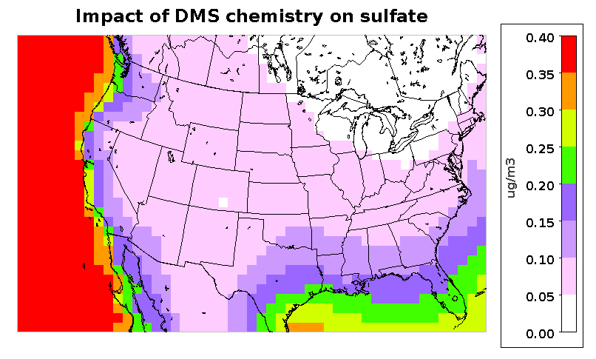
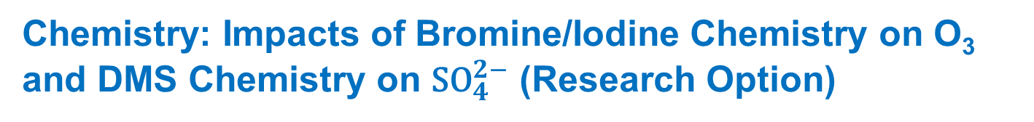
Chemistry: Impacts of Bromine/Iodine Chemistry on O₃ and DMS Chemistry on ${\text{SO}}_{4}^{2−}$ (Research Option)
Annual 2016
Annual 2016
Contact: Golam Sarwar
Bromine and iodine chemistry has been extended for CB6r3 and it reduces O₃
$$O₃
Annual 2016
Annual 2016
DMS chemistry has been added to CB6r3 and it increases ${\text{SO}}_{4}^{2−}$
$${\text{SO}}_{4}^{2−}$$
Detailed marine chemistry is only available for the CB6r3-AERO7-Marine mechanism

Slide 8
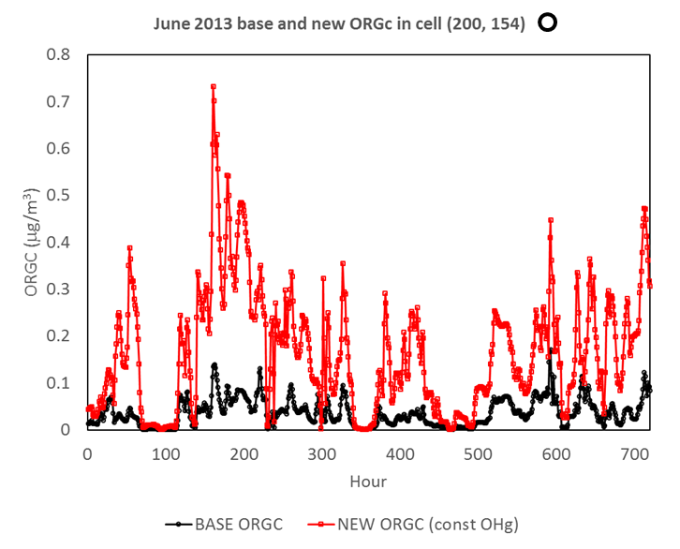
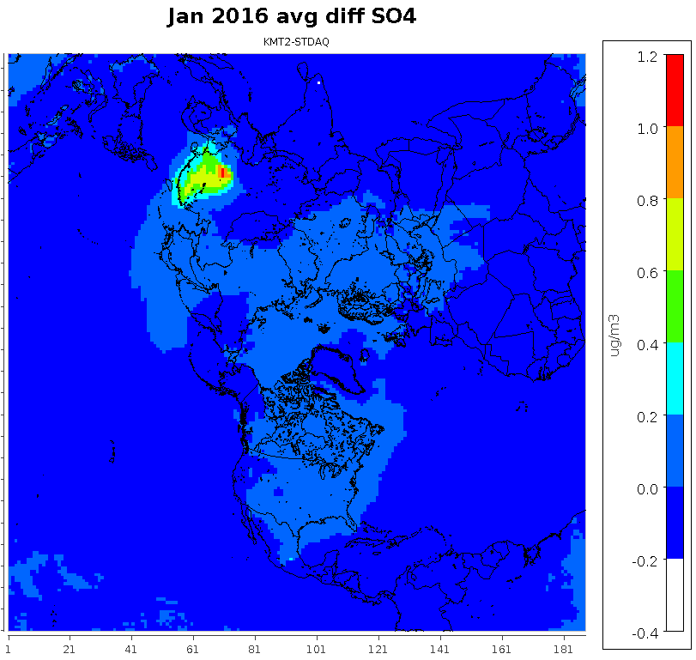
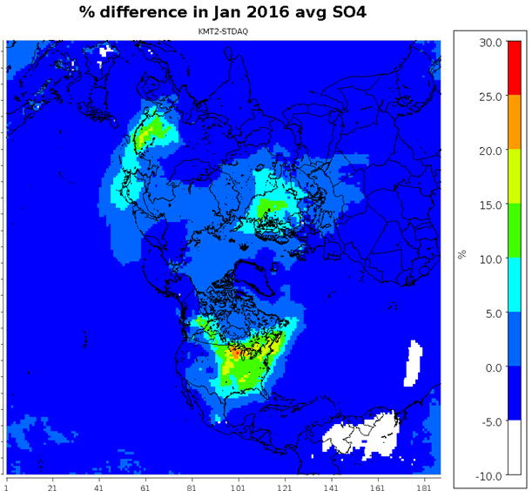
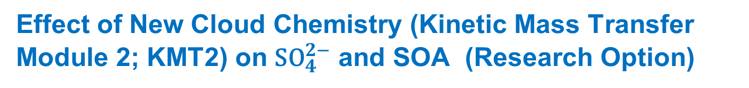
Effect of New Cloud Chemistry (Kinetic Mass Transfer Module 2; KMT2) on ${\text{SO}}_{4}^{2−}$ and SOA (Research Option)
June 2013 Cloud SOA; Pittsburgh
Aqueous oxidation of SO₂ to SO₄²⁻ often dominates over gas phase; evidence for non-trivial SOA formation in-cloud
SO₄²⁻ + OA are major contributors to PM_{2.5} levels around the globe (≥ 50% total mass)
Accurately representing the major sources and production pathways of these species in CTMs is necessary to assess the impacts of emissions changes on air quality/climate
  Cloud chemistry in many CTMs often outdated and oversimplified
KMT2
KMT
Contact: Kathleen Fahey
ΔSO₄²⁻ (μg/m³)
% change in average SO₄²⁻
1.2
30.0
0.8
20.0
Summer (June 2013, Top):
150-300+% increase in surface level “cloud SOA” in US
Elevated cloud SOA at both the surface and aloft; additional precursors as well as added pH dependence → changes in spatial distribution
Winter (January 2016, Bottom):
SO₄²⁻ increased up to 27%. NO₃⁻ tends to decrease with a similar pattern
23% increase in runtime for 2016 Q1 hemispheric run. Impacts on CMAQ runtime depend on domain, chemical mechanism, and season
0.4
10.0
0.0
0.0
January 2016
-0.4
-10.0
Notes:
Research Version: Runtime hit means it’s not incorporated in the base model
Notes: (1) AORGC = in-cloud SOA from yield parameterization GLY/MGLY + OH(base) or GLY/MGLY/CCOOH/GCOL + OH (new)
(2) January run was with cb6, June run was saprc07tic
Another NOTE: JUN 2013 run was for CMAQv5.2; JAN 2016 run was for a mid-September version of CMAQv5.3beta
Diff impacts (species impacted, amount) for different seasons and different regions
Made up ~2-6% of average surface SOA over much of the eastern US for June 2013 (CMAQv5.2); % increases aloft. ← that was for CMAQv52. prob lower percentage now
Summer: Monthly average AORGC with new chem in E. US during summer ≤ ~0.2 mg/m³, but max hourly change can reach 3 mg/m³ in June 2013
Winter: Monthly avg O₃, HCHO, and NOx saw small impacts over CONUS (≤~2%), but can see larger absolute impacts in other regions (e.g., DO₃ up to -11% in Asia)

Slide 9
Aerosols: Organic Aerosol in CMAQv5.3 (AERO7)
PAHs
+ OH
+ OH/NO
pcSOG
pcVOC
long
alkanes
SVAVB1
AAVB1
pcSOA
+ OH
+ OH/HO₂
OOG
AAVB2
OOA
+OH
high-yield aromatics
SVAVB2
+ OH/NO
AAVB3
POA
POG
SVAVB3
AOLGA
low-yield aromatics
+ OH/NO
AAVB4
POC+NCOM
SVAVB4
cloud
water
+ OH/NO
RH
AORGH₂O
benzene
+OH, +O₃, +NO₃, +O³P
SVSQT
AORGC
sesquiterpenes
ASQT
AOLGB
AGLY
+OH, +O₃, +O³P
SVMT1, SVMT2
SVMT3, SVMT4
SVMT5, SVMT6
APIN monoterpenes
AMT1, AMT2
AMT3, AMT4
AMT5, AMT6
GLY MGLY
ANTHROPOGENIC EMISSIONS
AISO3
+OH, +O₃, +O³P
TERP monoterpenes
+NO₃
AMTNO₃
AMTHYD
BIOGENIC EMISSIONS
MTNO₃
VOCs
+OH, + NO₃
SV_ISO1 SV_ISO2
AISO1 AISO2
isoprene
EMISSIONS
EMISSIONS
EMISSIONS
IEPOX
aqueous aerosol
Notes:
Figure: Schematic of SOA in updated simulation. See Pye et al. 2017 for a description of the traditional and aqueous aerosol SOA systems. See Pye et al. 2015 for MTNO3 formation and hydrolysis. See Murphy et al. 2017 for a description of the semivolatile POA (POA, POG), oxidized POA vapors (OOA, OOG) and potential SOA from combustion sources (pcSOA) system. Species different from the default configuration are in red.
Improved consistency between SAPRC and CB SOA mechanisms
Monoterpene organic nitrate SOA from SAPRC07tic (Pye et al. 2015 ES&T) now available in CB6r3-aero7.
Included in aero6i and aero7i as well.
Reduced number of species required for primarily anthropogenic SOA (benzene, toluene, xylene, alkanes, PAHs/naphthalene) (all aero7/7i mechanisms)
Updated monoterpene photooxidation SOA (all aero7/7i mechanisms)
Uptake of water onto hydrophilic organics (all aero7/7i mechanisms)
Process analysis can now access contributions from individual aerosol microphysical processes (e.g. coagulation from Aitken to Accumulation mode, condensation to each mode, new particle formation, etc)

Slide 10
Aerosols: Organic Aerosol in CMAQv5.3 (AERO7)
Anthropogenic SOA species number reduced
PAHs
+ OH
+ OH/NO
pcSOG
pcVOC
long
alkanes
SVAVB1
AAVB1
pcSOA
+ OH
+ OH/HO₂
OOG
AAVB2
OOA
+OH
high-yield aromatics
SVAVB2
+ OH/NO
AAVB3
POA
POG
SVAVB3
AOLGA
low-yield aromatics
+ OH/NO
AAVB4
POC+NCOM
SVAVB4
cloud
water
+ OH/NO
RH
AORGH₂O
benzene
+OH, +O₃, +NO₃, +O³P
SVSQT
AORGC
sesquiterpenes
ASQT
AOLGB
AGLY
+OH, +O₃, +O³P
SVMT1, SVMT2
SVMT3, SVMT4
SVMT5, SVMT6
APIN monoterpenes
AMT1, AMT2
AMT3, AMT4
AMT5, AMT6
GLY MGLY
ANTHROPOGENIC EMISSIONS
AISO3
+OH, +O₃, +O³P
TERP monoterpenes
+NO₃
AMTNO₃
AMTHYD
BIOGENIC EMISSIONS
MTNO₃
VOCs
+OH, + NO₃
SV_ISO1 SV_ISO2
AISO1 AISO2
isoprene
EMISSIONS
EMISSIONS
EMISSIONS
IEPOX
aqueous aerosol
Notes:
Figure: Schematic of SOA in updated simulation. See Pye et al. 2017 for a description of the traditional and aqueous aerosol SOA systems. See Pye et al. 2015 for MTNO3 formation and hydrolysis. See Murphy et al. 2017 for a description of the semivolatile POA (POA, POG), oxidized POA vapors (OOA, OOG) and potential SOA from combustion sources (pcSOA) system. Species different from the default configuration are in red.
Improved consistency between SAPRC and CB SOA mechanisms
Monoterpene organic nitrate SOA from SAPRC07tic (Pye et al. 2015 ES&T) now available in CB6r3-aero7.
Included in aero6i and aero7i as well.
Reduced number of species required for primarily anthropogenic SOA (benzene, toluene, xylene, alkanes, PAHs/naphthalene) (all aero7/7i mechanisms)
Updated monoterpene photooxidation SOA (all aero7/7i mechanisms)
Uptake of water onto hydrophilic organics (all aero7/7i mechanisms)
Process analysis can now access contributions from individual aerosol microphysical processes (e.g. coagulation from Aitken to Accumulation mode, condensation to each mode, new particle formation, etc)

Slide 11
Aerosols: Organic Aerosol in CMAQv5.3 (AERO7)
Anthropogenic SOA species number reduced
PAHs
+ OH
+ OH/NO
pcSOG
pcVOC
long
alkanes
SVAVB1
AAVB1
pcSOA
+ OH
+ OH/HO₂
OOG
AAVB2
OOA
+OH
high-yield aromatics
SVAVB2
+ OH/NO
AAVB3
POA
POG
SVAVB3
AOLGA
low-yield aromatics
+ OH/NO
AAVB4
POC+NCOM
SVAVB4
cloud
water
+ OH/NO
RH
AORGH₂O
benzene
+OH, +O₃, +NO₃, +O³P
SVSQT
AORGC
sesquiterpenes
ASQT
AOLGB
AGLY
+OH, +O₃, +O³P
SVMT1, SVMT2
SVMT3, SVMT4
SVMT5, SVMT6
APIN monoterpenes
AMT1, AMT2
AMT3, AMT4
AMT5, AMT6
GLY MGLY
ANTHROPOGENIC EMISSIONS
AISO3
+OH, +O₃, +O³P
TERP monoterpenes
+NO₃
AMTNO₃
AMTHYD
BIOGENIC EMISSIONS
MTNO₃
VOCs
+OH, + NO₃
Monoterpene Nitrates formation in all available mechanisms (Pye et al., 2015; Xu et al., 2018)
isoprene
SV_ISO1 SV_ISO2
AISO1 AISO2
EMISSIONS
EMISSIONS
EMISSIONS
IEPOX
aqueous aerosol
Notes:
Figure: Schematic of SOA in updated simulation. See Pye et al. 2017 for a description of the traditional and aqueous aerosol SOA systems. See Pye et al. 2015 for MTNO3 formation and hydrolysis. See Murphy et al. 2017 for a description of the semivolatile POA (POA, POG), oxidized POA vapors (OOA, OOG) and potential SOA from combustion sources (pcSOA) system. Species different from the default configuration are in red.
Improved consistency between SAPRC and CB SOA mechanisms
Monoterpene organic nitrate SOA from SAPRC07tic (Pye et al. 2015 ES&T) now available in CB6r3-aero7.
Included in aero6i and aero7i as well.
Reduced number of species required for primarily anthropogenic SOA (benzene, toluene, xylene, alkanes, PAHs/naphthalene) (all aero7/7i mechanisms)
Updated monoterpene photooxidation SOA (all aero7/7i mechanisms)
Uptake of water onto hydrophilic organics (all aero7/7i mechanisms)
Process analysis can now access contributions from individual aerosol microphysical processes (e.g. coagulation from Aitken to Accumulation mode, condensation to each mode, new particle formation, etc)

Slide 12
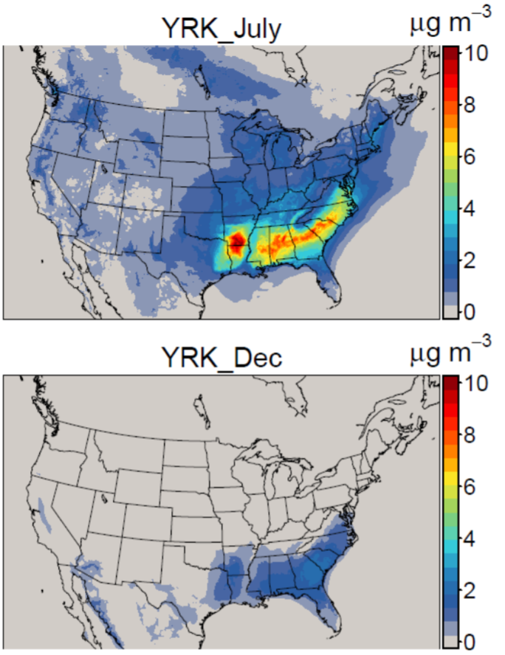
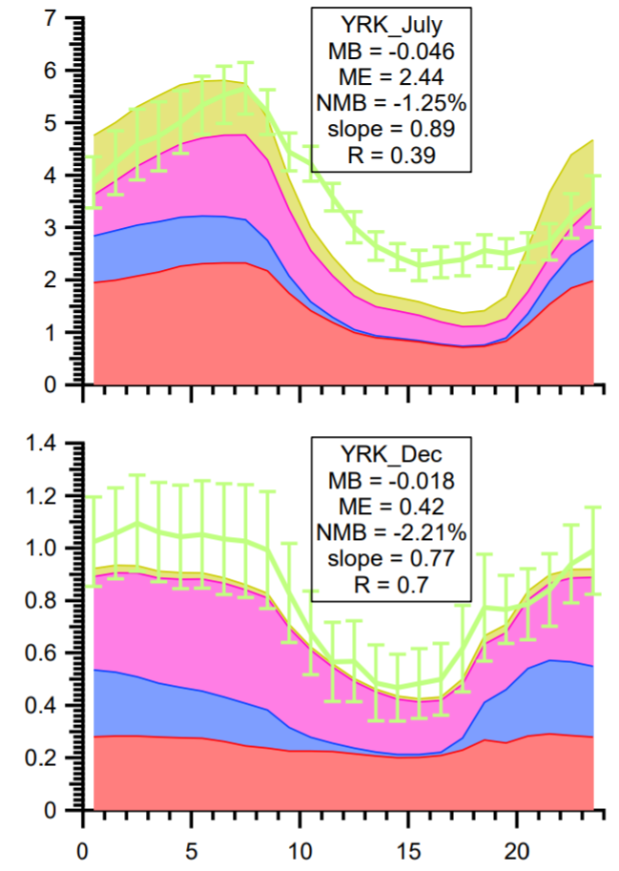


Modeled Monoterpene SOA Increases Year Round
CMAQ v5.3-aero7 predicted (stacked colors)
Observed MTSOA
July
CMAQ predictions now match the observed monoterpene SOA
Will see increased PM_{2.5}, particularly in biogenic source regions such as the southeast US
AERO6 → AERO7: α-Pinene emissions need to be considered since APIN is now an explicit species
  CB6:
    Online Biogenics: No changes needed.
    Offline Biogenics: APIN emissions should be scaled to TERP (30%).
  SAPRC07: No changes needed.
MTSOA
December
Stay for talk by Havala Pye next
Xu et al. 2018 ACP
Notes:
Observations from around the southeast in 2012-2013 used to identify monoterpene SOA
Monoterpene oxidation predicted to account for 20% of the WHO PM_{2.5} health standard in the southeast
If APIN is included in TERP, CMAQ v5.3-aero7 will overestimate organic aerosol significantly, particularly at night.

Slide 13
Aerosols: Organic Aerosol in CMAQv5.3 (AERO7)
Anthropogenic SOA species number reduced
PAHs
+ OH
+ OH/NO
pcSOG
pcVOC
long
alkanes
SVAVB1
AAVB1
pcSOA
+ OH
+ OH/HO₂
OOG
AAVB2
OOA
+OH
high-yield aromatics
SVAVB2
+ OH/NO
AAVB3
POA
POG
SVAVB3
AOLGA
low-yield aromatics
+ OH/NO
AAVB4
POC+NCOM
Water uptake to organic phase (Pye et al., 2017)
SVAVB4
cloud
water
+ OH/NO
RH
AORGH₂O
benzene
+OH, +O₃, +NO₃, +O³P
SVSQT
AORGC
sesquiterpenes
ASQT
AOLGB
AGLY
+OH, +O₃, +O³P
SVMT1, SVMT2
SVMT3, SVMT4
SVMT5, SVMT6
APIN monoterpenes
AMT1, AMT2
AMT3, AMT4
AMT5, AMT6
GLY MGLY
ANTHROPOGENIC EMISSIONS
AISO3
+OH, +O₃, +O³P
TERP monoterpenes
+NO₃
AMTNO₃
AMTHYD
BIOGENIC EMISSIONS
MTNO₃
VOCs
+OH, + NO₃
Monoterpene Nitrates formation in all available mechanisms (Pye et al., 2015)
isoprene
SV_ISO1 SV_ISO2
AISO1 AISO2
EMISSIONS
EMISSIONS
EMISSIONS
IEPOX
aqueous aerosol
Notes:
Figure: Schematic of SOA in updated simulation. See Pye et al. 2017 for a description of the traditional and aqueous aerosol SOA systems. See Pye et al. 2015 for MTNO3 formation and hydrolysis. See Murphy et al. 2017 for a description of the semivolatile POA (POA, POG), oxidized POA vapors (OOA, OOG) and potential SOA from combustion sources (pcSOA) system. Species different from the default configuration are in red.
Improved consistency between SAPRC and CB SOA mechanisms
Monoterpene organic nitrate SOA from SAPRC07tic (Pye et al. 2015 ES&T) now available in CB6r3-aero7.
Included in aero6i and aero7i as well.
Reduced number of species required for primarily anthropogenic SOA (benzene, toluene, xylene, alkanes, PAHs/naphthalene) (all aero7/7i mechanisms)
Updated monoterpene photooxidation SOA (all aero7/7i mechanisms)
Uptake of water onto hydrophilic organics (all aero7/7i mechanisms)
Process analysis can now access contributions from individual aerosol microphysical processes (e.g. coagulation from Aitken to Accumulation mode, condensation to each mode, new particle formation, etc)

Slide 14
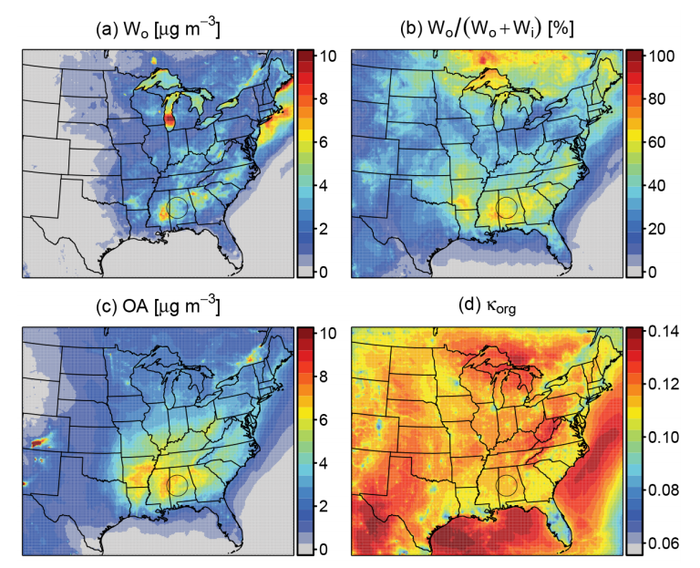
Aerosols: Water Uptake to Organic Phase
Previous versions of CMAQ only included aerosol water associated with inorganic constituents (W_{i}) (via ISORROPIA)
The contribution of aerosol water due to organic species (W_{o}) was estimated as 35 % with higher contributions (50 %) at night during SOAS (Guo et al. 2015 ACP)
Increased aerosol water leads to increased light scattering, reduced visibility, increased aerosol direct radiative effects, and changes in aerosol size and deposition
W_{o} will be largest when RH is high and OA is abundant
Contact: Havala Pye
Pye et al. 2017 ACP

Slide 15
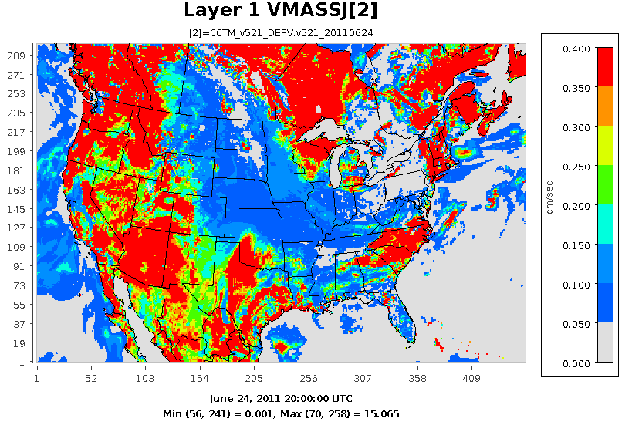
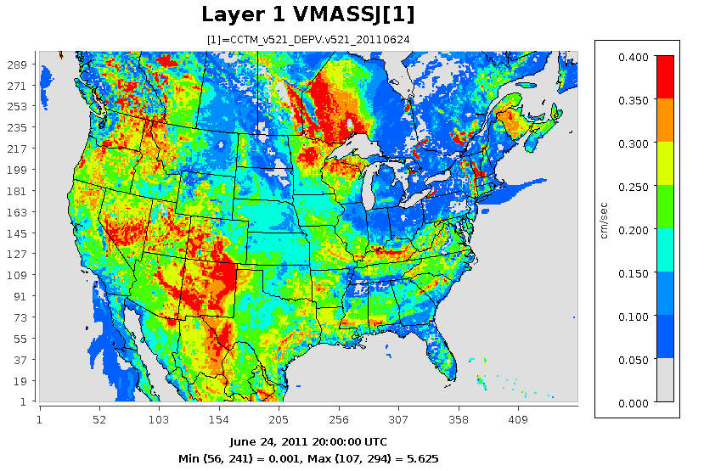
Deposition: Effect of r_{b} Revision on Aerosol Removal
The sub-laminar boundary layer resistance (r_{b}) is the key factor for aerosol dry deposition
New aerosol dry deposition velocity V_{d} is greater in most vegetated areas
Previously had unrealistically large V_{d} values that are reduced greatly
Accumulation Mode Deposition Velocity (June 24, 2011; 20z):
CMAQv5.2.1
Revised r_{b}
Notes:
Increases in vegetated areas is due to LAI scaling
The previous model integrated the entire Impaction term over the log-normal size modes which resulted in very large V_{d} when $σ_{g}$ was large

Slide 16
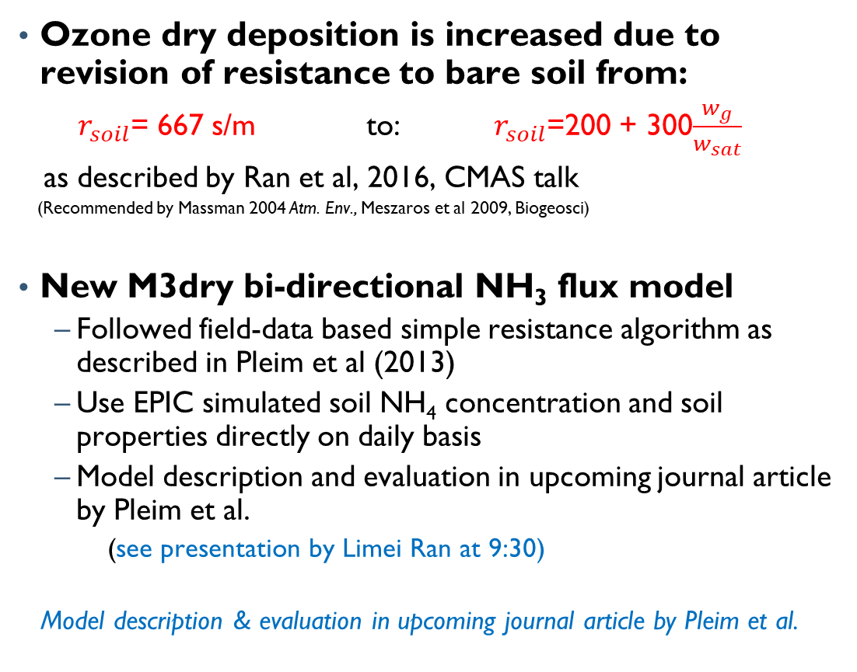
Deposition: Updates to M3dry Surface Flux Model
Ozone dry deposition is increased due to revision of resistance to bare soil from:
$r_{soil}$= 667 s/m to: $r_{soil}$=200 + 300$\frac{w_{g}}{w_{sat}}$
as described by Ran et al, 2016, CMAS talk
(Recommended by Massman 2004 Atm. Env., Meszaros et al 2009, Biogeosci)
New M3dry bi-directional NH₃ flux model
  Followed field-data based simple resistance algorithm as described in Pleim et al (2013)
  Use EPIC simulated soil NH₄ concentration and soil properties directly on daily basis
  Model description and evaluation in upcoming journal article by Pleim et al.
  (see presentation by Limei Ran at 9:30)
  Model description & evaluation in upcoming journal article by Pleim et al.
Monthly average model NH₃ with M3dry-bidi and no-bidi vs AMON obs for 2016
Obs (AMON)
With Bidirectional NH₃ Surface Flux
Without Bidirectional NH₃ Surface Flux

Slide 17
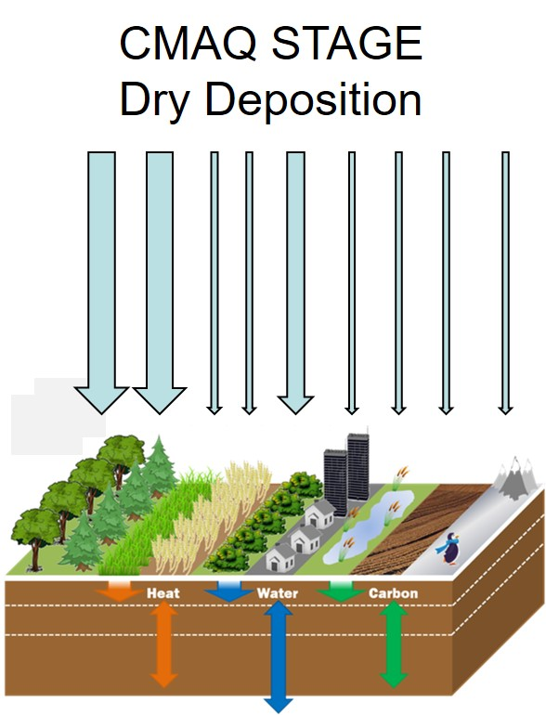
Deposition: New Option for Tiled Approach (STAGE; Research Option)
Surface Tiled Aerosol and Gaseous Exchange (STAGE) model
  Deposition option in CMAQ v5.3 to support TMDL and critical loads applications
Sub grid land use specific deposition
  Area weighted to grid cell
  Updates to snow resistance and cuticular resistance
Bidirectional and unidirectional schemes use the same resistance model
  Easy to add bidirectional exchange for modeled species
Improvements in evaluation against NADP, NH₃, and O₃ observations
For details see Jesse Bash’s 9:10 talk in this session

Slide 18
Direct Emissions: Improved Transparency and Flexibility
CMAQv5.2.1
CMAQv5.3: DESID
DESID – Detailed Emissions Scaling, Isolation, and Diagnostics Module
Any or all emission ‘streams’ may be turned off
Emissions scaling can be tailored to specific species from specific streams or applied across all species/streams
All aerosol size distributions can be parameterized for each stream independently
Scaling can be targeted to specific geographical areas with masks
Emissions Module
Emissions Module
Gridded Emissions 1
Read Gas and Aerosol Emissions
Read Gridded Gas Emissions
(1 and only 1 file)
Convert Lightning NO emissions with dedicated variables
Gridded Emissions 2
Convert Gas Emissions Units
Gridded Emissions 3…
Apply all scaling requests
Read in and apply hard-coded speciation rules (e.g. SULF → ASO4; OC + NCOM → SVPOA, etc. )
Point Emissions 1
Point Emissions 2…
Read point emissions; apply hard-coded scaling inside point emission module
Apply Size Distribution for aerosols, if applicable
Biogenics (BEIS)
Convert all emissions to correct units
Marine Gas
Convert units to ppmv.s
Check for negatives
Lightning
Wind-Blown Dust
Read and Map Biogenic Gases inside BEIS
Convert point emission units to ppmv/s and apply scaling
Output diagnostics if requested
Sea Spray
Ignore emissions if requested
Convert BEIS emissions to ppmv/s with dedicated variables
Read point and gridded Aerosol emissions, dust, and sea spray. Apply universal, fixed size distribution
Read and Map Marine Gases (MG)
Convert MG emissions using unique variables
If BIDI, remove NH3 fertilizer emissions
Read and Map Lightning NO
Vertical Dispersion Solver (VDIFF)
Vertical Dispersion Solver (VDIFF)

Slide 19
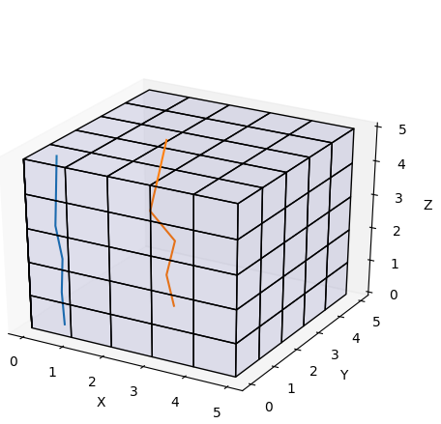
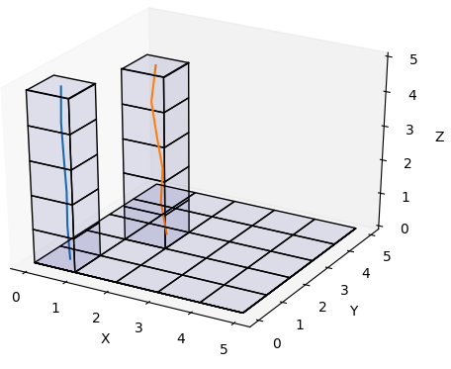
Diagnostics: Vertical Column Extraction (VEXT)
CONC (n = t * k * j * i)
Why save 299x459 columns for 3 sondes?
Why save 187x187 columns for boundaries on a perimeter?
Vertical Column Extraction
  Saves vectors (v) selected by lon/lat
  Outputs cell lon/lat in FILEDESC
  Outputs all species
First of new diagnostic framework
  CCTM/src/diag/
  Future updates:
    Time window average (eg, satellite overpass)
    Vertical Column Density
VEXT (n = t * k * v)
Contact: Barron Henderson

Slide 20
Summary and Path to CMAQv5.3 Official Release
CMAQv5.3 provides substantial improvements to chemistry, aerosol production, deposition, and diagnostic routines
Benchmark scenario inputs/outputs will be updated, although very few input changes are needed (i.e. high backward compatibility).
WRF-CMAQ build and run scripts will be available with the official model.
ICON/BCON generation tools are under final stages of development and will be released via GitHub when ready.
Instrumented Models:
  ISAM will be available with the official model release in summer 2019. It will include:
    New gas chemistry algorithms
    More explicit tracking of soluble species, like sulfate, in clouds
    More precise apportionment of aerosol mass among three available modes
    Faster runtimes
  DDM-3D will be available a few months after the official model release.
  The Sulfur Tracking Module (STM) will be released with the official model.

Slide 21
Priority Announcements
Beta model is available for download at www.github.com/usepa/cmaq
  Leave feedback and post issues
Community contributions are highly sought:
  Submit via GitHub. Check out our guide for developers. Available on CMAQ website and in the documentation folder of the CMAQ repo. (https://www.epa.gov/cmaq/cmaq-developers-guide)
  Request that contributors notify our team early to plan for submission, testing, etc.
User Survey is Now Available (deadline October 31)
  Go to: https://unc.az1.qualtrics.com/jfe/form/SV_1IcuS1wIZ2PQUu1
    www.cmascenter.org (link on homepage) -or-
    www.epa.gov/cmaq (link on recent news banner) -or-
    www.github.com/usepa/cmaq (link in top-level Readme text)
  CMAS and U.S. EPA take this feedback very seriously!
CMAQ Aerosol Committee – bring together research, development, and evaluation across the CMAS community. Membership is open to all. Currently seeking 3 chairs external to U. S. EPA. Email murphy.ben@epa.gov or pye.Havala@epa.gov with questions.

Slide 22
References
Chan, Arthur Wing Hong, et al. "Secondary organic aerosol formation from photooxidation of naphthalene and alkylnaphthalenes: implications for oxidation of intermediate volatility organic compounds (IVOCs)." Atmospheric Chemistry and Physics 9.9 (2009): 3049-3060.
Massman, W. J. "Toward an ozone standard to protect vegetation based on effective dose: a review of deposition resistances and a possible metric." Atmospheric Environment38.15 (2004): 2323-2337.
Mészáros, R., et al. "Measurement and modelling ozone fluxes over a cut and fertilized grassland." Biogeosciences 6.10 (2009): 1987-1999.
Pleim, Jonathan E., et al. "Development and evaluation of an ammonia bidirectional flux parameterization for air quality models." Journal of Geophysical Research: Atmospheres 118.9 (2013): 3794-3806.
Ng, N. L., et al. "Secondary organic aerosol formation from m-xylene, toluene, and benzene." Atmospheric Chemistry and Physics 7.14 (2007): 3909-3922.
Presto, Albert A., et al. "Secondary organic aerosol formation from high-NO x photo-oxidation of low volatility precursors: n-alkanes." Environmental science & technology 44.6 (2010): 2029-2034.
Pye, Havala OT, and John H. Seinfeld. "A global perspective on aerosol from low-volatility organic compounds." Atmospheric Chemistry and Physics 10.9 (2010): 4377-4401.
Pye, Havala OT, and George A. Pouliot. "Modeling the role of alkanes, polycyclic aromatic hydrocarbons, and their oligomers in secondary organic aerosol formation." Environmental science & technology 46.11 (2012): 6041-6047.
Pye, Havala OT, et al. "Modeling the current and future roles of particulate organic nitrates in the southeastern United States." Environmental science & technology 49.24 (2015): 14195-14203.
Pye, Havala OT, et al. "On the implications of aerosol liquid water and phase separation for organic aerosol mass." Atmospheric Chemistry and Physics 17.1 (2017): 343-369.
Xu, Lu, et al. "Experimental and model estimates of the contributions from biogenic monoterpenes and sesquiterpenes to secondary organic aerosol in the southeastern United States." Atmospheric Chemistry and Physics 18.17 (2018): 12613-12637.

Slide 23
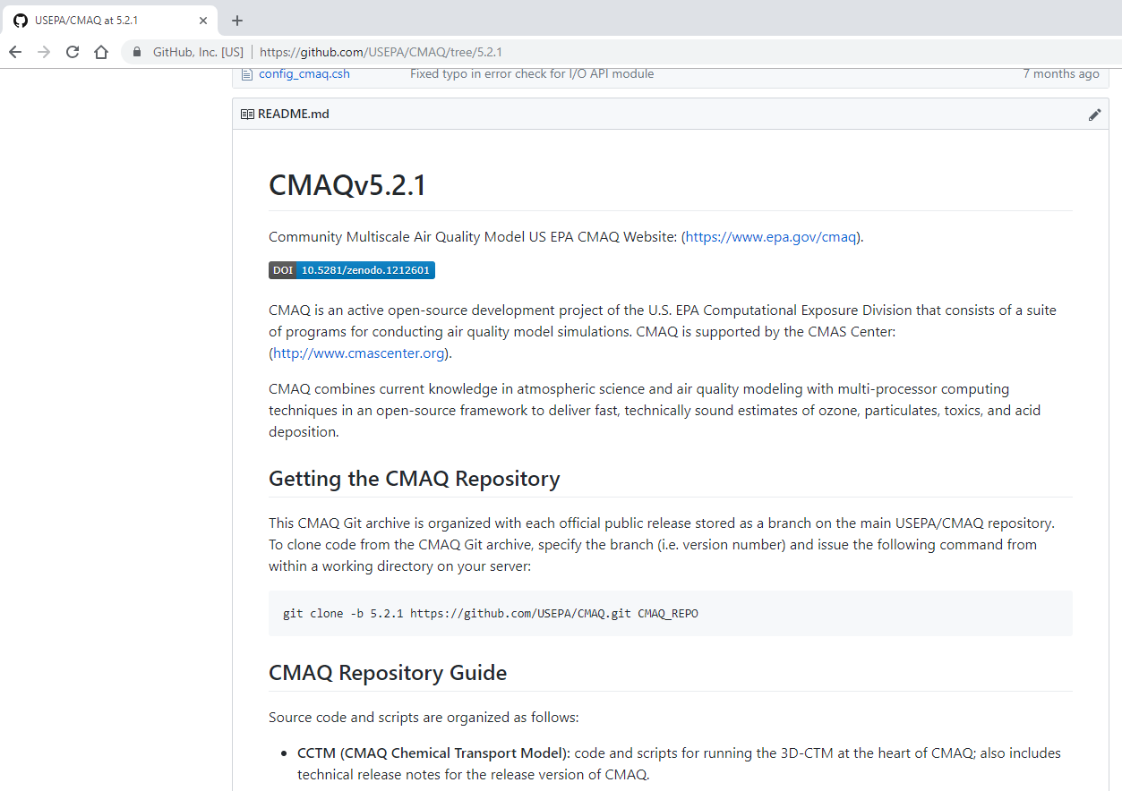
CMAQv5.2.1: Released March 2018
Resolved a number of known issues regarding model initialization and aerosol size distribution parameters
Second model version to be released via GitHub (v5.2)
Model is currently being used in several applications at EPA including:
  National Air Toxics Assessment
  Chesapeake Bay Study
  ORD Near-Real Time Forecast analysis
  Kansas City Green Infrastructure Study
  International Nitrogen Study – Pacific Northwest
  CDC PHASE Study
  4th National Climate Assessment
Known deficiencies
  Underpredicted biogenic SOA
  Overrepresented aerosol dry deposition
Mins / simulation day
Number of Processors
www.github.com/usepa/cmaq

Slide 24
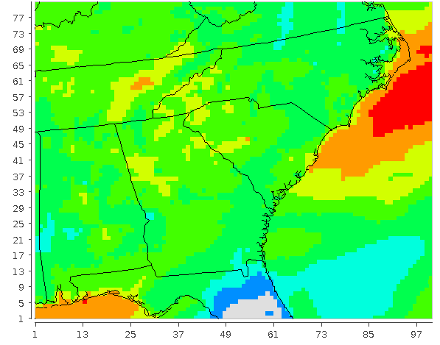
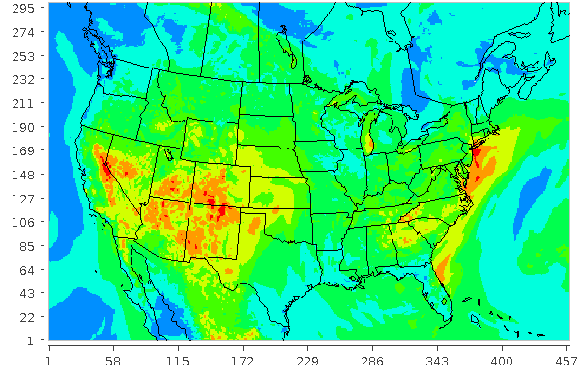
CMAQv5.3 (Beta): Runtime Performance
July 1-14, 2011
June 21-28, 2011
Compiler: Intel Fortran 17.1
Optimization: Level 3
Hardware: Intel Xeon (2) 16-Core Processors per node

Slide 26
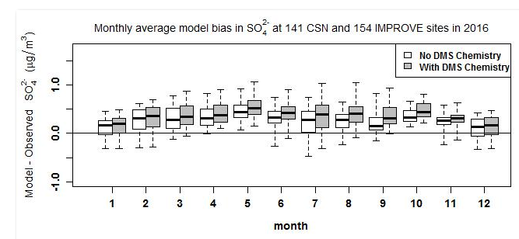
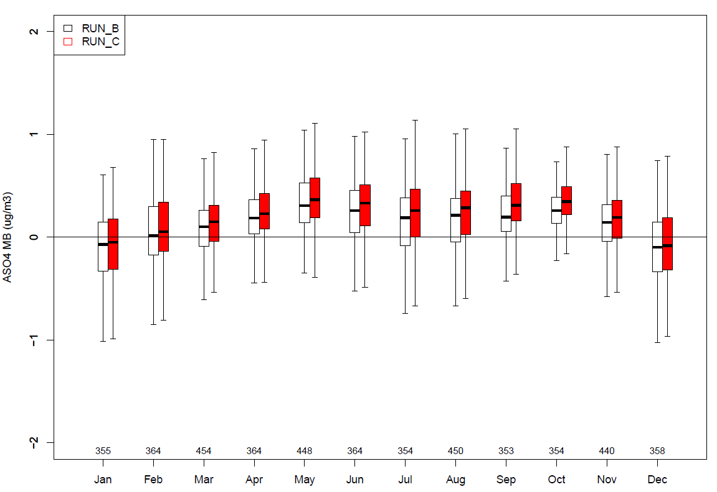
Evaluation of ${\text{SO}}_{4}^{2−}$
Model - Observed
CASTNET

Slide 27

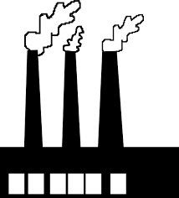

KMT2 Backup: cloud chemistry fundamentals
Clouds impact the amount, composition, and distribution of atmospheric species
Ionic dissociation, e.g.,
SO₂ ⁻HSO₃⁻ + H⁺
Inorg/org chemistry, e.g.,
(M)GLY + OH SOA_{cld}
S(IV) S(VI)
Gas φ species
Particulates
H₂O₂
HO₂
•OH
wet deposition
O₃
SO₂
•OH
NO_{x}
WSOGs
O₃
Aqueous oxidation of SO₂ to SO₄²⁻ often dominates over gas phase; evidence for non-trivial SOA formation in-cloud
SO₄²⁻ + OA are major contributors to PM_{2.5} levels around the globe (≥ 50% total mass)
Accurately representing the major sources and production pathways of these species in CTMs is necessary to assess the impacts of emissions changes on air quality/climate
  Cloud chemistry in many CTMs often outdated and oversimplified
* Figure adapted from Carlton et al. presentation at IAMA 2015
Notes:
Clouds and fogs impact the concentration and distribution of atmospheric gases and aerosols through chemistry, scavenging, and transport.
Aqueous oxidation of SO₂ to SO₄²⁻ often dominates over gas phase; evidence for non-trivial SOA formation in-cloud as well
Evolving research has indicated that aqueous pathways may have a significant role in the formation of SOA (Carlton et al., 2006, 2007; McNeill et al., 2012, 2015; Ervens, 2015; Ervens et al., 2011; Lim et al., 2005).
Oxidized VOCs dissolve into cloud droplets
Further oxidize in the aqueous phase
Remain in the particle phase after cloud evaporation
Global modeling studies suggest SOA formation formed via cloud processing of soluble organic compounds may be significant
[Also: clouds impact the evolution of gas phase chemistry in the interstitial air between cloud droplets by preferentially scavenging more soluble species and subjecting them to aqueous chemistry]
SO₄²⁻ + OA are major contributors to PM_{2.5} levels around the globe, often accounting for more than half of the total mass
Accurately representing the major sources and production pathways of these species in CTMs is necessary to assess the impacts of emissions changes on air quality and climate
Cloud chemistry in many CTMs is often outdated and oversimplified

Slide 28
KMT2 backup: CMAQv5.1 cloud chemistry
CMAQ v5.1 cloud chemistry
H₂O₂
O₃
O₂ (Fe³⁺/Mn²⁺)
MHP
PAA
S(IV) S(VI)
GLY, MGLY + OH 0.04 AORGC
IEPOX/MAE/HMML (+ H₂O, SO₄²⁻)
IETET/MGA/OS/dimers

Slide 29
Cloud Chemistry: Extended Kinetic Mass Transfer Module (KMT2; Research Option)
Aqueous oxidation of SO₂ to SO₄²⁻ often dominates over gas phase; evidence for non-trivial SOA formation in-cloud
SO₄²⁻ + OA are major contributors to PM_{2.5} levels around the globe (≥ 50% total mass)
Accurately representing the major sources and production pathways of these species in CTMs is necessary to assess the impacts of emissions changes on air quality/climate
  Cloud chemistry in many CTMs often outdated and oversimplified
Extensions in KMT2
CMAQ v5.1 cloud chemistry
H₂O₂
O₃
O₂ (Fe³⁺/Mn²⁺)
MHP
PAA
GLY, MGLY + OH
0.04 AORGC
+
S(IV) S(VI)
IEPOX/MAE/HMML (+ H₂O, SO₄²⁻)
IETET/MGA/OS/dimers
Notes:
In CMAQv5.3beta we extend the cloud chemistry mechanism to include additional S, N, O-H, and organic chemistry
-based on a reduced mechanism from “ReLACS-AQ” (Leriche et al., 2013) that was built from/tested against more state-of-the-art/extensive cloud chemistry models (CAPRAM 2.4 and Tost et al., 2007)
-and on a more mechanistic representation of in-cloud SOA formation of small carboxylic acids from reactions of species like glyoxal, methylglyoxal, and glycolaldehyde with OH (Lim et al. (2005), Tan et al. (2009), Lim et al. (2010, 2013) and updated by Sareen et al., 2013 – NOTE: in published studies, modeling with the proposed (SOA) mechanism successfully reproduced oxalic acid concentrations from batch experiments (Tan et al., 2009, Lim et al., 2010, 2013) for cloud-relevant concentrations).
Notes:
Oxalic acid/oxalate (the leading contributor to the total dicarboxylic mass in ambient organic aerosol) is thought to be a tracer for aqueous phase chemistry (no known effic sources in gas phase and direct emissions are thought to be minor – Ervens 2015) and has been shown to be especially abundant in the vicinity of clouds…
“The total contribution of oxalic acid to the total OA fraction usually does not exceed a few percent (e.g. Kawamura et al., 1996b, 2003) and is only one of many products formed through aqueous chemistry. However, the numerous data sets for oxalate and the availability of detailed chemical mechanisms of its formation pathways make it a good tracer to test our understanding of aqueous phase processing of small organic molecules.” (Ervens et al., 2011)

Slide 30
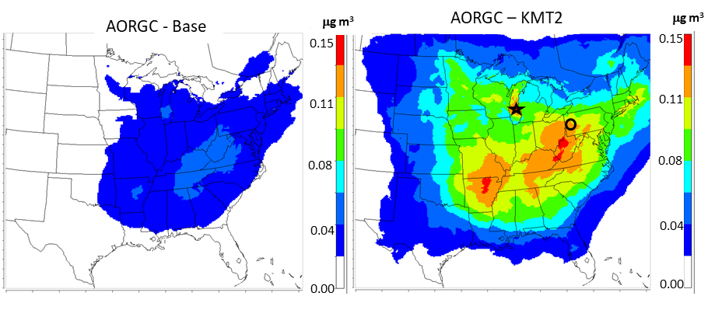
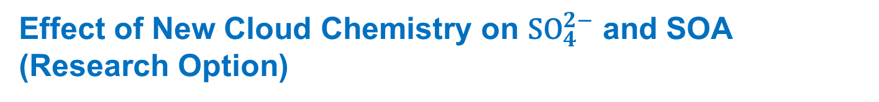
Effect of New Cloud Chemistry on ${\text{SO}}_{4}^{2−}$ and SOA (Research Option)
Base Avg AORGC
KMT2 Avg AORGC
June 2013 cloud SOA (GLY/MGLY)
June 2013 cloud SOA (GLY/MGLY/GCOL/CH₃COOH)
ΔSO₄²⁻ (μg/m³)
% change in average SO₄²⁻
Summer (June 2013, Top):
150-300+% increase in surface level “cloud SOA” in US
Elevated cloud SOA at both the surface and aloft; additional precursors as well as added pH dependence → changes in spatial distribution
Winter (January 2016, Bottom):
SO₄²⁻ increased up to 27%. NO₃⁻ tends to decrease with a similar pattern
23% increase in runtime for 2016 Q1 hemispheric run. Impacts on CMAQ runtime depend on domain, chemical mechanism, and season
1.2
30.0
0.8
20.0
0.4
10.0
0.0
0.0
January 2016
-0.4
-10.0
Notes:
Research Version: Runtime hit means it’s not incorporated in the base model
Notes: (1) AORGC = in-cloud SOA from yield parameterization GLY/MGLY + OH(base) or GLY/MGLY/CCOOH/GCOL + OH (new)
(2) January run was with cb6, June run was saprc07tic
Another NOTE: JUN 2013 run was for CMAQv5.2; JAN 2016 run was for a mid-September version of CMAQv5.3beta
Diff impacts (species impacted, amount) for different seasons and different regions
Made up ~2-6% of average surface SOA over much of the eastern US for June 2013 (CMAQv5.2); % increases aloft. ← that was for CMAQv52. prob lower percentage now
Summer: Monthly average AORGC with new chem in E. US during summer ≤ ~0.2 mg/m³, but max hourly change can reach 3 mg/m³ in June 2013
Winter: Monthly avg O₃, HCHO, and NOx saw small impacts over CONUS (≤~2%), but can see larger absolute impacts in other regions (e.g., DO₃ up to -11% in Asia)

Slide 31
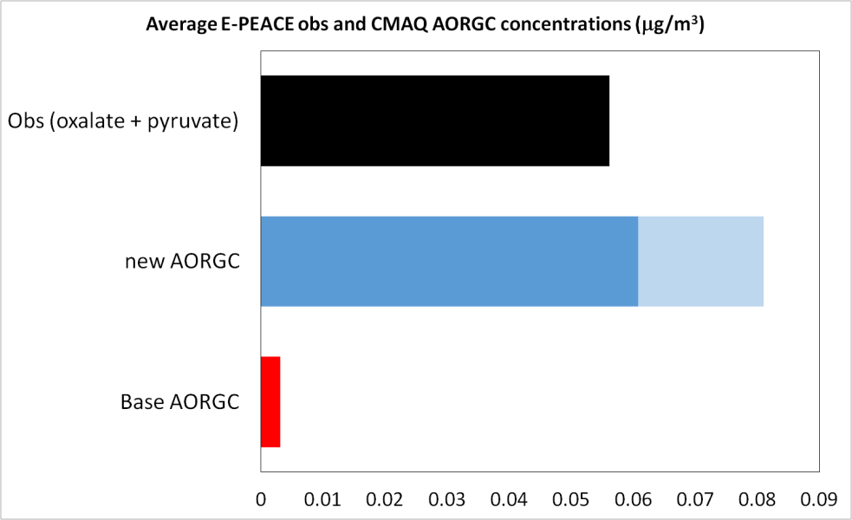
Evaluation of KMT2 for organic acids
SO₄²⁻ – Jan 2011 | stat | Base | KMT+
CSN | NME | 43.4 | 35.8
 | NMB | -32.6 | -23.3
IMPROVE | NME | 49 | 43.7
 | NMB | -13.2 | -4.1
CASTNET | NME | 43.3 | 36.0
 | NMB | -40.8 | -32.9
In winter (Jan 2011, CONUS), the largest model impacts are on sulfate
  Model still underpredicts, but error and bias are diminished
In summer, (base case) CMAQ predicts higher OC than observations, so the addition of new SOA chemistry leads to a small decrease in OC performance
Only limited measurements of oxalate and other organic acids available for modeled periods/locations
  E-PEACE campaign during July 2011 off CA coast had flight measurements of oxalate and pyruvate
  Not exact comparisons (AORGC = oxalate, pyruvate, glyoxylate, glycolate) but updated AORGC more in line with available measurements
    Shaded portion is estimated % of total AORGC from oxalate and pyruvate, based on simulations in Liu et al. (2012)
Sorooshian, Armin; MacDonald, Alexander B; Dadashazar, Hossein; Bates, Kelvin H; Coggon, Matthew M; Craven, Jill S; et al. (2017): A Multi-Year Data Set on Aerosol-Cloud-Precipitation-Meteorology Interactions for Marine Stratocumulus Clouds.
Notes:
NOTE: these are for Jan, Jul 2011 simulations for CONUS w CMAQv52
Medium blue = estimated fraction of total AORGC that is oxalate+pyruvate (~75%)

Slide 32
Aerosols: Reduction in Number of Anthropogenic SOA Species
PAHs
+ OH/NO
+ OH/HO₂
SVAVB1
long
alkanes
AAVB1
+ OH
SVAVB2
high-yield aromatics
AAVB2
+ OH/NO
SVAVB3
AAVB3
low-yield aromatics
+ OH/NO
SVAVB4
AAVB4
AOLGA
+ OH/NO
benzene
AERO6: 24 species | AERO7: 8 species
Achieved via volatility basis set (VBS) parameterization based on same underlying datasets
Same model predictions in terms of mass and dependencies with faster model run-time
Precursor | Reference
Single-ring Aromatics | Ng et al. (2007); Pye et al. (2010)
PAHs | Chan et al. (2009); Pye et al. (2010)
Alkanes | Presto et al. (2010); Pye and Pouliot (2012)
Notes:
Figure: Schematic of SOA in updated simulation. See Pye et al. 2017 for a description of the traditional and aqueous aerosol SOA systems. See Pye et al. 2015 for MTNO3 formation and hydrolysis. See Murphy et al. 2017 for a description of the semivolatile POA (POA, POG), oxidized POA vapors (OOA, OOG) and potential SOA from combustion sources (pcSOA) system. Species different from the default configuration are in red.
BTX: Ng et al. 2007 ACP chamber experiments parameterized with separate high and low-NOx yields and corresponding volatility
PAHs/naphthalene: Chan et al. 2009 ACP high and low-NOx experiments
Alkanes: dodecane basis (Presto et al. 2010 ES&T VBS fit) with empirical adjustment for length of alkanes
Fits available in Presto et al. 2010 ES&T (alkanes) and Pye et al. 2010 ACP (BTX, PAHs)
Long (~1 day) time scale aging of semivolatiles to oligomer form retained (Carlton et al. 2010 ES&T)

Slide 33
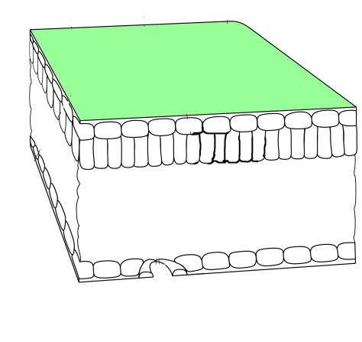
Deposition: updates to the bidirectional NH₃ flux model
Bidirectional flux of NH₃ is modeled by simple resistance algorithm as described in Pleim et al (2013)
Compensation concentration in soil is computed as:
χ_{a}
 | Resistance to deposition
R_{a} | Aerodynamic resistance
R_{b} | Laminar boundary layer resistance
R_{inc} | In-canopy aerodynamic resistance
R_{bg} | Ground laminar boundary layer resistance
R_{w} | Cuticular resistance
R­_{st} | Stomatal resistance
χ_{a} | Atmospheric concentration
χ_{c} | Canopy compensation point
χ_{g} | Soil compensation point concentration
χ_{st} | Stomatal compensation point concentration
R_{soil} | Soil resistance
R_{a}
0.5R_{inc}
χ_{c}
R_{w}
0.5R_{inc}
R_{b}
R_{b}
χ_{st}
R_{bg}
R_{soil}
R_{st}
Where L1_NH₃ is ammonia mass in top soil layer, d₁ is top soil layer thickness, w₁ is soil moisture in top layer
χ_{g}
Pleim et al 2013, JGR

Slide 34
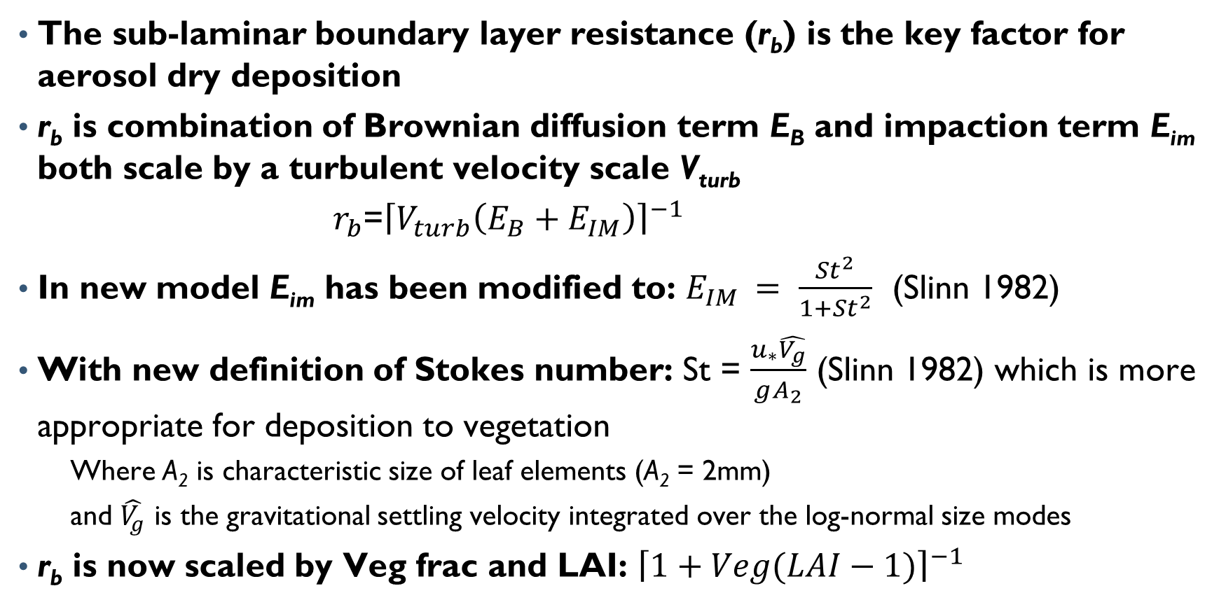
Deposition: update to aerosol boundary-layer resistance
The sub-laminar boundary layer resistance (r_{b}) is the key factor for aerosol dry deposition
r_{b} is combination of Brownian diffusion term E_{B} and impaction term E_{im} both scale by a turbulent velocity scale V_{turb}
$r_{b}$=${\left\lceil V_{turb}\left(E_{B}+E_{IM}\right)\right\rceil }^{−1}$
In new model E_{im} has been modified to: $E_{IM }= \frac{{St}^{2}}{1+{St}^{2}}$ (Slinn 1982)
With new definition of Stokes number: St = $\frac{u_{∗}\hat{V_{g}}}{gA_{2}}$ (Slinn 1982) which is more appropriate for deposition to vegetation
  Where A₂ is characteristic size of leaf elements (A₂ = 2mm)
  and $\hat{V_{g}}$ is the gravitational settling velocity integrated over the log-normal size modes
r_{b} is now scaled by Veg frac and LAI: ${\left\lceil 1+Veg(LAI−1)\right\rceil }^{−1}$

Slide 35
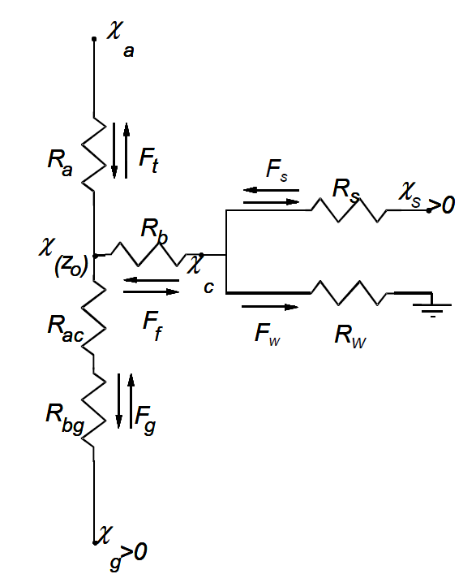
Deposition: new option for tiled approach (STAGE)
Surface Tiled Aerosol and Gaseous Exchange (STAGE) model
  Deposition option in CMAQ v5.3 to support TMDL and critical loads applications
Sub grid land use specific deposition
  Area weighted to grid cell
Resistance to ozone, NH₃ and aerosol deposition revised
Models fluxes as gradient based processes
  Using Kirchhoff’s current law
Bidirectional and unidirectional schemes use the same resistance model
  Easy to add bidirectional exchange for modeled species
Χ_{w}>0
Adapted from Nemitz et al. 2001

Slide 36
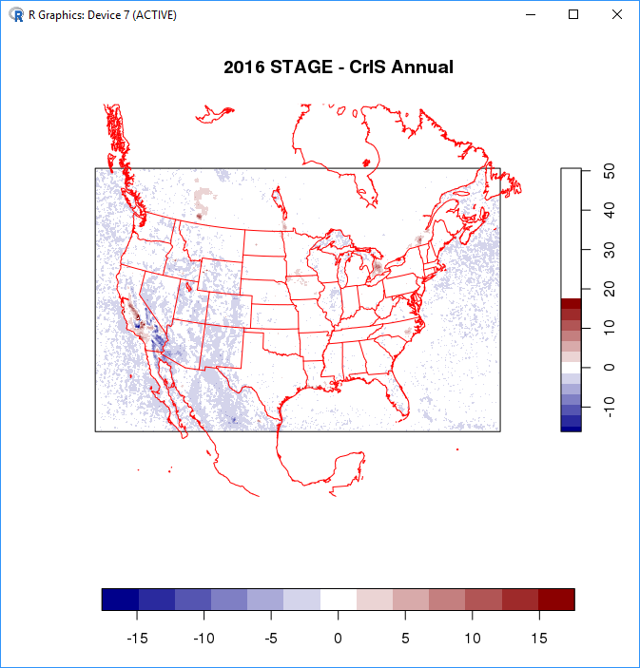
Deposition: Evaluation of STAGE module
Evaluated with field scale flux NH₃, HNO₃, and SO₂ observations
Evaluation of 2011 and 2016 annual simulations against network observations
Evaluation of NH₃ against CrIS satellite observations

