Slide 1





USING GAP-FILLED MAIAC AOD AND WRF-CHEM TO ESTIMATE DAILY PM2.5 CONCENTRATIONS AT
1 KM RESOLUTION IN THE EASTERN UNITED STATES
Aqua satellite
Image from: http://eospso.nasa.gov
Presentation by: Dan Goldberg¹
Co-Authors: Pawan Gupta², Kai Wang³, Chinmay Jena³, Yang Zhang³, Zifeng Lu¹ & David Streets¹
¹University of Chicago & Argonne National Laboratory, Argonne, IL
²NASA Goddard Space Flight Center & University Space Research Association, Greenbelt, MD
³North Carolina State University, Raleigh, NC

Slide 2

Funding Acknowledgments and Disclaimer
This work is partially sponsored by EPA under the SEARCH Center grant awarded to Yale University.
This presentation was developed under Assistance Agreement No. RD83587101 awarded by the U.S. Environmental Protection Agency to Yale University. It has not been formally reviewed by EPA. The views expressed in this document are solely those of the authors and do not necessarily reflect those of the Agency. EPA does not endorse any products or commercial services mentioned in this presentation.

Slide 3
HOW IS SATELLITE DATA USEFUL?
Role for satellite data?
To determine compliance with air quality standards?
To develop regional air pollution trends in urban and rural areas?
To get a better sense of the magnitude of air pollution in areas with no ground-level monitors or areas with privatized monitors?
To develop emission estimates from large point sources & cities?
To combine with models to estimate ground-level concentrations?
No
Yes
Yes
Yes
Yes
Adapted from Dr. Tracey Holloway, UW-Madison

Slide 4
Introduction to MAIAC AOD
MAIAC = Multi-Angle Implementation of Atmospheric Correction
Operational AOD algorithm released by NASA June 2018
Example: July 15, 2008
Calculates Aerosol Optical Depth (AOD) from the NASA MODIS sensors on Terra & Aqua
Data is 1 × 1 km²
The algorithm “observes the same grid cell over time, helping to separate atmospheric and surface contributions… using multi-angle observations from different orbits.” Lyapustin et al., 2018, AMT.

Slide 5
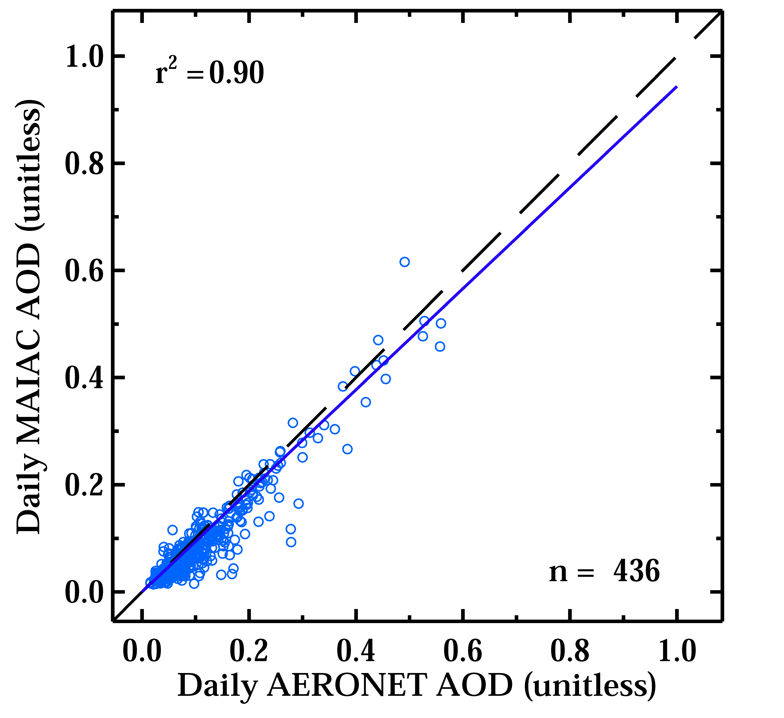
PERFORMANCE OF MAIAC AOD
Observed MAIAC AOD vs. AERONET in the Eastern US
Excellent agreement between MAIAC AOD and AERONET in the eastern United States.
AERONET = Aerosol Robotic Network A group of ground-based sun photometers observing AOD
PI: Brent Holben, NASA GSFC

Slide 6
Observed Satellite AOD by SEASON
1 km MAIAC AOD Collection 6 averaged for three different time periods in 2008
AOD is generally smallest during winter, and largest during summer.
Seasonal cycles can differ in different regions.
Notes:
Let’s take a quick look at seasonal AOD. Generally AOD is smallest during the winter and largest during the summer. Of course there are daily exceptions

Slide 7
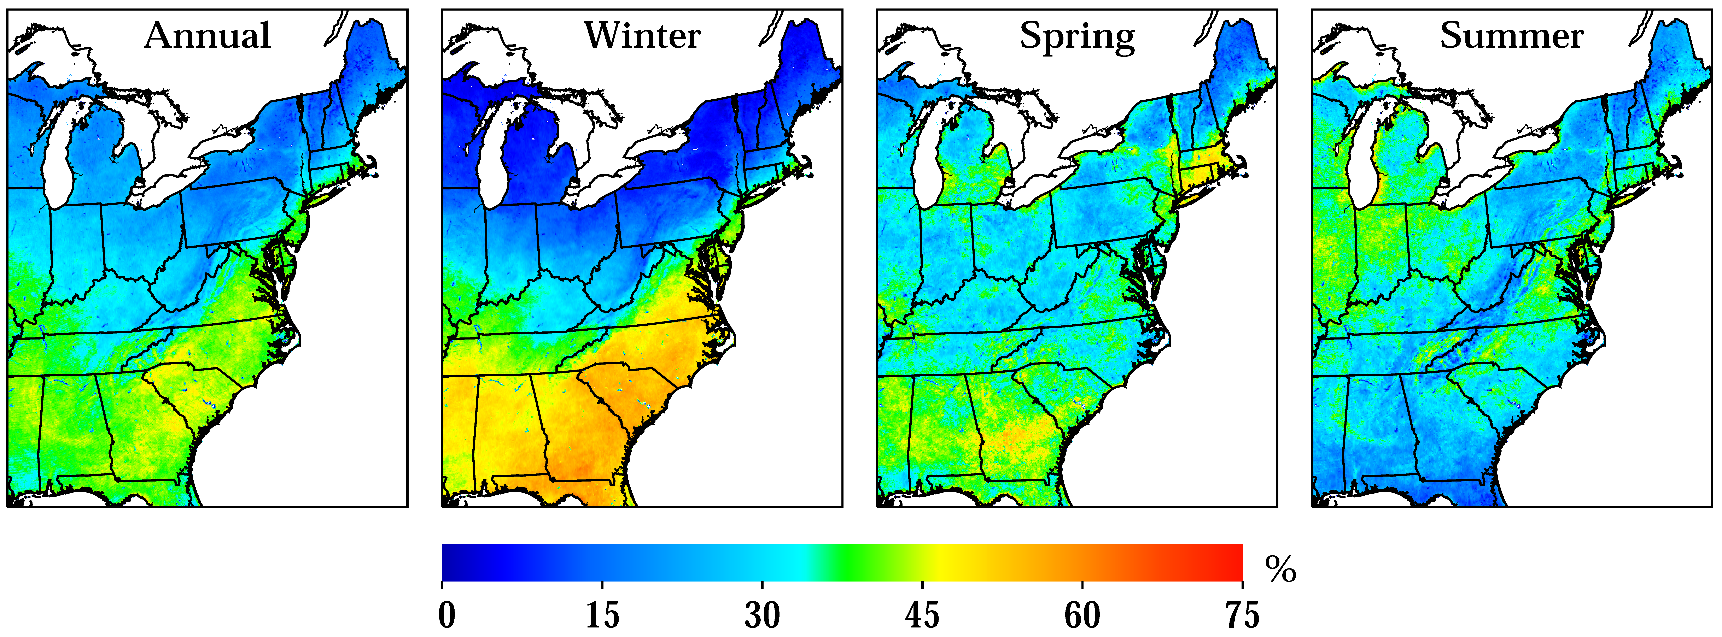
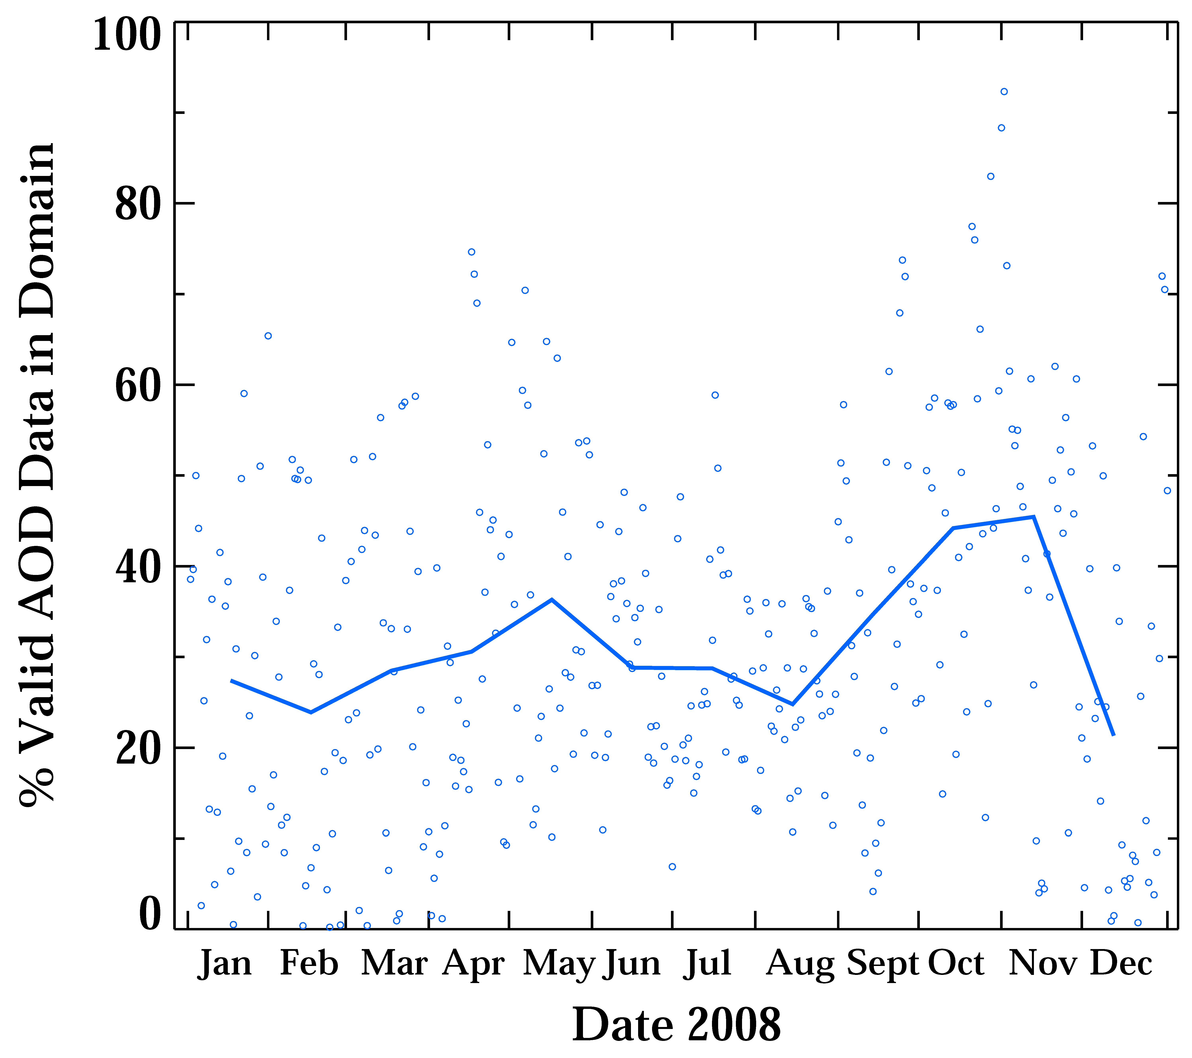
PERCENTAGE OF DAYS WITH CLEAR SKIES & No snow
In northern US more valid pixels in the summertime.
In southern US, more valid pixels in the wintertime.
Generally, days with the most valid pixels occur in October and November.
BUT… surface PM2.5 in the northern states can be poor during winter!
And surface PM2.5 in the southern states can be poor during summer!

Slide 8
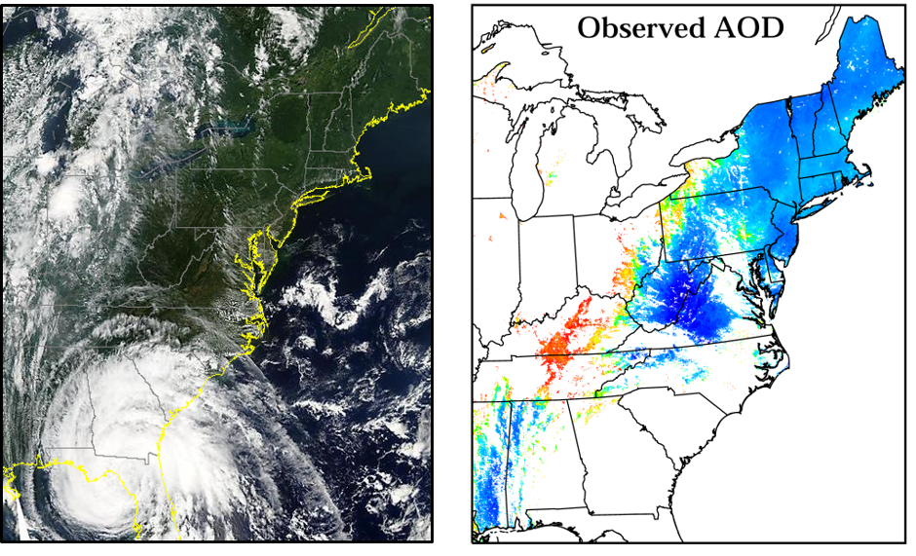
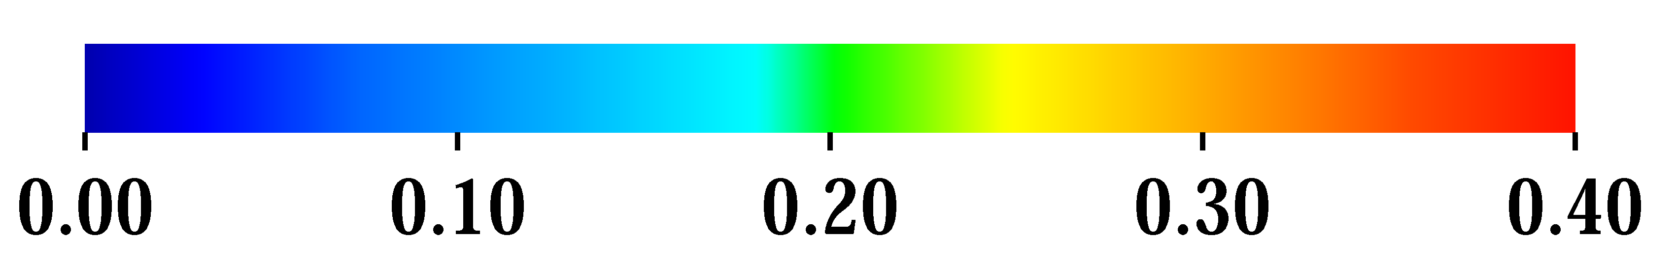
Daily AEROSOL OPTICAL DEPTH (AOD) on august 22, 2008:
CLOUDS OBSTRUCT 70% of THE area!
Visible imagery from MODIS on the Aqua satellite
Observed AOD from MAIAC on the Terra and Aqua satellites
We need to estimate the AOD in areas in which it is missing!

Slide 9
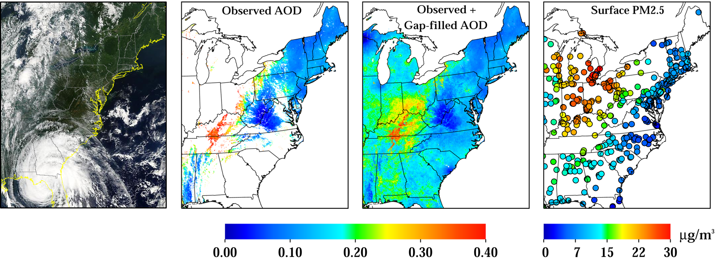
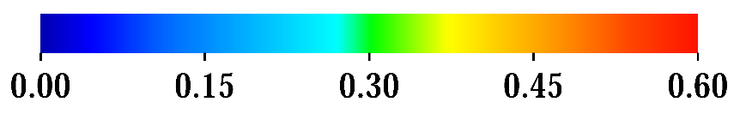
Daily AOD on august 22, 2008: example of gAP-filled aod
Aqua MODIS visible image
Observed MAIAC AOD
Gap-filled MAIAC AOD
Observed Surface PM_{2.5}
$$Daily AOD=α_{seasonal}\left[\frac{Daily PM2.5}{Seasonal PM2.5}×Seasonal AOD\right]+β_{seasonal}$$
Gap-filled AOD ~ Seasonal AOD tweaked by the regional surface PM2.5 perturbation
Method developed by: Tsinghua University, Lv et al., 2016; EST

Slide 10
PERFORMANCE OF THE GAP-FILLED AOD
Observed MAIAC AOD vs. AERONET
Gap-filled MAIAC AOD vs. AERONET
Seasonal MAIAC AOD vs. AERONET
Good agreement between AERONET, and gap-filled MAIAC AOD.
  As expected, not as good correlation, but no bias.
Using our methodology to gap-fill AOD is demonstrably better than using a seasonal average to fill in missing data.
AERONET = Aerosol Robotic Network A group of ground-based sun photometers observing AOD
PI: Brent Holben, NASA GSFC

Slide 11
Maiac AOD vs. GAP-FILLED MAIAC AOD
Generally, the gap-filing methodology does a good job at representing the daily observed MAIAC AOD, but there are some exceptions (e.g. wildfire smoke, unusual small sources).

Slide 12
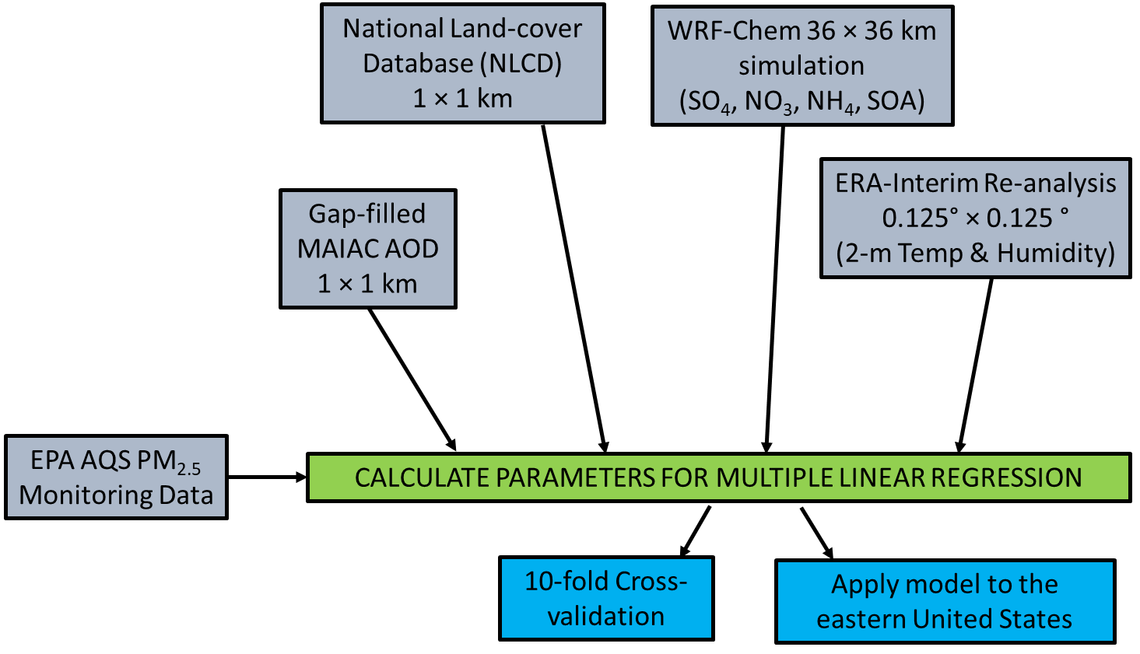
Block diagram of our methodology to calculate PM2.5 from GAP-filled AOD

Slide 13
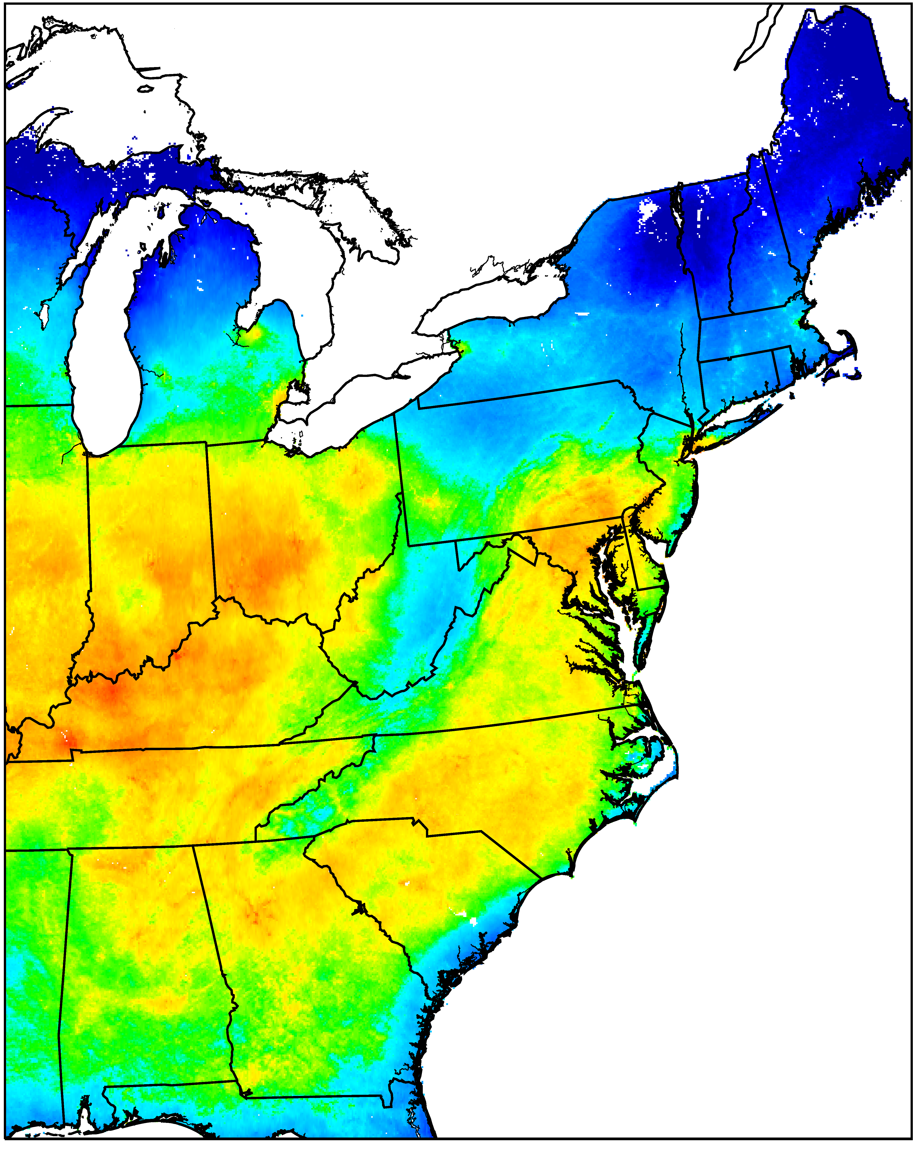
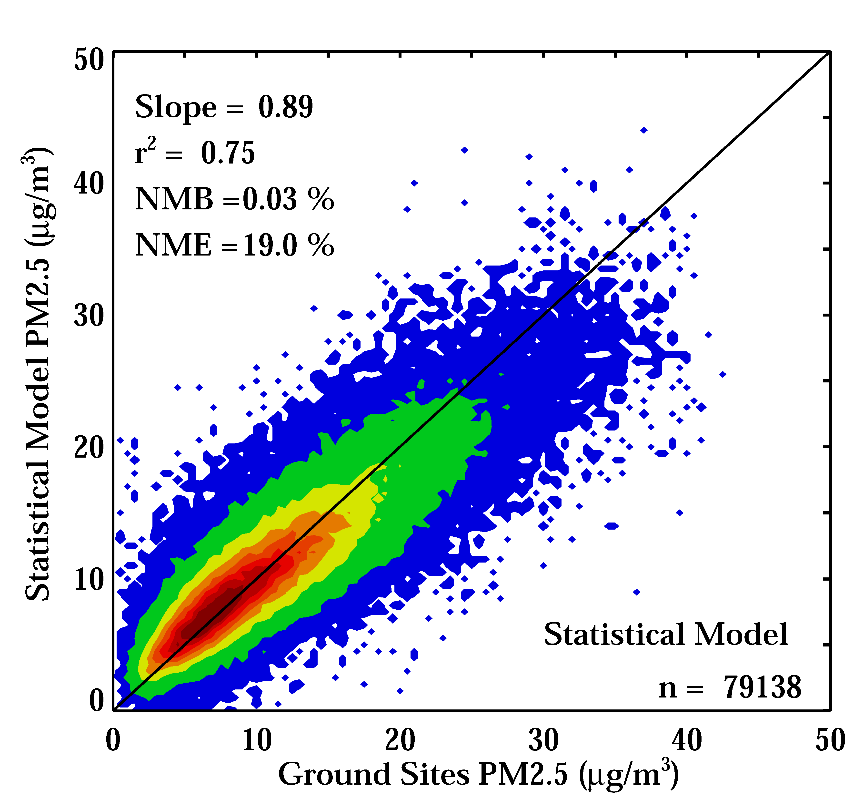
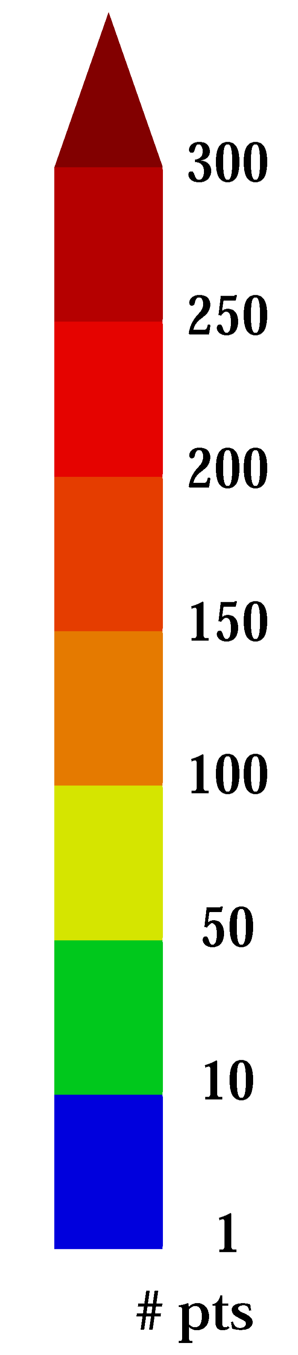
2008 ANNUAL AVERAGED surface PM_{2.5} from our DAILY regression model
10-fold cross validation** of the statistical model
Model estimates daily PM_{2.5} with excellent accuracy and precision. Comparable to other studies such as from Dalhousie, Harvard & Emory.
Same methodology can be applied to other years. 2008 is currently serving as a test-bed.
**10-fold cross-validation: 90% of the observations are used to predict values at the remaining 10% of the monitoring sites. Process is repeated 10 times.

Slide 14
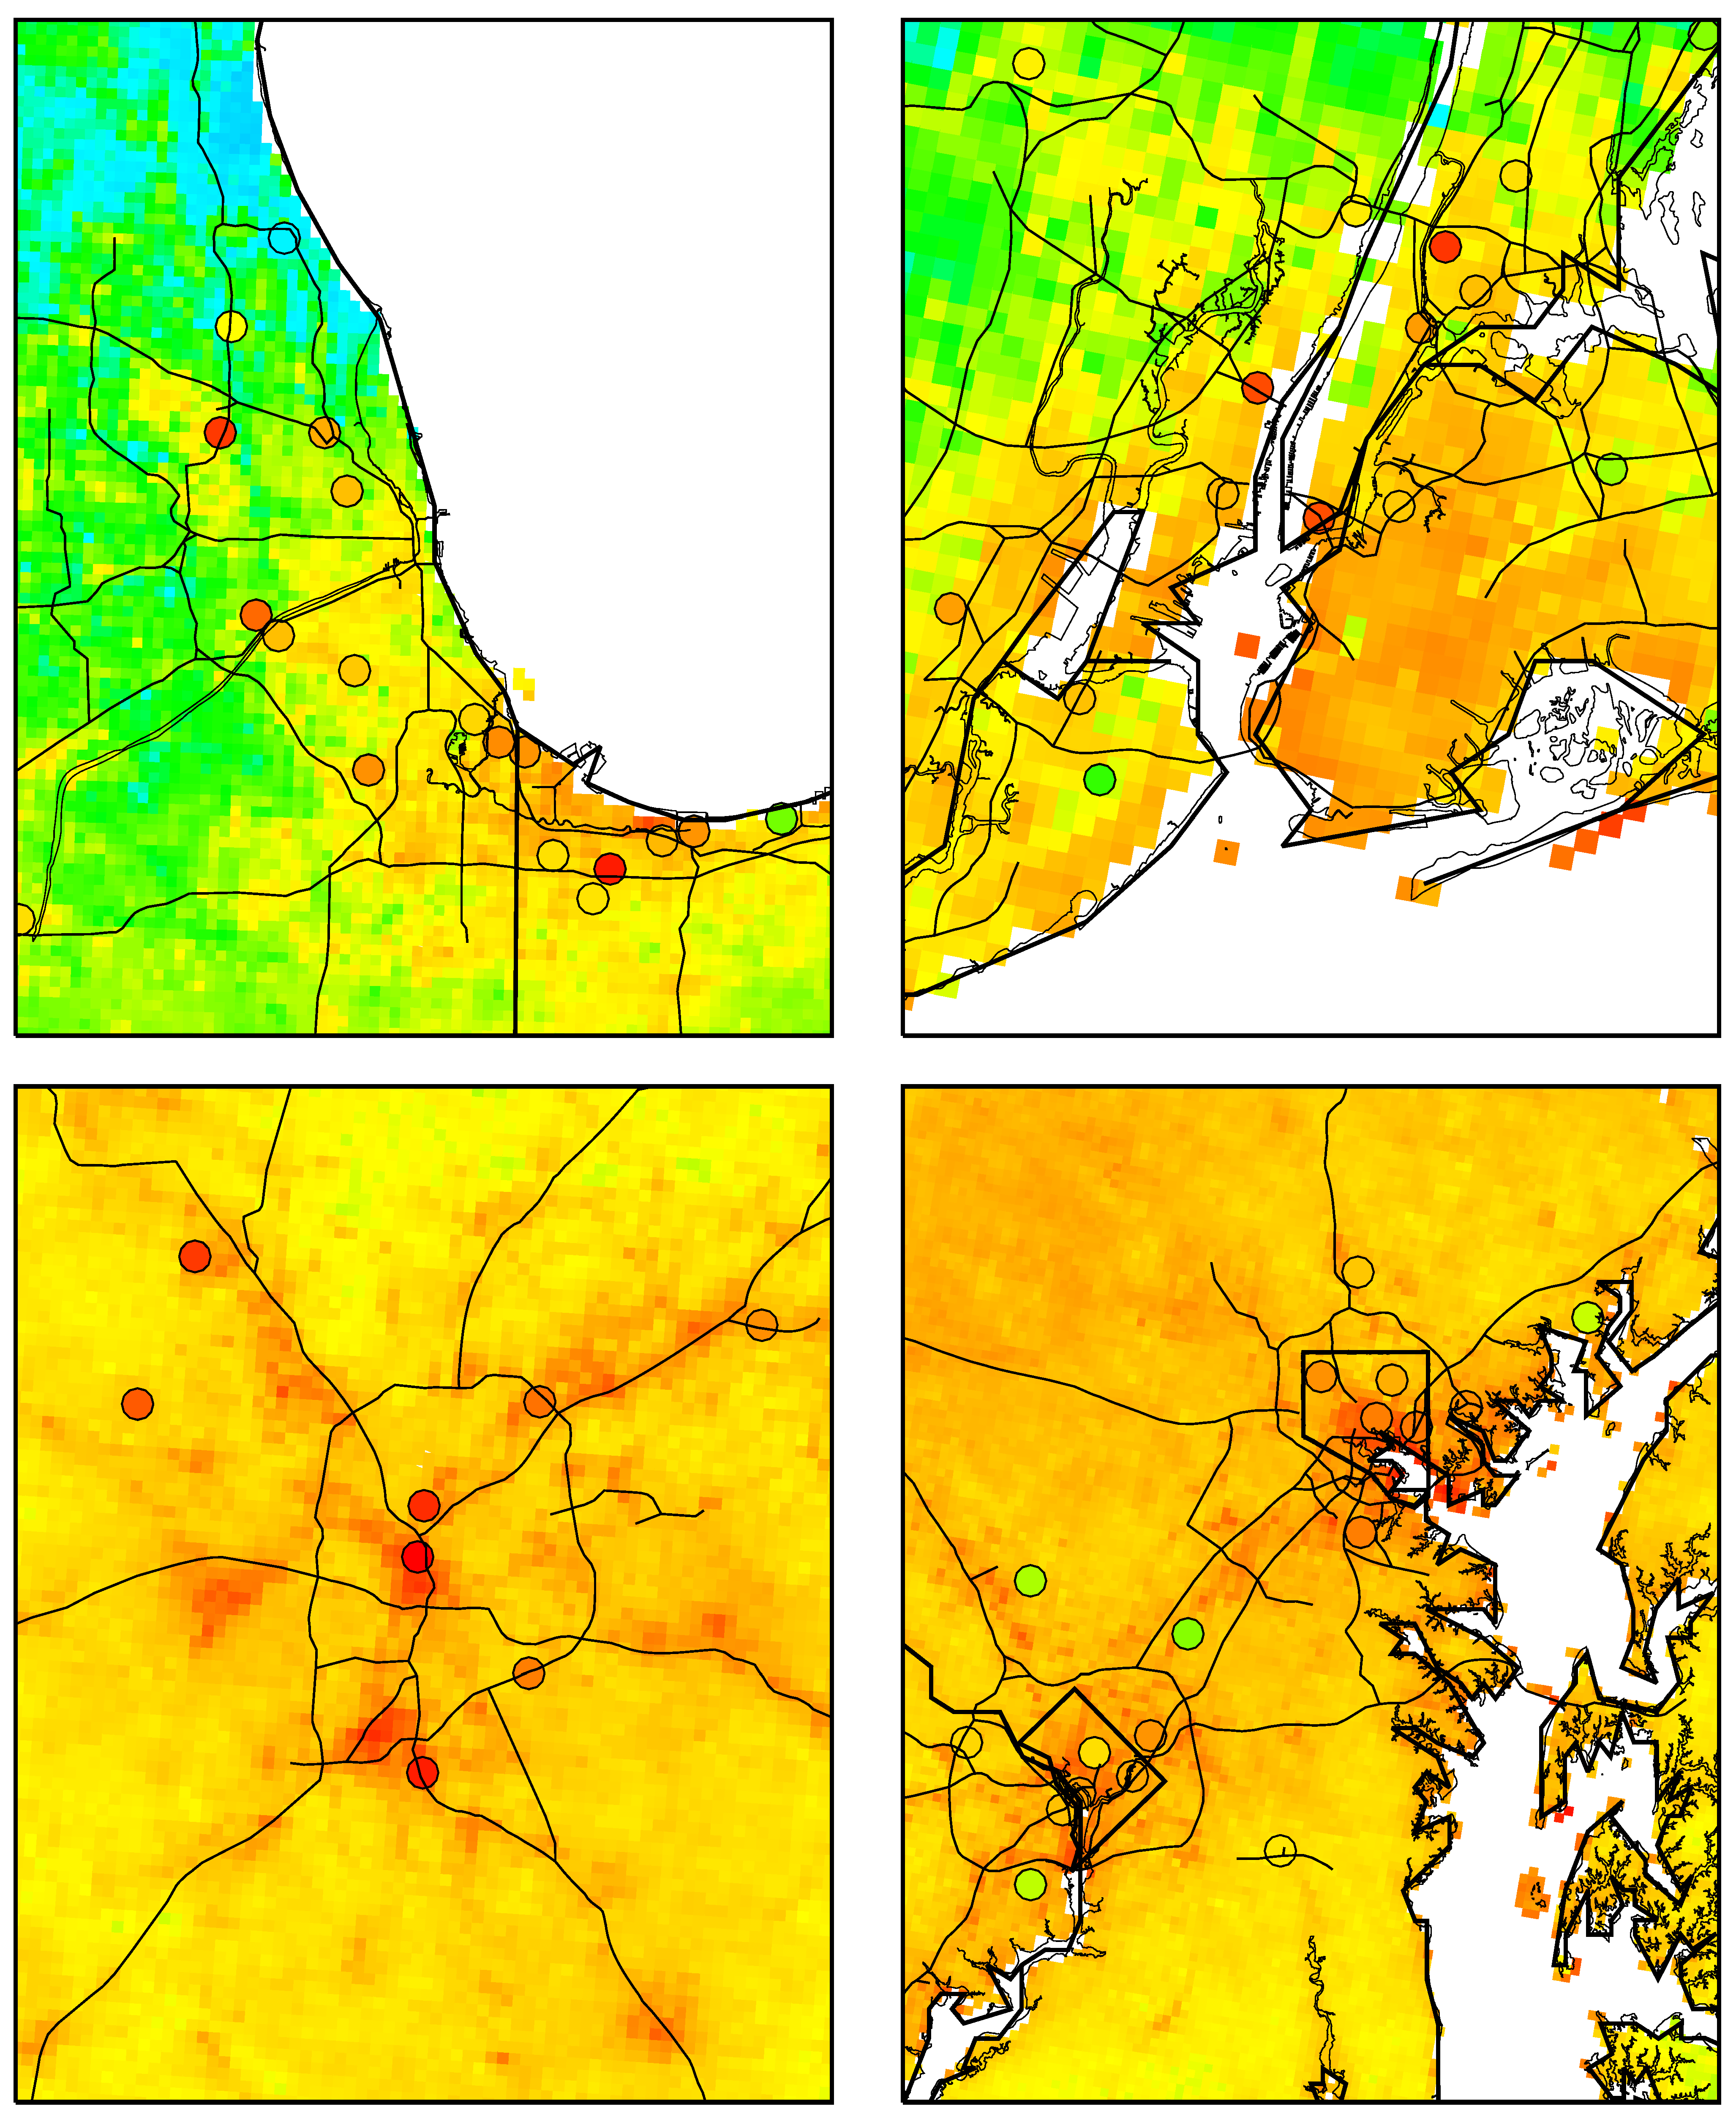
2008 ANNUAL AVERAGED surface PM_{2.5} from our regression model
Chicago
Observations are overlaid. (Note: not an exact comparison because many PM2.5 monitors only measure once every 3 days!)
New York City
Atlanta
Washington, DC

Slide 15
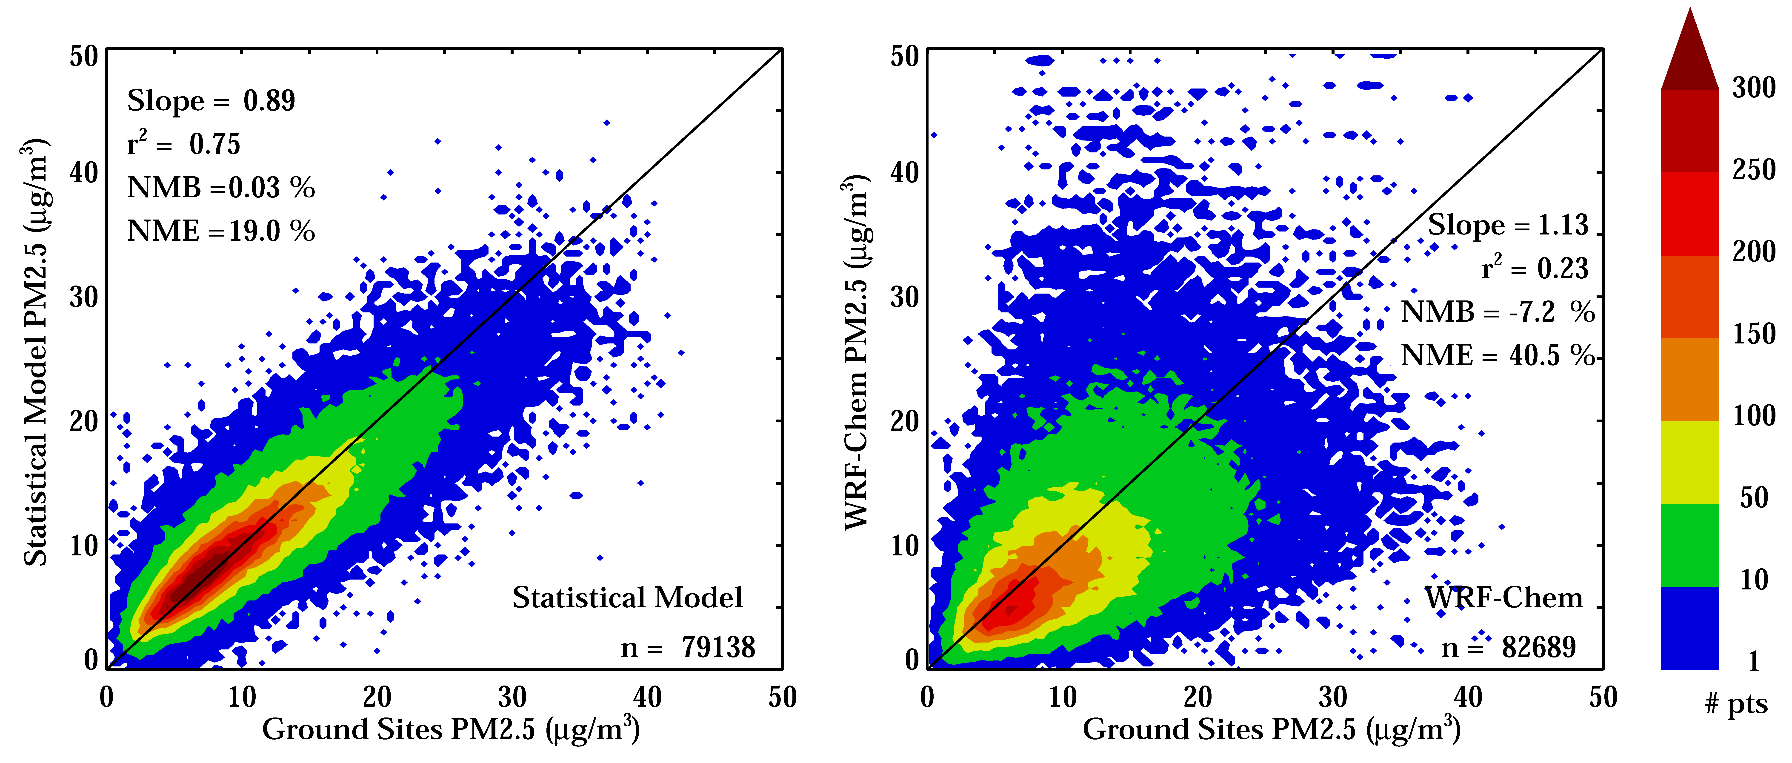
A comparison between our statistical model and WRF-CHEM
Statistical model
WRF-Chem
Small annual mean biases in both models, but the statistical model better captures the day-to-day variability.

Slide 16
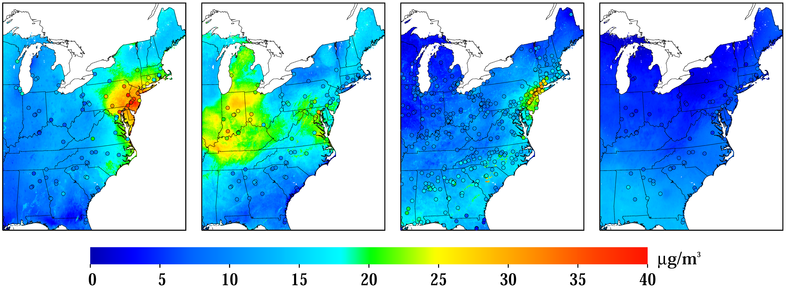
Daily estimates of PM2.5 from our statistical model
January 29th, 2008
February 23rd, 2008
June 23rd, 2008
October 2nd, 2008
Wintertime PM_{2.5} episode in the Northeast U.S.
Wintertime PM_{2.5} episode in the Midwestern U.S.
Wildfires in the Southeastern U.S.
A clean day across most of the U.S.

Slide 17
SKILL of The statistical model
A 10-fold cross-validation of the statistical model with various inputs used. The italicized model is the one used to generate the previous slides.
 | Daily fit
Name of run | R² | Slope | NME
Meteorology-only (Met) | 0.46 | 0.68 | 29.2%
Land-use type (LUT) | 0.41 | 0.66 | 30.5%
WRF-Chem | 0.66 | 0.80 | 22.3%
Met, LUT & WRF-Chem | 0.72 | 0.87 | 20.0%
AOD | 0.52 | 0.77 | 27.3%
AOD, Met, LUT & WRF-Chem | 0.75 | 0.89 | 19.0%
WRF-Chem-PM2.5 | 0.23 | 1.13 | 40.5%

Slide 18
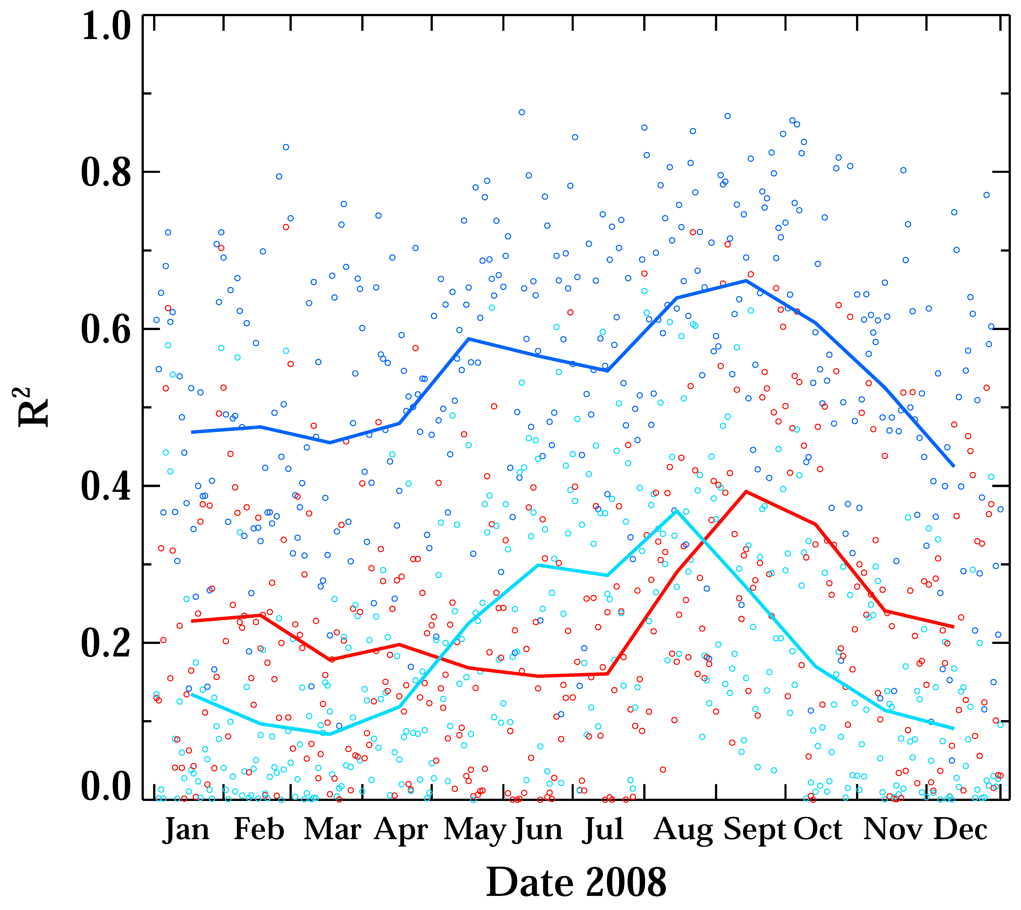
Daily R² values of various models
Dark blue – Full statistical model
Light blue – AOD-only statistical model
Red – WRF-Chem
Lines represent monthly averaged skill

Slide 19
CONCLUSIONS
We estimate daily PM2.5 in the eastern United States constrained by satellite data
  Currently only have 2008, but will have 2008 - 2012 shortly.
The model developed herein generates a high-fidelity estimate (r² = 0.75 using a 10-fold cross-validation) of daily PM_{2.5}.
Very computationally efficient
  Uses only 11 covariates (~2 hours to process 1 year at 1 km resolution on a single CPU)
Using information from a 36 km WRF-Chem simulation is a key contributor to overall performance.
  Coarse resolution models can be very useful!

Slide 20
Thank YOU!
Dan Goldberg, Ph.D.
Email: dgoldberg@anl.gov
Twitter: @DGoldbergAQ

