Slide 1
Preliminary Evaluation of the CMAQ v5.3 Beta Release
K. Wyat Appel, Christian Hogrefe, Kristen Foley, George Pouliot, Robert Gilliam, Benjamin Murphy, Havala Pye, Jesse Bash, Jon Pleim, Sarwar Golam, Shawn Roselle, Rohit Mathur and the CMAQ Development Team
Computational Exposure Division
National Exposure Research Laboratory
Office of Research and Development
U.S. Environmental Protection Agency
23 October 2018
Community Modeling and Analysis System Conference
Chapel Hill, NC

Slide 2
CMAQv5.3β – Release and Major Updates
Release schedule
Beta version released October 2018: https://github.com/USEPA/CMAQ
Final version planned release in June 2019: www.epa.gov/cmaq
Instrumented models – DDM, Sulfur tracking (available w/ final release)
New features
Aerosols
AERO7
Increased monoterpene SOA (Pye et al. 2015 ES&T, Xu et al. 2018 ACP), uptake of water onto hydrophilic organic aerosol (Pye et al. 2017 ACP), and reorganization of anthropogenic SOA (M. Qin)
Gas Chemistry
Minor updates to CB6r3 (ClNO3 reaction added; first-order O₃ depletion)
Full halogen chemistry – included in optional detailed mechanism
Dimethyl sulfide (DMS) chemistry – optional detailed mechanism
Deposition
Updated M3Dry deposition scheme
Surface Tiled Aerosol and Gaseous Exchange (STAGE) deposition scheme added

Slide 3
CMAQ Inputs and Configuration
 | CMAQv5.2.1 | CMAQv5.3β
Boundary Conditions | V5.2.1 Hemispheric CMAQ | V5.3 Hemispheric CMAQ
Chemical Mechanism | CB6r3 | CB6r3
Aerosol Module | AERO6 | AERO7
Deposition scheme | M3Dry | M3Dry; STAGE
Bi-directional Ammonia | No | No
Wind-blown Dust | No | No
Lightning NO | Yes | Yes
All simulations are CONUS annual simulation for 2016
MCIP from the same 2016 WRF simulation used in all simulations
Same 2016 emissions used in all simulations

Slide 4
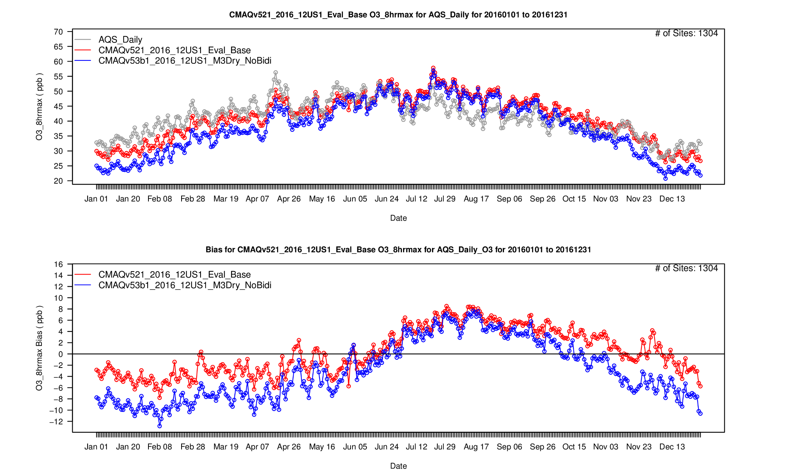
MDA8 O₃ – CMAQv5.2.1 vs v5.3β
AQS
CMAQv5.2.1
CMAQv5.3b M3Dry (No Bidi)
Lower O₃ in CMAQv5.3β due primarily to science updates in dry deposition and boundary conditions
CMAQv5.2.1
CMAQv5.3b M3Dry (No Bidi)

Slide 5
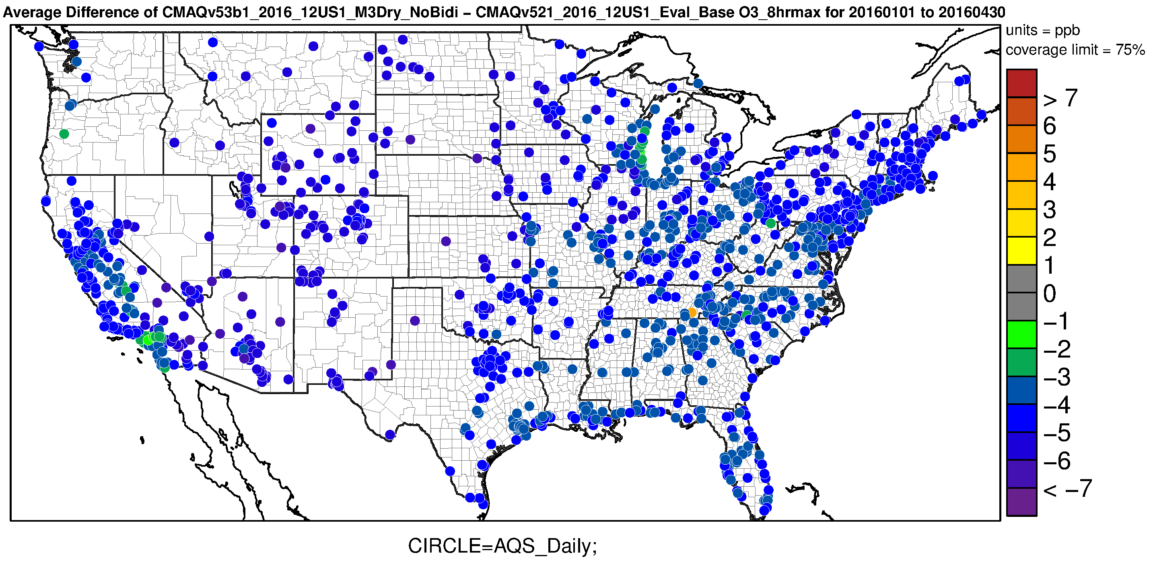
MDA8 O₃ – CMAQv5.2.1 vs v5.3β (Jan- Apr)
O₃ lower across the entire domain in the CMAQv5.3β simulation for January - April

Slide 6
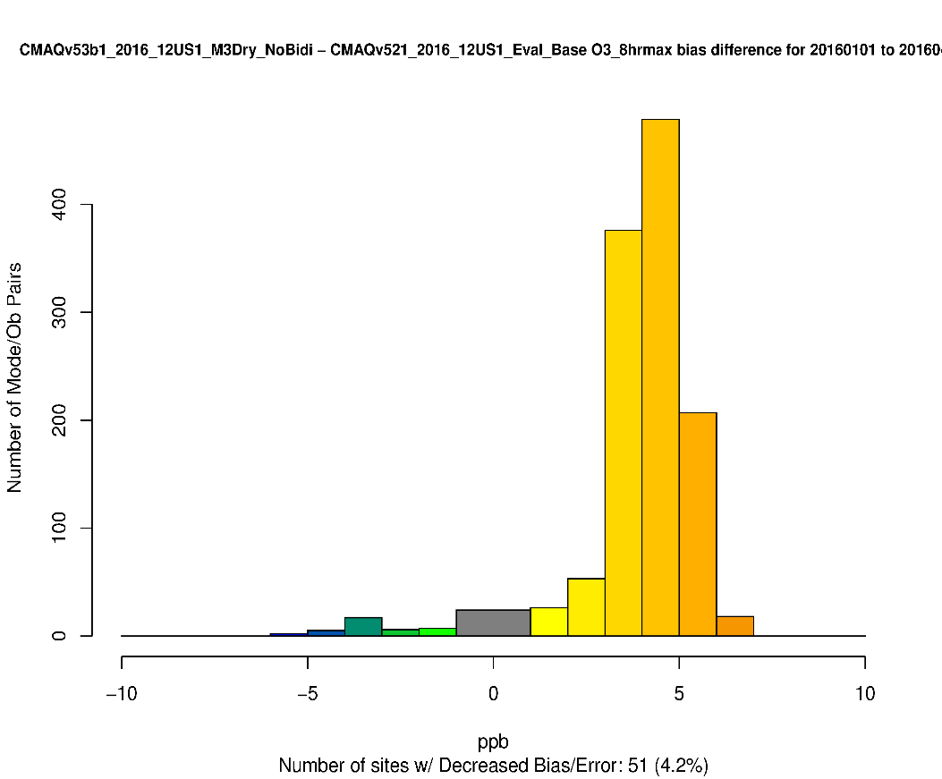
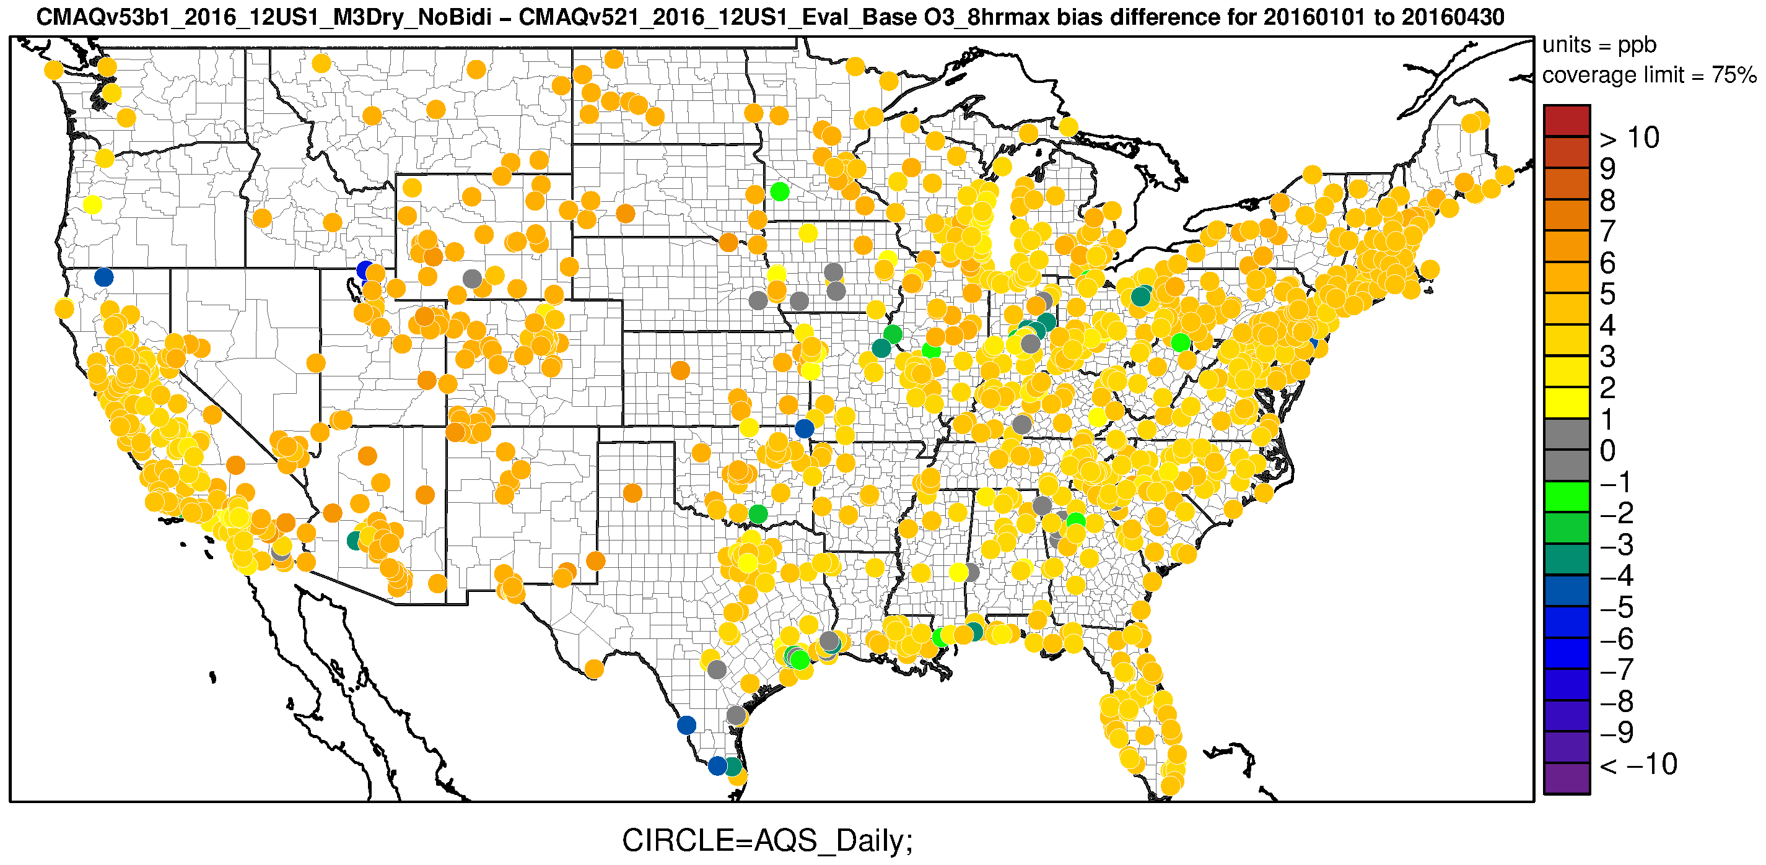
MDA8 O₃ – CMAQv5.2.1 vs v5.3β :
Change in Bias (Jan – Apr)
The decrease in O₃ results in higher bias for almost all sites as CMAQ underestimates MDA8 O₃ in the winter and spring in 2016

Slide 7
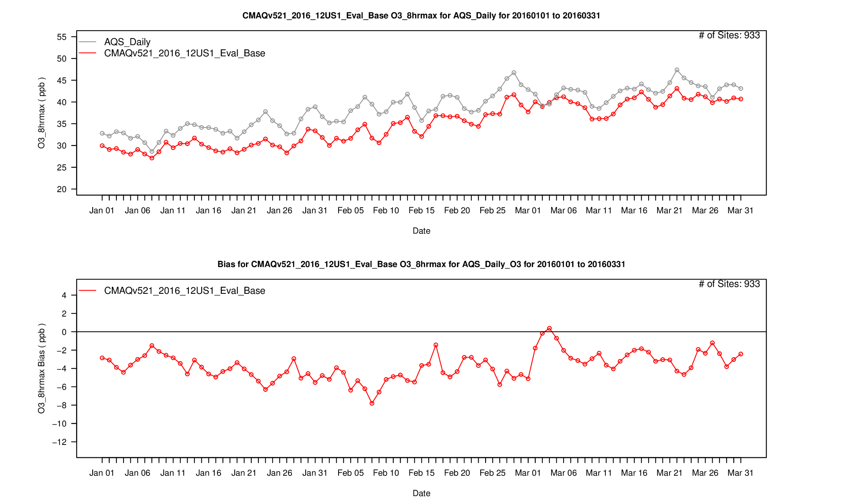
MDA8 O₃ – CMAQv5.2.1
AQS
CMAQv5.2.1
CMAQv5.2.1

Slide 8
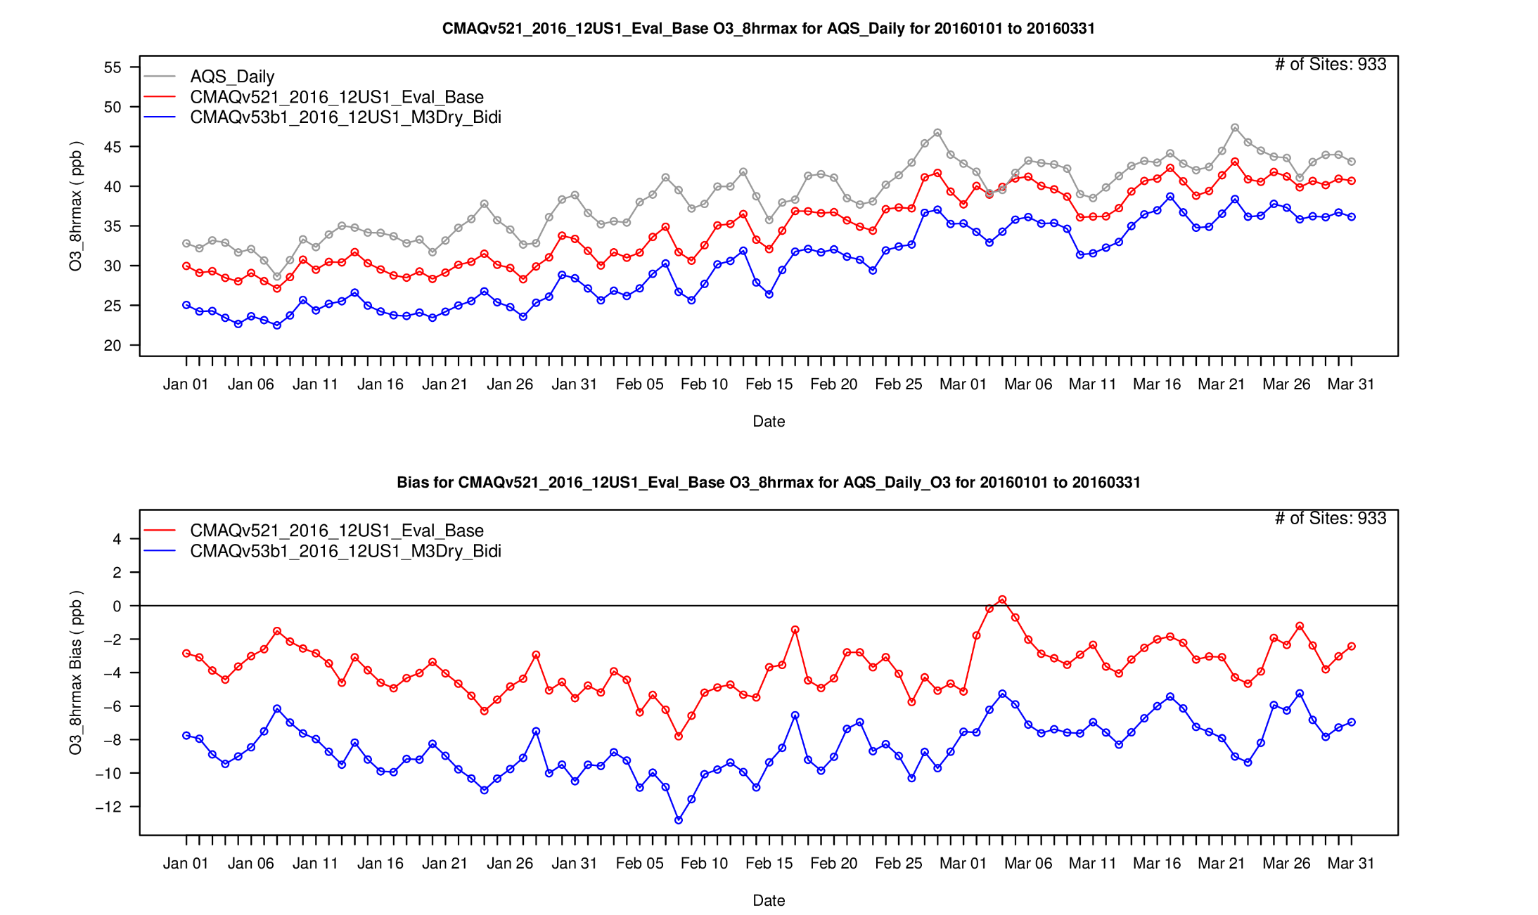
MDA8 O₃ – CMAQv5.3β w/ M3Dry Bidi
AQS
CMAQv5.2.1
CMAQv5.3b M3Dry w/ bidi
CMAQv5.2.1
CMAQv5.3b M3Dry w/ bidi

Slide 9
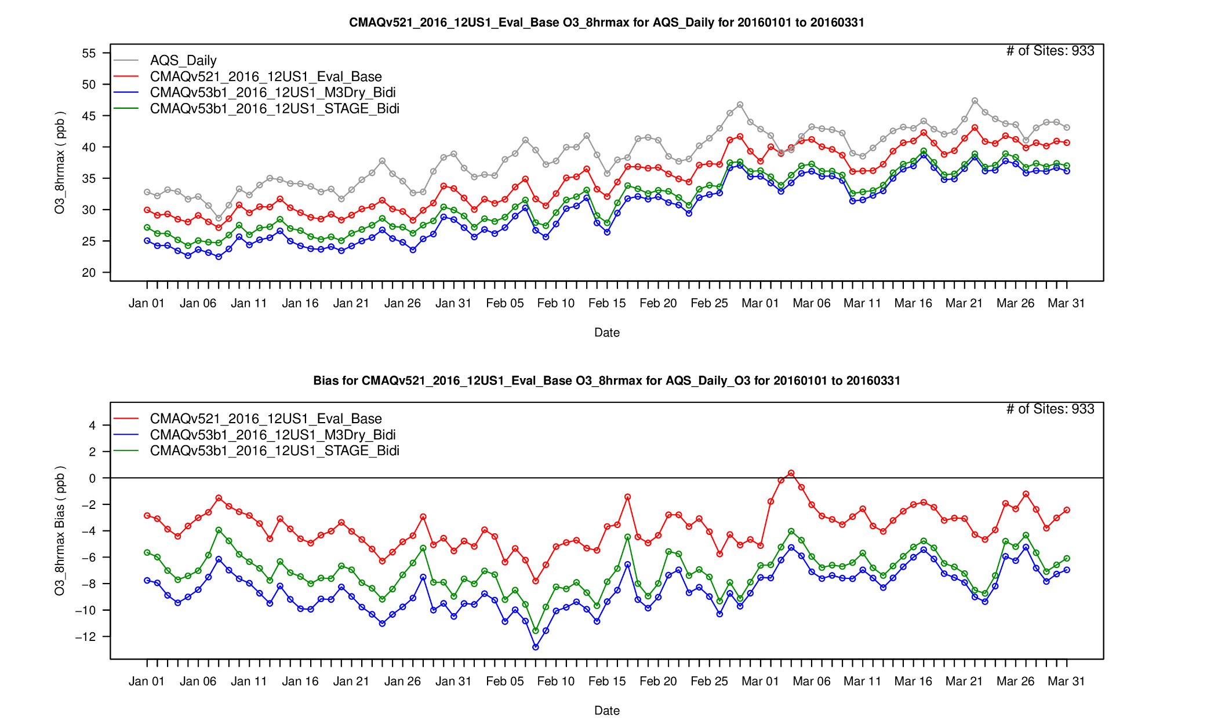
MDA8 O₃ – CMAQv5.3β w/ STAGE Bidi
AQS
CMAQv5.2.1
CMAQv5.3b M3Dry w/ bidi
CMAQv5.3b STAGE w/ bidi
CMAQv5.2.1
CMAQv5.3b M3Dry w/ bidi
CMAQv5.3b STAGE w/ bidi

Slide 10
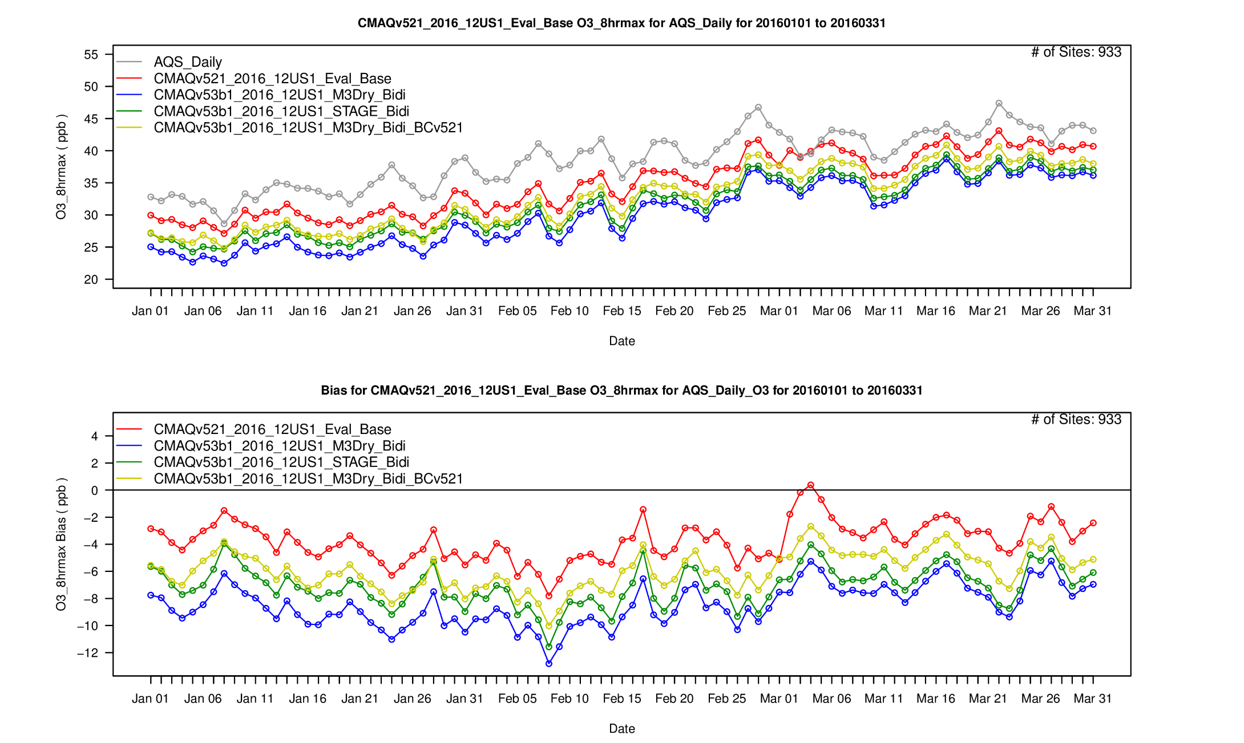
MDA8 O₃ – CMAQv5.3β w/ v5.2.1 BCs
AQS
CMAQv5.2.1
CMAQv5.3b M3Dry w/ bidi
CMAQv5.3b STAGE w/ bidi
CMAQv5.3b M3Dry w/ bid and v5.2.1 BCs
CMAQv5.2.1
CMAQv5.3b M3Dry w/ bidi
CMAQv5.3b STAGE w/ bidi
CMAQv5.3b M3Dry w/ bid and v5.2.1 BCs

Slide 11
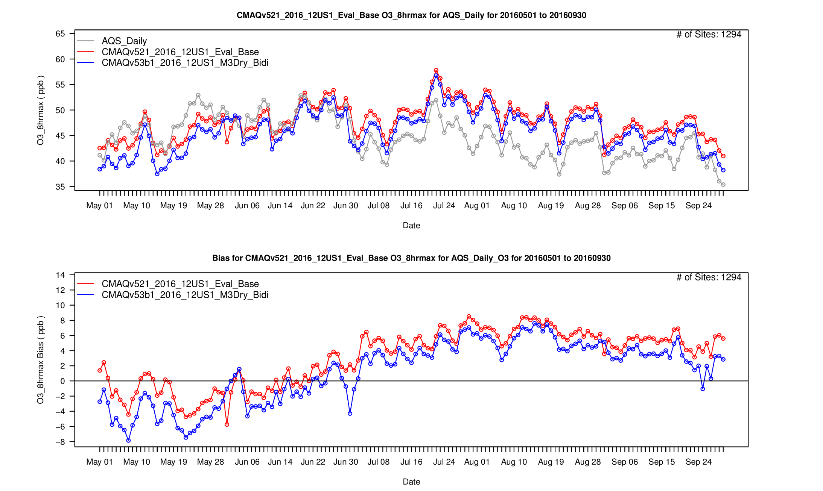
MDA8 O₃ – CMAQv5.2.1 vs v5.3β (May – Sep)

Slide 12
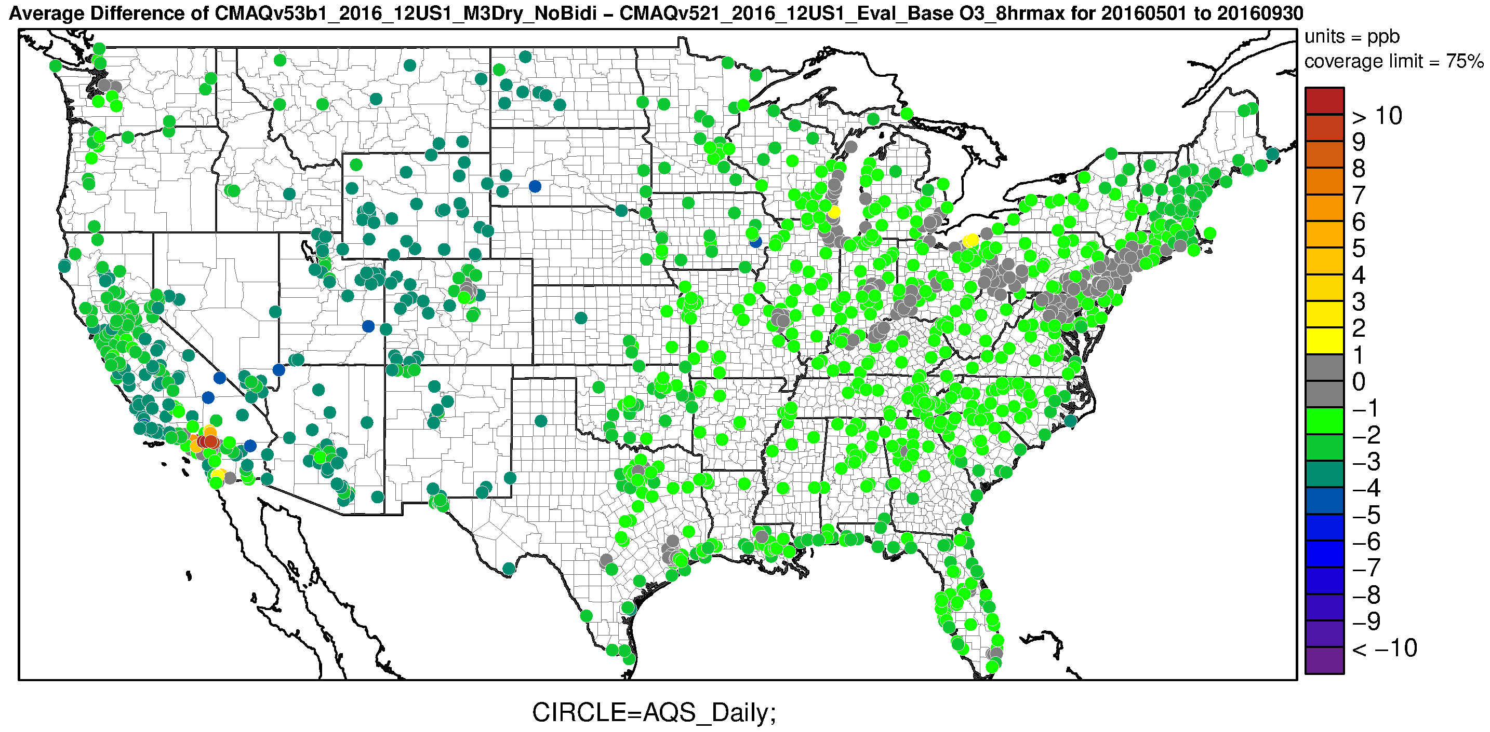
MDA8 O₃ – CMAQv5.2.1 vs v5.3β (May - Sep)
O₃ lower across most of the domain in the CMAQv5.3β simulation for May - September

Slide 13
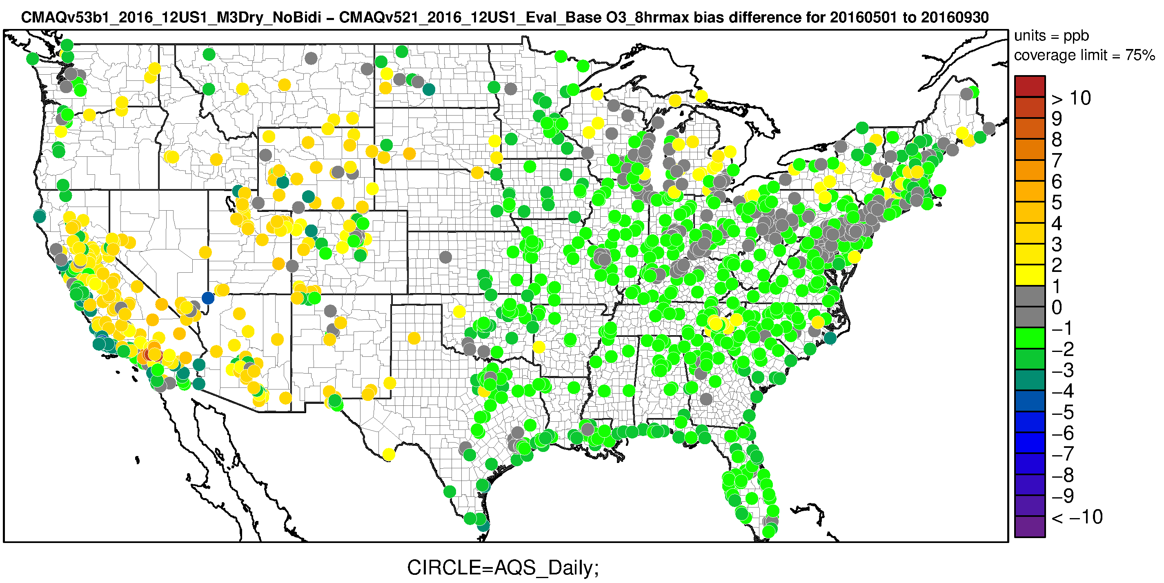
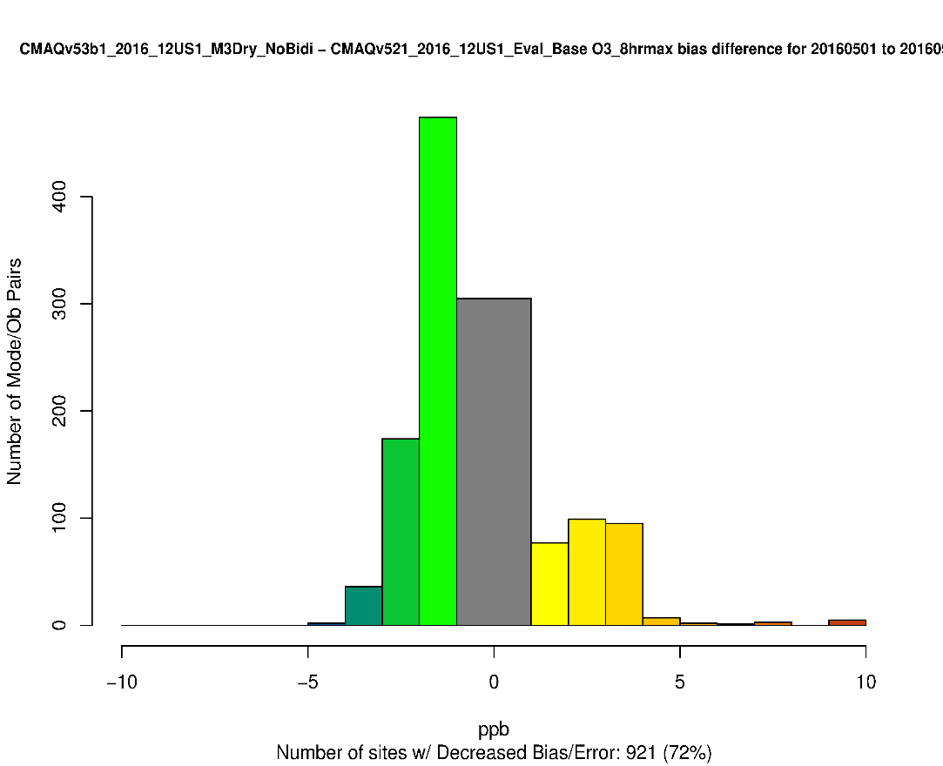
MDA8 O₃ – CMAQv5.2.1 vs v5.3β :
Change in Bias (May – Sep)
The lower O₃ in the CMAQv5.3β simulation results in generally lower bias in the eastern U.S. and higher bias in much of the western U.S. in the summer

Slide 14
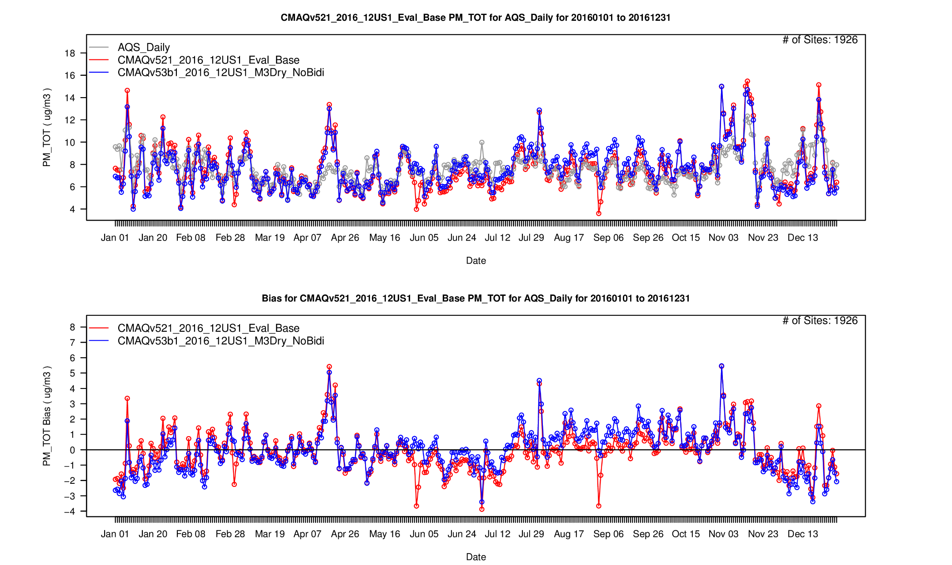
PM_{2.5} – CMAQv5.2.1 vs v5.3β
Higher PM_{2.5} in CMAQv5.3β primarily due increased SOA in AERO7

Slide 15
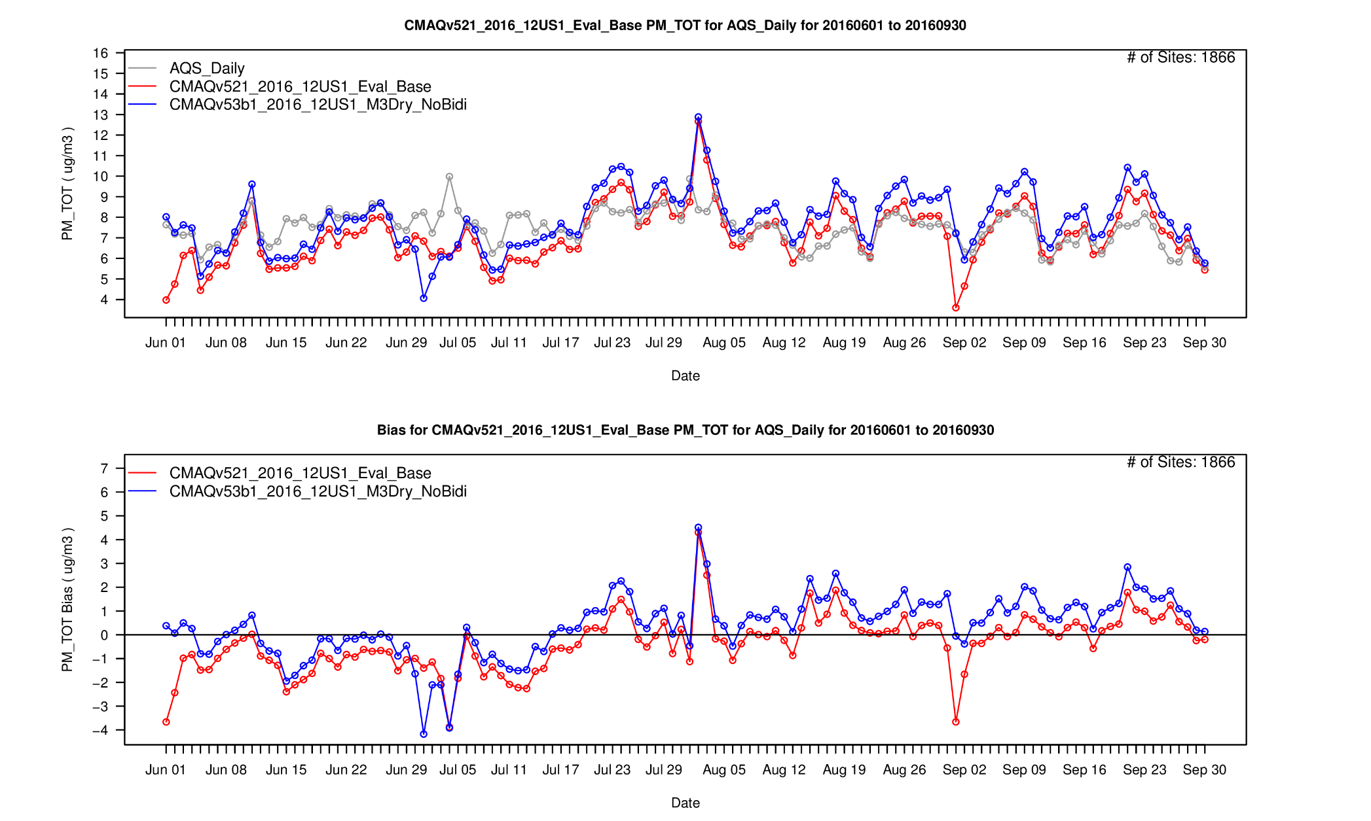
PM_{2.5} – CMAQv5.2.1 vs v5.3β (Jun – Sep)
Consistently higher PM_{2.5} in the summer w/ CMAQv5.3β

Slide 16
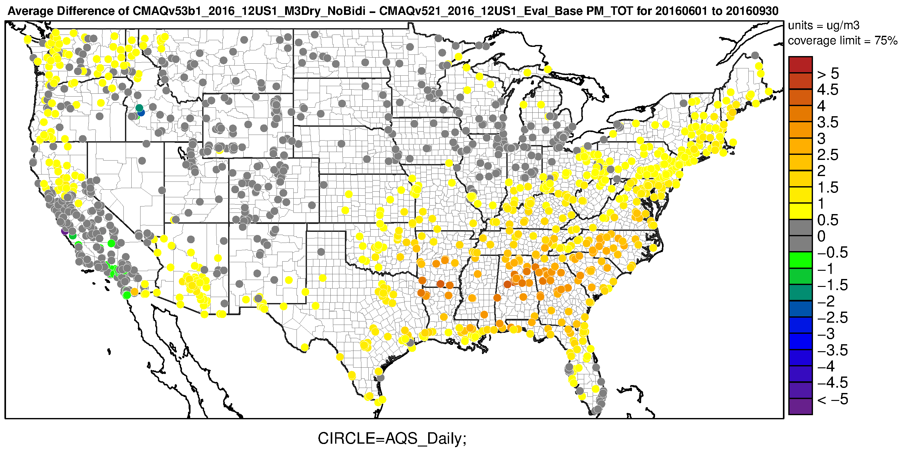
PM_{2.5} – CMAQv5.2.1 vs v5.3β (Jun – Sep)

Slide 17
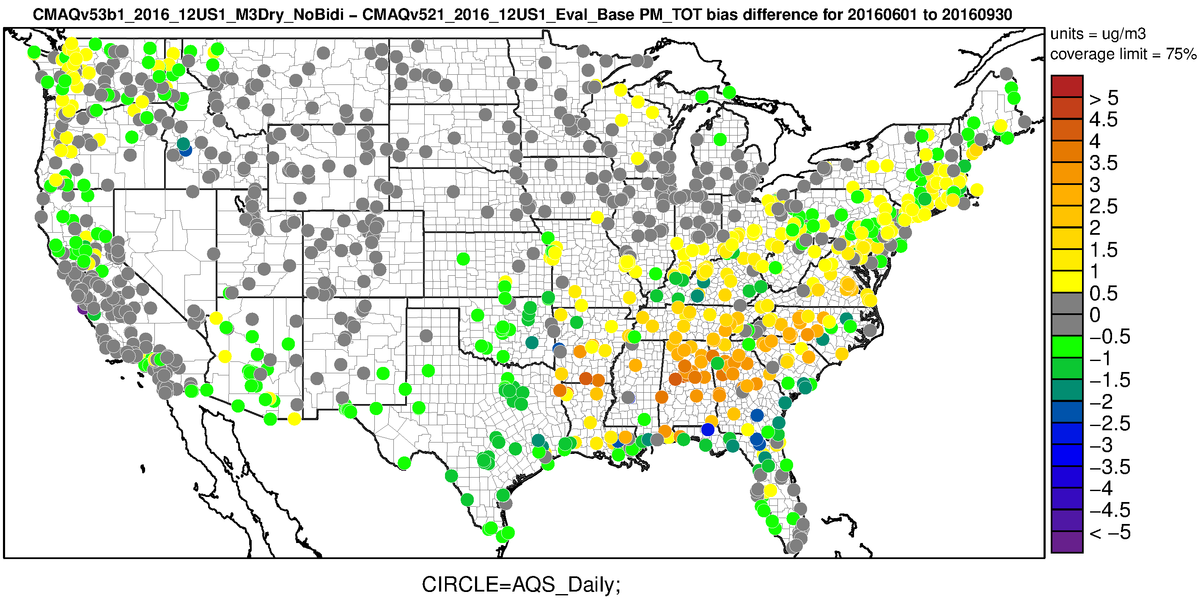
PM_{2.5} – CMAQv5.2.1 vs v5.3β (Jun – Sep):
Change in bias

Slide 18
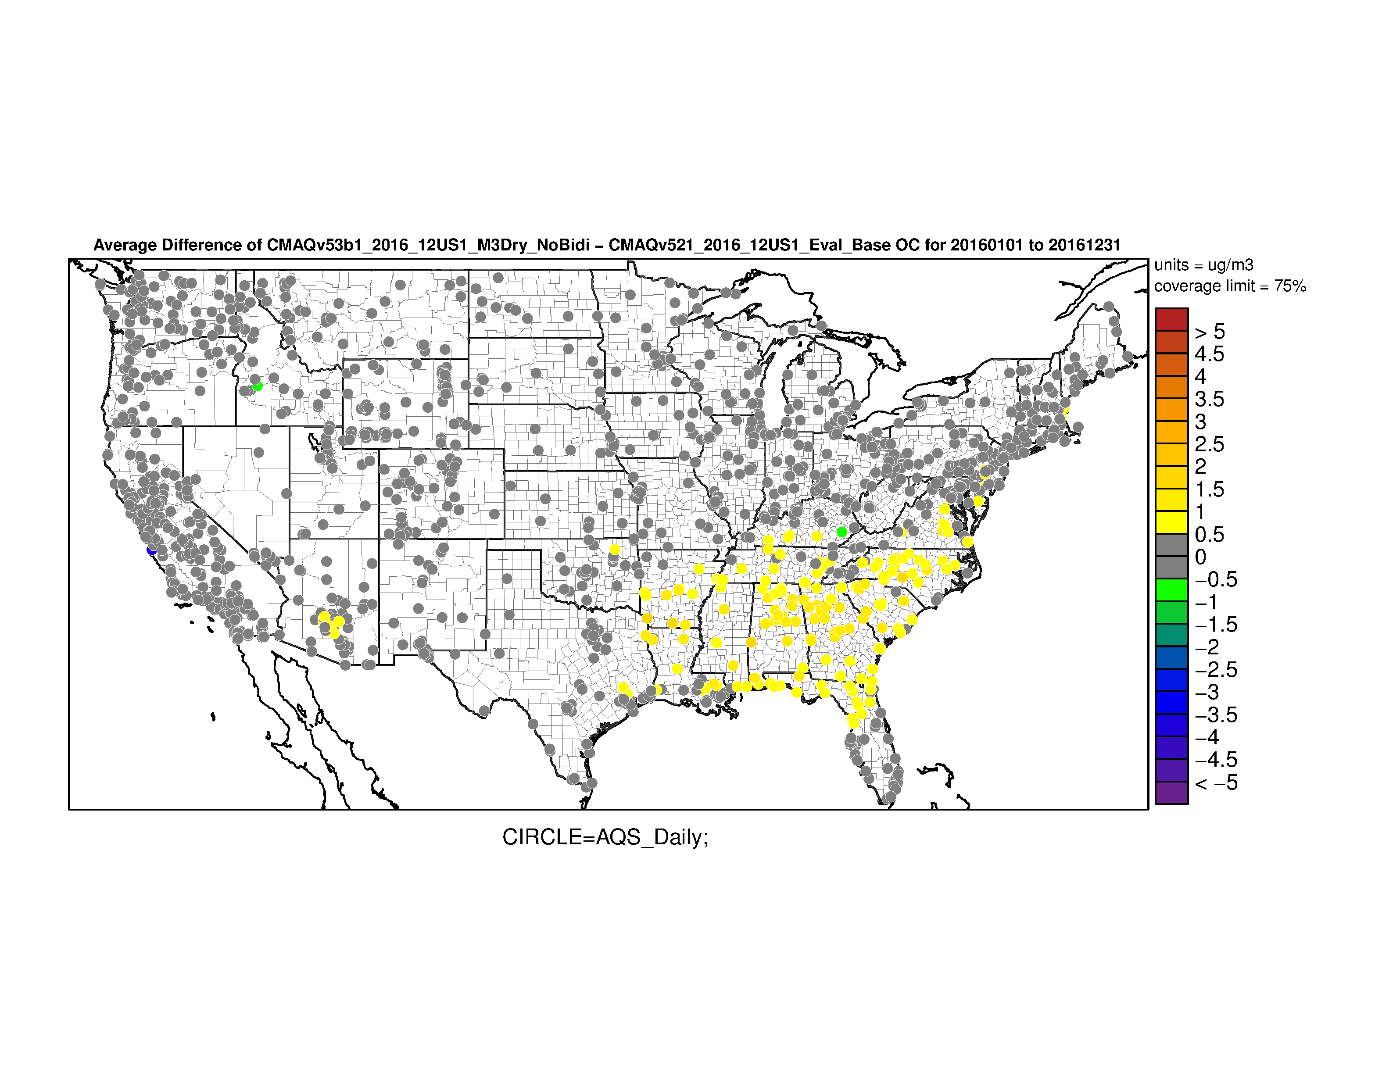
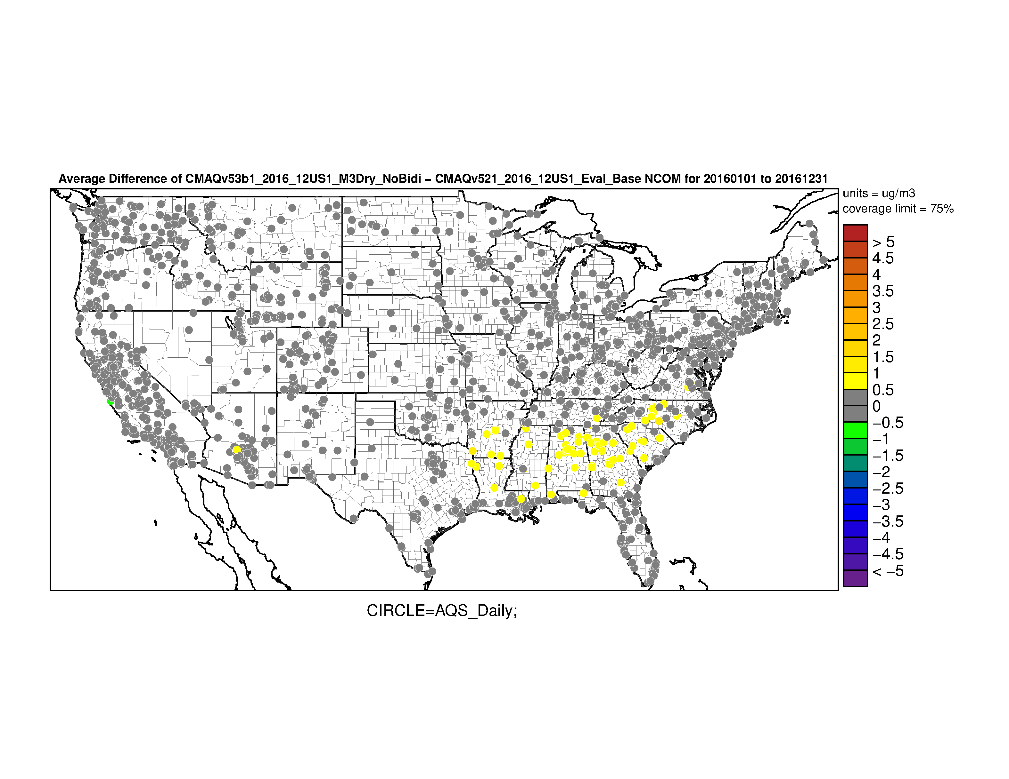
CMAQv5.2.1 vs v5.3β (Jun – Sep)
Organic Carbon
Non-Carbon Organic Matter

Slide 19
PM_{2.5} – M3Dry Bidi vs No Bidi (Seasonal):
Change in Bias
Winter
Spring
Summer
Fall

Slide 20
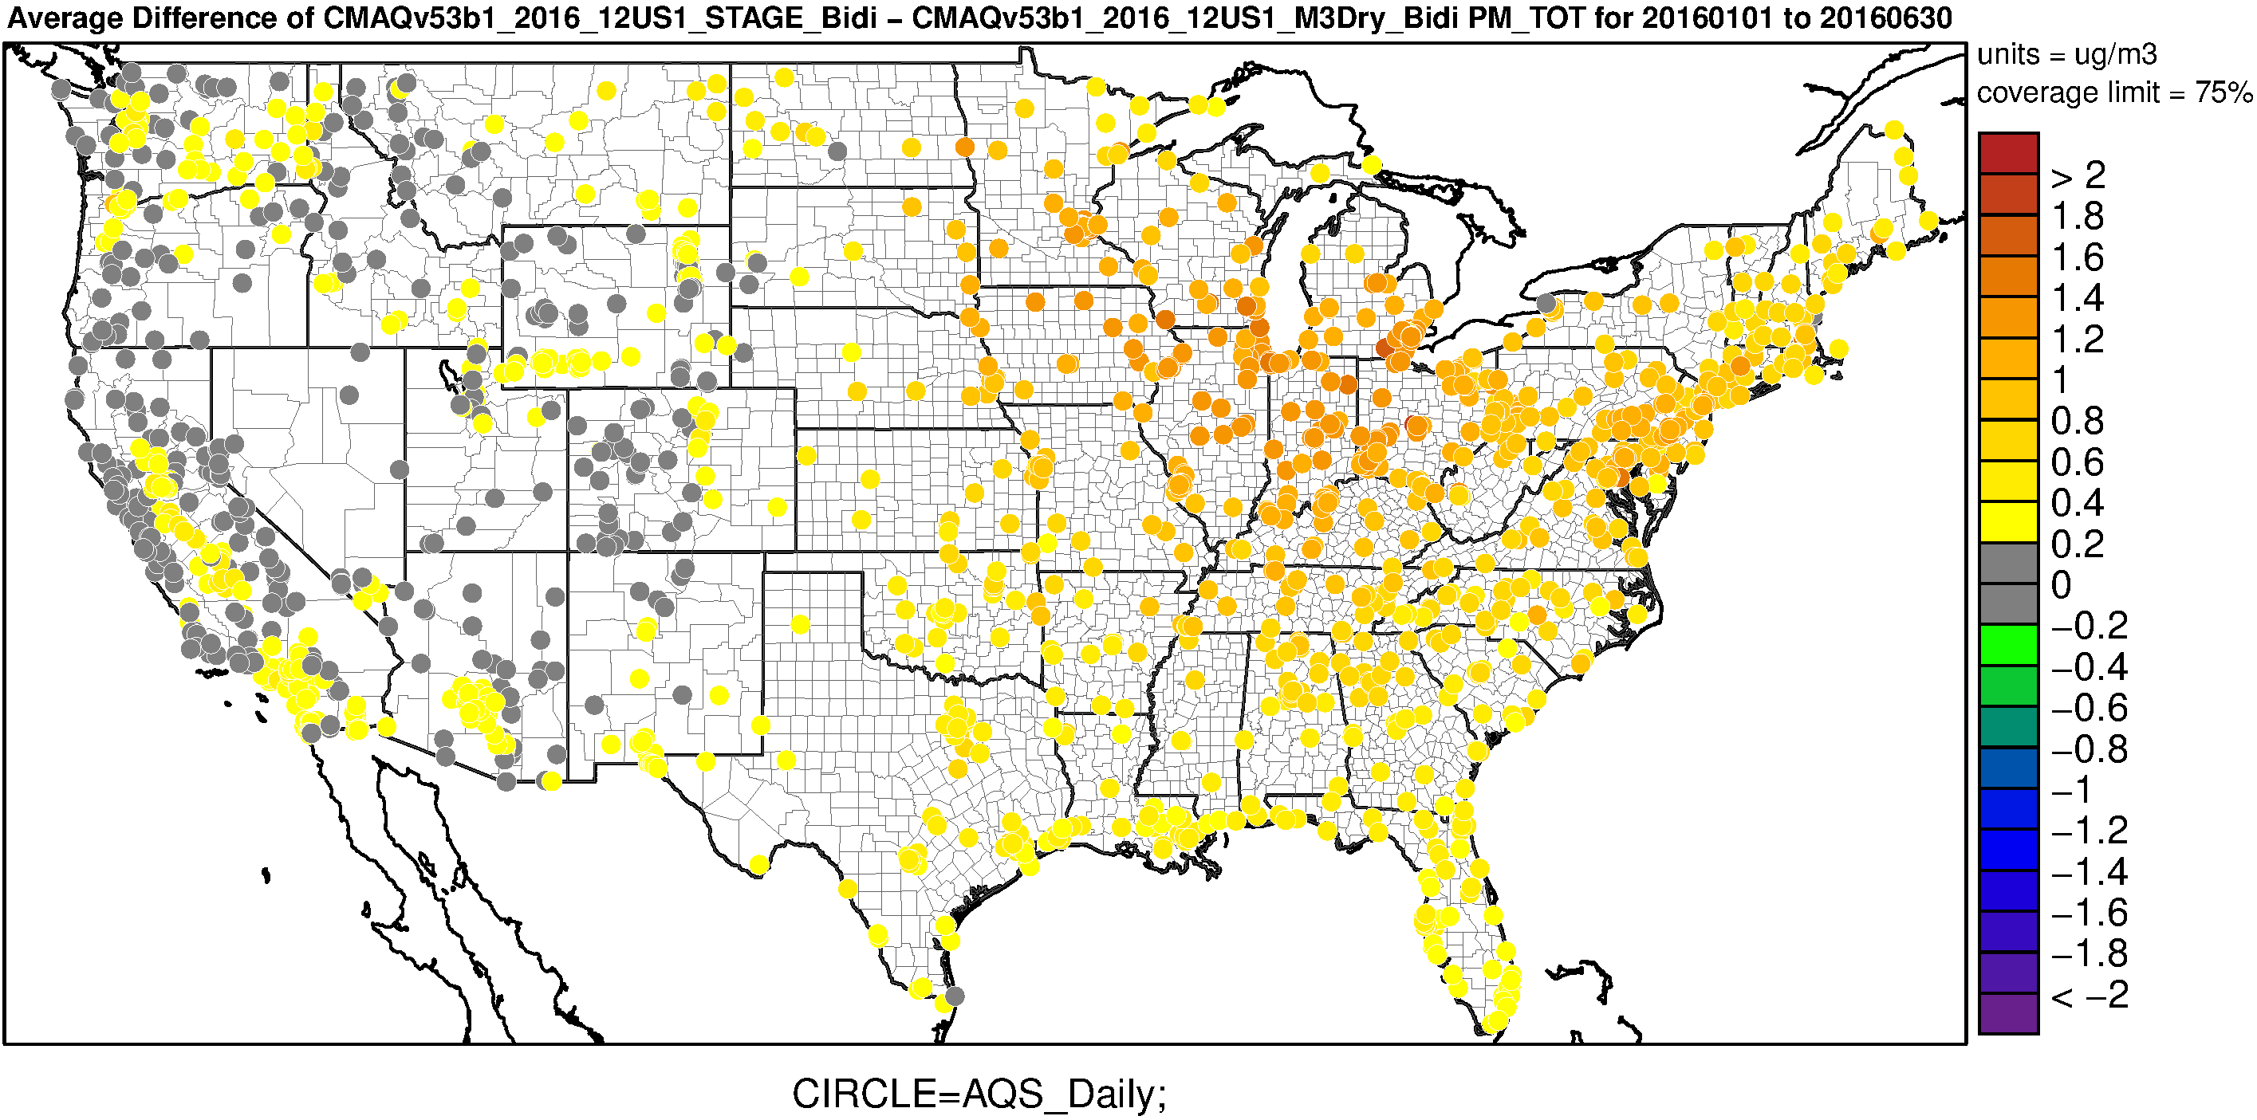
PM_{2.5} – v5.3β STAGE Bidi vs M3Dry Bidi (Jan-Jun)
STAGE bidi results in moderately higher total PM_{2.5} versus M3Dry bidi for January - June

Slide 21
Summary
Ozone
Lower O₃ with CMAQv5.3β
due primarily to changes in the representation of dry deposition in v5.3β
both M3Dry and STAGE reduce O₃
reduction in O₃ greater with M3Dry than STAGE
updates in M3Dry O₃ deposition to snow planned before final release of v5.3 to improve wintertime O₃
BCs created using v5.3β (M3Dry) hemispheric CMAQ simulation contribute to lower O₃ (vs BCs using v5.2.1)
largest in the winter and fall
Perform hemispheric CMAQ simulation with STAGE to provide BCs to regional CMAQ simulation
provide consistent deposition scheme
expect improve performance in cooler months
Total PM_{2.5}
Higher PM_{2.5} in the summer w/ CMAQv5.3β
result of increased SOA production with AERO7
Similar PM_{2.5} outside of the summer with AERO7
M3Dry has a mixed effect on total PM_{2.5}
largest impact in the southeastern U.S. and the San Joaquin Valley in California
Results of new STAGE deposition scheme will be presented by Jesse Bash (Wed 9:10am, Dogwood Room)

Slide 22
Acknowledgements and Disclaimer
CMAQ Development Team and Others
Jesse Bash
Kathleen Fahey
Bill Hutzell
Deborah Luecken
Benjamin Murphy
Jon Pleim
Havala Pye
Limei Ran
Golam Sarwar
Donna Schwede
David Wong
Robert Gilliam (Meteorology)
George Pouliot (Emissions)
Chris Nolte (Code integration)
The views expressed in this presentation are those of the authors and do not necessarily reflect the views or policies of the U.S. Environmental Protection Agency.

Slide 23
Extra Slides

Slide 24
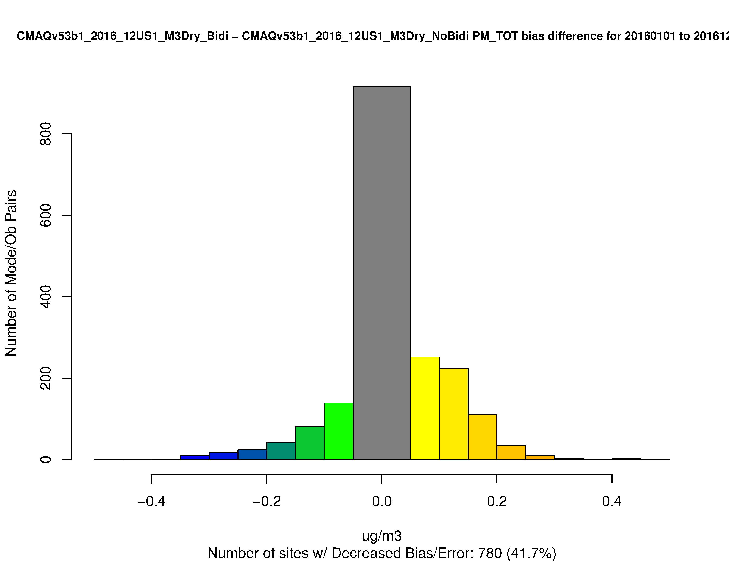
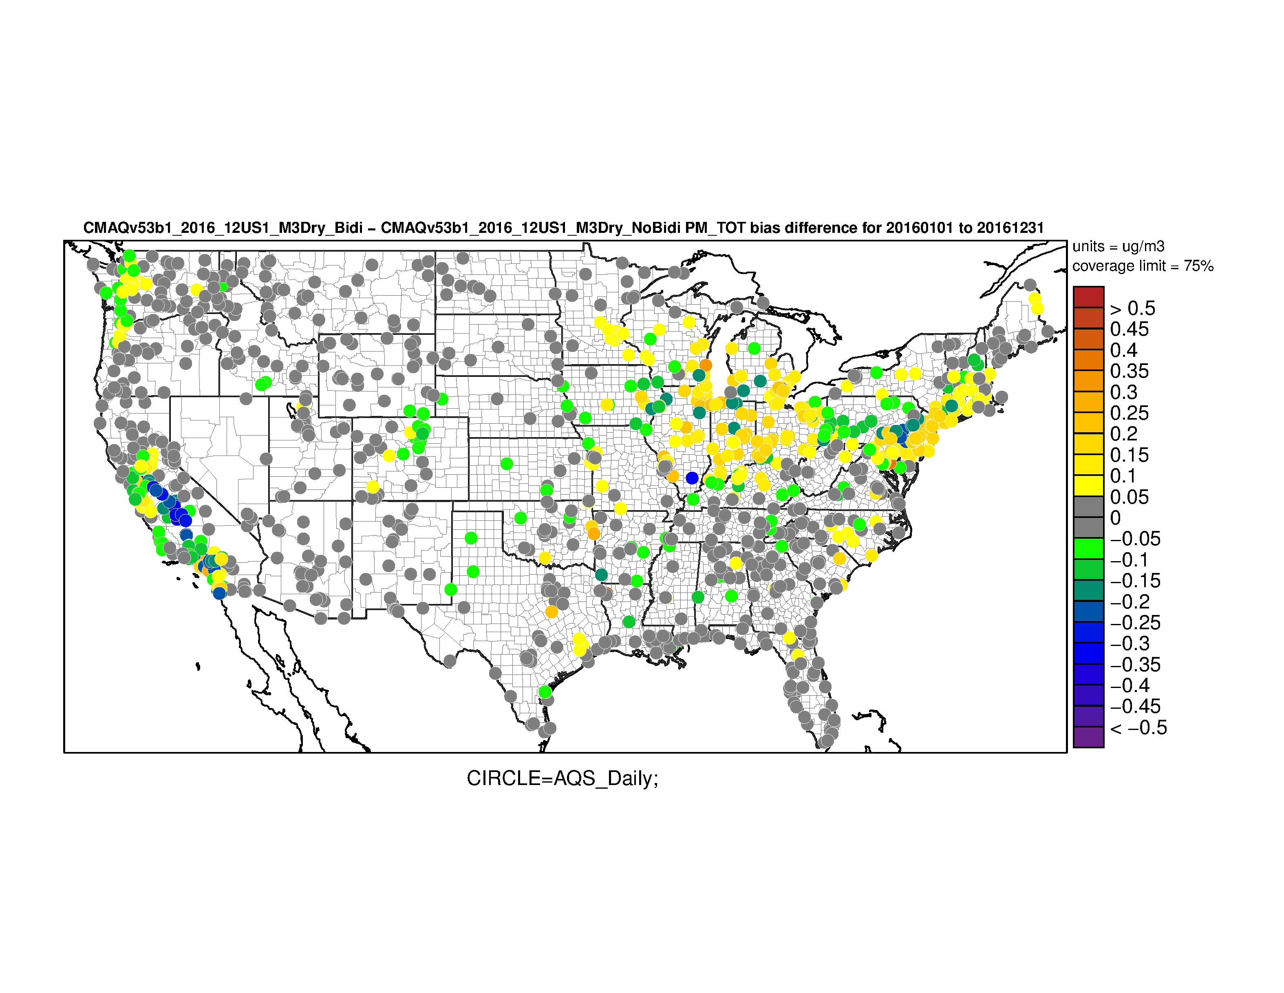
PM_{2.5} – M3Dry Bidi vs No Bidi (Annual):
Change in Bias

