Slide 1
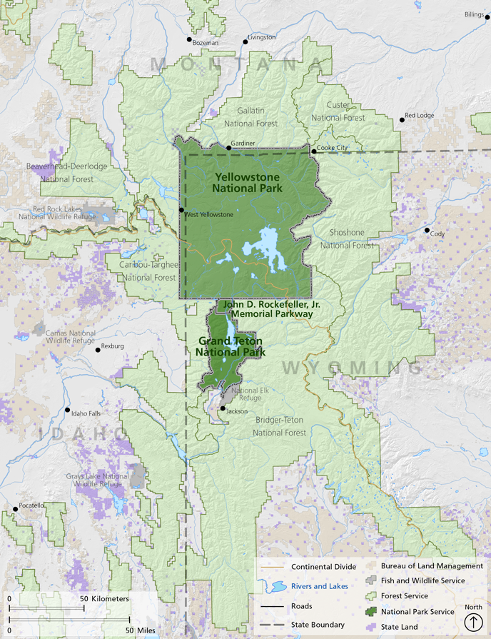
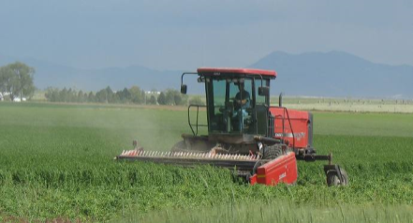
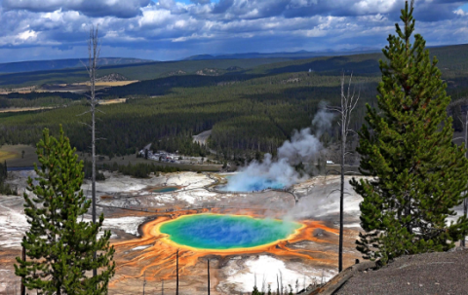
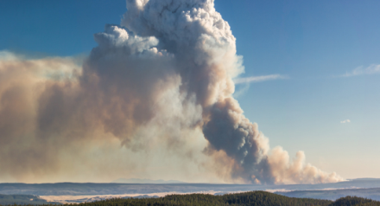
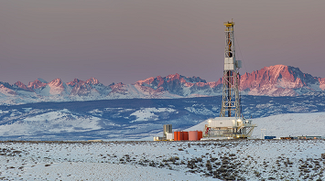
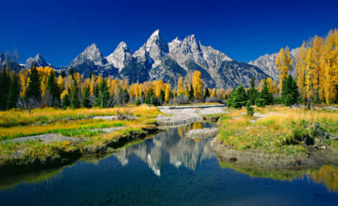
Source apportionment of reactive nitrogen deposition
in the Greater Yellowstone Area using CAMx-PSAT
Rui Zhang¹, Tammy Thompson², Michael Barna³, and Bret Schichtel³
¹ Colorado State University; ² American Association for the Advancement of Science; ³ National Park Service

Slide 2
Backgrounds and motivations
Total reactive nitrogen (Nr) is a mix of oxidized and reduced inorganic nitrogen (N) and organic N compounds and are deposited through dry and wet processes
Increasing importance of reduced N to total nitrogen budget due to the emission deduction from anthropogenic NOx
Excess N deposition can impose adverse impacts on aquatic and terrestrial ecosystems , causing eutrophication and acidification and decreasing of biodiversity
The current annual N deposition at Greater Yellowstone Area (GYA) is at the level of 2.5-4 kg N/ha, which exceeds the critical loads (CL) estimates for some alpine ecosystems
To quantify the composition, levels and origin of reactive N deposition in Grand Teton Region, the Grand Teton Reactive N Deposition Study (GrandTReNDS) was conducted during Apr-Sep 2011 @ 3 core sites
Detail source contribution to N deposition over GYA area is need through modeling study

Slide 3
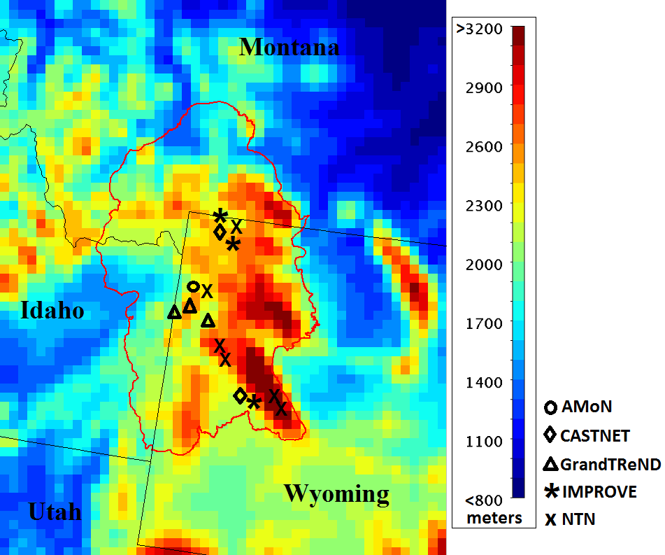
Nitrogen deposition measurement network in GYA
NTN: National Trend Network
AMoN: Ammonia Monitoring Network

Slide 4
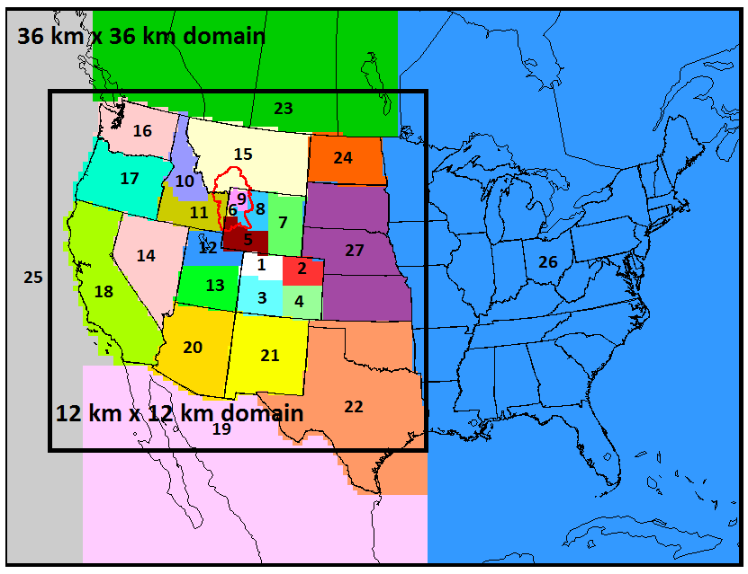
WRF-SMOKE-CAMx simulation platform
36km / 12km Domains focused on the Western US
2011 National Emissions Inventory with Improvements
Oil and Gas
Agriculture
Weather Research and Forecasting (WRF) 2011 met modeling by IWDW for Western US
MOZART BCs
Comprehensive Air Quality Model with Extensions (CAMx) V6.10
Fully Evaluated by IWDW

Slide 5
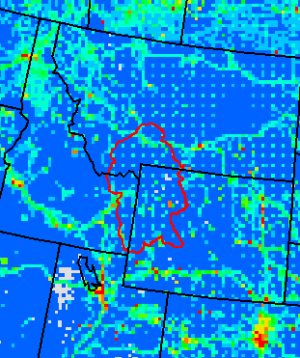
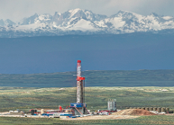
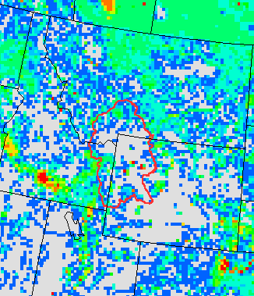
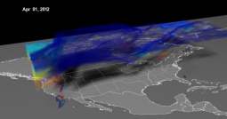
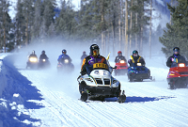
Source apportionment setting in PSAT
NOx annual emission in GYA
From Each Region, Trace Source Sectors Individually in PSAT:
Agriculture
(Snake River Valley)
Oil&Gas
(Green River Basin)
Fire activities
4. Model domain
boundaries
5. Others
(anthropogenic)
NH3 annual emission in GYA

Slide 6
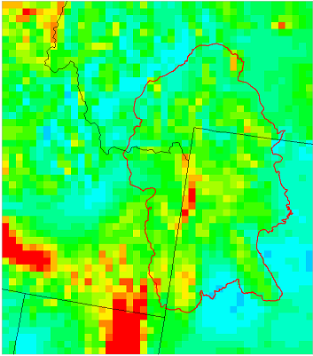
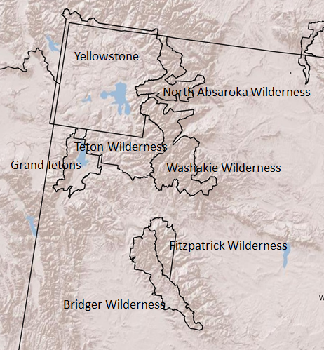
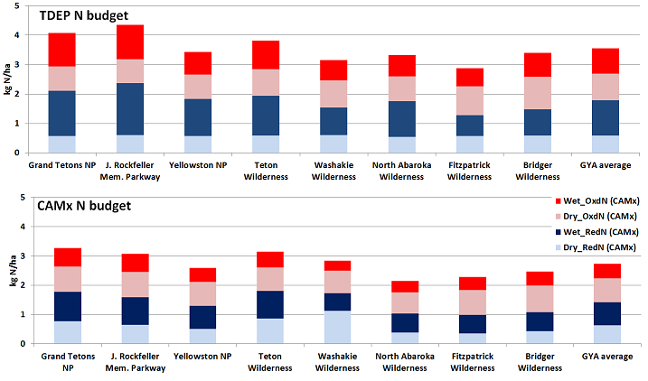
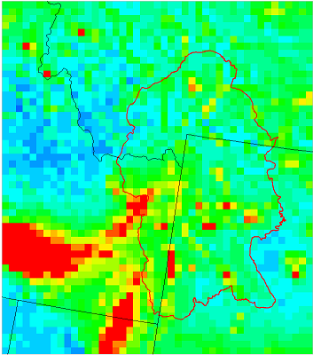
Total N deposition spatial pattern compared w/ TDep Map
Tdep map
CAMx

Slide 7
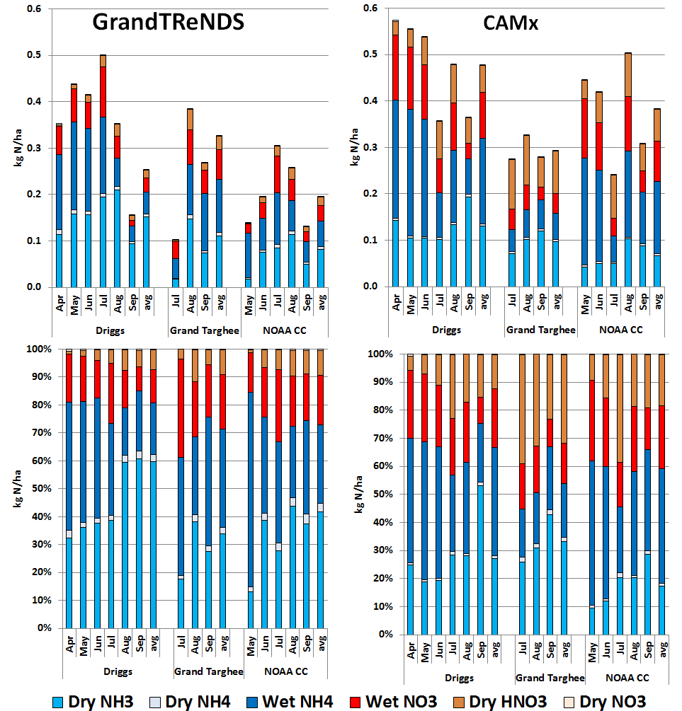
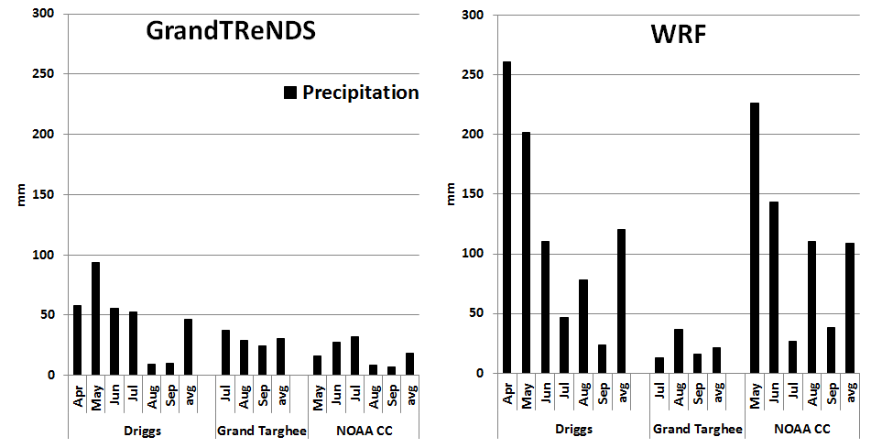
Inorganic nitrogen deposition budget @ GrandTReNDS
deposition of reduced nitrogen is critical at the 3 sites
model can replicate the measured fraction of reduced versus oxidized nitrogen
model has trouble to replicate the month-by-month variation trend, especially at Driggs and NOAA climate center sites
model discrepancy on predicting total nitrogen budget mainly depends on the accuracy of precipitation estimation

Slide 8
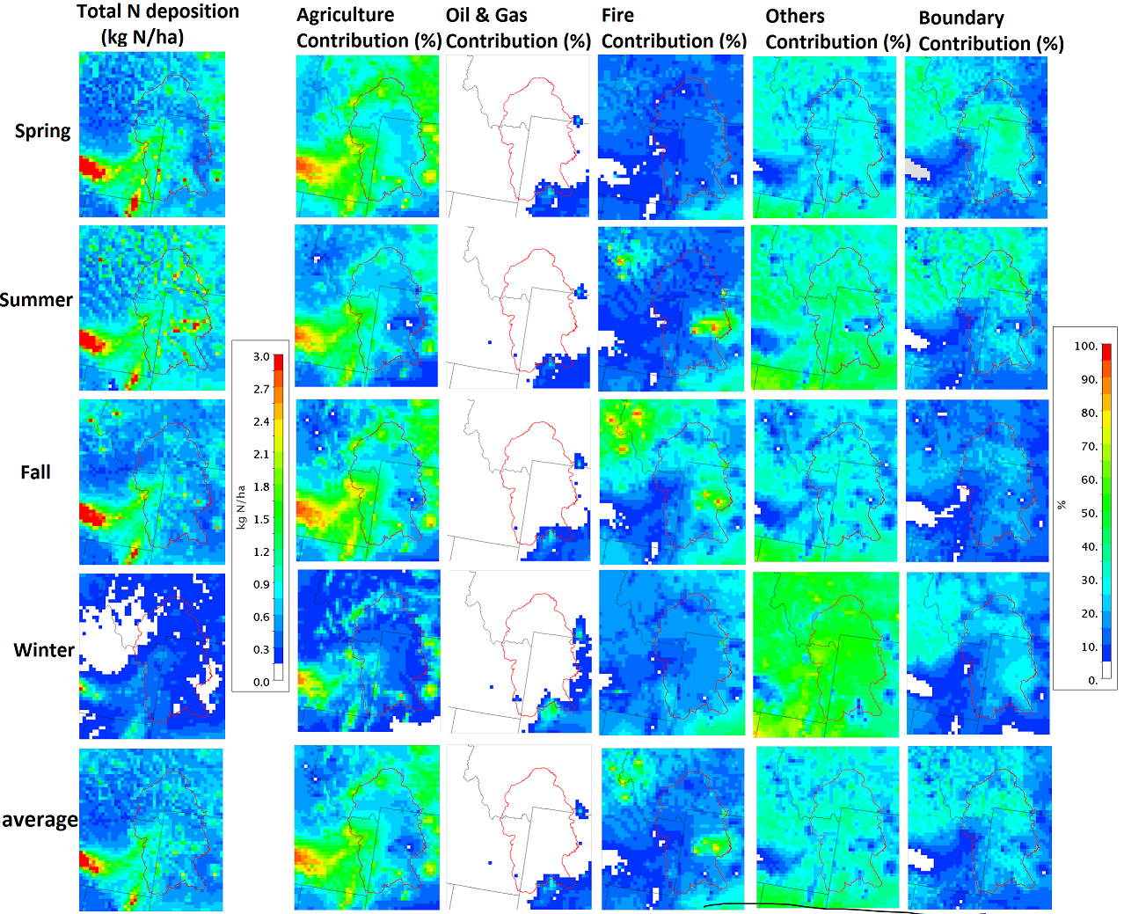
Seasonal pattern and source sectors contribution in GYA

Slide 9
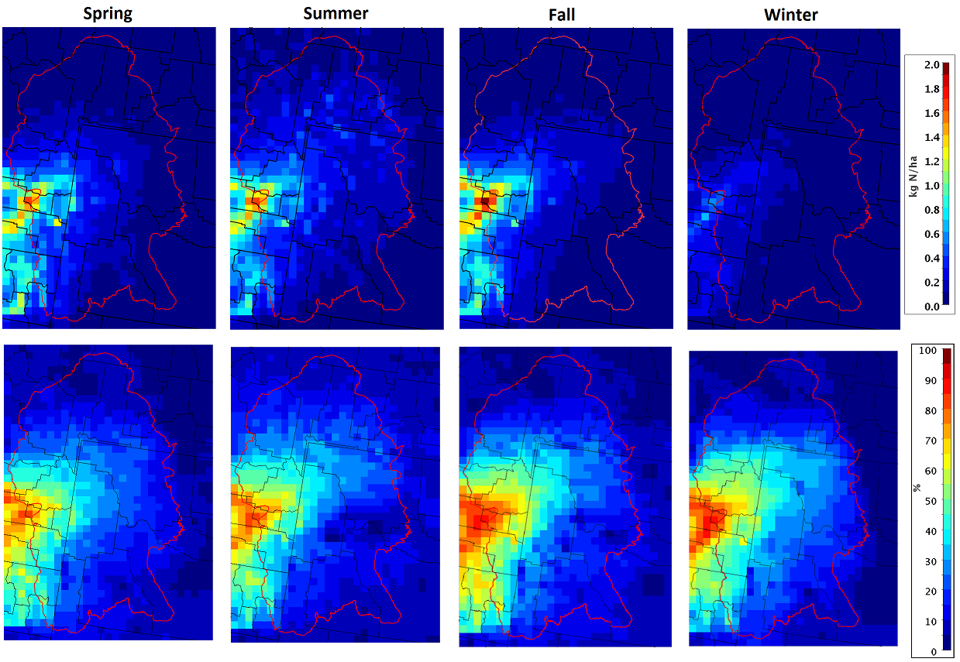
Snake River Valley (agriculture) impact to GYA N deposition

Slide 10
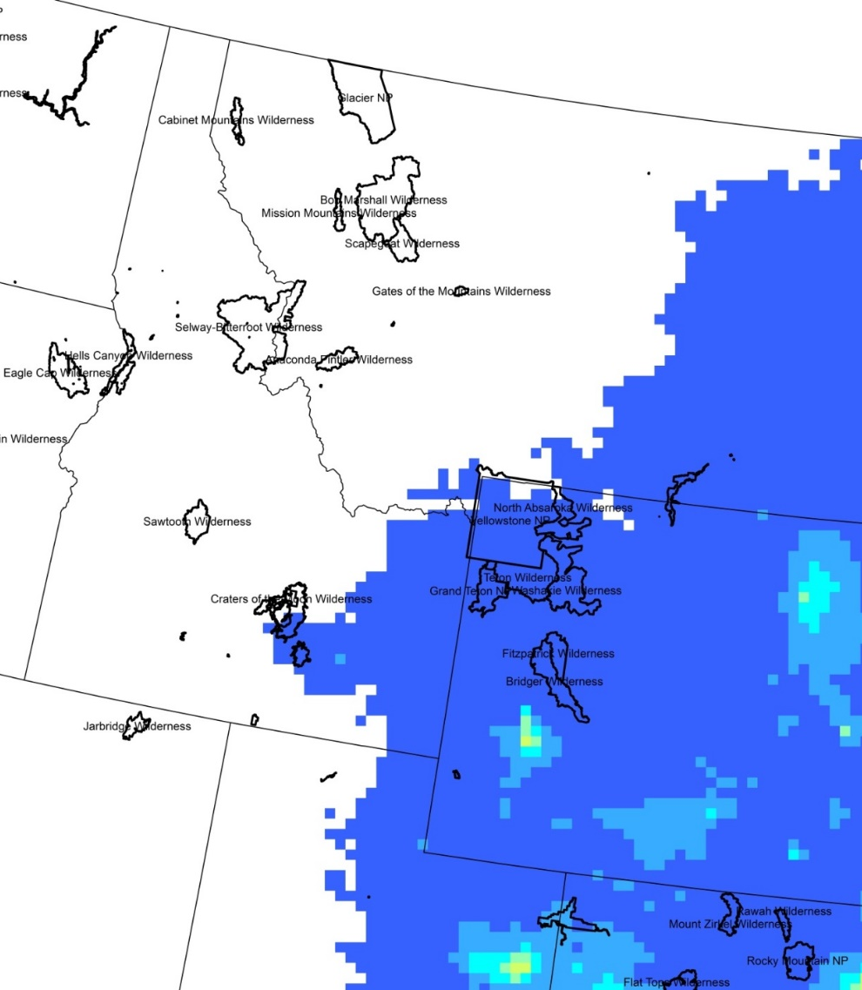
O&G activity impact to GYA N deposition
2008
2011
(Thompson et al., JAWMA 2016)

Slide 11
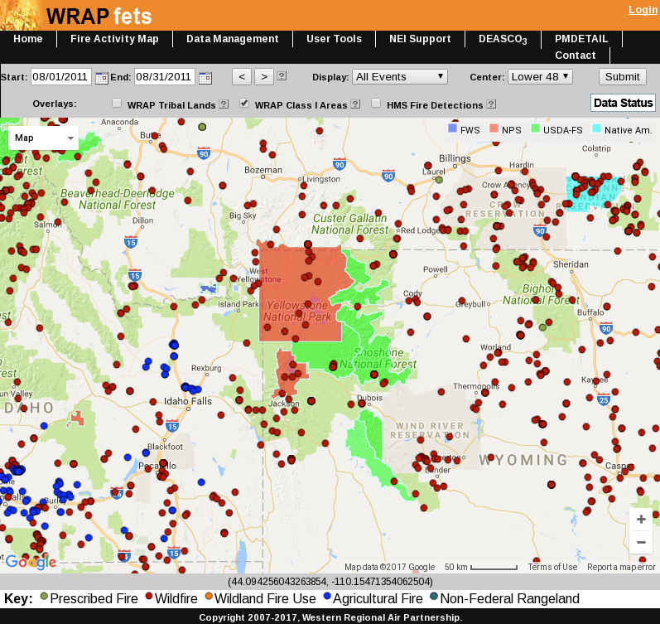
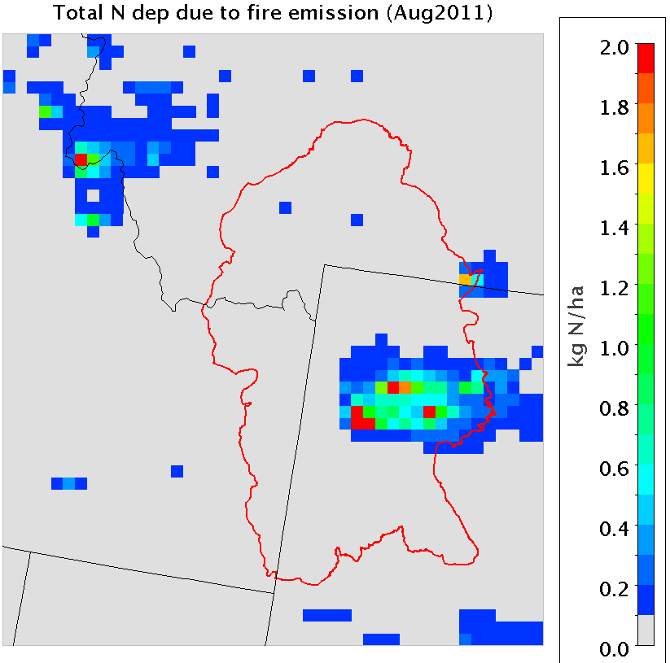
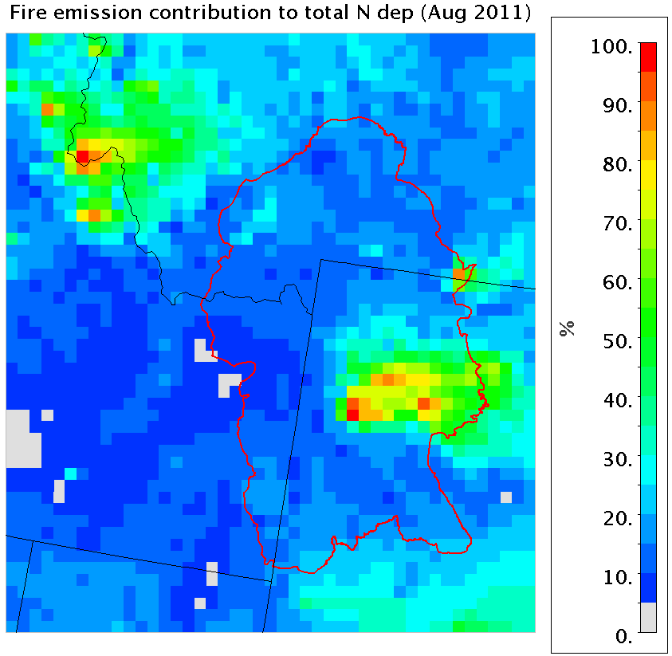
Wildfire impact to GYA N deposition
Nowlin Wildfire
(1 day, 240 acre, PM 7.5 ton)
Norton Point Wildfire
(1 day, 245 acre, PM 113.ton)
Warm Springs Wildfire
(1 day, 647 acre, PM 10 ton)

Slide 12
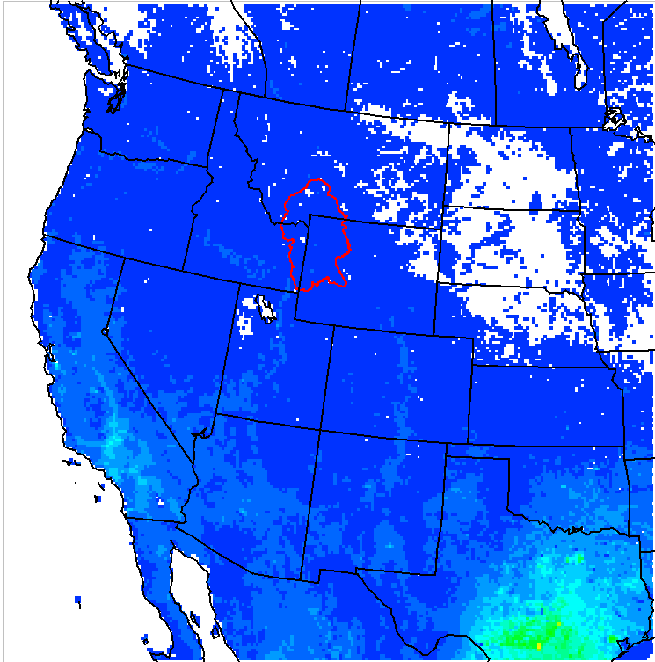
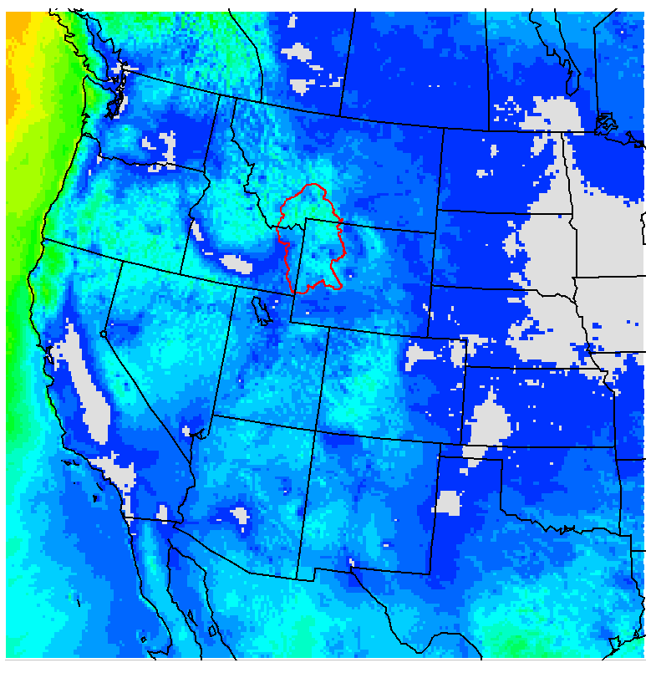
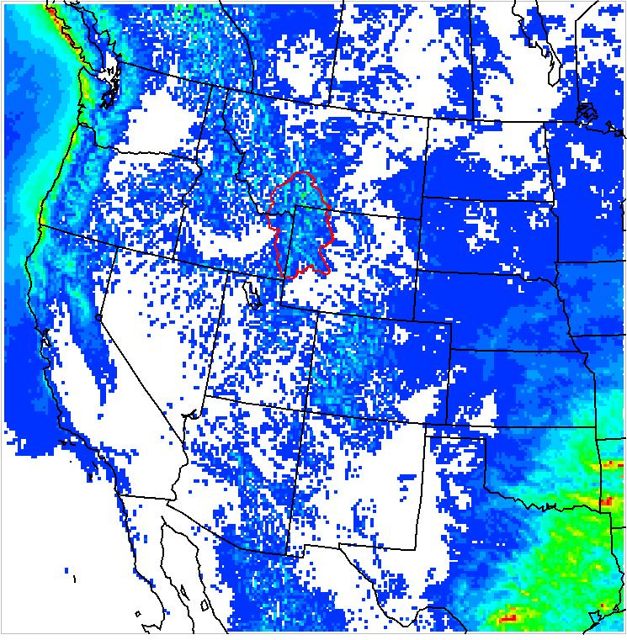
Model boundary impact to GYA N deposition
Annual dry deposition from BCON
Percentage contribution
Annual wet deposition from BCON

Slide 13
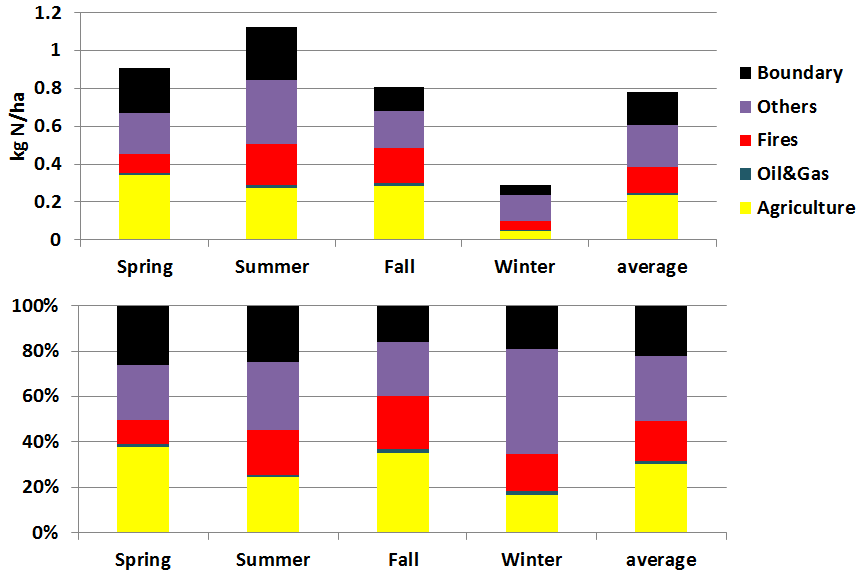
Seasonal source sectors contribution to GYA N deposition
Boundary-22%
Others -28%
Fires -17%
O&G-2%
Agriculture -30%

Slide 14
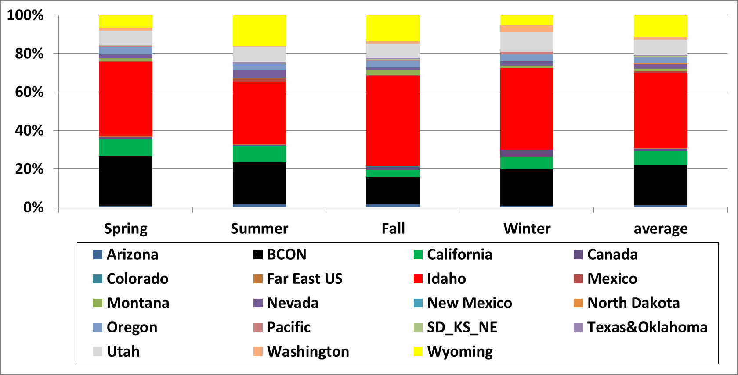
Seasonal source regions contribution to GYA N deposition
WY-12%
UT-8%
ID-39%
CA-9%
BC-22%

Slide 15
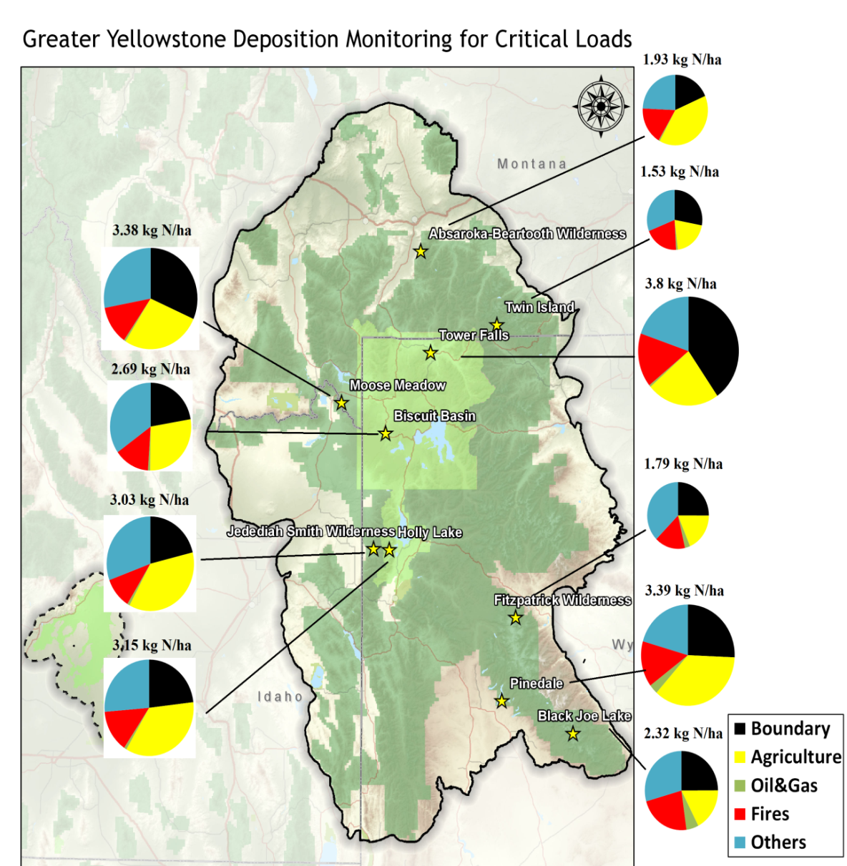
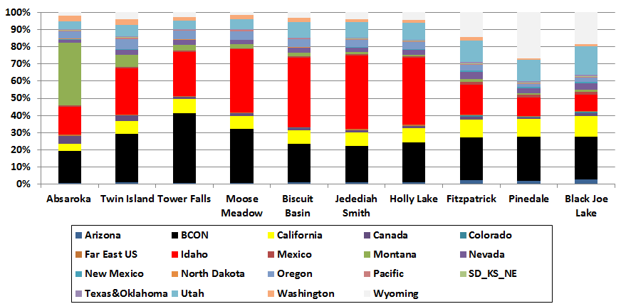
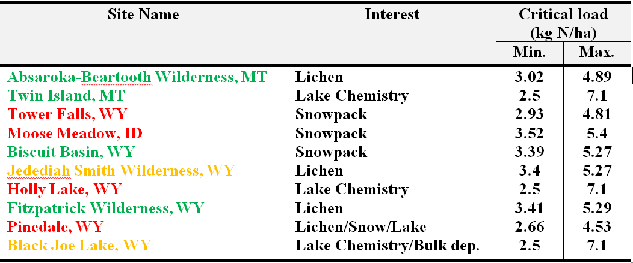
Source attribution to CL exceedance in GYA

Slide 16
Take home message
Reduced nitrogen (NH3 and NH4+) appears to now be the largest contributors to reactive N deposition in GYA
Source apportionment results suggest that the agriculture source in Snake River Valley is the largest source of reduced nitrogen deposition in GYA
2008 Oil and gas activity had little impact on most lands except in the southern Wind River Mountain Range in winter
Fire emission occurred inside GYA may dominate the local nitrogen deposition budget
Northern Utah, western WY, CA and boundaries are also important sources of N deposition
Excess reactive nitrogen (Nr) deposition in sensitive ecosystems in GYA has passed critical thresholds adversely affecting these alpine ecosystems

Slide 18
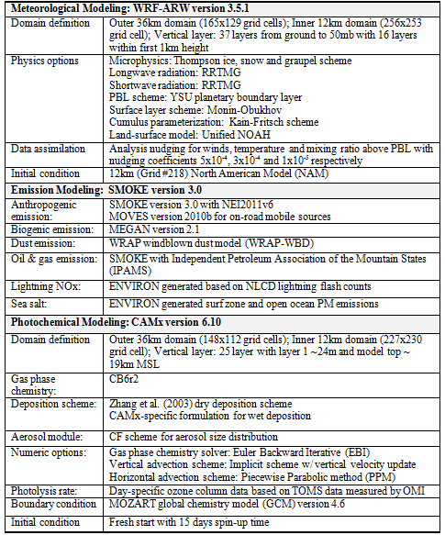

Slide 19
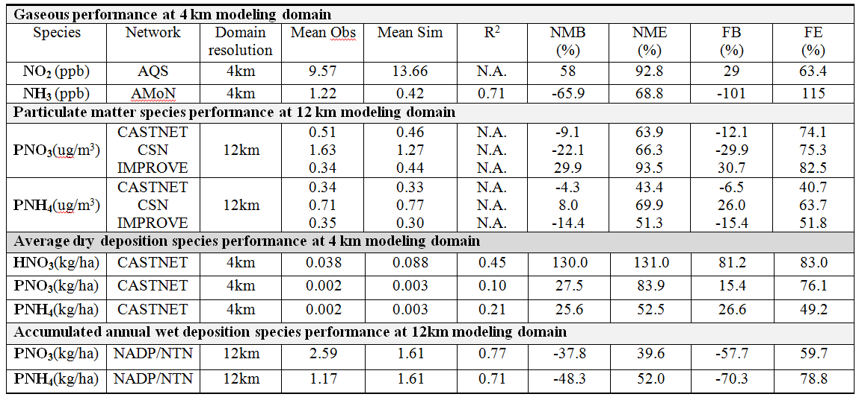
Model performance evaluation from 3SAQ 2011
Reasonable PM model performance satisfying the proposed goal (FB ≤ ±30% and FE ≤ 50%) and criteria (FB ≤ ±60% and FE ≤ 75%; Boylan 2004).
Different mean bias for PNO3 and PNH4 concentration simulations at different networks
Consistently overestimated NO₂ and HNO₃ concentrations and dry deposition
Underestimation of NH3 concentrations

Slide 20
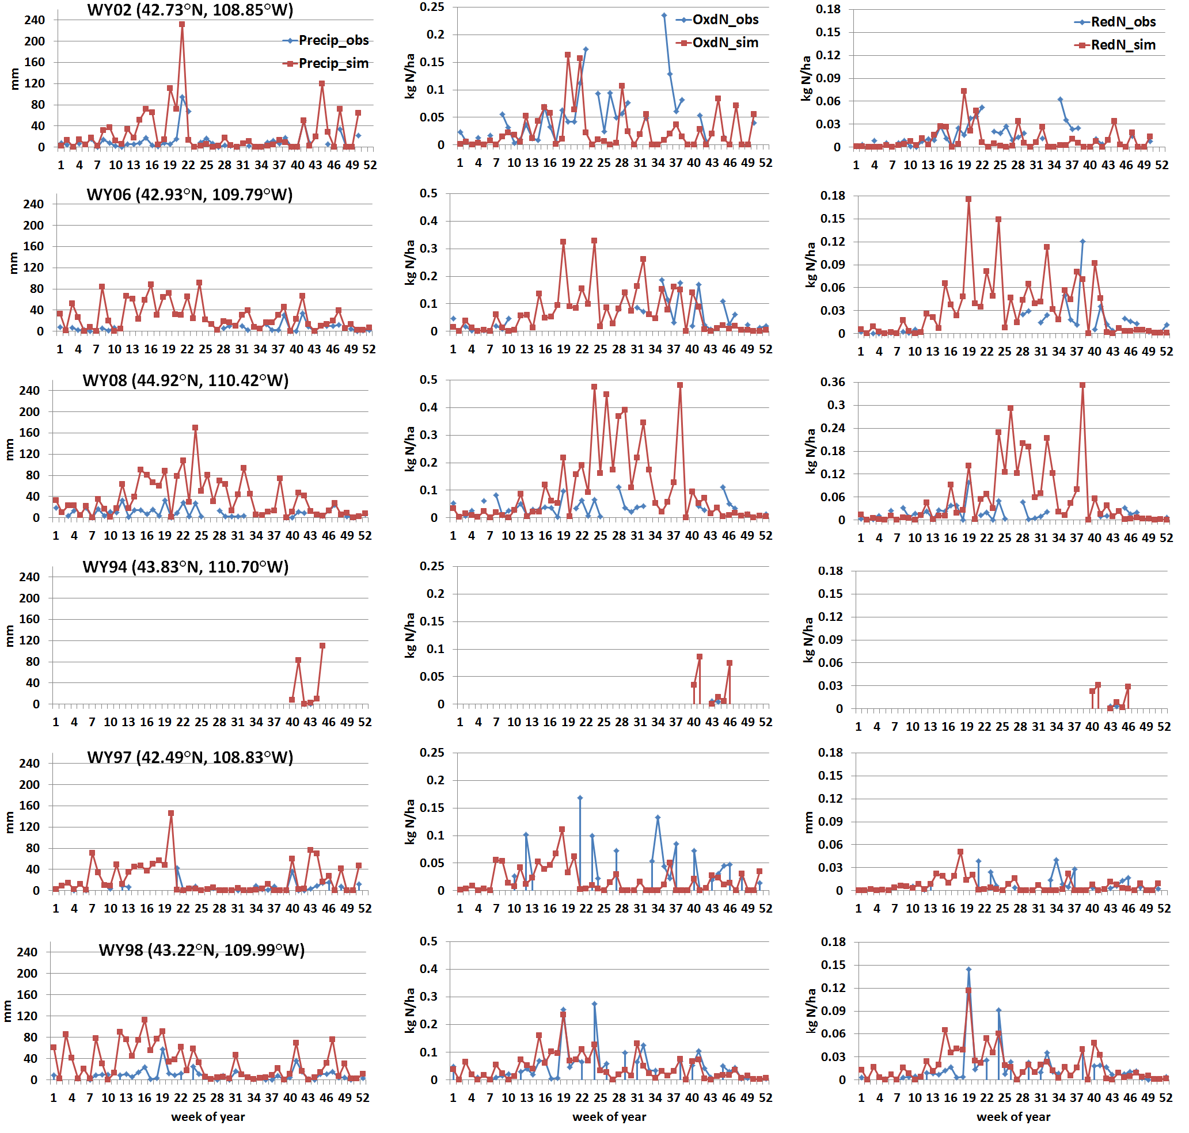
Wet deposition simulation in 6 NTN sites @ GYA

Slide 21
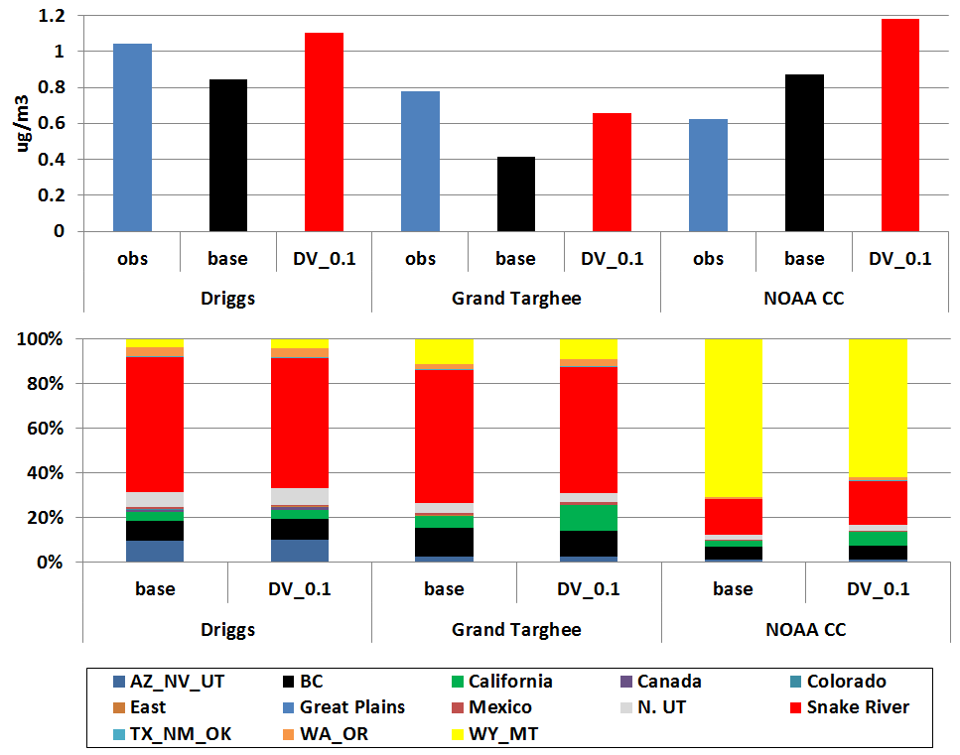
Impact of NH3 dry deposition velocity to source apportionment results

Slide 22
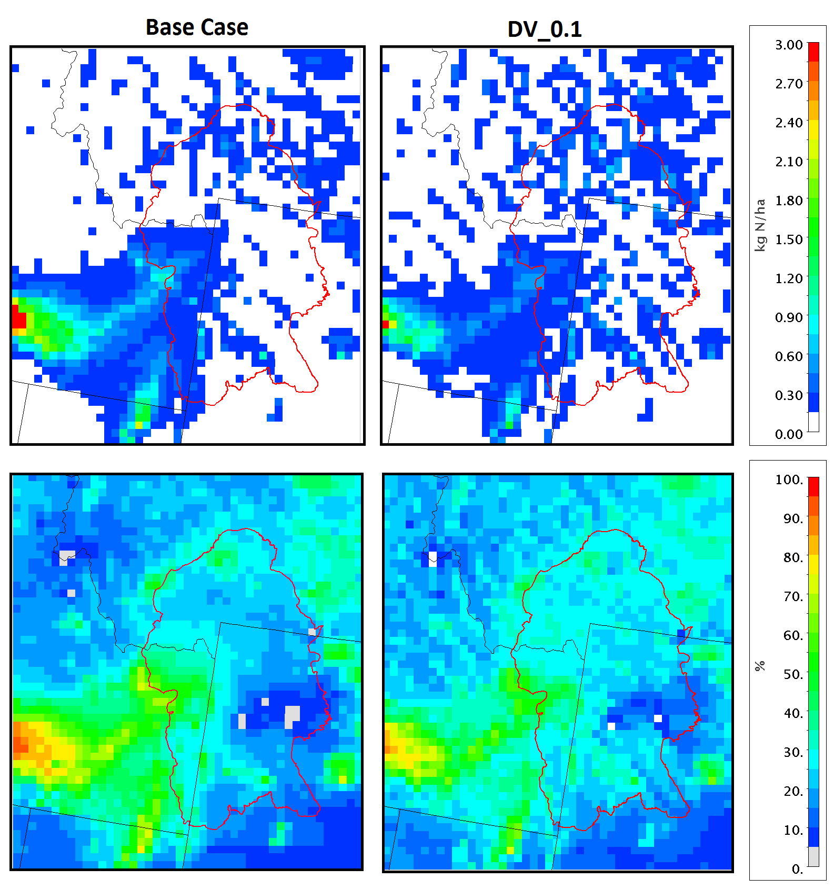
Impact of NH3 dry deposition velocity to source apportionment results

Slide 23
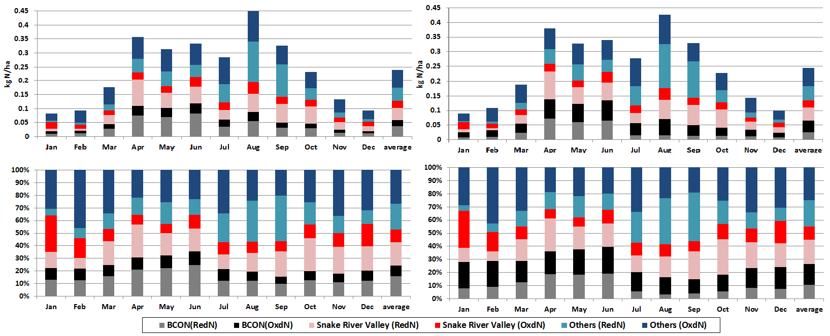
Impact of boundary conditions to source apportionment results

Slide 24
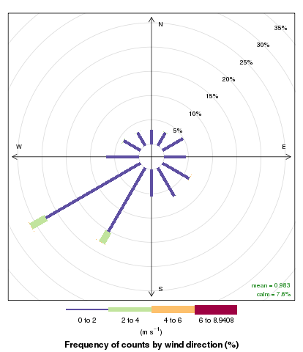
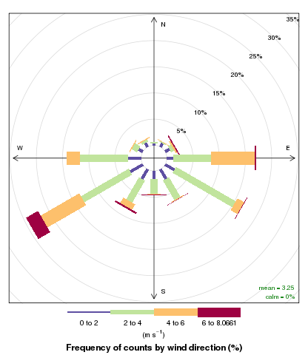
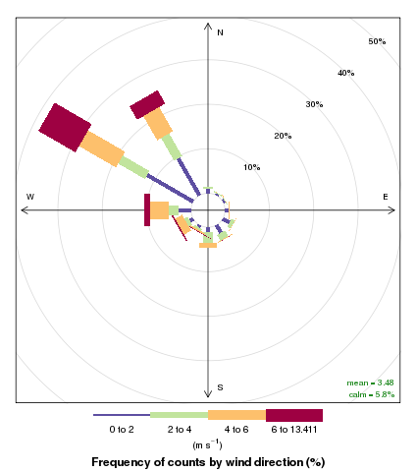
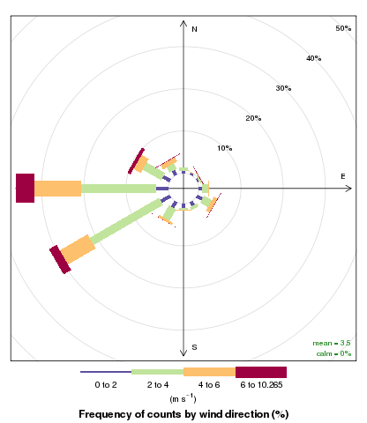
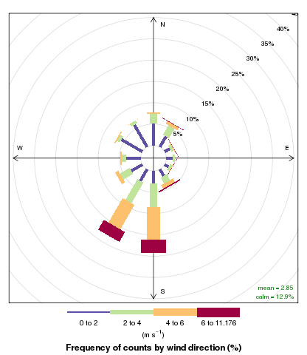
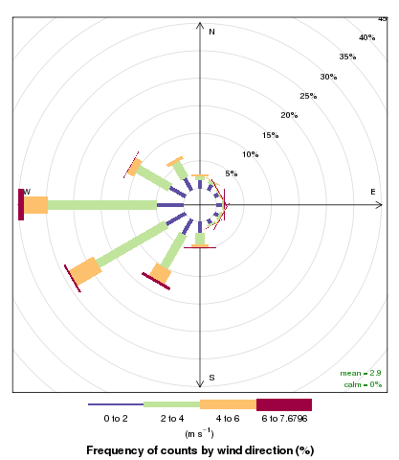
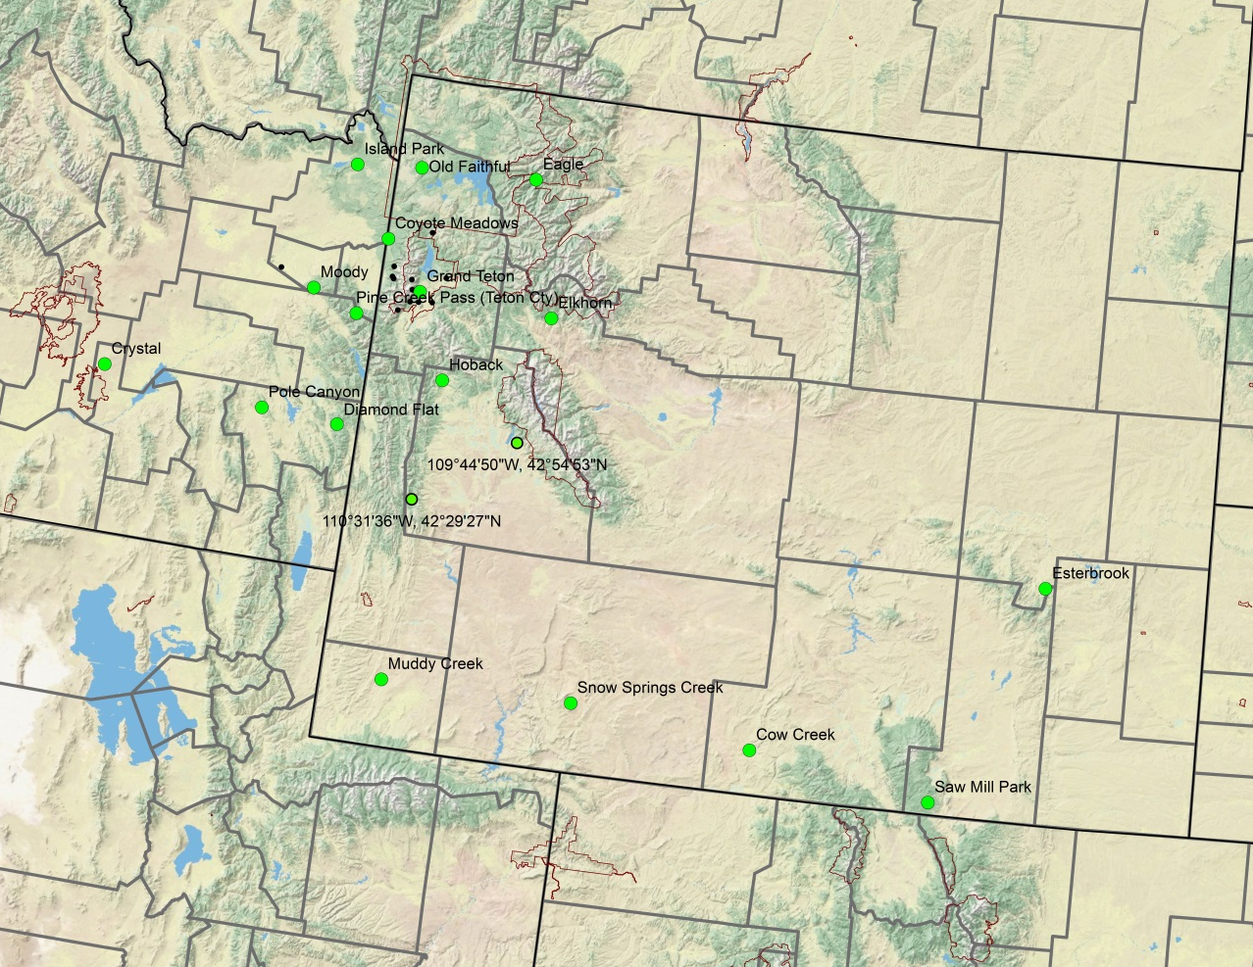
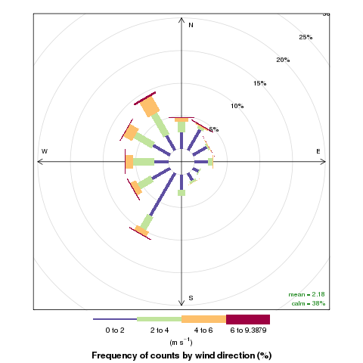
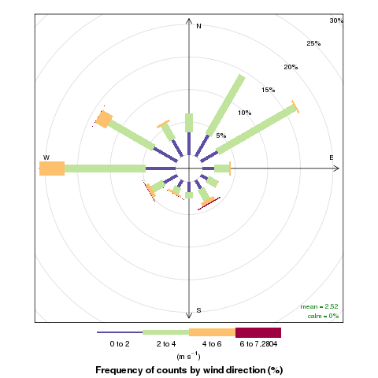
WRF wind simulation performance @ GYA
RAWS (remote automatic weather station)
April – Sept
2011 Hourly
RAWS
CAMx
RAWS
CAMx
RAWS
CAMx
RAWS
CAMx

Slide 25
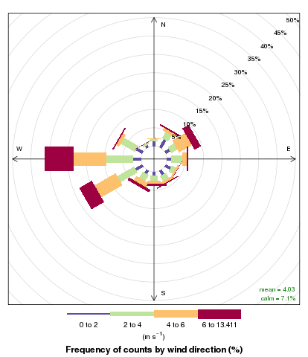
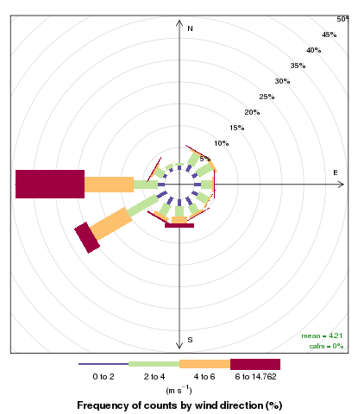
RAWS
CAMx
April – Sept
2011 Hourly
RAWS
CAMx
Measurement Sites
RAWS
CAMx

Slide 26
Total nitrogen deposition trend from TDep Map
2000
2005
2010
2015

Slide 27
Dominant transport patterns from back trajectory analysis
(courtesy to Kristi Gebhart)

Slide 28
Adjustment for precipitation impact to wet deposition modeling
(Appel et al., GMD 2011)

