Slide 1
Significantly Reduced Health Burden from Ambient Air Pollution in the U.S. Under Emission Reductions from 1990 to 2010
16th CMAS Conference
10/24/2017
Yuqiang Zhang¹, J. J West², Rohit Mathur³, Jia Xing⁴, Christian Hogrefe³, Shawn Roselle³, Jesse Bash³, Jonathan Pleim³, Chuen-Meei Gan³, David C. Wong³
¹ORISE Fellowship Participant at US EPA, RTP, NC 27711, USA
²UNC-CH, NC 27599, USA
³US EPA, RTP, NC 27711, USA
⁴Tsinghua University, Beijing 100084, China

Slide 2
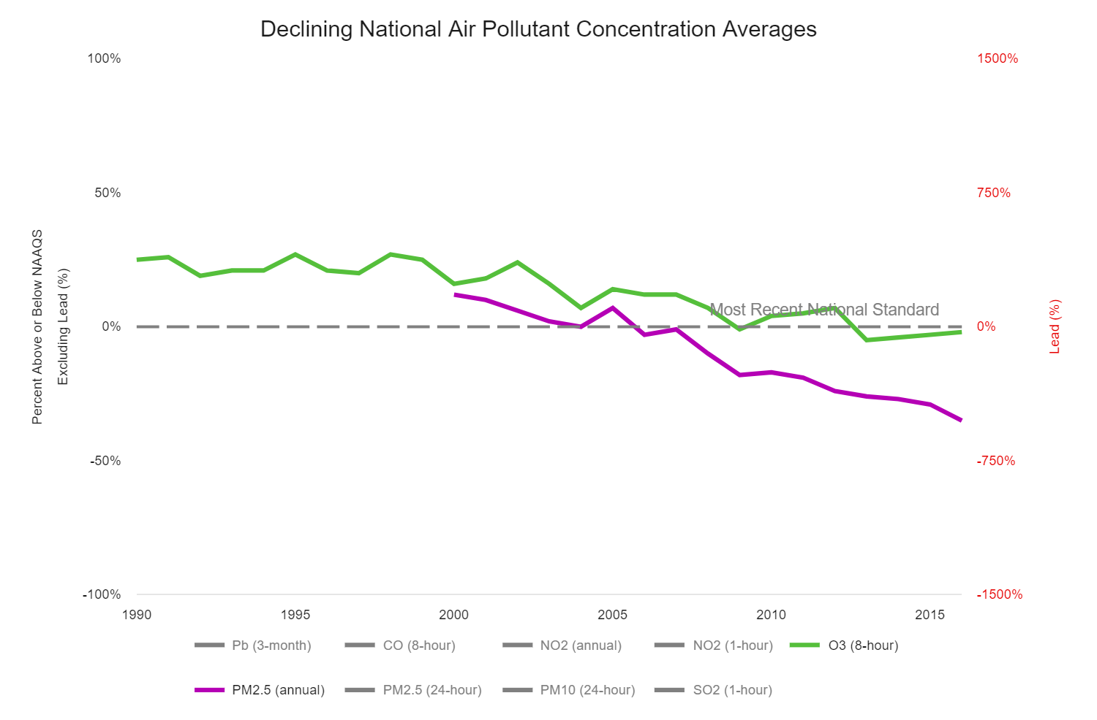
Introduction
“Air Quality Improves as America Grows”
EPA (2017):
Our Nation's Air: Status and Trends Through 2016
Annual PM_{2.5} decreased by 42% from 2000 to 2016.
MDA8 O₃ decreased by 22% from 1990 to 2016;

Slide 3
Introduction
Ambient air pollution and human health
Exposure to PM_{2.5} and O₃ has been associated with both morbidity (e.g. asthma exacerbation) and mortality (e.g. death from cardiovascular and respiratory diseases as well as lung cancer).
Estimated 88,400 adults deaths attributable to PM_{2.5} exposure, and 11,700 adults deaths attributable to O₃ exposure in 2015 by Global Burden of Disease(GBD) (Cohen et al., 2017).
What are the trends in air pollution mortality, due to changes in ambient air pollution?

Slide 4
Objectives
Quantify the annual mortality burden of ambient PM_{2.5} and O₃ in the continental U.S. from 1990 to 2010, based on long-term air quality model simulations by coupled WRF-CMAQ (Gan et al., 2015, 2016);
Analyze contributions of changes in air pollutant concentration, population, and baseline mortality to the overall trend;
Innovations:
Estimate the mortality burden annually, with annual baseline mortality and population data;
Analyze the inter-annual variability in mortality estimates.

Slide 5
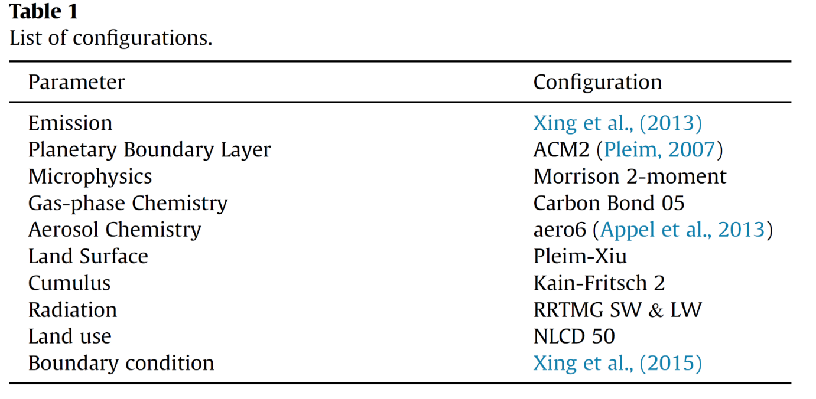
Methods
Model simulation: Coupled WRF-CMAQ model
Horizontal resolution of 36 × 36 km covering the Continental U.S. (CONUS);
With a self-consistent U.S. emission inventory from 1990 to 2010 developed by Xing et al., 2013;
Boundary conditions are obtained from 108 × 108 km WRF-CMAQ hemisphere simulation (Xing et al., 2015, Mathur et al., 2017);
Simulation period covering 1990 to 2010;
Model evaluations for aerosol and O₃ have been reported in previous studies (Gan et al., 2015, 2016; Astitha et al, 2017).
Gan et al., 2016

Slide 6
Methods
∆Mort = y₀ x AF x Pop
Health Impact Function
∆Mort: mortality burden for PM_{2.5} or O₃;
y₀: baseline mortality rates;
AF: attributable fraction;
Pop: Exposed population, ages > 25 yrs
For baseline mortality rates (y₀):
Calculated y₀ for individual counties using baseline incidence rates and population from CDC-Wonder database, and then regrid to the 36 km grid.
For attributable fraction (AF):
PM_{2.5}: Integrated Exposure–Response (IER) model (Burnett et al., 2014)
O₃: log-linear model from Jerrett et al., (2009).
For exposed population (Pop):
Annual data at county-level from the US CDC from 1990 to 2010
Notes:
CDC: Centers for Disease Control and Prevention
For the AF, they are both depending on the air pollution concentration;

Slide 7
Results
U.S. air quality trends from 1990 to 2010
April to September average of daily maximum 1hr O₃
Annual average PM_{2.5}
In U.S., for PM_{2.5} , the population-weighted average decreased by 39%, and regional average decreased by 29%;
For O₃, both decreased by 9%;
Both the PM_{2.5} and O₃ decreases were attributed to the significant emission reductions.

Slide 8
Results
PM_{2.5} mortality burden from 1990 to 2010
Decrease by 53%, from 123,700 deaths yr⁻¹ in 1990 (95%CI, 70,800-178,100), to 58,600 deaths yr⁻¹ (95%CI, 24,900-98,500) in 2010.
Interannual variability is small (coefficient of variation, CV, of 4% ).
Notes:
1. However, they use uniform 22, 30 ppbv for the east and west backgournd o3 concentration. The background O3 should be higher in both the east and the west, larger than 32 ppbv. So they underestimate the background and then overestimate the O3 health burdens

Slide 9
Results
PM_{2.5} mortality burden from 1990 to 2010
Concentration change only: -36% from 1990 to 2010;
Mortality rates change only: -45% from 1990 to 2010;
Population change only: 40% from 1990 to 2010;
Total Mortality burden: -53%
Notes:
1. However, they use uniform 22, 30 ppbv for the east and west backgournd o3 concentration. The background O3 should be higher in both the east and the west, larger than 32 ppbv. So they underestimate the background and then overestimate the O3 health burdens

Slide 10
Results
O₃ mortality burden from 1990 to 2010
Increase by 13%, from 109,000 (95%CI, 3,700-17,500) deaths yr⁻¹ in 1990 to 12,300 deaths yr⁻¹ (95%CI, 4,100-19,800) deaths yr⁻¹ in 2010 ;
Interannual variability is larger (CV of 12%).
Notes:
1. However, they use uniform 22, 30 ppbv for the east and west backgournd o3 concentration. The background O3 should be higher in both the east and the west, larger than 32 ppbv. So they underestimate the background and then overestimate the O3 health burdens

Slide 11
Results
O₃ mortality burden from 1990 to 2010
Concentration change only: -25% from 1990 to 2010;
Mortality rates change only: 20% from 1990 to 2010;
Population change only: 30% from 1990 to 2010.
Total Mortality burden: 13%
Notes:
1. However, they use uniform 22, 30 ppbv for the east and west backgournd o3 concentration. The background O3 should be higher in both the east and the west, larger than 32 ppbv. So they underestimate the background and then overestimate the O3 health burdens

Slide 12
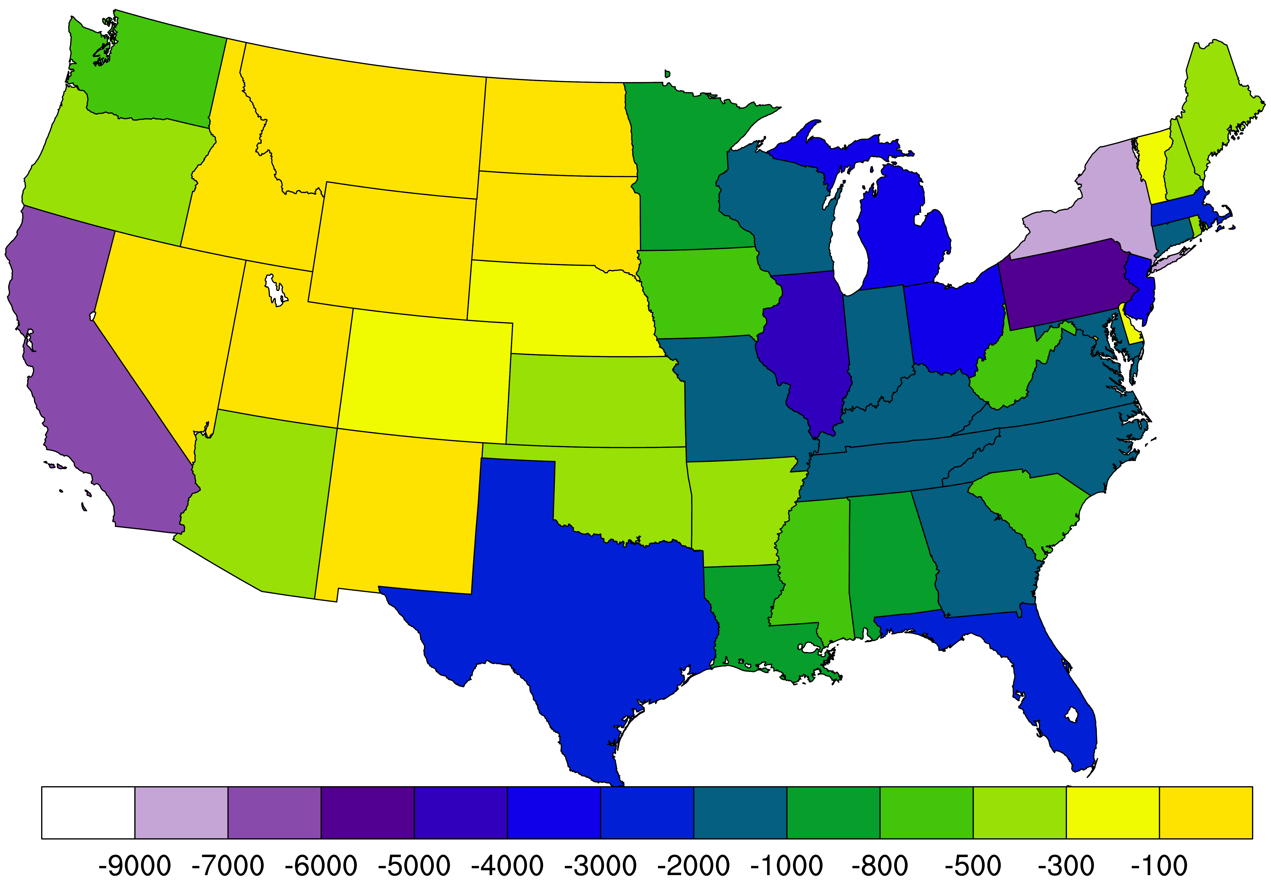
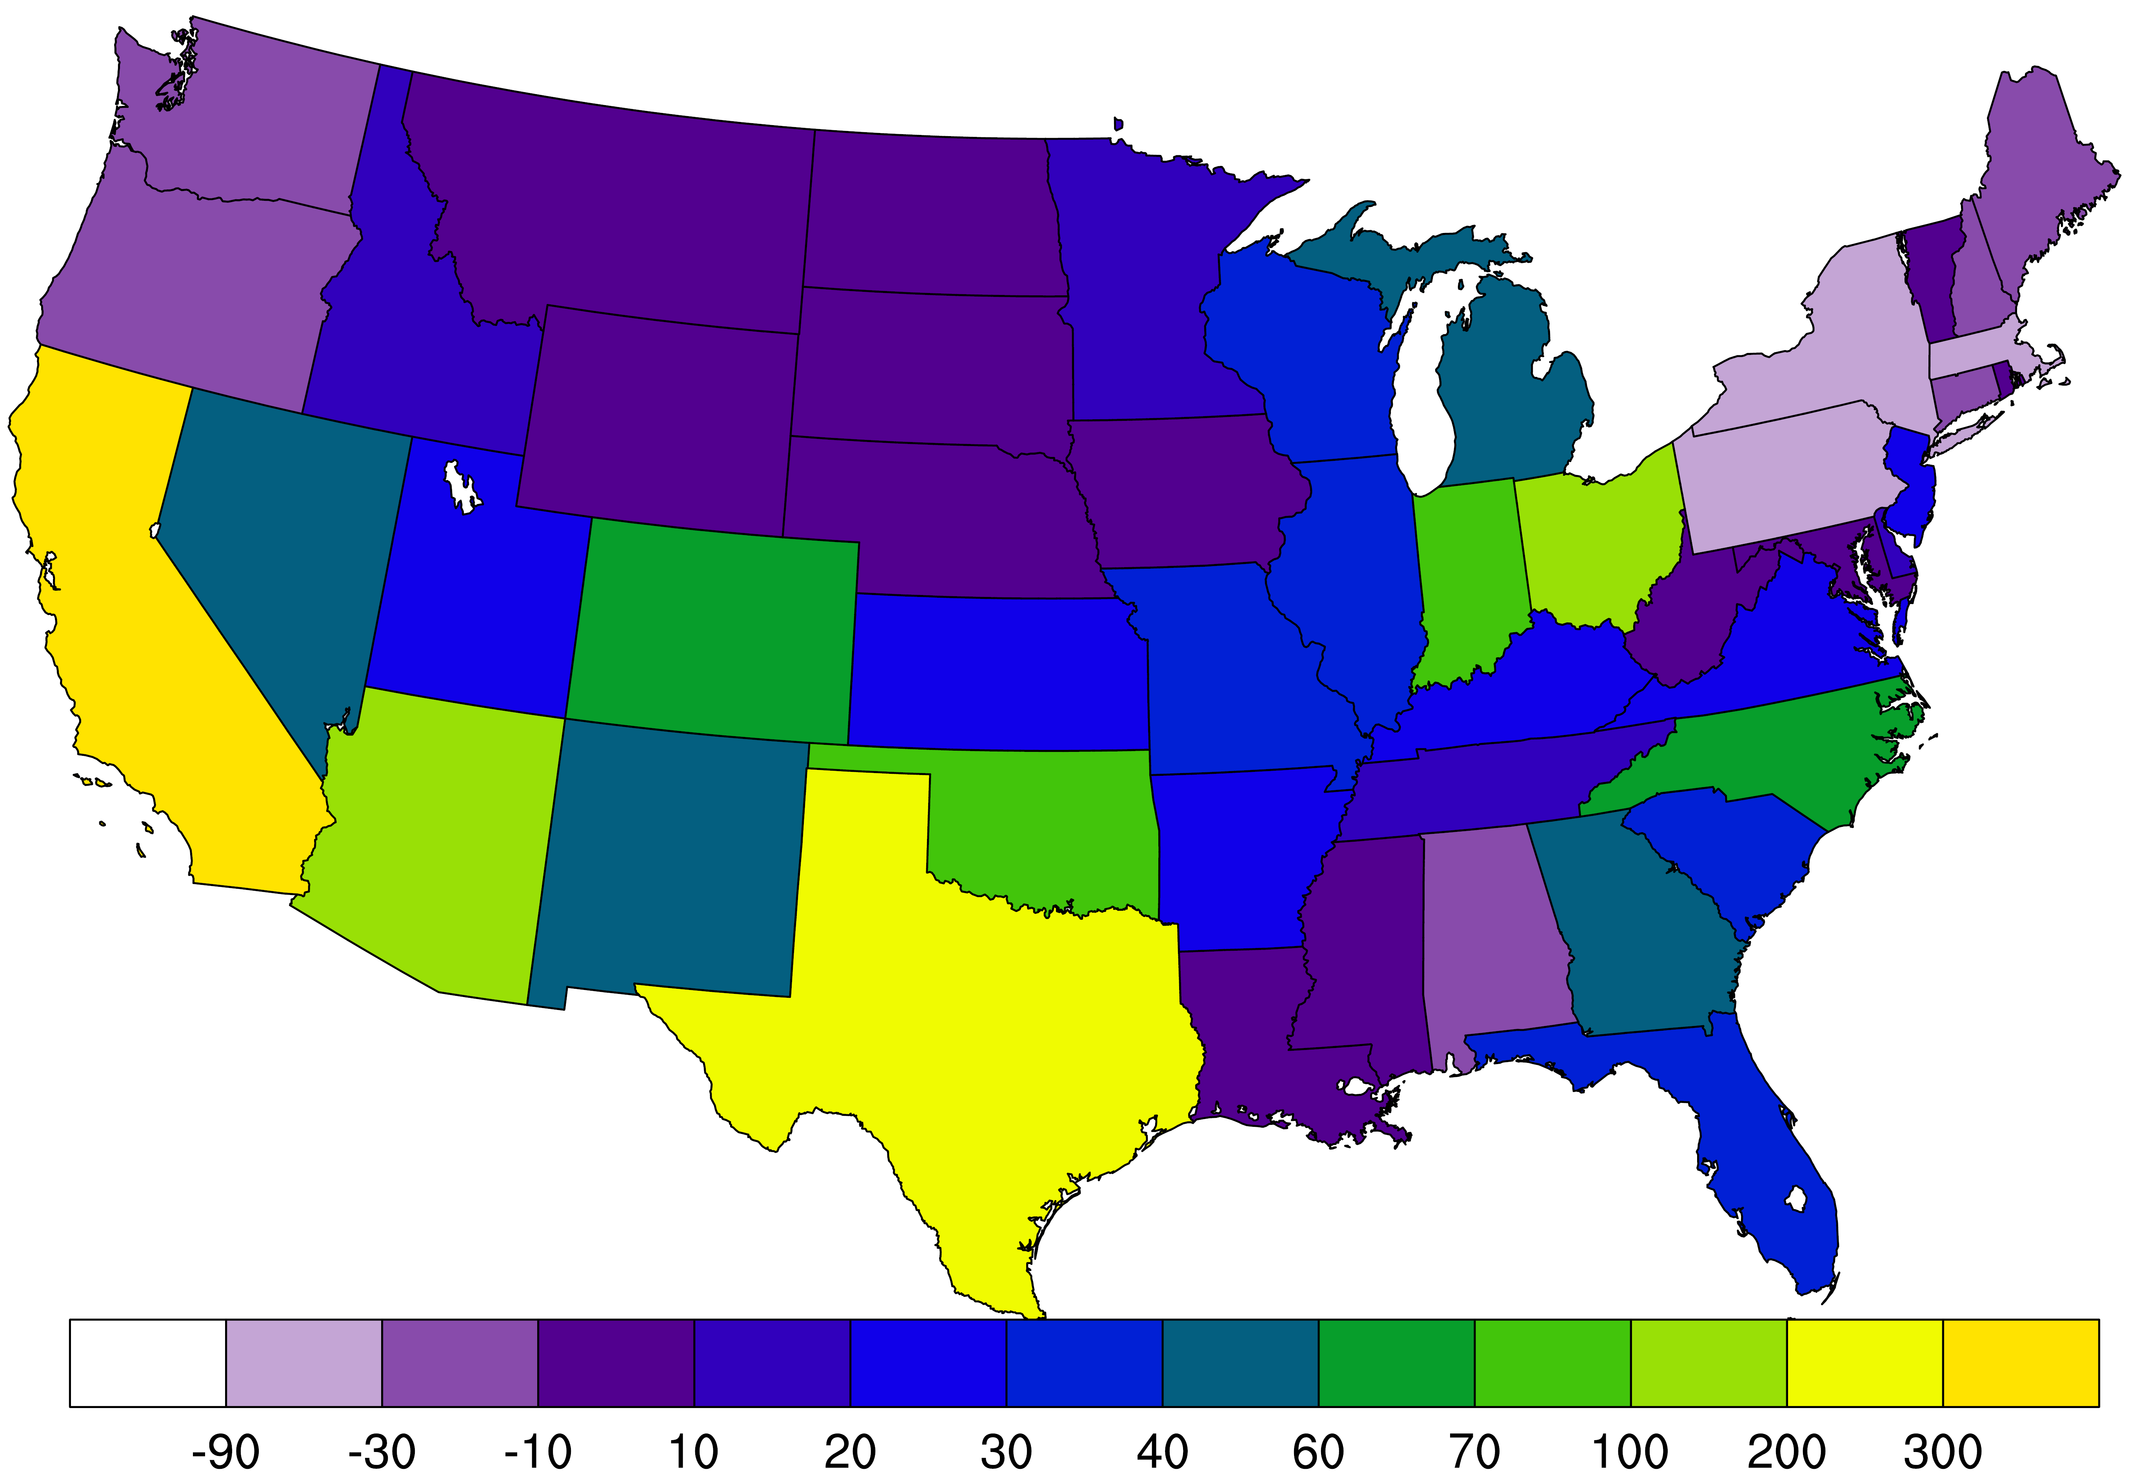
Results
Mortality burden change from 1990 to 2010 by states
PM_{2.5} O₃
For PM_{2.5}, New York has the largest decreases (-8,500 deaths yr⁻¹), followed by California (-6,100 deaths yr⁻¹), and Pennsylvania (-5,500 deaths yr⁻¹);
For O₃, the largest increases in CA (360 deaths yr⁻¹), followed by Texas (230 deaths yr⁻¹), and Arizona (140 deaths yr⁻¹).

Slide 13
Results
Compared with previous studies
Our results are comparable to previous studies;
The PM_{2.5} mortality burden trends were larger than Cohen et al. (2017), mainly caused by the overestimation of the PM_{2.5} concentration decrease trends (Gan et al., 2016).

Slide 14
Conclusion
Annual PM_{2.5} decreased by 39%, and summertime O₃ decreased by 9%;
The PM_{2.5} mortality burdens decreased by 53%, from 123,700 deaths yr⁻¹ in 1990 to 58,600 deaths yr⁻¹ in 2010, mainly caused by the decreasing PM_{2.5} concentration and baseline mortality rates;
The O₃ mortality burdens increased by 13%, from 10,900 deaths yr⁻¹ in 1990 to 12,300 deaths yr⁻¹ in 2010, mainly caused by the increases of the baseline mortality rates and population changes.

Slide 15
Acknowledgements
Thanks for the funding sources NASA Health Air Quality Applied Science Team #NNX16AQ80G. This work was also supported in part by MOST National Key R & D program in China (2016YFC0207601).
Y.Z. was supported in part by the Internship/Research Participation Program at Office of Research and Development, US Environmental Protection Agency (EPA), administered by the Oak Ridge Institute for Science and Education through an interagency agreement between the US Department of Energy and the US EPA.
Although this work has been reviewed and approved for publication by the US EPA, it does not reflect Agency’s views and policies.

Slide 16
Thanks for your attention!
Questions and Comments?

Slide 17
Extra slides

Slide 18
Introduction
Ambient air pollution and human health
Recent studies have assessed the global (Forouzanfar et al., 2015; Forouzanfar et al., 2016; Lelieveld et al., 2015; Silva et al., 2016) or national (Fann et al., 2012; Punger and West, 2013) burden of disease attributable to air pollution.
Few studies have focused on the mortality burden trends
Cohen et al. (2017) quantified both PM_{2.5} and O₃ mortality burden at global and regional scale from 1990 to 2016 at 5-yr interval;
Wang et al. (2017) quantified the PM_{2.5} mortality burden from 1990 to 2010 in the Northern Hemisphere using Hemispheric scale CMAQ;
Fann et al. (2017) quantified the PM_{2.5} all-cause mortality burden in US from 1980 to 2010 using geographic kriging PM_{2.5} from observation

Slide 19
Methods
∆Mort = y₀ x AF x Pop
Health Impact Function
∆Mort: mortality burden for PM_{2.5} or O₃;
Y₀: baseline mortality rates;
AF: attributable fraction = (RR – 1)/RR;
Pop: Exposed population, ages > 25 yrs
For attributable fraction (AF):
For PM_{2.5}
Use Integrated Exposure–Response (IER) model: RR equals to
z = ambient PM_{2.5} concentration;
z_{cf} = counterfactual conc. = Uniform(5.8,8.8)
For O₃
Use Log -linear model: RR = exp^{β∆X}
RR = 1.040 (1.1013-1.067) per 10 ppbv O₃ increases from Jerrett et al., 2009;
β: Concentration response factor
(3) ∆X = X₂(1990-2010) – X₁ (Threshold concentration)
Notes:
Model evaluation for the major air pollutants and meteorology variables are presented in several previous studies.
Why NH4 is poor—check the reference
Underestimating N—Check Wyat’s paper

Slide 20
Methods
∆Mort = y₀ x AF x Pop
∆Mort: Health burden for O₃ or PM_{2.5};
Y₀: baseline mortality rates;
AF: attributable fraction = (RR – 1)/RR;
Pop: Exposed population, ages > 25 yrs
For exposed population (ages > 25yrs):
Notes:
2000 2010

Slide 21
Methods
∆Mort = y₀ x AF x Pop
∆Mort: Health burden for O₃ or PM_{2.5};
Y₀: baseline mortality rates;
AF: attributable fraction = (RR – 1)/RR;
Pop: Exposed population, ages > 25 yrs
For baseline mortality rates:
Notes:
2000 2010

Slide 22
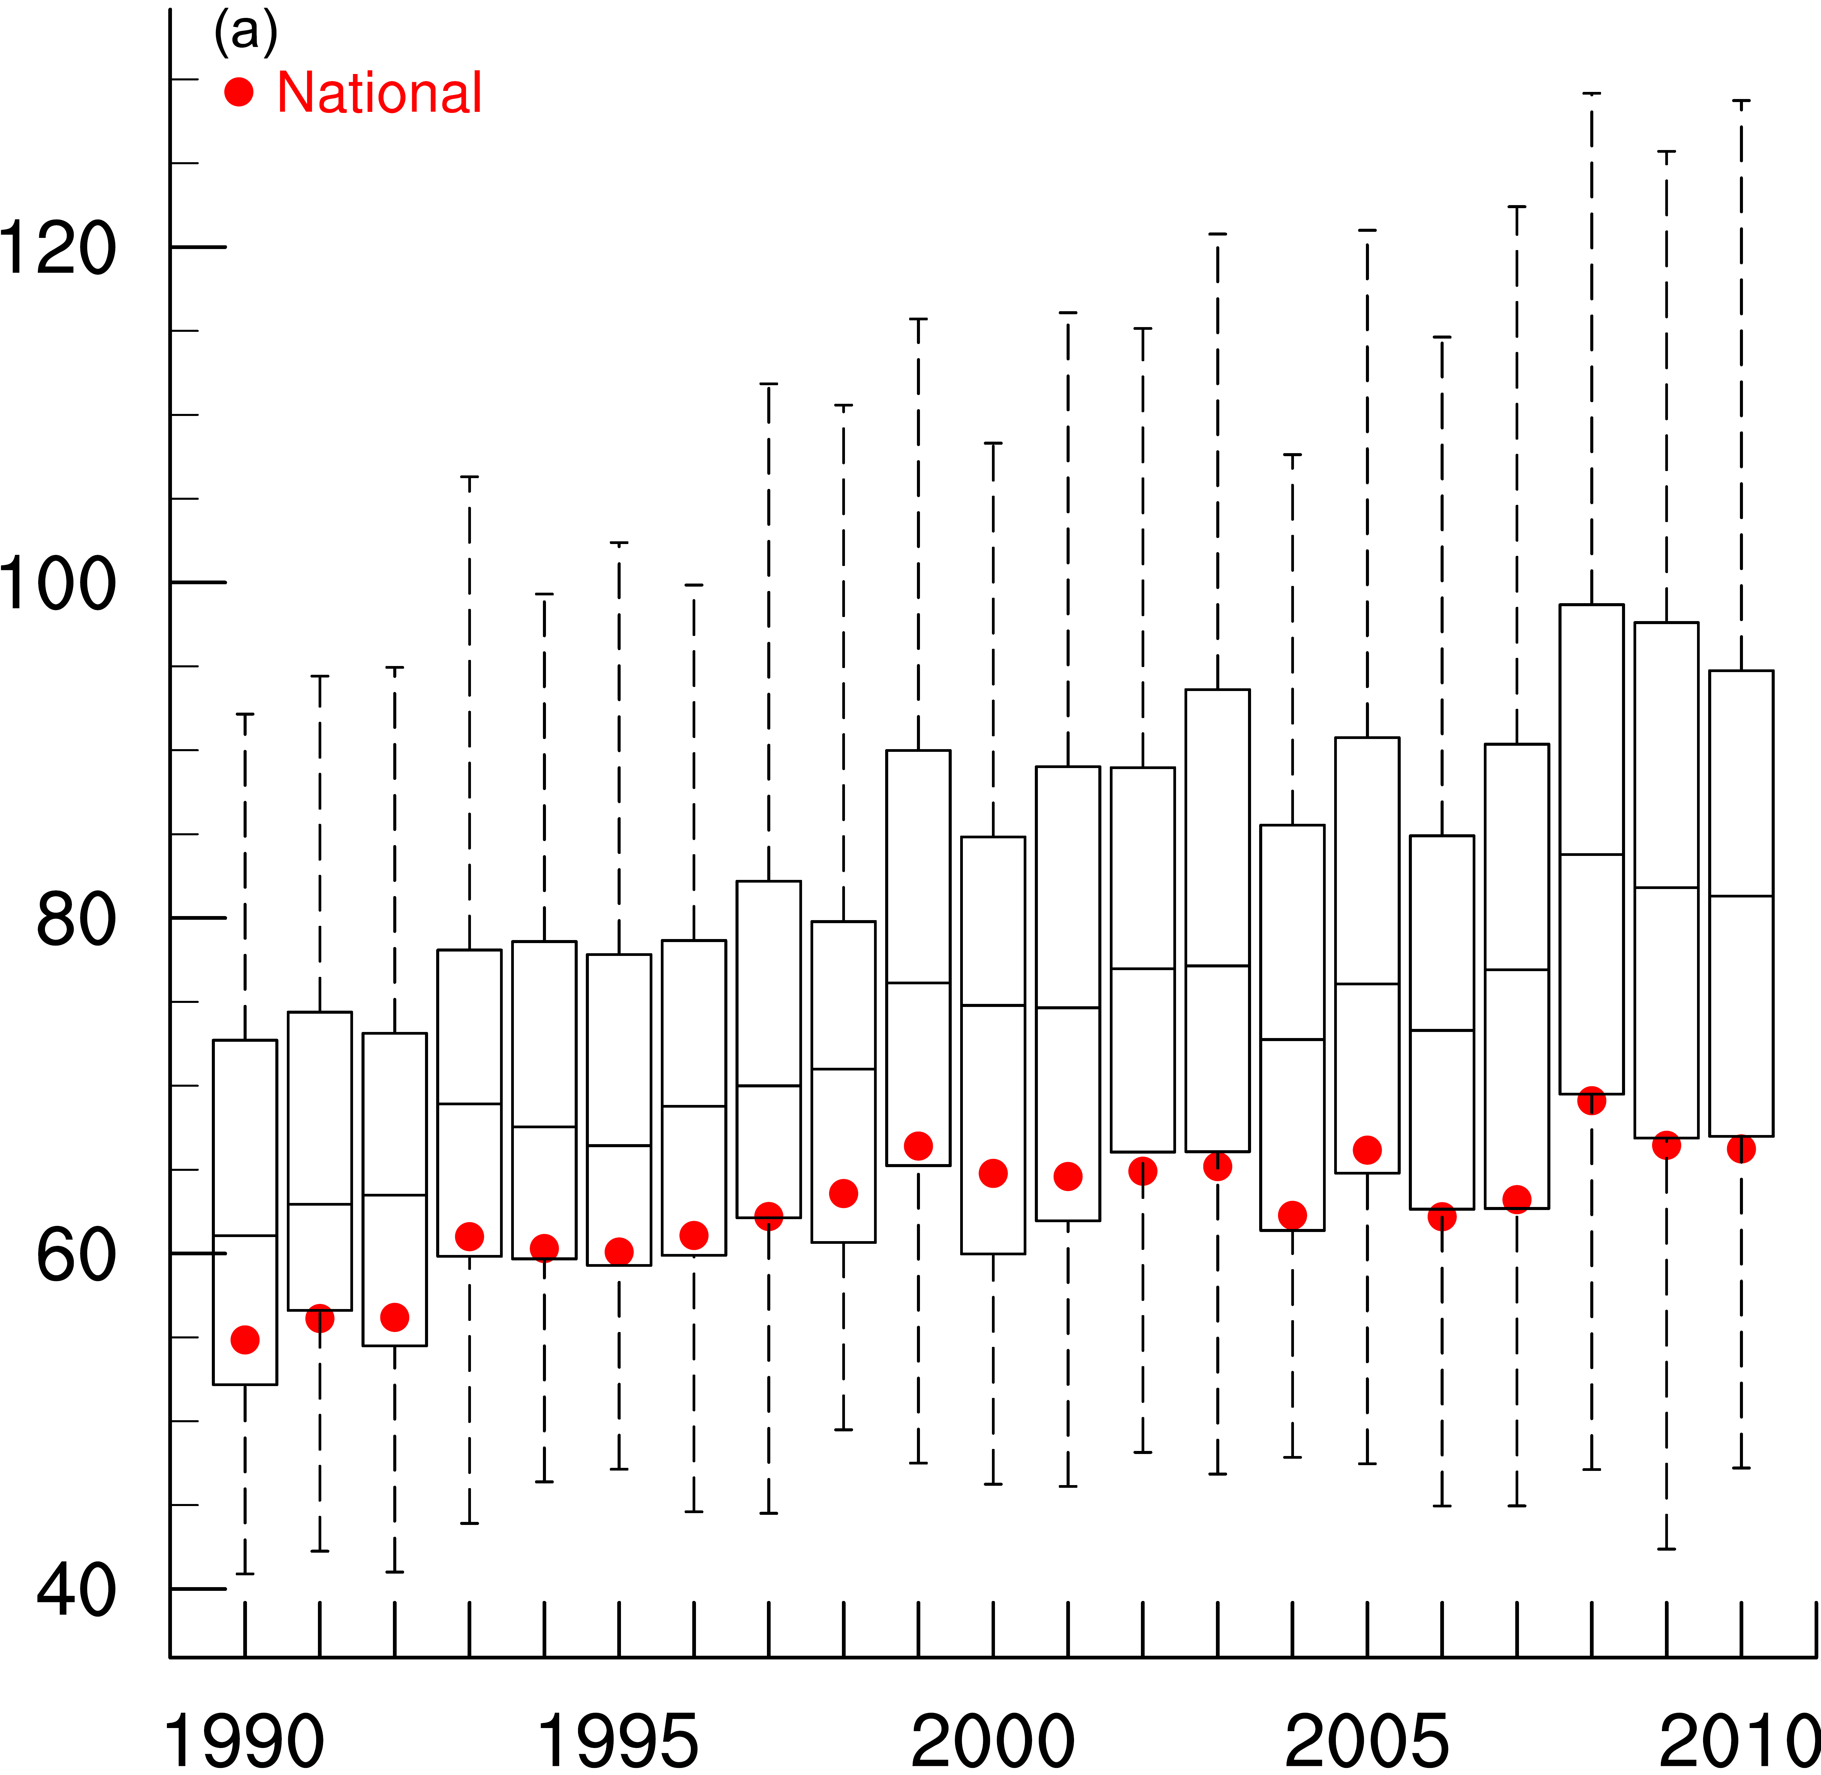
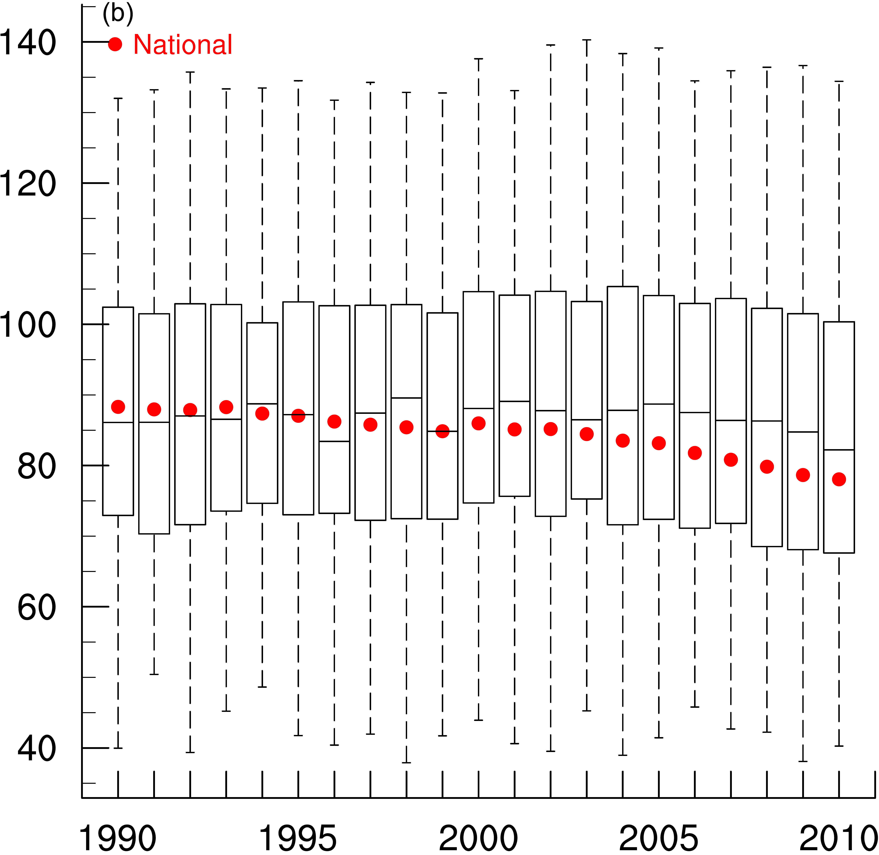
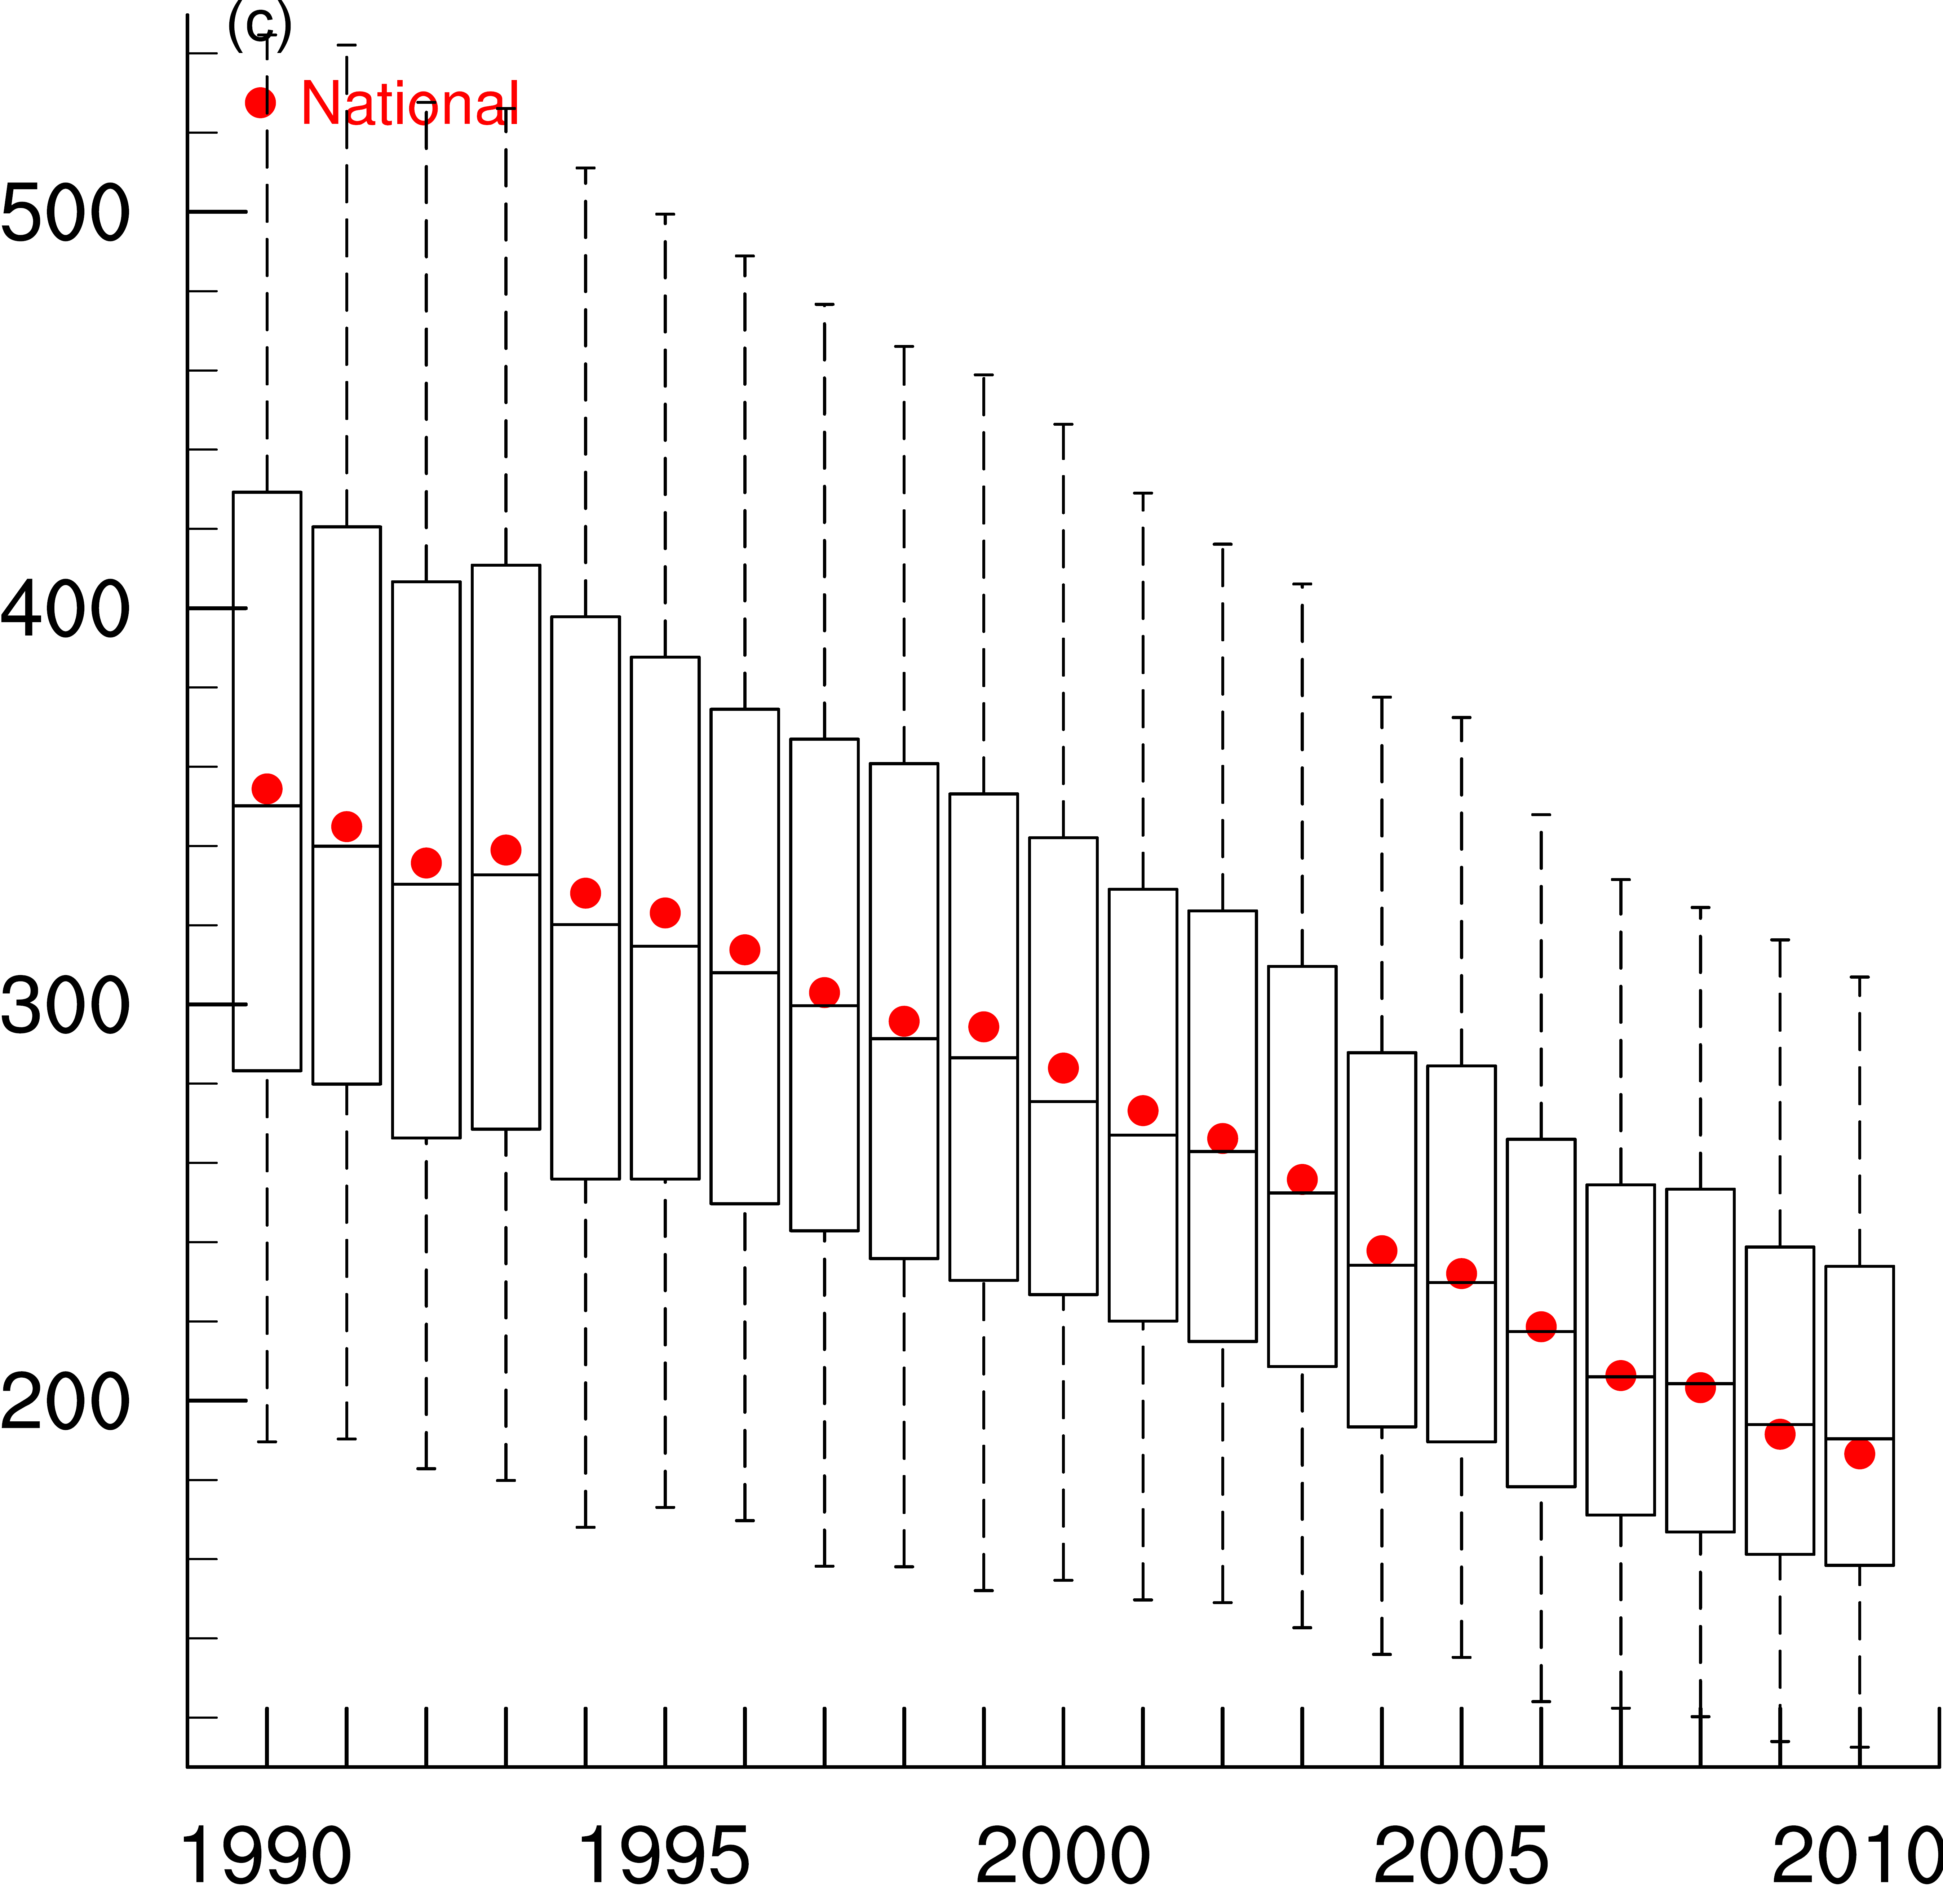
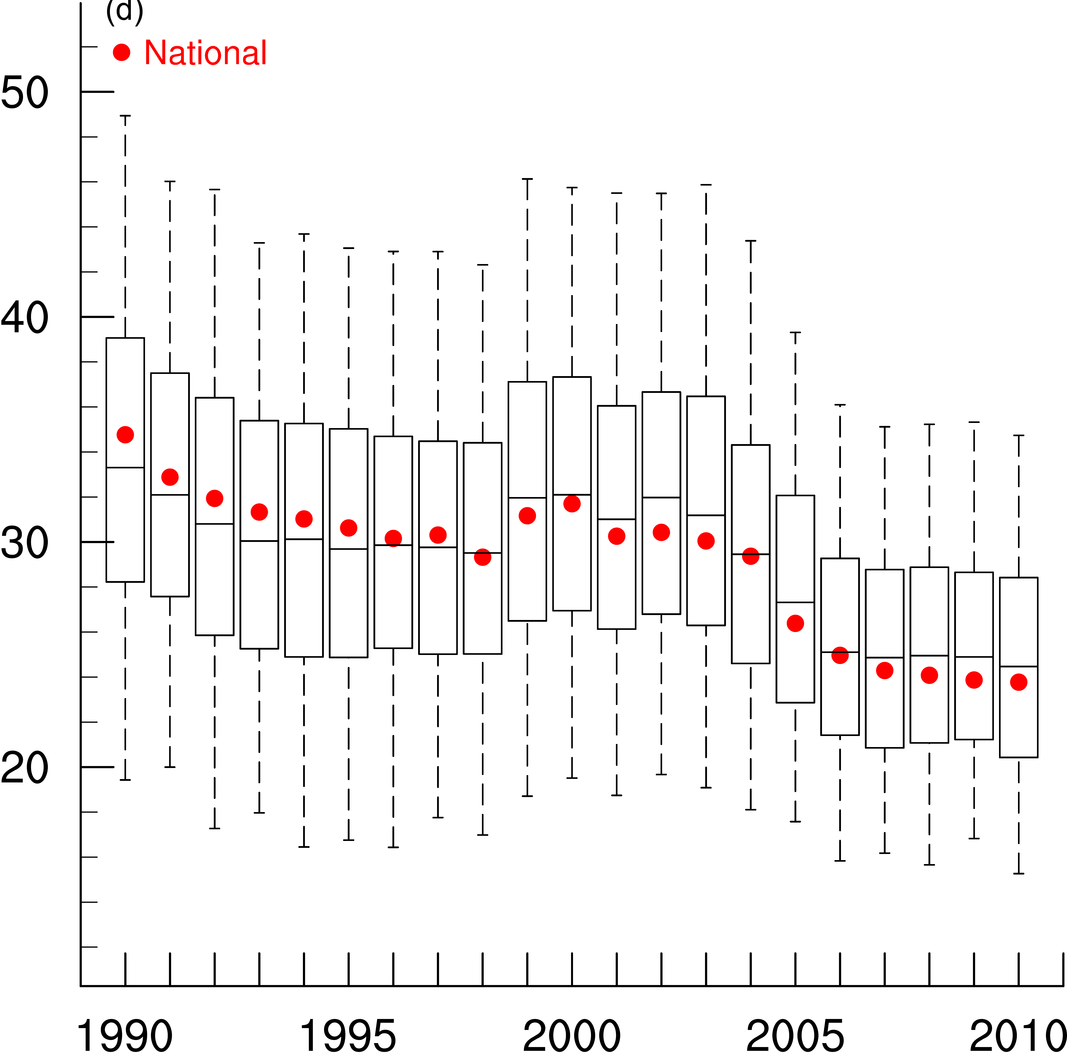
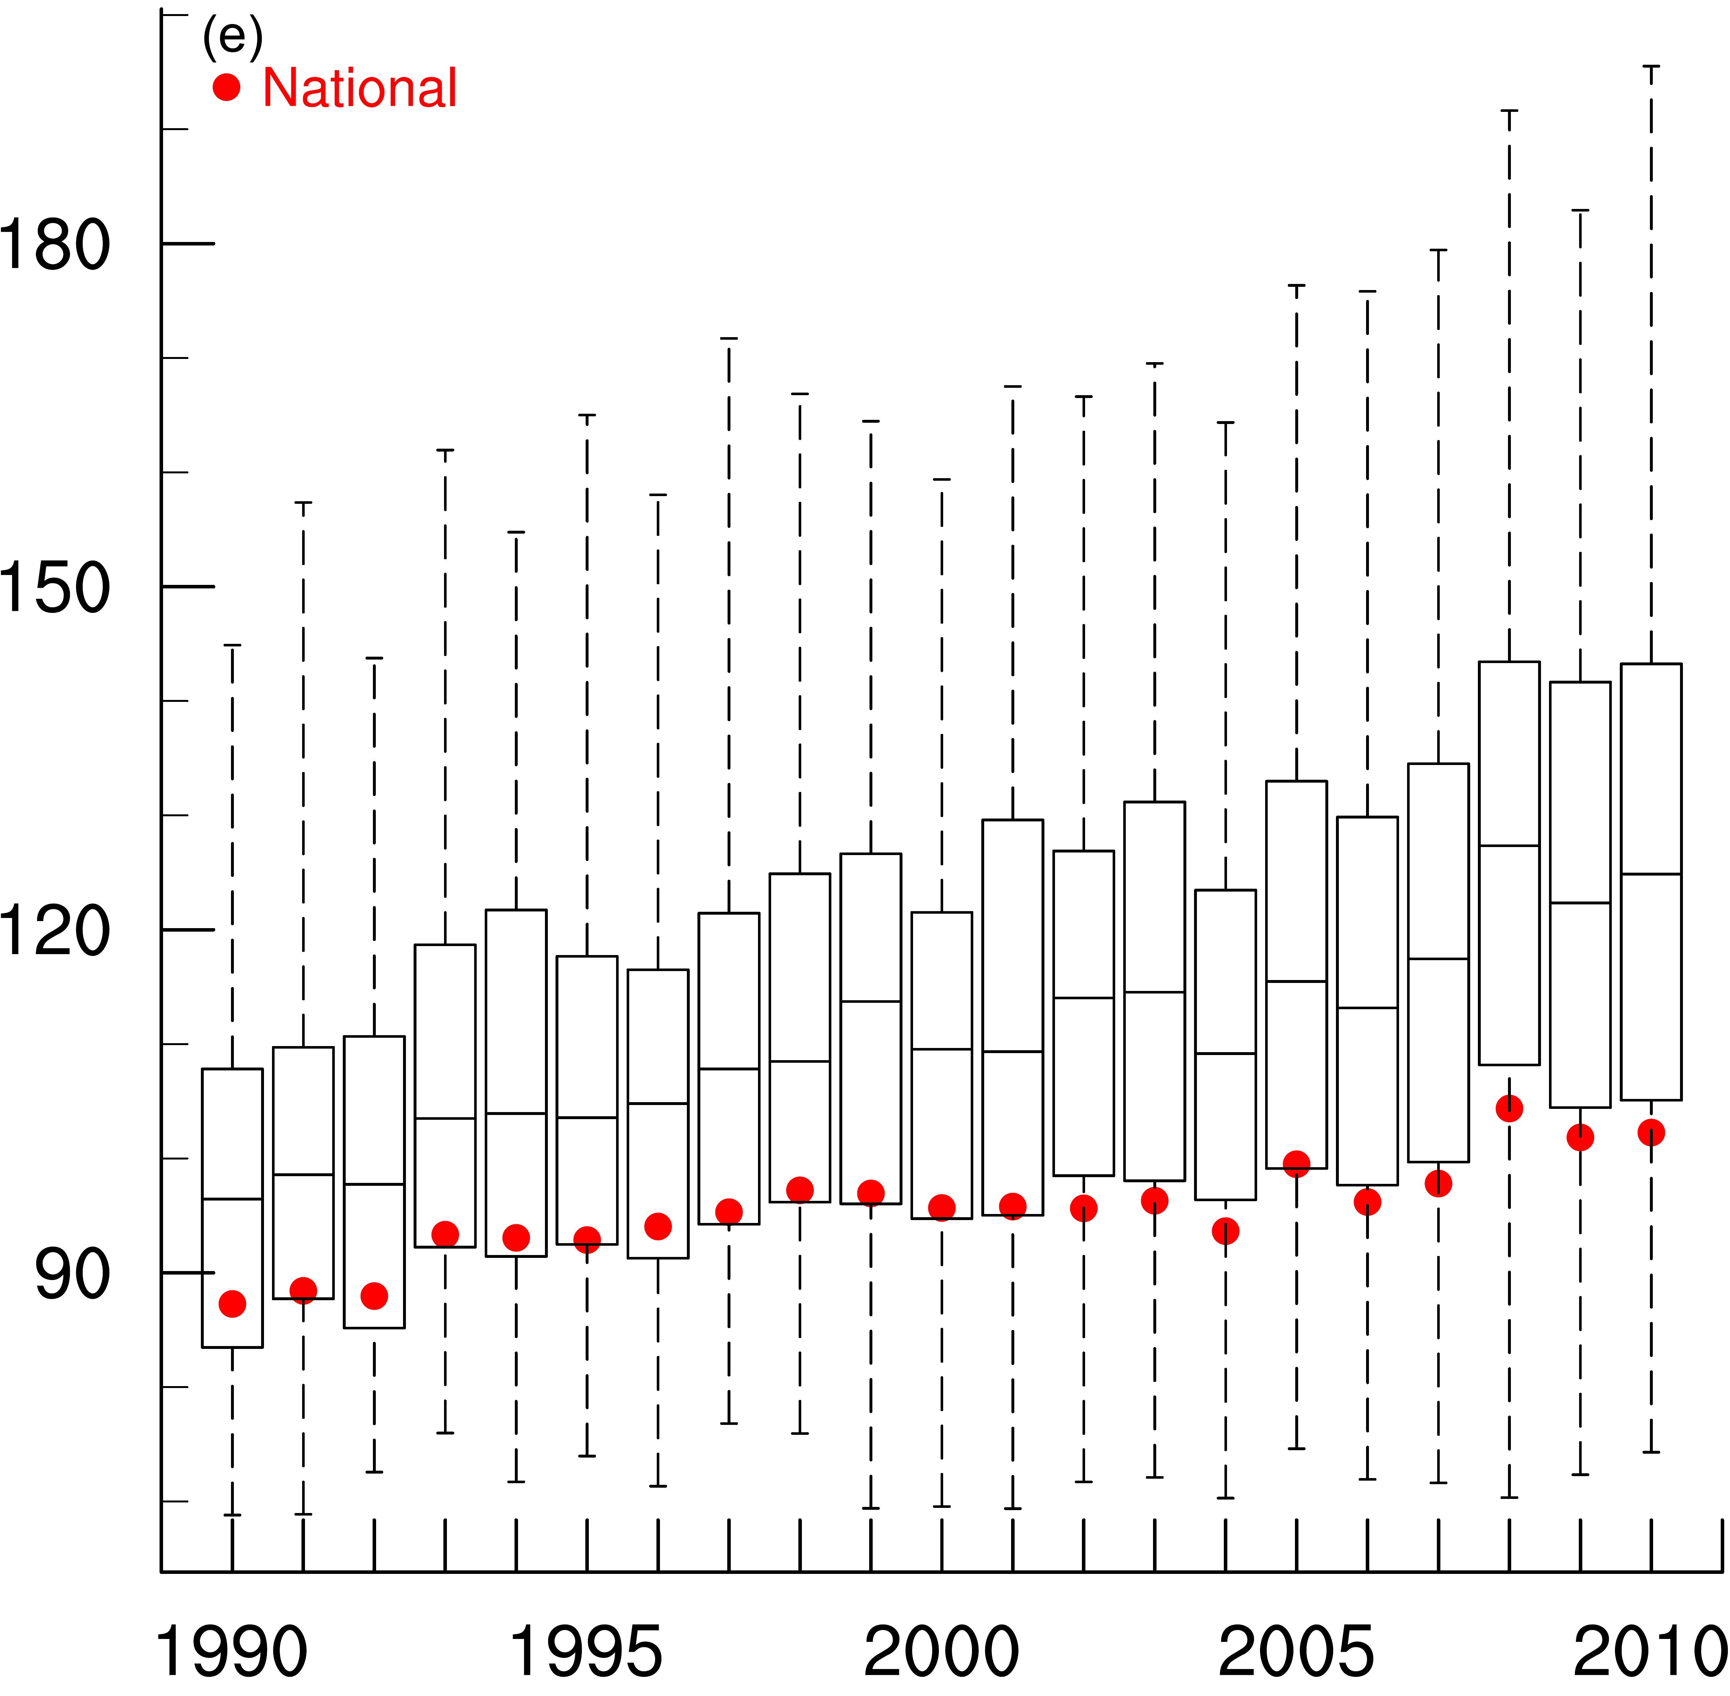
Methods
Baseline mortality rates
The baseline mortality rates for cause-specific death related with PM_{2.5}, including chronic obstructive pulmonary disease (a), lung cancer (b), ischemic heart disease (c) and stroke (d), and the Respiratory diseases (e) related with O₃. The bottom whiskers, bottom border, middle line, top border and the top whiskers of the boxes, indicate the 5th, 25th, 50th, and 75th, 95th percentiles, respectively, across all counties; The red circles are the national-level rate. Baseline mortality rates are shown for 1990-1998 after they are corrected to ensure comparability between ICD9 and ICD10 codes.
Notes:
Model evaluation for the major air pollutants and meteorology variables are presented in several previous studies.
Why NH4 is poor—check the reference
Underestimating N—Check Wyat’s paper

Slide 23
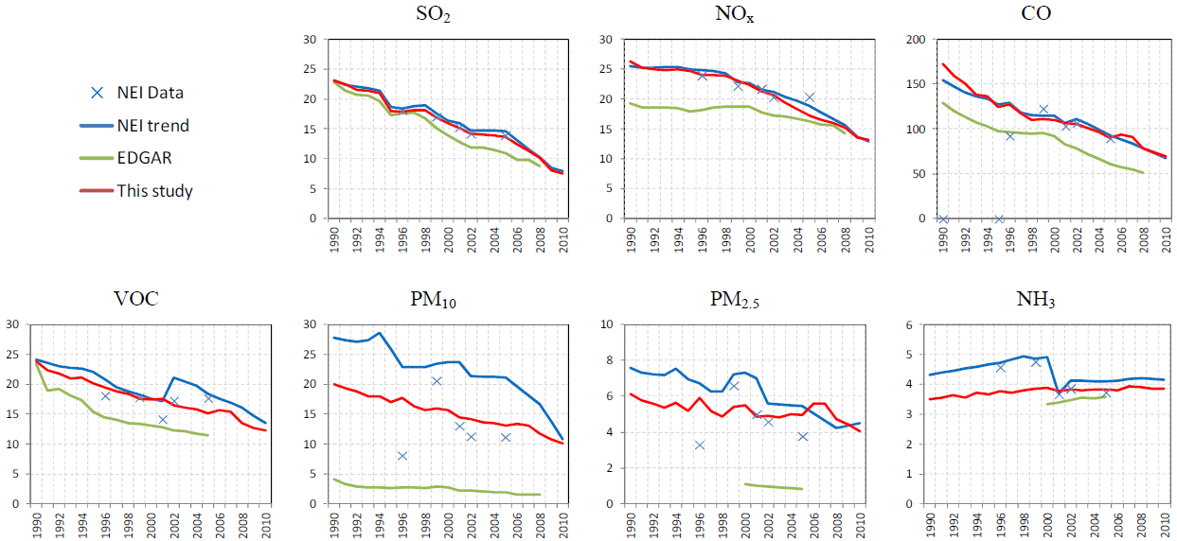
U.S. emission trends from 1990 to 2010
Xing et al., 2013
Use a consistent framework across years to develop U.S. emissions estimates from 1990 to 2010.
Emissions for major air pollutants are greatly decreasing, except for NH₃, the increase of which is mainly caused by the activity of livestock and agriculture.

Slide 24
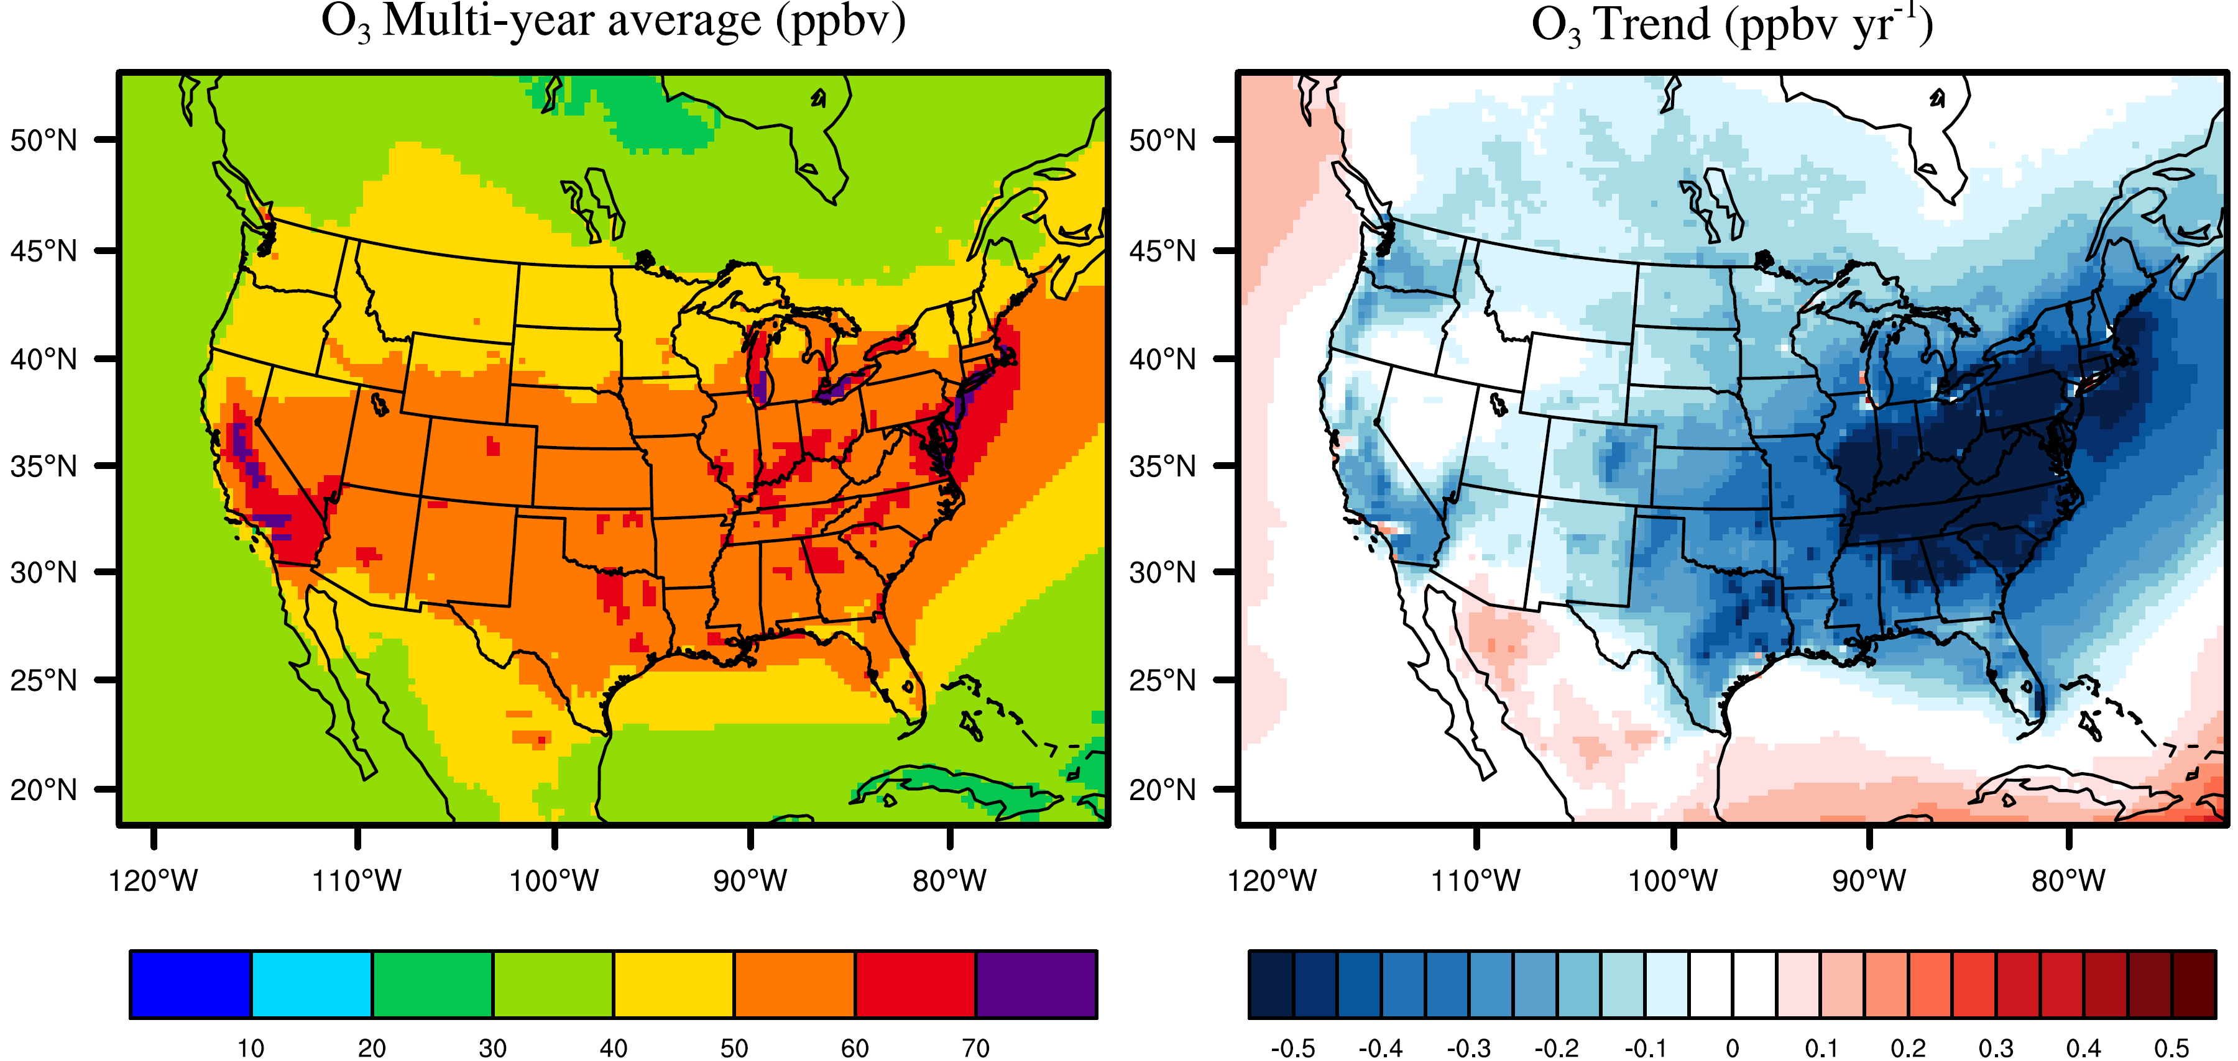
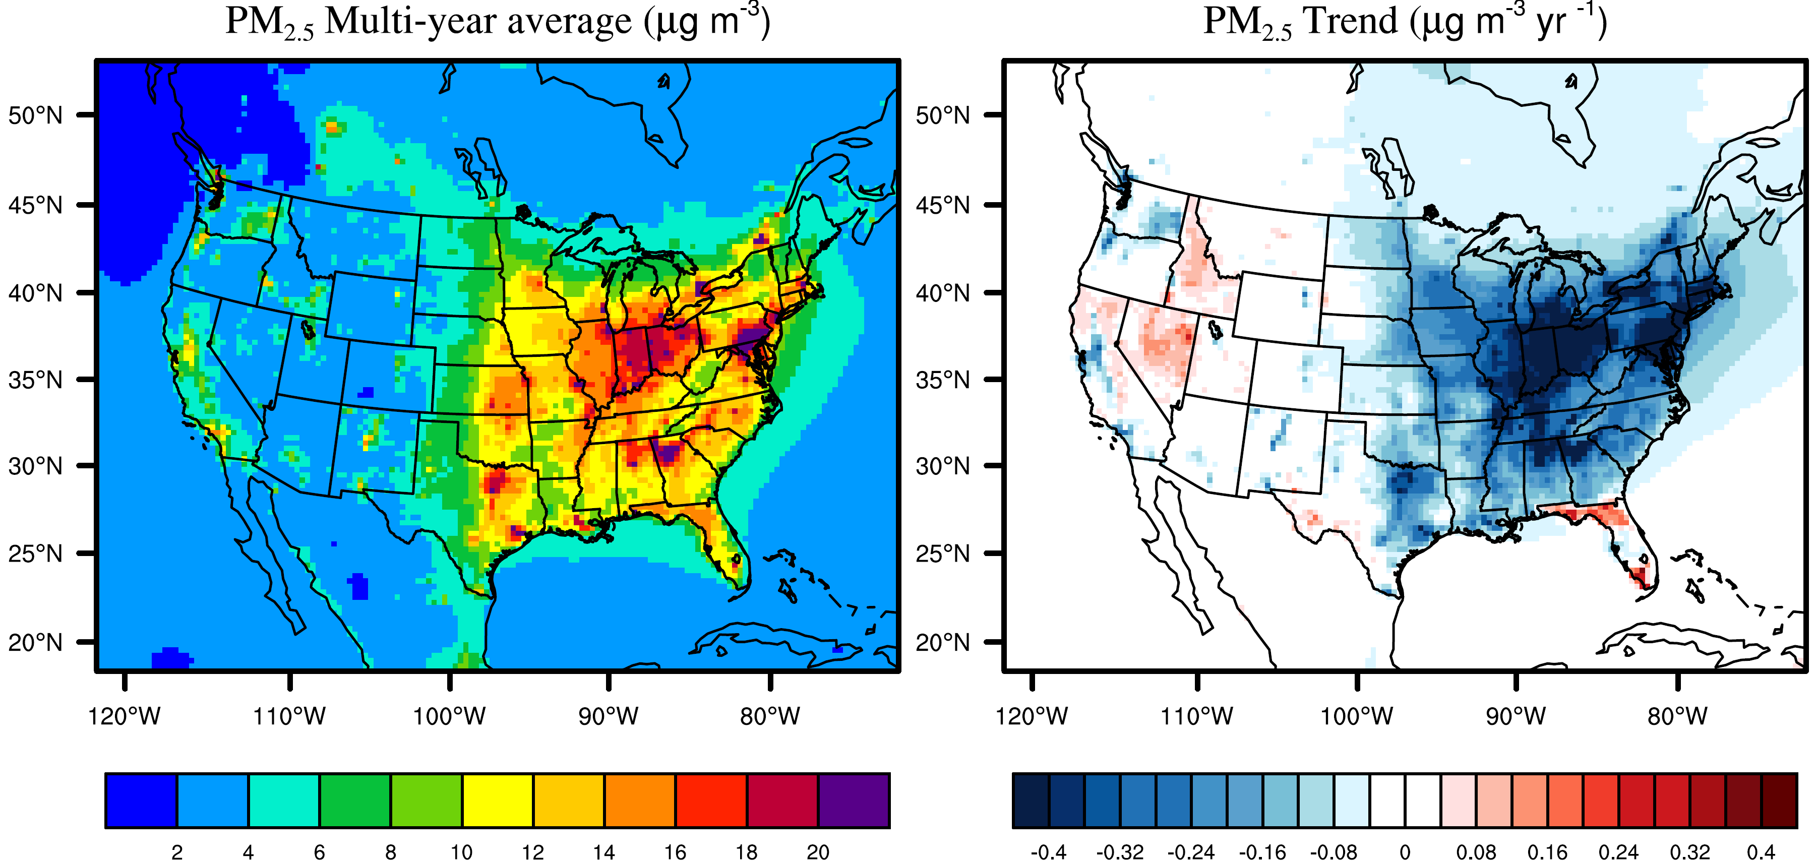
Results
U.S. air quality trends from 1990 to 2010
6-month average of daily maximum 1hr O₃
O₃ decreases significantly in the east and west, > 0.5 ppbv yr⁻¹;
The decreases are slow or insignificant in the middle;
PM_{2.5} decreases in the Northeast, but no significant changes in the west.
Annual average PM_{2.5}

Slide 25
Methods
∆Mort = y₀ x AF x Pop
Background O₃ (1850):
From an ensemble of 14 global chemistry–climate models (ACCMIP; Silva et al., 2013)
O₃ higher in the eastern and western U.S., large than 30 ppbv; lower in the middle, larger than 28 ppbv
Notes:
Model evaluation for the major air pollutants and meteorology variables are presented in several previous studies.
Why NH4 is poor—check the reference
Underestimating N—Check Wyat’s paper

Slide 26
Results
Trends for the absolute contribution of the three factors
Notes:
1. However, they use uniform 22, 30 ppbv for the east and west backgournd o3 concentration. The background O3 should be higher in both the east and the west, larger than 32 ppbv. So they underestimate the background and then overestimate the O3 health burdens

Slide 27
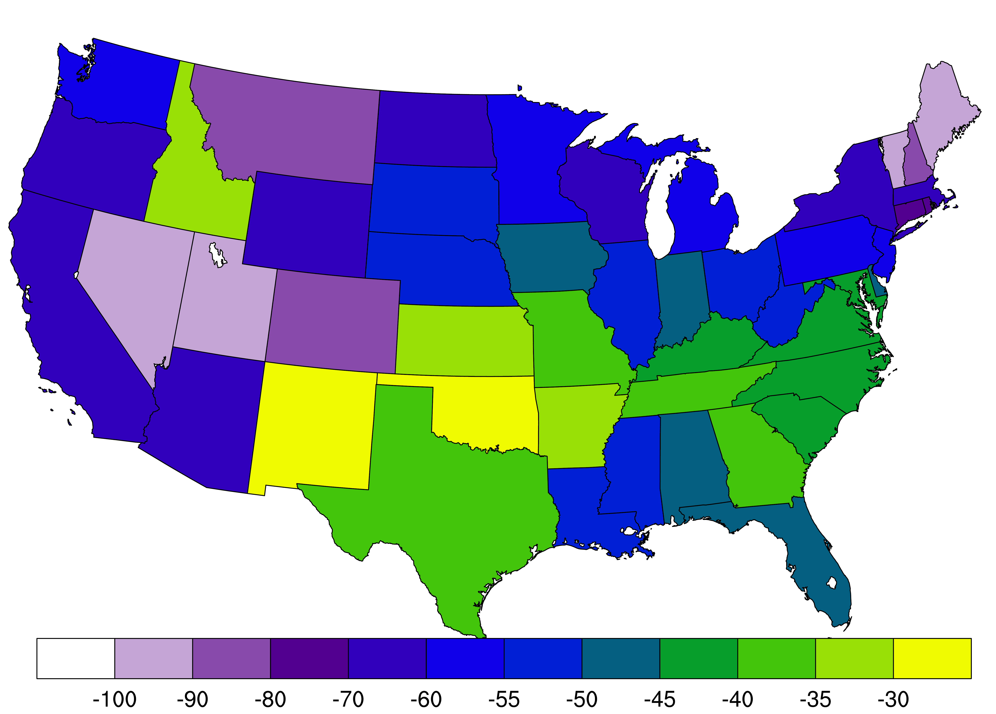
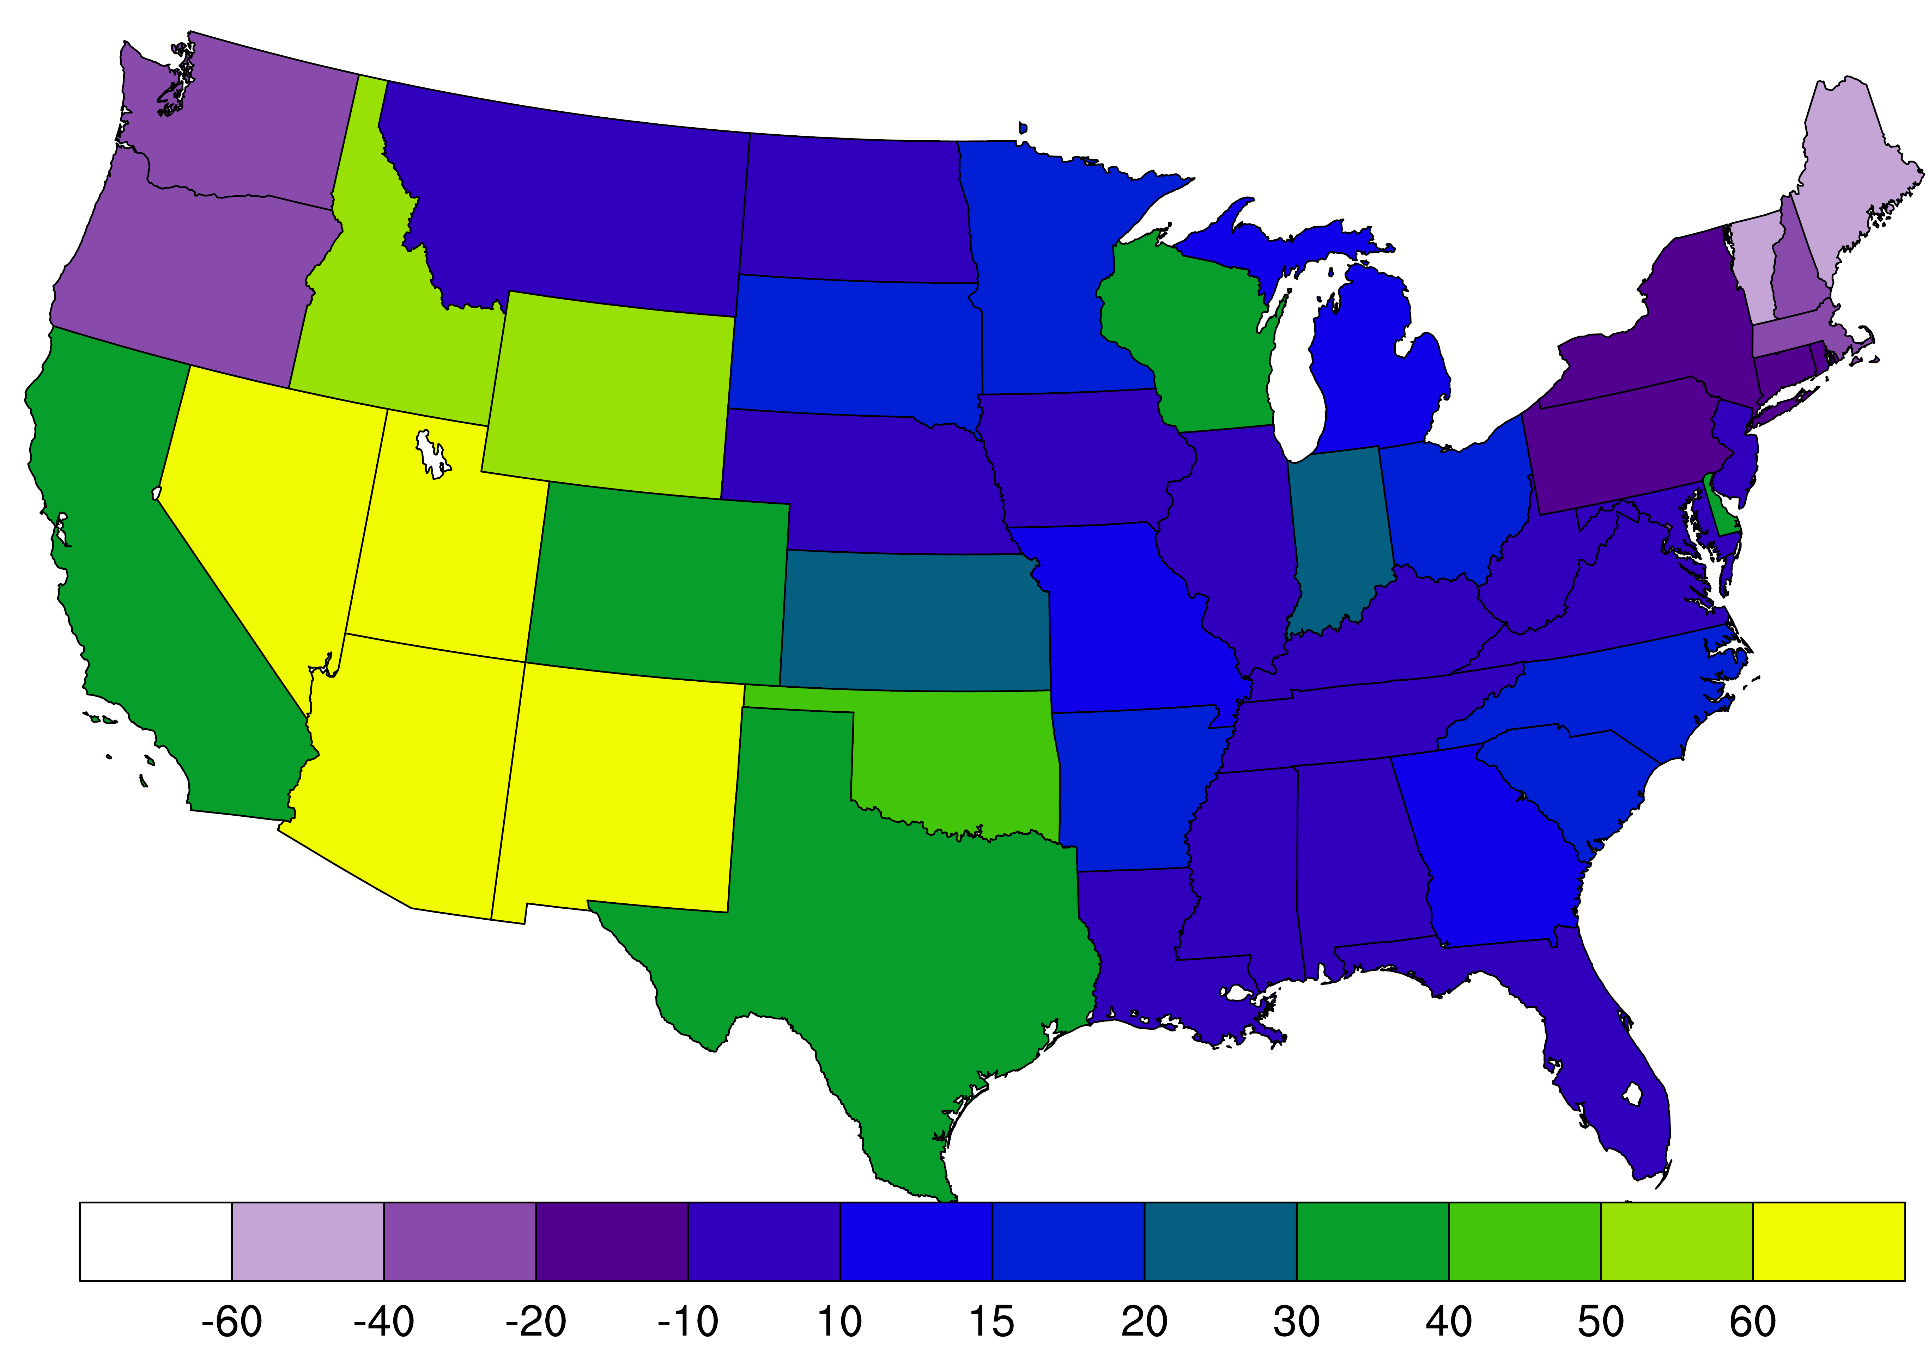
Results
Mortality burden relative change from 1990 to 2010 by states
PM_{2.5} O₃
For PM_{2.5}, New York has the largest decreases (-8,500 deaths yr⁻¹), followed by California (-6,100 deaths yr⁻¹), and Pennsylvania (-5,500 deaths yr⁻¹);
For O₃, the largest increases in CA (360 deaths yr⁻¹), followed by Texas (230 deaths yr⁻¹), and Arizona (140 deaths yr⁻¹).

