Slide 1
The leaf enclosure measurement for emission factors of Marijuana
CMAS conference
Chi-tsan Wang
Oct 24, 2017
Advisor : William Vizuete
Notes:
Introduce committee member
Add slice numbers

Slide 2
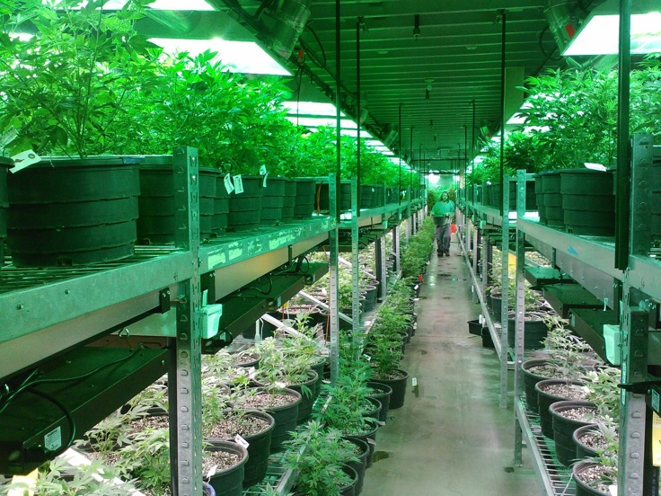
What is marijuana (Cannabis Sp)?
Marijuana Cigarette
http://www.breitbart.com/big-government/2016/10/04/denver-police-running-low-storage-space-confiscated-marijuana/
http://www.techtimes.com/articles/129956/20160202/this-is-what-happens-when-you-use-marijuana-every-day-for-five-years.htm

Slide 3
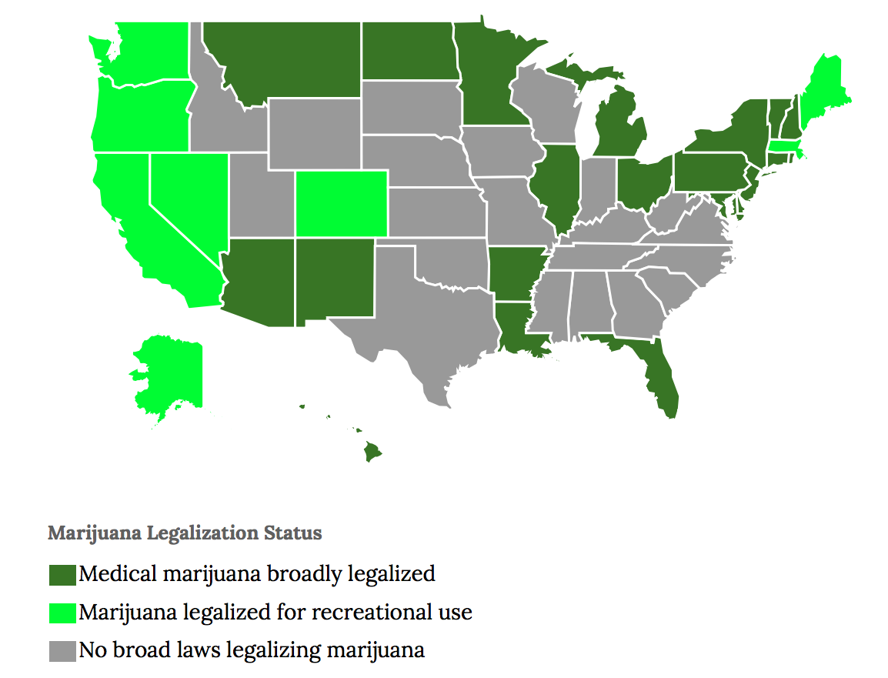
Research Background
Current marijuana legalization and industry in US
In 2012, Colorado and Washington started to legalize recreational marijuana.
The marijuana industry in Colorado has been active since 2014.
2015 annual sales reached almost $1 billion (996million) = grain farming in the state.
http://www.governing.com/gov-data/state-marijuana-laws-map-medical-recreational.html
Notes:
On November 8, 2016, four additional U.S. states (California, Massachusetts, Nevada, and Maine) legalized the use of recreational marijuana and four more relaxed medical marijuana laws. This is effectively creating a new industry in United States, one that looks set to rival all but the largest of current businesses with projected income expected to exceed that of the National Football League by 2020. In Colorado sales revenues have reached $1 billion, roughly equal to that from grain farming in the state and a third higher than residential construction,(1) an industry with strict environmental monitoring procedu
1 billion

Slide 4
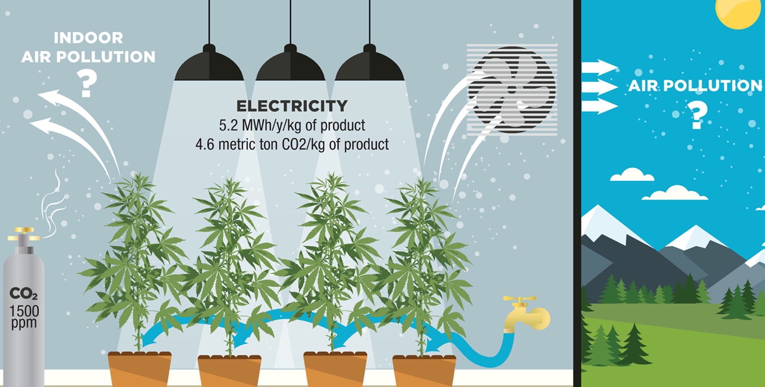
Marijuana Cultivation Facilities MCFs and Biogenic Volatile Organic Compounds (BVOC) emission
High Time to Assess the Environmental Impacts of Cannabis Cultivation. 2017, K. Ashworth† and W. Vizuete
Notes:
Organic compounds are chemicals that contain carbon and are found in all living things.VOCs are organic compounds that easily become vapors or gases.

Slide 5
Marijuana and VOC emission research
Earlier studies focus on pharmacological and health effects of Marijuana.
Principal components are monoterpenes, such as α- and β-pinene, β-myrcene, d-limonene and cis-ocimene, and the sesquiterpenes β-caryophyllene, β-farnesene and α-humulene.
VOC concentrations of 50-100 ppbv found within growing rooms.
The previous methods measured the concentration above the plants and dry plant leaves, but couldn’t be used to quantify the VOC emission rate of marijuana.
The emission rate is necessary to estimate the emission from MCFs.
(Hood 1973, Turner 1980, Martyny 2013, Rice 2015a, Marchini 2014, Hillig 2004, Fischedick 2010)
Notes:
Why Terpene emissions?
In this study, the indoor MCF measurement is for find other illicit MCFs. And the Mariju are fewer than 100.
There is not a way to calculation the emission factor.

Slide 6
Summary Of Motivation
Colorado is the first state to legalize the industrial-scale cultivation of marijuana plants, which has become a fast growing industry since 2014.
Indoor and lab measurement indicated that monoterpenes are the principle emission species from Cannabis spp. Their methods couldn’t calculate the emission rate of marijuana.
Monoterpenes from MCFs may impact the air quality in ozone non-attainment areas, including Denver and the Front Range metropolitan area.
Notes:
Three year to develop the industry in CO. mature industry

Slide 7
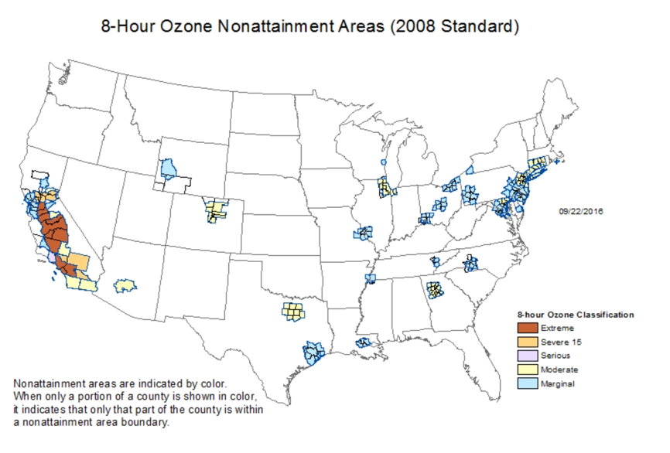
Why are the VOC emissions from MCFs important in Denver?
Marginal (2015)
Moderate (2016)
Notes:
Only show one photo and focus on Denver.
Really walk thriught his plot

Slide 8
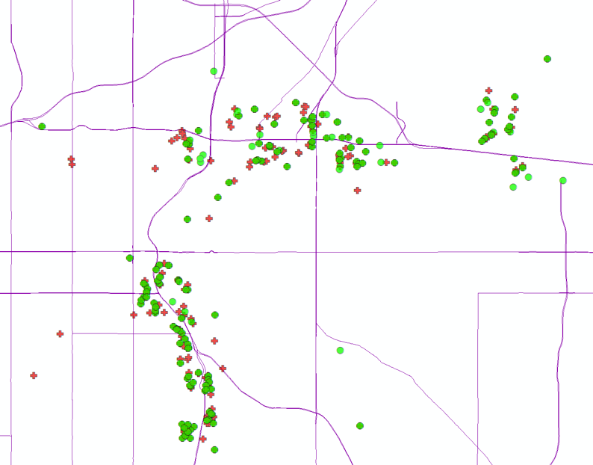
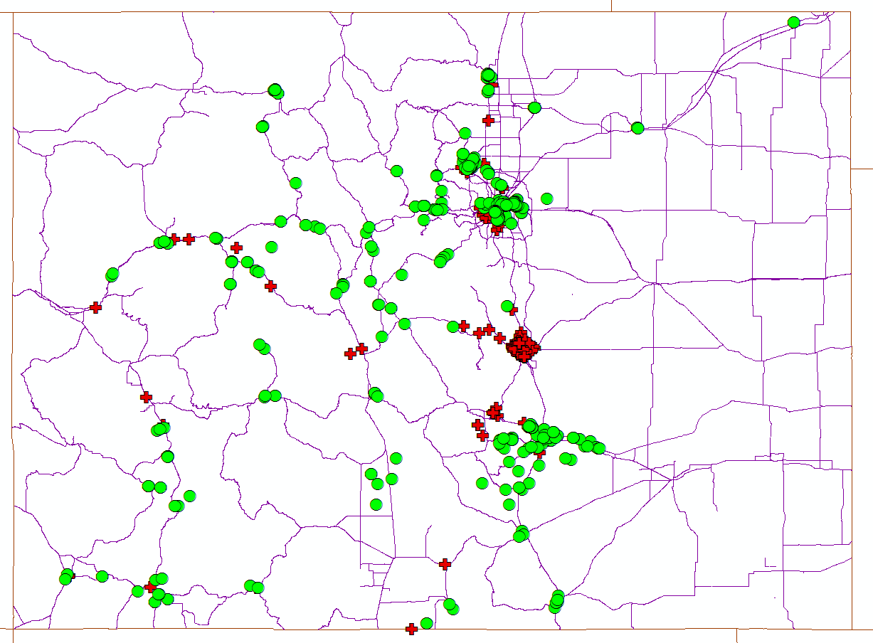
Marijuana Cultivation Facilities MCFs and Marijuana industry in CO
Retail MCFs
Medical MCFs
In Oct 2015, there were 493 retail and 762 medical MCFs in CO.
177 recreation MCFs and 346 Medical MCFs were in Downtown Denver.
I70
I25
Notes:
1.Show what is MCF
2.Most of the MCFs in Denver are alone I70 and I25
3.roughly equal to that from grain farming in the state and higher than residential construction
Remove US map and mov income to previous slides

Slide 9
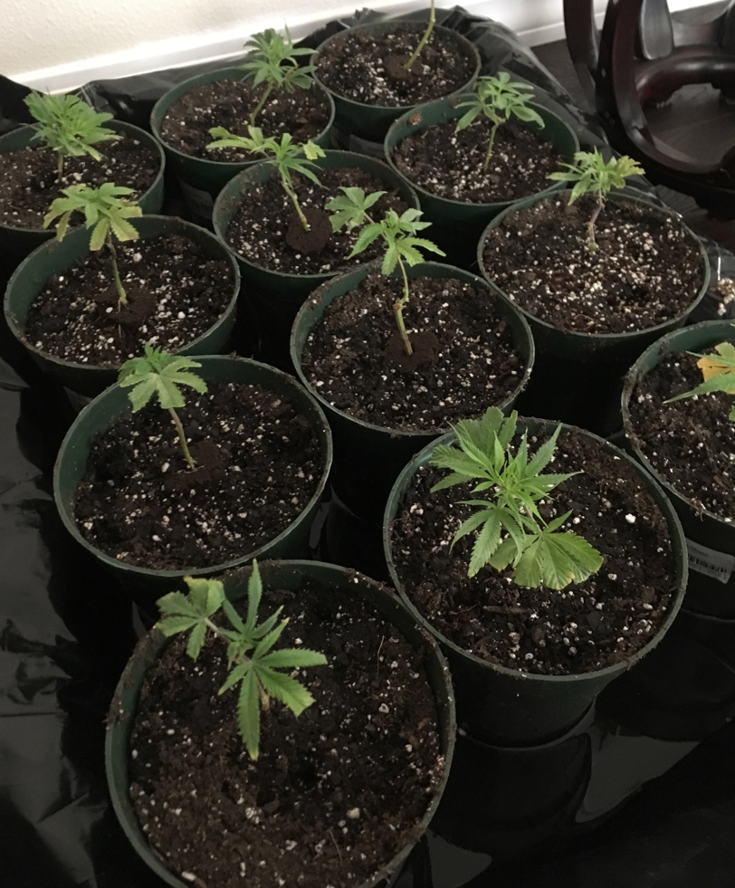
Leaf enclosure for marijuana plants
Research Questions:
What kind of biogenic VOC emissions come from marijuana?
What is the emission rate from marijuana?

Slide 10
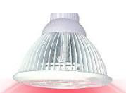
Leaf enclosure system
Photosynthesis
Emission Rate=Q(Ci_{out}-Ci_{empty})
Q= flow rate of purged air (L/min)
Ci_{out} :Conc. of species i at outlet with marijuana plant
Ci_{empty} : Conc. of species i at outlet with empty pot.
0.25L/min
2.6L/min
0.25L/min
Active carbon filter
Continuous Stirred Tank Reactor (CSTR), Volume is 4.73L

Slide 11
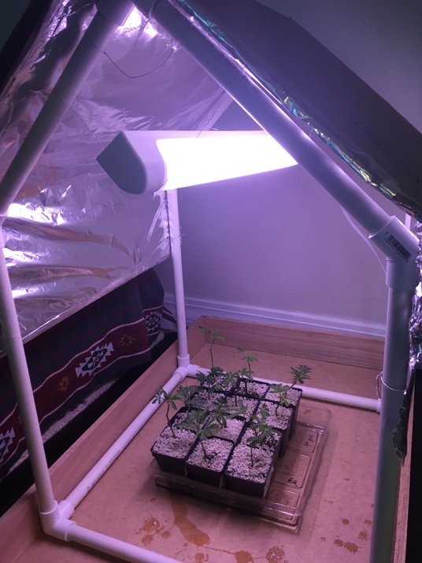
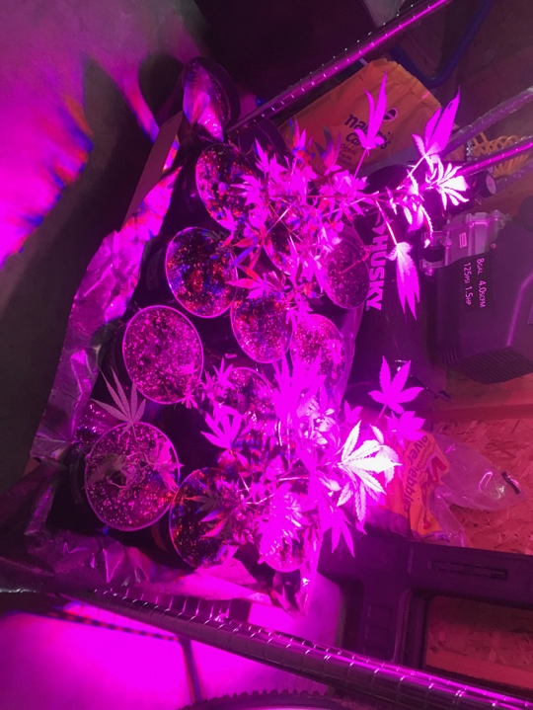
Experimental details
4 different strains, 12 plants total, due to state regulation on plants for private.
4 leaf enclosure experiments : the clone plants are 12days, 30days, 46days, 96days old.
The first(12days) and second(30days) measurements record the leaf areas; the third(46days) and fourth(96days) experiments harvested the plant for dry leaf weight, thereby killing the plant.
1day
35days

Slide 12
Sampling Method
No online GCMS in this project, we can only get the samples and analyze the VOCs composition in lab.
Portable and easy sample, small volume.
Accurate and specific for terpene and VOC species.
Compatible with GC analysis
Air was drawn into the cartridges using a pump in constant flow rate.
Cartridges : Sorbent are Tenax TA (C₇-C₃₀) and Carbograph 5TD (C_{3/4}-C_{6/7}) to optimize the capture of terpenoids.
Thermal Desorption cartridge
Clean carrier gas purged
GC MS&FID
https://www3.epa.gov/ttnamti1/files/2014conference/monairtoxmarkes.pdf

Slide 13
Emission rates($μ$g C/hr) and chemical composition(%) in two different growth stage
1.41 $μ$g C/hr
8.9 $μ$g C/hr
1.1 $μ$g C/hr
3.5 $μ$g C/hr

Slide 14
Emission rates($μ$g/hr) and chemical composition(%) in two different growth stage
30days
46days
0.8 $μ$g C/hr
4.1 $μ$g C/hr
0.6 $μ$g C/hr
2.1 $μ$g C/hr

Slide 15
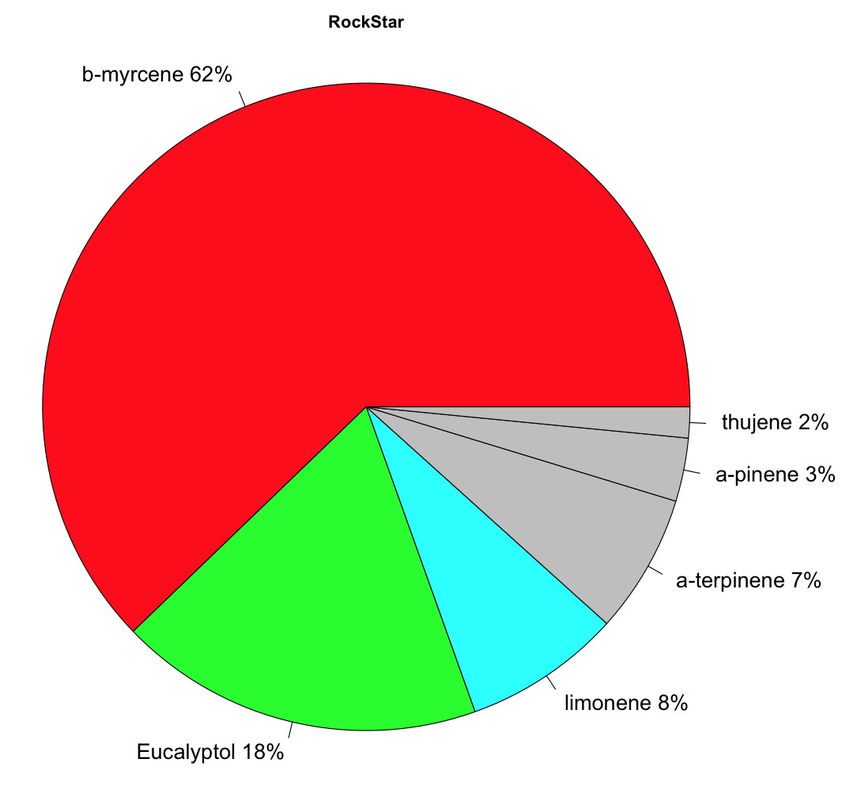
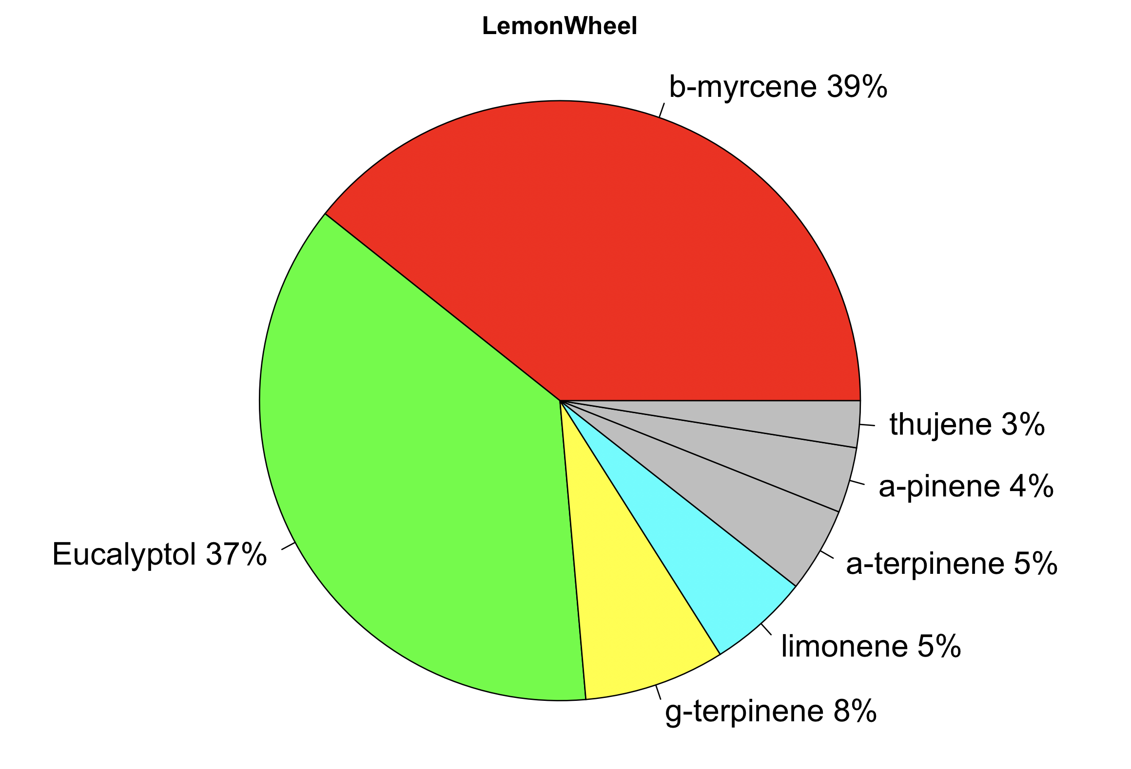
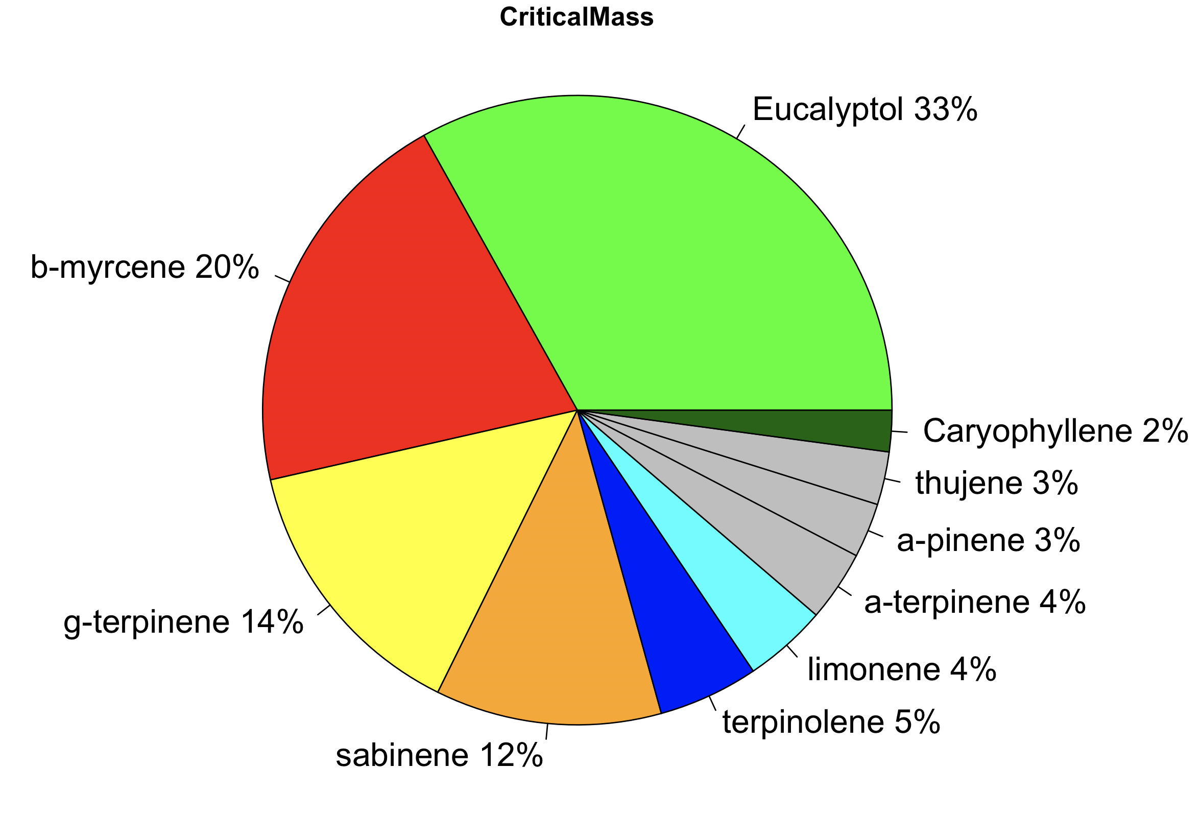
Standard emission rate for 46 days at 30°C
Notes:
This number is lower than tomato plant but higher than pin tree. No body calculate it, no one know about it.

Slide 16
Comparing the emission rate with other plants

Slide 17
Conclusion:
We identified the marijuana emission factors using the leaf enclosure method.
Those emission factors are reasonable for marijuana plants, but could be higher due to better growing conditions in the MCFs.
This outcome implies that marijuana plant growth at MCFs in Denver may have an adverse impact on ozone generation.

Slide 18
Next steps
Apply the emission factors into CAMx 3SAQS in Colorado for 4km resolution.
Compare the model result with our ambient measurement data.

Slide 19
Thank you
Acknowledgement NCAR Advanced Study Program(ASP) Fellowship Intermountain West Data Warehouse (IWDW) Advisor: Dr. William Vizuete Dr. Christine Wiedinmyer Dr. Kirsti Ashworth Dr. Peter Harley Dr. John Ortega Dr. Jason Surratt Dr. Michael Barna Dr. Feng-Chi Hsu(David Hsu) Grant Josenhans

