Slide 1
Surface Turbulent Fluxes during Cold Air Pool Events
16th Annual CMAS conference
Xia Sun, Heather A. Holmes, Cesunica E. Ivey
Atmospheric Sciences Program, University of Nevada, Reno
10/25/2017

Slide 2
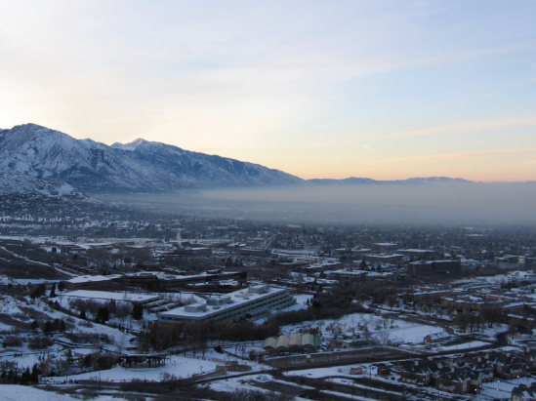
Motivation
Build up of air pollutant concentrations
Identified in many cities across the intermountain west U.S.
WRF failed to replicate the meteorological conditions
CMAQ underestimates the air pollutant concentrations
Stratified layer of pollution during a “cold pool” event near Salt Lake City, Utah.
Erik Crosman (photographed December 19, 2009) (Baker et al. 2011)
Notes:
If the daily intergration of surface heat flux can’t break the time inversion, temperature inversion will last for a longer time.
Cold air pool events are accompanied by temperature inversions.
Cold air pool is defined as a topographic depression filled with cold air,Light winds
High atmospheric pressure, and low isolation are favorable conditions for the formation of cold air pool.
2. Poor air quality, as high as 100 per cubic meter
3. Has been documented in salt lake valley and similar nearby valleys
This picture taken by eric crosman shows the pollution near salt lake city
It relates with periods of prolonged temperature inversions and
stagnant winds, which is also called cold pool
WRF needs improved land surface model and PBL schemes to improve its performance under these conditions

Slide 3
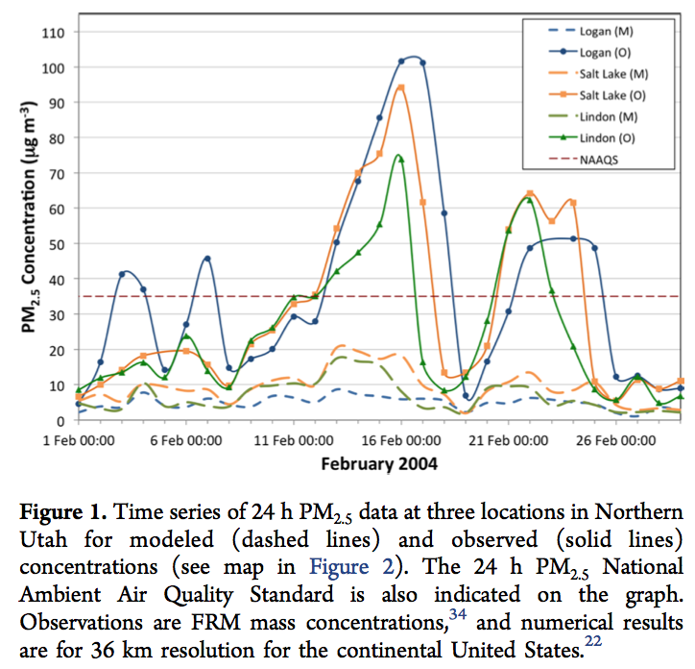
Particulate Matter: Observations vs. Model
CAP
CAP
(Holmes et al., ES&T 2015)

Slide 4
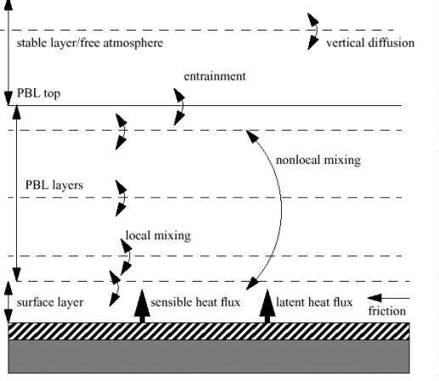
Surface turbulent flux
Surface layer coupled to the PBL
Latent heat flux impacts the surface water exchange
Illustration of surface and PBL processes
(Jimy Dudhia, NCAR)
Notes:
Sensible and latent heat fluxes are two dominante items in the energy budget equation
1.The surface layer is coupled to the the splanetary boundary layer (PBL) by surface fluxes. Sinks or sources of heat, moisture, momentum, and atmospheric pollutants
2. Evaporation from land and water surfaces is not only important in the surface water budget and the hydrological cycle, but the latent heat of
evaporation is also an important component of urface energy budget.
This water vapor, evaporated from surface when condensed on tiny dust particles and other aerosols (cloud condensation nuclei), leads to the formation of fog, haze, and
clouds in the atmosphere

Slide 5
Objectives
Objective
To characterize turbulent fluxes and surface energy balance over different land use types during CAP events.
Evaluation of WRF simulation results on each component of the surface energy budget.
Evaluation of WRF performance on simulation of PBL structure based on observational datasets during CAPs.
Hypothesis
Daily surface fluxes will be smaller during CAP periods compared to non-CAP episodes.
Energy balance depends on land use type.
NWP models will not adequately capture the turbulence magnitude and variation during daytime of persistent CAPs periods.
Vertical gradients are difficult for models to simulate during CAPs

Slide 6
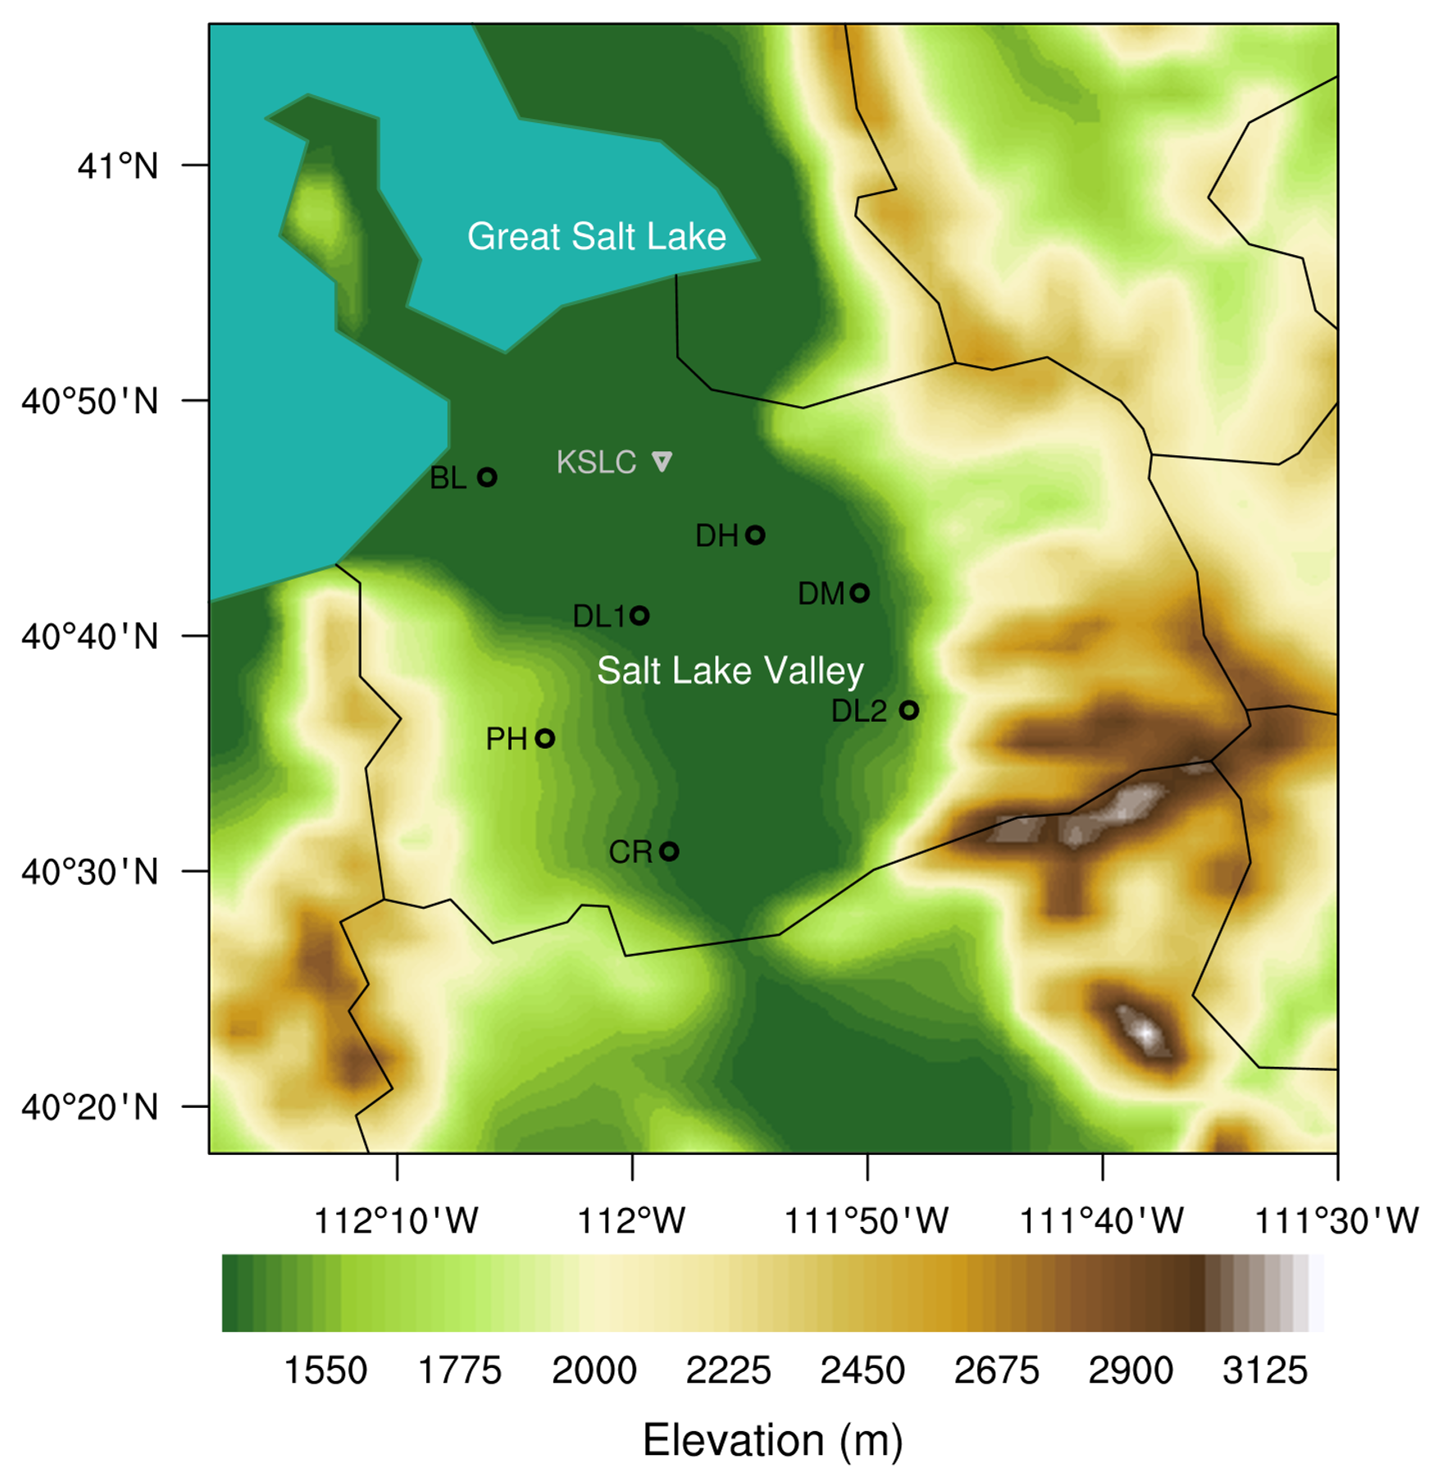
Observation Sites
Persistent Cold Air Pool Study (PCAPS)
*PI – David Whiteman (U. Utah), NSF
Integrated Surface Flux System (ISFS)
(Lareau et al. 2013)
Code | Site | Land Use
BL | Playa | Barren land
DH | ABC Urban | Developed, high intensity
DM | Highland | Developed, medium intensity
DL1 | West Valley | Developed, low intensity
DL2 | East Slope | Developed, low intensity
PH | West Slope | Pasture/Hay
CR | Riverton | Cultivated crops

Slide 7
PCAPS Study Time Period: Winter 2010-2011
10 Intensive Observation Periods (IOPs)
Brief and weak CAPs throughout
4 IOPs with Strong Multiday Persistent CAPs
Modeling – IOP3 & IOP5

Slide 8
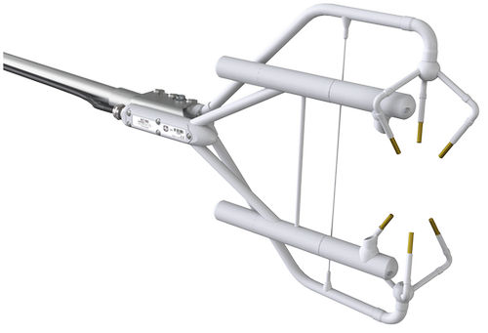

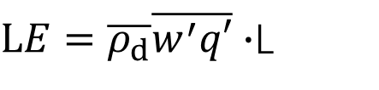
Measurements
Sonic anemometer
Gas analyzer
(https://www.campbellsci.com/irgason)
Friction velocity
Sensible heat flux
Latent heat flux
$$u_{∗}={({\overline{u^{′}w′}}^{2}+{\overline{v^{′}w′}}^{2})}^{1/4}$$
$$H=\overline{ρ_{d}}c_{p}\overline{w′θ_{s}′}$$
$LE=\overline{ρ_{d}}\overline{w^{′}q′}∙$L
covariance of vertical and horizontal wind components
ρ: air density
C_{p}: the specific heat capacity at constant pressure (J kg⁻¹ K⁻¹)
θs: the sonic temperature
q: water mixing ratio
L: the latent heat of vaporization for water(J kg ⁻¹).
8
Notes:
10hz

Slide 9
Surface Meteorology Fields
T (℃)
RH (%)
WS (m s⁻¹)
P (hPa)

Slide 10
Surface Turbulent and Energy Fluxes
H (W m⁻²)
Rn (W m⁻²)

Slide 11
Surface Energy Balance Closure
Energy Balance Ratio
Bowen Ratio
Site Name | Land Use | n | EBR | B
BL | Barren land | 1236 | 0.981 | 0.594
DH | Developed, high intensity | 1347 | 1.276 | 1.261
DM | Developed, medium intensity | 999 | 0.953 | 0.995
DL1 | Developed, low intensity | 1539 | 0.887 | 0.577
DL2 | Developed, low intensity | 1402 | 0.635 | 0.009
PH | Pasture/Hay | 1546 | 0.559 | -0.070
CR | Cultivated crops | 1554 | 0.671 | 0.331
Notes:
Urban has higher energy balance ratio (surface sensible heat fluxes might be overestimated by the extra generated heat energy in the urban environment in the measurements) and Bowen ratio greater than 1 because of reduced evapotranspiration.
West slope cultivated crops. Negtive bowen ratio, small and negative surface sensible heat flux
the long-term averaged energy balance ratio (EBR) is calculated by summing half-hour fluxes during the observation period (Equation 3). EBR is able to give an overall evaluation of the surface energy balance by lessening the random errors of the 30-minute turbulence measurement
regression parameters (slope and intercept) and correlation coefficient (R²) between the turbulent fluxes and the available energy. Ideal closure is represented by an intercept of zero and slope of 1.
Urban has higher energy balance ratio (surface sensible heat fluxes might be overestimated by the extra generated heat energy in the urban environment ) and Bowen ration than 1 because of reduced evapotranspiration.
West slope cultivated crops. Negtive bowen ratio , small and negative surface sensible heat flux
Typical values are 5 over semiarid regions, 0.5 over grasslands and forests, 0.2 over irrigated orchards or grass, 0.1 over the sea, and negative in some advective situations such as over oases where sensible heat flux can be downward while latent heat flux is upward.
Playa wetland

Slide 12
Non-CAPs vs CAPs
H (W m⁻²)
u* (m s⁻¹)

Slide 13
Non-CAPs vs CAPs
Mean midday (±3 h around the solar noon) averages
Item | Non-PCAPs | Weak PCAPs | Strong PCAPs
Rn | 97.79(±88.88) | 166.25(±84.91) | 72.20(±85.76)
H | 38.11(±54.26) | 51.30(±44.08) | 25.46(±29.99)
LE | 26.26(±23.96) | 31.54(±16.03) | 12.92(±14.76)
H/Rn | 0.40 | 0.32 | 0.39
(H+LE)/Rn | 0.72 | 0.52 | 0.60
u* | 0.34(±0.23) | 0.24(±0.14) | 0.19(±0.12)

Slide 14
Case Study-IOP 9 (Cloudy PCAPs)
Ceiling height (km)
Energy Fluxes (W m⁻²)

Slide 15
WRF Simulation
Configurations
NAM analysis dataset
3 Two-Way Nested Domains (12km, 2.4km, 480m)
30 Vertical Levels (10 in first 1,000m AGL)
Surface and Upper Air Nudging (OBSGRID)
Common Physics
Cloud Microphysics: Lin
Longwave Radiation: Rapid Radiative Transfer Model
Shortwave Radiation: Dudhia
Cumulus Parameterizations: Kain-Fritsch
Cloud Fraction Option: Xu-Randall

Slide 16
WRF Sensitivity Experiments
Planetary Boundary Layer, Surface Physics, Land Surface
ACM2, Pleim-Xiu, Pleim-Xiu (with soil nudging) [ACM2]
YSU, Monin-Obukhov Similarity, Noah [YSU]
MYJ, Monin-Obukhov Janjic Eta Similarity, Noah [MYJ]
Combination based on what the PBL model developers intended the configuration to be!

Slide 17
Simulated Meteorology (IOP3)
Buildup
Maintenance
Breakup
Temperature (K)
Wind Speed (m/s)
Notes:
Sonic Anemometer Observations: Daily ensemble averaged data from 11-15 Feb 2004 (CAP period) and 11-15 March 2004 (non-CAP) at 9.16m above ground level, showing (a) wind speed, (b) friction velocity, and (c) sensible heat flux.

Slide 18
Simulated Surface Fluxes (IOP3)
Buildup
Maintenance
Breakup
Sensible HF (W/m²)
Friction Velocity (m/s)
Notes:
sensible heat flux is well simulated. This is unexpected. This cold air pool only last for three days and is associated with lake breeze. The lake breeze process is caught by wrf?
The higher latent heat flux at noon of 12 December is related with the high simulated soil moisture in next slides.
Sensible heat flux (H) was underestimated by 6.36 W m-2 on average by WRF runs.
In summary, for H and LE, YSU better than ACM2 and MYJ, NAM better than NARR.
Friction velocity was underestimated by 0.03 m s-1 on average. NARR better. YSU best in simulating u*.

Slide 19
Simulated Vertical Profiles
14 Dec 2010
0500MST
14 Dec 2010
1100MST

Slide 20
Summary
Friction velocity decreases during CAPs
Sensible heat flux decreases during strong PCAPs
Low level clouds induce weak surface turbulence
WRF reasonably simulated SHF & friction velocity (IOP3)
WRF vertical profiles do not show observed gradients

Slide 21
THANKS!

Slide 22
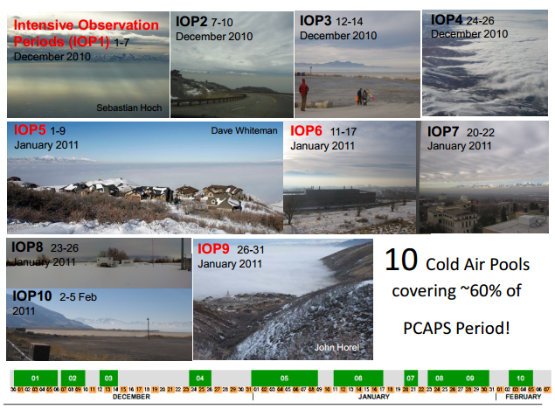
IOPs

Slide 23
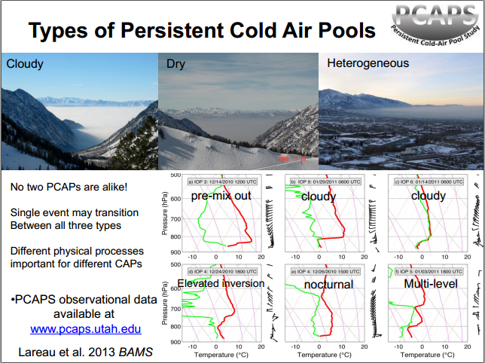
IOPs

Slide 24
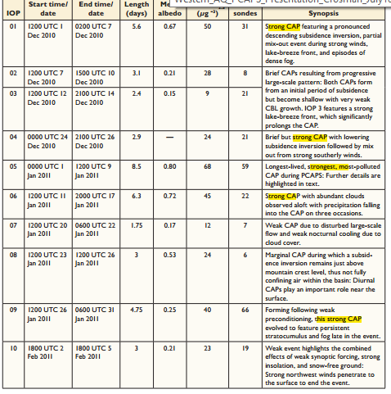

Slide 25
Surface Meteorology Fields
T (℃)
RH (%)
WS (m s⁻¹)
P (hPa)

Slide 26
Weather Conditions

Slide 27
LE (W m⁻²)
u* (m s⁻¹)

Slide 28
Soil Volumetric Water Content

Slide 31
Meteorology
CAP versus non-CAP
Wind Speed (m/s)
Temperature (ºC)
Notes:
I think this T2 don't necessarily relate with PCAPs events. because if we use the valley heat deficit method, we get different results. T2 under nonpcaps can be higher than pcaps.
But the wind speed has a relation with pcaps. it's lower during pcaps events.

