Slide 1
Representative Meteorological Data for AERMOD: A Case Study of WRF-Extracted Data Versus Nearby Airport Data
October 23, 2017
Brian Holland
Tiffany Stefanescu
Qiguo Jing
Weiping Dai

Slide 2
Introduction
Met data for near-field air dispersion modeling:
Closest airport station to facility being modeled
Purpose-built “onsite” stations located at or near the facility
These typical data sources become less representative of actual facility, introducing substantial error, in some cases
Where nearby observational data is not available
Where met conditions change rapidly with distance
Recent changes to U.S. EPA’s Appendix W open the possibility of increased use of mesoscale meteorological model data
Promising in that it has the potential to eliminate most of the distance-based representativeness error
Potential for forecast error from the mesoscale model, which would typically be larger than the observation error of a perfectly-placed surface met station
Necessary to weigh the representativeness error of a distant airport met station against that of an imperfect mesoscale met model
Notes:
Historically, meteorological data for near-field air dispersion modeling (e.g., AERMOD) has come primarily from
Recent changes to U.S. EPA’s Appendix W air dispersion modeling document have opened the possibility of increased use of mesoscale meteorological model data (WRF or MM5) as an alternative source of met data for near-field air dispersion modeling

Slide 3
Introduction
Objective:
Examine the relative magnitude of the errors in these met data sources in two case studies
Facility located in relatively flat terrain
Facility located in complex terrain
Met data in both cases:
An on-site met station is used as “truth”
Met data taken from:
A moderately distant airport station
The closest grid cell of a WRF model run
Both are compared to the on-site station’s observations to quantify the relative error of each
AERMOD model runs using each data source (site specific “truth”, distant airport, and WRF) to quantify the extent to which error in each met source translates into dispersion model result error

Slide 4
Methods
Simple Terrain Case Study
Wallisville Road air quality monitor location near Houston, TX (AQS: 48-201-0617) was used as source location
Onsite data from the monitor was used as “true” met conditions at the site
NWS airport met data taken from George Bush Intercontinental (KIAH)
WRF dataset extracted from the nearest gridpoint of a 12 km resolution national WRF simulation obtained from US EPA
Data from January-December 2007 was used
Most recent year available from all three data sources
Notes:
KIAH:
40 km NW of the site
Closest and most representative NWS station to Wallisville Road
Most likely would have been used in a typical real-world regulatory modeling application

Slide 5
Methods

Slide 6
Methods
Complex Terrain Case Study
Wamsutter, WY air quality monitor location (AQS: 56-037-0200) was used as source location
Onsite data from the monitor was used as “true” met conditions at the site
NWS airport met data was taken from the Rock Springs, Wyoming Airport (KRKS)
WRF dataset extracted from the nearest gridpoint of a 12 km resolution national WRF simulation obtained from US EPA
Data from January-December 2008 was used
Most recent year available from all three data sources
Notes:
KRKS:
86 km west of the site
Of the available met stations, most representative of Wamsutter site
Significant distance and differences in elevation and surrounding topography make it less than ideally representative
Common occurrence faced by industry and regulators in particularly in areas of the Mountain West where topography and widely-spaced airports mean many possible source locations do not have representative meteorological data readily-available.
This situation, in which the best-available NWS data is far from ideal in representing a project site, is a common occurrence faced by industry and regulators, particularly in areas of the Mountain West where topography and widely-spaced airports mean many possible source locations do not have representative meteorological data readily-available.

Slide 7
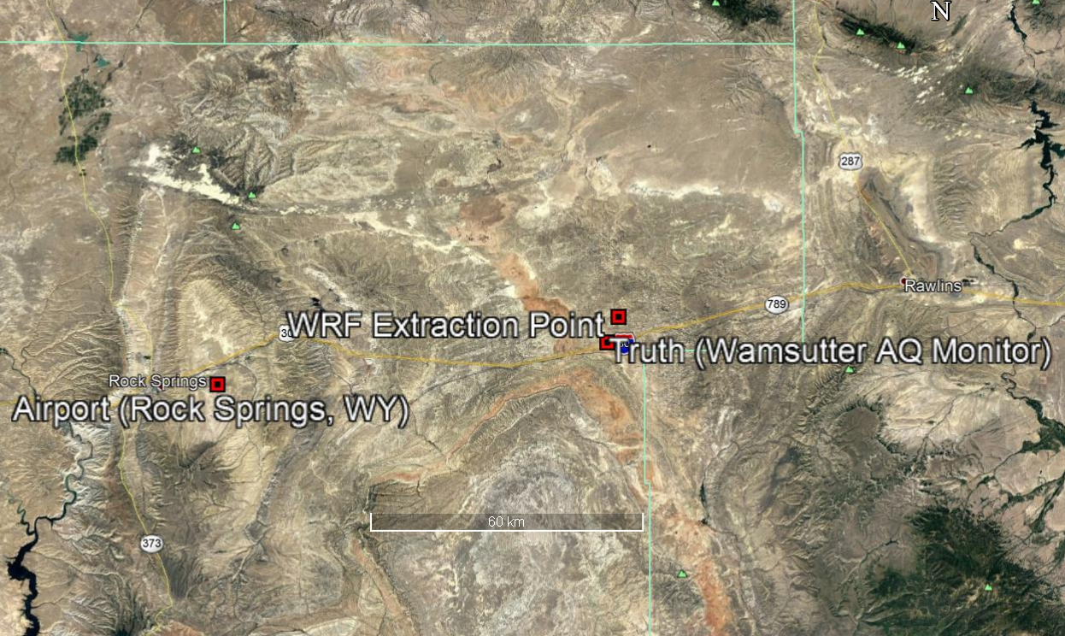
Methods

Slide 8
Methods
Meteorological Data Processing
All 6 datasets were processed with the latest version of AERMET
WRF data extracted into simulated surface and onsite point data files using U.S. EPA’s MMIF tool, then processed through AERMET to ensure as much consistency as possible with the “truth” and airport datasets
Airport data incorporates 1-minute wind data using AERMINUTE
All datasets used the same 0.5 m/s wind threshold, with winds below that being treated as calm hours (and thus being ignored by AERMOD)
AERSURFACE was used to analyze the land use for the “truth” and airport datasets, while WRF land use as extracted by MMIF was used for the WRF datasets

Slide 9
Methods
Meteorological Data Processing (con’t)
ADJ_U* option in AERMET
Intended to offset AERMOD’s tendency to over-predict concentrations from near-ground sources under stable, low wind conditions
Applied to the airport and WRF met datasets in accordance with US EPA guidance
Not applied to the “truth” datasets
The onsite stations used as “truth” include hourly σ_{ϴ} (standard deviation of horizontal wind direction) data
US EPA guidance on use of ADJ_U* recommends that it not be used if direct measurements of turbulence are available

Slide 10
Methods
AERMOD Simulations
Two different sources were modeled
Ground-level volume source
35-meter stack source
Terrain data incorporated with AERMAP
No building downwash
AERMOD simulations were carried out for a one-year period using the six datasets
“Truth”, WRF, and airport datasets for both simple and complex terrain case study locations
January-December 2007 for simple terrain case study
January-December 2008 for complex terrain case study
Regulatory default settings were used
Maximum 1-hr, 24-hr, and annual concentrations modeled
Notes:
To gauge the effect on different types of sources, which might be affected very differently by differences in weather patterns, two sources were used

Slide 11
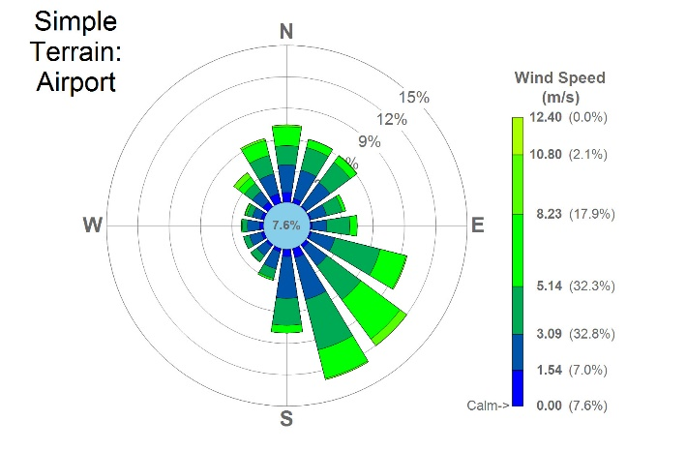
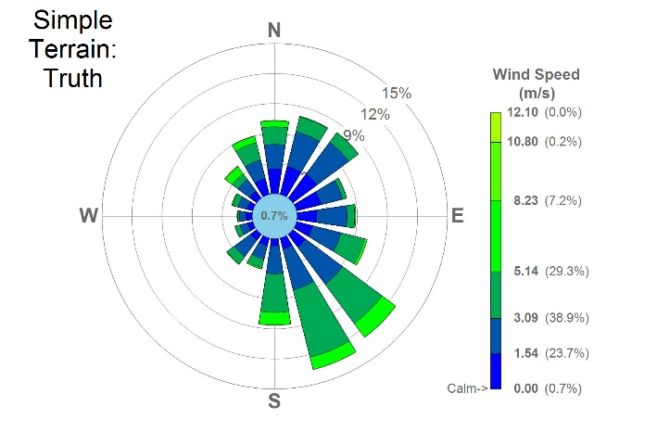
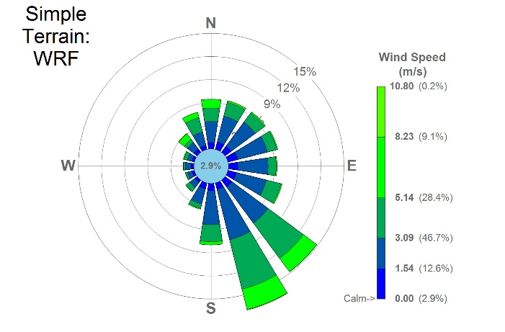
Results
Comparison of Met Data
Simple Terrain Case
Increased frequency of prevailing SSE/SE wind pattern in WRF dataset
Low wind speeds less frequent in WRF data and particularly in the Airport data compared to the Truth dataset
Airport dataset also overrepresented high wind speeds relative to Truth and WRF datasets
Average wind speed highest in Airport dataset
Notes:
Generally similar wind patterns present in all
In addition to underrepresenting low winds, the Airport dataset also overrepresented high wind speeds relative to the Truth dataset. This is consistent with the relatively low surface roughness typically found at airports

Slide 12
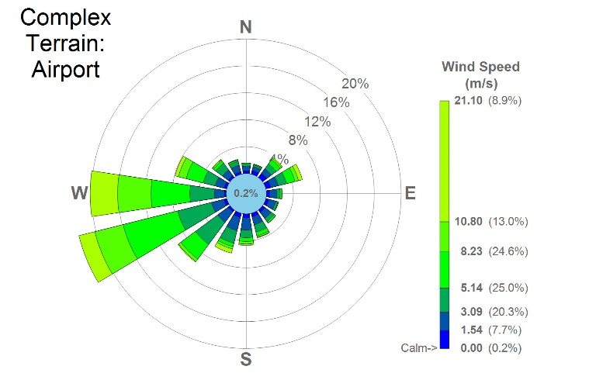
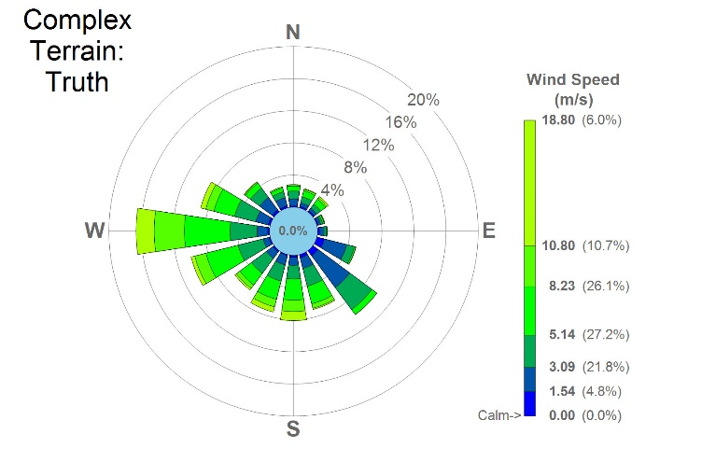
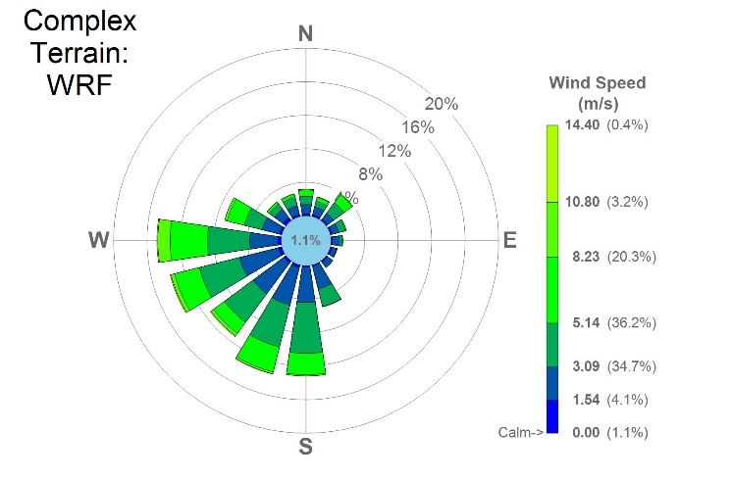
Results
Comparison of Met Data
Complex Terrain Case
Major differences in wind speed and direction patterns
High winds somewhat more frequent in the Airport dataset than Truth
WRF dataset underrepresents high winds
Average Airport wind speeds were higher than average WRF or Truth wind speeds
Notes:
The major differences are not surprising given that complex terrain causes met data patterns to change on smaller scales
The Truth dataset shows a prevailing WNW-WSW wind that represents 36% of hours, but a wide range of other wind directions are also common. The WRF dataset captures some of this variability (WNW-WSW represents 35% of hours) but a frequent SE wind in the Truth data is not seen in the WRF data). The airport data gives much heavier weight to the prevailing WNW-WSW wind (51% frequency) and underrepresents other wind directions.
WRF dataset underrepresents high winds possibly as a result of insufficient grid resolution to resolve terrain- or thunderstorm-induced winds

Slide 13
Comparison of AERMOD Results
Maximum Annual Concentration
Source Group | Simple Terrain |  | Complex Terrain
 | Airport | WRF | Airport | WRF
Tall Stack | 1.34 | 1.67 | 1.28 | 0.80
Ground Level | 0.52 | 0.45 | 0.50 | 0.39
Maximum 1-Hour Concentration
Source Group | Simple Terrain |  | Complex Terrain
 | Airport | WRF | Airport | WRF
Tall Stack | 0.85 | 1.29 | 0.85 | 1.21
Ground Level | 0.14 | 0.16 | 0.21 | 0.29
Maximum 24-Hour Concentration
Source Group | Simple Terrain |  | Complex Terrain
 | Airport | WRF | Airport | WRF
Tall Stack | 1.37 | 1.70 | 0.86 | 1.10
Ground Level | 0.37 | 0.42 | 0.24 | 0.22
Simple Terrain
WRF dataset consistently over-predicted peak conc. for tall stack and under-predicted peak conc. for ground-level source
Airport dataset over-predicted conc. for the tall stack in 24-hr and annual periods, but under-predicted max 1-hr avg. conc.
Aside from the ground level source annual averaging period, the WRF dataset consistently produced more conservative results than the Airport dataset
Both datasets consistently under-predicted conc. for ground-level source
Summary of max ground-level 1-hour, 24-hour, and annual average concentrations, normalized so “Truth” concentration is 1.00
Notes:
Thus, higher values represent over-prediction relative to the “Truth”, and lower values represent under-prediction.
More conservative results, meaning that the values are on the higher side
Last point: The one that jumps out the most - we are way underpredicting ground-level source in every case relative to the “truth” dataset

Slide 14
Comparison of AERMOD Results
Maximum Annual Concentration
Source Group | Simple Terrain |  | Complex Terrain
 | Airport | WRF | Airport | WRF
Tall Stack | 1.34 | 1.67 | 1.28 | 0.80
Ground Level | 0.52 | 0.45 | 0.50 | 0.39
Maximum 1-Hour Concentration
Source Group | Simple Terrain |  | Complex Terrain
 | Airport | WRF | Airport | WRF
Tall Stack | 0.85 | 1.29 | 0.85 | 1.21
Ground Level | 0.14 | 0.16 | 0.21 | 0.29
Maximum 24-Hour Concentration
Source Group | Simple Terrain |  | Complex Terrain
 | Airport | WRF | Airport | WRF
Tall Stack | 1.37 | 1.70 | 0.86 | 1.10
Ground Level | 0.37 | 0.42 | 0.24 | 0.22
Complex Terrain
Tall stack results are more mixed
Pattern present of ground-level results consistently being under-predicted by both Airport and WRF datasets
Summary of max ground-level 1-hour, 24-hour, and annual average concentrations, normalized so “Truth” concentration is 1.00

Slide 15
Comparison of AERMOD Results
Both the Airport and WRF datasets showed:
a consistent under-prediction bias for the ground level source
lower bias for the tall stack source
Normalized RMSE for the WRF dataset was lower than for the Airport dataset with the exception of the simple terrain, tall stack case.
Normalized Bias (1-Hour Concentrations)
Source Group | Simple Terrain |  | Complex Terrain
 | Airport | WRF | Airport | WRF
Tall Stack | -20% | 30% | 2% | -12%
Ground Level | -81% | -63% | -45% | -35%
Normalized RMSE (1-Hour Concentrations)
Source Group | Simple Terrain |  | Complex Terrain
 | Airport | WRF | Airport | WRF
Tall Stack | 34% | 49% | 47% | 38%
Ground Level | 124% | 110% | 126% | 119%
Bias and RMSE, normalized based on the average “Truth” concentration.
Notes:
Normalized bias and RMSE were also calculated for 1-hour concentrations, treating the modeled onsite calculations as “Truth”. Similar to the findings for the max concentrations, both the Airport and WRF..
Given that RMSE for the WRF-derived data was consistently lower than the Airport data in the complex terrain case, it appears that, as would be expected, the benefits of using WRF data over Airport data increase as the degree to which the Airport location is representative of the source location decreases
These general trends of error and bias can be seen in the following Q-Q plots

Slide 16
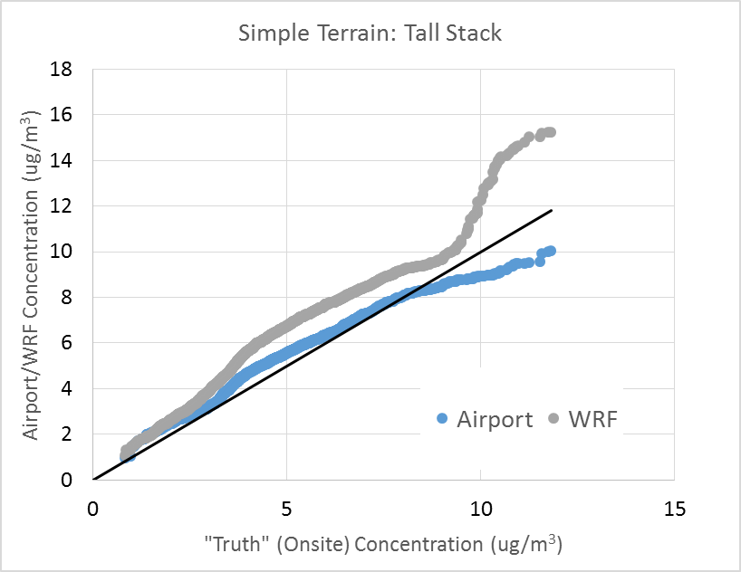
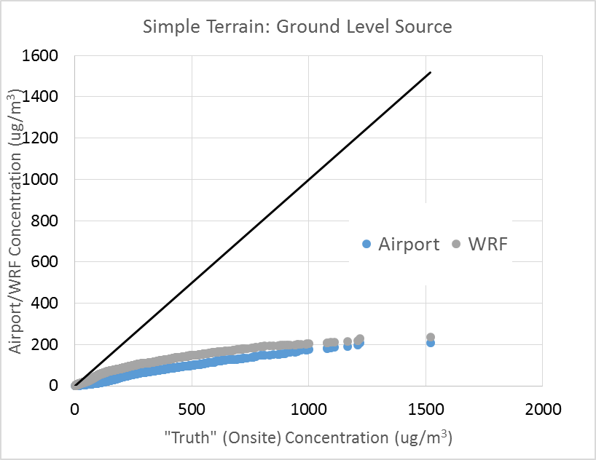
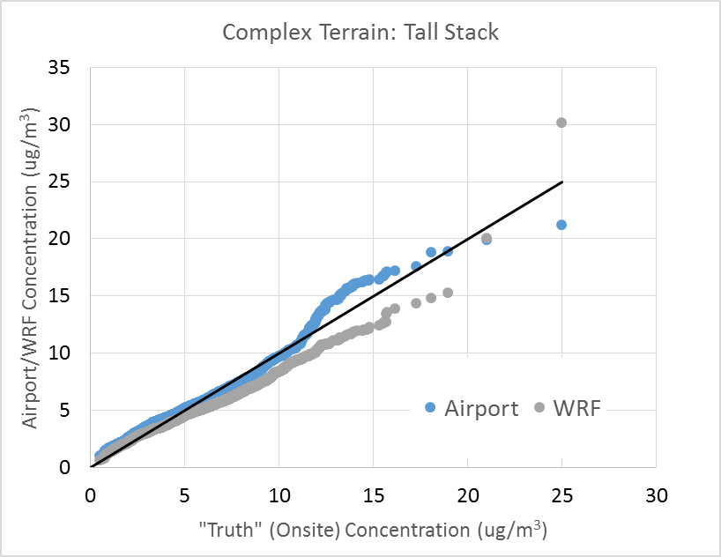
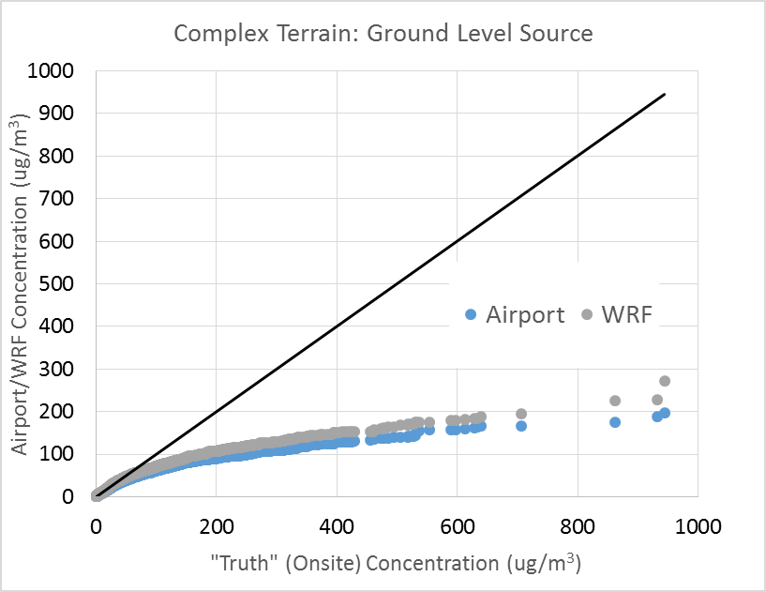
Comparison of AERMOD Results
Q-Q plots for 1-hour concentrations resulting from a tall stack and ground level source in the simple and complex terrain cases
Notes:
Both the Airport and WRF datasets showed a lower bias for the tall stack source, and a consistent under-prediction bias for the ground level source.

Slide 17
Conclusions
Effectiveness of WRF-Derived Met Data vs Traditional Airport Data
AERMOD model accuracy when using WRF-derived data was approximately equal to accuracy when using Airport meteorological data for both cases
Relative performance of WRF and Airport datasets varied among source type, averaging period, and assessment metric, but were broadly equal in quality
These findings that AERMOD performance using WRF data is at least as good as AERMOD performance using Airport data are consistent with the findings of U.S. EPA’s evaluation of WRF and MMIF-derived meteorological data performance
https://www3.epa.gov/ttn/scram/appendix_w/2016/MMIF_Evaluation_TSD.pdf
Notes:
Obviously some of these patterns will be specific to these cases. One pattern that IS likely to generalize to many other cases is that airport met data, even when it comes from a site close to the source location, will often tend to have lower surface roughness than the source location because airports are big, flat, empty expanses of concrete and grass.
That means that the pattern of wind speeds being too high in airport met data (relative to what they would be if measured at a source location) is likely to be a common issue, and one that WRF (because it doesn't use airport land use data) would not be affected by.
For that reason, WRF might have somewhat of an advantage over airport data even when the airport is pretty close to the actual source location.

Slide 18
Conclusions
Applicability of ADJ_U* to Onsite Met Datasets that Include Partial Turbulence
Both WRF and Airport datasets resulted in large under-predictions of max ground-level concentrations when compared to AERMOD results using onsite met data
Appears to be due to the decision to use the ADJ_U* AERMET option when processing the Airport and WRF-derived datasets, but not when processing the onsite “Truth” datasets
The large change in AERMOD performance when using ADJ_U* versus not using it is not unusual
Notes:
Possibly the most interesting results in this study actually did not relate to the intended study objective, but to the poor performance of both Airport and WRF data when modeling a ground-level source
The large change in AERMOD performance for ground level sources seen in the cases where ADJ_U* is applied is not unusual, and is in keeping with the findings of U.S. EPA’s thorough evaluation of the benefits of ADJ_U*. As such, it is likely the case that for the ground level source in this case, the low concentrations produced by the WRF and Airport datasets are in fact more accurate than the high concentrations produced by the “Truth” onsite datasets.
Our credibility for this statement comes from the fact that U.S. EPA did a thorough evaluation of ADJ_U* before making it an official regulatory part of the AERMOD/AERMET system. So if they concluded that airport and WRF data will often badly overpredict with ADJ_U* turned off and will be much better with ADJ_U* turned on, then we can conclude that the low concentrations Airport and WRF data produce in this case are probably correct behavior (ADJ_U* keeping them from overpredicting), and that the onsite-with-partial-turbulence data (kind of a niche case that hasn't been explored in depth by anyone) is the one with the problem (overpredicting because it SHOULD have ADJ_U*).

Slide 19
Conclusions
Applicability of ADJ_U* to Onsite Met Datasets that Include Partial Turbulence (con’t)
Recall that we decided not to apply ADJ_U* to the onsite datasets because ADJ_U* is supposed to be applied when turbulence data is not measured at the onsite station, but is not supposed to be applied when turbulence data is available
In this case, a small amount of turbulence data (σ_{ϴ}) was available
Suggests that when σ_{ϴ} is the only available turbulence data at an onsite station, ADJ_U* should in fact be applied, as the AERMOD results will otherwise be likely to produce the over-predictions of concentrations for ground-level sources

Slide 20
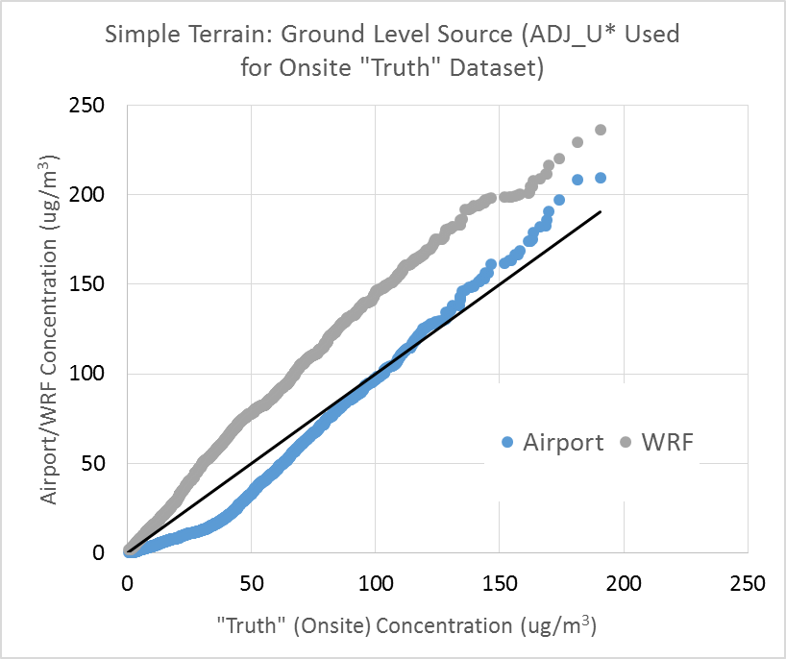
Conclusions
Applicability of ADJ_U* to Onsite Met Datasets that Include Partial Turbulence (con’t)
Q-Q plots for 1-hour concentrations resulting from a ground-level
source in the simple terrain case, with ADJ_U* not applied to the onsite
(“Truth”) meteorological dataset (left) and with ADJ_U* applied (right)
Notes:
Without ADJ_U*, there are big differences but when ADU_U* is applied to the onsite data, we see that performance of both WRF and Airport data is comparable to the onsite “Truth” data.
When comparing plots of when ADJ_U* is and is not applied, we see that performance of both WRF and Airport data is comparable to the onsite “Truth” data if ADJ_U* is applied to the onsite data.
“Without ADJ_U*, there are big differences that don't make sense if all of these are supposed to be "credible" methods according to U.S. EPA. Then, magically, when you turn on ADJ_U*, they all look similar, everything makes sense, and all is right with the world!"

Slide 21
Questions?
bholland@trinityconsultants.com
tstefanescu@trinityconsultants.com
Phone: +1 972 661-8881
Notes:
Future work

