Slide 1
Advances in National Air Quality Forecast Capability predictions
Ivanka Stajner¹, Jeff McQueen^{2,} Pius Lee³, Jianping Huang^{2,5},
Li Pan^{3,6}, Ho-Chun Huang^{2,5}, Daniel Tong^{3,6}, Ariel Stein³, James Wilzak⁴, Irina Djalalova^{4,8}, Phil Dickerson⁷, Sikchya Upadhayay^{1,9}
(1) NOAA NWS/STI
(2) NOAA NWS/NCEP
(3) NOAA ARL
(4) NOAA ESRL
(5) IMSG
(6) CICS, University of Maryland
(7) EPA
(8) CIRES, University of Colorado
(9) Syneren Technologies
with contributions from the entire NAQFC Implementation Team
CMAS Conference, Chapel Hill, NC October, 2017

Slide 2
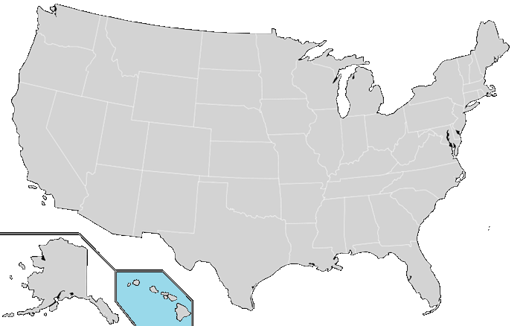
National Air Quality Forecast Capability status in October 2017
Improving the basis for air quality alerts
Providing air quality information for people at risk
Prediction Capabilities:
Operations:
Ozone nationwide
Smoke nationwide
Dust over CONUS
Fine particulate matter (PM2.5) nationwide
Testing of improvements:
Ozone
Smoke
PM2.5
2004: ozone
2007: ozone and smoke
2012: dust
2016: PM2.5
2005: ozone
2009: smoke
2010: ozone
2016: PM2.5
2010: ozone & smoke
2016: PM2.5

Slide 3
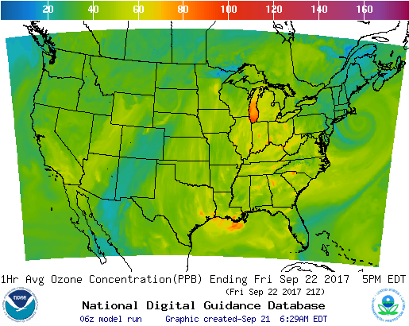
Ozone predictions
Operational predictions at http://airquality.weather.gov
over expanding domains since 2004
Model: Linked numerical prediction system
Operationally integrated on NCEP’s supercomputer
NOAA/EPA Community Multiscale Air Quality (CMAQ) model
NOAA/NCEP North American Mesoscale (NAM) numerical weather prediction
Observational Input:
NWS compilation weather observations
EPA emissions inventory
Gridded forecast guidance products
On NWS servers: airquality.weather.gov and ftp-servers (12km resolution, hourly for 48 hours)
On EPA servers
Updated 2x daily
Verification basis, near-real time: Ground-level AIRNow observations of surface ozone and PM2.5
Customer outreach/feedback
State & Local AQ forecasters coordinated with EPA
Public and Private Sector AQ constituents
CONUS, wrt 70 ppb Threshold
Operational
Maintaining prediction accuracy as the warning threshold was lowered and emissions of pollutants are changing

Slide 4
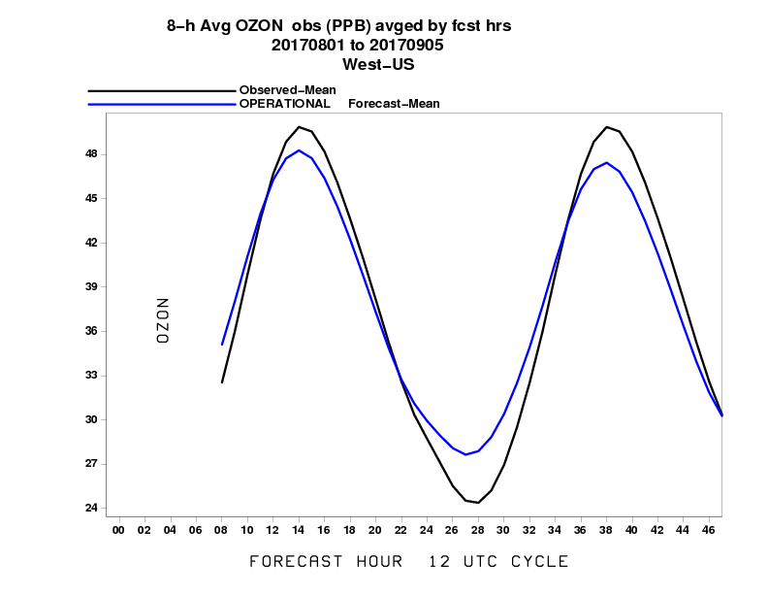
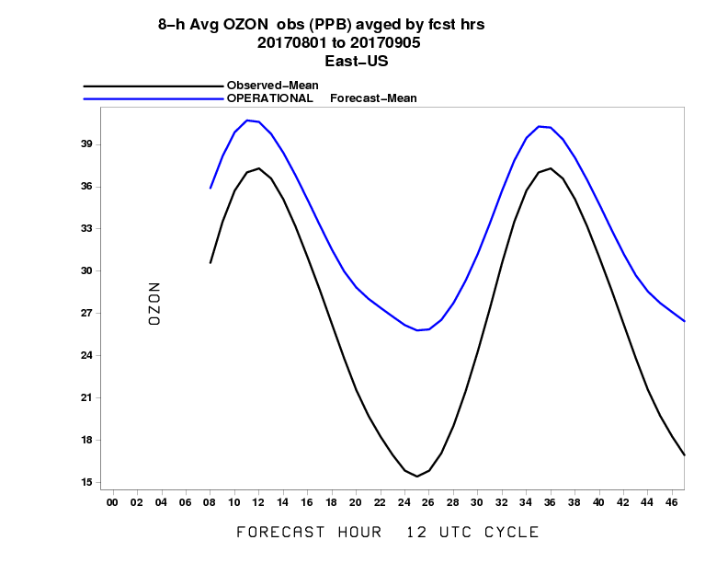
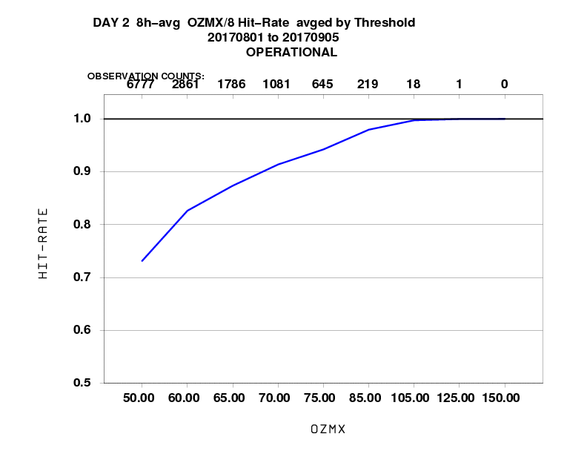
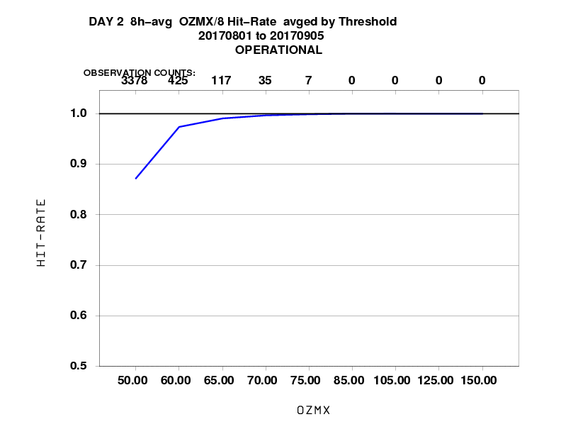
Statistical performance for Ozone (Aug 2017)
Western U.S.
Eastern U.S.
Mean
Fraction correct
See on Oct 25 at 1:20 pm: Evaluation of the NOAA NAM-CMAQ predictions for recent air quality episodes (J. McQueen)

Slide 5
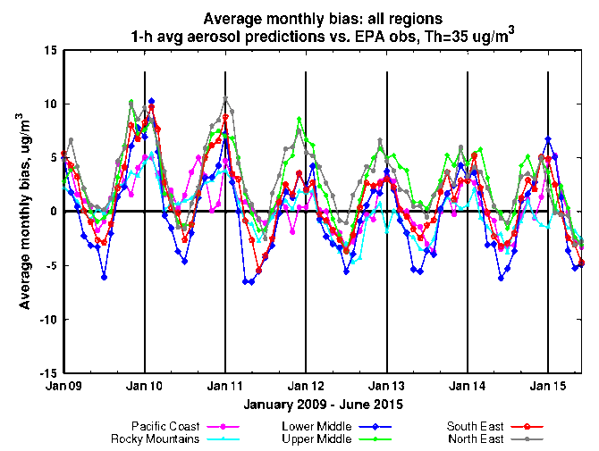
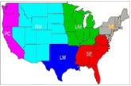
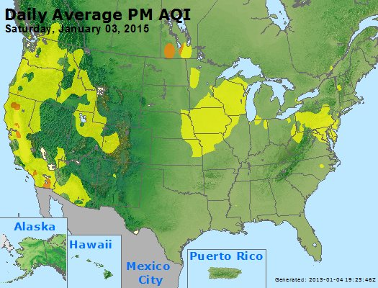
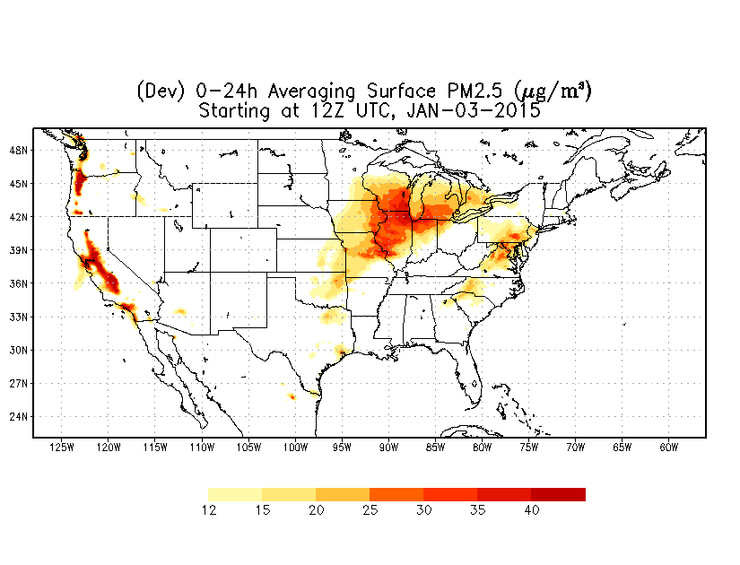
PM2.5 predictions
Predictions for 48h at 12km resolution over CONUS
CMAQ 5.0.2: CB05 gases, AERO-6 aerosols since June 2017; CMAQ 4.7, CB05 with AERO-4 prior
Sea salt emissions, wildfire and dust emissions and suppression of soil emissions from snow/ice covered terrain included since summer 2014 (Lee et al., Weather and Forecasting 2016); only NEI sources prior
Model predictions exhibit seasonal prediction biases: overestimate in the winter; underestimate in summer.
Additional observational input: AIRNow PM2.5 observations for bias correction and verification
Forecast challenges
Improving sources for wildfire smoke and dust
Chemical mechanisms eg. SOA
Meteorology eg. PBL height
Chemical boundary conditions/trans-boundary inputs
NAQFC PM2.5 test predictions

Slide 6
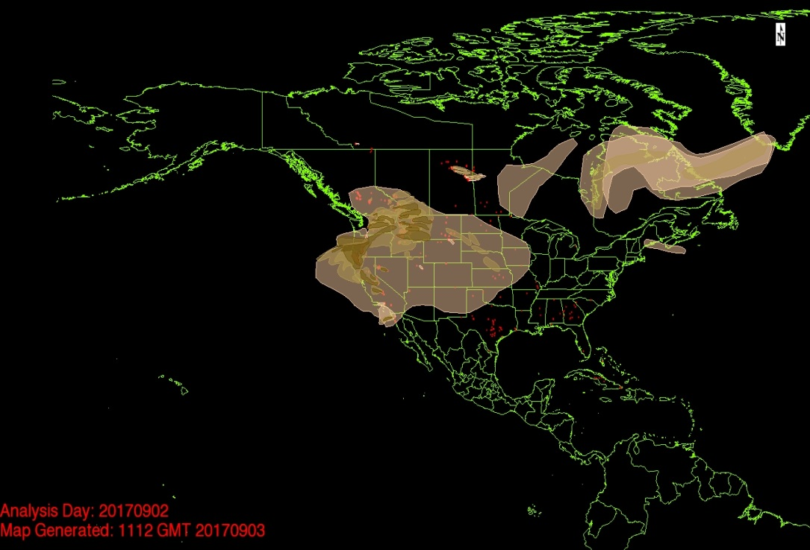
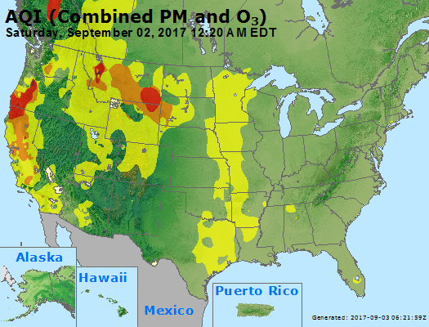
La Tuna Fire in California (September 2017)
Current operational PM2.5 captured the La Tuna fire in Verdugo Mountains in Los Angeles, California which caused more than 300 homes to be evacuated.

Slide 7
Updates to air quality predictions implemented in June 2017
Update to Community Multi-scale Air Quality (CMAQ) model v5.0.2
Update to US Forecast Service BlueSky smoke emissions system v3.5.1
Fuel Characteristic Classification System version 2 (FCCS2), which includes a more detailed description of the fuel loadings with additional plant type categories.
Improved fuel consumption model and fire emission production system (FEPS).
Explicit fuel load map for Alaska (HYSPLIT only)
Addition of 24-hour analysis cycle to include wildfire emissions at the time when they are observed
Update of the bias-correction post-processing for PM2.5 forecast guidance to use the Kalman Filter Analog (KFAN) technique
Update of point source emissions to projections for 2017
Update of dust related aerosol species at the CMAQ lateral boundaries to use the NEMS Global Aerosol Component (NGAC) v2 forecasts

Slide 8
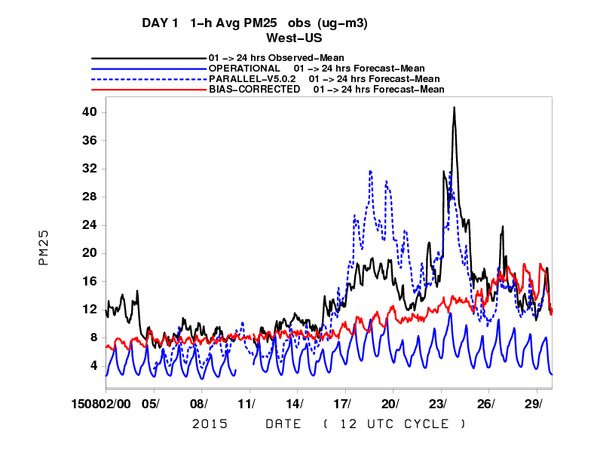
PM2.5 from wildfires in CMAQ
Better representation of wildfire smoke emissions based on detections of wildfire locations from satellite imagery, BlueSky system emissions, included over previous 24 hours when fires were detected and projected with reduced intensity into the 48 hour forecast period
Daily mean for Western US
Observations
Previous model
Current op. model
Bias correction of previous model
PM2.5 in August 2015

Slide 9
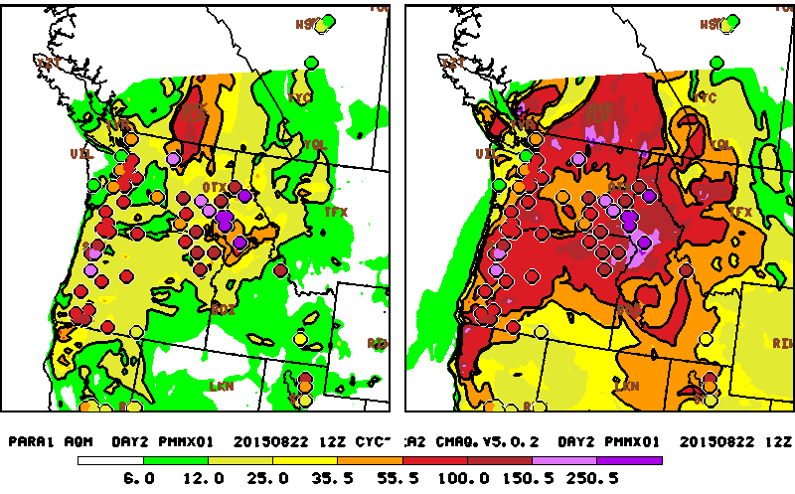
Representation of wildfires – NW U.S. example on August 23, 2015
Previous CMAQ 4.7
Updated CMAQ 5.0.2
µg/m³
Wildfires are strongly impacting air quality in the region
Observed daily maximum of hourly PM2.5 exceeds 55 µg/m³and even 100 µg/m³
Operational system predicts values below 25 µg/m³ for many of these monitors
Updated system in testing predicts values much closer observed

Slide 10
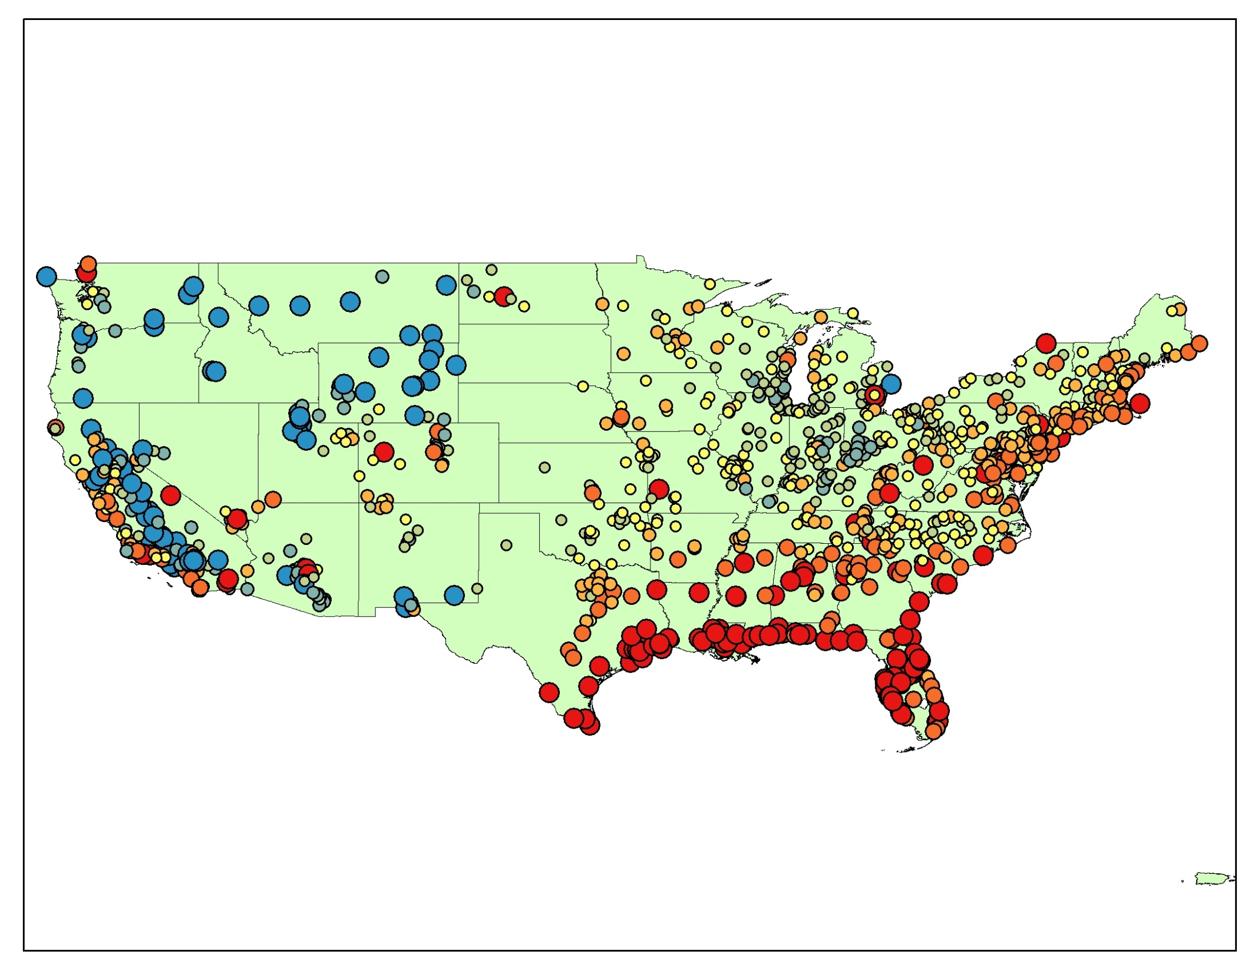
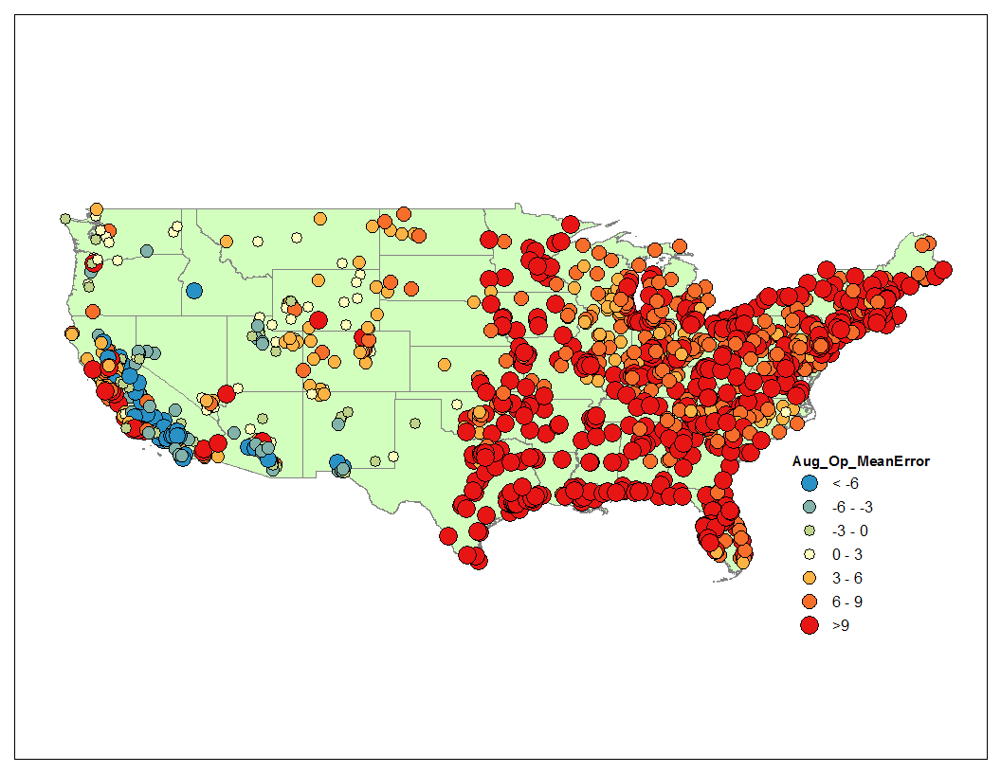
Daily maximum 8 hour ozone
August 2017
Ozone bias has decreased substantially with CMAQ 5.0.2 implemented in June 2017
August 2016
+ = Model Over-Predicted
- = Model Under-Predicted
Courtesy: Joel Dreessen & James Boyle,
MD DOE
2017 data is preliminary and subject to change

Slide 11
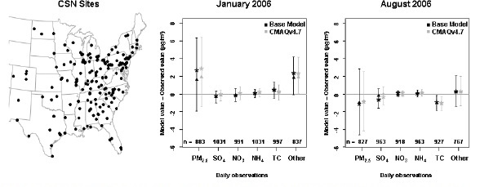
Seasonal Bias in PM2.5 prediction
Mean (star), median (triangle), and inter-quartile ranges of model bias (model value – observed value) for multiple fine-particle species measured at CSN sites in the 12km domain. The number of model/observation pairs for each species is shown above the x-axis.
The bias in the total mass of PM2.5 is dominated by overpredictions of unspecified PM in the winter and by underpredictions of carbon aerosols in the summer. (Foley et. al., Incremental testing of the Community Multiscale Air Quality (CMAQ) modeling system version 4.7, Geosci. Model Dev., 3, 205-226, 2010)
Saylor et. al. found same type of seasonal speciation biases in the CMAQ v4.6 for IMPROVE sites.
11

Slide 12
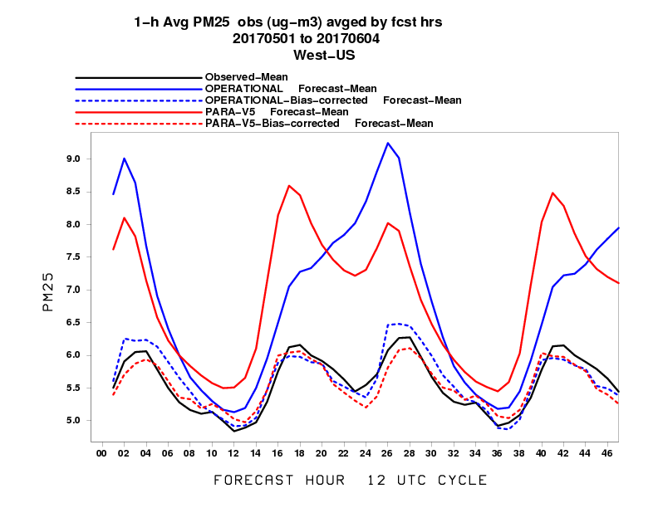
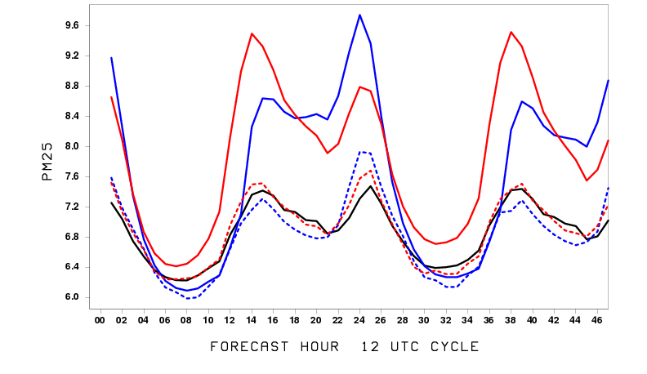
Statistical performance of PM2.5 for May 2017
Mean PM2.5 by forecast hour
Western U.S.
Eastern U.S.
µg/m³
µg/m³
Observations
Previous operational model
Bias correction for previous model
Current operational model
Bias correction for current model
I. Djalalova, L. Delle Monache, and J. Wilczak: PM2.5 analog forecast and Kalman filter post-processing for the Community Multiscale Air Quality (CMAQ) model, Atmospheric Environment, Volume 108, May 2015, pp.76–87.
Huang et al., Improving NOAA NAQFC PM2.5 predictions with a bias correction approach, Weather and Forecasting, 2016.
12

Slide 13
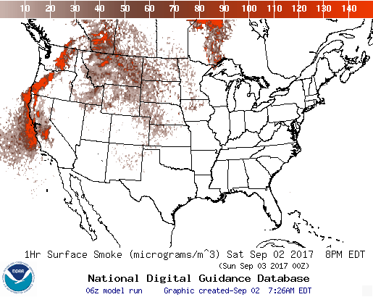
Smoke predictions
Operational Predictions at http://airquality.weather.gov/
Smoke predictions for CONUS (continental US), Alaska and Hawaii
NESDIS provides wildfire locations detected from satellite imagery
Bluesky provides emissions estimates
HYSPLIT model for transport, dispersion and deposition (Rolph et. al., W&F, 2009)
Increased plume rise, decreased wet deposition, changes in daily emissions cycling
Developed satellite product for verification (Kondragunta et.al. AMS 2008)
Since June 2017
Updated BlueSky System v3.5.1 for smoke emissions (first BlueSky update since predictions became operational in 2007)

Slide 14
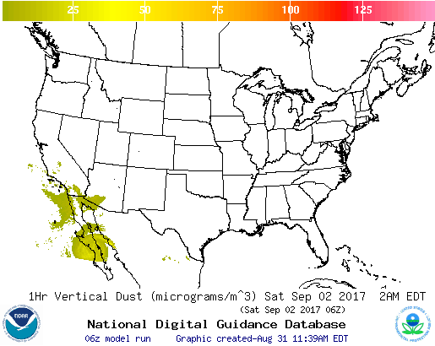
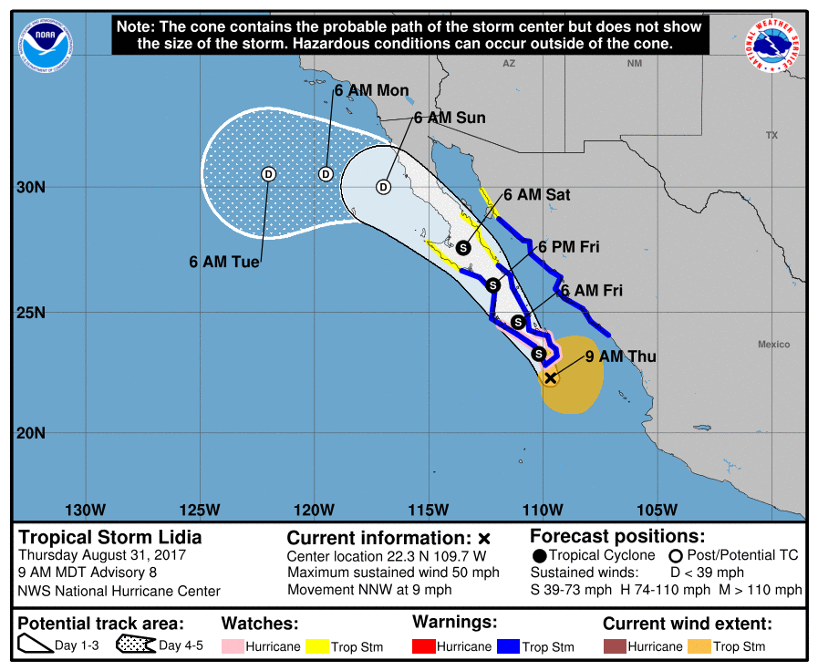
CONUS dust predictions
Operational Predictions at http://airquality.weather.gov/
Standalone prediction of airborne dust from dust storms:
Wind-driven dust emitted where surface winds exceed thresholds over source regions
Source regions with emission potential estimated from MODIS deep blue climatology for 2003-2006 (Ginoux et. al. 2010).
Emissions modulated by real-time soil moisture.
HYSPLIT model for transport, dispersion and deposition (Draxler et al., JGR, 2010)
Wet deposition updates in July 2013
Developed satellite product for verification (Ciren et.al., JGR 2014)

Slide 15
Testing in progress
Extension of predictions to 72 hours
Emissions updates: testing of oil and gas updates, testing of NEI 2014
Ozone bias correction
Wildfire emissions: hourly estimates from BlueSky, ECCC emissions
Additional NOAA-funded research and development
See on Oct 25 at 1:40 pm: Impact of Chemical Lateral Boundary Conditions (LBC) from GEOS-5 Global Chemical Transport Model Compared to the Operational NGAC LBC (Y. Tang)

Slide 16
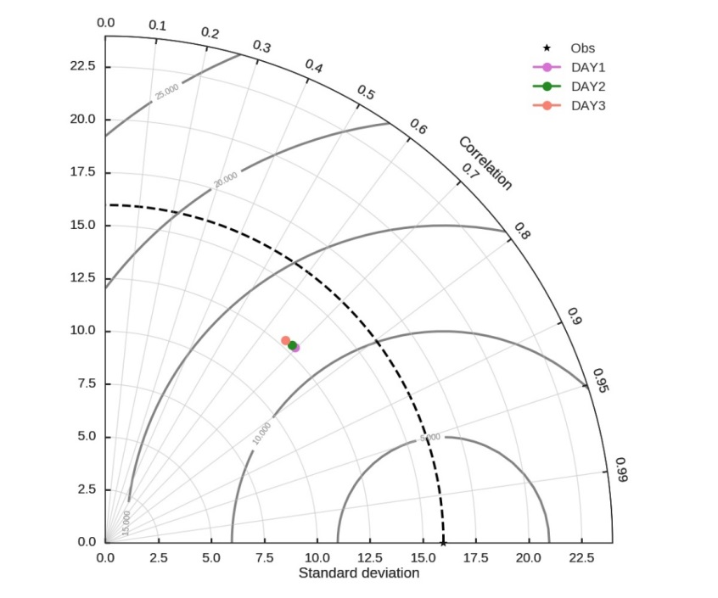
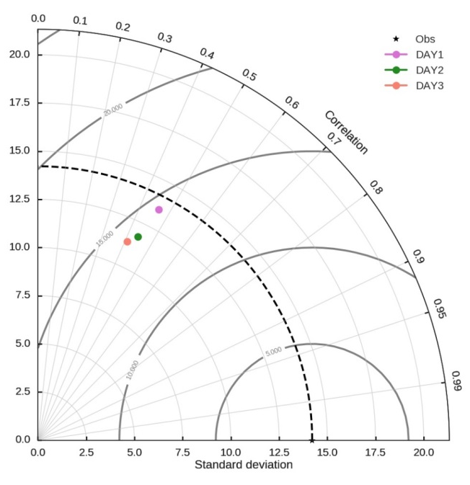
Testing of predictions for 72 hours evaluation for CONUS
O₃
PM_{2.5}
Statistics for all hours
Performance of predictions for days 1, 2 & 3 over CONUS for August 10-19, 2017
Pollutant | Prediction day | obs | Bias | RMSE | corr, r
Daily max. of 8h average ozone [ppb] (N=27300) | D1 | 39.0 | 2.58 | 9.65 | 0.75
 | D2 |  | 2.23 | 9.78 | 0.74
 | D3 |  | 1.76 | 10.14 | 0.71
Daily average PM2.5 [ug/m³] (N=18560) | D1 | 10.61 | 1.55 | 10.32 | 0.59
 | D2 |  | 0.92 | 9.88 | 0.58
 | D3 |  | 0.76 | 10.28 | 0.53

Slide 17
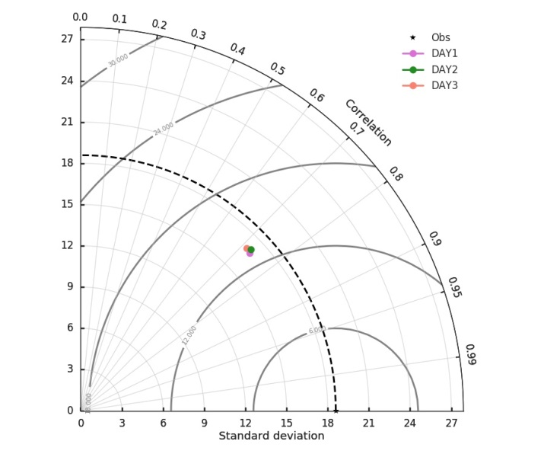
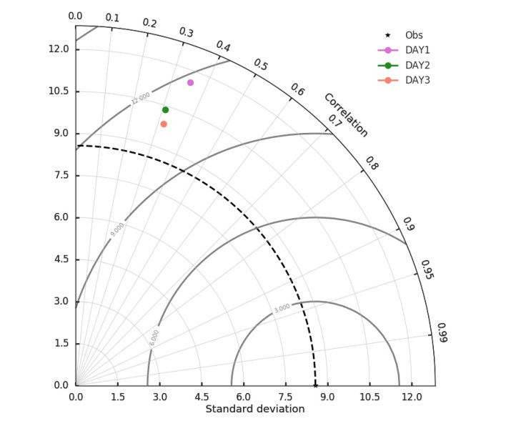
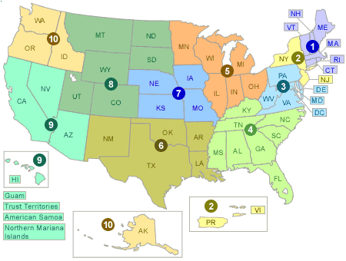
Testing predictions for 72 hours evaluation for Pacific Southwest
O₃
PM_{2.5}
Statistics for all hours
Day1,2,3 Performance over Pacific Southwest (region 9) for August 10-19, 2017
Pollutant | Obs | Bias | RMSE | corr, r
Daily max of 8h ozone (N= 4620) D1 | 49.7 | -0.30 | 11.15 | 0.77
D2 |  | -0.72 | 11.40 | 0.77
D3 |  | -1.53 | 11.91 | 0.75
Daily average of PM2.5 (N= 2875) D1 | 11.6 | 1.98 | 10.52 | 0.46
D2 |  | 0.03 | 8.65 | 0.40
D3 |  | 0.53 | 9.59 | 0.38
See Oct 24 Poster: Overview of the Model and Observation Evaluation Tool (MONET) version 1.0 for evaluating chemical transport models (B. Baker)

Slide 18
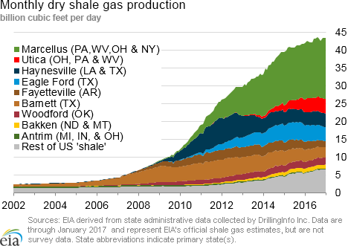
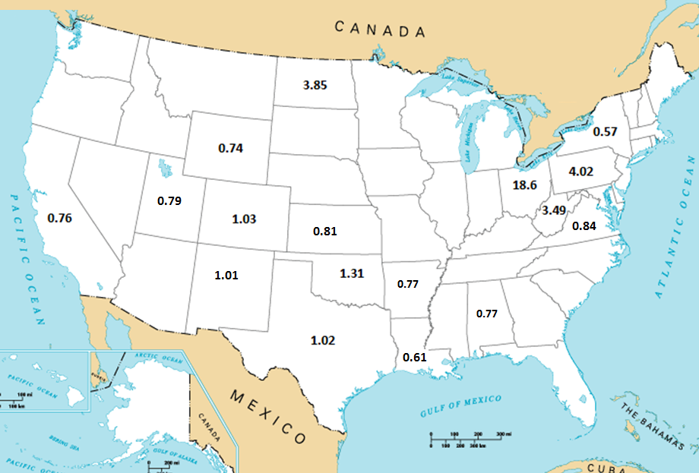
Updating oil and gas sector emissions
2014 Energy Information Administration on Shale Plays
Adjustment factor applied to NEI2011 oil and gas area source sector

Slide 19
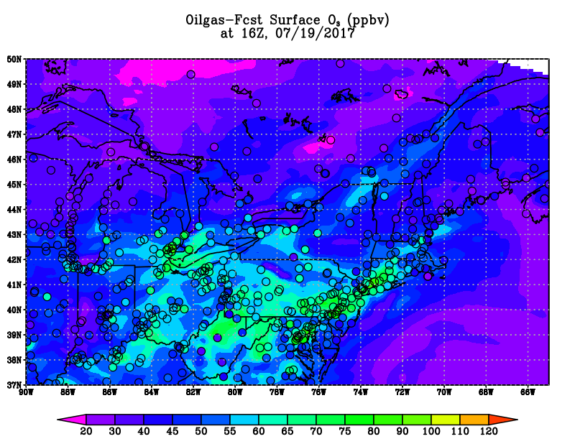
Testing of oil and gas emissions
Operational
Adjusted
Testing of State-specific scaling for Oil_n_Gas area source
July 11-21 sensitivity run confirmed that Marcellus area O3 increased
Under-prediction in O₃ in the Marcellus area was reduced
However the over-prediction in O₃ elsewhere was exacerbated
See on Oct 25 at 1:00 pm: An air quality impact study for the recent increase in oil and gas activity over the Conterminous U.S. (P. Lee)

Slide 20
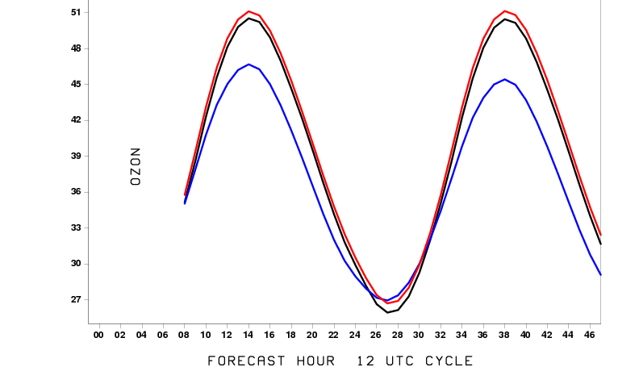
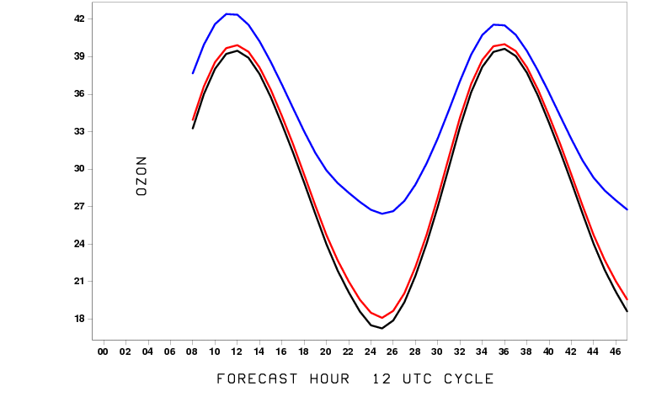
Evaluation of ozone predictions (July 2017)
Western U.S.
Eastern U.S.
8h averaged ozone [ppb]
Observations
Operational model predictions
Testing of bias corrected predictions
See Oct 24 Poster: Meteorological factor analyses of NOAA NAQFC surface ozone predictions' biases and improvement with a bias correction approach (J. Huang)

Slide 21
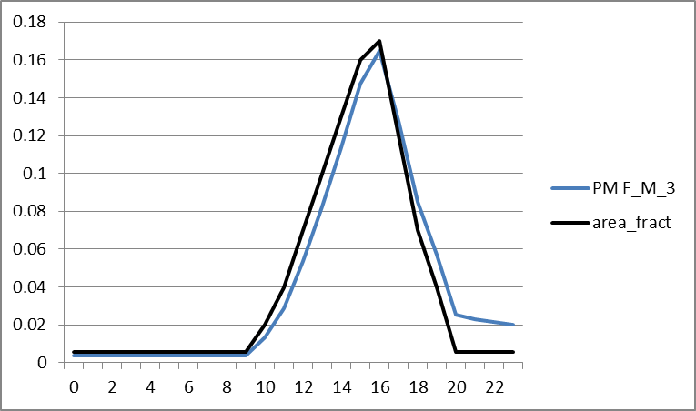
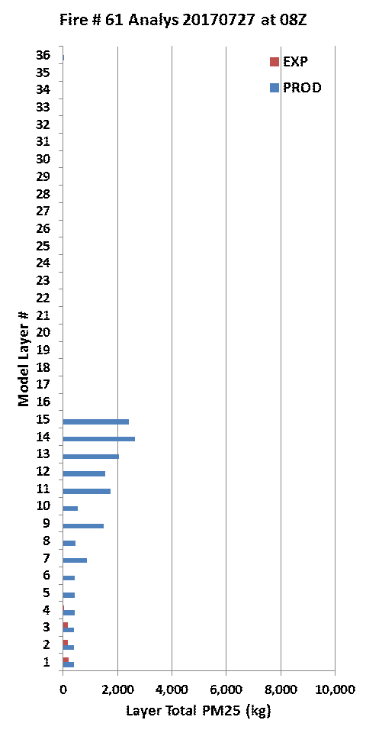
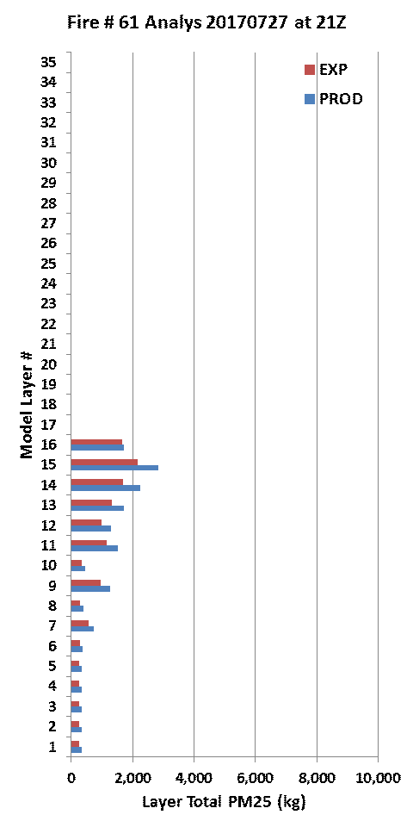
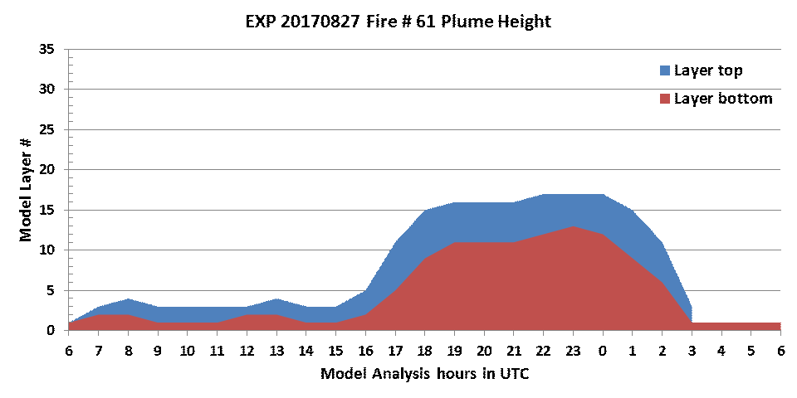
Testing of BlueSky wildfire smoke emissions changing hourly
Example PM diurnal profile for mixed forest
Vertical Distribution of fire emissions
PROD: Blue Bar
EXP : Red Bar
Testing of hourly changes in emission amounts and plume rise.

Slide 22
Summary and plans
US national AQ forecasting capability:
Ozone prediction nationwide; updated to CMAQ version 5.0.2 and new Bluesky
Smoke prediction nationwide; updated with newer BlueSky system
Dust prediction for CONUS sources
PM2.5 predictions; include wildfire and dust emissions, dust LBCs from global predictions; refinement of bias correction using KFAN approach
Current testing and plans:
Extension of CMAQ predictions to 72 hours
Emissions updates (NEI 2014 including oil and gas sources)
Ozone bias correction
Wildfire smoke inputs: hourly evolution from BlueSky for CONUS and ECCC for Canada
Update display, dissemination and web presence
Finer resolution and inline with meteorology (longer term)

Slide 23
Acknowledgments: AQF implementation team members
Special thanks to previous NOAA and EPA team members who contributed to the system development
NOAA/NWS/OSTI Ivanka Stajner NAQFC Manager
NWS/AFSO Jannie Ferrell Outreach, Feedback
NWS/OD Cynthia Jones Data Communications
NWS/OSTI/MDL Marc Saccucci, NDGD Product Development
Dave Ruth
NWS/OSTI Sikchya Upadhayay Program Support
NESDIS/NCDC Alan Hall Product Archiving
NWS/NCEP
Jeff McQueen, Jianping Huang, AQF model interface development, testing, & integration
Jun Wang, *Sarah Lu Global dust aerosol and feedback testing
*Brad Ferrier, *Eric Rogers, NAM coordination
*Hui-Ya Chuang
Ho-Chun Huang Smoke and dust product testing and integration
Rebecca Cosgrove, Steven Earle NCO transition and systems testing
Andrew Orrison HPC coordination and AQF webdrawer
NOAA/OAR/ARL
Pius Lee, Daniel Tong, Tianfeng Chai CMAQ development, adaptation of AQ simulations for AQF
Li Pan, Hyun-Cheol Kim, Youhua Tang
Ariel Stein HYSPLIT adaptations
NESDIS/STAR Shobha Kondragunta Smoke and dust verification product development
NESDIS/OSDPD Liqun Ma, Mark Ruminski Production of smoke and dust verification products,
HMS product integration with smoke forecast tool
EPA/OAQPS partners:
Chet Wayland, Phil Dickerson, Brad Johns, John White AIRNow development, coordination with NAQFC
* Guest Contributors

Slide 24
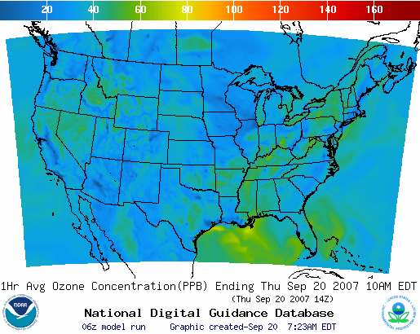
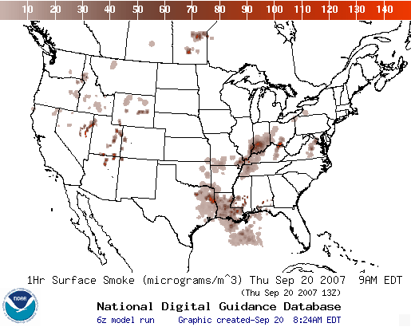
Operational AQ forecast guidance at airquality.weather.gov
Ozone products Nationwide since 2010
Smoke Products Nationwide since 2010
Dust Products
Implemented 2012
New web site:
https://www.weather.gov/sti/stimodeling_airquality

Slide 25
Back-up

Slide 26
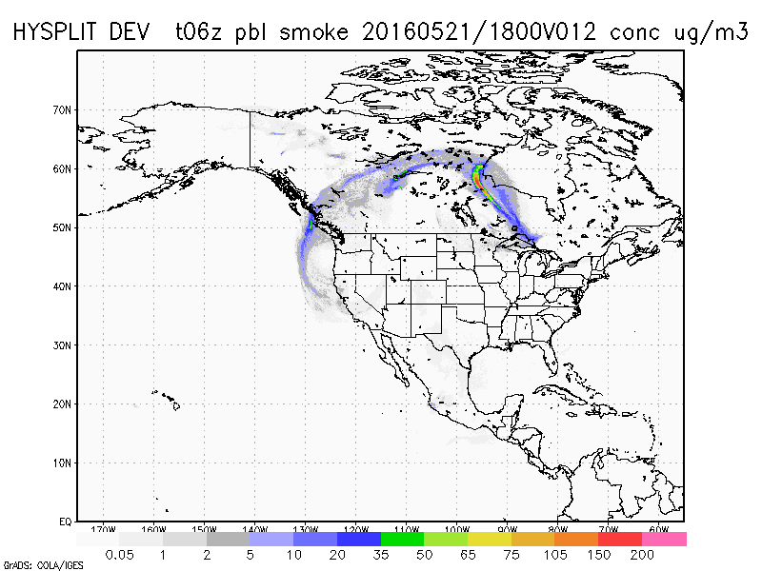
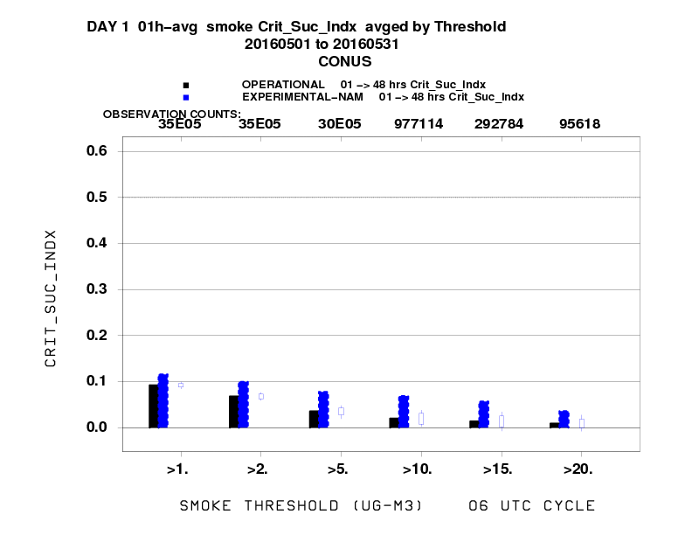
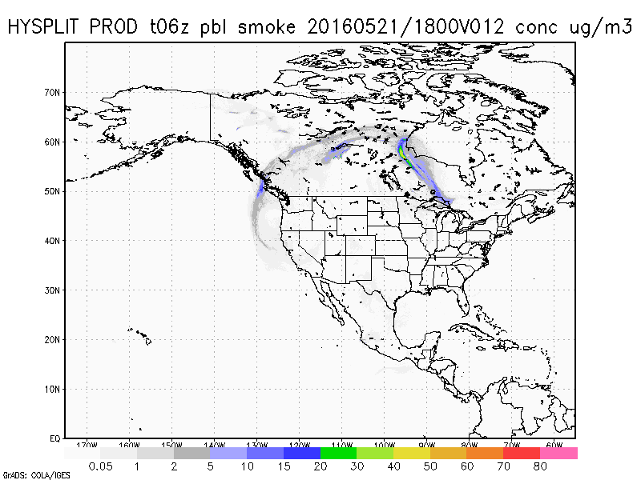
BlueSky Evaluation
Comparing previous operational smoke predictions with those using updated BlueSky for May 2016
Operational HYSPLIT
HYSPLIT with updated BlueSky
HYSPLIT with updated BlueSky
HYSPLIT with previous BlueSky
Improved skill scores in May from large Ft. McMurray fires for currently operational HYSPLIT with updated BlueSky
26

Slide 27
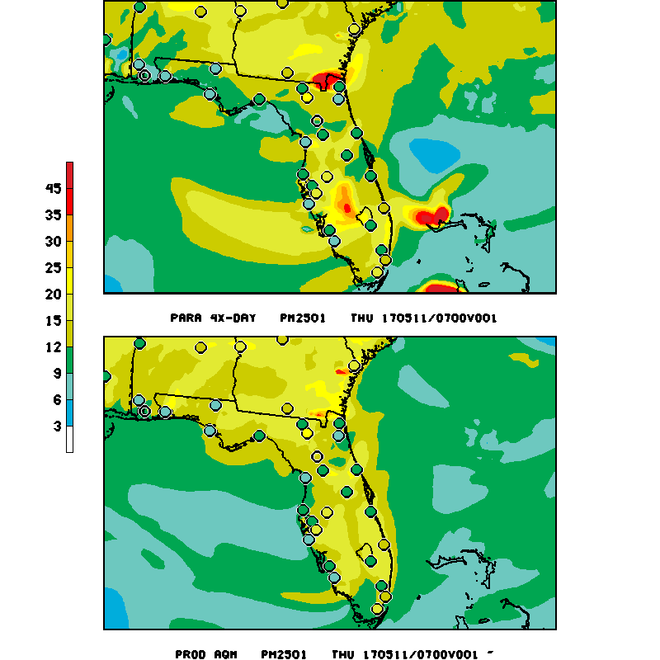
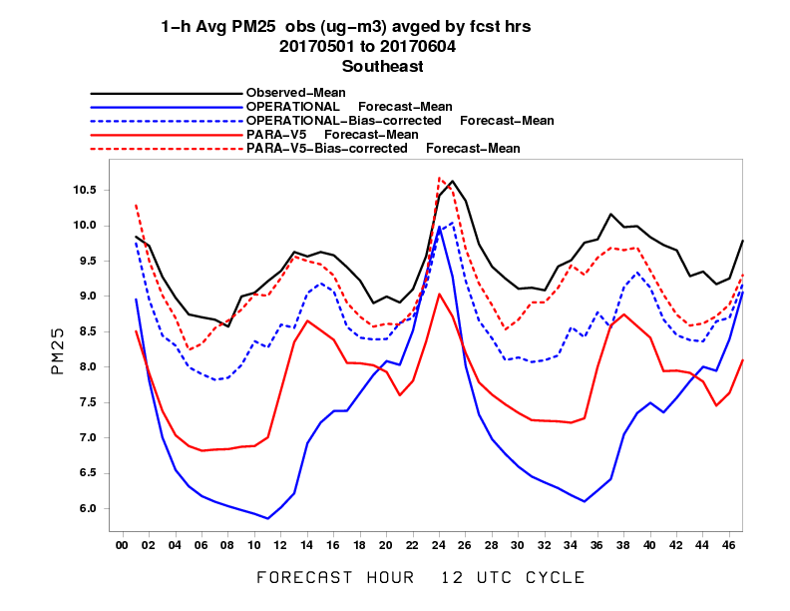
May 11 2017 Florida/Georgia Fires 1hr PM2.5 CMAQ loop
New model
Old model
µg/m³
Updated model captures Fl and Bahama fires
Notes:
Much better fire smoke signature in the near field at least i

Slide 28
Verification of smoke predictions
for CONUS
Daily time series of FMS for smoke concentrations larger than 1um/m3
Figure of merit in space (FMS), which is a fraction of overlap between predicted and observed smoke plumes, threshold is 0.08 marked by red line
NESDIS GOES Aerosol/Smoke Product is used for verification

Slide 29
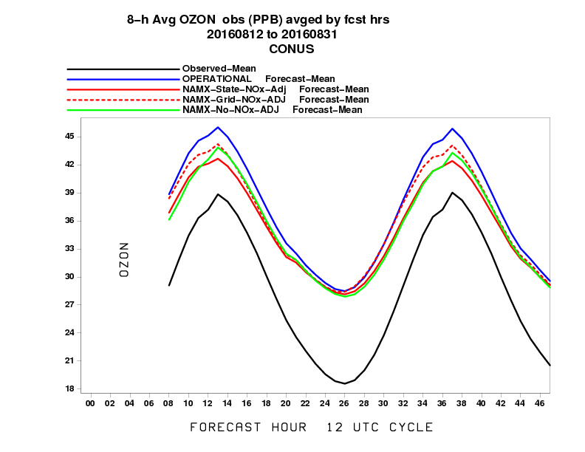
Improvements in ozone predictions in Eastern U.S.
Current operational
Currently operational CMAQ V5.0.2 showed a great improvement over previously operational model for August 18, 2016 case
Observations
Old operational model
State-NOx adjustment with new NAM
Grid NOx adjustment with new NAM
New operational model with no NOx adjustment and new NAM
Previously operational
µg/m³
Notes:
Advantage of having daily maps with comparisons, observation overlays….aids in user feedback

Slide 30
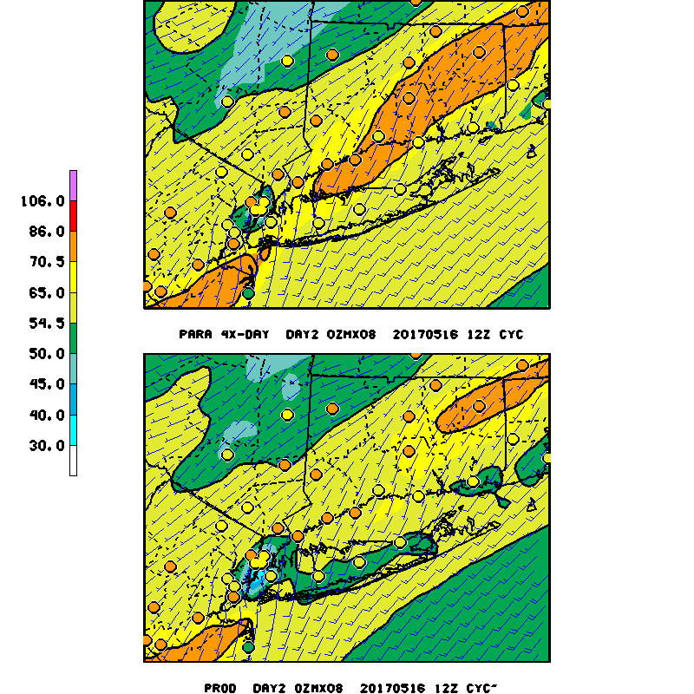
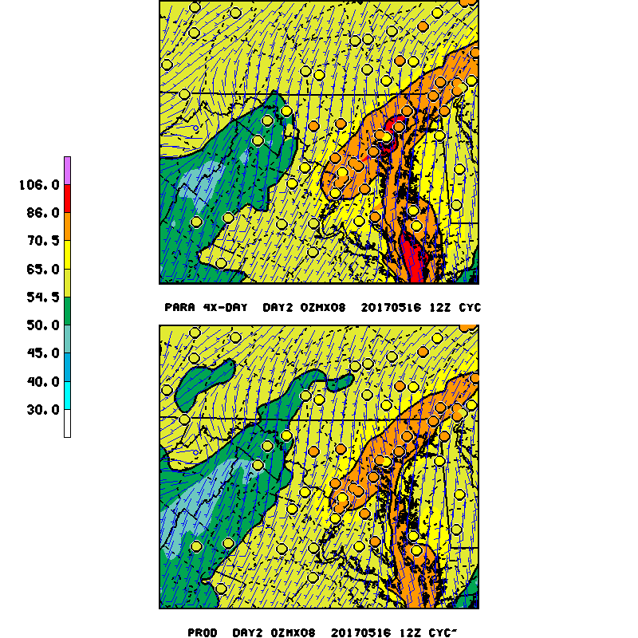
Improvements in ozone near coastal areas Day 2 predictions for May 17, 2017 8h Max Ozone
More ozone formation in new model
Updated model
µg/m³
Previous model
Notes:
No-NOX more ozone production over Sacramento Valley as compared to Nox adj run

Slide 31
Testing of bias correction for ozone predictions for Pacific/Western U.S.
James Wilczak and Irina Djalalova

Slide 32
Testing of bias correction for ozone predictions for Atlantic/Eastern U.S.
James Wilczak and Irina Djalalova

Slide 33
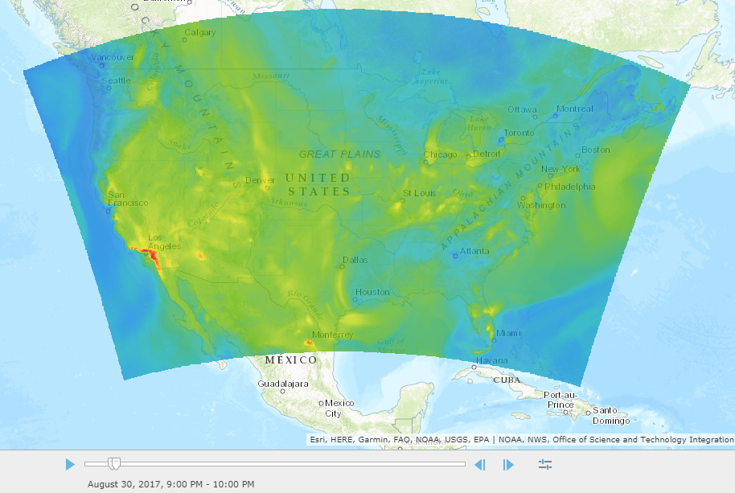
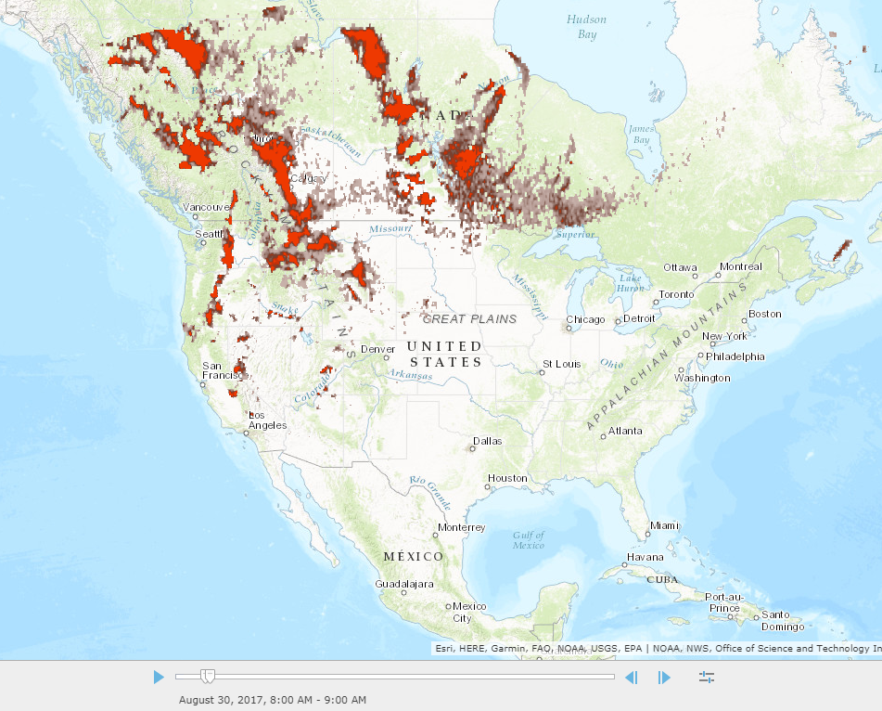
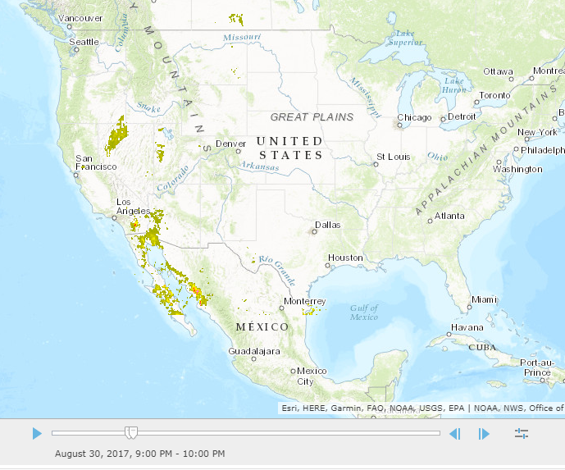
Webservices
8 hr average ozone
1 hr surface smoke
1 hr surface dust
Examples of ozone predictions in web enabled map service currently in development based on GIS application

