Slide 1
Comparing light-duty gasoline NOx emission rates estimated with MOVES to real-world measurements
Darrell Sonntag¹, David Choi¹, James Warila¹, Claudia Toro², Megan Beardsley¹, Barron Henderson³, Alison Eyth³, and Laurel Driver³
16th Annual CMAS Conference
October 23, 2017
¹ EPA, Office of Transportation & Air Quality
² ORISE participant supported by an interagency agreement between EPA and DOE
³ EPA, Office of Air Quality Planning & Standards

Slide 2
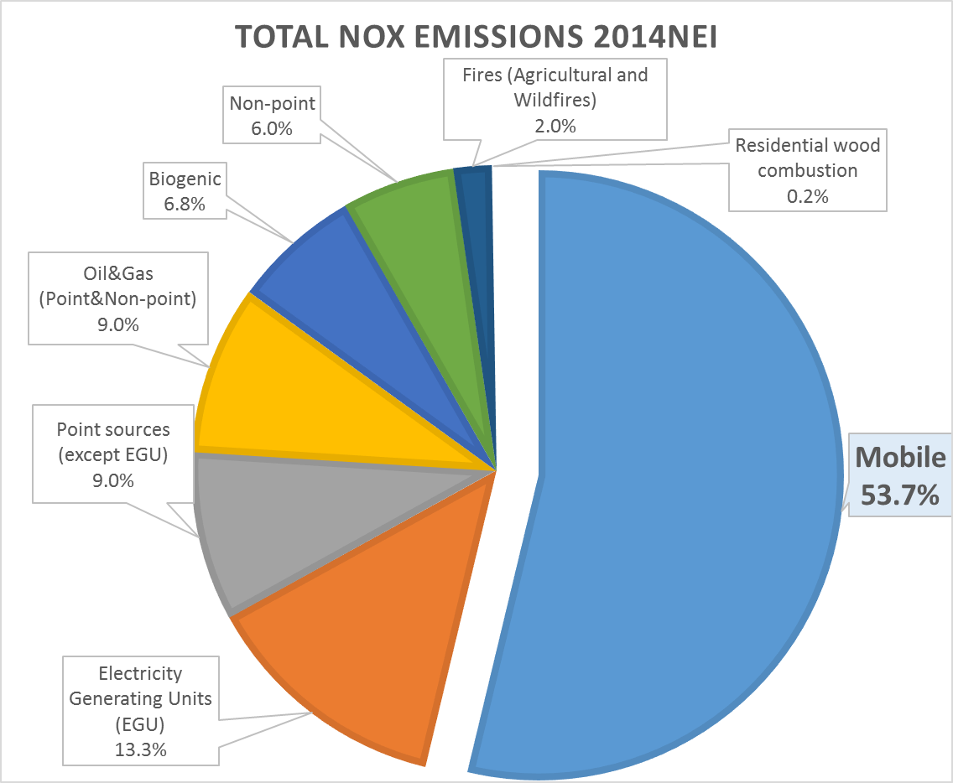
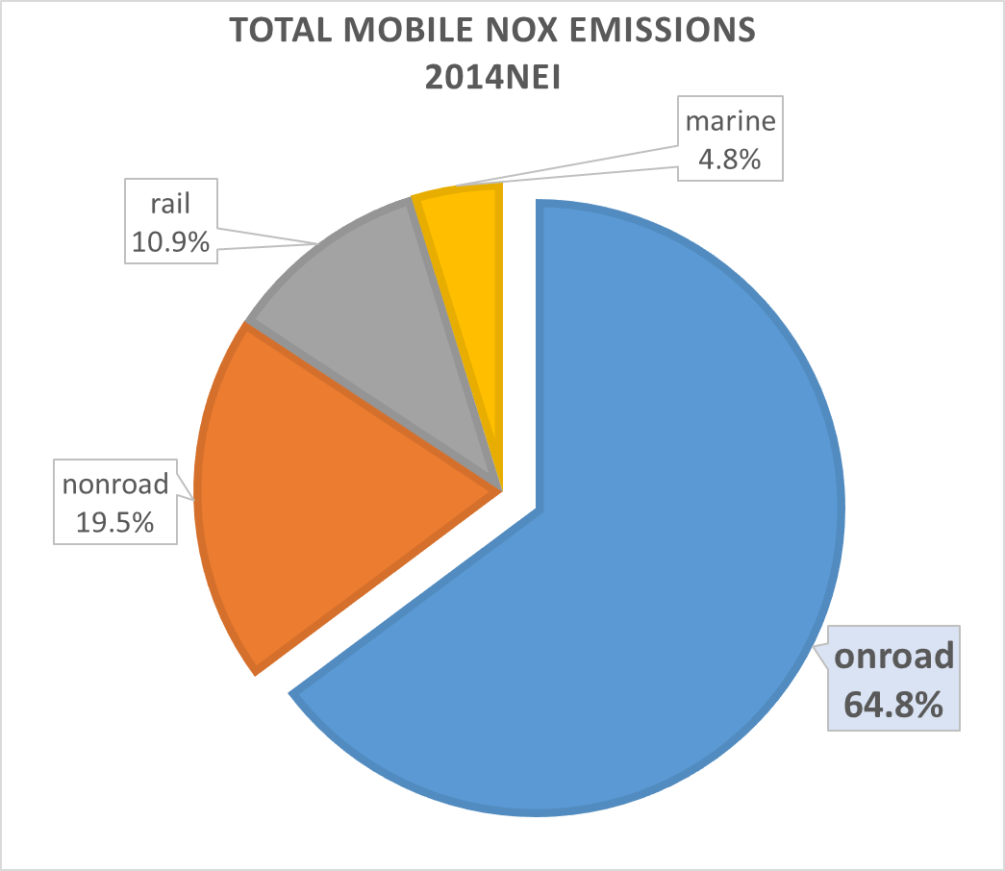
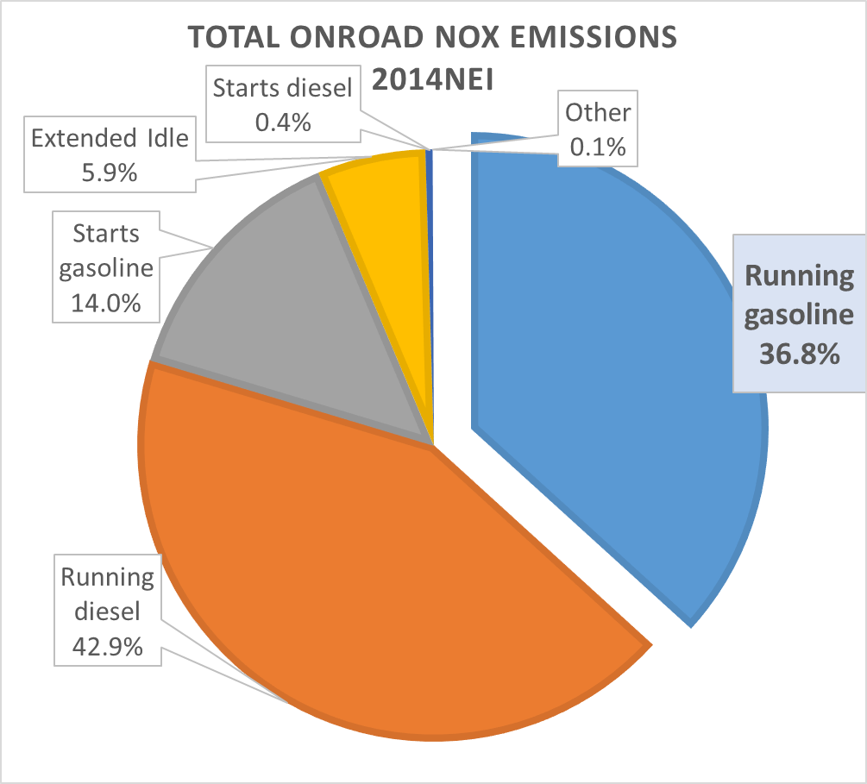
Why focus on light-duty NOx?
Several researchers have suggested mobile emissions, specifically light-duty NOx emissions, may be overestimated
Mobile sources contribute ~54% of NOx emissions in the 2014 NEI
  ~65% of mobile are on-road
  ~37% of onroad are light-duty gasoline running
In sample counties observed with large NOx discrepancy between monitored and modeled values during 2011 summer months, starts and diesel extended idle emissions are minor contributors to total NOx

Slide 3
Data for Evaluating Light-Duty Rates
 | Inspection/Maintenance (I/M) | Remote Sensing Data (RSD) | Tunnels
Individual vehicle measurements? | Yes | Yes | No: Fleet average
Calendar Years | 2008-2015 | 1999-2015 | 2001,2006,2010
Location | Denver | Fourteen cities | Oakland
Ability to capture rare high emitters? | Yes | Yes | Yes
Known operating conditions ? (for replicating in MOVES) | Yes: preconditioned IM240 | Yes: vehicle speed & acceleration recorded | Estimated based on sample vehicle speed traces in 1996
Real-world driving conditions? | IM240 driving cycle on chassis dynamometer | Snapshot (typically during vehicle acceleration on freeway ramps) | 1 km of driving through Caldecott Tunnel on urban freeway. 37 mph, 4% uphill grade
Known vehicle characteristics? (car/truck, gas/diesel, model year/age) | Yes | Yes | Some: age distribution and fleet mix measured in 2006 for Caldecott Tunnel, estimated for 2001 and 2010

Slide 4
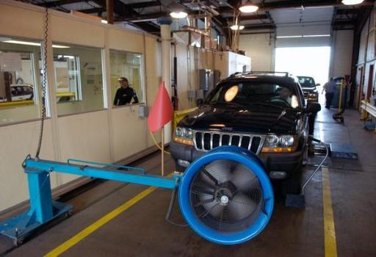
Denver I/M Dynamometer Testing Data
Denver Inspection & Maintenance (I/M) test data on light-duty vehicles
  NOx emissions on IM240 cycle
  Random evaluation sample
    Calendar years 2008-2015
    Corrected for bias due to testing exemption for clean cars
  Tier 1 cars (1996-2000 model years)¹
    n=1,360
  Tier 2 cars and trucks (2010-2016 model years)
    n_{cars} = 10,700
    n_{trucks} = 9,700
MOVES comparisons
  Compare emissions by vehicle age, class, and federal emission standards (Tier 1 and Tier 2)
  Simulate IM240 using MOVES base rates
  No MOVES adjustments for temperature/humidity and fuel properties
Denver Post, 2007

Slide 5
Denver I/M Comparison to MOVES
MOVES is higher than I/M data for pre-2000 (Tier 1) cars
MOVES is lower than I/M data for 2010+ (Tier 2) cars
Tier 2 light trucks estimated well
MOVES deterioration trends compare well
Tier 1 cars
Tier 2 cars
Tier 2 trucks

Slide 6
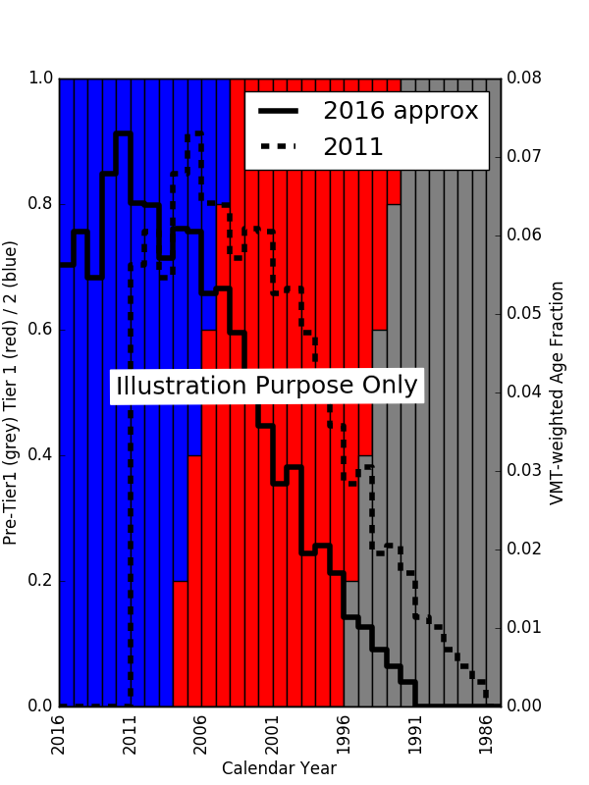
What is the potential impact on the emissions inventory?
NOx emission inventory adjusted using the passenger car Denver I/M vs. MOVES emission rates would be:
  Lower for calendar year 2010 and earlier
    Tier 1 (red) vehicles contribute a larger share of the age distribution in 2011 than 2016
  Higher for calendar year ~2016 and later
    Tier 2 (Blue) vehicles contribute a larger share of the age distribution in 2016
We need to conduct in-depth comparisons because MOVES gasoline emission rates vary by:
  Model year, vehicle age, fleet-mix (car vs. light truck)
Comparisons from one location and time may not apply to others:
  E.g. some states have younger cars, more trucks, different driving conditions
  Vehicle fleet and fuel properties change over time
Model Year
Notes:
2016 or Young Fleet State
2011 or Older Fleet State
What is incorrect about this graph (updated and attached)?
- VMT weighted age fraction: This age distribution is based on the MOVES manual. The annual mileage is from the MOVES manual Tables 5 and 6. The age fraction distribution from the "Population and Activity of On-road Vehicles in MOVES2014" Table 7-1. I am using RMAR method of calculating the age.
- The Tier 1/Tier 2 fraction was previously not showing the pre-Tier 1 vehicles which I have added.

Slide 7
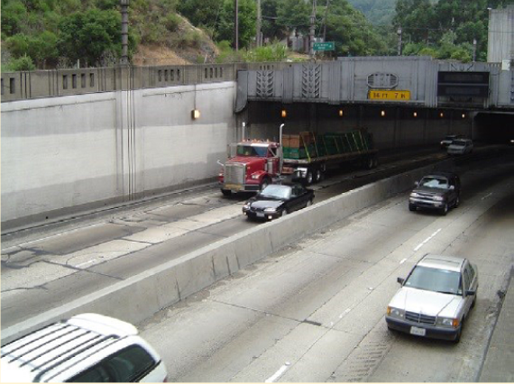
Comparison to RSD and Tunnel Studies
Remote Sensing Data (RSD) studies conducted by University of Denver²
  Individual vehicles measured remotely from the road-side
  Reported percent concentration of NO
  Converted to fuel-specific rates (g/kg fuel) in NO₂ mass-equivalence
  Vehicle information (i.e., make and model) obtained from license plate and vehicle registration data
Caldecott Tunnel studies by the University of California-Berkeley
  Fleet-wide emission rates measured in Summer, 2001³, 2006⁴, 2010^{5,6}
  NOx fuel-specific rates (g/kg-fuel) calculated from elevated NOx, CO₂, and CO concentrations measured within the tunnel
  Converted NOx to NO using MOVES NO/NOx ratio’s
  2 tunnel bores, with light-duty-only bore
  ~600,000 vehicles passed through the tunnel in the light-duty bore during the 2006 sampling campaign⁴
Light source
Speed & acceleration detectors
Calibration cylinders
Detectors
Bishop, 2017
Caldecott Tunnel Image from Dallman et al. (2012)⁶

Slide 8
RSD Data Summary
RSD Sites | Calendar Years | Number of Valid Measurements
Phoenix, AZ | 1999, 2000, 2002, 2004, 2006 | 95,226
Los Angeles, CA (LA710) | 1999 | 9,336
Sacramento, CA | 1999 | 12,965
Riverside, CA | 1999-2001 | 49,878
San Jose, CA | 1999, 2008 | 49,550
Fresno, CA | 2008 | 11,595
Van Nuys, CA | 2010 | 10,669
Los Angeles, CA (LaBrea Blvd) | 1999, 2001, 2003, 2005, 2008, 2013, 2015 | 120,436
Denver, CO (6th Ave) | 1999-2001, 2003, 2005, 2007, 2013 | 127,518
Glenwood Springs, CO | 2001 | 324
Grand Junction, CO | 2001 | 3,346
Denver, CO (Speer Blvd) | 2002 | 8,311
Chicago, IL | 1999, 2000, 2002, 2004, 2006, 2014 | 107,007
Tulsa, OK | 2003, 2005, 2013, 2015 | 64,658
TOTAL |  | 670,819

Slide 9
MOVES Model Runs
Project-scale runs with inputs customized to remote sensing and tunnel sites
  Operating mode distribution (function of vehicle speed, acceleration, VSP)
  Age distribution
  Vehicle class distribution (passenger car vs. truck)
  Adoption of 1994-and-later California vehicle emission standards, where applicable†
  Calendar-specific fuel sulfur level based on EPA’s fuel compliance data⁷ (RSD) and fuel survey data⁸ (Tunnel)
  Inspection & Maintenance programs, where applicable
  Local temperature/humidity
National-scale runs
  Use MOVES default inputs
  Do not account for the measurement conditions
† Note: Differences in pre-1994 California emission standards is not modeled

Slide 10
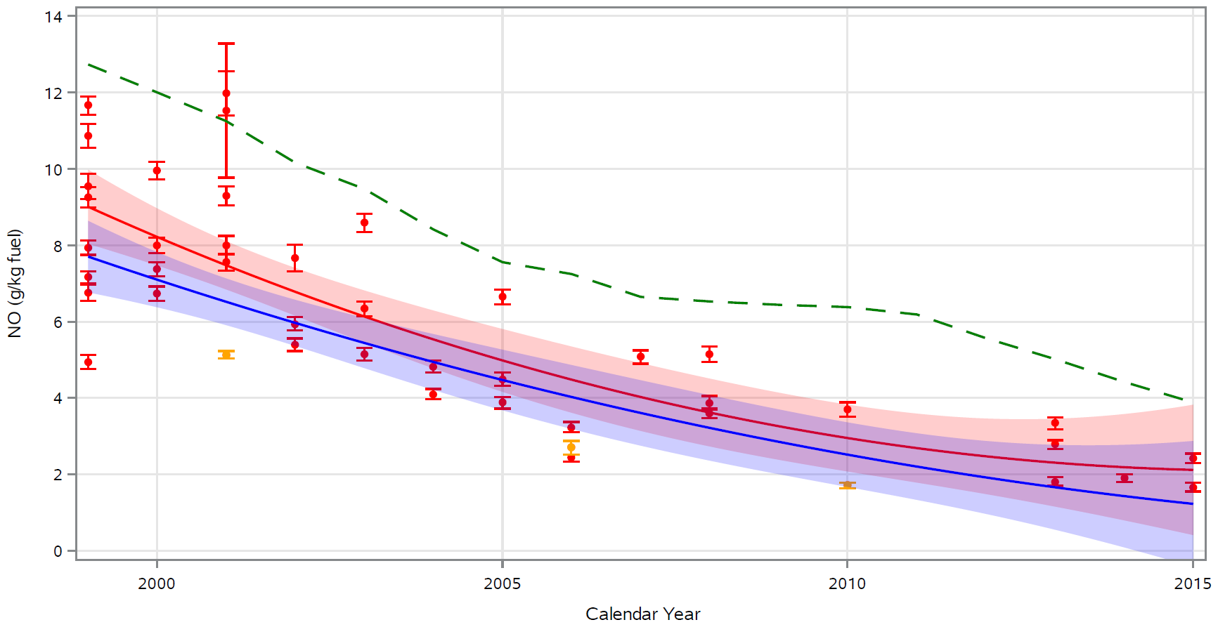
Comparisons of RSD/Tunnel and MOVES
Measured Modeled
RSD data MOVES project-scale regression line
RSD regression line MOVES project-scale 95% confidence band
RSD 95% confidence band MOVES national-scale
Measured Modeled
RSD data MOVES project-scale regression line
Caldecott Tunnel MOVES project-scale 95% confidence band
RSD/Tunnel regression line MOVES national-scale
RSD/Tunnel 95% confidence band
MOVES lower than RSD and generally within the variability of the data
MOVES lower than RSD/tunnel regression and generally within the variability of the data

Slide 11
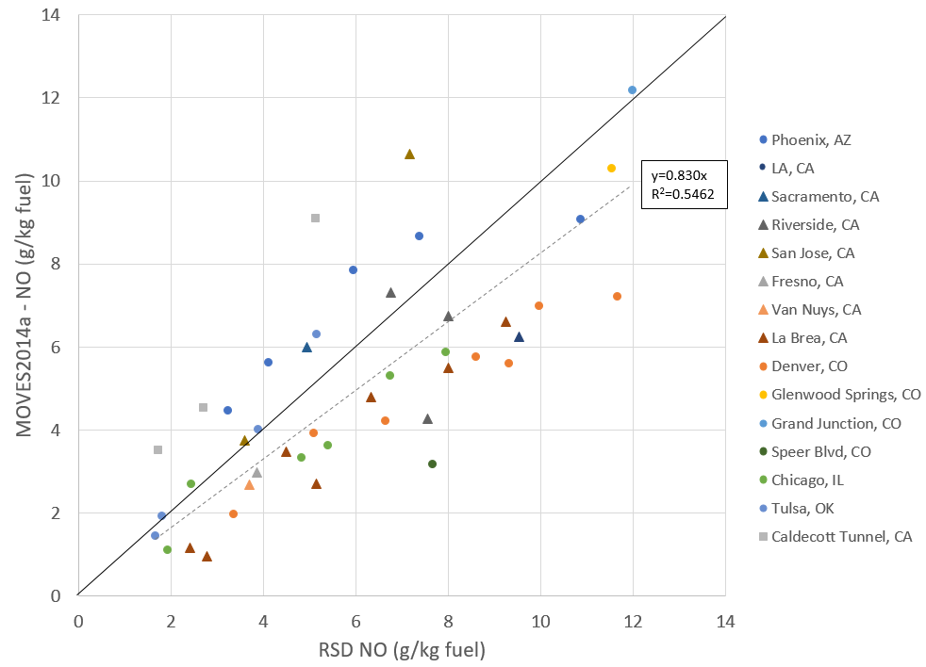
Comparison of RSD/Tunnel and MOVES
1:1 Plot
MOVES predictions lower than the data for majority of the remote sensing sites
MOVES predictions higher than Caldecott Tunnel measurements

Slide 12
Comparisons of RSD and Tunnels to MOVES
MOVES project-scale
  Under-predicts onroad remote sensing measurements
  For most years, MOVES predictions are within the data variability
  Demonstrates the importance of accounting for the measurement conditions (e.g. fleet composition, vehicle activity) when evaluating MOVES
MOVES national scale
  Using the MOVES default inputs can show clear over-prediction
  Consistent with what’s reported in the literature⁹
  NOT a proper way to compare MOVES to independent data

Slide 13
Why are the MOVES estimates using national default inputs higher than project-level estimates?
California Vehicle Emission Standards
  Project-level runs use emission inputs that account for the Low Emission Vehicle (LEV) Program
  LEV inputs not accounted for in MOVES national defaults runs
  For example, LEV inputs reduce NOx by ~ 23% in Caldecott Tunnel 2010 runs
Fuel Properties
  In project-scale, more recent fuel certification⁷ and survey data⁸ used to update MOVES default gasoline sulfur with lower values for 2010+ calendar years
  For example, lowering gasoline sulfur from 30 to 9 ppm in Caldecott Tunnel in 2010 reduces NOx by ~13%
Additional factors differ between project and national defaults
  Age distributions
  Speed and acceleration driving patterns
  Car/light-truck mix
We are working towards better understanding why the national defaults are consistently higher than the project-level runs

Slide 14
Are the MOVES national default inputs relevant to the NEI platform?
NEI prioritizes local inputs over default data
State and local agencies submit MOVES inputs to the NEI, including information about:
  Vehicle age distributions, vehicle fleet mix
  Temporal and road type distributions
  Vehicle miles traveled, speeds
  Inspection/Maintenance and LEV program inputs
EPA develops default inputs that often differ from MOVES national defaults, for example, in 2011 NEI v2 :
  County-specific population and age distribution data for light-duty vehicles from CRC A-88
  County-specific VMT data from FHWA
  Updated fuel property information
NEI platform uses some MOVES national defaults, for example, in 2011 NEI v2:
  Speeds, driving cycles
  Hourly and monthly VMT distributions
Figure 4-1: Dark blue indicates States/Counties that submitted at least 1 CDB input table

Slide 15
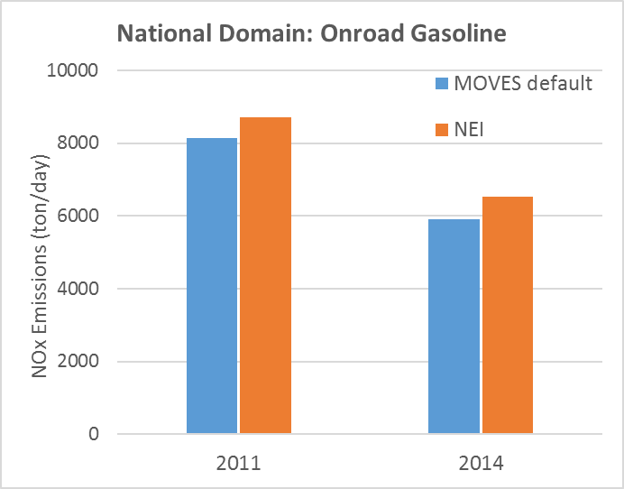
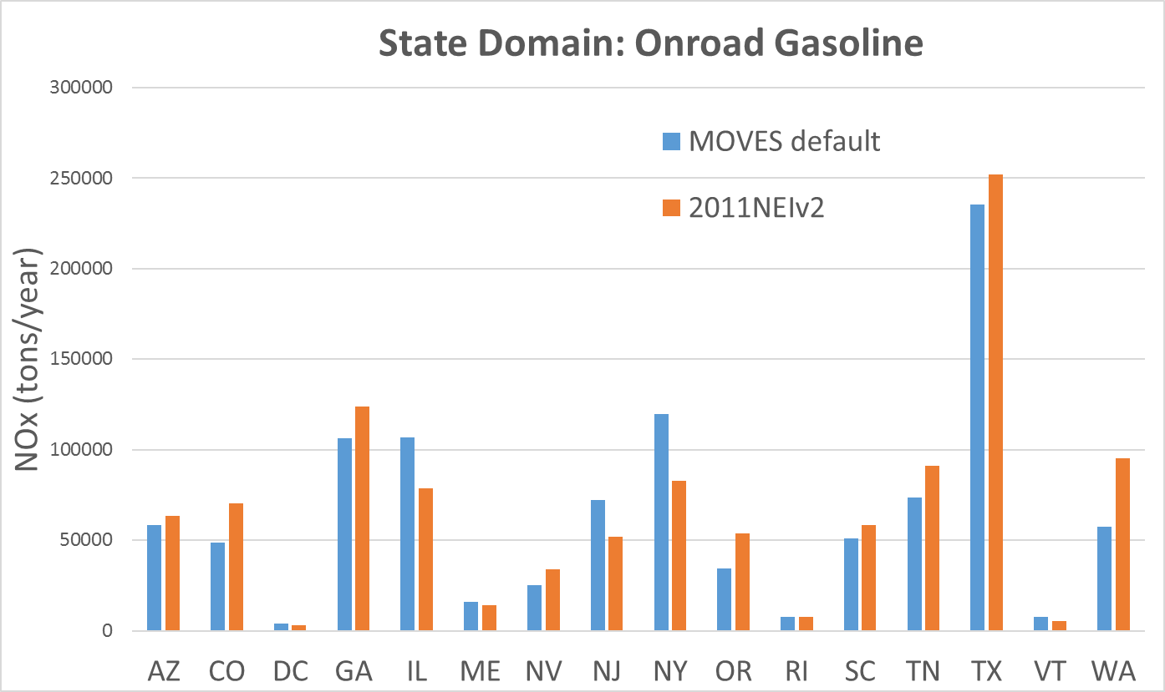
Do the NEI inputs matter? How do NEI platform emissions compare to MOVES default emissions?
+7%
+7%
+9%
+14%
-45%
+19%
+40%
+9%
+31%
-36%
-38%
+36%
+13%
+26%
-25%
-13%
-3%
-43%
At national level, the NEI emissions are comparable to MOVES default emissions
At state level, emissions between NEI and MOVES national defaults vary considerably
We are working to better understand the NEI inputs that lead to these differences

Slide 16
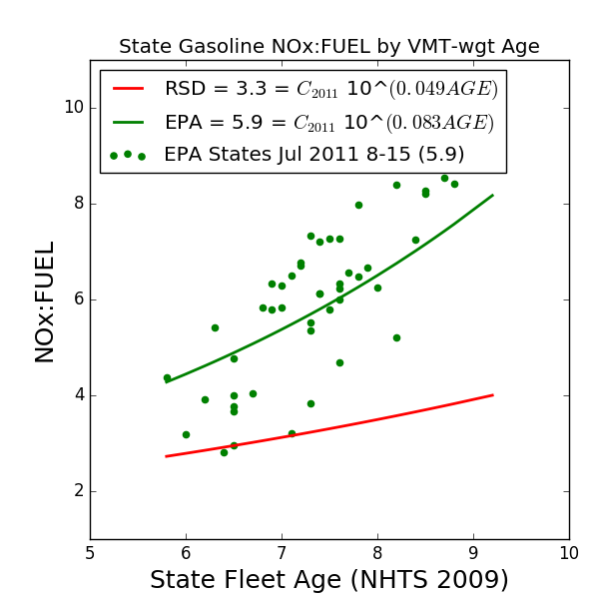
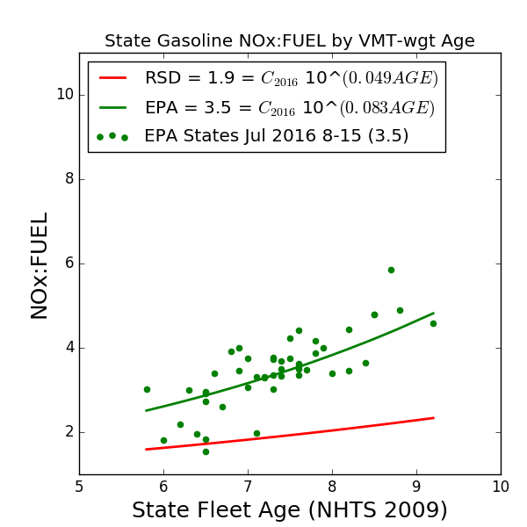
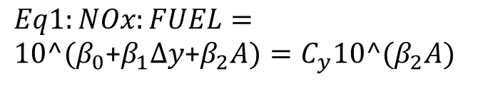
How do RSD measurements compare to the
NEI/EPA modeling platform?
2011 & 2016 EPA platform NOx:Fuel ratios are higher than RSD ratios
  Differences vary with average fleet age
  Both platform and RSD ratios drop between 2016 and 2011
Platform emissions show variation by state not captured in fitted RSD data
  Platform captures differences due to MOVES inputs including fleet-mix, age distribution, road types, driving behavior, I/M and LEV programs, and fuel properties
We are evaluating why the platform emissions are consistently higher
  For example, RSD sites don’t represent the full variety of vehicle operation captured in the MOVES inputs
Calendar Year 2011
Calendar Year 2016
– See Eyth 8:30a Tue
NOx:Fuel fit to modeled and RSD data
Eq 1 Holding C_{y} constant
Fit line cannot capture variability
$Eq1:NOx:FUEL=10^(β_{0}$+$β_{1}Δy$+$β_{2}A)=C_{y}10^(β_{2}A)$

Slide 17
Summary
EPA’s evaluation of MOVES light-duty NOx emission rates shows mixed results
  Denver I/M dynamometer suggest MOVES NOx emission rates may be too high for 1996-2000 passenger cars, and too low for 2010-2016 passenger cars
  RSD and tunnel measurements of NO/Fuel and NOx/Fuel
    Are consistently lower than MOVES when running national defaults and the EPA modeling platform
    RSD sites are generally higher than MOVES when MOVES is used to appropriately model the specific roadside conditions
    Mean trend of the combined RSD and tunnel data is within the variability of MOVES trend when appropriately modeled with the specific roadside conditions
We are continuing work to better understand the observed differences between the platform and RSD data
  NOx/Fuel ratios among states and calendar years in the EPA platform vary considerably, which is not captured by a fitted trend to the RSD data
  RSD measurements also varied considerably compared to the MOVES national defaults
  We don’t expect the RSD sites to fully represent all light-duty NOx emissions within a county or grid-cell
EPA has not concluded that MOVES light-duty gasoline NOx rates are too high and does not support adjustments to the mobile source inventory.

Slide 18
Next Steps
We are continuing to evaluate MOVES NOx light-duty gasoline emission rates, including comparing rates to additional vehicle emission and roadside studies
We are continuing to evaluate and improve the MOVES inputs used in the NEI and EPA Emissions Platform
We encourage further work in evaluating and improving MOVES inputs for all scales of modeling
See Posters:
    #10 Owen et al. “Sensitivity of MOVES emissions specifications on modeled air quality using traffic data and near-road ambient measurements from the Las Vegas and Detroit field studies”
    #12 Simon et al. “Evaluating CO:NOx in a near-road environment using ambient data from Las Vegas”
    #13 Sonntag et al. “Sensitivity of MOVES-estimated vehicle emissions to inputs when comparing to real-world measurements”
    #15 Toro et al. “Investigating modeling platform emissions for grid cells associated with a near-road study site during a field campaign in Las Vegas”
    #16 Toro et al. “Exploring differences in nitrogen oxides overestimation at the seasonal and day-of-week levels to understand potential relationships with mobile source emission inventories”

Slide 19
References
Light-Duty Vehicles and Light-Duty Trucks: Tier 0, Tier 1, and National Low Emission Vehicle (NLEV) Implementation Schedule https://nepis.epa.gov/Exe/ZyPDF.cgi?Dockey=P100O9ZN.pdf
http://www.feat.biochem.du.edu/light_duty_vehicles.html
Kean, A. J., R. F. Sawyer, R. A. Harley and G. R. Kendall (2002). Trends in Exhaust Emissions from In-Use California Light-Duty Vehicles, 1994-2001, SAE International.
Ban-Weiss, G. A., J. P. McLaughlin, R. A. Harley, M. M. Lunden, T. W. Kirchstetter, A. J. Kean, A. W. Strawa, E. D. Stevenson and G. R. Kendall (2008). Long-term changes in emissions of nitrogen oxides and particulate matter from on-road gasoline and diesel vehicles. Atmospheric Environment 42(2): 220-232. http://dx.doi.org/10.1016/j.atmosenv.2007.09.049.
Dallmann, T. R., T. W. Kirchstetter, S. J. DeMartini and R. A. Harley (2013). Quantifying On-Road Emissions from Gasoline-Powered Motor Vehicles: Accounting for the Presence of Medium- and Heavy-Duty Diesel Trucks. Environ Sci Technol 47(23): 13873-13881.
Dallmann, T. R., S. J. DeMartini, T. W. Kirchstetter, S. C. Herndon, T. B. Onasch, E. C. Wood and R. A. Harley (2012). On-Road Measurement of Gas and Particle Phase Pollutant Emission Factors for Individual Heavy-Duty Diesel Trucks. Environ Sci Technol 46(15): 8511-8518.
https://www.epa.gov/sites/production/files/2017-02/documents/conventional-gasoline.pdf
Alliance of Automobile Manufacturers North American Fuel Survey. Summer 2010. Regular Unleaded. San Francisco, CA.
McDonald, B. C., T. R. Dallmann, E. W. Martin and R. A. Harley (2012). Long-term trends in nitrogen oxide emissions from motor vehicles at national, state, and air basin scales. Journal of Geophysical Research: Atmospheres 117.
https://www.epa.gov/air-emissions-inventories/2011-national-emissions-inventory-nei-technical-support-document

