Slide 1

Simple chemistry gone wrong: uncertainty in NO-NO₂ cycling in the upper troposphere and the implications for air quality
Rachel Silvern¹
16th Annual CMAS Conference
October 23, 2017
with Daniel Jacob¹, Katie Travis², Tomas Sherwen³, Mat Evans³,
Ron Cohen⁴, Josh Laughner⁴, Samuel Hall⁵, Kirk Ullmann⁵, John Crounse⁶,
Paul Wennberg⁶, Jeff Peischl⁷, Tom Ryerson⁷, and Ilana Pollack⁸
¹Harvard University | ²MIT | ³University of York | ⁴UC Berkeley |
⁵NCAR | ⁶Caltech | ⁷NOAA | ⁸Colorado State University

Slide 2
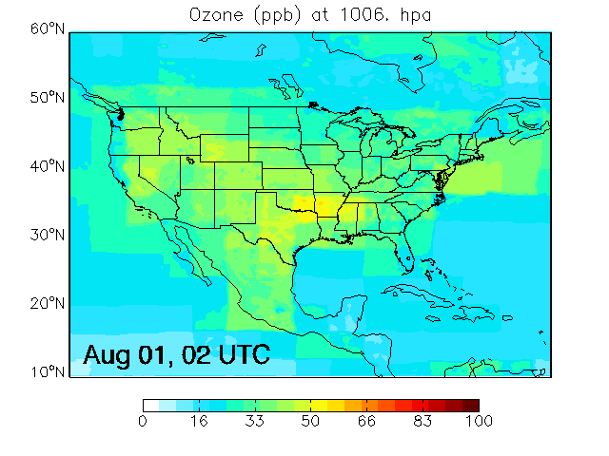
SEAC⁴RS aircraft campaign during August-September 2013 provided detailed observations of O₃-NO_{x}-VOC chemistry
Extensive observations over the Southeast US during summer 2013
GEOS-Chem near real time simulation during SEAC⁴RS at 0.25°×0.3125° resolution with observations overlaid

Slide 3
Observations show elevated NO_{x} concentrations in the upper troposphere mostly present as NO
Median daytime vertical profiles during SEAC⁴RS
NO measurements: T. Ryerson
NO₂ measurements: R. Cohen
O₃ measurements:
T. Ryerson
J_{NO2} measurements:
S. Hall
GEOS-Chem overestimates the NO/NO₂ ratio by over a factor of 2
in the upper troposphere
Anderson et al., 2014
Notes:
Can constraint NO/NO2 ratio well from observations

Slide 4
Conversion of NO to NO₂ balances only half of NO₂ photolysis
NO-NO₂ cycling in the upper troposphere during SEAC⁴RS
[O₃], J_{NO2} from observations, radical concentrations from GEOS-Chem along the flight tracks
Notes:
Explain contrast with the surface where peroxy radicals are more important for NO → NO2 conversion

Slide 5
Underestimate of NO/NO₂ ratio cannot be explained by errors in GEOS-Chem radical concentrations
H₂O₂ measurements:
P. Wennberg
Halogen concentrations from Sherwen et al. (2016)
Underestimate in peroxy and BrO radicals would have to be factor of
5 and 21 to close NO-NO₂ budget
Notes:
Observations of BrO consistent with 1 ppt in UT; 15 ppt would be values observed in Arctic spring boundary layer/ would wipe out ozone

Slide 6
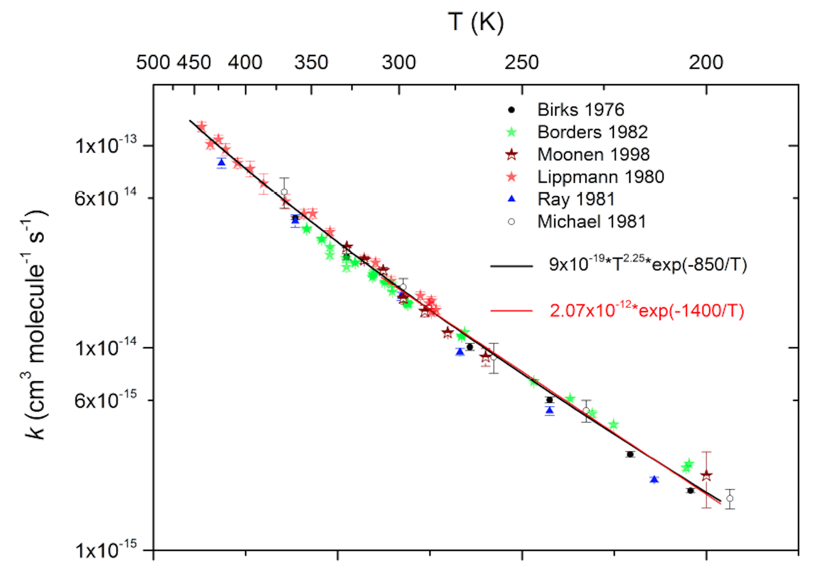
Uncertainties in NO₂ photolysis and the NO+O₃ reaction rate are major sources of errors in tropospheric chemistry models
NO₂ spectroscopic data have 20% uncertainty
NO₂ photolysis frequency:
F = actinic flux
σ = absorption cross section
ϕ = quantum yield
±20% at all temperatures (JPL compilation)
NO+O₃ reaction rate may be biased low at cold temperatures
NO+O₃ Arrhenius rate constant:
k = Aexp[-E/RT]
A = pre-exponential factor
E = activation energy
R = ideal gas constant
T = temperature
298K
Atkinson et al. (2004)
Factor of 6 difference
220K
Notes:
Measurements = chemical actinometers

Slide 7
Increasing NO+O₃ reaction rate combined with decreasing J_{NO2} closes NO-NO₂ budget
Decreasing activation energy of NO+O₃ rate (k₁) at low temperatures
Decreasing J_{NO2} to 1σ uncertainty would affect model and measurements
Notes:
Close NO-NO₂ budget reproducing NO and NO₂ in the upper troposphere without compromising the surface

Slide 8
Correction of the NO/NO₂ ratio results in large decreases in
O₃ throughout the troposphere in the Southeast US
Surface ozone decreases by 5 ppb due to reduction in J_{NO2}, improving agreement with observations
Free troposphere O₃ underestimate may be due to insufficient transport from the stratosphere
Globally, annual mean tropospheric OH decreases by 20%
Notes:
Models generally overestimate global OH, this bring models closer to OH constrained by methyl chloroform observations (with implications for methane lifetime)

Slide 9
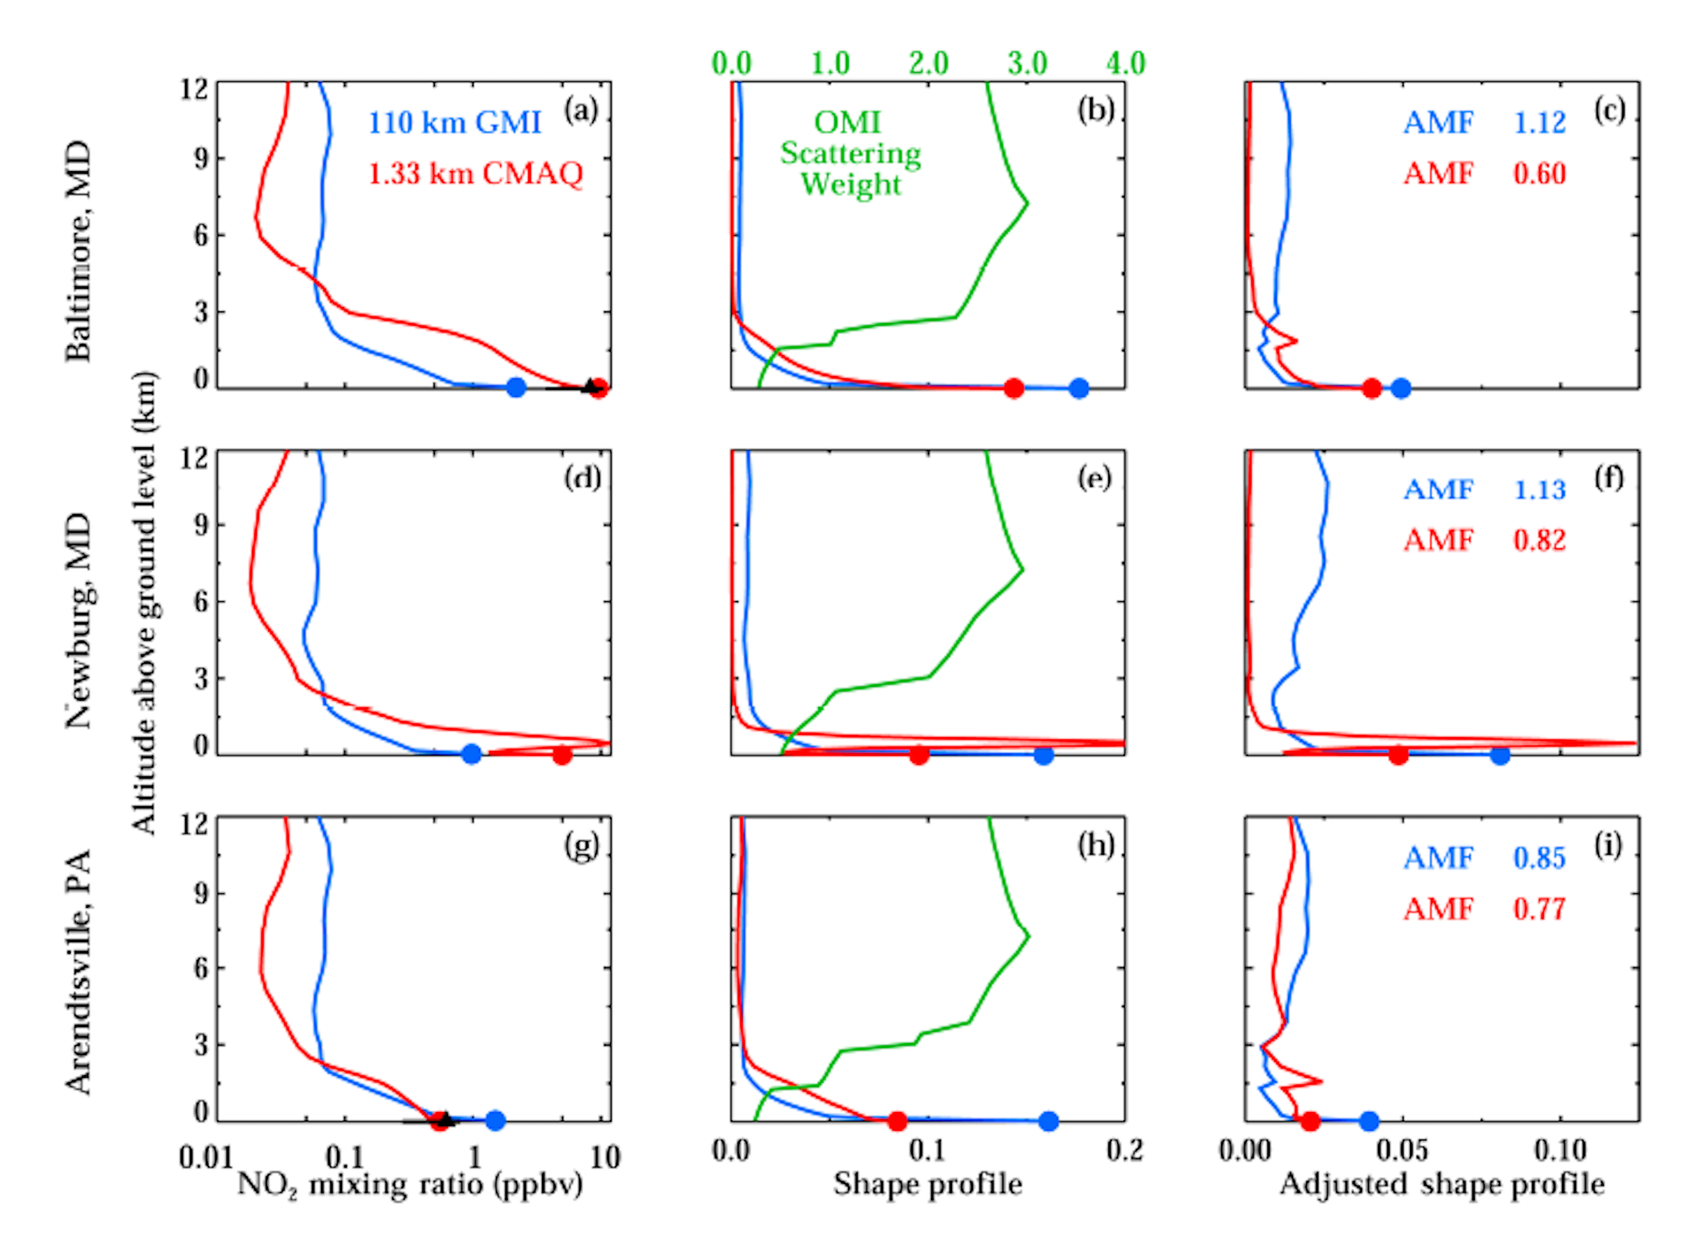
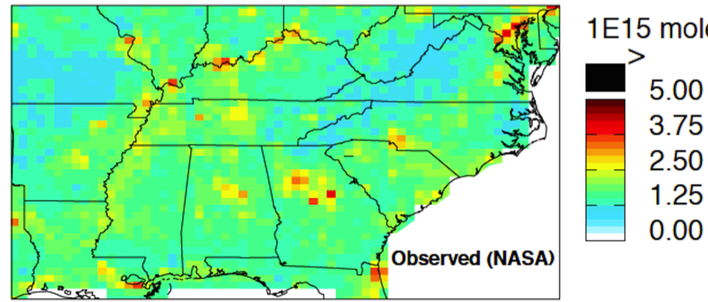
Satellite measurements of NO₂ are particularly sensitive to abundance in the upper troposphere
Altitude above ground level (km)
Scattering by surface and atmosphere
Goldberg et al. (2017)
OMI observes backscattered solar radiation
0.01
0.1
1
10
0
0.1
0.2
NO₂ Mixing Ratio (ppbv)
Shape Profile
NO₂ tropospheric column density observed from NASA
10¹⁵
molecule cm⁻²
>
Travis et al. (2016)

Slide 10
Model underestimates of upper tropospheric NO₂ cause positive bias in tropospheric NO₂ column retrievals from satellites
NO₂ columns are 14-23% lower than previously thought;
The upper troposphere contributes 46% to total column;
Implies that NO_{x} emissions are 30-50% lower than NEI.
Notes:
Continuing to work to better understand implications of correction to the NO2 column for NOx emissions and trends (work in progress)

Slide 11
Conclusions and implications
An observationally constrained analysis of the NO/NO₂ ratio in the upper troposphere in the Southeast US suggests underestimates in conversion of NO to NO₂ may be due to biases in low-temperature kinetic (NO+O₃) and spectroscopic (J_{NO2}) laboratory data.
The simulation of surface ozone is improved through decreased NO₂ photolysis but may require increased transport from the stratosphere to correct ozone in the upper troposphere.
Tropospheric NO₂ columns inferred from satellite observations over the Southeast US decrease by 14-23%, implying lower NO_{x} emissions for a given column amount.
rsilvern@g.harvard.edu

