Slide 1
Projecting State-level Air Pollutant Emissions Using An Integrated Assessment Model: GCAM-USA
Wenjing Shi¹, Yang Ou^{1,2}, Steven J. Smith³, Catherine Ledna³,
Christopher G. Nolte⁴, Daniel H. Loughlin⁴
¹ Research Participant, Oak Ridge Institute for Science and Education, assigned to the U.S. EPA
² University of North Carolina at Chapel Hill
³ Joint Global Change Research Institute, Pacific Northwest National Laboratory
⁴ U.S. EPA Office of Research and Development

Slide 2
Foreword
Objectives of this presentation
  Provide an overview of the GCAM-USA integrated assessment model
  Present a quantitative approach for evaluating the pollutant-, sector-, and state-specific emission projection performance of GCAM-USA
Intended audience
  Emissions and air quality modelers, as well as air quality and energy planners
Acknowledgements
  Additional contributors: Carol Lenox, Troy Hottle, Samaneh Babaee, and Tai Wu
  This project was supported in part by an appointment to the Internship/Research Participation Program at the U.S. EPA, administered by the Oak Ridge Institute for Science and Education through an interagency agreement between the U.S. Department of Energy and EPA.
Disclaimer
  While this presentation has been reviewed and cleared for dissemination, the materials and views expressed here are those of the authors and are not intended to represent the views nor policies of the U.S. EPA

Slide 3
Introduction
Integrated Assessment Models (IAMs):
Characterize human and earth systems and the interactions among their components
Applications: projections of future energy, land use, and water supply and demand; climate impacts assessment; climate change mitigation evaluation
Compared to highly aggregated IAMs, a new class of detailed IAMs includes increasing technological, spatial, and temporal resolution, as well as features of greenhouse gases and air pollutant emissions

Slide 4
Introduction
Global Change Assessment Model (GCAM) version 4.3:
A technology-rich Integrated Assessment Model (IAM)
Represents the economy, energy sector, land use, and climate
Economy
Labor and productivity, GDP
Energy system
Electricity, industry, buildings, transportation
Land use
Agriculture: food, biomass
Environment
Carbon cycle, atmospheric composition, temperature, air pollutant emissions
Global coverage, 32 regions
Time horizon of 2005-2100 in 5-year time steps
Emissions cover criteria pollutants: NO_{X}, SO₂, PM_{2.5}, CO, NH₃; Short-lived climate pollutants: BC, OC, SO₂ ; Greenhouse gases: CO₂, CH₄, N₂O, HFCs
open source, free
~1-2 hour runtime on desktop computer

Slide 5
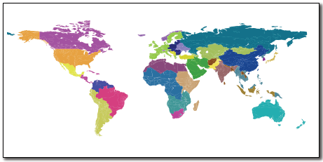
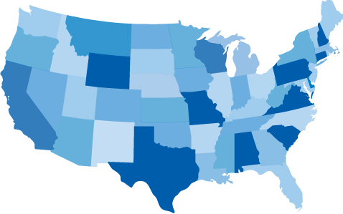
Introduction
GCAM-USA:
Built upon the GCAM 4.3 platform
Resolves the U.S. state-level energy-economic system
The goal of our research is to explore how GCAM-USA can be used to address air, climate, and energy system goals simultaneously and cost-effectively.

Slide 6
Research Approach
We incorporate characterizations of U.S. air pollutant emission factors, air pollutant controls as well as state-level air pollutant and energy policies into GCAM-USA.
Future-year Emission Factors: represent on-the-books regulations and harmonized with emission factors from EPA regulatory modeling efforts;
1) Electric sector: Integrated Planning Model (IPM) v5.13 and v5.14; the Greenhouse
Gases, Regulated Emissions, and Energy Use in Transportation (GREET)
2) Industrial sector: GREET; EPAUS9r2014 MARKAL
3) Light- and heavy-duty vehicles: Mobile Vehicle Emission Simulator (MOVES) 2014
4) Non-highway vehicles: NONROAD model; MARPOL Annex VI

Slide 7
Research Approach
We incorporate characterizations of U.S. air pollutant emission factors, air pollutant controls as well as state-level air pollutant and energy policies into GCAM-USA.
Future-year Emission Factors: represent on-the-books regulations and harmonized with emission factors from EPA regulatory modeling efforts;
State-level Emission Caps: Cross-State Air Pollution Rule (CSAPR) places electric sector NO_{X} and SO₂ caps in 23 states along Mississippi Valley and eastward.
Electric Sector Controls: marginal abatement cost curves for NO_{X} and SO₂ are derived from IPM v5.13.
Transport Sector Fuel Economy: Corporate Average Fuel Economy (CAFE) standard reduces energy consumption by increasing the fuel economy of light-duty vehicles (2015 Annual Energy Outlook).

Slide 8
Model Evaluation: Emissions Projections
GCAM 4.3 and GCAM-USA emissions compared to 2011 Emissions Modeling Platform and inventory projections at 2017 and 2025.
The 2011 inventory refers to 2011 Modeling Inventory. The 2017 and 2025 projections incorporate CSAPR, CAFE, and Tier 3, as well as various industrial New Source Performance Standards.
* PM_{2.5} is not an output in GCAM 4.3.

Slide 9
Model Evaluation: Sectoral Emissions
EGUs (Electric Generating Units)
Industrial sector
Building sector

Slide 10
Model Evaluation for Sectoral Emissions
Light-duty vehicles
Heavy-duty vehicles
Non-highway vehicles

Slide 11
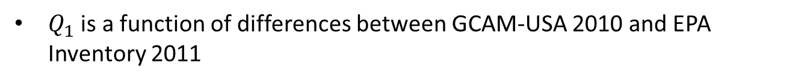
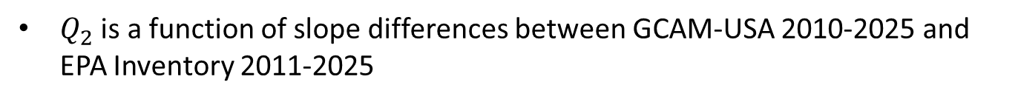
Model Evaluation: Quality Metric
A Quality Metric (QM) is developed to quantify GCAM-USA performance for each pollutant.
QM =$Q_{1}$ + $Q_{2}$
$Q_{1}$ is a function of differences between GCAM-USA 2010 and EPA Inventory 2011
$Q_{2}$ is a function of slope differences between GCAM-USA 2010-2025 and EPA Inventory 2011-2025
Acceptable tolerances for $Q_{1}$ and $Q_{2}$ are chosen as 10% and 20%
$Q_{1}$ and $Q_{2}$ each ranges between 0 and 1, thus QM ranges between 0 and 2
Only for sectors that comprise >= 5% of total emissions for that species

Slide 12
National-Scale Quality Metric Results
GCAM-USA has higher QM than GCAM 4.3.
For GCAM-USA, agreement in absolute magnitude in 2010 is better than agreement in future slopes.
Industrial SO₂ slope difference is as high as 33%, due to the lack of technology-specific industrial emission factors in GCAM-USA.
Source: Shi et al. (in press)

Slide 13
Model Evaluation: State-level QMs
NO_{X}
SO₂
PM_{2.5}
Black: High quality fit
White: Low quality fit, but within tolerances
Red: outside tolerances
Transparent: not measured since category < 5% of inventory
Total
EGUs
Higher QMs for total emissions and electric sector emissions
Industrial
Relative low industrial sector and on-road transportation sector QMs
Higher electric sector QMs in CSAPR states
On-road
Transportation
Source: Shi et al. (in press)

Slide 14
Conclusion and Future Direction
GCAM-USA can support both air quality management decision-making and energy system planning. We have characterized GCAM-USA in a way that produces national-level and state-level NO_{X}, SO₂, and PM_{2.5} emissions in a manner generally consistent with the EPA inventory and its projections.
Add technological-, industry-, and state-specific resolution to the industrial sector;
Disaggregate energy supplies and demands by season and time of day, to more fully capture energy system dynamics;
Include state and regional policies that are not currently being captured, such as Regional Greenhouse Gas Initiative (RGGI) among northeastern states and California light-duty vehicle greenhouse gas emission regulation.

Slide 15
Questions?
Contact information:
Wenjing Shi, U.S. EPA, ORD – Shi.Wenjing@epa.gov
Dan Loughlin, U.S. EPA, ORD – Loughlin.Dan@epa.gov
Chris Nolte, U.S. EPA, ORD – Nolte.Chris@epa.gov
Reference:
Shi et al., Applied Energy, doi: 10.1016/j.apenergy.2017.09.122

Slide 16
Quality Metric Formula
A Quality Metric (QM) is developed to quantify GCAM-USA performance for each pollutant.
The QM is the sum of $Q_{1}$ and $Q_{2}$, each ranging between 0 and 1.
Only for sectors that comprise >= 5% of total emissions for that species
 |  |  | 0 ≤ ≤
 |  | 0 | ≥
 |  |  | 0 ≤ ≤
 |  | 0 | ≥
Quality metric components in terms of GCAM-USA modeled emissions at 2010 and 2025 ($y$ and $y′$, respectively) and inventory values at 2011 and 2025 ($x$ and $x′$, respectively). Scaling parameters $β_{1}$ and $β_{2}$ define acceptable tolerances for $Q_{1}$ and $Q_{2}$, and here are chosen as 10% and 20%, respectively.

