Slide 1


What factors contribute to O₃ overestimation by the CMAQ Model in the Great Lakes Region?
Momei Qin, Yongtao Hu, M. Talat Odman, Armistead G. Russell, Arastoo P. Biazar, Kevin Doty and Richard T. McNider
October 25, 2017
CMAS Conference
Notes:
Good afternoon, everyone. I am Momei, a postdoc from Georgia Tech.
I’m going to talk about the factors contributing to O3 overestimation by CMAQ in the Great Lakes Region.
This project is funded by EPRI and NASA HAQAST. And I would like to acknowledge the co-authors of this presentation

Slide 2
Outline
Background
Model configurations
Baseline evaluations
  WRF (surface wind speed, temperature, humidity)
  CMAQ (O₃, NO_{x})
Emissions
  50% NO_{x} from mobile sources
  MEGAN vs. BEIS
Chemistry
  CB6 vs. CB05
Deposition
  10-fold dry deposition of O₃ over fresh water
Notes:
This is the outline of my talk.
After a brief introduction of background and model configurations, I will present baseline evaluations.
The evaluation shows CMAQ overestimated O3 and NOx, so we did several tests with changed emissions, chemistry and dry deposition of ozone.
Using MEGAN instead of BEIS, or increasing dry deposition of O3 over fresh water even by a factor 10 will not improve model performance, so I will not talk about that.
This presentation focuses on the test with 50% reduction of NOx from mobile sources and the other test using CB6 instead of CB05.

Slide 3
Background
O₃ exceedance is still of concern in the Great Lakes Region
Air quality model tends to overestimate O₃ over cooler bodies of water, e.g. over Lake Michigan
1-24h forecast
25-48h forecast
Cleary et al., ACP, 2015
Notes:
Non-attainment of O3 is still of concern in the Great Lakes Region.
On the other hand, air quality model tends to overestimate O3 over water
For example, this figure shows the differences between simulated O3 in a 48hr forecast and ferry observations. The maximum of high bias can reach about 17ppb over the lake.
In this study, we were tying to figure out what factors could be responsible for such overestimation.

Slide 4
WRF configurations
 | 12-km | 4-km
Longwave radiation | rrtmg scheme
Shortwave radiation | rrtmg scheme
Land surface | Pleim-Xiu LSM
Cumulus | Kain-Fritsch scheme
microphysics | Morrison (2 moments)
PBL | ACM2 (Pleim) PBL
Surface nudging | off
Grid nudging | above the PBL | off
Soil nudging | on | on
WRFv3.8.1
Jun 15th to Aug 1st, 2011
One-way nested
  12-km (402×252)
  4-km (390×279)
Notes:
This slide shows WRF configurations
WRFv3.8.1 was used, and the simulation period went from Jun 15th to Aug 1st, 2011.
One-way nested runs were conducted. The 12-km domain covers the entire continental US and the 4-km domain pays attention to the Great Lakes Region.
The table on the right hand shows the major options, for instance, grid nudging above the PBL was applied in the 12-km simulation only, and we didn’t use surface nudging.

Slide 5
CMAQ configurations (baseline)
Mechanism
  Cb05e51, with 6th aerosol module
Emissions
  2011 NEI (Version 6.2 Platform)
  In-line calculation in CMAQ
    Point sources & Biogenic emissions (BEIS3)
Other options
Use inline windblown dust emissions | N
Turn on lightning NO_{x} | N
Use min Kz in edyintb | Y
Calculate in-line deposition velocities | Y
Ammonia bi-directional flux for in-line deposition velocity | N
Mercury bi-directional flux for in-line deposition velocity | N
Surface HONO interaction | Y
CMAQv5.1
Jun 21st to Aug 1st, 2011
Grids
  12-km, 12US2 (396×246)
  4-km, 04GL (384×273)
  35 vertical layers
Notes:
The slide shows the configurations in CMAQ.
CMAQ version 5.1 was applied. The horizontal grids were similar to that in WRF. There were 35 grids in vertical direction.
CB05 was applied. The anthropogenic emissions were obtained from 2011 NEI. One should note that plume rise of point sources and biogenic emissions were calculated in-line in CMAQ.
This table shows some other options.
Next, let’s take a look at WRF performance.

Slide 6
WRF performance
Surface temperature, humidity
Wind speed (m/s)
Distance from the shoreline | Type
>100km | Inland
20-100km | Buffer
<20km | Coastal
12-km
High biases occurred during the nighttime and in the early morning (19:00-8:00 CST), when wind speed is low
4-km
Notes:
When we did model evaluation, the observational sites were grouped into three categories, i.e. inland sites, sites in buffer area and coastal sites, based on the distance from the shoreline.
WRF was able to reproduce surface temperature and humidity successfully. I didn’t show the results here.
As you can see in the figure, there were model-observation gaps in wind speed, regardless of the resolution, or the site categories.
High biases occurred during the nighttime and in the early morning, when wind speed is low.
Let’s go to the evaluation of CMAQ baseline simulation.

Slide 7
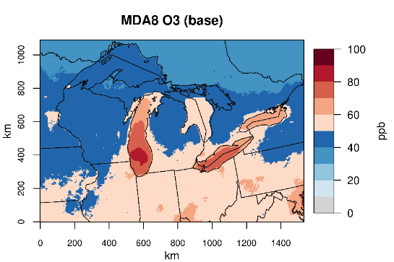
CMAQ performance (baseline)
MDA8 O₃
better
worse
Notes:
The figure in the top right corner shows monthly mean of simulated daily maximum 8 hour average O3. I will refer to it as MDA8 O3. We can see elevated O3 over the lake.
The top row of the figures show mean biases for MDA8 O3 in 12-km and 4-km simulation, and the differences in absolute mean biases between the two cases. The negative values, shown in blue, mean 4-km is better. The red mean 4-km is worse than 12-km.
Likewise, the bottom row shows the evaluation of MDA8 O3 larger than 60 ppb.
CMAQ tended to overestimate MDA8 O3, particularly along the coast. The maximum of the bias reached 10 ppb or higher.
MDA8 O3 larger than 60ppb was underestimated at most sites except coastal area.
Comparing the simulations at different resolutions, it was found that CMAQ performed better on MDA8 O3 at 4-km resolution. For MDA8 O3 larger than 60ppb, 4-km was better in the coastal area.

Slide 8
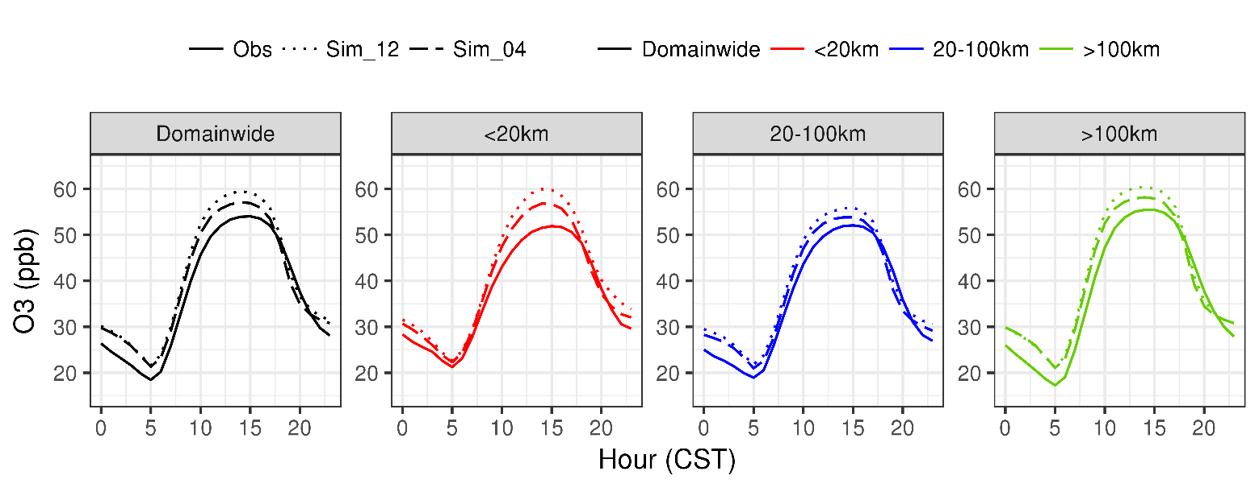
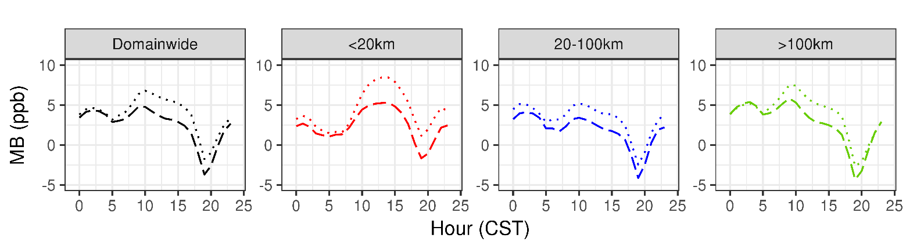
CMAQ performance (baseline)
O₃
July Monthly Means
Group |  | <20km | 20 – 100km | >100km
MDA8 O₃ | Obs | 51.2 | 50.9 | 54.1
 | 12-km | 60.3 | 55.0 | 58.6
 | 4-km | 56.6 | 52.5 | 56.4
MDA8 O₃ (>60ppb) | Obs | 69.1 | 67.8 | 68.1
 | 12-km | 71.4 | 65.1 | 68.3
 | 4-km | 67.4 | 61.5 | 64.7
(65)
(52)
(175)
Number of sites given in parentheses
Notes:
This table shows monthly average. In 4-km simulation, the simulated MDA8 O3 was about 5 and 2ppb higher than observations in coastal and inland area, respectively. For MDA8 O3 larger than 60 ppb, the simulation was about 2 and 3 ppb lower.
When we look at the diurnal pattern, we can see that the positive bias was highest around noon at coastal sites.
In inland area, the positive bias was higher at night and in the morning.

Slide 9
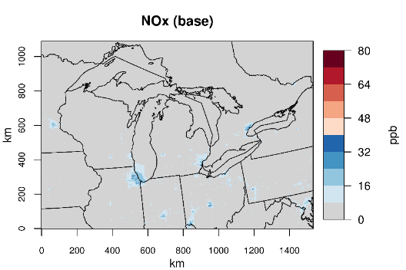
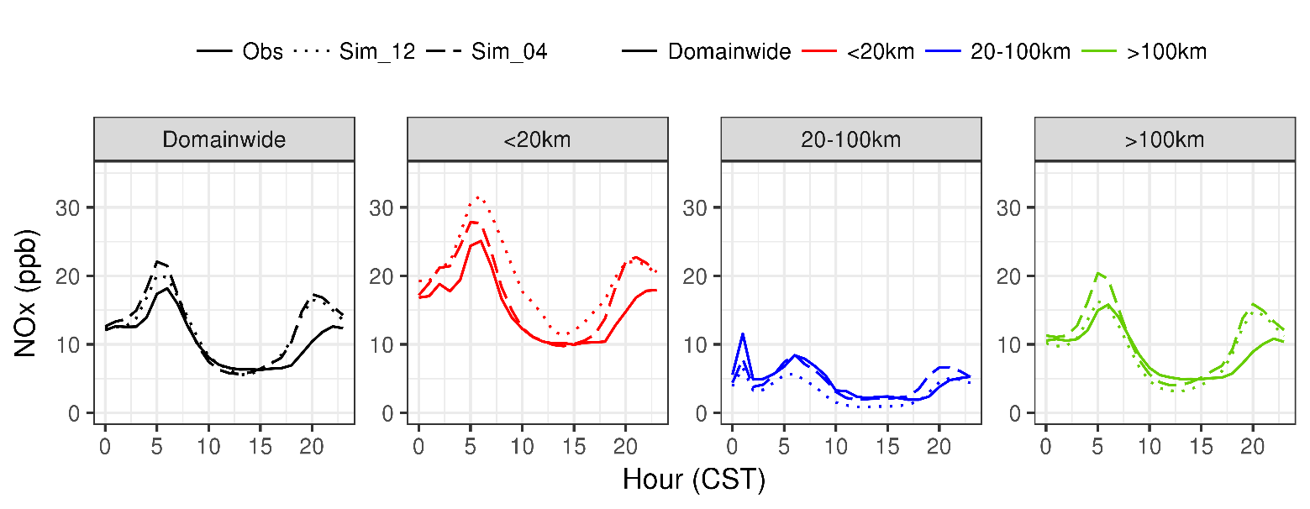
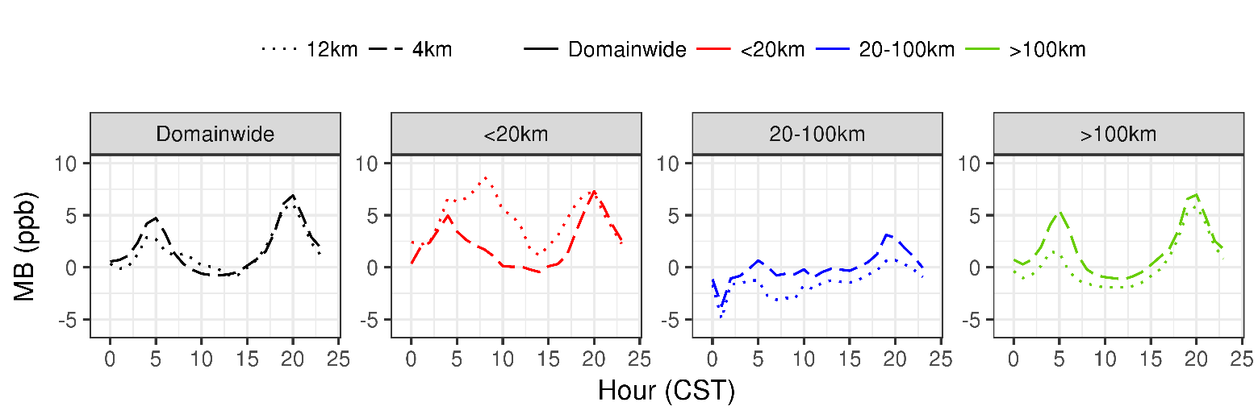
CMAQ performance (baseline)
NO_{x}
(14)
(2)
(33)
Group |  | <20km | 20 – 100km | >100km
NO_{x} | Obs | 15.3 | 4.4 | 9.0
 | 12-km | 20.0 | 3.1 | 9.3
 | 4-km | 17.5 | 4.5 | 10.7
Number of sites given in parentheses
Notes:
The simulated NOx shows high mixing ratio in urban areas. Compared to the observations, simulated NOx was about 2 ppb higher based on montly average.
Simulated NOx reached maximum at 5 a.m. and 8 p.m. due to rush-hour traffic. The high biaes also peaked over rush-hour, which could be an evidence that NOx emisions from mobile sources was overestimated. If this was true, how will it affect O3 simulation?
So we did a test with 50% reduction in Nox emissions from mobile sources. I will show the result next.

Slide 10
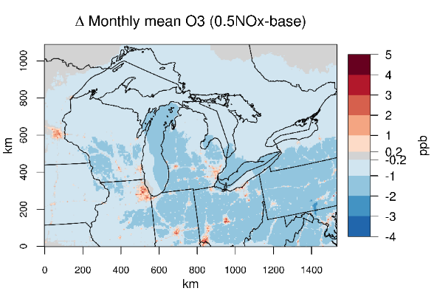
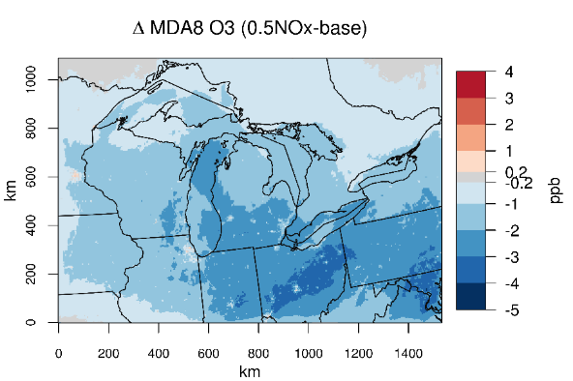
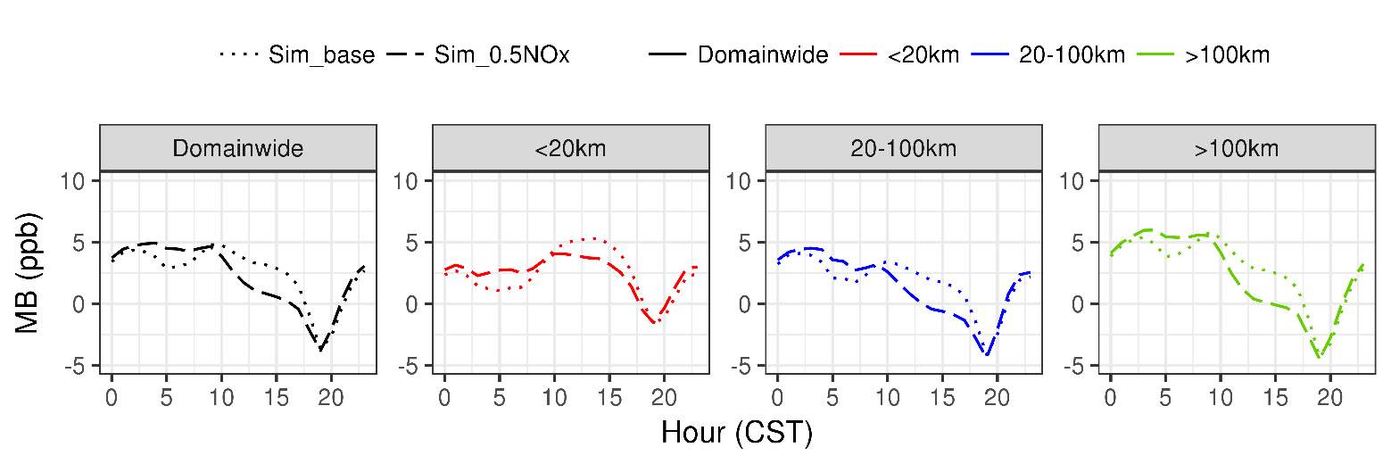
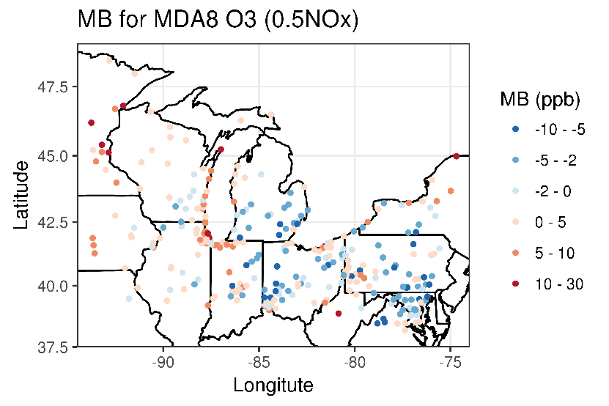
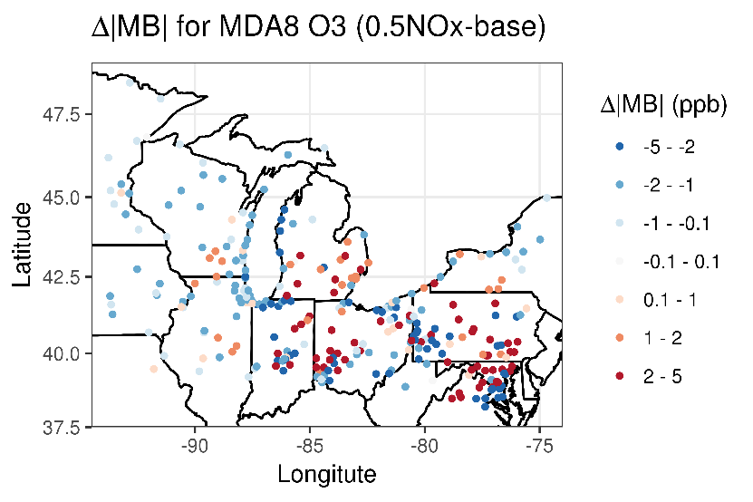
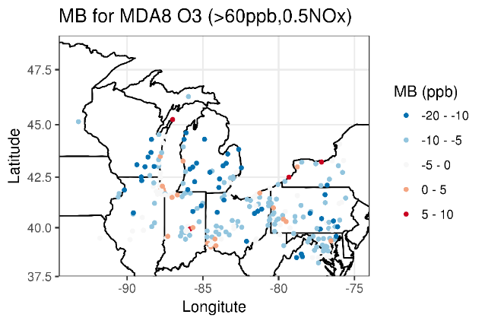
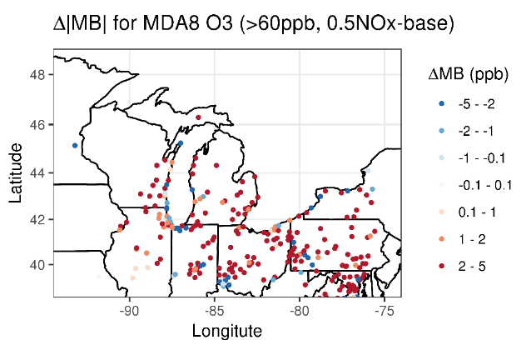
50% NO_{x} emissions from mobile sources：O₃ performance
Group |  | <20km | 20 – 100km | >100km
MDA8 O₃ | Obs | 51.2 | 50.9 | 54.1
 | Base | 56.6 | 52.5 | 56.4
 | 0.5NO_{x} | 55.2 | 50.6 | 54.3
MDA8 O₃ (>60ppb) | Obs | 69.1 | 67.8 | 68.1
 | Base | 67.4 | 61.5 | 64.7
 | 0.5NO_{x} | 65.1 | 58.7 | 61.8
Notes:
The monthly mean O3 increased in urban area as titration of Nox was suppressed, with domain-wide decrease of MDA8 O3.
High biases of MDA8 O3 along the shoreline remained while MDA8 O3 was underestimated in other areas. Compared to the baseline, simulation of MDA8 O3 was improved along the coast.
Similarly, CMAQ performed better along the coast while worse at most sites.
One of the good things is that high bias of O3 in the middle of the day decreased with reduction of NOx emissions. On the other hand, high bias in the morning went up.
50% reduction of NOx emissions can lead to O3 1-2 ppb lower than baseline, with more reduction in MDA8 O3 larger than 60ppb.
Overestimation of MDA8 O3 was still present at coastal sites while MDA8 O3 larger than 60ppb was underestimated.

Slide 11
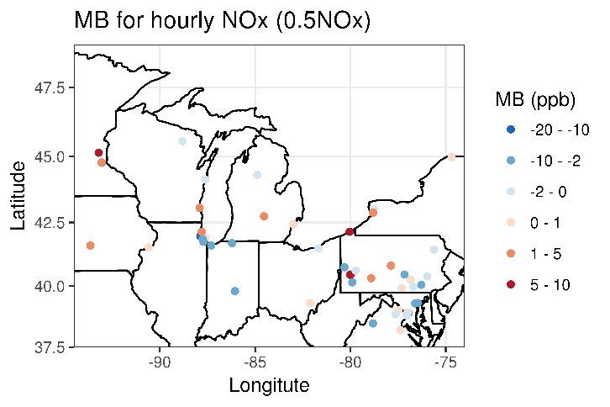
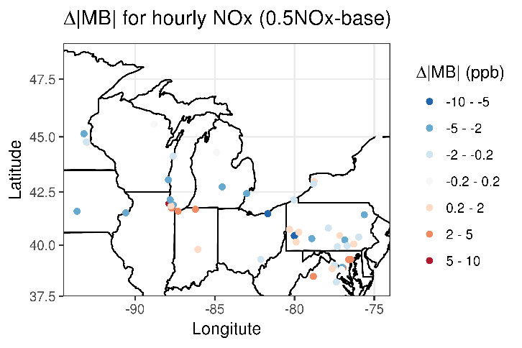
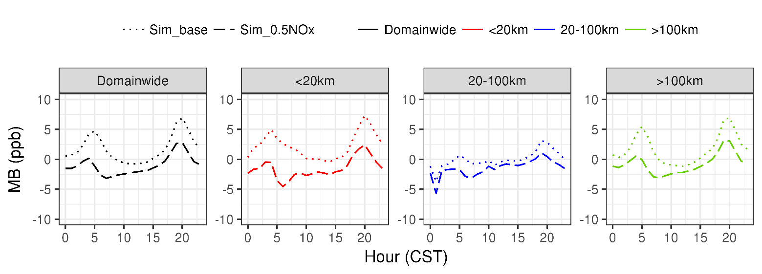
50% NO_{x} emissions from mobile sources: NO_{x} performance
Group |  | <20km | 20 – 100km | >100km
NO_{x} | Obs | 15.3 | 4.4 | 9.0
 | Base | 17.5 | 4.5 | 10.7
 | 0.5NO_{x} | 13.8 | 3.1 | 8.2
Notes:
Now let’s take a look at the evaluation of NOx. As you can see, with 50% reduction of NOx, two peaks of the model bias during the rush-hour decreased significantly. Simulated NOx concentration was about ~1 ppb lower than observation

Slide 12
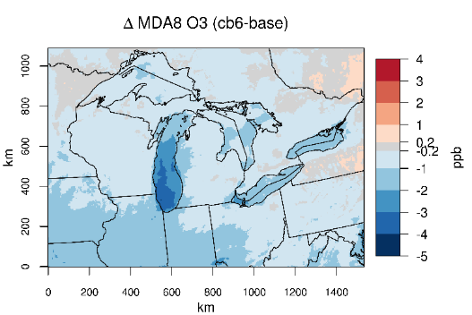
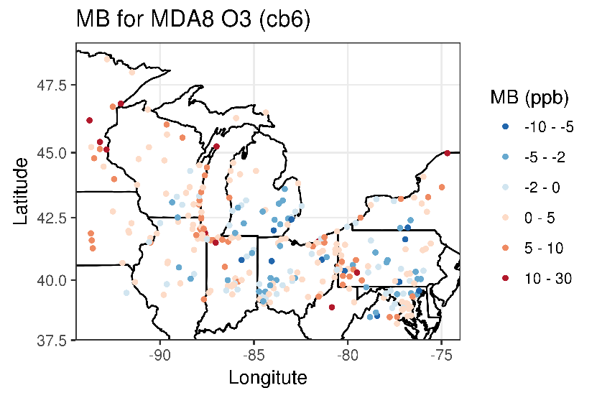
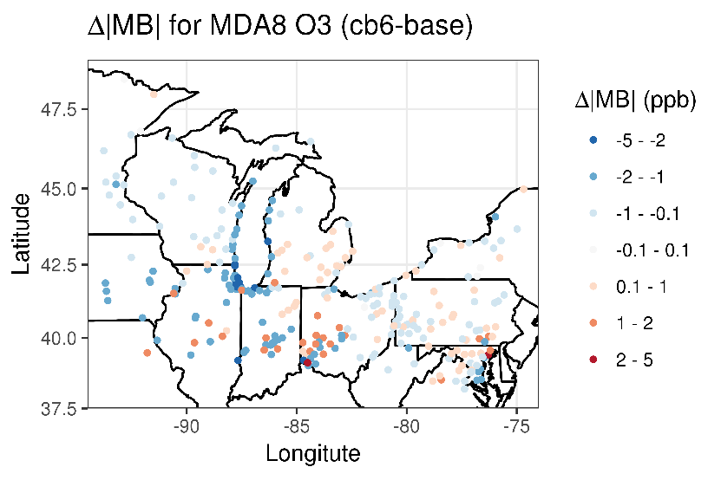
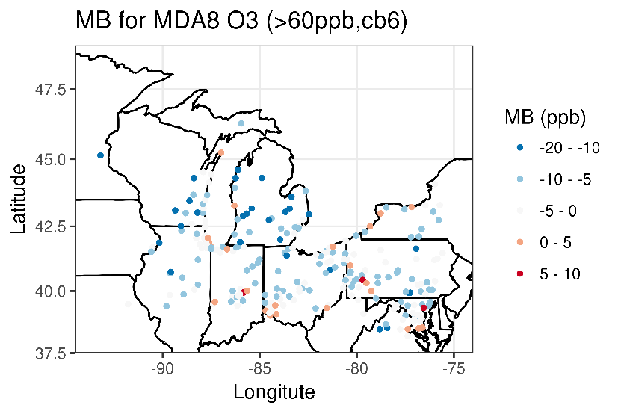
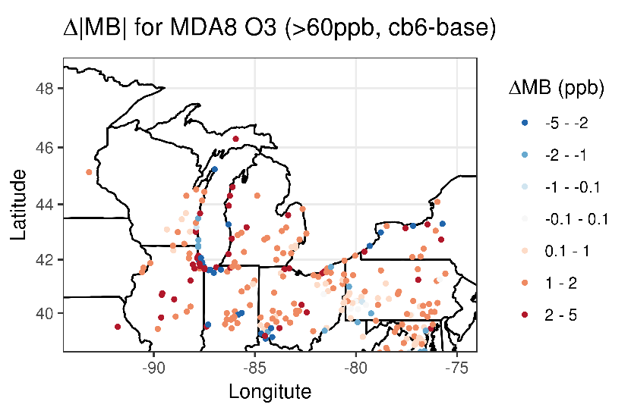
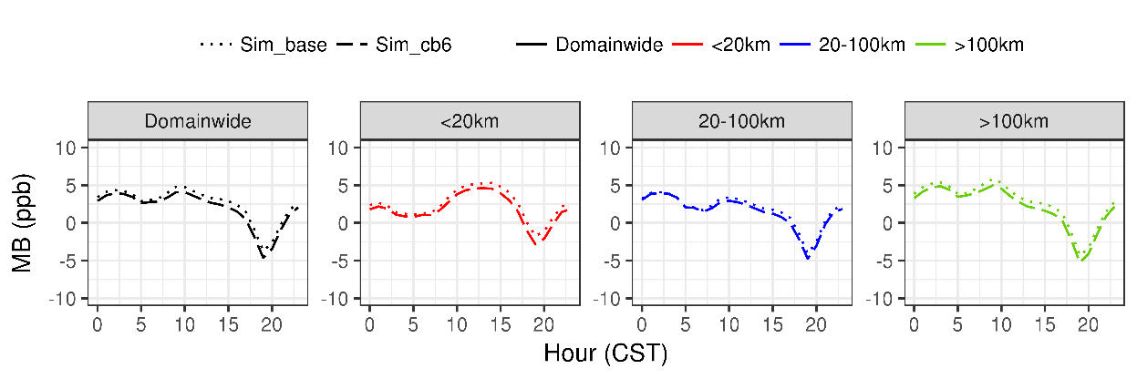
CB6 compared to baseline (CB05)
O₃
Group |  | <20km | 20 – 100km | >100km
MDA8 O₃ | Obs | 51.2 | 50.9 | 54.1
 | Base | 56.6 | 52.5 | 56.4
 | CB6 | 55.4 | 51.9 | 55.5
MDA8 O₃ (>60ppb) | Obs | 69.1 | 67.8 | 68.1
 | Base | 67.4 | 61.5 | 64.7
 | CB6 | 64.9 | 60.0 | 63.3
NO_{x} | Obs | 15.3 | 4.4 | 9.0
 | Base | 17.5 | 4.5 | 10.7
 | CB6 | 17.6 | 4.5 | 10.8
Notes:
Using CB6, CMAQ simulated lower MDA8 O3, compared to the baseline, which used CB05. The difference can reach 4 ppb over southern Lake Michigan.
Compared with observation, MDA8 O3 was overestimated in some locations, for example, along the coast. In these locations, CB6 will be better than CB05 in O3 simulation. Similar to the baseline, MDA8 O3 larger than 60 ppb was underestimated generally, and the negative biases became larger with CB6.
When we examined the diurnal pattern of mean bias, we found that the mean bias of cb6 is close to that using cb05.
monthly mean was caculated, as shown in the table, cb6 produced 1ppb lower MDA8 O3 than CB05, along with approximately 2ppb lower of MDA8 O3 larger than 60 ppb. However, switching to cb6 will not have large effect on simulated NOx concentration.

Slide 13
Conclusions
 | Baseline | 50% NO_{x} emissions from mobile sources | CB6
MDA8 O₃ | Higher than observation Coastal (~10%) vs. inland (~5%) After midnight and in the afternoon Better performance at 4-km resolution (compared to 12-km) | Domain-wide reduction (1-2 ppb) High biases decreased significantly near the lake | Up to 4ppb reduction over southern Lake Michigan Better agreement with observation along the Lake Michigan
MDA8 O₃ (> 60ppb) | Biased low | Negative biases became larger | Negative biases became larger
NO_{x} | Biased high by 15-20% Around 5 am and 8 pm CST | Biased low | Minor change
Notes:
Finally, I will summarize our findings in the current work with this table. The baseline simulated higher MDA8 O3 than observation, ~10% in the coastal and 5% inland farther, parcticularly after midnight and in the afternoon. Either reduction of NOx emissions or using CB6 can produce lower MDA8 O3, compared to the baseline, and the high biases near the lake significantly decreased.
MDA8 O3 larger than 60ppb was biased low, the positive biases became larger with changed NOx emission or CB6.
Nox concentration was biased high by 15-20%, especially over the rush hour. It was biased low when the emissions were cut, cb6 had minor difference with cb05.

Slide 14
Thank you for your attention!
Questions?

Slide 15
Conclusions
Baseline O₃ Performance
  Higher simulated O₃ than observed, particularly along Lake Michigan’s shoreline, after midnight and in the afternoon
  At 4-km resolution, MDA8 O₃ was biased high by ~10% on average in coastal areas and ~5% in inland areas, while elevated MDA8 O₃ (> 60 ppb) was biased low
  Better performance at 4-km resolution (compared to 12-km simulation), particularly in coastal areas
Baseline NO_{x} Performance
  Higher positive biases around 5 am and 8 pm CST
  Biased high by 15-20% at 4-km resolution
  Better performance at 4-km resolution than 12-km simulation in coastal areas

Slide 16
Conclusions
50% reduction in NO_{x} emissions from mobile sources
  Domain-wide reduction of MDA8 O₃ (~ 1-2 ppb)
  High biases of MDA8 O₃ decreased significantly near the lake, while negative biases of elevated MDA8 O₃ (> 60 ppb) became larger
  NO_{x} was biased low
CB6 compared to CB05
  MDA8 O₃ decreased up to 4ppb over southern Lake Michigan
  MDA8 O₃ was in better agreement with observation, while higher MDA8 O₃ (>60ppb) was more biased low
  Minor change in NO_{x}

