Slide 1
Development of the Next Generation Air Quality Modeling System
Jonathan Pleim, Robert Gilliam, David Wong, Jerold Herwehe, Russell Bullock, Bill Hutzell, George Pouliot, Christian Hogrefe, Wyat Appel, Daiwen Kang, Limei Ran
CED/NERL/ORD/USEPA
Hosein Foroutan
Virginia Tech
16th Annual CMAS Conference: October 24, 2017

Slide 2
Vision for Next Generation Model
Overarching goals for Next Generation Model System:
  Urban – Global scale interactions
  Atmosphere – Biosphere Interactions
Extend to global scales
  Single global mesh with seamless refinement to local scales
  Integrated chemistry, dynamics, physics
Three configurations of flexible systems:
  On-line global variable grid (e.g. MPAS)
  Online regional (WRF-AQ or limited area MPAS)
  Offline regional (redesigned CMAQ)
Interoperability of as much model code as possible
  1-D AQ component coupled to various met models
Transport in met models for online systems (adv, diffusion)
  Ensure mass conservation
  Consistency with met parameters
  Minimize numerical diffusion and dispersion
MPAS

Slide 3

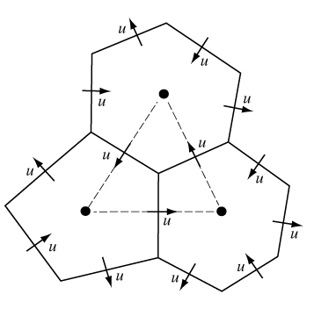
MPAS
Fully-compressible, non-hydrostatic dynamics
Finite volume discretization on centroidal Voronoi (nominally hexagonal) grids
Single global mesh with seamless refinement to local scales
Latest version: MPAS 5.2 released on August 1, 2017
MPAS uniform mesh (240 km)
MPAS non-uniform mesh (92km – 25km)
Refinement over CONUS

Slide 4
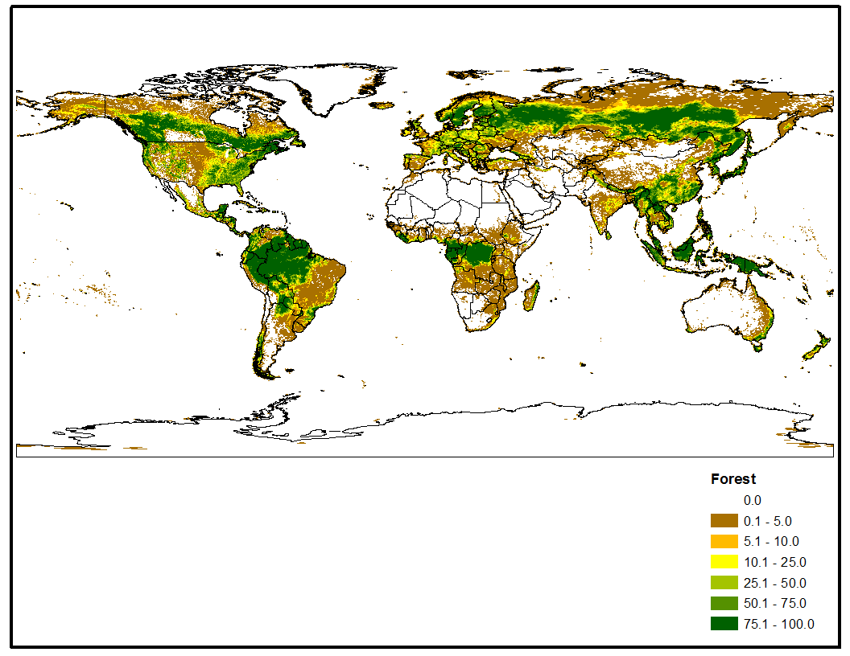
MPAS development and testing for AQ
Added physics
  ACM2 Boundary layer model
  Pleim-Xiu Land Surface Model (PX-LSM)
  Updated Kain-Fritsch convective cloud scheme (see Jerry Herwehe’s poster)
    including radiation feedback and dynamic lifetime
Data Assimilation
  Implemented FDDA similar to WRF
  Implemented indirect soil moisture data assimilation in PX LSM
Landuse for met and biogenics
  NLCD 2011 US Blended with MODIS 2013 including subgrid fractional coverage

Slide 5
MPAS Testing and Evaluation (July 2013)
Tested two mesh configurations
  92 km mesh resolution refined to 25 km over N. America
  46 km mesh resolution refined to 12 km over N. America
Two physics suites:
  Standard Physics:
    KF (WRFv3.2.1), YSU PBL (WRFv3.8.1), Noah LSM (WRFv3.3.1), RRTMG LW and SW Radiation (WRFv3.8.1), WSM6 MP (WRFv3.8.1)
  EPA Physics:
    KF w/ feedback to Rad, ACM2 PBL, PX LSM, RRTMG LW and SW Radiation (WRFv3.8.1), WSM6 MP (WRFv3.8.1)
  Data Assimilation
    FDDA analysis nudging of T, Qv, U, V above PBL using GFS FNL 1-deg
    Indirect soil moisture and temperature nudging in PX LSM using surface analysis based on RUC 13 km US blended with GFS 0.5 deg Global

Slide 6
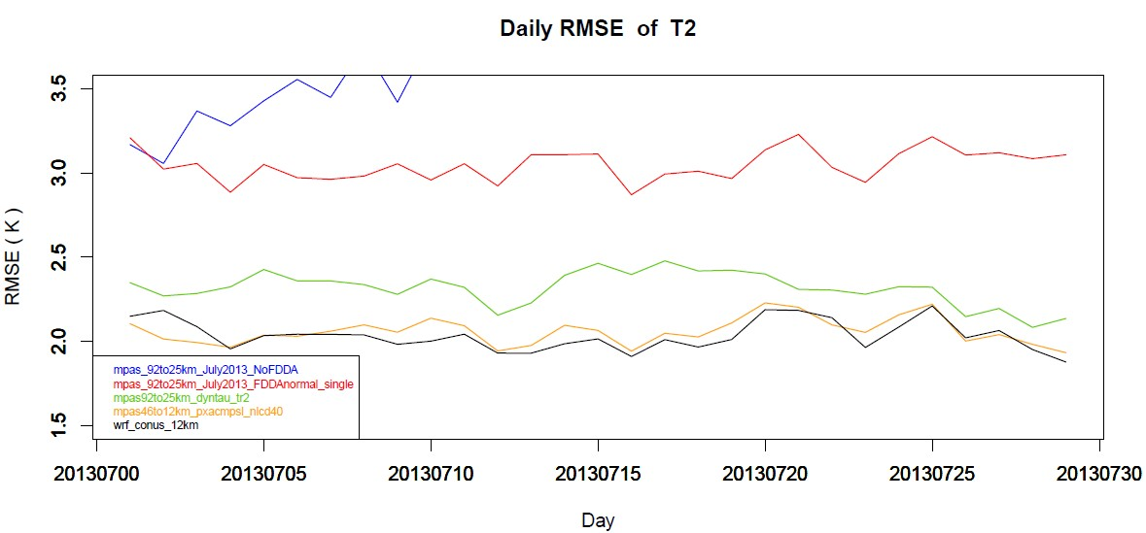
2-m Temperature Daily RMSE for CONUS
Standard physics No FDDA 92to25km
Standard physics w/ FDDA 92to25km
EPA physics 92to25km
EPA physics 46to12km
EPA physics WRF 12km
Courtesy of Rob Gilliam

Slide 7
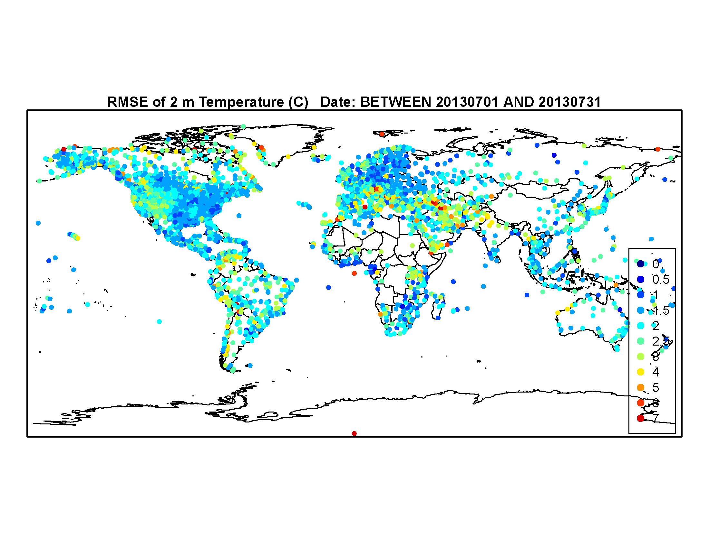
MPAS evaluation using EPA mods
46 km mesh resolution refined to 12 km over N. America
Physics:
  KF w/ feedback to Rad
  PX LSM
  ACM2 PBL scheme
  RRTMG Radiation
  WSM6 MP
  NLCD LU for CONUS
  Modis LU elsewhere
FDDA analysis nudging of T, Qv, U, V above PBL using GFS FNL 1-deg
Indirect soil moisture and temperature nudging in PX LSM
T-2m RMSE for July 2013

Slide 8
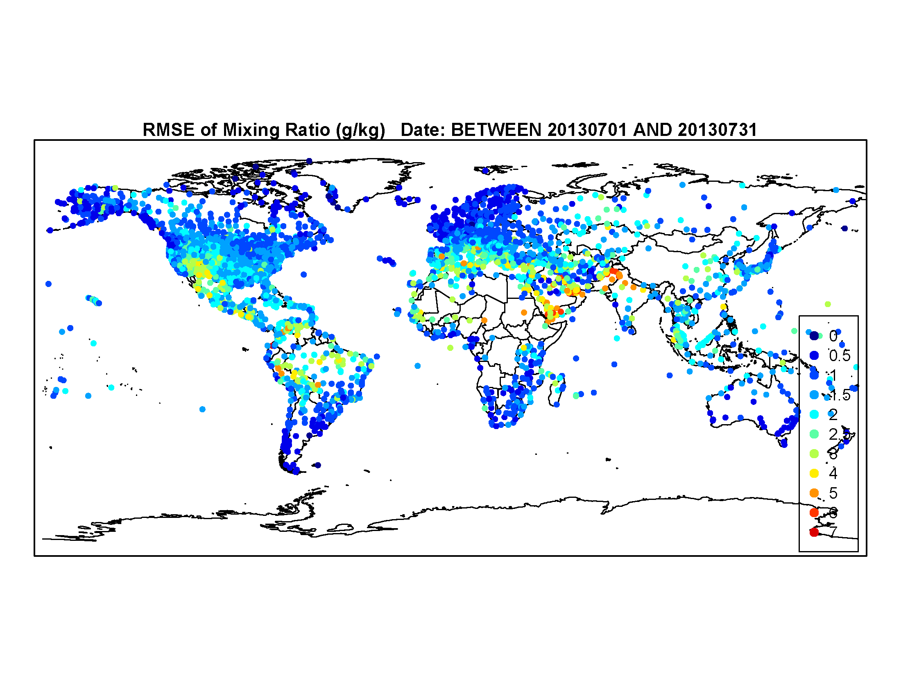
MPAS evaluation using EPA mods
Qv-2m RMSE for July 2013

Slide 9
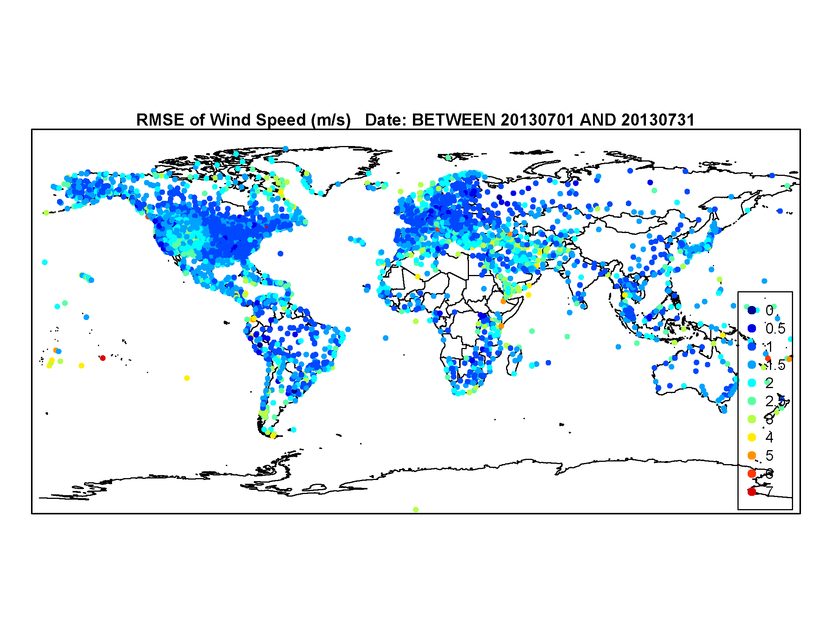
MPAS evaluation using EPA mods
WS-10m RMSE for July 2013

Slide 10
MPAS - CMAQ
MPAS-CMAQ is a prototype of Next Gen AQ model
  CMAQ is called as module in MPAS
  2-way data transfer through MPAS - CMAQ Coupler analogous to MPAS coupler for WRF Physics
  Chemical mechanism and numerical solver are 5.2 version of cb6r3 and its EBI solver.
  Advection of chemical species in MPAS identical to meteorological scalars
    No need for mass adjustment for continuity
  MPAS uses z-coordinates in a hybrid terrain following layer structure
  For CMAQ generalized coordinates the vertical Jacobian = 1, ρJ = ρ
  The ACM2 PBL model has been rewritten in z-coords for both meteorology and AQ
  Subgrid cloud fractions from KF used to affect photolysis
Initial testing for July 1-12, 2013 with no spin-up

Slide 11
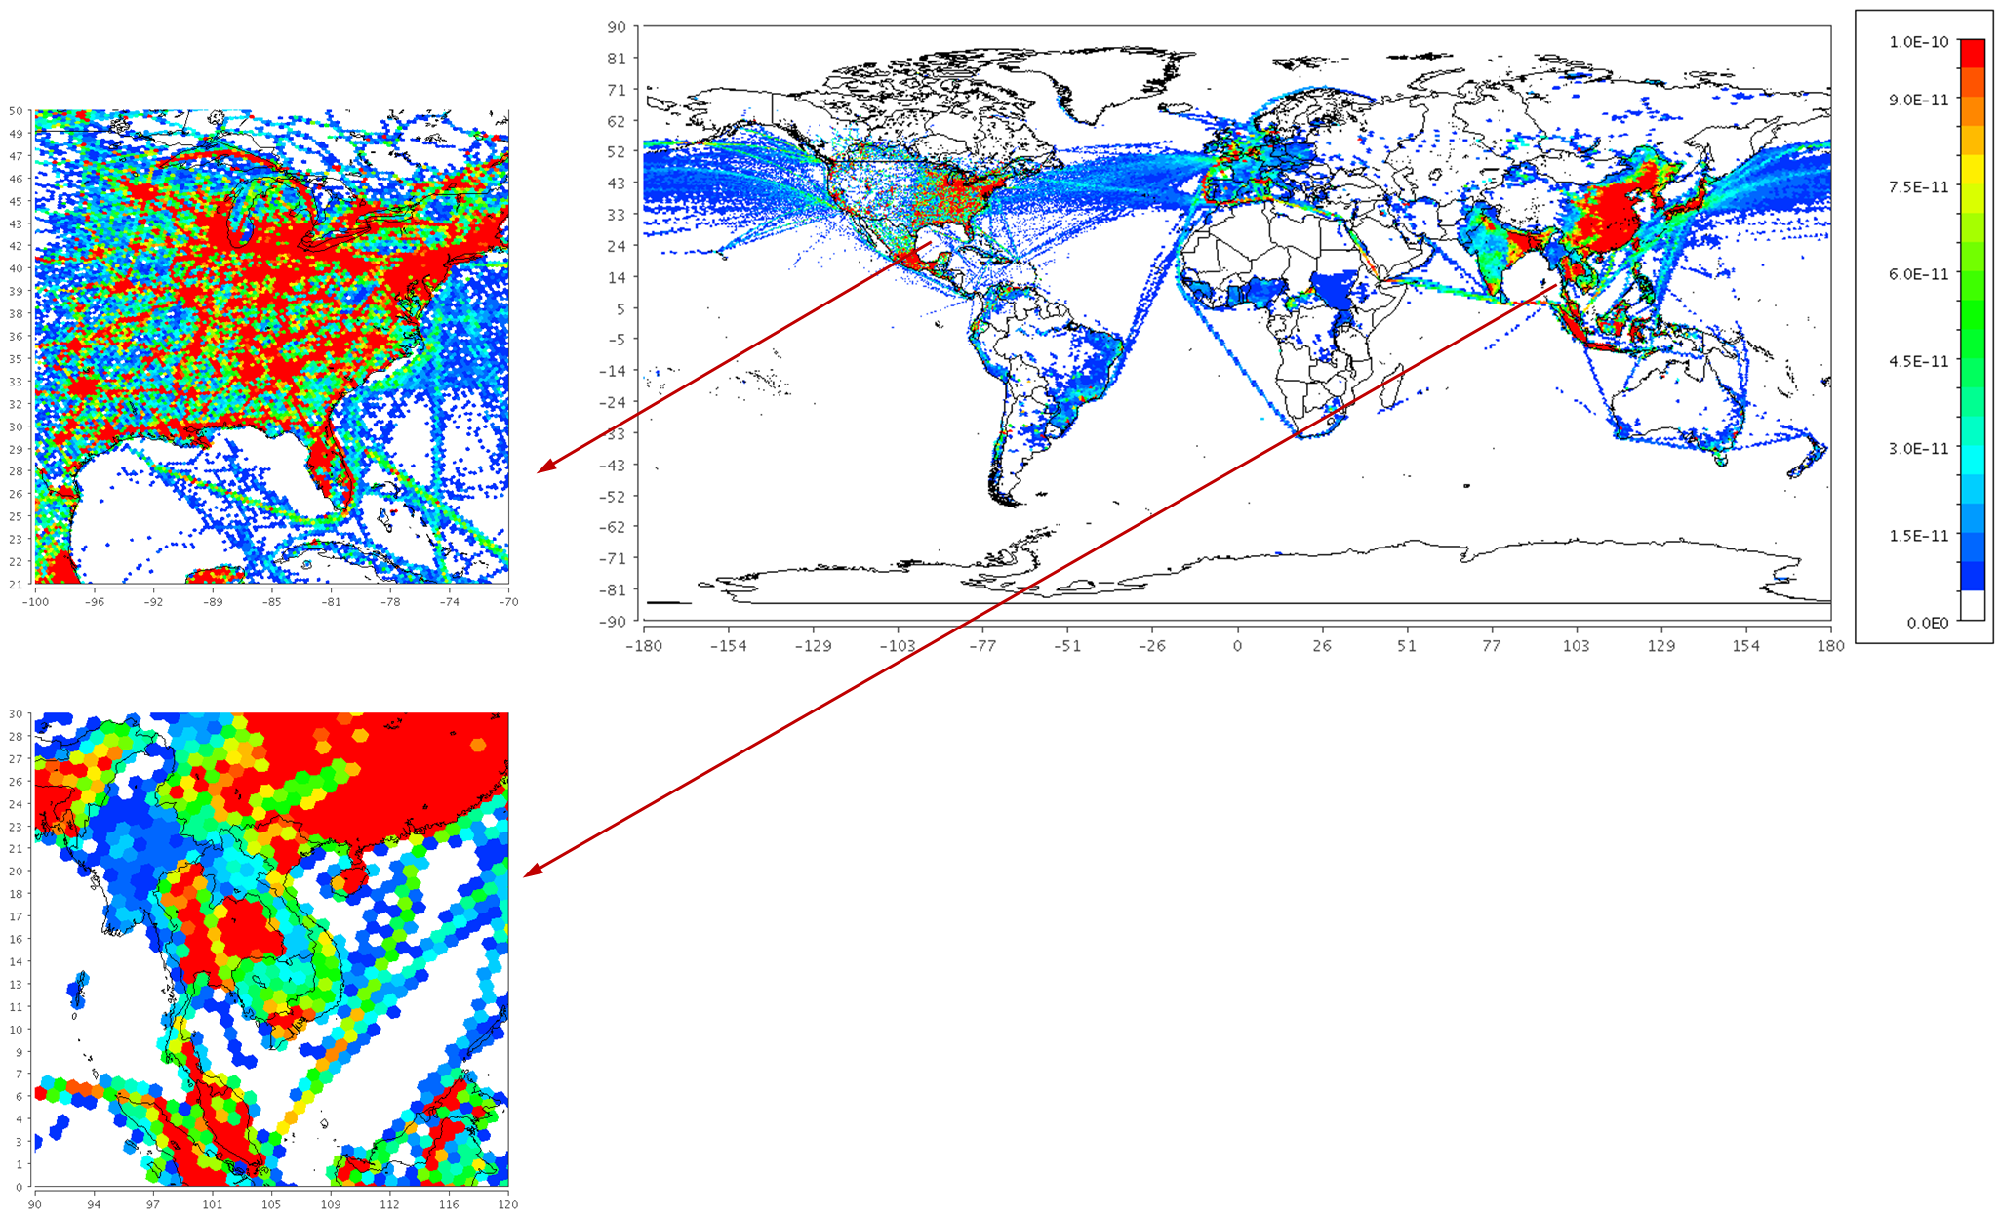
Global emissions for MPAS-AQ
Global surface emissions of NO₂ (moles/m²/s) from 0.1 x 0.1 degree HTAP_v2.2 [Janssens-Maenhout et al., ACP 2015] grid maps re-gridded to unstructured 92-25 km MPAS-A mesh.

Slide 12
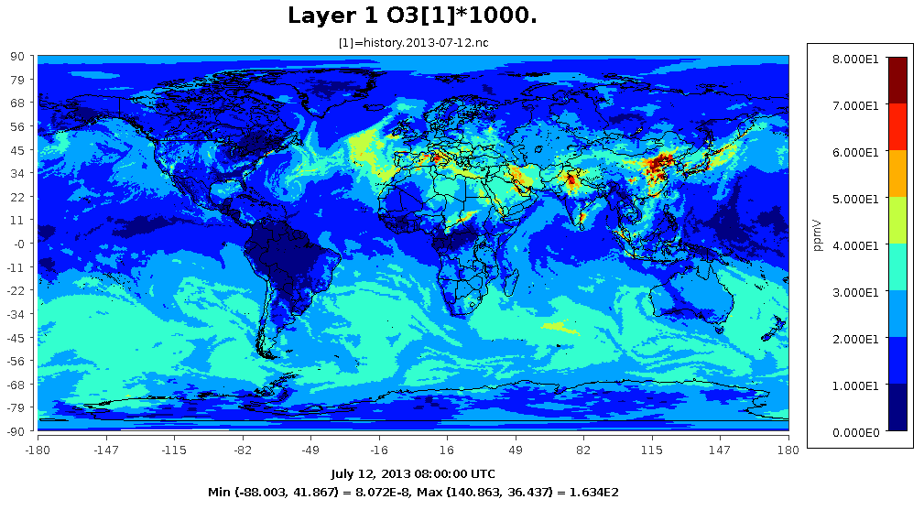
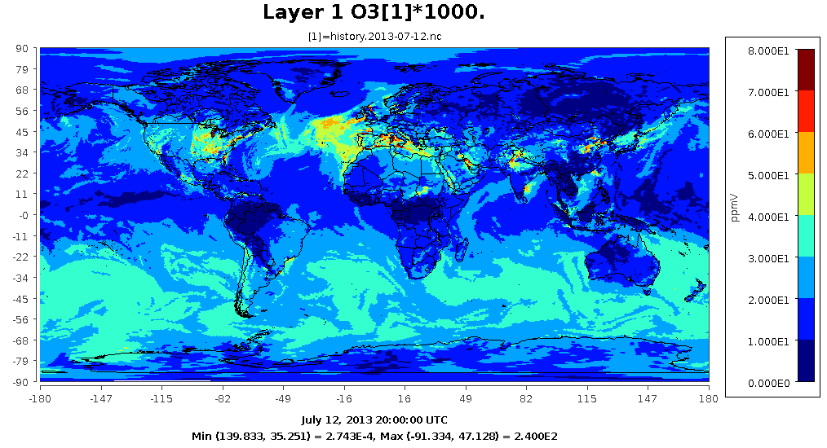
MPAS-AQ
Initial development of MPAS-AQ: Coupling MPASv5.1 with CMAQv5.2 - Layer 1 Ozone concentrations
July 12, 2013 at 08Z (afternoon in Asia)
July 12, 2013 at 20Z (afternoon in EUS)

Slide 13
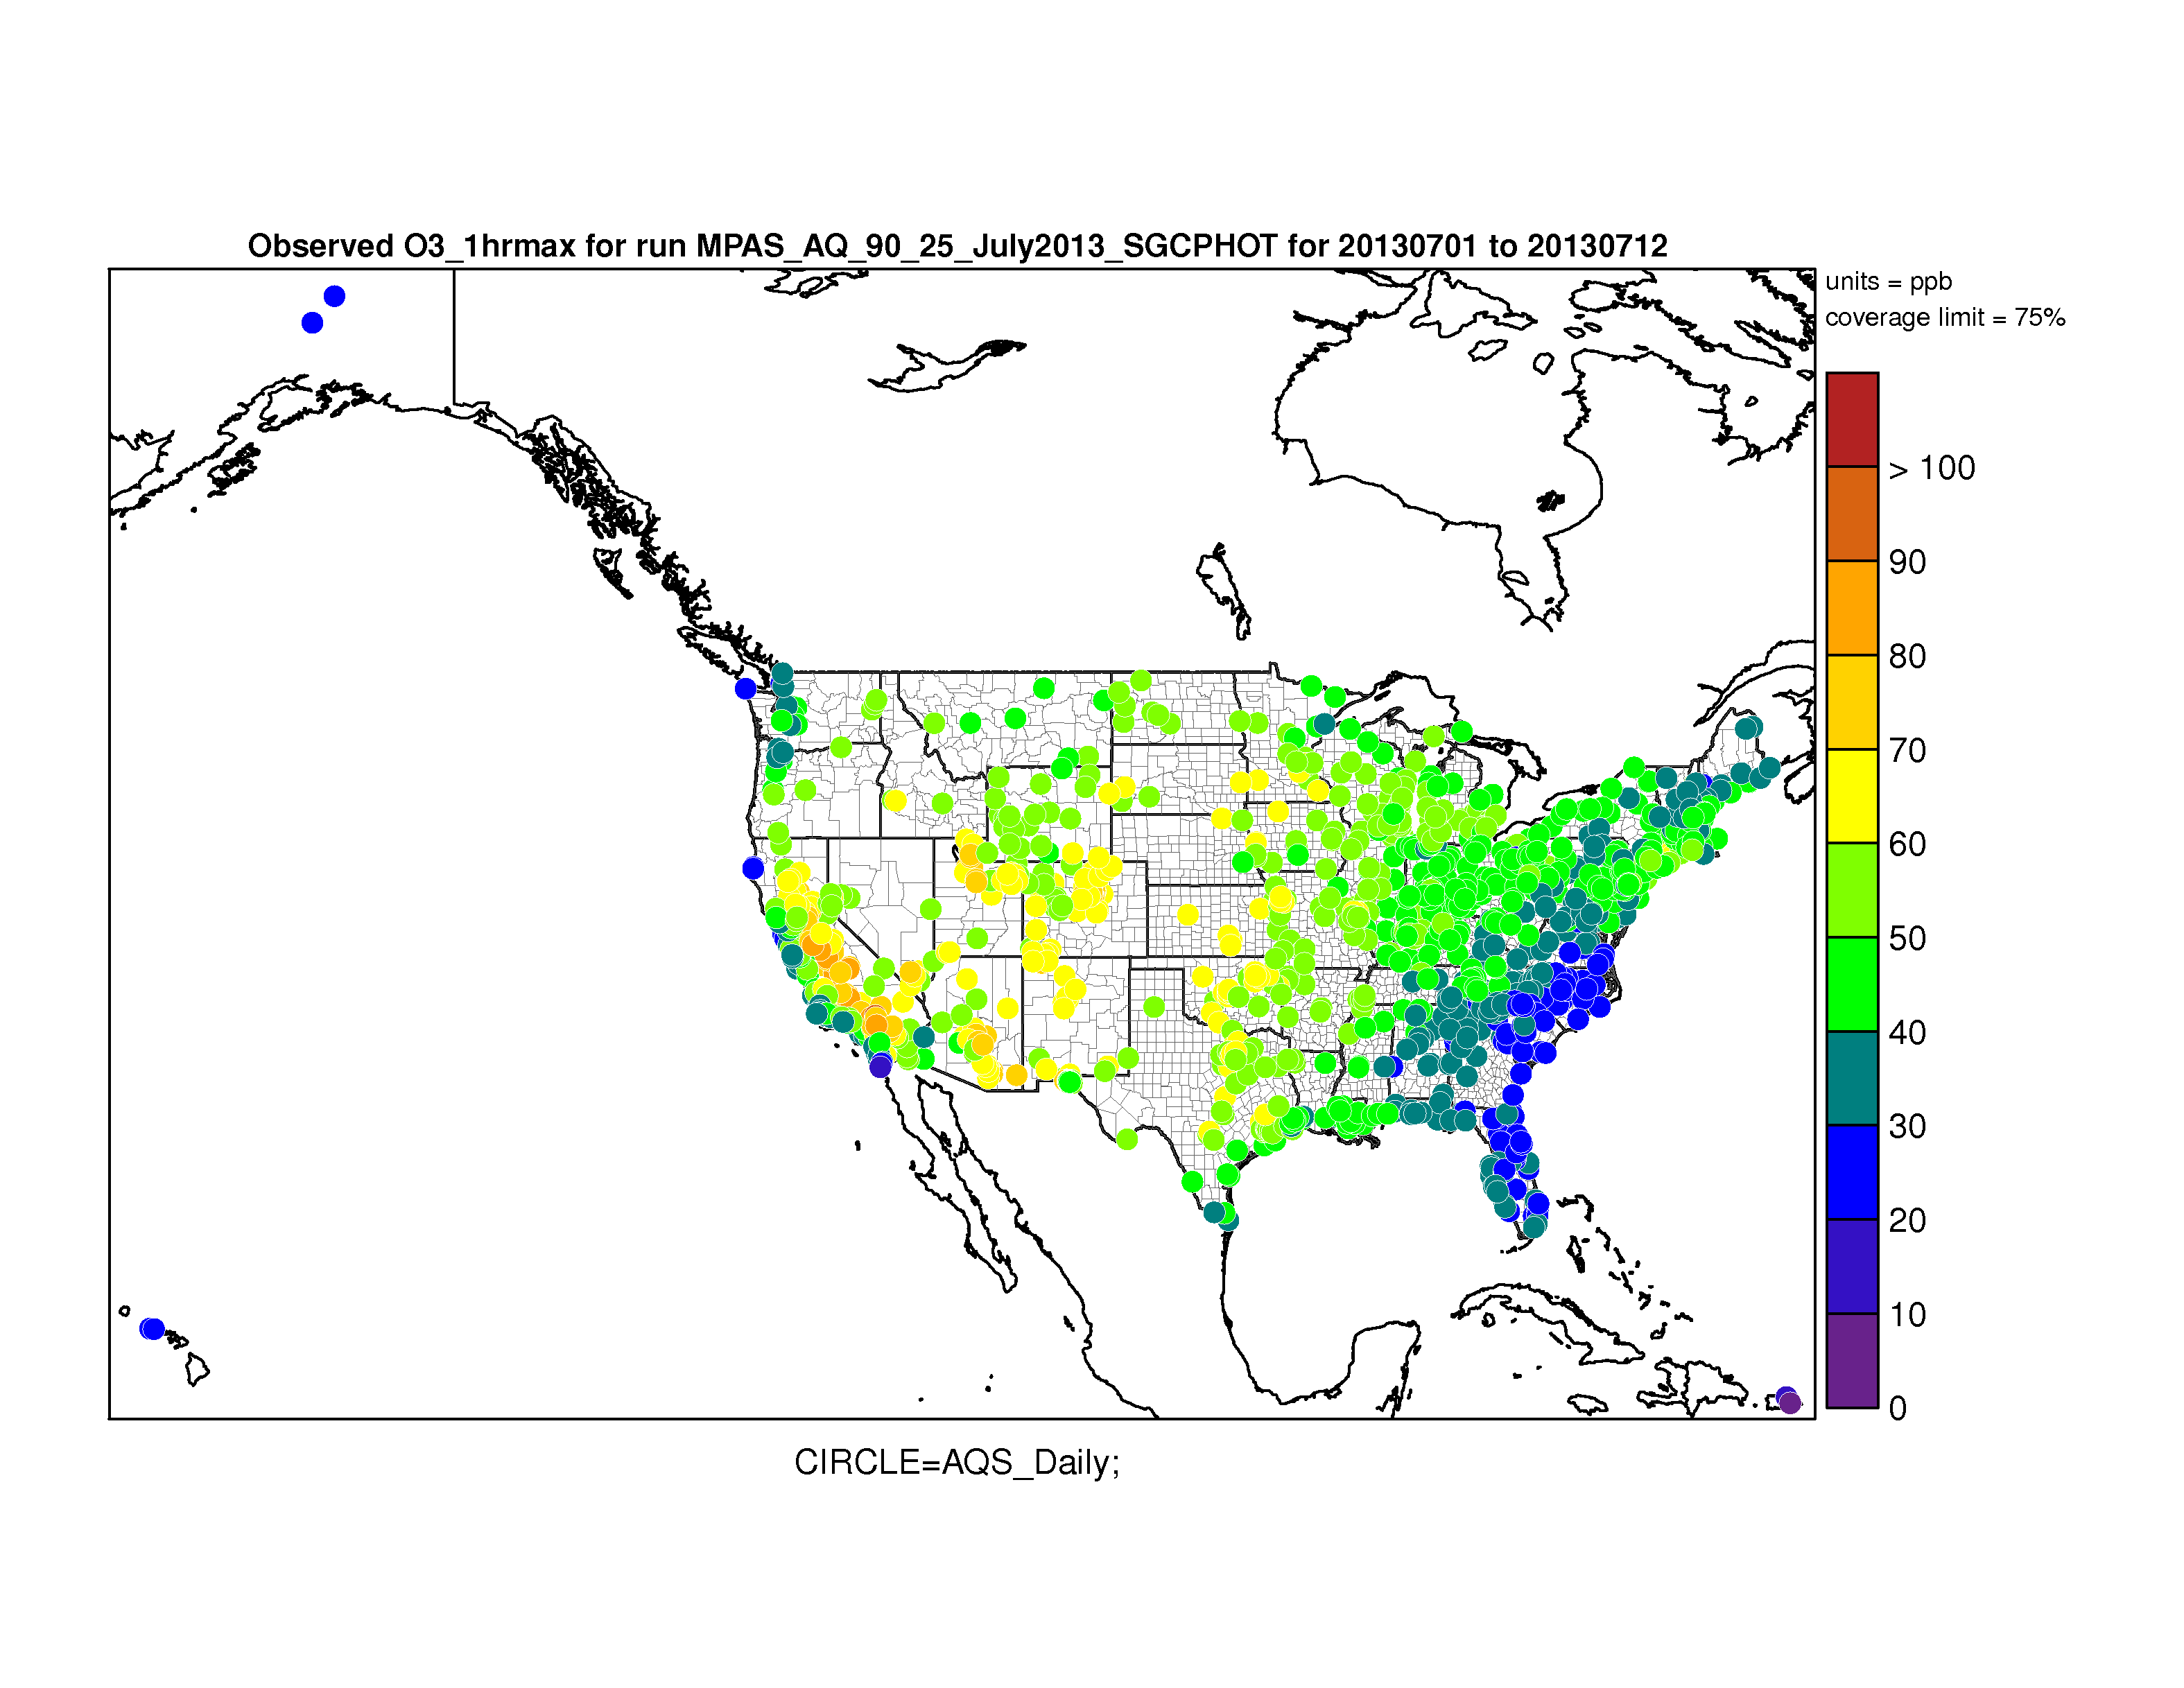
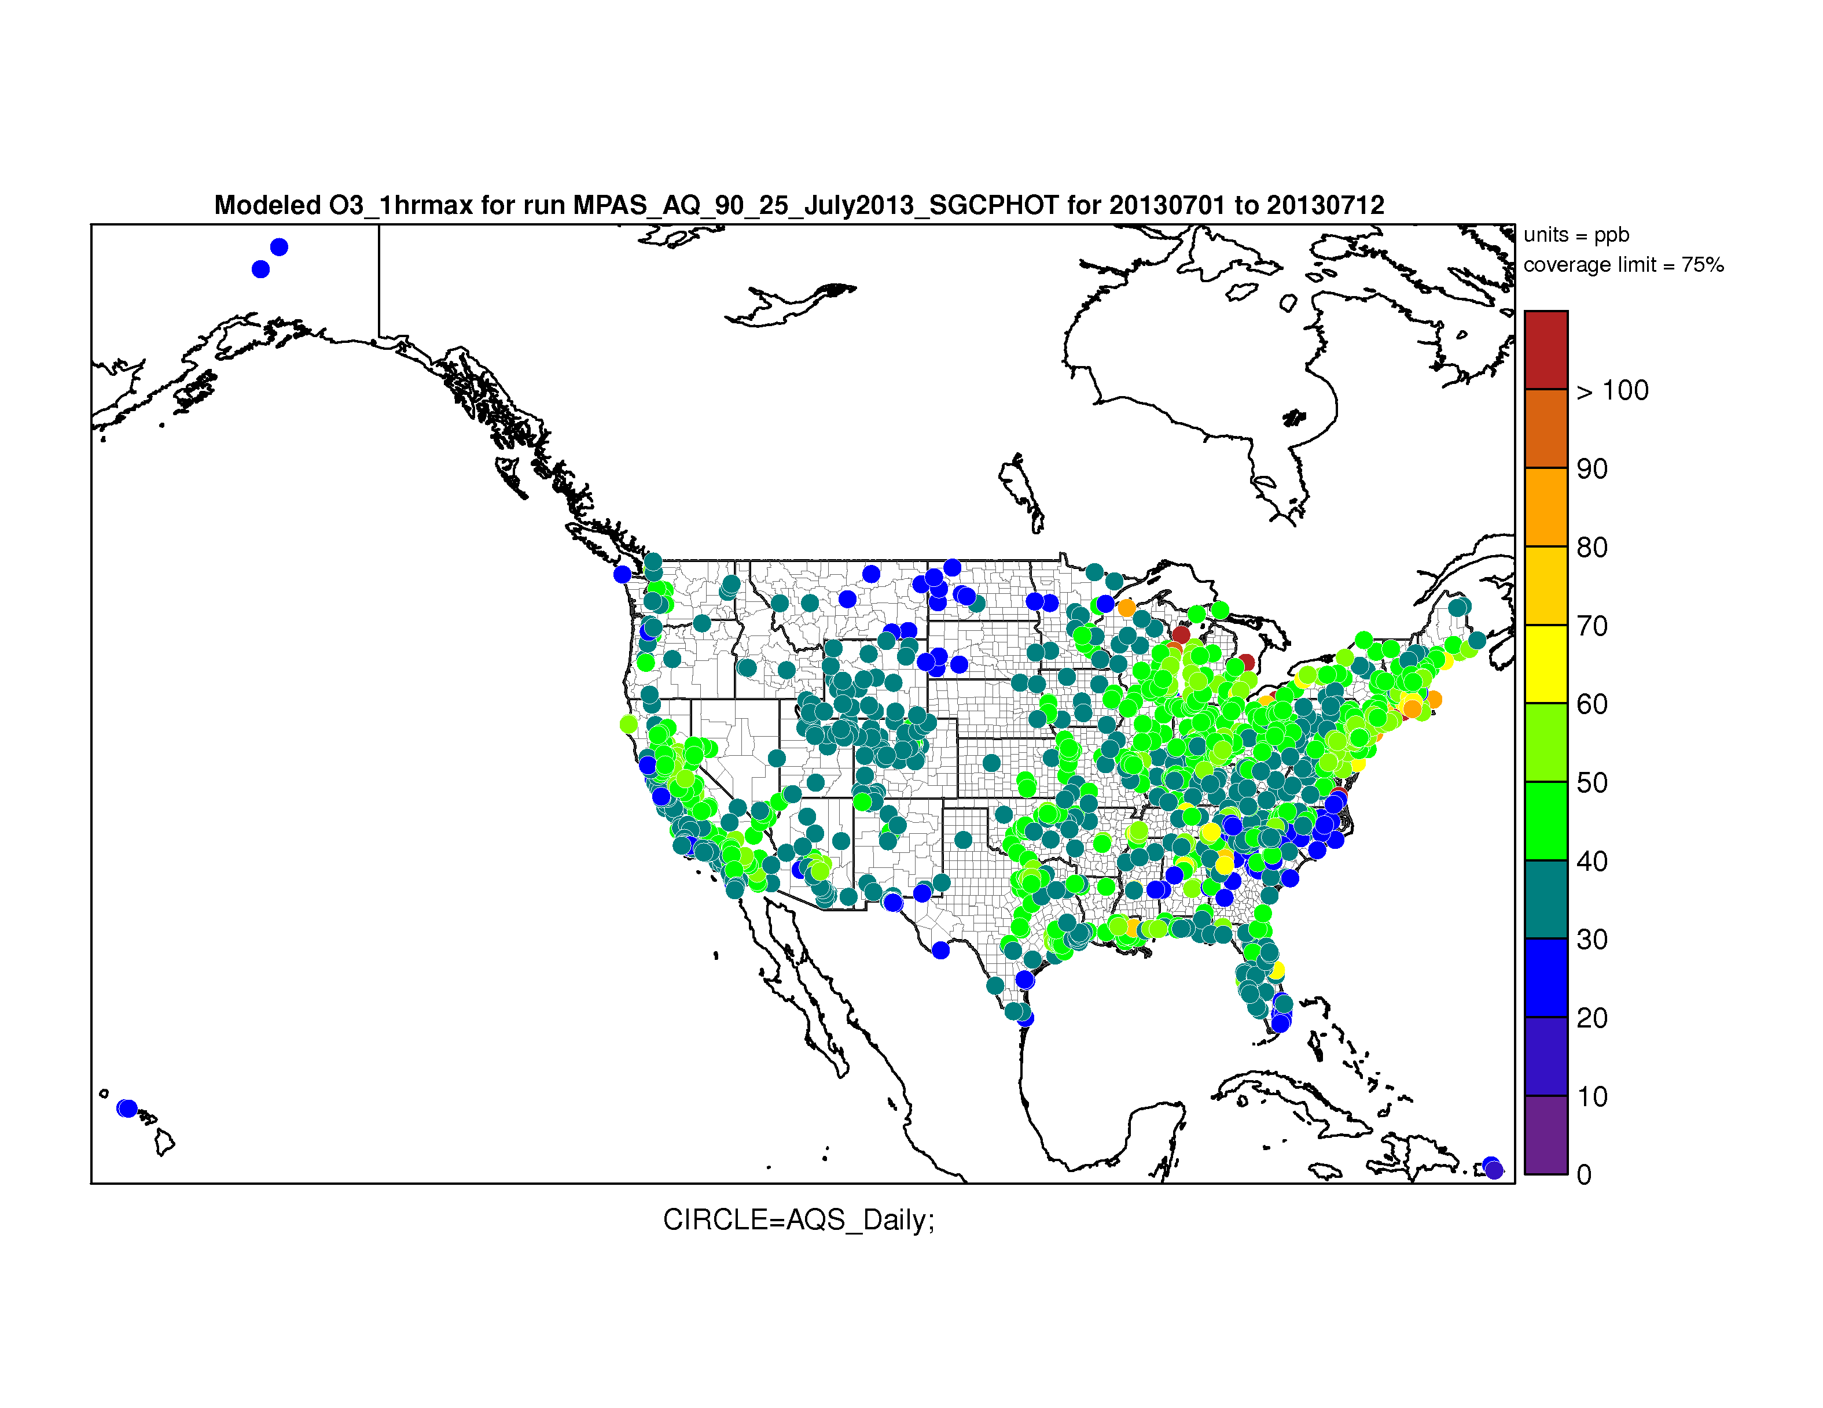
Preliminary ozone evaluation July 1-12, 2013
Observed max 1hr
Modeled max 1hr
Pattern of model ozone concentration is similar to observations in eastern part
Too high in eastern cities (NYC, BOS, ATL, NOLA)
Model ozone way too low in Mt West

Slide 14
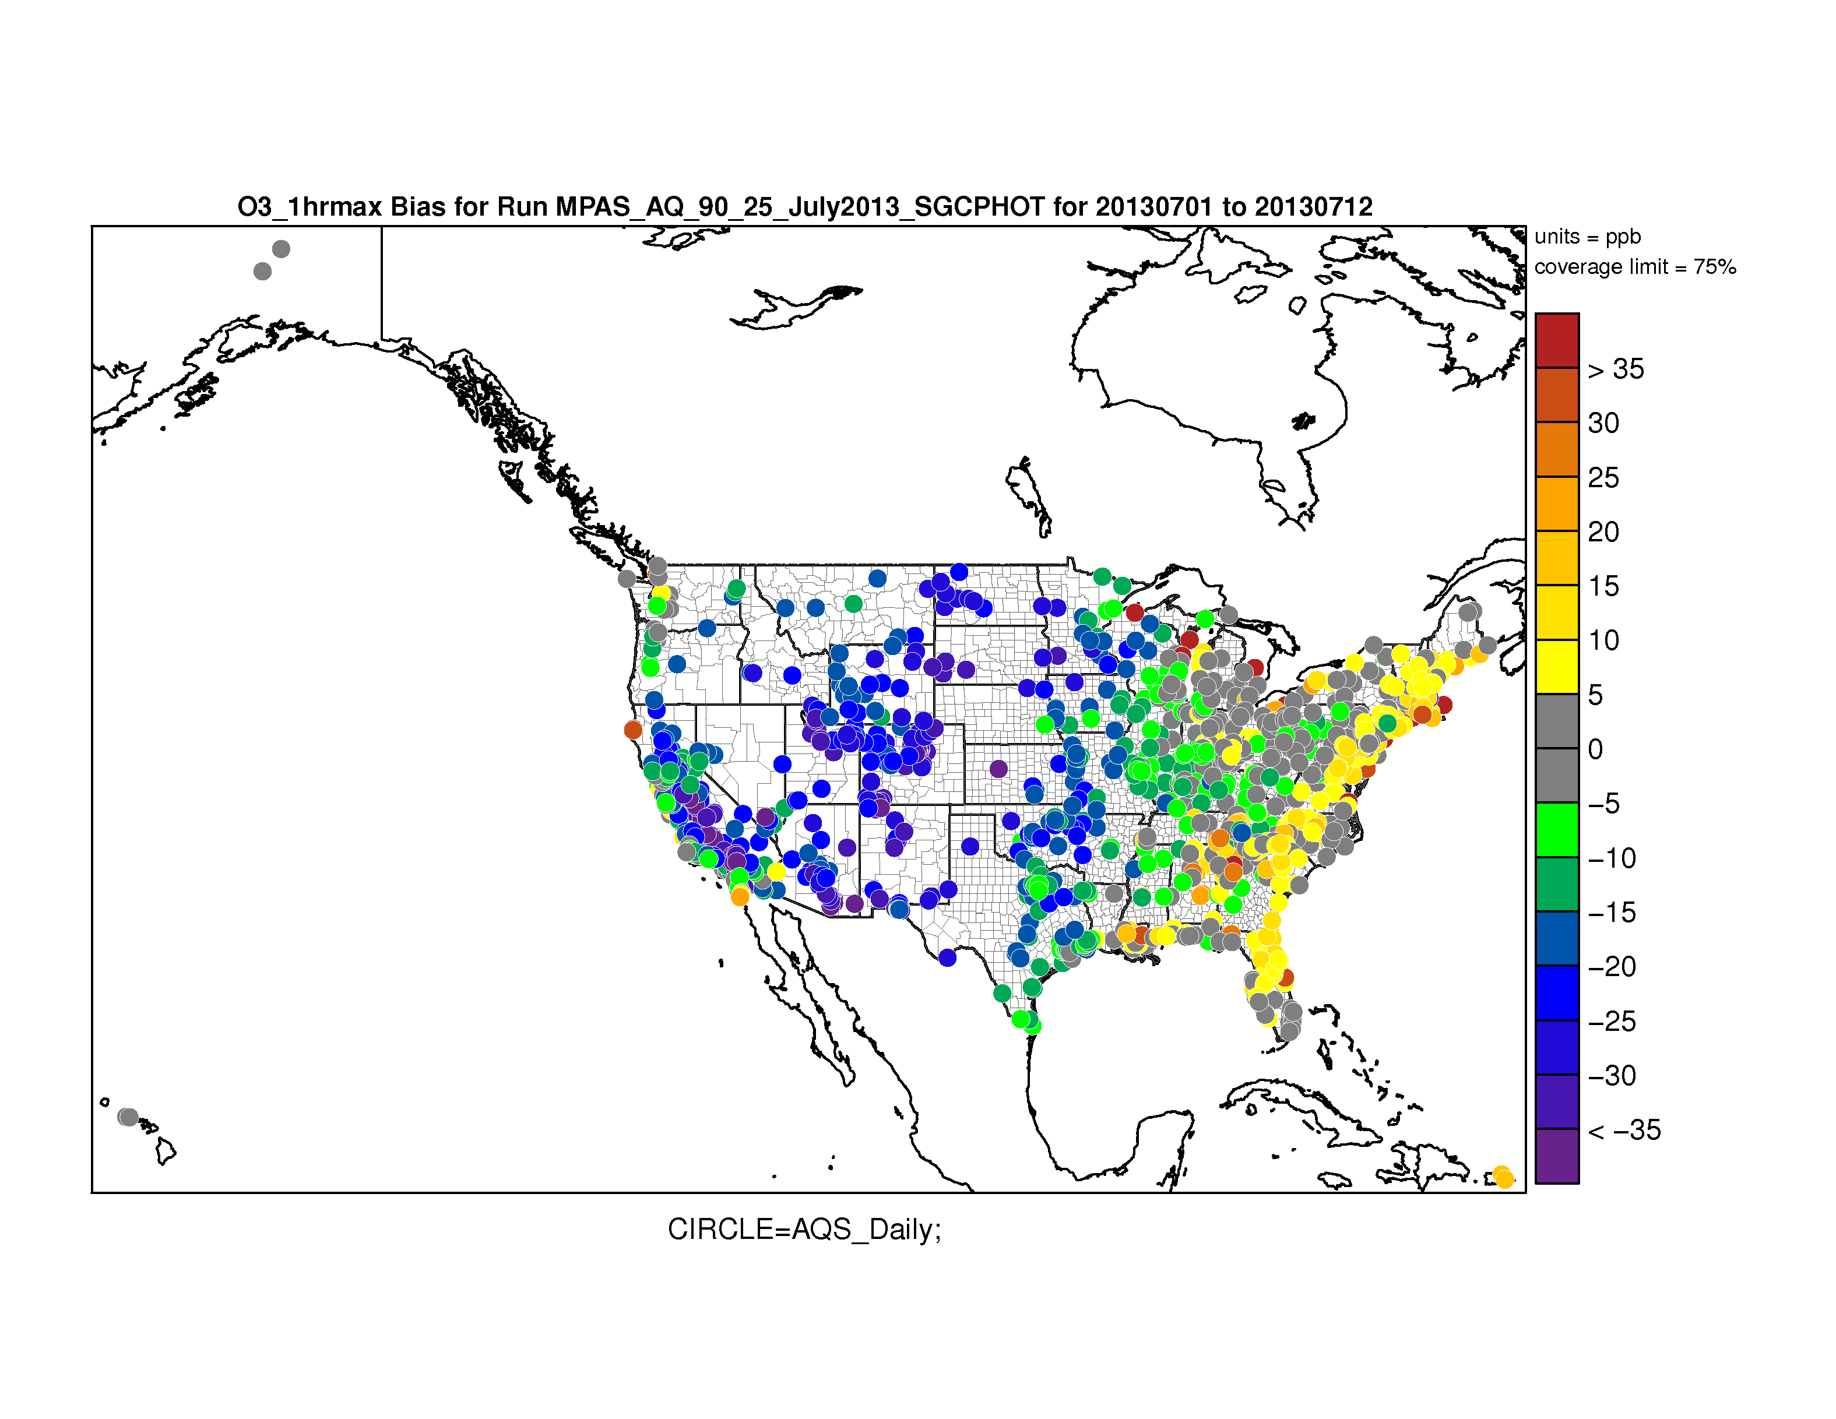
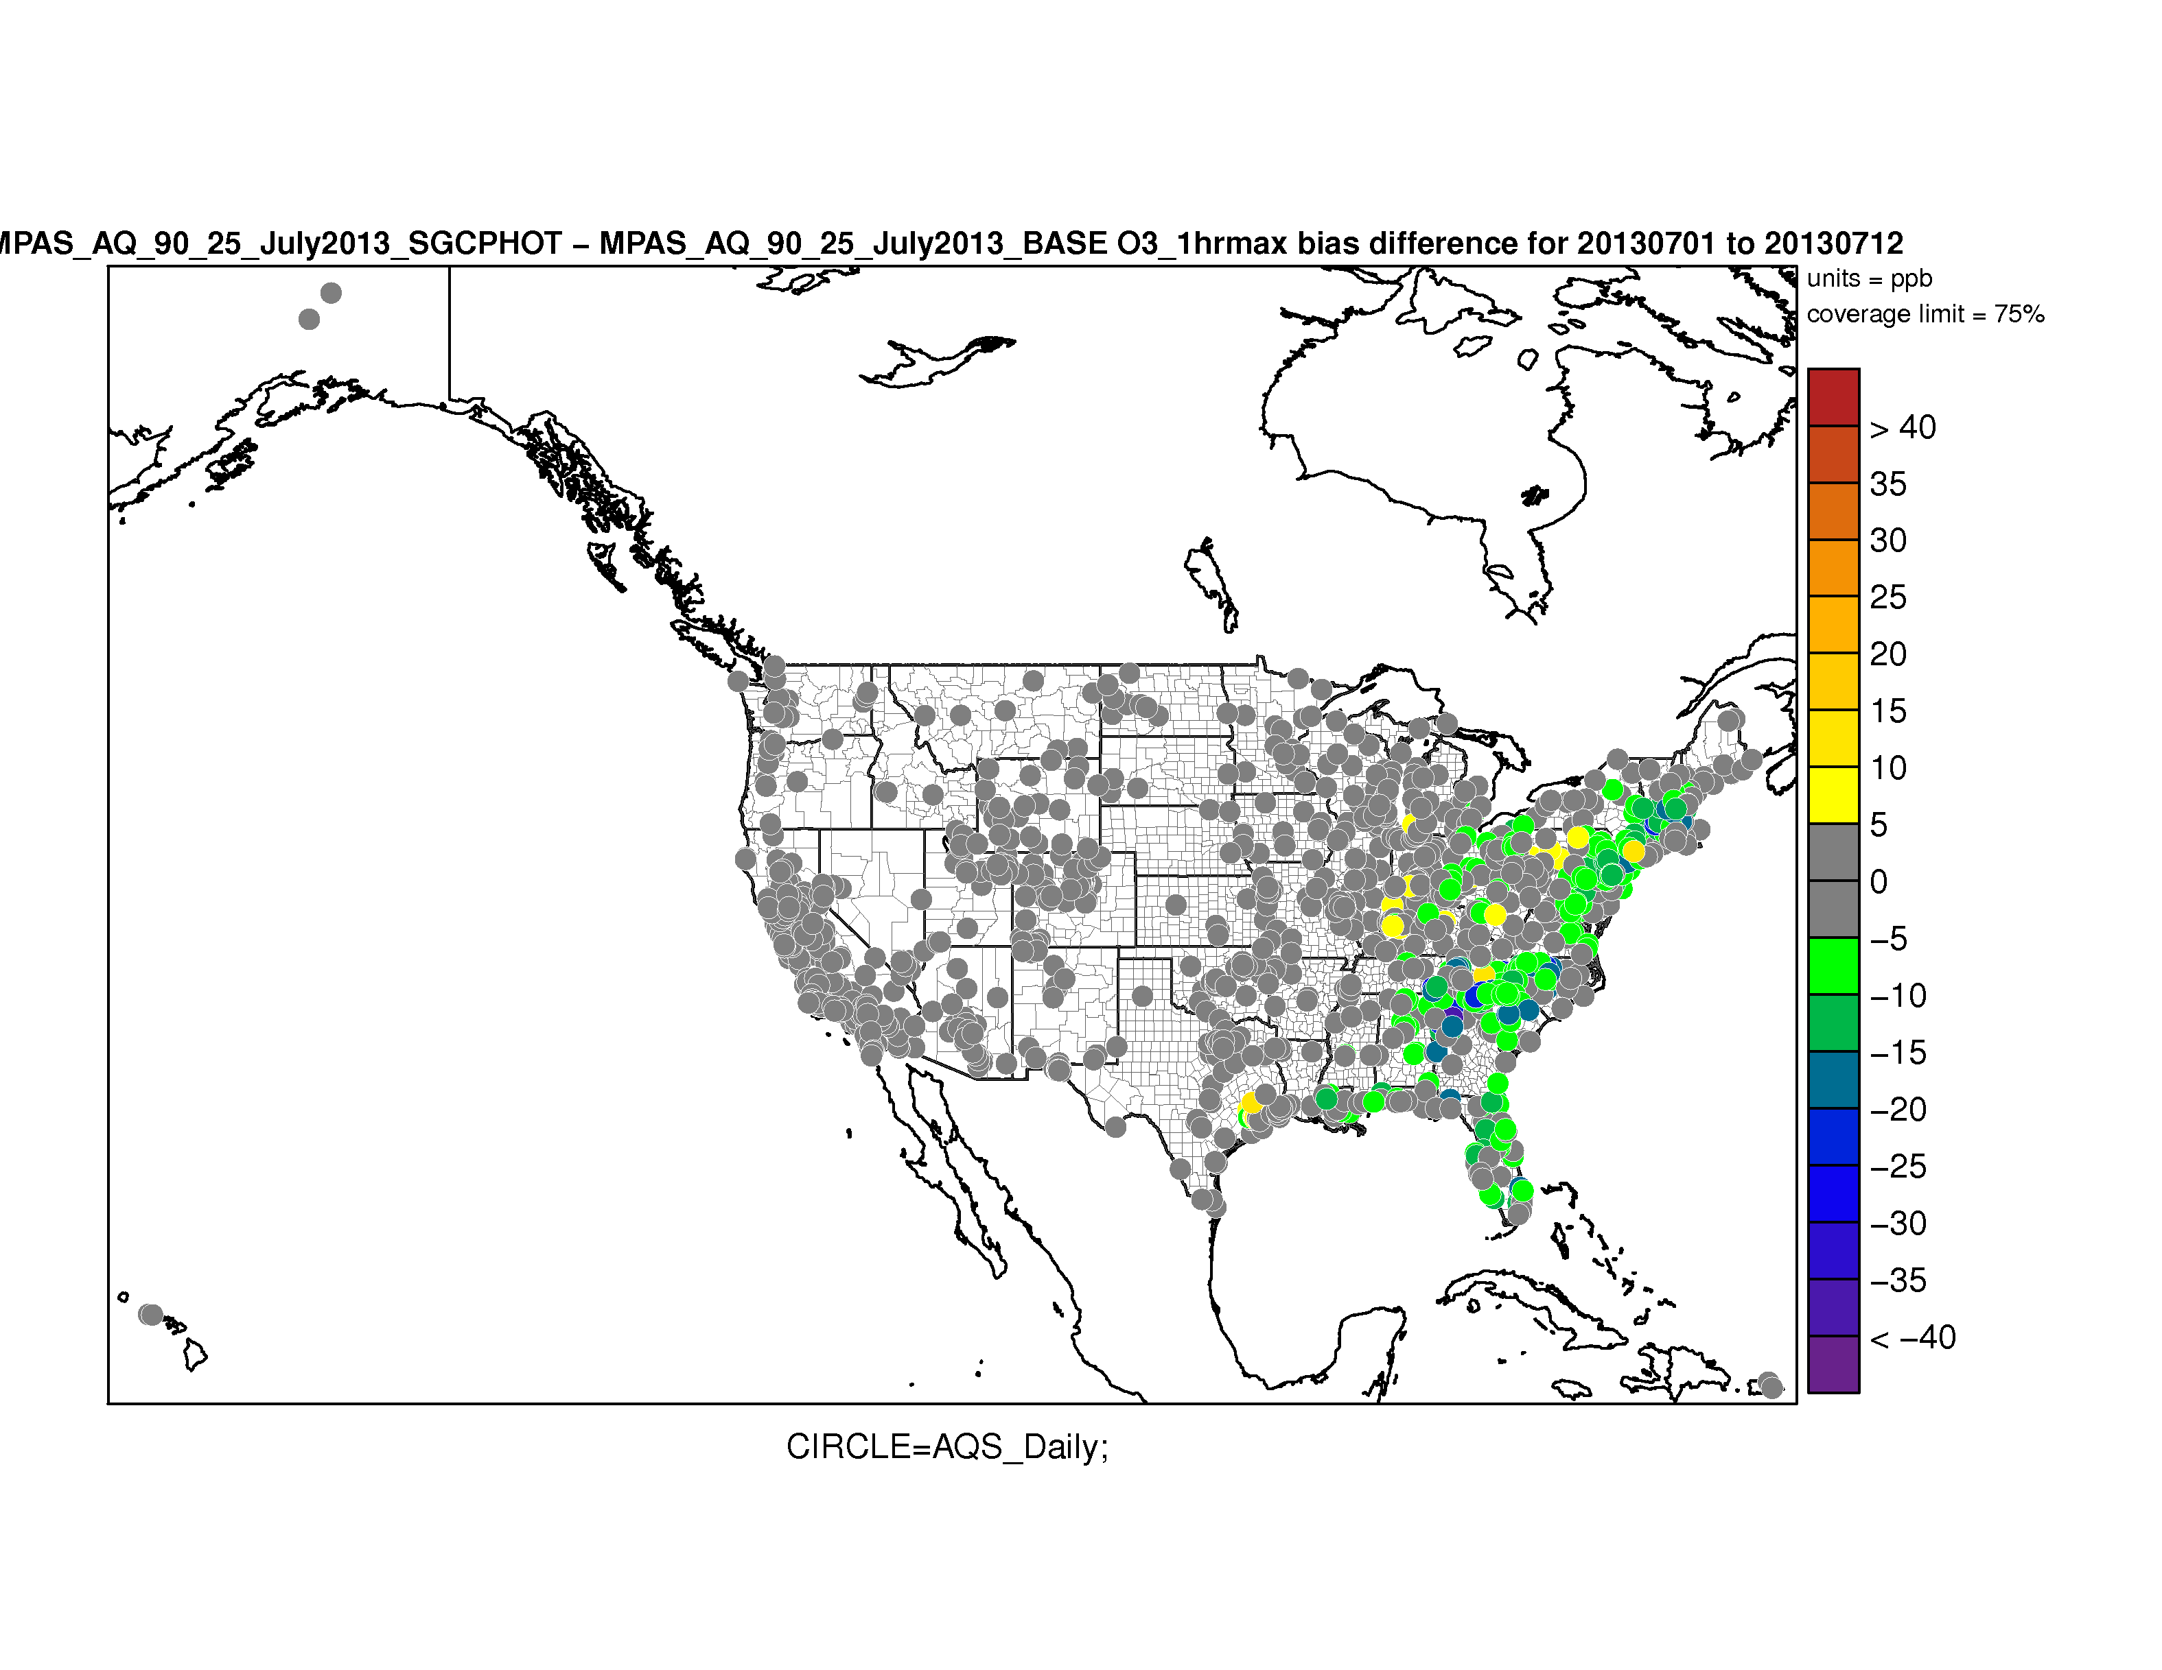
Ozone evaluation July 1-12, 2013
Comparing new run with subgrid convective clouds (KF) effects on photolysis with previous run without these effects
Including subgrid convective clouds effects on photolysis reduces high bias along East Coast
O3 Max 1hr Bias
New run
Bias difference
New - Old

Slide 15
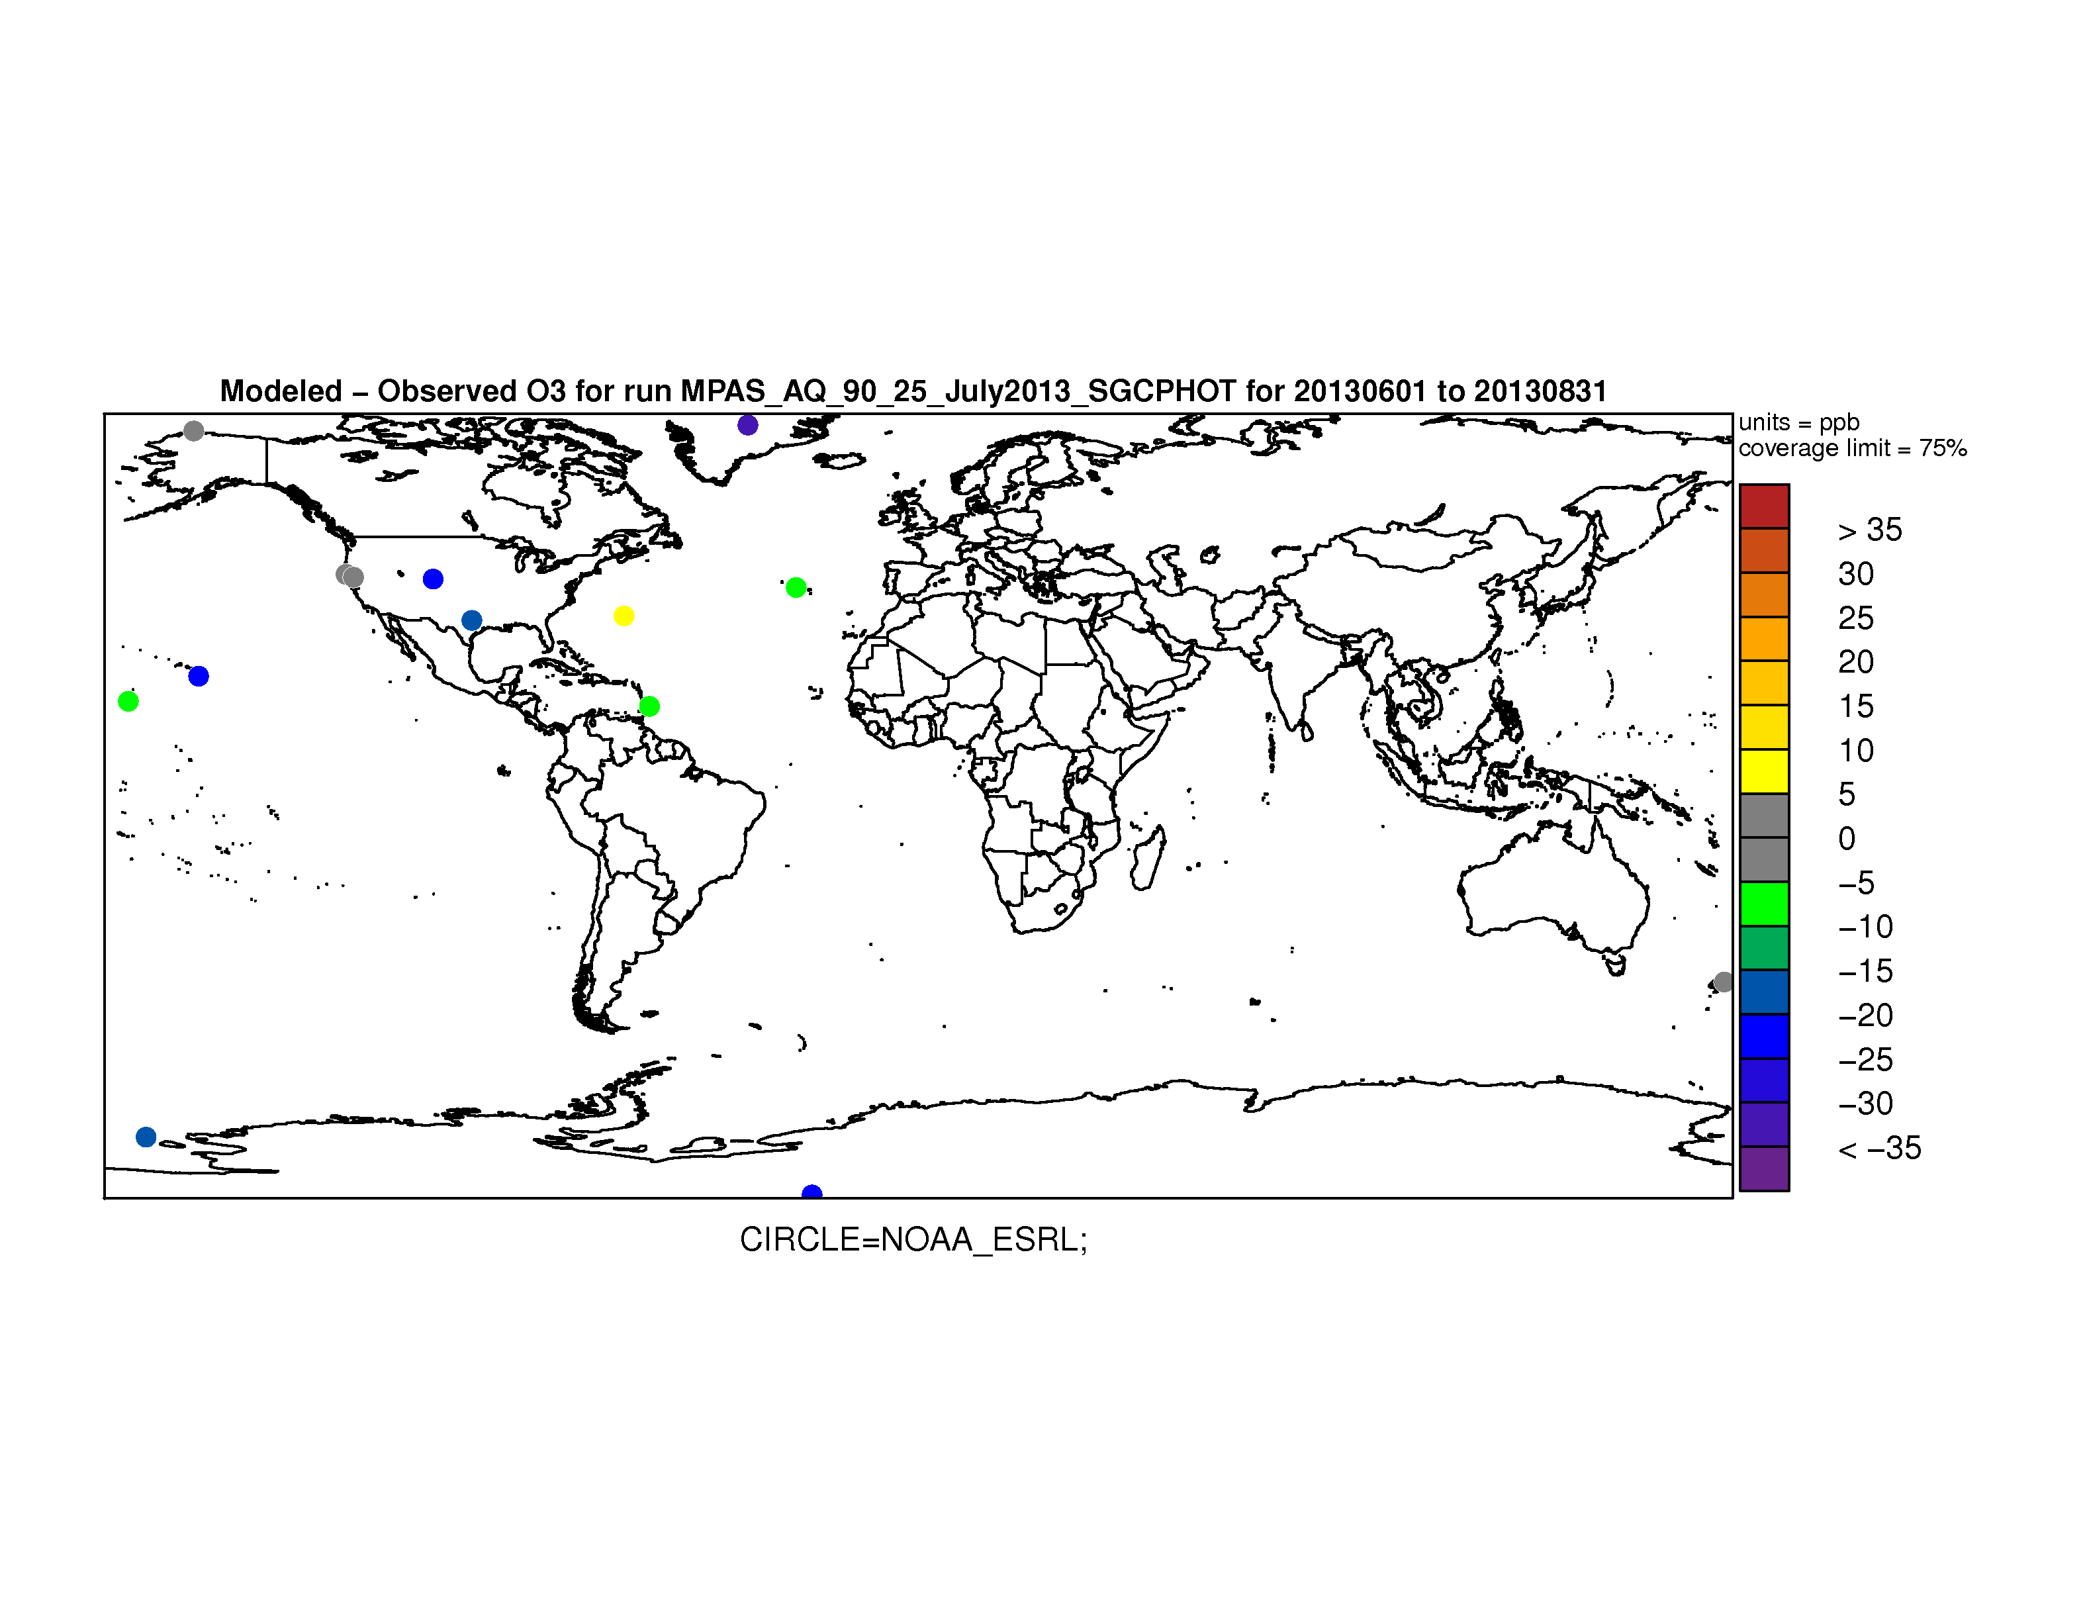
Comparison to remote sites from NOAA/ESRL
ARH (Arrival Heights, Antarctica)
BAR (Ragged Point, Barbados)
BER (Tudor Hill, Bermuda)
BRW (Barrow, Alaska)
LAU (Lauder, New Zealand)
MLO (Mauna Loa, Hawaii)
NWR (Niwot Ridge, Colorado)
PCO (Pico, Azores)
SMO (Tutuila, American Samoa)
SPO (South Pole, Antarctica)
SUM (Summit, Greenland)
THD (Trinidad Head, California)
TUN (Tundra Lab near Niwot Ridge)
WKT (Moody, Texas)
WVR (Weaverville, California)
Model – observations of hourly ozone for July 1 – 12, 2013
Model is especially low for high altitude sites (e.g. MLO, NWR, SUM) suggesting underprediction in FT

Slide 16
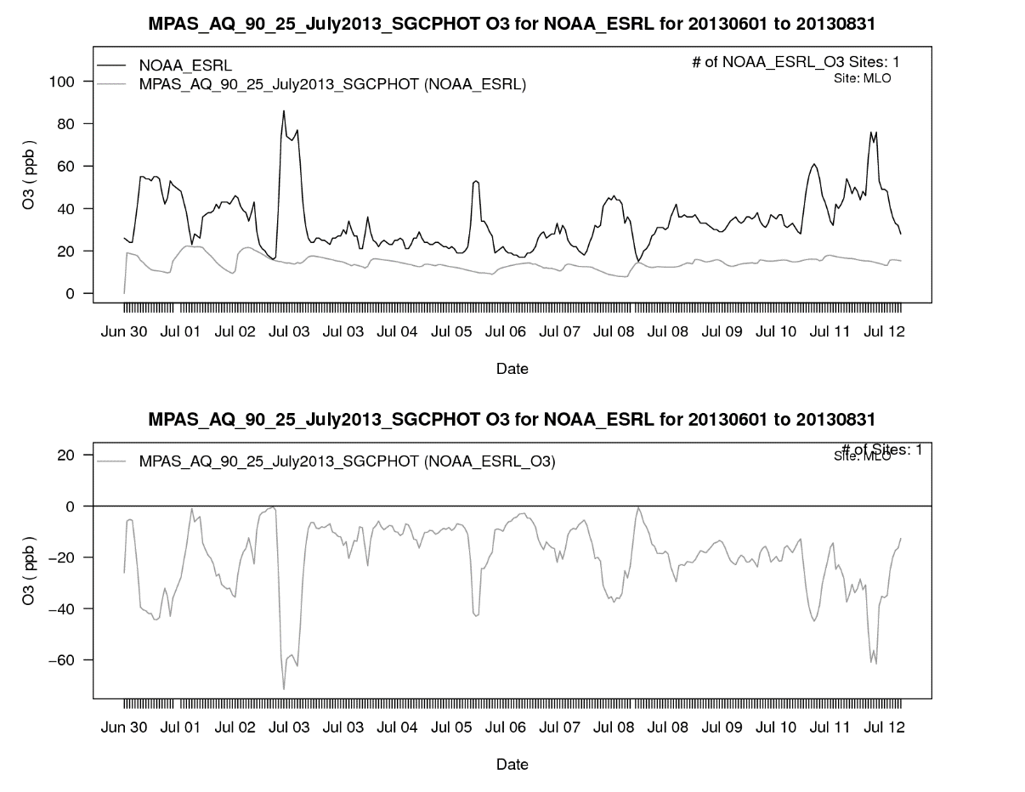
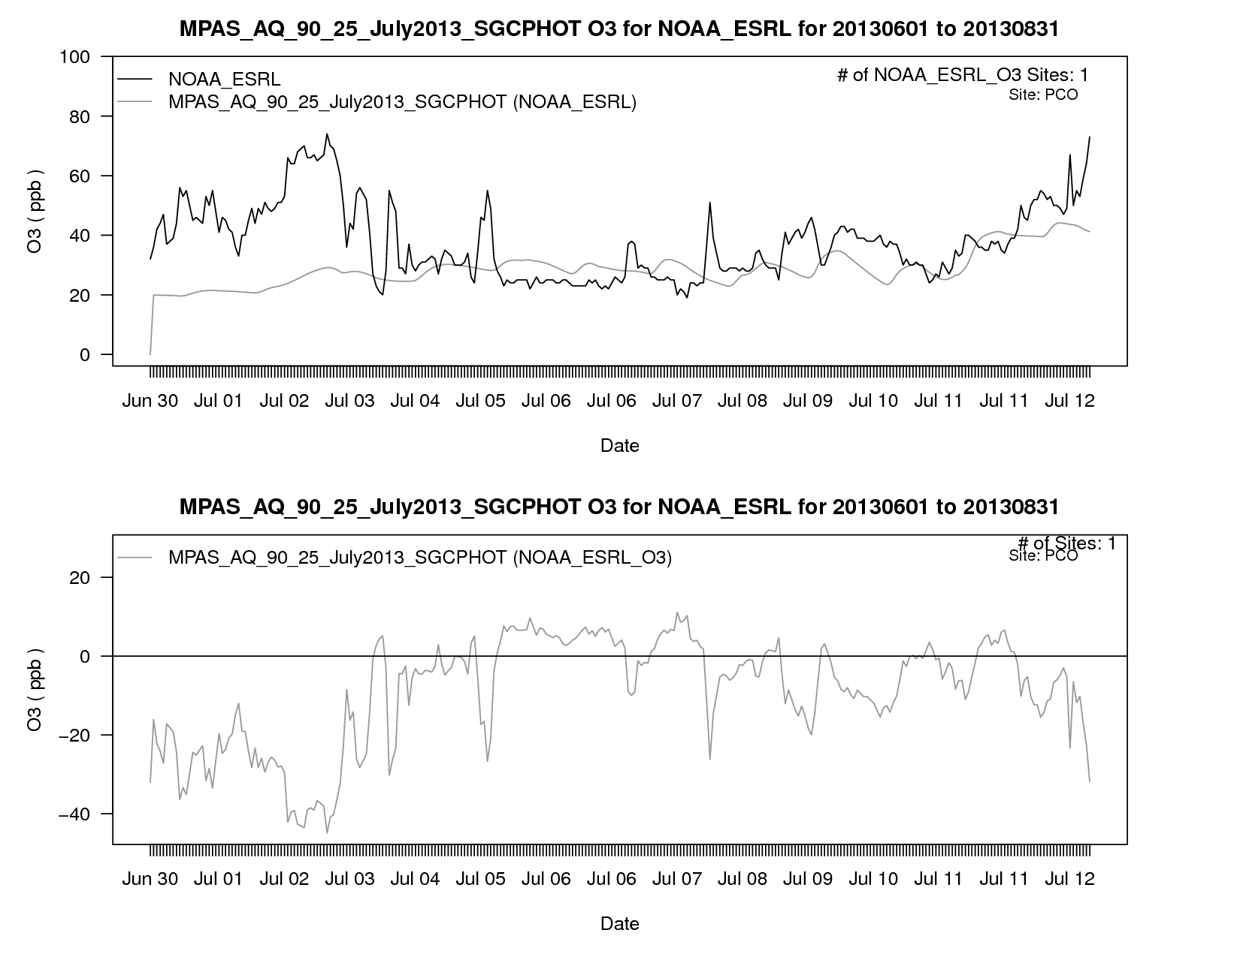
Ozone time series
Mauna Loa – Persistently too low
Pico, Azores– tracks obs after a few days

Slide 17
Next steps
Add GFS ozone analysis for stratospheric layers (P < 100 mb) to improve global concentrations aloft
  Run MPAS-AQ for 3 months (July – September 2013) compare to SEACIONS ozonesondes
Aerosol Model is running and being debugged
Cloud processes
  Implement CMAQ subgrid and resolved cloud processes including aqueous chemistry and wet deposition
  Implement new subgrid cloud model developed by Nick Heath that integrates meteorological and AQ processes
New MPAS runs for all of 2016 with 2 meshes: 46 – 12 km and 92 – 25 km
  GFS 0.25 deg for FDDA
  Surface analysis: 12km NAM blended w/ GFS 0.25 deg
Acquire the MPAS mesh generator software from NCAR to enable customized variable meshes
Design and develop new AQ module for improved efficiency and modularity

Slide 18
Extras

Slide 19
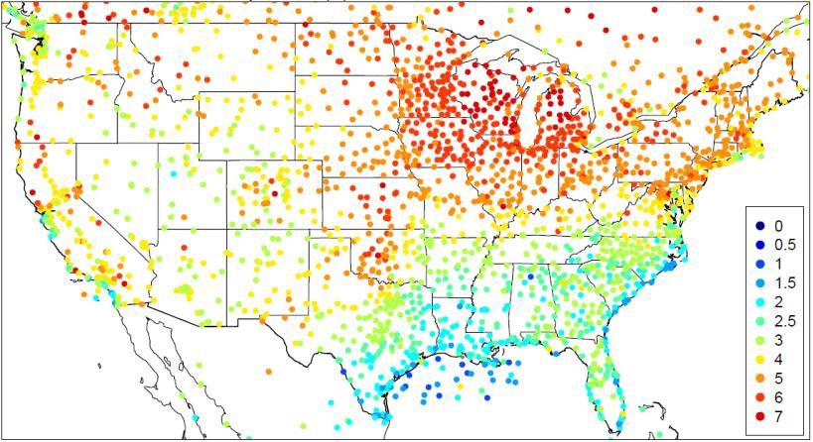
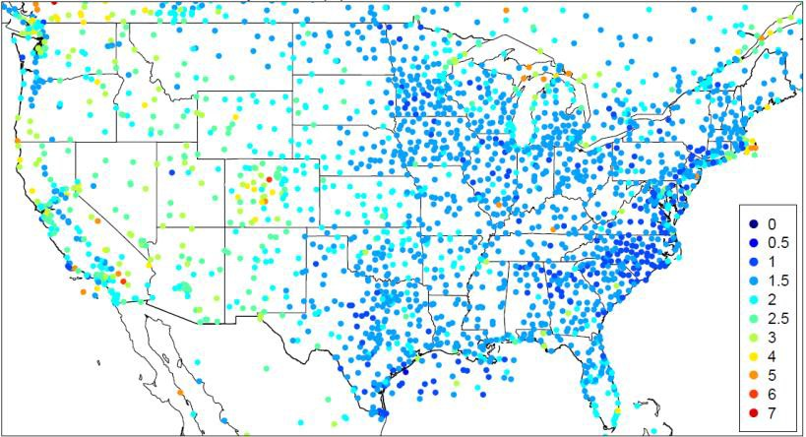
T_{2m} RMSE for July 2013
MPASv5.1 Rel
MPASv5.1 EPA
T2m Statistic | MPAS51rel | MPAS51EPA
RMSE (K) | 4.692 | 2.150
MAE (K) | 3.517 | 1.599
NME (%) | 6.952 | 3.197
MB (K) | 0.632 | 0.002
NMB (%) | 1.249 | 0.004
Corr. | 0.694 | 0.932
T_{2m} statistics are much improved when using all EPA enhancements compared to the release version of MPAS v5.1
Courtesy of Jerry Herwehe

